Slide 1

From Colliding Heavy Ions to the Future of Transportation
Jan Urbahn,
CERN WA98 1995-1998
CERN Public Relations 1995-1998
CERN Alumni Advisory Board 2019-2022

Slide 2

Welcome
Please ask Questions

Slide 3
Today’s Agenda
Introduction
Time at CERN
Transition into Automotive Industry
Which skills developed at CERN are useful for prospective employers?
Working in a Established Corporation vs. Start-Up
Useful management skills for a career in physics outside of academia
Some useful soft skills to acquire/develop
Future Mobility
A typical day for Jan.

Slide 4
Jan Main Stations
My brief history:
At DESY Hasylab + H1 from 92-94
at CERN WA98 from 1995-98
1998-2004 Worked at BMW AG
2004-2012 BMW North America
2012-2019 BMW Mobility Services
2019 – 2020: Lyft (Ridesharing)
2020 – 2021: Urbahn Enterprise
2022 - now: Canoo Technologies

Slide 5
WA98

Slide 6
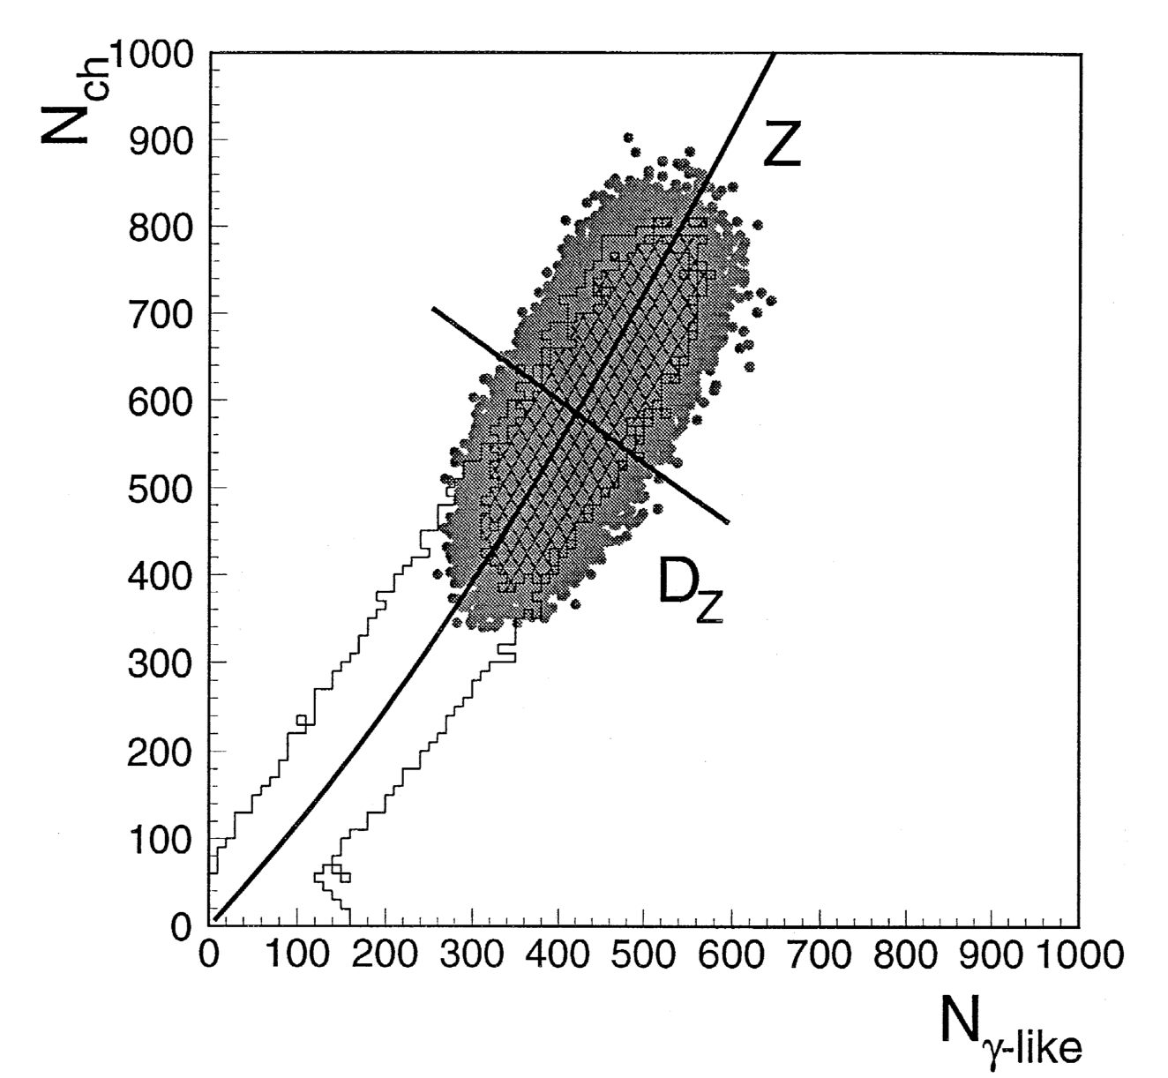
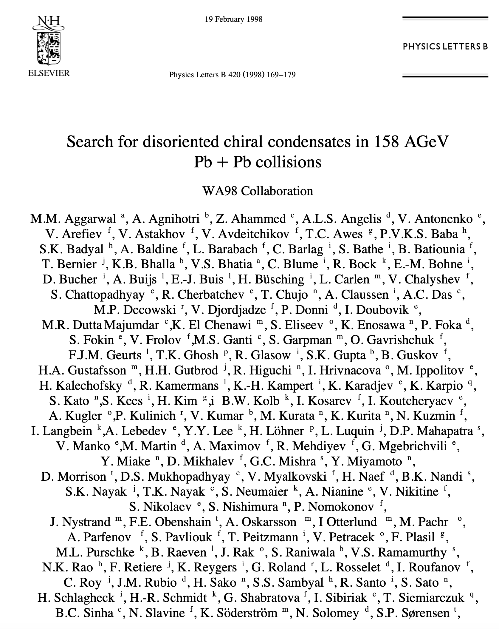
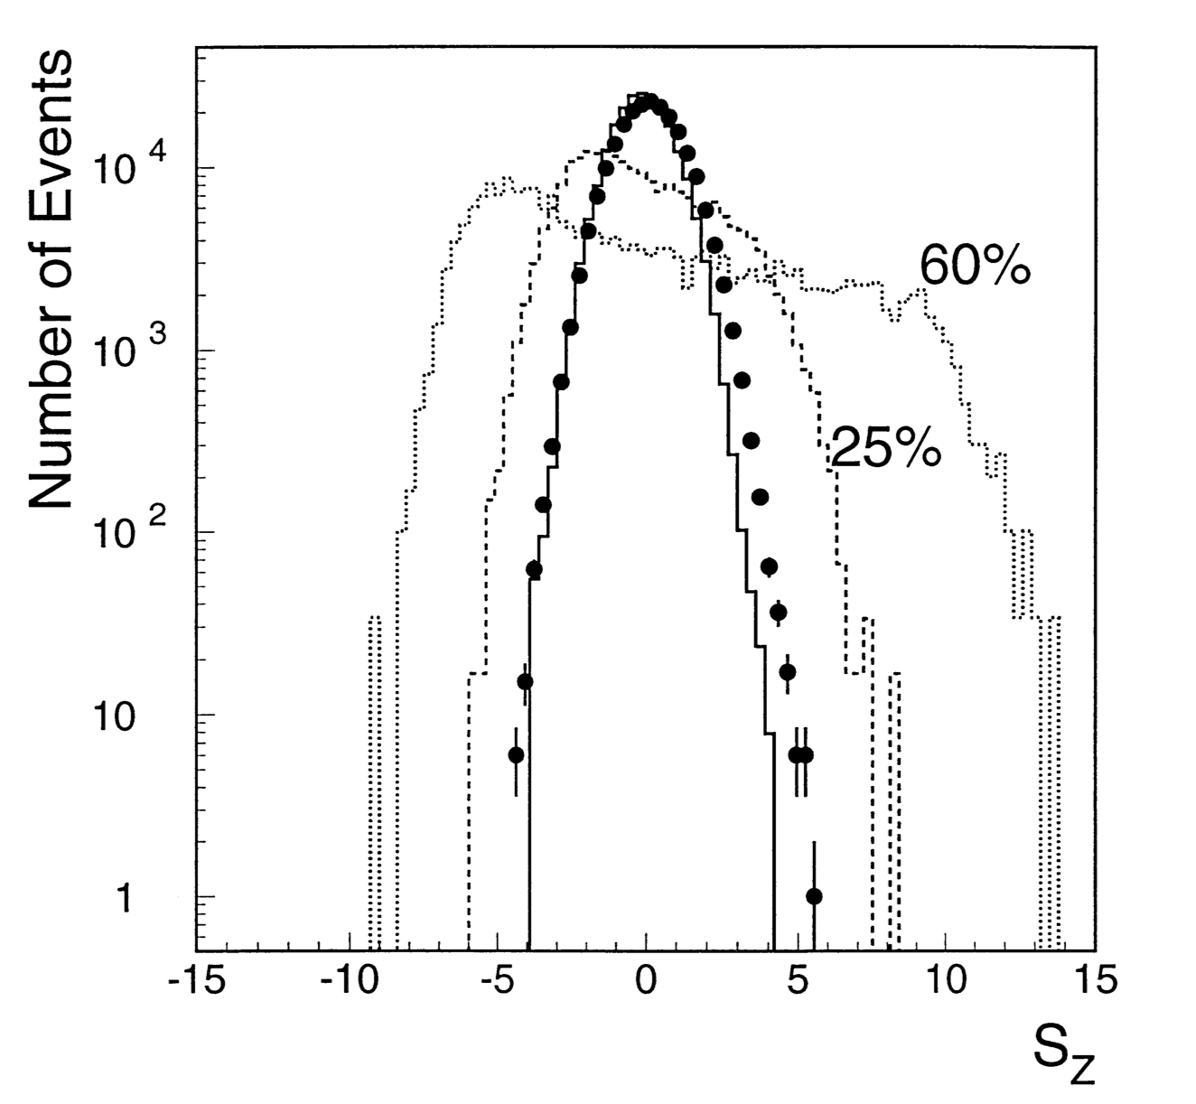
My research at WA98:
Disoriented Chiral Condensates

Slide 7
My work at CERN: What I actually did
Large scale computer simulations across computer farms (VAX!)
Large scale data analysis using innovative statistical methods (DLTs)
Working hard and intensely
Building relationships in international collaborations
Speaking multiple languages
Writing reports about my analysis results
Presenting in front of large groups
>>> This is a very attractive skill set

Slide 8
How I made my transition to BMW
My professor suggested to consider ”solving real world problems” after my graduation
Very quickly it became clear I want to work for BMW, because they had an innovative way of working in their new Engineering and Research Center
Was searching for a connection inside (before LinkedIn), so I went to Frankfurt Auto Show (IAA) and asked an BMW engineer how I can work there
He gave me a name of a department manager who invited me to come by in person, which I did about 2 months later
They encouraged me to put in my application and after a tough 2.5 hour interview I was hired from among 1200 applicants as I was told later.

Slide 9
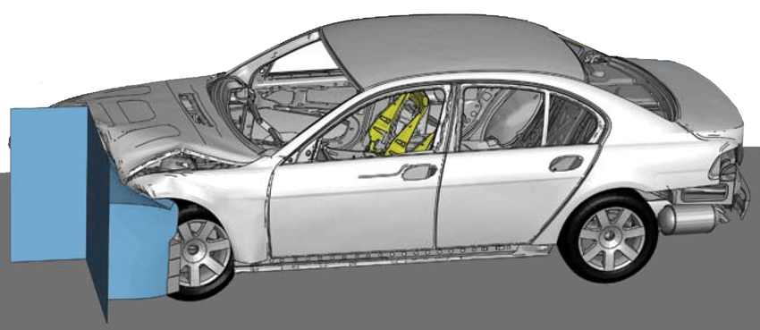
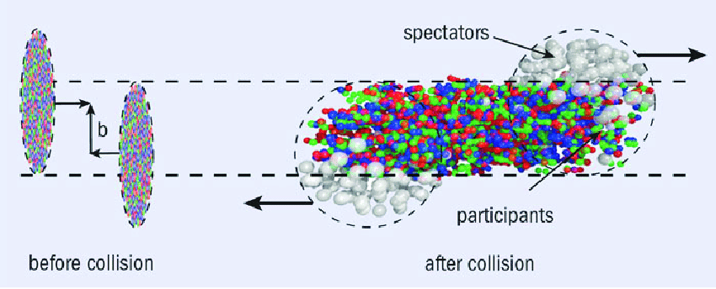
First station at BMW was Crash Simulation

Slide 10
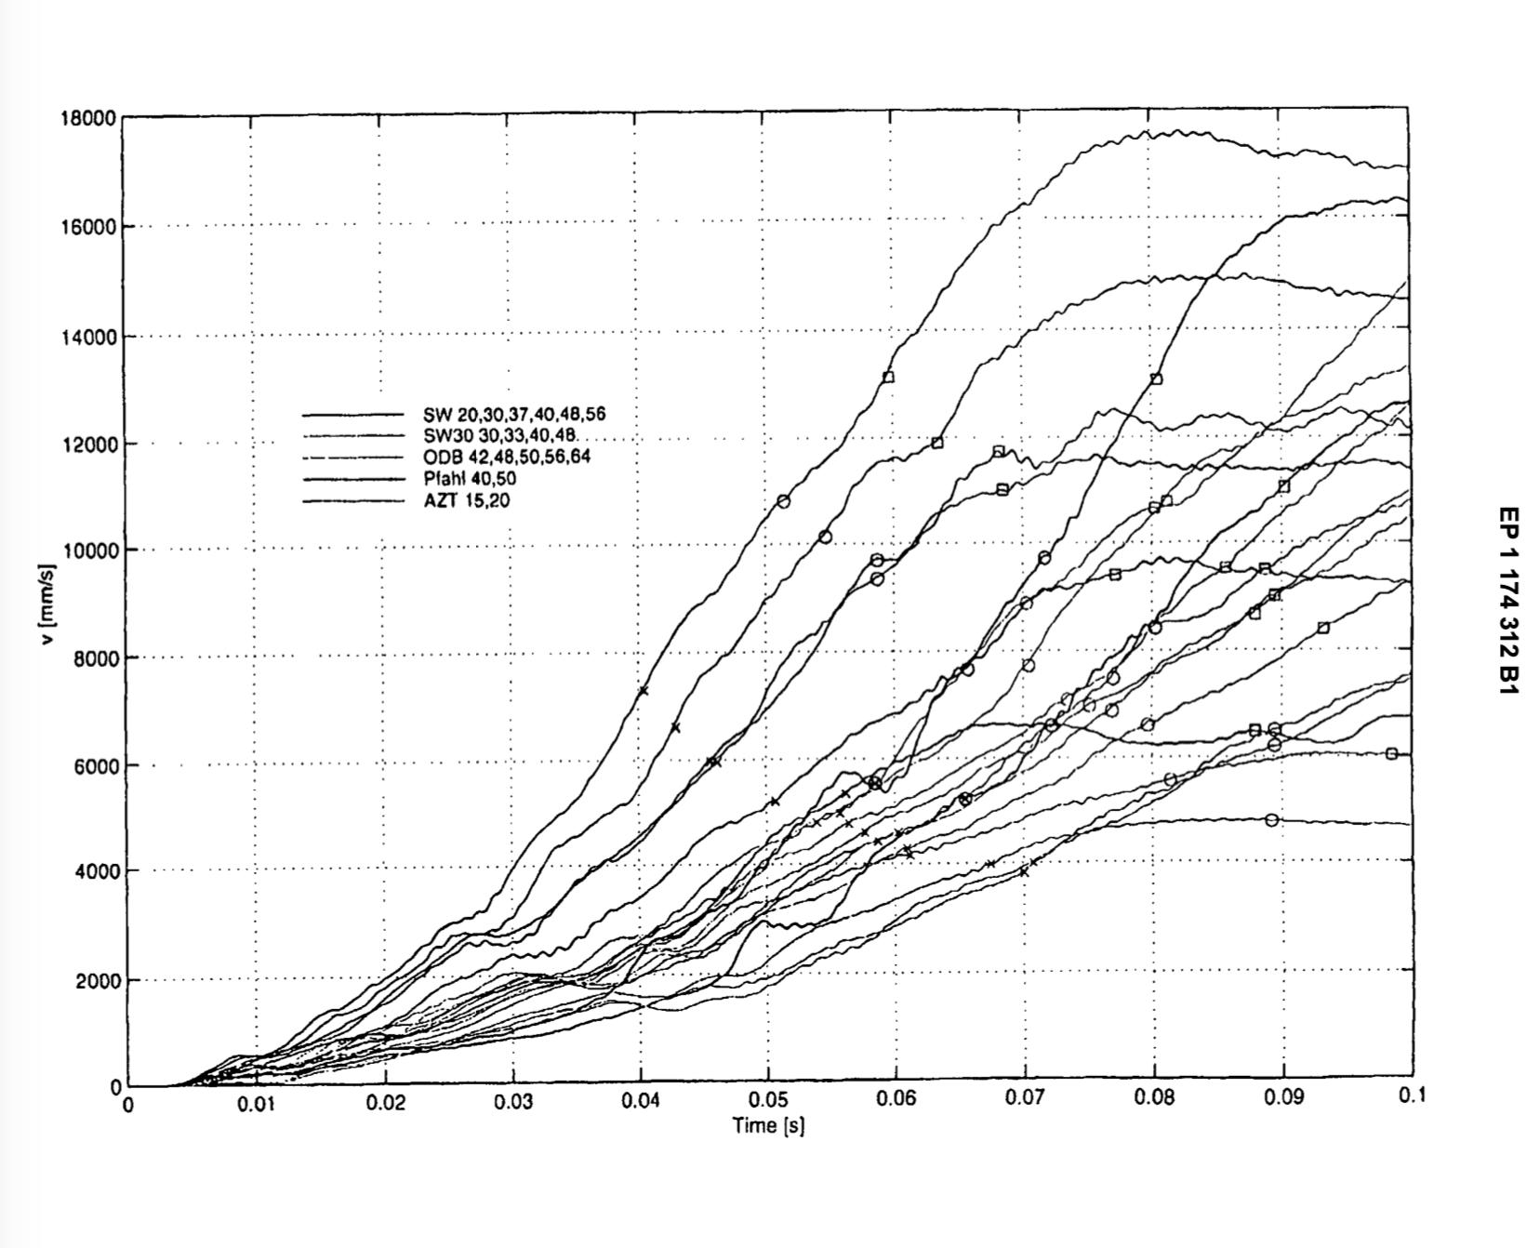
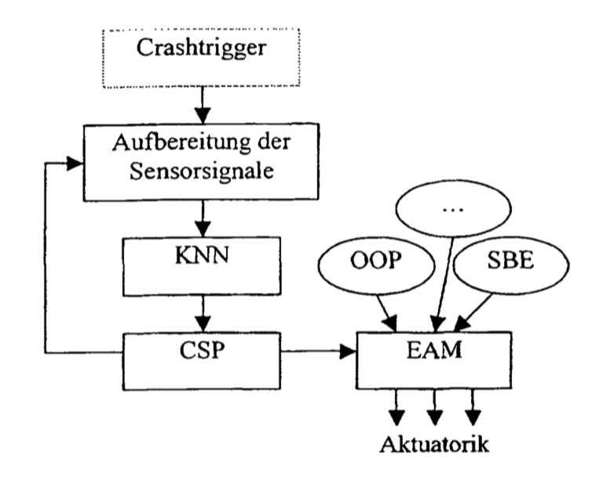
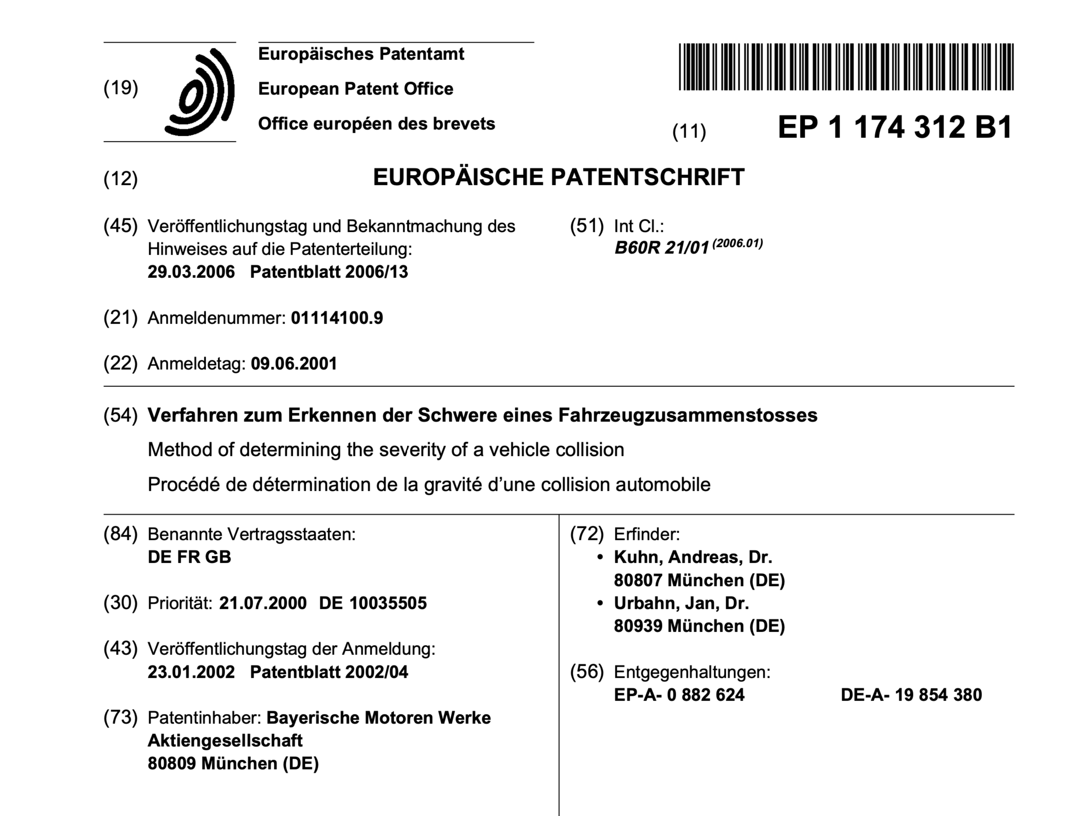
I could bring in my skill set aquired at CERN
Identifying the crash severity by AI

Slide 11
Which skills developed at CERN are useful for prospective employers?
Agility in Thinking and Acting
Ability to put in many hours of work and dedication to solve a problem
Ability to manage many variables simultaneously in your analysis
Working in really large, diverse, international collaborations
Languages, ability to communicate across ethnic borders
Thriving for excellence in operations and work results
Being used to fierce competition among “market participants”
Ability to learn new things quickly and apply them to own work
Data Analysis Skills are required today on any level of work
Understanding and application of AI to large complex problems

Slide 12
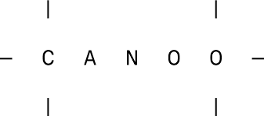
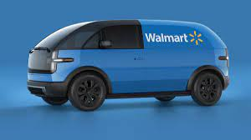
Established Corporation vs Start-Up
Transition happening in business world

Slide 13
Ambidexterity: 2 Corporate Strategies

Slide 14
Cynefin Framework (David Snowden)

Slide 15
The Most Important Skill for the 21st Century
The most important skill in the 21s Century is “to learn, unlearn and re-learn”

Slide 16
Overall Trend: Management -> Leadership
Shift your focus from Management to Leadership
  Continually learn, unlearn and re-learn
  Value yesterday but live in today
  Rely on speed but thrive on timing
  See the big picture as the picture keeps getting bigger
  Live in today, but think about tomorrow
  Move forward courageously in the midst of uncertainty
  Realize today’s best will not meet tomorrow’s challenges

Slide 17
Maxwell’s 5 levels of
Leadership
You are moving up the levels over time
But if you have a new employee, you start at level 1, always!

Slide 18

Some useful management skills to have
(and where to find something to learn from)
Budget Process (SEC Edgar )
Communication Skills (Giving effective Feedback + MBTI)
Conflict Resolution Skills (5 conflict resolution model)
Reporting Skills (find something “how to manage up”)
People Management Skills “how to make a manager” & 5 level of Maxwell
Organization skill (GTD, David Allen)
Process Skills (CMMI + Spice / PMP)
Agile Skills (Scrum / Scrum Alliance / Kanban)
Negotiation Skills (Herb Cohen “You have to care – but not that much”)
Presentation Skills (Steve Jobs Videos + Edward Tufte)
Digital Work Skills (Working Out Loud)
Collaboration Skills (Gretchen Anderson)

Slide 19
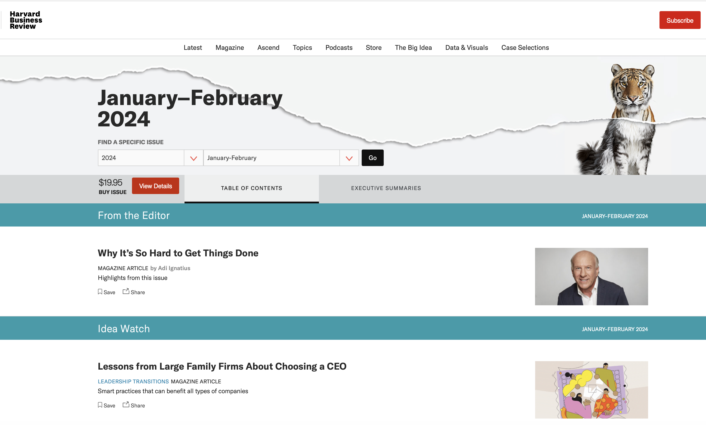
Suggestion: Read Harvard Business Review

Slide 20
Communication Skills
Giving effective Feedback
  Avoid “You”-directed messages
  Instead:
    Say what you observed
    Say what your interpretation is how the observed will affect the team, yourself, product…
    Ask if there is a way to make it work for both of you
    Discuss and come to an agreement
MBTI as a tool (“Do what you are” book)

Slide 21
MBTI as a tool
MBTI has 4 dimensions
  External E / Internal I
  Sensing S / Big Picture N
  Feeling F / Thinking T
  Judging J / Perceiving P
Resulting in 16 Types
Ask: What type of person am I communicating with
Then determine a communication style for that person
  For example humanmetrics.com
  My example:
  http://www.humanmetrics.com/personality/entp-communication-style

Slide 22


Popular: Enneagrams

Slide 23
Conflict Resolution Skills
Thomas Klimann Model
In general compromising provides the most sustainable solutions
Ask yourself in a conflict situation where you are on this map. Then adjust cooperativeness or assertiveness as useful

Slide 24

Reporting Skills
Have awareness about managing up
Your communication upwards must be different from communicating to peers and again different from communicating with your team
Great article to start with in HBR:
  https://hbr.org/2015/01/what-everyone-should-know-about-managing-up

Slide 25
People Management Skills
Be aware when you manage and when you lead
You can’t make it right for everyone
Managing people is difficult for everyone. Everyone!!!
Great book by Julie Zhuo (Facebook) about how to become a people manager

Slide 26
Organization Skills
Great Methodology by David Allen:
“Getting Things Done”
`

Slide 27
Process Skills
CMMI (“Capability Maturity Model Implementation”) by CMU
5 Level Process Modell -> Living on Level 2 is really difficult!

Slide 28

Presentation Skills – Steve Jobs
Steve Jobs introduces the iPhone
https://www.youtube.com/watch?v=e7EfxMOElBE
Steve Jobs introduces the Mac
https://www.youtube.com/watch?v=1tQ5XwvjPmA&t=807s
Steve Jobs dealing with a difficult question
https://www.youtube.com/watch?v=oeqPrUmVz-o

Slide 29
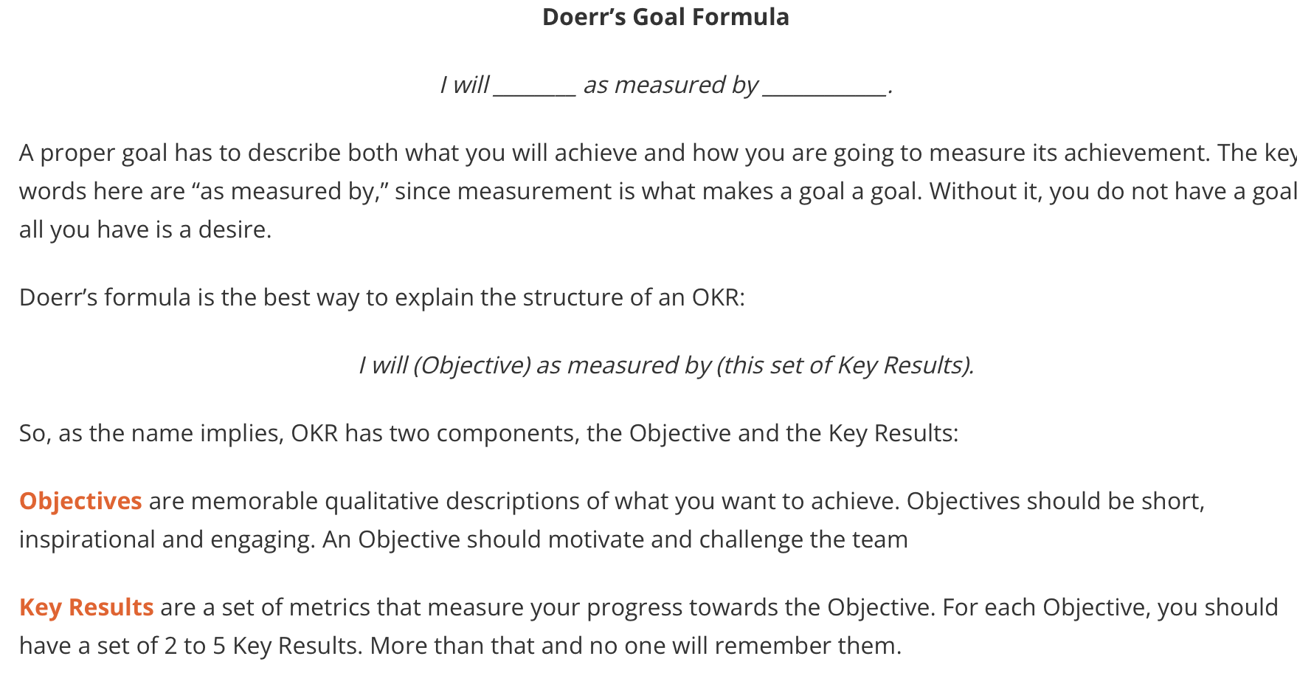

Goal Setting – Via OKRs
OKR are Objectives and Key Results
Used at Google from almost the very beginning by Joseph Doerr

Slide 30
>>> STRESS <<<
Stress will affect your
  Brain
  Pituitary Gland
  Heart
  Adrenal Glands
  Stomach & Intestines
  Body Fat
  Reproductive System
  Aging Process
You have these handles
  Nutrition
  Meditation
  Skilled Rest
  Reducing Intensity
  Exercise
  Positivity
  Creative Work
  Nature

Slide 31
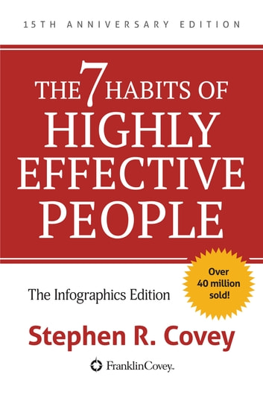
Mindset
Be aware how you want
to approach a task or
project
(Stephen Covey)

Slide 32















A Selection of Books that influenced me

Slide 33

… or find your own favorite books
But read books regularly
Leaders are always readers

Slide 34

Future of Transportation

Slide 35

Where we are today: Almost everything runs on Oil, because…
High energy density
Easy to handle
Oil is cheap
>>> If you go away from oil to an alternative, at least one advantage no longer available

Slide 36
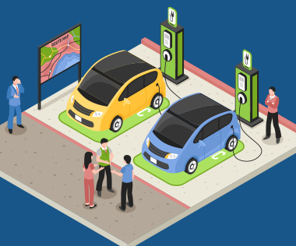
Individual Transportation: Gas to Electric
Driven by global regulations
Electric Zero Emission Vehicles (EV)
to replace combustion engines (ICE)
California and China global drivers
Happening now
2035 Only EVs for sale

Slide 37
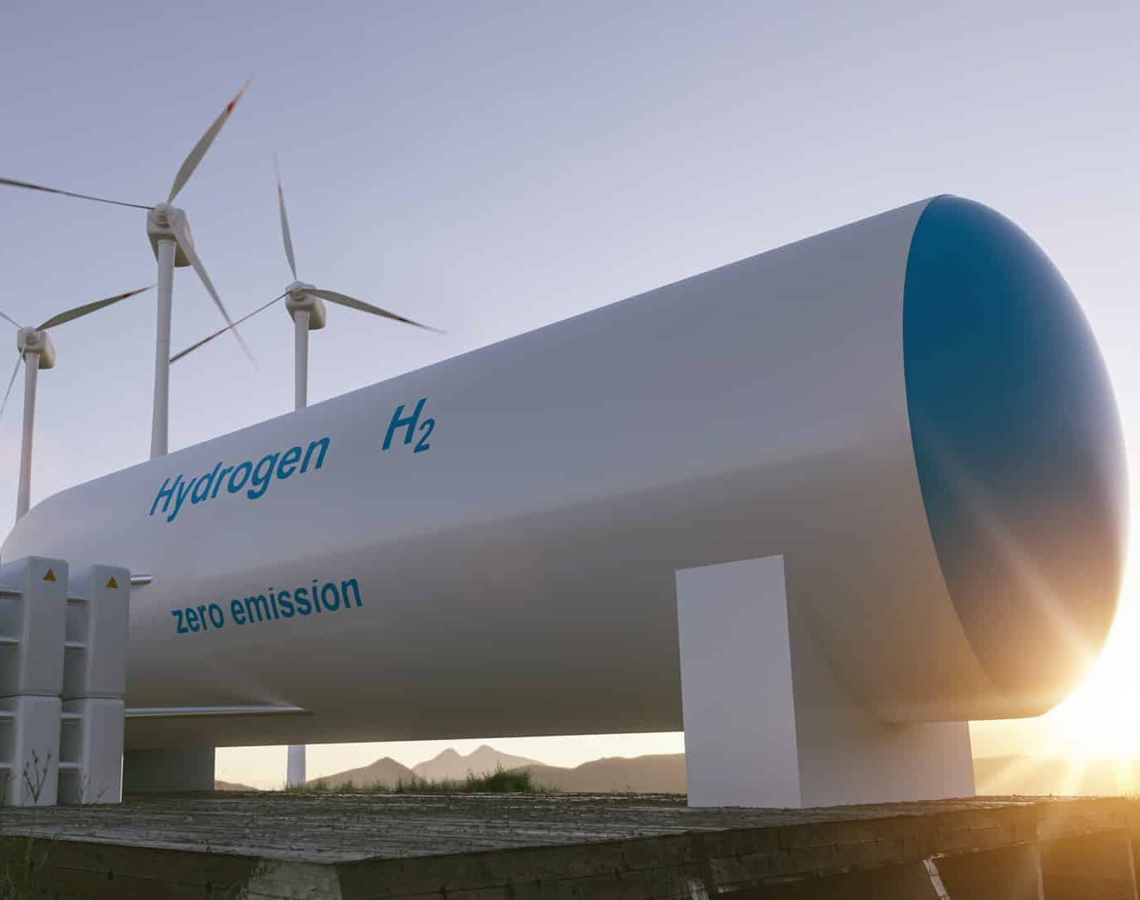
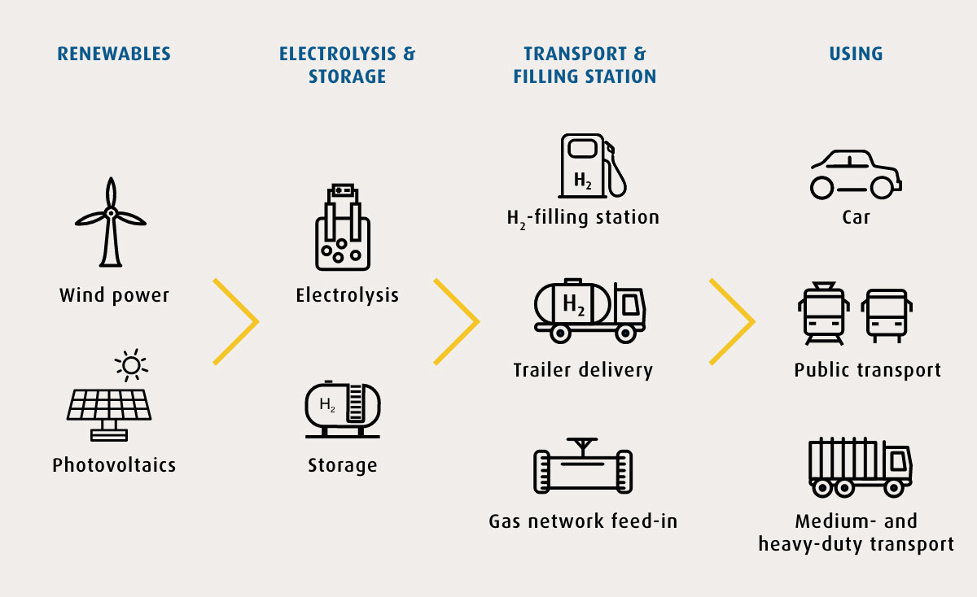
Coming in the future: Hydrogen as energy storage (viable around 2030)

Slide 38
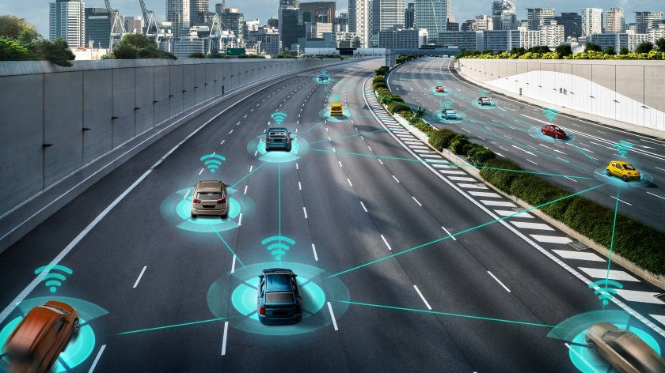
Autonomous Mobility

Slide 39
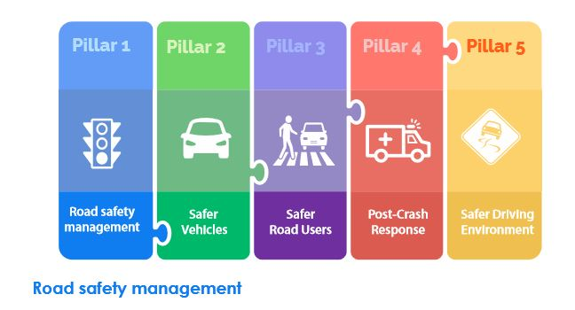
Vision Zero

Slide 40
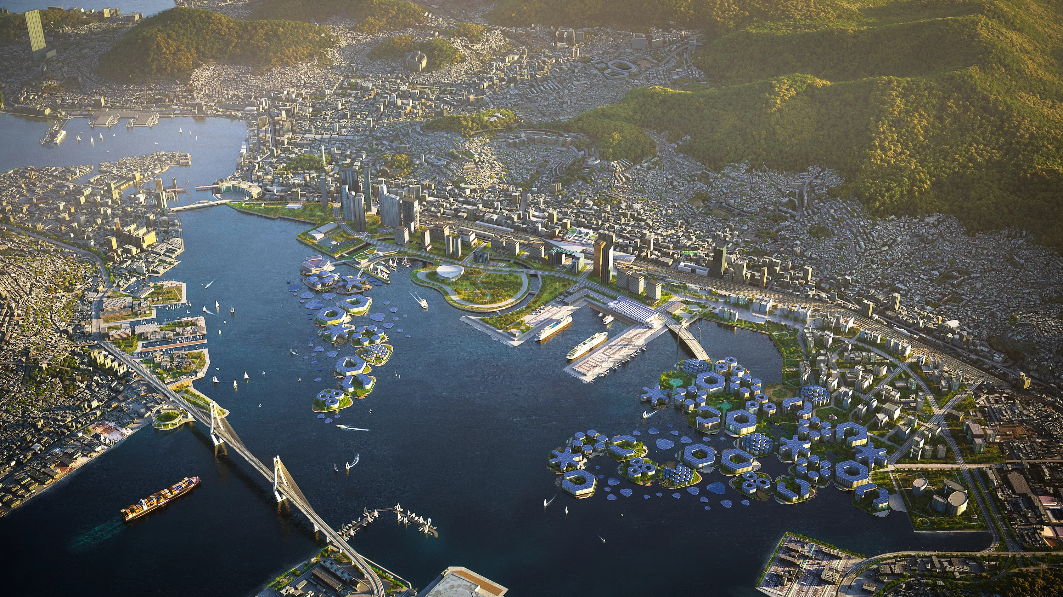
Future: Floating Cities

Slide 41

Future: Fusion Energy

Slide 42

One more thing…

Slide 43
A day in the life of Jan
3:15 am: Run / Shower / first messages
4:45am: Drive to Starbucks, meditate in my car (20 mins), Cappuccino, drive to work
6:00am: arrive at office
6:30am: Factory Leadership Call
7:00 -9:00am: 2 Power Hours, nobody disturbs me
9-11:30am: Email, chat with colleagues, meetings
11:30 lunch at desk, project work
Noon-5pm: meetings, project work
5pm: Meditation 20 min in my car
5:30-6pm: Take a walk
6pm-8pm: Work on personal projects, closeout work items, meet friends, go out
8pm: Sleep
Weekends: Personal Things

Slide 44
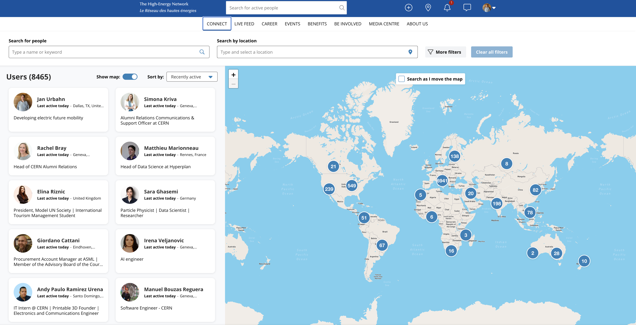
Will be back at CERN through Alumni Program

Slide 45
Thank you!
I hope this presentation was useful for you!
Jan.urbahn@gmail.com
WhatsApp: +1-201-962-6448 (preferred)

