Slide 1
AWAKE RUN 2
Electron injectors
Steffen Doebert, SY-RF

Slide 2
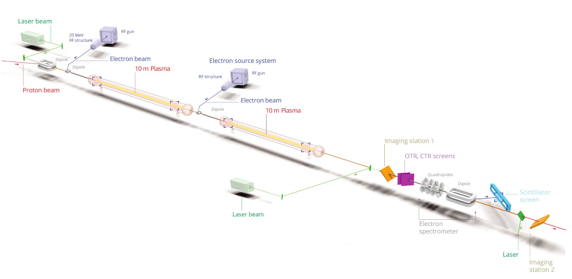
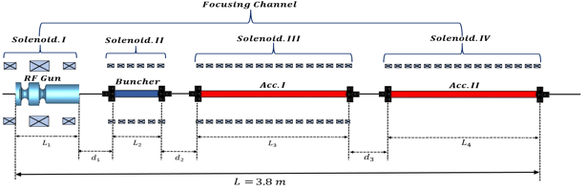
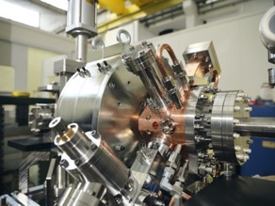
AWAKE Run 2
Demonstrate possibility to use AWAKE scheme for high energy physics applications in mid-term future!
  Need to work in blow-out regime and do beam-loading
  New electron beam based on x-band:
  150 MeV, 200 fs, 100 pC, σ = 5.75 µm
Goals:
Accelerate an electron beam to high energy (gradient of 0.5-1GV/m)
Preserve electron beam quality as well as possible (emittance preservation)
Demonstrate scalable plasma source technology (discharge, helicon)

Slide 3
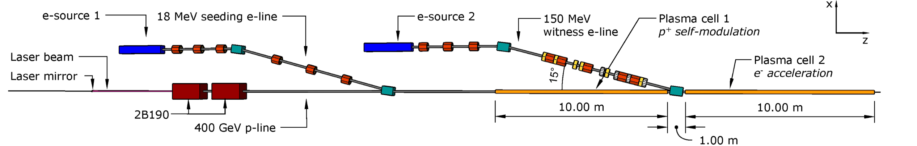
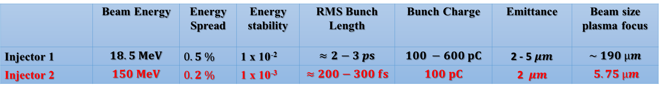
Parameters for both injectors
Working documents held by Rebecca (Injector 2, EDMS 2378918) and John (Injector 1, EDMS 2417022,2588263)
 | Beam Energy | Energy Spread | Energy stability | RMS Bunch Length | Bunch Charge | Emittance | Beam size plasma focus
Injector 1 | $$18.5 MeV$$ | $0.5 \%$ | 1 x 10⁻² | $$≈2−3 ps$$ | $$100 −600 pC$$ | 2 - 5$μm$ | $$\sim 190 µm$$
Injector 2 | $$150 MeV$$ | $0.2 \%$ | 1 x 10⁻³ | $$≈200−300 fs$$ | $$100 pC$$ | 2 $μm$ | $$5.75 µm$$
Flexibility in the beam parameters which can be delivered keeping good energy spread and emittance
Energy: +- 10%, Charge: up to 400 pC, Bunch length: 0.2-1 ps, beam size : see transport
Constraint space for hardware
Excellent timing stability and synchronisation with laser and self-modulation device; ~ 30 fs stability

Slide 4

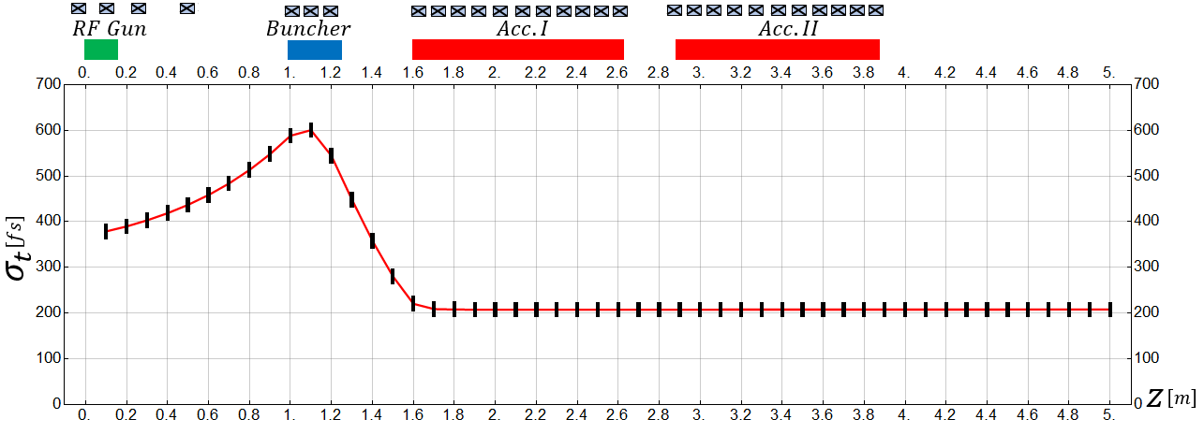
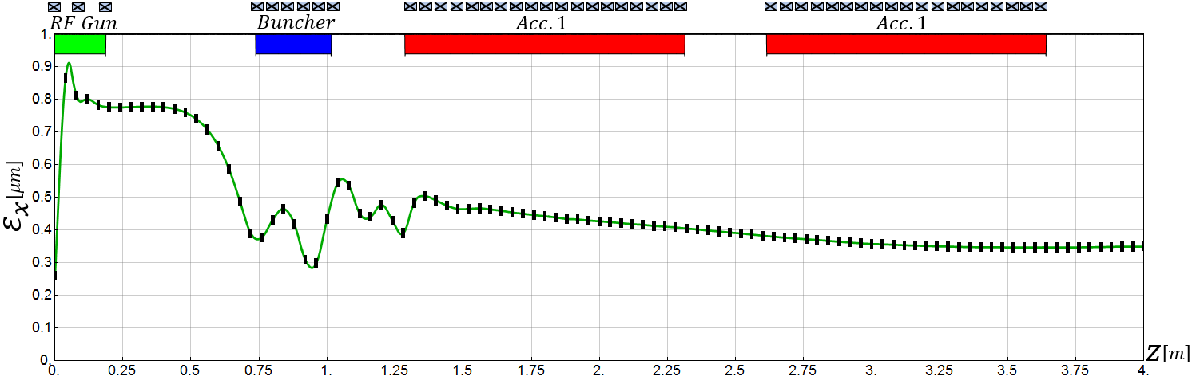
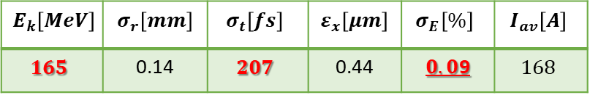
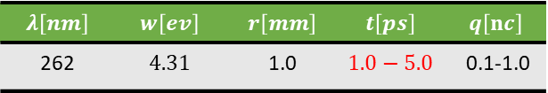
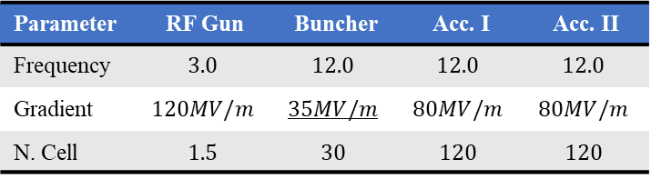
Reference design
Very compact electron injector
Laser parameters
$$λ\left[nm\right]$$ | $$w\left[ev\right]$$ | $$r\left[mm\right]$$ | $$t\left[ps\right]$$ | $$q\left[nc\right]$$
262 | $$4.31$$ | 1.0 | $$1.0−5.0$$ | 0.1-1.0
RF parameters
Parameter | RF Gun | Buncher | Acc. I | Acc. II
Frequency | $$3.0$$ | $$12.0$$ | $$12.0$$ | $$12.0$$
Gradient | $$120MV/m$$ | $$35MV/m$$ | $$80MV/m$$ | $$80MV/m$$
N. Cell | $$1.5$$ | $$30$$ | $$120$$ | $$120$$
$$E_{k}\left[MeV\right]$$ | $$σ_{r}\left[mm\right]$$ | $$σ_{t}\left[fs\right]$$ | $$ε_{x}\left[μm\right]$$ | $$σ_{E}\left[\%\right]$$ | $$I_{av}\left[A\right]$$
$$165$$ | 0.14 | $$207$$ | 0.44 | $0.0$9 | $$168$$
Mohsen Dayyani Kelisani

Slide 5
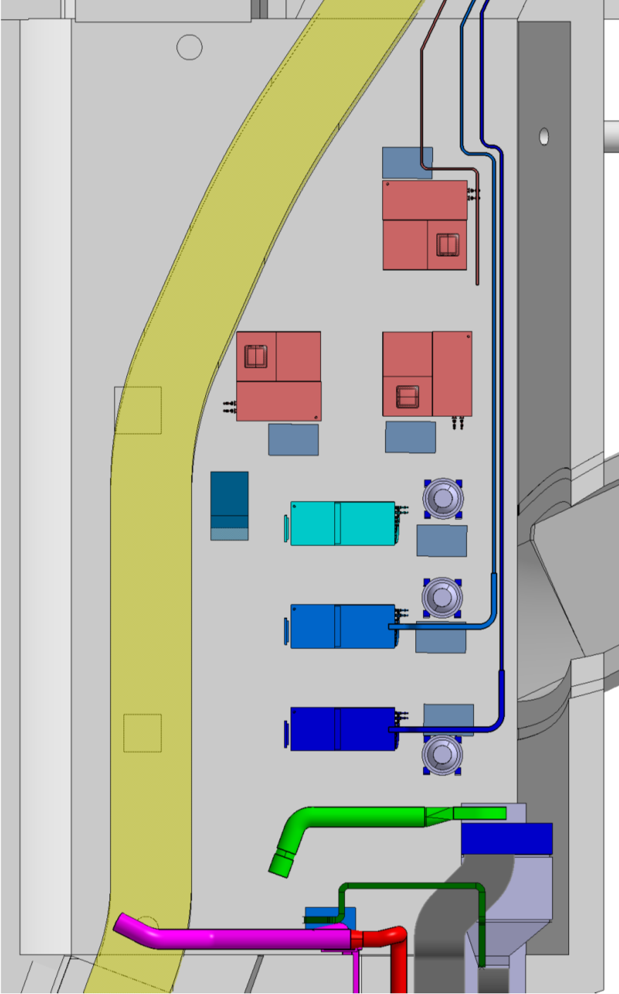
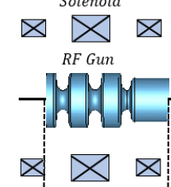

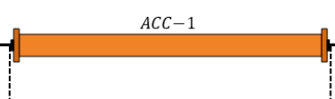
Awake schematic RF layout
7-10 MW, S-band
5-10 MW, x-band
25 / 50 MW, x-band
Klystron layout on the tunnel
PC, 15 -20 MW
PC, 160 -200 MW
A, ϕ
Possibly long waveguides 30 m
Round or double height WG needed
Solenoid
Solenoid
X
X
X
X
X
X
X
X
X
X
X
X
X
X
3 structures at 55 MV/m
Total Energy 100- 160 MeV, 10 Hz rep. rate, single bunch
Will use CLIC developed x-band components as much as possible
Multiple RF-power configurations studied

Slide 6
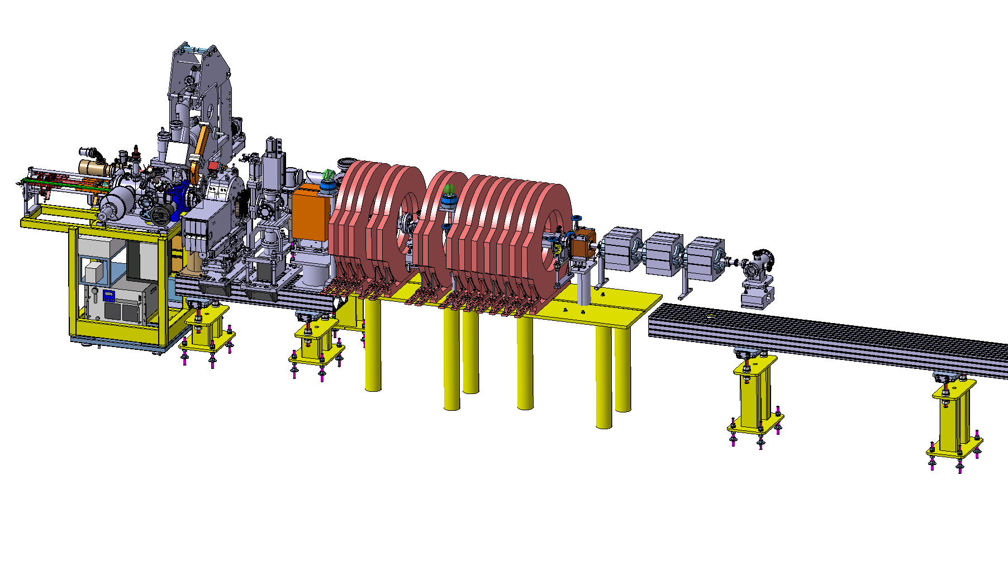
Injector prototype in CTF2 for CLEAR and AWAKE
ARTI (AWAKE Run2 Test Injector)
Reduced scale prototype, 60 MeV, INFN gun, CLIC-structure as buncher and PSI-linearizing structure for acceleration.
Goal: demonstrate the velocity bunching and emittance preservation with x-band
Prototyping of key accelerator hardware and diagnostics
Gaining experience before installation in the AWAKE tunnel

Slide 7
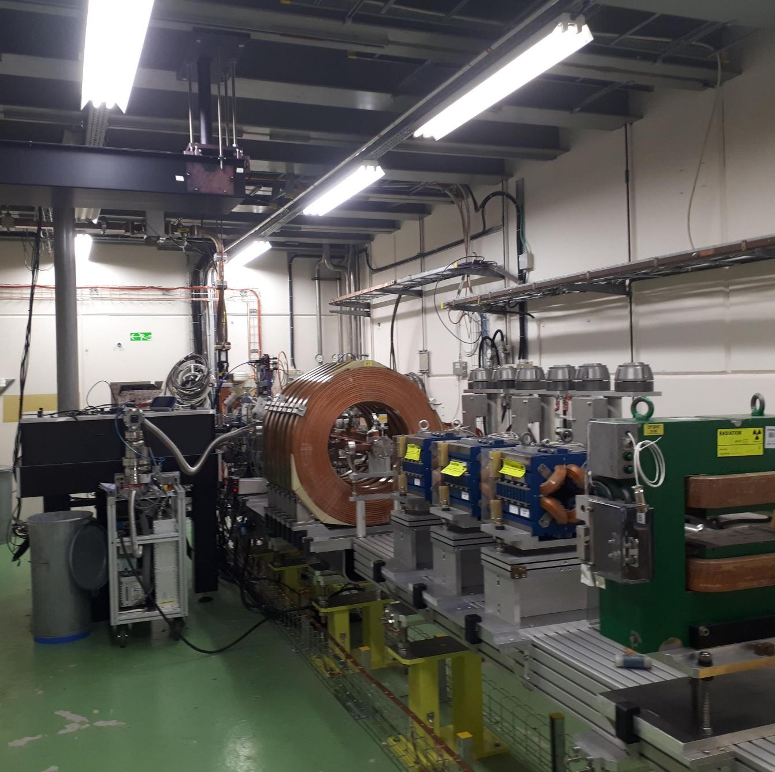
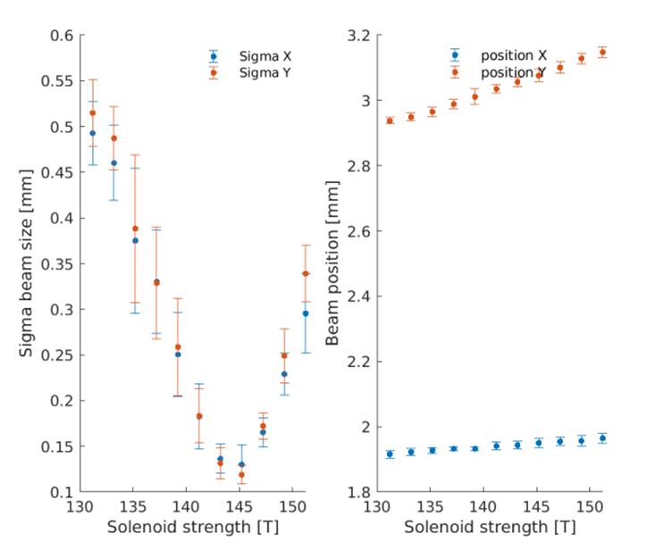
ARTI status
RF-gun (INFN contribution)
and diagnostics operational and under commissioning
Magnets for second phase installed
First ‘CLEAR user’ experiment planned in spring:
Vlad’s CBS experiment

Slide 8
Conclusions
Robust baseline design exists, ‘innovative and conventional’ design with very good stability and flexibility in the final parameters,
further optimisation for performance, cost and integration are ongoing
Strong support from collaborations: INFN, Uppsala, STFC (UK) and of course CLIC / CLEAR
Prototype injector tests:
Very good start of the beam commissioning with the rf-gun.
Next step: x-band bunching and acceleration, demonstration of emittance and stability
Compact x-band accelerator can be a model for other external injection experiments for plasma accelerators
and compact x-band applications: medical (DEFT), x-ray sources (CBS), neutron sources
Synergy with future electron/positron colliders at CERN including FCC-ee

Slide 9
Additional material

Slide 10
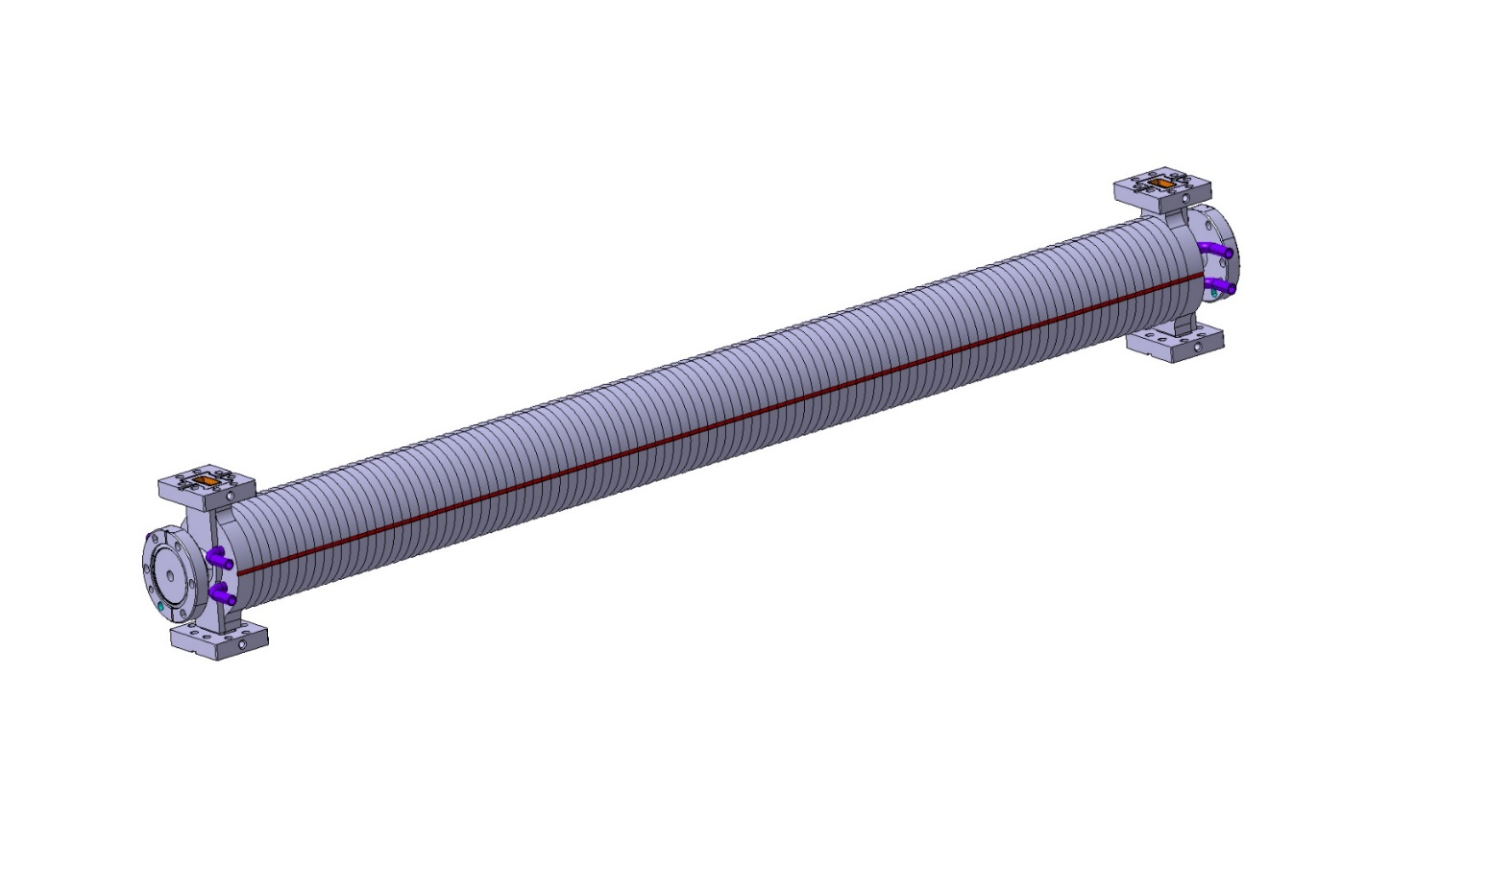
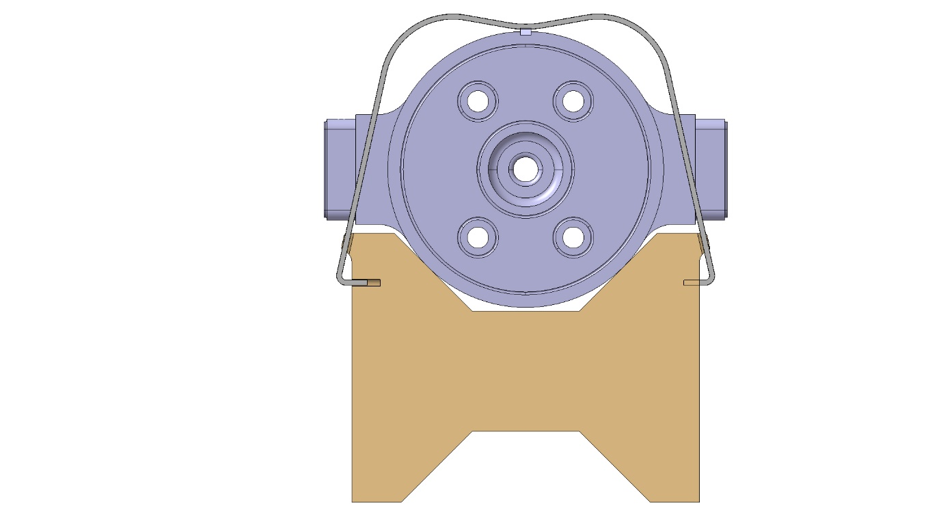
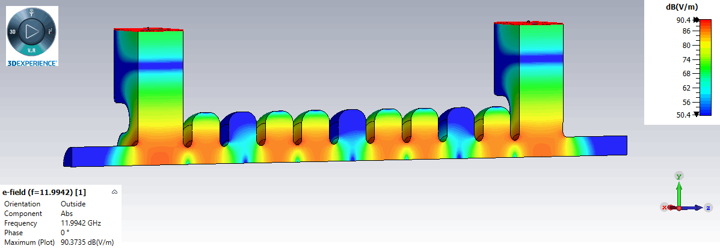
X-band structure developments
Travelling wave Constant Impedance
Shunt Impedance [MΩ/m] | 100
Group Velocity vg/c [%] | 2.4
Q-Factor | 7061
Attenuation [1/m] | 0.7
Length [m] | 0.9
Mechanical design
made at CERN
CLIC style tolerances
Vacuum brazing design
Structure to be inserted in a solenoid of 150 mm diameter bore radius
Designed by INFN Frascati, D. Alesini, M. Diomede,
for CompactLight and EuPraxia

Slide 11
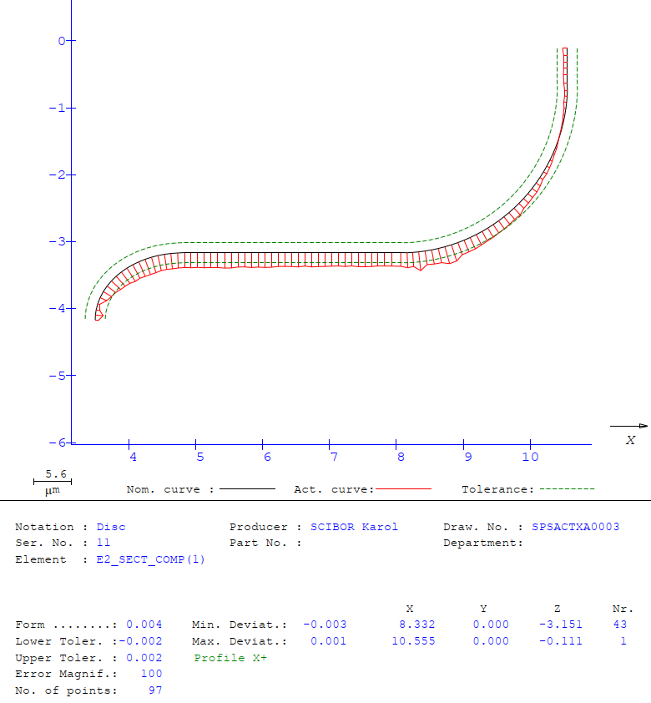
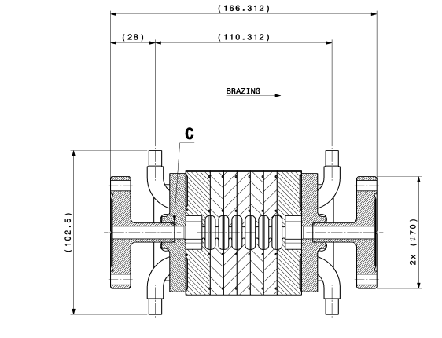
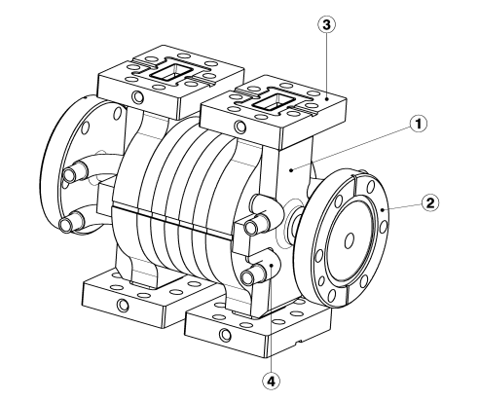
First short prototype under construction
C. Capelli, N. Chritin
Verify mechanical design, brazing assembly and tolerances needed
Maybe low power RF measurements but no high-power test planned

Slide 12
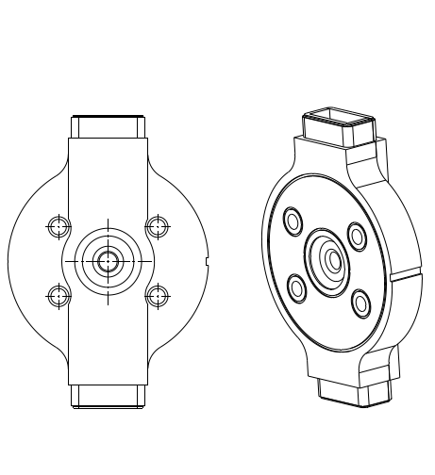
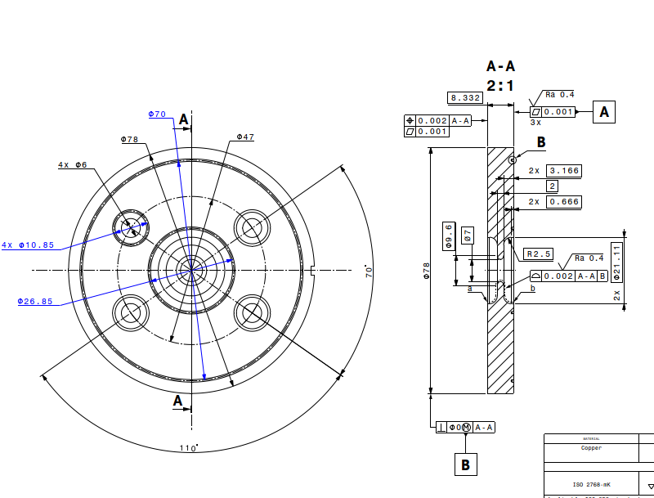

X-band accelerating structure
Mechanical design
Structure to be inserted in a solenoid of
150 mm diameter bore radius
RF-Design made by D. Alesini, M. Diomede, INFN Frascati

Slide 13
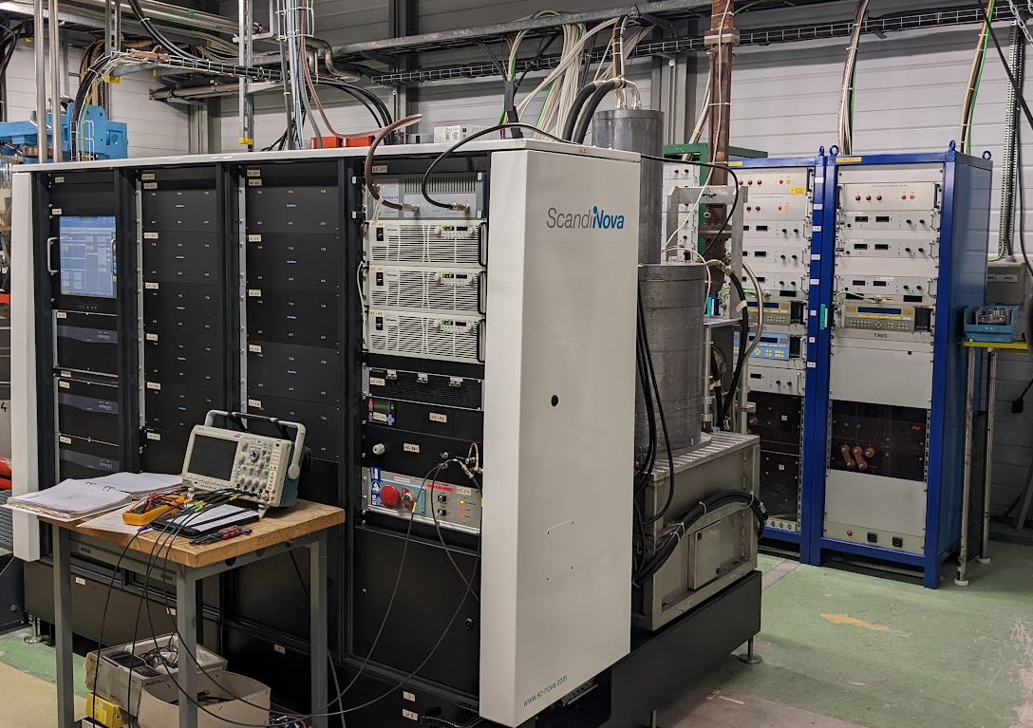
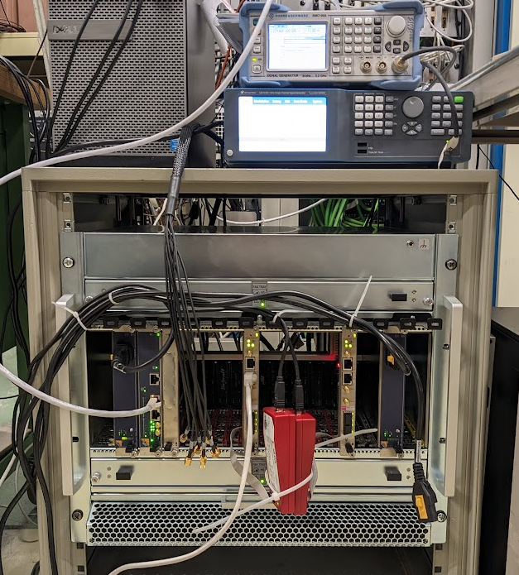
u-TCA LLRF development with Uppsala
System shipped to CERN from Uppsala, installed in the form CLIC test facility.
RF signal acquisition, generation and feedback/forward loops tested.
Use of DESY BSP and python GUI.
External trigger injection through RJ45 connector on SIS8300KU AMC, distributed to mLVDS lines.
  Currently under test/development (still some bugs to iron out)
Work progressing well on a DESYRDL to CERN/Cheby convertor script.
Modulator and S-band 40MW klystron (above)
MicroTCA crate and LO, CLK generators (right)

Slide 14
Studied alternative scenarios
Beam dynamics:
3 identical structures, one 50 MW klystron → Save small klystron, waveguide run and buncher structure
RF power variants:
One 25 MW klystron for acceleration, small 8 MW klystron for bunching → less expensive klystron and modulator
Only one 25 MW klystron for everything → less expensive klystron, save second waveguide run and small klystron
Integration scenarios:
Keep Run 1 modulator (PPT) for LINAC 1, instead of two K100 modulators → no new hardware needed
Use K400 modulator instead of PPT → better performance and stability
Replace K400 x-band with 2x K200 x-band → essentially staged scenario to upgrade energy later

Slide 15
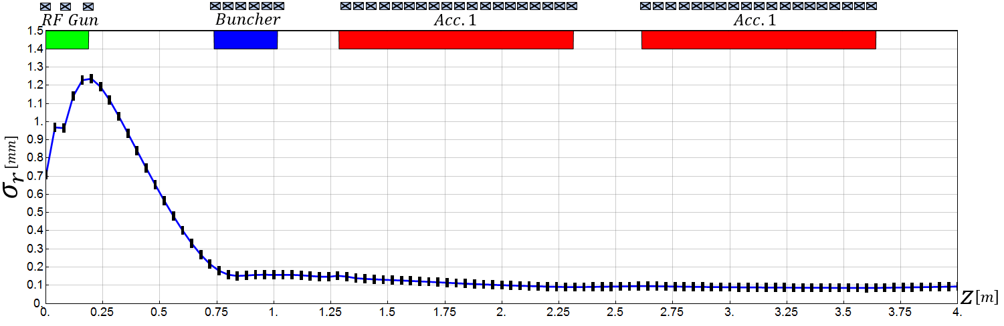
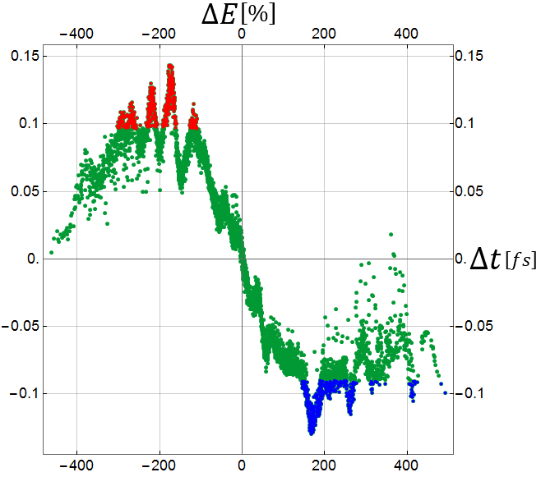
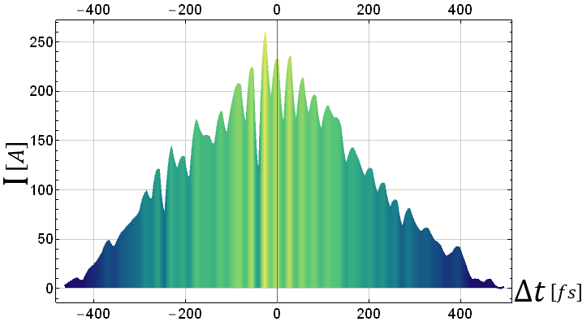
Reference design
Mohsen Dayyani Kelisani

Slide 16
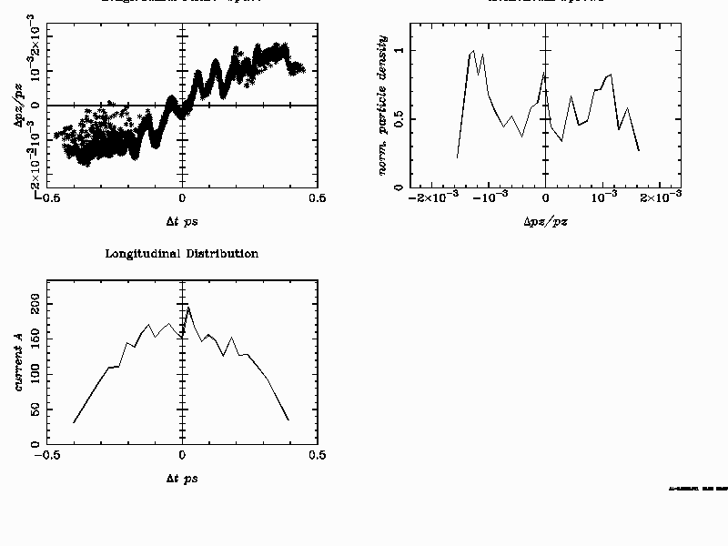
Tentative RUN 2 injector parameter for 150 MeV
Only scaled down accelerating gradient, identical initial distributions,
no new optimization
Energy: 151.8 MeV
Energy Spread: 144.5 keV rms =9.5 10⁻⁴
Emittance: x/y: 0.7 mm mrad
Bunch length: 60 um rms
Bunch Charge: 100 pC

Slide 17
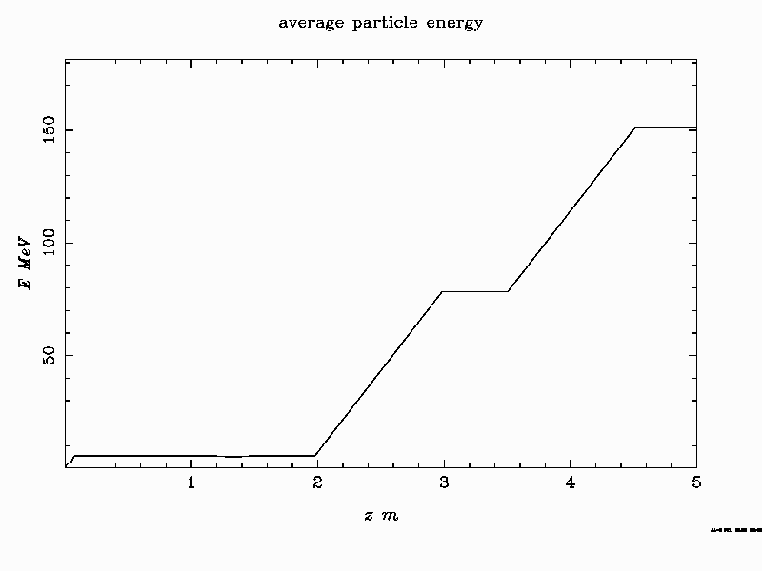
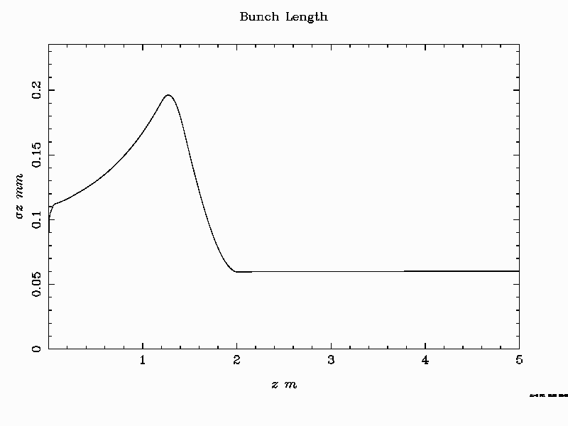
Tentative RUN 2 injector parameter for 150 MeV

Slide 18
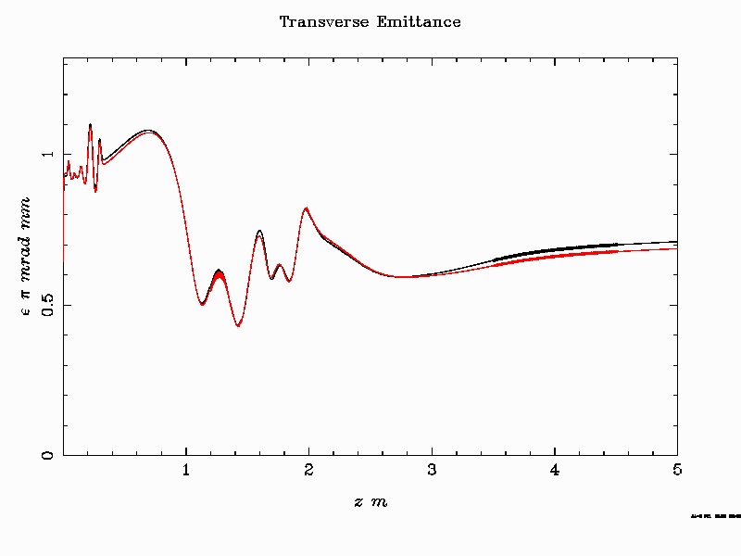
Tentative RUN 2 injector parameter for 150 MeV

Slide 19
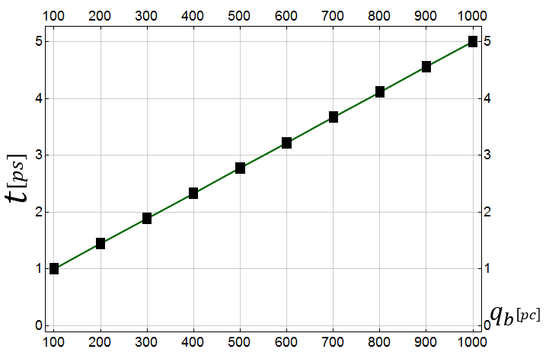
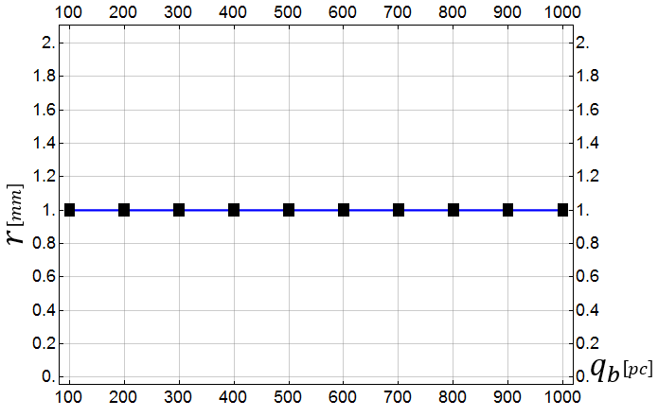
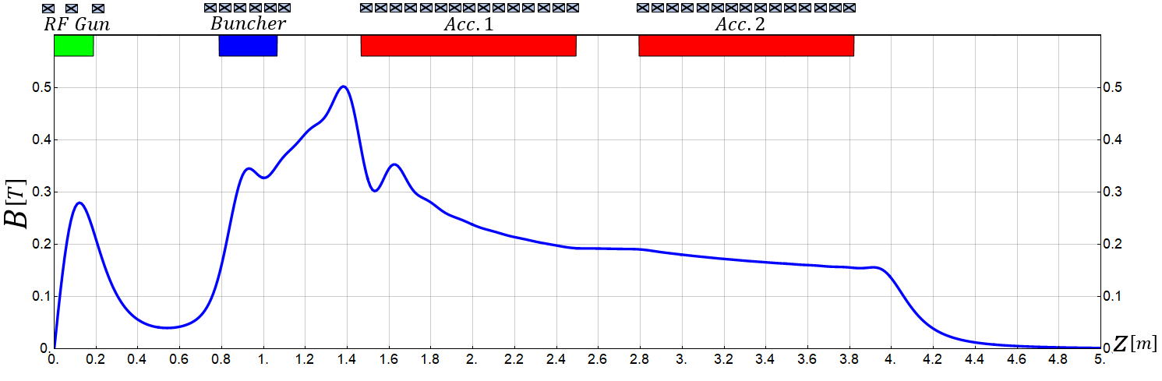
3. High Current Operation
Flexibility to produce higher charge
(for lower plasma density or experimental reasons)
3.1 100pC-1000pC
Changing only laser pulse length and adapting magnetic field slightly
Laser Pulse Duration
Laser Spot Size
Mohsen Dayyani Kelisani

Slide 20
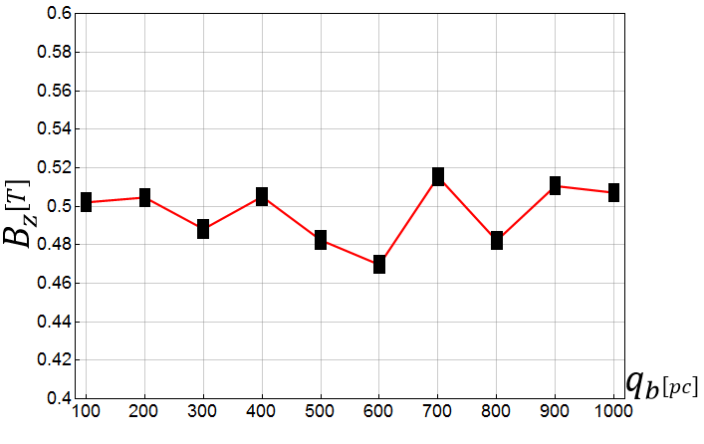
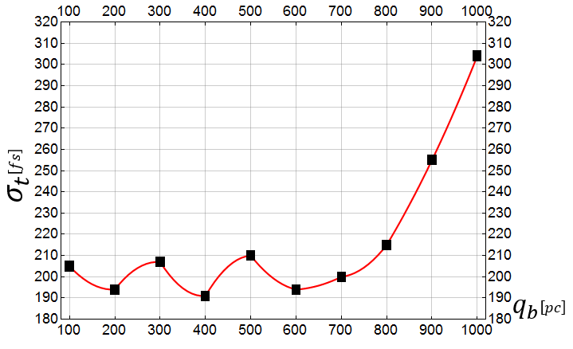
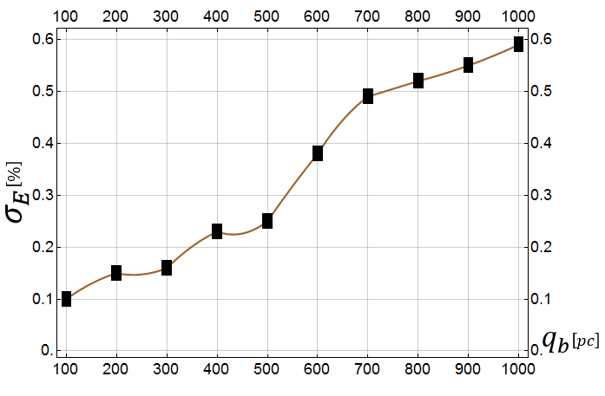
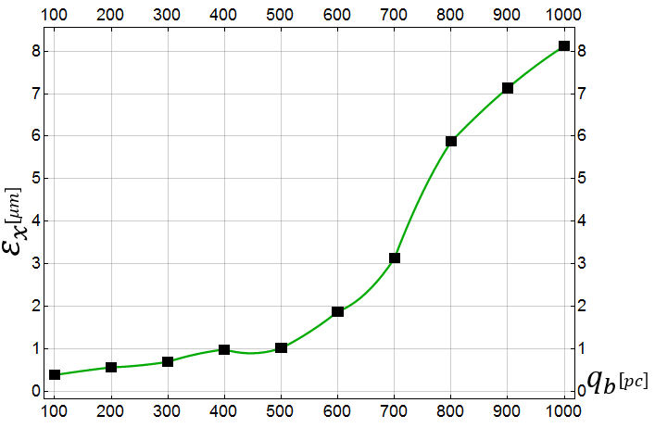

3. High Current Operation
Flexibility to produce higher charge
0.1 to 1 nC per bunch
3.1 100pC-1000pC
Max_$B_{z}$
Bunch Length
Energy Spread
Bunch Emittance
Mohsen Dayyani Kelisani

Slide 21
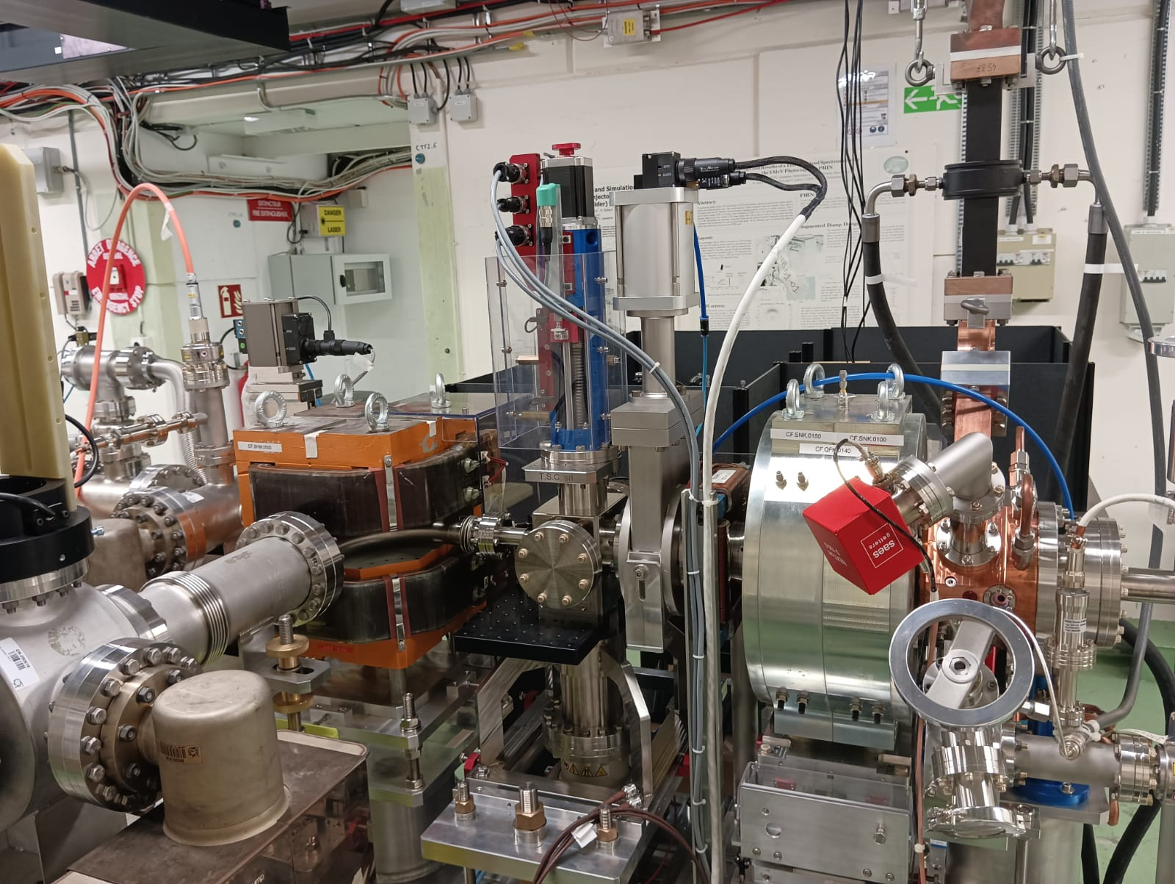
F-Cup
ARTI in CTF2
Screen BTV1
RF-GUN
RF-gun conditioned to 120 MV/m on the cathode
200 ns
400 ns
600 ns
800 ns
1 us
Spectrometer
Notes:
.

Slide 22
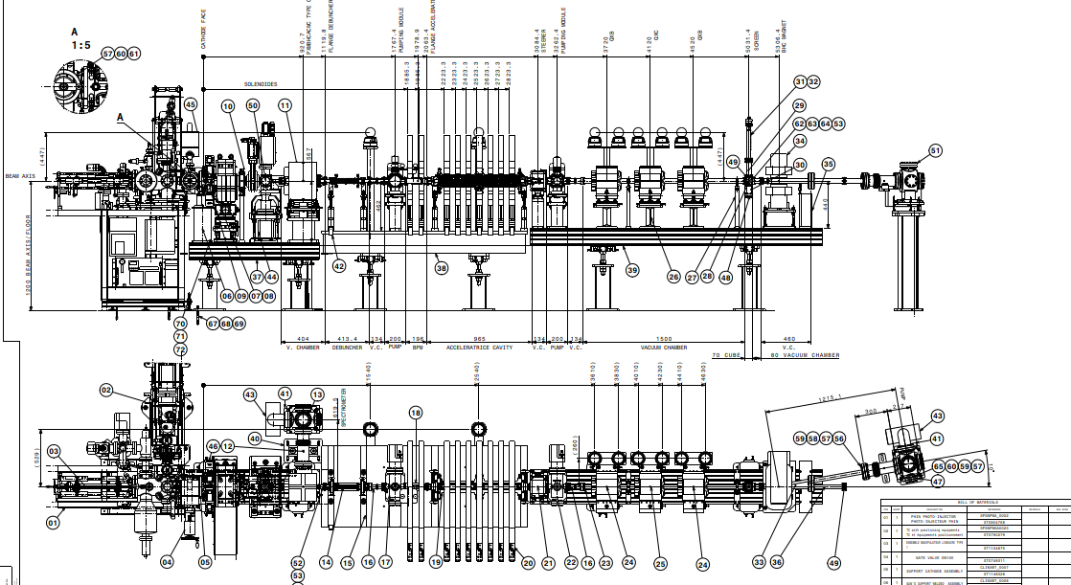

Slide 23
Detailed integration studies have been performed
0.8m
0.9m
1m
0.9m
0.9m

