Slide 1
External electron injection: from electron source to plasma
S. Doebert and V. Bencini for the AWAKE collaboration

Slide 2
External electron injection: electron sources
S. Doebert

Slide 3
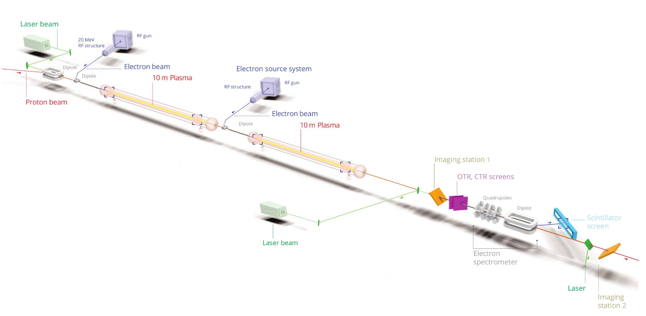
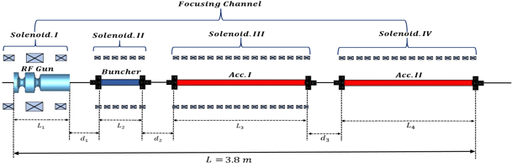
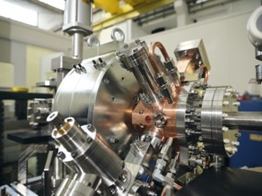
AWAKE Run 2
Demonstrate possibility to use AWAKE scheme for high energy physics applications in mid-term future!
  Need to work in blow-out regime and do beam-loading
  New electron beam based on x-band:
  150 MeV, 200 fs, 100 pC, σ = 5.75 µm
Goals:
Accelerate an electron beam to high energy (gradient of 0.5-1GV/m)
Preserve electron beam quality as well as possible (emittance preservation)
Demonstrate scalable plasma source technology (discharge, helicon)

Slide 4
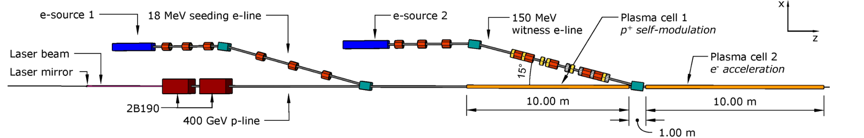
Parameters for both injectors
Flexibility in the beam parameters which can be delivered keeping good energy spread and emittance
Energy: +- 10%, Charge: up to 400 pC, Bunch length: 0.2-1 ps, beam size : see transport
Constraint space for hardware
Excellent timing stability and synchronisation with laser and self-modulation device; ~ 30 fs stability
 | 18 MeV injector | 150 MeV injector
Beam Energy (MeV) | 18.5 | 150
Energy Spread (ΔE/E₀) (%) | 0.50% | 0.20%
Energy stability (ΔE₀/E₀) | 1 x 10-2 | 1 x 10-3
RMS Bunch Length (ps) | ≈2-3 | ≈0.2-0.3
Bunch Charge (pC) | 100 -600 pC | 100 pC
Emittance (mm mrad) | 2 - 5 | 2
Beam size (µm) | ~ 190 | 5.75

Slide 5

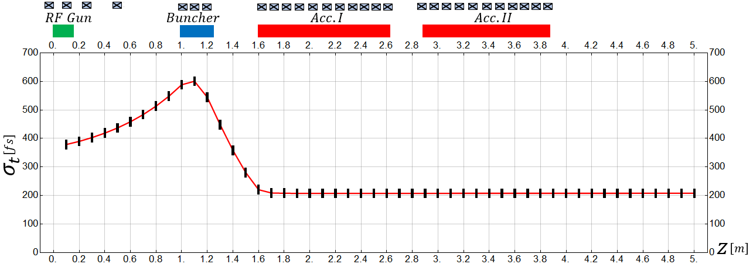
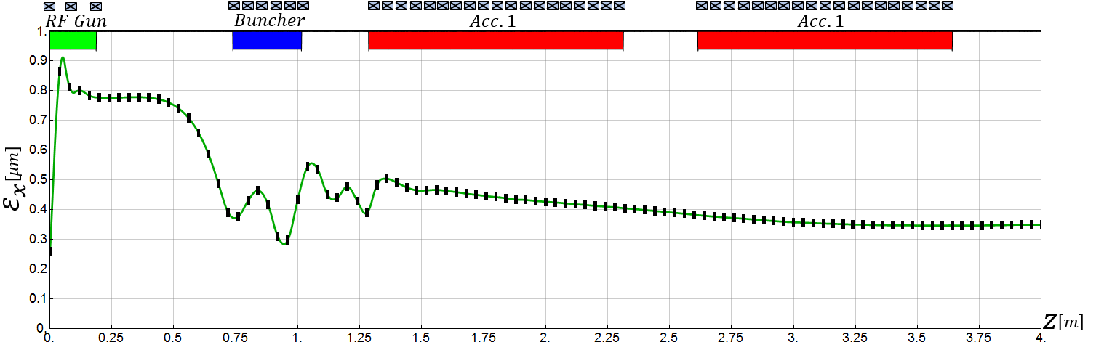
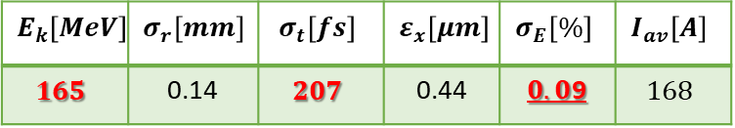
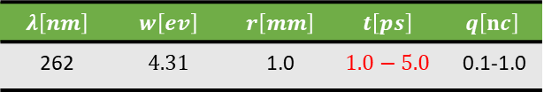
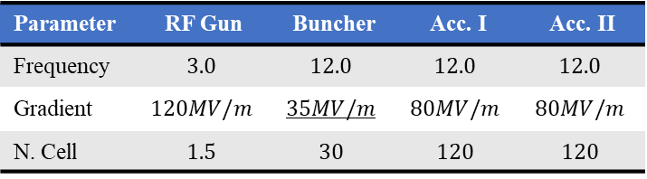
150 MeV injector – beam dynamics design
Very compact electron injector
Simulated parameters within specifications
$$E_{k}\left[MeV\right]$$ | $$σ_{r}\left[mm\right]$$ | $$σ_{t}\left[fs\right]$$ | $$ε_{x}\left[μm\right]$$ | $$σ_{E}\left[\%\right]$$ | $$I_{av}\left[A\right]$$
$$165$$ | 0.14 | $$207$$ | 0.44 | $0.0$9 | $$168$$
Laser parameters
$$λ\left[nm\right]$$ | $$w\left[ev\right]$$ | $$r\left[mm\right]$$ | $$t\left[ps\right]$$ | $$q\left[nc\right]$$
262 | $$4.31$$ | 1.0 | $$1.0−5.0$$ | 0.1-1.0
RF parameters
Parameter | RF Gun | Buncher | Acc. I | Acc. II
Frequency | $$3.0$$ | $$12.0$$ | $$12.0$$ | $$12.0$$
Gradient | $$120MV/m$$ | $$35MV/m$$ | $$80MV/m$$ | $$80MV/m$$
N. Cell | $$1.5$$ | $$30$$ | $$120$$ | $$120$$

Slide 6
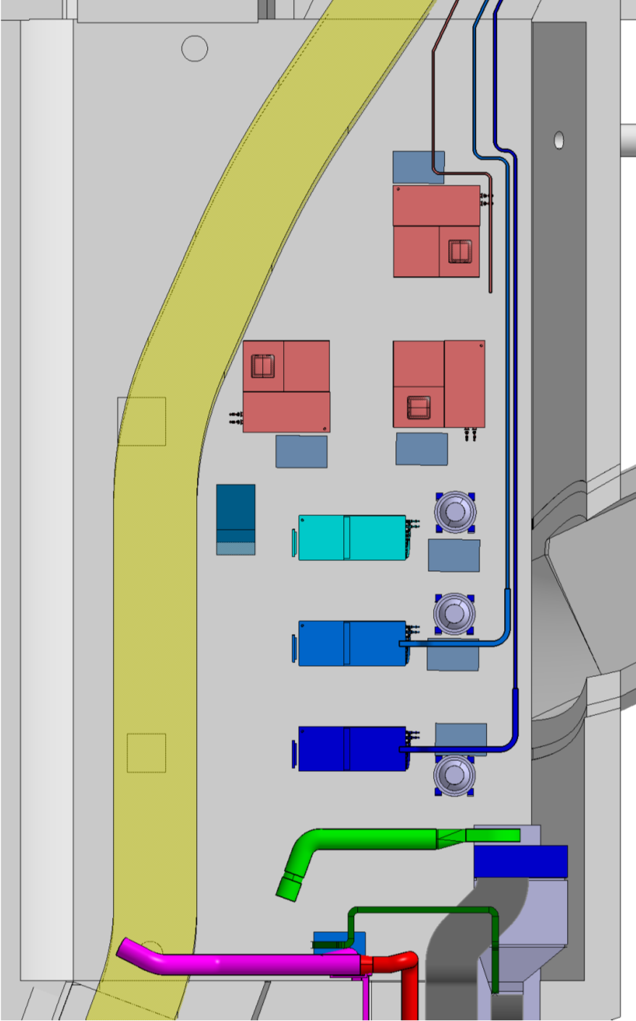
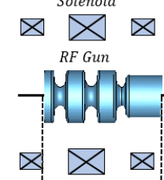

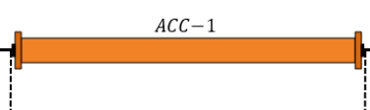
150 MeV injector – RF layout
7-10 MW, S-band
5-10 MW, x-band
25 / 50 MW, x-band
Klystron layout on the tunnel
PC, 15 -20 MW
PC, 160 -200 MW
A, ϕ
Possibly long waveguides 30 m
Round or double height WG needed
Solenoid
Solenoid
X
X
X
X
X
X
X
X
X
X
X
X
X
X
3 structures at 55 MV/m
Total Energy 100- 160 MeV, 10 Hz rep. rate, single bunch
Will use CLIC developed x-band components as much as possible
Multiple RF-power configurations studied

Slide 7
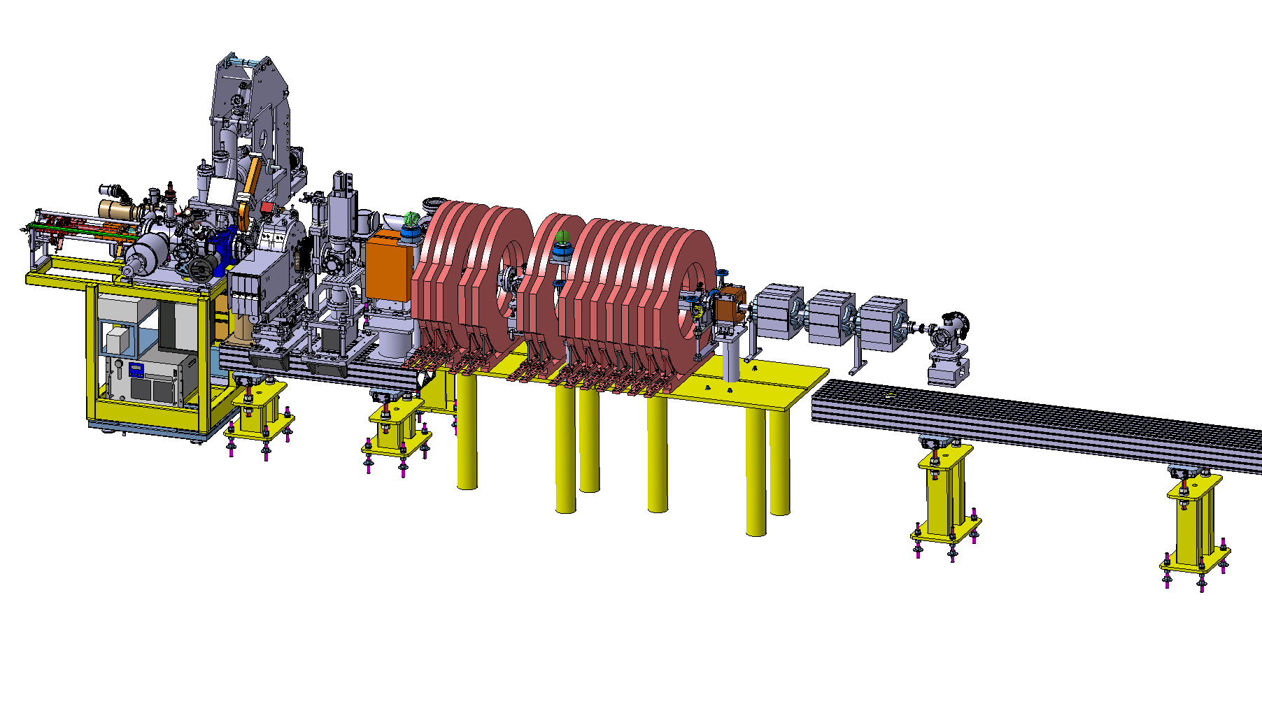
150 MeV injector – Prototype
ARTI (AWAKE Run2 Test Injector)
Reduced scale prototype, 60 MeV, INFN gun, CLIC-structure as buncher and PSI-linearizing structure for acceleration.
Goal: demonstrate the velocity bunching and emittance preservation with x-band
Prototyping of key accelerator hardware and diagnostics
Gaining experience before installation in the AWAKE tunnel

Slide 8
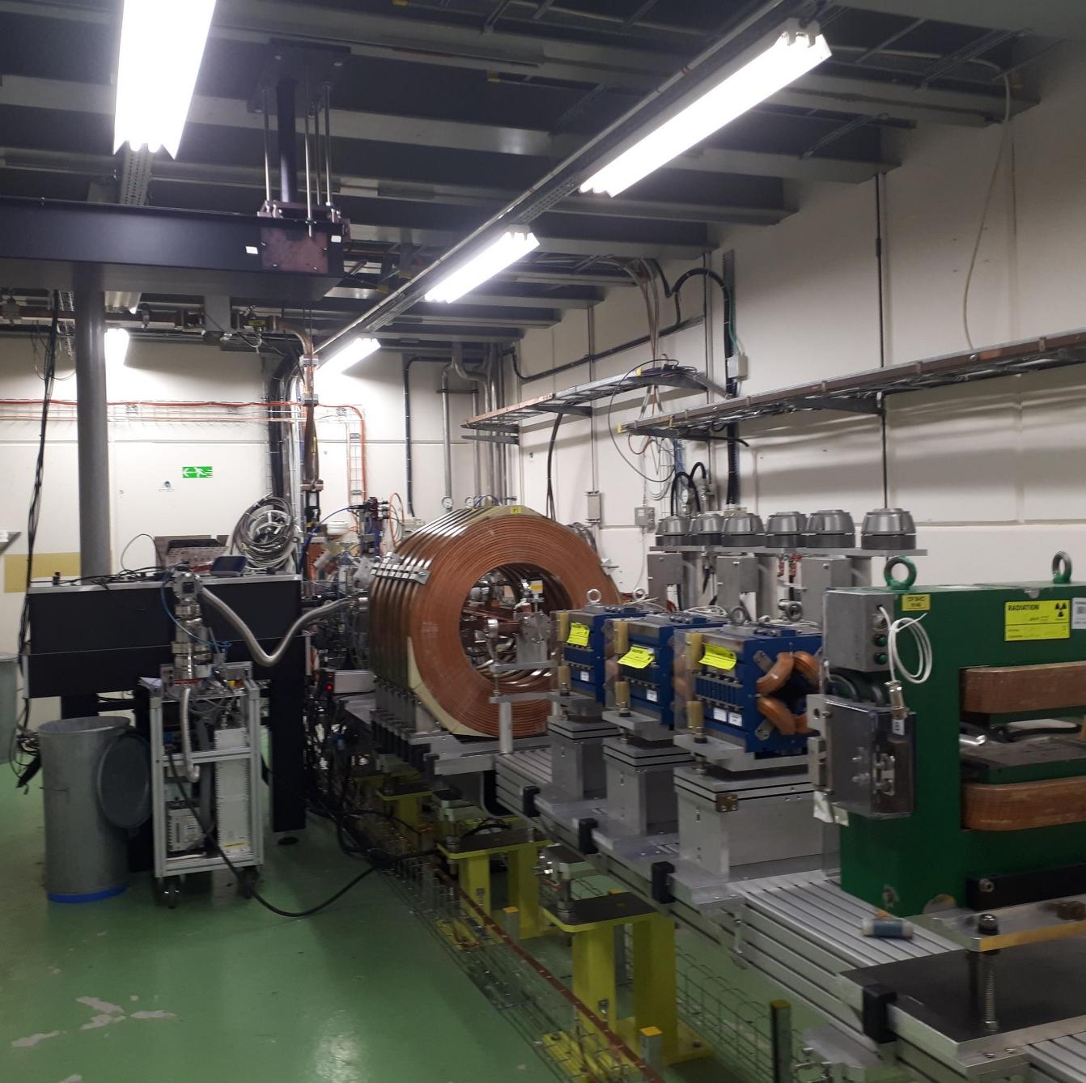
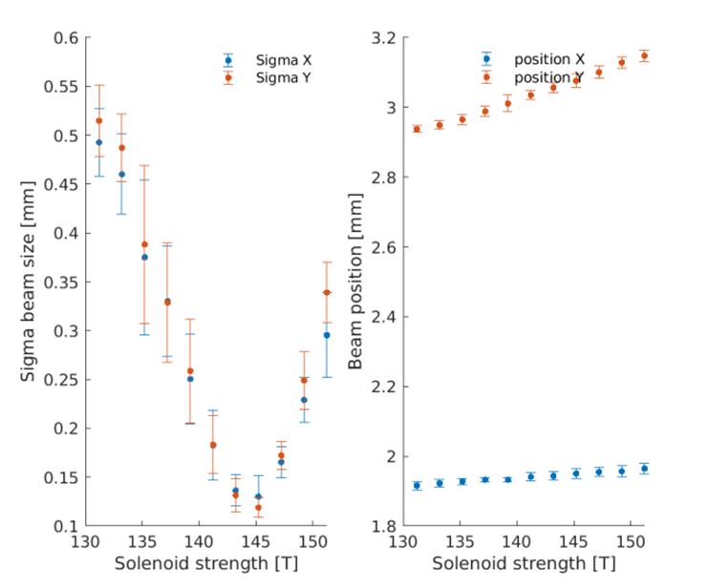
150 MeV injector – Prototype
ARTI (AWAKE Run2 Test Injector) under commissioning at CERN
RF-gun (INFN contribution) and diagnostics operational and under commissioning
Magnets for second phase installed
First ‘CLEAR user’ experiment planned in spring:
(Compton Back-Scattering)

Slide 9
Conclusions /challenges
Robust baseline design exists, ‘conventional’ design with very good stability and flexibility in the final parameters,
further optimisation for performance, cost and integration are ongoing
Strong support from collaborations: INFN, Uppsala, STFC (UK) and of course CLIC / CLEAR
Prototype injector tests:
Very good start of the beam commissioning with the rf-gun.
Next step: x-band bunching and acceleration, demonstration of emittance and stability
Compact x-band accelerator can be a model for other external injection experiments for plasma accelerators and compact x-band applications: medical (DEFT), x-ray sources (CBS), neutron sources. Synergy with future electron/positron colliders at CERN

Slide 10
External electron injection: beam transfer lines
V. Bencini
Notes:
Steffen has presented you the results about the electron sources for Run2c, I am going to speak about the tranfser lines needed to transport electron and protons to the plasma.

Slide 11
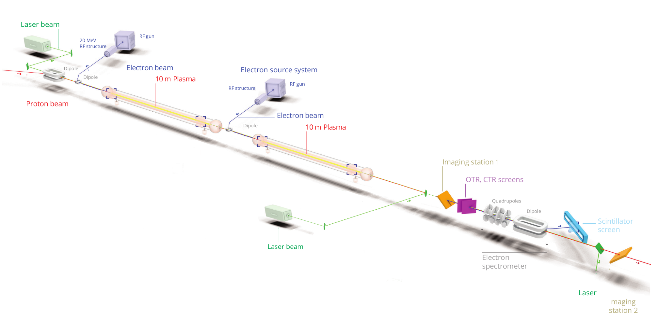
Run2c beamlines layout
Run2c foresees several changes in experiment layout and beamlines configuration
Reconfiguration of 18 MeV electron seeding beam line.
New 150 MeV witness electron beam line for external injection.
Reconfiguration of proton beam transfer line from SPS to AWAKE.
Design optimisation needed to match beam target experimental requirements
Notes:
- As mentioned by Edda and Patric, the AWAKE experimental layout will be radically modified for Run2c.
- The existing proton and electron beam lines will moved and a brand new 150 MeV line will be added.
-

Slide 12
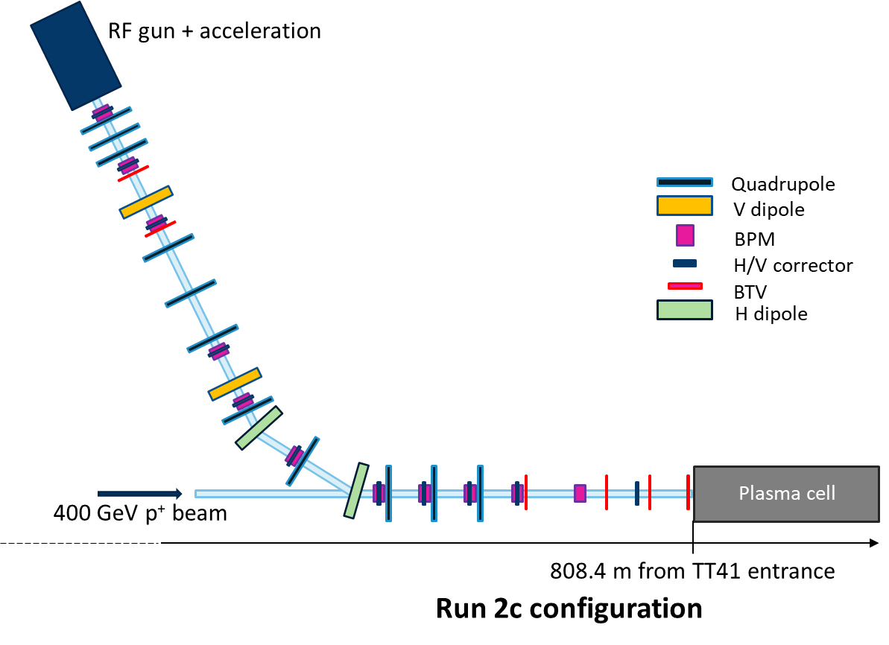
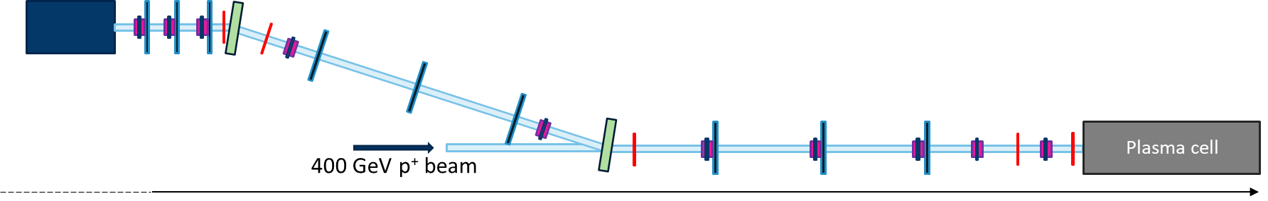
18 MeV seeding line layout
Run 1,2a/b configuration
Witness electron beamline would be used as seeding line for Run2c.
New layout constrained by AWAKE tunnel geometry.
Beamline design based on existing hardware, setting stability tolerances and beam input parameters.
Parameter | Value
Momentum (MeV/c) | 18
Rep. rate (Hz) | 10
Bunch length (ps (mm)) | 4 (1.2)
Relative mom. Spread | 0.5
Emittance r.m.s. norm. (mm mrad) | 2
Run 2c configuration
RF gun + acceleration
848.4 m from TT41 entrance
Notes:
The 18 MeV electron line that today serves as witness beam injector will become a seeding line.

Slide 13
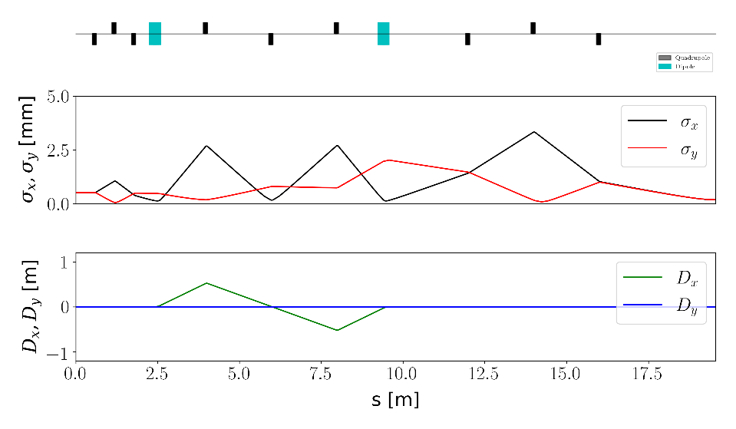
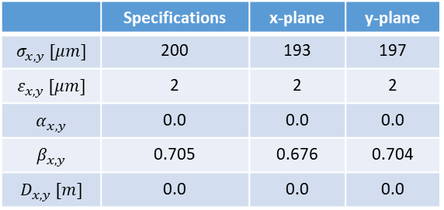
18 MeV seeding line optics design
Witness electron beamline would be used as seeding line for Run2c.
New layout constrained by AWAKE tunnel geometry.
Beamline design based on existing hardware, setting stability tolerances and beam input parameters.
 | Specifications | x-plane | y-plane
$$σ_{x,y} [μm]$$ | 200 | 193 | 197
$$ε_{x,y} [μm]$$ | 2 | 2 | 2
$$α_{x,y}$$ | 0.0 | 0.0 | 0.0
$$β_{x,y}$$ | 0.705 | 0.676 | 0.704
$$D_{x,y} [m]$$ | 0.0 | 0.0 | 0.0
New design matches beam experimental target requirements [1].
Error study confirms target stability [1].
[1] Bencini, V., et al “Design of the new 18 MeV electron injection line for AWAKE Run2c” (https://cds.cern.ch/record/2886194/files/document.pdf)

Slide 14
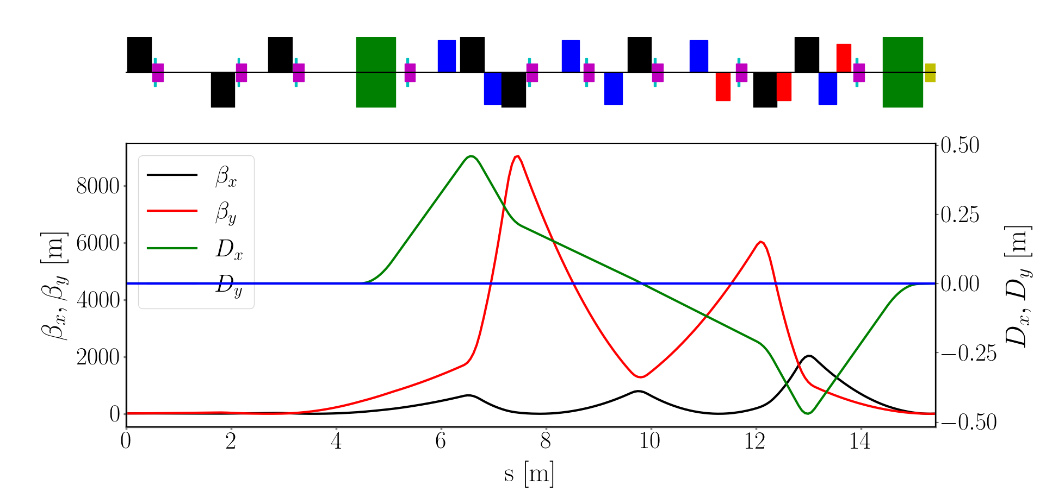
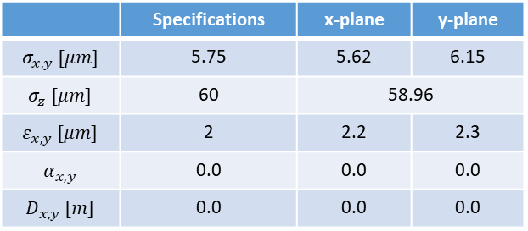
150 MeV line for external injection
New witness electron beamline will be used to perform external injection in second plasma.
  Beam requirements at the forefront of technological state-of-the-art.
  Design involved a combination of advanced numerical optimization techniques. [2]
  Sextupoles and octupoles essential to compensate for high order effects and achieve design parameters.
  Space charge and synchrotron radiation effects considered in simulation. [3]
Quadrupole
Octopule
Corrector
Sextupole
Dipole
BPM
BTV
 | Specifications | x-plane | y-plane
$$σ_{x,y} [μm]$$ | 5.75 | 5.62 | 6.15
$$σ_{z} [μm]$$ | 60 | 58.96
$$ε_{x,y} [μm]$$ | 2 | 2.2 | 2.3
$$α_{x,y}$$ | 0.0 | 0.0 | 0.0
$$D_{x,y} [m]$$ | 0.0 | 0.0 | 0.0
[2] Ramjiawan, R., et al. "Design and operation of transfer lines for plasma wakefield accelerators using numerical optimizers."
Physical Review Accelerators and Beams 25.10 (2022): 101602. (https://journals.aps.org/prab/abstract/10.1103/PhysRevAccelBeams.25.101602)
[3] Ramjiawan, R., et al. "Design of the proton and electron transfer lines for AWAKE Run 2c." Nuclear Instruments and Methods in Physics Research Section A: Accelerators, Spectrometers, Detectors and Associated Equipment 1049 (2023): 168094. (https://www.sciencedirect.com/science/article/pii/S0168900223000840)

Slide 15
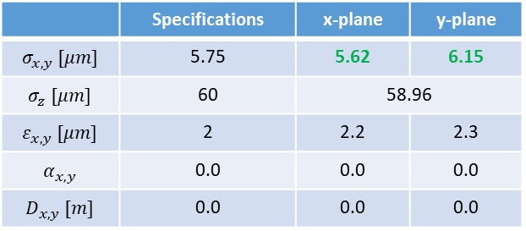
150 MeV line for external injection
New witness electron beamline will be used to perform external injection in second plasma.
  Beam requirements at the forefront of technological state-of-the-art.
  Design involved a combination of advanced numerical optimization techniques. [2]
  Sextupoles and octupoles essential to compensate for high order effects and achieve design parameters.
  Space charge and synchrotron radiation effects considered in simulation. [3]
Quadrupole
Octopule
Corrector
Sextupole
Dipole
BPM
BTV
 | Specifications | x-plane | y-plane
$$σ_{x,y} [μm]$$ | 5.75 | 5.62 | 6.15
$$σ_{z} [μm]$$ | 60 | 58.96
$$ε_{x,y} [μm]$$ | 2 | 2.2 | 2.3
$$α_{x,y}$$ | 0.0 | 0.0 | 0.0
$$D_{x,y} [m]$$ | 0.0 | 0.0 | 0.0
New design matches beam experimental target requirements [2].
[2] Ramjiawan, R., et al. "Design and operation of transfer lines for plasma wakefield accelerators using numerical optimizers."
Physical Review Accelerators and Beams 25.10 (2022): 101602. (https://journals.aps.org/prab/abstract/10.1103/PhysRevAccelBeams.25.101602)
[3] Ramjiawan, R., et al. "Design of the proton and electron transfer lines for AWAKE Run 2c." Nuclear Instruments and Methods in Physics Research Section A: Accelerators, Spectrometers, Detectors and Associated Equipment 1049 (2023): 168094. (https://www.sciencedirect.com/science/article/pii/S0168900223000840)

Slide 16
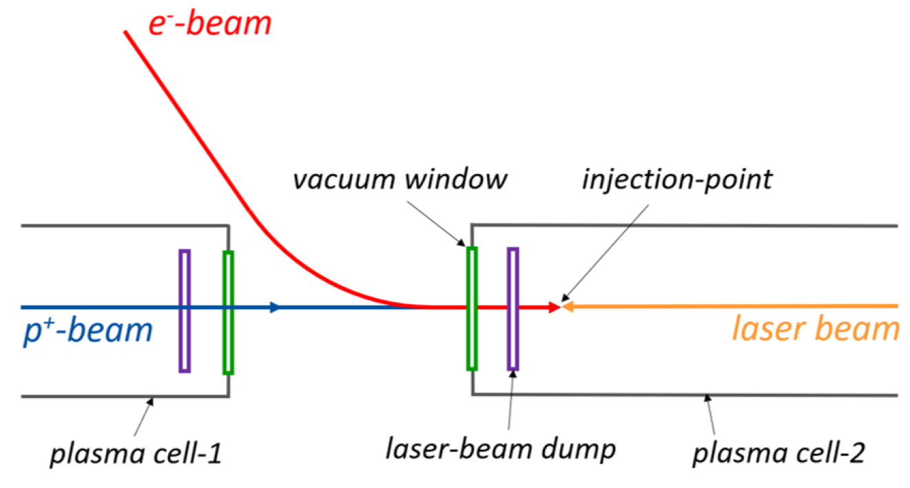
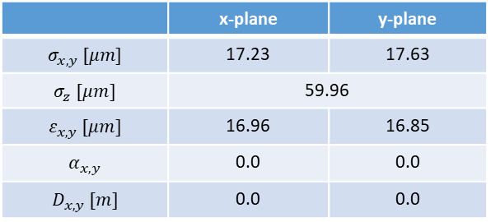
150 MeV line – Scattering foils
Studied effects of scattering foils potentially needed for integration. [3]
  Plasma simulations (see John’s talk) show that emittance control can be achieved.
  Optimisation to be performed to further improve beam quality for propagation.
 | x-plane | y-plane
$$σ_{x,y} [μm]$$ | 17.23 | 17.63
$$σ_{z} [μm]$$ | 59.96
$$ε_{x,y} [μm]$$ | 16.96 | 16.85
$$α_{x,y}$$ | 0.0 | 0.0
$$D_{x,y} [m]$$ | 0.0 | 0.0
[3] Ramjiawan, R., et al. "Design of the proton and electron transfer lines for AWAKE Run 2c." Nuclear Instruments and Methods in Physics Research Section A: Accelerators, Spectrometers, Detectors and Associated Equipment 1049 (2023): 168094. (https://www.sciencedirect.com/science/article/pii/S0168900223000840)

Slide 17
150 MeV line – Error studies
Error studies allowed to define tolerances for alignment, field stability and beam diagnostic resolution. [3]
  Hardware (power converters, magnets, vacuum, diagnostics) technical specification were defined and approved by experts.
  Design and procurement phase is ongoing.
Beam Based Alignment (BBA) procedure was developed and tested in simulations.
  BBA allows to compensate for alignment and field errors.
  Beam size at the experiment strongly depends on the alignment of the active elements down to 1 um level.
  ➔ possible and done at ATF2 [4] but still rather challenging.
New beamline has high potential for development and testing of Machine Learning methods developed at CERN. [2]
[2] Ramjiawan, R., et al. "Design and operation of transfer lines for plasma wakefield accelerators using numerical optimizers."
Physical Review Accelerators and Beams 25.10 (2022): 101602. (https://journals.aps.org/prab/abstract/10.1103/PhysRevAccelBeams.25.101602)
[3] Ramjiawan, R., et al. "Design of the proton and electron transfer lines for AWAKE Run 2c." Nuclear Instruments and Methods in Physics Research Section A: Accelerators, Spectrometers, Detectors and Associated Equipment 1049 (2023): 168094. (https://www.sciencedirect.com/science/article/pii/S0168900223000840)
[4] Seryi, A., et al. "ATF2 commissioning." 23rd Particle Accelerator Conference" PAC09". Triumf Vancouver, 2009.

Slide 18
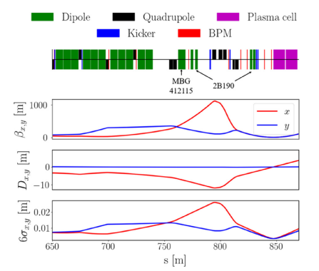
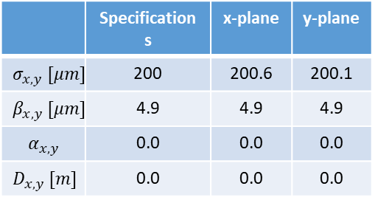
Proton injection
New experimental layout requires reconfiguration of proton transfer line
  Plasma cell position will be shifted of 40 m
  Design relies on existing magnets, to be re-organized to fit the new layout
 | Specifications | x-plane | y-plane
$$σ_{x,y} [μm]$$ | 200 | 200.6 | 200.1
$$β_{x,y} [μm]$$ | 4.9 | 4.9 | 4.9
$$α_{x,y}$$ | 0.0 | 0.0 | 0.0
$$D_{x,y} [m]$$ | 0.0 | 0.0 | 0.0
[3] Ramjiawan, R., et al. "Design of the proton and electron transfer lines for AWAKE Run 2c." Nuclear Instruments and Methods in Physics Research Section A: Accelerators, Spectrometers, Detectors and Associated Equipment 1049 (2023): 168094. (https://www.sciencedirect.com/science/article/pii/S0168900223000840)

Slide 19
Proton injection
New experimental layout requires reconfiguration of proton transfer line
  Plasma cell position will be shifted of 40 m
  Design relies on existing magnets, to be re-organized to fit the new layout
New design matches beam parameters experimental target requirements [3].
Beam jitter is presently the only parameter above threshold.
 | Specifications | x-plane | y-plane
$$σ_{x,y} [μm]$$ | 200 | 200.6 | 200.1
$$β_{x,y} [μm]$$ | 4.9 | 4.9 | 4.9
$$α_{x,y}$$ | 0.0 | 0.0 | 0.0
$$D_{x,y} [m]$$ | 0.0 | 0.0 | 0.0
[3] Ramjiawan, R., et al. "Design of the proton and electron transfer lines for AWAKE Run 2c." Nuclear Instruments and Methods in Physics Research Section A: Accelerators, Spectrometers, Detectors and Associated Equipment 1049 (2023): 168094. (https://www.sciencedirect.com/science/article/pii/S0168900223000840)

Slide 20
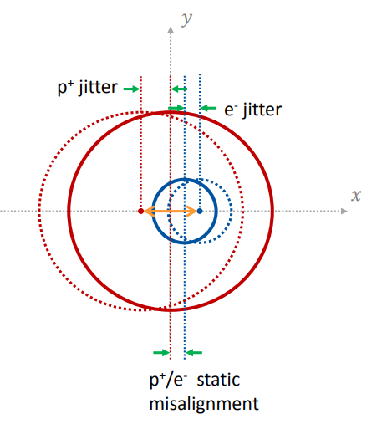
Proton beam jitter
Beam jitter is mainly caused by ripple in proton beam line power converters.
  A relative distance between the p+ and e- beams at injection lower than ≈10 um is needed for emittance control.
  Beam jitter for Run2c can only be estimated from measurements taken in the current configuration and simulations → Relies on several assumptions

Slide 21
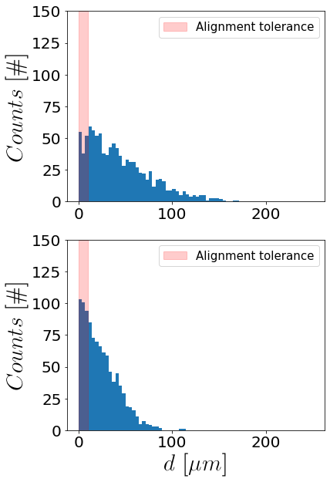

Proton beam jitter
Beam jitter is mainly caused by ripple in proton beam line power converters.
  A relative distance between the p+ and e- beams at injection lower than ≈10 um is needed for emittance control.
  Beam jitter for Run2c can only be estimated from measurements taken in the current configuration and simulations → Relies on several assumptions
  Assuming the same power converters presently in operation, beam jitter would result in ≈10% shots within experimental requirements.
Run2a/b

Slide 22
Proton beam jitter
Beam jitter is mainly caused by ripple in proton beam line power converters.
  A relative distance between the p+ and e- beams at injection lower than ≈10 um is needed for emittance control.
  Beam jitter for Run2c can only be estimated from measurements taken in the current configuration and simulations → Relies on several assumptions
  Assuming the same power converters presently in operation, beam jitter would result in ≈10% shots within experimental requirements.
  During LS3 most power converters on the proton transfer line will be upgraded (class 3 [5]). Upgrade anyway planned for SPS extraction.
  The upgrade should result in an increase of shots within requirements to ≈30% (Assuming all power converters fall in Class 3 specs).
  Additional improvements in hardware could lead to a further decrease in beam jitter.
Run2a/b
Run2c/d
[5] Gamba, Davide, et al. Beam dynamics requirements for HL–LHC electrical circuits. No. CERN-ACC-2017-0101. 2017.

Slide 23
Summary and conclusions
A comprehensive simulation study demonstrated the feasibility of delivering electron and proton beams conforming to Run2c specifications (except for proton beam jitter).
Hardware components for all beamlines are already procured (18 MeV and proton line) or in design phase (150 MeV line).
Leveraging CERN's know-how and expertise have been and are crucial at every stage to ensure adherence to specifications and timely delivery.
The knowledge and expertise acquired in the design and operation of electron beamlines are aligned with several CERN projects and initiatives (FCC, CLEAR) and is propaedeutic to other developments (Machine Learning).
The technological advancement arising from the effort to meet the tight experimental parameters (high stability, small beam size) impact the whole plasma accelerator community.

Slide 24
Backup slides

Slide 25
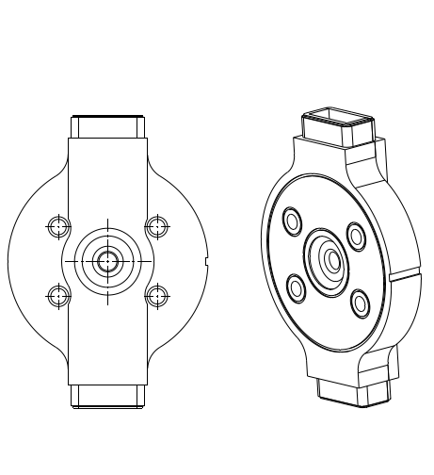
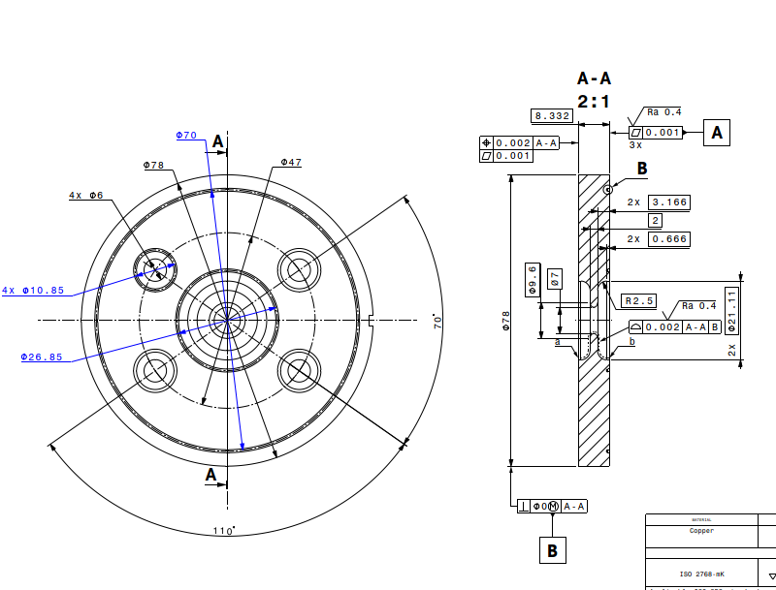
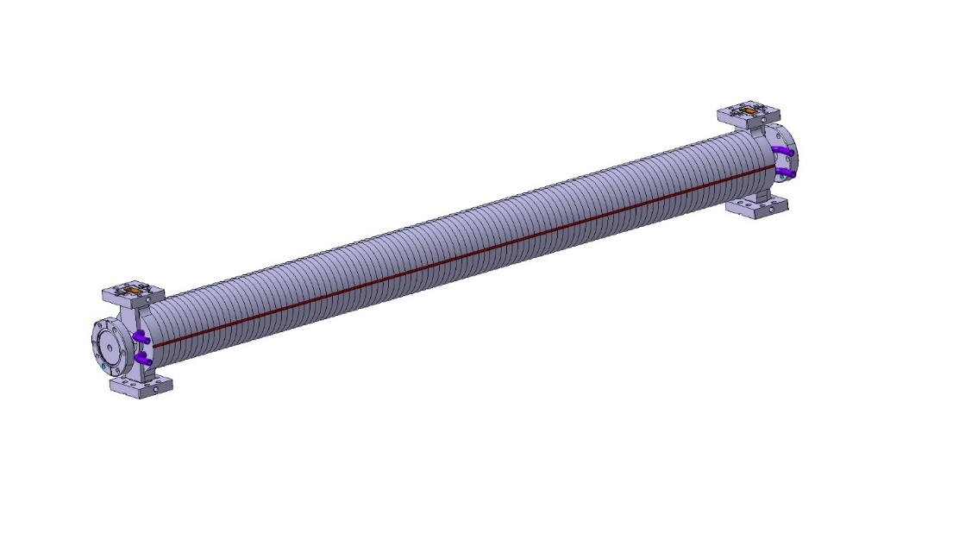
X-band accelerating structure
Mechanical design
Structure to be inserted in a solenoid of
150 mm diameter bore radius
RF-Design made by D. Alesini, M. Diomede, INFN Frascati

Slide 26
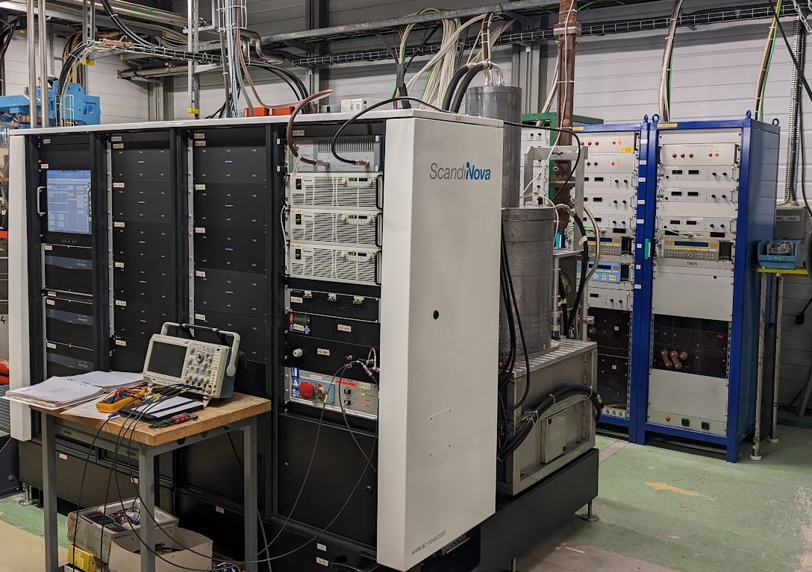
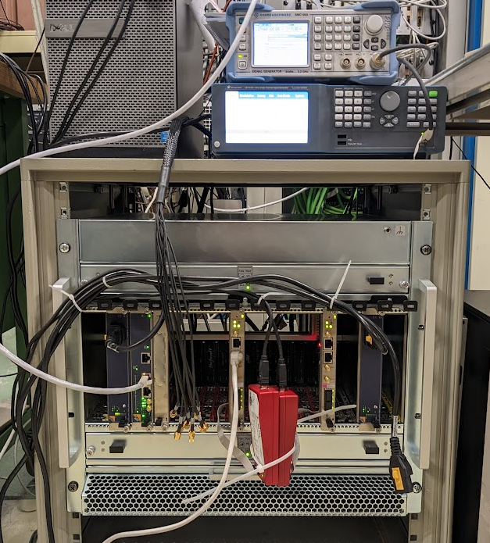
u-TCA LLRF development with Uppsala
System shipped to CERN from Uppsala, installed in the form CLIC test facility.
RF signal acquisition, generation and feedback/forward loops tested.
Use of DESY BSP and python GUI.
External trigger injection through RJ45 connector on SIS8300KU AMC, distributed to mLVDS lines.
  Currently under test/development (still some bugs to iron out)
Work progressing well on a DESYRDL to CERN/Cheby convertor script.
Modulator and S-band 40MW klystron (above)
MicroTCA crate and LO, CLK generators (right)

Slide 27
Studied alternative scenarios
Beam dynamics:
3 identical structures, one 50 MW klystron → Save small klystron, waveguide run and buncher structure
RF power variants:
One 25 MW klystron for acceleration, small 8 MW klystron for bunching → less expensive klystron and modulator
Only one 25 MW klystron for everything → less expensive klystron, save second waveguide run and small klystron
Integration scenarios:
Keep Run 1 modulator (PPT) for LINAC 1, instead of two K100 modulators → no new hardware needed
Use K400 modulator instead of PPT → better performance and stability
Replace K400 x-band with 2x K200 x-band → essentially staged scenario to upgrade energy later

Slide 28
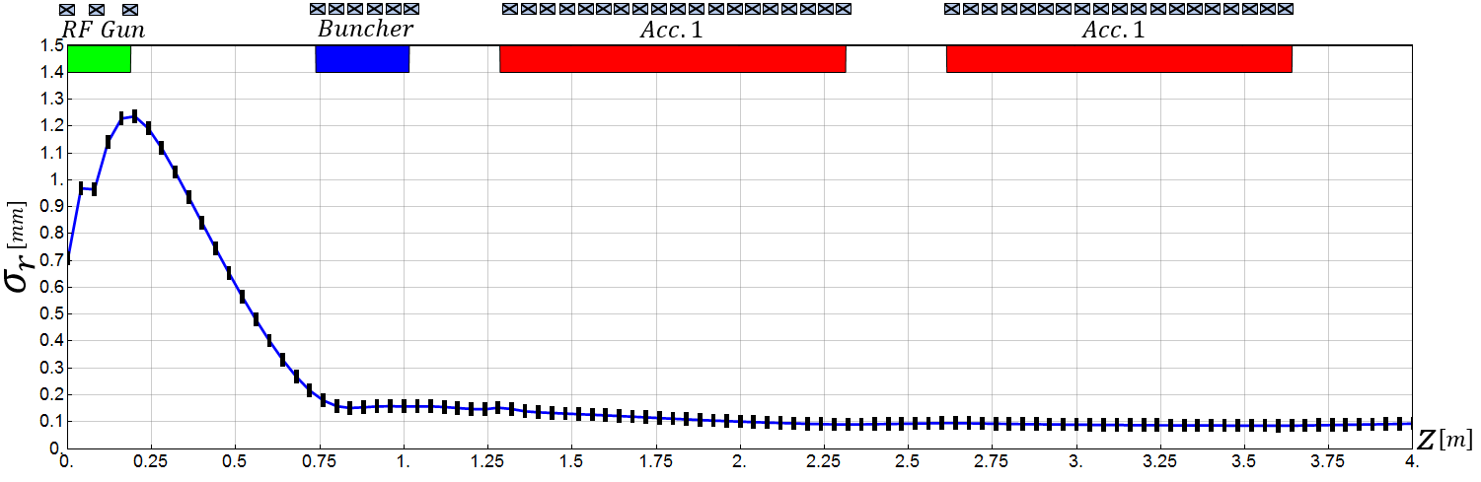
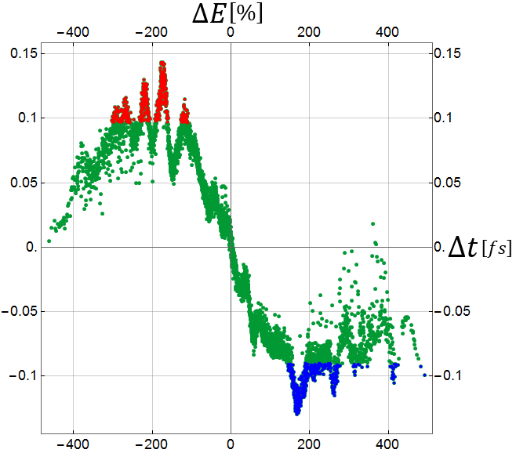
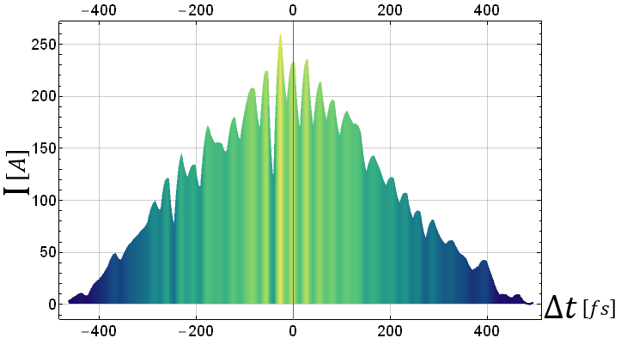
Reference design
Mohsen Dayyani Kelisani

Slide 29
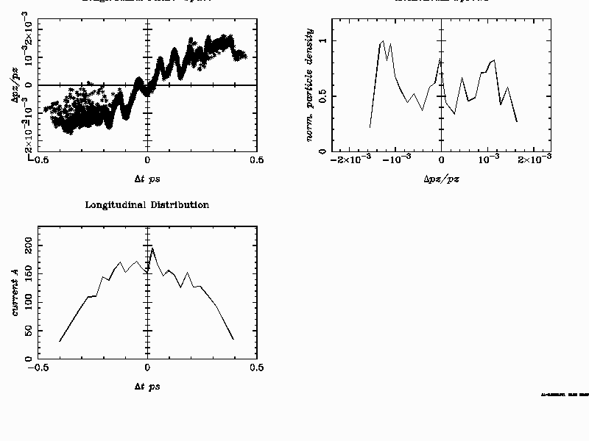
Tentative RUN 2 injector parameter for 150 MeV
Only scaled down accelerating gradient, identical initial distributions,
no new optimization
Energy: 151.8 MeV
Energy Spread: 144.5 keV rms =9.5 10⁻⁴
Emittance: x/y: 0.7 mm mrad
Bunch length: 60 um rms
Bunch Charge: 100 pC

Slide 30
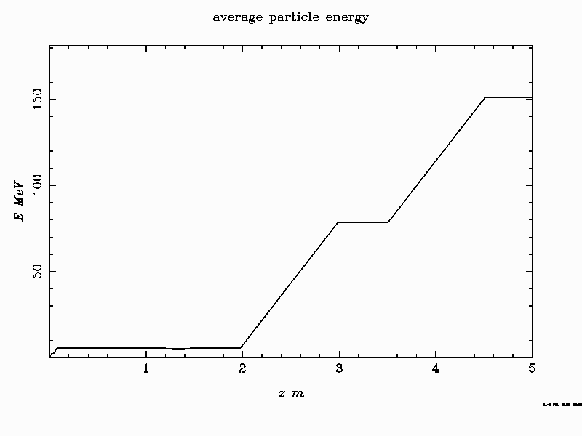
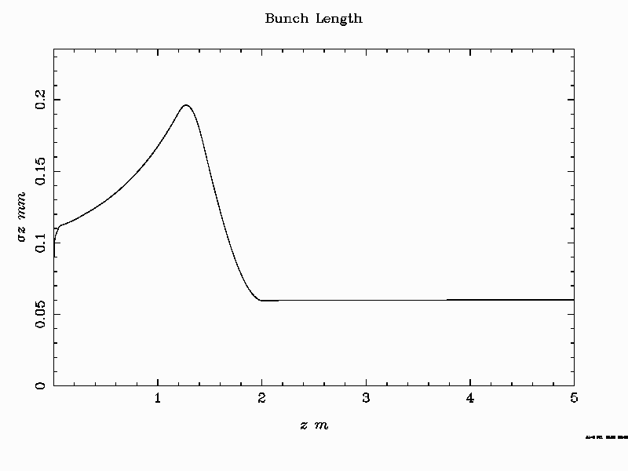
Tentative RUN 2 injector parameter for 150 MeV

Slide 31
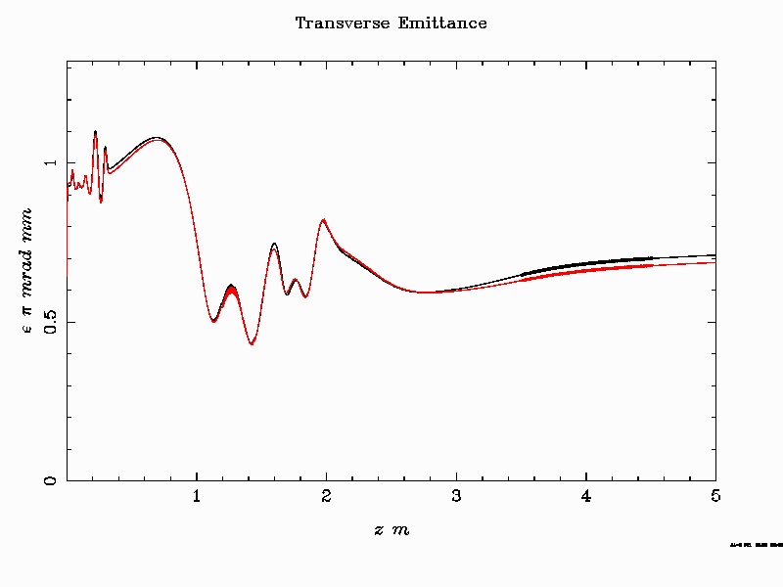
Tentative RUN 2 injector parameter for 150 MeV

Slide 32
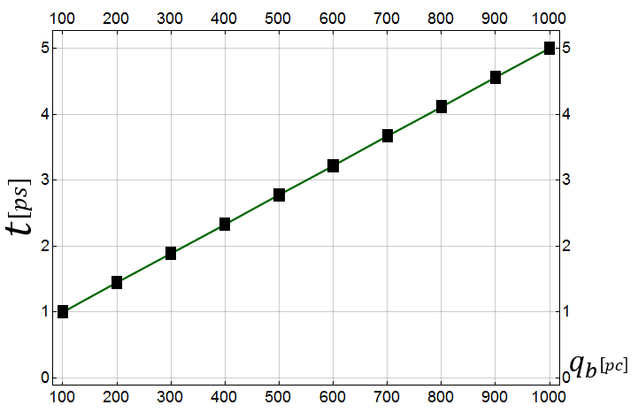
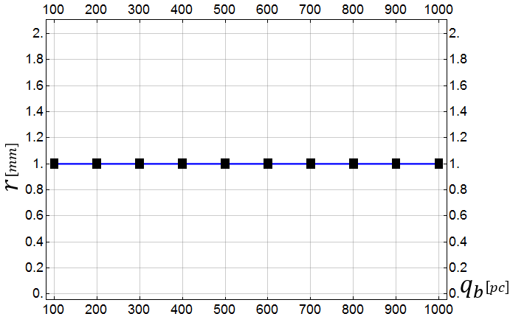
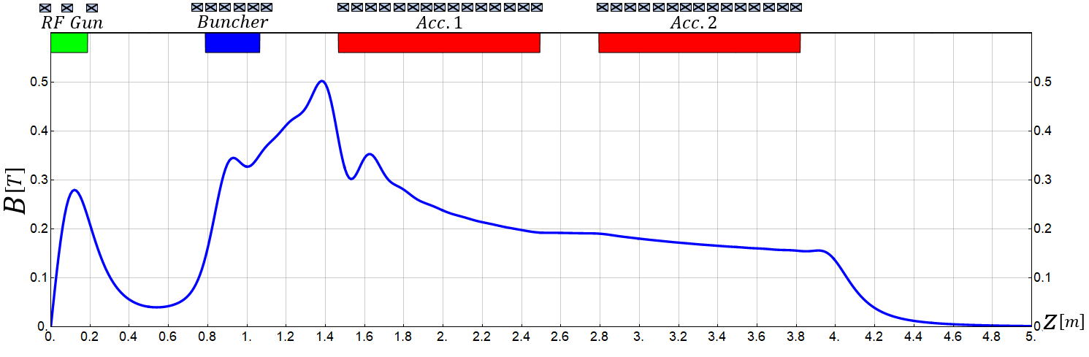
3. High Current Operation
Flexibility to produce higher charge
(for lower plasma density or experimental reasons)
3.1 100pC-1000pC
Changing only laser pulse length and adapting magnetic field slightly
Laser Pulse Duration
Laser Spot Size
Mohsen Dayyani Kelisani

Slide 33
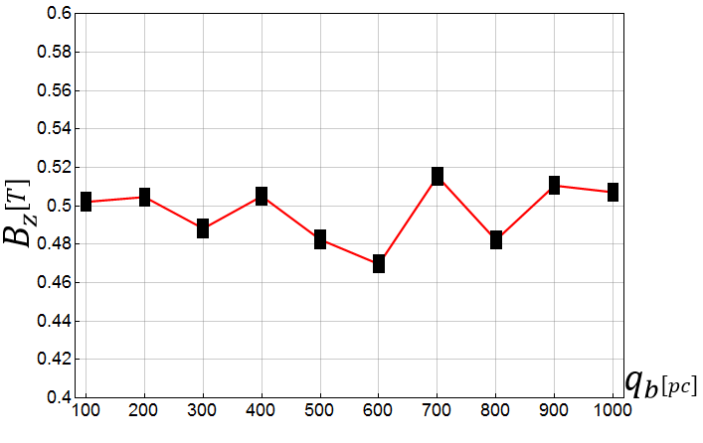
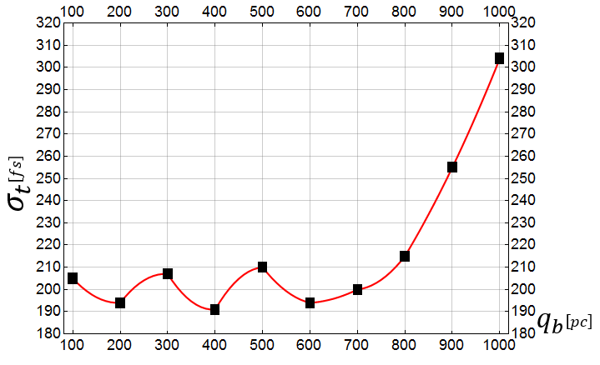
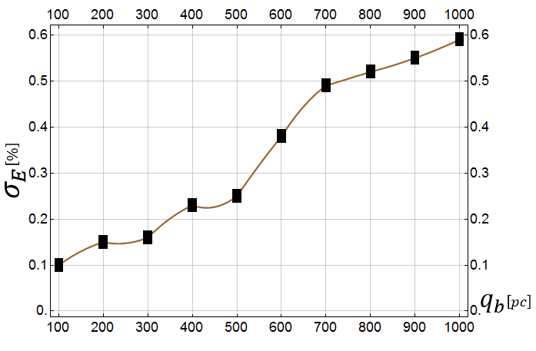
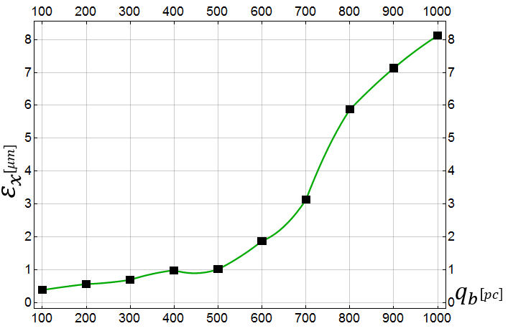

3. High Current Operation
Flexibility to produce higher charge
0.1 to 1 nC per bunch
3.1 100pC-1000pC
Max_$B_{z}$
Bunch Length
Energy Spread
Bunch Emittance
Mohsen Dayyani Kelisani

Slide 34
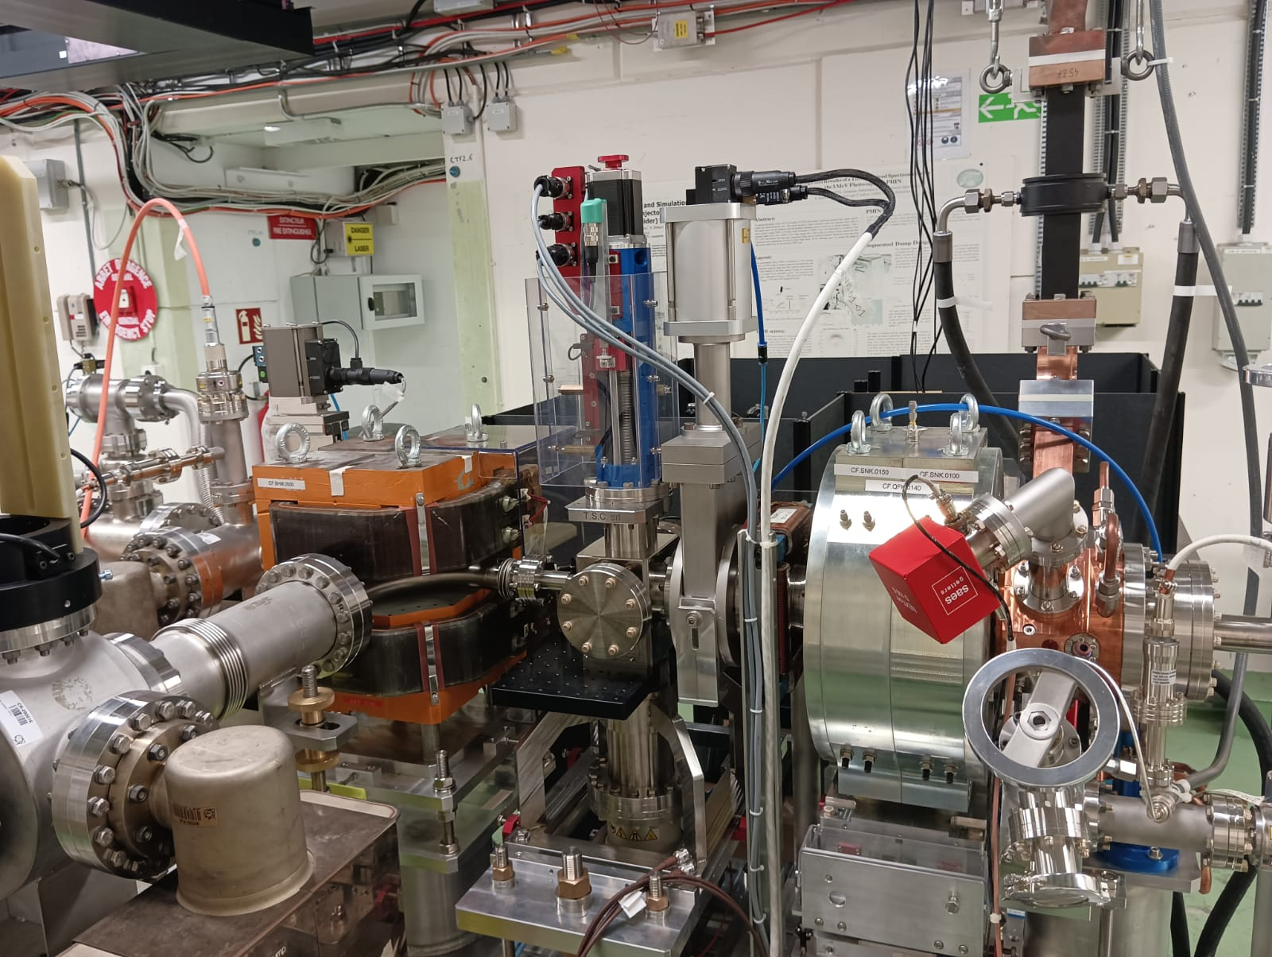
F-Cup
ARTI in CTF2
Screen BTV1
RF-GUN
RF-gun conditioned to 120 MV/m on the cathode
200 ns
400 ns
600 ns
800 ns
1 us
Spectrometer
Notes:
.

Slide 35
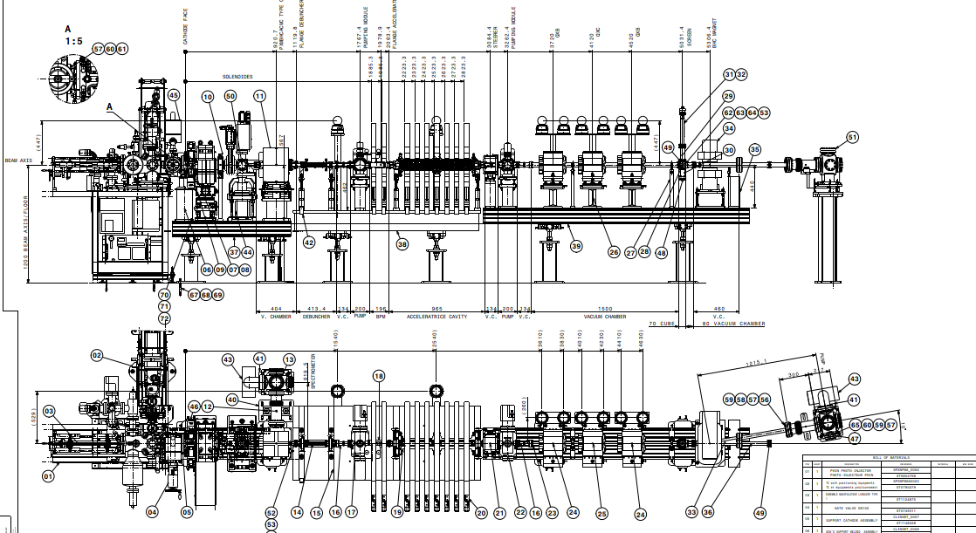

Slide 36
Detailed integration studies have been performed
0.8m
0.9m
1m
0.9m
0.9m

Slide 37



18 MeV seeding line – error studies
Output of the study was used to set preliminary tolerances on the injection jitter:
Position jitter: $≤10 μm$
Angular jitter: $≤10 μm$
Momentum jitter: $≤0.2 \%$
RMS beam jitter at plasma merge resulting from running 1000 errors seeds sampled form normal distribution with tolerances as std. dev.
[1] Bencini, V., et al “Design of the new 18 MeV electron injection line for AWAKE Run2c” (https://cds.cern.ch/record/2886194/files/document.pdf)

Slide 38





18 MeV seeding line – error studies
Scan of input beam Twiss parameters to assess effect on beam parameters at plasma merge.
Two figures of merit defined to assess the mismatch at plasma merge:
  $(σ−σ_{ref})/σ_{ref}$: relative percentage error w.r.t. nominal beam size.
  $s_{f}−s_{f,ref}$: waste position w.r.t to nominal case (plasma merge).
a)
b)
c)
d)
Results of the scan of the input Twiss $α_{x,y}$ and $β_{x,y}$. (a) and (b) show the relative output beam size changein x and y respectively. In (c) and (d) the change in focal point position w.r.t the nominal case is shown.
[1] Bencini, V., et al “Design of the new 18 MeV electron injection line for AWAKE Run2c” (https://cds.cern.ch/record/2886194/files/document.pdf)

Slide 39

150 MeV line
The first version of the design was finalized by R. Ramjiawan, and the main results are summarized in a paper presently under review*.
Frist step:
  Use genetic algorithms to optimize quadrupoles positions and strengths
  The beam sizes specification were not achieved due to chromatic effects
*Preprint on Arxiv: “Design of the AWAKE Run 2c transfer lines using numerical optimizers” (https://arxiv.org/abs/2203.01605)

Slide 40


150 MeV line
In order to compensate for chromatic contributions to beam sizes sextupoles were added
Octupoles were finally added to mitigate detuning with amplitude effects
At each stage a combination of different optimization algorithms was used (Powell, Nelder Mead)
Reached specifications and set baseline design
 | Specifications | x-plane | y-plane
$$σ_{x,y} [μm]$$ | 5.75 | 5.97 | 6.11
$$σ_{z} [μm]$$ | 60 | 59.87
$$β_{x,y} [μm]$$ | 4.8 | 4.82 | 5.41
$$α_{x,y}$$ | 0.0 | 0.0 | 0.0
$$D_{x,y} [m]$$ | 0.0 | 0.0 | 0.0

Slide 41


Tolerance studies
Effect of single error type on beam size was used to define tolerances (R. Ramjiawan paper)
Then alignment procedure was optimized to correct for all errors together
Goals
Beam size within${1.5σ}^{∗}=8.6 μm$
Relative beam offset between e- and p+ beam < $10 μm$
R.M.S of errors used in simulation
BPM resolution: $10 μm$
BTV resolution: $1 μm$
Magnet mover error: $1 μm$
Corrector error: $1 μrad$
Initial magnet offsets: $100 μm$ r.m.s
e-line power converter ripples = 7 ppm
Momentum jitter = 1e-3
e-line input position jitter = 10 µm

Slide 42

Alignment procedure
Quadrupole, sextupoles and octupoles need to be installed on movers to reach beam pointing specifications
Three techniques used for alignment
Quadrupole shunting
Dispersion free steering
Numerical optimization
①
②
③
Numerical optimization
Use optimization algorithms to align sextupoles and octupoles
Minimize beam size at injection point
Use algorithm that requires low number of function evaluations (BOBYQA)
Minimize parasitic dispersion and orbit
Change beam energy
Record the change in position at the BPM
Use corrector to steer the beam trough the quadrupole
Centre quadrupoles w.r.t beam orbit.
Change quad strength $∆k$ and record change in BPM reading ${∆x}_{BPM}$
Calculate quad-beam position shift ${∆x}_{QUAD}$
Move quadrupole of - ${∆x}_{QUAD}$
Alignment procedure consists of a combination of iterations of ①+②+③ (less than 1 hour time)

Slide 43


150 MeV line
Error studies defined tolerances for alignment, field stability and diagnostic elements resolution.
Alignment procedure developed and tested in simulations show capability of the system of getting:
  Beam within specs in 95% of cases (1 alignment run)
  Beam within specs in 100% of cases (2 alignment runs)
Technical specifications defined and approved by experts.
Design and procurement is ongoing.

Slide 44

Proton line
Chicane has t be modified to account for presence of laser mirror.

Slide 45

Proton beam jitter
The analysis was carried out in three stages:
  Measure power converters ripple and beam jitter in present configuration.
BTV images
BPMs trajectory fit

Slide 46
Proton beam jitter
The analysis was carried out in three stages:
  Measure power converters ripple and beam jitter in present configuration.
  Find sources of jitter at plasma.
  Perform optics simulations to estimate jitter in Run2c configuration
BTV images
BPMs trajectory fit

Slide 47





Proton beam jitter
The methodology was tested in simulations
The beam position at every BPM along the line can be expressed as
$$i=1,…,N$$
$$N=Number of BPMs$$
$$x_{i}= \sqrt{β_{i}}Rsin\left(μ_{i}+φ\right)+Dδp$$
$$δp=Relative momentum offset$$
Unknowns
We want to find
$$R,φ,δp →min⁡(\sum_{i=1}^{N}{{(x_{i,meas}−x_{i})}^{2}})$$

Slide 48


Proton beam jitter
BPMs resolution is too low to resolve the beam jitter we expect at injection
To overcome this limit trajectory fit technique is applied
Simulation

Slide 49

Proton beam jitter
Extending the prediction to BTVs and comparing to measurements we find good agreement
The measured jitter can be relied.

Slide 50


Model Independent Analysis
MIA consists in applying SVD to BPM measurements.
This allows to identifies the main sources of jitter
It produces eigenvectors that allows to identify the sources of jitter by comparison with simulations
→ We can apply it to the trajectory fits, which naturally filter out the bpm resolution error
1
1
2
2
3
3

Slide 51








Model Independent Analysis
We can simulate the effect of different jitter sources and look at the corresponding modes shape.
Optimize sources to find best agreement with measurements
x’ = 10 urad
mbg = 100 ppm
y’ = 10 urad
mbsg = 100 ppm

Slide 52



Model Independent Analysis
We can simulate the effect of different jitter sources and look at the corresponding modes shape.
Optimize sources to find best agreement with measurements

Slide 53

Model Independent Analysis
We can simulate the effect of different jitter sources and look at the corresponding modes shape.
Optimize sources to find best agreement with measurements
In y, we hit resolution limit of trajectory fit. We tune simulations to fit BTV measurments

Slide 54





Propagation in Run2c layout
With the obtained settings for simulations, we can now propagate the simulations to Run2c configuration
Run2a/b
$$σ_{x}=40 μm$$
$$σ_{y}=8 μm$$
Run2c/d
$$σ_{x}=24 μm$$
$$σ_{y}=8 μm$$

