Slide 1
Scalable Plasma Sources R&D
Alban Sublet for the AWAKE collaboration

Slide 2
Outline
Motivation for scalable plasma sources
AWAKE plasma sources technologies
Challenges and potentials
Program and lab capabilities
Summary

Slide 3

Motivation
Scalable plasma sources at CERN:
Accelerator technology expertise (many CERN groups: TE/VSC, BE/ABP, BE/BI, EN/MME...)
Available high energy proton beam, facilities and resources
Beyond table-top-institute projects capabilities
Next steps for AWAKE:
scalability → 10+ m for Run 2d
towards HEP experiment applications
today

Slide 4
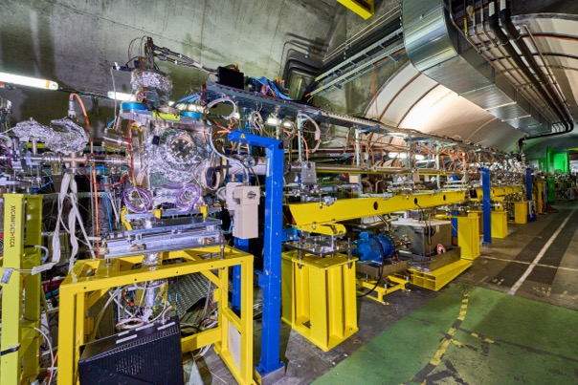



Plasma sources technologies
AWAKE Run2 plasma source: 10 m Rb vapour ionized by TW laser
Limitation: laser pulse energy depletion for length > 10 m
10 m Rb cell in AWAKE tunnel
10 m Rb cell in AWAKE tunnel

Slide 5
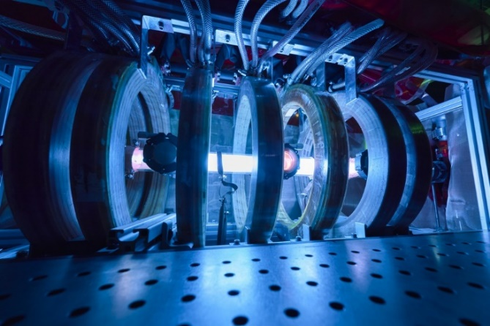
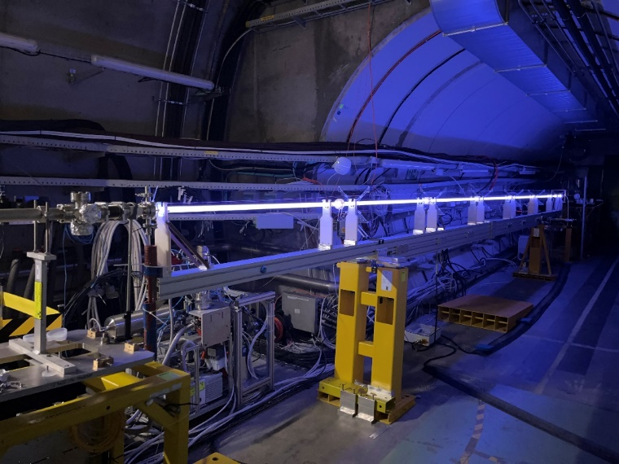





Plasma sources technologies
AWAKE Run2 plasma source: 10 m Rb vapour ionized by TW laser
Limitation: laser pulse energy depletion for length > 10 m
→ Beyond 10 m, two scalable technologies identified and under study:
10 m Rb cell in AWAKE tunnel
Helicon Plasma Source (HPS)
→ RF wave heated plasma, pulsed 10 Hz rep. rate
Discharge Plasma Source (DPS)
→ pulsed-DC discharge, 1 Hz rep. rate
1 m HPS in CERN lab
10 m DPS in AWAKE tunnel

Slide 6
Challenges and potentials
For AWAKE:
  Reach nominal plasma electron density: 7x10¹⁴ cm⁻³ → achieved by both sources
  Reach longitudinal uniformity: 0.25% over 10 m
  Demonstrate scalability, reproducibility and compatibility with existing source and beams
Plasma diagnostics and sources optimization

Slide 7
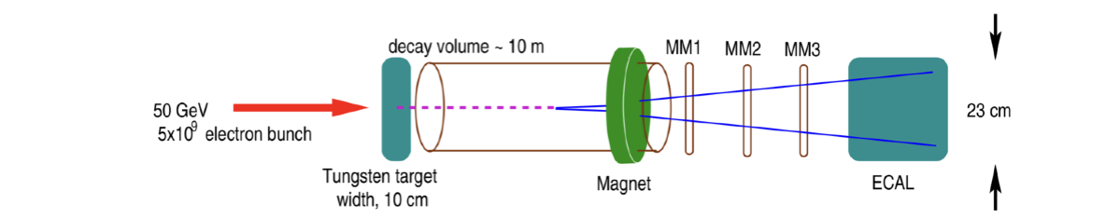
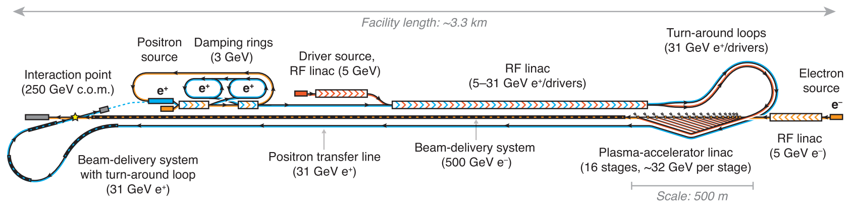
Challenges and potentials
AWAKE challenges:
  Reach nominal plasma electron density: 7x10¹⁴ cm⁻³ → achieved by both sources
  Reach longitudinal uniformity: 0.25% over 10 m
  Demonstrate scalability, reproducibility and compatibility with existing source and beams
Potentials for AWAKE and beyond:
  Physics Beyond Colliders Project (PBC), HALHF → addressing staging issues
Plasma sources → contribution to the field in general: laser, plasma-wall interaction, plasma processing…
Plasma diagnostics and sources optimization
→ Beam Dump Experiment: search for dark photons
→ Decay of dark photon into visible particles (e.g. e+/e-)
https://doi.org/10.1088/1367-2630/acf395
AWAKE scalable plasma source could be an alternative

Slide 8
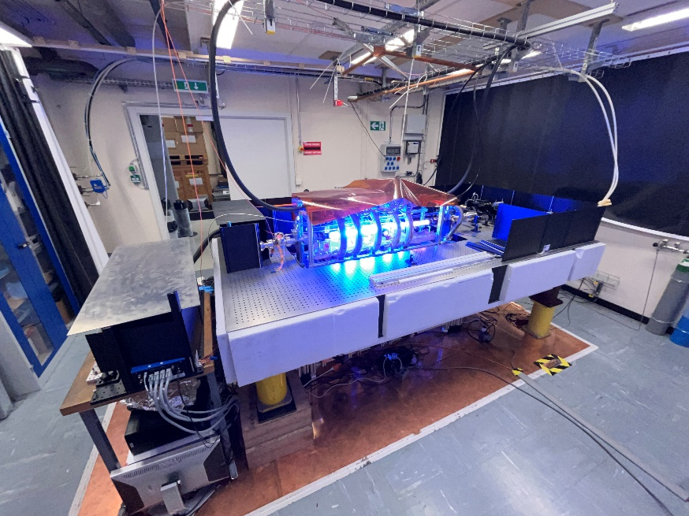
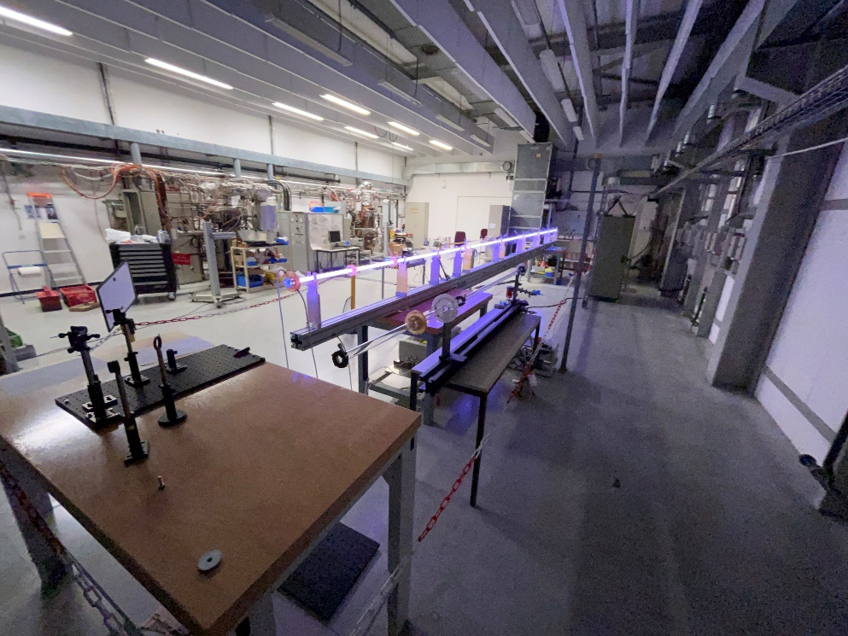
Program
AWAKE dedicated plasma sources R&D program launched in 2018
5 collaboration institutes + CERN as host, 6 PhD works
Two dedicated laboratories at CERN, capable to house up to 20 m long source and diagnostics
HPS lab (launched in 2019)
DPS lab (launched in 2021)
1 m HPS in 169 lab, Ar 8 Pa, 3x10 kW RF/400 A DC
10 m DPS in 101 lab, Ar 23 Pa, 500 A current pulse
→ HPS setup designed and built by IPP-Greifswald, moved to CERN in 2019
→ DPS pulsed generators designed and built by IST-Lisbon

Slide 9
Program
AWAKE dedicated plasma sources R&D program launched in 2018
5 collaboration institutes + CERN as host, 6 PhD works
Two dedicated laboratories at CERN, capable to house up to 20 m long source and diagnostics
1st milestone achieved = 10 m DPS test with protons in the AWAKE tunnel “DPS May 2023 Run”
End 2024 = Internal review whether scalable technology can already be used for Run 2c
Scalable Plasma Sources review (around 2027): decision for Run 2d scalable source, procurement and design
HPS lab (launched in 2019)
DPS lab (launched in 2021)
1 m HPS in 169 lab, Ar 8 Pa, 3x10 kW RF/400 A DC
10 m DPS in 101 lab, Ar 23 Pa, 500 A current pulse

Slide 10
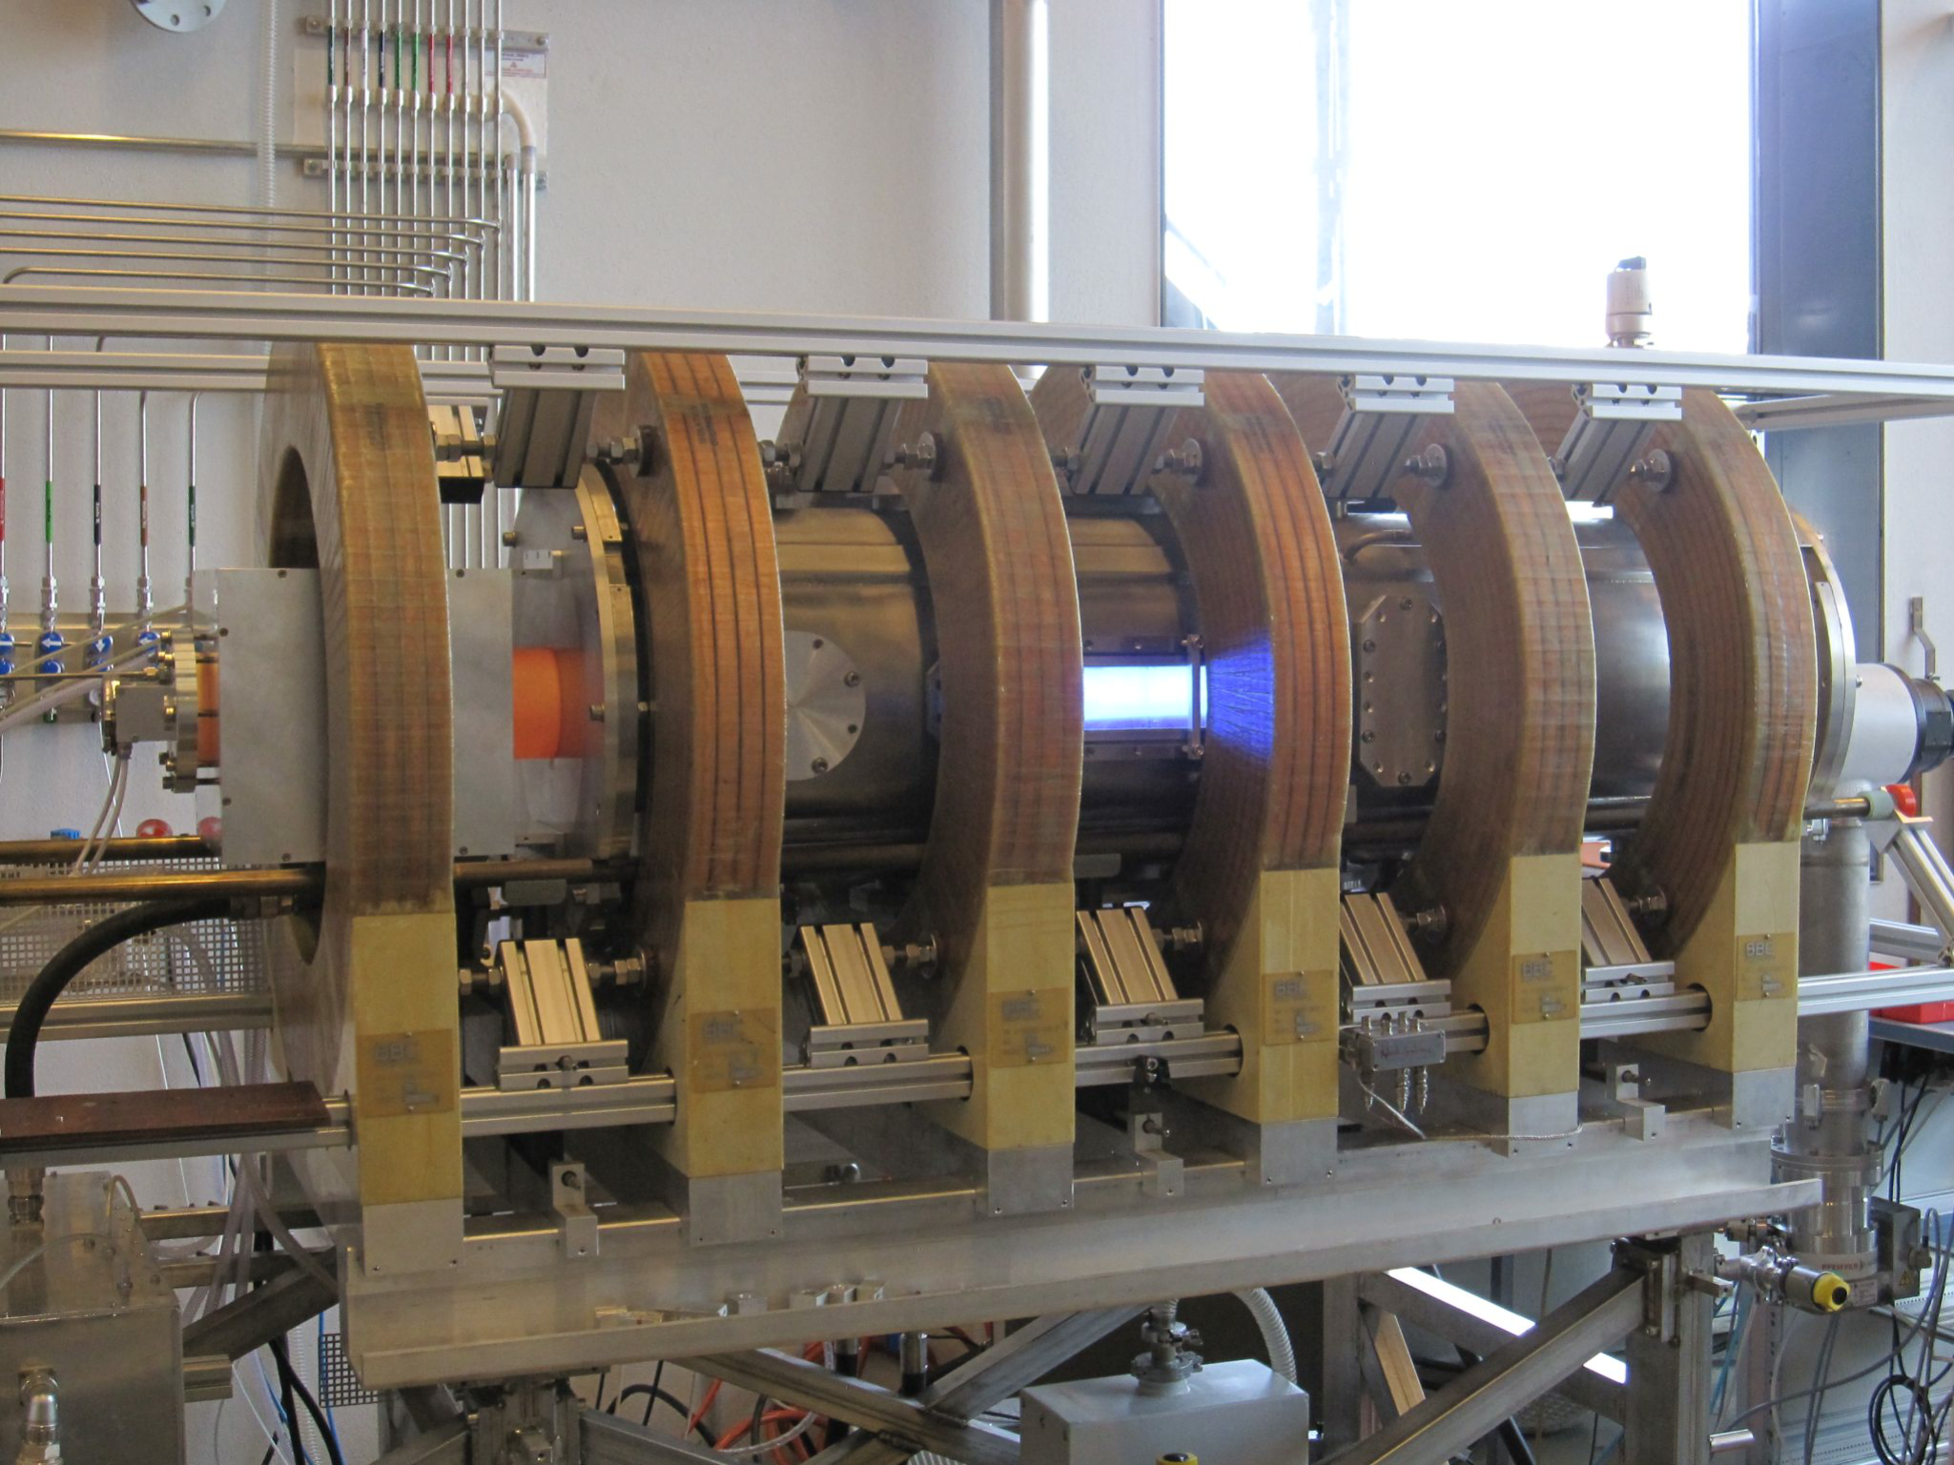
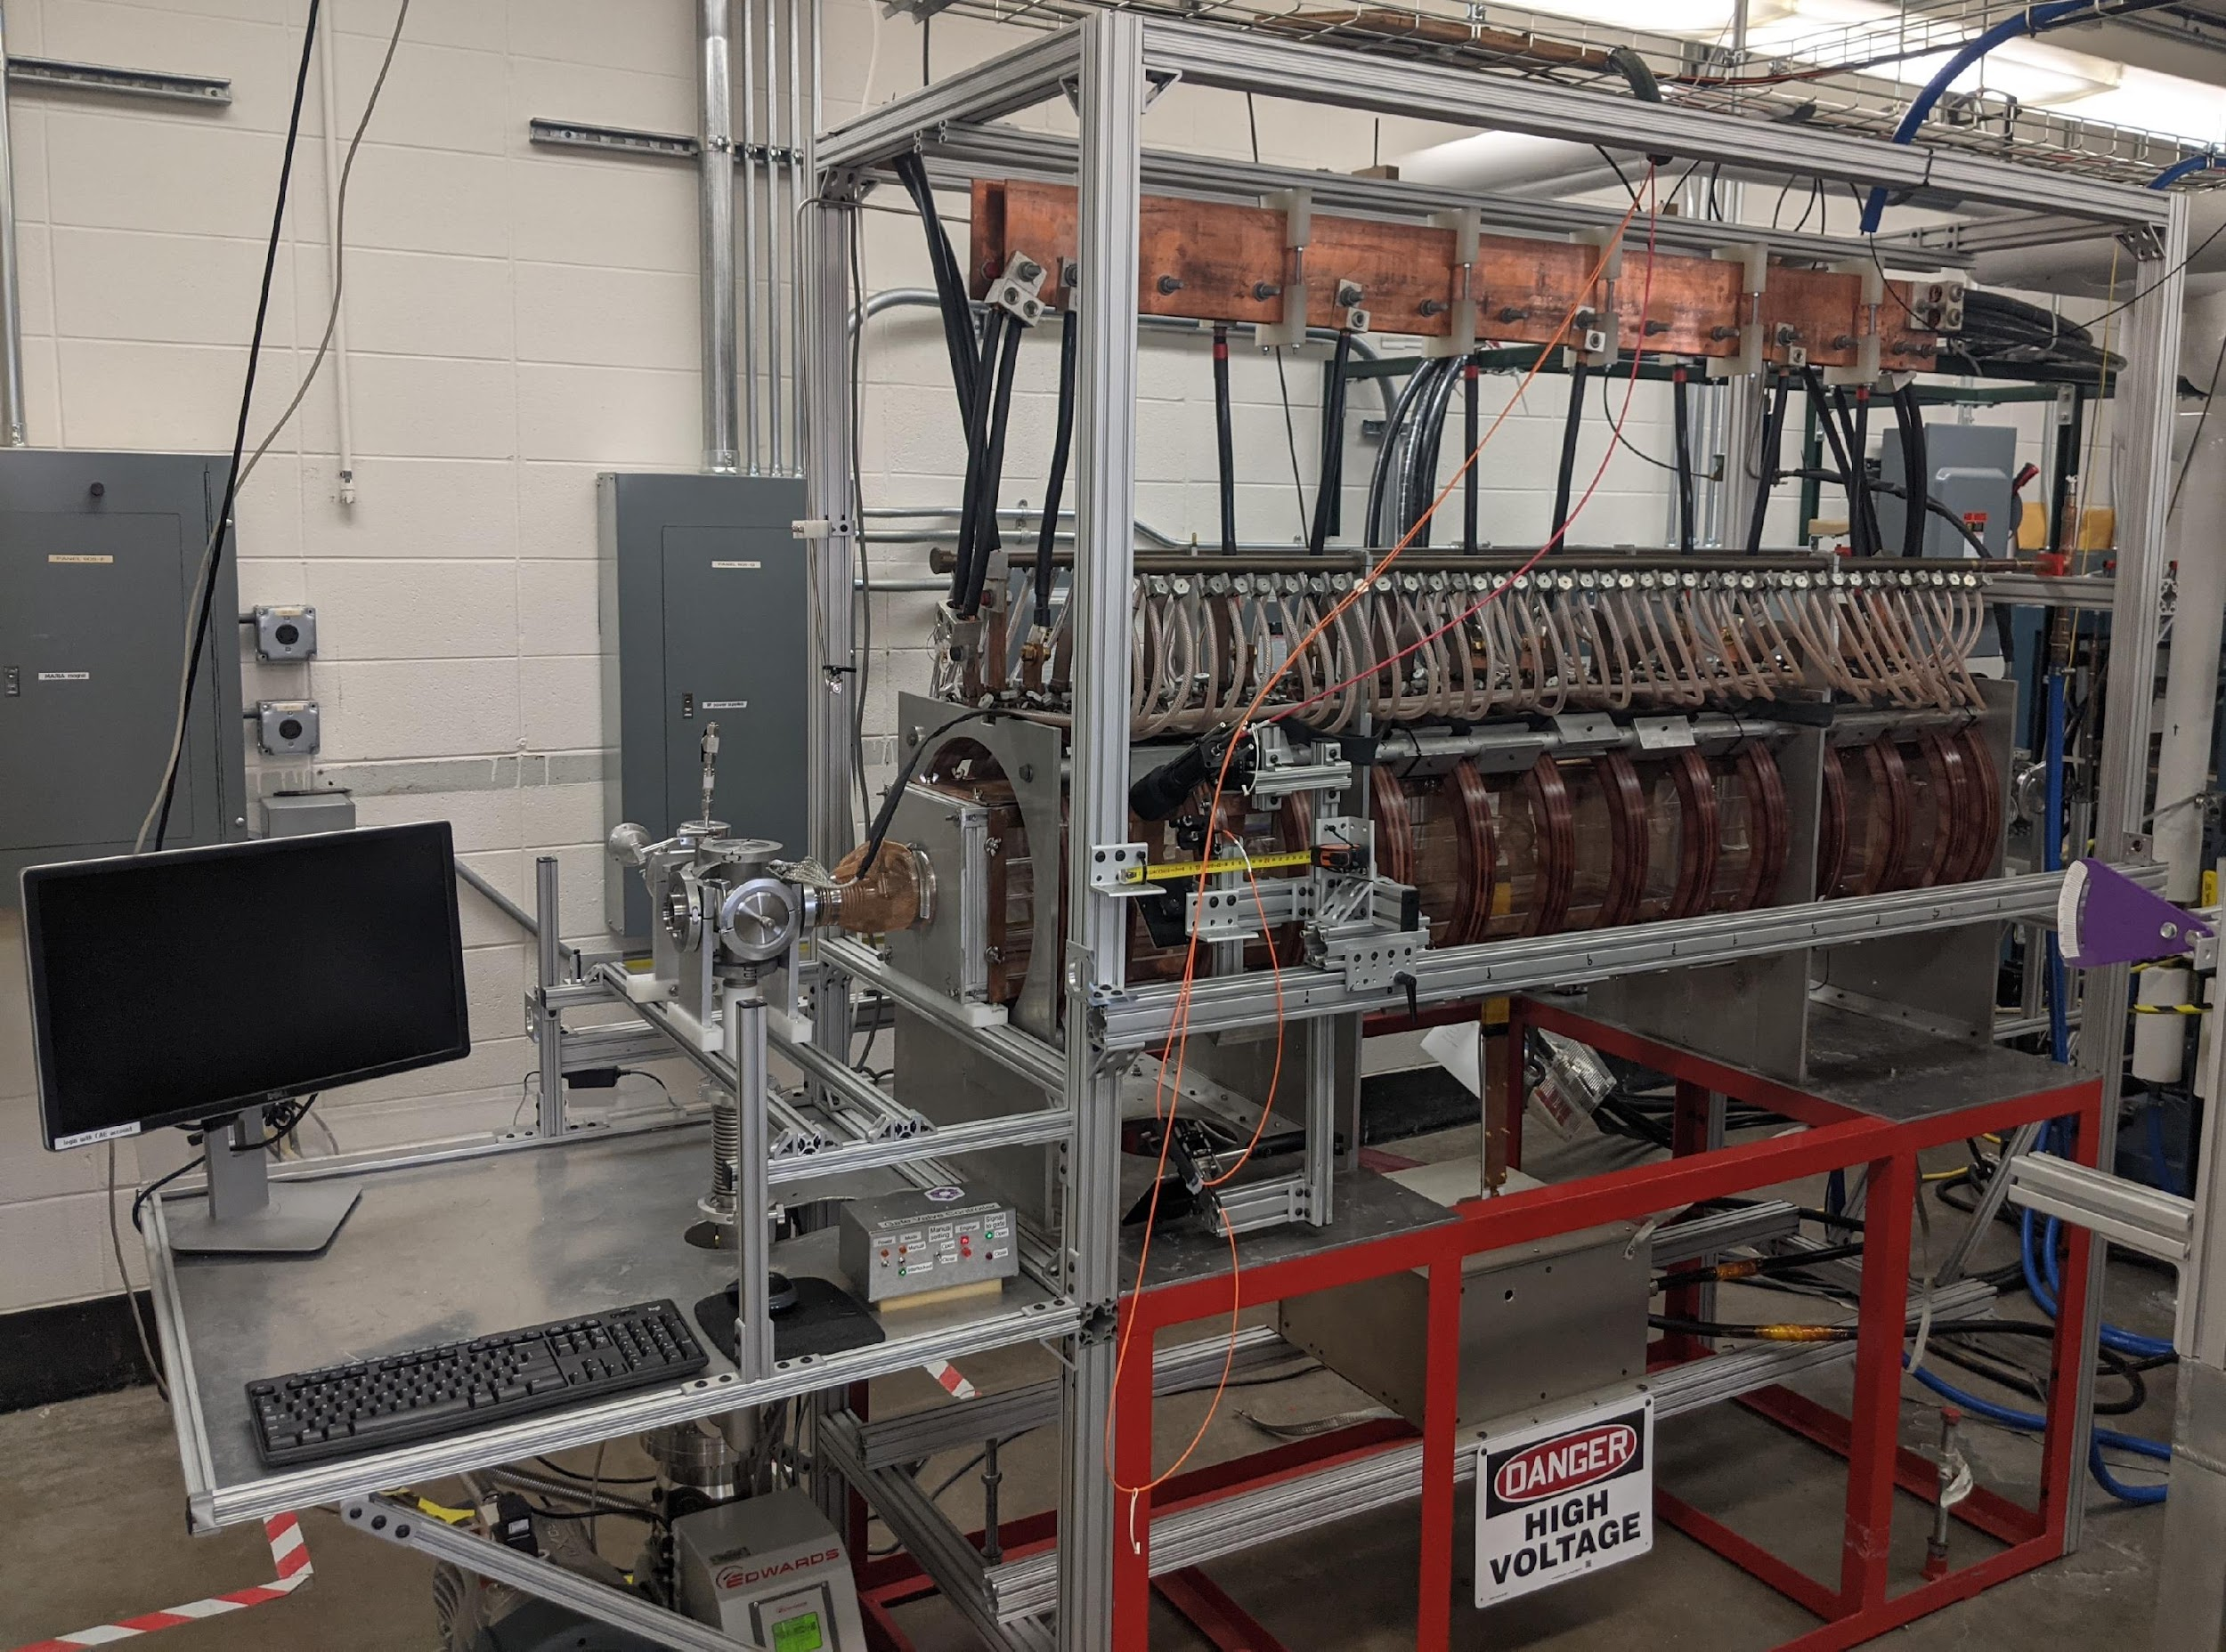
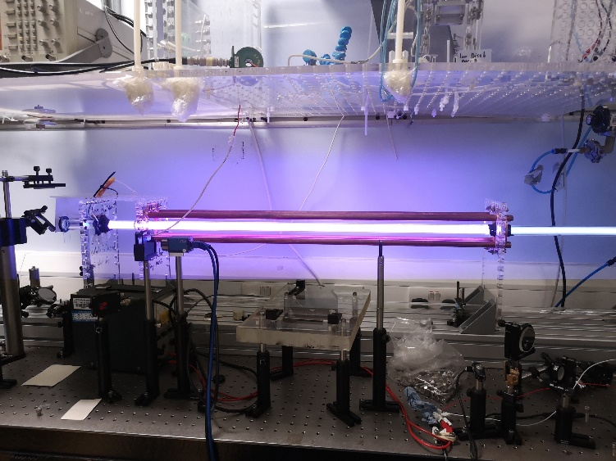
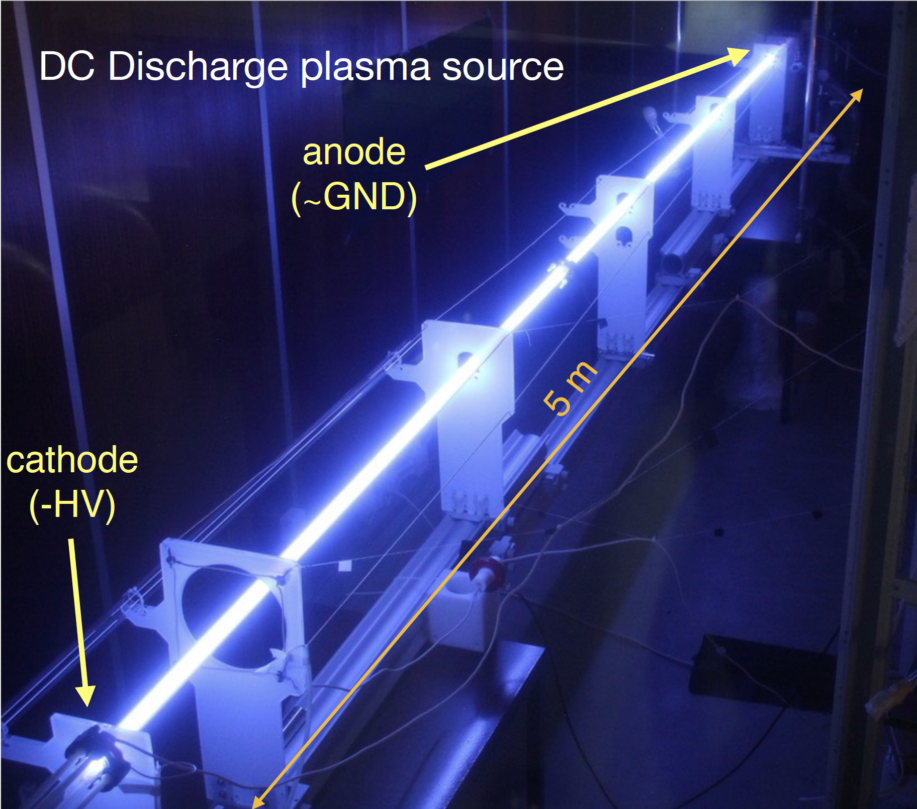
Program
Focus on
  uniformity → plasma diagnostics
  scalability and reproducibility → plasma lengths between 1 and 10 m in the lab
Physics program defined with the different institutes with focus on plasma diagnostics, plasma physics and simulations
Redundancy of sources for HW design/optimisation and diagnostics qualification at institutes before transfer to CERN
Share diagnostics between plasma sources
Tolerance studies through dedicated simulations and benchmarking with lab experiment data
Technical aspects endorsed by CERN (vacuum, control, design, integration, beam interfaces, etc.)
Sharing and networking within PWFA community through international conferences/workshops

Slide 11

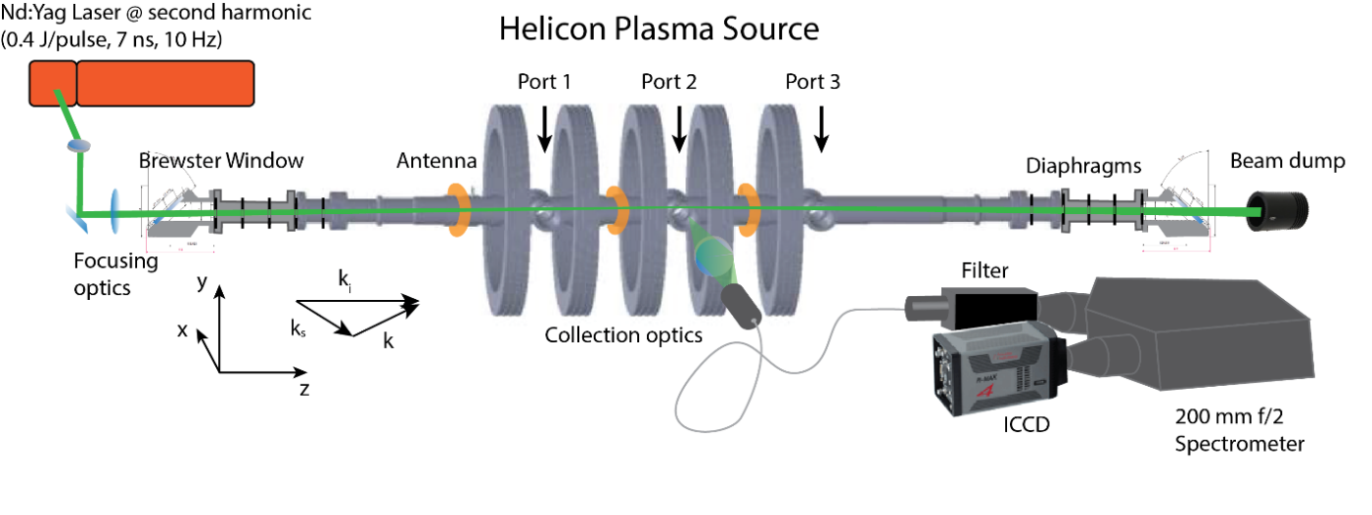
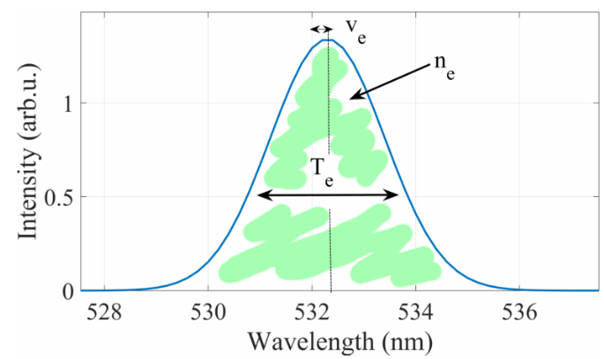
Uniformity
Short plasma setup for both sources to fit in the laser lab (1 to 3 m plasma length),
Several plasma diagnostics being developped or in use: interferometry (longitudinal/transverse – IST, IC, IPP), LIF (Univ. Maddison), Thomson Scattering (EPFL-SPC)
Example: Thomson scattering
Longitudinal density profile for both sources by end 2024
Operating regime: 1x10¹⁸ - 1x10²¹ m⁻³
Uncertainties: 0.1 eV and < 10% in density
Courtesy C. Stollberg, EPFL-SPC

Slide 12
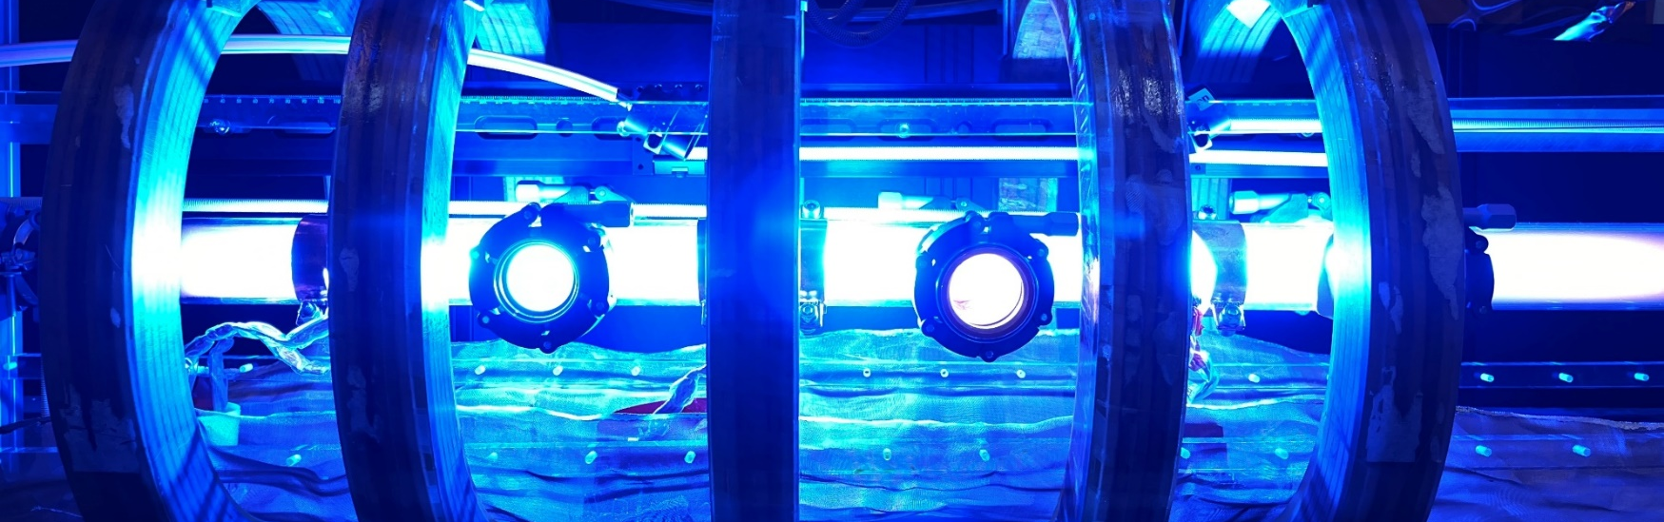
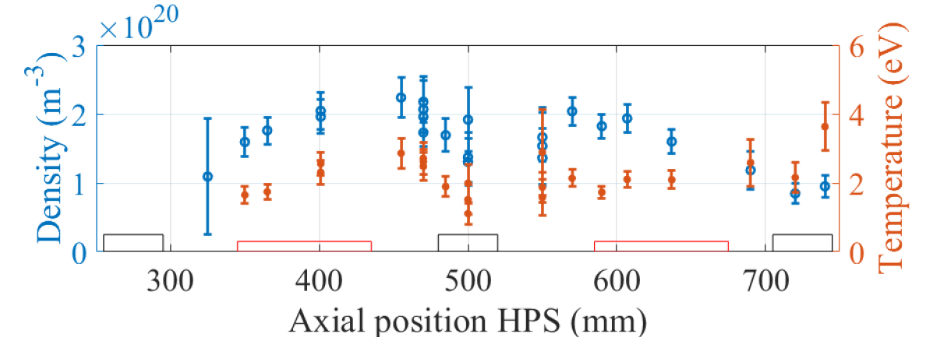
Uniformity
Preliminary HPS density profile with Thomson scattering:
Diagnostic qualification on HPS prototype setup
Will be applied to DPS in summer 2024 to assess longitudinal uniformity of single and double plasmas
2025 on: apply diagnostics on upgraded setups
2 antennas at 10kW RF each, 85 mT, Ar 8 Pa
Courtesy C. Stollberg, EPFL-SPC

Slide 13
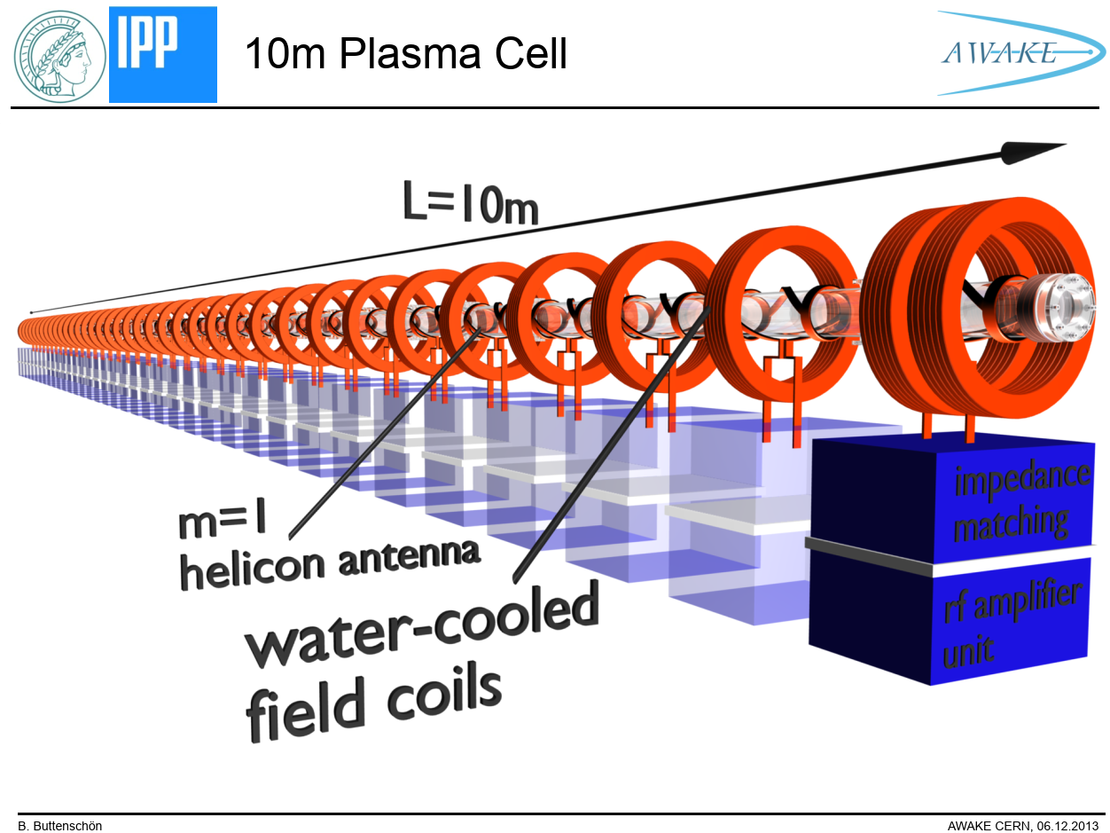
Scalability and reproducibility
10 m
DPS: scalability driven by arrangement of the sources and tunability
  Double plasma (5 m + 5 m) with common cathode: Anode/Cathode/Anode scheme and 1 or 2 pulse generators
  → summer 2024
  Quadruple plasma (1.5 m + 1.5 m + 1.5 m + 1.5 m): A/C/A/C/A scheme with 2 pulse generators to test common anode and common cathodes scheme
  → winter 2024
HPS: scalability by stacking antenna/coils/generators
  New design of a 2.5 m unit module with 10 antennas/RF generators based on institutes/CERN inputs and uniformity results
  2025
A1
C
A2
5 m
5 m
6 m
A1
C1
A2
C2
A3
1.5 m
2.5 m
RF-antennas
water-cooled
field coils
adapted from O. Grulke IPP-Greifswald

Slide 14
AWAKE May 2023 DPS run
→ See Marlene’s presentation

Slide 15
Summary
CERN as host of the Plasma Sources R&D program with 2 dedicated laboratories
Benefit of CERN expertise in accelerator technology
5 collaboration institutes contributing to the development of the sources and diagnostics
1st milestone achieved with the DPS May 2023 Run in AWAKE:
  DPS: proven tunnel operation as self-modulator plasma source, with high flexibility and reliability
  Enabled several physics studies in a single AWAKE Run of 3 weeks
R&D focuses on uniformity, scalability and reproducibility towards Run 2d 10+ m accelerator source
Plasma sources R&D program of technological relevance for the plasma-based accelerator community
“Single stage accelerator with very long plasma” part of European Strategy for Particle Physics roadmap

Slide 16
HPS organization
CERN AWAKE project, Coordination Package 8: Plasma Sources R&D
Coordination of HPS and DPS experiments at CERN
Periodic follow-up meetings
Report in project team meeting
Source design, development, operation within AWAKE requirements
Plasma diagnostics and campaigns organization
Adaptation to AWAKE tunnel infrastructures
In charge of institute Work Package for the HPS R&D
Launched the helicon plasma cell study ~ 2009 (PPA09 conference)
1m HPS setup designed/build/operated at IPP and moved to CERN
Reference plasma diagnostic (CO2 interferometer)
Development of MW cut-off frequency “monitoring” diagnostic
→ Several campaigns per year with visiting institutes, technical and experimental
Development Thomson Scattering for axial density profile
Helicon wave physics and simulation, RF and plasma simulations
RAID test setup at EPFL-SPC + alternative resonant antenna design
Diagnostics: Laser Induced Fluorescence and emission spectroscopy
RF coupling and impact on density formation and profile
Particle balance to identify sources and sinks causing anisotropies
MAP (Madison AWAKE prototype) as sister experiment to HPS for extrapolation to longer cell, qualify diagnostics and test bed for optimization concepts towards AWAKE goals

Slide 17

DPS organization
CERN AWAKE project, Coordination Package 8: Plasma Sources R&D
Coordination of HPS and DPS experiments at CERN
Periodic follow-up meetings
Report in project team meeting
Source design, development, operation within AWAKE requirements
Plasma diagnostics
Adaptation to AWAKE tunnel infrastructures (control, vacuum, etc.)
In charge of institute Work Package for the DPS R&D
Launched the discharge plasma cell study ~ 2011 with Z. Najmudin
Pulsed DC power supplies (ignition and heater module) design, test (5 m test plasma cell at IST) and fabrication + spec. for industrialisation
Longitudinal interferometry
Tube design
1 m DPS test setup at ICL
Longitudinal interferometry
Transverse interferometry
Deflectometry
Spectroscopy
Discharge current control/shaping system
Plasma modelling

Slide 18
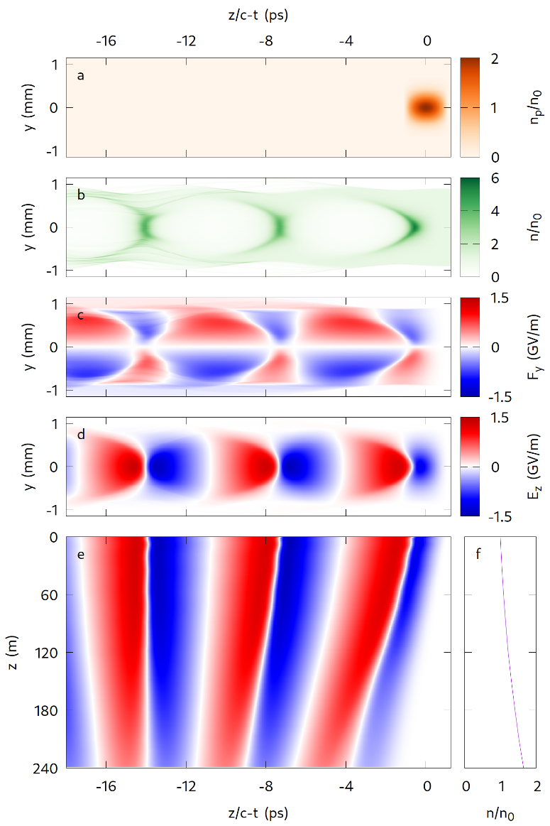
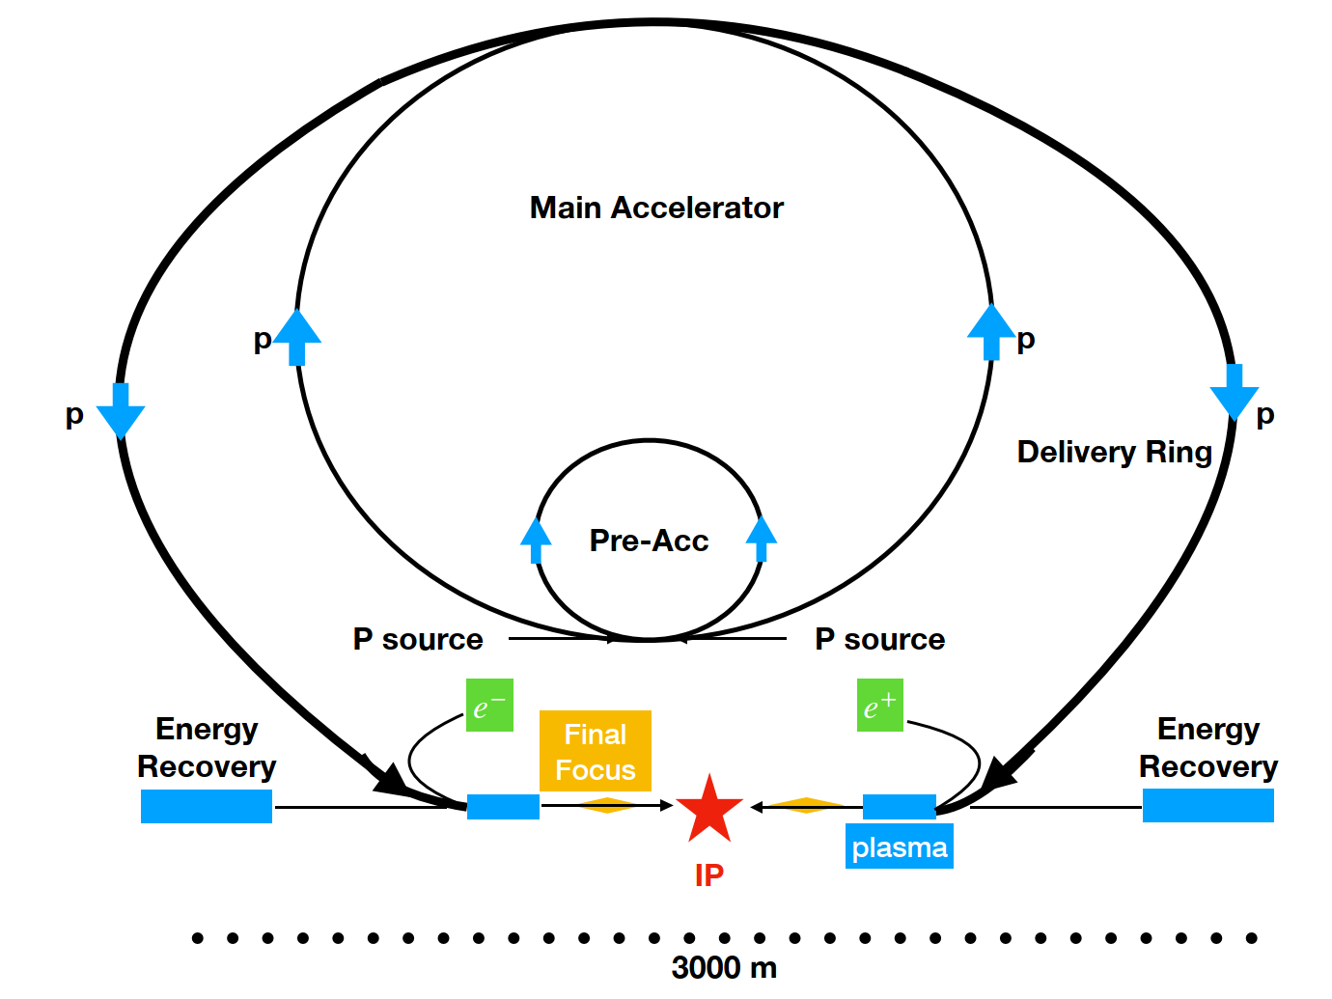
Challenges and potentials
→ Higgs factory based on proton-driven PWFA (J. Farmer et al., in preparation)
Courtesy J. Farmer

Slide 19
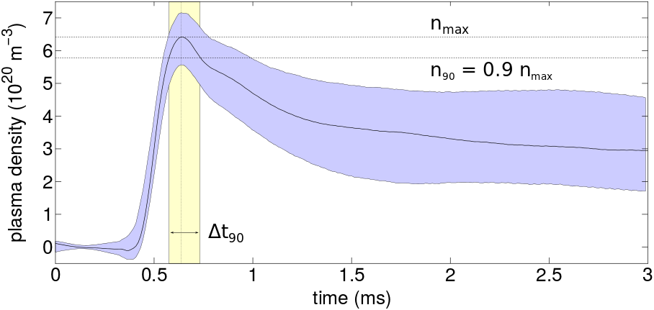
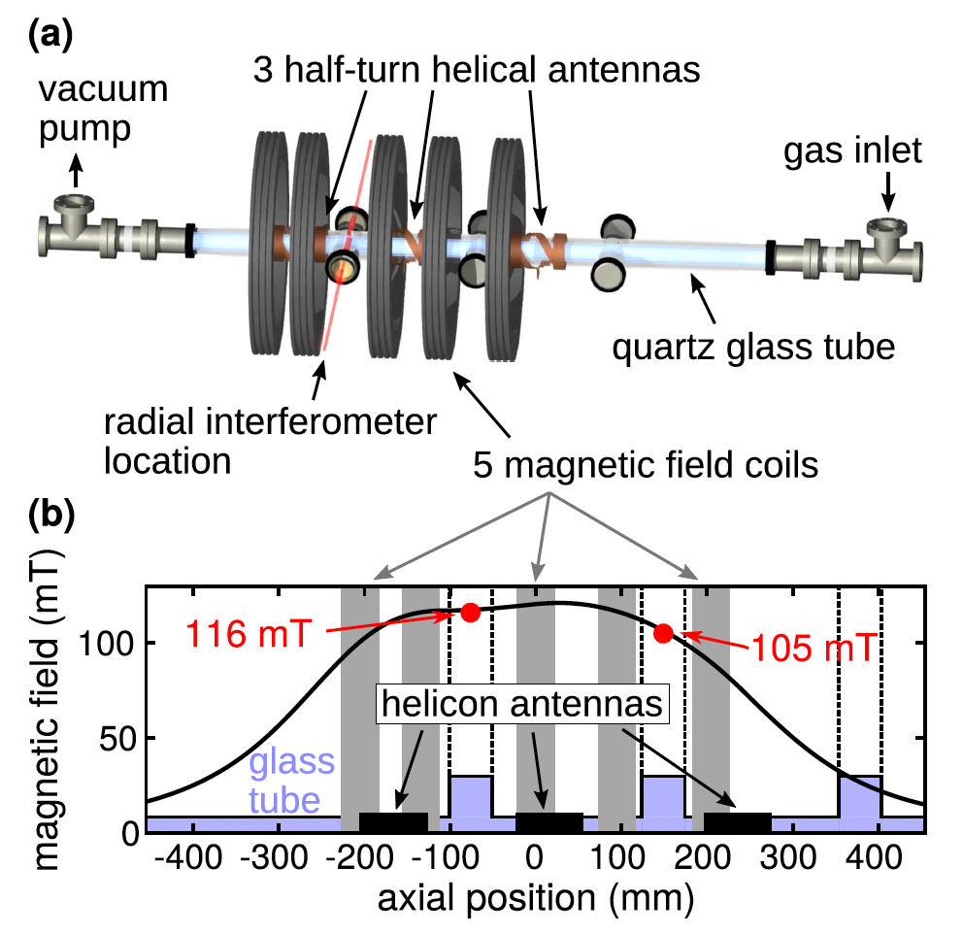
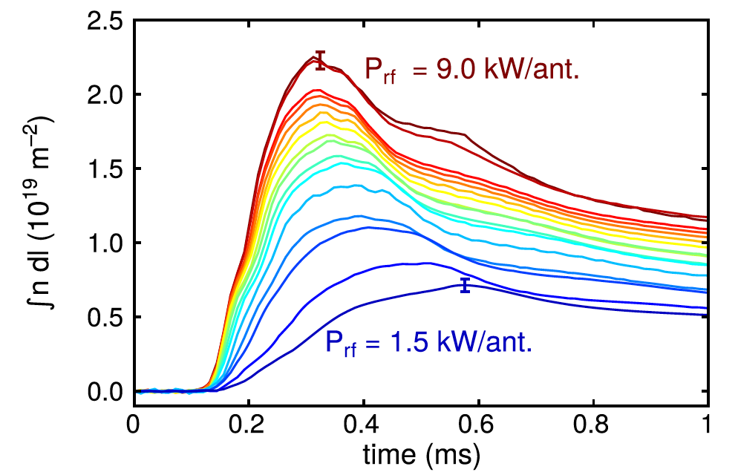

Plasma sources technologies: HPS
Helicon Plasma Source (HPS)
→ RF wave heated plasma, pulsed 10 Hz rep. rate
27 kW power (3 antennas) at 13.56 MHz with 120 mT
B. Buttenschön et al 2018 Plasma Phys. Control. Fusion 60 075005

Slide 20
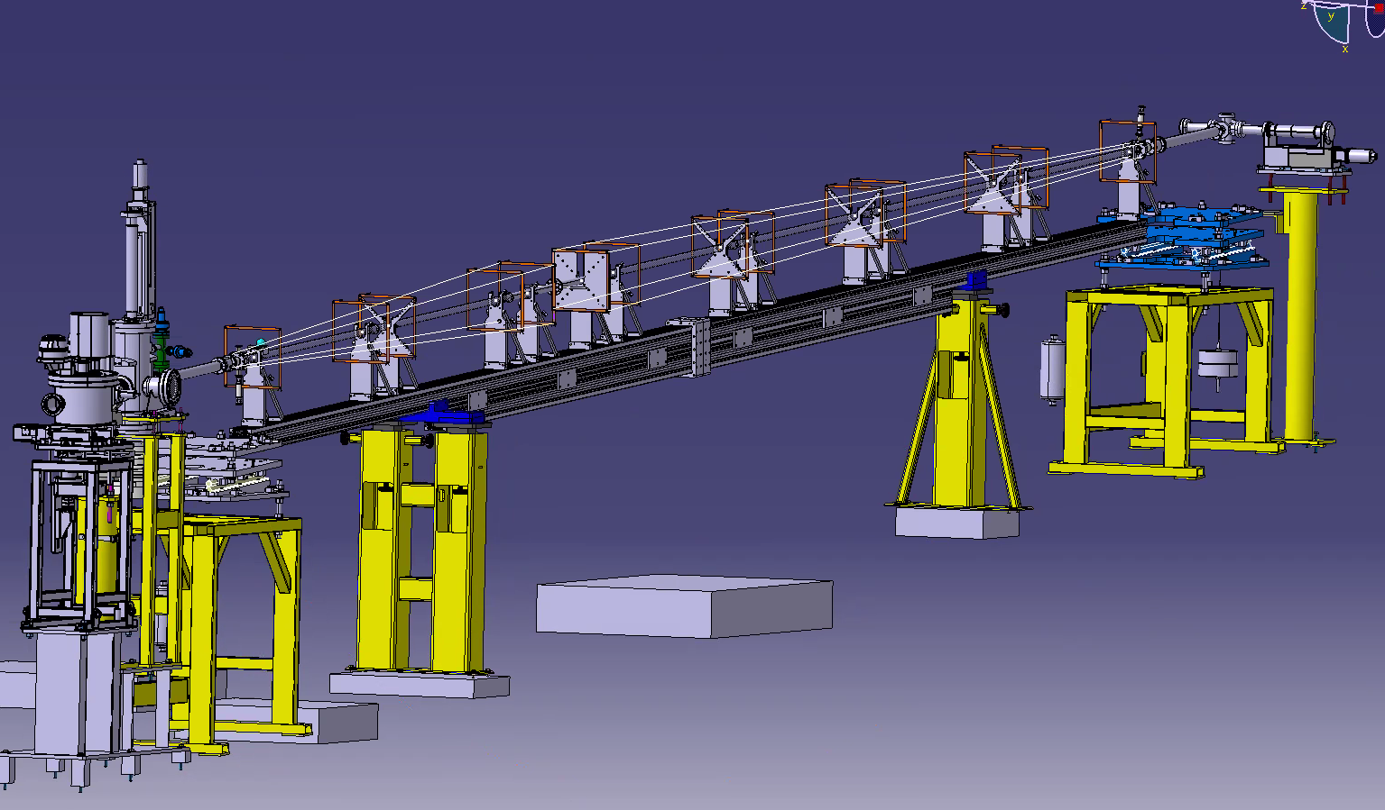

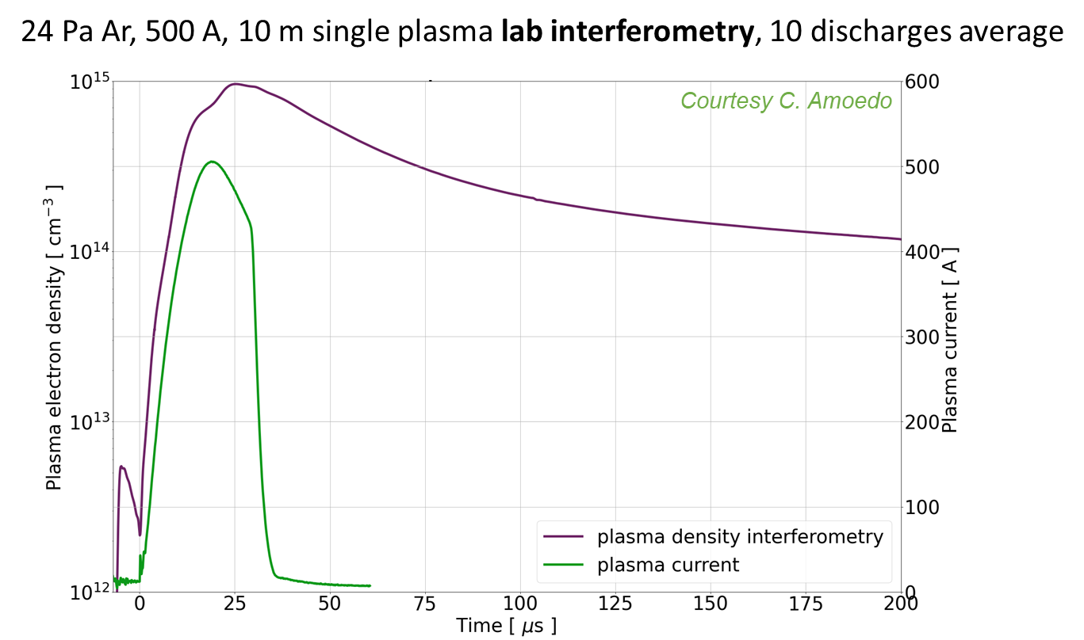
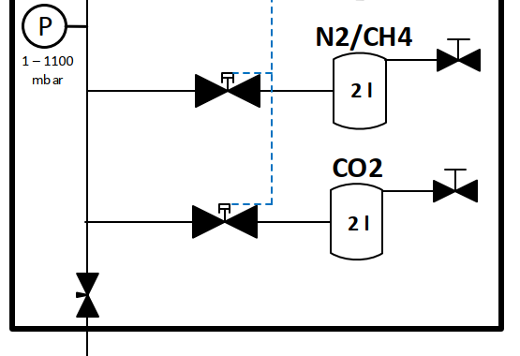



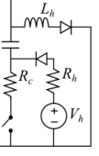
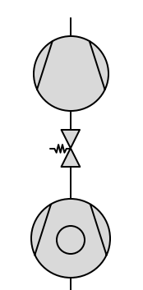
Plasma sources technologies: DPS
Discharge Plasma Source (DPS)
→ pulsed-DC discharge, 1 Hz rep. rate
CAD drawing of 10 m DPS in AWAKE tunnel
10 m
Anode
Cathode
anode return cage
Pressure relief valve
glass tubes D_{i} = 26 mm (KF25 flanges)
P
0.1 - 100 Pa
C
50 kV cathode cable
FR
GND
Xe
Pulsed DC switches
Up to 40 kV ignition voltage
600 A heater peak current
30 μs pulse, 1 Hz rep. rate
Base pressure ~ 10⁻⁴ Pa
Operating range 1 - 50 Pa
Ar
He
Gas Injection System
Pumping group

Slide 21
Scalability and reproducibility (> 2026)
20 m
DPS: scalability driven by tunability and arrangement of the source
  Double plasma (10 m + 10 m) with common cathode
  Quadruple plasma (5 m + 5 m + 5 m + 5 m): A/C/A/C/A scheme
  New generation of high precision pulse generator (outsourced)
HPS: scalability by adding antenna/coils/generators
  10 m source (4x unit module) with 40 antennas/RF generators
+ Address technical aspects for tunnel integration/operation: control and regulation of tube temperature/pressure/gas/interfaces...
A1
C
A2
10 m
10 m
20 m
A1
C1
A2
C2
A3
5 m
10 m
RF-antennas
water-cooled
field coils
adapted from O. Grulke IPP-Greifswald

