Slide 1
BISv2 CIBDS
Reliability Study
Top-level functions, functional diagram, FMECA

Slide 2
List of contents
Top-level functions overview
Functional Block Diagram
Failure rate prediction & FMECA
Firmware verification methods

Slide 3
Top level functions
Overview
Main – critical: sending asynchronous dump request to the TDU (Trigger Delay Unit)
Link Mode: dumping the second beam depending on the status of an SMP flag.
Secondary:
  sending synchronous dump request to ???
  Arming process.
Diagnostics.

Slide 4
Top-level functions FMECA
Situation | Function | Failure | Effect | Criticality
Normal operation | Keep the BIS loop closed | Opening the beam permit loop | Downtime
 |  | Spurious trigger | Asynchronous dump, downtime
 |  | Assuming the LBDS is in the LOCAL mode while it is in REMOTE (failure of path A and B)
The beam is being dumped | Regonize change or lack of signal and send an asynchronous dump request | Not sending an asynchronous dump request | Downtime
 |  |  | If TSU not dumping the beam and it CIBDS both A and B paths fail then missed beam dump
The other beam dumped | Depending on the link mode flag status, removing beam permit and sending a delayed asynchronous dump request | Not removing the beam permit | Beam remains in the machine and does not have beam-beam kick effect (both A and B paths failing)
 |  | Not sending a delayed asynchronous beam request
Arming | Check status and confirm readiness | Unable to arm when conditions allow | Downtime
 |  | Arming when conditions not allow | Risk of being unable to dump asynchronously when needed
Diagnostics | Collect diagnostics data and send to Post-Mortem | Lack of diagnostic data | Downtime

Slide 5
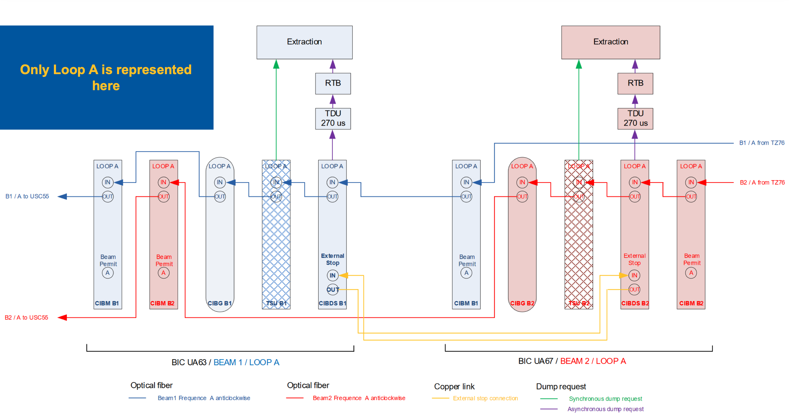
CIBDS in the BIS loop
Schema from the BISv2 developments for LS3 presentation
https://indi.to/KWLHR, I. Romera Ramirez

Slide 6
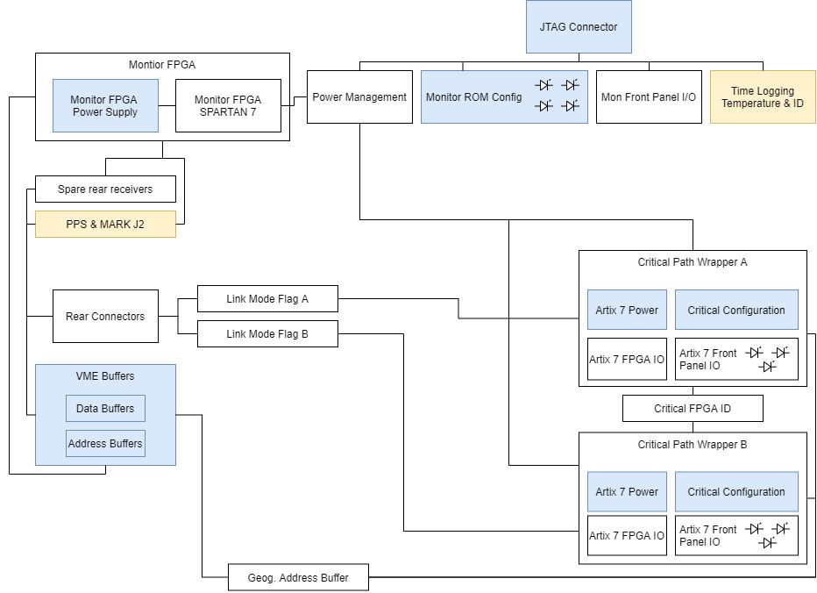
Functional Block Diagram
Elements of the design
The blue and yellow boxes indicate pages which are listed as ”unmodified”.
Missing input and output flows.
Link Mode Flag
Notes:
Link mode in yellow and beam loop in blue (or red)

Slide 7
Component-level FMECA
Concept
What is FMECA?
  Each component is assigned failure rate prediction from 217 Plus standard, applicable failure modes and their share of the failure mode
  Each failure mode is to be assigned one of the end-effects listed to the right
End-effects:
  Blind failure (whole board)
  Blind failure (per path)
  False dump (asynchronous)
  False dump (synchronous)
  Maintenance
  No effects
Designator | Description | Part Number | Category | Page | Failure mode | Failure rate | End Effect
C1 | 10% 50V X7R… | CC0603… | Capacitor | CRITICAL_CONFIG | Open | 0.02 | No Effect
C1 | 10% 50V X7R… | CC0603… | Capacitor | CRITICAL_CONFIG | Short | 0.1 | Beam dump
…
IC4 | IttyBitty | MIC15… | Integrated Circuit | CRITICAL_CONFIG | Short | 0.98 | Beam dump
…

Slide 8
Questions
For failure rate prediction
1. Is the transistors’ applied voltage always equal to 3V?
2. “Quad Channel Optocoupler, Phototransistor Output”: assigned category ”IC, Plastic Encapsulated”; type: linear?
3. The derating of the capacitors is much lower than in other boards. Still, maximum up to values above 50%.
4. “High speed switching diodes” assigned type “Current regulator”.

Slide 9
Firmware reliability assurance

