Slide 1
CIBFX Reliability Study
Summary of the FMECA – results and conclusions

Slide 2
List of contents
Failure rate prediction
  CIBFX Motherboard
    Capacitors
    Resistors
    Externals
  CIBFX Connectors
End-effects analysis
  End-effects breakdown
  End-effects rate per page – CIBFX Motherboard
  End-effects rate per page – CIBFX Connectors
  Blind failures
  False dumps – CIBFX Motherboard
  False dumps – CIBFX Connectors
  Maintenance
Remaining questions
Conclusions & next steps
References

Slide 3
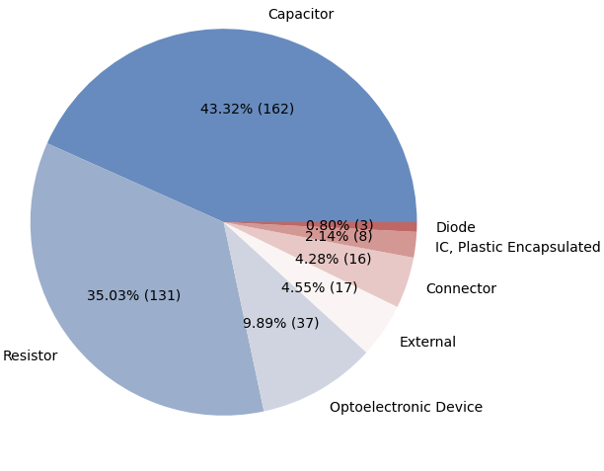
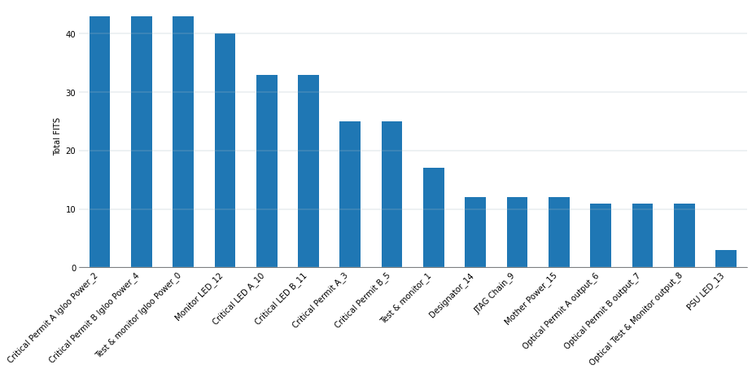
Failure rate prediction
For CIBFX Motherboard
Total of 374 components.
  Capacitors & resistors taking top spots.
  Third group is made of LEDs.
  Then externals: a mix of components not assigned to other categories (see next slides).
  Then there are connectors, integrated circuits (plastic encapsulated) and diodes.
The 16 design pages of the project
  Most of components (44 in each) are in 3 Igloo Power pages.
  Those are followed by LED pages (30-40 each).
  Then Critical Permit and Test & Monitor.
  Remaining have roughly 10 components each.

Slide 4
Failure rates (CIBFX Motherboard)
Of capacitors
10 Tantalum, 152 ceramic capacitors:
  Voltages for 153 identified automatically:
    Minimal rating: 10V.
    Maximum stress fraction: 0.3.
    More than 75% below 0.1.
  9 operating voltages missing (can be added for completeness).
Total of 127 FIT:
  An individual capacitor adds 0.78 FIT each.
  Maximum failure rate: 4 FIT for 3 ceramic capacitors with 0.33 stress factor.
  Minimum failure rate: 0.34 FIT.
  Tantalum: 1.2 FIT

Slide 5
Failure rates (CIBFX Motherboard)
For resistors
131 resistors adding 94 FIT.
  Each contributes roughly the same 0.72 FIT (with small deviation).
All assigned matching power rating (0.125W or 0.25W)
All assigned “Fixed, Metal Film” 217Plus sub-category.

Slide 6
Failure rates (CIBFX Motherboard)
For external components
Part number | Description | Qunatity | Failure rate [FIT] | Designator | Reference
ADP1740ACPZ | Low-Dropout Linear Regulator | 2 | 0.51 | IC1, IC2 | Analog Wafer Fabrication Data [1]
MC100EPT20DT | LVTTL/LVCMOS to Differential LVPECL | 3 | 4.83 | IC4, IC11, IC18 | Onsemi Reliability Data [2]
MC100EPT21DT | Differential LVPECL/etc to LVTTL/LVCMOS | 3 | 4.83 | IC5, IC12, IC19 | Onsemi Reliability Data [2]
M2GL010-TQG144 | IGLOO2 FPGA | 3 | 8 | IC6, IC14, IC20 | Device Reliability Report UG116 [3]
24AA025E48-I/SN | Serial EEPROMs | 1 | 2 | IC8, | Microchip Reliability Data [4]
PCA9552PW | I2C-BUS LED Driver | 2 | 2 | IC10, IC16 | NXP Semiconductors Reliability Data [5]
LFSPXO018045 | Surface Mount Clock Oscillator | 3 | 7.76 | OSC1, OSC2, OSC3 | CFPS-73 document [6]
 | TOTAL | 17 | 83.28
Table 1. Failure rates of components in the CIBFX Motherboard; 90% confidence level interval, 55 deg C, 0.7 eV activation

Slide 7
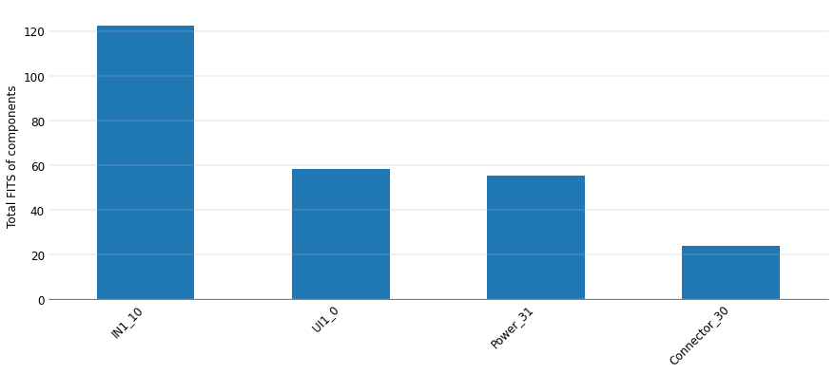
Failure rate prediction
For CIBFX Connectors
Structure of the project:
Power - single
39 components, adding 50 FITs.
Connector – single
12 components, adding 24 FITs (2 x 12 connectors)
IN – x20
11 components, adding 122 FITs (80 relay, 14 x 2 transistors).
UI – x10
16 components, adding 58 FITs (14 transistor, 6 x 3 optocouplers, 4-5 x 4 TVS)
Total
463 components, 3104 FITs.

Slide 8
End-effect analysis
Results of the full FMECA

Slide 9
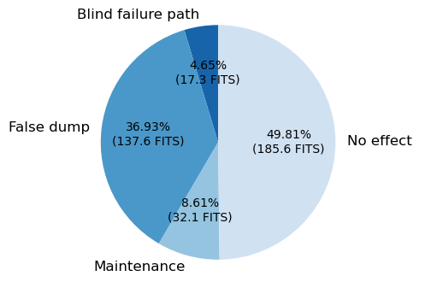
End-effects breakdown
For CIBFX Motherboard

Slide 10
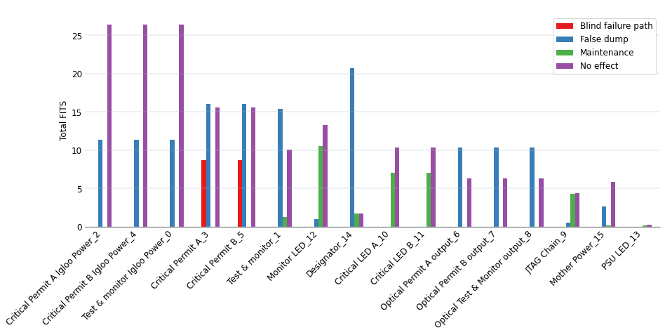
End-effects failure rate (FITs) per page
CIBFX Motherboard

Slide 11
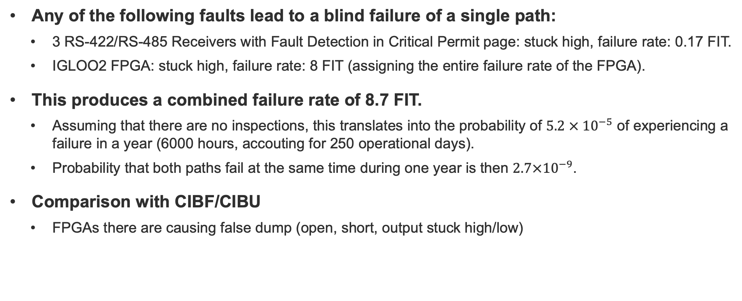
Blind failures
Only CIBFX Motherboard
Any of the following faults lead to a blind failure of a single path:
  3 RS-422/RS-485 Receivers with Fault Detection in Critical Permit page: stuck high, failure rate: 0.17 FIT.
  IGLOO2 FPGA: stuck high, failure rate: 8 FIT (assigning the entire failure rate of the FPGA).
This produces a combined failure rate of 8.7 FIT.
  Assuming that there are no inspections, this translates into the probability of $5.2 × {10}^{−5}$ of experiencing a failure in a year (6000 hours, accouting for 250 operational days).
  Probability that both paths fail at the same time during one year is then $2.7×{10}^{−9}$.
Comparison with CIBF/CIBU
  FPGAs there are causing false dump (open, short, output stuck high/low)

Slide 12
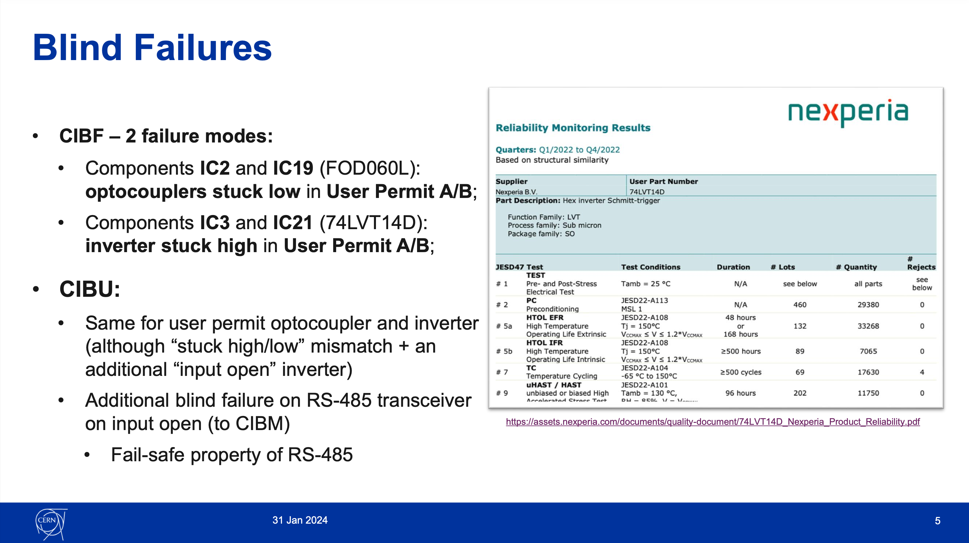
CIBF Reliability Study

Slide 13
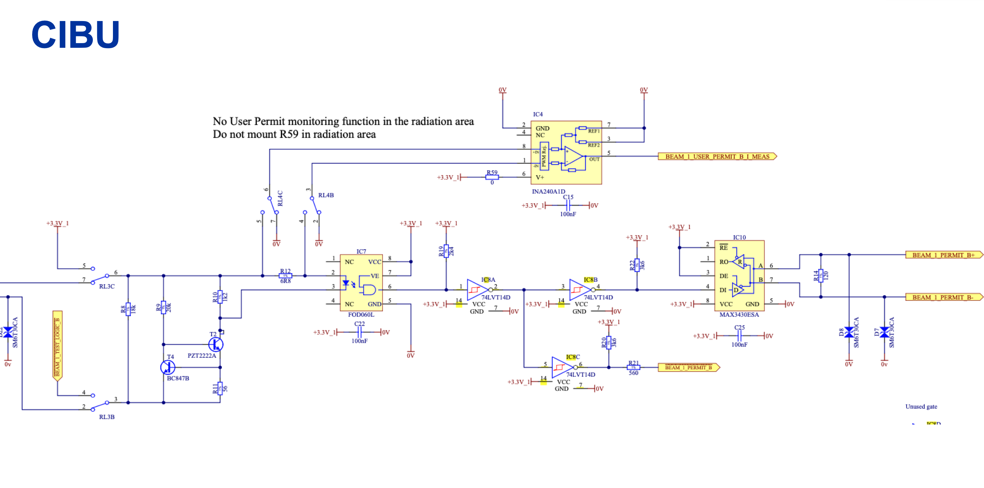

Slide 14
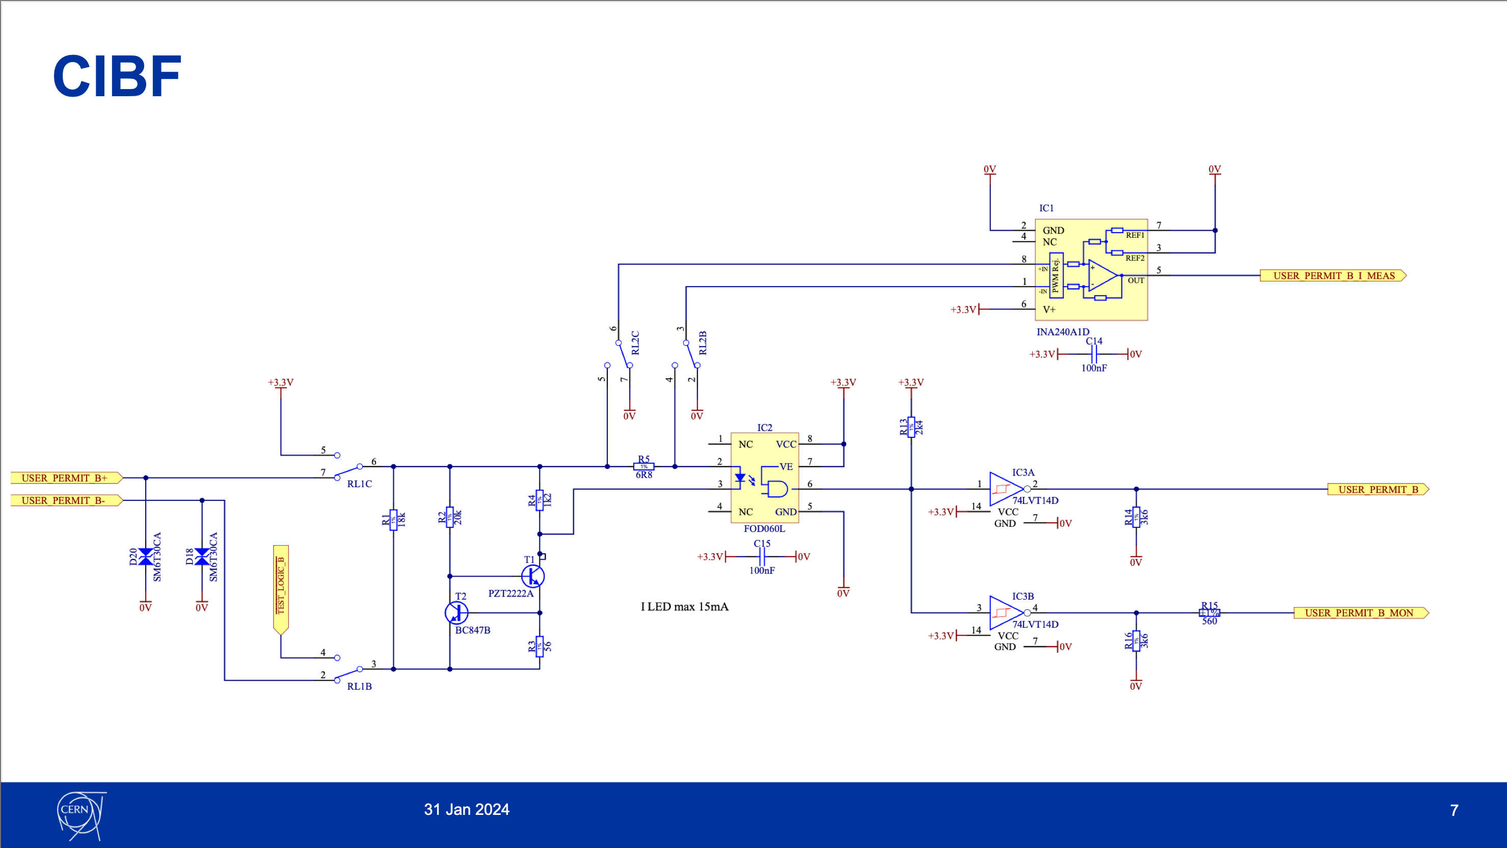

Slide 15
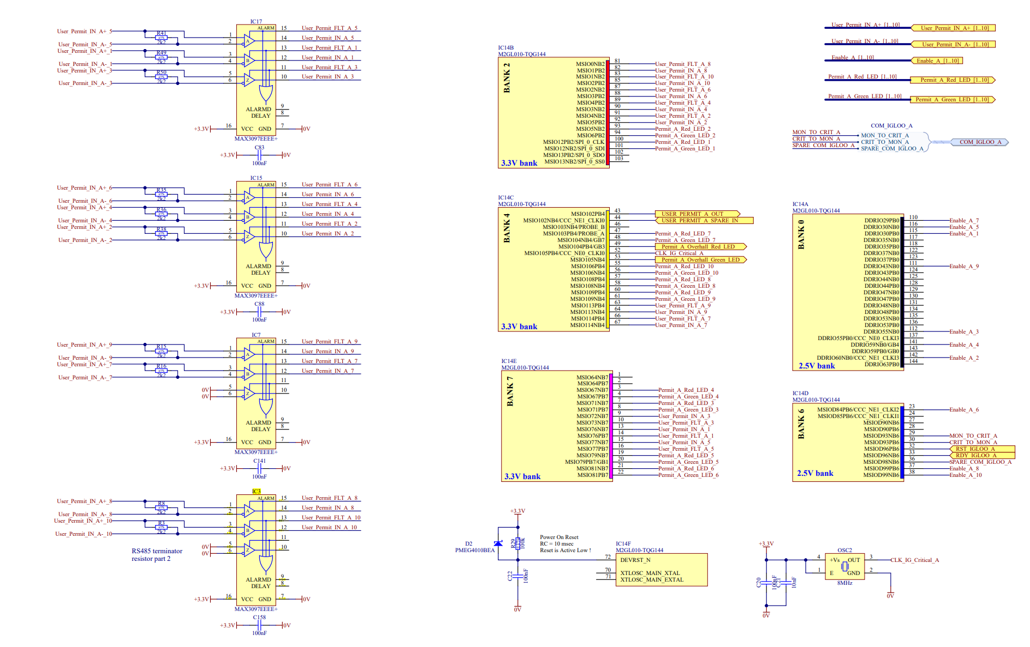
CIBFX

Slide 16
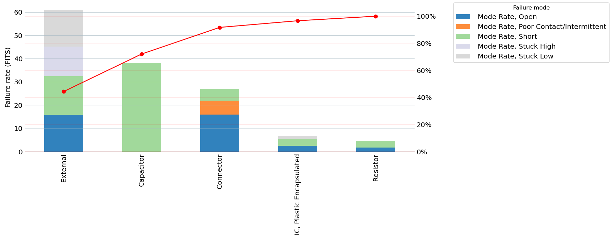
False dumps
In CIBFX Motherboard, 137 FIT

Slide 17
False dumps
In CIBFX Motherboard, 137 FIT
Id | PartNumber | AlternatePN | CategoryDescription | Page | Failure Mode Rate
15.60 | M2GL010-TQG144 | IC6 | External | Test & monitor_1 | 6.400
0.14 | LFSPXO018045 | OSC3 | External | Critical Permit B_5 | 6.208
15.10 | LFSPXO018045 | OSC1 | External | Test & monitor_1 | 6.208
1.14 | LFSPXO018045 | OSC2 | External | Critical Permit A_3 | 6.208
1.13 | M2GL010-TQG144 | IC14 | External | Critical Permit A_3 | 4.800
0.13 | M2GL010-TQG144 | IC20 | External | Critical Permit B_5 | 4.800
8.30 | MC100EPT20DT | IC4 | External | Optical Test & Monitor output_8 | 3.864
13.40 | MC100EPT21DT | IC19 | External | Optical Permit B output_7 | 3.864
8.40 | MC100EPT21DT | IC5 | External | Optical Test & Monitor output_8 | 3.864
12.30 | MC100EPT20DT | IC11 | External | Optical Permit A output_6 | 3.864

Slide 18
End-effects failure rate (FITs) per page
CIBFX Connectors
4 categories:
  Power (x1)
    39 components
    False dump: 1.32 FIT
    Maintenance: 67.6 FIT
  Connector (x1)
    12 components
    False dump: 20.7 FIT
    Maintenance: 1.7 FIT
  IN (x20)
    11 components x 20 = 220
    False dump: 27.8 x 20 = 556 FIT
    Maintenance: 84 x 20 = 1680 FIT
  UI (x10) 16 components
    16 components x 10 = 160
    False dump: 21.6 x 10 = 216 FIT
    Maintenance: 23.3 x 10 = 233 FIT

Slide 19
False dumps
In CIBFX Connectors
Id | Part Number | Alternate PN | Category Description | Page | Failure Mode Rate
25.9 | G6K-2F-Y-DC3 | RL19 | Relay | IN1_10 | 20.807088
9.5 | SFH6186-5 | IC3 | Optoelectronic Device | UI1_0 | 4.639290
9.7 | SFH6186-5 | IC5 | Optoelectronic Device | UI1_0 | 4.639290
9.3 | SMBJ3V3 | D11 | Diode | UI1_0 | 4.571906
9.4 | SMBJ3V3 | D18 | Diode | UI1_0 | 4.571906
25.2 | SMBJ20CA | D17 | Diode | IN1_10 | 3.440471
25.1 | SMBJ20CA | D16 | Diode | IN1_10 | 3.440471
23.1 | 354071 | J20 | Connector | Connector_30 | 2.006967
23.9 | 354071 | J19 | Connector | Connector_30 | 2.006967
23.8 | 354071 | J18 | Connector | Connector_30 | 2.006967

Slide 20
Maintenance in IN
AlternatePN | Category | PartNumber | CategoryDescription | failure_mode | Alpha | FailureModeRate | EndEffect
RL19 | 217-RE | G6K-2F-Y-DC3 | Relay | Fails to Trip | 55 | 44.0149937 | Maintenance
RL19 | 217-RE | G6K-2F-Y-DC3 | Relay | Short | 19 | 15.2051796 | Maintenance
T46 | 217-TR | BC847B | Transistor | Short | 60 | 8.35926473 | Maintenance
T47 | 217-TR | BC847B | Transistor | Short | 60 | 8.35926473 | Maintenance
T46 | 217-TR | BC847B | Transistor | Open | 20 | 2.78642158 | Maintenance
T47 | 217-TR | BC847B | Transistor | Open | 20 | 2.78642158 | Maintenance
D15 | 217-DI | ES1D | Diode | Short | 80 | 1.79340759 | Maintenance
R119 | 217-RS | R0805_2K_1%_0.125W_100PPM | Resistor | Open | 30 | 0.21582689 | Maintenance
R117 | 217-RS | R0805_1K_1%_0.125W_100PPM | Resistor | Open | 30 | 0.21582689 | Maintenance
R119 | 217-RS | R0805_2K_1%_0.125W_100PPM | Resistor | Short | 10 | 0.0719423 | Maintenance
R116 | 217-RS | R0805_10K_1%_0.125W_100PPM | Resistor | Short | 10 | 0.0719423 | Maintenance
R118 | 217-RS | R0805_10K_1%_0.125W_100PPM | Resistor | Short | 10 | 0.0719423 | Maintenance
R117 | 217-RS | R0805_1K_1%_0.125W_100PPM | Resistor | Short | 10 | 0.0719423 | Maintenance

Slide 21
Remaining questions
Failure modes of optocouplers
  In the FMECA, it was stated that “short” failure mode is not applicable.
  The goal of an optocoupler is to separate circuits from each other.
  Isn’t it possible that the circuit becomes shorted between isolated parts nevertheless, as a fault and failure to deliver expected functionality?
Is there a testing procedure for the user connections possible similarly as is done for current loops in CIBU/CIBF?

Slide 22
References
[1] https://www.analog.com/en/about-adi/quality-reliability/reliability-data/wafer-fabrication-data.html#
[2] https://www.onsemi.com/PowerSolutions/reliability.do?device=MC100EPT20DT
[3] https://docs.amd.com/r/en-US/ug116/The-Reliability-Program
[4] https://www.microchip.com/reliabilityreport/Default.aspx
[5] https://www.nxp.com/part/PCA9552PW#/
[6] Communication with the manufacturer

