Slide 1
CIBDS FMECA
BISv2 Reliability Study Progress Meetings

Slide 2
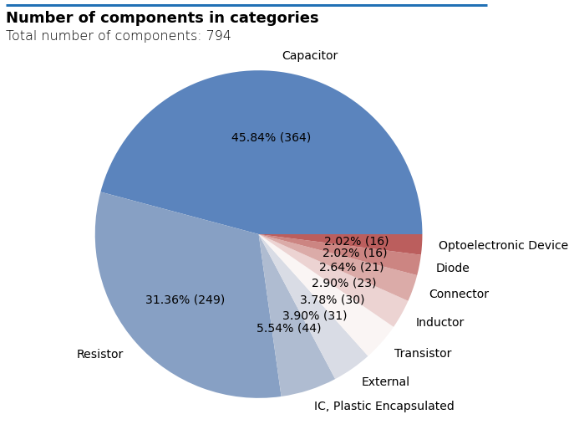
Project statistics
Total of 794 components
  Capacitors and resistors in total make up almost 80%
    Average failure rate of 1.8 FITS
  23 transistors
    Failure rate doubled if dual
  Critical component: FPGA
    Failure rate of 11 FITS assumed universally to each critical failure mode

Slide 3
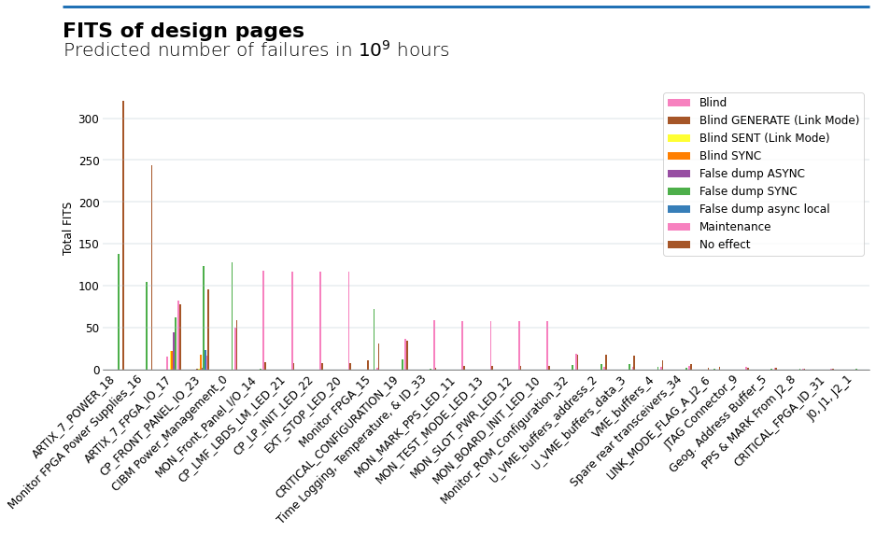
Failure rates across various design pages
Total: 2,788 FITS

Slide 4
Breakdown of end-effect options
Blind failure
  Blind
  Blind synchronous (only synchronous request sent)
  Blind asynchronous – never used
Link mode
  Blind sent external
  Blind generate external
False dumps
  Asynchronous false dump in local
  Asynchronous false dump
  False dump synchronous
  False dump
Maintenance
1 in 1,000 years
1 in a year
1 in 10 years
merged
1 in a year

Slide 6
Blind failures
Total: 15.5 FITS
“
FPGA wouldn't meet timing requirements, could potentially lead to a blind failure
Contributing components:
OSC1, Oscillator; Parameter change
7.8 FITS (α 100%) x2
Previously in this category:
IC32, Artix-7 FPGA; Short
11 FITS (α 100%)
  ONLY with additional factors (see comment) – 1st order failure: blind sync
“
if short between SFP RX/TX pins (pins next to each other) -> blind sync + short between pulse to TDU and GND -> blind async
Notes:
FIDES: 2.4 – 3.5 FITS (depends on description options – quality-wise meets the highest categories)
OSC1 7.76 FITS – IQD document (private communications)

Slide 7
Blind Sync – missing asynchronous request
Total: 39.5 FITS
Contributing components:
IC19, MOSFET Drivers; open, short
2 x 1.4 = 2.8 FITS
IC17, Optocoupler; diode/transistor stuck close/short, short from diode
2.3 FITS
IC29, Buffer; Open, short, stuck low
0.7 FITS
IC32, Artix-7 FPGA; Short
11 FITS (α 100%)
And: two resistors, a capacitor and an AND gate (all below 1 FITS).
“
if considered in local mode, probably not true because feedback to TSU is checked I suppose

Slide 8
Blind Link mode
Total: 36.1 FITS
Contributing components:
IC32 Artix-7 FPGA; Stuck low: 11 FITS (α 100%)
IC38 Spartan-7 FPGA; Stuck low: 11 FITS (α 100%)
IC56 Single Buffer Gate; Short, open, stuck low: 0.7 FITS (α 50%)
IC20 RS-485 Transceiver; Open, stuck low: 0.4 FITS (α 27%)
IC21 RS-485 Transceiver; Open: 0.24 FITS (α 17%)
R142 Resistor; Open: 0.22 FITS (α 30%)

Slide 9
False dump – asynchronous
Total: 45.4 FITS
Contributors:
IC32 Artix-7 FPGA; open, stuck high: 22 FITS (α 100%)
ZD1 TVS Diode; short: 3.4 FITS (α 80%)
IC17 Optocoupler; diode or transistor stuck open: 2.9 FITS (α 50%)
LM1 Elbow socket; open, poor contact, short: 2 FITS (α 100%)
D9 High-speed switching diodes; short: 1.8 FITS (α 80%)
Remaining: gates, diodes, buffer, resistors, capacitor and ferrite bead contribute less than 1 FITS each.
All (aside from the FPGA) are in CP Front Panel IO page.

Slide 10
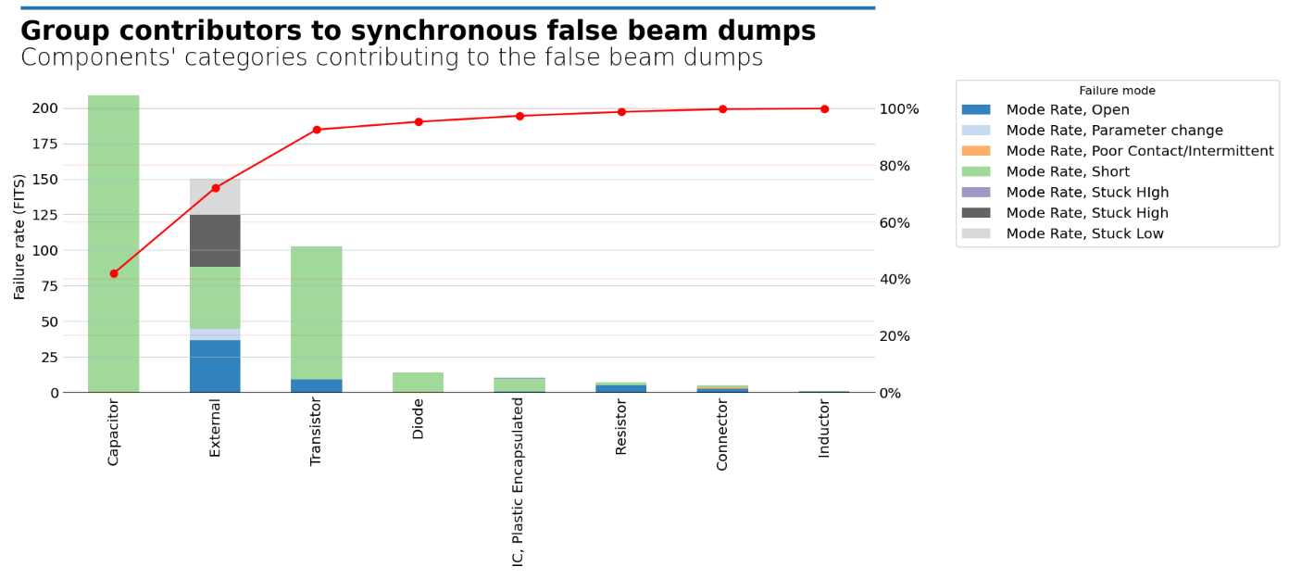
False dump – synchronous
Total: 668 FITS
Top contributors: OSC5 (Monitor FPGA), T15 Dual N-Channel Transistor (Power Management), IC28 FPGA (Monitor FPGA), OSC1 (ARTIX_7_FPGA_IO), IC42 IC43 IC44 (Power Management), ICTX1 and ICRX1Translators

Slide 11
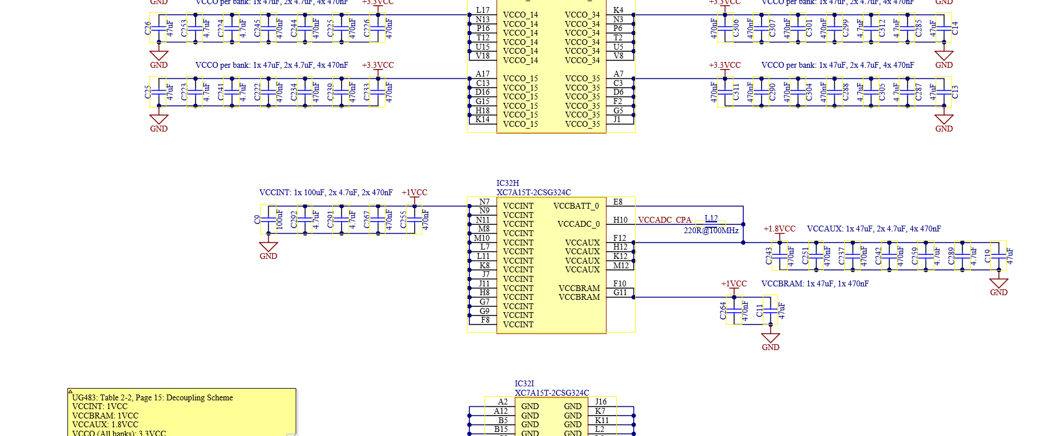
Behaviour under short of decoupling capacitors?
“In many failure modes (shorts between VCC and GND for example), we would only have a false dump sync, without the asynchronous dump request. This would happen in both A and B paths simultaneously, because they are shared on the same board. The BIS post mortem analysis checks that each synchronous dump is followed by an asynchronous dump request (arriving with a longer latency). So I think it could potentially happen once, but we wouldn’t be able to refill the machine (or even access the CIBDS) afterwards.”
Saw in uQDS project, that decoupling capacitor shorts (even partial & intermittent) can cause uncontrolled outputs on FPGA level
  Is it clear how CIBDS FPGA will behave under such circumstances (cannot really find answer in documentation - https://docs.amd.com/v/u/en-US/ug483_7Series_PCB ) ?
  For uQDS it is an IGLOO FPGA, where brown-out detection is required - https://onlinedocs.microchip.com/pr/GUID-2952C8AA-A592-489E-8058-3FD06065EDDB-en-US-2/index.html?GUID-F5331690-5A67-4B65-8B6F-4EBF72A08AD6

Slide 12
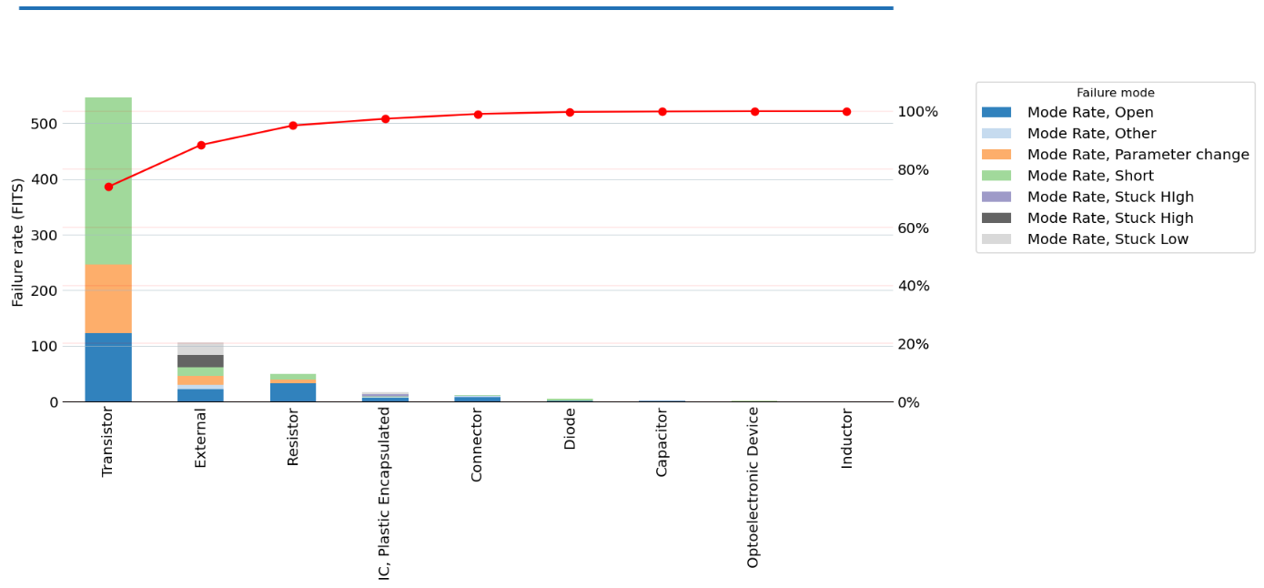
Maintenance
Total: 980 FITS

Slide 13
Conclusions
Takeaways for the global model
  Blind failures: 15.5 FITS
    Attributed to a single failure mode of an oscillator
  False beam dumps:
    Asynchronous: 45.4 FITS
    Synchronous: 668 FITS
  Link mode malfunction: 36.1 FITS

