Slide 1
CIBAB Study
Kick-off meeting
BISv2 Reliabity Study Progress Meetings

Slide 2
List of contents
Results of failure rate prediction.
Critical path – simplied diagram.
List of proposed end-effects.
Main contributors to total failure rate.
Questions.

Slide 3
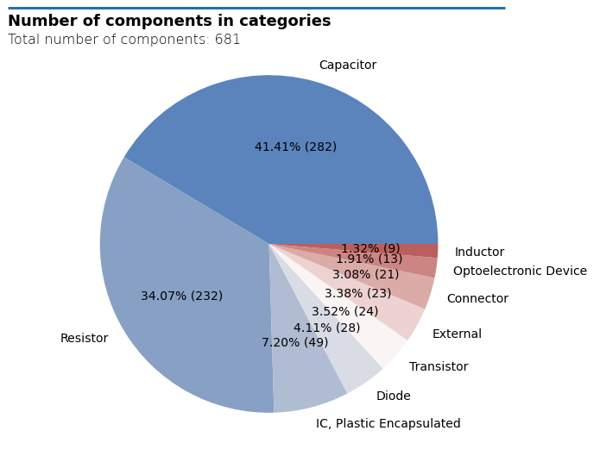
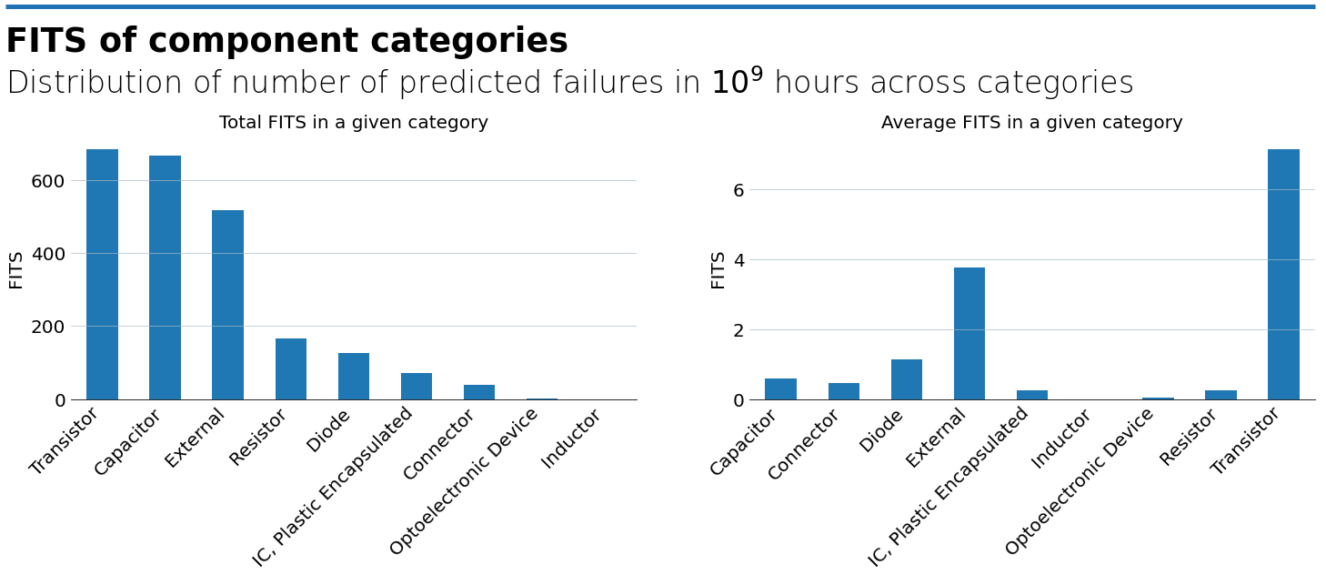
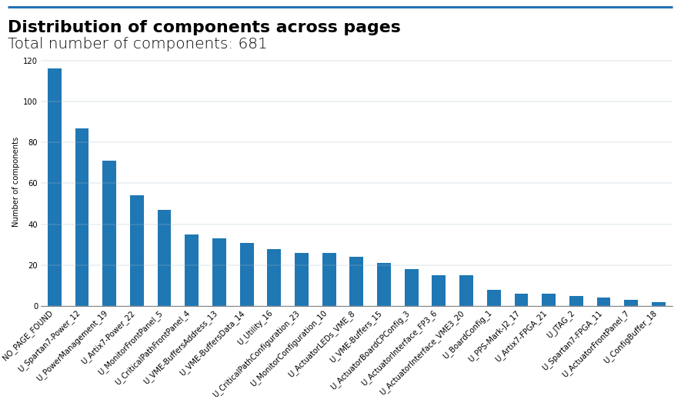
Failure rate prediction results
General statistics
681 components across 31 pages
  Isograph count is 731 due to dual transistors
Identified operating voltage for 263 mounted capacitors
  Remaining 19 were assumed the default 3.3V.
  All below 50% - with 42 capacitors close to that value.

Slide 4
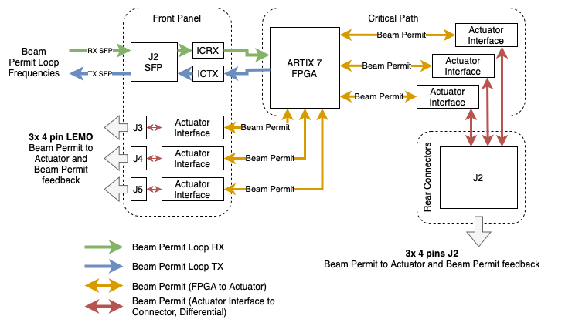
Critical Path
Simplified diagram

Slide 5
End-effects
BISv2 list
Blind failure
When occuring, the CIBAB will not be able to dump the beam when required (i.e., when detecting ruptured BIS loop).
False dump
The failure would result in an unnecessary beam dump, stopping the LHC fill and likely causing follow-up interventions.
Maintenance
Maintenance actions such as repairs or replacements will take place after finishing a running LHC fill.
No effect
Given failure mode occurring will not result in any direct or indirect consequences.

Slide 6
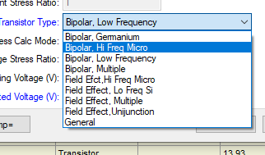
Main contributors to total failure rate
Part I
Transistor, Dual N-Channel 2.5V: 2 x 21.88 FITS (source: 217Plus)
  Assigned “Field Effect, Multiple” category
23 transistors, Dual NPN General Purpose: 2 x 13.93 FITS (source: 217Plus)
  Assigned “Bipolar, Low Frequency” category
14 SMD Multilayer Ceramic Capacitors: 12.31 FITS (source: 217Plus)
  Operating voltage 3V, rated: 6.3V
  Capacitance: 47 µF
FPGA Artix 7 and FPGA Spartan 7: 11 FITS (source: manufacturer HTOL test)
SMD Multilayer Ceramic Capacitors: 10.07 FITS (source: 217Plus)
  Operating voltage 3V, rated: 6.3V
  Capacitance: 4.7 µF
3 CFPS-73 oscillators (OSC1 - OSC3): 7.76 FITS (source: CFPS-73 mails)

Slide 7
Main contributors to total failure rate
Part II
4 TVS diodes: 5.7 FITS (source: 217Plus).
  Operating voltage set to rated voltage (3.3V).
ADCs (MAX1239EEE): 5.71 (source: manufacturer data).
2 Translators (Differential to LVTTL/LVCMOS and vice versa): 4.83 FITS (source: manufacturer data).
2 SMD Multilayer Ceramic Capacitors: 4.32 FITS (source 217Plus).
  Operating voltage 3V, rated: 10V.
24 TVS diodes: 4.3 FITS (source: 217Plus).
  Operating voltage 3.3V (default), rated: 30V
2 IttyBitty Oscillators: 3.5 FITS (source: manufacturer data).

Slide 8
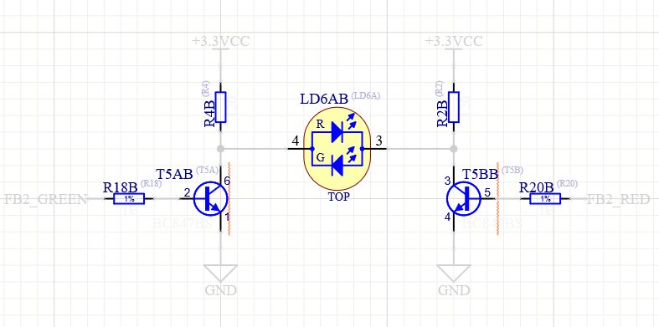
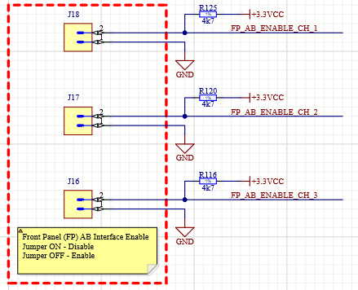
Questions
Why are there 3 instead of 2 sets of signals on the output?
  I.e., BEAM_PERMIT_1, BEAM_PERMIT_2, BEAM_PERMIT_3
  (OUT_P, OUT_N, FB_P, FB_N).
Is there a designator naming convention?
  See the example below.
  Letters at the end also used to refer to the same
  component in multiple places (i.e., FPGA).
Can a misconfiguration of enabling/disabling
Front Panel or Rear Connectors modes impact
operation?
Temperatures assumed for failure rate prediction:
  25°C non-operating,
  35°C operating,
  10°C case temp rise (where applicable).
Actuator LEDs (VME)
Actuator Board CP Config

