Slide 1
BISv2 Global Model
BISv2 Reliability Study Progress Meetings #7

Slide 2
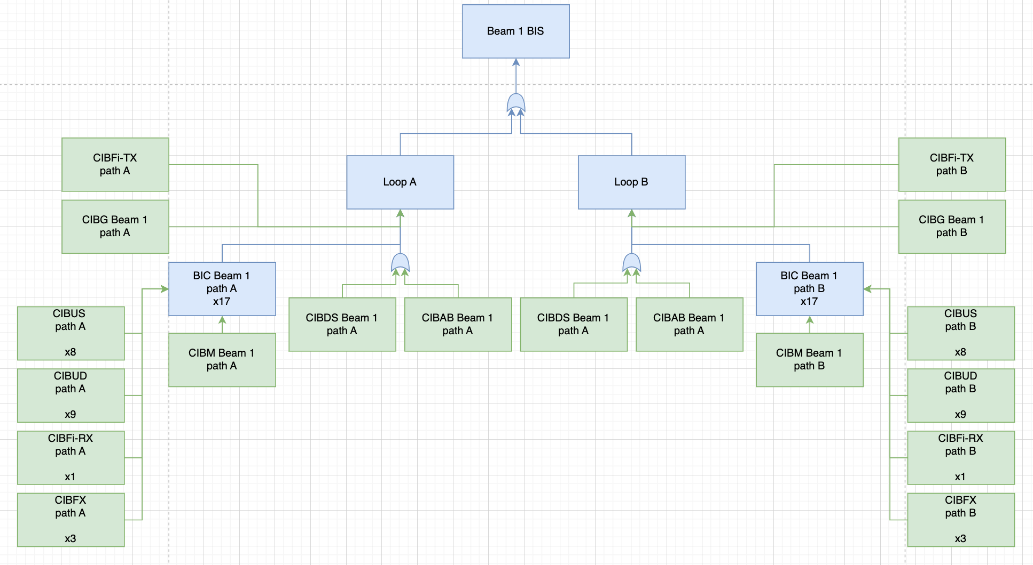
Worst-case configuration: all BICs contain 17 CIBUD/S, 3 CIBFx, 1x CIBFi-RX
Where no gate in the fault tree is defined, an AND gate is assumed

Slide 3
0 FITS
0 FITS
0 FITS
0 FITS
0.5 FITS
0.5 FITS
7.8 FITS
30 FITS
7.8 FITS
30 FITS
0.5 FITS
17 FITS
17 FITS
0.5 FITS
6.1 FITS
6.1 FITS
17.3 FITS
17.3 FITS

Slide 4

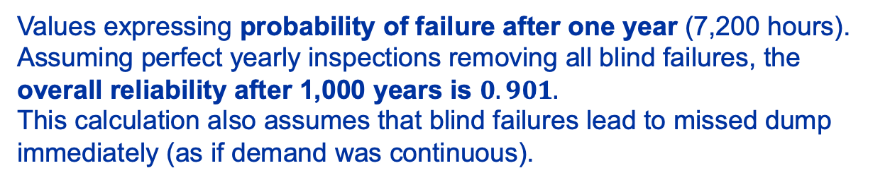





$$1×{10}^{−4}$$
$$6×{10}^{−4}$$
$$1×{10}^{−2}$$
0 FITS
0 FITS
0 FITS
$$1.2×{10}^{−8}$$
$$1.2×{10}^{−8}$$
0 FITS
0.5 FITS
0.5 FITS
7.8 FITS
30 FITS
7.8 FITS
30 FITS
0.5 FITS
17 FITS
17 FITS
0.5 FITS
6.1 FITS
Values expressing probability of failure after one year (7,200 hours).
Assuming perfect yearly inspections removing all blind failures, the overall reliability after 1,000 years is $0.901.$
This calculation also assumes that blind failures lead to missed dump immediately (as if demand was continuous).
6.1 FITS
17.3 FITS
17.3 FITS

Slide 5
Boards
CIBM: 1 per path, in total 2 beams x 17 BICs x 2 loops (68 boards).
CIBUS & CIBUD: mulitple in each BIC, up to 17. Failure rate calcluated from “CIBU Channel”. (total – 160 boards)
CIBF & CIBFX: max 3 in a BICs (total 8 boards).
CIBAB: 1 per path, in total 2 beams x 2 loops (total 4 boards).
CIBDS: one shared across two loops, however: two independent paths inside (total – 2 boards).
  7.8 FITS per path from an oscillator in ARTIX 7 IO page “FPGA wouldn't meet timing requirements, could potentially lead to a blind failure”
CIBG: one per beam; regardless: 0 FITS in blind failures (2 boards).
CIBFi-Rx: 3 x A&B (total – 4 boards)

