Slide 1
AvailSim4 v2.1
January 2024 Release

Slide 2
List of contents
Summary of changes
New features I
New fetures II
Refactors
Fixed Bugs
CVMFS

Slide 3
Changes
Summary
28 issues closed:
15 adding new features,
9 fixing bugs,
3 concerned with refactoring & tests,
1 updating documentation.
Code released to CVMFS for HTCondor users.

Slide 4
Changes
New features I
HTCondor Support
  Results being exported periodically, to avoid complete loss of results when reaching MAX_RUNTIME.
Three-parameters Weibull
  New probability distribution requested by Jack.
  Support for lists of lists to be part of the sensitivity analysis.
Seeds
  Enabled Numpy’s random entropy to be used as the seed (“None”).
  Updated pseudo-random number generator use.
  Warning when the seeds are overlapping between concurent jobs.

Slide 5
Changes
New features II
Default values in input files
  Some columns are now optional (see user guide).
  Modified behaviour of “None” keyword for Phases (applicable to all phases).
Importance Splitting
  Metric tracking the criticallity of system configuration
Other
  “Status” field in the LAST_TIMELINE.
  Streamlining of error messages (phase jumps, incorrect input, etc.).
  User experience: guides, notebooks, examples (to be continued).
  Sanity checks (Thomas)

Slide 6
Refactoring larger structures
Exporters
Previously
Currently
Aggregate_exporter,
Results_exporter,
XLSX_Analysis_Exporter,
XLSX_Component_Listing,
XLSX_Component_Tree_Extended,
XLSX_Component_Tree_Simple,
XLSX_Connectivity_Matrix,
XLSX_Critical_Failure_Paths,
XLSX_Execution_Metrics,
XLSX_Last_Timeline,
XLSX_Rca, XLSX_Summary
xlsx/
  analysis/
  XLSXAnalysisExporter, XLSXComponentListing, XLSXComponentTreeExtended, XLSXComponentTreeSimple, XLSXConnectivityMatrix, XLSXCriticalFailurePaths
  result/
  XLSXExecutionMetrics, XLSXLastTimeline, XLSXRca, XLSXSummary
  XLSXExporter (abstract class)
ExportManager
Exporter (abstract class)
GraphExporter
InputFileExporter (abstract class)

Slide 7
Refactoring larger structures
Readers
Previously
Currently
xlsx/
  system_template/
  ArchitectureSheetReader, FailureModesSheetReader, FailureModesAssignmentReader, InspectionSheetReader, MruSheetReader, PhaseJumpTriggersSheetReader, PhaseSheetReader, …,
  SheetReader
  MonteCarloReader
  QuasiMonteCarloReader
  SensitivityAnalysisReader
  SimulationReader
  SplittingMonteCarloReader
  SystemTemplateReader
  XlsxUtils
Reader (interface)
xlsx/
  MonteCarloReader
  QuasiMonteCarloReader
  SensitivityAnalysisReader
  SimulationReader
  SystemTemplateReader
  XlsxReader

Slide 8
Refactoring larger structures
HTCondorRunner & Other
HTCondorRunner
Other
Submission and Bash scripts now stored as templates
Runner rewritten from a module-style to a testable class
And we even have tests!
PyLint in CI pipeline
Pathlib to handle paths across the entire framework
Specification moved from Overleaf to Markdown

Slide 9
Changes
Fixed bugs
Children logic
  Enabling arbitrary locations of the user-defined Python classes defining the custom logic.
  Regex expressions to match standard logic (XooY, xTF, xRC, etc.).
  Custom logic on HTCondor.
  Output file name with timestamp.
Phase jumps
  Avoiding infinite loop by disregarding such jumps to the current phase.
  Warnings for user for improper or unexpected use.
Failure modes
  Multiple failure modes per component (Thomas).
  No failure modes of a componet (Thomas).
Other.
  Removing indeterminism caused by MRUs (Thomas).

Slide 10
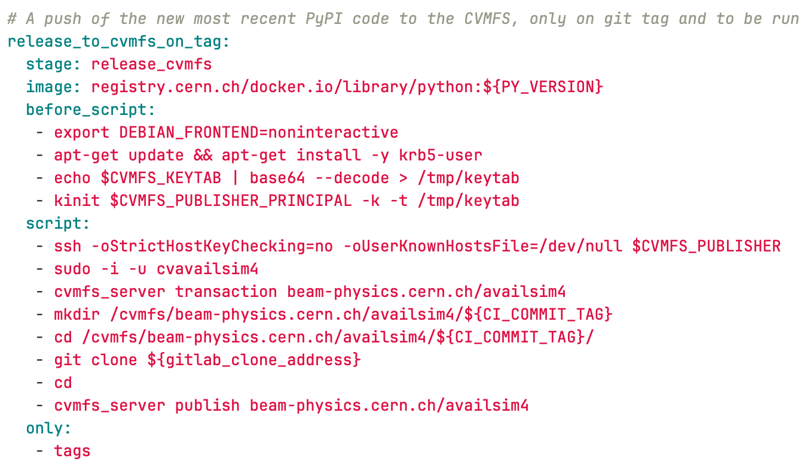
CVMFS
Automated release directly from the Gitlab CI
Service account “as4team” to keep it running independently
  Belongs to an e-group “lxcvmfs-availsim4” with write permissions to the AvailSim4 repository
Kerberos authentication using keytab file from the release manager

Slide 11
Distribution
git clone https://gitlab.cern.ch/availsim4/availsim4.git
Gitlab
pip install availsim4
PyPI
source /cvmfs/beam-physics.cern.ch/availsim4/v2.1.0/availsim4-setup.sh
from machines with access to CVMFS
CVMFS

