Slide 1
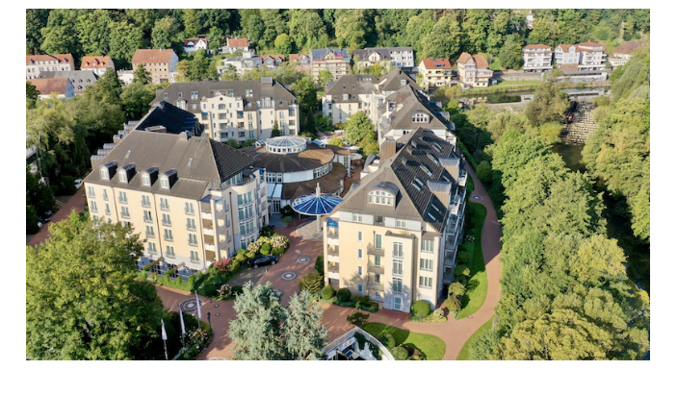
Project and
Review Meeting
Marburg, May 22nd-23rd, 2024
Vila Vita Rosenpark Hotel

