Slide 1
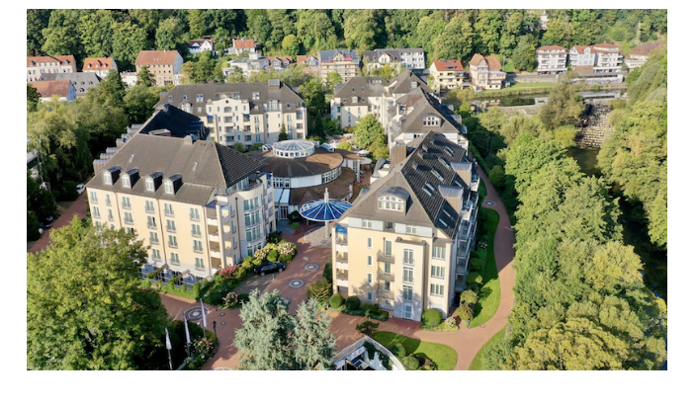
Project Overview
WP1 & WP13
Sandro Rossi
Coordinator
Project Meeting – Marburg, May 22nd-23rd, 2024
Vila Vita Rosenpark Hotel

Slide 2
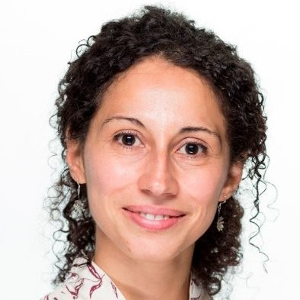
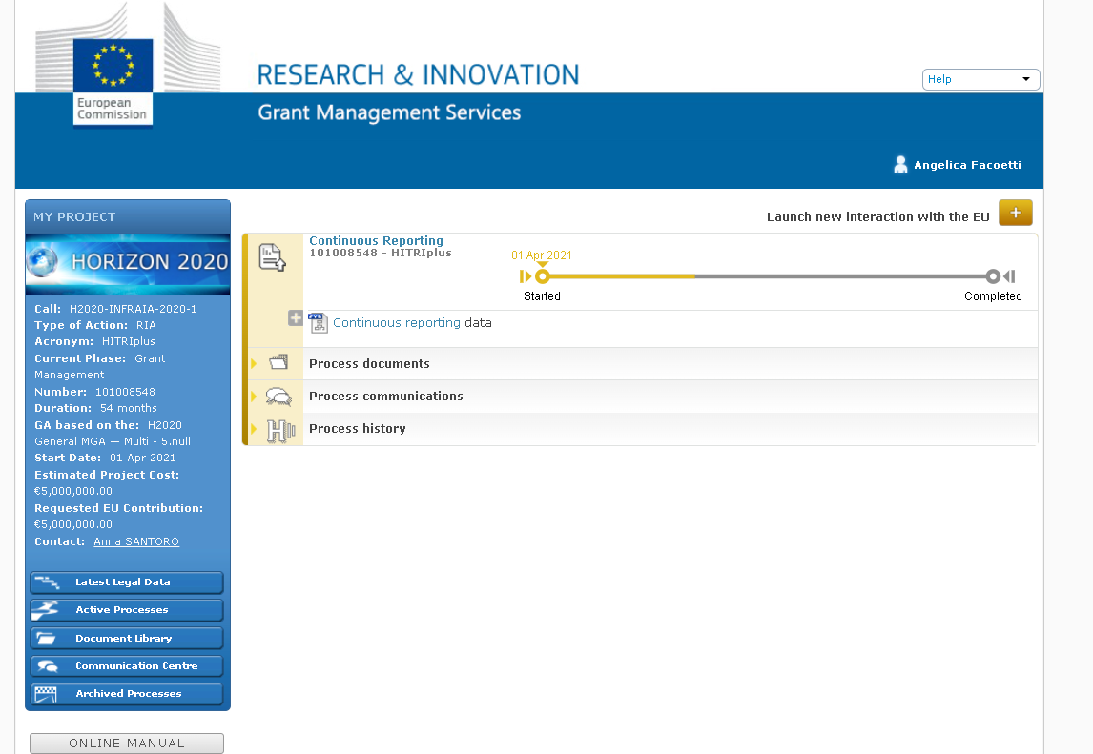
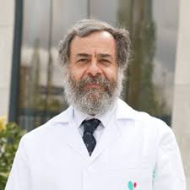
New Project Officer
Anna Santoro
Expert - Reviewer
Due to internal re-shuffling (partly linked to our Project Office retirement likely next year), a new PO has been appointed for HITRIplus, Anna Santoro.
“…she is well familiar with particle accelerators and linked technology”.
Andreas Holtel will still remain available to ensure smooth handover and/or additional assistance as needed.
Alejandro Mazal

Slide 3
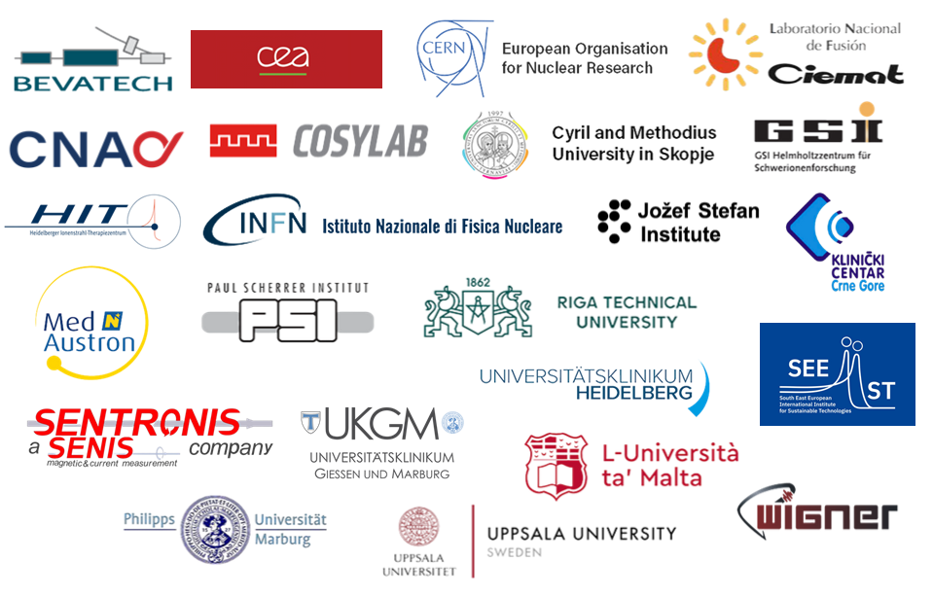



HITRIplus Consortium (started April 2021)
23 Institutes
(4 CIRT centres, 11 research institutions, 5 universities, 3 SMEs)
14 European Countries
4.5 years Project
(1st April 2021 – 30th September 2025)
Total budget: 5 MEuro
New Entries
Tera-Care
Grant Agreement number: 101008548 – HITRIplus
H2020-INFRAIA-2018-2020

Slide 4
HITRIplus Objectives
1. To integrate, open up and broaden the leading European Research Infrastructure for the treatment of cancer with beams of ions, ranging from helium to carbon and to heavier ions.
2. To coordinate and strengthen the research programmes on heavy ion therapy of different European institutions, by promoting synergies, collaborations, innovation, knowledge transfer, new initiatives and sharing of tools and data.
3. To develop in a joint and coordinated way novel technologies to improve the accelerators and their ancillary systems that provide particle beams to this scientific community. These technologies will improve the present generation of facilities and will be the foundation for a next generation European design for ion therapy facilities.
4. To establish a European multidisciplinary community for heavy ion therapy research, aiming at improving treatment strategies and modalities by connecting physics and engineering with medicine, biology and biophysics, and to extend this community towards emerging European regions, addressing in particular new initiatives in South East Europe.
5. To define the main technical features and the scientific programme of a future pan-European Research Infrastructure for medical and radiobiological research with heavy ion beams, to be built in South East Europe or in another European region.

Slide 5
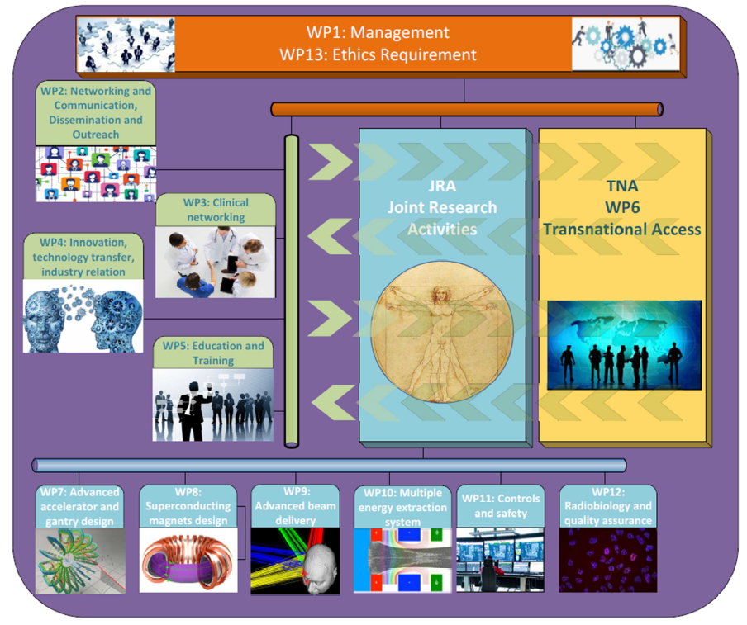

Slide 6
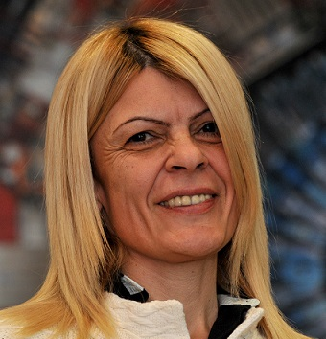
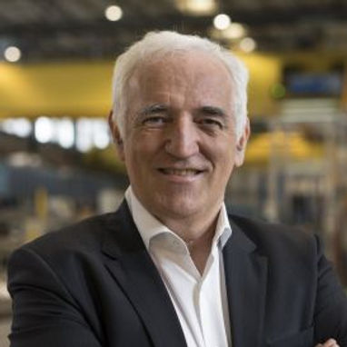
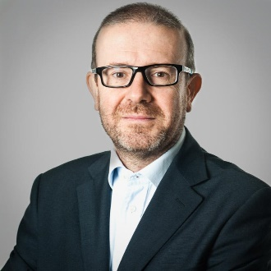
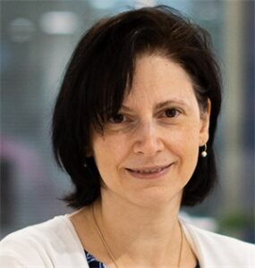
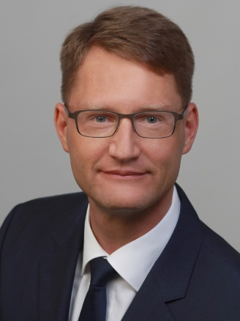
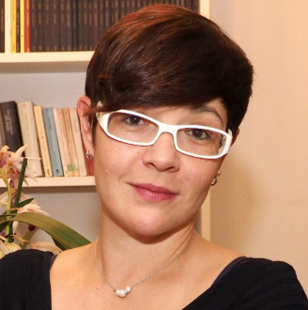
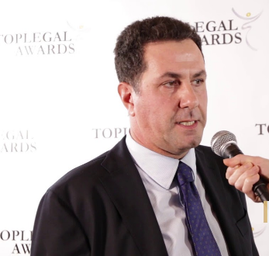
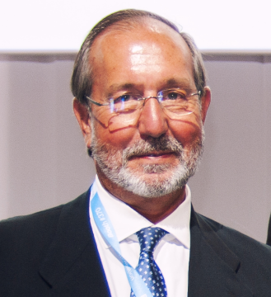
HITRIplus Governance
General Assembly
1 representative per Party
Sanja Damjanovic, SEEIIST
Sanja.Damjanovic@cern.ch
Frederick Bordry
External Scientific Advisory Board
Giovanni Anelli
Advisory Board for ethical/legal/
industrial issues
Katia Parodi
Jens Habermann
Chiara Delaini
Paolo De Carlo
Felipe Calvo

Slide 7
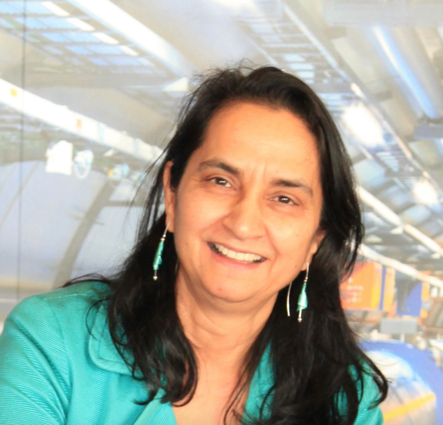
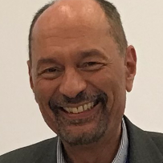
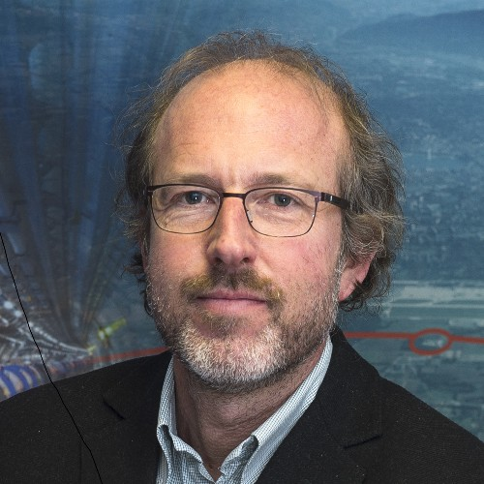
The Pillars
Networking Activities NA
Trans National Access TNA
Joint Research Activities JRA
Manjit Dosanjh
Senior Advisor for Medical Applications at CERN and visiting professor
at University of Oxford
Manjit.Dosanjh@cern.ch
Marco Durante
Director of the Biophysics Department of GSI and Professor of Physics at the Technical University of Darmstadt, Germany
M.Durante@gsi.de
.
Maurizio Vretenar
Senior physicist and project manager at CERN
In HITRIplus is
Deputy Project Coordinator
Maurizio.Vretenar@cern.ch
.

Slide 8
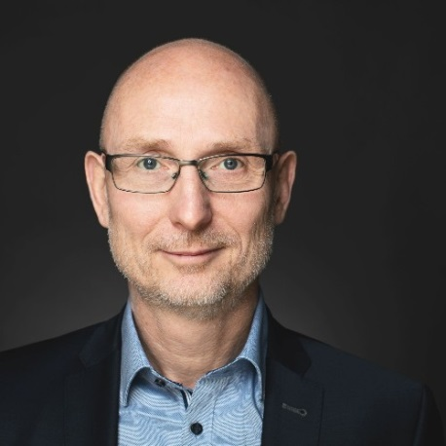
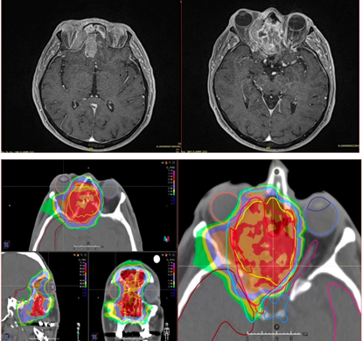
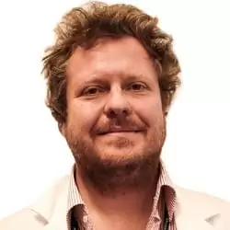
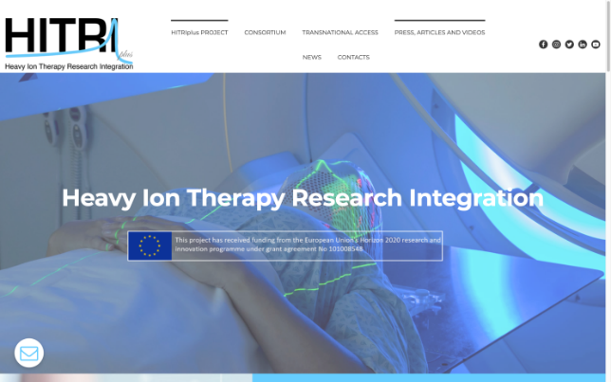
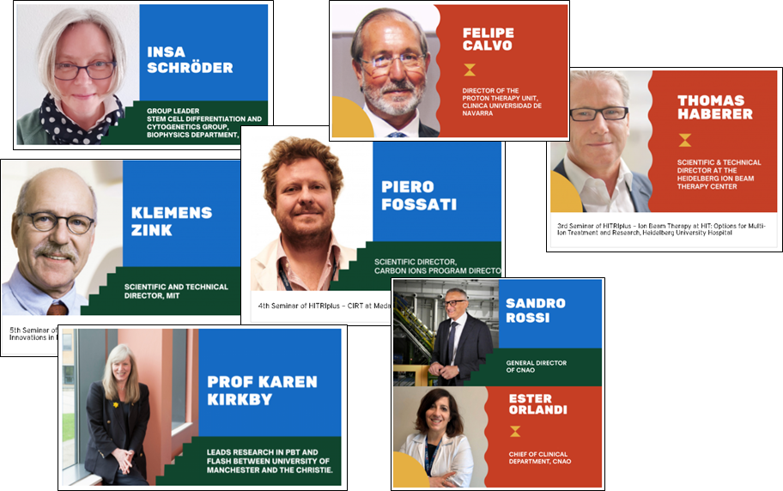
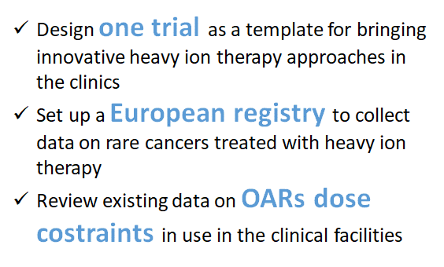
NA: Networking Activities
WP2
Networking and Communication, Dissemination and Outreach
WP3
Clinical Networking
Peter Grübling, SEEIIST
Piero Fossati, MEDA

Slide 9
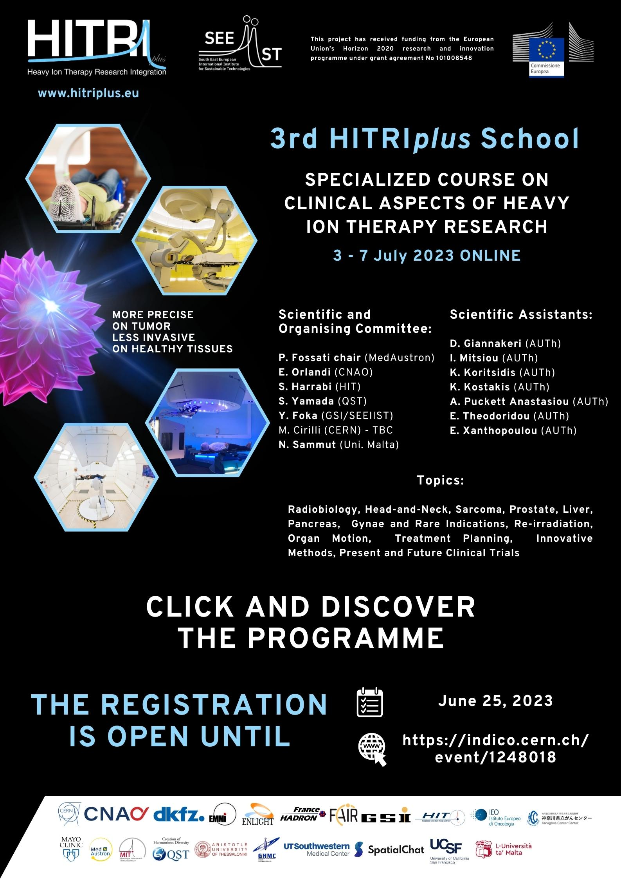
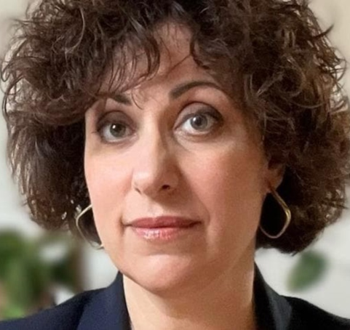
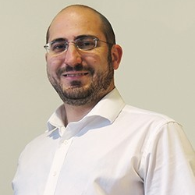
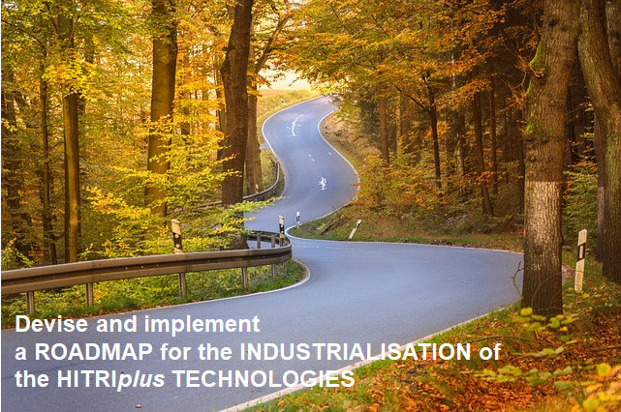
NA: Networking Activities
WP4
Innovation, technology transfer, industry relation
WP5
Education and training
Manuela Cirilli, CERN
Nicholas Sammut, UM

Slide 10
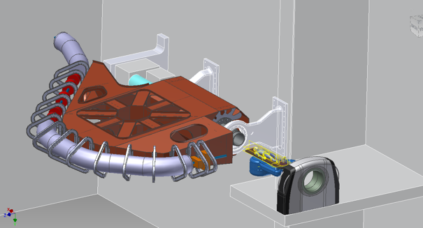

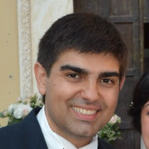
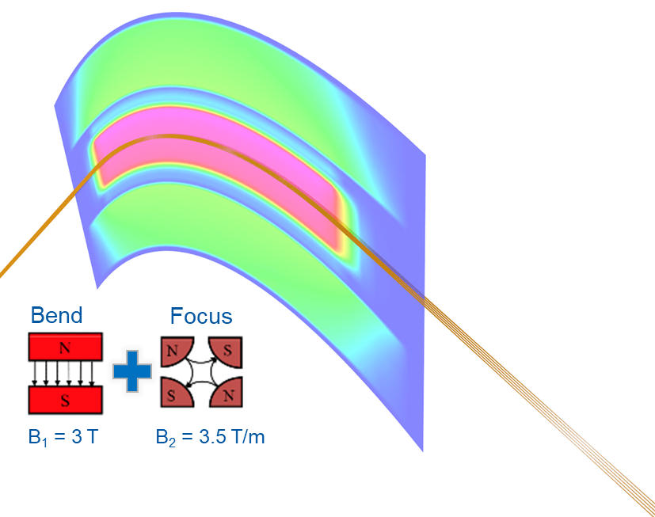
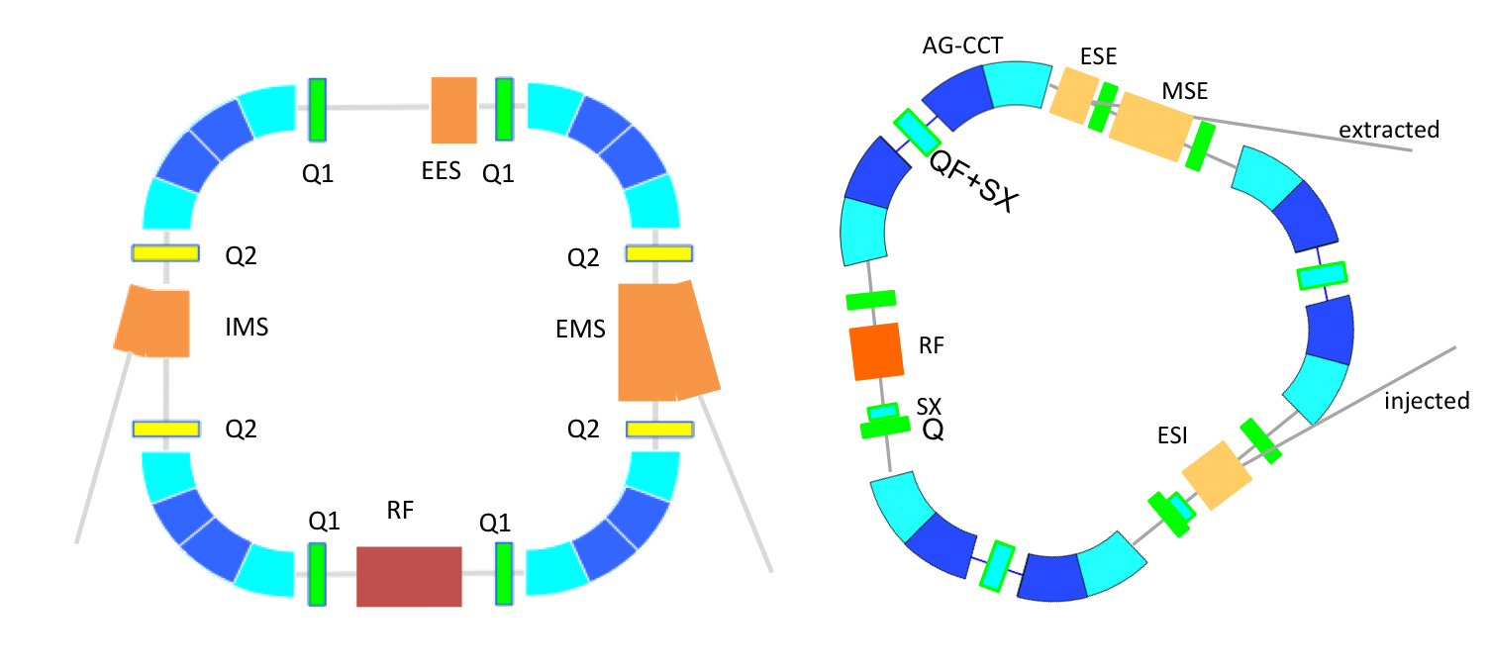
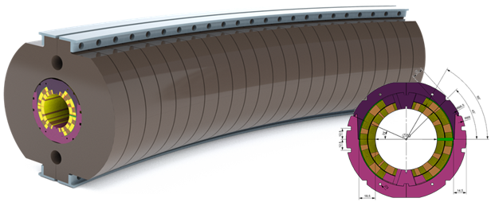
JRA: Joint Research Activities
WP7
Advanced accelerator and gantry design
WP8
Superconducting magnet design
Maurizio Vretenar, CERN
Ernesto De Matteis, INFN

Slide 11
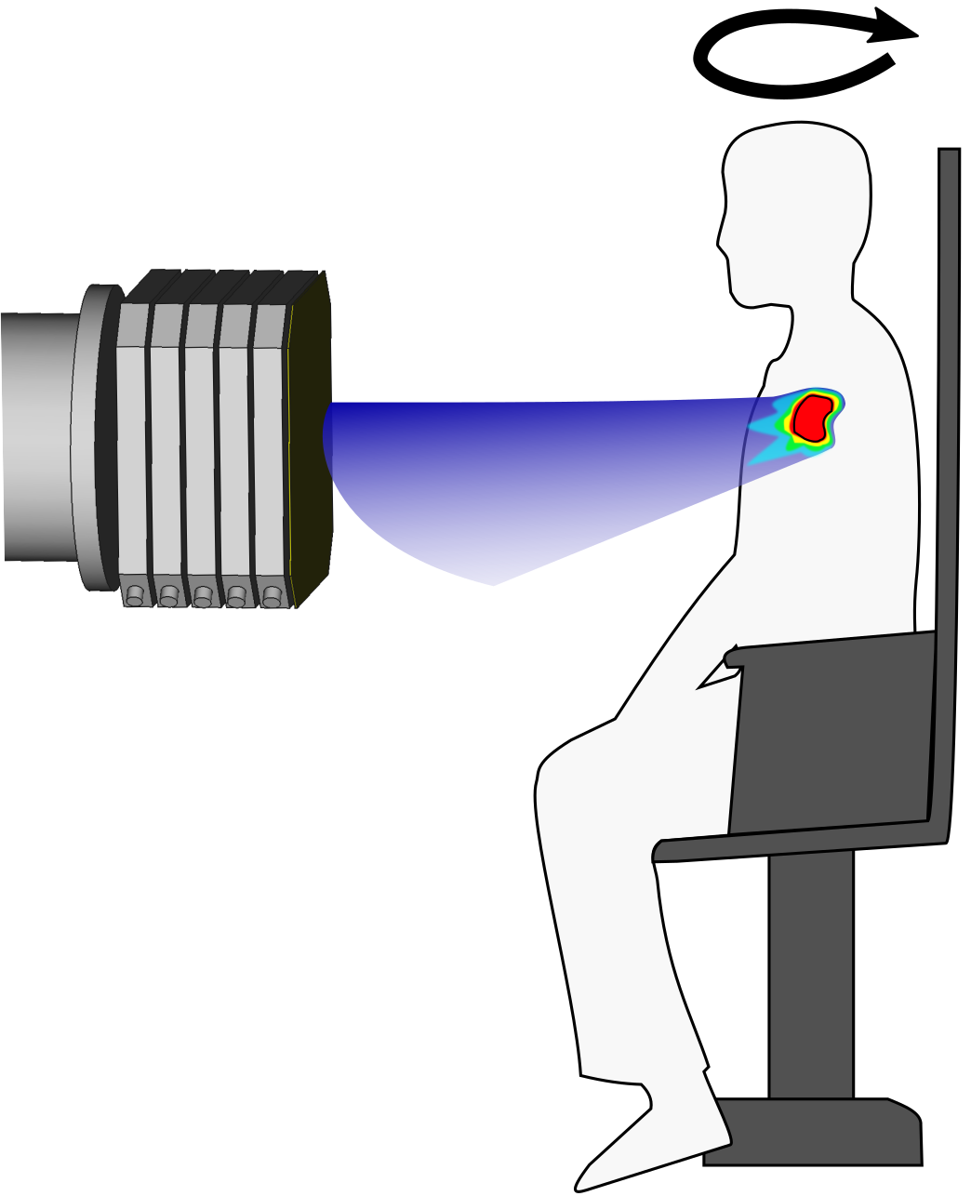
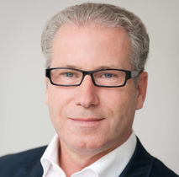
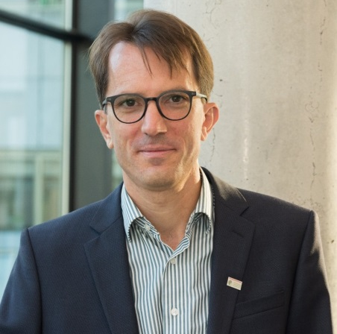
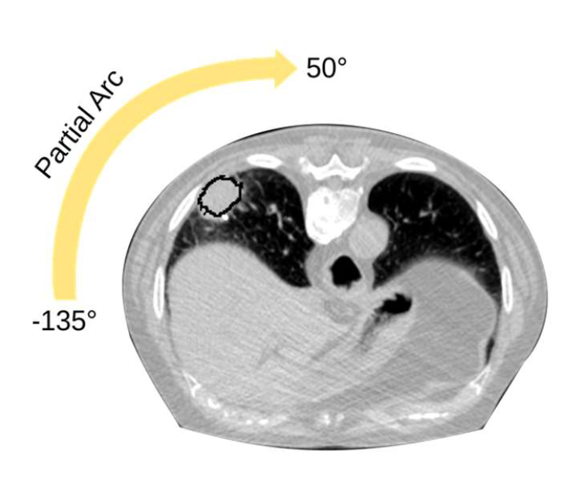
JRA: Joint Research Activities
WP10
Multiple energy
extraction system
WP9
Advanced
beam delivery
Thomas Haberer, UKHD/HIT
Christian Graeff, GSI
Arc - Therapy

Slide 12
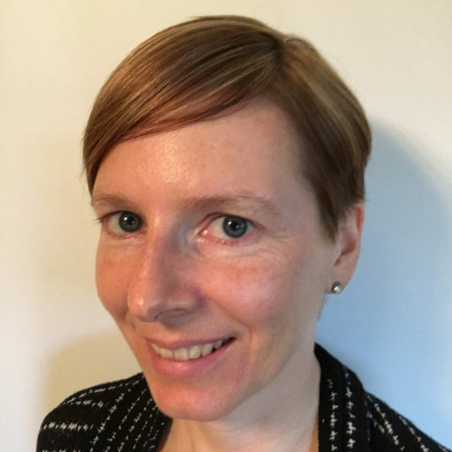
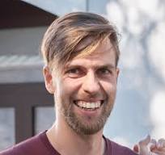
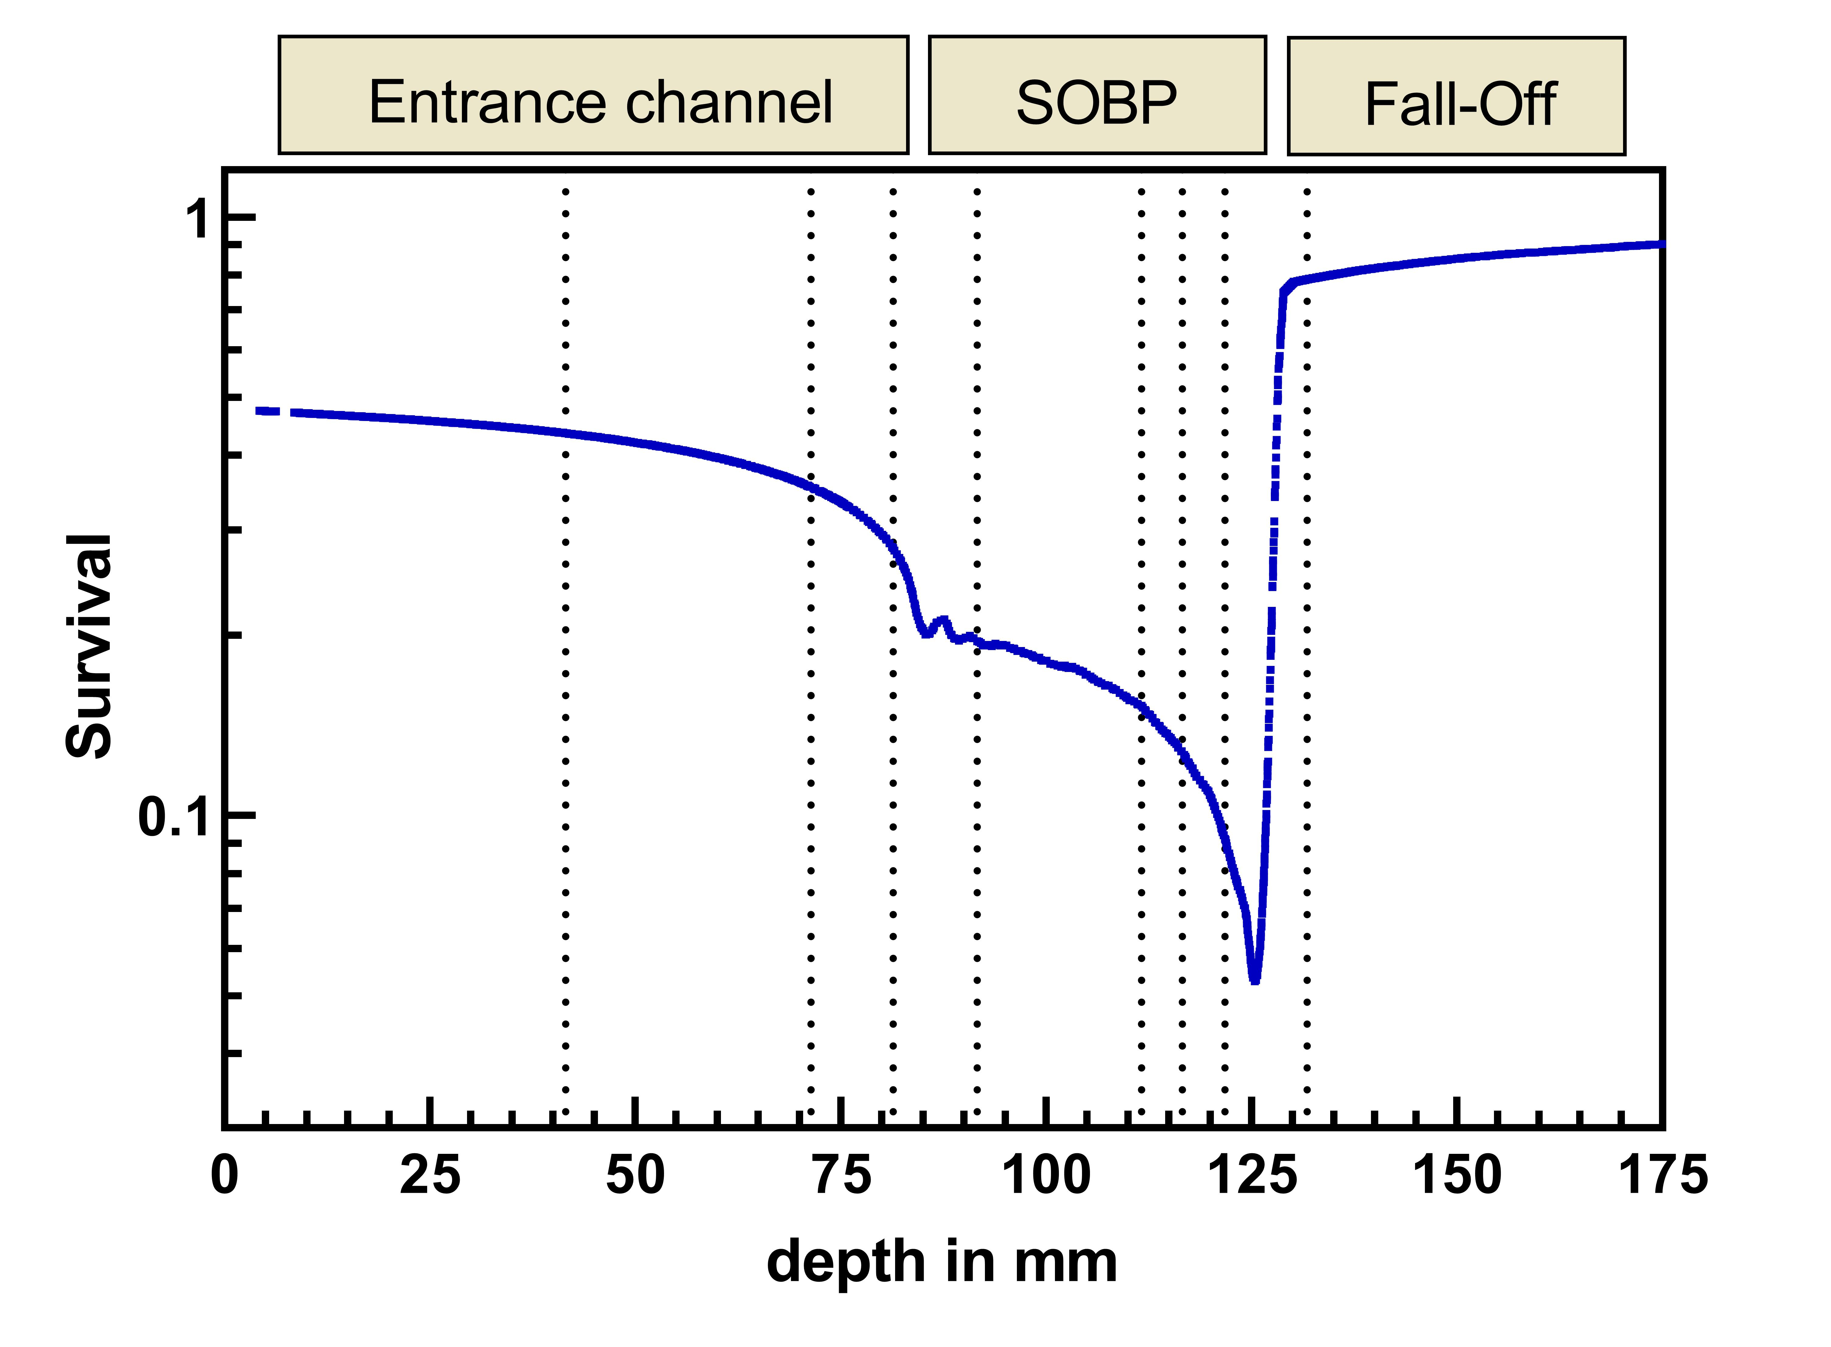
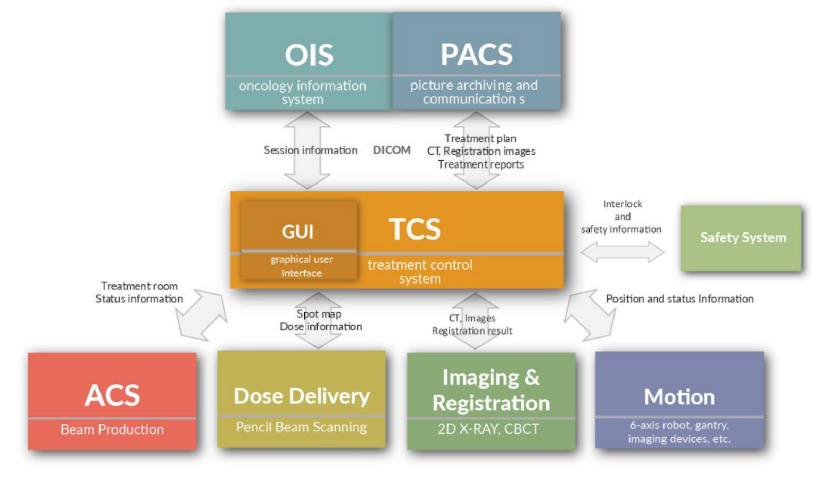
JRA: Joint Research Activities
WP12
Radiobiological Dosimetry
and QA
WP11
Controls and Safety
Ulrike Schötz, UMR
Dominik Perusko, CSL

Slide 13
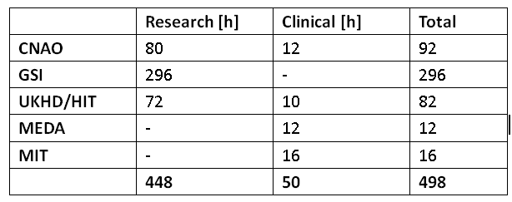
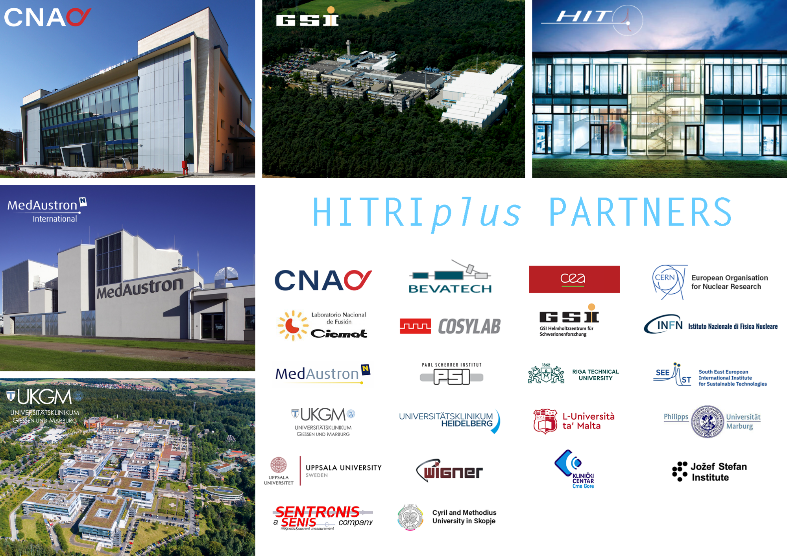
TNA: Trans National Access
Clinical Research Access to clinicians/medical physicists/technicians Free travel and accommodation for a 3 days full immersion in hadrontherapy clinics to discuss and examine real research clinical cases
Research Access to perform research activities with carbon ion beams Free beam-time, travel and accommodation reimbursement

Slide 14
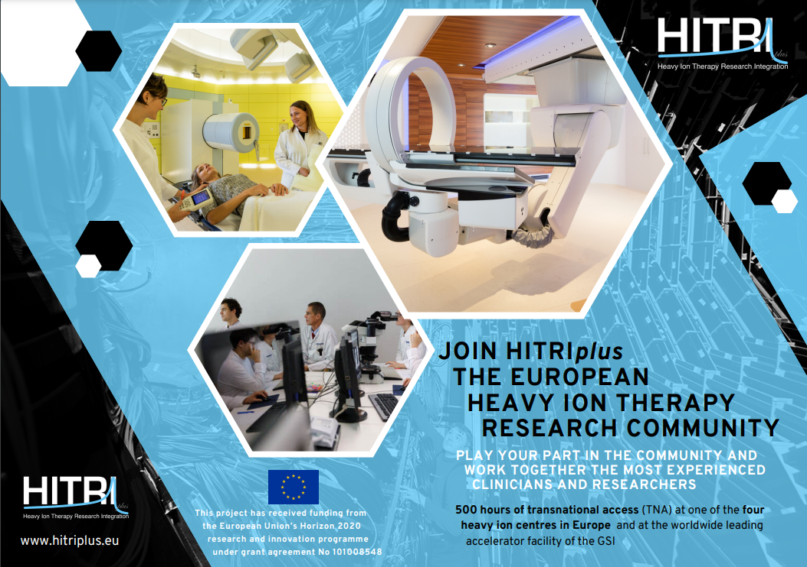
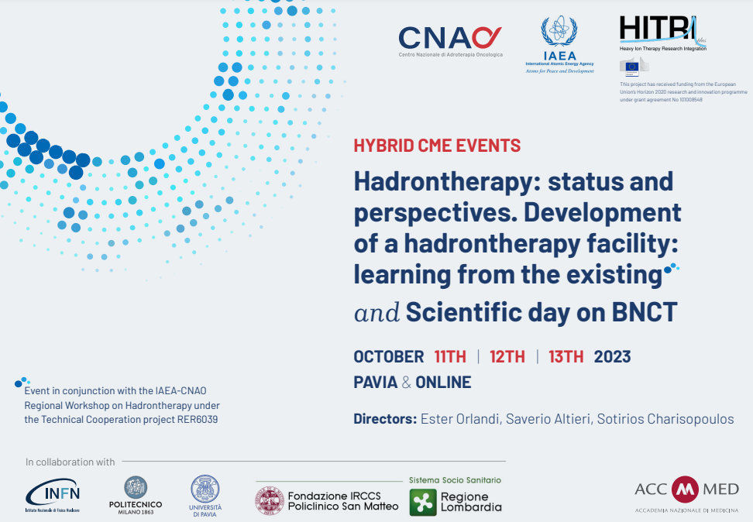
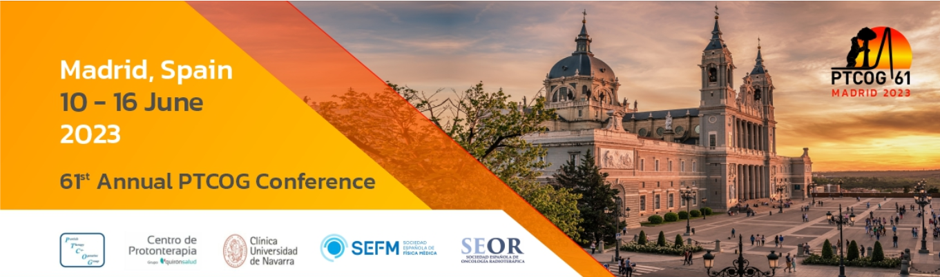
TNA: Trans National Access

Slide 15
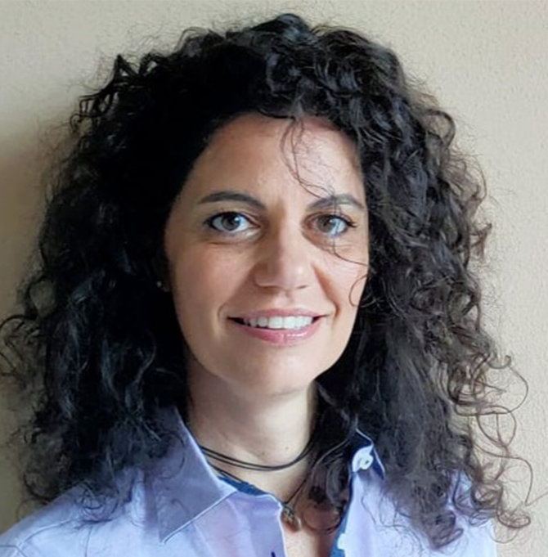
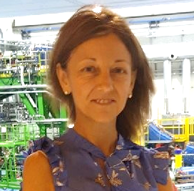
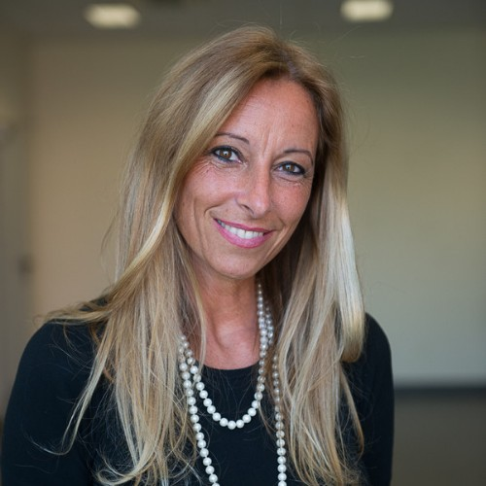
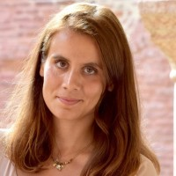
WP1: Management (‘the Angels’)
‘Actual’ Deputy
Administration & Finance
Communication
Organization
Angelica Facoetti, CNAO
Angelica.Facoetti@cnao.it
Maria Vittoria Livraga , CNAO
mariavittoria.livraga@cnao.it
Silvia Meneghello , CNAO
Silvia.Meneghello@cnao.it
Chiara Marazzi , CNAO
Chiara.Marazzi@cnao.it

Slide 16
Coordination meetings so far …
Technical Project Board meeting:
April 9, 2021
June 30, 2021
July 29, 2021
September 29, 2021
October 27, 2021
November 25, 2021
January 18, 2022
February 10, 2022
March 22, 2022
April 27, 2022
June 23, 2022
July 28, 2022
October 25, 2022
November 22, 2022
January 26, 2023
February 28, 2023
April 4, 2024
May 23, 2023
June 26, 2023
September 13, 2023
November 3, 2023
January 26, 2024
March 8, 2024
WorkPackage Leaders Meeting:
June 16, 2021
December 12, 2022
GA meetings:
(19 March 2021)
June 21, 2021
December 7, 2021
May 18, 2022
December 13, 2022
June 28, 2023
December 14, 20243
Project meetings:
April 13, 2021 (Kick off meeting)
December 7, 2021
May 17-18, 2022 (CNAO, Pavia)
June 26-28, 2023 (Riga, Latvia)
May 22-23, 2024 (Marburg, Germany)
ESAB meeting:
April 28, 2022
December 12, 2022
June 26, 2023
May 22, 2024
ABELII Meetings:
November 16, 2021
May 18, 2022
December 12, 2022
April 28, 2023

Slide 17

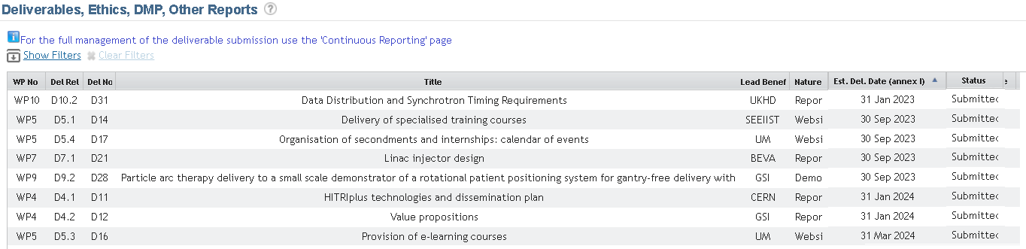
Deliverables
8/8 Deliverables completed
(18/18 Deliverables completed)

Slide 18

Milestones
1/1 Milestones completed
(11/11 Milestones completed)

Slide 19


Publications during 2nd reporting period
19 articles, 9 conference proceedings, 9 posters

Slide 20


Summary of scientific contributions
Scientific Talks
(50 speeches)
Public talks
(13 events)
Webinars
(9 events)
Lectures
(18 events)

Slide 21


Agenda Wednesday 22nd

Slide 22

Agenda Thursday 23rd

Slide 23

Agenda General Assembly

Slide 24



THANK YOU!
https://www.hitriplus.eu/
@HITRIplus - Heavy Ion Therapy Research Integration
HITRIplus
@heavy_ion
HITRIplus

Slide 25








TNA Research

Slide 26











TNA Clinical
9 accesses completed in 2 RP
19 clinical researchers
10 countries

Slide 27
“Understanding the technology and medical indications specific to Carbon ion therapy prior to sending our own patients there is of paramount importance. Witnessing first-hand the comprehensive approach your team takes in providing state-of-the-art treatment to patients has not only broadened our knowledge but has also equipped us with essential insights into the medical indications that fit treatment at your facility. Your commitment to excellence in patient care and research is truly commendable. Additionally, it was of great importance to us to have the opportunity to visit Mr. Y.L and Mrs. B.K, during their challenging treatments. Witnessing the path and care they are receiving was impressive.
Moreover, witnessing the futuristic carbon ion technology in action was nothing short of impressive. The innovative approaches and cutting-edge technology employed at MedAustron underscore the facility's commitment to pushing the boundaries of medical science and patient care. […].
Prof. Salem Billan, Dr Roy Holland, Israel
”[…] We strongly believe particle therapy is the future for the Baltic States. […] The knowledge the experts at CNAO have shared with us allows us to have a better understanding of the intricacies of cancer treatment with protons and especially with carbon ions. We were familiarised with different clinical cases, treatment planning and delivery processes, as well as challenges and future directions for hadrontherapy.
The knowledge we have received in CNAO will help us to manage our expectations and envision possibilities regarding the future particle therapy centre in Lithuania or other Baltic states. Therefore, our goal is to establish a close collaborative partnership with CNAO, with a focus on actively participating in patient treatment, clinical research, as well as education and training initiatives.”
Julija Joksaite (Lithuania, Medical Physicist).

