Slide 1
WP2: Networking and communication, dissemination and outreach
Peter Grübling (SEEIIST)
Yiota Foka (GSI, SEEIIST)
Silvia Meneghello (CNAO), Petya Georgieva (SEEIIST),
CHIARA Argenteri (CNAO)

Slide 2





WP2 - Objectives
The Networking and dissemination, communication and outreach Work Package will organize and implement efficient communication inside and outside the consortium. These activities shall enhance the internal synergies and provide added value by allowing information flow to/from other projects and the general public as well as within HITRIplus.

Slide 3
WP2 – Organisation / Personnel
WP – Coordination:
  Manjit Dosanjh until end of 2022
  Peter Grübling since beginning of 2023
  Yiota Foka supports as deputy
WP – Tasks
  Yiota Foka
  Silvia Meneghello
  Petya Georgieva
  Chiara Argenteri

Slide 4
WP2 – Tasks
Task 2.1: Coordination of Communication tools
Task 2.2: Building the user community
Task 2.3. Dissemination and outreach
  → Acitivity report see next slides

Slide 5
WP2 – Tasks: Activity Report
Seminars:
[Manjit, please add content]

Slide 6
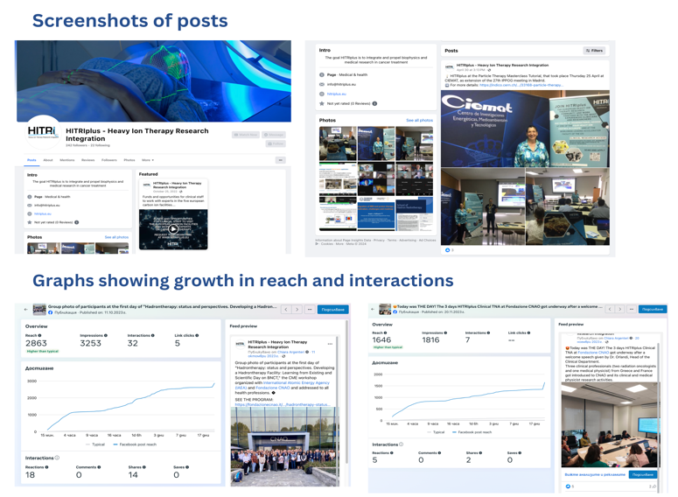
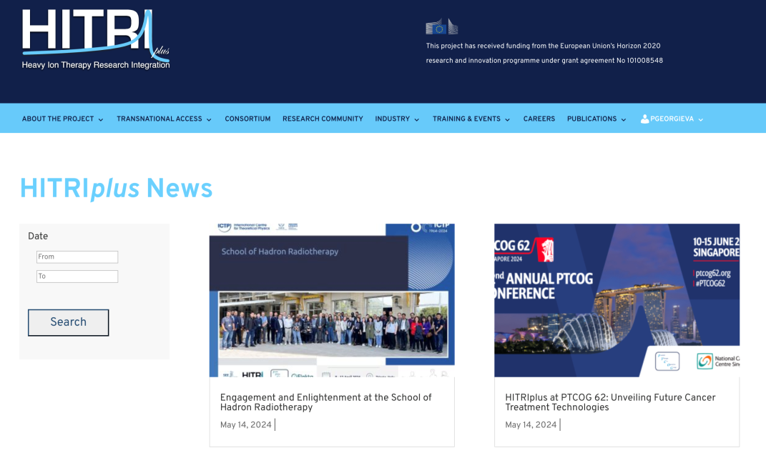
WP2 – Tasks: Activity Report
Overview of Communication Tools and Website Updates
Website Updates:
Total Updates: 29 updates on the HITRIplus website since October 1, 2022.
Focus Areas: Advancements in hadron therapy, medical engineering innovations, public science engagement.
Social Media Engagement:
Facebook (Nov 2022 - Mar 2024):
  Reach: Increased by 673.3% to over 10,000.
  Content Interactions: Rose by 724.5%.
  Activities Highlighted: Clinical TNA event, educational events.
Twitter (Oct 2023 - Jan 2024):
  Average Impressions: 21 per day, totaling 2,000.
  Engagement Fluctuations: Varied across different periods.

Slide 7
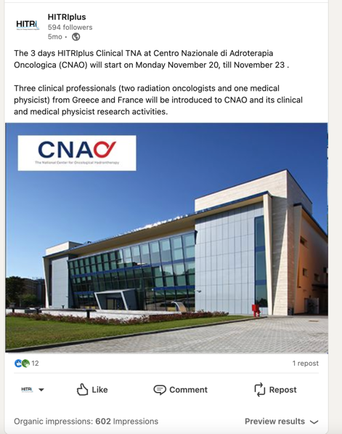
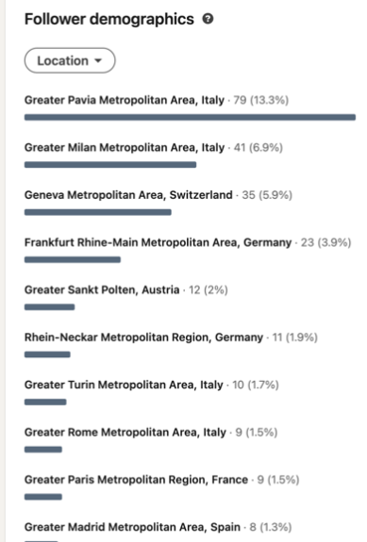
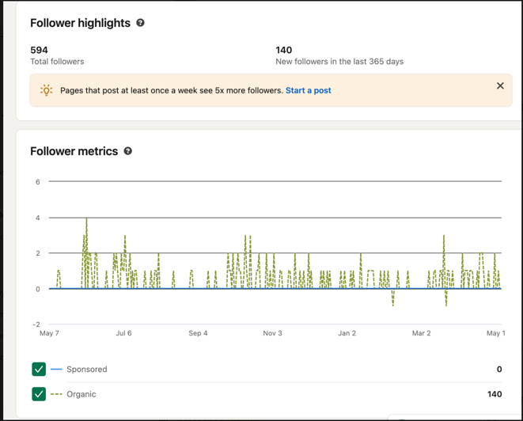
Social Media Performance and Outreach Impact
LinkedIn (Apr 2023 - Apr 2024):
  Organic Impressions: 27,533.
  New Followers: 140, totaling 594.
YouTube:
  Subscribers: 325.
  Content: Educational videos, seminar recordings.
Instagram:
  Total Followers: 117.
  Content: Visual storytelling, research activities.
Impact Summary:
  Consistent Messaging: Tailored content for each platform.
  Interactive Content: Live seminars, Q&As.
  Educational Impact: Highlighting student research, conferences.
  Professional Growth: Leveraging LinkedIn for networking.
Strategic Achievements:
  Increased engagement (e.g., 50% rise in rates, 30% in followers).
  Data-driven strategies for growth and outreach expansion.

Slide 8
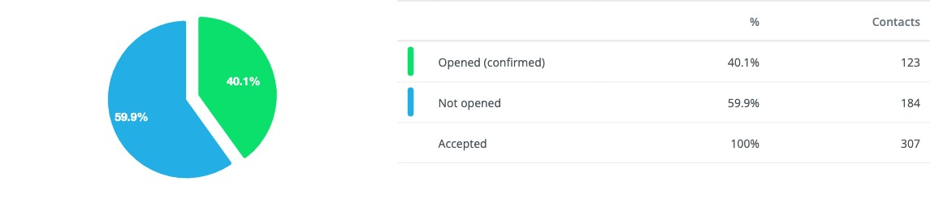

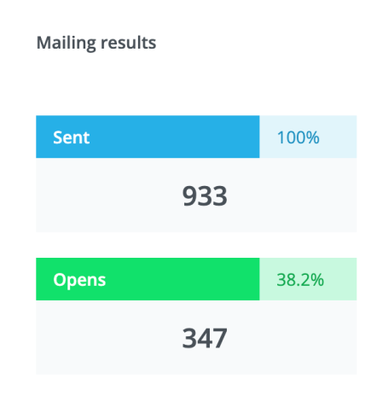
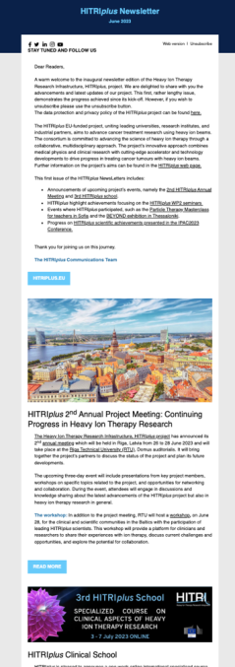
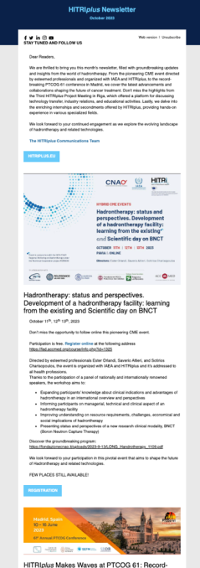
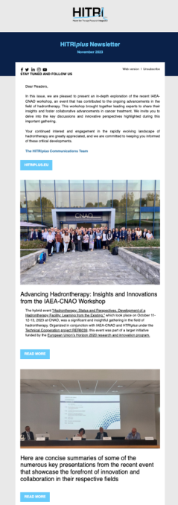
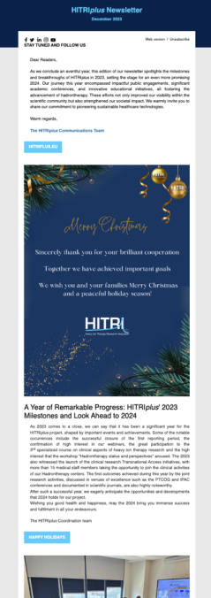

WP2 – Tasks: Activity Report
Overview of Newsletter Performance
Tool Used:
  Spotler: Facilitated seamless delivery and tracking of newsletters.
Number of Newsletters:
  Total: 4 newsletters distributed between October 2023 and March 2024.
Distribution Channels:
  Email delivery using Spotler.
Number of Addressees:
  Emails Sent: 312.
  Acceptance Rate: 98.4%.
  Subscriber Retention Rate: 99.7%.
Key Metrics:
  Open Rate: 40.1%.
  Click-to-Open Rate: 15.4%.
  Click-Through Rate: 6.2%.
  Conversion Rate: 0.8%.
Impact:
  High open rates and subscriber retention indicate engaging and relevant content.
Summary of the last 3 NL

Slide 9
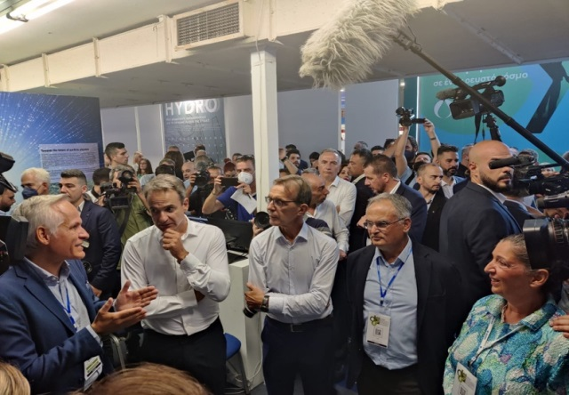
WP2 – Tasks: Activity Report
Hadrontherapy Workshops:
Event: Hadrontherapy: Status and Perspectives
  Date: October 11-13, 2023
  Location: CNAO
  Focus: Clinical, managerial, and technical aspects of hadrontherapy; Boron Neutron Capture Therapy (BNCT)
  Organizers: CNAO, IAEA, HITRIplus
  Goals:
    Advance hadrontherapy knowledge
    Enhance understanding of applications and challenges
    Global engagement with health professionals
Workshops and Public Events
Public Event Participation:
Thessaloniki Exhibitions:
  TIF (2022 & 2023): Engaging general public (~250,000 visitors)
  BEYOND (2022 & 2023): Highlighting technological advancements
  FORWARD GREEN (2023): Emphasizing sustainable initiatives
  Goals:
    Demonstrate societal benefits of fundamental research
    Publicize HITRIplus TNA program
    Inspire students towards related studies and careers
  Statistics:
    1500 brochures distributed
    Student outcomes: PhDs, Masters, summer studentships
The Greek Prime Minister visiting the HITRIplus stand at TIF exhibition.

Slide 10
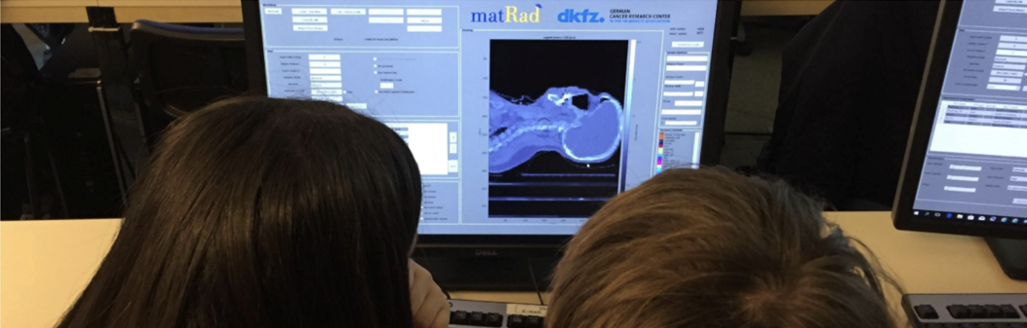
Conferences and Educational Outreach
Conference Participation:
Medicon Sarajevo (Sept 2023):
  Focus: Accelerator technology and educational outreach
  Highlights: Plenary session, student-focused sessions
  Outcomes: Engaged with experts, researchers, and students
XVIII Mexican Symposium on Medical Physics (Mar 2024):
  Presentation: "Hadron therapy: status and perspectives"
  Outcomes: Strong impression on participants, discussions on future collaborations
Educational Outreach:
Particle Therapy MasterClasses (PTMC):
  PTMC for Tutors (Sofia, May 2023):
    Focus: Practical education using matRad Treatment Planning
    Participants: 50+ Bulgarian educators and international representatives
  International PTMC 2023:
    Mode: In-person, hybrid, and online
    Reach: 1500+ students, 50+ trained tutors
    Goals:
      Promote awareness of particle therapy
      Foster international collaboration

Slide 11

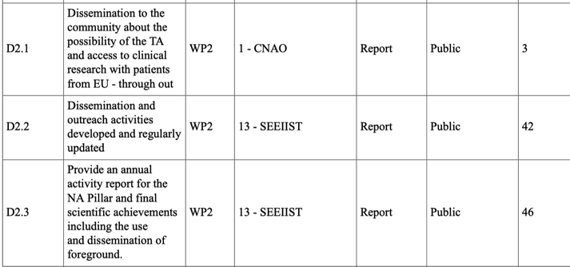




WP2 Deliverables and Milestones
done
done and in progress
done and in progress
done

