Slide 1
WP9: Advanced beam delivery
C. Graeff
GSI Helmholtz Center for Heavy Ion Research

Slide 2
Overview
Task 9.1: A modular patient chair and imaging design
Task 9.2: Particle arc therapy for fixed beam lines
Task 9.3: Clinical scenarios for particle arc therapy on sitting patients
Task 9.4: Particle arc therapy at high dose rates
Milestones/deliverables:
Deliverable 9.1 (M9): Conceptual design report for a modular patient chair and vertical imaging
Deliverable 9.2 (M30): Particle arc therapy delivery to a small scale demonstrator of a rotational patient positioning system for gantry-free delivery with a position feedback integrated to the DDS
Deliverable 9.3 (M48): Patient identification and Experimental validation of arc therapy treatment plans through patient QA-like procedures
Milestone 9 (M18): Finished simulation environment for particle arc therapy

Slide 3
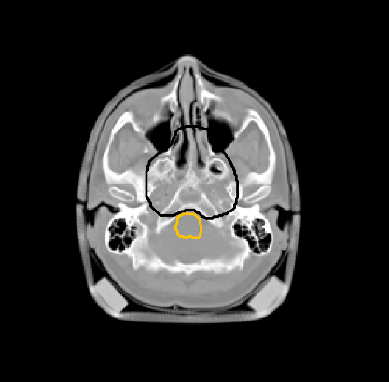
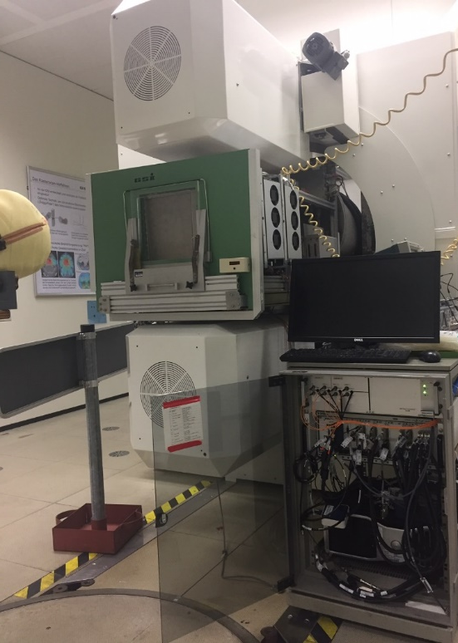

Task 9.2: Particle arc therapy for fixed beam line
Carbon arc TPS:
Small scale demonstrator:
Field setup
Beam nozzle
Pre-selection of energy band and spot positions
A-priori energy selection
Raster point setup
Iterative energy optimization
Dose delivery system
Rotating stage
Rob. bio. optimization and plan refinement
Notes:
In photon therapy, arc delivery of a continuously moving gantry enables the highest degree of flexibility and doseconformity. First studies on proton arc therapy show its feasibility at comparable or shorter delivery times andcomparable or better plan quality. In this task, a simulation environment for particle arc therapy will be developed toderive efficient treatment planning strategies. The resulting plans will consist of a large number of discrete beam angleswith a single energy each and will rely on the fast dose delivery capability as well as the feedback control of the chairrotation during delivery. A demonstrator rotational stage will be developed and interfaced to the DDS at GSI, to permit adynamic rotation for arc therapy (CNAO). Outside of the scope of this project, this stage will be usable also for precisionirradiation of orthotopic tumours in small animals (note: there will be no animal studies performed within the projectitself). The DDS itself will be modified to be able to deliver plans to a continuously rotating chair

Slide 4
Task 9.2: First experiments at GSI
Arc simulator running at GSI
Rotation controlled by (our research version of) the CNAO dose delivery system
  Step & shoot with multiple angles per spill –
  synchroniziation of delivery and rotation by gating
  180 control points with single energies to small targets
Laila El Ouali

Slide 5
Task 9.2: First experiments at GSI - results
Several issues identified, a.o. gating system at GSI is not sufficient, upcoming beam time in 2025 will use one spill per angle –
delivery still within 5-10 min
Outcome: synchronization was successful; ready for next experiments
angle
dose
Laila El Ouali
acceleration
5
10
Time [s]
25
30
35
volume

Slide 6
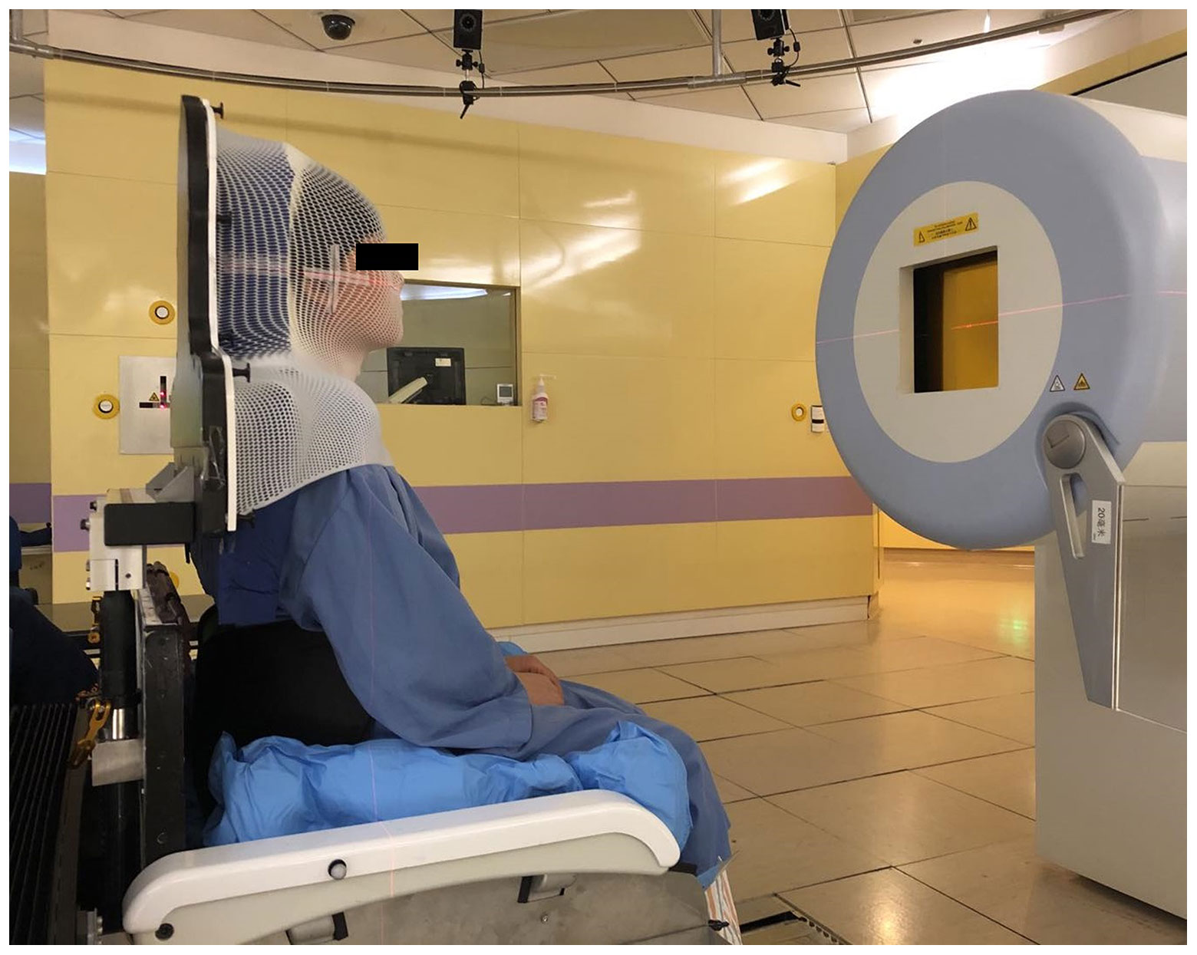
Task 9.3:
Clinical scenarios for particle arc therapy on sitting patients
Datasets of upright patient treatment
  arc simulations on energy selection in 6 patients from SPHIC (presented last year, now published)
  Volz et al, Health and Technology 2024, https://doi.org/10.1007/s12553-024-00877-0)
  6 lung patients scanned upright and supine:
    developed method for co-registration (ready for submission)
    investigated dosimetric differences, will be extended to 14 pax
  dataset on multiple metastases in the brain: comparison of
  photon hyper arcs, proton and carbon ion arc therapy
Notes:
Based on the data gathered in 9.1 and the performance achieved in 9.2, a comprehensive set of simulations will beperformed to assess the potential clinical benefit and usability of particle arc therapy to sitting patients. This includestarget locations, such as brain, head-and-neck, thoracic or abdominal, as well as different treatment modalities. In a technically more challenging strategy, the Bragg Peak can be used in arc therapy as well, demanding for angle-dependentenergy changes. While strategies exist to reduce energy layers, fast energy changes will still pose a challenge to thetechnique. Moreover, range uncertainty for a sitting patient might be considerably higher, depending on the treatmentsite. An alternative could be to use the plateau of the beam in a shoot-through therapy, which would eliminate the need forenergy changes as well as most of the range dependence, but would also reduce the inherent benefit of particle therapy.This drawback could be overcome by combining arc therapy with strategies to reduce side effects, such as Flash therapy.

Slide 7
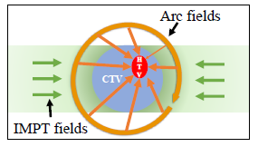
Ion-based LET boost by particle arc irradiation (LEOPARD)
Idea: boost hypoxic core with dose and LET
Boost delivered by arc vs. by conventional SIB
and because we can: multi-ion combinations
to further concentrate LET where it matters
tested in H&N patient cases,
with hypoxic target volume (HTV) defined as GTV minus 1…5 mm
courtesy of
Guangru Li

Slide 8
LEOPARD simulations in TRiP98
C+C
He+C
He+O
courtesy of
Guangru Li

Slide 9


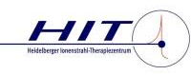

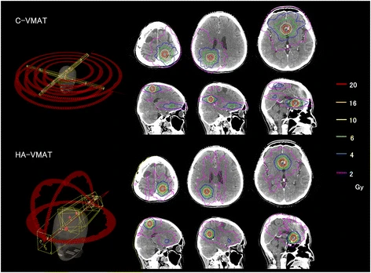
Spot-scanning hadron arc (SHArc) for stereotactic radiosurgery of multiple brain metastases
L. Volz¹, P. Liu², T. Tessonnier³, M. Durante¹, A. Mairani³, X. Ding², T. Li⁴ and S. Mein^{3,4}
oral presentation at ESTRO 2024
use case: recurring metastases in the brain
Stereotactic radiosurgery (SRS),
esp. Hyper-Arc VMAT (HA-VMAT)¹
Single dose SRS effective²
Recurrences are common, re-irradiation leads to
challenging brain exposure
protons (non-coplanar SPArc, RayStation) or
carbon (SHArc, FROG, TRiP98) for lower dose volume
  robust optimization to 1mm / 2.5%
Ohira et al. (2018) Radiat. Oncol.
¹Palmer et al (2020) Neurooncol. Adv.; ²Zelefsky (2021) IJROBP.;
³Milano et al. (2021) IJROBP; ⁴Atkins et al. (2018) IJROBP

Slide 10
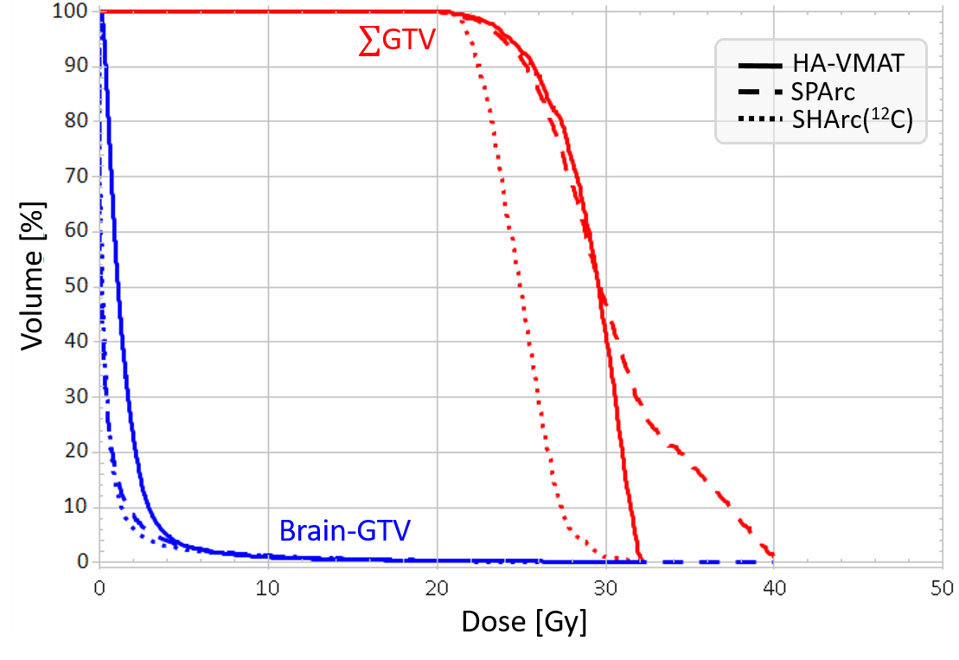
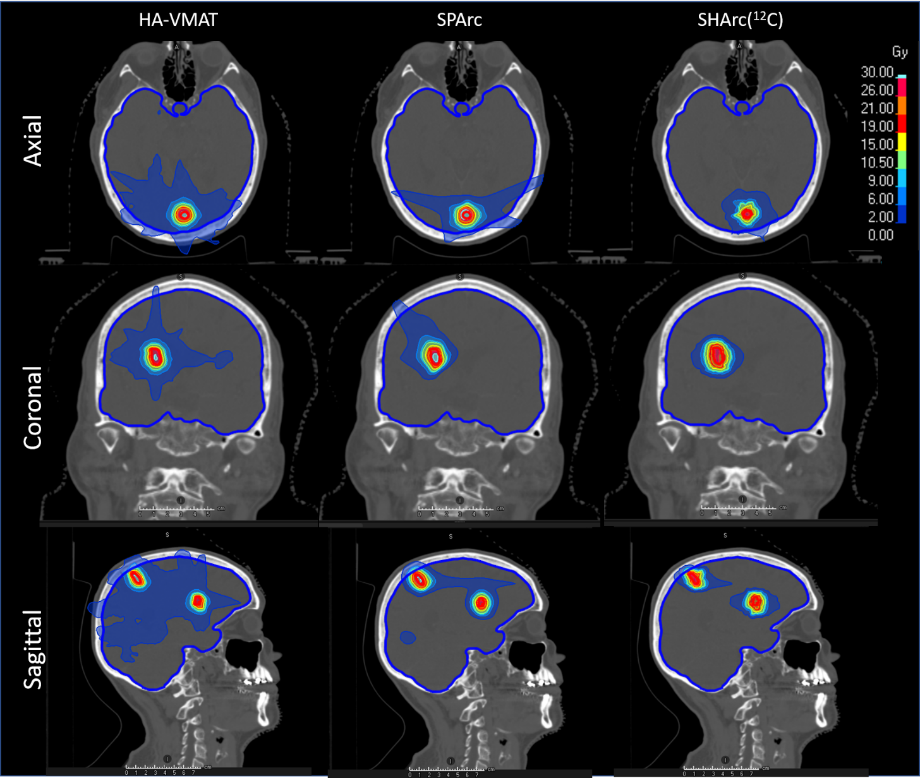
Patient case with 3 metastases
HA-VMAT
SPArc
SHArc(¹²C)
Modality | D99% | D1% | V2Gy | V12Gy
HA-VMAT | 25 Gy | 32 Gy | 342 cc | 9 cc
SPArc | 25 Gy | 35 Gy | 123 cc | 12 cc
SHArc¹²C | 21 Gy | 29 Gy | 89 cc | 11 cc

Slide 11
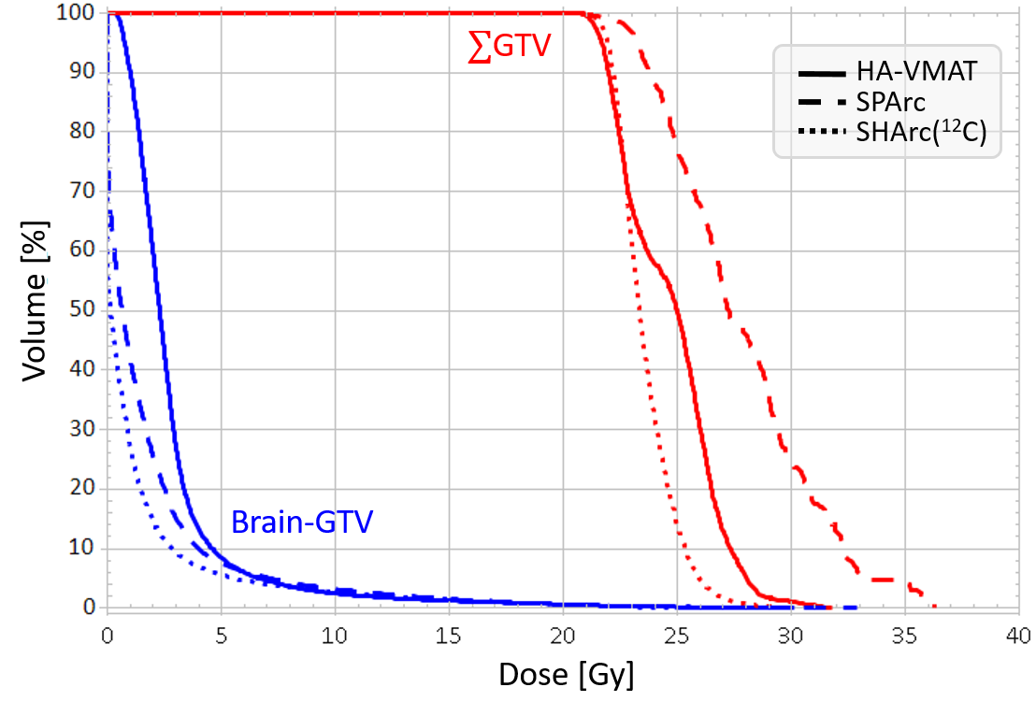
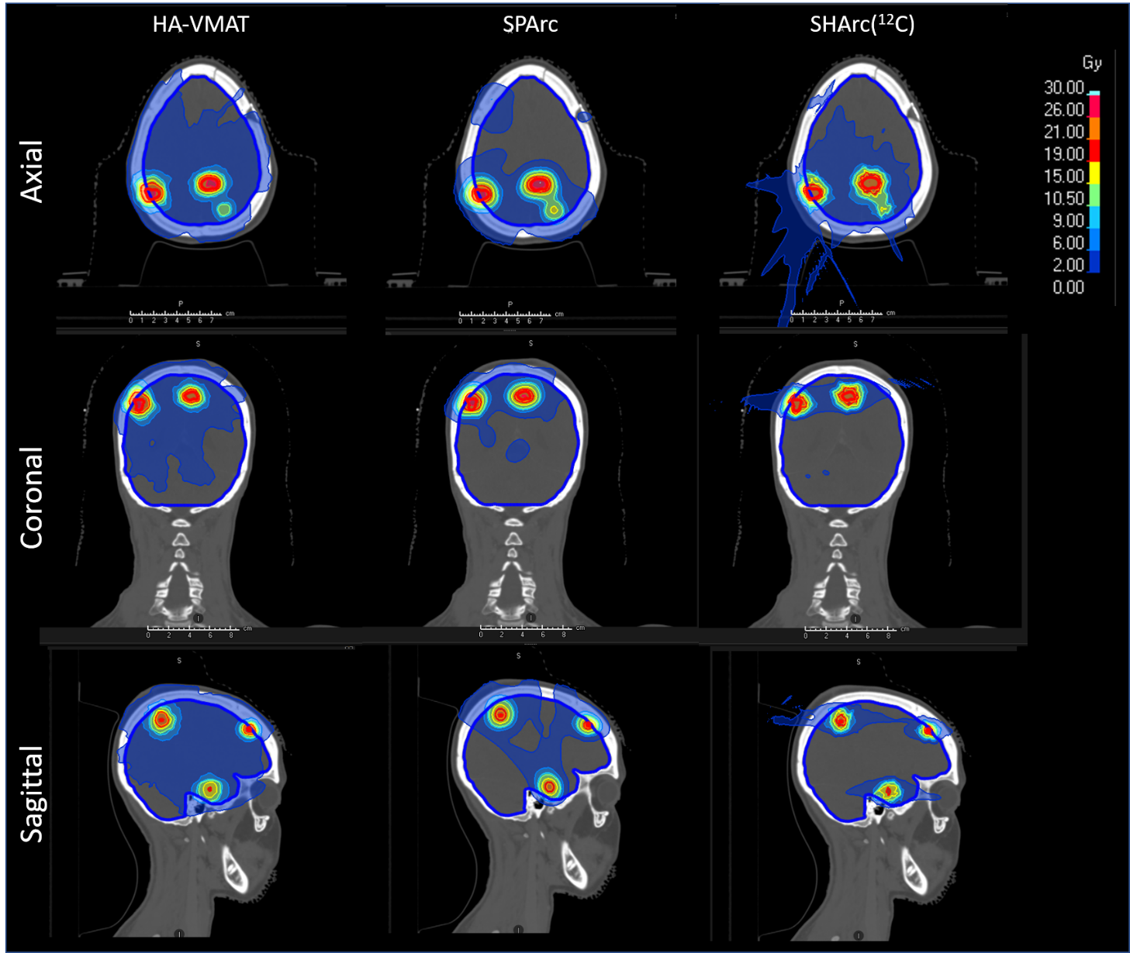
Patient case with 5 metastases
HA-VMAT
SPArc
SHArc(¹²C)
Modality | D99% | D1% | V2Gy | V12Gy
HA-VMAT | 25 Gy | 28 Gy | 776 cc | 12 cc
SPArc | 22 Gy | 31 Gy | 331 cc | 15 cc
SHArc¹²C | 22 Gy | 27 Gy | 190 cc | 14 cc

Slide 12
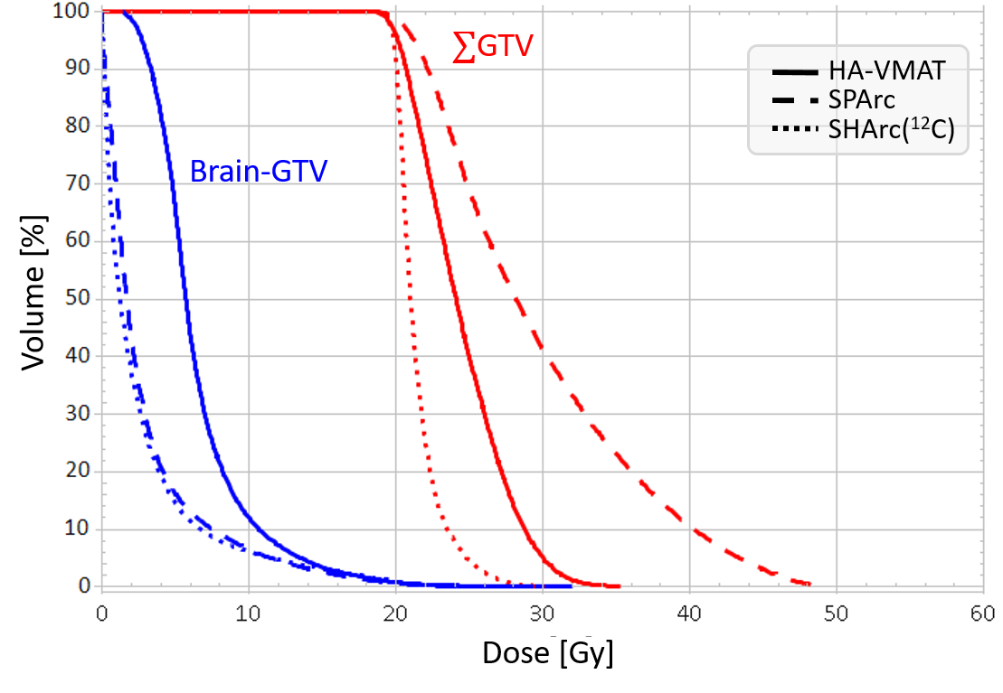
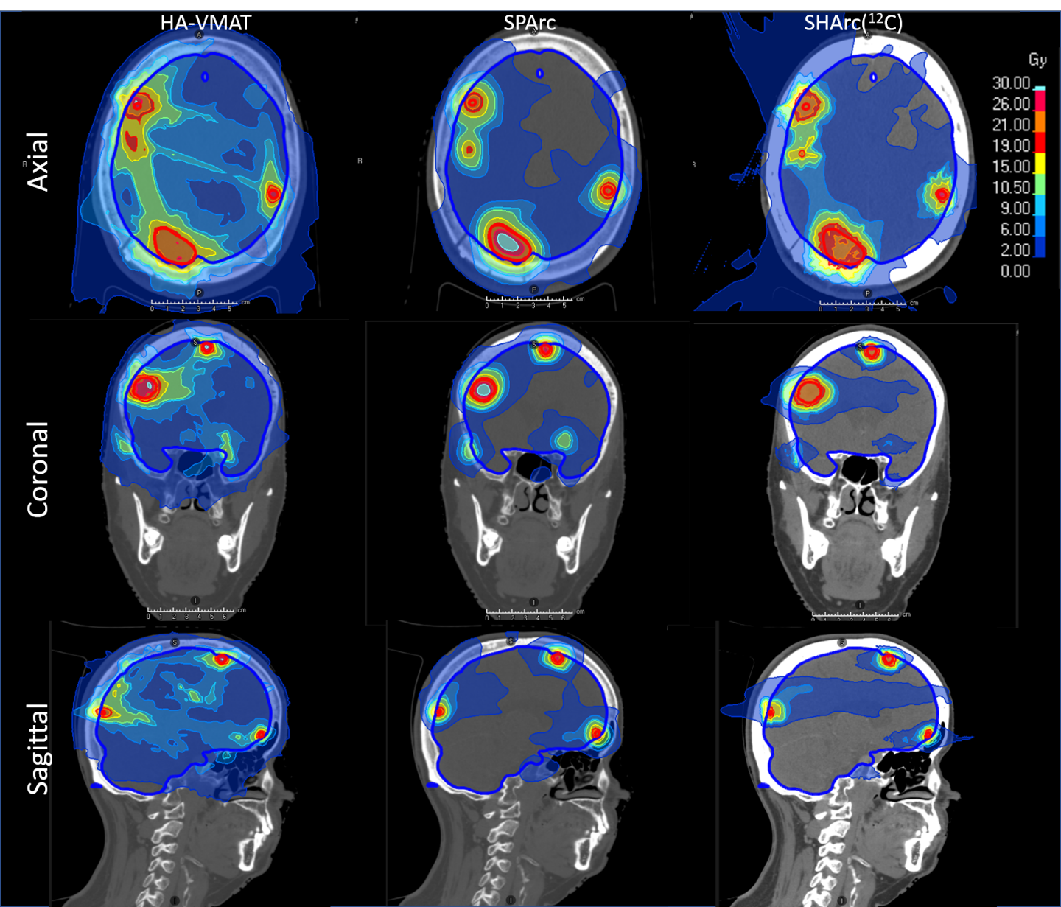
Patient case with 10 metastases and resection cavity
HA-VMAT
SPArc
SHArc(¹²C)
Modality | D99% | D1% | V2Gy | V12Gy
HA-VMAT | 23 Gy | 28 Gy | 1278 cc | 93 cc
SPArc | 22 Gy | 29 Gy | 565 cc | 58 cc
SHArc¹²C | 21 Gy | 28 Gy | 488 cc | 60 cc

Slide 13
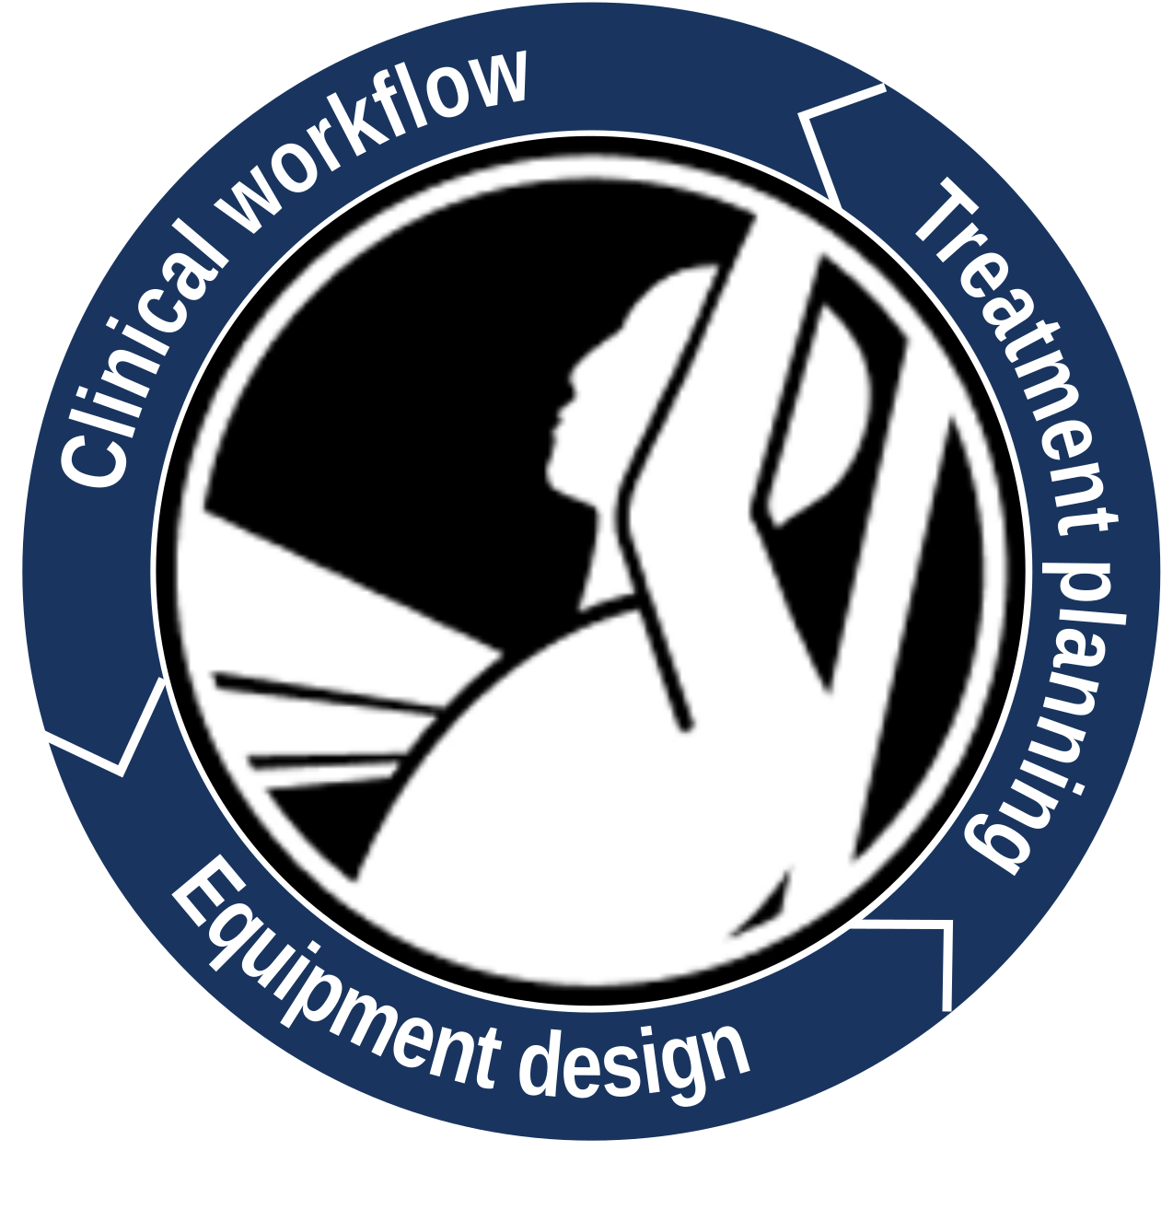
UPLIFT Doctoral Network coordinated by GSI
Strong interest in upright particle therapy enabled us to assemble DN consortium
  14 institutes across Europe to host 19 ESR (15 EU, 2 CH, 2 UK) ~ 5 M€
  spanning industry, particle and photon centers
  from clinical & technical to health economics and patient empowerment
Funding granted in April 2024, project start is Oct 1, 2024:
we need excellent students – please send us yours!
GA awaits signature, details still in embargo

Slide 14

Summary and contributions
Research platform for particle arc established & exploited for new approaches
Continuation funding secured
Upright therapy project developed into a large international collaboration
  Lennart Volz co-organizer of Upright Research Consortium
Publications & Talks:
  2 Talks (Volz, Li) on arc therapy at ESTRO2024, upcoming proffered posters at PTCOG
  PT review including WP9 topics (Graeff et al, PPNP 2023); arc strategy (Volz et al, Health & Technology 2024)
  Particle arc review (Mein et al, Green Journal) in revision
  Manuscripts ready to be submitted for upright therapy strategies & arc boost therapy.

Slide 15
THANK YOU

