Slide 1
Beam instrumentation studies
LSWG meeting on 2024 MD plans overview
Sara Morales Vigo on behalf of the SY-BI group
20/02/2024

Slide 2
Content
Characterization of the BSRH (beam halo measurements using a coronograph)
  Originally proposed in 2023 – MD10303
  Slides slightly adapted from presentation at rMPP
Wire-scanners Hybrid+ and operational system beam size measures comparison in H and V
  Added on 22/01/2024 – MD11623
  Follow up of MD9545
Schottky MDs
  MD requests not added yet
Beam scrapings for BLM calibration
  Originally proposed in 2023 - MD6950, MD9504, MD11067, follow up of these!

Slide 3
Characterization of the BSRH
Enrico Bravin, Daniele Butti, Federico Roncarolo, Georges Trad

Slide 4
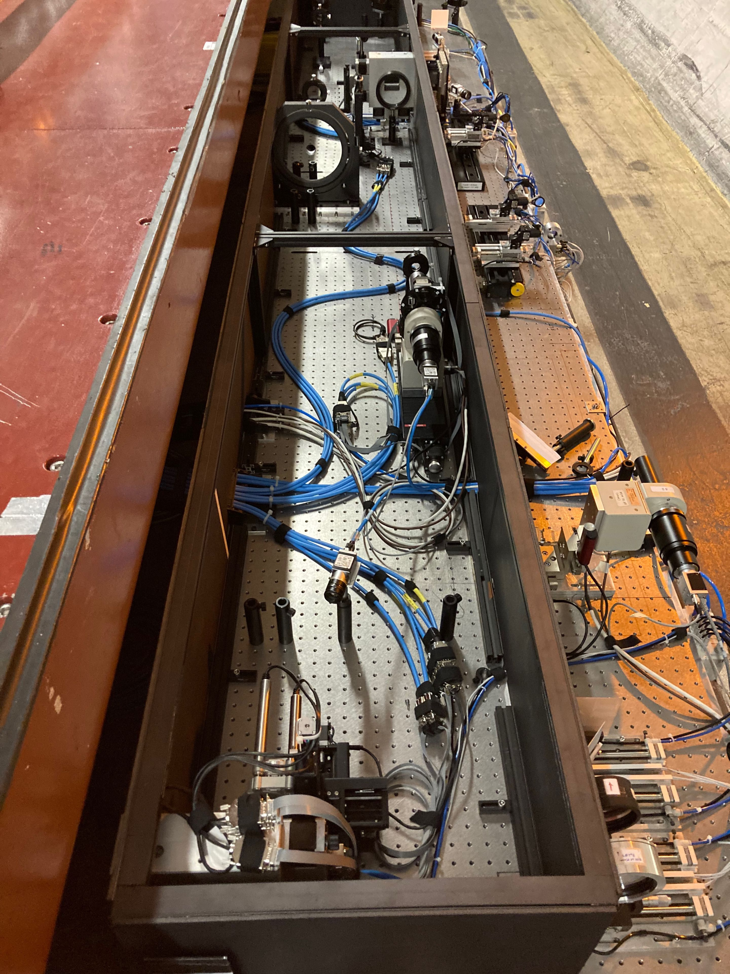
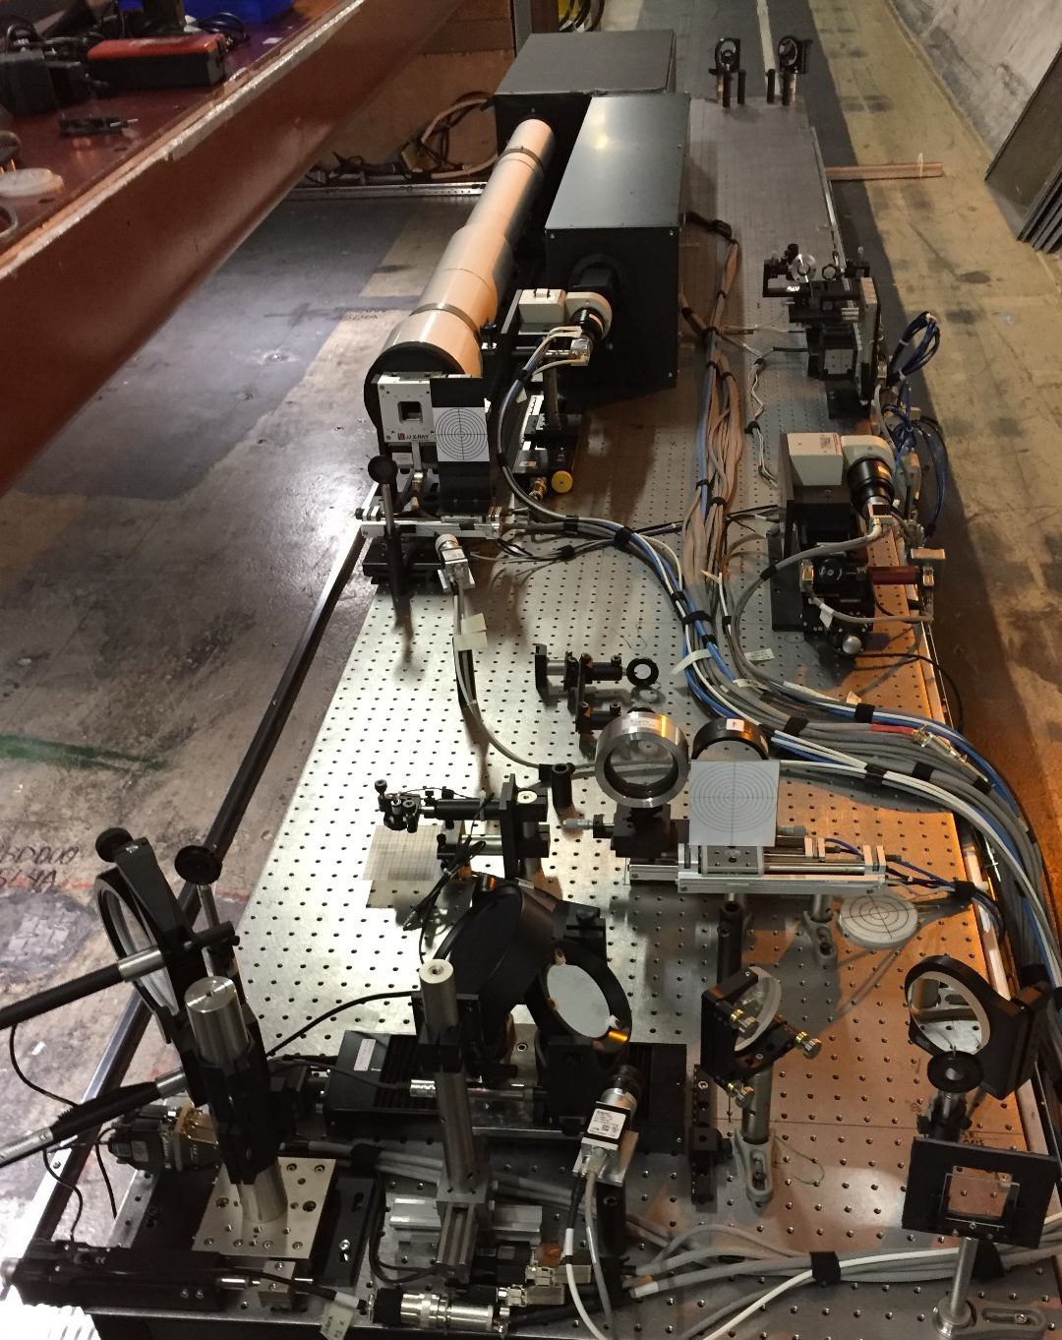
MD goal
Synchrotron radiation (SR) halo monitor (BSRH) refurbished for Run3
Extensive simulations carried out in LS2 provided better understanding of LHC SR source and its limitations
Run 2 setup
proof of concept
validated at injection (MD1900), discrepancies at flat-top (MD2243)
Run 3 setup:
setup optimized for LHC parameters
commissioning ongoing
Objectives:
  Is there a gain in contrast using a coronagraph instead of standard imaging (BSRT)?
  What is the ultimate sensitivity of SR based diagnostics to halo population? (May require more MDs…)

Slide 5
MD requirements
Two (4h + 4h) MD slots, optionally as floating MD
Beam 2 only
Work in setup beam, 2 nominals and a few pilots
A filling scheme with evenly spaced bunches would help the measurements
Ramp to 6.8 TeV
Frequent wire scanner measurements for reference
Collimator scraping and ADT blow-up on both planes
Perform multiple ramps to increase statistics (given the few bunches allowed by setup beam)

Slide 6
MD procedure (update)
Principle: scrape nominals to simulate a beam core and overlap blown-up probes to simulate the halo
Inject 2 nominals surrounded by a few probes (nominal 2.5 um emittance).
Quick coronagraph check at injection and ramp
Scrape beam, ideally down to 3σ (HL reference, ~2.5σ LHC reference)
Open collimators >5σ, blow up probes to have several background levels.
Take wire scanner reference profiles and reference images.
Acq. window
Take BSRH images overlapping nominal and probe(s) in the same acquisition window to assess the sensitivity to the fade background.
Repeat blow-up / scraping sequence.
“core”
“halo”
If possible, repeat entire cycle to increase statistics on both planes.

Slide 7
Wire-scanners Hybrid+ and operational system beam size measures comparison in H and V
Federico Roncarolo, Ana Guerrero Ollacarizqueta, David Belohrad, Jonathan Emery, Nabil El-Kassem, Daniele Butti, G. Trad

Slide 8
24

Slide 9
Schottky MDs
K. Łasocha, C. Lannoy, T. Pieloni, N. Mounet, D. Alves, T. Levens, O. Marqversen

Slide 10
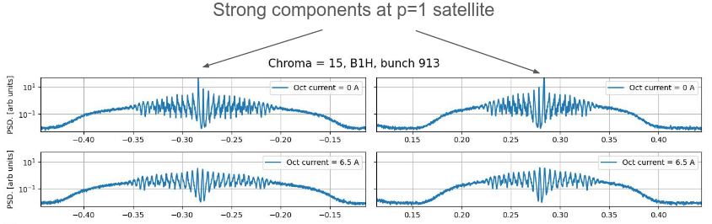
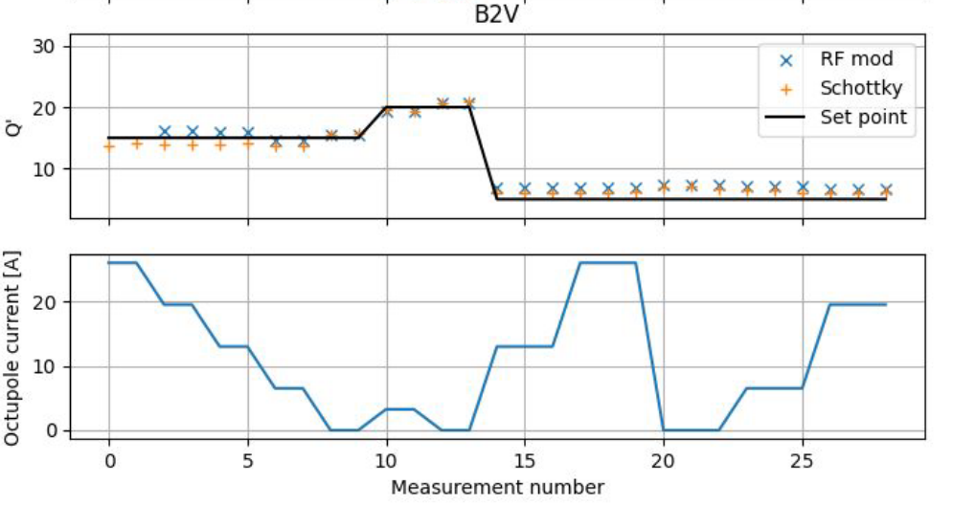
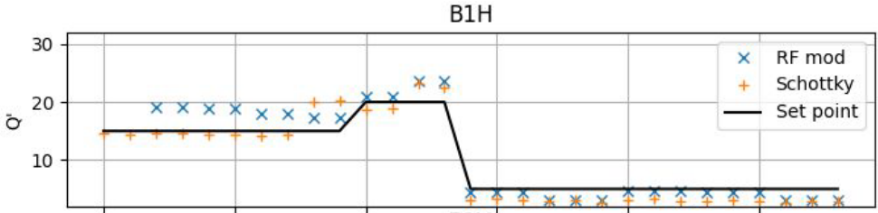
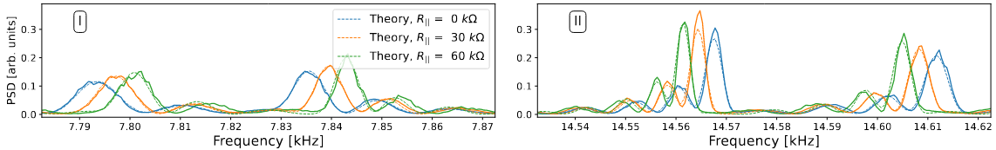
MD: Schottky studies with proton beam
Motivation:
Previous MD9263 (ions) has shown a positive impact of octupole magnets, which diminish coherent components and do not affect the chromaticity estimate. We would like to determine the magnitude of the octupole current needed to suppress all coherent components in proton spectra, and provide a reliable chromaticity estimate.
In the same measurement, using different bunch intensities we will also benchmark the new theory for the effect of the longitudinal impedance on the Schottky spectrum. Simulations suggest a visible, impedance-dependent shift of Schottky satellites for typical LHC conditions:
20.02.24
S.Morales - LSWG meeting on 2024 MD plans - Beam instrumentation studies

Slide 11
MD: Schottky studies with proton beam
MD details:
Species: Protons
Duration: 8 hours
Energy: INJ+Flattop
Bunches: 3-6 bunches of different intensities
Brief description: For different chromaticity values we would like to perform an octupole current scan, and record Schottky spectra from all the bunches. Done twice, at INJ and flattop energy.
20.02.24
S.Morales - LSWG meeting on 2024 MD plans - Beam instrumentation studies

Slide 12
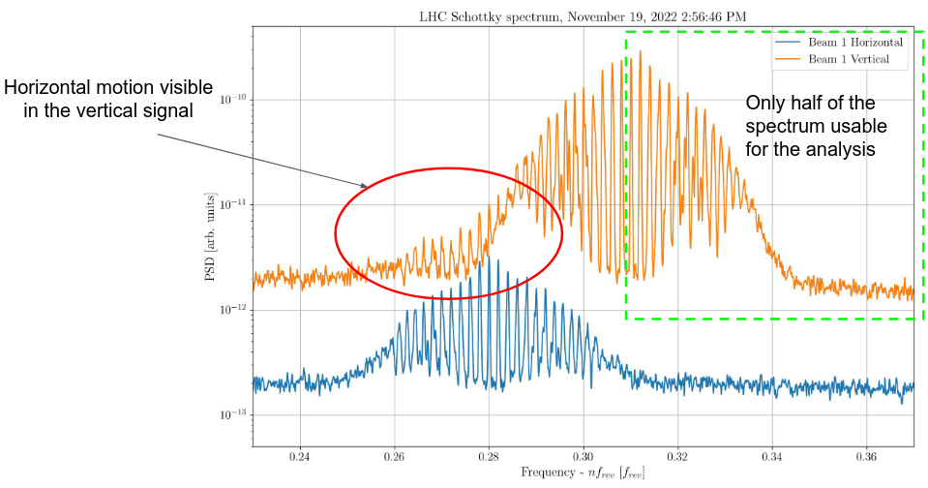
MD: Schottky-based coupling & emittance measurements
Motivation:
In day-to-day operation we have frequently observed the signatures of transverse coupling in the measured Schottky spectra.
The goal of this MD would be to acquire Schottky spectra for different values of the coupling constant. This data would then be compared to simulations and theoretical predictions, with the assessment of the coupling C⁻ coefficient measurement potential.
If successful, such an approach would allow for the non-invasive measurement of the coupling coefficient not only with the probe beams, but also for high-intensity beams at flattop energies.
In addition, we would like to revisit the potential of deriving the transverse emittance from Schottky spectra. The theory suggests that the presence of coherent components, which can be mitigated with increased octupole current, is the limiting factor for Schottky-based emittance measurements.
20.02.24
S.Morales - LSWG meeting on 2024 MD plans - Beam instrumentation studies

Slide 13
MD: Schottky-based coupling & emittance measurements
MD details:
Species: ions
Duration: 8 hours
Energy: INJ+Flattop
Bunches: 3-6 bunches of different emittance (ADT blow-up)
Brief description: We would like to sequentially change the coupling coefficient, and acquire the Schottky spectra for all the bunches present in the machine. In between, the standard measurements of the coupling coefficient and emittance (wirescanner) will be performed. Done twice, at INJ and flattop energy.
20.02.24
S.Morales - LSWG meeting on 2024 MD plans - Beam instrumentation studies

Slide 14
Beam Scraping MDs
S.Morales¹, B.Salvachua¹, E.Calvo, S.Redaelli, P.Hermes, M.Rakic, C.Zamantzas
¹Also part of beam scraping requests from RF and collimation

Slide 15
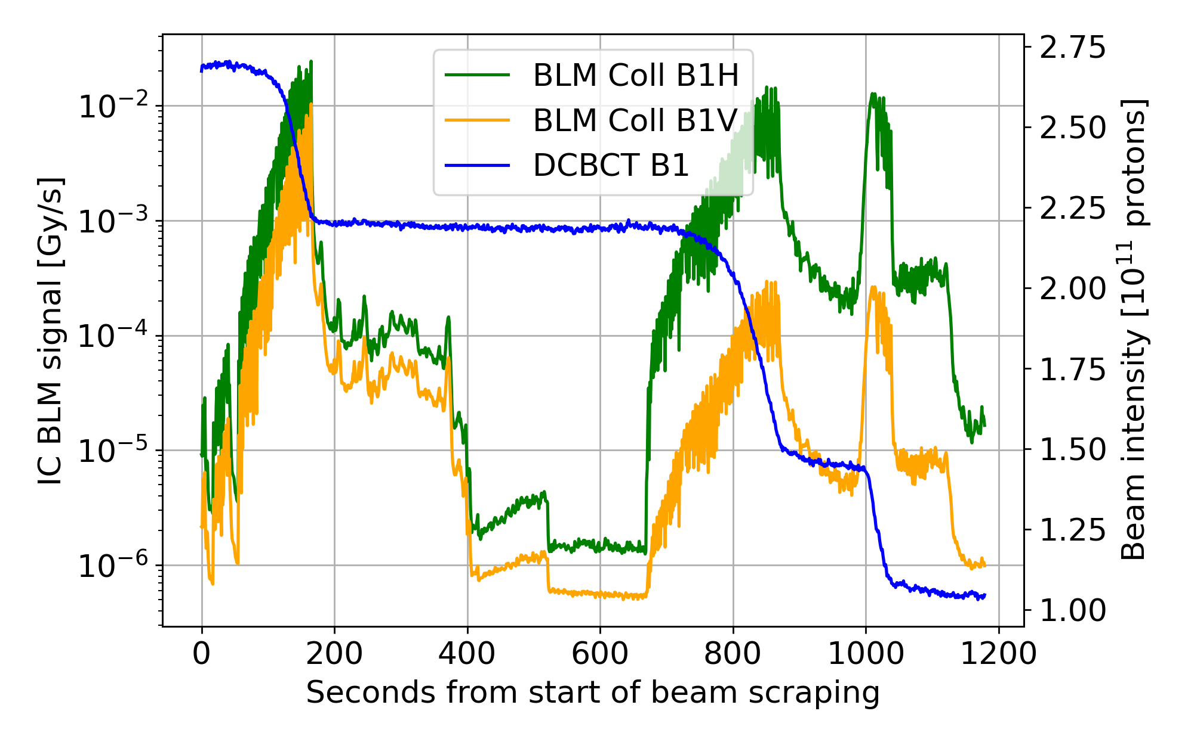
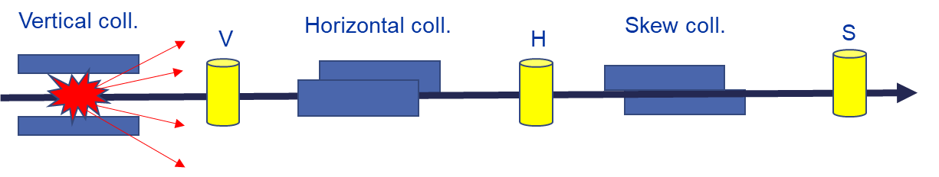
MD#6950 – Study of beam loss patterns for improving online BLM diagnostics – 2024 session
Calibration of the BLM system (Gy/s to protons/s)
  Based on the analysis of the BLM detector signals for different well-defined beam loss scenarios
  Proton impacts on the jaws of the primary B1 and B2 betatron and off-momentum collimators
  Beam loss scenarios reproduced by controlled beam scraping on single collimators
  To be repeated after every change in settings or long technical stop
From analysis of past beam scrapings, a dependence of the BLM response on the collimator jaw used was observed (especially in IR3!).
Check reproducibility of results and if changes are observed with the 2024 configuration

Slide 16
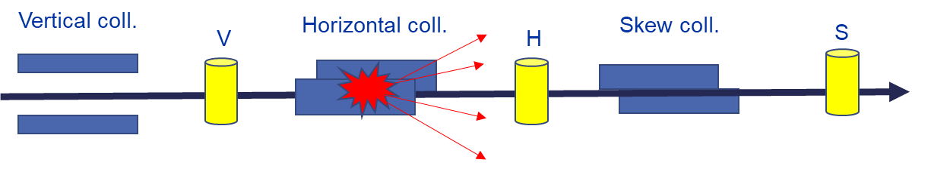
MD#6950 – Study of beam loss patterns for improving online BLM diagnostics – 2024 session
Calibration of the BLM system (Gy/s to protons/s)
  Based on the analysis of the BLM detector signals for different well-defined beam loss scenarios
  Proton impacts on the jaws of the primary B1 and B2 betatron and off-momentum collimators
  Beam loss scenarios reproduced by controlled beam scraping on single collimators
  To be repeated after every change in settings or long technical stop
From analysis of past beam scrapings, a dependence of the BLM response on the collimator jaw used was observed (especially in IR3!).
Check reproducibility of results and if changes are observed with the 2024 configuration

Slide 17
MD#6950 – Study of beam loss patterns for improving online BLM diagnostics - 2024 session
Injection of 3 nominals (protons) per beam (to stay below SBF) and ramp to top energy
BIC mask collimators, BLMs and BPMs
BLM thresholds remain at the nominal settings in all the machine
Correct beam orbit (if feedback is off)
Check dBLM phasing
Beam scraping with primary collimators in IR3 (off-momentum) and IR7 (horizontal, vertical and skew) with only left jaw, only right jaw, and both jaws
Two sessions of 4 hours (or one of 8)
Data useful for both IC BLM and dBLM calibrations
OK to do during beam commissioning once the final configuration of the machine is in place –> collimation settings and optics
Possibility to check differences in FLATTOP, SQUEEZE, ADJUST? -> Request of 2 fills

Slide 18
MD#9504 – Diamond detector and ionization chamber BLM response studies at injection energy – 2024 session
Calibration of the BLM system at injection energy (beam scraping)
Study the dependence of the BLM response on the collimator jaw used for beam scraping
BLM thresholds remain at the nominal settings in all the machine
Data useful for both IC BLM and dBLM response studies
One session of 4 hours
Vertical coll.
From analysis of past beam scrapings, a dependence of the BLM response on the collimator jaw used was observed (especially in IR3!).
Check reproducibility of results and if changes are observed with the 2024 configuration
V

Slide 19
MD#9504 – Diamond detector and ionization chamber BLM response studies at injection energy - 2024 session
Injection of 5 nominals (protons) per beam (to stay below SBF)
BIC mask collimators, BLMs and BPMs
Correct beam orbit (if feedback is off)
Check dBLM phasing
Beam scraping with left jaw of primary vertical collimators in IR3 and IR7
Dump the beam and reinject
Beam scraping with right jaw of primary vertical collimators in IR3 and IR7
Dump the beam and reinject
Beam scraping with both jaws of primary vertical collimators in IR3 and IR7
OK to do during beam commissioning once the final configuration of the machine is in place –> collimation settings and optics

Slide 20
MD #11067: Beam Loss Patterns with Ions and Crystal Collimation – 2024 session
Calibration of the BLM system (Gy/s to ions/s)
  Based on the analysis of the BLM detector signals for different well-defined beam loss scenarios
    Crystal collimator acting as primary now -> Completely different loss patterns!
  Ion impacts on the jaws of the primary B1 and B2 off-momentum collimators in IP3
  Ion losses from crystal collimation in IP7
  Beam loss scenarios reproduced by controlled beam scraping on single collimators
  Exploration of beam loss patterns for crystal operational modes -> channeling, amorphous, VR
Could not finish MD as an electrical perturbation caused the beam dump!
Possibility to also perform at injection energy?
Crystal coll.
V
OK to do during beam commissioning once the final configuration of the machine is in place –> collimation settings and optics

Slide 21
MD #11067: Beam Loss Patterns with Ions and Crystal Collimation – 2024 session
Injection of 20 nominals (ions) per beam (to stay below SBF) and ramp to top energy
BIC mask collimators, BLMs and BPMs
BLM thresholds remain at the nominal settings in all the machine
Correct beam orbit (if feedback is off)
Check dBLM phasing
Beam scraping with primary collimators in IR3 (off-momentum) and crystal collimators in IR7 (horizontal, vertical)
  First attempt optimizing the crystals at the start of the scraping, losing the channeling conditions at some point and scraping in amorphous or VR – Useful data as well for the calibration!
  Second attempt optimizing the crystals at the start of the scraping, and every 0.5 sigmas scraped in order to keep the channeling conditions
One session of 4 hours
Data useful for both IC BLM and dBLM calibrations

Slide 23
Spare slides

Slide 24
Comments
No need for Beam 1, available for other (non-conflicting) activities
Setup beam should allow maximum flexibility on scraping / blow-up.
Discussions with BLM and collimation teams, no significant limitations in safe beam.
First MD on the new BSRH setup. Exact data taking plan adapted to experimental findings.
Longer* allocated time (8h-10h) would help to perform multiple ramps and increase statistics
  If only one cycle available, check both planes with only one bunch
*w.r.t. to the initial request of a 6h slot with with many nominals

Slide 25
Basic requirements (BSRH)
Number of hours needed: 8
Number of sessions: 2
Ready? Yes
Specie: protons
Beam phase: Flat-top
Beam: beam 2
Total # bunches: 20
Beam parameters: INDIV
Non-standard parameters: several PILOTs and INDIVs, about 10 pairs. PILOT and INDIV should be alternate so that gating can be made on one of each. Several pairs are needed to allow different blow-up configurations
Collimation change: Yes
Need to mask detector BCM?: Yes

Slide 26
Wire-scanner prototypes and operational system beam size measures comparison
Federico Roncarolo, Ana Guerrero Ollacarizqueta, David Belohrad, Jonathan Emery, Nabil El-Kassem, Daniele Butti, G. Trad

Slide 28
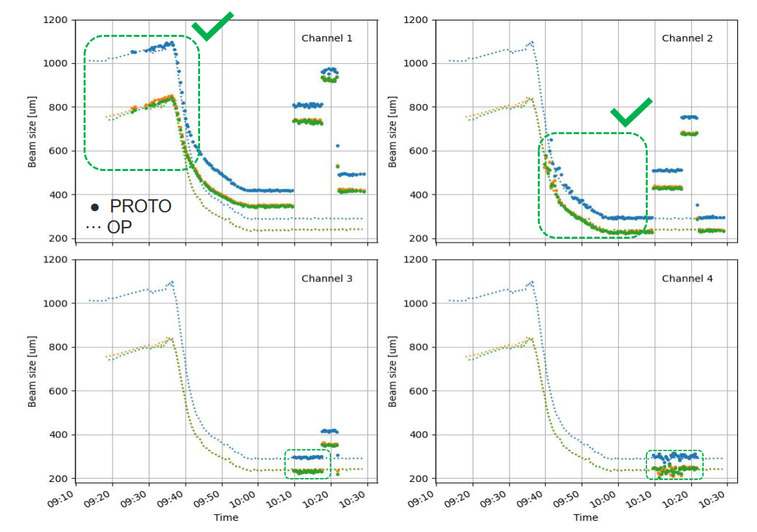
MD9545 – Preliminary qualitative comparison Beam 1
The injector electronics uses 4 PMT with different filters in parallel supressing the need to change filter during the ramp
Using the OP scanner (small dots), we see sensible measurements of the prototypes (large dots) on CH1 at injection and CH2 from the middle of the ramp.
Changing the PMT supply, to change its gain, we can see that CH3 and CH4 can also measure sensible beam size at FT (tbc).
Next:
1) Detailed analysis to quantify precision and accuracy of the prototypes with the OP as reference
2) Verify the data fitting, channel automatic selection, internal FPGA and SW processing of the position and acquisition using RAW samples available on disk.
D. Butti

Slide 29
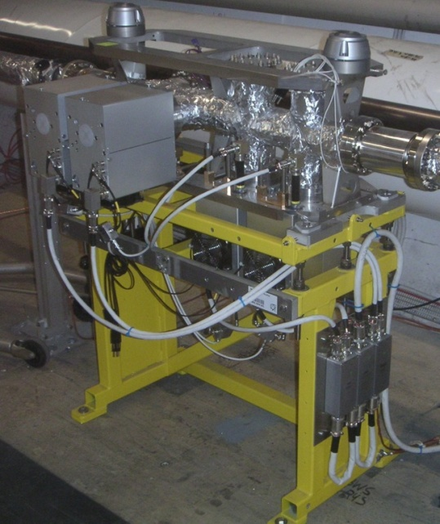
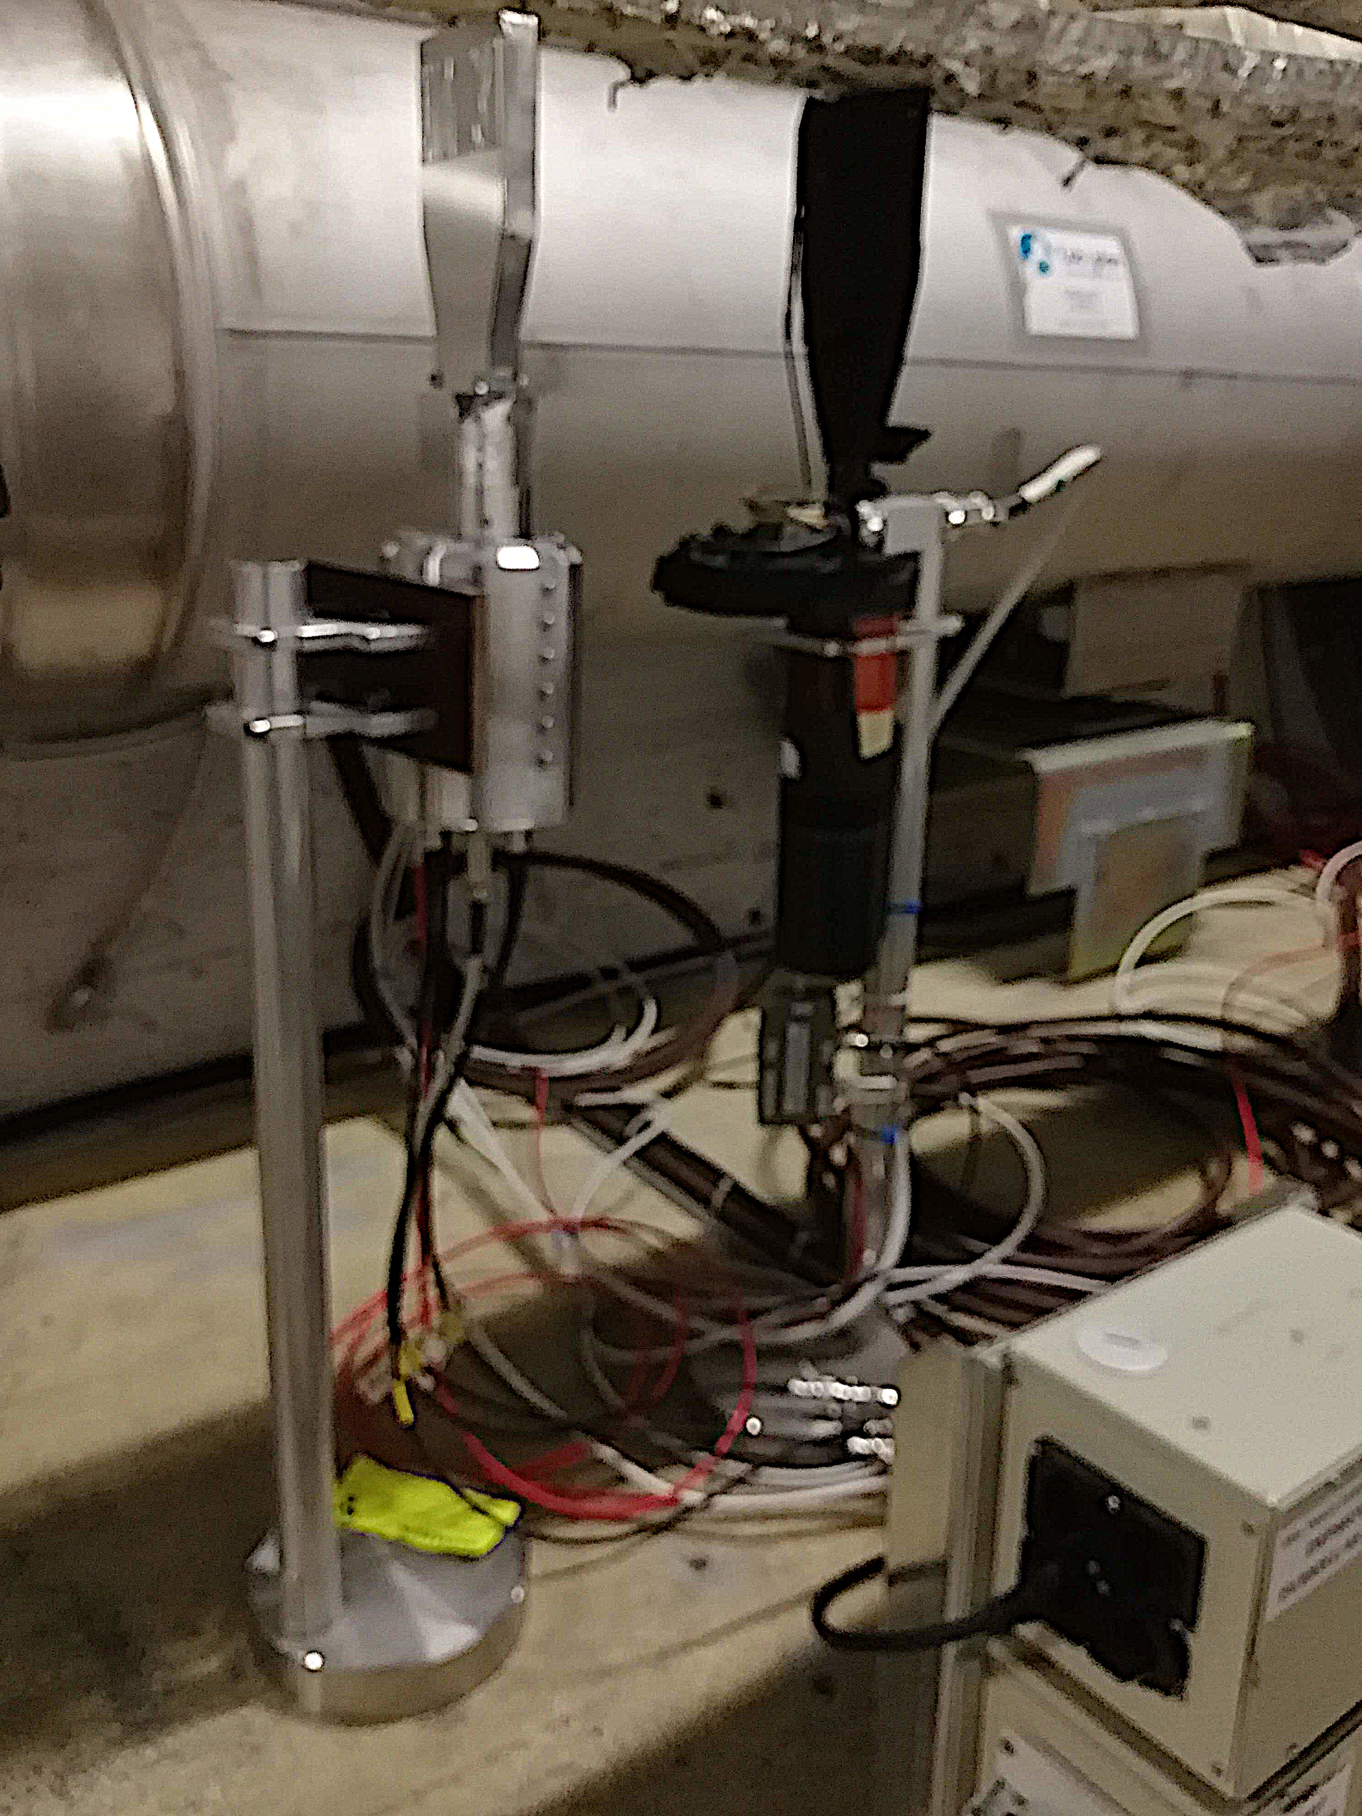
LHC wire-scanners setup
Prototype
mechanism position
Operational PMT assembly
Operational
mechanism
LIU based PMT assembly
5m away
LHC BWS BEAM 1
MOTION PART
LHC BWS BEAM 1
PMT PART

