Slide 1
2024 MD plans overview
MD coordination team
20 Feb 2024 - LSWG

Slide 2
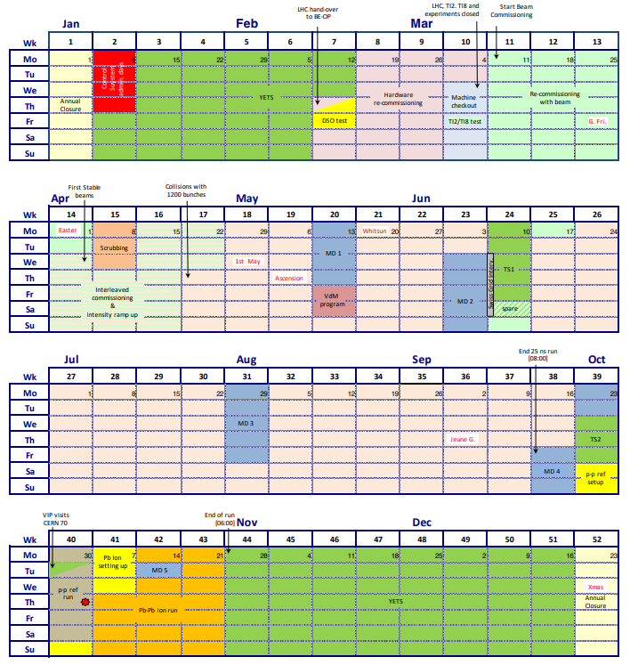
Planning
LHC Schedule 2024
in numbers
Activity | Duration [days] | Ratio
Physics time | 14.5 | 64% of total beam time
MD time | 20 | 13% w.r.t. physics time
3 MD days more to compensate for loss in 2023

Slide 3
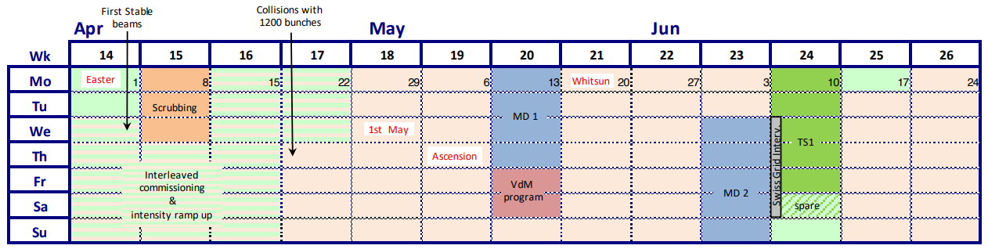
Planning

Slide 4
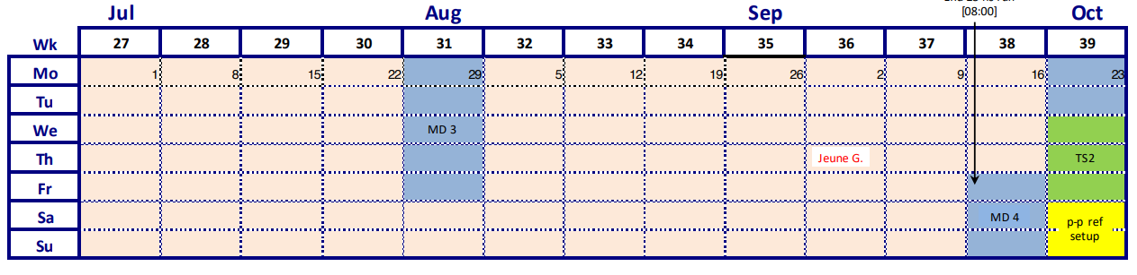
Planning

Slide 5
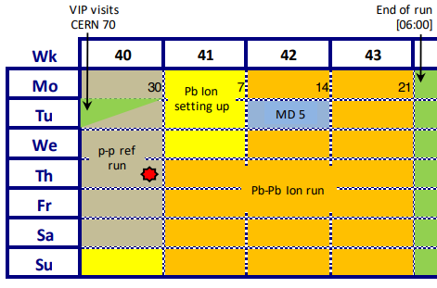
Planning

Slide 6
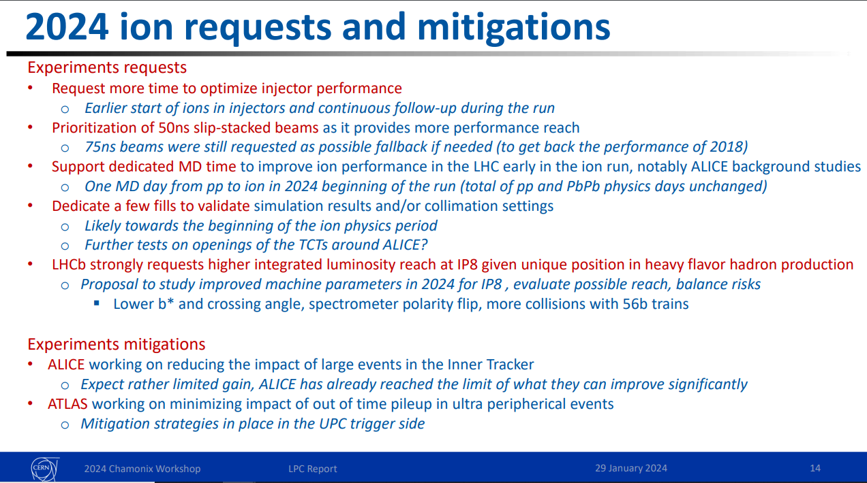
IONs MD BLOCK
Support from LPC for an extended MD block for IONs Run

Slide 7
AIMS of LSWG
Global inventory of all activities
Teams availability
Ions block MD “popularity”
Possibility of advancing activities to Beam commissioning phase

Slide 8
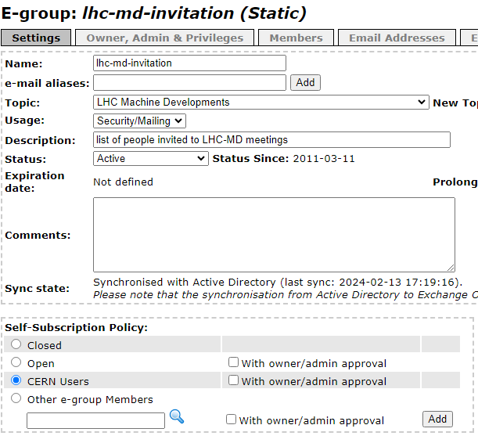
Membership

