Slide 2
OP MD requests
J. Wenninger, M. Solfaroli, G. Trad, T. Persson

Slide 3
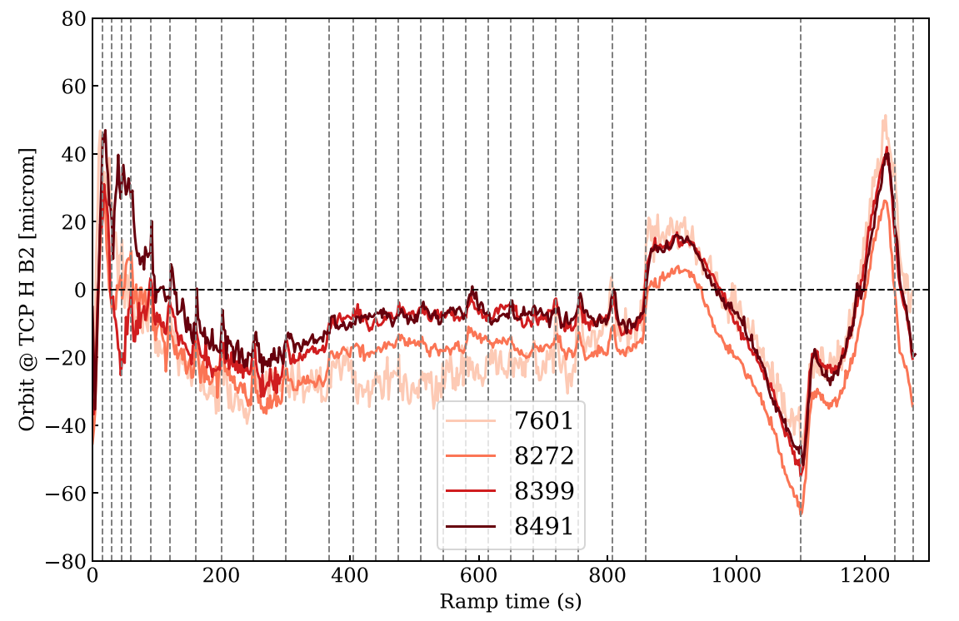
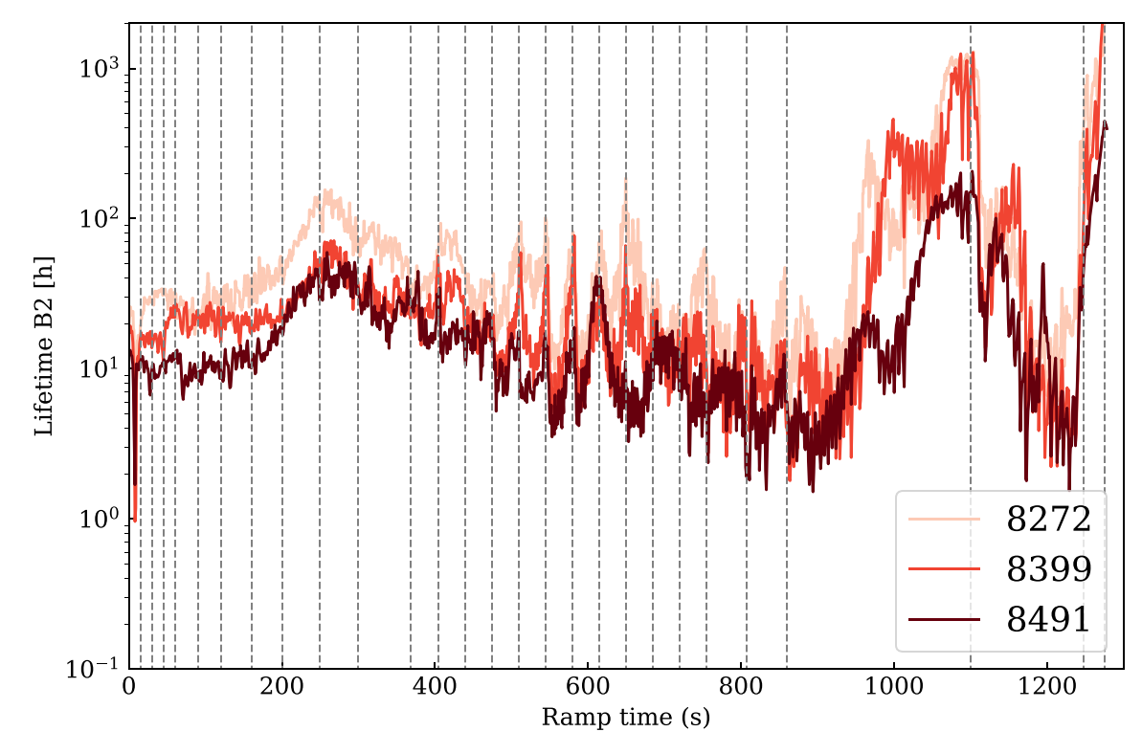
MD request #10386 - residual orbit excursion in the ramp
Residual horizontal orbit excursions are present in the ramp while the vertical plane is stable at 10-20 microns.
Spikes are visible at matched points in all ramps. They are due to the parabolic rounding applied to feed-forward corrections.
Eliminating such orbit spikes will remove some of the lifetime dips in the ramp. This effect contributes to ion downtime (ramp losses).
Life structures due to beta-beating introduced by optics interpolations require other measures.
This MD is left over from 2023, maybe. Some pre-work may be done during beam commissioning.
Requirements:
2-3 consecutive ramps to be able to feed-forward corrections.
One nominal bunch per beam.
8h are required for ~3 ramps.
Vertical dashed lines: matched points

Slide 4
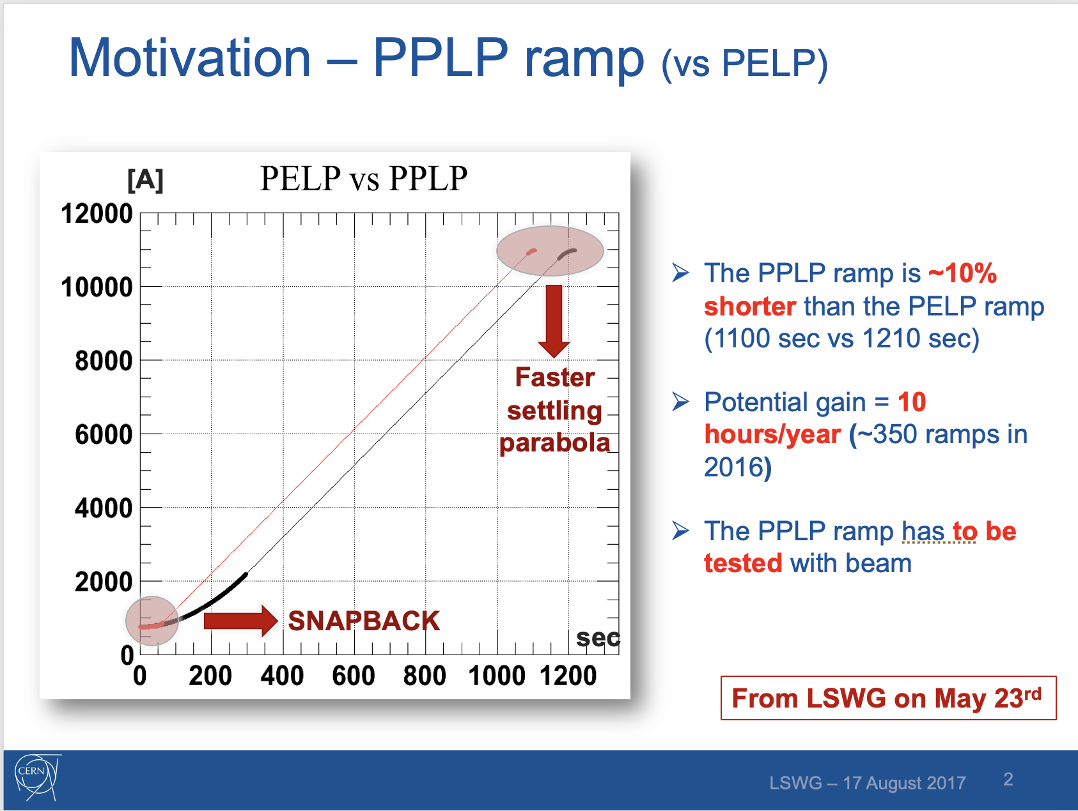
PPLP ramp revisited
The PPLP ramp tested successfully in 2017 (MD), it was implemented for 2018 operation.
During commissioning problems with controlling the bunch length at the start of the ramp appeared (not observed during MD probably due to slightly lower bunch intensity) → switch back to PELP ramp.
New inputs will come from the optimization of bunch length required by the vacuum module preservation.
Requirements:
1-3 indivs (setup beam intensity).
Coarse collimator settings.
8h to be able to perform ~3 ramps.

Slide 5
Ramp in steps
The idea to reach 6.8 TeV performing multiple ramp segments, stopping at different energy level was discussed several times in the past.
Motivation for different studies:
Emittance preservation studies
More precise BSRT calibration
Measurement of channelling efficiency as function of energy for new TWOCRYST (PBC) in IR3.
…
Some operational / control aspects issues need to be tackled. This MD aims to perform a first test of the feasibility and of the control of the magnetic errors.
Requirements:
Up to 3 probe bunches, possibly one indiv if time permits.
Coarse collimator settings.
8h are necessary for a first series of tests (~2 attempts with correction feed-forward).

Slide 6
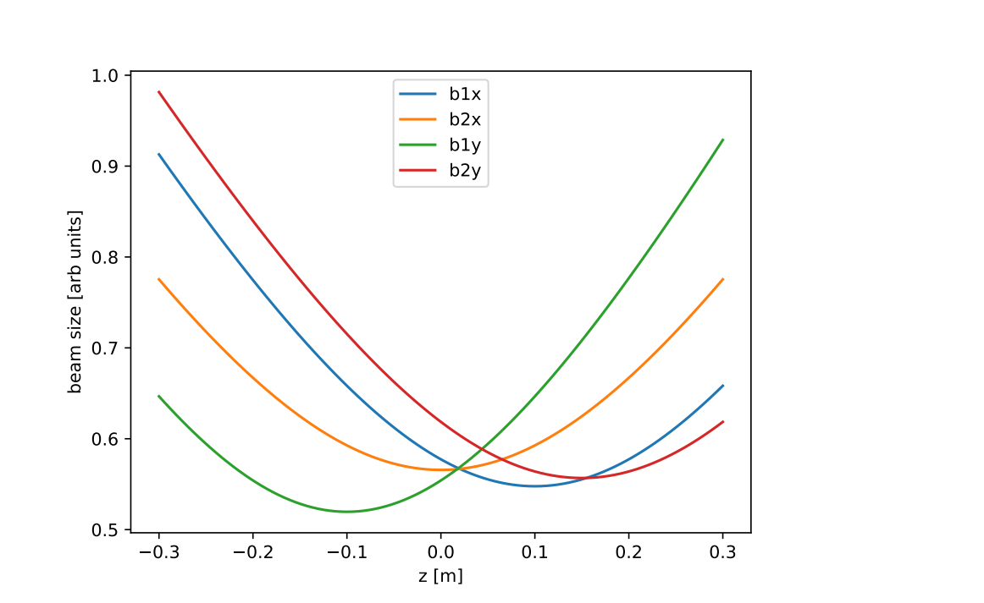
Betatron waist determination using cogging
Motivation:
To determine the beta-waist has proven difficult with K-modulation, even more difficult for HL.
Essential to equalize the luminosity of ATLAS-CMS (we are still almost half of the time NOT in lumi levelling)
An additional benefit is that a better knowledge of beta* and waist reduces the error on the emittance determination from luminosity.

Slide 7
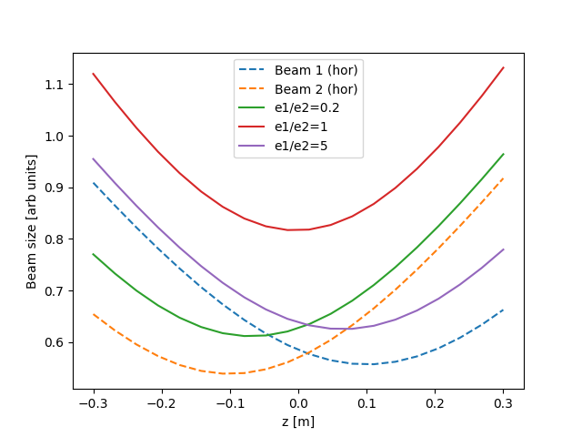
Betatron waist determination using cogging (2)
Principle:
The MD requires bunches with very different emittances.
Emittance scans provide the convoluted beam sizes (B1+B2).
The waist position can be obtained from emittance scans performed at different z-positions using cogging.
Requirements:
Many indiv-like bunches with large differences in emittance.
Total time 8-10h, 3-4h needed for the emittance scans at different cogging values.
There is synergy with the BSRT calibration fills, but the pattern of emittances between B1 and B2 are different.
  Collide large with small emittance !
In this example the waist is shifted by 0.1 m for beam 1 and by -0.1 m for beam 2.
For scans with equal emittances in the two beams the minimum is in the centre, but not when the emittances are different.

Slide 8
Injection-standby-injection magnetic history
Background:
To enter LHC service areas, the two adjacent sectors must be put to standby.
  This often happens when the machine is already at injection current.
A pre-cycle is performed when the intervention is finished to reset the magnet history.
Motivation:
If one could skip the pre-cycle, ~30 min would be saved every time this situation occurs.
It is complicated to estimate the impact on the optics, a measurement of the static effect would give insight if this is worth investigating further. If OK more studies would be needed.
The MD is also interesting to understand the hysteresis of the magnet.
Requirements:
1 measurement after 2 sectors on standby, 1 measurement after all sectors on standby.
3 pilots and coarse collimator settings for optics, tune and chroma decay measurements.
4-6h would be necessary for a first exploration.

Slide 9
Beta* levelling to 30/20cm moving TCS
Background:
Squeezing further beyond beta* = 30cm could gain ~5-6% of integrated luminosity
This requires a tightening of the collimator hierarchy
  Either during the ramp or in collisions
Motivation:
Once in Stable Beams and beta* levelling, moving collimators with sequencer is not ideal
  Problems with continuity and possible resident BP
  Need to stop levelling for experiments – not smooth in lumi / pile-up
Moving TCS with lumi server as part of beta* levelling would allow for a smooth tightening
  Presently lumi server is only moving TCTs/TCLs
Requirements:
2 nominal bunches colliding in all IPs (setup beam)
Commissioned beta* levelling to 30cm, optics to go to 30/20cm
Collimation set up for the nominal cycle, including angular alignment
Total 6h for a cycle to 30/20cm

