Slide 1
Beam-beam and luminosity studies
G. Sterbini on behalf BB and Luminosity team and the HL-WP2
Acknowledgment to the MD coordinators, H. Bartosik, P. Belanger, X. Buffat, C. Droin, I. Efthymiopoulos, S. Fartoukh, A. Fornara, M. Giovannozzi, P. Hermes, M. Hostettler, S. Kostoglou, E. Lamb, T. Levens, N. Mounet, Y. Papaphilippou, M. Solfaroli, S. Redaelli, J. Wenninger, R. Tomas, G. Trad.

Slide 2
Beam-beam and luminosity studies (+IBS, +crabbing, +noise, +VdM)
At 450 GeV
  MD11663: Emittance BU at injection for for the HL-LHC single bunches → IBS focused, 4 h
  MD11603: HOBB induced crabbing → To induce/see the 20 um/sigma_z crabbing, 5 h
  MD11643: Non-factorizable distributions → For the absolute luminosity calibration, 4 h
During the ramp
  MD6983: Emittance BU for the HL-LHC single bunches → Measure and localize the BU, 6 h
At 6.8 TeV
  MD9603: BB limit at the EoL → optimization of Run3 (nominal vs BCMS), 10 h, EoF MD (?)
  MD11666: impact of the SPS scraping on losses/𝜎_{eff} during L-level, 10 h, intensity ramp-up MD (?)
  MD10363: BBLR compensation → test the wires during the lumi-levelling, 8 h
  MD11644: VdM cycle MD → test the impact of controlled NF distributions on the L-calibration, 8 h
  MD11665: Test collapse with HL optics → see Riccardo’s presentation, (combined with HL MDs)
  MD11664: Noise from the MB PC → HL tele-index + before next EYETS ECR, 6 h (combined with HL MDs)
  MD10793: BB limit and ions → to prepare for the Pb-Pb 2025 configuration, 8 h

Slide 3
Beam-beam and luminosity studies (+IBS, +crabbing, +noise, +VdM)
At 450 GeV
  MD11663: Emittance BU at injection for for the HL-LHC single bunches → IBS focused, 4 h
  MD11603: HOBB induced crabbing → To induce/see the 20 um/sigma_z crabbing, 5 h
  MD11643: Non-factorizable distributions → For the absolute luminosity calibration, 4 h
During the ramp
  MD6983: Emittance BU for the HL-LHC single bunches → Measure and localize the BU, 6 h
At 6.8 TeV
  MD9603: BB limit at the EoL → optimization of Run3 (nominal vs BCMS), 10 h, EoF MD (?)
  MD11666: impact of the SPS scraping on losses/𝜎_{eff} during L-level, 10 h, intensity ramp-up MD (?)
  MD10363: BBLR compensation → test the wires during the lumi-levelling, 8 h
  MD11644: VdM cycle MD → test the impact of controlled NF distributions on the L-calibration, 8 h
  MD11665: Test collapse with HL optics → see Riccardo’s presentation, (combined with HL MDs)
  MD11664: Noise from the MB PC → HL tele-index + before next EYETS ECR, 6 h (combined with HL MDs)
  MD10793: BB limit and ions → to prepare for the Pb-Pb 2025 configuration, 8 h
Legend → MD1/2 or before, MD3/4, MD5

Slide 4
Studies of IBS at injection (4 h)
AIM: Study IBS for various distributions and detect additional sources of emittance blowup at injection to:
  benchmark our IBS models
  study impact of non-Gaussian tails on IBS emittance growth
  identifying additional sources of emittance blowup during injection beyond IBS
PROCEDURE:
  Inject from SPS a few high-intensity single bunches (2.3e11 ppb) per SPS injection and control their tails with scraping in the SPS: 1st class “nominal emittance/nominal tails”, 2nd class “larger emittance, nominal tails”, 3rd class “large tails”. Inject also few pilots to disentangle emittance BU not intensity driven.
  Stay at injection in the LHC and perform regular wire scanner measurements (→ WS intensive MD).
  (if time allows) check effect with reduce bunch length, test positive/negative octupoles and cycle them before dumping.

Slide 5
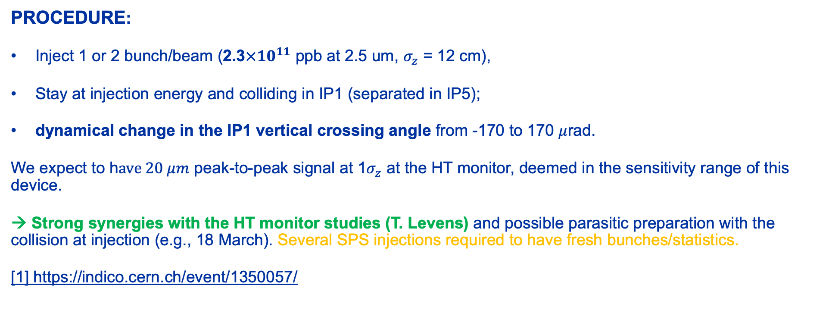
Crabbing in the LHC via HOBB (5 h)
AIM: measure HOBB induced crabbing in the LHC and test the head-tail monitor [1]
PROCEDURE:
Inject 1 or 2 bunch/beam (2.3$×{10}^{11}$ ppb at 2.5 um, $σ_{z}\text{ = 12 }\text{cm}$),
Stay at injection energy and colliding in IP1 (separated in IP5);
dynamical change in the IP1 vertical crossing angle from -170 to 170 $μ$rad.
We expect to h$ave 20 μm$ peak-to-peak signal at 1$σ_{z}$ at the HT monitor, deemed in the sensitivity range of this device.
→ Strong synergies with the HT monitor studies (T. Levens) and possible parasitic preparation with the collision at injection (e.g., 18 March). Several SPS injections required to have fresh bunches/statistics.
[1] https://indico.cern.ch/event/1350057/

Slide 6
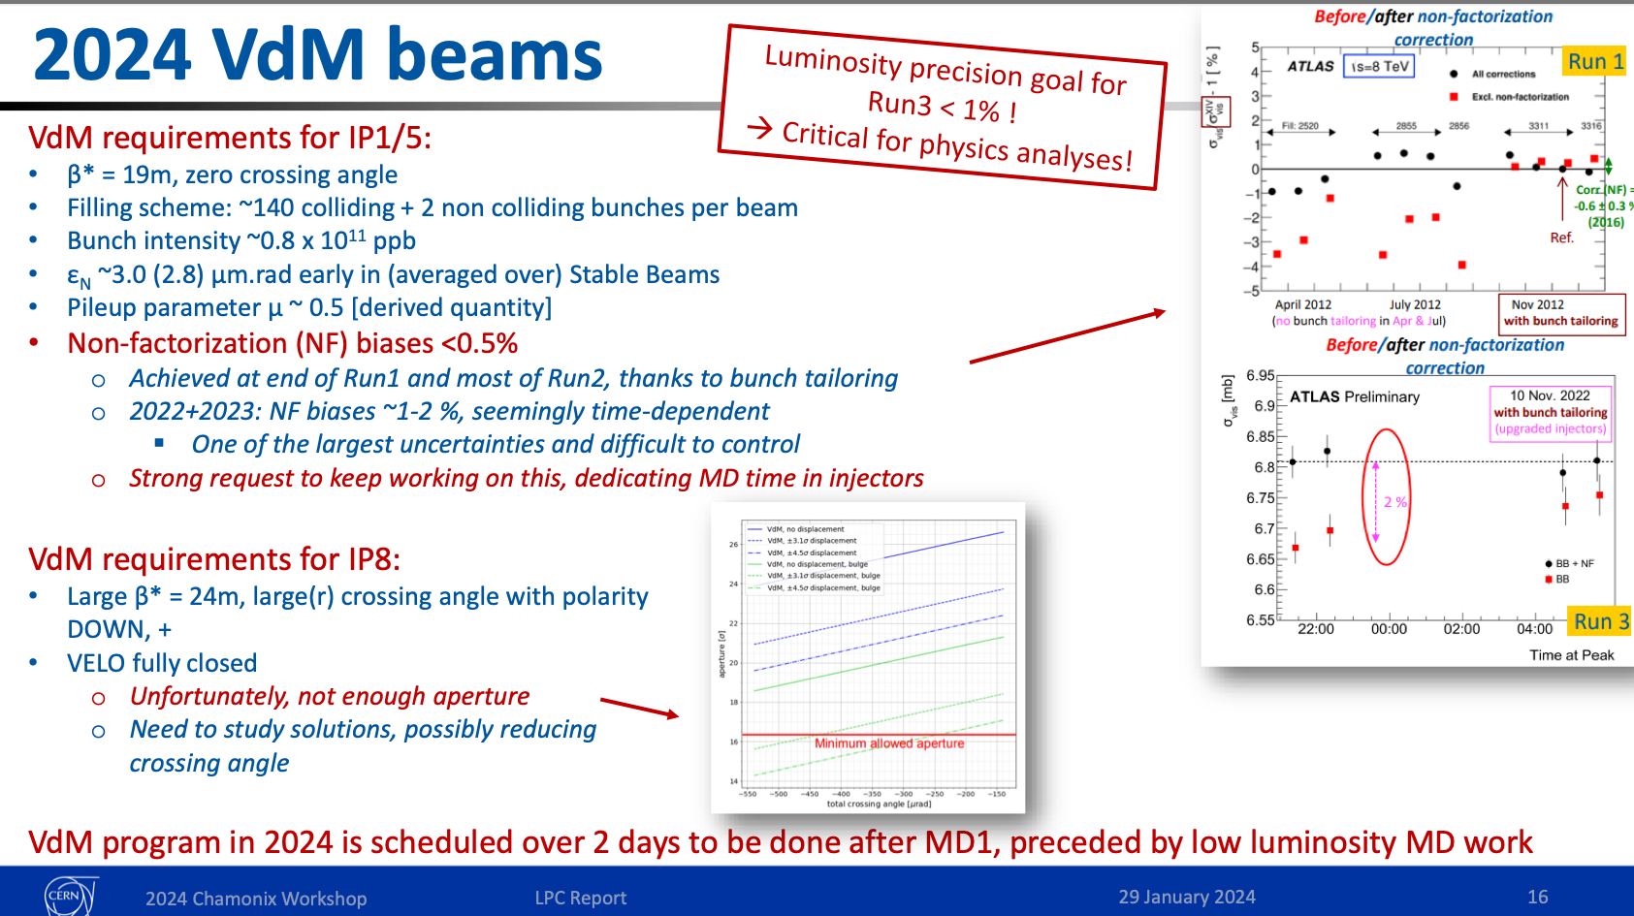
Non-factorizable transverse distribution (4 h)
AIM: Inject and observe non-factorizable (NF) transverse distributions in LHC (see Elleanor’s presentation in JAP2023).
NF start to be the dominating contributor of the luminosity calibration error and situation degraded in Run3 → clear request from LPC to dedicate MD time on the problem. The proposal is to stage it in the different machines (PSB → PS → SPS).
Courtesy of F. Alessio
PROCEDURE:
Prepare VdM like flavor in the PSB (NF and F) and after qualification in the PS and SPS, inject them in LHC (mimic part of the filling scheme of the recent VdM scans).
Stay at injection and using consecutive V/H scraping and/or WS measurement (→ WS intensive MD), observe and quantify if the NF feature is preserved.
→ Strong synergy with the halo/tail MD program and the LHC Luminosity Calibration and Monitoring Working Group

Slide 7
Beam-beam and luminosity studies (+IBS, +crabbing, +noise, +VdM)
At 450 GeV
  MD11663: Emittance BU at injection for for the HL-LHC single bunches → IBS focused, 4 h
  MD11603: HOBB induced crabbing → To induce/see the 20 um/sigma_z crabbing, 5 h
  MD11643: Non-factorizable distributions → For the absolute luminosity calibration, 4 h
During the ramp
  MD6983: Emittance BU for the HL-LHC single bunches → Measure and localize the BU, 6 h
At 6.8 TeV
  MD9603: BB limit at the EoL → optimization of Run3 (nominal vs BCMS), 10 h, EoF MD (?)
  MD11666: impact of the SPS scraping on losses/𝜎_{eff} during L-level, 10 h, intensity ramp-up MD (?)
  MD10363: BBLR compensation → test the wires during the lumi-levelling, 8 h
  MD11644: VdM cycle MD → test the impact of controlled NF distributions on the L-calibration, 8 h
  MD11665: Test collapse with HL optics → see Riccardo’s presentation, (combined with HL MDs)
  MD11664: Noise from the MB PC → HL tele-index + before next EYETS ECR, 6 h (combined with HL MDs)
  MD10793: BB limit and ions → to prepare for the Pb-Pb 2025 configuration, 8 h
Legend → MD1/2 or before, MD3/4, MD5

Slide 8
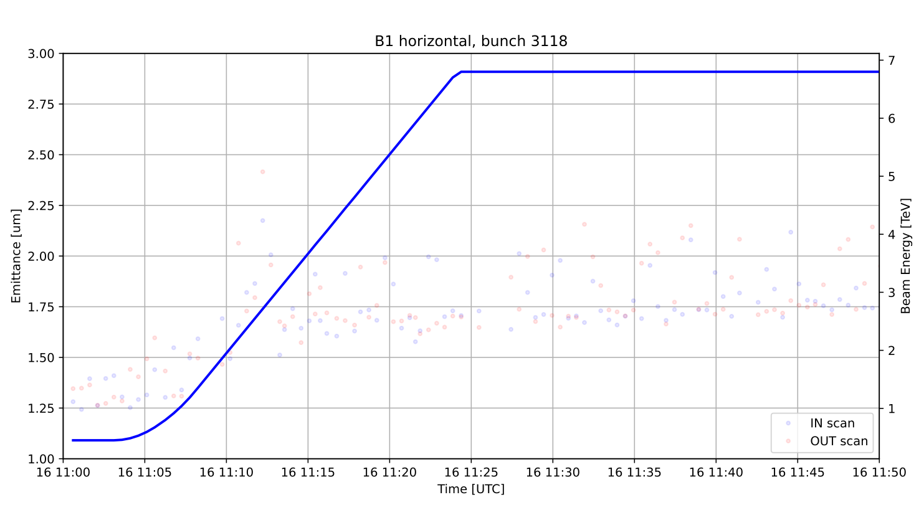
Emittance BU of HL single bunches (RAMP) 6 h
AIM:
Quantify the the HL-LHC single bunch emittance blow-up during the ramp.
PROCEDURE:
Very similar approach of the BSRT calibration but with the bunches having 2.3e11 ppb and emittance injected in range of 1.5-2.5 urad. (1.3e12 p was the integral for BSRT calibration, FILL8778). In principle we could consider 5 HL-LHC bunches per beam (TBC).
Once ramped, we could test the end-of-collapse and stay in collision for 30 min.
Partial synergy with the BSRT calibration
→ WS intensive MD
BSRT Calibration in 2023 (courtesy of G. Trad)
Depending on the result:
- test bunches with different scraping from the SPS to see the tail evolution.
- test a single bunch (SETUP beam) with relaxed collimators.)

Slide 9
Beam-beam and luminosity studies (+IBS, +crabbing, +noise, +VdM)
At 450 GeV
  MD11663: Emittance BU at injection for for the HL-LHC single bunches → IBS focused, 4 h
  MD11603: HOBB induced crabbing → To induce/see the 20 um/sigma_z crabbing, 5 h
  MD11643: Non-factorizable distributions → For the absolute luminosity calibration, 4 h
During the ramp
  MD6983: Emittance BU for the HL-LHC single bunches → Measure and localize the BU, 6 h
At 6.8 TeV
  MD9603: BB limit at the EoL → optimization of Run3 (nominal vs BCMS), 10 h, EoF MD (?)
  MD11666: impact of the SPS scraping on losses/𝜎_{eff} during L-level, 10 h, intensity ramp-up MD (?)
  MD10363: BBLR compensation → test the wires during the lumi-levelling, 8 h
  MD11644: VdM cycle MD → test the impact of controlled NF distributions on the L-calibration, 8 h
  MD11665: Test collapse with HL optics → see Riccardo’s presentation, (combined with HL MDs)
  MD11664: Noise from the MB PC → HL tele-index + before next EYETS ECR, 6 h (combined with HL MDs)
  MD10793: BB limit and ions → to prepare for the Pb-Pb 2025 configuration, 8 h
Legend → MD1/2 or before, MD3/4, MD5

Slide 10
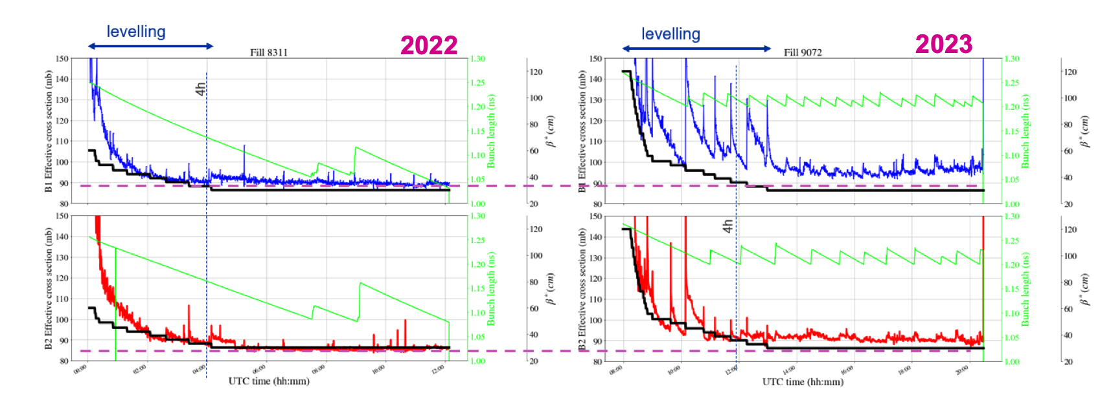
Explore the BB limit for nominal and BCMS (EoF MD or 10 h)
Courtesy of I. Eftymiopoulous
AIM: Interest to see the BB limit at the EoL. Observations during 2023 show extra-losses during the levelling step. Chamonix → to validate the performance Nominal vs BCMS. As commented by Stéphane: performance should be evaluated at constant BB limit (BCMS could work at lower crossing
PROCEDURE: Explore BB limit for nominal/BCMS bunches at EoL (e.g. reduce Xing angle 160 → 120 urad). We assume β∗ = 30 cm and >4 trains at top energy .
Ideally we would like to profit of the octupole reversal polarity (from the start of SB).
We would like also to use the wires compensators.
Can it be and EoF MD?

Slide 11
Extra losses during collisions
AIM: To study the impact of distributions with different tails from the injectors to the extra losses observed at the start and during collisions.
PROCEDURE:
  During intensity ramp up, SPS injections with nominal and aggressive scraping
  Compare effective cross section during the L-levelling for the different scraping flavor
  Can it be included in the intensity ramp-up?

Slide 12
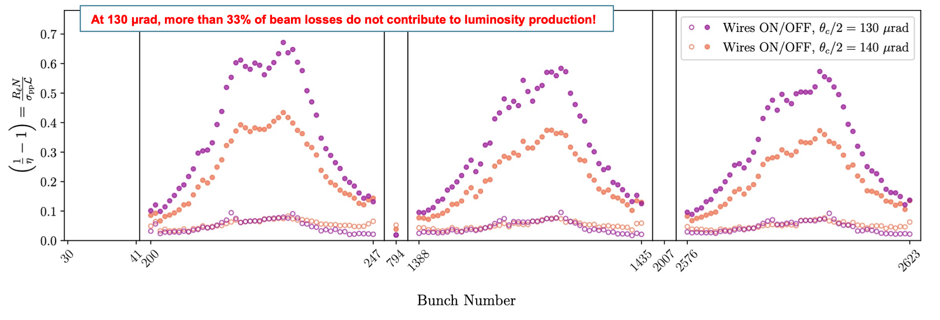
Wire compensation and β* leveling (8 h)
Courtesy P. Belanger
AIM: In 2022 we tested the wire compensation during crossing angle anti-leveling at constant β*. We propose to explore the compensation varying β*.
The segment 20<β*<30 cm range is interesting for us: pushed BBLR and potential to extend the L-level time (e.g. Run4 perspective).
PROCEDURE: Collide 3 or 4 trains of nominal and BCMS. Inject the trains to have several super-PACMAN bunches (see plot of BB signature above). Power ON-OFF the wire at different beta* (e.g. 20<β*<30 cm range + at β*=20 cm, reduce the xing.

Slide 13
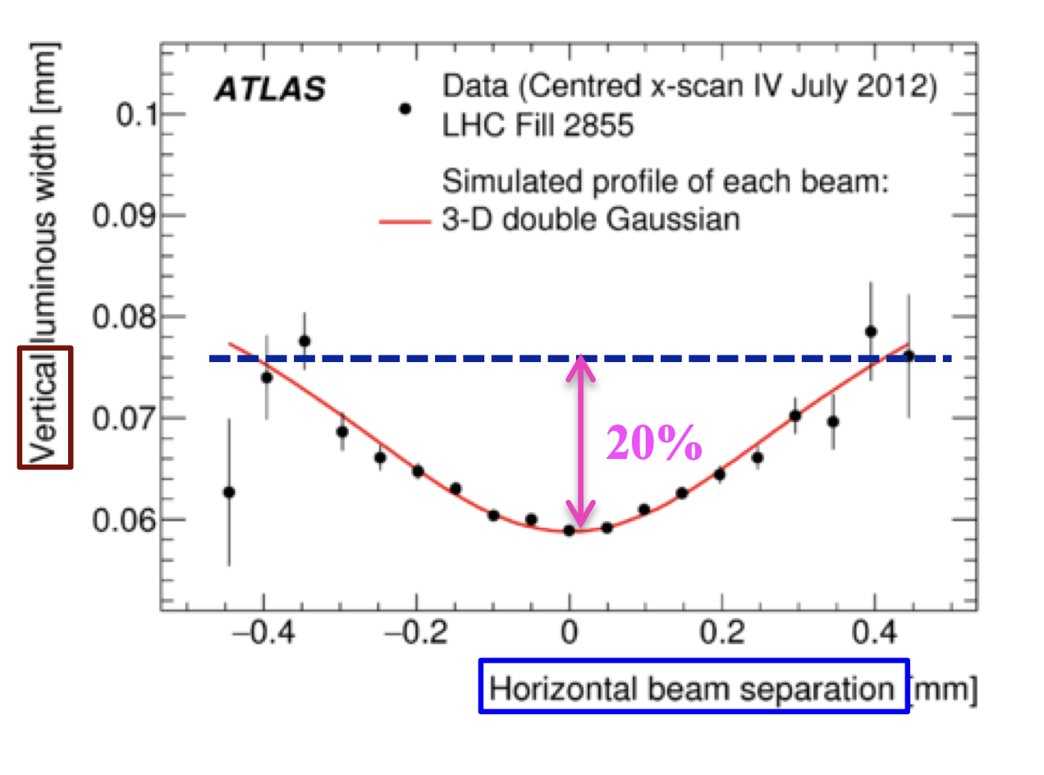
VdM bunches and non-factorization (8 h)
Preliminary: we need to further discuss with the experiments on the feasibility of such study!
AIM: Verify if NF distributions, if measured at 450 GeV, are transported and L-visible at 6.8 TeV → if confirmed this is an important ingredient in the understanding the NF of the VdM scans.
PROCEDURE: Use the VdM cycle and filling scheme but interleaving NF and F bunches. Accelerate to FT and perform luminosity scans (TBC) and scraping tests to verify if and how much the NF is transported from FB to FT.
Courtesy of W. Kozanecki
→ Strong synergy with the halo/tail MD program and the LHC Luminosity Calibration and Monitoring Working Group

Slide 14
Noise from the dipole converters (6 h, HL cycle)
AIM: Understanding if 8 kHz cluster is related to main bends power converters leveraging on the HL optics high-tele index, switching ON and OFF the active filters of MB power converters (as done in MD4147 but using the ADT obs-box for b-by-b and t-by-t measurements). → Important reference measurement before the MB PC upgrade next EYETS (ECR LHC-R-EC-0002).
PROCEDURE:
  Inject 20 PILOTs regularly distributed in the machine
  Ramp-up and HL squeeze (see Riccardo’s presentation) with maximum tele-index.
  Observe the 8 kHz spectrum while switching ON/OFF the MB active filters.

Slide 15
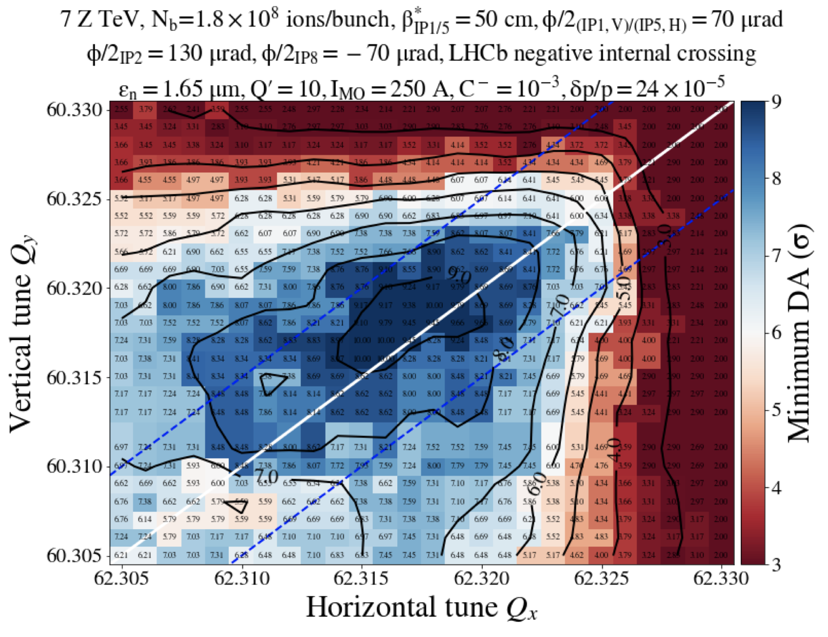
Ions and BB 2025 configuration (8 h)
AIM: test a new optics and reduced crossing configuration for the 2025 ions run. Potential performance gain (especially in IP8 thanks to reduced β*).
PROCEDURE:
After validation of the smaller β* optics in IP8. θ_{X}-scan in IP1/2/5/8 with β*=50/50/50/? cm (4 trains at top energy).
Procedure is to be finalized.
Ions DA simulations with reduced θ_{X}
Courtesy of S. Kostoglou

Slide 16
Thank you for your attention.

Slide 17
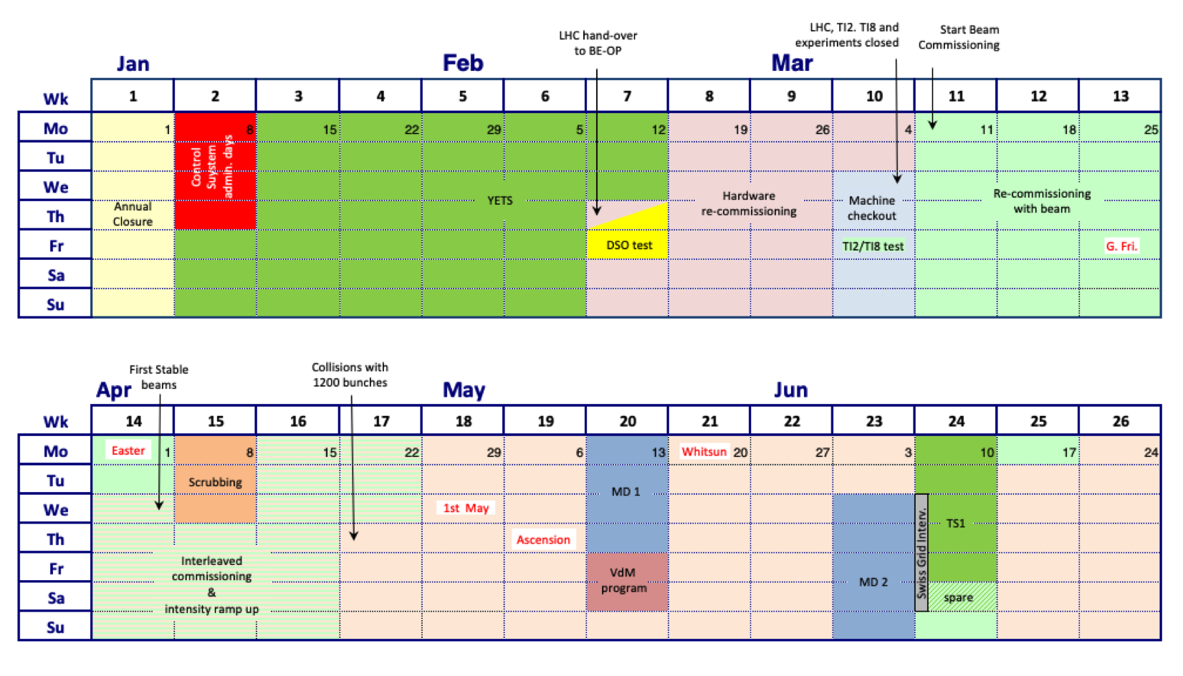
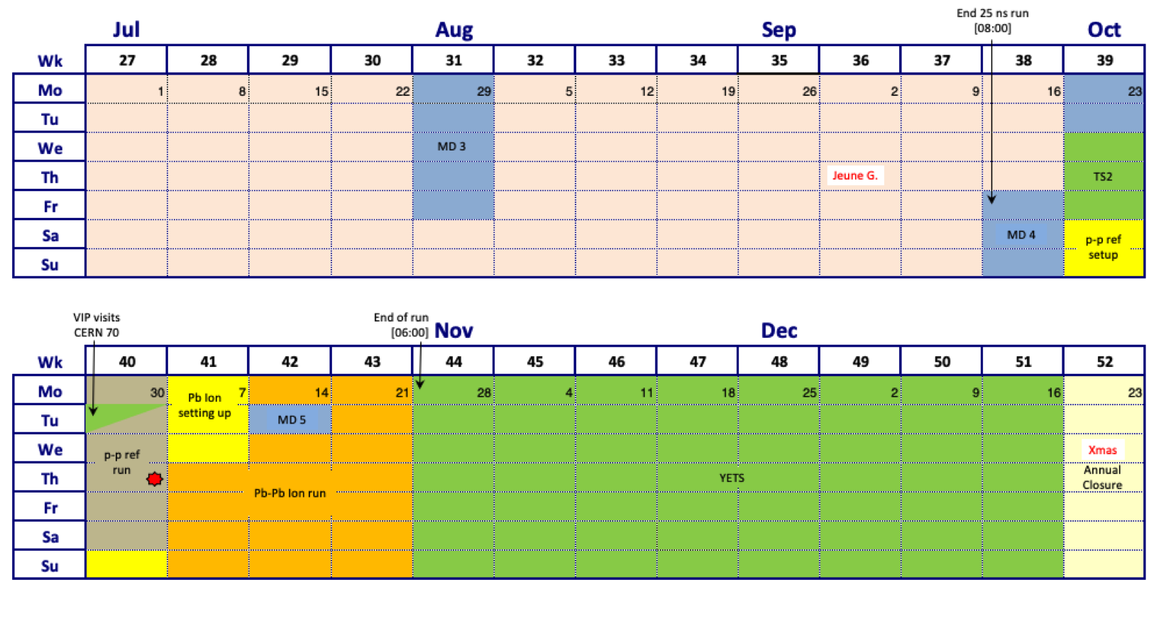
20 days of MDs
https://edms.cern.ch/document/2872429/1.0

