Slide 1
PUR Jack Taskforce
Meeting #5 13/02/2024
P. Bestmann

Slide 2
Agenda
Minutes approval
  Any comments or remarks for the minutes of the Meeting No. 4?
Latest News
  Tracing
  Test jacks in SPS and NA
  TI2 and TI8 inspections
Ongoing Tests
  Mechanical simulations
  Ageing tests and sample fabrication
  Radiation tests
Consolidation Plan for YETS 24/25 and LS3

Slide 3
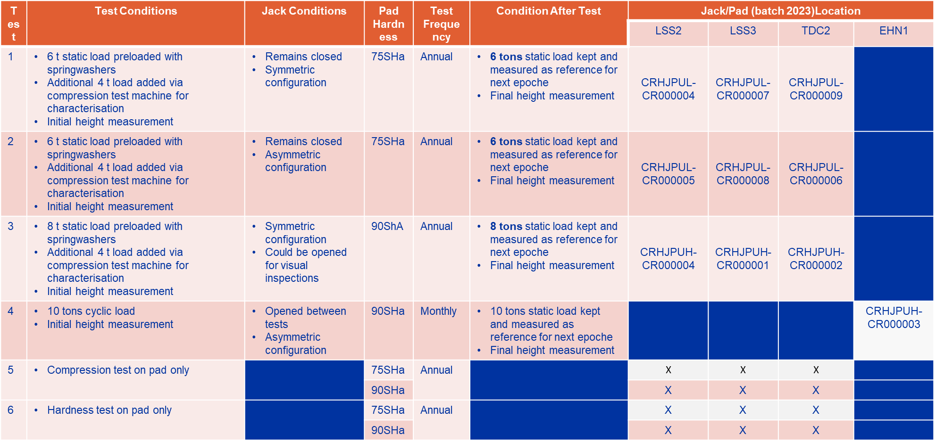
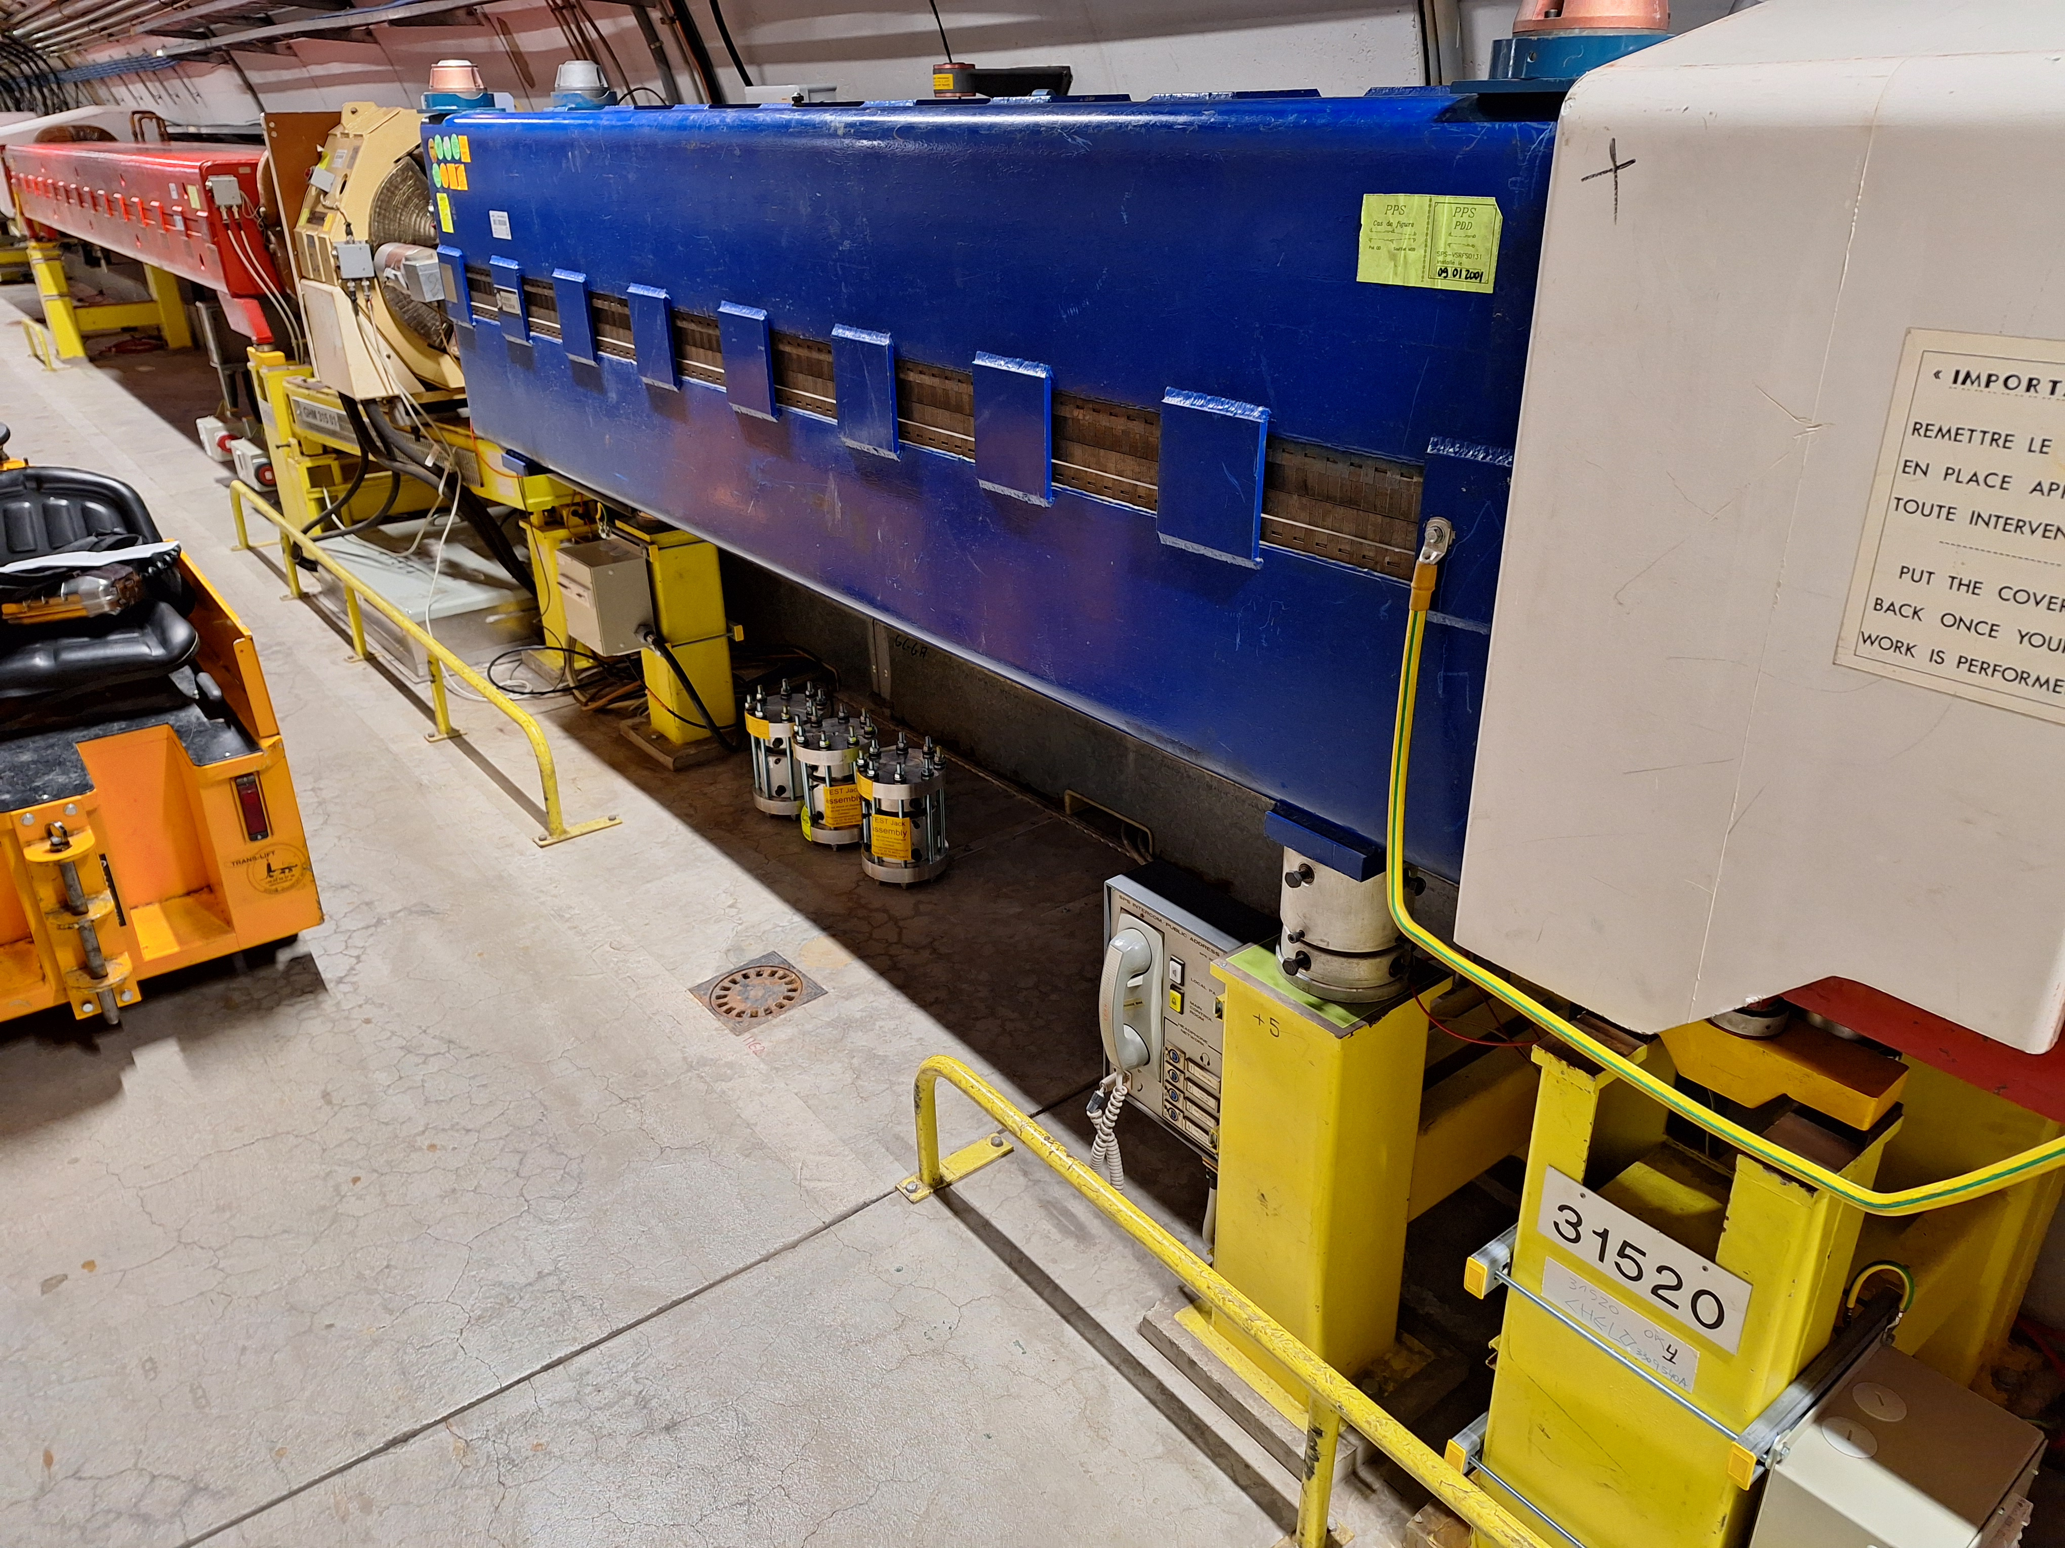
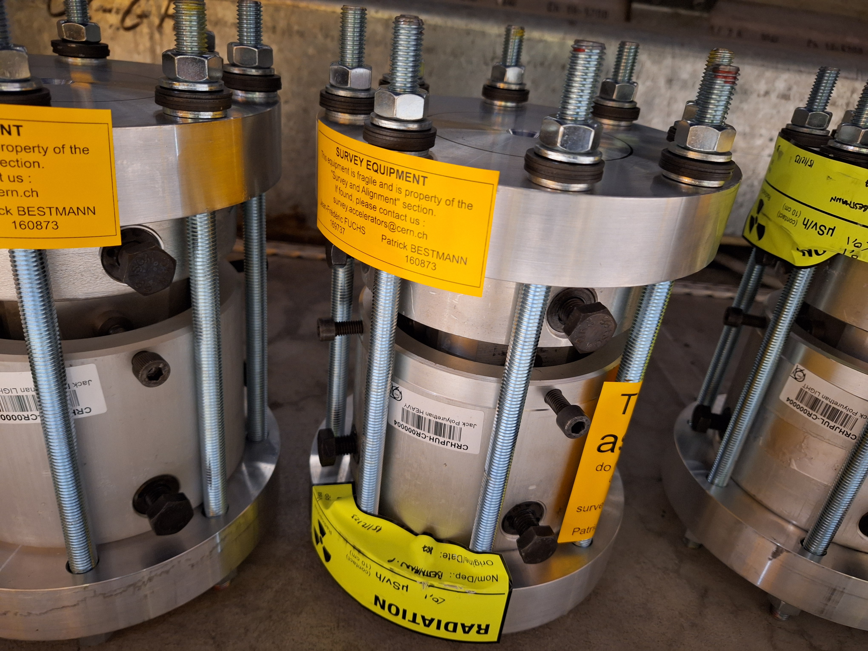
Latest news
Tracing
  The SPS Ring is fully traced, found some NC`s on jack types
  P42 started
SPS Test Jack assemblies tested and installed in the SPS

Slide 4
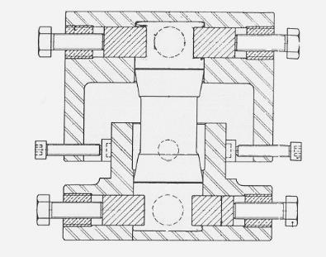
Latest news
TI2/TI8 Visual inspection
  Jacks are from 2005/2007
  No visual sign of defaults
  Surprising as the pads are the same failing in the SPS in 2019
  Need to understand the difference!
    Radiation?
New type of central column for SPS Jacks to be tested
  Replacing only central part
  With 2 spherical bearings
  Avoiding assymetric load on pads

Slide 5
Grease testing
  Possible candidate is MOLYCOTE PG-65 Plastislip
    It has excellent compatibility with plastics such as PET, HDPE, PTFE, nylon, and PBT and rubbers such as NBR, PIB, polyurethane, and neoprene. It has a low coefficient of friction and offers good lubricity at high operating speeds.
  Radiation tests in preparation
    R2M experts Dominika and Sonia started test campaign
    Lubrilog and PG-65 for radiation compatibility tests

Slide 6
Chemical testing
  Need to reproduce the pad liquifaction!
  Swelling tests on 75ShA pads are in preparation
    CRHJPULP-CR000007 white translucide
    CRHJPULP-CR000008 slightly yellow

Slide 7
Tracing
  Tracing structure in place
    SPS Fully traced
    Extracted Jacks traced as well and in preparation for mechanical tests
  Tests on extracted jacks in comparison to non exposed samples
    Mechanical tests
    Chemical analysis

Slide 8
Consolidation Plan
Important aspects
  We need to reproduce the pad liquifaction to be sure of the reason!
  We need to test PG-65 and Lubrilog in the same test conditions to validate those!
  Need to validate the radiation influence on the pads (hardening effect)
    This might lead to the observed breakdown in combination with assymetric load
  We need to reproduce the mechanical failure in the lab!
  We need to produce a new test jack avoiding assymetric load!
  We need to develop a consolidation plan from the YETS 2024/25 onwards
Practical aspects like tracing and procedures already in place
  Introduce this for all other lines

Slide 9
Ongoing / upcoming Tests
  Molycote BBR2 compatibility test Roland ongoing
  Compression tests with DIC (on pads) Mickael done
  Tensile tests (depending on samples) Mickael upcoming
  Creep tests (depending on samples) Mickael upcoming
  Swelling Tests (on pads) Benoit ongoing
  Compression Tests on Test Stands Michael done
  Radiation Test nTOF (pad+grease PG65/BBR2) Sonia ongoing
  Radiation Test on full jack gamma facility Sonia upcoming

