Slide 1
Motorized Adapters Polyurethane pastils Issue: accelerated ageing
Vincent Schenk and Jean-Sébastien Rigaud (TE/MSC/SMT, polymer lab)
12/02/2024

Slide 2
I. Accelerated ageing of PU: preliminary tests
  Reproduce PU sample failure under different conditions based on ASTM D543-95 “Evaluating the Resistance of Plastics to Chemical Reagents” Practice B “MECHANICAL STRESS AND REAGENT EXPOSURE”
  Ageing conditions based on previous accelerating ageing of polymide wire: “Environmental Stress Cracking of Thermoplastic Polyimide Insulated Wires”.

Slide 3
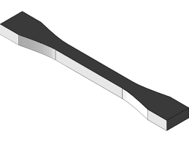
Accelerated ageing of PU: candidates suggested by the POLAB
  Test plan and ageing parameters:
  Materials: Synthene HPE 70, SikaBiresin UR350
  Duration: 168 hours
  Temperature: 60°C in a convection oven
  Properties monitored: Shore A hardness and tensile modulus
  Samples: 5 samples per configuration for reproducibility
  Ageing configuration:
          60°C + Molykote BR2 Plus
          60°C + Molykote BR2 Plus + 5% Strain
Shore A and tensile sample:
DIN 50125 Type E

Slide 4
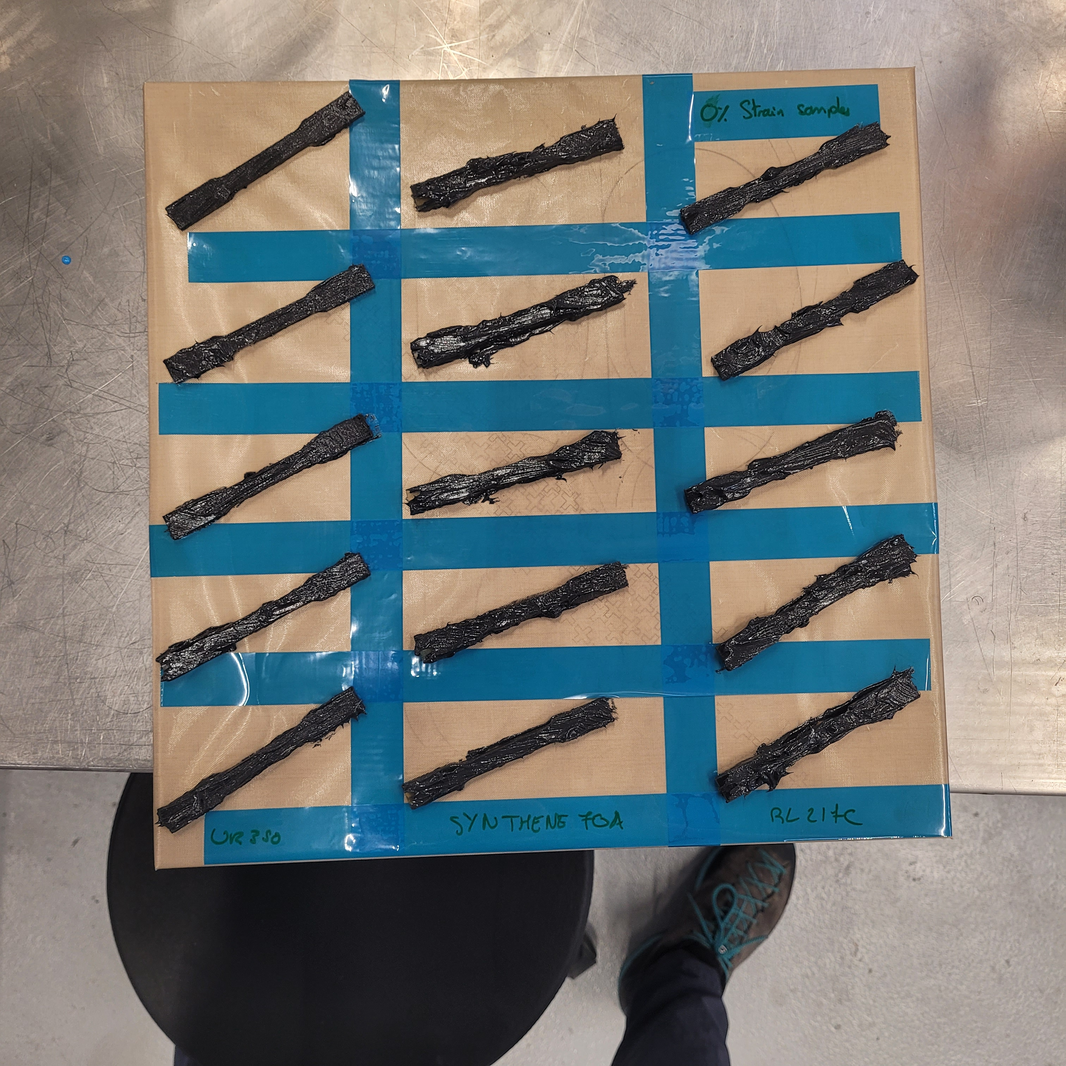
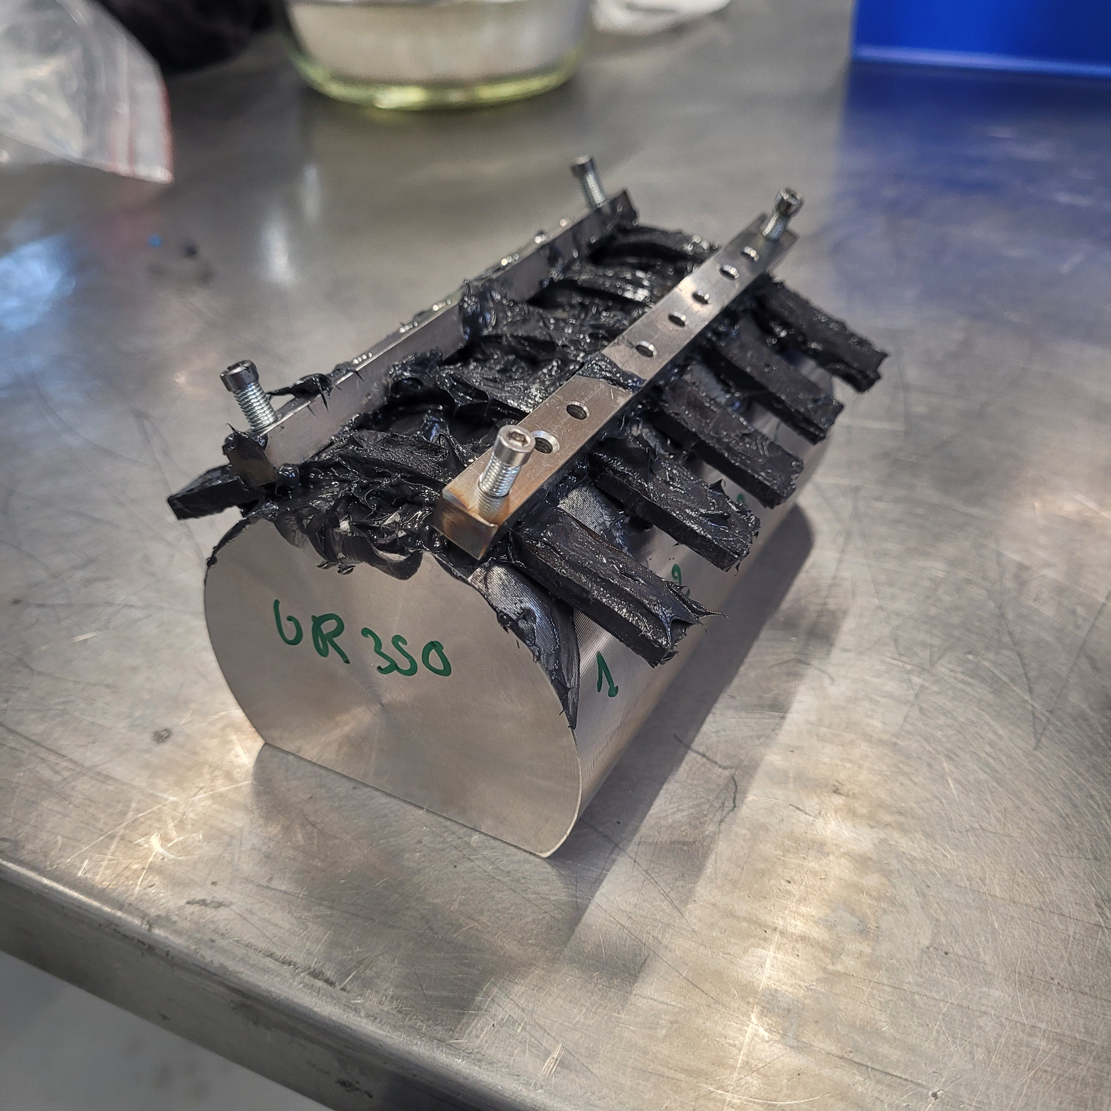
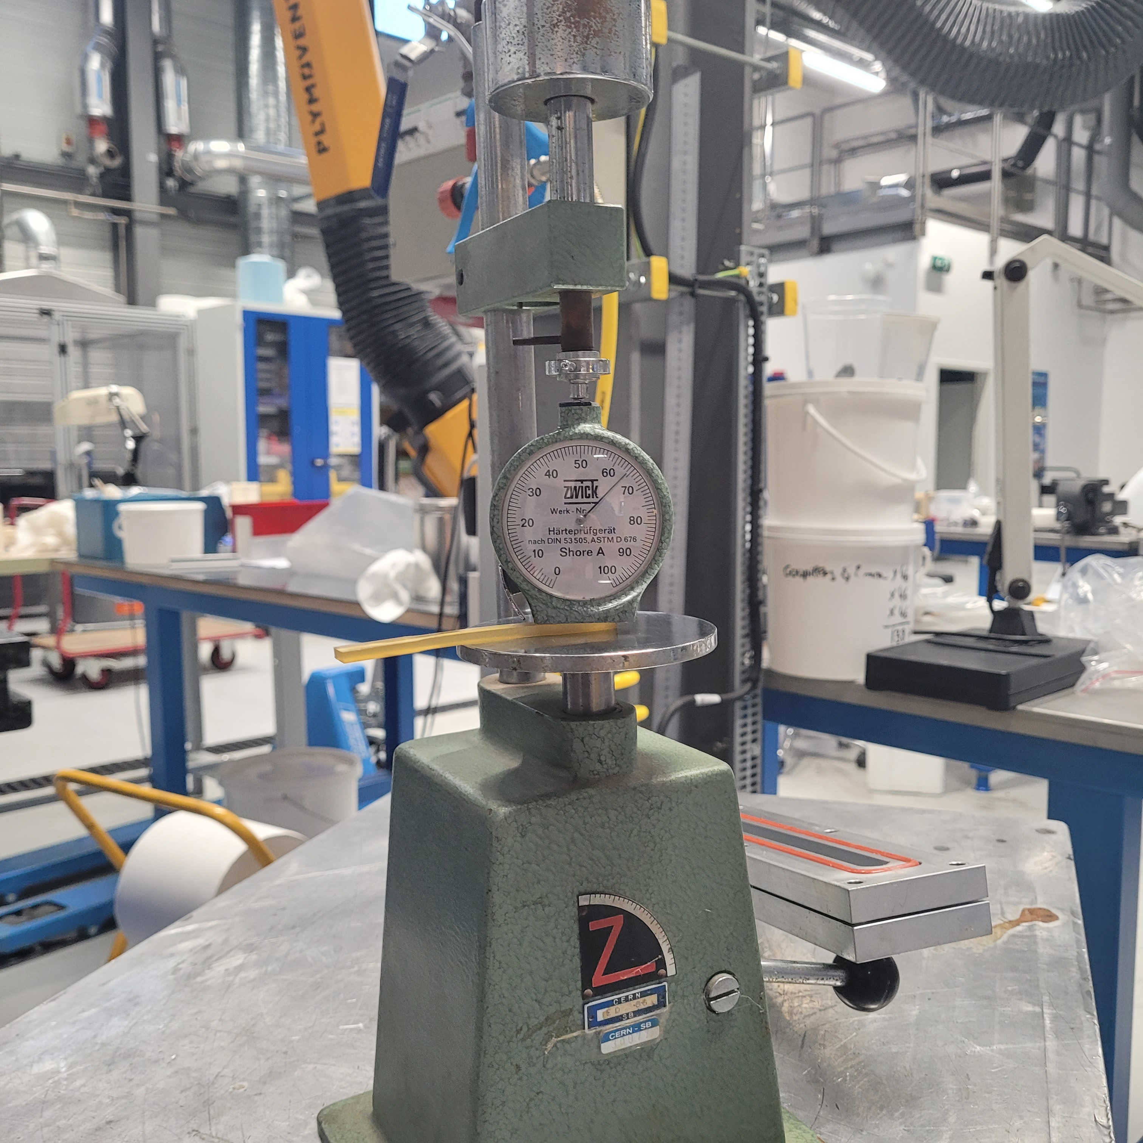
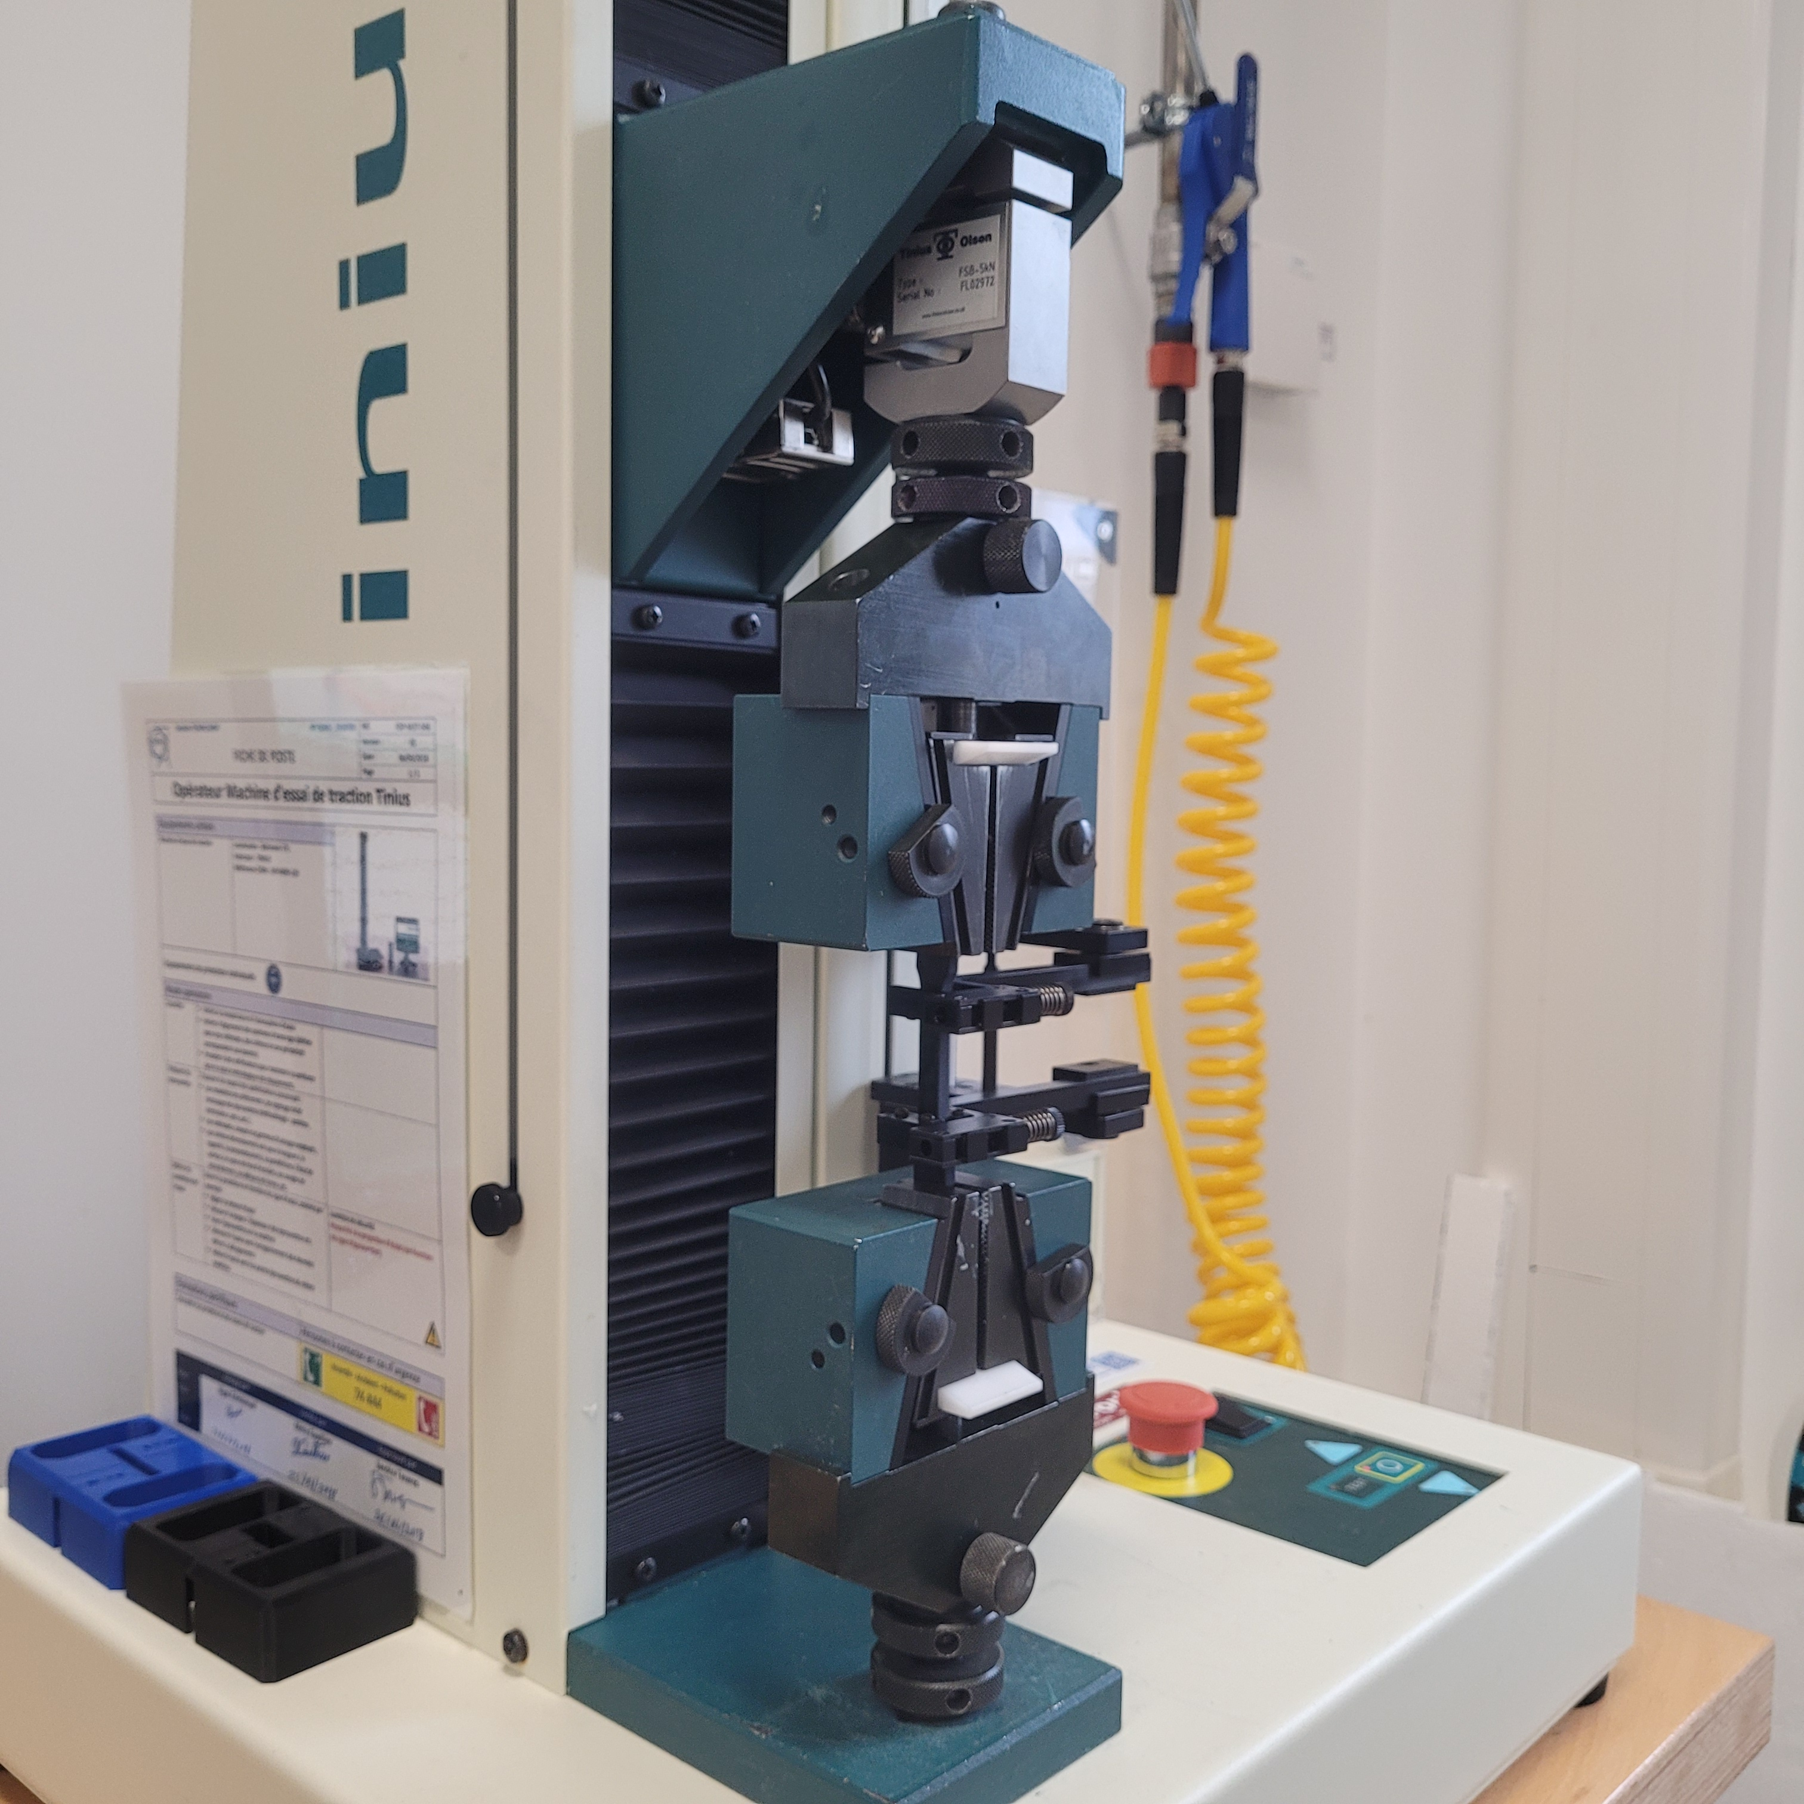
Ageing set-up and testing devices
Tensile sample cover with Molykote grease – no strain
Tensile sample cover with Molykote grease – 5% strain
Shore A measuring device
Tensile test device

Slide 5
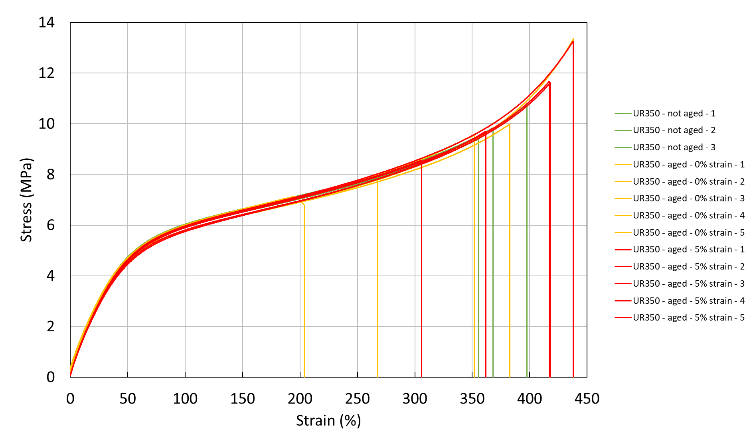
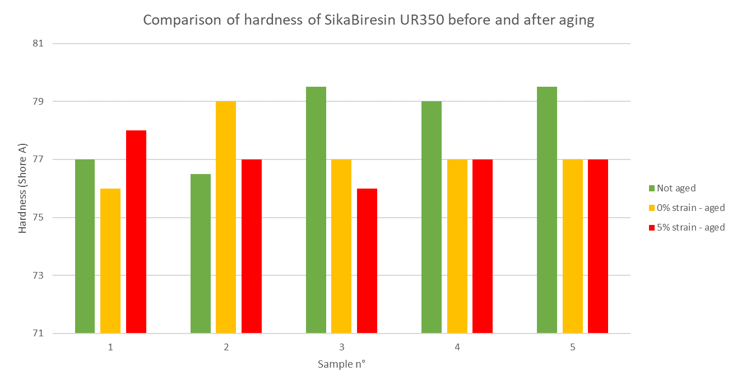
Test results
SikaBiresin UR350

Slide 6
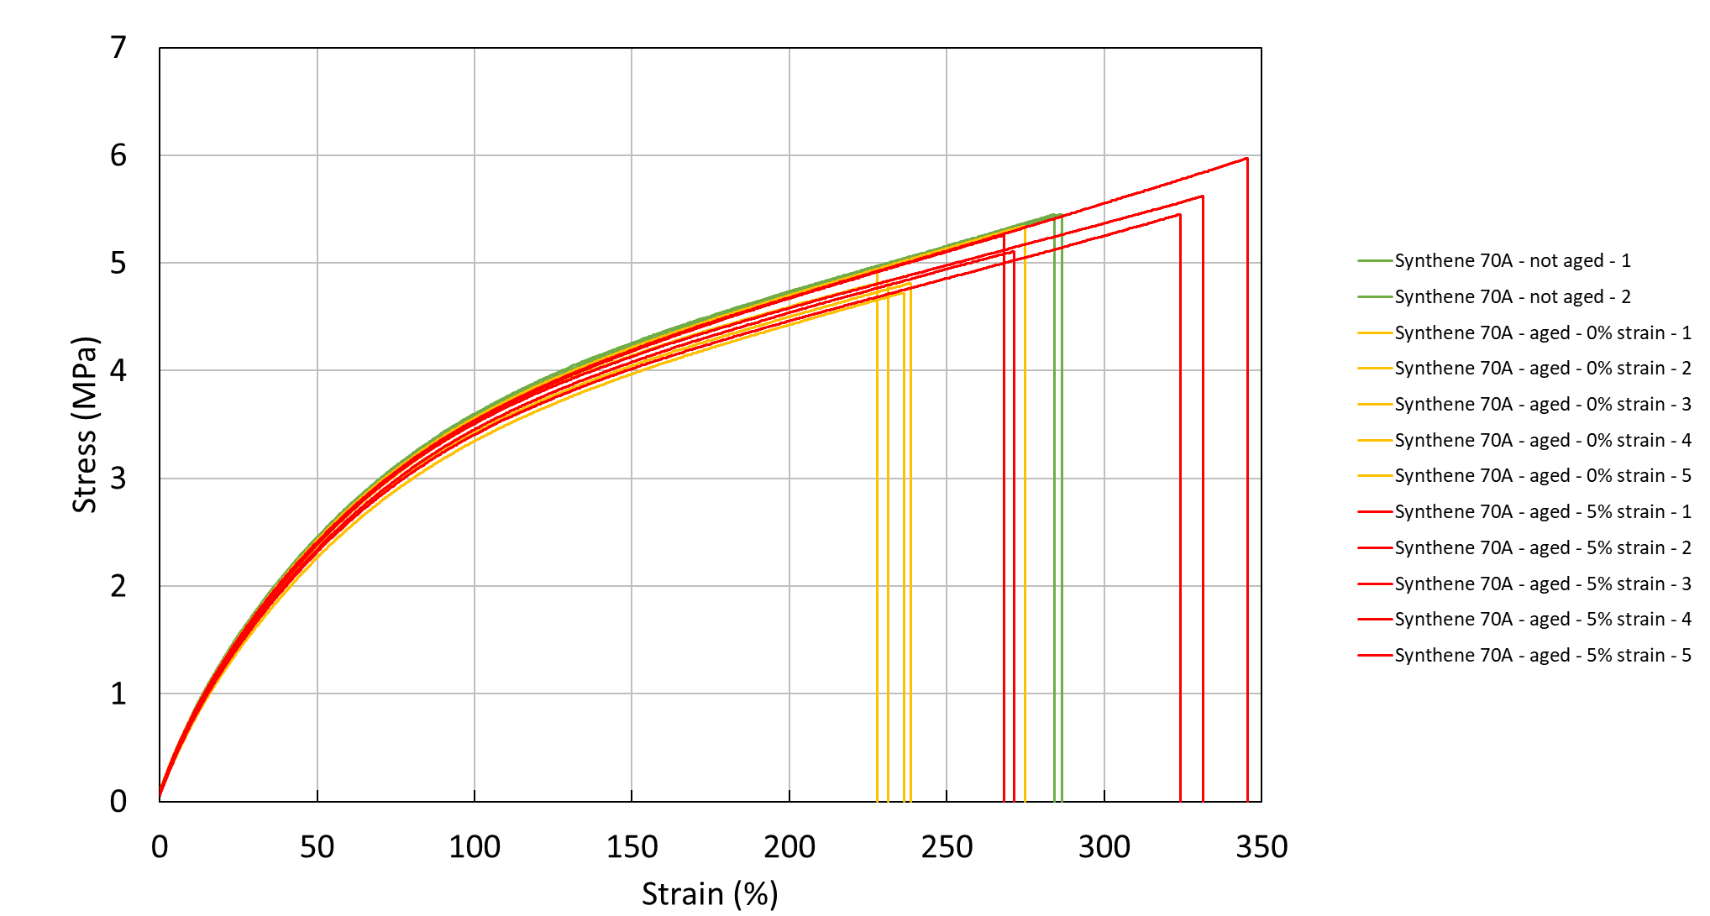
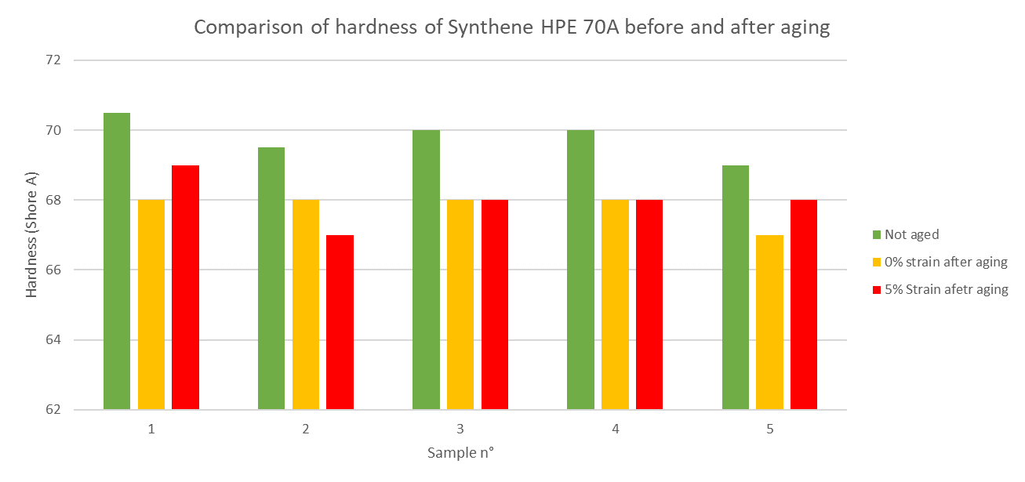
Test results
Synthene HPE 70A

Slide 7
Conclusion of preliminary tests
The preliminary tests didn’t reveal any significant degradation regarding the different polyurethanes : no visual, physical and mechanical changes.
Based on the tensile test, it appears that there is a large dispersion for the tensile stress and especially the elongation at break unlike the modulus which is more reliable to follow the degradation of the PU.
Ageing at 60°C for one week is not long and hot enough. To really hope to see a change, we will have to increase the temperature and extend the ageing time.
Finally, regarding the temperature and time on this test, the bending strain of 5% is probably not enough to aged the polyurethane.

Slide 8
II. Accelerated ageing of PU
  Different studies will be conducted:
  Understand and reproduce PU sample failure under different conditions (high temperature and grease) with PU available in the POLAB
  If successful, apply previous study to A&P PU samples and compare chemical compatibility with Molykote BR2+
  Use the properties monitored and extrapolate them using a thermokinetic software to define a lifetime

Slide 9
Accelerated ageing of POLAB’s PU
  Test plan and ageing parameters:
  Materials: Synthene HPE 70, Sikabiresin UR350 and Molykote BR2+
  Duration: to be determined during the ageing
  Temperature: 3 to 4 isotherms depending on TGA/DSC results (80 < T°C < 120)
  Properties monitored: Shore A hardness, compression modulus (NDT to reduce the number of samples) or tensile strength/strain at break (destructive)
  Samples: 1/3 samples per configuration for reproducibility
  Ageing configuration:
  Synthene HPE 70 = 8
  Sikabiresin UR350 = 8
  Total of 16 samples to produce per isotherm
Shore A sample:
Ø = 20 mm, h = 4 mm
ISO 868
Test \ Configuration | T°C | T°C + grease
Shore A | 1 | 1
Compression | 3 | 3
Compression sample:
Ø = 10 mm, h = 4 mm
Based on ISO 7743

Slide 10
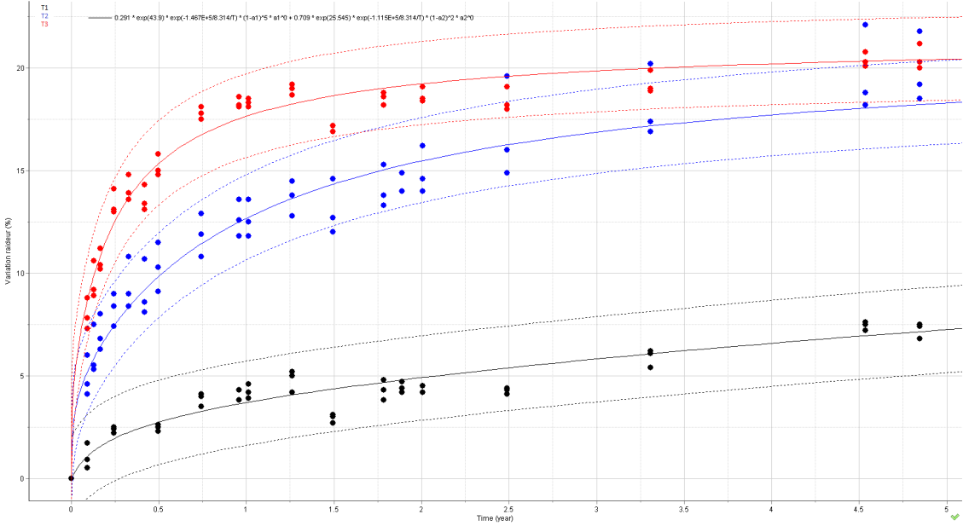
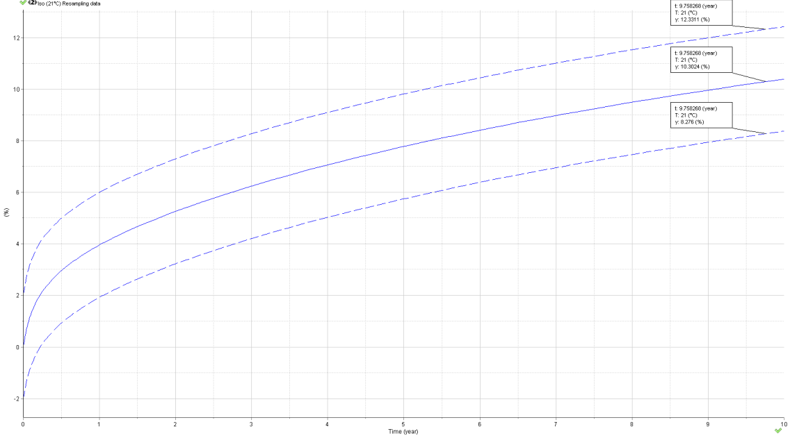

Accelerated ageing of PU: thermokinetic analysis
  To avoid a premature failure of PU pads in the future, a thermokinetic analysis could be carried out to estimate their lifetime:
  Monitoring properties (shore A, compression modulus…) during the accelerated ageing at different isotherms
  Use of a thermokinetic software called AKTS-Thermokinetics and enter data obtained at different isotherms and ageing durations
  Fit a model (based on Arrhenius-type law) with the experimental data and extrapolate to longer times, and define the lifetime of the material studied
Experimental data:
Prediction:

