Slide 1
Vérins polyurethane - tests https://edms.cern.ch/document/3001273/
S. Girod

Slide 2
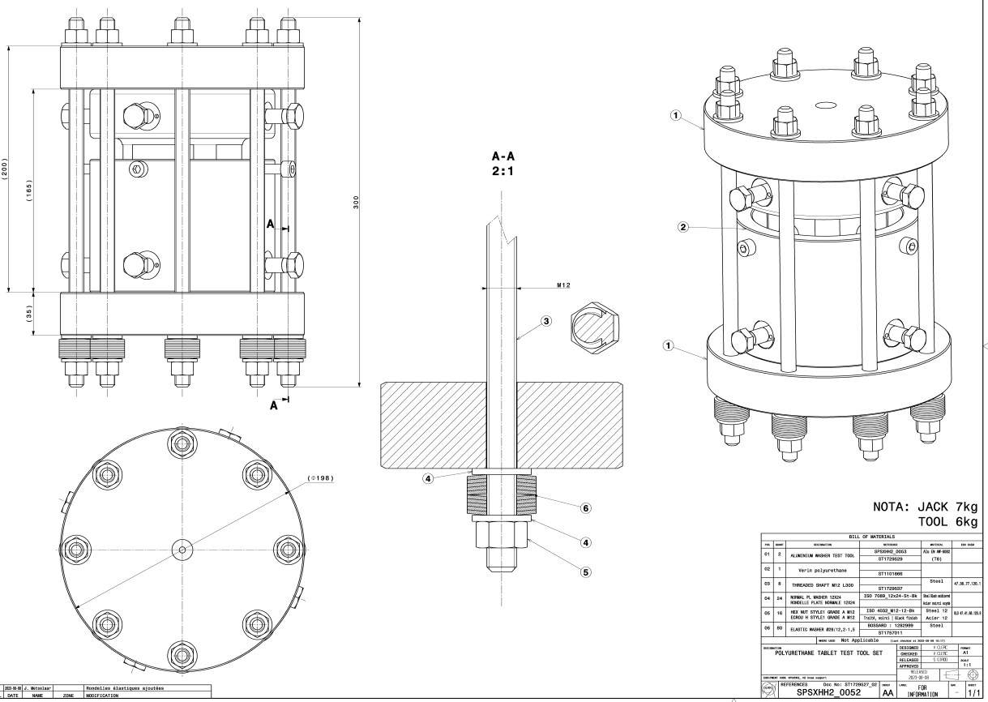
SPSXHH2_0052-AA https://edms.cern.ch/document/2906562/
10x assembly available W 39 (29 Sep)

Slide 3
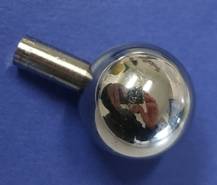
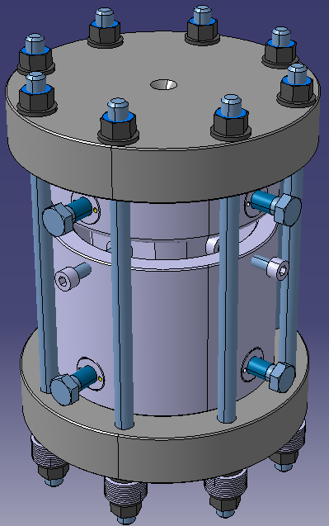
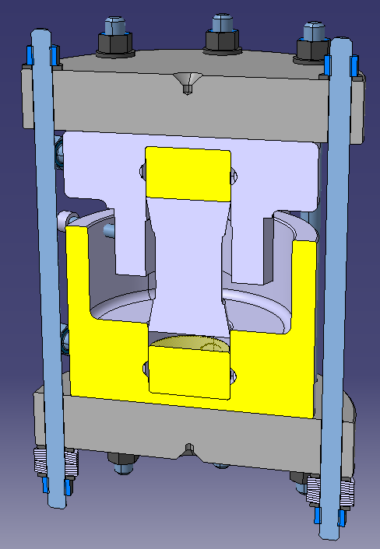
ST1729527 (SPSXHH2_0052-AA)
Centering cone for height measure with a sphere Ø16 mm
Gap 5 mm
h
8x M12
800 mm
Spring whashers

Slide 4
Programe de tests 2023
Test | Test Conditions | Jack Conditions | Pad Hardness | Test Frequency | Condition After Test | Jack/Pad (batch 2023)Location
 |  |  |  |  |  | LSS2 | LSS3 | TDC2 | EHN1
1 | 6 t static load preloaded with springwashers Additional 4 t load added via compression test machine for characterisation Initial height measurement | Remains closed Symmetric configuration | 75SHa | Annual | 6 tons static load kept and measured as reference for next epoche Final height measurement | CRHJPUL-CR000004 | CRHJPUL-CR000007 | CRHJPUL-CR000009
2 | 6 t static load preloaded with springwashers Additional 4 t load added via compression test machine for characterisation Initial height measurement | Remains closed Asymmetric configuration | 75SHa | Annual | 6 tons static load kept and measured as reference for next epoche Final height measurement | CRHJPUL-CR000005 | CRHJPUL-CR000008 | CRHJPUL-CR000006
3 | 8 t static load preloaded with springwashers Additional 4 t load added via compression test machine for characterisation Initial height measurement | Symmetric configuration Could be opened for visual inspections | 90ShA | Annual | 8 tons static load kept and measured as reference for next epoche Final height measurement | CRHJPUH-CR000004 | CRHJPUH-CR000001 | CRHJPUH-CR000002
4 | 10 tons cyclic load Initial height measurement | Opened between tests Asymmetric configuration | 90SHa | Monthly | 10 tons static load kept and measured as reference for next epoche Final height measurement |  |  |  | CRHJPUH-CR000003 Sans plaques de compression
5 | Compression test on pad only |  | 75SHa | Annual |  | X | X | X
 |  |  | 90SHa |  |  | X | X | X
6 | Hardness test on pad only |  | 75SHa | Annual |  | X | X | X
 |  |  | 90SHa |  |  | X | X | X
CRHJPUL-CR000002 (75 ShA batch 2017)

Slide 5
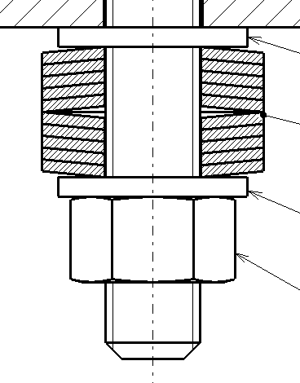
rondelles ressort Ø12.2/30 ep 1.5 acier ressort (BN806)
rondelle ressort Ø12.2/30 ep 1.5 acier ressort 42-52 HRC (BN806)
ecrasement | ep rondelle [mm] | Ecrasement/rondelle [mm] | charge [daN] | raideur [daN/mm] | nombre vis M12 | nombre de rondelles | tot load [daN]
0% | 2.25 | 0 | 0 |  | 8 | 5 | 0
50% | 1.875 | 0.375 | 215.9 | 575.73 | 8 | 4 | 6908.8
75% | 1.6875 | 0.5625 | 307.7 | 547.02 | 8 | 4 | 9846.4
80% | 1.65 | 0.6 | 324 | 540.00 | 8 | 3 | 7776
90% | 1.575 | 0.675 | 360.3 | 533.78 | 8 | 3 | 8647.2
95% | 1.5375 | 0.7125 | 374.775 | 526.00 | 8 | 2 | 5996.4
100% | 1.5 | 0.75 | 390 | 520 | 8 | 2 | 6240
1.35
1.425
8t
6t

Slide 6
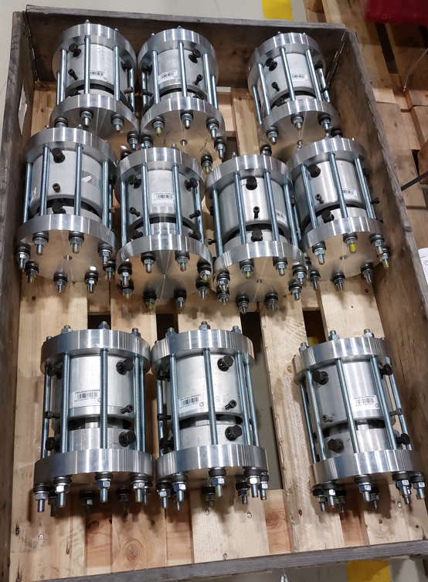
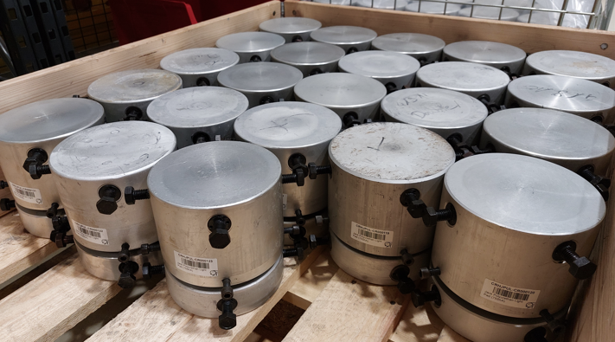
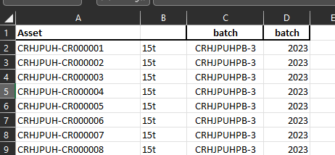
Verins de tests
~120 vérins rénovés
En cours d’ installation sur H6 H8
Asset / batch /slots association

Slide 7
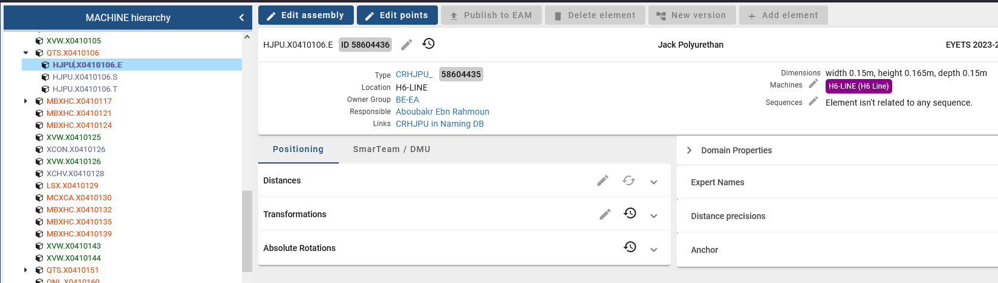
Layout database
https://layout.cern.ch/elements?navigator=MACHINE&version=EYETS%202023-2024&id=58604436&parentId=56055903&tab=BASIC_ELEMENT
Slots created for jacks
Tilt jack a left side

