Slide 1
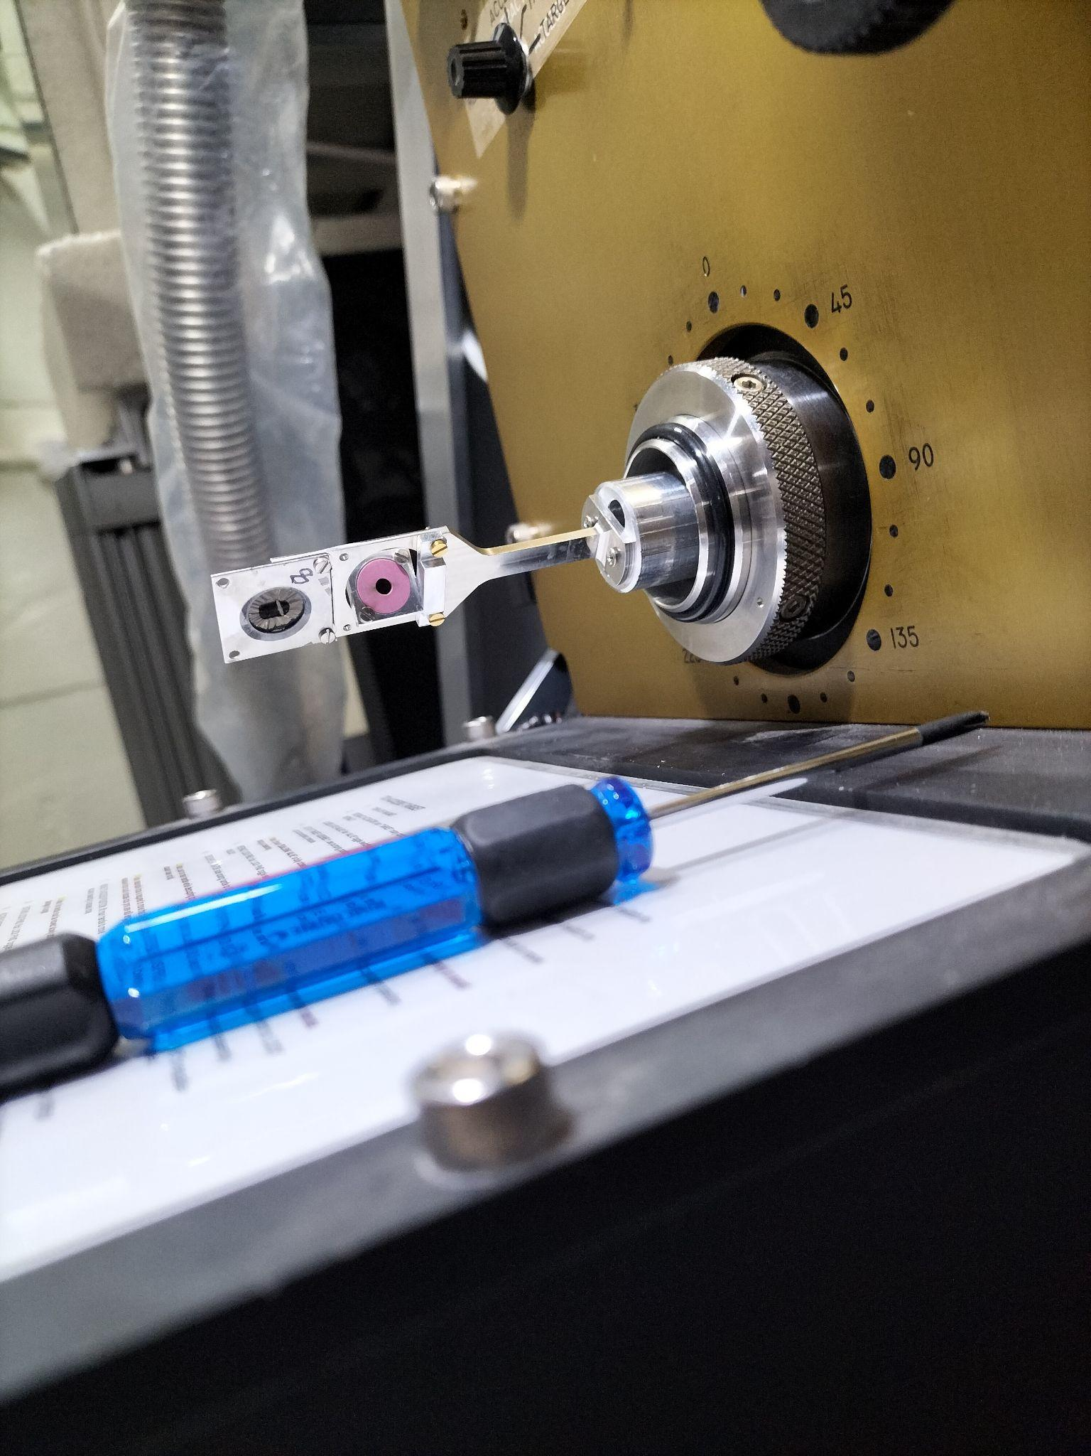
Shape Coexistence in ²⁸Si
August 2024
Supervisor: Professor David Jenkins
Speaker: Jacob Towers
Email: jt1518@york.ac.uk

Slide 2
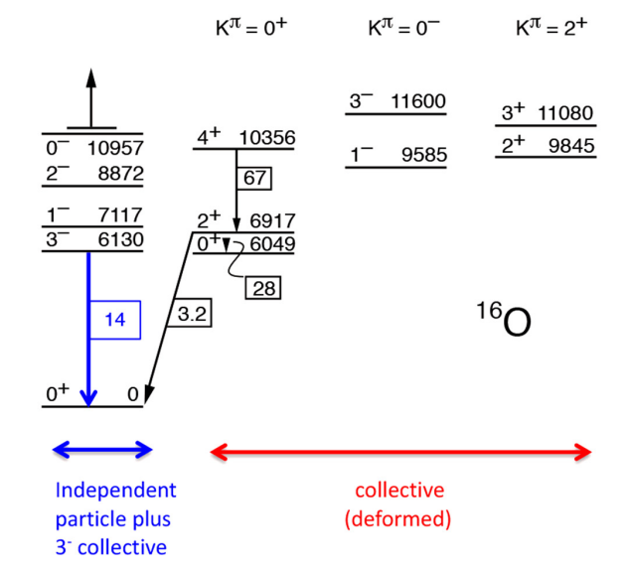
Shape Coexistence - What is it?
Shape coexistence refers to the observation of distinct collective configurations at low energies
A change in the deformation of the nucleus increases the binding energy, accounting for the energy discrepancy

Slide 3
Why does it matter?
It is impossible to explain some of the lowest lying excited states in nuclei without shape coexistence
This has become increasingly evident as we have progressed across the nuclear chart
This has effects on nuclear reaction cross-sections, particularly in nucleosynthesis
0₂⁺
7.65 MeV
0₁⁺
¹²C

Slide 4
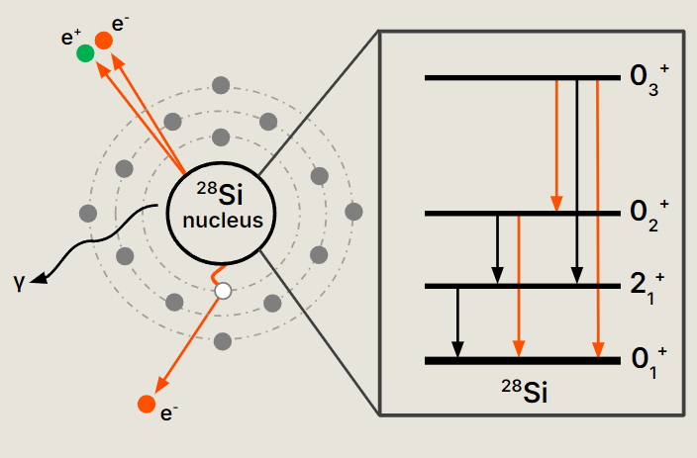
How do we investigate it?
IPF
Monopole (E0) transition strengths are directly related to changes in deformation and the mixing between the initial and final configurations
These components must conserve spin, through internal conversion (IC) or internal pair formation (IPF)
Single Photon
Emission
IC

Slide 5
Why ²⁸Si?
0₄⁺
E0 transition strengths have not been reported for ²⁸Si previously, and its oblate ground state is uncommon
Further, the 9.71 MeV 0₄⁺ state was recently identified for the first time by inelastic ⍺-scattering and is predicted to be the superdeformed bandhead
3.02 MeV
²⁴Mg + ⍺
0₃⁺
9.71 MeV
4.73 MeV
¹⁶O + ¹²C
1.71 MeV
0₂⁺
6.69 MeV
²⁰Ne + ⁸Be
4.98 MeV
0₁⁺
²⁸Si

Slide 6
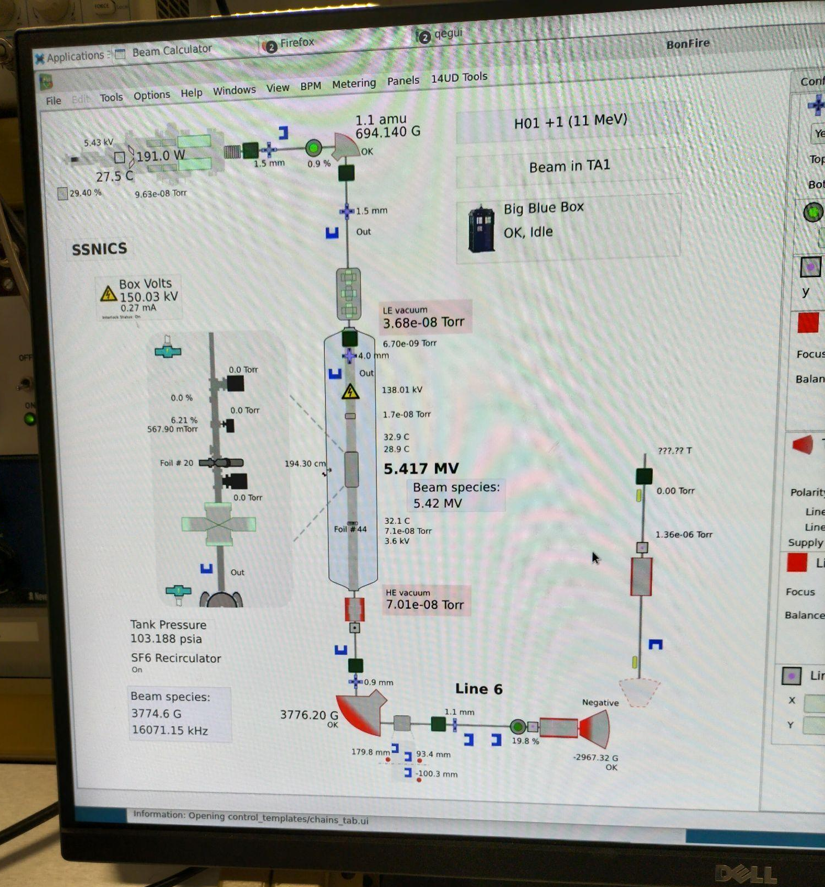
The First Experiment
A 2 week investigation took place at the Australian National University (ANU) using the 14UD accelerator in November 2023
Protons were accelerated onto a ²⁸Si target and data recorded by a single HPGe detector and the Super-e Pair Spectrometer

Slide 7
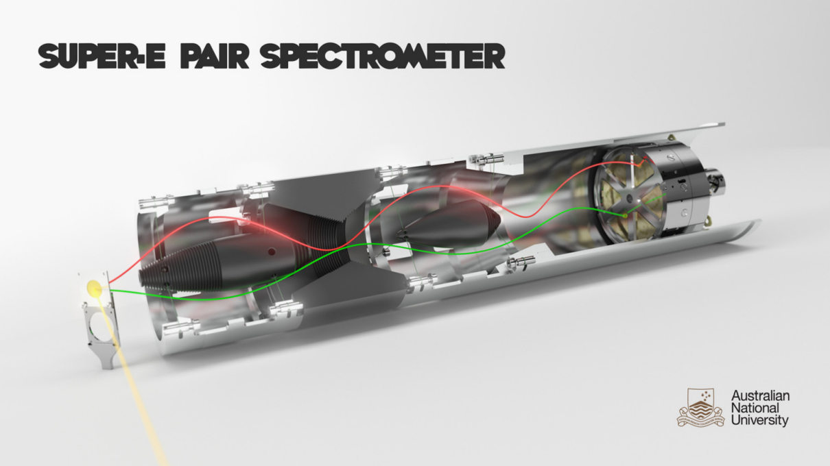
Superconducting coils (not pictured)
Electron
Positron
²⁸Si Target
The Miel detector array
Boron-loaded
Aluminium Oxide
(not pictured)
Baffles
Incident Protons

Slide 8
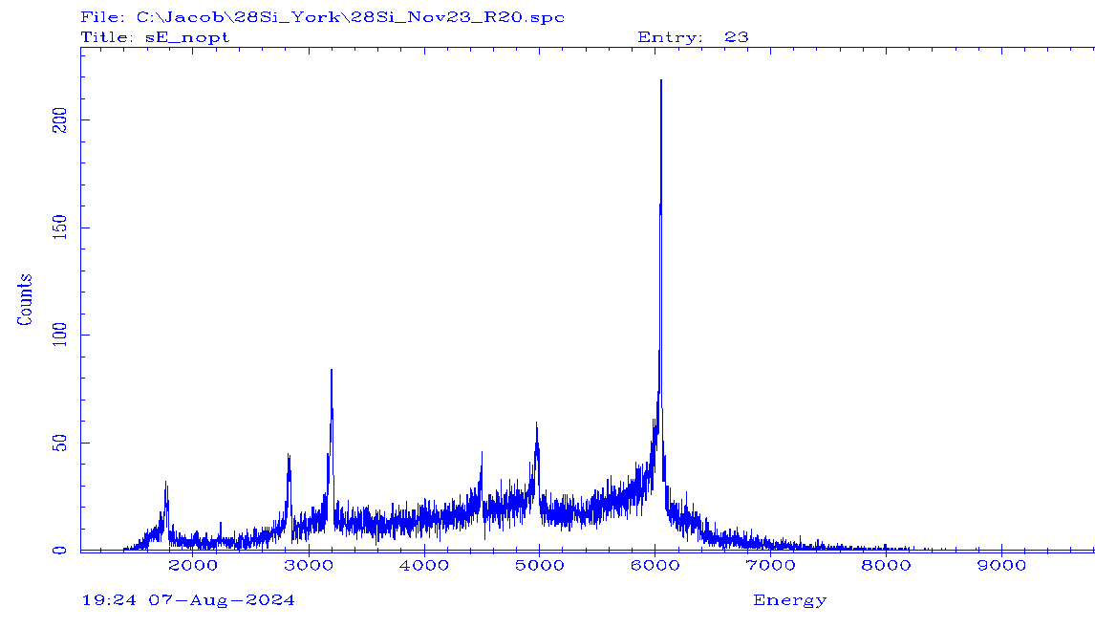
Initial Analysis
¹⁶O contamination (0₂⁺ → 0₁⁺)
0₄⁺ ?
0₂⁺ → 2₁⁺
0₂⁺ → 0₁⁺
2₁⁺ → 0₁⁺
4₁⁺ → 0₁⁺
4₁⁺ → 2₁⁺
0₃⁺ → 0₂⁺
0₃⁺ → 0₁⁺

Slide 9

Future Runs
A 4 month placement at ANU is planned, beginning February 2025.
The initial aim is to obtain more counts for the decays from the 0₃⁺ state
The beam energy will then be increased to target the 0₄⁺ state

Slide 10
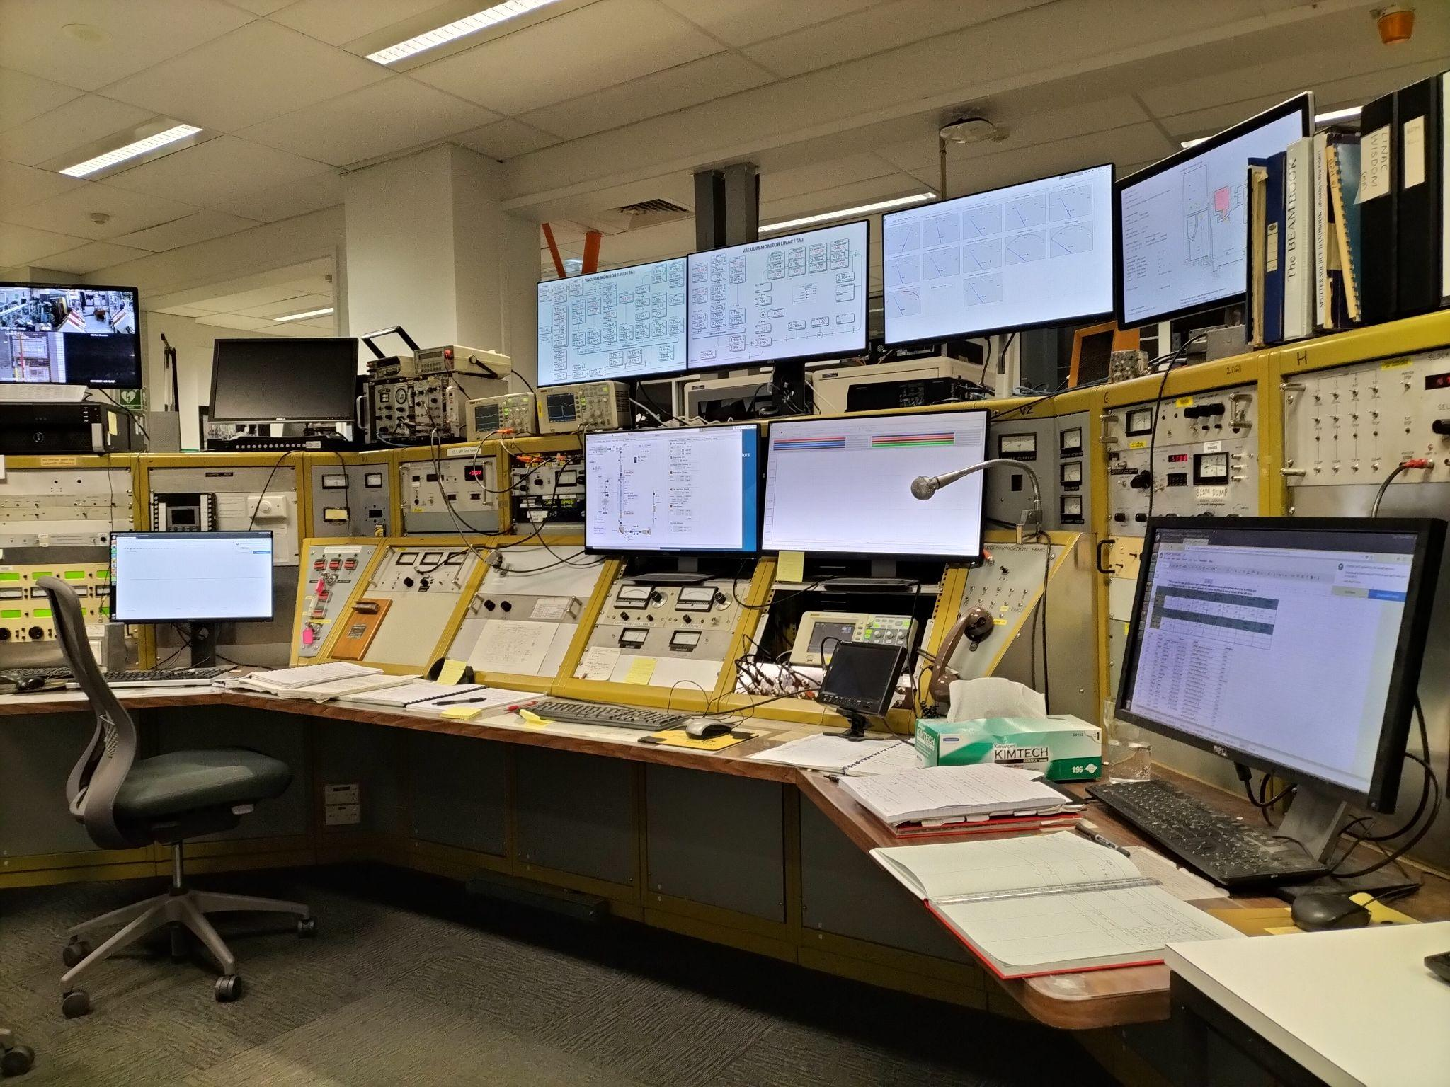
Bibliography
D G Jenkins and J L Wood 2023 Nuclear Data: A Collective Motion View (Bristol: IOP Publishing)
P Adsley et al. 2017 ⍺ clustering in ²⁸Si probed through the identification of high-lying 0⁺ states Phys. Rev. B 95 024319
P Adsley et al. 2021 Isoscalar monopole and dipole transitions in ²⁴Mg, ²⁶Mg, and ²⁸Si Phys. Rev. C 103 044315
J T H Dowie et al. 2020 Evidence for Shape Coexistence and Superdeformation in ²⁴Mg Phys. Lett. B 811 135855
Any Questions?

Slide 11
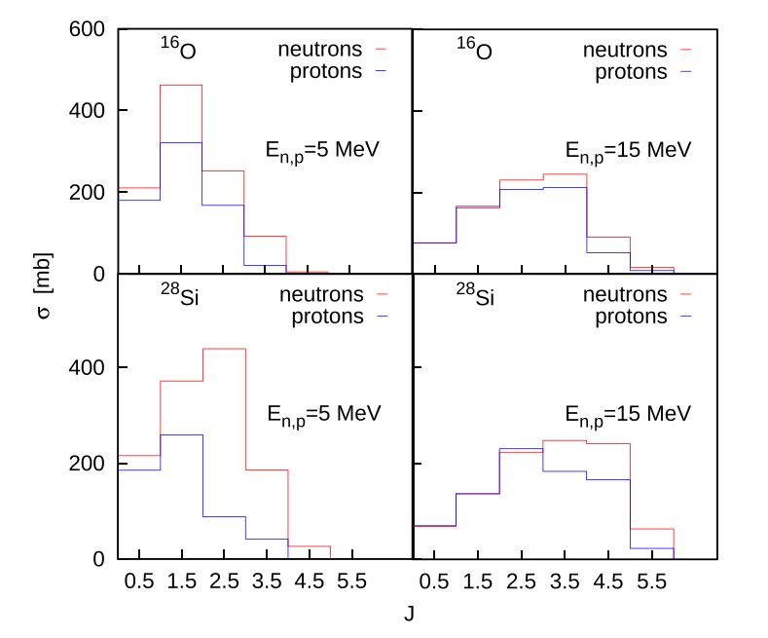
Why proton scattering?
Heavy ion fusion-evaporation reactions favour the population of high energy, high spin states
Inelastic electron scattering depends on theoretical models to estimate E0 transition strengths
Inelastic nucleon scattering allows for model-independent analysis of monopole transitions
Protons favour the population of low spin states at low incident energies
M Boromiza et al. 2020 Nucleon inelastic scattering cross sections on ¹⁶O and ²⁸Si Phys. Rev. C 101 024604

Slide 12
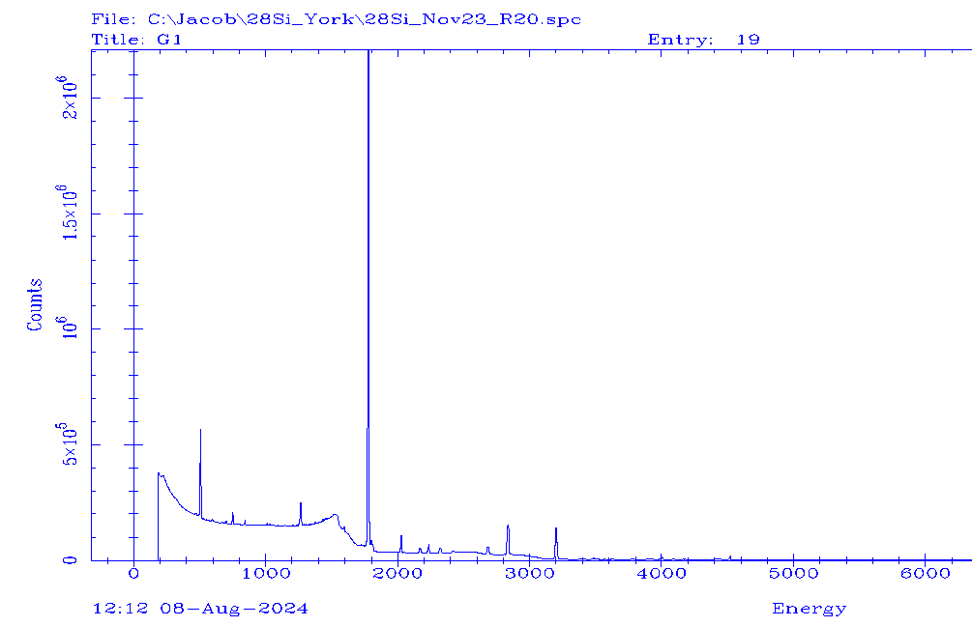
Why can we see other transitions?
Many transitions have a monopole component
This is typically weaker than the other components, but is isolated in the pair spectrum
As for the 0⁺ → 0⁺ case, the strength of this component can indicate a change in deformation

