Slide 1
Particle Identification
PPD Lectures 2024
Antonis Papanestis
RAL – STFC

Slide 2
Outline
Introduction
Particle ID techniques:
  Time of flight
  dE/dx
  Transition radiation
  Cherenkov radiation
    RICH detectors
    DIRC detectors
Give examples of experiments and detectors

Slide 3
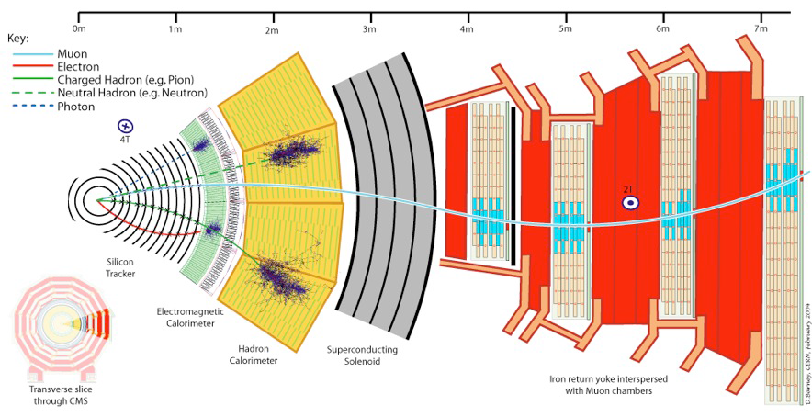
Introduction (i)
A “generic” particle physics experiment has “built-in” a lot of particle ID for:
Electrons, photons, neutrons and muons

Slide 4
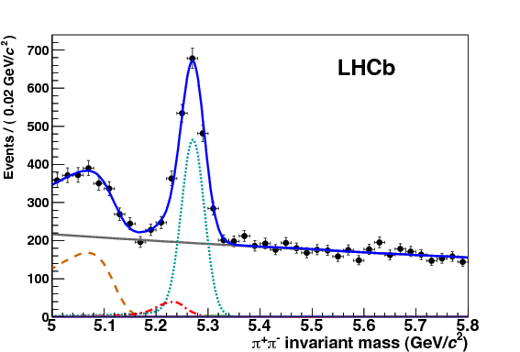
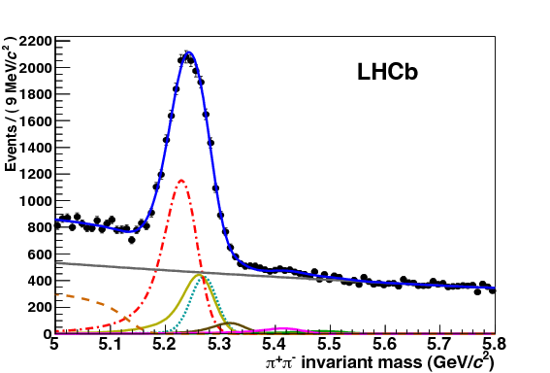

Introduction (ii)
Particle ID for hadrons
  Distinguish between kaons, pions, protons, deuterons
    Required for flavour physics
Specific experiment requirements
  Distinguish between electrons and charged pions
  Distinguish between electrons and muons
    For neutrino experiments
    For rare decay searches
$$B→π^{+}π^{−} (h^{+}h^{−})$$
before and after RICH PID

Slide 5
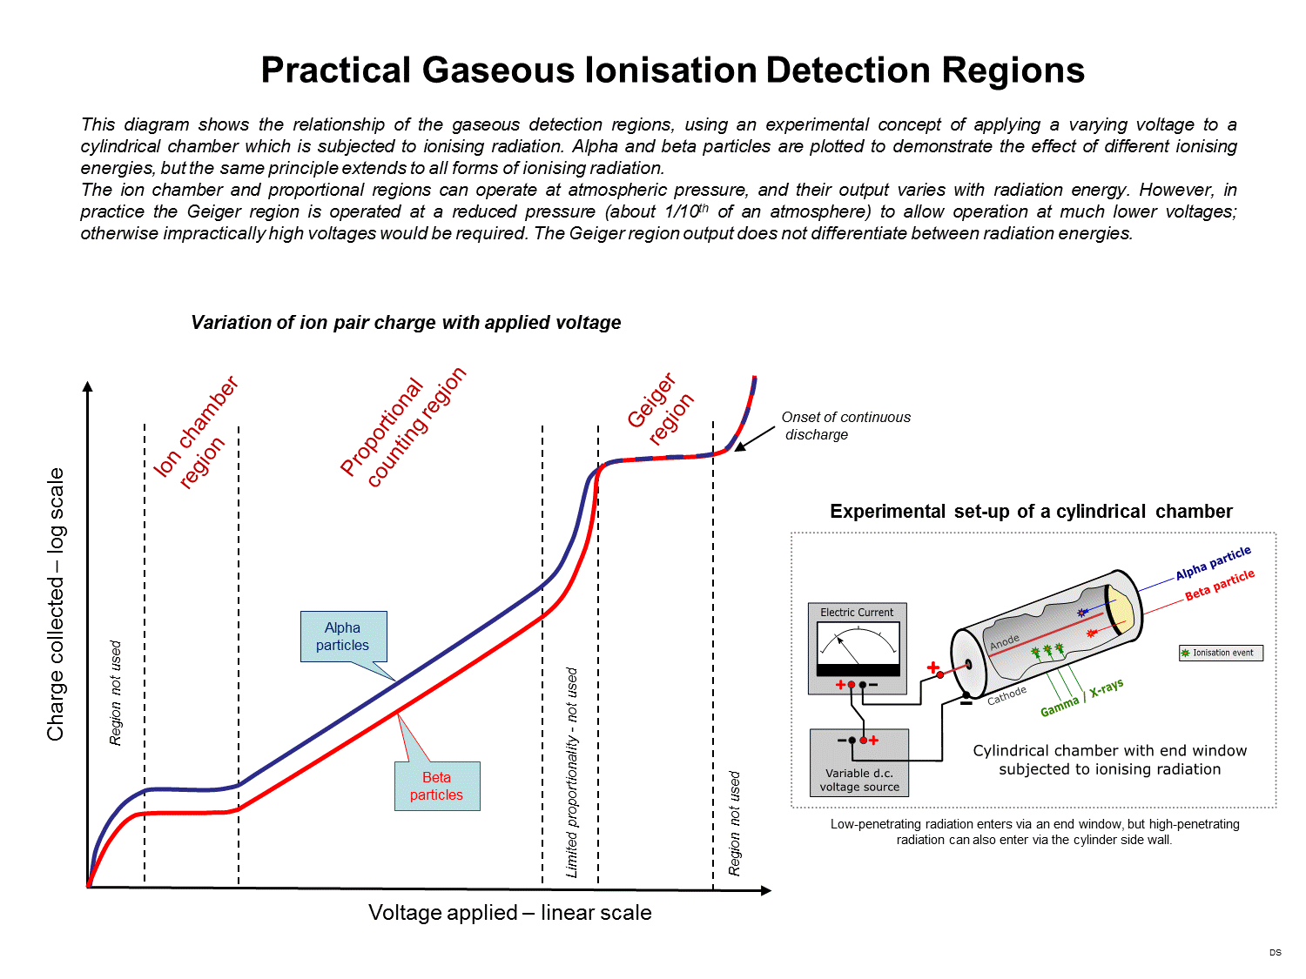
Detector technologies
From Wikipedia

Slide 6
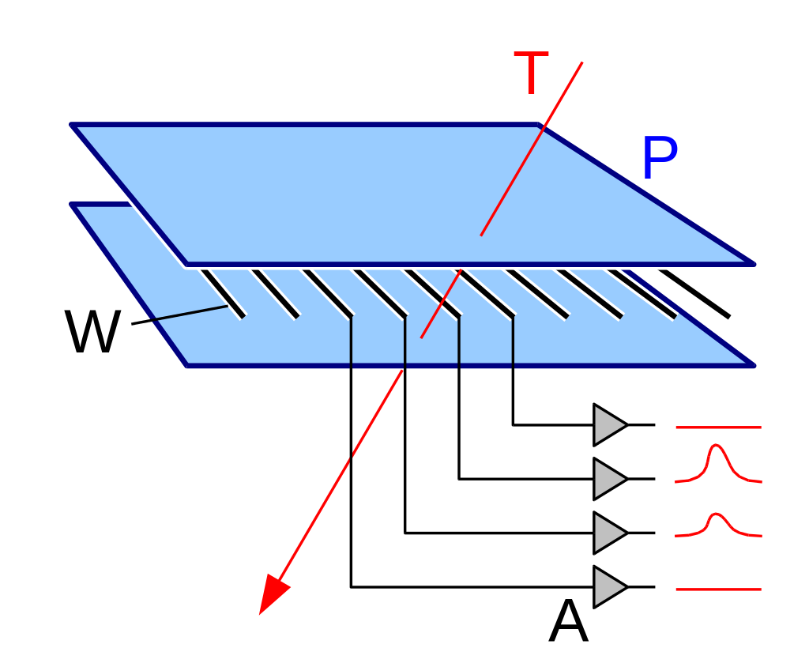
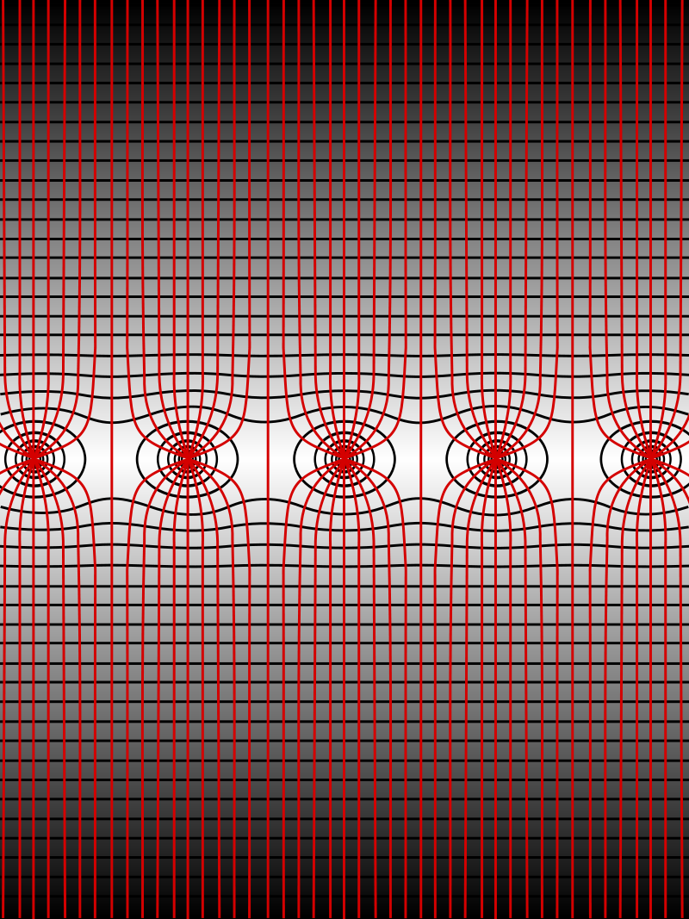
Multiwire proportional chamber
By Michael Schmid - CC BY-SA 3.0, https://commons.wikimedia.org/w/index.php?curid=442715
By Wiso - CC BY-SA 3.0, https://commons.wikimedia.org/w/index.php?curid=2934457

Slide 7
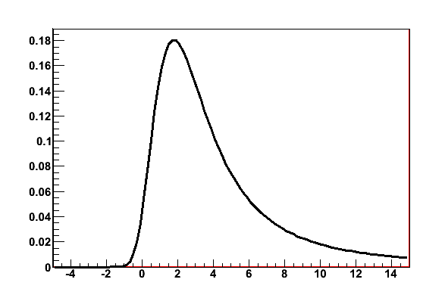
Landau distribution
Energy loss due to ionisation

Slide 8

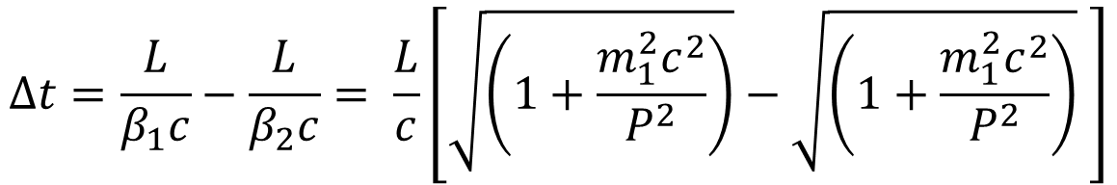
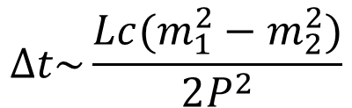
Time of flight
Time difference for two particles with masses m₁ and m₂ for length L and momentum P (which is given by the tracking system)
$$∆t=\frac{L}{β_{1}c}−\frac{L}{β_{2}c}= \frac{L}{c}\left[\sqrt{\left(1+\frac{m_{1}^{2}c^{2}}{P^{2}}\right)}−\sqrt{\left(1+\frac{m_{1}^{2}c^{2}}{P^{2}}\right)} \right]$$
$$P^{2}≫m^{2}c^{2}$$
$$∆t\sim \frac{Lc(m_{1}^{2}−m_{2}^{2})}{2P^{2}}$$
Mass resolution depends on time resolution of detectors and distance L
Typical values: L=3.5 m, Δt=100 ps, for 3 σ separation, P_{max}=2.1 GeV/c
Requires fast detectors: scintillation, Cherenkov, fast collection of ionisation

Slide 9
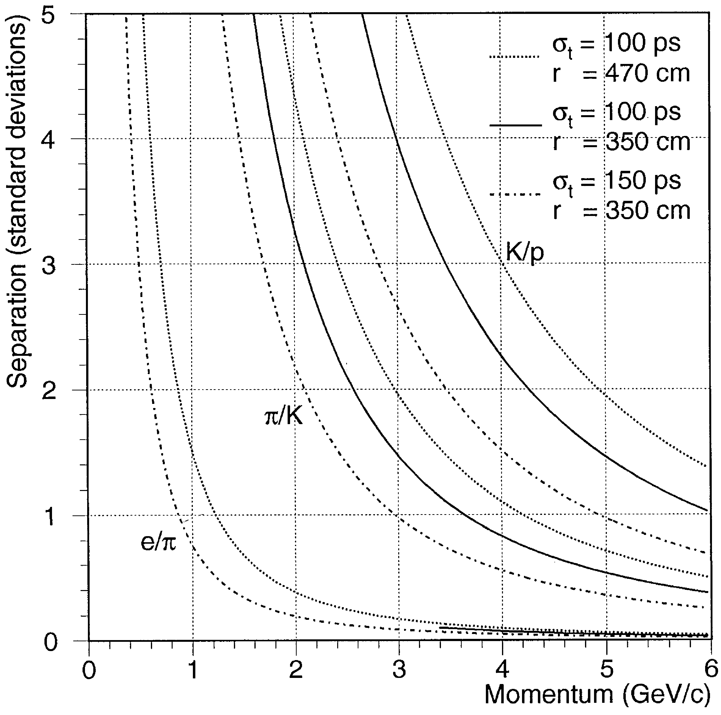
PID with TOF
Expected PID performance for various path lengths and time resolutions
In 100 ps light travels 3 cm
TORCH, a proposed future detector, can push π/K separation to 9 GeV/c with L~10 m and time resolution per track ~ 20 ps

Slide 10
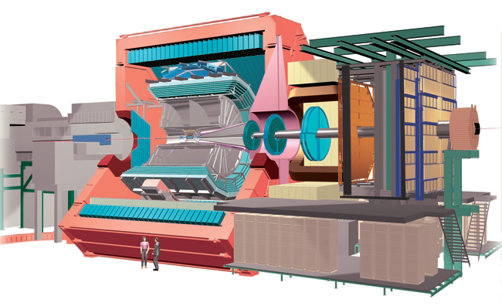
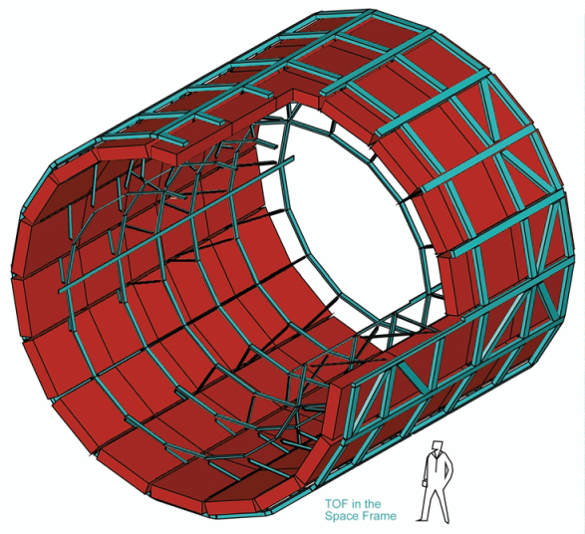
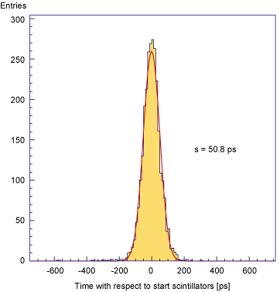
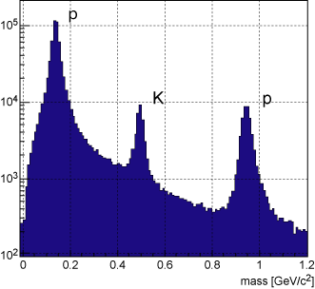
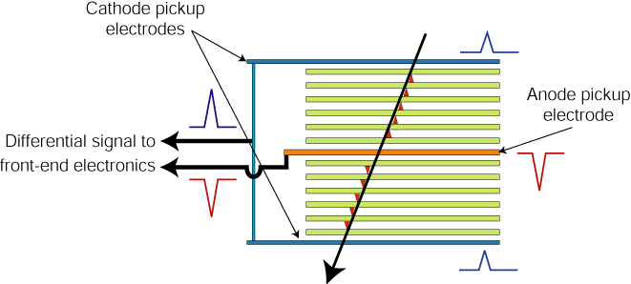
TOF: ALICE experiment
http://aliceinfo.cern.ch/Public/en/Chapter2/Chap2_TOF.html
Resistive plates made of glass.
2 X5 gaps : 250 mm
Readout by HPTDC chip (High Performance Time to Digital Converter)
σ=50.8ps
3σ π/K separation up to 2.2 GeV/c and K/p separation up to 4 GeV/c.

Slide 11
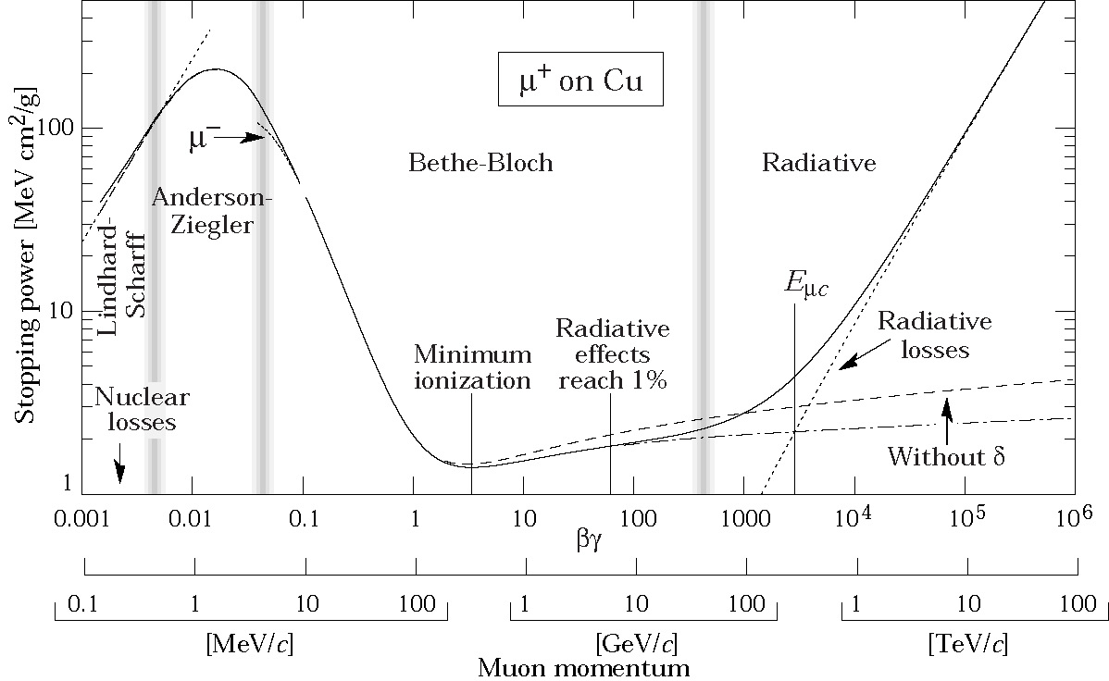



Ionisation Measurement (dE/dx)
Ionisation Constant for material
Density correction
Max energy in single
collision
$$1/{β^{2}}$$
$$\ln{(γ)}$$
$$K=4πNr_{e}^{2}m_{e}c^{2}$$

Slide 12
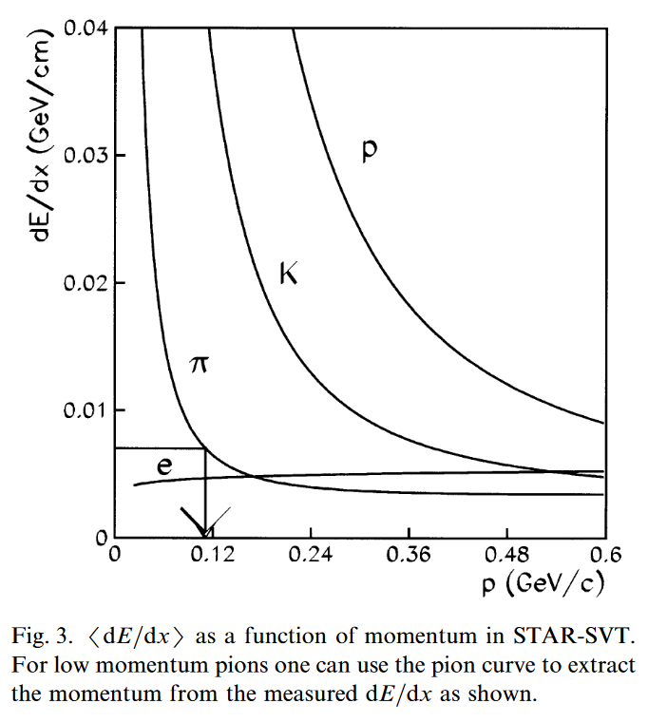
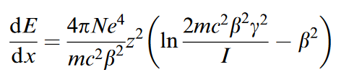
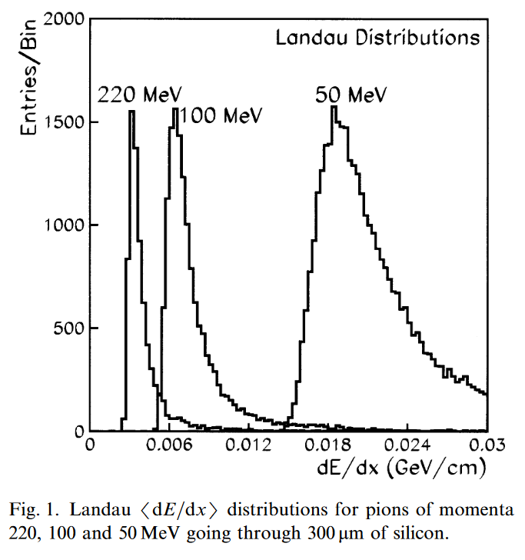
dE/dx in silicon
Bethe-Block formula ( for 2 γ m/M << 1 )
Ref: NIMA 469(2001) 311-315

Slide 13
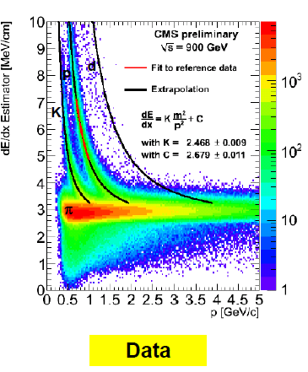
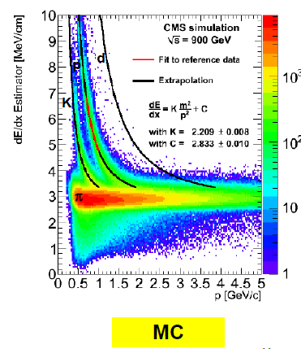
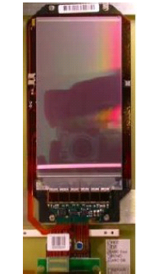
dE/dx: CMS Si tracker
Each Silicon sensor gives a dE/dX measurement.
Estimate the Most Probable Value from several (10-25)
measurements (Truncated Mean: Ignore upper 40%)

Slide 14
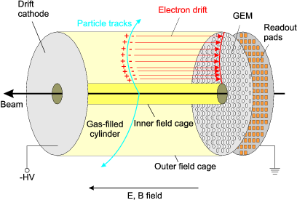
Drift chambers

Slide 15

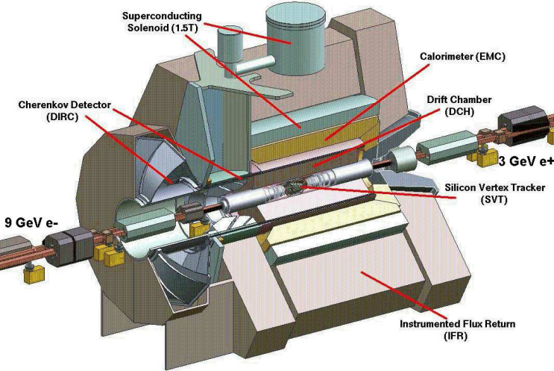
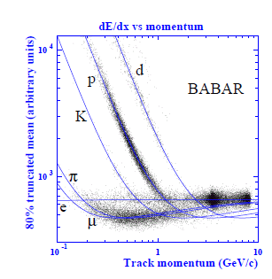
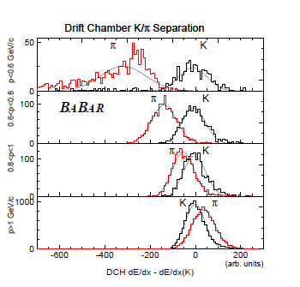

dE/dx : Drift Chambers
Larger Landau fluctuations compared to those from Silicon detectors.
So many measurements needed to get the average.
Ref: IEEE-TNS VOL:47 , NO:6, Dec2000.
BABAR Drift Chamber:

Slide 16
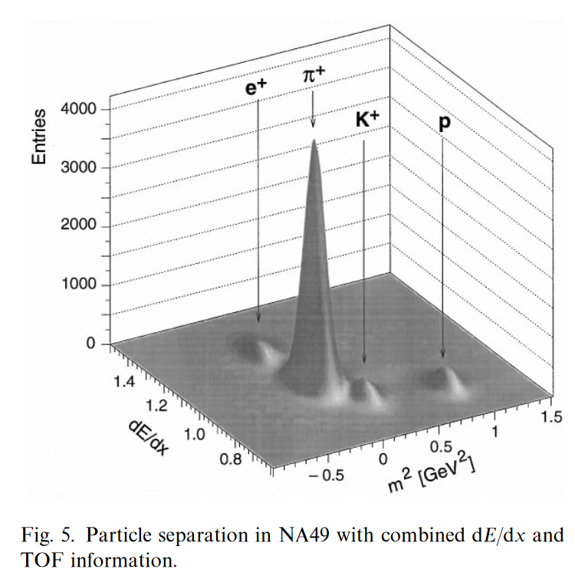
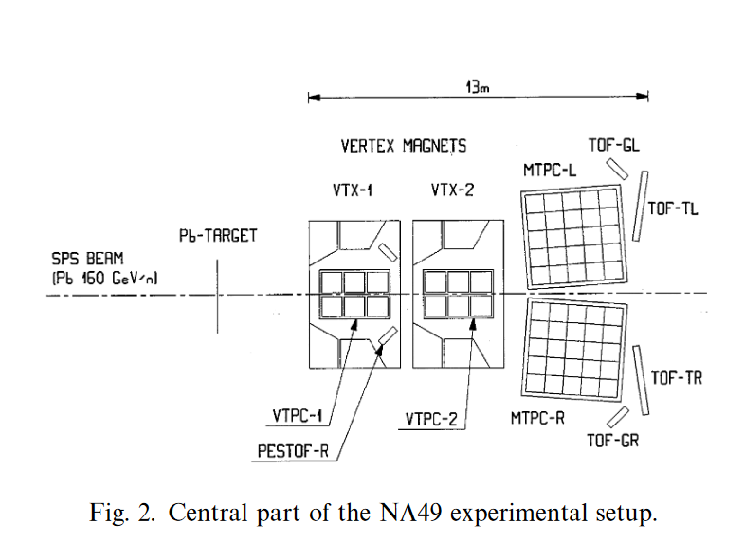
Combined TOF and dE/dx
NA 49: Heavy ion experiment,
TOF: Scintillator thickness=2.3 cm, time resolutions= 59 ps, 95 ps
TPC for dE/dx.

Slide 17

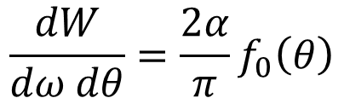
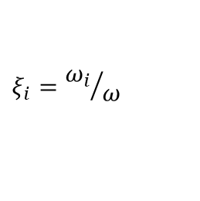
Transition Radiation (TR)
Transition Radiation: Radiation in the x-ray region when ultra
relativistic particles cross the boundary
between 2 media with different dielectric constants.
Mainly for e-π separation in 0.5 GeV/c → 200 GeV/c.
Full explanations and the derivations from Maxwell’s equations:
NIMA 326 (1993) 434-469 and in references
f
θ
The radiation is peaked at a small angle:
θ = 1/γ
g
$$f_{0}\left(θ\right)=θ^{3}\left(\frac{1}{γ^{−2}+θ^{2}+ξ_{g}^{2}}−\frac{1}{γ^{−2}+θ^{2}+ξ_{f}^{2}}\right)$$
$$\frac{dW}{dω dθ}=\frac{2α}{π}f_{0}\left(θ\right)$$
$$ξ_{i}={ω_{i}}/ω$$
ω_{i} =plasma freq of medium i

Slide 18
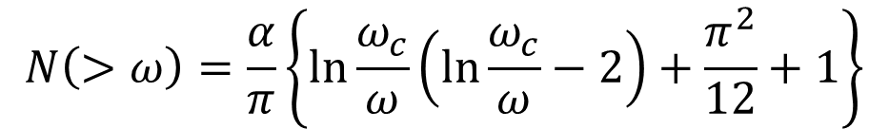

TR Detection
Integrating the previous equation, one can get , for ξ_{g}=0,
γ = E/m of the particle. This makes PID possible by measuring W.
Lighter particle give larger signal
ω_{f} = plasma frequency = 28.8 (ρ Z/A)^{0.5} eV
  ρ=density, Z=atomic weight, A=atomic number
$$W_{TR}=2.43×{10}^{−3}ω_{f}γ$$
For example, for ω_{f} = 0.02 keV and γ = 5000, most of the photon energy is
in the range 10 keV< ω <100 keV (ie. 0.1 ω_{c}< ω < ω_{c}
where ω _{c} = cut-off frequency ).
$$N\left(>ω\right)=\frac{α}{π}\left\{\ln{\frac{ω_{c}}{ω}\left(\ln{\frac{ω_{c}}{ω}−2}\right)+\frac{π^{2}}{12}+1}\right\}$$
Number of photons produced =
For ω_{c}=100 keV and ω=1 keV, N= 0.03 for a single surface.
Hence to get sufficient number of photons , large number of interfaces are used:
a stack of many foils with gaps in between.

Slide 19
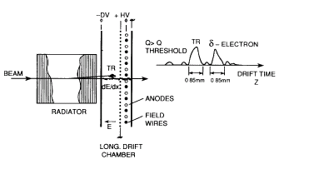
TRD Example 1: HELIOS experiment (NA34)
The minimum thickness of the foils and air gaps are determined by the size of the
‘formation zone’ and the interference effects.
( typically, foils can be 10-20 μm thick and are made of polypropelene)
Behind a TRD foil stack there is a MWPC or drift chamber where the
TRD signal is detected along with the signal from the charged track.
Drift space = 10 mm,
Anode space = 6 mm
Drift time=0.5→1 μs
May use FADC or discriminators

Slide 20
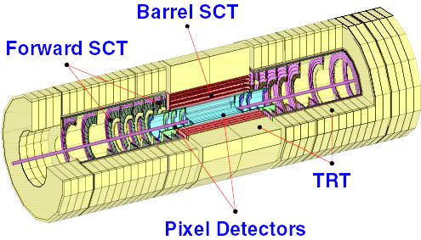
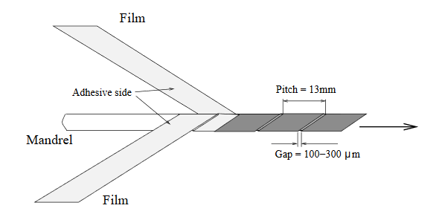
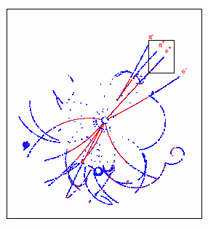
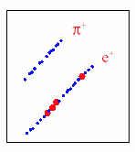
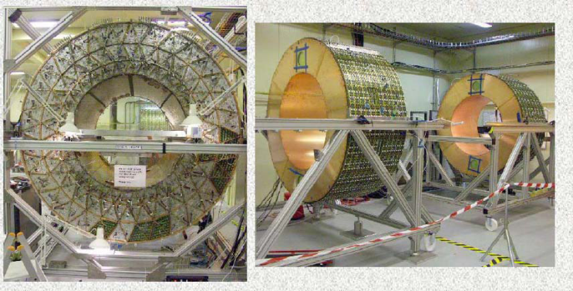
TRD Example 2: ATLAS TRT
TRT straw wall design
Barrel and endcap TRT
B_{d}→J/ψ K_{s}
Blue dots: ionizing hits
Red dots : TR hits
In an average event, energy deposit from:
Ionization loss of charged particles ~ 2.5 keV
TR photon > 5 keV.
(Photon emission spectrum peaks at 10-30keV)

Slide 21


Cherenkov radiation
Lake Placid – LHCb Collaboration Week

Slide 22
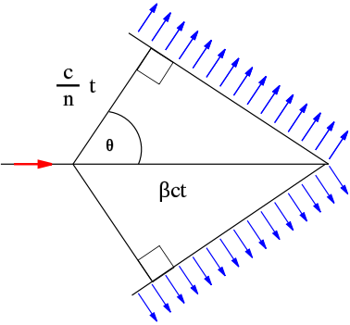

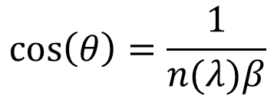
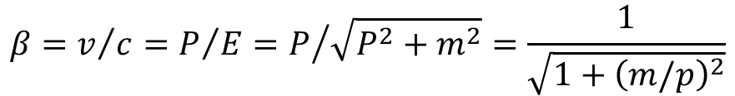
Basics of Cherenkov radiation
photon
θ
Charged particle
$$\cos\left(θ\right)=\frac{1}{n(λ)β}$$
$$n\left(E_{ph}\right)=c/c_{M}$$
Refractive index
$$β=v/c=P/E=P/{\sqrt{P^{2}+m^{2}}=\frac{1}{\sqrt{1+{\left(m/p\right)}^{2}}}}$$
β = velocity of the charged particle in units of speed of light (c) vacuum
P, E ,m = momentum, energy, mass of the charged particle
C_{M} = speed of light in the medium (phase velocity)
E_{ph} = photon energy
λ = Photon wavelength
Theory of Cherenkov Radiation: Classical Electrodynamics by J. D. Jackson (Section 13.5)

Slide 23
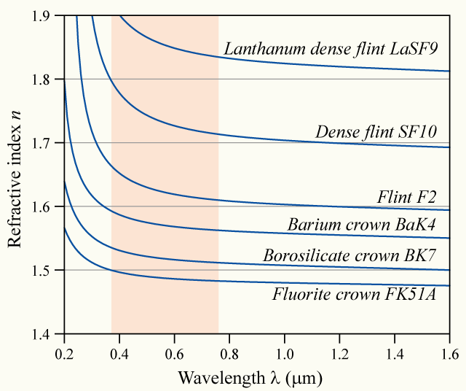
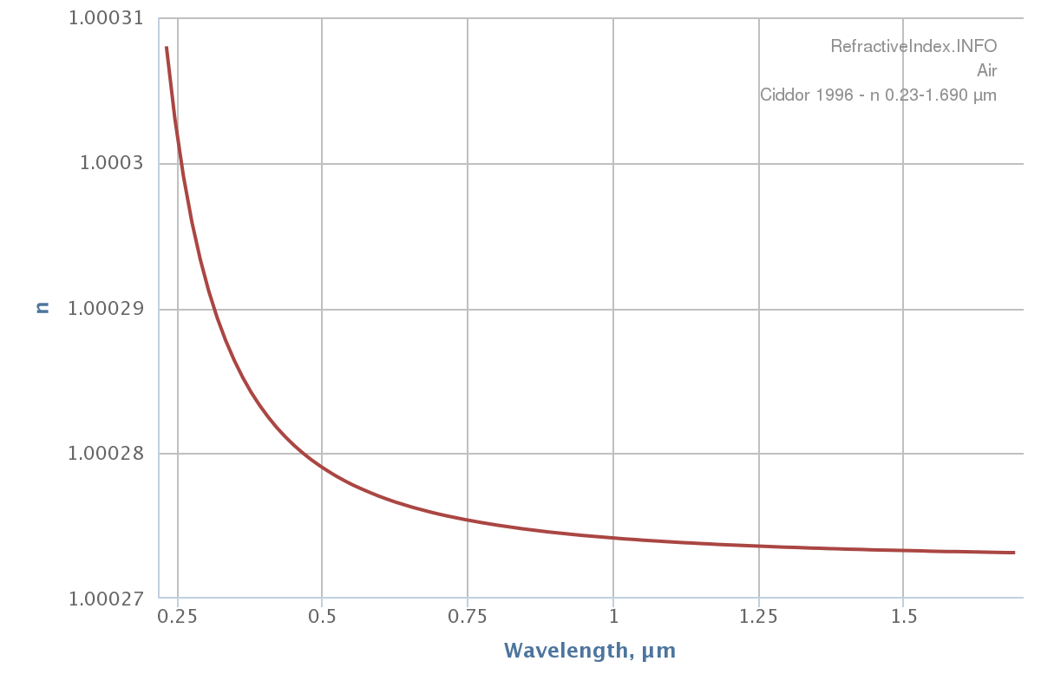
Refractive index
Glass
Air
Dependence of the refractive index on photon frequency means the Cherenkov angle is not constant
The spread of angles is referred to as Chromatic Error

Slide 24
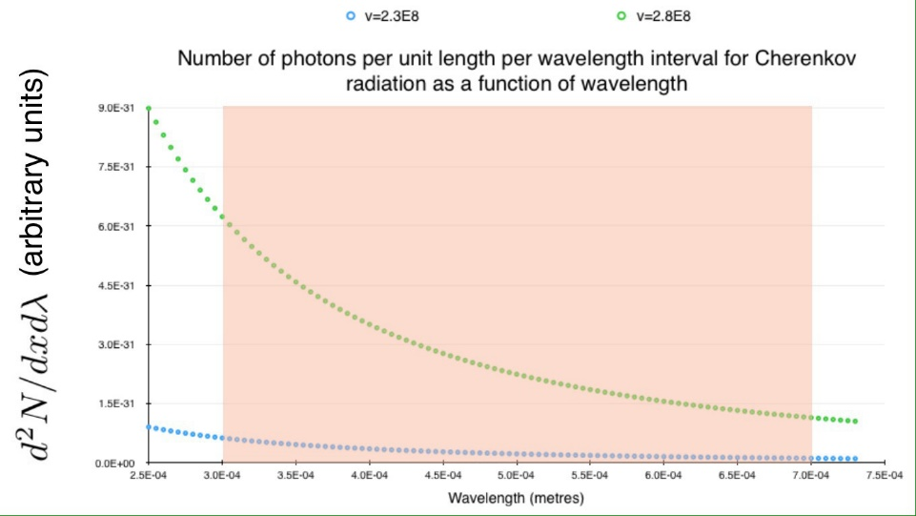



Number of photons
Number of emitted photons:
$$\frac{∂^{2}N}{∂x∂λ}=2πa\left(1−\frac{1}{β^{2}n^{2}}\right)\frac{1}{λ^{2}}$$
Between two wavelengths:
$$\frac{∂N}{∂x}=2πa\left(1−\frac{1}{β^{2}n^{2}}\right)\left(\frac{1}{λ_{L}}−\frac{1}{λ_{H}}\right)$$
The number of photons increases with energy
Using frequency instead of wavelength
$$\frac{dE}{dx}=\frac{q^{2}}{4π}\int_{v>\frac{c}{n\left(ω\right)}}{μ\left(ω\right)ω\left(1−\frac{c^{2}}{v^{2}n^{2}\left(ω\right)}\right)dω}$$
Typical example: Charged particle with momentum of few GeV/c or more emitting Cherenkov photons with few eV of energy

Slide 25





Detected photons
$$\frac{∂N}{∂x}=2πa\left(1−\frac{1}{β^{2}n^{2}}\right)\left(\frac{1}{λ_{L}}−\frac{1}{λ_{H}}\right)$$
For λ_{L}=400 nm and λ_{H}=700 nm
$$\frac{N}{L}=490\sin^{2}{θ}$$
If the photons are reflected by a mirror with reflectivity R(λ), and detected by a photon detector with quantum efficiency QE(λ) through a window with transmission T(λ)
$$N=490 L R Q T\sin^{2}{θ}$$
$$=N_{0}L\sin^{2}{θ}$$
And if we assume the mean angle θ_{c}
$$N=N_{0}L\sin^{2}{θ_{c}}$$
Ν₀ is a figure of merit for a Cherenkov detector; e.g. Ν₀=200/cm is a good value

Slide 26
A variety of Cherenkov detectors
Detector design:
  Threshold Counters
  Imaging detectors
    Differential Cherenkov detectors
    Ring Imaging Cherenkov detectors (RICH)
    Detector for Internally Reflected light (DIRC)
Types of photon detectors:
  Gas based
  Vacuum
  Solid state
Applications:
  Accelerator HEP detectors
  Astroparticle Physics detectors
  Neutrino detectors

Slide 27
Threhold Cherenkov Counters
Signal produced from only those particles which are above Cherenkov Threshold.
Basic version: Yes/No decision on the existence of the particle type.
One counts the number of photoelectrons detected.
Improved version: Use the number of observed photoelectrons or a calibrated pulse height
to discriminate between particle types.
For typical detectors: N_{o} = 90 cm^{-1,}
N_{ph} per unit length of the radiator = N_{o} * (m₁² – m₂²)/(p²+m₁²)
At p= 1 GeV/c, N_{ph} per unit length = 16 /cm for Pions and 0 for Kaons.
At p= 5 GeV/c, N_{ph} per unit length= 0.8 /cm for Pions and 0 for Kaons.
Δ β / β = tan² θ / (2 * sqrt (N_{ph}) )

Slide 28
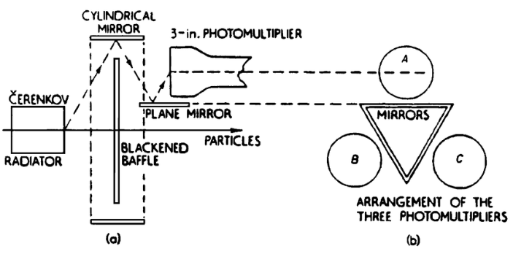
Differential Cherenkov detectors
Very small acceptance in β and direction of the charged particle. (Narrow range in velocity and direction intervals ).
Mostly used for identifying particles in the beam lines.
With Solid (quartz) radiator
Δ β/ β = (m₁² – m₂²) /2 p ² = tan θ Δθ
m₁,m₂ (particle masses )<< p ( momentum)
Δβ/ β from 0.011 to 4* 10 ⁻⁶ achieved.
Discovery of anti-proton
in 1955 by Chamberlain,
Segre et. al. at Berkeley.
Nobel Prize in 1959

Slide 29
Threshold Counters
BELLE: Threshold Cherenkov Detector
Five aerogel tiles
inside an aluminum box
lined with a white
reflector(Goretex reflector)
Performance from test- beam
Approx .
20 photoelectrons
per Pion detected
at 3.5 GeV/c
More than 3σ
separation
p below and π above Threshold

Slide 30
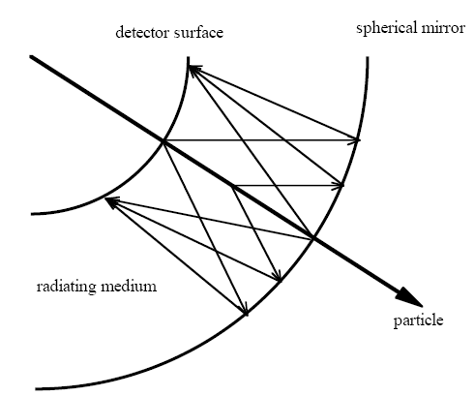
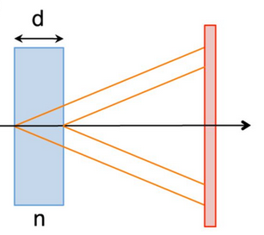
RICH Detectors
Proximity focusing geometry
Measures both the Cherenkov angle and the number of photoelectrons detected.
Can be used over particle identification over large surfaces.
Requires photodetectors with single photon identification capability.

Slide 31
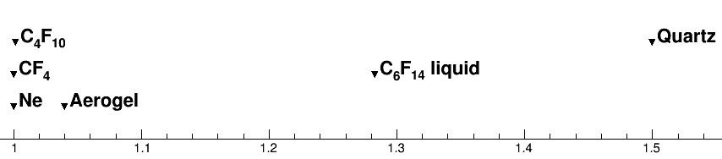
Refractive index range
1
1.5
~100 GeV/c
~1 GeV/c
Momentum

Slide 32
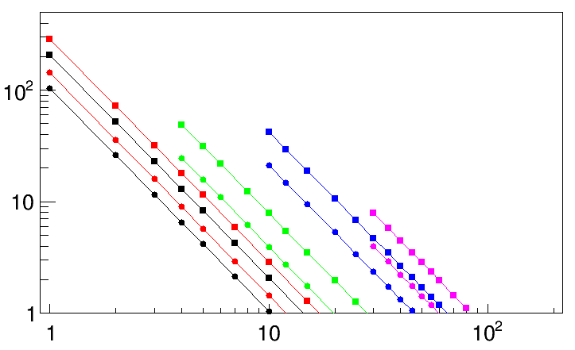
RICH performance
$$N_{σ}≈\frac{\left|m_{1}^{2}\right.−\left.m_{2}^{2}\right|}{2P^{2}σ\left[θ_{c}(tot)\right]\sqrt{n^{2}−1}}$$
For particles well above threshold
B. N. Ratcliff, NIMA 502 (2003) 211-221
0.5 mrad
Fused Silica
1 mrad
C₆F₁₄ (liquid)
Aerogel (1.04)
Nσ π/K separation
C₄F₁₀
CF₄
3 σ
Particle momentum (GeV/c)

Slide 33
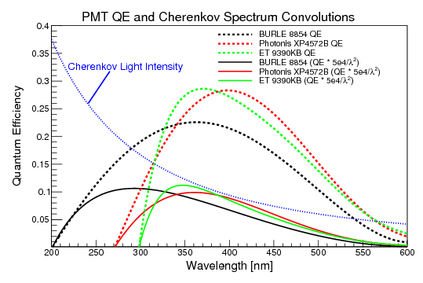
Detection of optical photons
Photocathode:
  A surface engineered to convert optical photons to electrons using the photo-electric effect
  Requires the energy of the photon to be higher than the “work function”
  Also possible in gas form
  Quantum Efficiency (QE): fraction of photons converted to electrons

Slide 34
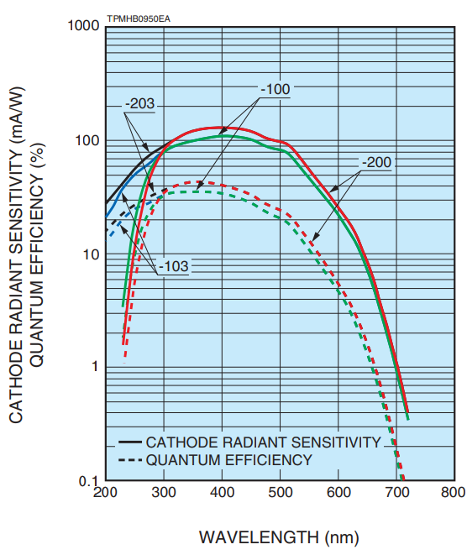

Latest photocathodes

Slide 35
Detection of photo-electrons
Gas based detectors
  Proportional counters
  MWPC
  GEM
  Other kind of micro-pattern detector
Vacuum:
  Photomultipliers
  Microchannel plates
  Hybrid photon detectors (HPD)
Solid state
  Avalanche photo-diodes (APD)
  SiPMs

Slide 36
Gas based detectors
Used in ALICE experiment at CERN
Thickness of :
radiator = 10mm
quartz window= 5mm
MWPC gaps= 2 mm
Wire cathode pitch=2 mm
Anode pitch= 4 mm
anode diameter= 20 micron
pad size = 8*8 mm²
Total detector area: 12 m²
Open geometry: using MWPC
Proximity focussing
photon
Backscatterd electron
Electron transport region (diffusion)
Typical gain: 10 ⁴
cause feedback: leading to loss of original signal info.
photon

Slide 37



GEM based gas detectors
GEM: Gas Electron Multiplier
GEM with semi-transparent Photocathode
(K-Cs-Sb)
Photon and ion feed back reduced.
Gated operation to reduce noise.
(no readout outside a ‘time window of signal’)
For now only closed geometry ( in sealed tubes):
Reduced fraction of useful area for photon
detection (Active Area Fraction) compared to open
geometry.

Slide 38

Pixel-HPD description
Vacuum photon detector
Anode
Main features:
Quartz window with thin S20 pK
Cross-focussing optics (tetrode structure):
  De-magnification by ~5
  Active diameter 75mm
  ⇒ 484 tubes for overall RICH system
  20 kV operating voltage (~5000 e– [eq. Si])
32×32 pixel sensor array (500μm×500μm each)
Encapsulated binary electronics readout chip
Schematic
view

Slide 39

Silicon Photo-Multiplier
Photon Detection Efficiency (PDE)
for SiPM is better that of ordinary PMT.
Time resolution= ~ 100 ps.
Works in magnetic field
Gain = ~ 10 ⁶
Reducing noise levels for single photon
detection is still an issue especially after irradiation

Slide 40

SiPM spectrum
Hamamatsu SiPM S13360–3075CS
https://doi.org/10.3390/electronics10080961

Slide 41

Micro-Channel Plate (MCP) Detectors

Slide 42


MCP detectors
Typical Size:
2 mm thickness,
51 mm X 51 mm active area.
10 micron pores separated by 15 microns
Chevron: 8 degree tilt : To increase
th gain and reduce ion-feed back
Gain: ~ 5 * 10 ⁵
Typically ~ 1000 channels per MCP.
Measure Space and time of the hits.
Manufactured by industry ( Photonics for example).
Resolutions: Space: ~100 microns, Time: ~ 50 - 100 psec.
Short flight path of photoelectrons: Resistant to magnetic fields up to 0.8 Tesla.
Can work at 40 MHz readout rate.
Can detect single photons ( No noise from ‘first dynode’ as in MAPMT).
Fast ‘ageing’ at large luminosity (eg: LHC) is an issue, but there are some solutions.

Slide 43

LHCb Experiment
Precision measurement of B-Decays and search for signals beyond standard model.
Two RICH detectors covering the particle momentum range 1→100 GeV/c using
aerogel, C₄F₁₀ and CF₄ gas radiators.

Slide 44


LHCb RICH Specifications
(Refractive Index-1) vs. Photon Energy
RICH1: Aerogel 2→10 GeV/c
C₄F₁₀ < 70 GeV/c
RICH2: CF₄ <100 GeV/c.
n=1.03
Aerogel C₄F₁₀ CF₄
L 5 86 196 cm
θ_{c}^{max} 242 53 32 mrad
π _{Th} 0.6 2.6 4.4 GeV/c
K_{Th} 2.0 9.3 15.6 GeV/c
n=1.0014
n=1.0005
Aerogel Transmission
Aerogel: Rayleigh Scattering
Not used from 2015 onwards
T = A e ^{(-C t / λ4)}
Typically: Α= 0.94, C =0.0059 μm⁴ /cm

Slide 45





Belle II ARICH (Endcap)
Two tile focusing aerogel radiator
Proximity focusing optics
HAPD detectors
  Bi-alkali photocathode
  Work in magnetic field

Slide 46


LHCb- RICH1 SCHEMATIC
RICH1 OPTICS
Magnetic Shield
Gas Enclosure
Beam Pipe
Spherical Mirror
Flat Mirror
Photodetectors
Readout Electronics
Spherical Mirror tilted
to keep photodetectors outside acceptance
(tilt ~ 0.3 rad)

Slide 47

Performance of LHCb RICH
From isolated Cherenkov rings from RICH1 in Real Data
Compare with the expectations plotted in page 9.

Slide 48

LHCb-RICH resolution
Single photon resolutions
Real Data 2011:
C₄F₁₀
CF₄
From simulation in 2011:
σ_{Δθ} = 1.53 mrad
From simulation in 2011:
σ_{Δθ} = 0.68 mrad
Resolution components: Chromatic : ref. index variation
Emission Point: tilt of the mirror
Pixel size: granularity of the pixel
PSF: spread of photo electron direction inside HPD

Slide 49


HPD photocathode position
One pixel
Automatic Online calibration for every run (max 1 hour)

Slide 50


Pattern recognition
Red: From particles from Primary and Secondary Vertex
Blue: From secondaries and background processes (sometimes with no reconstructed track)

Slide 51
Pattern Recognition in Accelerator based Cherenkov Detector
Events with large number of charged tracks giving rise to several
overlapping Cherenkov Rings on the Photo detector plane.
Problem: To identify which tracks correspond to which hits and then identify
the type (e, π, p etc.) of the particle which created the tracks.
Hough Transform:
(used by ALICE
at CERN)
Project the particle direction on to the detector plane
Accumulate the distance of each hit from these projection points
in case of circular rings.
Collect the peaks in the accumulated set and associate the
corresponding hits to the tracks.
Likelihood Method:
For each of the track in the event, for a given mass hypothesis,
create photons and project them to the detector plane using the
knowledge of the geometry of the detector and its optical properties.
Repeat this for all the other tracks.
From this calculate the probability that a signal would be seen in each
pixel of the detector from all tracks.
Compare this with the observed set of photoelectron signal on the pixels,
by creating a likelihood.
Repeat all the above after changing the set of mass hypothesis of the tracks.
Find the set of mass hypothesis, which maximize the likelihood.
(used by LHCb
at CERN)
(Ref: R.Forty: Nucl. Inst. Mech. A 433 (1999) 257-261)
51

Slide 52


LHCb RICH: PID performance
Data
Red: Kaon identification efficiency
Black: Pion mis-identification probability
PID performance in D* events (calibration channel)
General agreement between real data and simulation

Slide 53

Physics impact of hadron PID
First measurement of the diﬀerential branching fraction and 𝐶𝑃 asymmetry of the
𝐵± → 𝜋± 𝜇+ 𝜇− decay, JHEP 10 (2015) 034 [arXiv:1509.00414]

Slide 54
How to make a better RICH detector
Increase the number of photons
  Better photon detectors (photo-cathodes)
  Better area coverage by photon detectors
  Better optical coupling of components
Improve Cherenkov angle resolution
  Smaller pixels
  Lower chromatic error
    Detectors sensitive to green rather than blue
  Improve aberrations
    Light weight mirrors in the acceptance

Slide 55

The LHCb RICH Upgrade (i)
Continuous 40 MHz readout
MaPMTs from Hamamatsu
New radiation hard asic (CLARO) for MaPMT readout
FPGA based digital board
GBT for data transmission
Single photon spectrum

Slide 56

The LHCb RICH Upgrade (ii)
More complex events
Completely new RICH1
New mirrors with longer focus
New position for the photon detectors
New gas enclosure, exit window, cooling and support structures

Slide 57
Cherenkov angle resolution
Contributions to resolution (in mrad) | RICH1-2015 HPD | RICH1-Upgrade MaPMT | RICH2-2015 HPD | RICH2-Upgrade MaPMT
Chromatic | 0.84 | 0.58 | 0.48 | 0.31
Pixel | 0.60, PSF=0.86 | 0.44 | 0.19, PSF=0.29 | 0.19
Emission Point | 0.76 | 0.37 | 0.27 | 0.27
Overall | 1.60 → | 0.78 | 0.65 → | 0.45
Improvements due to:
Chromatic error; MaPMTs QE peaks at higher wavelength
No Point Spread Function for MaPMTs
Better emission point error with new RICH1 geometry

Slide 58




Performance of new RICH

Slide 59

Future (LHCb) Upgrades
Improve pattern recognition using accurate timing of primary vertices

Slide 60

Evolution of the RICH photon detection

Slide 61


DIRC
Direct Internally Reflected Cherenkov light
Detectors outside the “acceptance”
Can fit in a narrow space
The standoff region is designed to maximize the transfer efficiency between the radiator and the detector.
If this region has the same index of refraction as the radiator, n₁≅n₂, the transfer efficiency is maximized and the image will emerge without reflection or refraction at the end surface.

Slide 62



Babar DIRC
± 8 ns Δt window for background rejection

Slide 63




Panda Barrel DIRC
DIRC detector following the design principles of the BABAR DIRC
Very compact Expansion Volume
Focusing optics; NLaK33 ref index 1.786
Photon detectors: MCP-PMTs; use of timing information

Slide 64

TORCH (i)
A time of flight detector based on Cherenkov radiation

Slide 65


TORCH (ii)
The focusing unit converts angles to positions allowing the measurement of propagation time
Multiple photons from the same track can improve the time accuracy

Slide 66



Photonic Crystals
Optical micrograph of blue feather barbs
www.pnas.org/cgi/doi/10.1073/pnas.1204383109
Parrot (scarlet macaw) in a tropical forest
CERN Courier Aug23, 2005
Phys. Rev. E 72, 010902 (2005)

Slide 67
Photonic Crystals
Periodic arrangement of objects with two different refractive indices.
Lattice constants comparable to the
wavelength of light in the material
electrons in pure semi-conductor : similar features to photons in photonic crystal
Cherenkov radiation:
Physical origin is a mixture of conventional Cherenkov radiation
and Transition radiation
Photon propagation in the crystal in the form of Bloch waves
All the properties can be derived from solving Maxwell’s arXiV:0808:3519
equations for periodic lattice
There is no Cherenkov Threshold
Cherenkov cone can be forward or backward
r=cylinder radius
a= lattice constant
Starting from two media with refractive indices n₁ and n₂,
create a new effective refractive index n₃.

Slide 68
Summary
The field of Particle Identification Detectors is an evolving field.
They have contributed to some of the important discoveries in High Energy Physics in the last 50 years and they continue to be a crucial part of some of the recent experiments.
The RICH detectors offer excellent Particle Identification capability for the hadrons since they can be designed to have very good single photon Cherenkov Angle resolution and large Photoelectron yield. Recent advances in photodetectors enhance the capability of these detectors.
The particle ID using dE/dx, time-of-flight and Transition Radiation detectors continue to provide Particle Identification in different experiments.
Particle identification is a crucial part of some of the Astroparticle physics experiments and long base line neutrino experiments

Slide 69
The end
Thank you for
your attention
Any (more) questions?

Slide 70
Features of the PMTs and HPDs
PMT:
Typical Gain of MAPMT 300 K.
Excellent time resolution: 125 ps for example
(Ex: used in underwater Cherenkov detectors).
Active area fraction: 40 % : Fraction of effective detection area.
This can be Improved with a lens, but then one may loose some
photons at the lens surface.
Recent developments: Flat panel pmts with 89 % active area fraction.
New photocathodes with >45% QE at 400 nm
HPD:
Typical gain 5K, but quite uniform across different channels.
Excellent Single photon identification capability.
Active area fraction: 35→ 76 %

Slide 71


DIRC PRINCIPLE
If n>√2 some photons are always
totally internally reflected for β≈1 tracks.
Radiator and light guide: Long, rectangular
Synthetic Fused Silica (“Quartz”) bars
(Spectrosil: average <n(λ)> ≈ 1.473, radiation hard,
homogenous, low chromatic dispersion)
Photons exit via wedge into expansion region
(filled with 6m³ pure, de-ionized water).
Pinhole imaging on PMT array (bar dimension small compared to standoff distance).
(10,752 traditional PMTs ETL 9125, immersed in water, surrounded by hexagonal “light-catcher”,
transit time spread ~1.5nsec, ~30mm diameter)
DIRC is a 3-D device, measuring: x, y and time of Cherenkov photons,
defining θ_{c}, φ_{c}, t_{propagation} of photon.

Slide 72


DIRC PERFORMANCE
Number of Cherenkov photons
per track (di-muons) vs. polar angle:
Resolution of Cherenkov angle fit
per track (di-muons):
Between 20 and 60 signal photons per track.
σ(Δθ_{c}) = 2.4 mrad
Track Cherenkov angle resolution is
within ~10% of design

Slide 73




DIRC PERFORMANCE
Kaon selection efficiency
typically above 95%
with mis-ID of 2-10%
between 0.8-3GeV/c.
D∗– → D⁰ π –
K– π ⁺
(6% comb.
background)
Kaon selection efficiency for
L ^{K} > L ^{π}
(track in DIRC fiducial, comb. background corrected)
π mis-id as K

Slide 74

New Development: Focussing DIRC
Red photons arrive before blue photons
Time of Propagation= PathLength/ v _{group}
Correct for Chromatic error from the
mesurement of time of propagation.
Ref: NIMA 595(2008)104-107

Slide 75
Gas Based Photon Detectors
QE: 33% at 150 nm
Spectral Range: 135-165 nm
TEA: Triethylamine
Photon Detector of the CLEO-III Cherenkov detector
photon passes through the CaF₂ and converts to photoelectron by ionizing a TEA molecule.
The photoelectron drifts towards and avalanches near the anode wires,
theirby inducing a charge signal on the cathode pads.

Slide 76

Balloon Experiment:
RICH detector
CAPRICE Experiment
TMAE:
(tetrakis(dimethylamino)
ethylene)

Slide 77


Components of a Cherenkov Detector
Main Components:
Radiator : To produce photons
Mirror/lens etc. : To help with the transport of photons
Photodetector : To detect the photons
Radiator: Any medium with a Refractive Index.
Aerogel: network of
SiO₂ nano-crystals
γ = 1/sqrt(1-β²)
The atmosphere, ocean are the radiators in some Astro Particle Cherenkov Detectors

Slide 78

LHCb-RICH Design
RICH1: Aerogel L=5cm p:2→10 GeV/c
n=1.03 (nominal at 540 nm)
C₄F₁₀ L=85 cm p: < 70 GeV/c
n=1.0014 (nominal at 400 nm)
Upstream of LHCb Magnet
Acceptance: 25→250 mrad (vertical)
300 mrad (horizontal)
Gas vessel: 2 X 3 X 1 m³
RICH2: CF₄ L=196 cm p: < 100 GeV/c
n =1.0005 (nominal at 400 nm)
Downstream of LHCb Magnet
Acceptance: 15→100 mrad (vertical)
120 mrad (horizontal)
Gas vessel : 100 m³

Slide 79


LHCb RICH Data in Physics Analysis
φ → K ⁺ K ⁻
Status in 2011
using RICH data
RICH data has been used in Physics analysis

Slide 80
Example of LHCb-RICH PERFORMANCE
Performance as seen in Simulated Data in 2010
Yield: Mean Number of hits per isolated
saturated track ( β ~1).
Aerogel | C4F10 | CF4
4.6 | 34.0 | 24
Single Photon Cherenkov Angle Resolutions in mrad.
Components and Overall (mrad) | Aerogel | C₄F₁₀ | CF₄
Chromatic | 2.65 | 0.84 | 0.48
Emission Point | 0.34 | 0.61 | 0.27
Pixel Size | 0.59 | 0.6 | 0.19
PSF | 0.78 | 0.79 | 0.29
Overall RICH | 2.84 | 1.45 | 0.65
Overall RICH+Tracks | 2.86 | 1.50 | 0.76
Chromatic: From the variation in
refractive index.
Emission Point: Essentially from the
tilt of the mirrors.
Pixel Size: From the granularity of the
Silicon detector pixels in HPD
PSF ( Point Spread Function):
From the spread of the Photoelectron direction
as it travells inside the HPD,
(from the cross focussing in the electron optics)

Slide 81
Differential Cherenkov Detectors
Very small acceptance in β and direction of the charged particle.
(Narrow range in velocity and direction intervals ).
From the Cherenkov angle (θ ) determine β.
Mostly used for identifying particles in the beam lines.
Resolution that can be achieved = Δ β/ β = (m₁² – m₂²) /2 p ² = tan θ Δθ
m₁,m₂ (particle masses )<< p ( momentum)
At high momentum, to get better resolution, use gas radiators which have smaller
refractive index than solid radiators. Have long enough
radiators to get sufficient signal photons in the detector.
To compensate for Chromatic dispersion (n (E_{ph}) ) , lens used in the path of the photons.
(DISC: Differential Isochronous self- collimating Cherenkov Counter).
Δβ/ β from 0.011 to 4* 10 ⁻⁶ achieved.

Slide 82
Differential Cherenkov Detectors
With a Gas radiator

Slide 83
Threshold Cherenkov Detectors
Can be used over a large area, for Example : For secondary particles in a fixed target or
Collider experiment.
E691 at Fermilab: To study decays of charm particles in the 1980’s
Δβ/β = 2.3 * 10⁻⁵ using gas radiator.
BELLE Experiment: To observe CP ciolation in B-meson decays at an electron-positron
collider.
BELLE: Continues to take
Data.

Slide 84


LHCb-RICH2 SCHEMATIC
Mirror Support Panel
RICH2 Optics Top View
Spherical Mirror
Support Structure
Y
X
X
Z
Beam Axis-→
Z
Flat Mirror
Plane Mirrors to reduce the length of RICH2
Spherical mirror tilted to keep photodetectors
outside acceptance.(tilt=0.39 rad)
Central Tube
Photon funnel+Shielding

Slide 85


LHCb- RICH2 STRUCTURE
Entrance Window
(PMI foam between two
carbon fibre epoxy Skins)
RICH2

Slide 86
RICH detectors
Δ β / β = tan(θ) * Δθ_{c} = K where Δθ _{c} = < Δθ > / sqrt(N _{ph} ) + C
where <Δθ> is the mean resolution per single photon in a ring and C is the
error contribution from the tracking , alignment etc.
For example , for 1.4 m long CF₄ gas radiator at STP and a detector with N₀ = 75 cm⁻¹
K = 1.6 * 10 ⁻⁶ . ( E=6.5 eV, ΔE = 1 eV)
This is better than similar Threshold counters by a factor 125.
This is also better than similar Differential counters by a factor 2.
Reason: RICH measures both θ and N_{ph} directly.
RICH detectors have better resolution than equivalent Differential and Threshold counters.
Let u= sin² (θ) = 1- (1/n²⁾ - (m/p*n) ²
Number of standard deviations to discriminate between mass m₁ an m₂
= N _{σ} = (u₂-u₁) / ( σ _{u} * sqrt( N)) where σ _{u} : Δ θ converted into the parameter u.
( Δ θ = error in single photon θ measurement)
At momentum p (=β E), p= sqrt((m₂²-m₁²)/(2* K * N_{σ} )) , for β ∼1
This equation can be used in the design of the RICH detectors.
One the first large size RICH detector: in DELPHI at LEP.

Slide 87
History of Cherenkov radiation
The formula cos (θ ) =1/(nβ) was already predicted by Heaviside in 1888
~1900: ‘Blue glow’ seen in fluids containing concentrated Radium (Marie & Pierre Curie)
Pavel Alexeevich Cherenkov (1904-1990): Lebedev Physical Institute of the Russian Academy of Sciences.
Discovery and Validation of Cherenkov Effect : 1934-37
Full Explanation using Maxwell’s equations: I.M. Frank and I.E. Tamm in 1937
Nobel Prize in 1958: Cherenkov, Frank and Tamm.

Slide 88

First experiments
1: vessel with liquid
2: mirror
3: Cherenkov photons towards the photographic plate
Typical Apparatus used by Cherenkov to study the angular distribution of Cherenkov photons.
(Incident γ ray produces electrons by Compton scattering in the liquid).
P. Cherenkov established that:
Light Intensity is proportional to the electron path length in the medium.
Light comes only from the ‘fast’ electrons above a velocity threshold, in his Apparatus.
Light emission is prompt and the light is polarized.
The wavelength spectrum of the light produced is continuous. No special spectral lines.
The angular distribution of the radiation, its intensity, wavelength spectrum and its dependence on the refractive index agree with the theory proposed by his colleagues Frank and Tamm.

