Slide 1
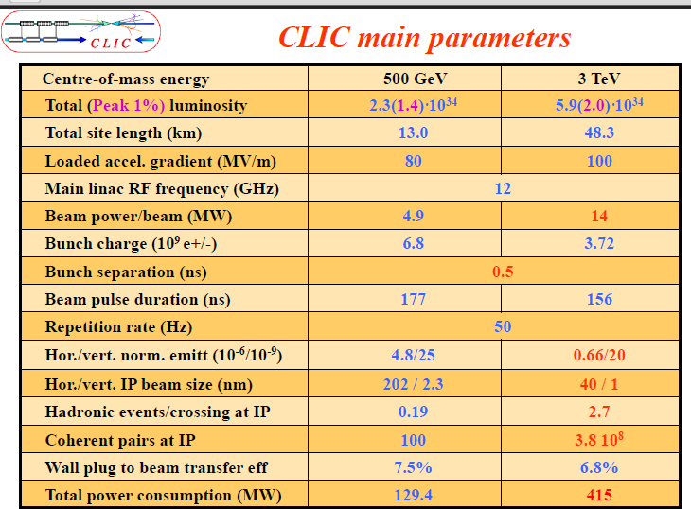
Incoherent pairs (10^5) 1.7 3

