Slide 1
LHC Cryogenic Availability
Fault tracking in LHC cryogenics operation section
With a focus on the 2023 run
L. Delprat, on behalf of TE-CRG

Slide 2
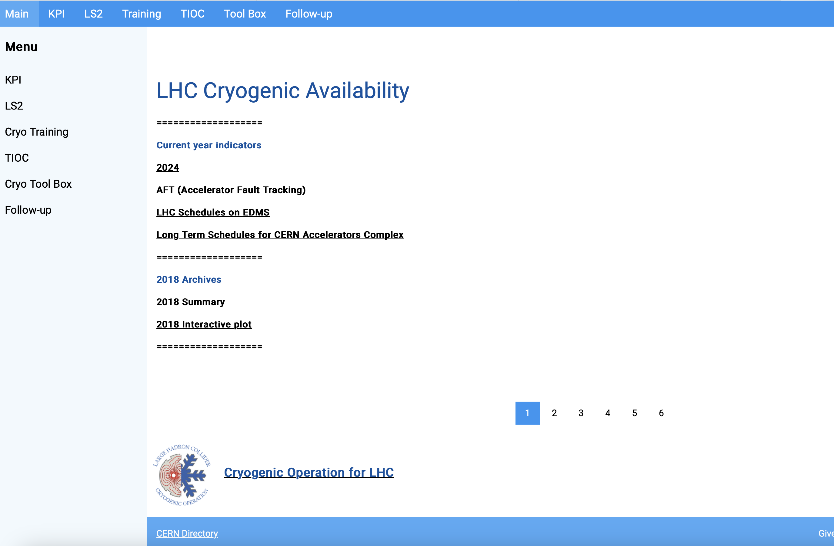
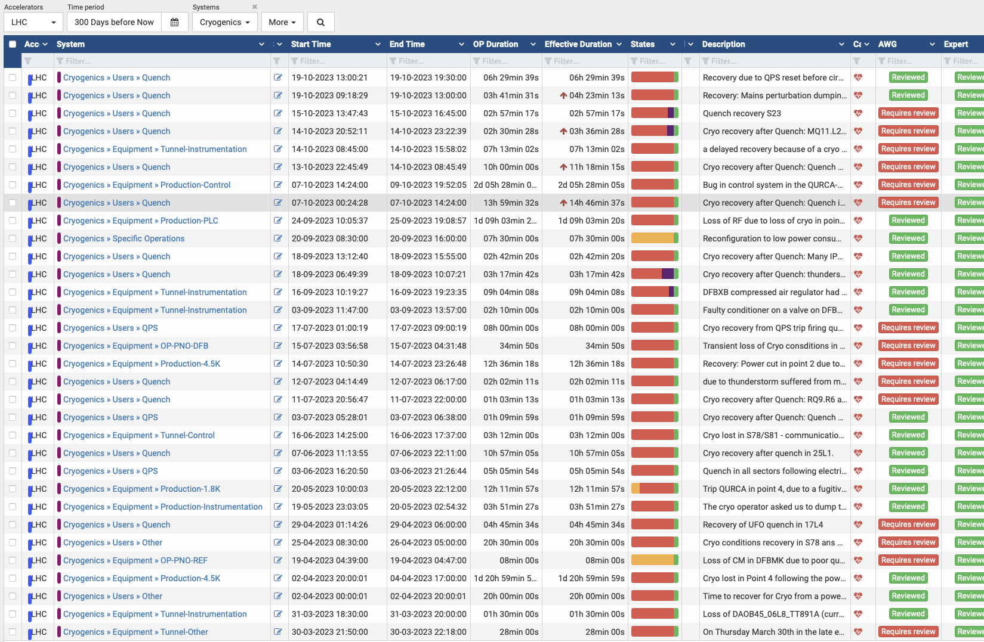
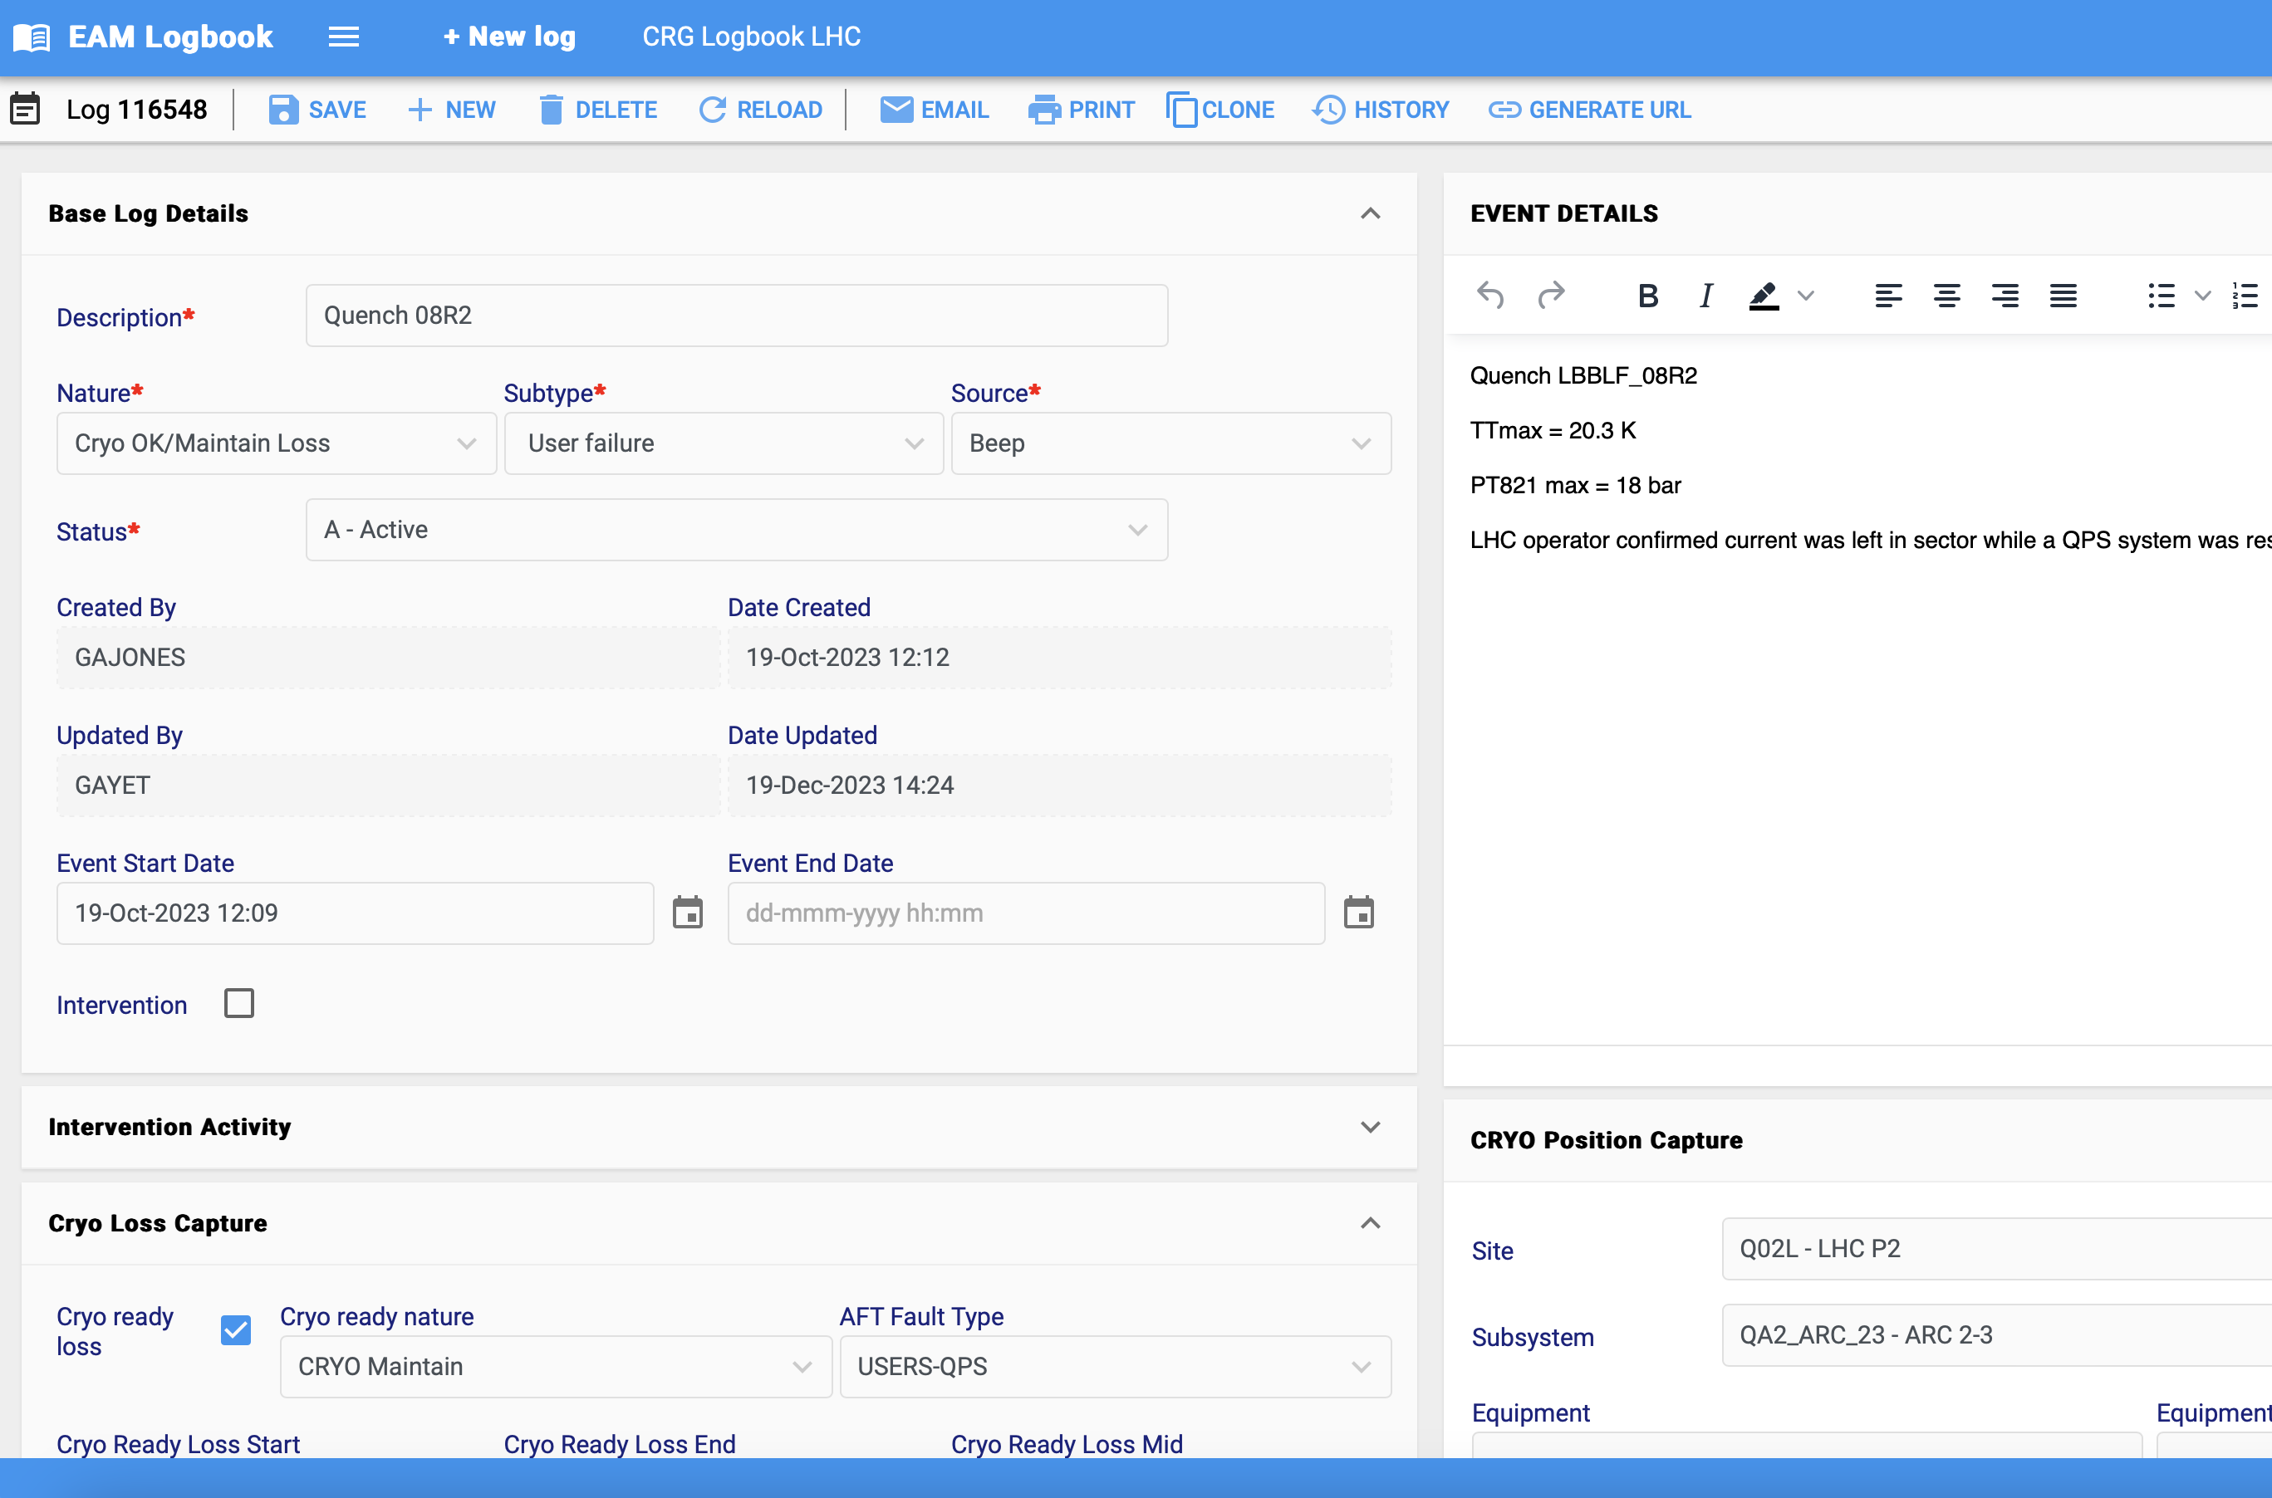
Outlook
Fault
tracking in
TE-CRG-OP
Availability tracking workflow in CRG-OP
AFT
Data
Use of AFT
INFOR
EAM
TE-CRG-OP logbook (https://eamlogbook.cern.ch)

Slide 3
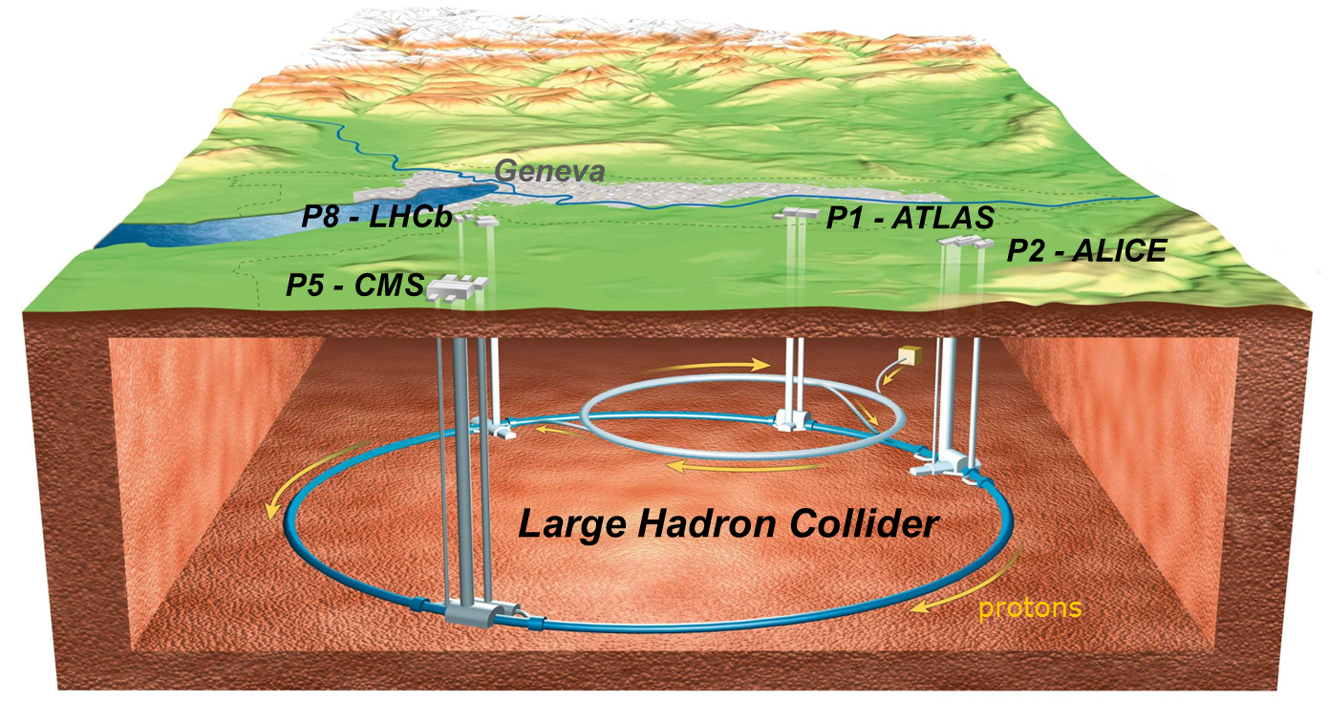
LHC Cryogenic System Architecture
HL
HL
B
P5
B
A
A
P4
P6
LL
A – upgraded ex-LEP cryo plant
B – new LHC cryogenic plant
LL
P3
LHC Cryogenics
P7
LL
LL – Low Load sector
HL – High Load sector
LL
circumference ➔ ~ 27 km,
constructed at ~ 100 m underground,
the accelerator ring inclination is 1.4 %
P2
P8
A
P18
A
P1
B
HL
HL
LHC cryogenics:
8 x 18 kW @ 4.5 K
1800 sc magnets
24 km & 20 kW @ 1.8 K
37 000 tons @ 1.9 K
130 tons of helium inventory
B
Compressor station
4.5 K refrigerator
Interconnection box
1.8 K pumping unit (cold compressor)
14/02/2024
L. Delprat | Fault tracking in LHC cryogenics operation section
3
Notes:
Total for 8 sectors:
Compressors: 64
Turbines: 74
Cold Comp.: 28
Leads: 1’200
I/O signals: 60’000
PID loops: 4’000

Slide 4
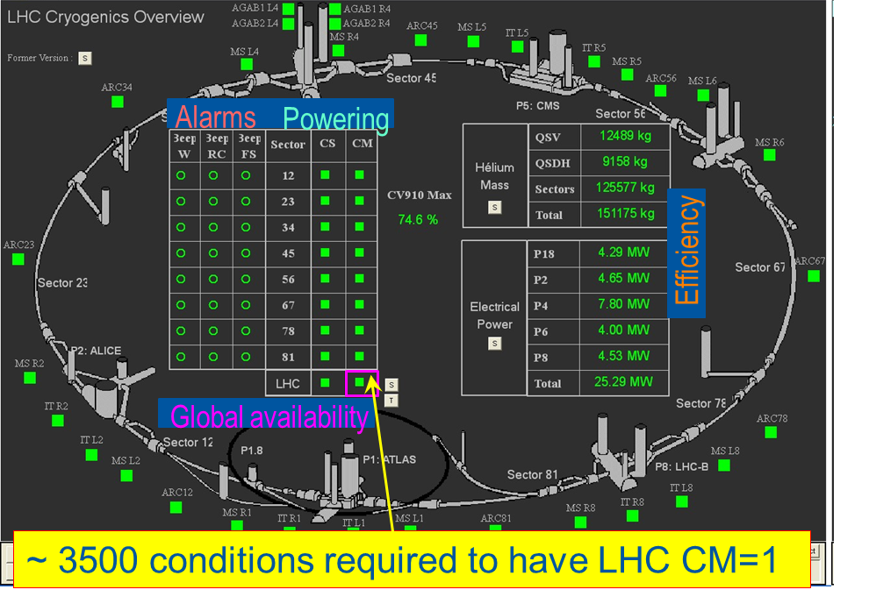
Cryogenic Conditions Definition
Set of cryogenic conditions:
to start powering (Cryo Start – CS)
to keep the magnets powered (Cryo Maintain – CM)…
… and in the end to allow for beams to circulate, and for physics production !
14/02/2024
L. Delprat | Fault tracking in LHC cryogenics operation section

Slide 5
Interface with the users
Quality of helium
Hardware / Production
Control modification
Instrumentation / Distribution
PID & SP of regulation loops
Example: loss of cooling water on a compressor station
Tests to validate wrt Tech. Resp.
Operation boundaries adaptation
Human Factor
LHe level
Temperature
Training
3 ways to lose availability:
Act directly on level or temperature
Recruitment
⬄ Quench
CRYO START = 1
CRYO MAINTAIN = 1
Act on one of the 4 root causes
⬄ Technical Services or Cryo Equipment
The context
Operational context (delayed injections, …)
⬄ Ask for delayed injection
14/02/2024
L. Delprat | Fault tracking in LHC cryogenics operation section

Slide 6
Example for magnet temperature
Set of cryogenic conditions:
to start powering (Cryo Start – CS)
to keep the magnets powered (Cryo Maintain – CM)
Availability impacted!
Magnet Temperature (K)
Loss of
cryo conditions
Diagnose,
Repair (if needed),
Restart
Cryo Maintain
2.15 K
Temperature drift
Temperature decrease
Cryo Start
2.05 K
Cryo conditions
back, towards nominal
Perturbation
Operation Temperature
1.90 K
14/02/2024
L. Delprat | Fault tracking in LHC cryogenics operation section

Slide 7
How to calculate cryogenic availability
Set of cryogenic conditions:
to start powering (Cryo Start – CS)
to keep the magnets powered (Cryo Maintain – CM)
LHC operation schedule:
Beam start: Date D1
Beam end: Date D2
Technical stops: duration d (usually 2 to 3 times one week per year)
Due operation time: D = (D2 – D1) – d
Cryogenic downtime accounting
Cryo downtime: counted from CM lost to CS back = Dc
Does not take into account cryo faults originating from “Users” and “Technical Services”
Cryogenic Availability Calculation:
Cryogenic Availability: A = 1 – ( Dc / D )
14/02/2024
L. Delprat | Fault tracking in LHC cryogenics operation section

Slide 8
Availability losses categorization
14/02/2024
L. Delprat | Fault tracking in LHC cryogenics operation section

Slide 9
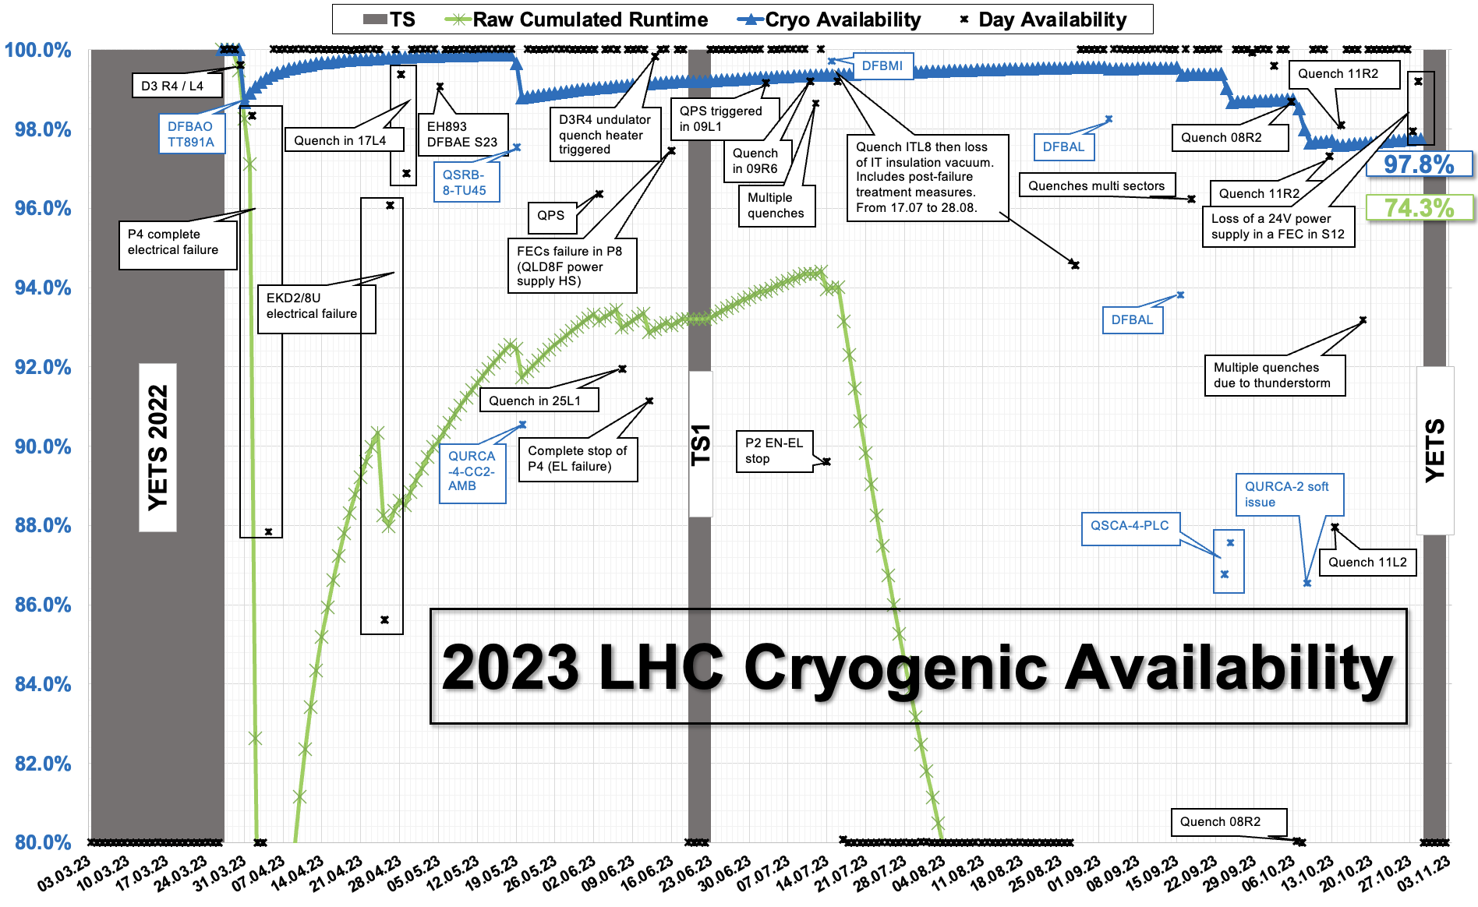
Outputs
14/02/2024
L. Delprat | Fault tracking in LHC cryogenics operation section

Slide 10
Cryoplants issues follow-up

Slide 11
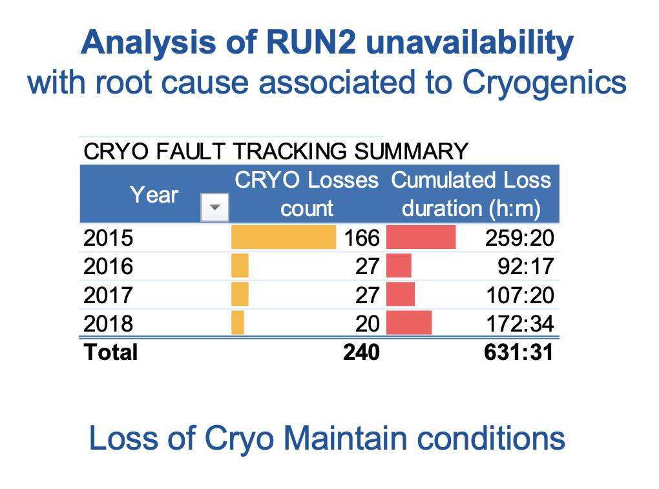
Use of availability to steer corrective maintenance

Slide 12
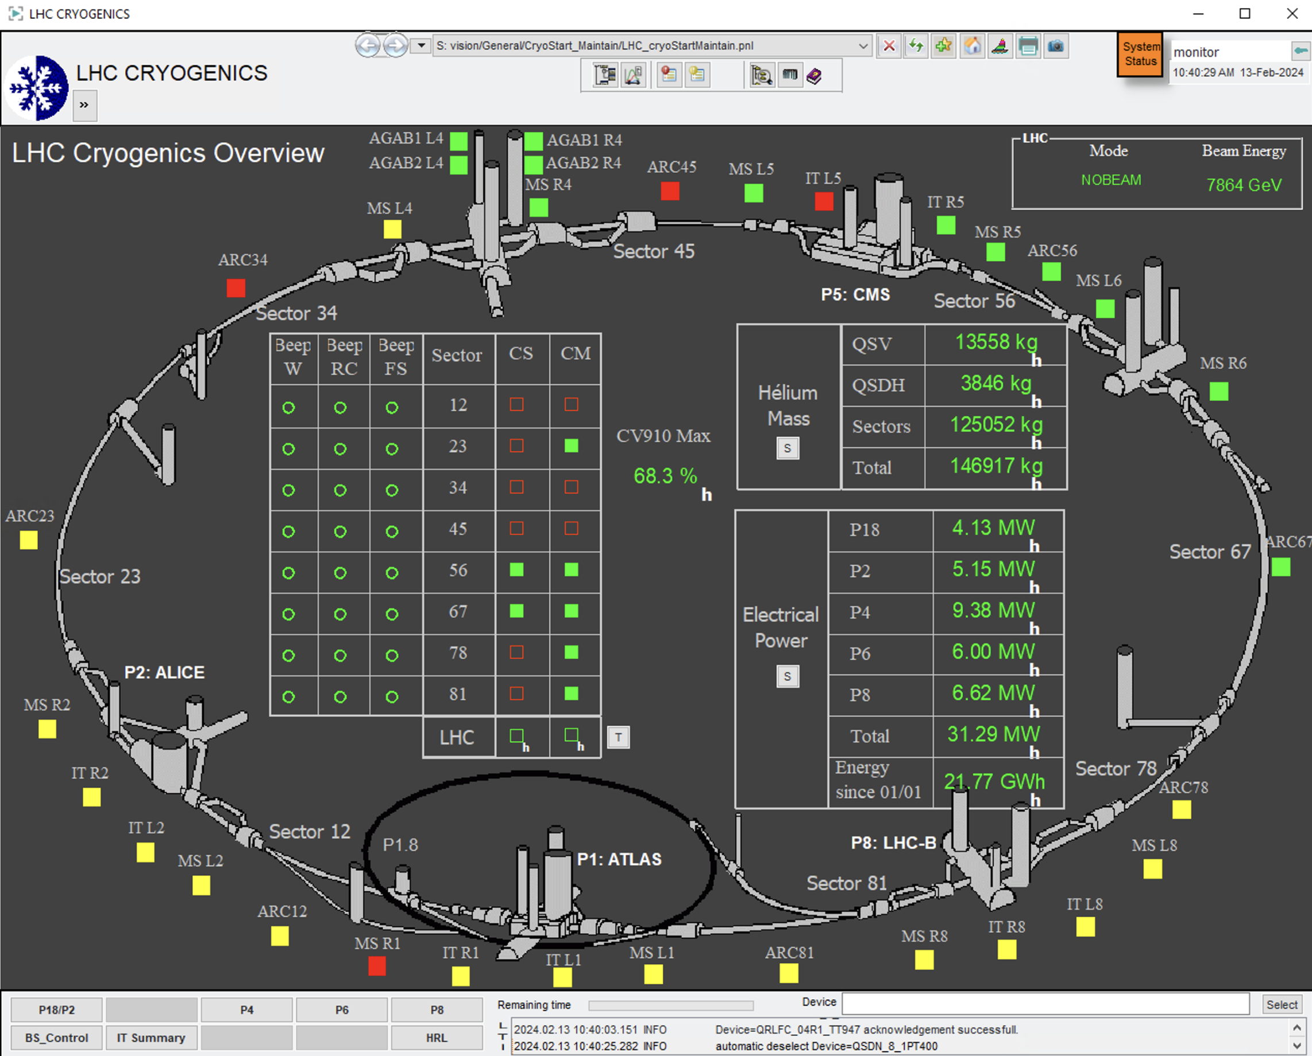
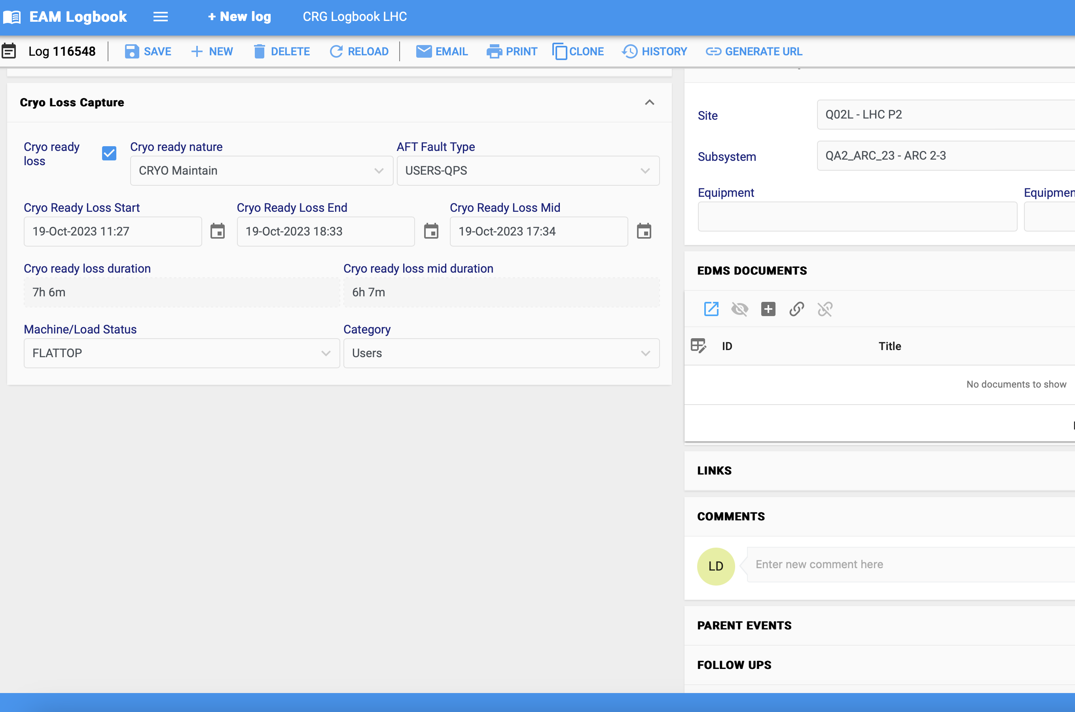
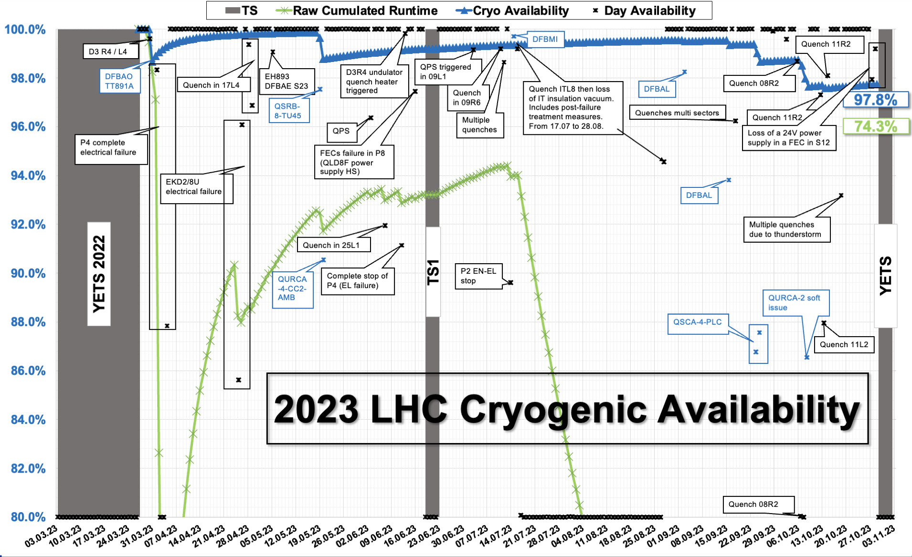
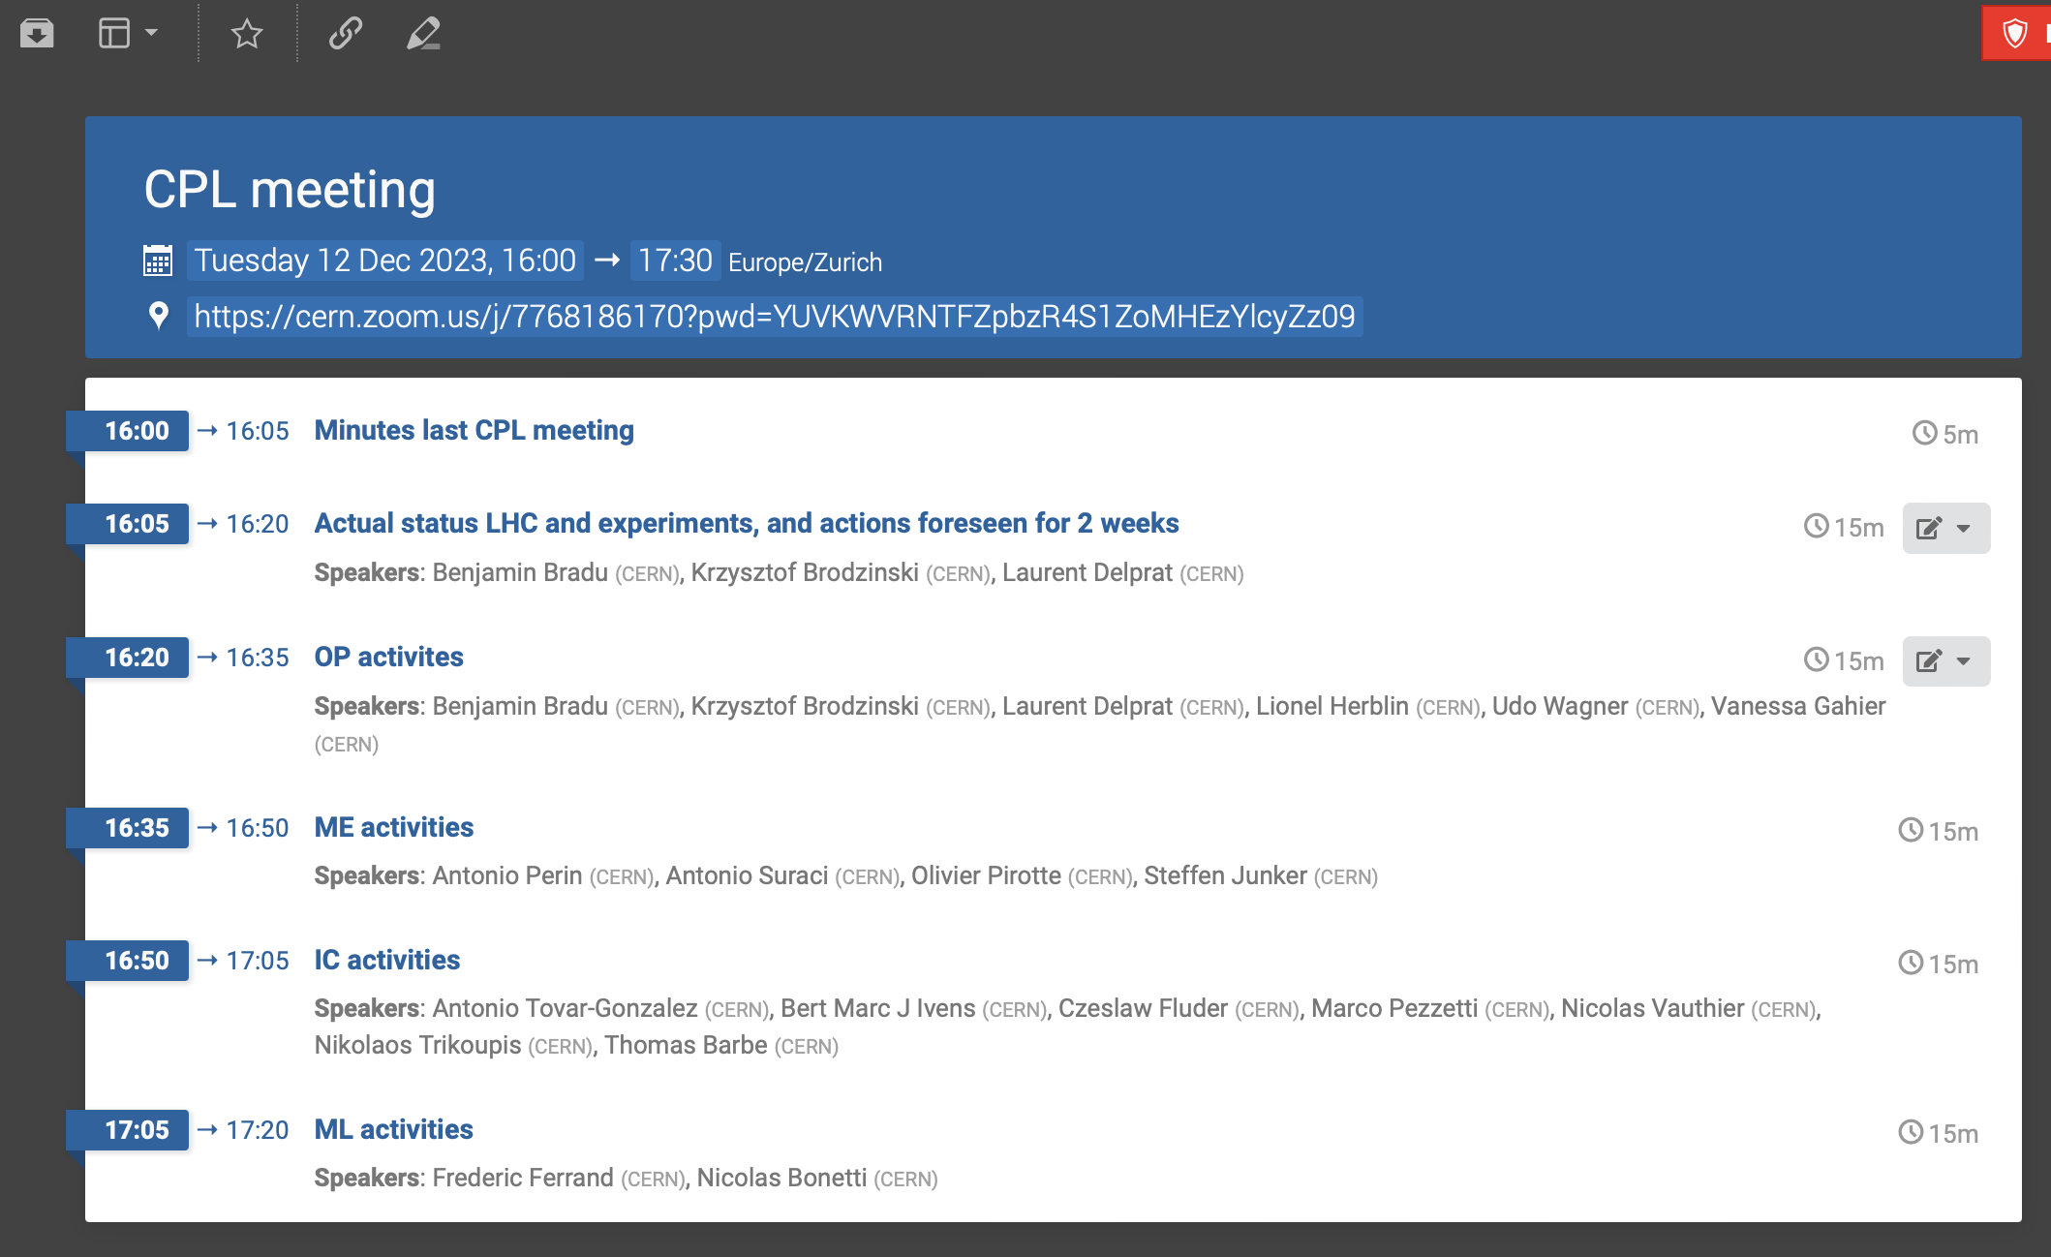
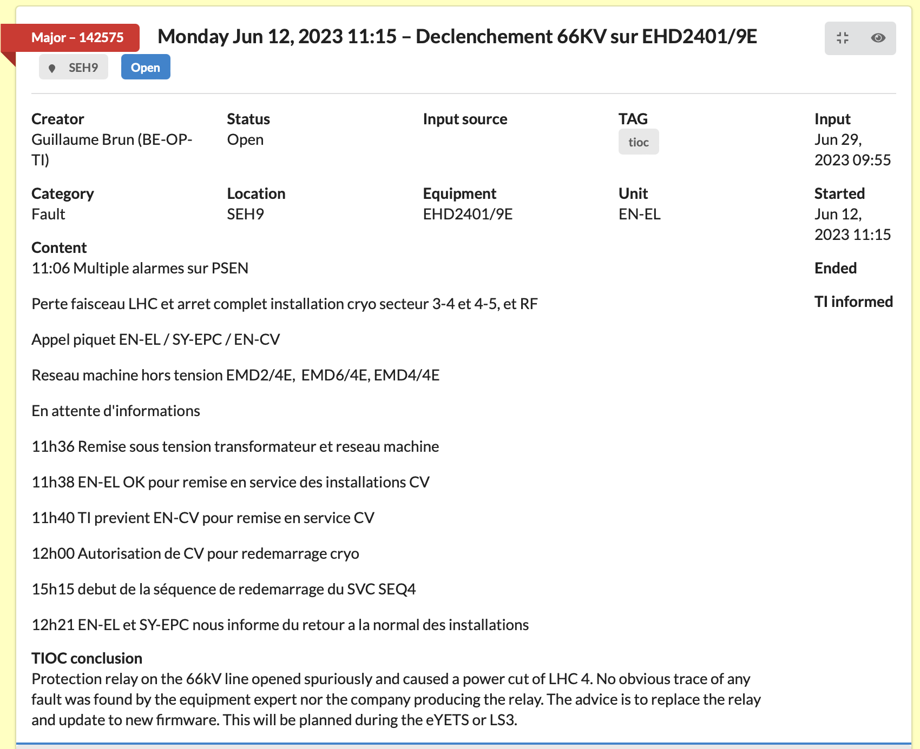
Summary
Fault registered in OP logbook
Fault added to KPI
TIOC reviewed, CRG reviewed
AFT reviewed
CS/CM loss

Slide 13
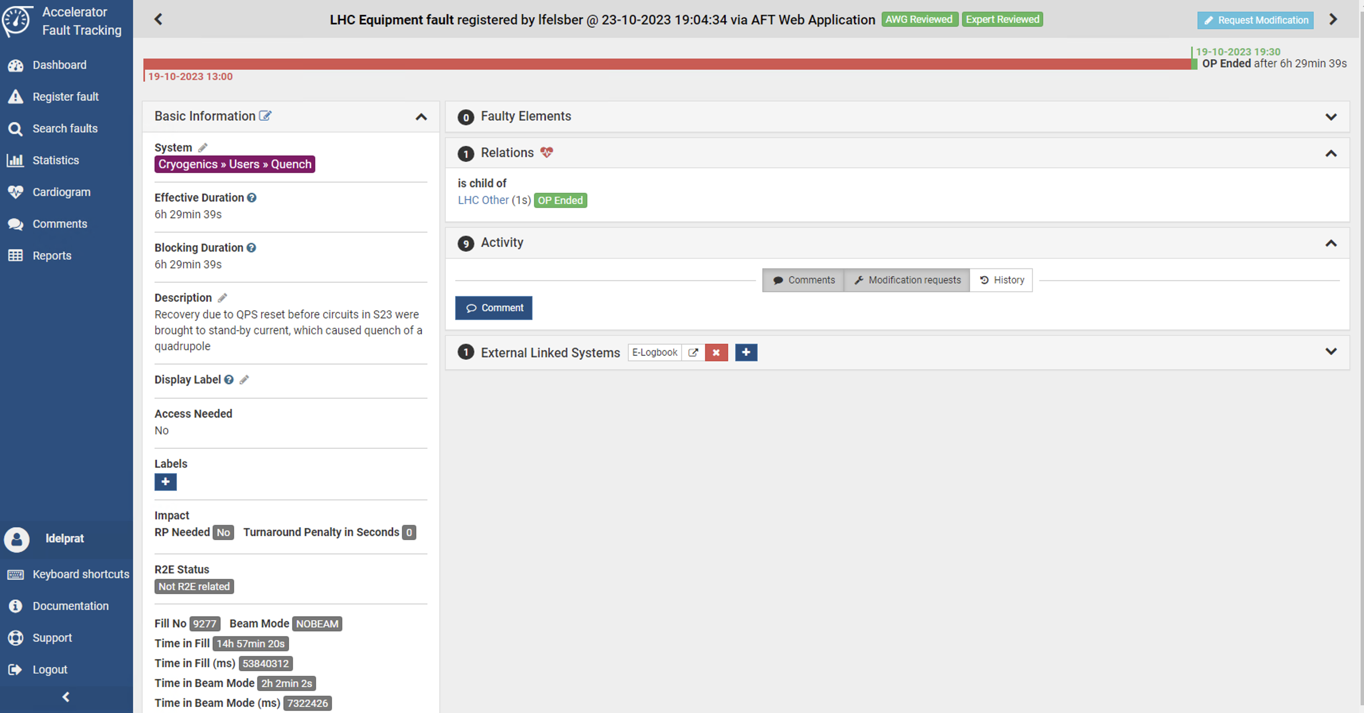
What we make out of the AFT
Start time
End time
Effective duration
Categorization
Description
Only for CS/CM impacting events

Slide 14
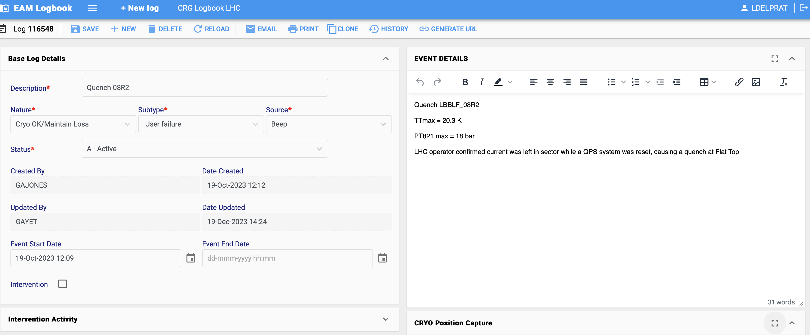
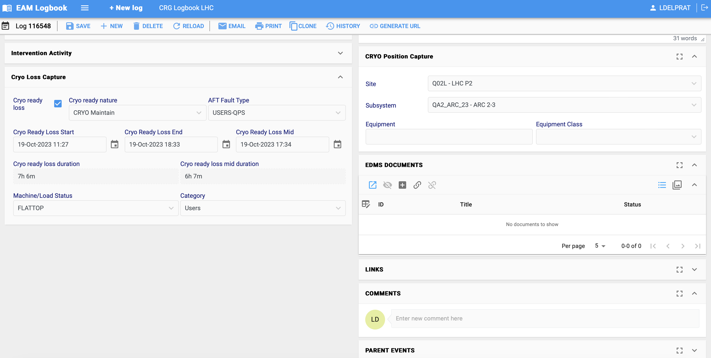
We mainly miss from the AFT (for now)…
…the possibility to directly push data from our TE-CRG-OP logbook (INFOR EAM) into the AFT

Slide 15
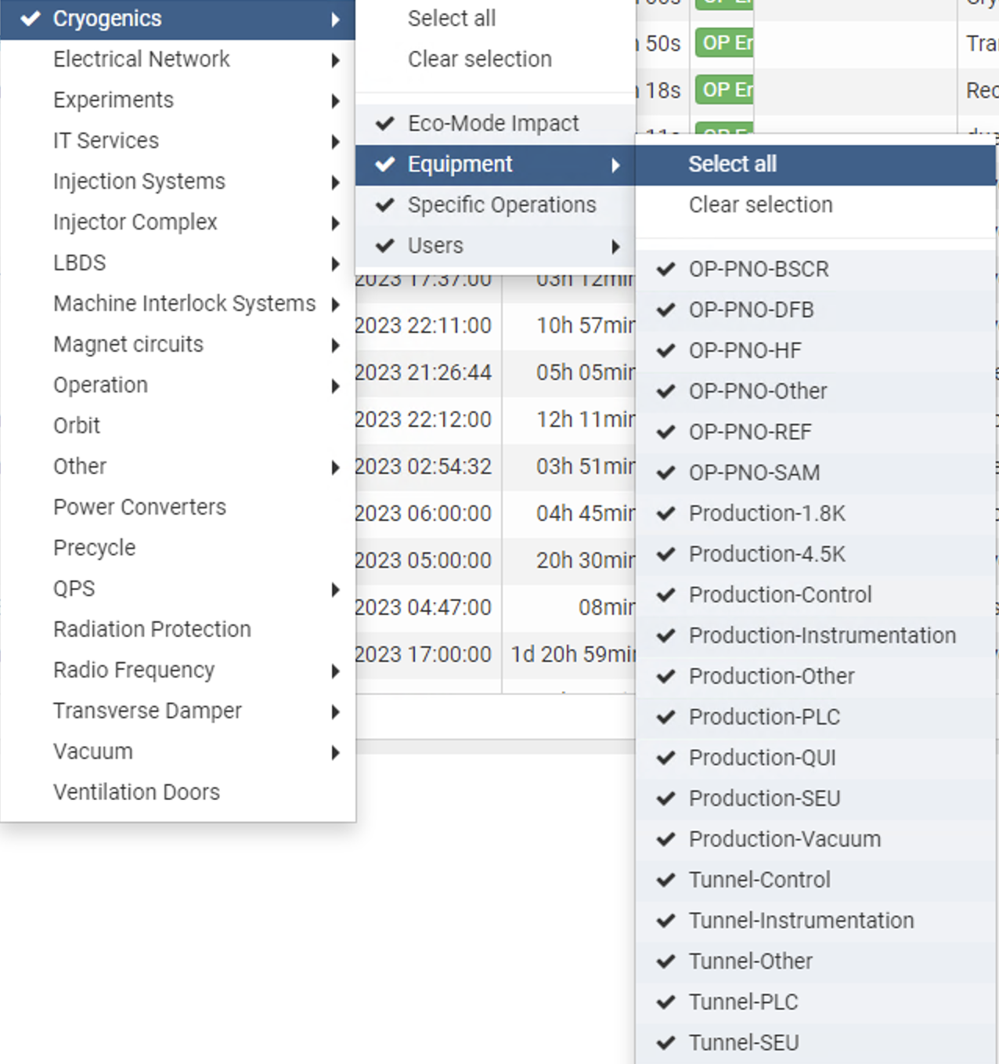
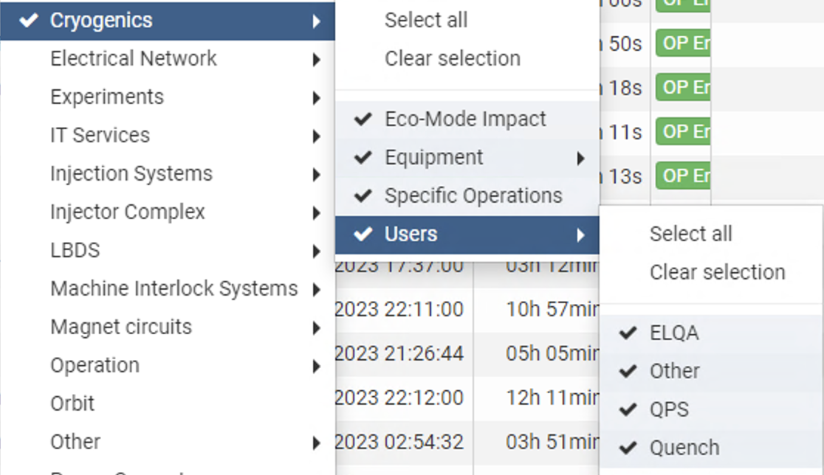
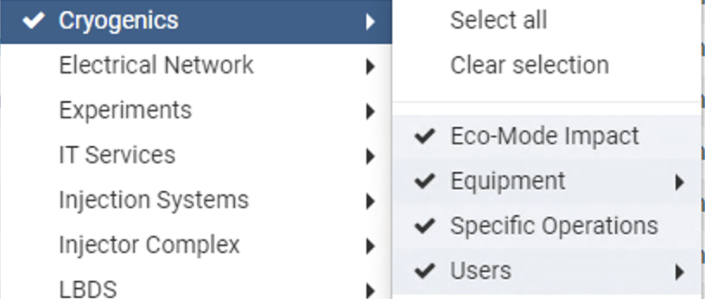
AFT cryo categories as of today
Good to remember:
No “technical services” category as it is sorted in another branch in the AFT (however we do have such one in CRG)
“Equipment” and “Users” are identical
“Eco-Mode Impact”: to track the influence of the eco-mode configuration of the cryoplants, e.g. in case of an electrical failure (longer recovery time as less CPs running)
“Specific Operations”: ”everything” that is agreed beforehand with LHC and during which the cryo conditions are lost (e.g. reconfiguration of the cryoplants to low power consumption for the ion run) – only for P6 & P8 eventually for 2024 (see next slide)

Slide 16
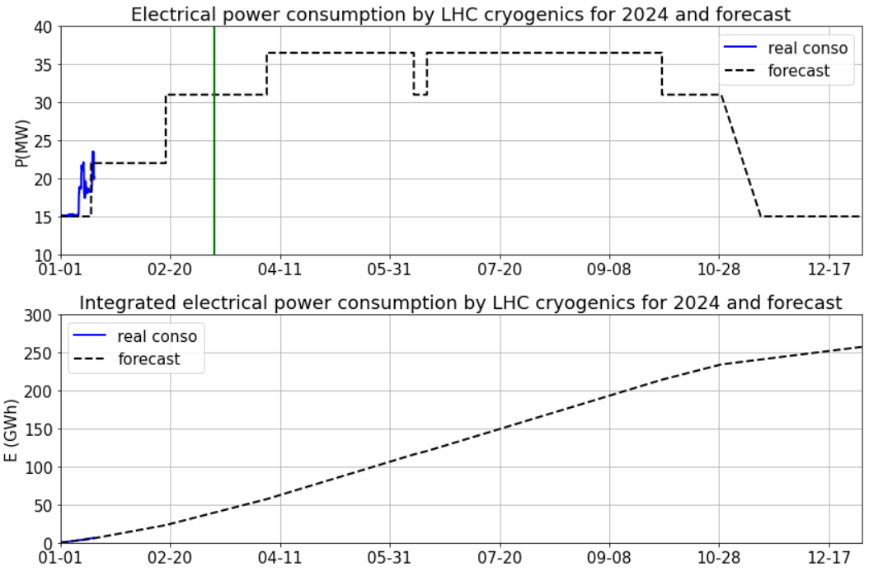
Electrical power consumption forecast for 2024
Based on the latest LHC planning on 9th January 2024 (2 Technical Stops and only Pb+ run after TS2)
P18/P2 & P4 always in “Full Power” when liquid helium in the tunnel.
P6 & P8 in “eco mode” during the recommissioning, the TS and the Ion Run.
Scrubbing & Proton Run
Recommissioning
TS1
TS2
+ Ion Run
LHC cryogenics in 2024:
Eco mode at P6&P8 ➔ ~31 MW
Full power ➔ ~36.5 MW
1st Beam
EYETS
Forecast in 2024
➔ 257 GWh
  Always try to optimize the electrical consumption whenever it is possible.

Slide 17
Perspectives
Availability tracking workflow in CRG-OP to be simplified
Adding the possibility to push the data from the CRG-OP logbook into the AFT ?
Adding the possibility to create directly within the AFT the outputs currently produced internally to CRG-OP ?
THANK YOU FOR YOUR ATTENTION

