Slide 1
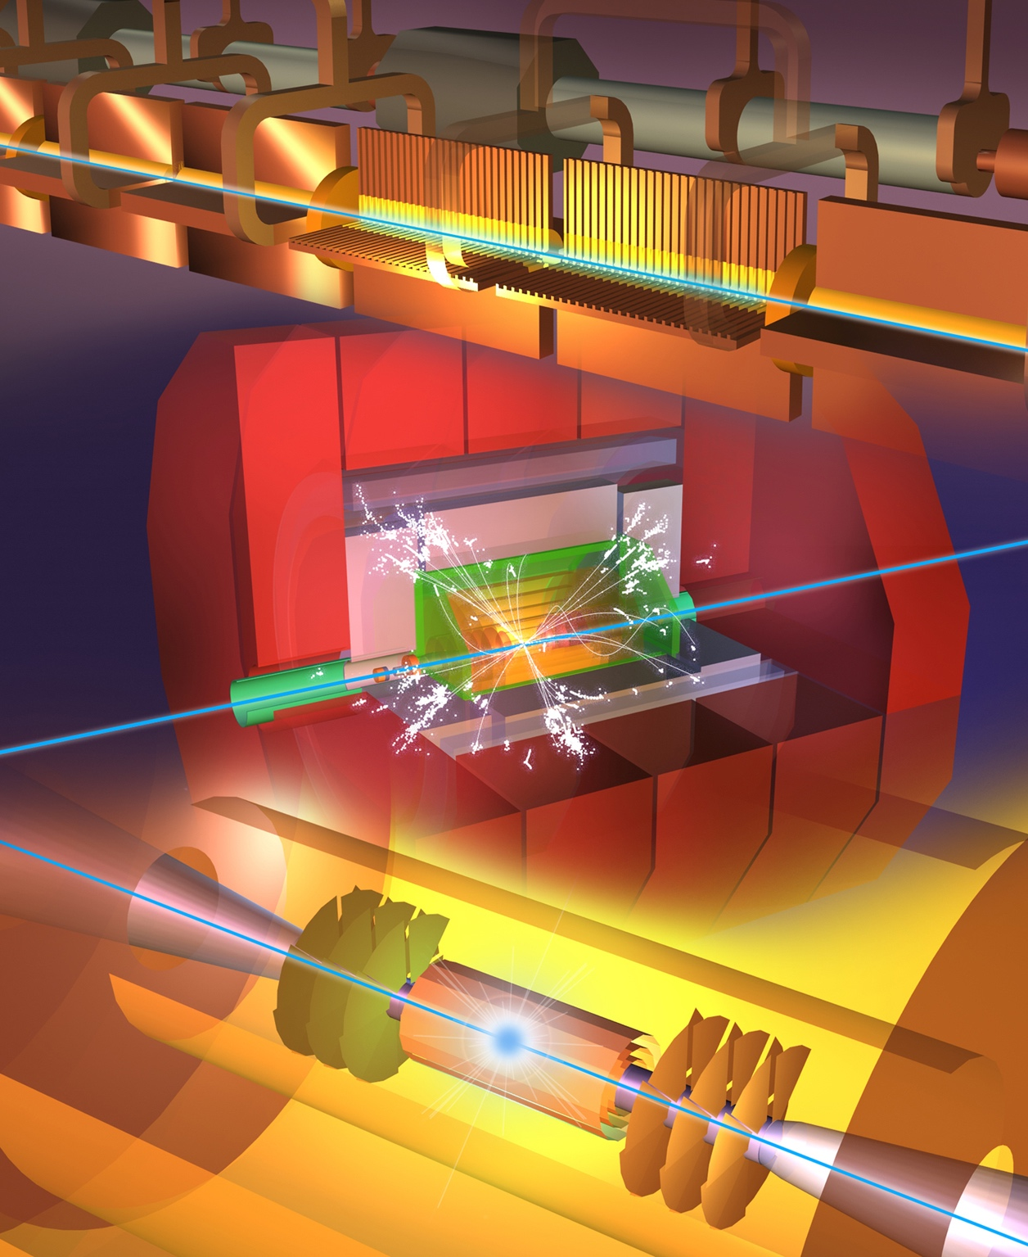
Readiness Report around ~2025-26
Update wrt Project Implementation Plan document 2018
Key updates:
Luminosity numbers, covering beam-dynamics, nanobeam studies and hardware, and positron production - at all energies
  Risk reduction (wrt performance), bumps, redundancies
Energy/power/sustainability: 380 well underway, 3 TeV to be done, L-band klystrons
Sustainability issues, more work on running/energy models, carbon (construction/operation/disassembly)
X-band progress – for CLIC, smaller machines, industry availability, including RF network
RF design optimization/development – including injectors, R&D for higher energies, gradient (cool/HTS/etc.), power, beam parameters - links to plasma (if it can be made)
Cost update. Changes wrt to 2018, plus impact of going green.
Physics “update”, use for “diversity” types of physics, LDM etc.
Low cost/power klystron version, with fewer klystrons, 250 GeV

Slide 2
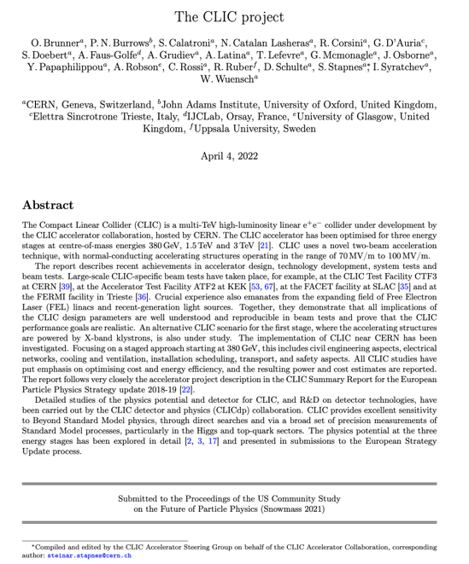
Status reports and studies
Several LoIs have been submitted on behalf of CLIC and CLICdp to the Snowmass process:
The CLIC accelerator study: Link
Beam-dynamics focused on very high energies: Link
The physics potential: Link
The detector: Link
Snowmass white paper:
https://arxiv.org/abs/2203.09186
Available at:
clic.cern/european-strategy
Broadly speaking: “Updated accelerator part of 2018 Summary Report”

Slide 3
