Slide 1


RF design of the CLIC-K module and BOC and CC measurements
Ping Wang, Alexej Grudiev
19.03.2024
Acknowledgements:, Karol Scibor, Alan Saillet, Emmanuel Berthome, Fritz Motschmann, Laurene Giordanino, Pedro Morales Scanchez, Nuria Catalan Lasheras, Benoit Riffaud, Igor Syratchev, Xiaowei Wu, Steffen Doebert, Matthew John Capstick, Carlo Rossi

Slide 2
Outline
Background
RF design of the CLIC-K module
RF measurement of the BOC pulse compressor
RF measurement of the bowl cavity
Summary

Slide 3
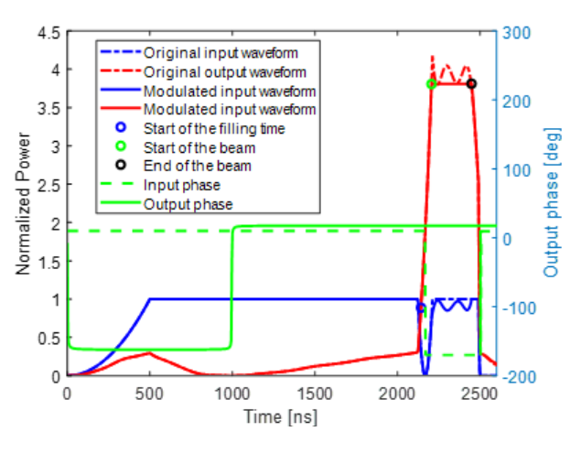
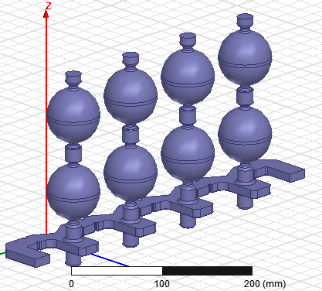
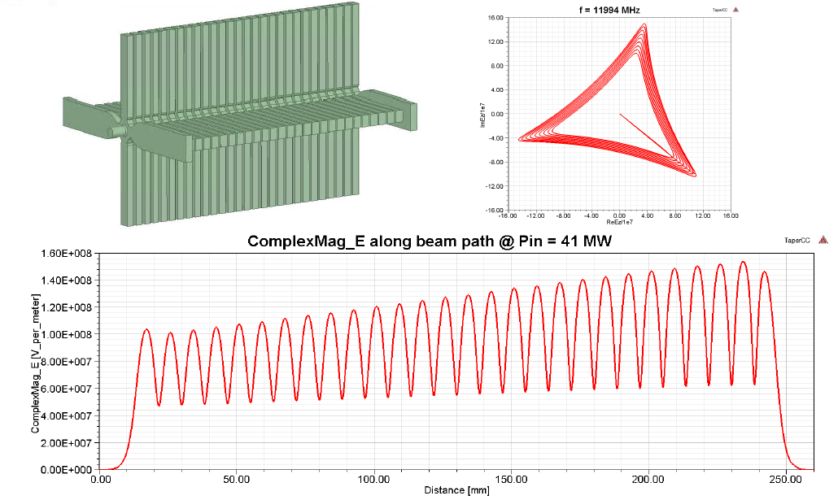
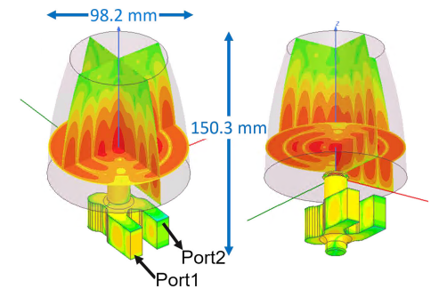
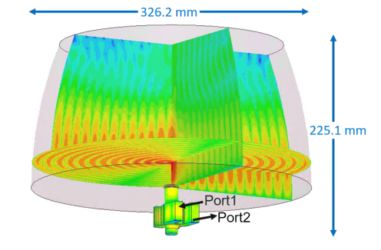
Introduction of Klystron-based CLIC
Klystron-based CLIC was proposed due to possible low cost for 380 GeV
CLIC-K structure
Pulse compressor with correction cavity chain

Slide 4
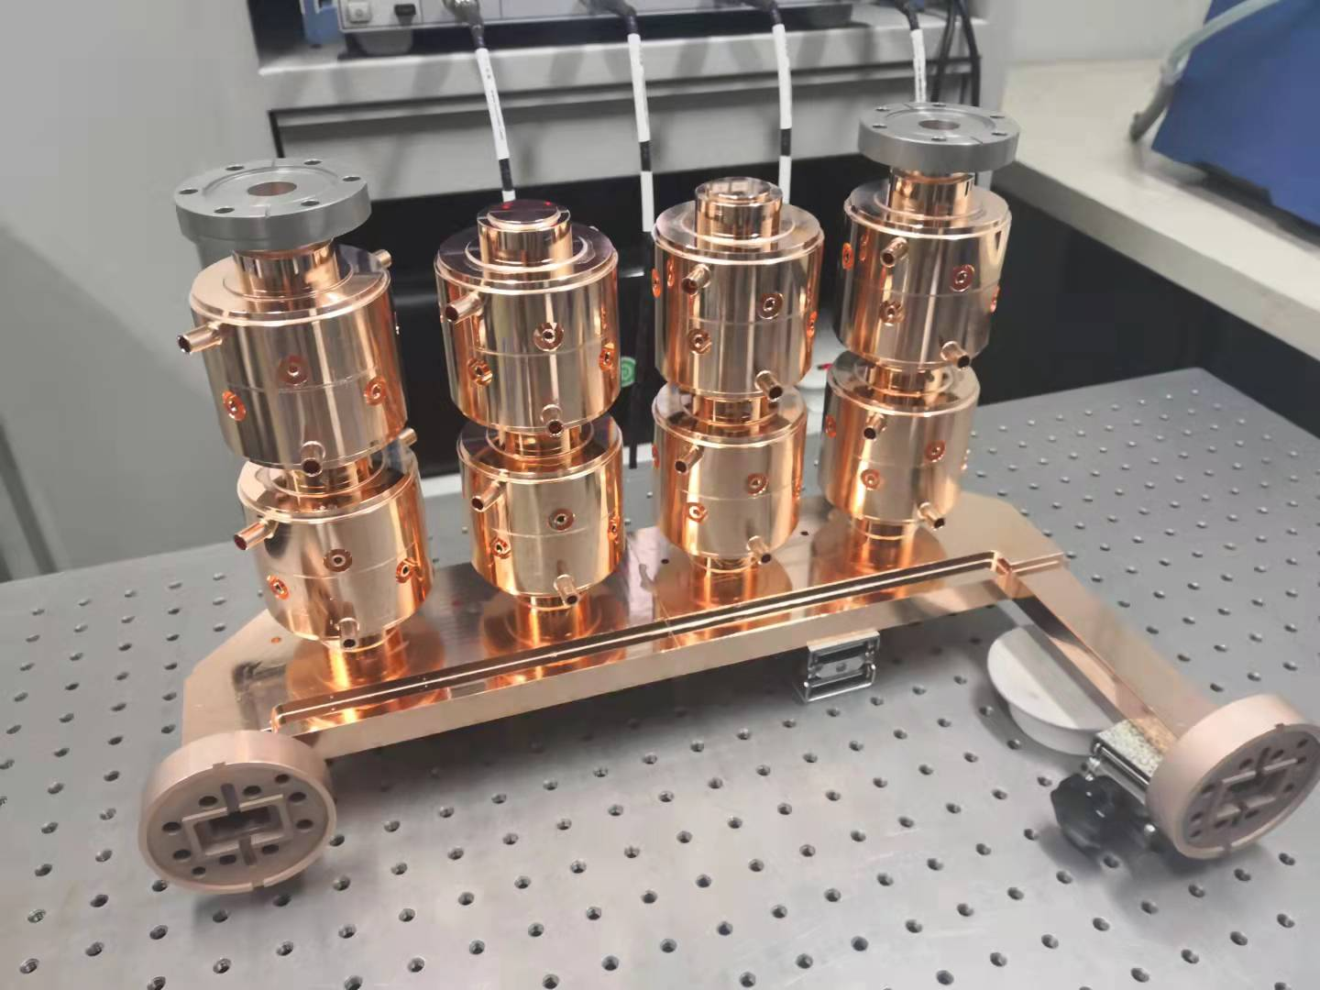
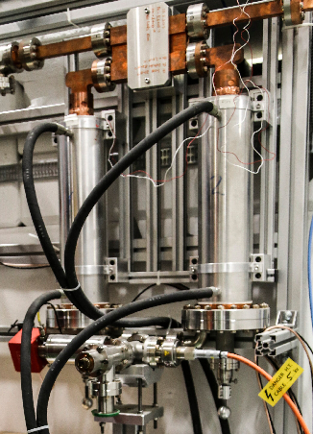
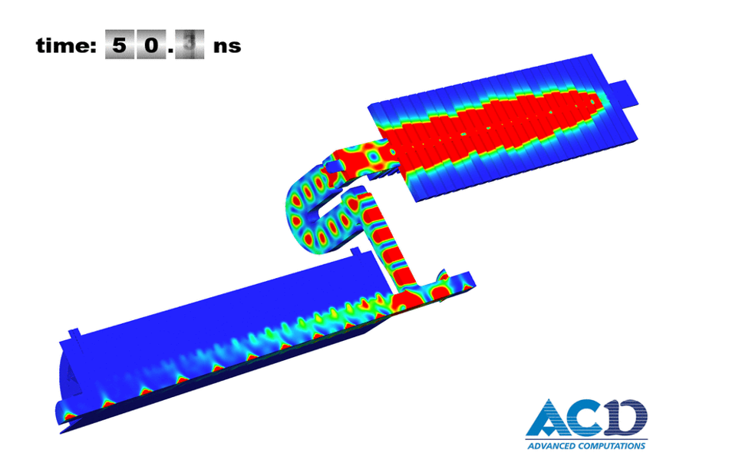
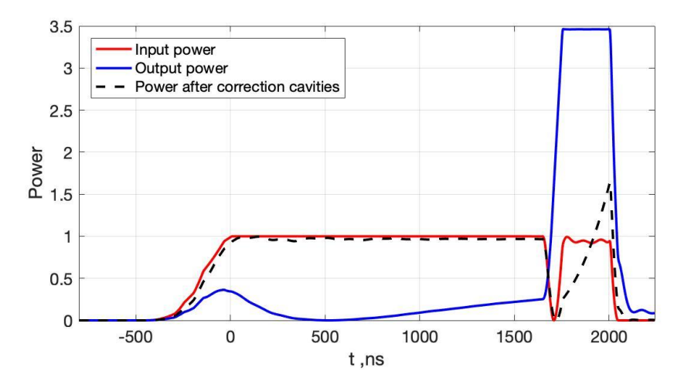
Challenges of Klystron-based CLIC
RF loss of the RF network
Power gain of the pulse compression system
Short path for RF power transmission
PETS
Accelerating structure

Slide 5
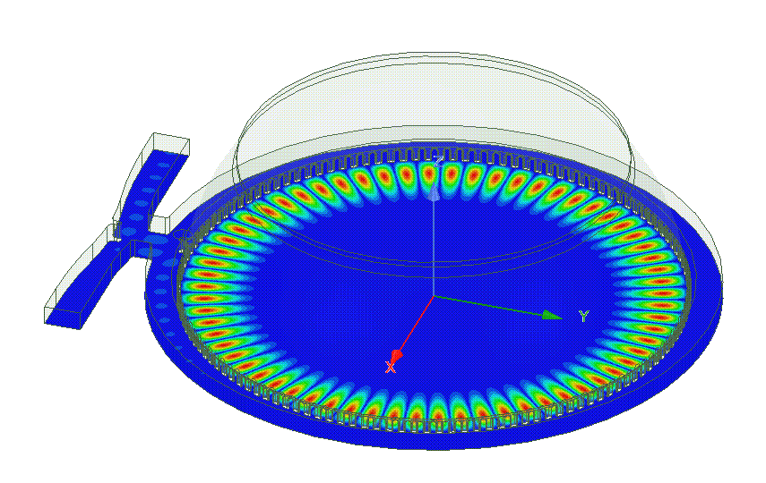
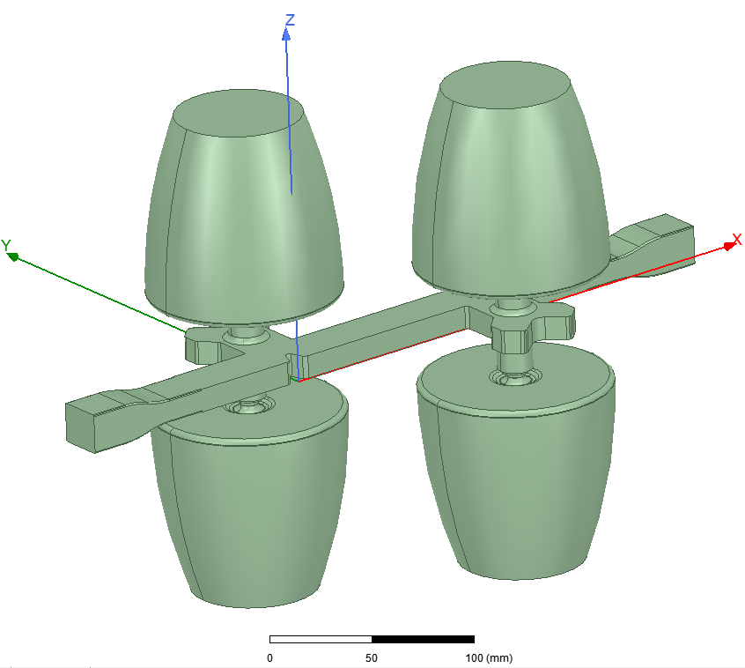
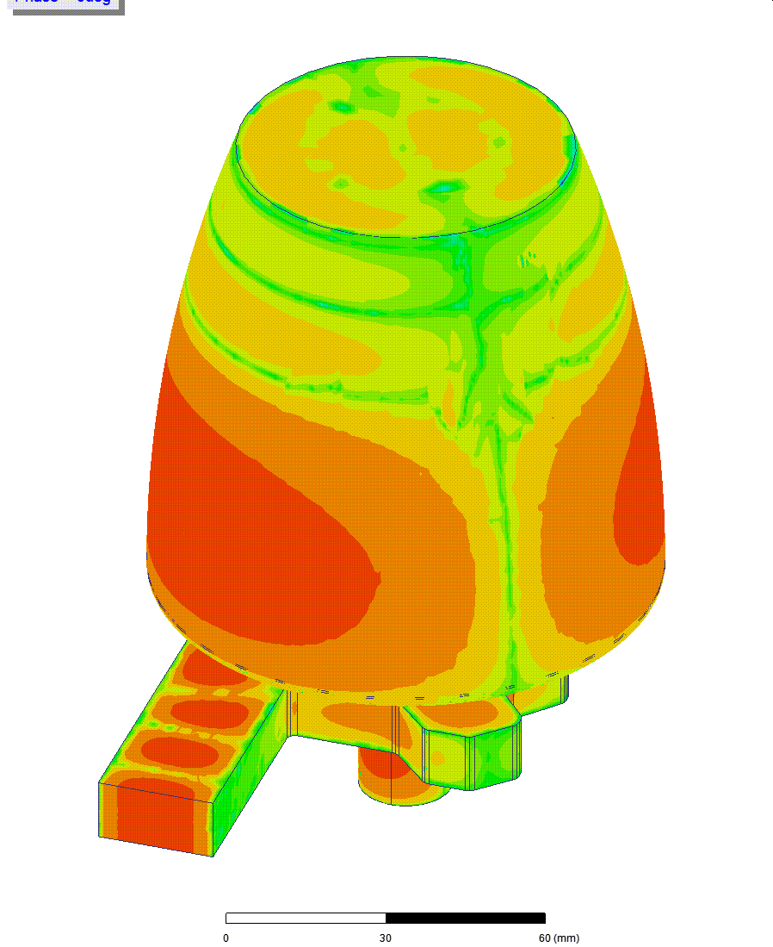
Challenges of Klystron-based CLIC
RF loss of the RF network → Double-height waveguides
Power gain of the pulse compression system → Larger unloaded quality factor
 | Power gain | Qs | Qc | Beta_s | Beta_c | Ns | Nc
New system | 3.8 | 2.35e5 | 7.5e4 | 6.6 | 1.95 | 1 | 4
First Prototype | 3.5 | 1.79e9 | 4.5e4 | 5.98 | 1.45 | 2 | 8

Slide 6
Outline
Background
RF design of the CLIC-K module
RF measurement of the BOC pulse compressor
RF measurement of the bowl cavity
Summary

Slide 7
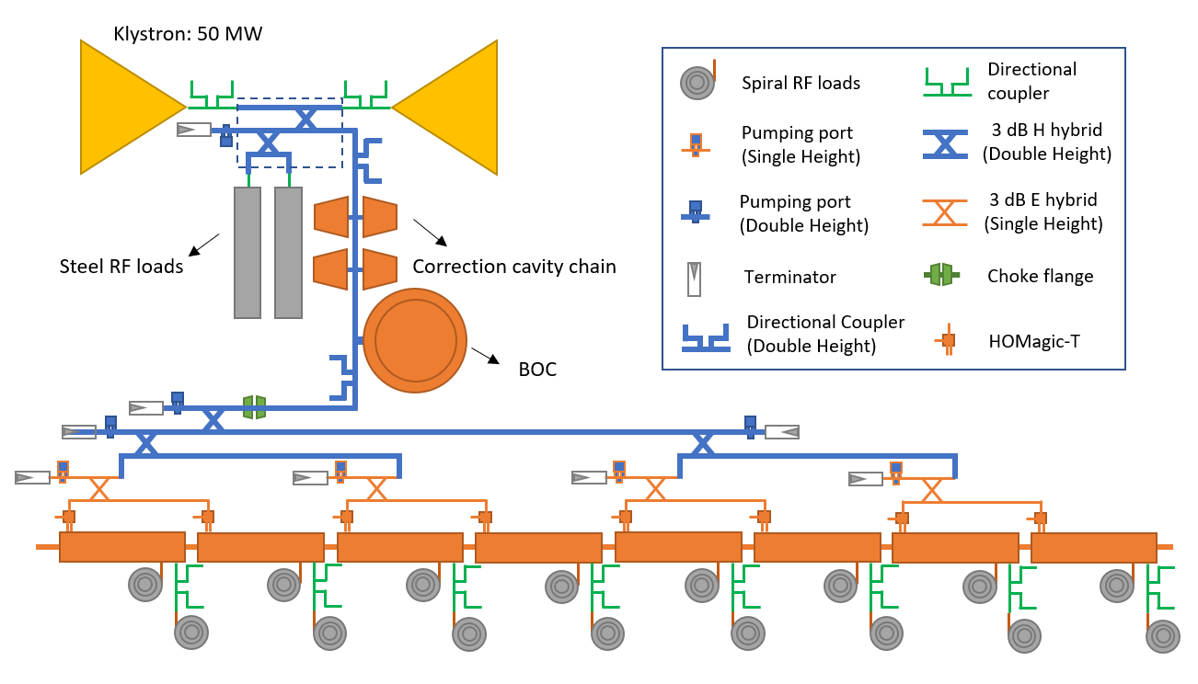
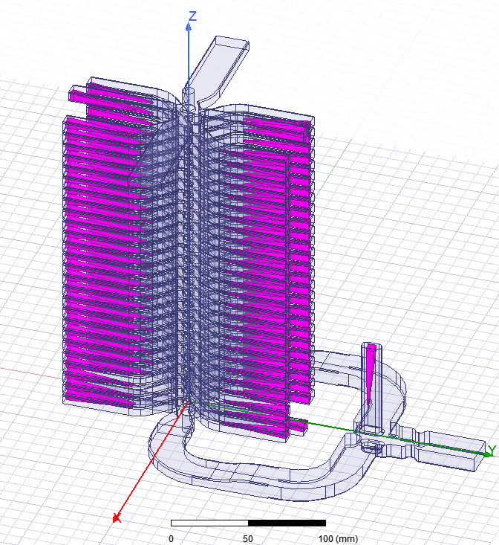
Preliminary layout of RF module for klystron-based CLIC
Input power for Linacs: 40.6 MW
Two klystrons
Power of klyston: 50 MW
Power gain: 3.80
RF loss in RF system: 13%
[1] Ping Wang, M. Capstick, N. Catalan Lasheras, et al., RF design of the waveguide network for the klystron-based clic module. Proc. 14th Int. Particle Accel. Conf. (IPAC), Venezia, Italy, 2023.

Slide 8
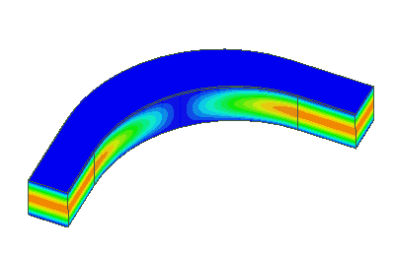
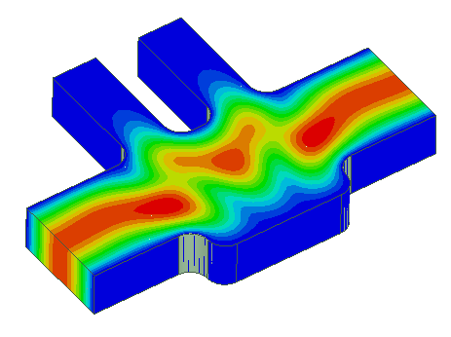
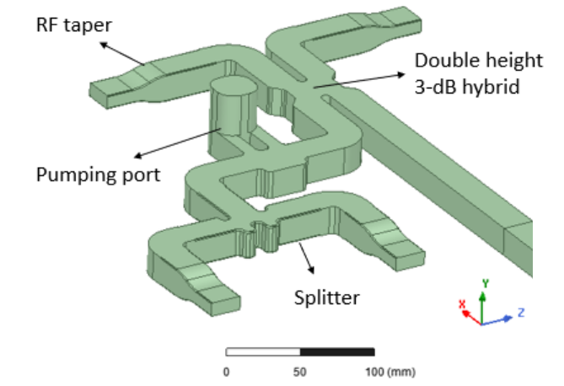
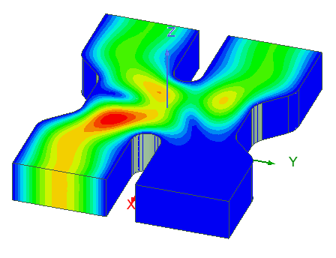
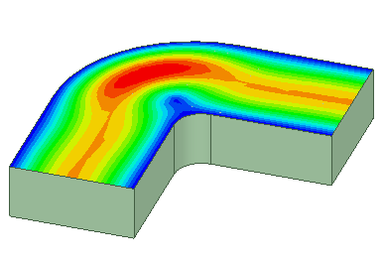
RF combiner
Two combine the RF power from two klystrons
The ability to absorb the RF power from two klystrons
Double Height E-bend
Single Height Pumping port
Single Height 3-dB hybrid
Single Height H-bend

Slide 9
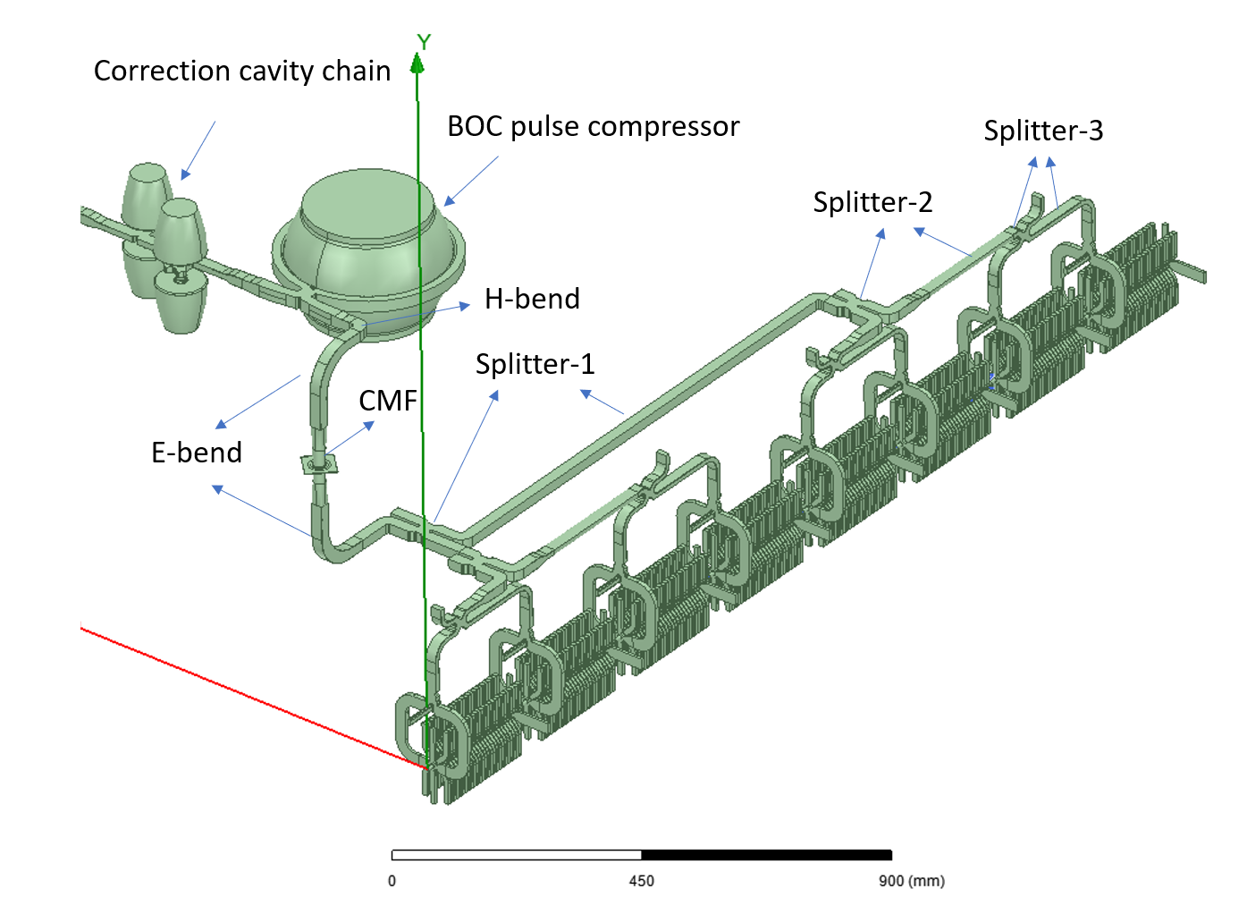
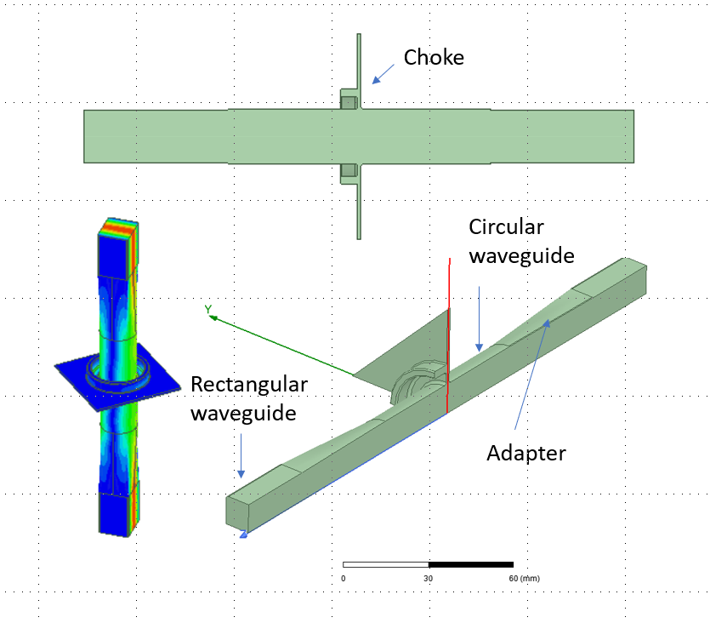
RF splitter
Choke Mode Flange based scenario
X direction | Y direction | Z direction
± 0.89 mm | ± 0.12 mm | ± 0.96 mm

Slide 10
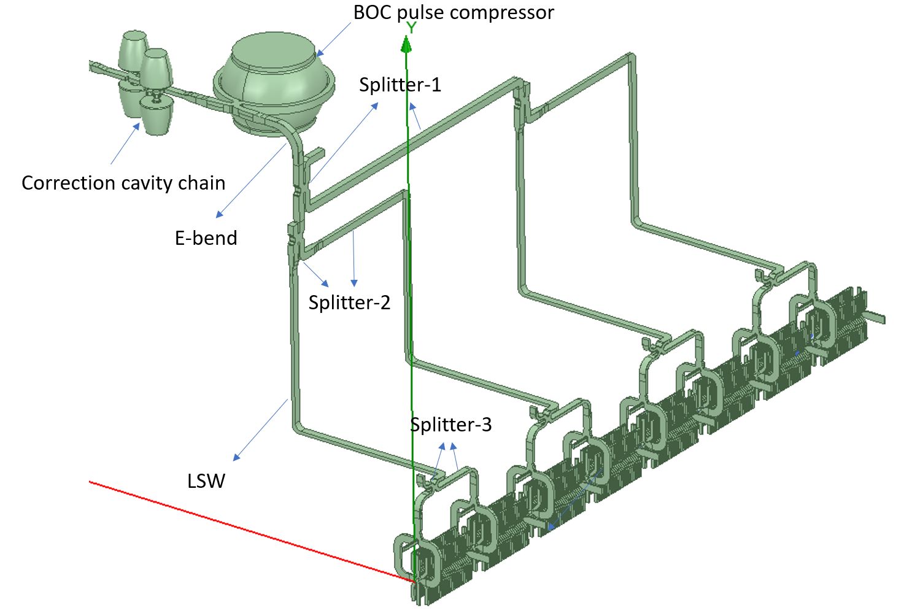
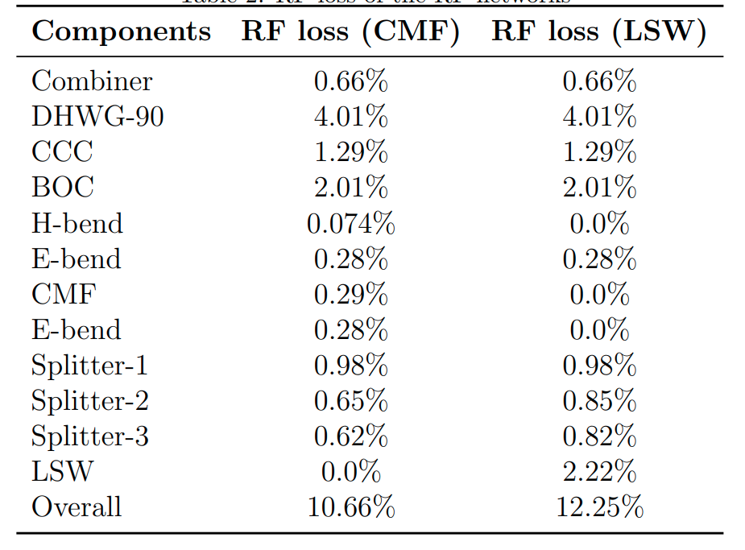
RF splitter
L Shape Waveguide based scenario
RF loss calculation of the two scenarios

Slide 11
Outline
Background
RF design of the CLIC-K module
RF measurement of the BOC pulse compressor
RF measurement of the bowl cavity
Summary

Slide 12
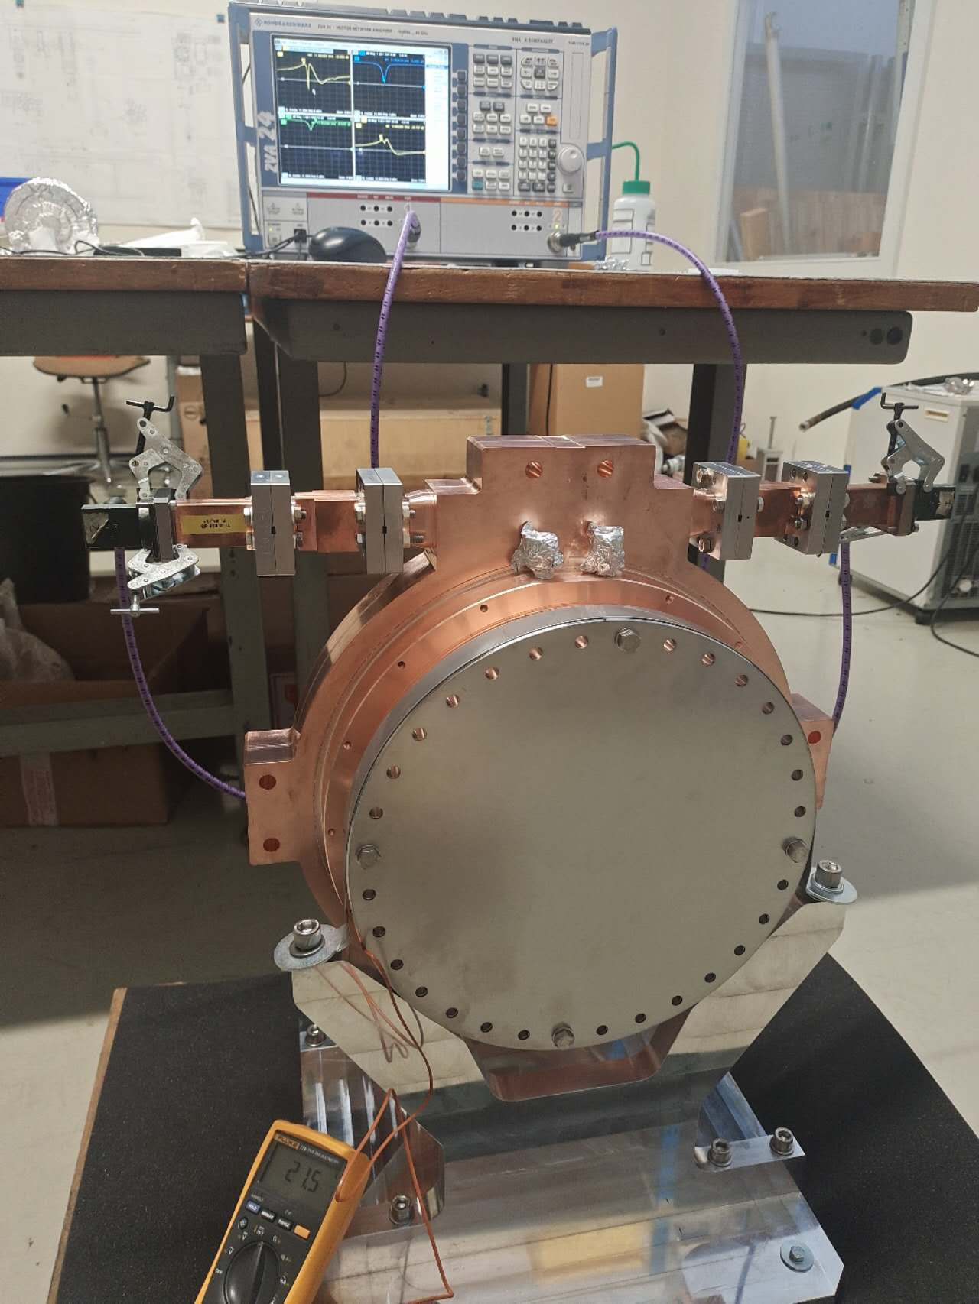
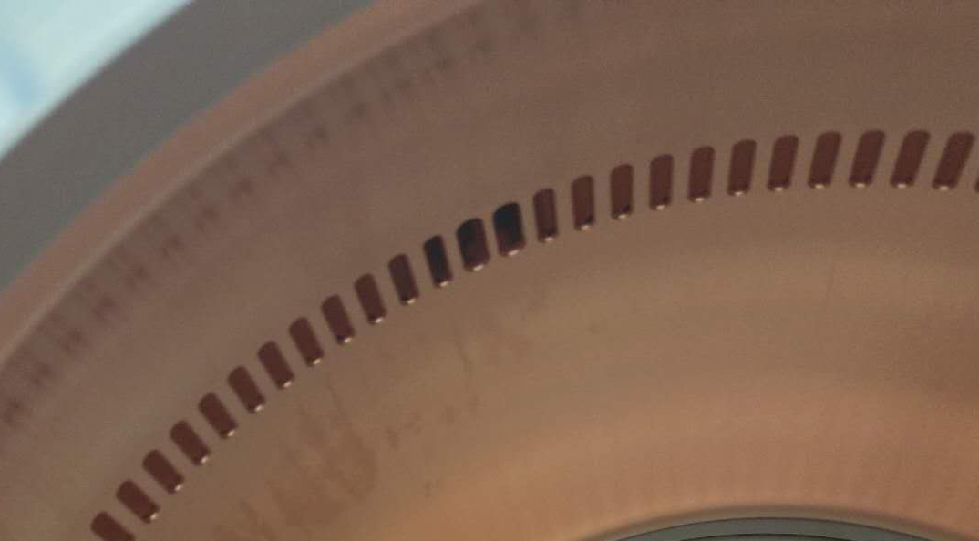
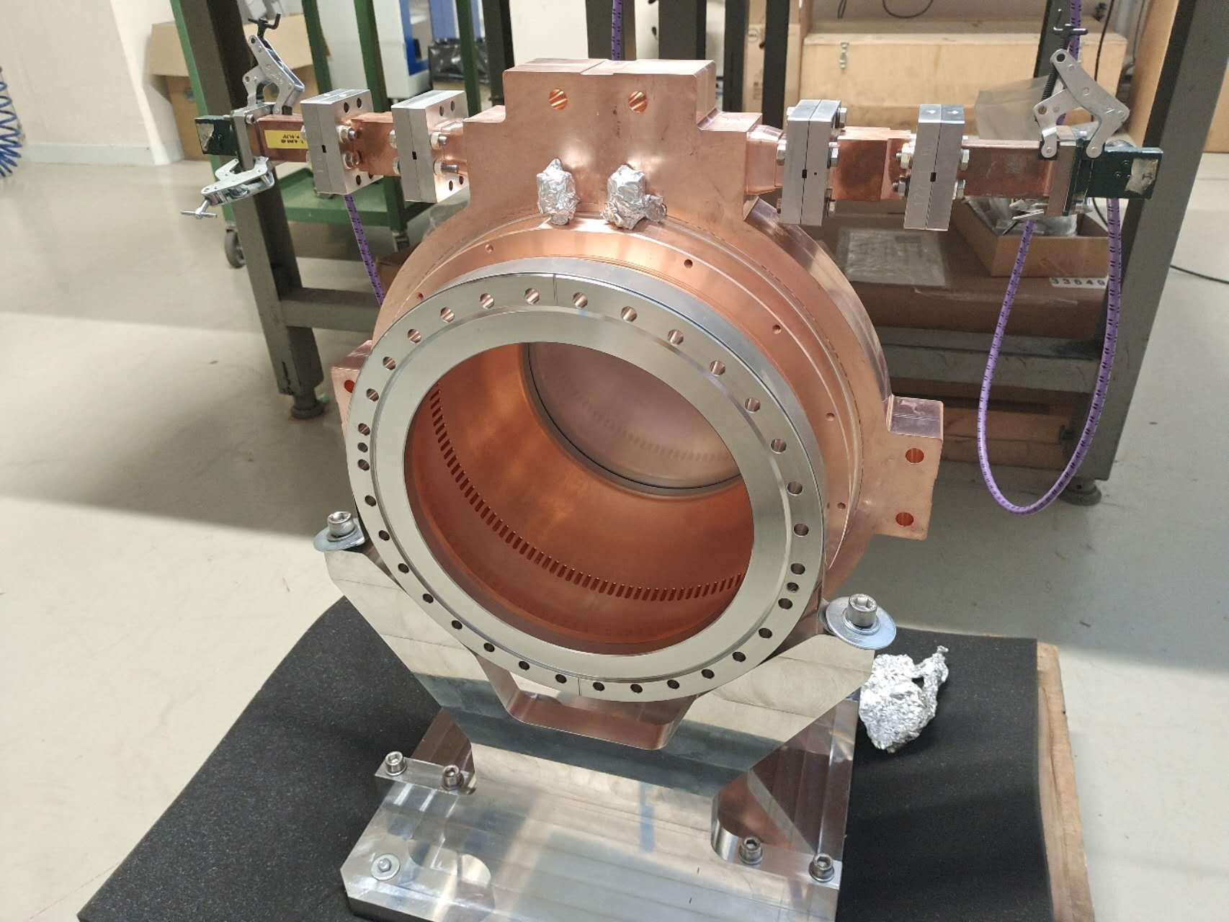
RF measurement of the BOC pulse compressor
Closed
Two special coupling holes
Open
One side
S-parameters of the BOC

Slide 13
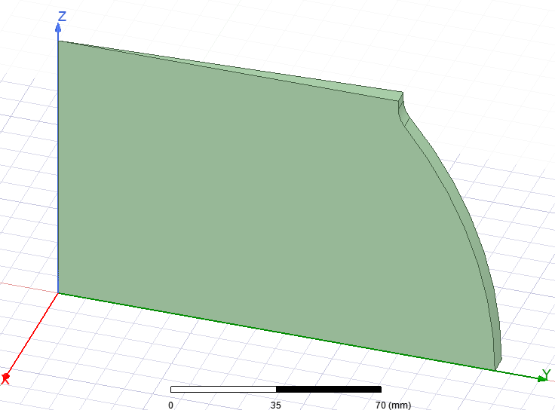
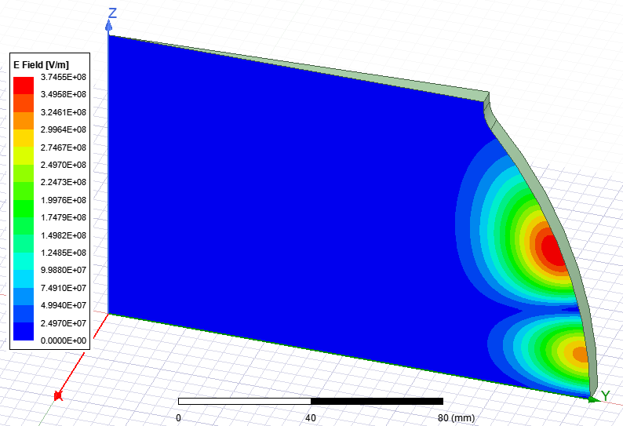
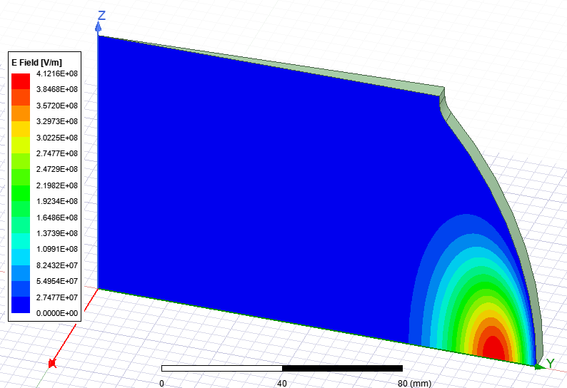

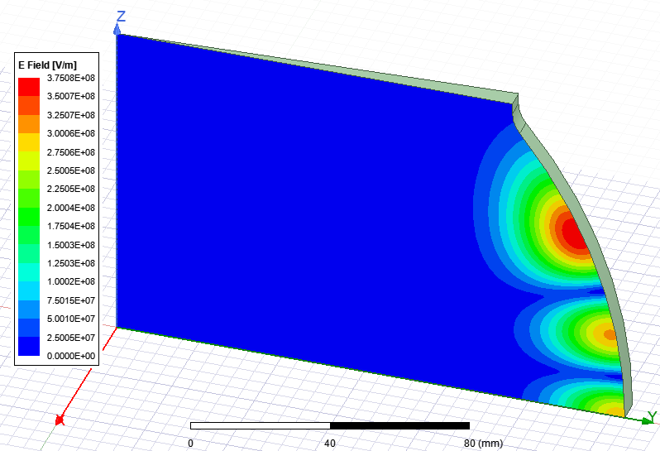

RF measurement of the BOC pulse compressor
Measurement @ 500 MHz span and 21.5 ℃
11.882 GHz
Two nearby modes: 11.896 GHz and 12.193 GHz
PerfE
PerfH
11.994 GHz
11.994 GHz

Slide 14
RF parameters of the BOC pulse compressor
 | Frequency [GHz] closed | Frequency [GHz] open
Air & 21.5℃ | 11.9936 | 11.9936
Vacuum & 21.5℃ | 11.9968 | 11.9968
Vacuum & 34.9℃ | 11.994 | 11.994
 | Measured open | Measured closed | Designed
Q0 | 1.91e5 | 2.15e5 | 2.36e5
Qe | 4.30e4 | 4.28e4 | 3.58e4
Beta | 4.44 | 5.03 | 6.6
closed
open

Slide 15
Outline
Background
RF design of the CLIC-K module
RF measurement of the BOC pulse compressor
RF measurement of the bowl cavity
Summary

Slide 16
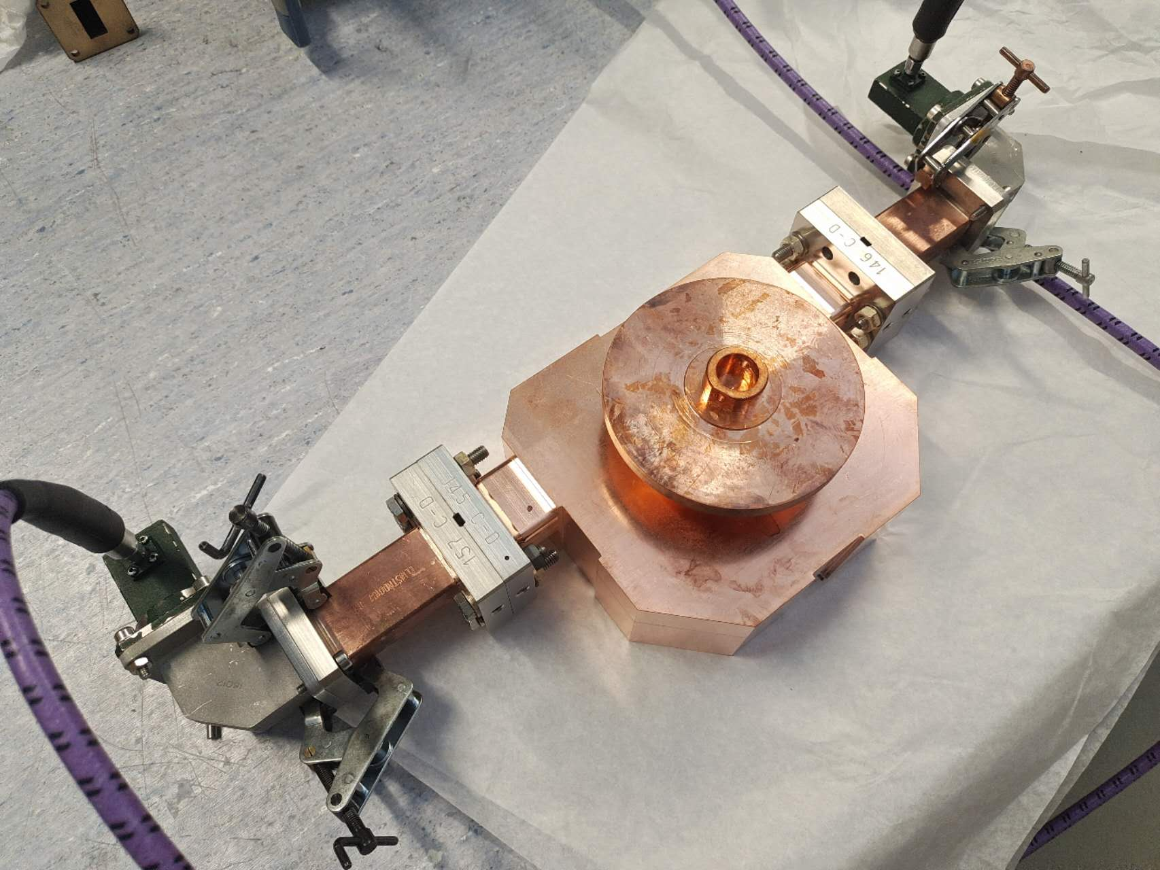
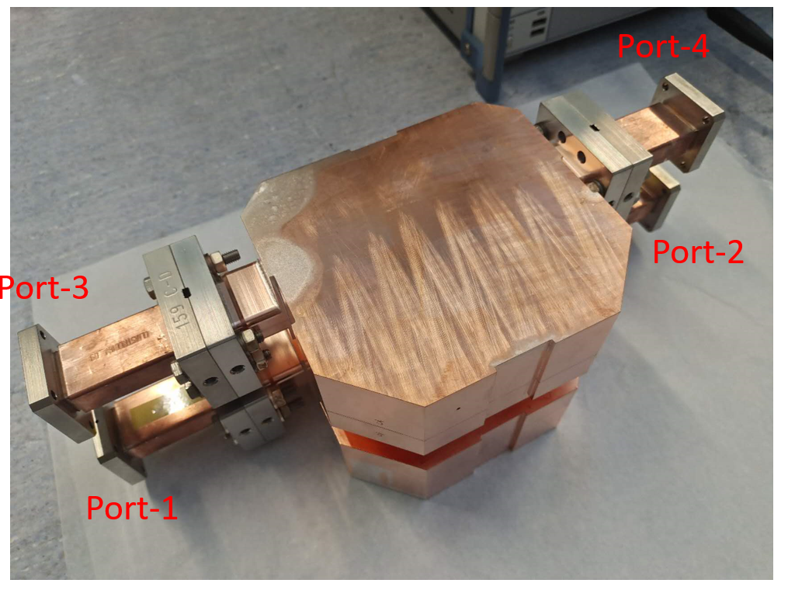
RF measurement of the RF rotator
Reflection
Transmission from port-1 to port-4

Slide 17
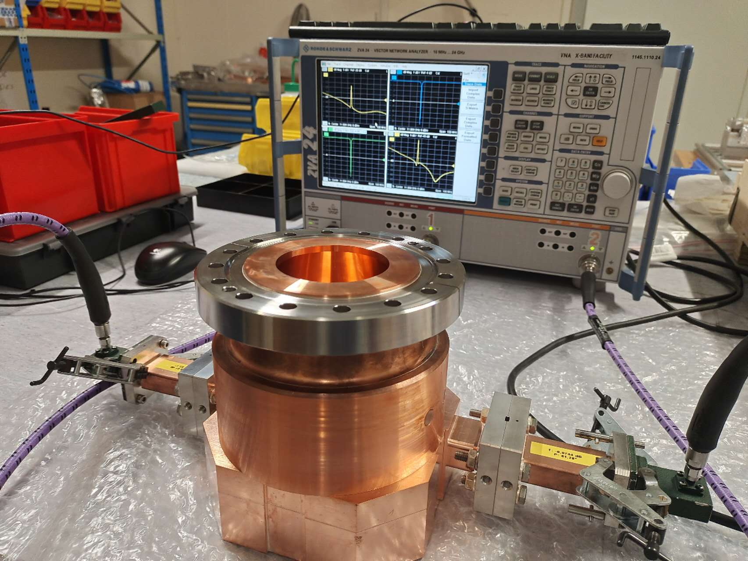
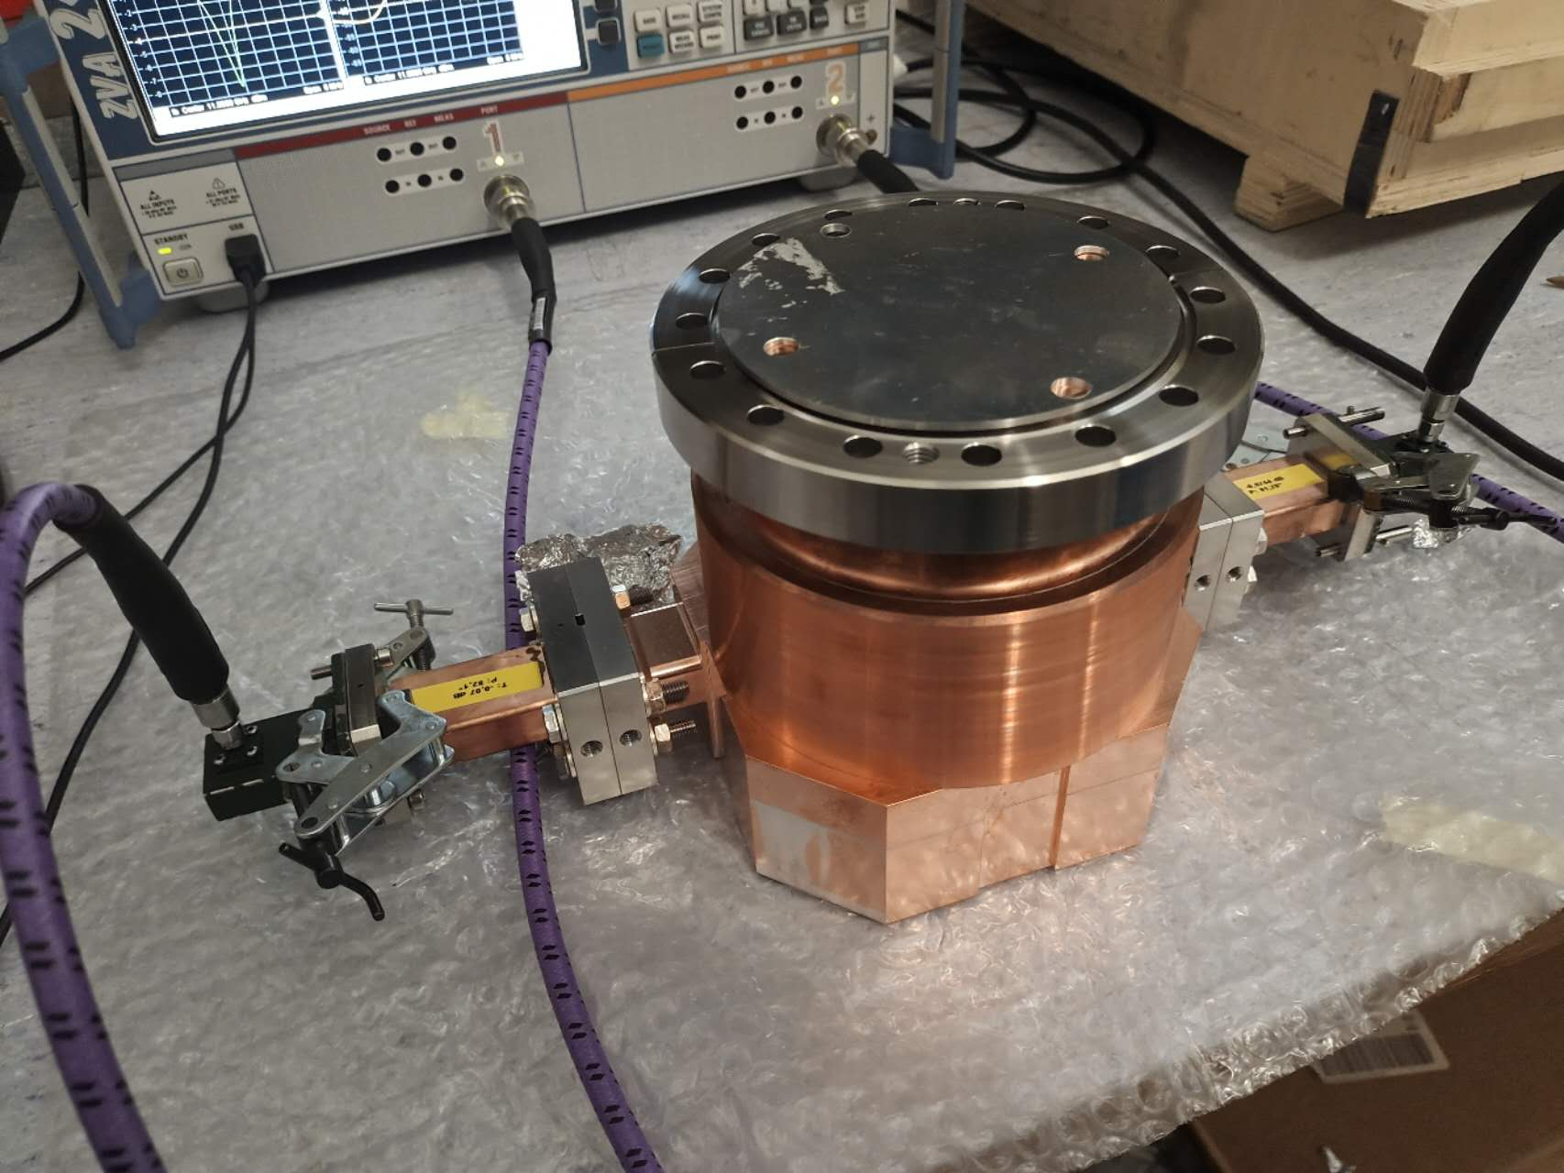
RF measurement of the Bowl cavity before final brazing
 | Open | Short
Measured | 11989.740 | 11989.715
Vacuum | 11992.916 | 11992.892
Scaled to 30 ℃ | 11991.836 | 11991.811
Scaled to 20 ℃ | 11993.875 | 11993.850
 | Frequency [MHz] | Q₀ | Q_{e} | Beta
Mechanical | 11993.9 | 7.45e4 | 2.74e4 | 2.72
Open (Vacuum) | 11991.836 | 6.08e4 | 2.72e4 | 2.234
Closed (Vacuum) | 11991.811 | 6.88e4 | 2.70e4 | 2.55
Temperature: 24.7 ℃

Slide 18
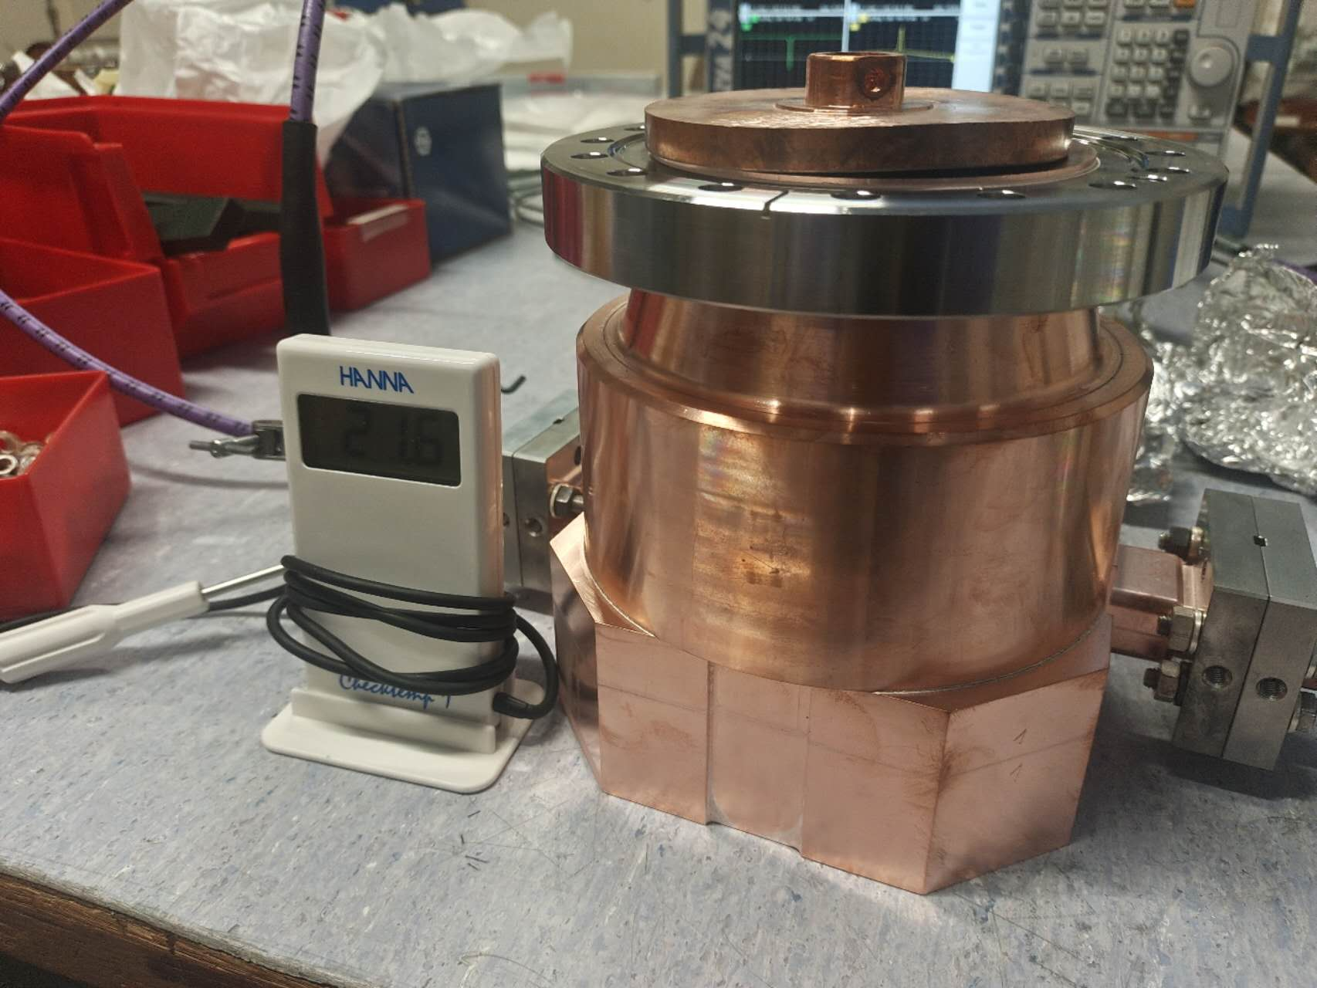
RF measurement of the Bowl cavity after final brazing
Reflection is increased after the final brazing
Closed
Open
Summry | Design | Closed Before. | Closed After. | Open Before. | Open After.
Frequency [MHz] | 11994 | 11994 | 11994 | 11994 | 11994
Temperature [℃] | ---- | 20.0 | 20.8 | 20.0 | 20.8
Q0 | 7.47e4 | 6.88e4 | 6.88e4 | 6.08e4 | 6.35e4
Beta | 2.72 | 2.55 | 2.59 | 2.34 | 2.36
S11 @ f0 [dB] | -59.7 | -22.6 | -9.4 | -22.0 | -9.6
S11 @ f0+1MHz [dB] | -48.0 | -38.4 | -24.6 | -39.2 | -24.2
S11 @ f0-1MHz [dB] | -48.0 | -41.1 | -28.3 | -40.0 | -27.7

Slide 19
Outline
Background
RF design of the CLIC-K module
RF measurement of the BOC pulse compressor
RF measurement of the bowl cavity
Summary

Slide 20
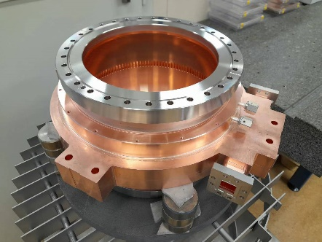
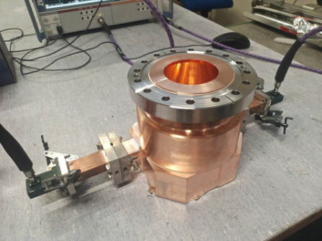
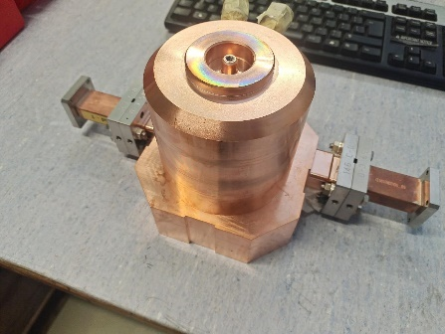
Summary
We designed a new RF module for klystron-based CLIC
We fabricated and measured two prototypes for BOC pulse compressor and bowl cavity
Metrology and analysis will be done for the two prototypes
The spherical pulse compressor will be measured and analyzed

Slide 21
Thanks for your attention !!!

