Slide 1


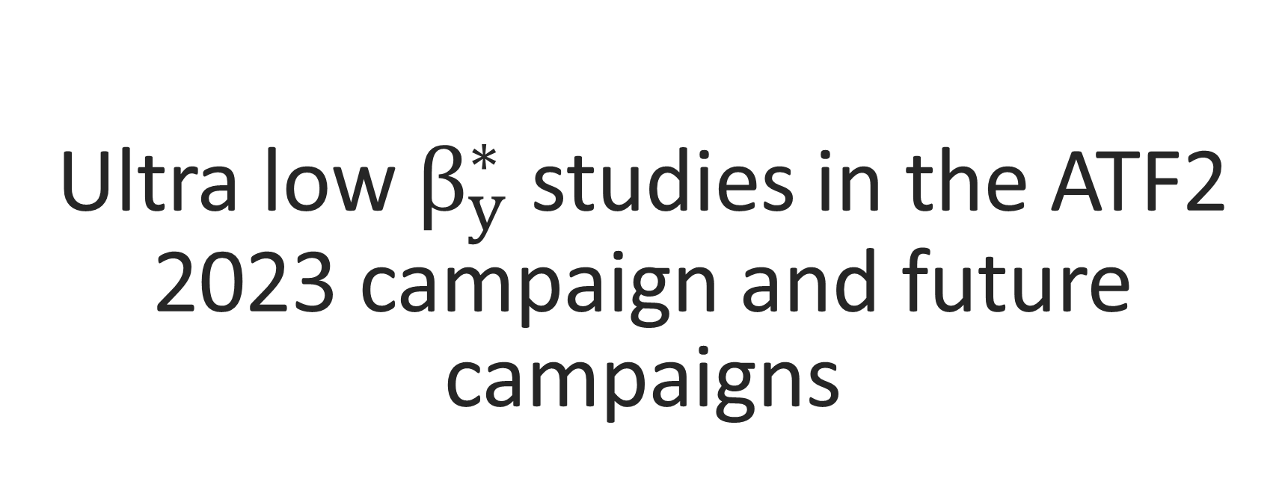
Ultra low $β_{y}^{∗}$ studies in the ATF2 2023 campaign and future campaigns
Enrico Manosperti, Andrii Pastushenko, Rogelio tomas
CLIC Project Meeting
19/03/2024

Slide 2
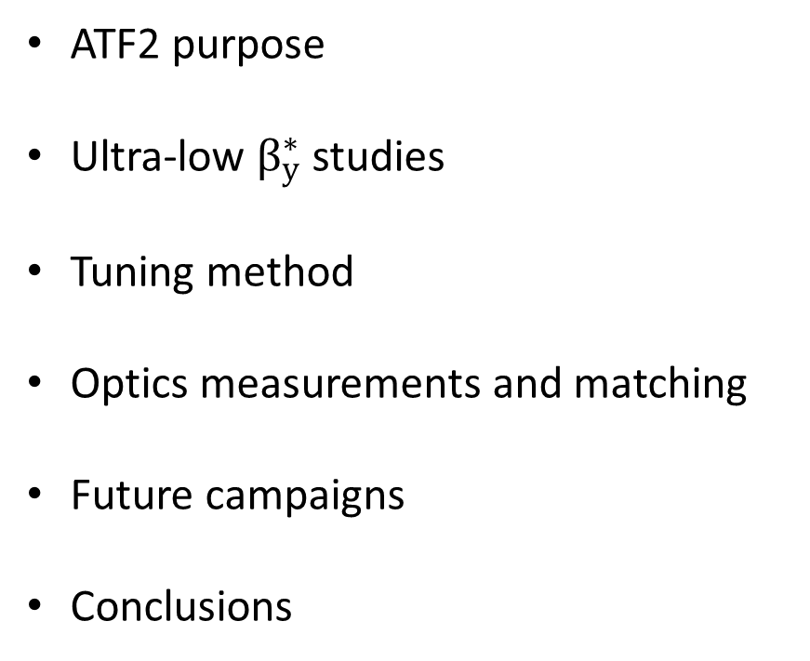
Outline
ATF2 purpose
Ultra-low $β_{y}^{∗}$ studies
Tuning method
Optics measurements and matching
Future campaigns
Conclusions

Slide 3
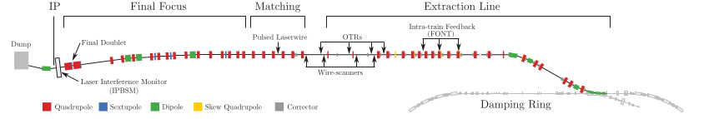
ATF2 purpose
Project to build and operate a facility for the final focus system of future colliders.
Feasibility studies on local chromaticity correction scheme.
Focusing an electron beam to 40 nm vertical for ILC-like FFS optics and to 20 nm vertical for CLIC-like FFS optics.

Slide 4
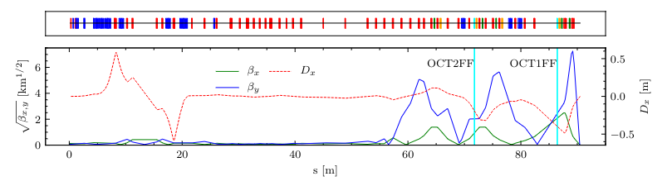
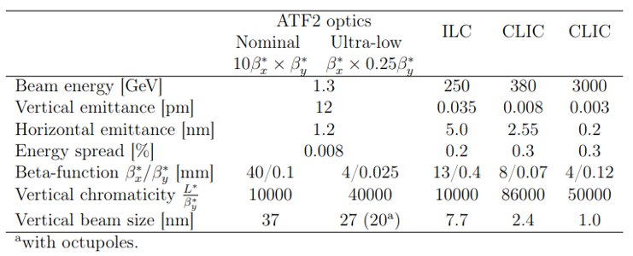

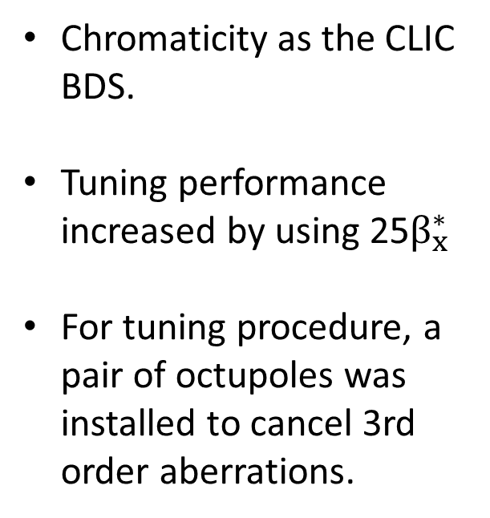
Ultra low $β_{y}^{∗}$ studies
Chromaticity as the CLIC BDS.
Tuning performance increased by using 25$β_{x}^{∗}$
For tuning procedure, a pair of octupoles was installed to cancel 3rd order aberrations.
[A. Pastushenko et al, Tunability Study of the Ultra-Low β* Optics at ATF2 with New Octupole Setup and Tuning Knobs, JACoW IPAC, 2021, 752–755. https://doi.org/10.18429/JACoW-IPAC2021-MOPAB231]
[Pastushenko, A. (2022). Optimization of CLIC Final Focus System at 380 GeV and implementation studies for Ultra-low β* at ATF2. https://cds.cern.ch/record/2871709]

Slide 5
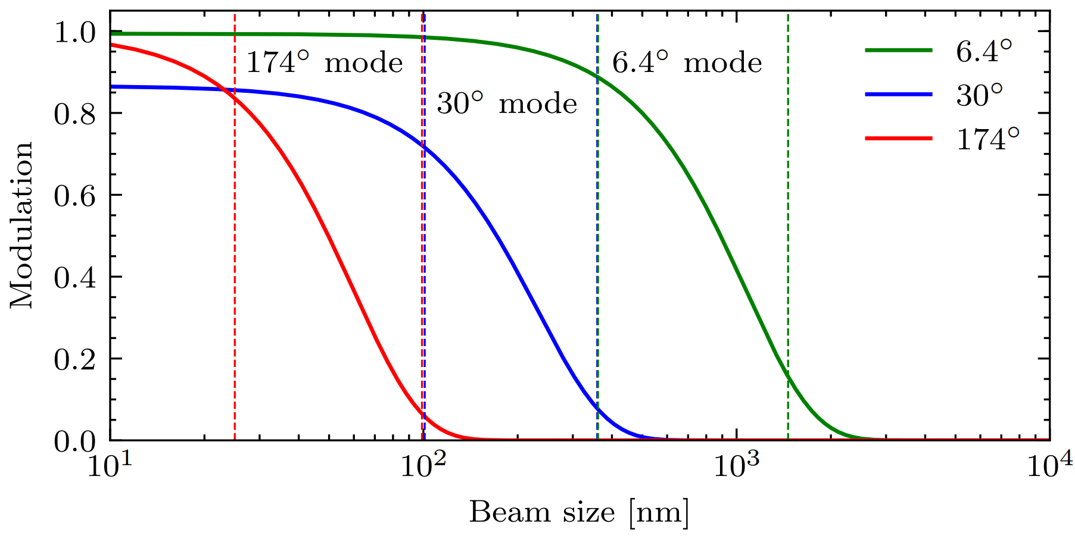
Tuning method
Orbit correction and dispersion measurements
Performing wire scan
Optics matching and measurement
Beam size with IPBSM

Slide 6
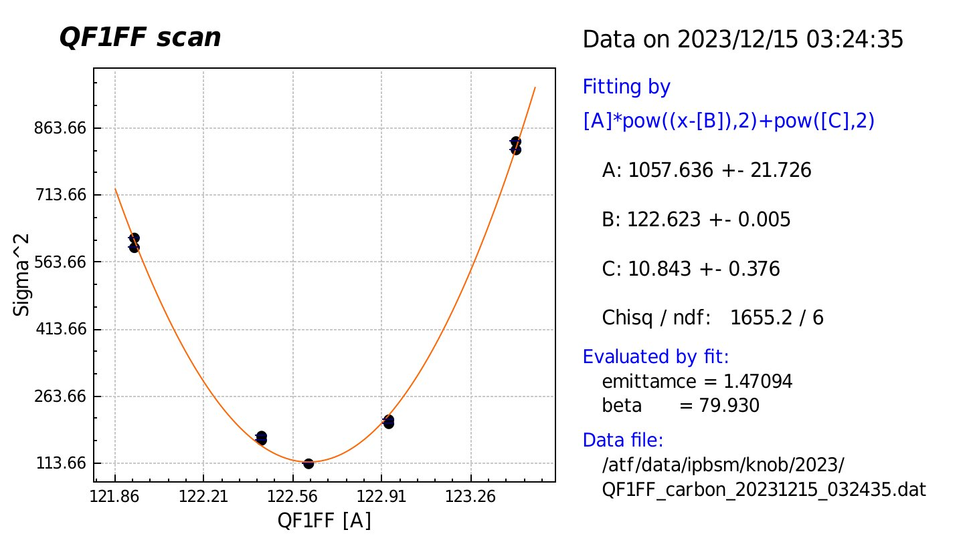
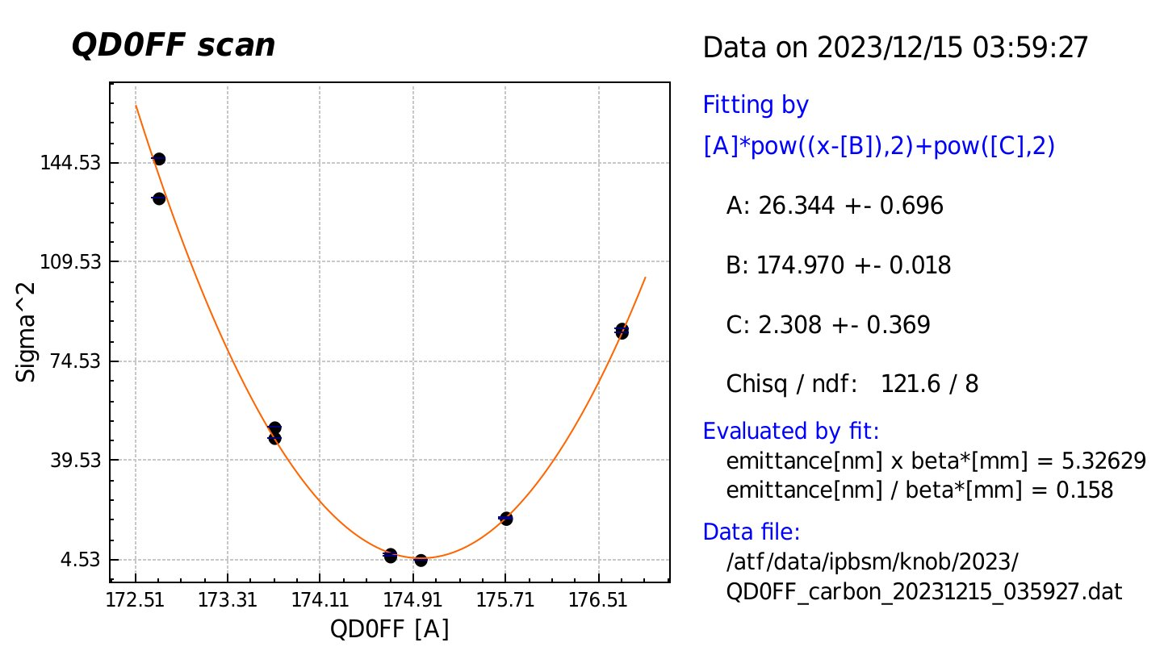
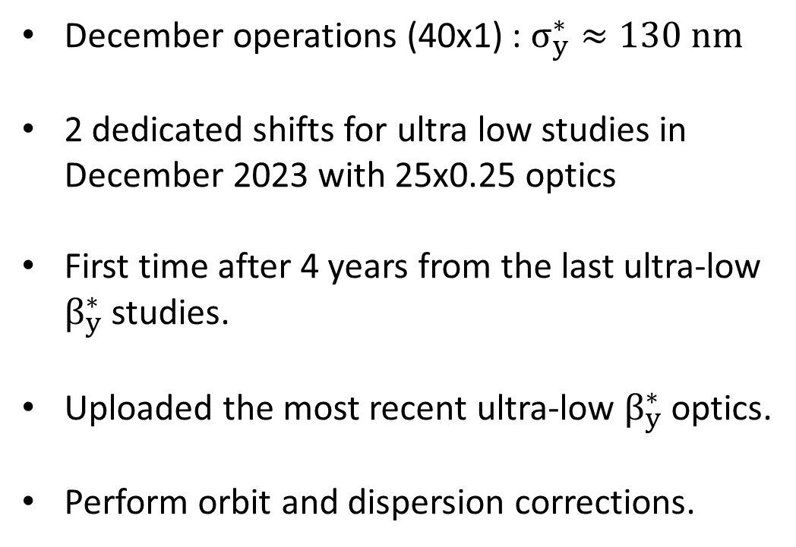
Optics measurement
December operations (40x1) : $σ_{y}^{∗}≈130 nm$
2 dedicated shifts for ultra low studies in December 2023 with 25x0.25 optics
First time after 4 years from the last ultra-low $β_{y}^{∗}$ studies.
Uploaded the most recent ultra-low $β_{y}^{∗}$ optics.
Perform orbit and dispersion corrections.

Slide 7
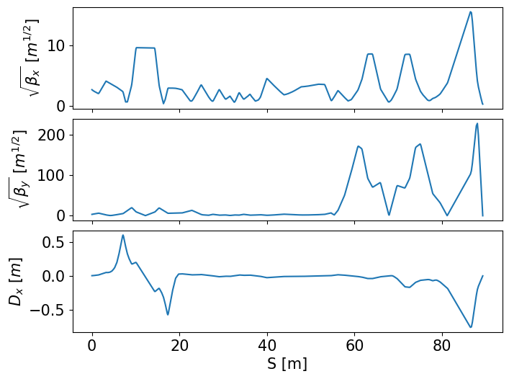
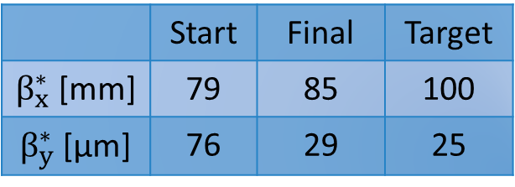
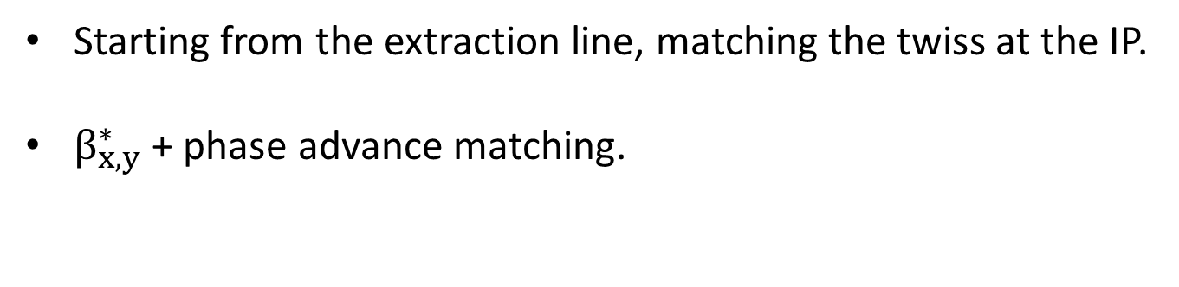
Optics matching
Starting from the extraction line, matching the twiss at the IP.
$β_{x,y}^{∗}$ + phase advance matching.
 | Start | Final | Target
$β_{x}^{∗}$ [mm] | 79 | 85 | 100
$β_{y}^{∗}$ [µm] | 76 | 29 | 25

Slide 8
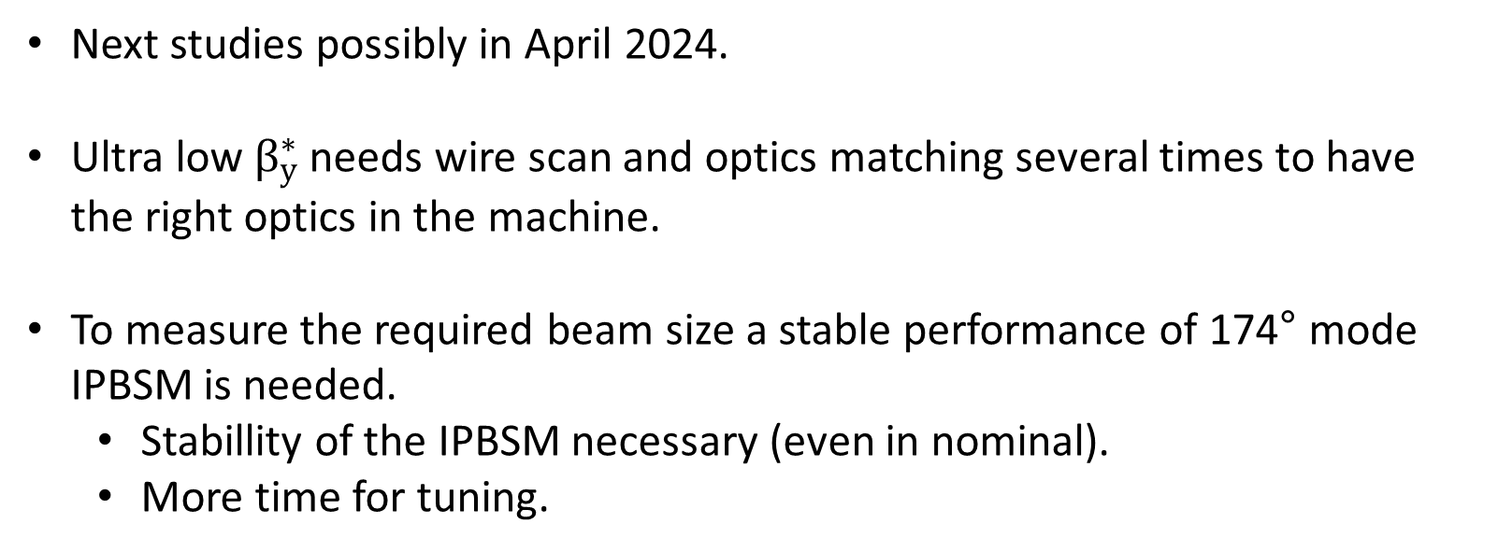
Future campaigns
Next studies possibly in April 2024.
Ultra low $β_{y}^{∗}$ needs wire scan and optics matching several times to have the right optics in the machine.
To measure the required beam size a stable performance of 174° mode IPBSM is needed.
  Stabillity of the IPBSM necessary (even in nominal).
  More time for tuning.

Slide 9
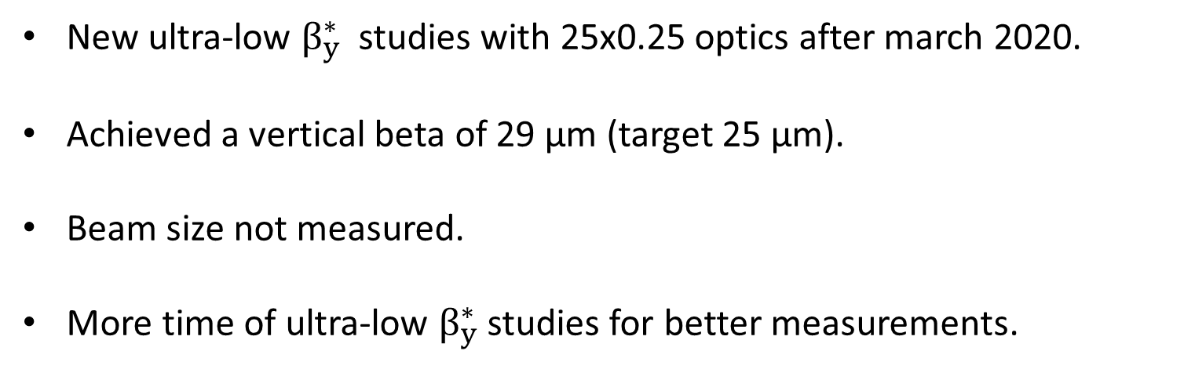
Conclusions
New ultra-low $β_{y}^{∗}$ studies with 25x0.25 optics after march 2020.
Achieved a vertical beta of 29 µm (target 25 µm).
Beam size not measured.
More time of ultra-low $β_{y}^{∗}$ studies for better measurements.

Slide 10
Thank you!

