Slide 1
ChDR ATF2 monitor status and upgrade plans
Stefano Mazzoni, Kacper Lasocha, Thibaut Lefevre, Andreas Schloegelhofer, CERN
Pavel Karatev, RHUL
Renjun Yang, CSNS
Alex Aryshev, KEK
19/3/2024 CLIC project meeting #45

Slide 2
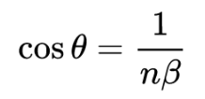
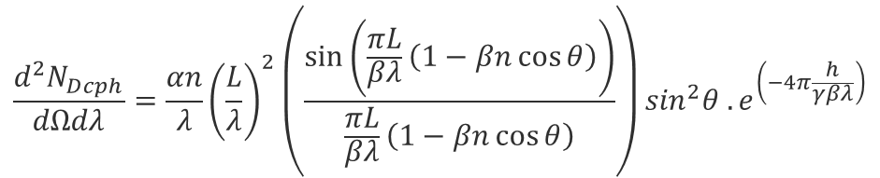

Cherenkov Diffraction Radiation (ChDR)
The electric field of ultra-relativistic charged particles passing in the vicinity of a dielectric radiator produces photons by the Cherenkov mechanism (polarization effect).
  Large emission angle: $\cos\left(θ_{Ch}\right)=\frac{1}{βn}$
  Photons emitted along the target
For cylindrical geometry:
Dielectric: ɛ,n
ChDR
θ
h - “impact parameter”
Particle: γ,β
Exponential decay
of the particle field
Cherenkov emission – spectral angular
$$\frac{d^{2}N_{Dcph}}{dΩdλ}=\frac{αn}{λ}{\left(\frac{L}{λ}\right)}^{2}\left(\frac{\sin\left(\frac{πL}{βλ}\left(1−βn\cos{θ}\right)\right)}{\frac{πL}{βλ}\left(1−βn\cos{θ}\right)}\right)\sin^{2}θ .e^{\left(−4π\frac{h}{γβλ}\right)}$$
α, fine structure constant
β, normalised beam velocity
γ, beam relativistic factor
θ, angle of observation
L, radiator length
n, index of refraction
h, impact parameter

Slide 3
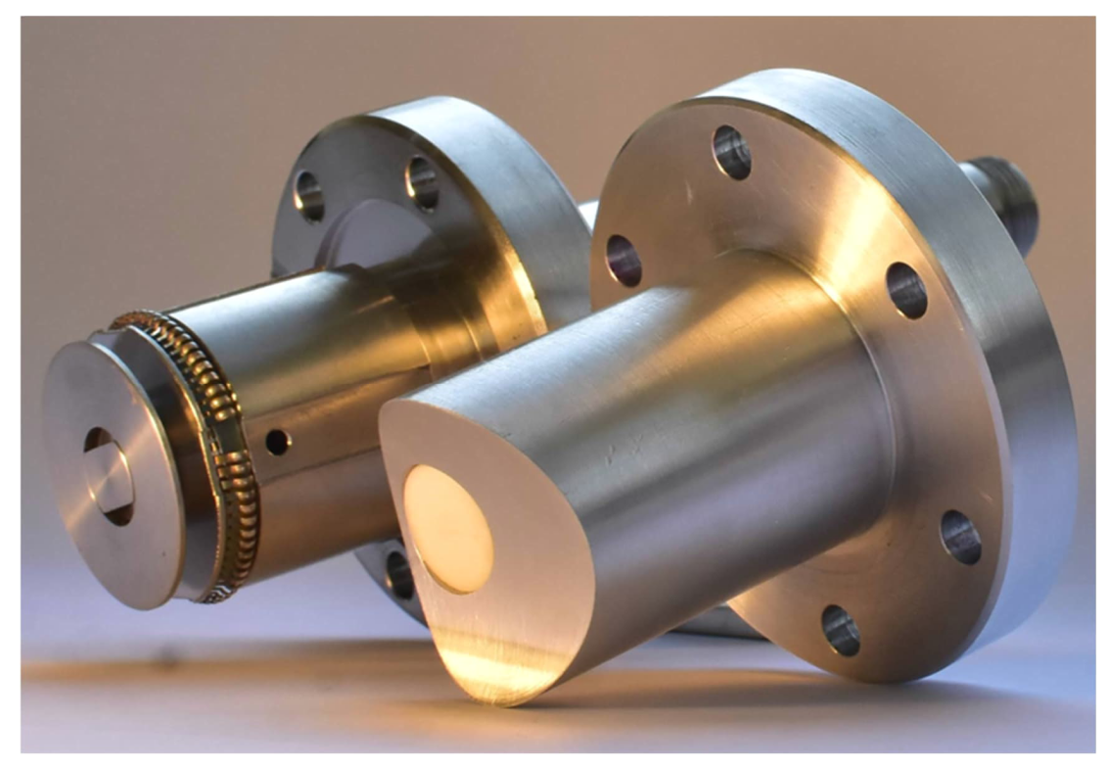
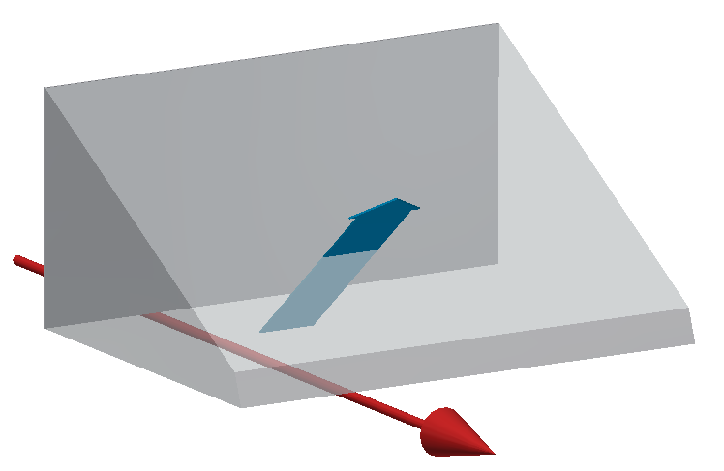
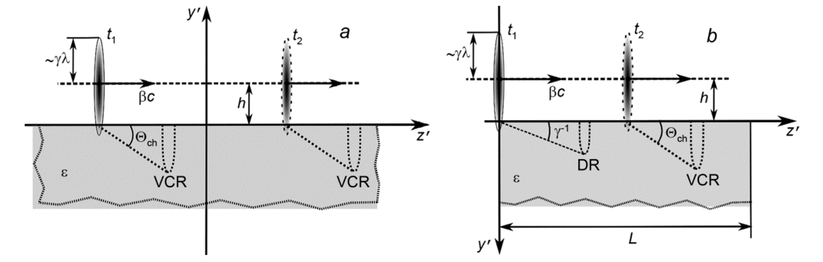
ChDR in realistic geometries
In real accelerators, dielectrics emitting ChDR will be elements embedded in beam pipe walls (a) or prisms (b)
non-cylindrical geometry
finite length
a)
b)
Diagram: A. Potylitsyn,
Russ Phys J 62, 2187–2193
1 B.M. Bolotovskii, Sov. Phys. Usp. 4 781 (1962).
2 Ulrich, Z. Physik 194, 180–192 (1966).
3. H. A. Olsen and H. Kolbenstvedt, Phys. Rev. A, vol. 21, Jun 1980.
4. Karlovets, D.V., Potylitsyn, Jetp Lett. 90, 326 (2009).

Slide 4
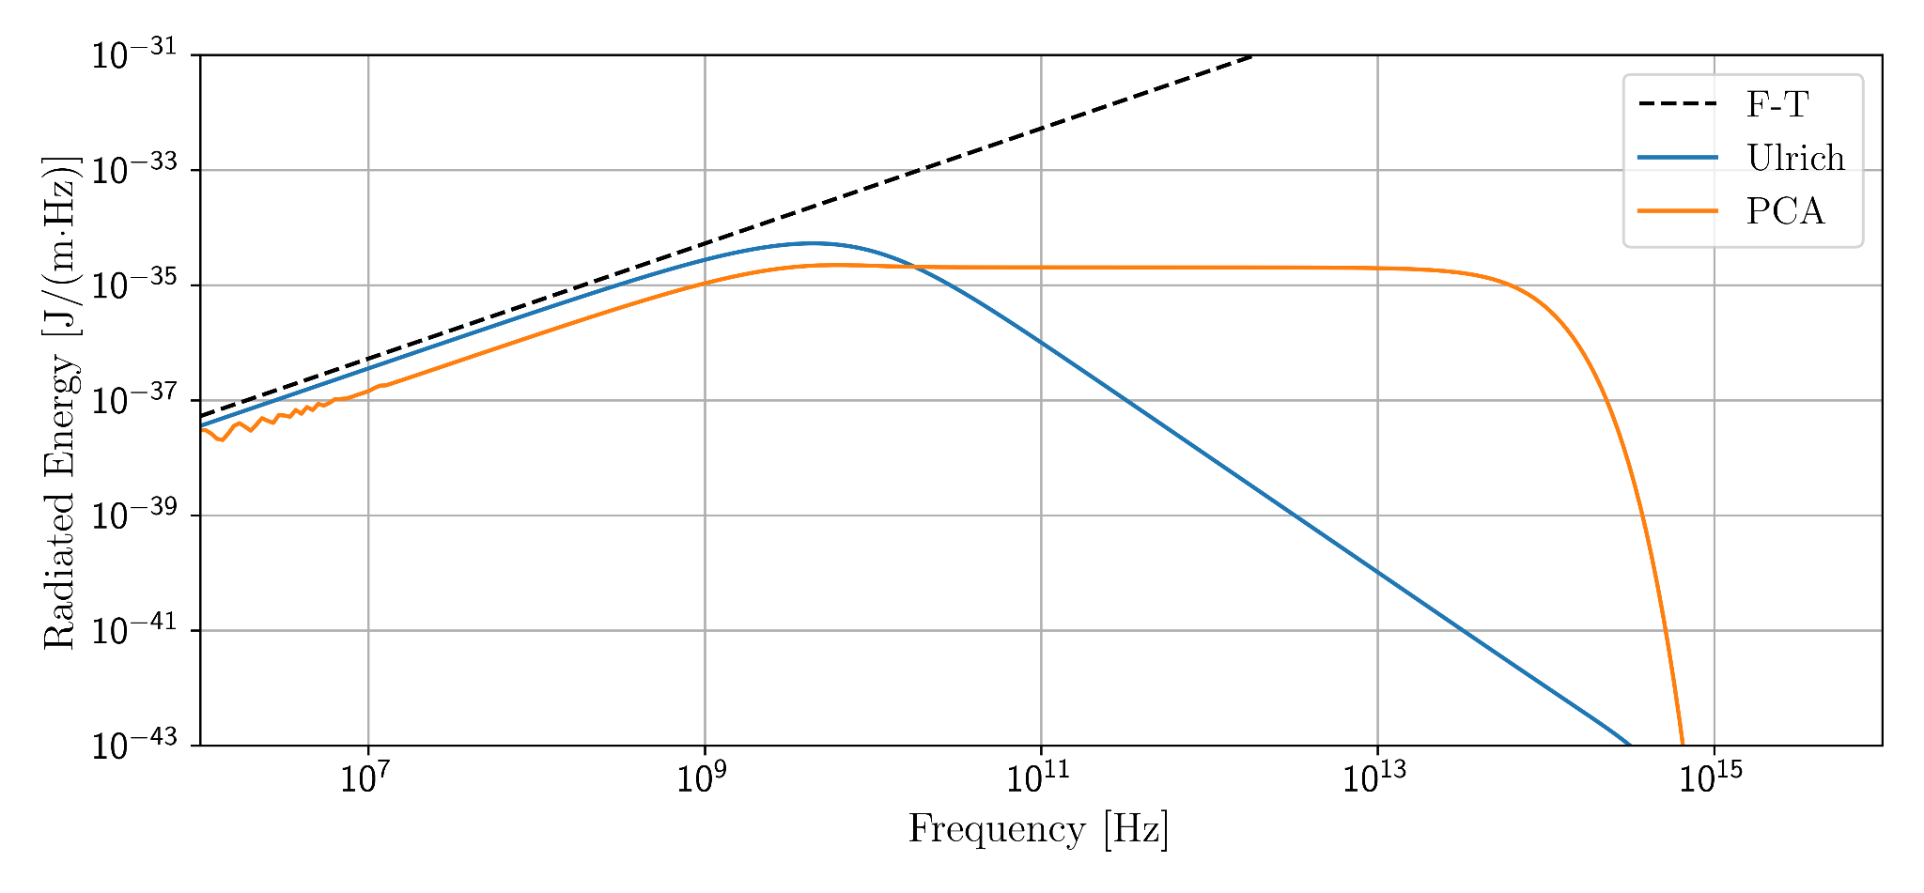
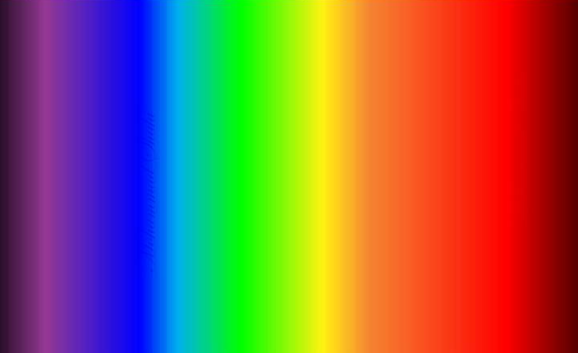




ChDR light yield: not measured to date!
ChDR has a potential for longitudinal diagnostics for high energy future colliders (CLIC, ILC, FCCee), but models predict large differences in photon yield and impact parameter dependence (1/h vs 1/h³)
$$∝1/h$$
$$∝γ/h$$
FCC ee Z (45 GeV)
h = 1 cm
$$λ∝h$$
$$λ∝h/γ$$

Slide 5
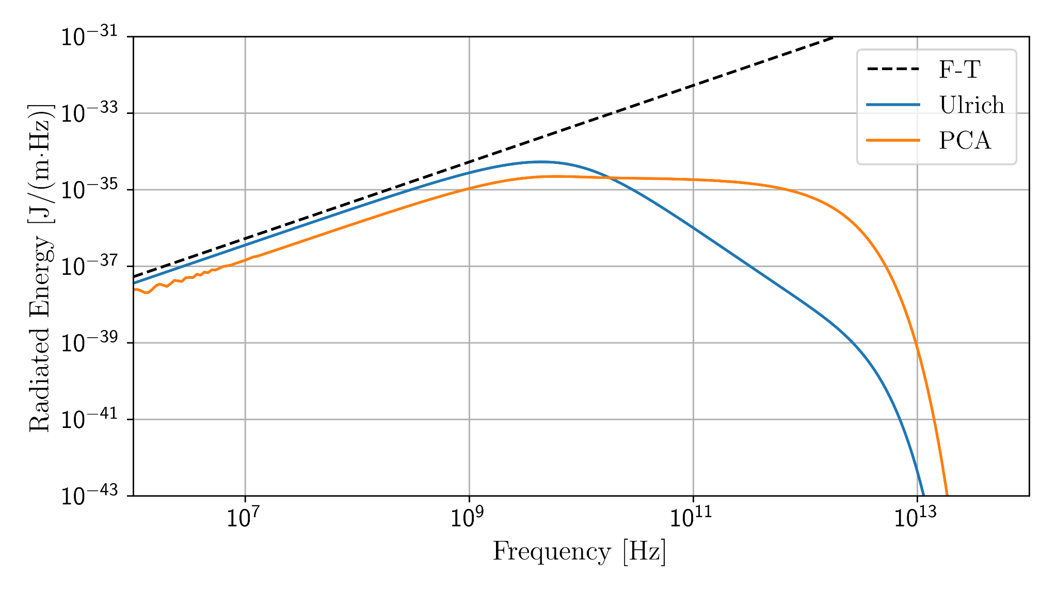
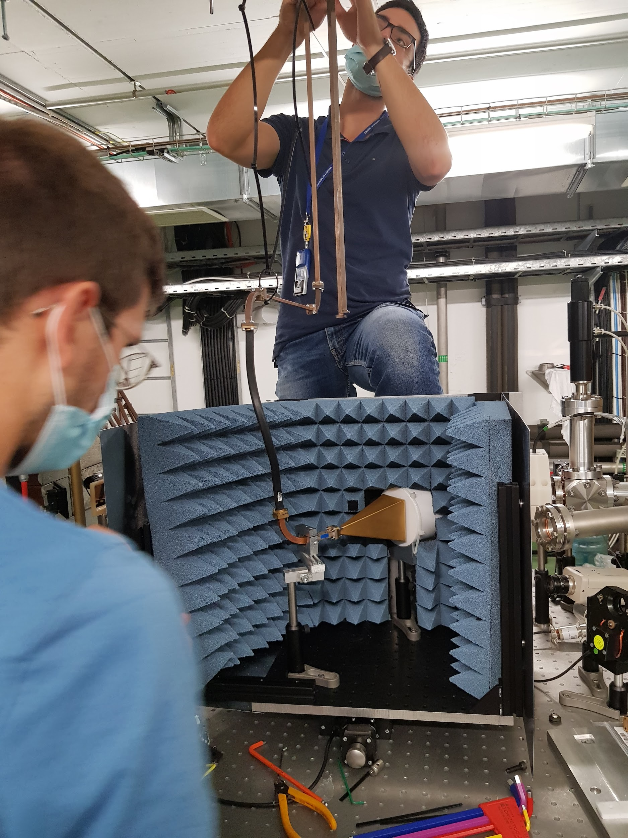
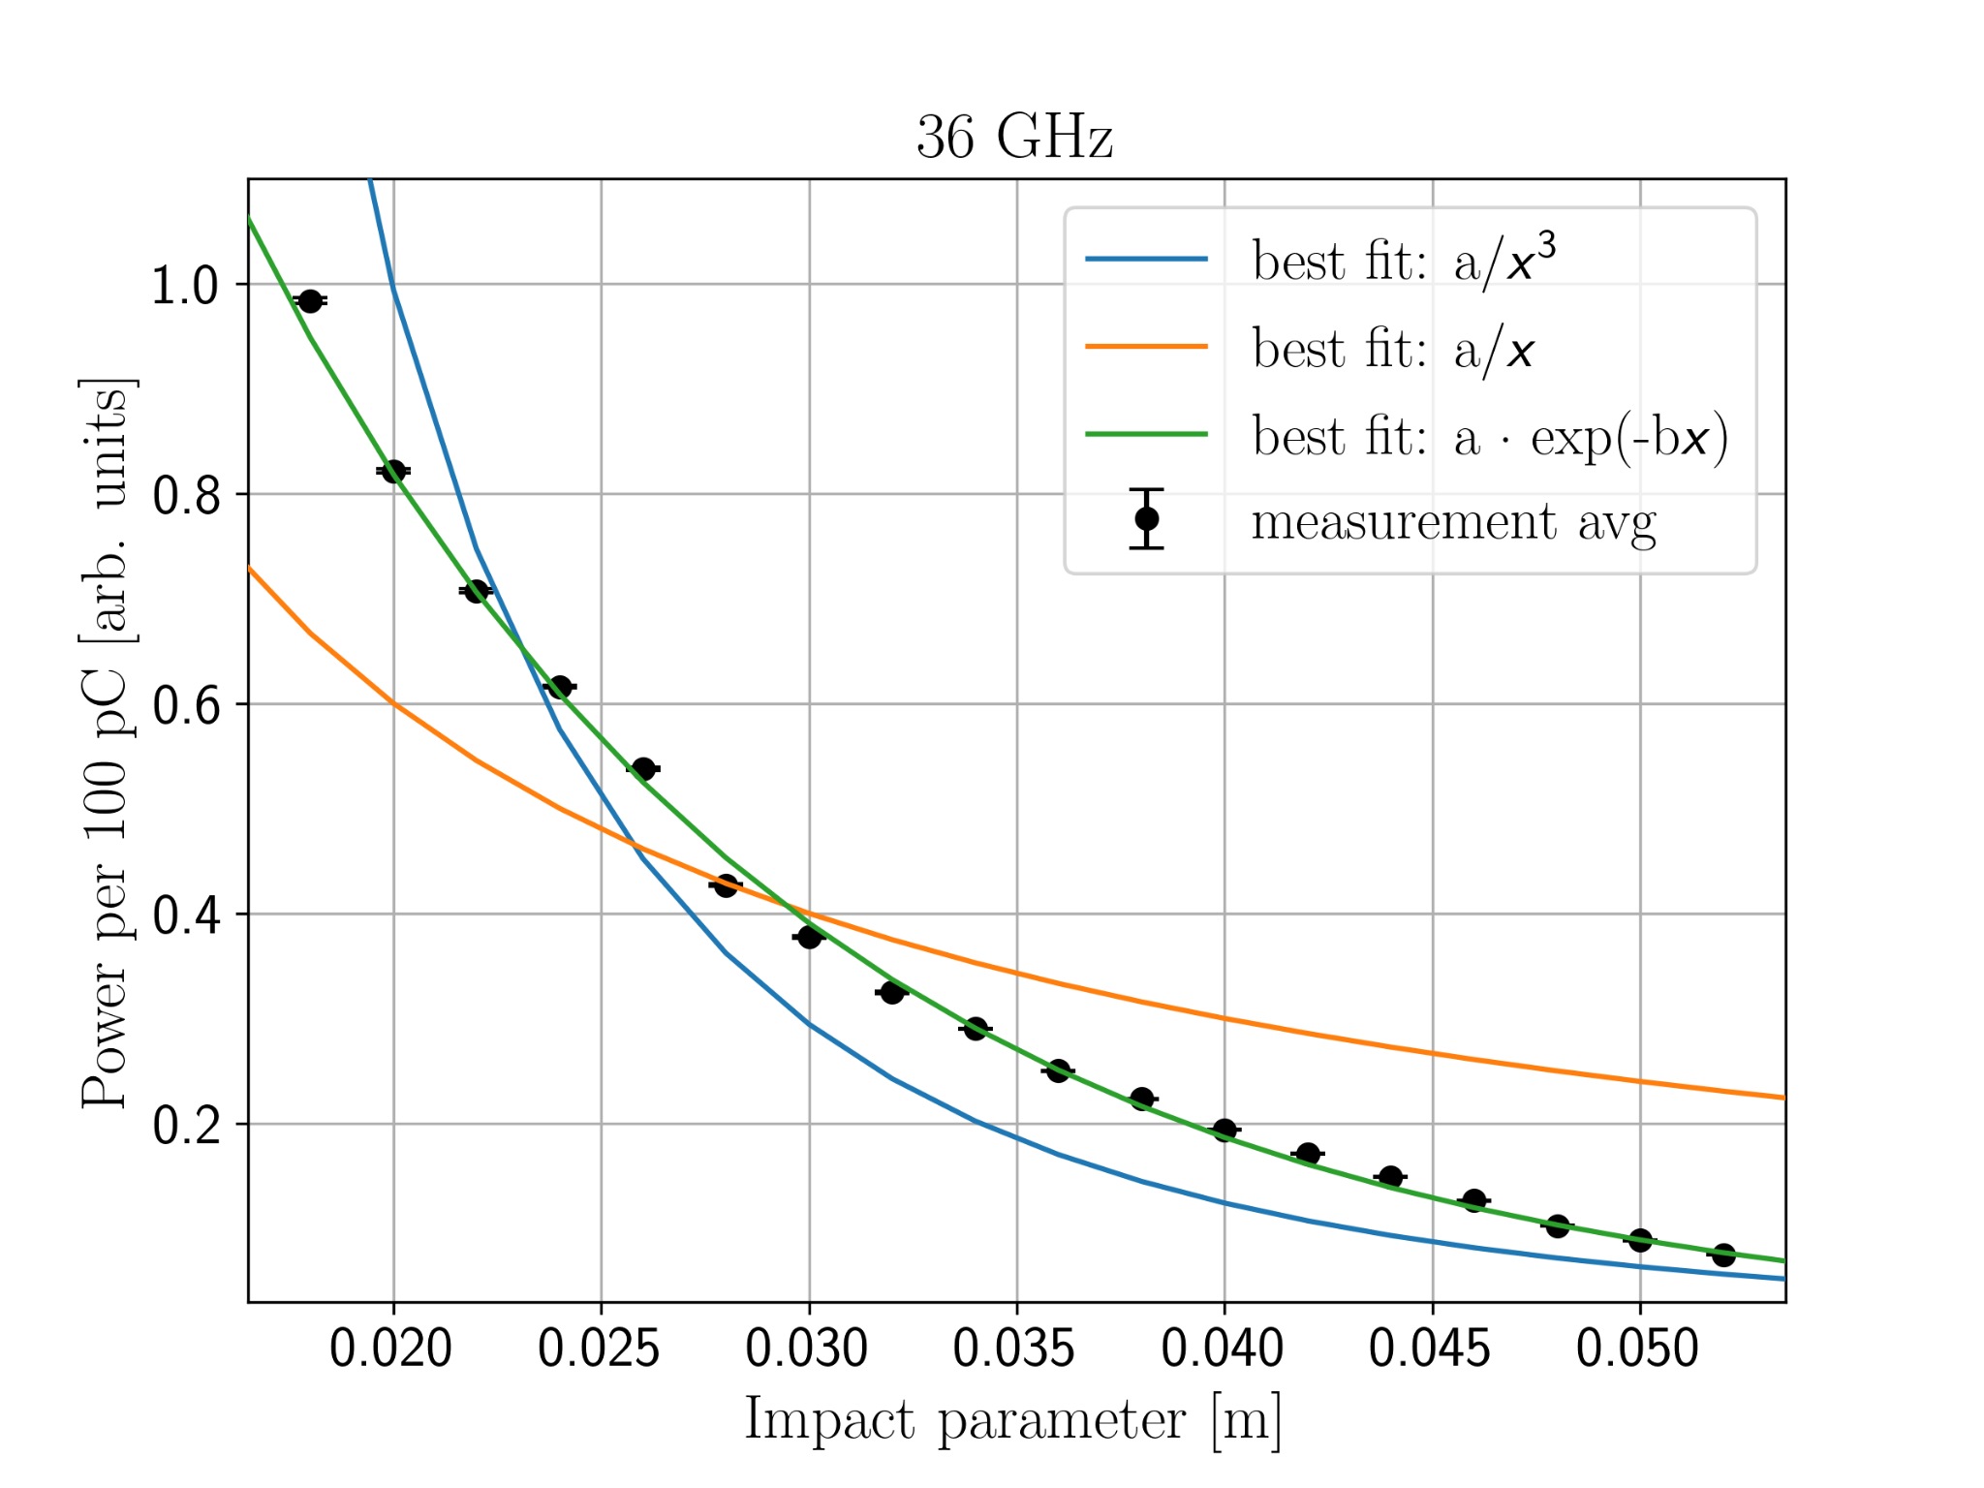
Coherent ChDR light yield
tests in CLEAR in 2021-2022 (200 MeV e-, 36 GHz). Test in full coherent regime. Impact parameter 20-50 mm
Results did not support neither Ulrich or PCA models, rather ‘in between‘
Coherent regime: large yield but large wavelengths: diffraction, angular acceptance.
K. Lasocha, IPAC 22

Slide 6
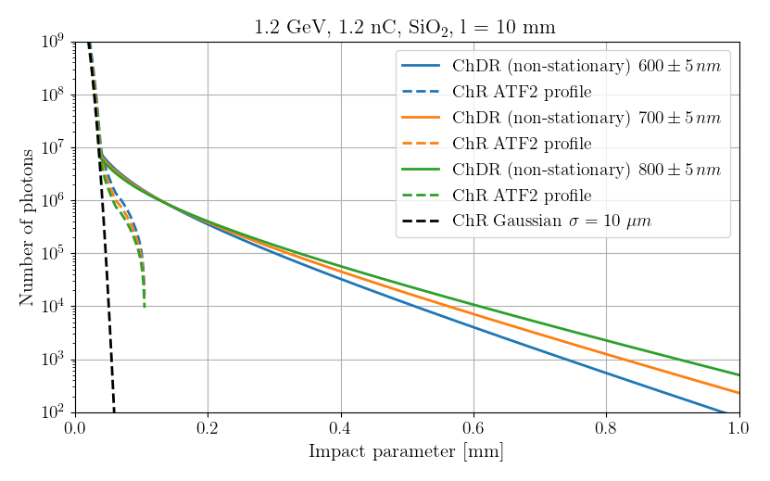
Incoherent optical ChDR yield at ATF2
Incoherent visible ChDR offers advantages:
  acceptance angle does not depend on impact parameter
  ‘easy’ absolute detection (visible photons)
  signal can be used for fast longitudinal profile measurement (streak, single photon TDC,…)
…but requires high γ! In clear case, to measure optical ChDR (700 nm) one needs to be as close as 200 um
Need large(r) γ and small beam: ATF2. Accurate halo estimation is mandatory!

Slide 7
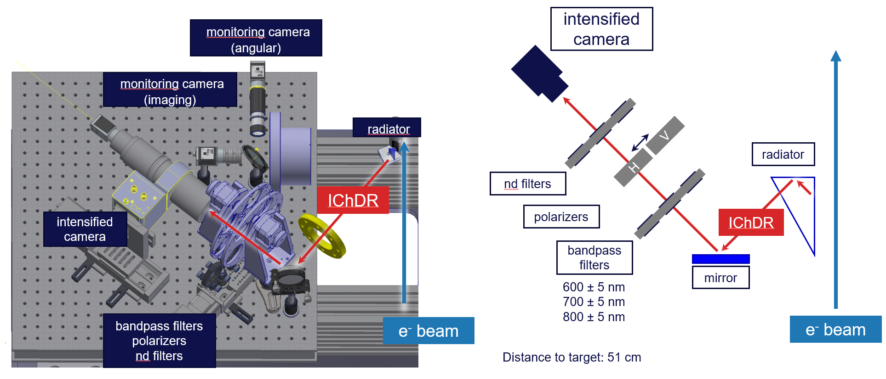
Incoherent ChDR at ATF2 - setup

Slide 8
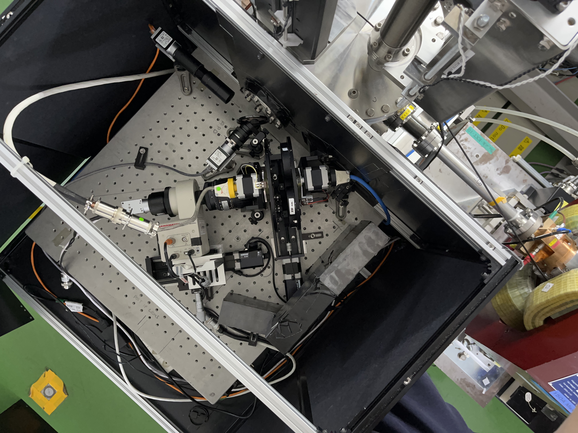
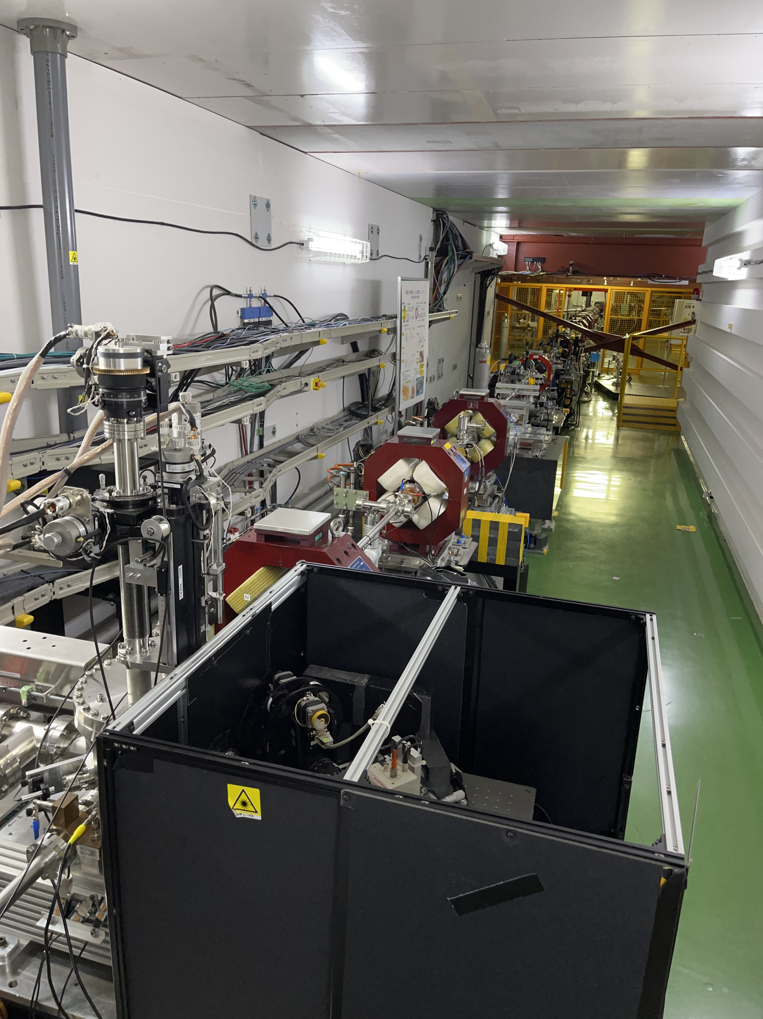
Incoherent ChDR at ATF2 - setup

Slide 9
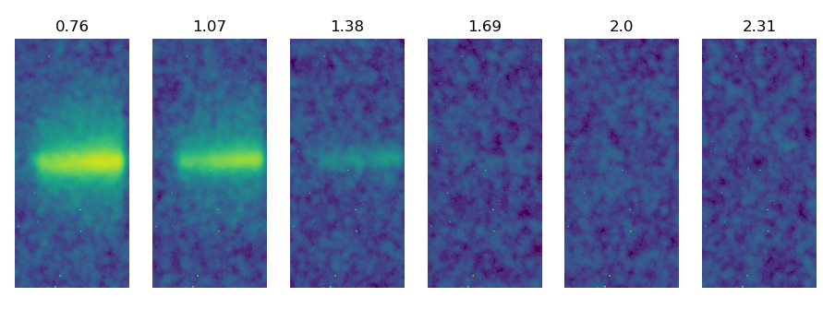
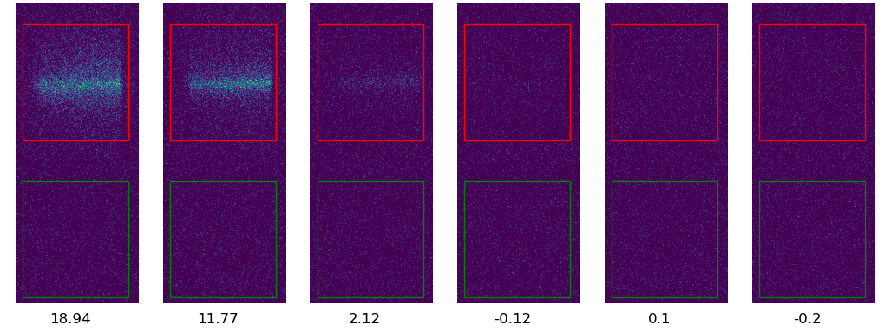
Summary of June tests
Integrated images
Impact parameter
20 different distances/bandpass filter
500 images per position
Normalized for bunch charge
Photon counting
Signal
Background
Number of Photons

Slide 10
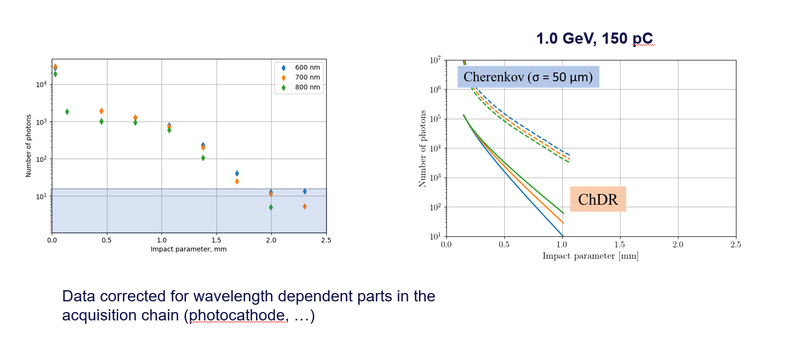
Summary of June tests
1.3 GeV, 150 pC
Signal dominated by Cherenkov produced by halo particles crossing the target!

Slide 11
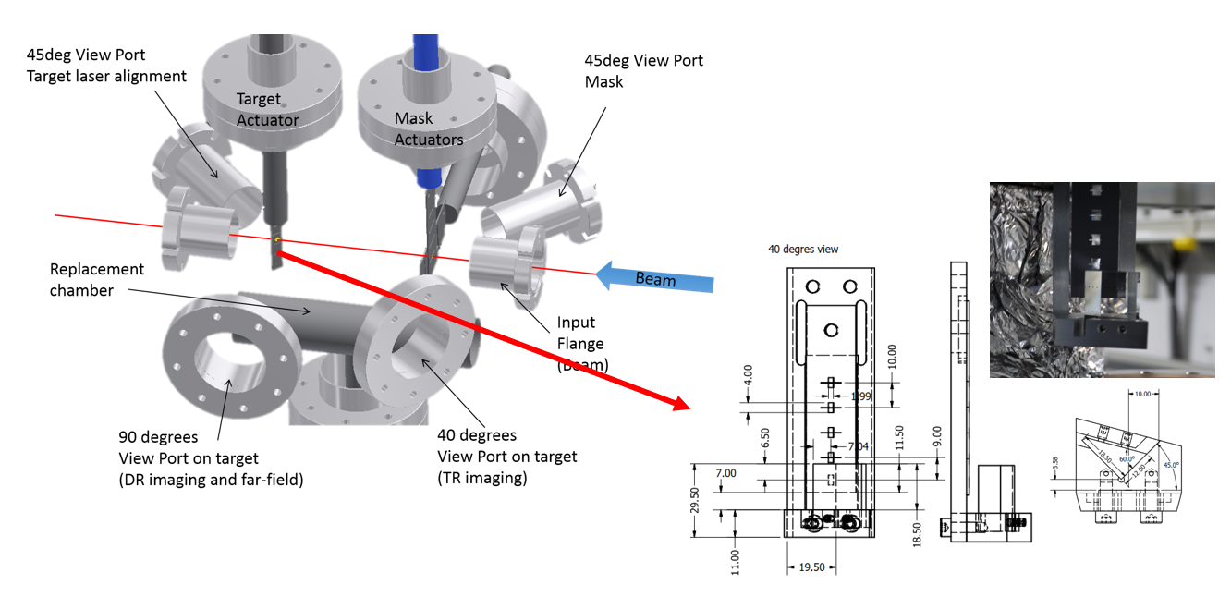
Possible upgrade of ChDR setup

Slide 12
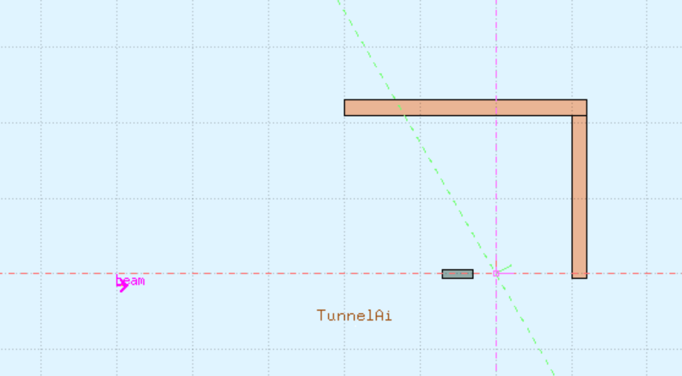
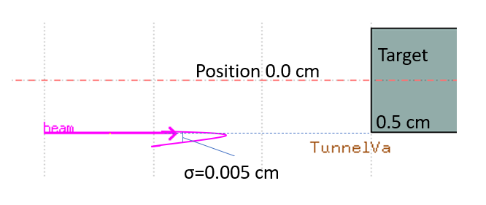
Possible upgrade of ChDR setup
FLUKA simulation: effect of 1x1x4 cm W absorber
1.2 Gev, 1,2 nC, 50 um sigma gaussian bunch
Look for charged particles with b>0.685 in a 10 mrad cone co-axial with beam direction
Expected reduction order 10⁶
preliminary estimation performed by S. Benitez
Sensor
Tungsten target
1x1x4 cm
e-
Vacuum

Slide 13
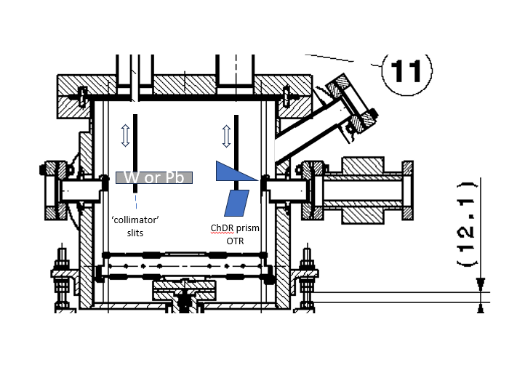
Possible upgrade of ChDR setup
preserve most of existing design: vertical actuators, support, replacement chamber
new chamber probably needed for adding 45 deg viewport
new design should better reject synchrotron radiation (vertical polarisation)

Slide 14
Summary
Incoherent ChDR can be source for beam diagnostics for future high energy colliders
Attempts at ATF2 unsuccessful so far, partially due to setup not adapted to ChDR
(Very) preliminary studies show a possible new setup design that would allow better noise rejection
New technical student starting in 2024 to measure incoherent ChDR light yield and possibly perform longitudinal profile measurement at ATF2.
Plan is to perform simulation of new target shielding and of expected halo (vertical plane), then move to design upgrade. Installation / upgrade in 2025.

