Slide 1
PSI SoC Practices
Elif Balci, Irene Degl’Innocenti, Manuel Gonzalez Berges
08/02/2023 – BI Technical Board

Slide 2
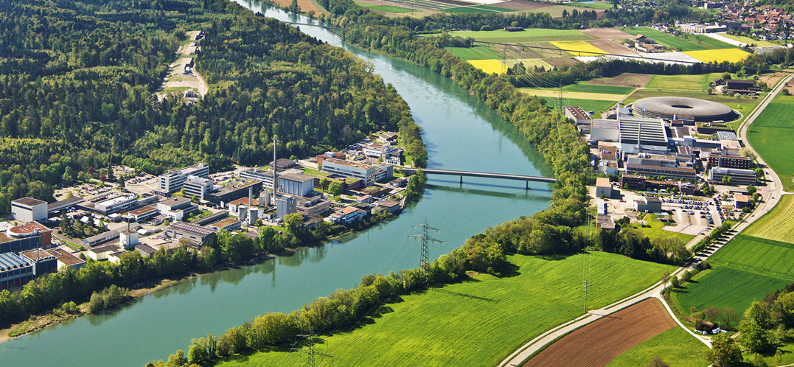
Introduction
ICALEPCS 2023:
  Elif presents her poster about a prototype of integration of a SoC in the accelerator control system for HL-LHC BPMs.
  Elif, Manuel and Goran (PSI) start discussing SoCs and how to use them for BPM electronics.
… some emails later…
PSI, 09/01/2024:
  Elif, Irene and Manuel spend a day in PSI laboratories discussing with different members of the teams developing BPM electronics based on SoCs.

Slide 3
Systems we discussed
RFSoC development:
  Multi-Bunch Feedback system (MBFB) and Filling Pattern Feedback system (FPFB) for SLS upgrade
  Developed on the ZCU111 Evaluation board (RFSoC Gen1).
DBPM3: multi-purpose MPSoC PSI platform in a box
  Generic digital back-end with Xilinx/AMD Zynq UltraScale+ MPSoC
  Application-specific Analog/RF Front-End with integrated JESD204B
  Temperature control (fan-based cooling + resistor-based heating)
VME bus limit: upgrade from FEC + VME FPGA card to SoM on a VME carrier
  BPM read-out CBPM for the SwissFEL
  Enclustra SoM
  Existing electronics now being replaced, same Linux/framework as DBPM3

Slide 4
SoC Hardware practices
All-in-a-box system with embedded Linux
  Compact system, minimization of analog interfaces, refined temperature control
  No hardware/board standard
  Abundance of communication standards (USB3.0, 1GbEthernet, etc.)
SoM vs. custom PCB
  SoM easier to upgrade
  SoM portable to other board standard (see VME case)
  SoM used for new CPCI-Serial generic control system hardware
Power cycling
  uC for remote control of power cycling foreseen on CPCI system
  Remotely controlled power switch in the rack

Slide 5
SoC Gateware practices
PSI Common IP packager and shared repository
Versioning of all the layers, standard format
  automatically generated
  version compatibility control, SW responsibility
  GW: custom IP instantiating flip flops; tcl script launched at compilation time encodes in the flip-flop status current date and time and git checksum; flip flops accessible by AXI bus.
Data-exchange between PL and PS
  Custom module for transferring data to PS DDR – more info to be collected
  Controlled use of caching to speed-up algorithm execution in the RPU based on PL data
Remote debugging: xvc server and Virtual cable

Slide 6
Operating System
Linux distribution
  Currently using Yocto 4.0 (Petalinux before)
  10 different SoC systems supported (including some SoMs)
  One person for central support (does also VME and other equipment).
    Overlays for the device tree provided by application developers for each system
  Many changes when starting to use SoCs. Now more stable.
    Customized following users requests (e.g. tmux, python)
System boot
  Network boot (same servers as for VME)
    Loads also firmware and application
  SD card possible
Gitlab CI/CD to prepare images
Use RT patch
  Small performance penalty (~5%)

Slide 7
Software
EPICS based applications
  Compiled EPICS Base & Drivers for 3.14 and 7 versions
    Straight forward
  They use ~400 EPICS drivers
  One person in charge for all PSI platforms
Embedded application development similar to VME
  Measurement and feedback systems
Currently only ESS and PSI use EPICS on SoCs

Slide 8
Conclusions
Very useful 1-day trip!
  Open discussions with PSI colleagues on all topics (many thanks for their availability!)
  Visit to XFEL, SLS, control room, labs
SoCs de facto PSI standard for embedded systems
  Success in BPM applications extended to other systems
  Performance gain, better synergies between firmware and software
  Central support for Linux & EPICS easily integrated with other systems
Collaboration possibilities
  Some topics despite different context:
    E.g: specific FPGA IPs, high performance TCP link, general experience share, etc

Slide 10
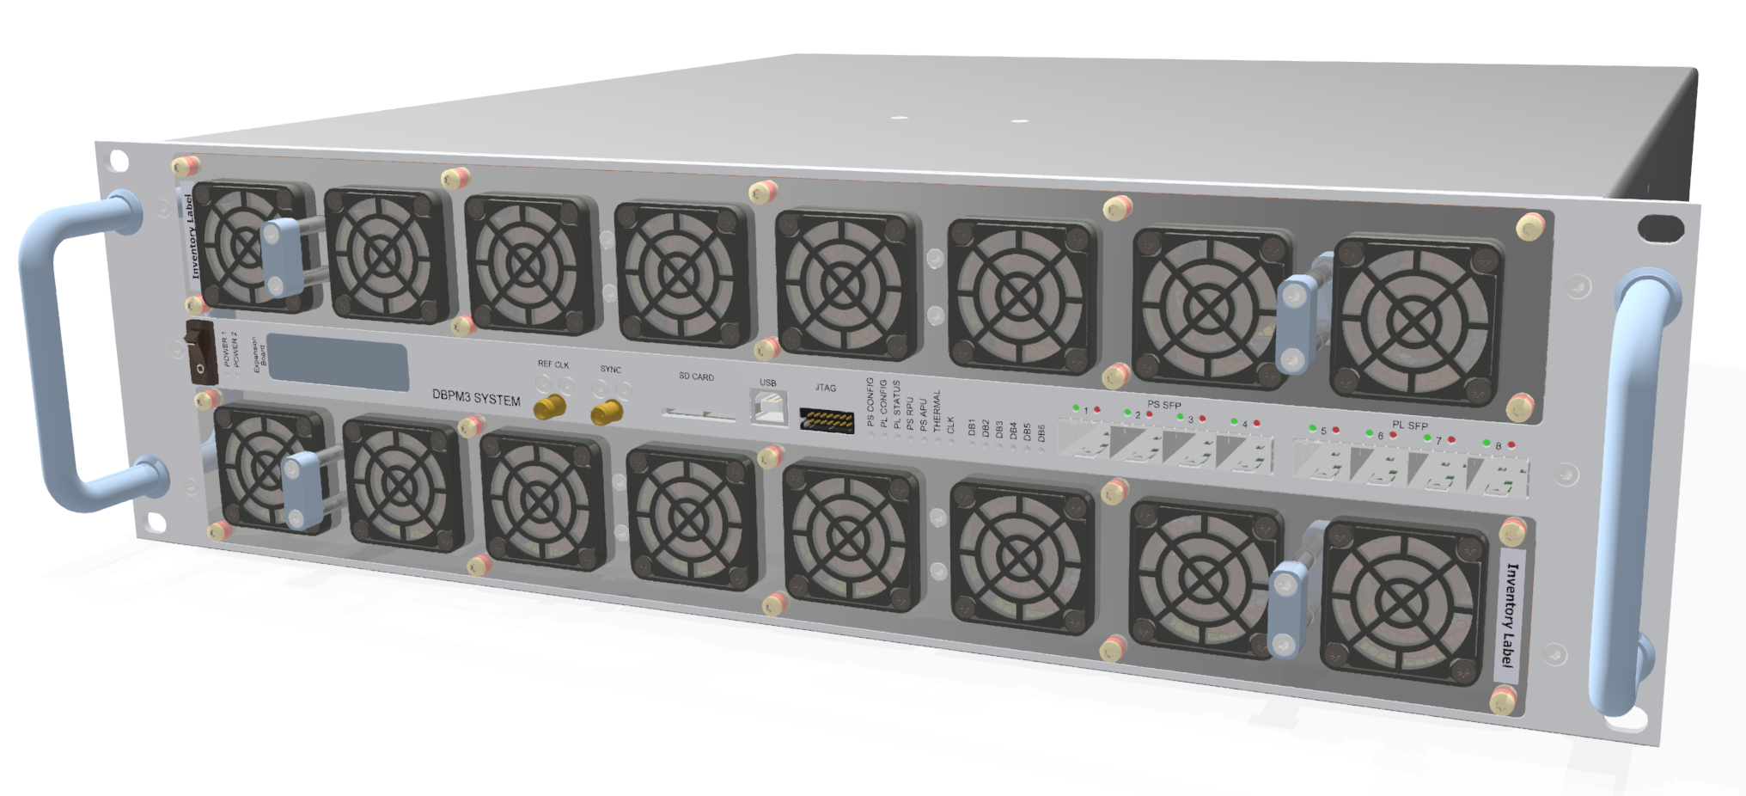
Hardware: DBPM3 Unit
The fans are used in feedback mode and are supervised.
In case of a failure the complete fan tray can be replaced.
Communication by SFPs (small form-factor pluggable), serial optical or electrical interface
MO4AO01 – G. Marinkovic talk at ICALEPCS ’23
Page 10
Notes:
The DBPM3 unit is designed with stability, reliability and redundancy in mind. The analog electronics is separated from the digital backend, only digital signals are routed by connectors (except reference clocks, where the analog properties are important), the analog electronics is directly connected differentially to the ADC on the same board, which makes calibration and storing of calibration data, on an EEPROM on the same board, simpler. The temperature is regulated by heaters on the RF electronics and several speed controlled fans for cooling. The balance between heating and cooling stabilizes the measurement. The fans are supervised in EPICS such that we see when a fan is getting slower and schedule the replacement of the fan tray long before the fan breaks and an urgent repair is needed.
The complete communication is done by SFP interfaces… hence serial links able to provide various protocols.
10

Slide 11
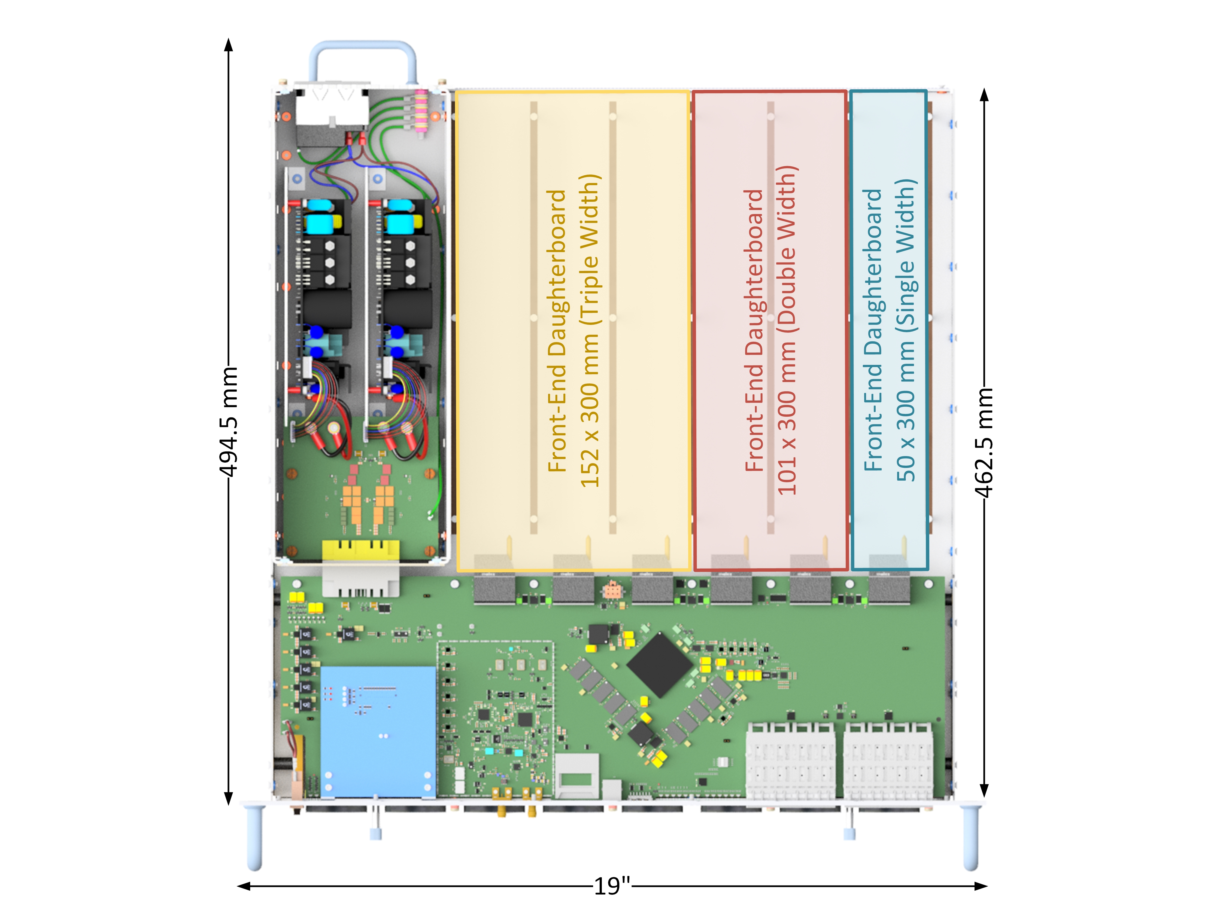
Hardware: DBPM3 Box
Front-ends ("daughter- boards") plugged in from rear side (live insertion possible)
Commercial power supply (optional redundancy)
Guided coplanar daughterboard connector (multi-gigabit data links, clocks, user IOs, ...). Dual-source.
Back-end mainboard (with SoC, external interfaces, ...)
Front side
MO4AO01 – G. Marinkovic talk at ICALEPCS ’23
Page 11
Notes:
The DBPM3 can incorporate various Front-End daughterboard sizes. From 50 x 300 to 304 x 300 mm. As well the number of connectors can be adapted to the needs of the application.
The power supply is redundant but not hot replaceable, since the power supply is one unit. However, for us it was important to have a indication that a power supply is broken and the spare power supply has taken over without interrupting the operation of the accelerator. The information of a broken power supply can be connected to the alarm handler and in turn a replace can be done during the next maintenance day.
The digital backend is comparable small. The V shaped close to the Zynq UltraScale+ are the DDR4 SDRAM memories, one connected to the PS and one to the PL of the Zynq. The SFPs are the communication interfaces. 4 SFPs are connected to the PS and 4 SFP are connected to the PL of the Zynq UltraScale+.
11

Slide 12
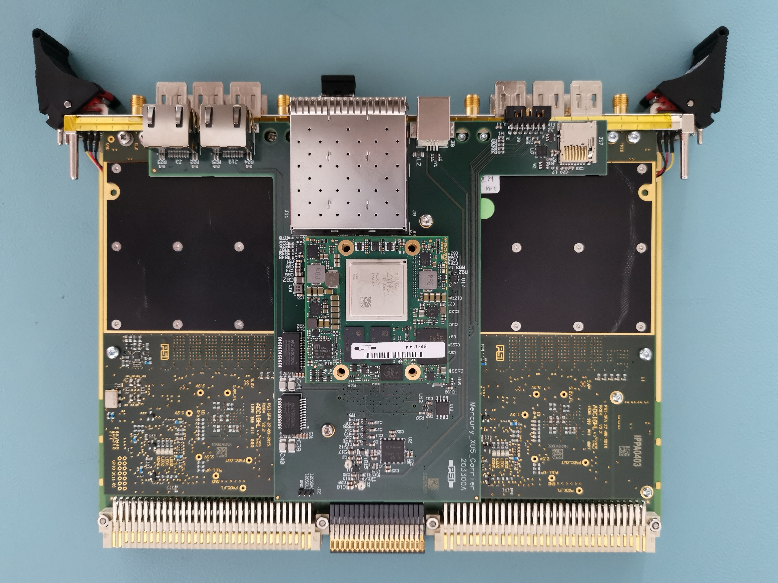
Zynq UltraScale+ Upgrade of older (pre-DBPM3) BPMs
SwissFEL presently uses two BPM electronics generations: Newer DBPM3 & older "MBU" platform. We are currently upgrading the external VME IOCs of the MBU platform with a Zynq UltraScale+ System-on-Module (SoM)
MO4AO01 – G. Marinkovic talk at ICALEPCS ’23
Page 12
Notes:
GPAC3 is the VME based BPM system, developed for SwissFEL using 7Series Xilinx FPGAs. The photo shows the so called GPAC3 digital back end with a SoM (System on Module) plugged on top. The SoM contains a Zynq UltraScale+ chip as IOC replacement.
12

