Slide 1
Intrinsic spin resonances for FCC-ee Booster lattices
Zhe Duan
Institute of High Energy Physics, CAS
2024. 02. 22
Acknowledgement:
F. Zimmermann for his proposal of this work, A. Chance and B. Danela for sharing the lattice files.

Slide 2
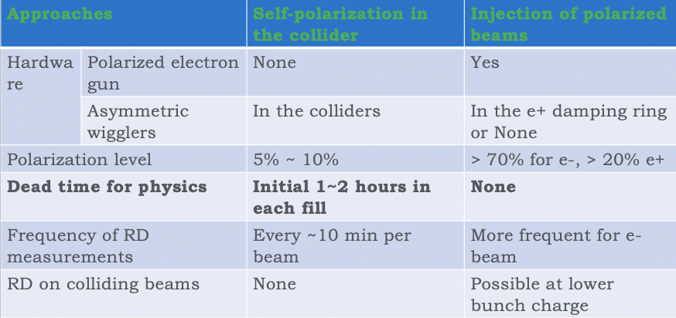
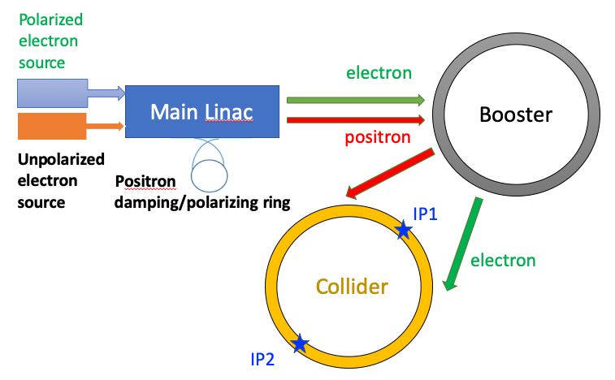
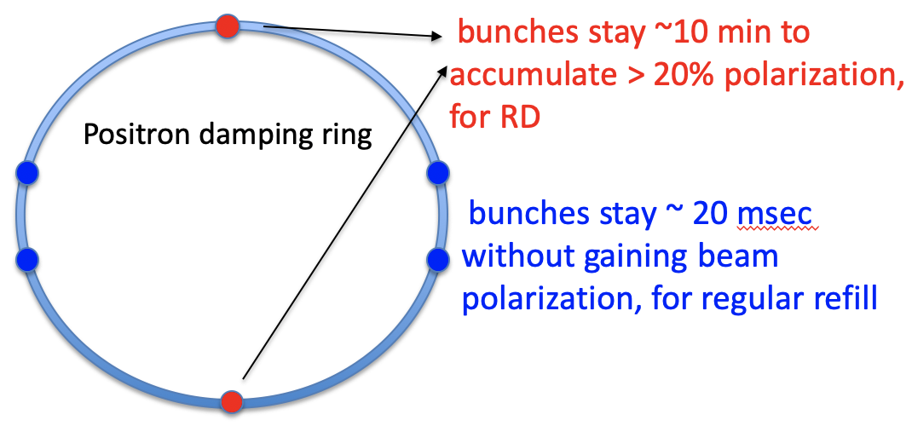
Resonant Depolarization at Z-pole
Self-polarization at Z-pole is very slow (~250 hour)
It’s possible to inject > 20% polarized beams to enable RD measurements at Z-pole
  No dead time for physics, a few pilot bunches
  Polarized e- source is a matured technology
  Polarized e+ source ? Dual-purpose damping/polarizing ring (could accommodate both e+/e- beams to gain sufficient polarization)
One typical design:
beam energy ~ 2 GeV, circumference ~ 150 m
polarization build-up time ~ 14.5 min
Extracted beam polarization @ 10min ~ 44%
This approach can also enable longitudinal polarization > 50% for electron beams at Z-pole, w/ spin rotators implemented

Slide 3
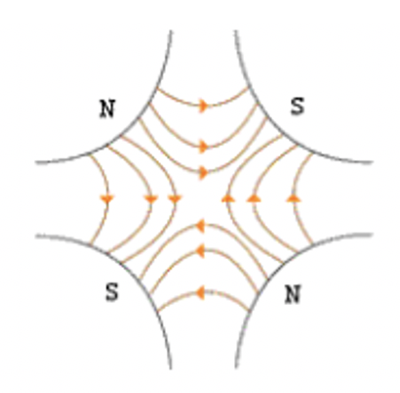
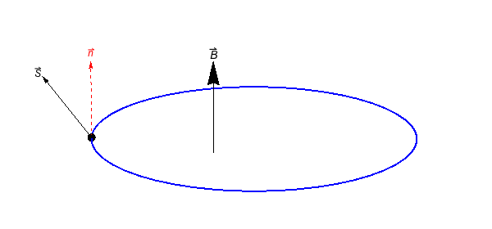
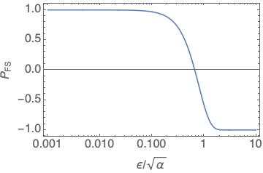

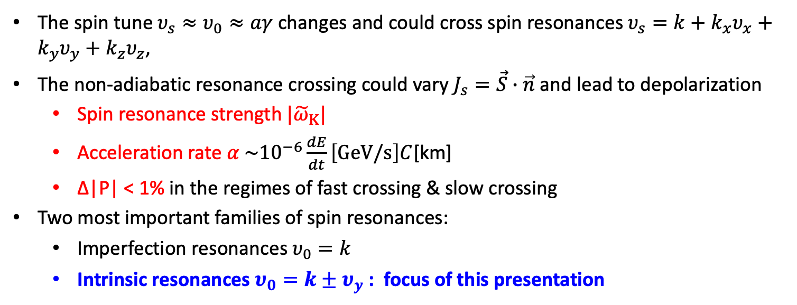

Depolarization in the Booster
The spin tune $υ_{s}≈υ_{0}≈aγ$ changes and could cross spin resonances $υ_{s}=k+k_{x}υ_{x}+k_{y}υ_{y}+k_{z}υ_{z}$,
The non-adiabatic resonance crossing could vary $J_{s}=\vec{S}∙\vec{n}$ and lead to depolarization
  Spin resonance strength ${|\tilde{ω}}_{Κ}|$
  Acceleration rate $α \sim {10}^{−6}\frac{dE}{dt}\left[GeV/s\right]C$[km]
  Δ|P| < 1% in the regimes of fast crossing & slow crossing
Two most important families of spin resonances:
  Imperfection resonances $υ_{0}=k$
  Intrinsic resonances $υ_{0}=k±υ_{y}$ : focus of this presentation
Δy
$$B_{x}∝∆y=−y_{mis}+y_{co}+y_{β}$$
Fast crossing
Slow crossing
Imperfection resonance
Intrinsic resonance
Spin precession
${|\tilde{ω}}_{Κ}|/\sqrt{α}$

Slide 4
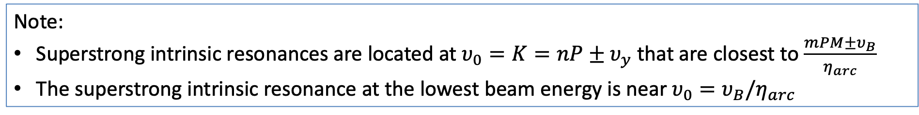
Two lattices studied
 | FODO 90 deg (provided by B. Dalena) | HFD (provided by A. Chance)
Number of arcs (P) | 8 | 8
Number of standard arc cells (M) | 175 | 175
Total bending angle of standard arc cells (2π * η_{arc}) | 0.745 rad * 8 = 2π * 0.9486 | 0.745 rad * 8 = 2π * 0.9486
Vertical betatron tune ν_{y} | 416.29 | 382.29
Vertical betatron tune from standard arc cells ν_{B} | ¼ * 175 * 8 = 350 | ~ 40 * 8 = 320
ν_{B}/η_{arc} | ~ 369 (corresponding to a beam energy of 162.6 GeV) | ~ 337 (corresponding to a beam energy of 148.5 GeV)
Note:
Superstrong intrinsic resonances are located at $υ_{0}=K=nP±υ_{y}$ that are closest to $\frac{mPM±υ_{B}}{η_{arc}}$
The superstrong intrinsic resonance at the lowest beam energy is near ${υ_{0}=υ}_{B}/η_{arc}$

Slide 5
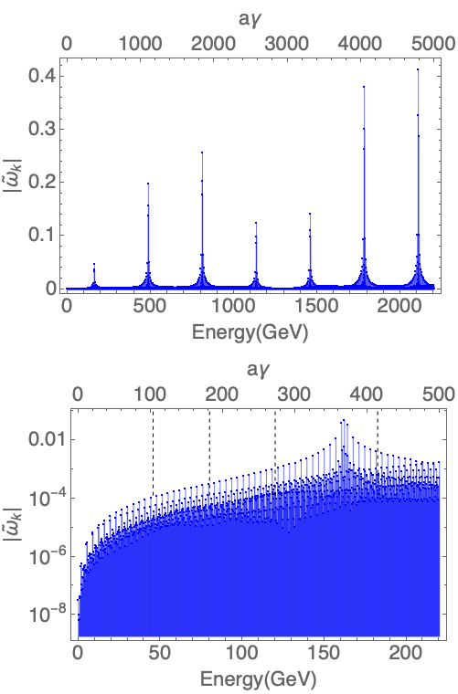
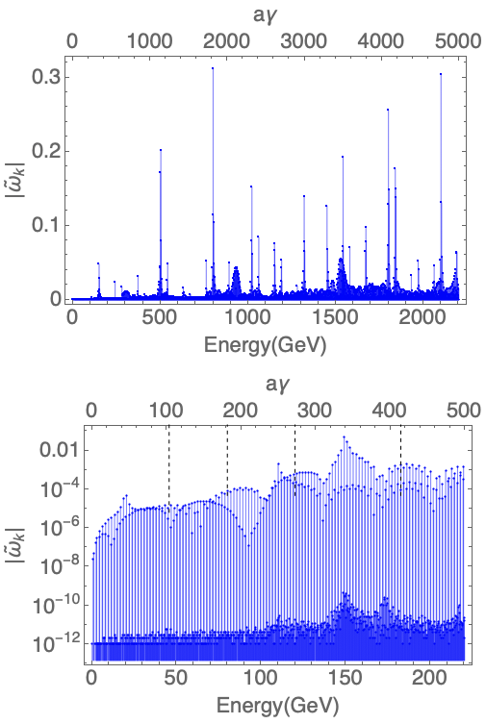
Intrinsic resonances for a vertical normalized amplitude of 10π mm・mrad
FODO 90
HFD

Slide 6
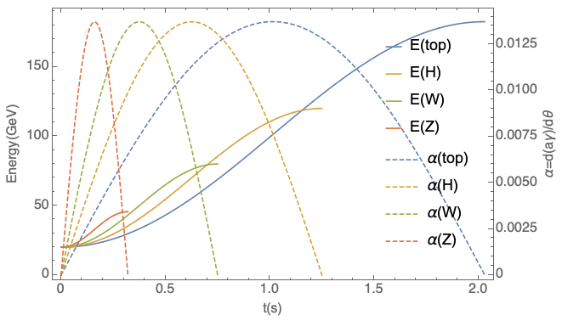
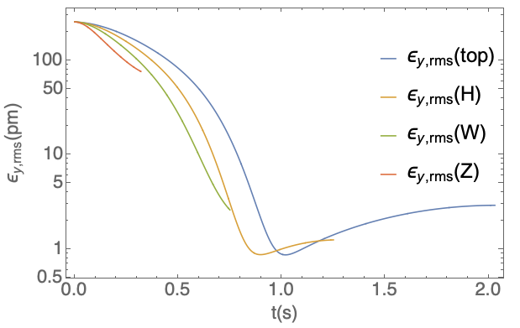
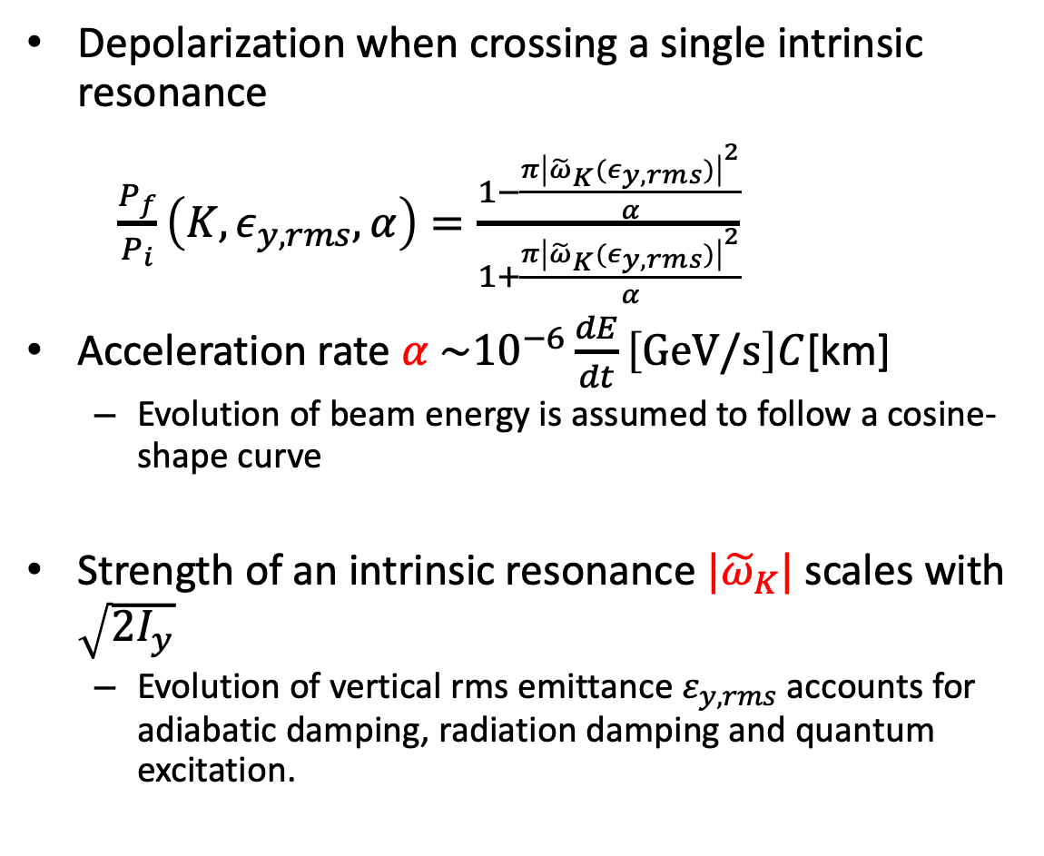
Depolarization due to crossings of intrinsic resonances
Depolarization when crossing a single intrinsic resonance
$\frac{P_{f}}{P_{i}}\left(K, ε_{y,rms},α\right)=\frac{1−\frac{π{\left|{\tilde{ω}}_{K}(ε_{y,rms})\right|}^{2}}{α}}{1+\frac{π{\left|{\tilde{ω}}_{K}(ε_{y,rms})\right|}^{2}}{α}}$
Acceleration rate $α \sim {10}^{−6}\frac{dE}{dt}\left[GeV/s\right]C$[km]
  Evolution of beam energy is assumed to follow a cosine-shape curve
Strength of an intrinsic resonance ${|\tilde{ω}}_{K}|$scales with $\sqrt{2I_{y}}$
  Evolution of vertical rms emittance $ε_{y,rms}$ accounts for adiabatic damping, radiation damping and quantum excitation.
Injected emittance 10 mm mrad (norm)

Slide 7
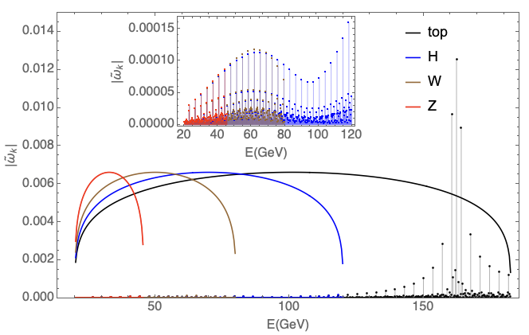
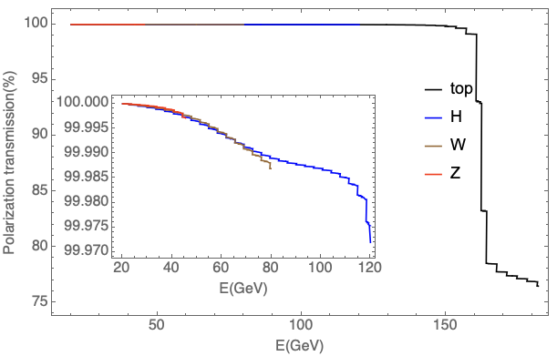
Polarization transmission for FODO 90 degree lattice
Intrinsic resonance strength at the rms vertical emittance during the acceleration for the four operation modes
Polarization transmission as a function of beam
energy during the acceleration for the four operation modes, assuming spin resonance crossings are independent from each other.
The curves indicate the resonance strength corresponding to 99% polarization transmission
Only a few resonances in the top-mode are considered to be dangerous
Depolarization due to crossings of the superstrong intrinsic resonances in the top-mode is observed
Otherwise the depolarization due to intrinsic resonances are negligible

Slide 8
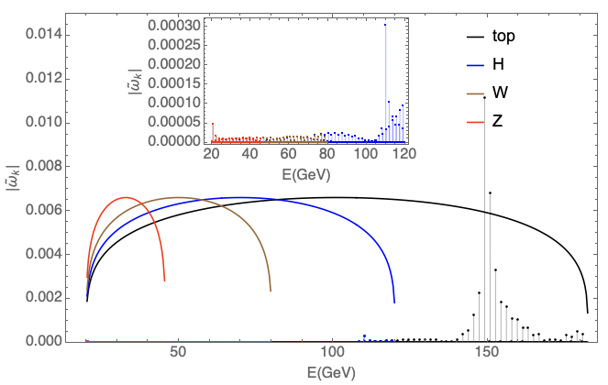
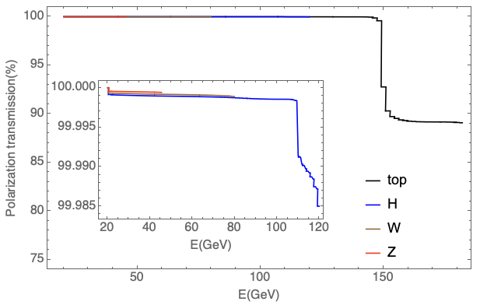
Polarization transmission for HFD lattice
Intrinsic resonance strength at the rms vertical emittance during the acceleration for the four operation modes
Polarization transmission as a function of beam
energy during the acceleration for the four operation modes, assuming spin resonance crossings are independent from each other.
The curves indicate the resonance strength corresponding to 99% polarization transmission
Only a few resonances in the top-mode are considered to be dangerous
Depolarization due to crossings of the superstrong intrinsic resonances in the top-mode is observed
Otherwise the depolarization due to intrinsic resonances are negligible

Slide 9
Summary
The spectra of intrinsic resonances are obtained for the two versions of FCC-ee Booster lattices, exhibiting similar patterns as our previous studies for the CEPC Booster lattice have shown.
Intrinsic resonances are generally weak leading to negligible depolarization in the acceleration to Z, W and Higgs energies.
The first superstrong intrinsic resonances are located between the Higgs and the top energies, leading to some depolarization in the acceleration to the top energies.
The spectra and depolarization effects of imperfection resonances remain to be analyzed for these lattice versions, based on imperfect lattices after comprehensive orbit and optics corrections.
References:
[1] T. Chen, Phys. Rev. Accel. Beams 26, 051003 (2023).
[2] E. Courant and R. Ruth, BNL Report 51270 (1980).
[3] A. Chance, Booster lattice, talk on FCCIS WP2 Workshop, 14/11/2023.

Slide 10
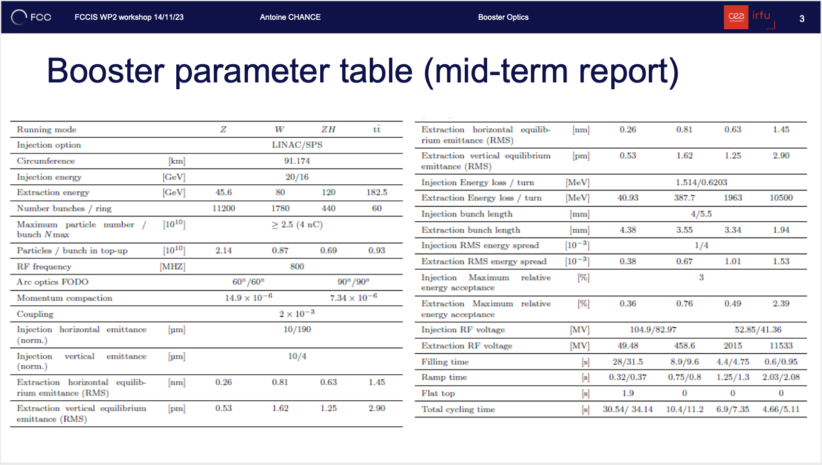
Backup: the highlighted data were used in this study
Vertical damping time [s] 0.754 0.14 0.04 0.012

