Slide 1
NA-CONS underground coordination
EN-ACE Seminar
Xavier Palle
15/11/2024

Slide 2
My background
Studies: Master of sciences: Mechanical engineering and computational sciences, fluid mechanics specialization
EPFL, Lausanne Switzerland
2022: Research internship: Use of AI to support models for acoustic meta-material design (~100% sound absorbers, confidential development)
Sony, Stuttgart Germany
2023: Master thesis: Machine learning based simulator with perceptual enhancement (Input psychological and psychophysical factors in a ML based simulator)
Sony, Tokyo Japan
2024: Graduate at CERN: NA-CONS & HI-ECN3 coordination of underground activities and synergies between the projects

Slide 3
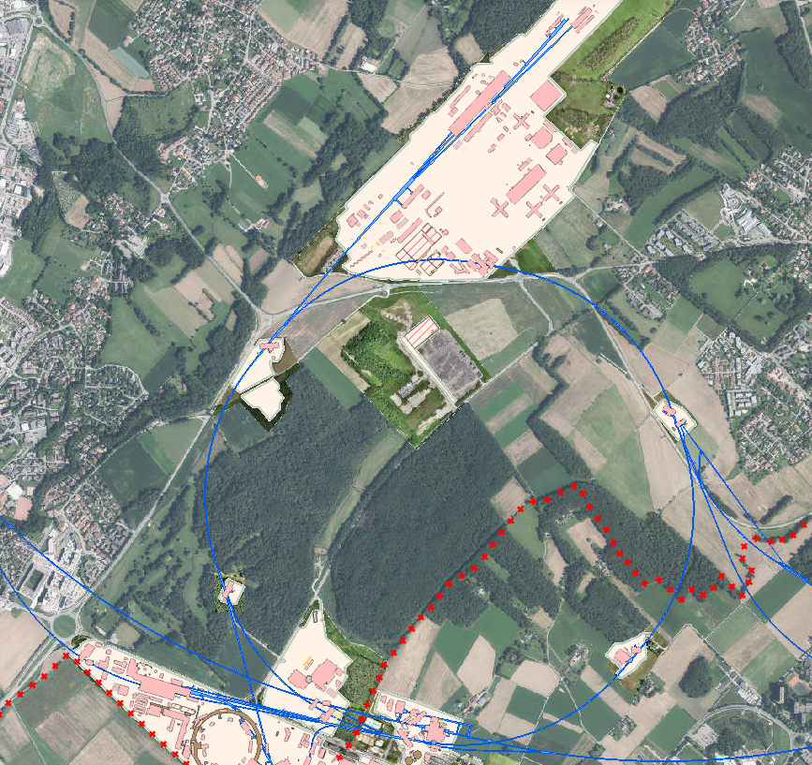
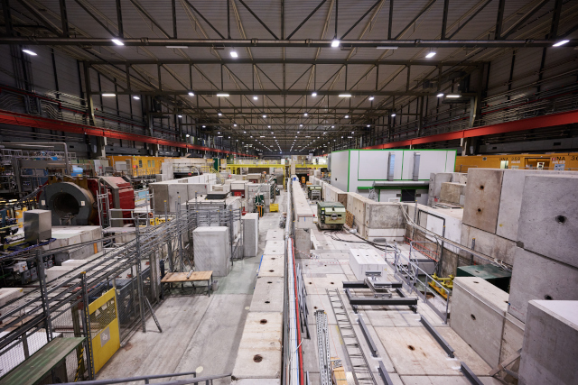
NA-CONS – Presentation of the North Area
CERN's largest experimental area
Constructed in 1970, with first beam received in 1978
Experiments conducted:
SHINE
NA62, NA64, and NA65
COMPASS
MADMAX
Neutrino platform
Various research and development (R&D) programs
Key characteristics & challenges:
High radiation risk
Use of fixed targets

Slide 4
NA-CONS Roadmap
Consolidation Phase 1 (2019 – 2028):
Primary areas incl. TDC2, TCC2, BA2, BA80 & beamlines towards EHN1 & TDC8
Consolidation Phase 2 (2029 – 2034): BA81, BA82, EHN1, EHN2 & associated beamlines

Slide 5
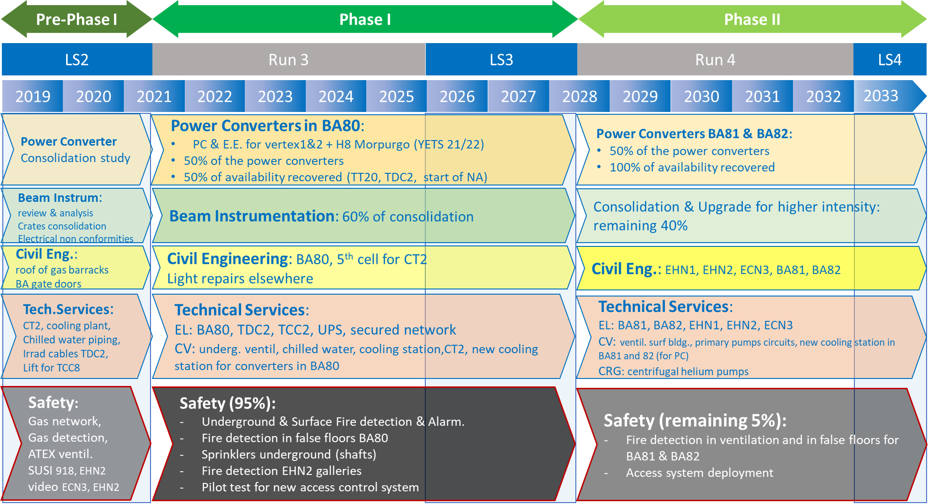
NA-CONS Roadmap

Slide 6
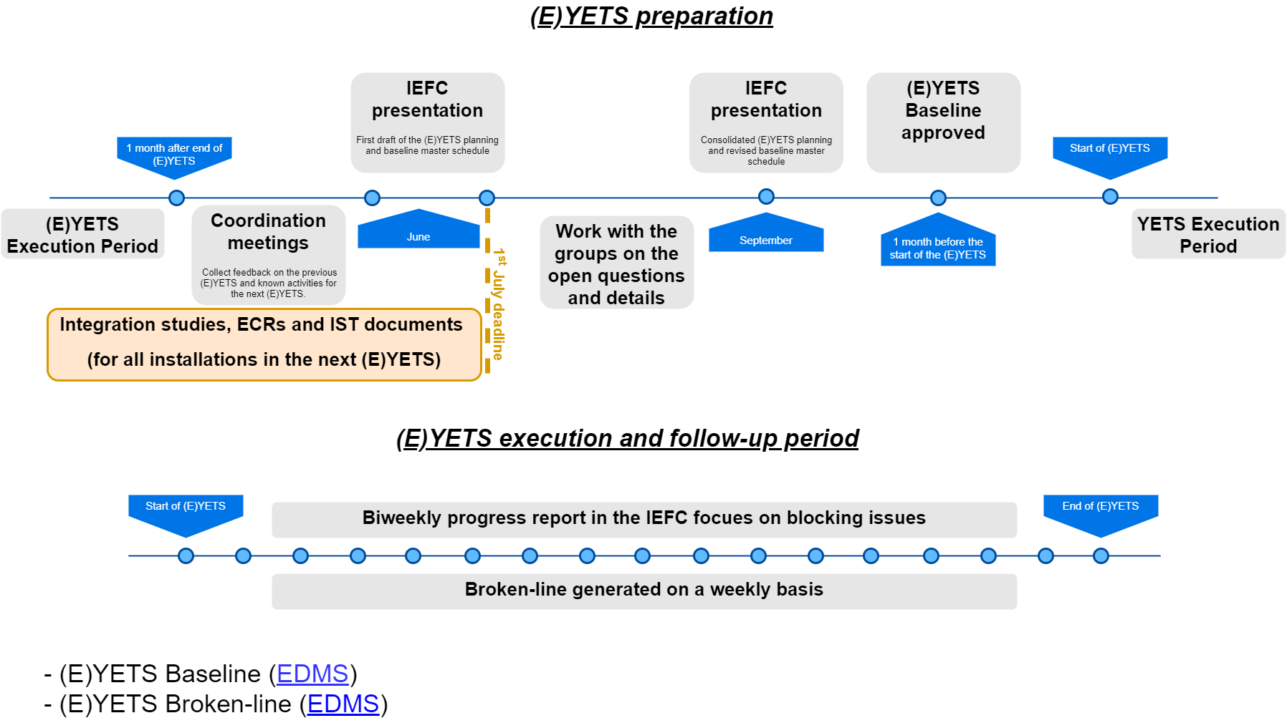
ACE methodology

Slide 7
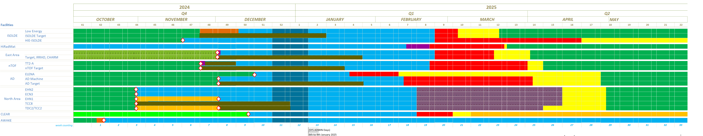
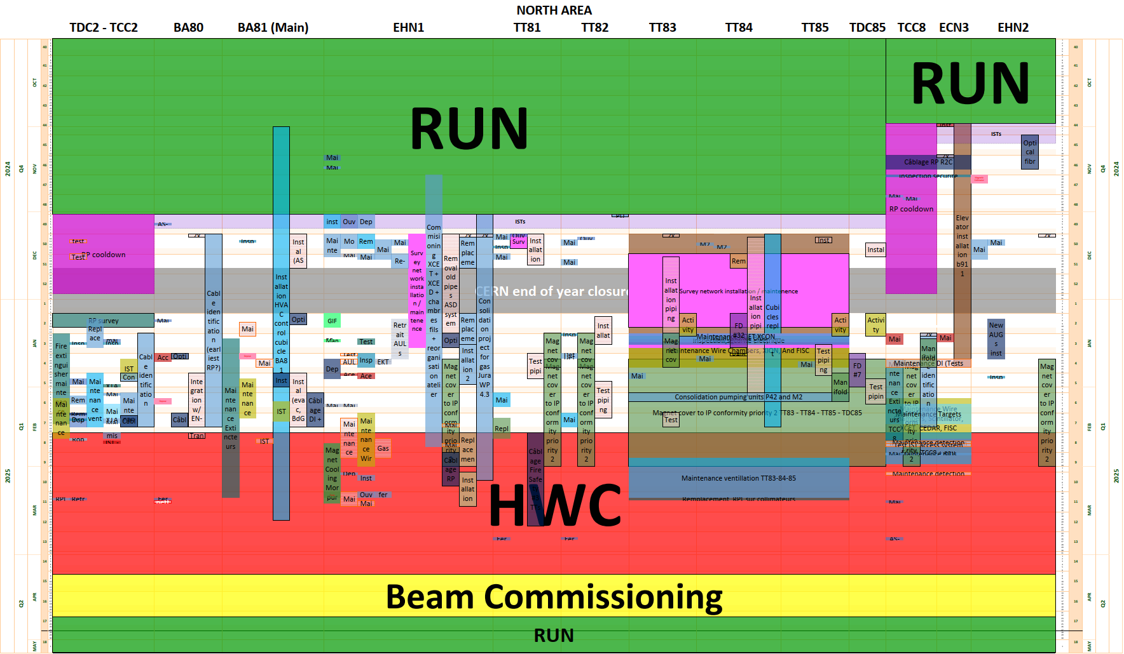
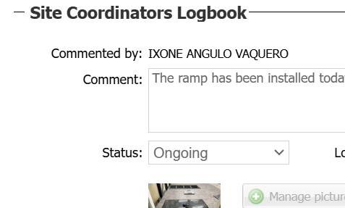
Preparation & Execution Follow-up
Daily basis on-site visits

Slide 8
Preparation & Execution Follow-up
Information flow
NA-CONS Project Leader
Coordination
(EN-ACE like)
WSSs
WPLs
Company
  Warning:
  It is essential that information flows from the preparation phase and that the follow of information is right from the beginning.
  Parallel flow of information leads to accidents, delays, confusion and extra cost.

Slide 9

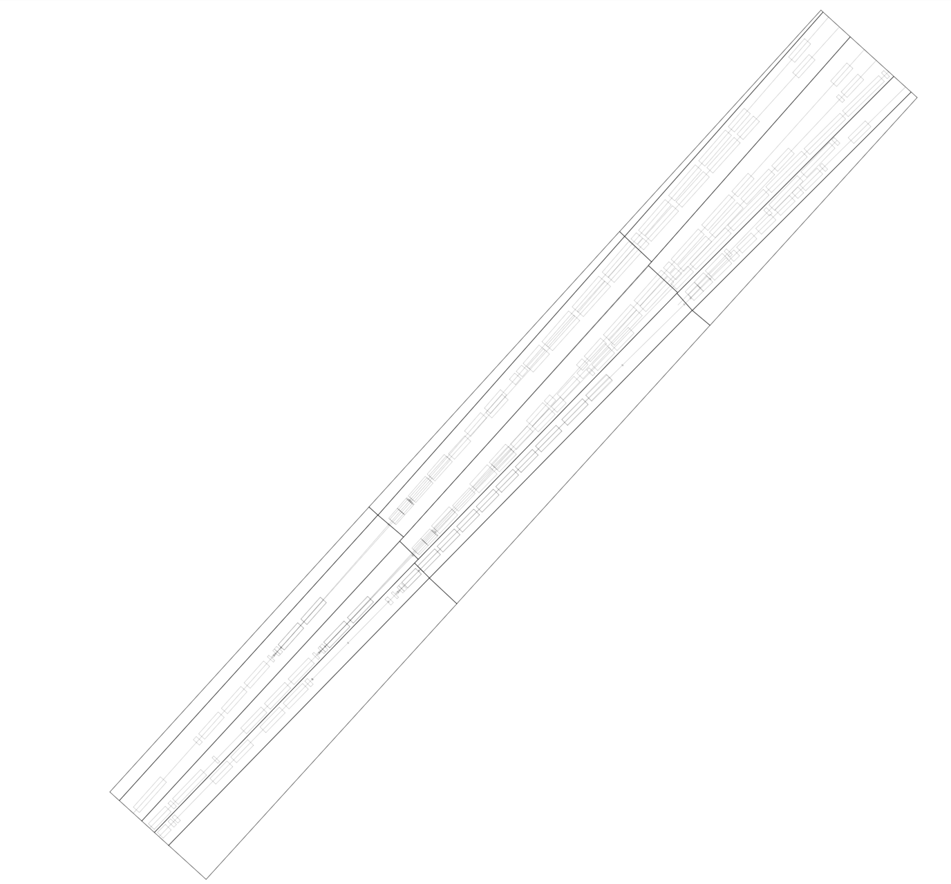
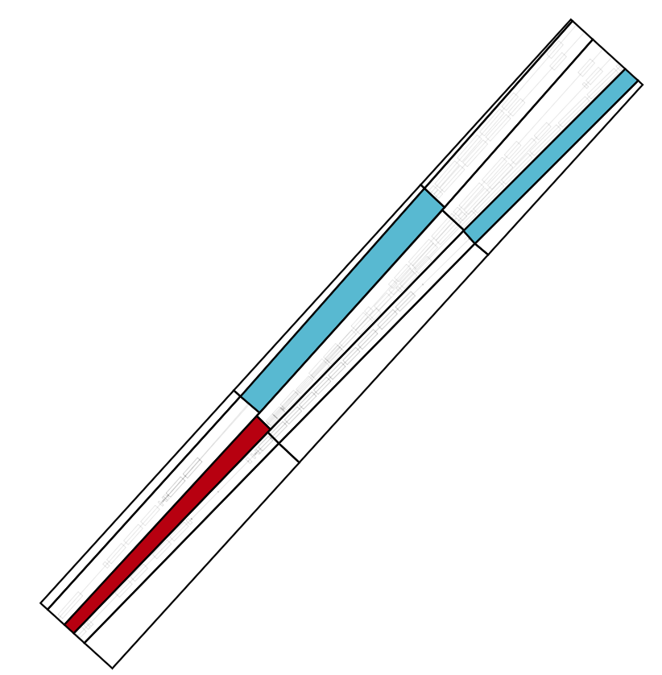
Support tool for the methodology – Time&Space
Building partitioning
Dates and locations

Slide 10
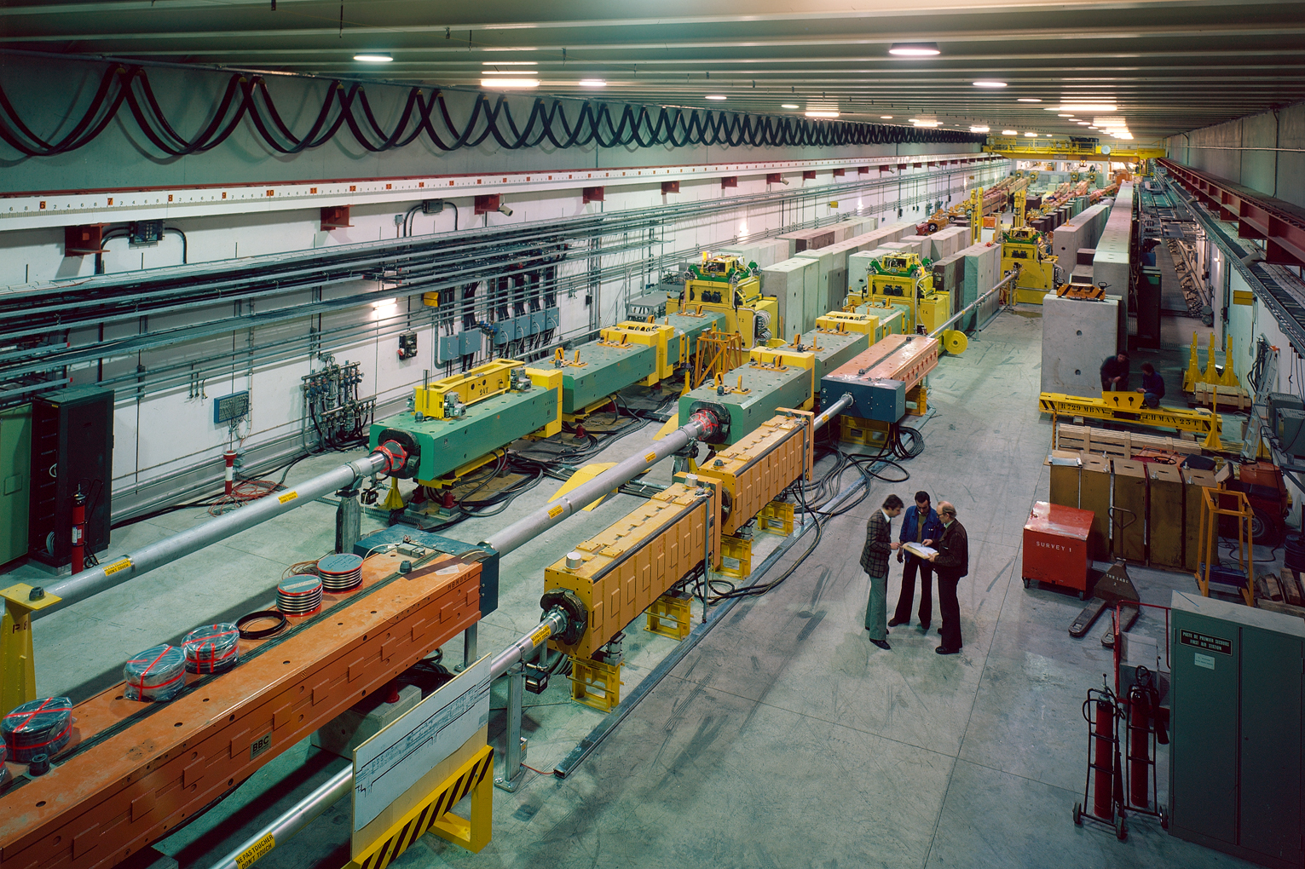
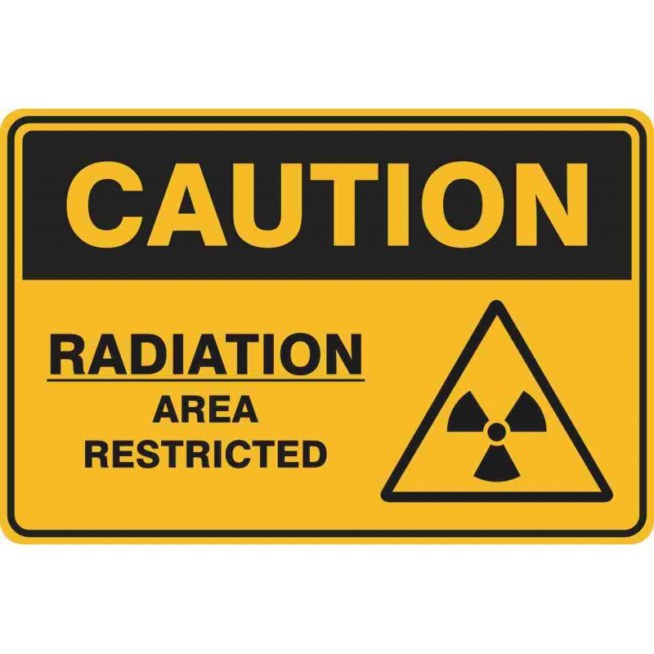
Phase 1 underground – TDC2 & TCC2 renovation
Facility characteristics
Junction cavern - Splits primary beamline into 6 beams (nowadays)
Adjusts beam properties for specific downstream experiments
Facility challenges
Underground location - Limited space, access only through shafts
High radiation levels - Requires optimized strategy and procedures for works
15/11/2024

Slide 11
Defining a renovation strategy in a radioactive area
Define possible scenarios
Calculate total collective radioactive dose for each scenario and planning
Comparison of the scenarios
Management decision on the selected scenario

Slide 12
Defining a renovation strategy in a radioactive area
Define possible scenarios
What is radioactive ?
The equipment in the cavern depending on its location
Scenario 1
Scenario 2
We perform the renovation works without touching any equipment
We perform the renovation works after removing all equipment from the cavern
Lower dose rate environment, but removal phase costs doses and need storage space
High dose rate environment

Slide 13
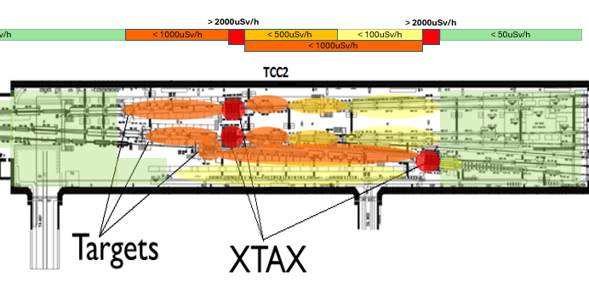
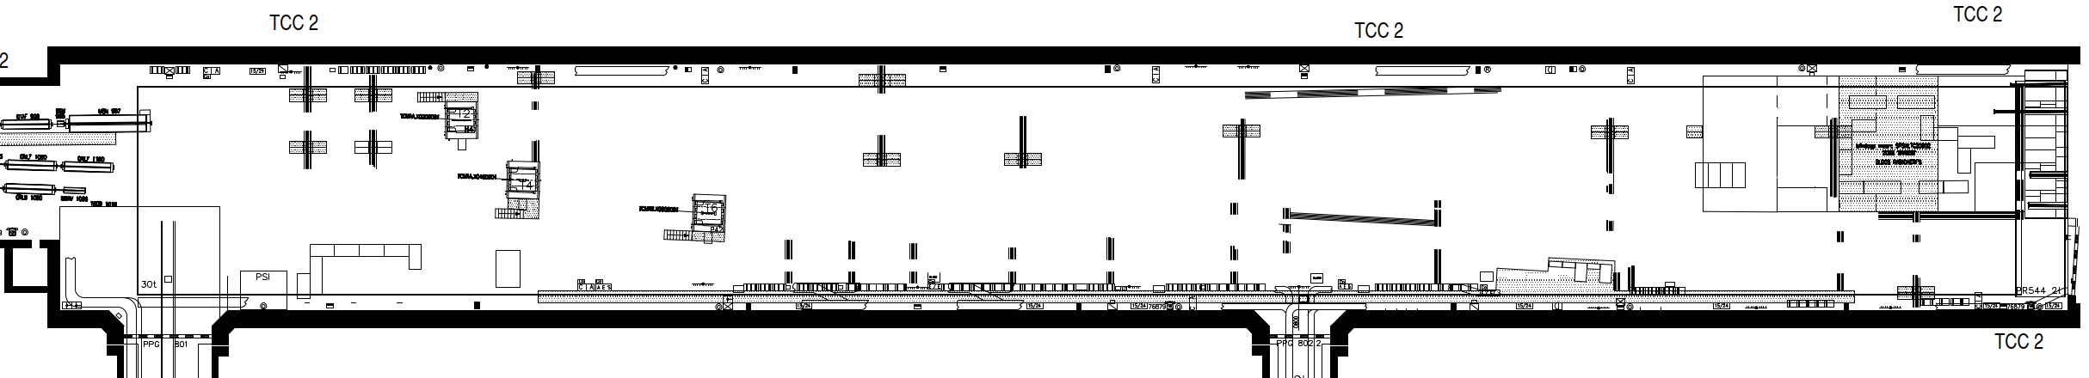
Defining a renovation strategy in a radioactive area
Define possible scenarios
Calculate total collective radioactive dose for each scenario
Scenario 1
Scenario 2
High dose rates
High dose rates
Low dose rates
VS
+
Renovation
Removal Renovation
Equation to solve

Slide 14
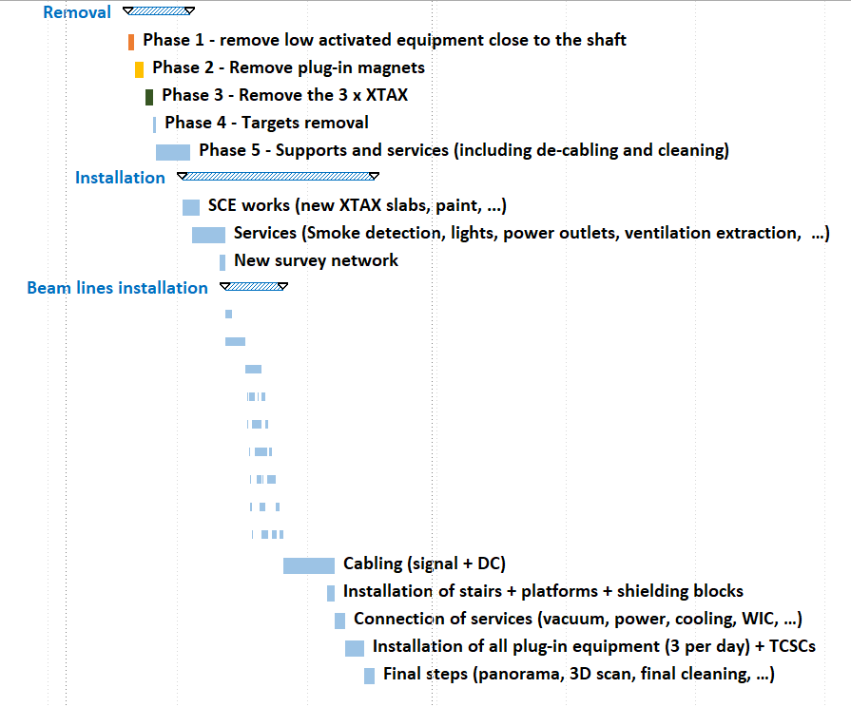
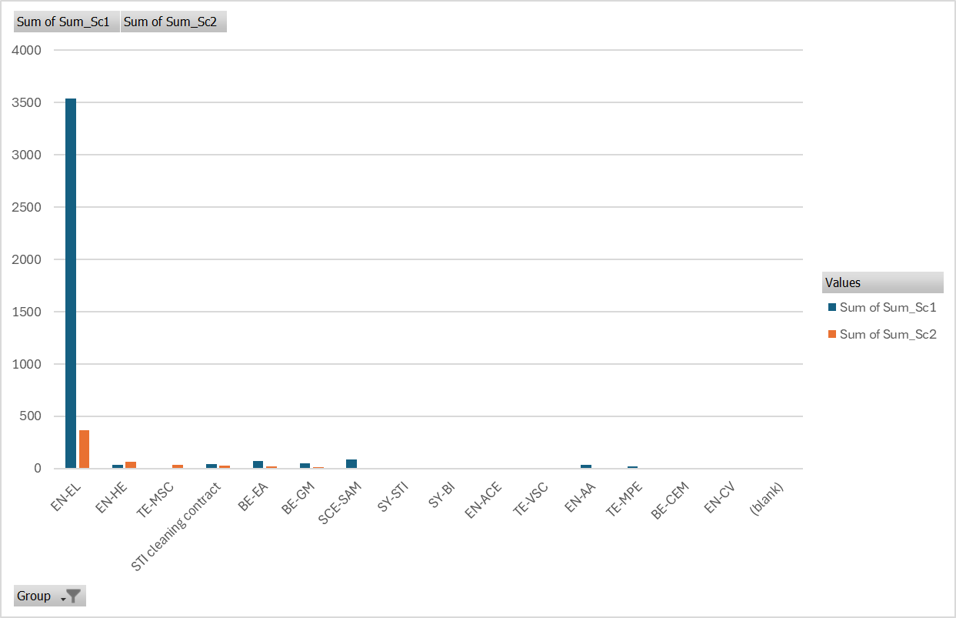
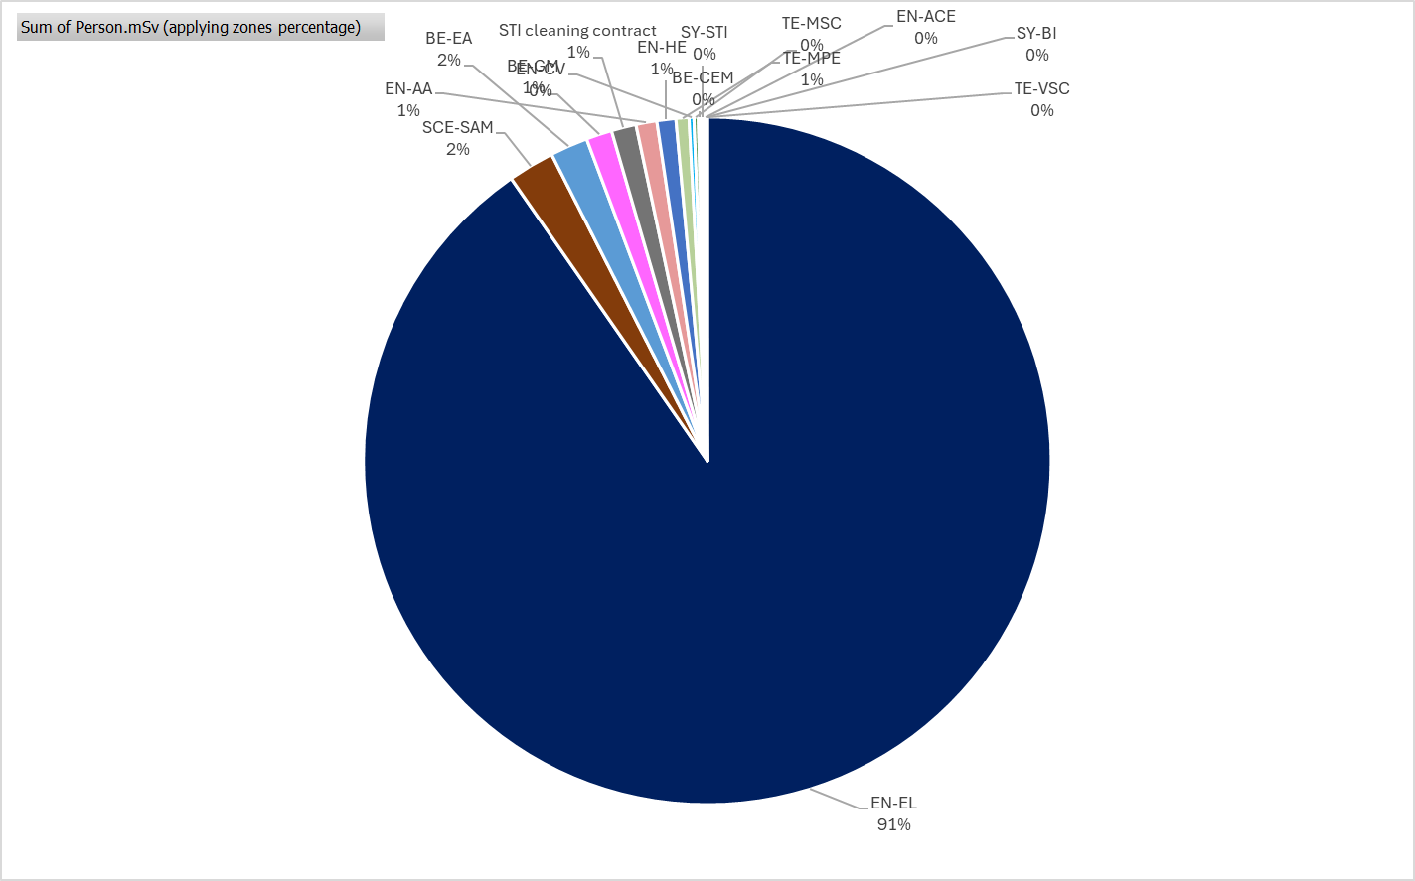
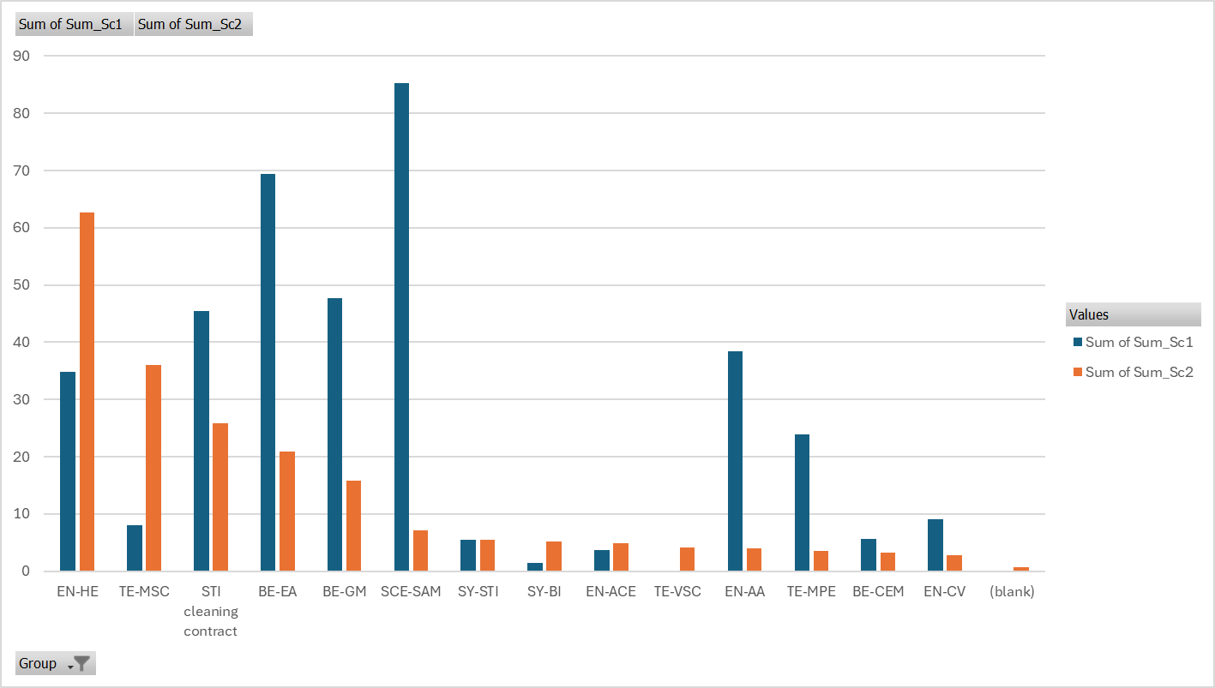
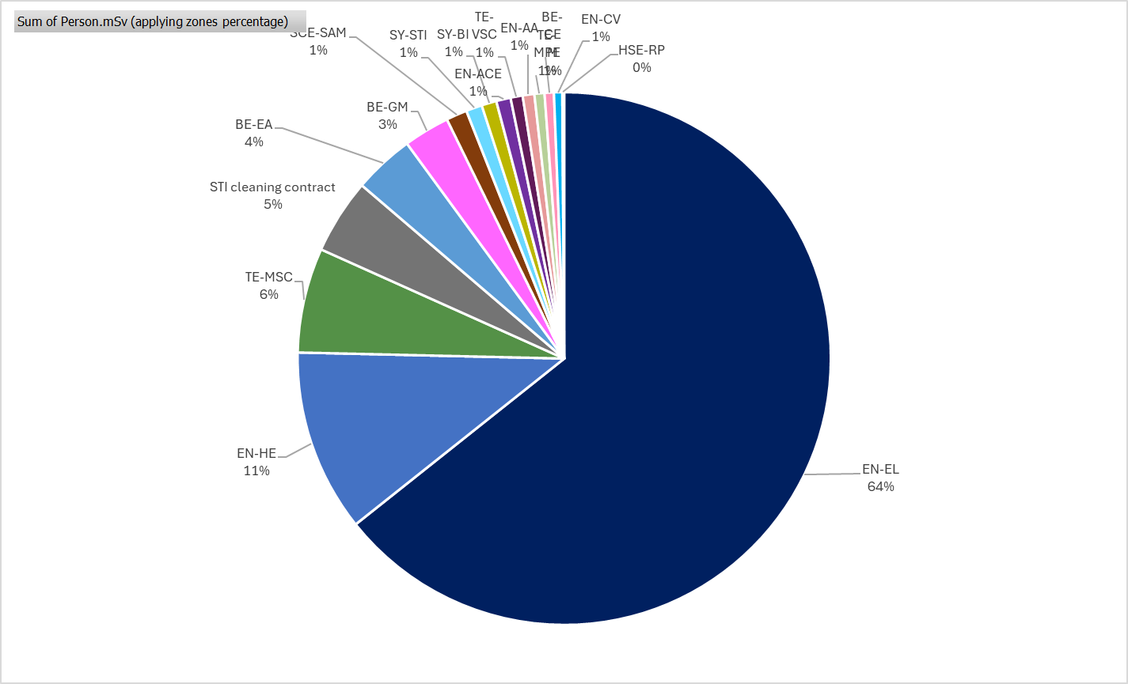
Defining a renovation strategy in a radioactive area
Define possible scenarios
Calculate total collective radioactive dose for each scenario
Comparison of the scenarios: Scenario 1 = 3917 Person.mSv, Scenario 2 = 566 Person.mSv
Collective dose direct comparison per group
Distribution of the dose across groups for both scenarios
Master planning
Scenario 1
Scenario 2
Notes:
Petit fromage vs grand fromage (x10)

Slide 15
Why such a difference between scenarios ?
  Scenario 1: Approved baseline
  Scenario 2: Full refurbishment of TCC2
    XTAXs replacement;
    TCSCs replacement;
    WIC installation;
    Additional Beam instrumentation;
    De-cabling of all obsolete cables;
    Cabling (DC and signal cables);
    Fire doors;
    + few extra activities without moving magnets
    Empty the TCC2;
    Everything that is in the approved baseline;
    Magnet refurbishment + some new magnets;
    Reorganization of the area:
      Cable trays to avoid cables pulled on the floor;
      Move the cooling manifolds closer to the lines to avoid flexible pipes in the passage;
      New survey network system.
Dose rates for is ~ x10 with respect to
Notes:
Tableau des groups d’activit;es lesquelles sont exposées a hautes radiations et lesquelles sont exposées à faibles radiations.

Slide 16
Defining a renovation strategy in a radioactive area
Define possible scenarios
Calculate total collective radioactive dose for each scenario
Comparison of the scenarios
Management decision on the selected scenario
Collective dose direct comparison per group
Distribution of the dose across groups for both scenarios
Master planning
Scenario 1
Scenario 2
Which scenario
Resources to allocate
Time needed

Slide 17

Thank You!

Slide 18
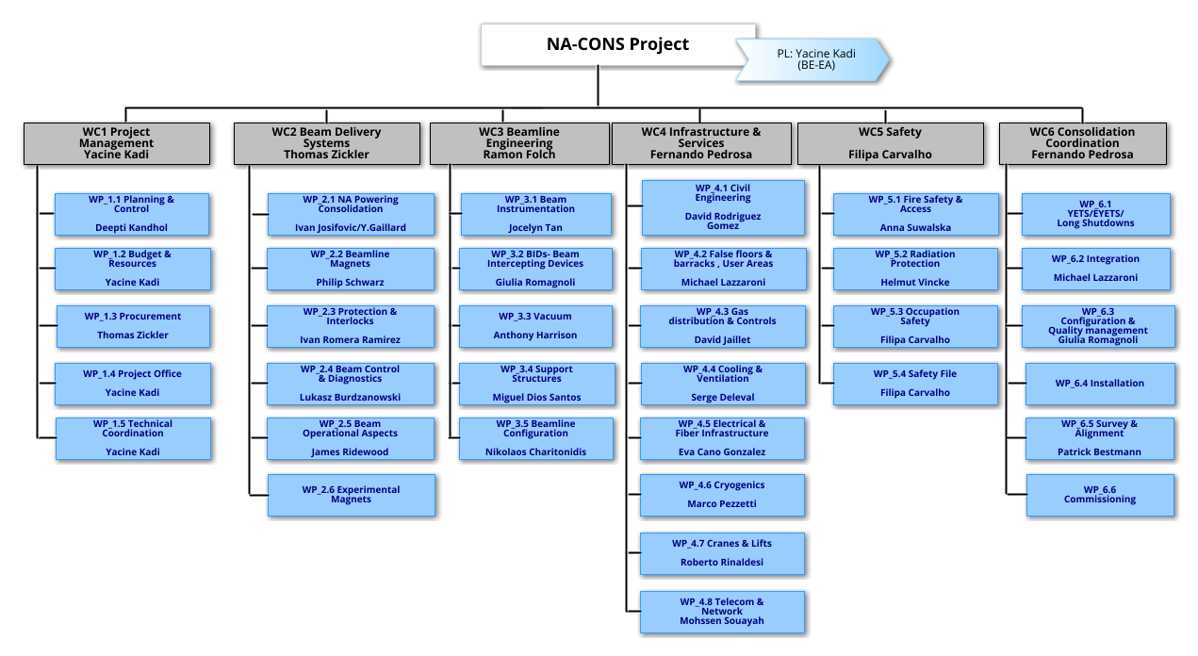
NA-CONS Organigram
F. Pedrosa with TEAM A
F. Pedrosa with TEAM A
6 Work Categories
34 Work Packages
280 Work Units in EVM

Slide 19
ACE methodology
YETS 24/25
Collect each group’s list of planned activities.
Draft an initial planning.
Hold meetings with each group to refine and adjust the planning.
Set a baseline of activities in EDMS.
Create the linear schedule.
Monitor and track progress on each activity.
15/11/2024
X. Palle | NA-CONS underground coordination | EN-ACE Seminar

Slide 20
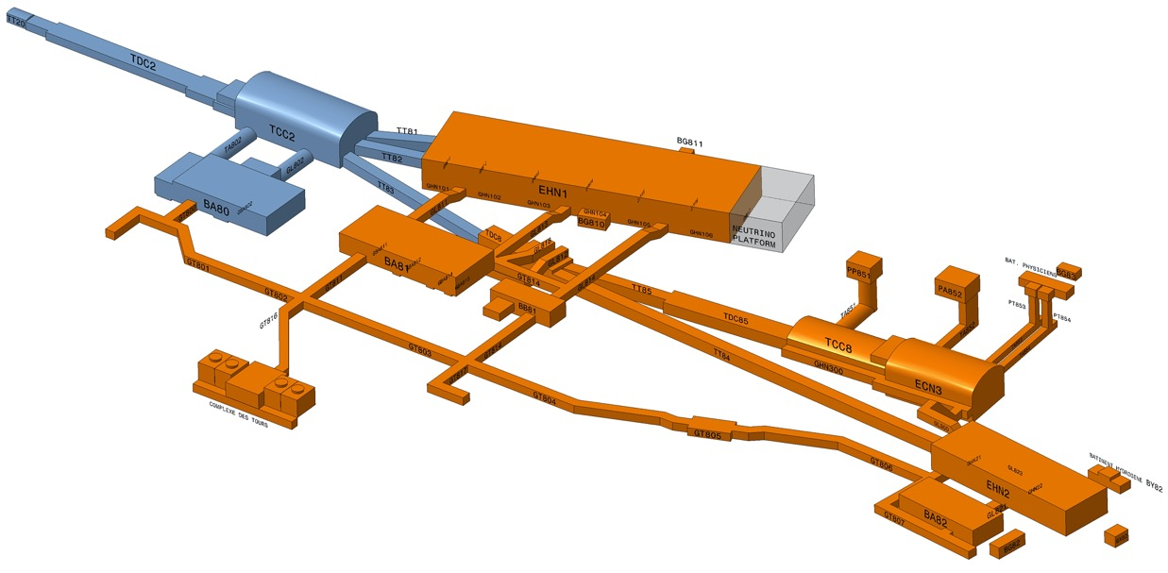
NA-CONS Roadmap
Consolidation Phase 1 (2019 – 2028):
Primary areas incl. TDC2, TCC2, BA2, BA80 & beamlines towards EHN1 & TDC8
  Beam Areas concerned with the upgrade of ECN3 to a high-intensity facility for SHiP (Synergies between the two projects are followed closely to optimize as much as possible the resources and the work) – Specific TCCs are organized on this subject
Consolidation Phase 2 (2029 – 2034): BA81, BA82, EHN1, EHN2 & associated beamlines

