Slide 1
Applications of particle accelerators outside particle physics
Ken Peach
APPEAL 2
Oxford 2nd July 2011

Slide 2
Contents
Introduction
Scientific Applications
  Neutrons
  Photons
  Ions
Industrial Applications
Medical Applications
  Radiotherapy
  Radiobiology
  Radionuclides
Summary & Conclusions

Slide 3
Scientific Applications
Neutrons
Photons (X-rays …)
Ions

Slide 4
NIMROD @ RAL & NINA @ Daresbury
Built in the 1960s
  NIMROD @ RAL
    8 GeV proton synchrotron
  NINA @ Daresbury
    3 GeV electron synchrotron
Both closed in the 1970s!
  The UK’s accelerators were “@CERN”
New projects from their ashes
  ISIS @ RAL
    800MeV proton synchrotron for a
    Spallation Neutron Source
  SRS @ Daresbury
    2GeV Synchrotron Radiation Source
Particle Accelerators for other sciences
(Physics, Chemistry, Engineering, Biology, Medicine)
}

Slide 5
What is a Spallation Neutron Source?
High Energy (~1GeV)
High Power (~MW)
(ISIS – 0.16MW)
Target
Protons
n
n
n
n
n
n
n
n

Slide 6
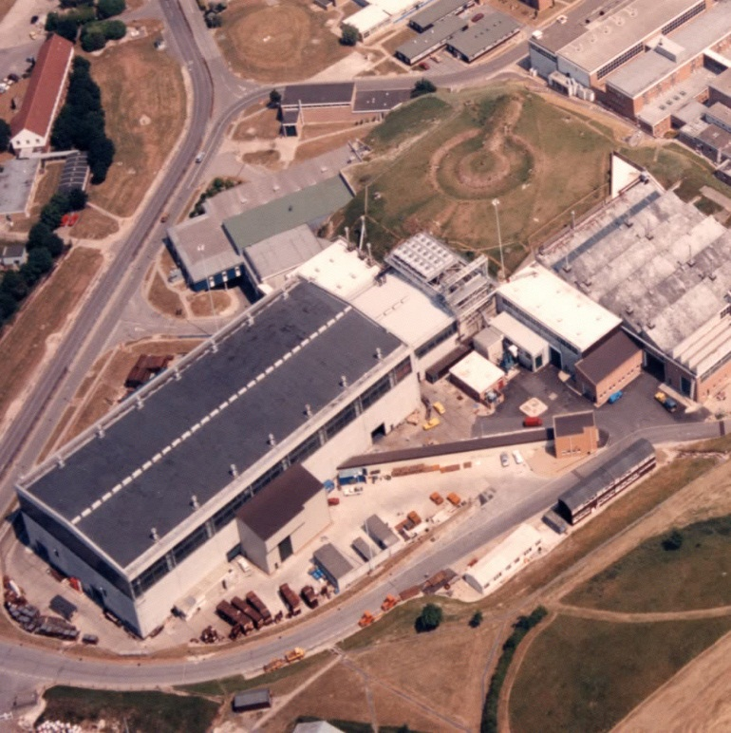
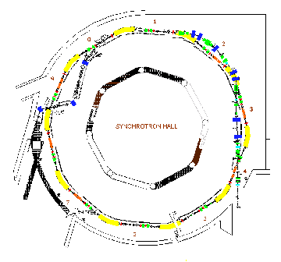
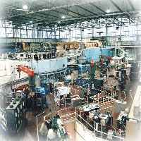
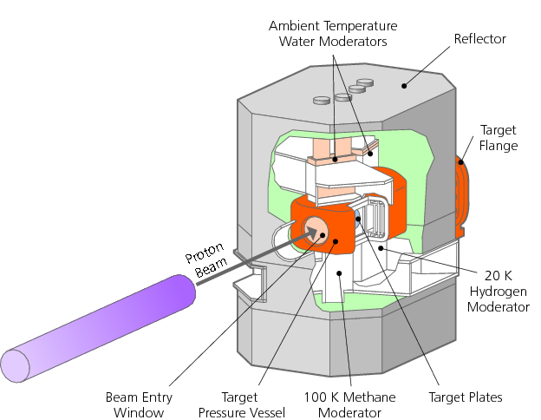
ISIS @ RAL
ISIS @ RAL
600 Experiments/year
1200 Users/year
235 UK Groups
ISIS:
50 Hz
800 MeV
300 µA

Slide 7
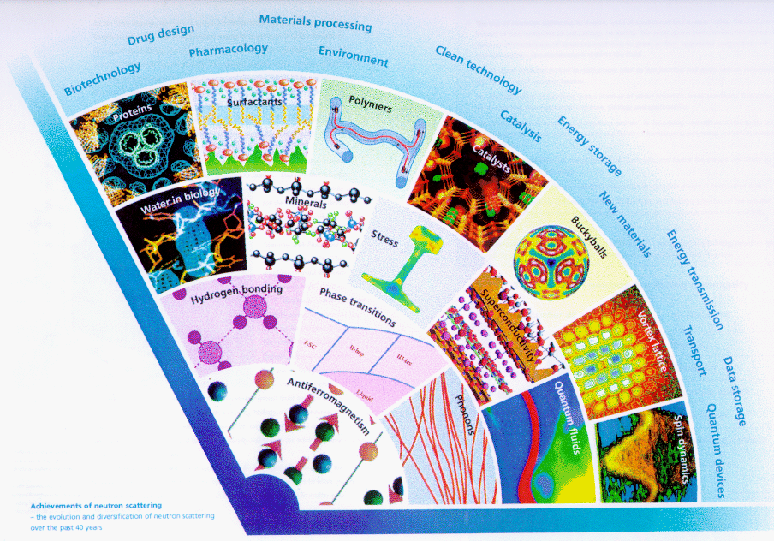
Neutron Scattering (ISIS)

Slide 8
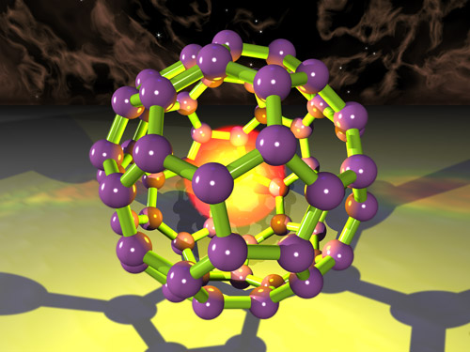
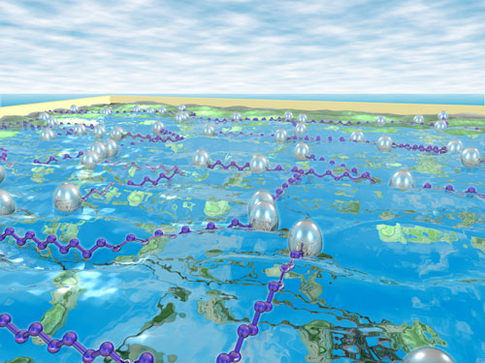
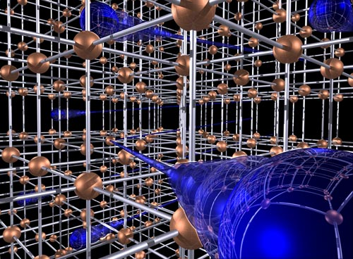
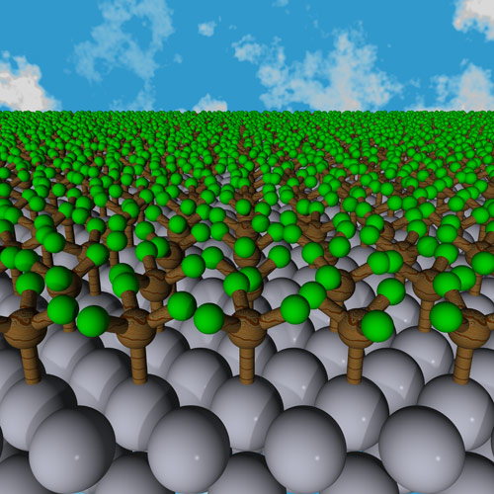
Some ISIS Science
Muonium trapped inside C⁶⁰
Surfactant molecules on liquid
© CCLRC
© CCLRC
Crystal lattice seen by a neutron
Accumulation of CH₃ on Palladium
© CCLRC
© CCLRC

Slide 9
What is Synchrotron Radiation?
X-ray
Motion of a charged particle (an electron) in a magnetic field
When ultra-relativistic, emits x-rays tangential to the motion

Slide 10
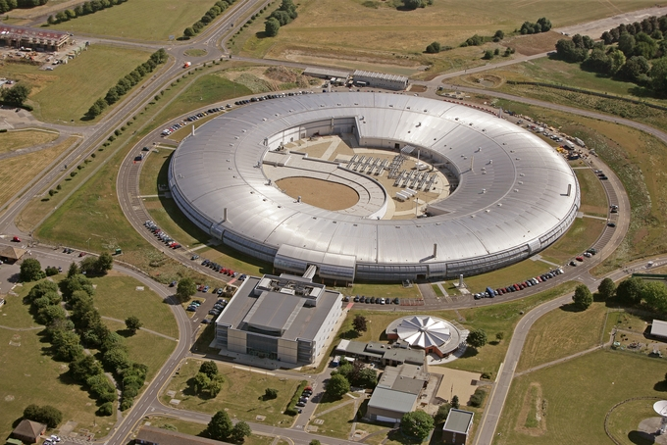
Diamond Light Source
Physics
Chemistry
Biology
Geology
Materials science
Environmental science
Engineering
Conservation
Archaeology
Medicine
...
X-rays from an electron accelerator
Image: Diamond Light Source
Notes:
Images not to be used independently of talk. Fan blade (jet engine) from Rolls Royce, in beamline I12.

Slide 11
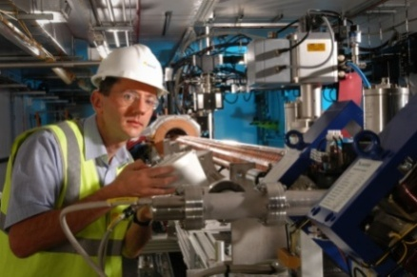
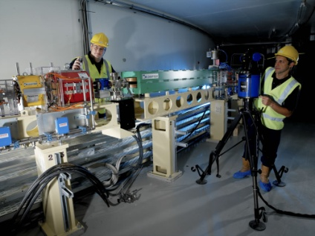
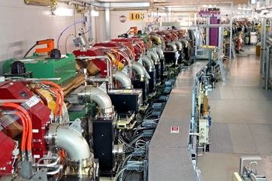
3 particle accelerators
Thermionic gun produces 90keV electrons
Three particle accelerators:
Linear accelerator to 100 MeV
Booster synchrotron (158m) to 3 GeV
Storage ring (562m)
(actually a series of 24 straight sections)
Vacuum ~10⁻¹³ atm
~10¹² electrons in storage ring
Lifetime of electrons ~25 hours
Image: Diamond Light Source
Notes:
Micron positioning of components

Slide 12
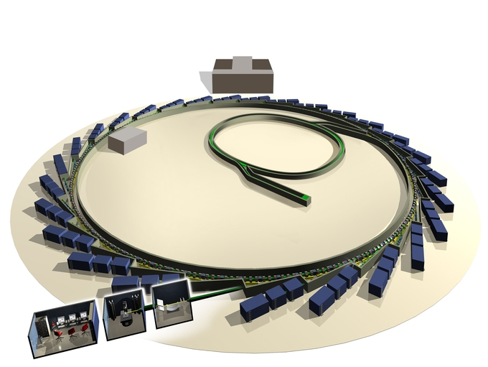
Beamlines for experiments
X-rays (or UV or IR) directed into beamlines for experiments.
Beamlines are used independently so many experiments occurring simultaneously.
Currently 20 beamlines operational and 15 more in planning or construction.
Image: Diamond Light Source
Notes:
3 parts of beamline are (starting from ring) optics hutch, expt hutch, user area.

Slide 13
Ranges of energies & wavelength
Choose wavelength(s) appropriate to experiment.
Most beamlines use one wavelength at a time
Lab source: Cu K_{α}:
E=8 keV, λ=1.54Å
150 keV, λ=0.08Å
X-ray
0.8 keV, λ=1.5 nm
IR
UV
1.2 meV, λ=1mm
80 eV, λ=15.5 nm
Notes:
8 keV (typical) has wavelength 1.5A, which is comparable to interatomic spacing so very useful for diffraction .
Not an accident that Diamond is optimised for this energy of X-rays.
Not all beamlines represented here – mostly those for physical sciences

Slide 14
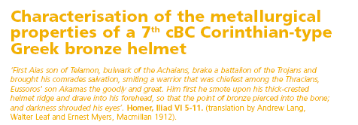
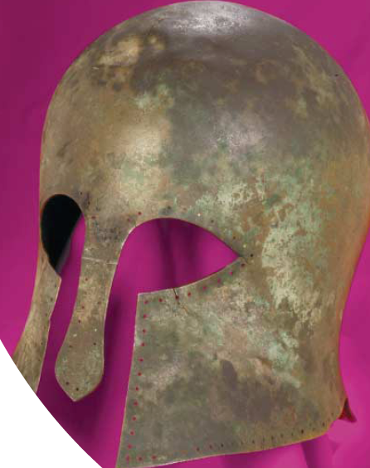
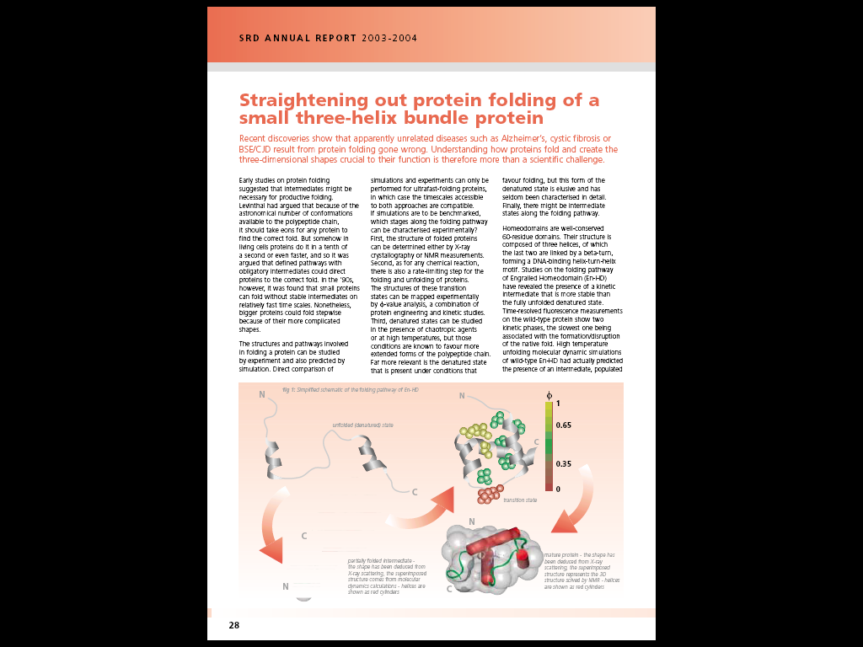
Examples of use of Synchrotron Radiation
CCLRC/SRD annual report

Slide 15
Resources
Diamond Light Source
  www.diamond.ac.uk
  ‘Inside Diamond’ open days
  Resources to download
    including animations
  Accelerator and beamlines status
also
  www.lightsources.org

Slide 16
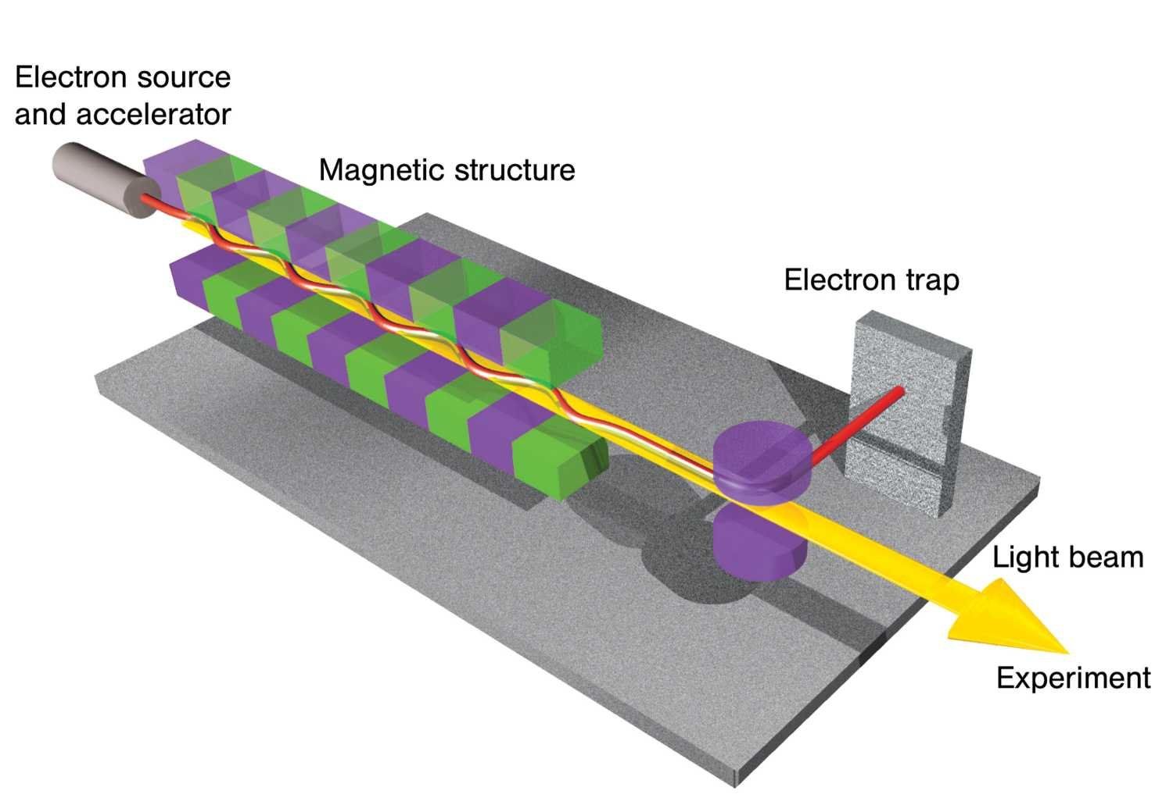
The X-ray Free Electron Laser

Slide 17
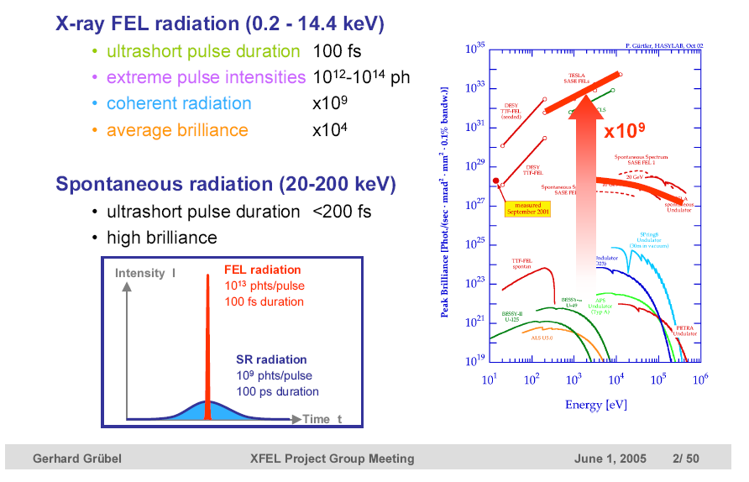
The X-ray Free Electron Laser

Slide 18
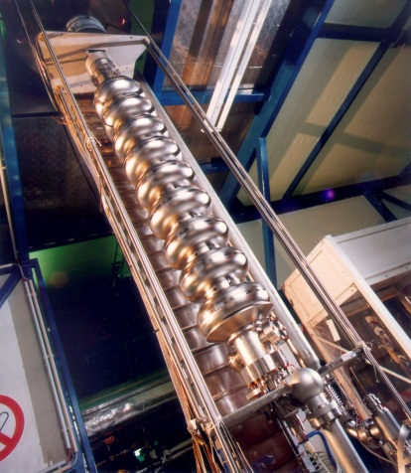
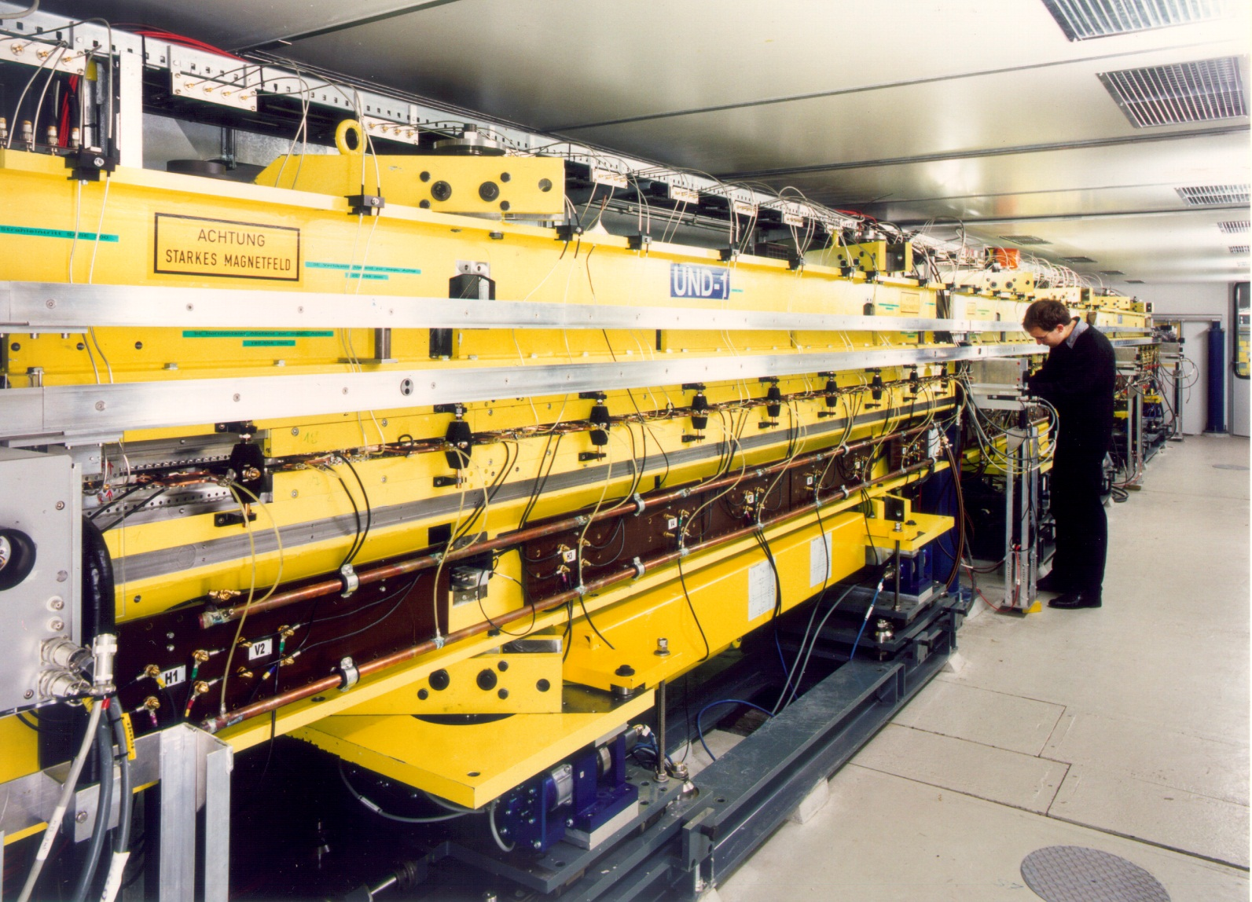
The X-FEL

Slide 19
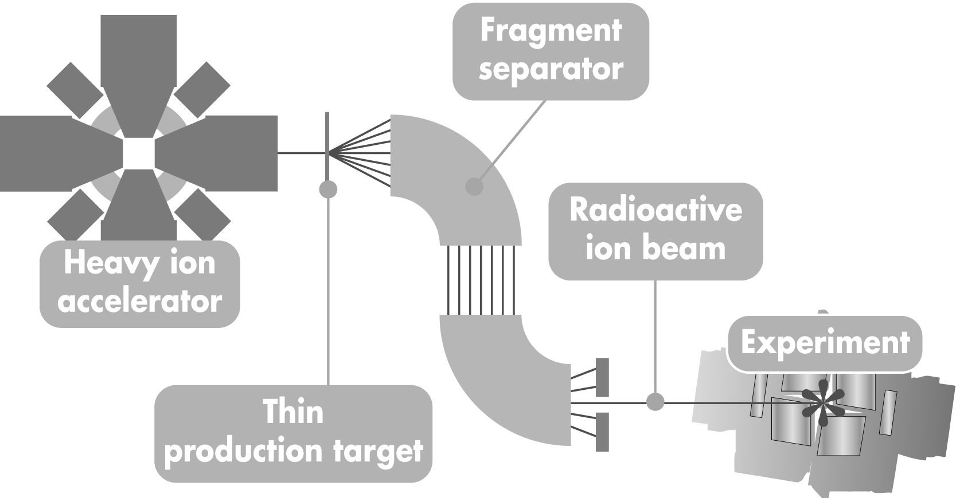
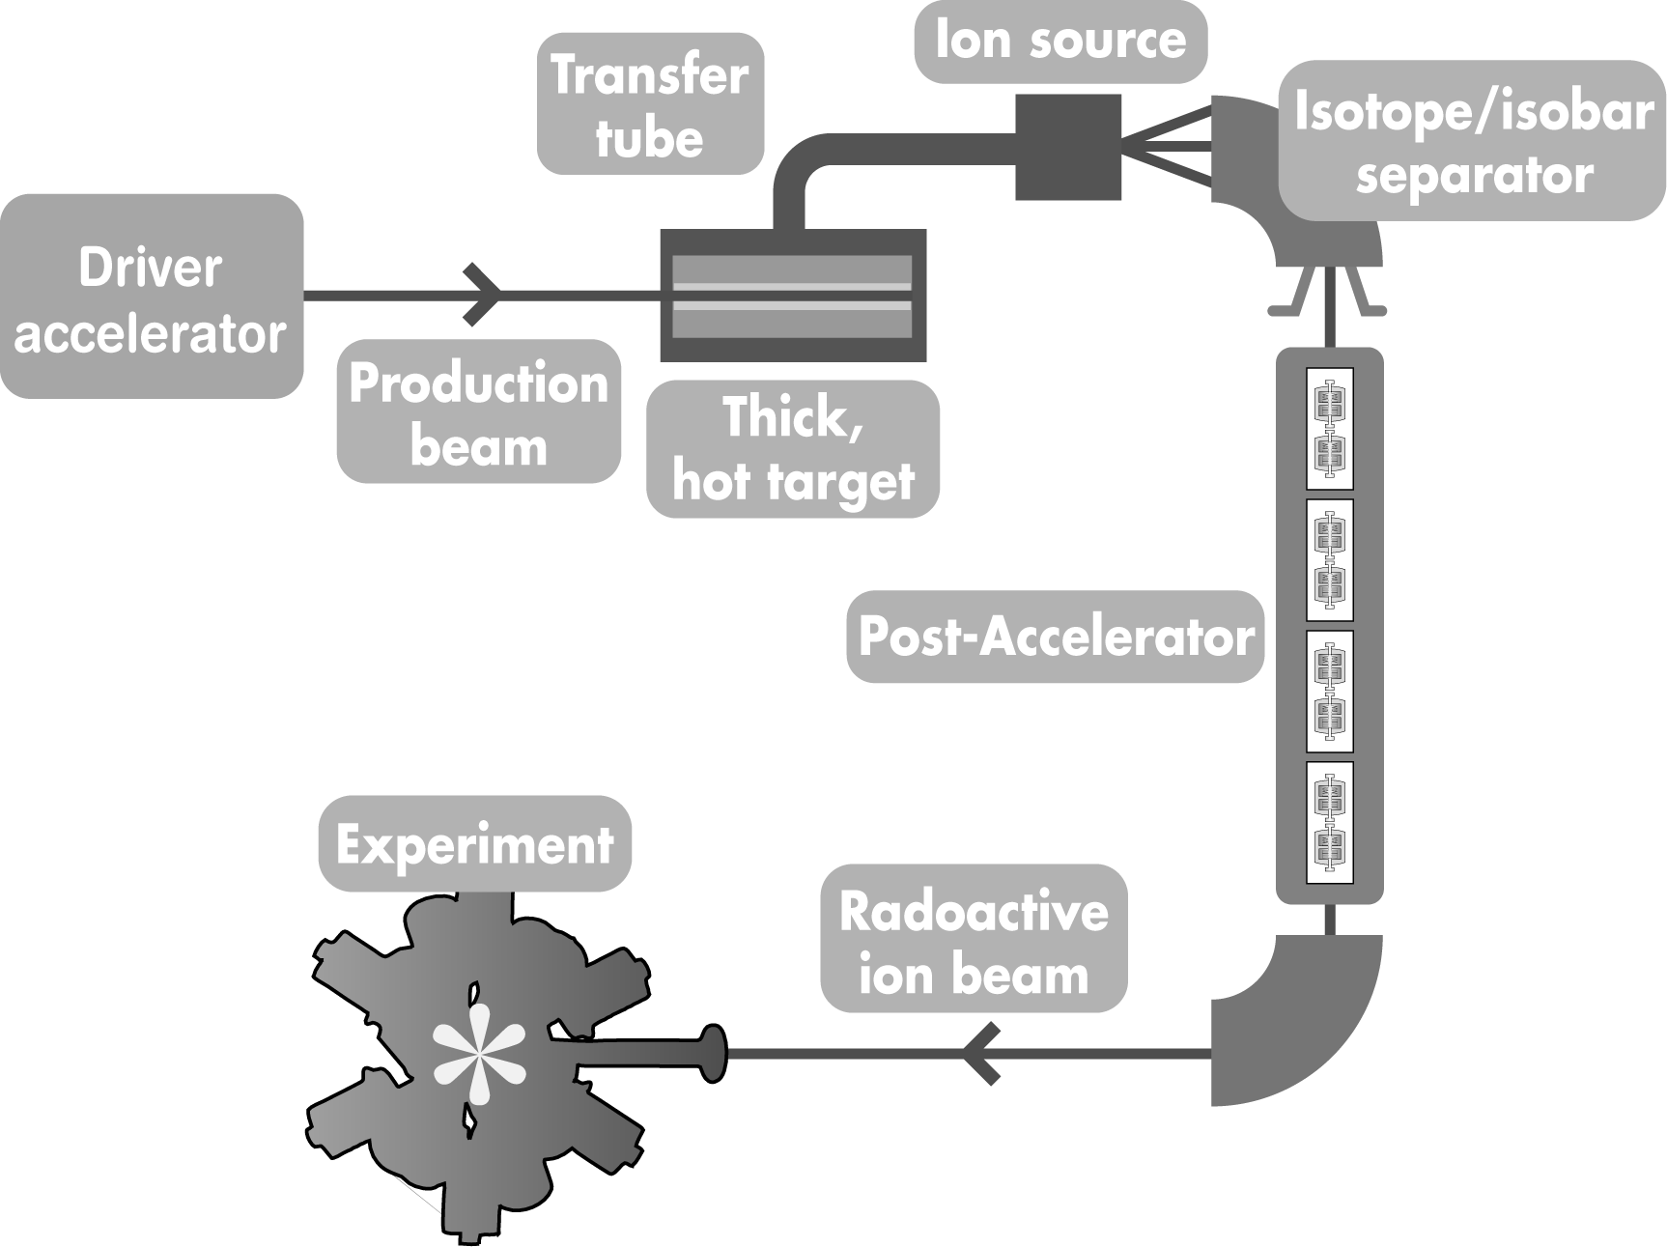
Accelerated heavy ions
Studies of nuclear properties
  New superheavy (> uranium) elements
  Nuclear structure
  Two techniques
Isotope separation “in-flight”

Slide 20
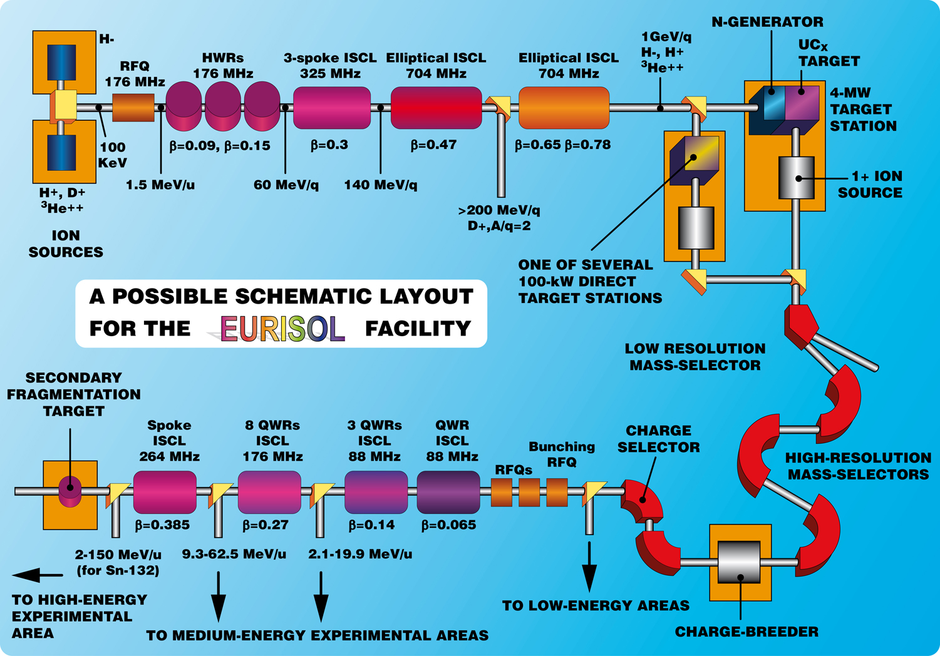
EURISOL

Slide 21
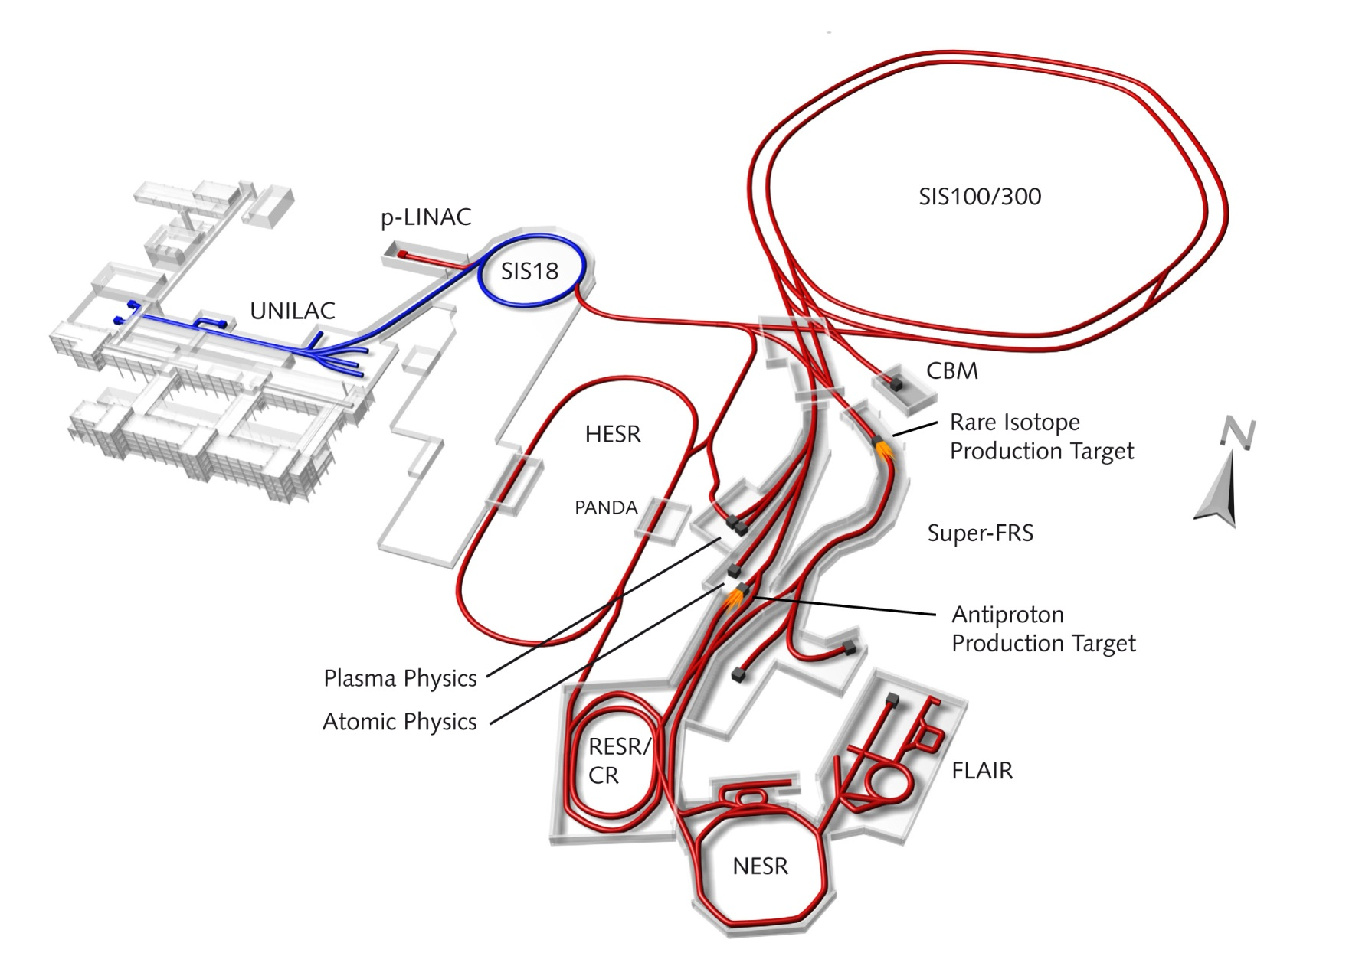
FAIR (Darmstadt)

Slide 22
Accelerators in Industry
Ion Implantation
Electron beam materials processing
Electron beam irradiation
Ion Beam Analysis
X-ray inspection
Neutron generators
Synchrotron radiation

Slide 23
Industrial Accelerators
Direct Voltage
  Van de Graaf, Cockcroft Walton …
    Protons, ions to a few MeV (~5)
Linacs
  Electron beam
    Up to 16 MeV
  Ion beam
    Up to ~70 MeV
Rings
  Cyclotrons
    Ions up to ~70+ MeV
  Betatrons
    Electrons up to a few 10s of MeV
  Synchrotrons
    Up to several GeV

Slide 24
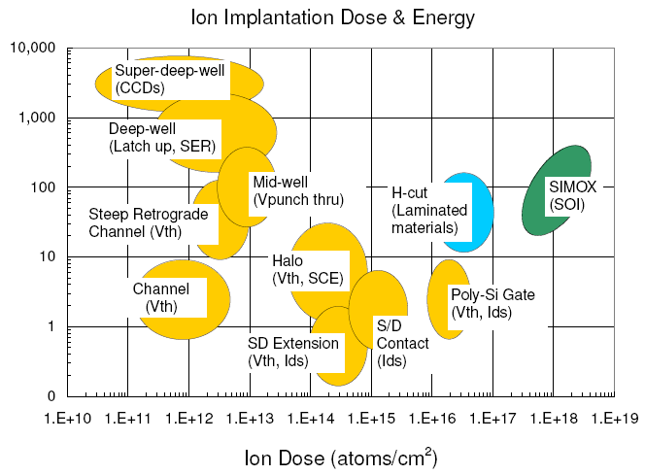
Ion Implantation
Semiconductors
  Precision composition
Metals
  hardening
Glass
  Hardening
  Modified optics
    Note: All digital electronics depends upon ion implantation

Slide 25
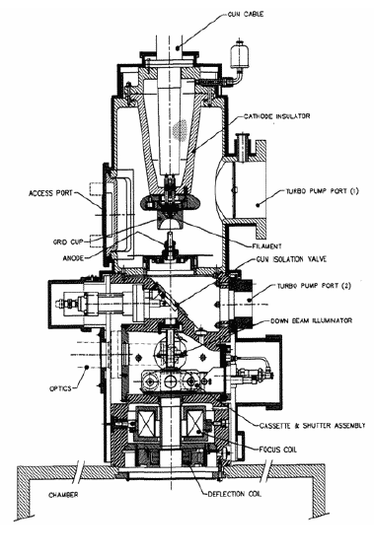
Electron Beam Materials Processing
Usually low energy
  Few hundred keV
  Used for precision
  engineering
  (cutting, welding)

Slide 26
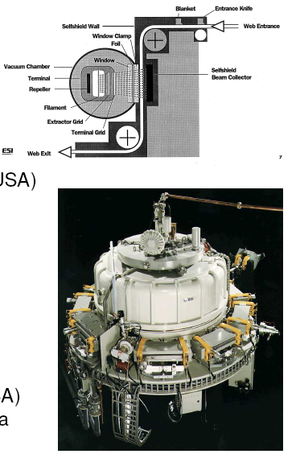
Electron Beam Irradiators
Low energy (<300 keV)
    Curing, laminating
  up to 1 MeV
    Also polymerisation
Medium energy (<5 MeV)
  Polimerisation
  Sterilisation (medical)
High Energy (~10 MeV)
  Food irradiation
  Waste water treatment
  Gemstone colour enhancement

Slide 27
Accelerators in Medicine
Charged Particle Therapy
Radionuclide production (Nuclear Medicine)
Radiobiology

Slide 28
Cancer Therapy

Slide 29
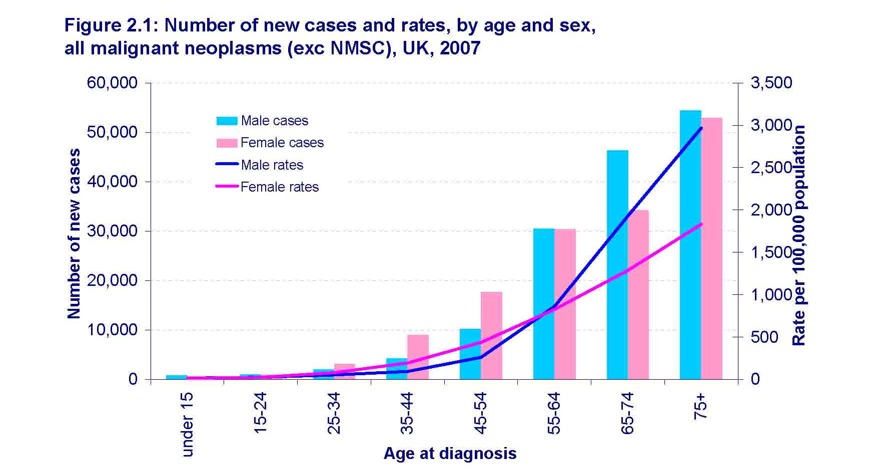
Cancer Statistics
About one third of us will have cancer
About two thirds of cancers are in people over 65
Source CRUK

Slide 30
Introduction
Cancer is a terrible condition
but there have been great advances in therapy
“ Radiotherapy remains a mainstay in the treatment of cancer. Comparison of the contribution towards cure by the major cancer treatment modalities shows that of those cured, 49% are cured by surgery, 40% by radiotherapy and 11% by chemotherapy”.
RCR document BFCO(03)3, (2003).
Radiotherapy is a very important weapon in the battle against cancer

Slide 31
Medical applications of accelerators
Oncology
  Protons, heavy ions, electrons
    Why so little interest in the UK?
Preparation of radio-nuclides
Requires precision control of
  Energy
  Dose
    Just like the linear collider (energy, luminosity)

Slide 32
tumour
100
80
SOBP
Dose (%)
60
40
Pristine peak
20
50
100
150
Depth (mm)

Slide 33
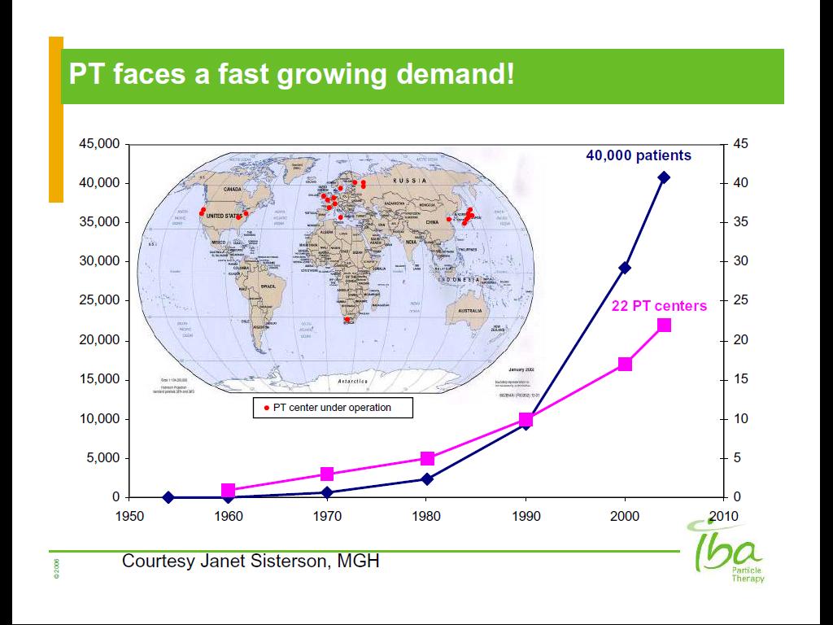
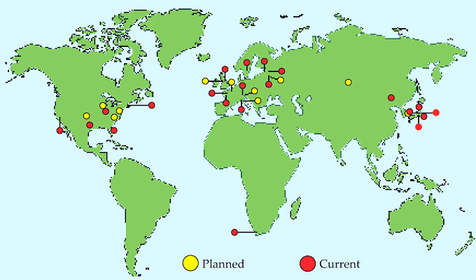
CPT worldwide
>78,000
(>68000 protons)
After Janet Sisterson, MGH
33
In Physics Laboratories
In Hospitals (mostly)
2010

Slide 34
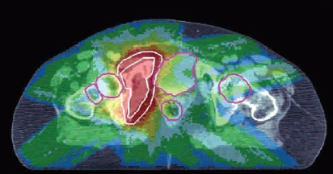
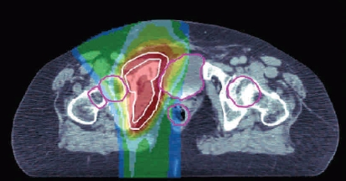

X-rays compared with protons
X-rays
protons

Slide 35
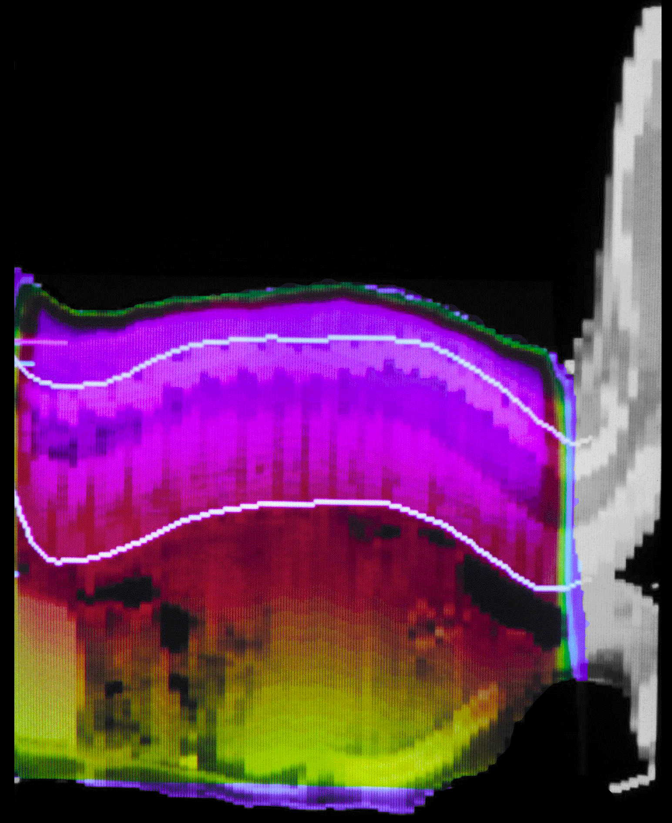
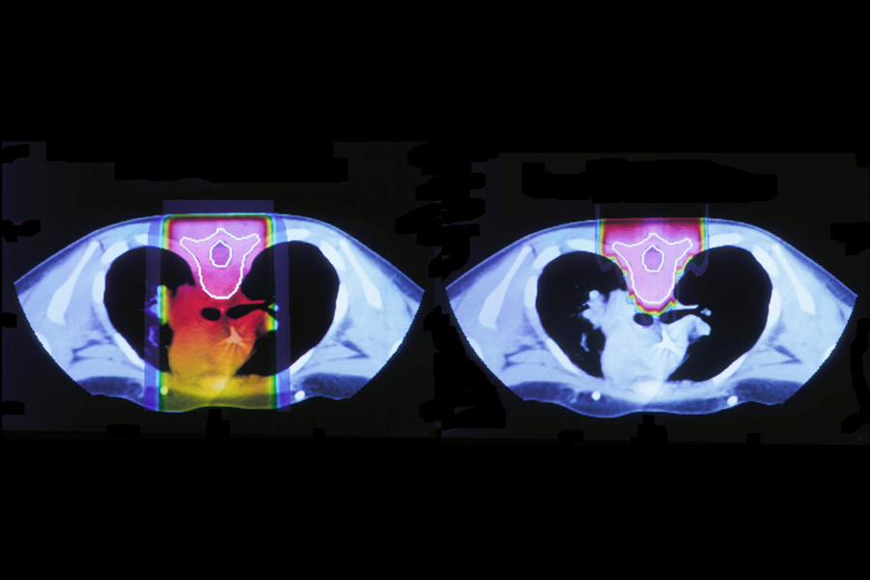
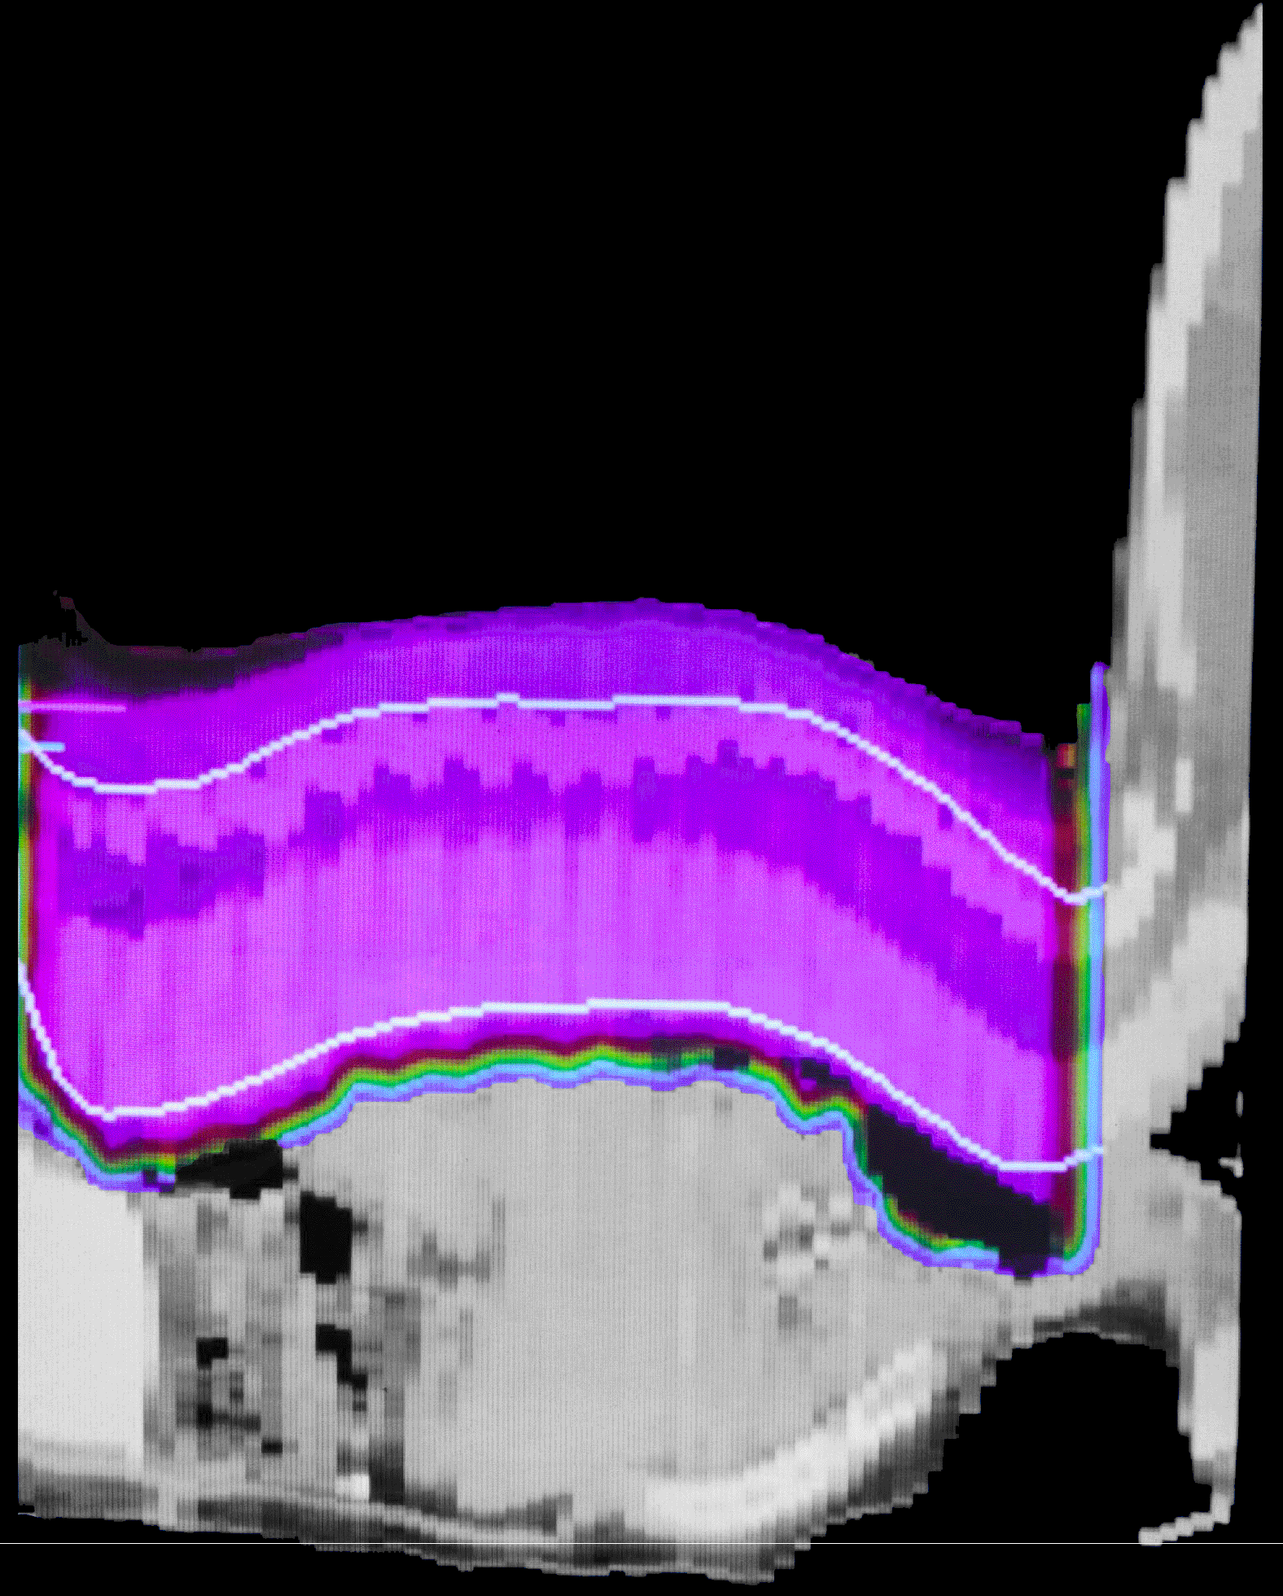
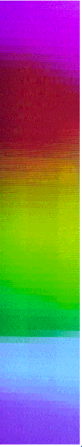
Medulloblastoma in a child
X-rays
100
60
10
With Protons

Slide 36
Beam Delivery - Scattering
Courtesy of T. Lomax, PSI, Switzerland.

Slide 37
Beam Delivery - Scanning
Parallel proton pencil beams are used (~3mm σ )
Sweeper magnets scan the target volume in transverse plane (steps of 4mm)
One litre target volume typically 10000 spots are deposited in less than 5min.
Beam direction
Target
Patient
Beam direction
Target
Patient
Notes:
parallel proton pencil beams are used (~3mm σ )
position and dose of each spot is chosen by the computer in the treatment planning system, individually for each spot
sweeper magnets are used to scan the target volume in transverse plane (steps of 4mm)
scanning depth is controlled by changing beam energies.
for one litre target volume typically 10000 spots are deposited in less than 5min.
dose distributions of complex shapes can be constructed with less entrance dose

Slide 38
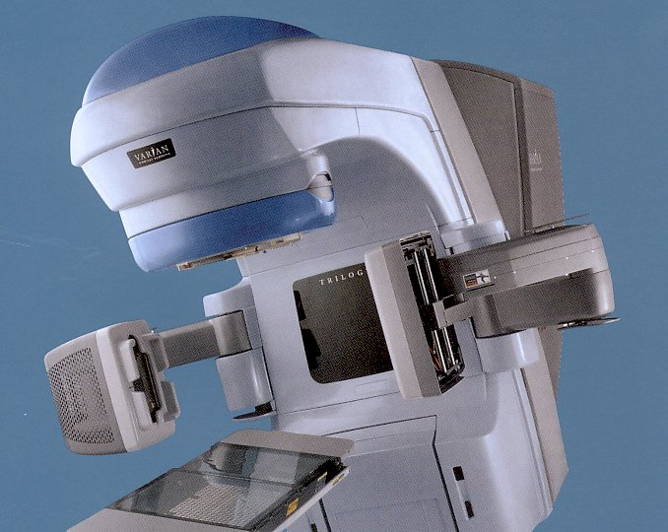
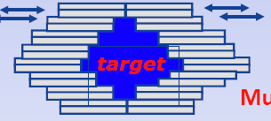
Linacs with on-Board Imaging
MLC
MV Beam
kV imager
kV X-ray tube
Remote
couch
control
MV EPID
Liz Macauley/ORHT

Slide 39
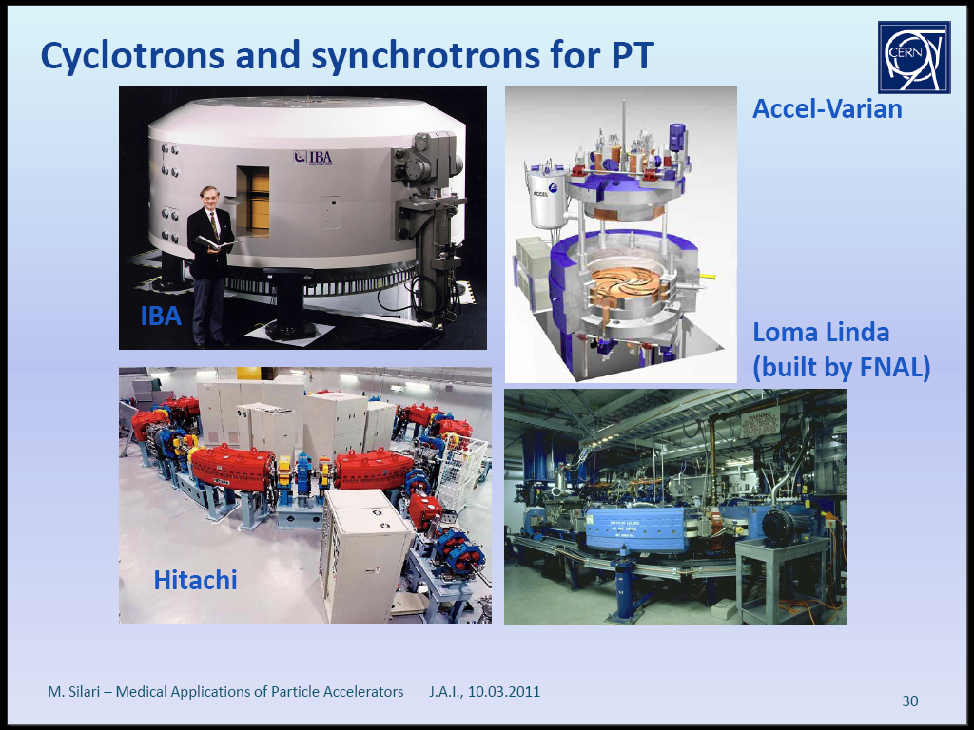
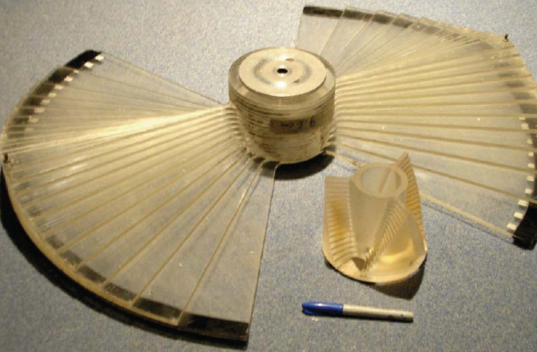
IBA & Varian cyclotrons
Cyclotrons are essentially fixed energy extraction

Slide 40
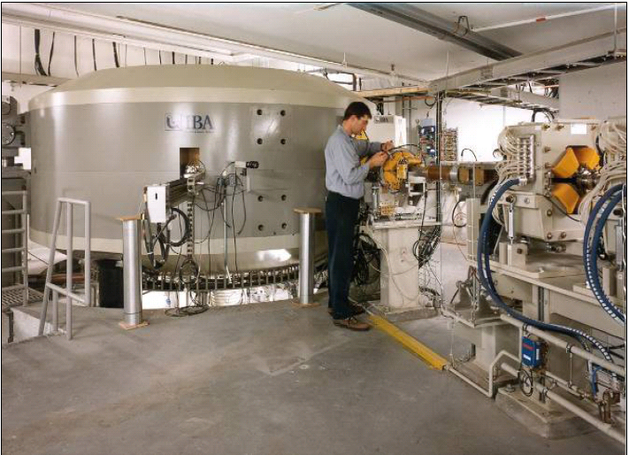
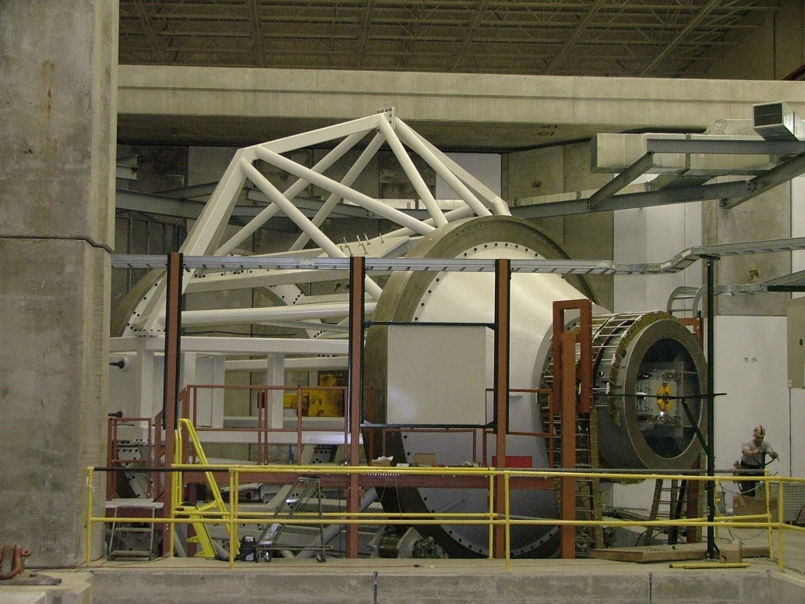
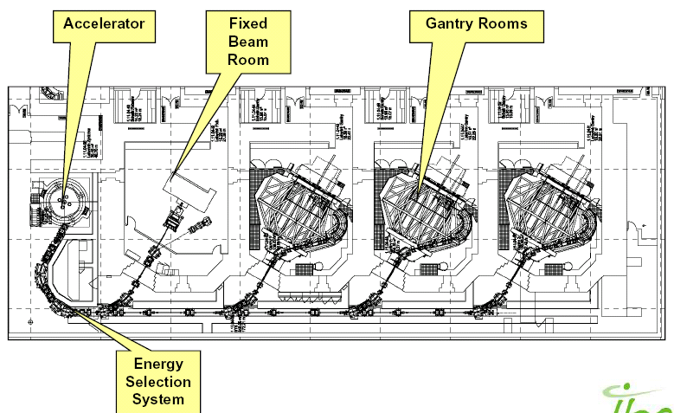
IBA
Courtesy Robert Proton Therapy Center, Penn
Courtesy IBA

Slide 41
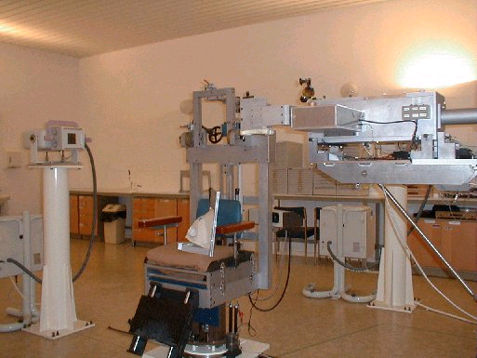
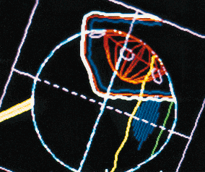
The Clatterbridge Centre for Oncology
Established 1989
  First hospital based proton therapy
  >1400 patients with ocular melanoma
  First example of 3D computer treatment planning in UK;
    eye gaze direction used to obtain best approach angle to eye.
Unsung success story of British Oncology!
After Bleddyn Jones

Slide 42
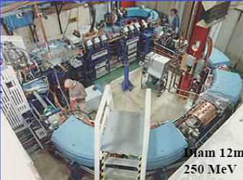
The Loma Linda Synchrotron
Loma Linda

Slide 43
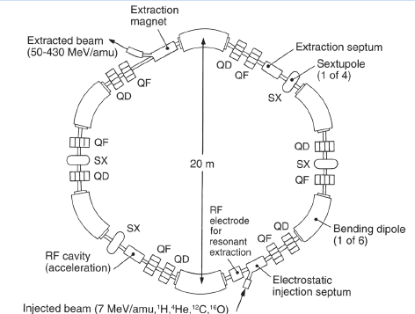
The Siemens Ion Synchrotron
Ramp down
acceleration
“flat top”
B(t)
Set-up
t
After Silari

Slide 44
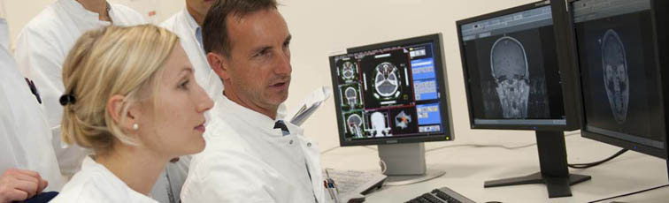
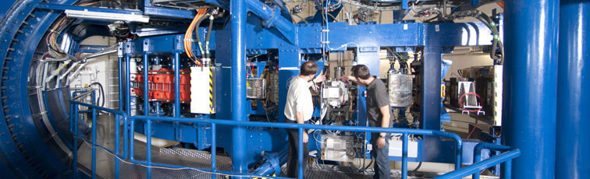



HIT in action
Courtesy HIT

Slide 45

PIMMS (CERN/TERA) Synchrotron Hall @ CNAO
Courtesy Amaldi
Ugo Amaldi/TERA

Slide 46
Radionuclides

Slide 47

Coulomb Barrier for p, d, ³He, ⁴He
From IAEA Technical report 468 (2009)

Slide 48

An example
From IAEA Technical report 468 (2009)

Slide 49

A list of 49 “useful” radionuclides
From IAEA Technical report 468 (2009)

Slide 50

IBA Cyclone 30

Slide 51


PET Scanning
Positron Emission Tomography
Excerpt of PET-CT clinical images from a 69-yrs old female with metastases in the pelvic area, evidenced by hypermetabolic spots, one near the sigmoid colon (at right), another in a lymphatic node (at left).

Slide 52



Brachytherapy
Little radioactive needles

Slide 53
Summary & Conclusions
Particle Accelerators were invented
  for nuclear and particle physics
but have been found to be useful
  for other sciences
    physical, life, earth, environment, medical
  for industry
    generating materials needed for today
  for health
    diagnostics and therapy
& they are fun too!

