Slide 1


Machine-Learning for residual gas analysing
Development of a Web-based application
Fernando Mateo Jimenez (IDAL)
Juan José GARCÈS-INIESTA (IDAL)
Berthold JENNINGER (CERN)
Berthold Jenninger
TE-VSC
VSC Seminar
Machine-Learning Web-application
22 March 2023

Slide 2
Introduction and context
Berthold JENNINGER
VSC Seminar
Machine-Learning Web-application
22 March 2023

Slide 3
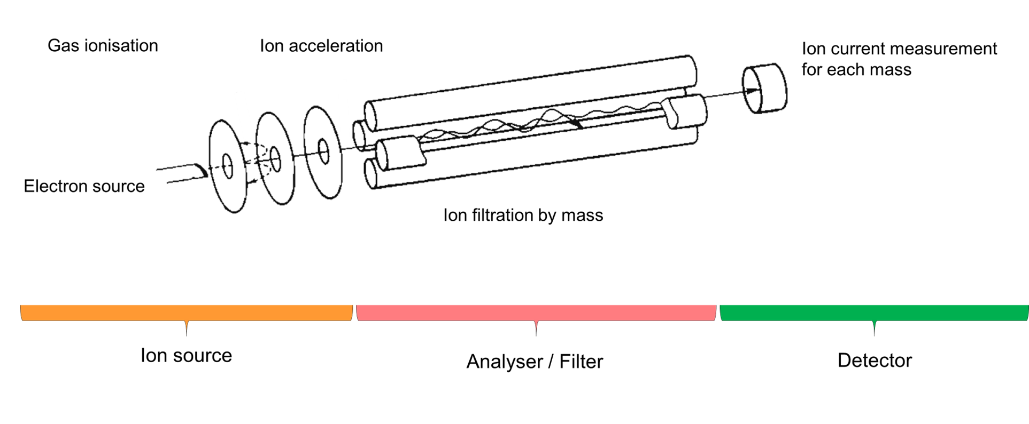
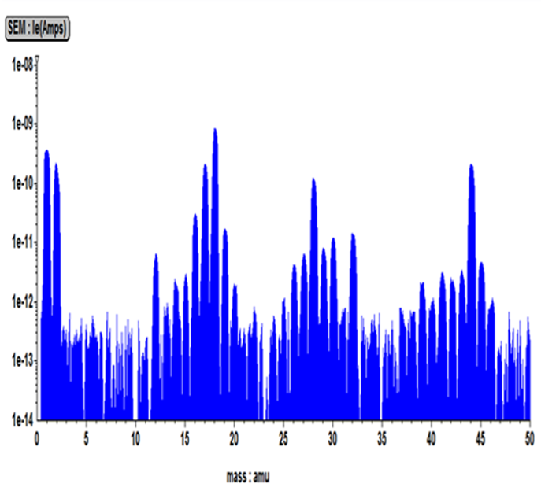
Residual gas analyser
Basic components of a quadrupole mass spectrometer
Fragmentation and ionisation by electron impact
Ion acceleration
Disentangle of spectrum required
(Quadrupole)
(SEM or Faraday cup)
Residual gas analyser: Rather compact and mobile mass spectrometers
Mass resolution of the order of 0.5 amu.
Mass range 1 … 100 amu.
VSC Seminar
Machine-Learning Web-application
22 March 2023

Slide 4
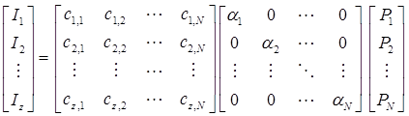

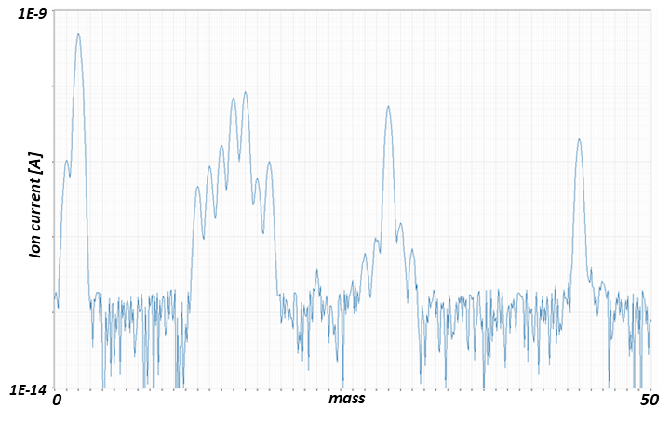
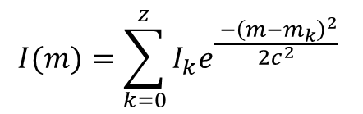

From Ion Current Spectrum to Partial Pressures
Fragmentation pattern database
Bar graph spectrum
With Gaussian around each peak
Analogue spectrum
$$I(m)=\sum_{k=0}^{z}{I_{k}e^{\frac{ {−\left(m−m_{k}\right)}^{2}}{2c^{2}}} }$$
$$+I_{offs}+I_{noise}$$
VSC Seminar
Machine-Learning Web-application
22 March 2023

Slide 5
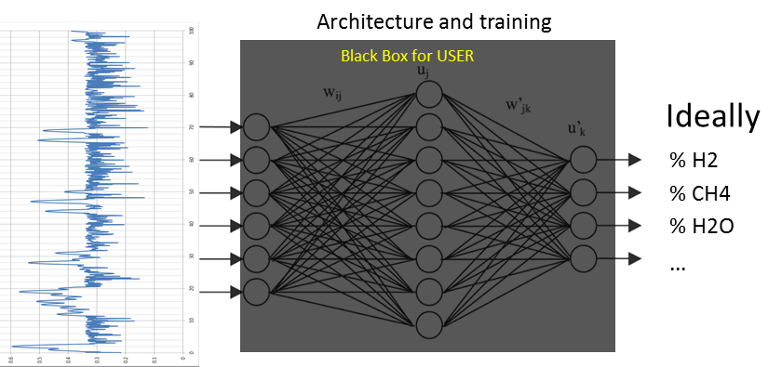

From Ion Current Spectrum to Partial Pressures
Simulations
automatic
Iterative deconvolution (CERN)
(in logarithmic scale)
Both need rapid simulation of thousands of mass spectra
Machine-Learning
Recognition of residual gas composition by pattern
Deconvolution:
Identify composition and determine partial pressures
Extensive training with random simulated spectra
Comparison: measured and simulated spectra
Variation of partial pressures -> simulate spectrum -> determine error
Search: Global Minimum Integral Error
Error calculation and ML training in normalized scale
$$I_{norm}=\frac{Log\left(I\right)+16}{10}$$
VSC Seminar
Machine-Learning Web-application
22 March 2023

Slide 6
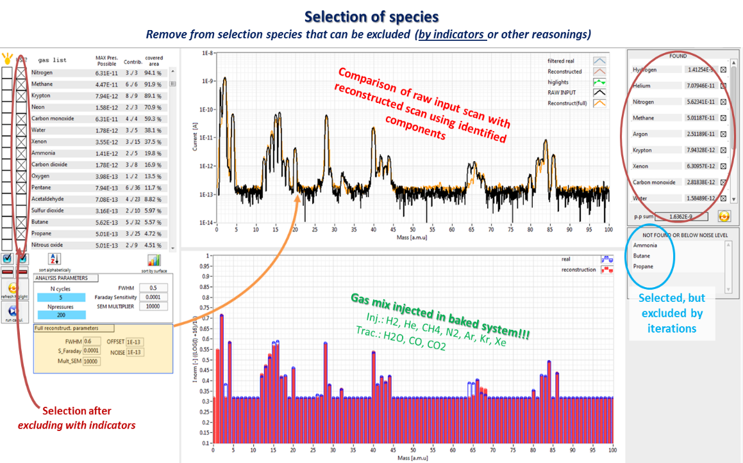
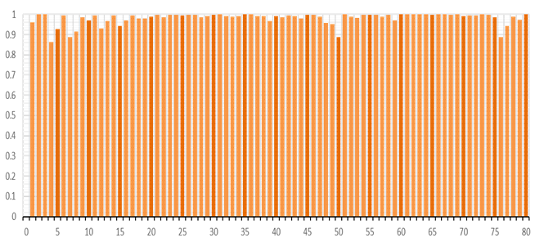
Results of feasibility studies
Iterative deconvolution approach
Machine-Learning approach
CERN-IDAL collaboration KE3129/TE (2019)
Application:
\\cern.ch\dfs\Services\PMA\Vacuum\MAST
Intelligent Data Analysing Laboratory (IDAL)
Publication:
https://doi.org/10.1016/j.vacuum.2020.109876
(Feasibility study)
Prototype application (in LabVIEW)
Summarising report:
https://cds.cern.ch/record/2740627
Publication in ESWA-journal:
https://doi.org/10.1016/j.eswa.2021.114959
AUC performance
Performance
Gas label (species)
Very fast reconstruction with identified components
Training sets: 50000 random spectra
Can be applied to a full library for identification
(in combination with indicators)
Both approaches proof valuable and are complementary
Learning rate: 0.1
Test set: 50000 random spectra
Iterations: 80000 simulations + error calculation: 6 seconds
Impressive in identification of complex molecules
(80 species, 5 iterations, 10 decades, 20 pp-steps per decade)
VSC Seminar
Machine-Learning Web-application
22 March 2023

Slide 7
Feasibility study:
-
Did not include noise and offset.
Old agreement KE3129/TE
-
Perfect match with NIST fragmentation patterns
-
Small fragmentation pattern database
NEW collaboration with IDAL
Agreement KE4557 TE
Objectives:
- Studies with noise (cut-off limits)
- Studies fragmentations of compositions in spectrum does not fit NIST references
- Behaviour when species are in spectrum are not in the reference database
- Increase fragmentation patter database > 200 species
- Develop a web-based tool that combines both the two approaches :
- Machine-Learning
- Iterative Deconvolution
VSC Seminar
Machine-Learning Web-application
22 March 2023

Slide 8
Fernando:
- Introduce Machine-Learning (ML)
- Features of the tool
Juan José:
- Demonstration of use of the application
Berthold:
- Tests from CERN (view of a user)
VSC Seminar
Machine-Learning Web-application
22 March 2023

