Slide 1
SPS EYETS 2024
A. Harrison
TE-VSC-IVO

Slide 2
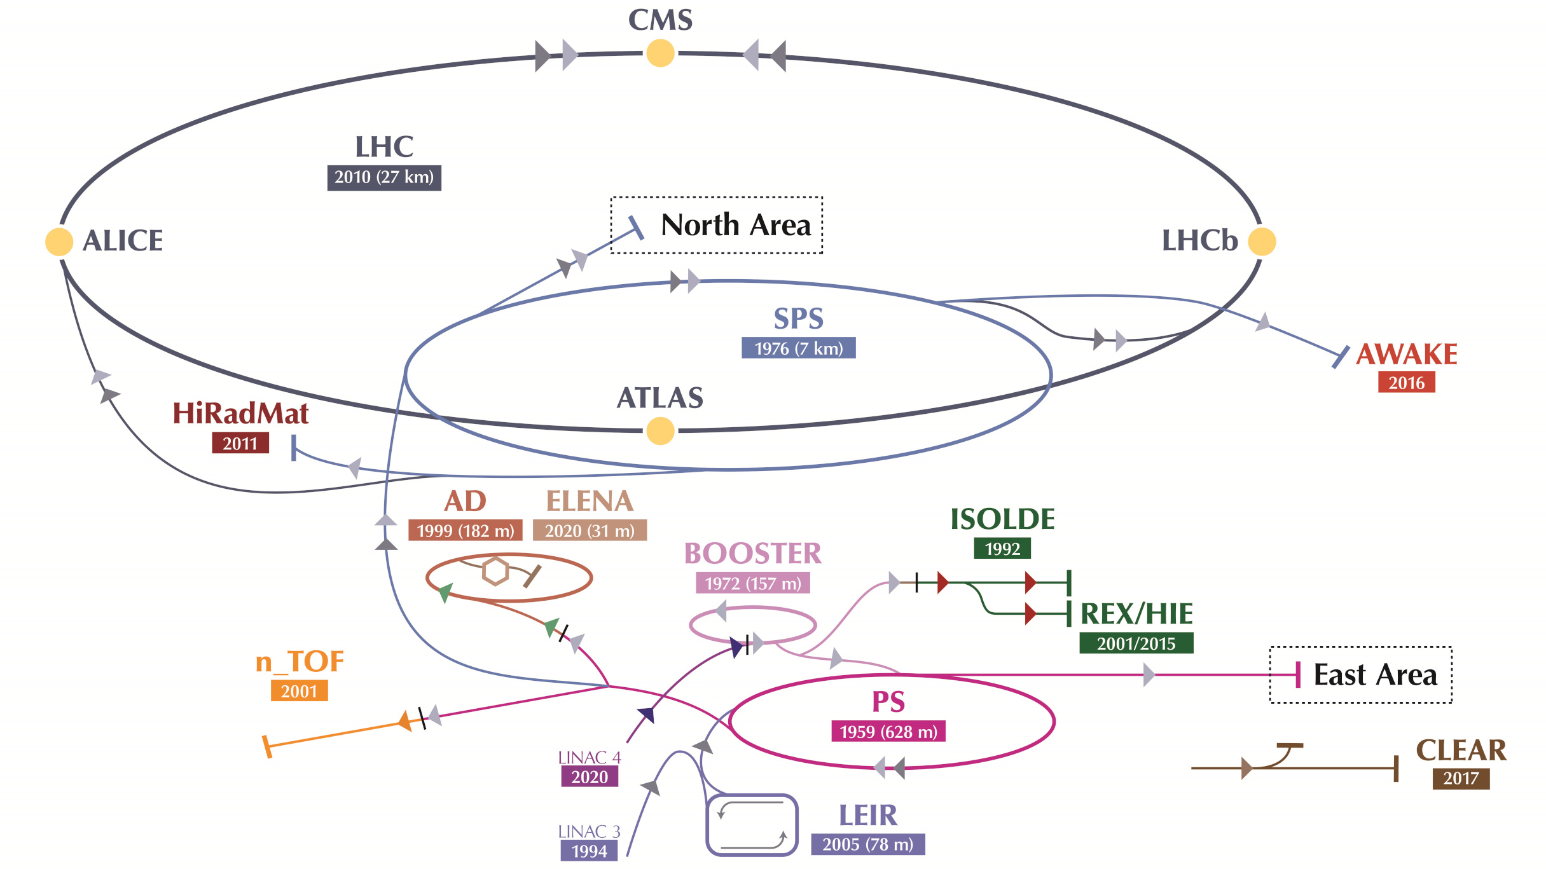
Accelerator overview
Notes:
LINAC (H-) up to 160MeV
PSB (2 electrons stripped) up to 2GeV
PS up to 26GeV
7km ring
~8km Transfer Lines
From 26GeV up to 450GeV
1317 normal conducting magnets
1521 Ion pumps
Ring experiments COLDEX, UA9 & CRAB
Feeds: North Area physics, AWAKE, HiRadMat also injects into LHC in both directions (Ti2 Blue clockwise and Ti8 Red anticlockwise)

Slide 3
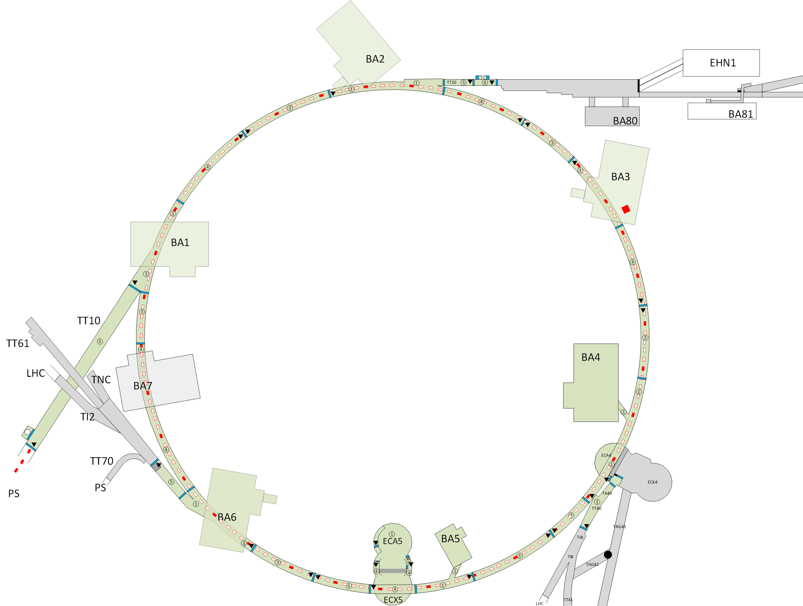
SPS Overview
BSGV 210350,
Spill Monitor.
Aperture improvement BPCN,
Layout improvement BPNC.
MST leak detection.
Ion pump consolidation,
Layout improvement BPVC,
De-cabling.
RF Cavity leak detection
Mode Trap
TT66 windows upgrade
TED upgrade
Vacuum Primary Line
Fast Wire Scanners
EO Pick-up
De-cabling
Fast Wire Scanners
BGI & re-sectorisation
Pumping Port Shielding
Aperture improvement BPCN,
Re-sectorisation MKE06,
Crab Cavities removal.
AWAKE
Notes:
Slide to be updated

Slide 4
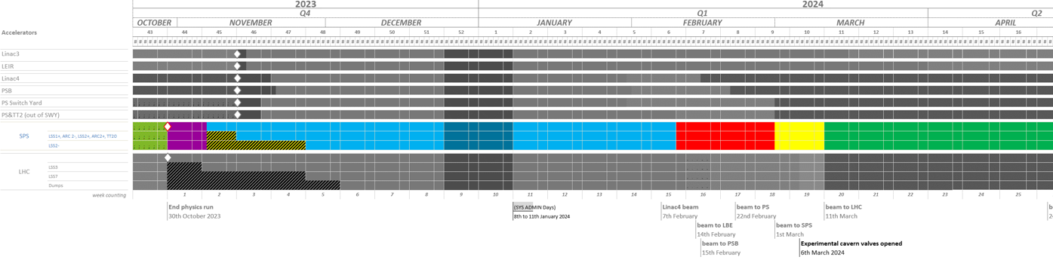
SPS – EYETS & Schedule
  Extended Year End Technical Stop (EYETS) 2023/2024.
  Maintenance and upgrade of the accelerators.
  SPS From 31st November 2023 to 9th February 2024
  (general access from 07/11/2023 to 31/01/2024)
65 working days / 15 weeks including CERN closure
43 working days
RP Cooldown
30.10.2023
09.02.2023
IST (Begin of EYETS)
IST (End of EYETS)

Slide 5
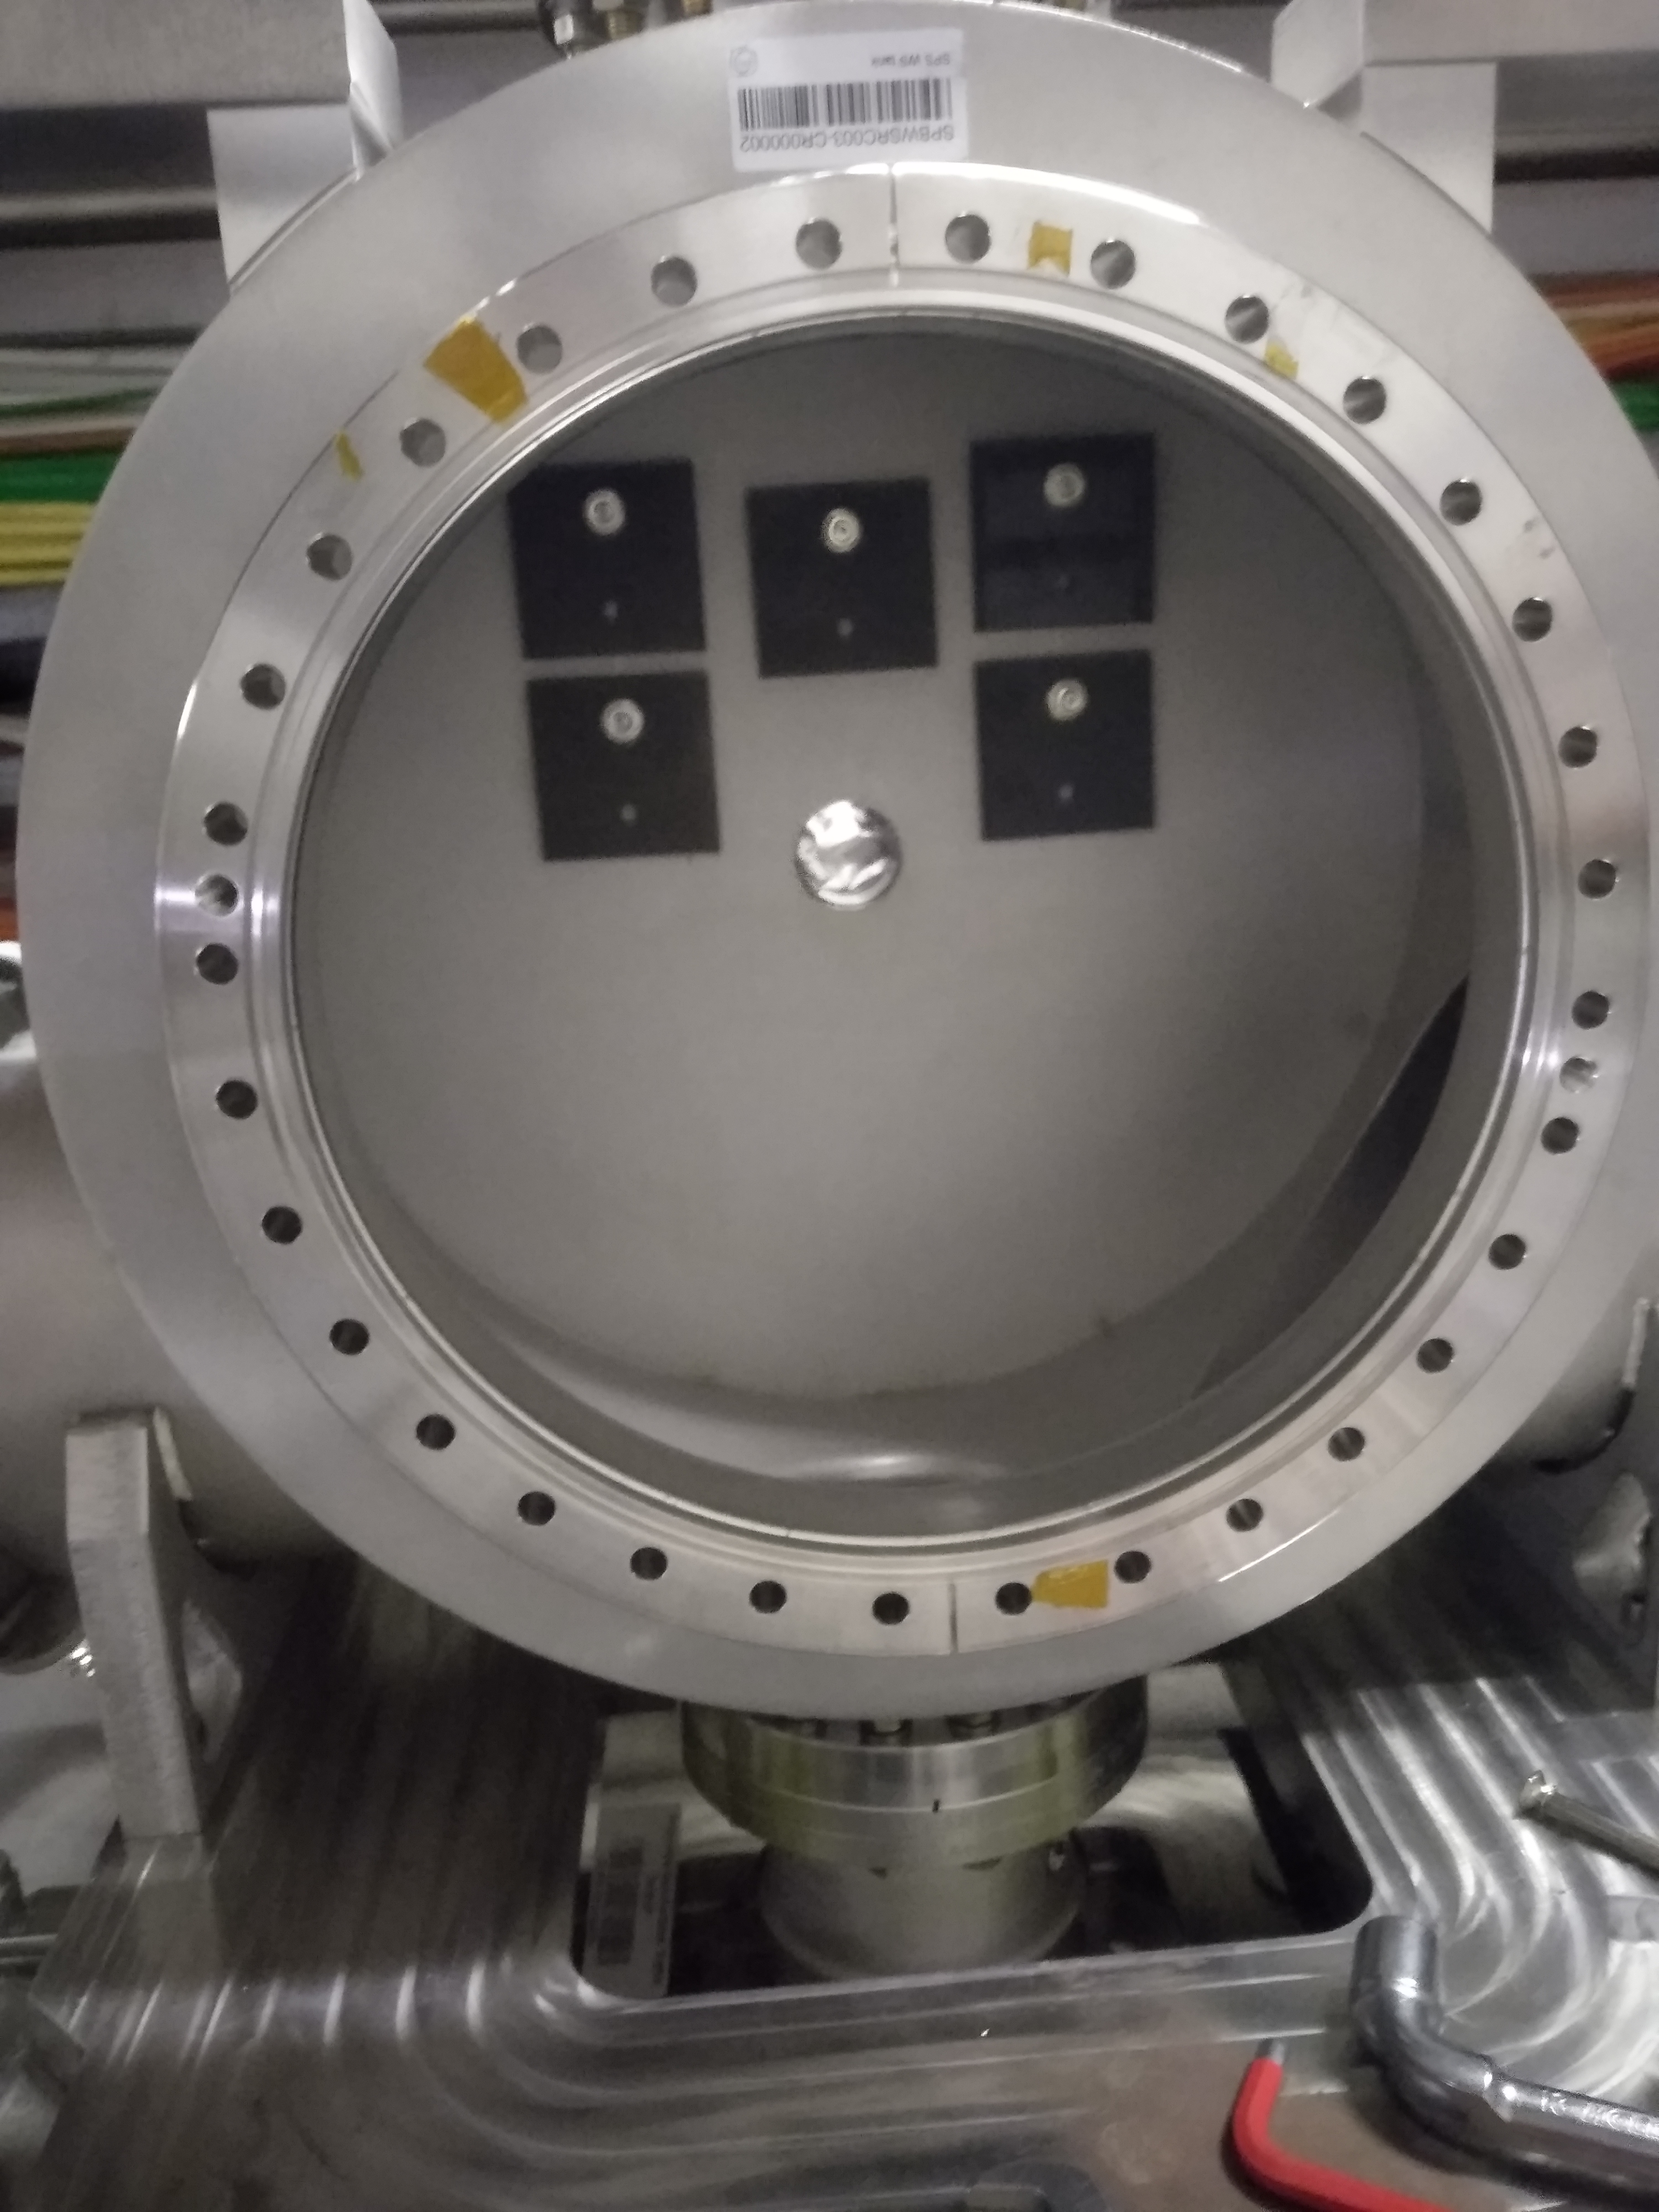
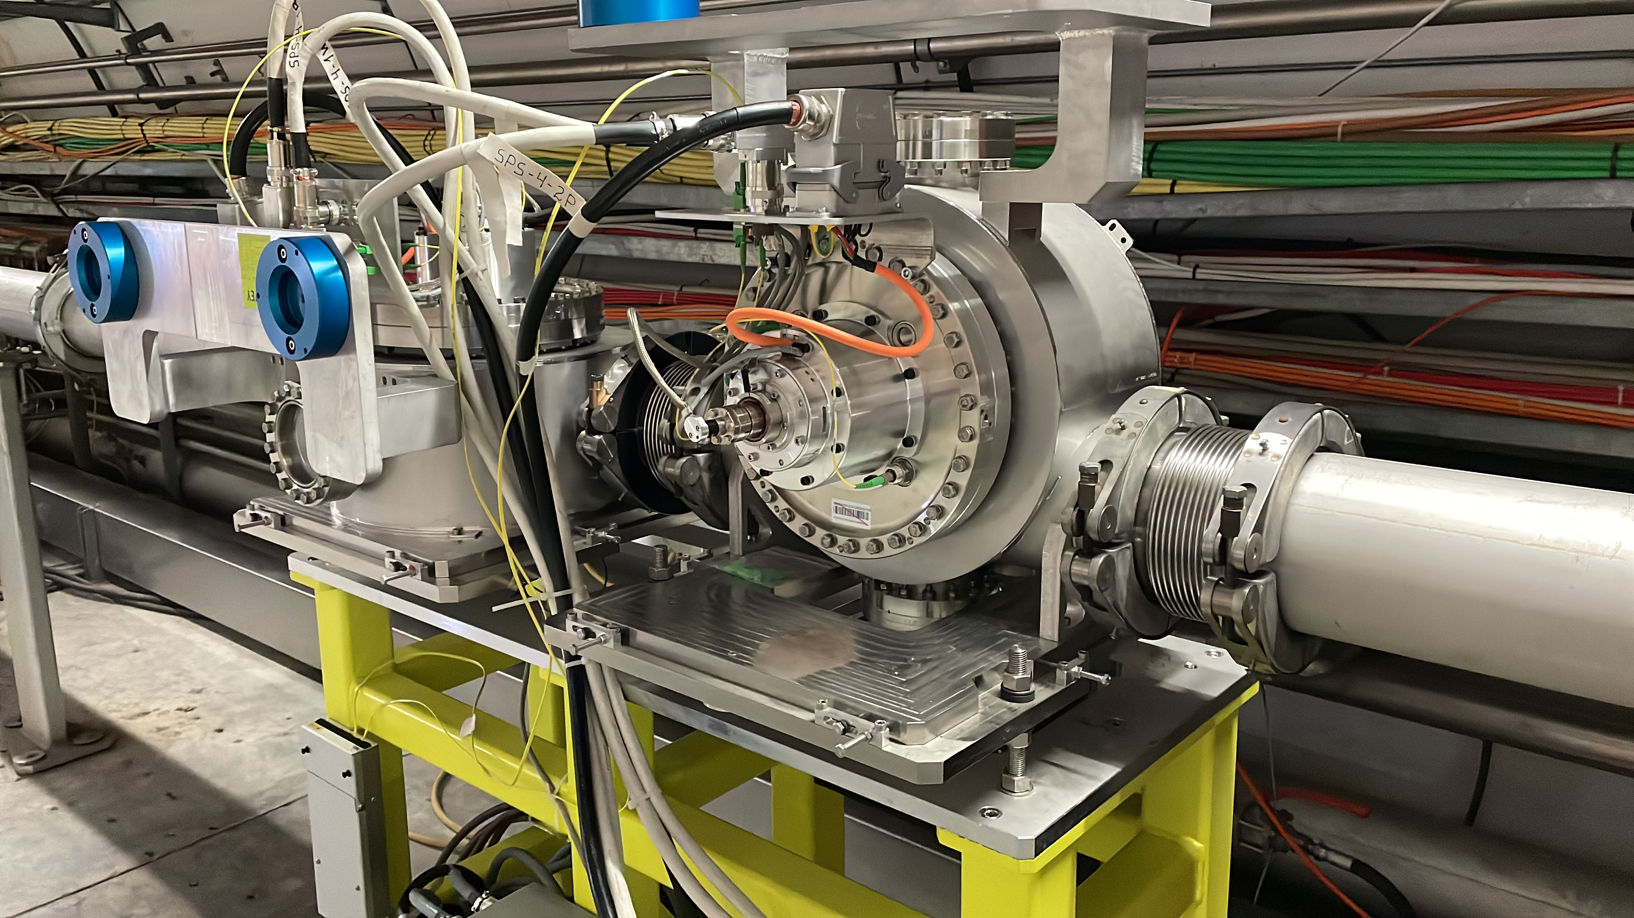
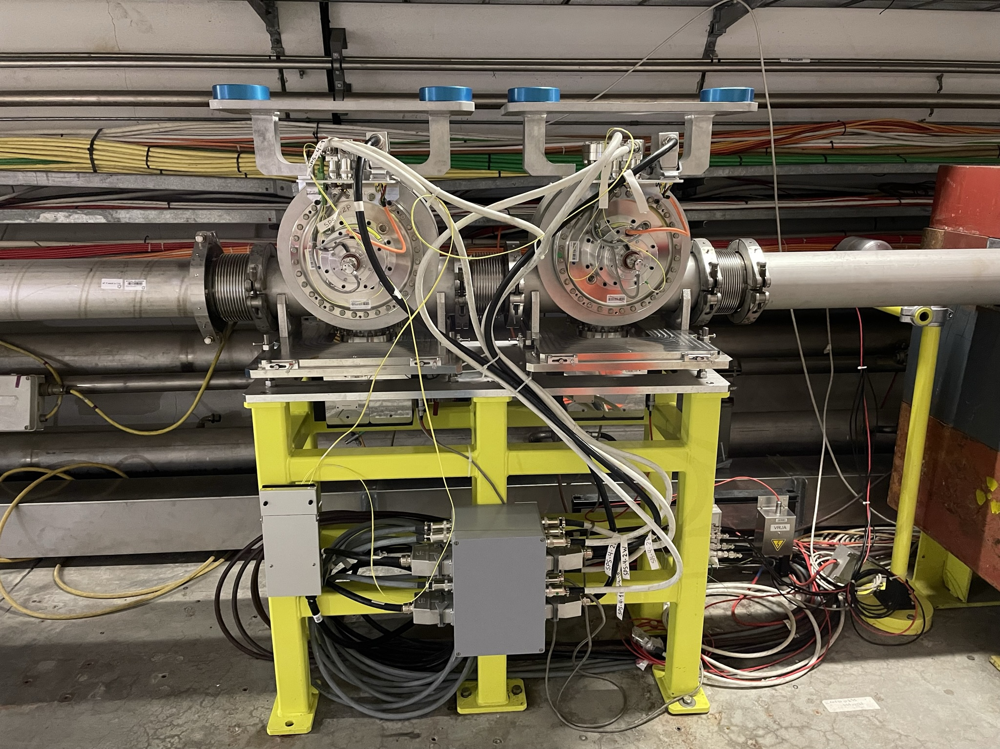
Fast Wire Scanners
ECR: SPS-BWSRC-EC-0003
During physics run all 4x Wire Scanners carbon wires broke, a Task Force found beam impedance induced high temperatures on carbon wire.
  April - intervention to replace 2x BA4 wire scanners, both failed within several days.
  TS1 2x Wire scanners replaced BA4; 1x Horizontal, 1x vertical including 6x ferrite tiles to dampen beam impedance.
EYETS – replace all 4x scanners, returning to original configuration and install ferrite modification.
Modified configuration (horizontal/vertical)
BA4 Original configuration (vertical)
Ferrite tiles
Notes:
Measurement of Transversal beam profiles – BA5 horizontal and BA4 vertical
Broke in parking position (out of the beam)
Failed 12th April, replaced 19th April, failed again 21st April.
Induced temperature up to 1700°C

Slide 6
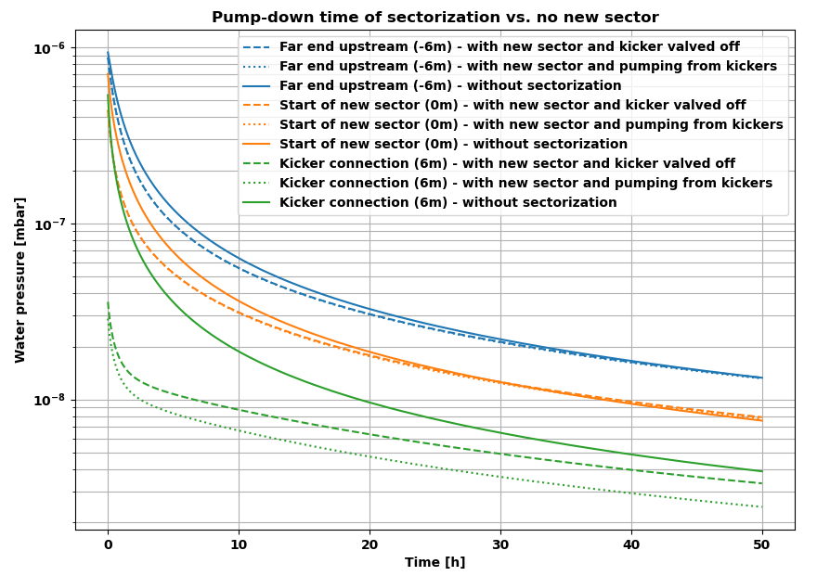
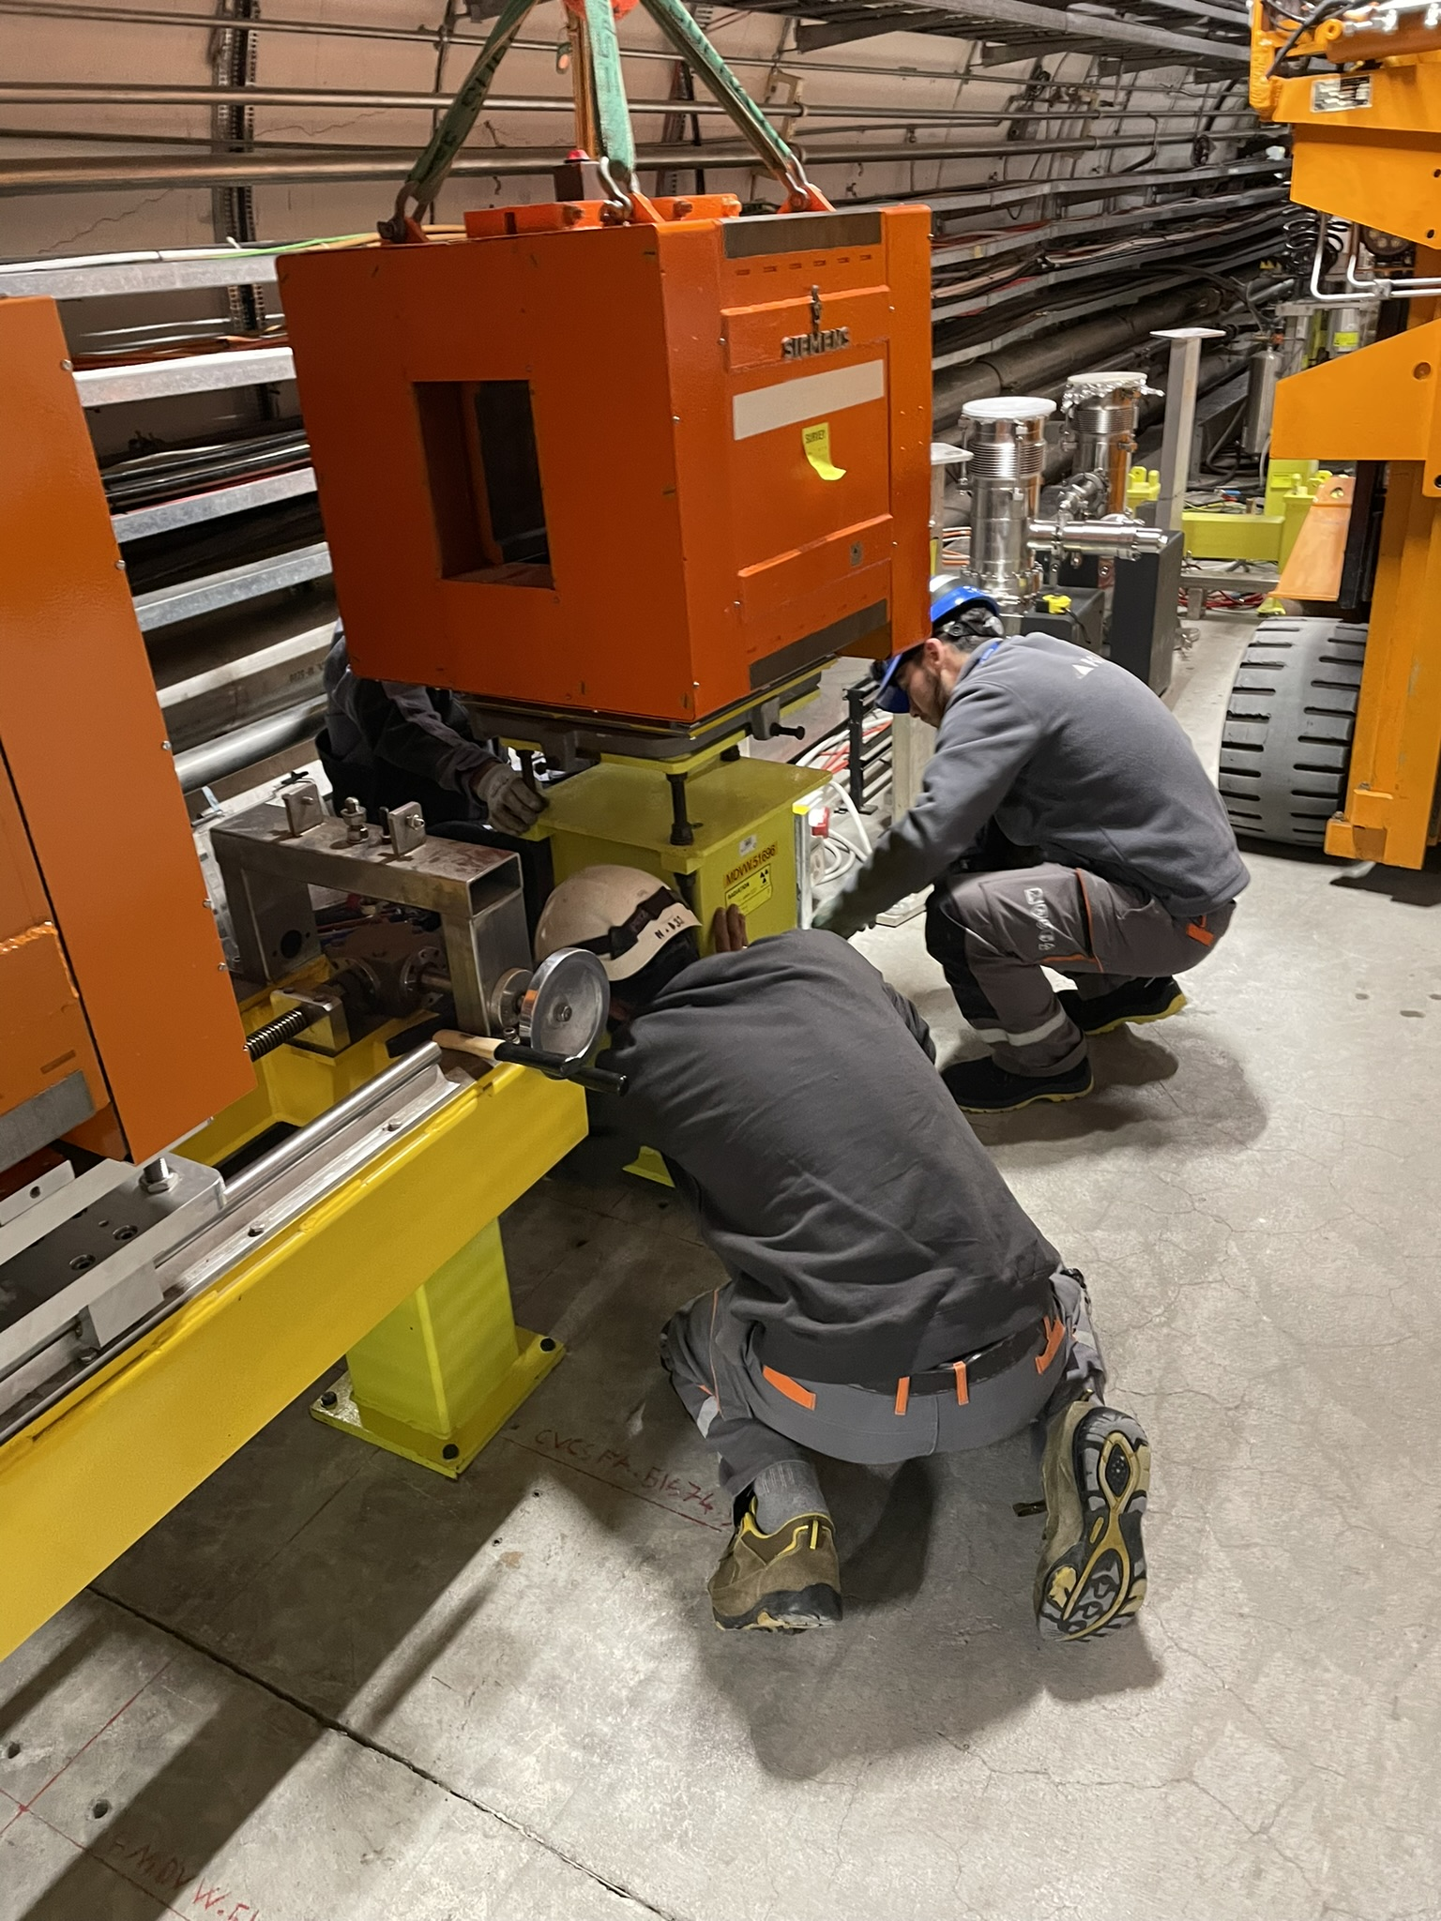
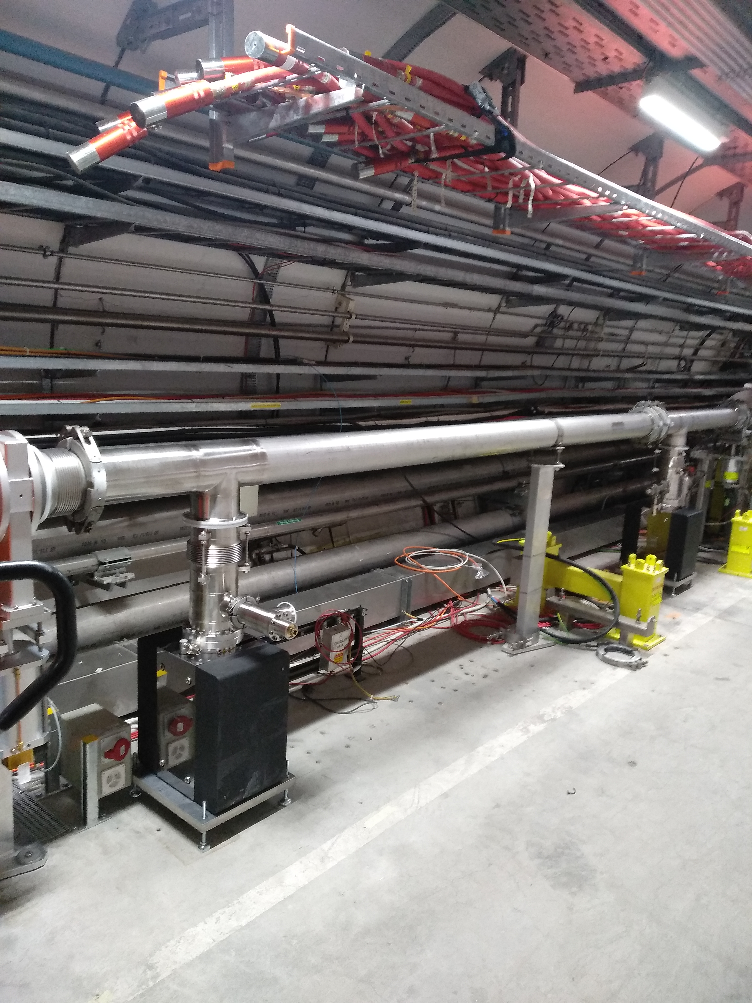
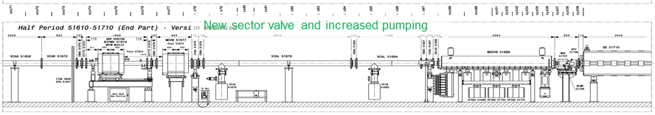
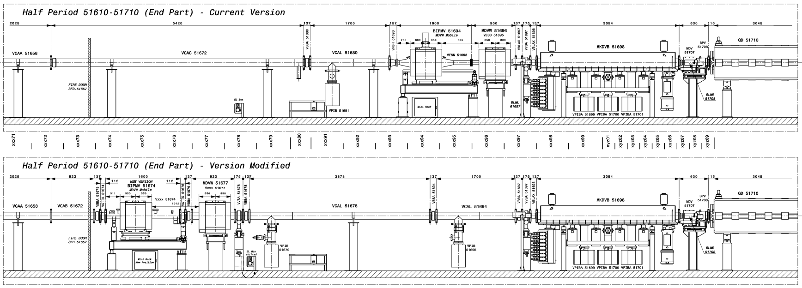
BGI & re-sectorisation
High degassing equipment next to sensitive MKDV.
Simulations to determine acceptable buffer sector length - maintaining 24h recovery after intervention.
New sector & layout.
COMSOL simulation using Temkin adsorption isotherm
(thanks to Anke Stoeltzel!)
6.5m downstream
ECR: SPS-BGI-EC-0001
Notes:
Animations!
Both Wire Scanner and BGI measure Beam Transverse Profiles, the difference is BGI has no limits with Beam energies whereas the Wire would sublimate at higher energies of LHC
Sector opening pressure of 1e-6mbar, with the buffer sector pressure of 1e-8 mbar
Sticking 1e-3, nm=4.9e19 molecules/m^2, E0=28.43 and E1=10 kcal/mol, s0=1
The linearized form of the Temkin isotherm equation is as follows: [ q_e = B \ln(A + B \cdot C_e) ] where:
(q_e) represents the amount of adsorbate at equilibrium (in mg/g).
(A) and (B) are the Temkin isotherm constants (in L/g and J/mol, respectively).
(C_e) denotes the equilibrium concentration of the adsorbate on the adsorbent.

Slide 7
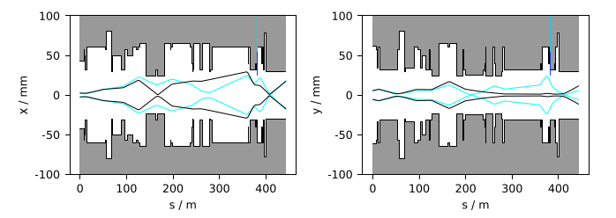
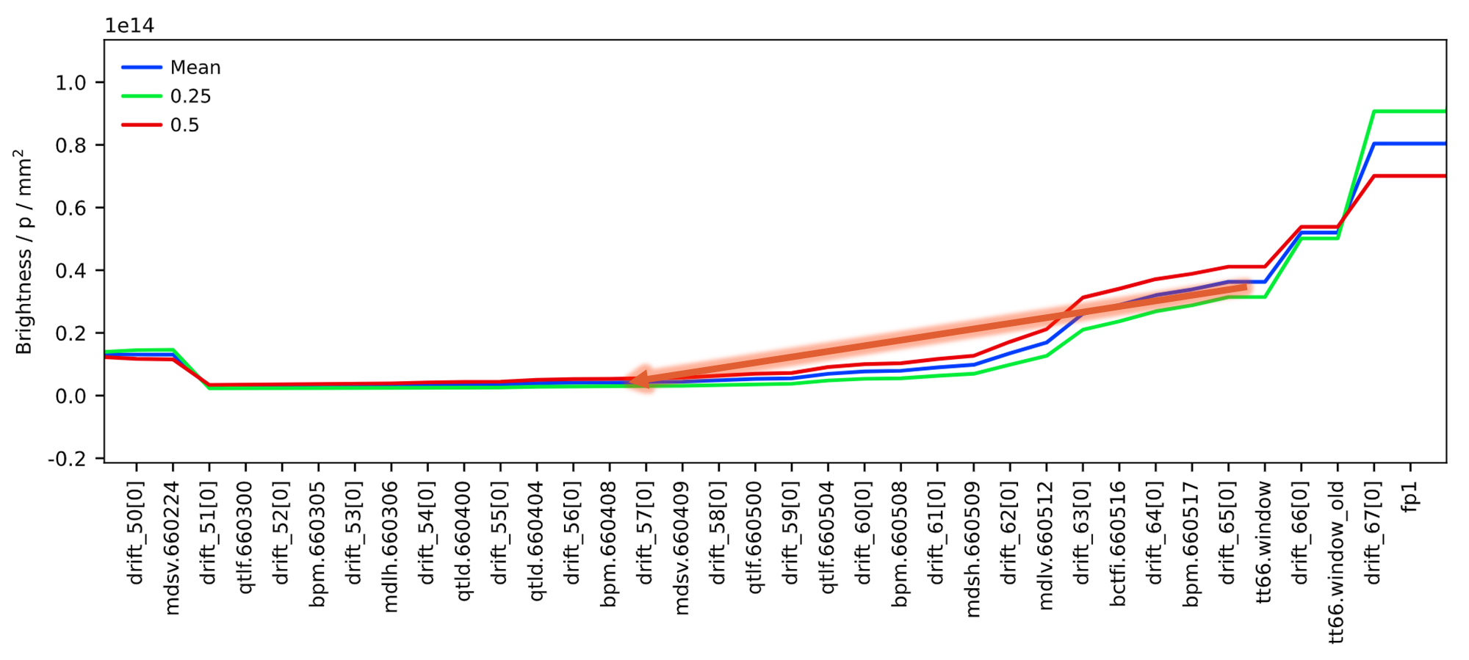
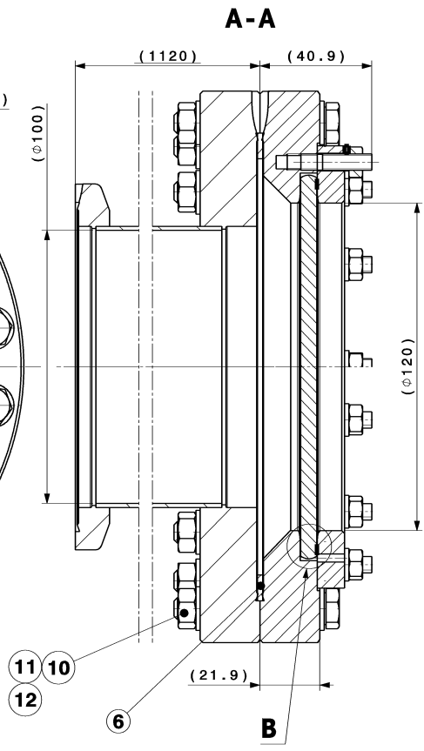
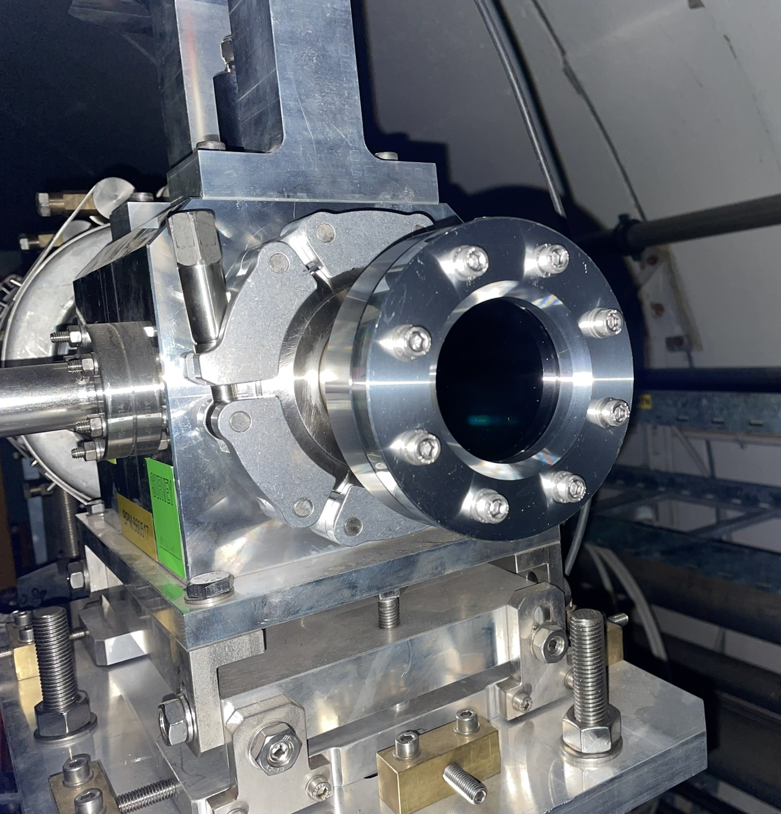
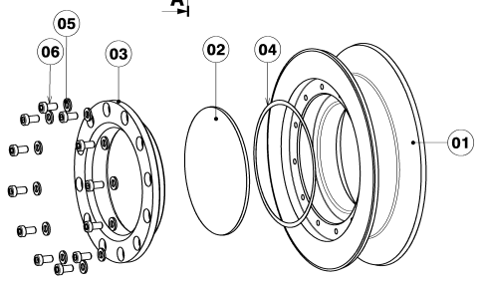
HiRadMat upgrades
ECR: HRM-V-EC-0002
Glassy carbon windows
- Beryllium window failures due to higher intensity beam
- Recommendation from HRM-Be-WG.
- Re-sectorisation of TT66 using in-line GC window.
- Replacement of Beryllium window with GC.
TT66 aperture simulation
Beam Brightness
Aperture >Ø70mm for future beams.
Position 660418 lower beam brightness.
In-line Ø100mm, 3mm Glassy Carbon.
End window Ø60mm x 3mm Glassy Carbon.
Notes:
Animations!

Slide 8
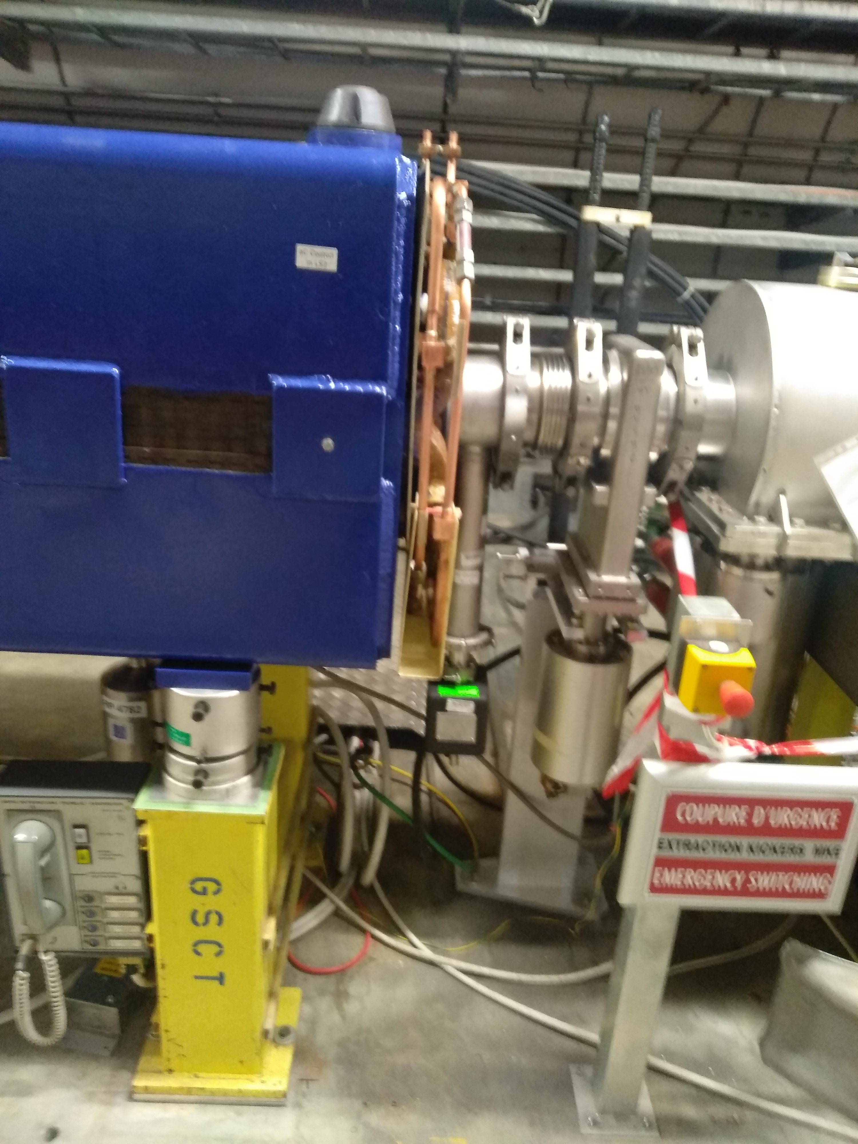
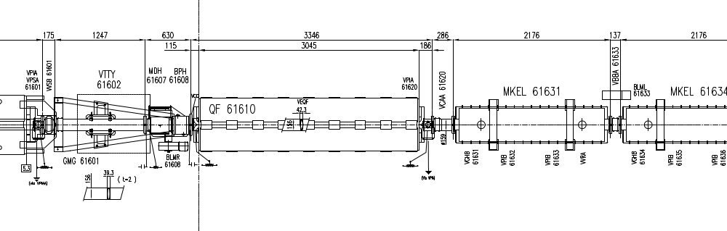
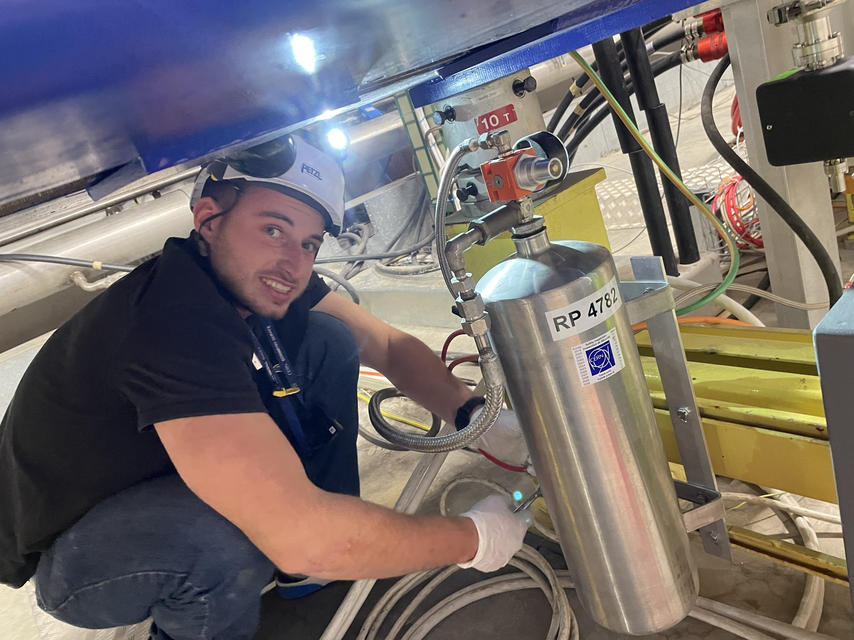
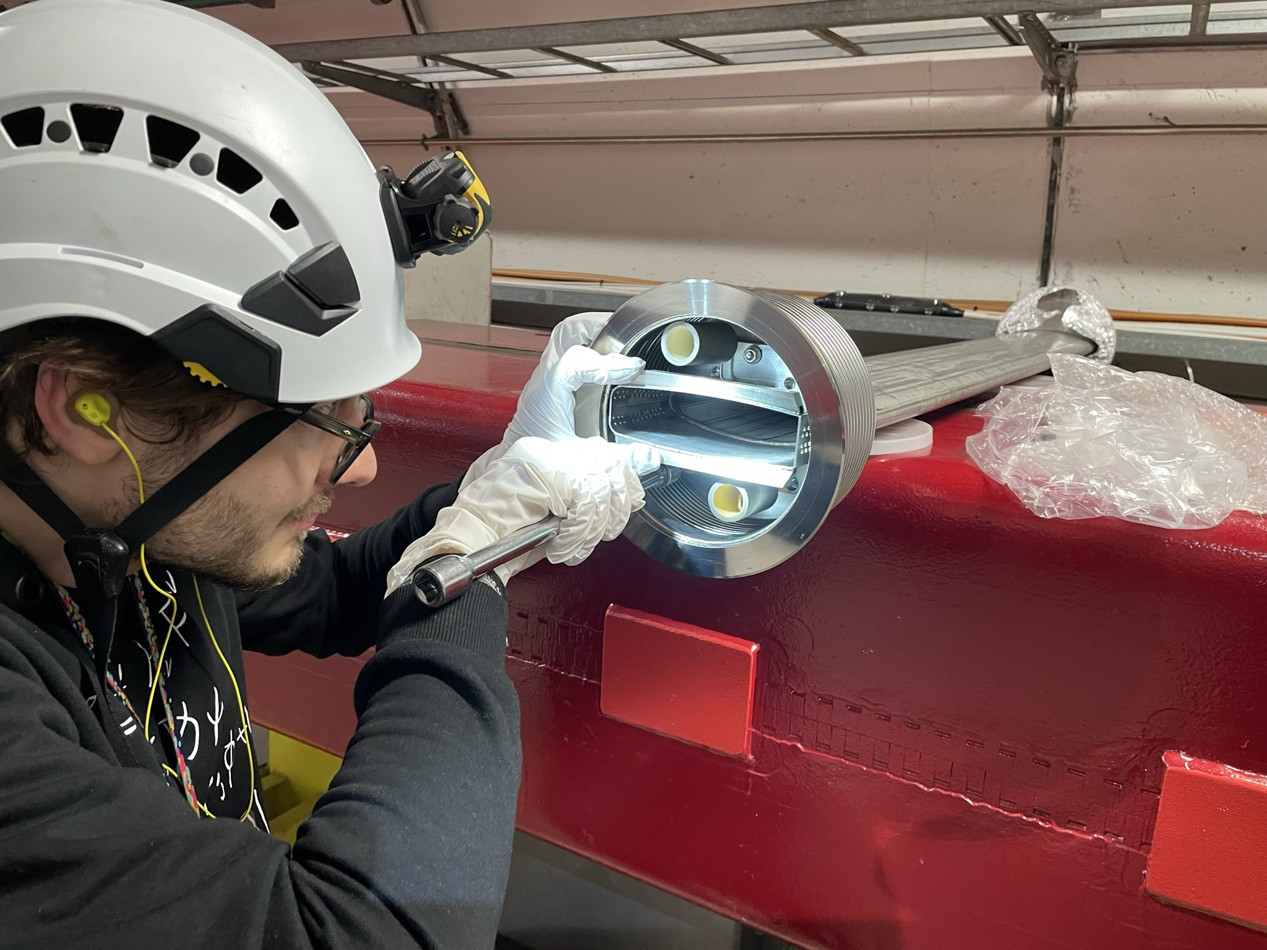
MKE Re-sectorisation
Re-locating the sector valve to liberate QD_61610 from MKE sector.
QF.61610 magnet exchange for a-C coated.
Impedance improvement and PU Jacks exchanged.
ECR: SPS-VVS-EC-0001

Slide 9
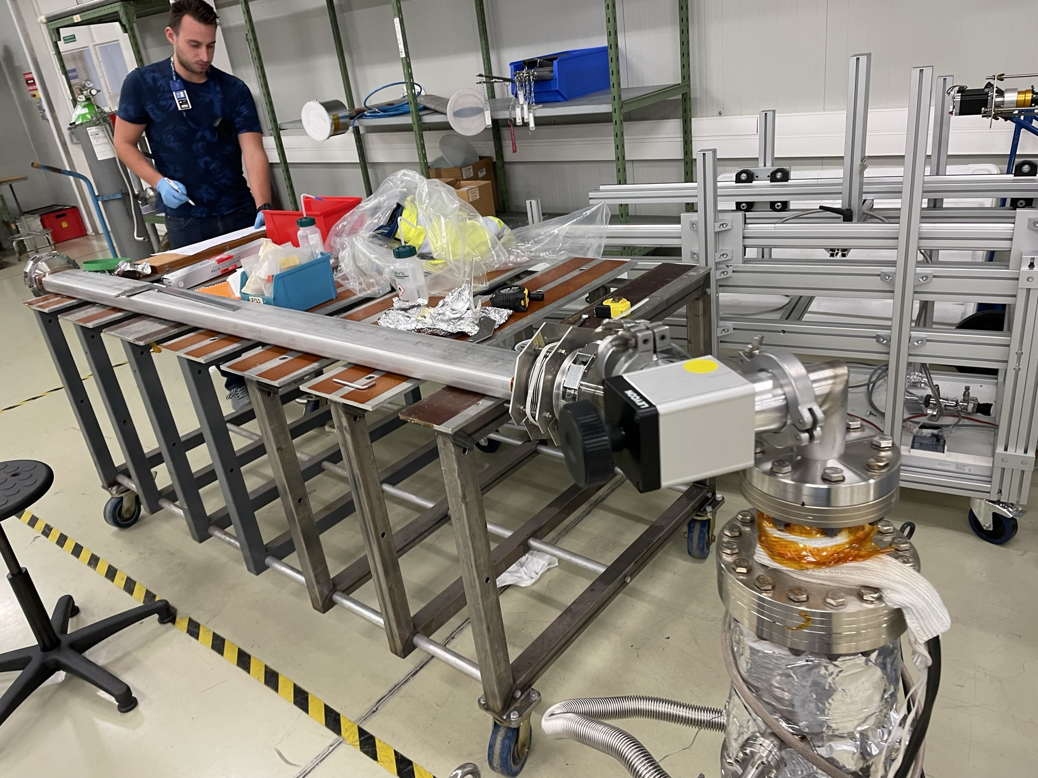
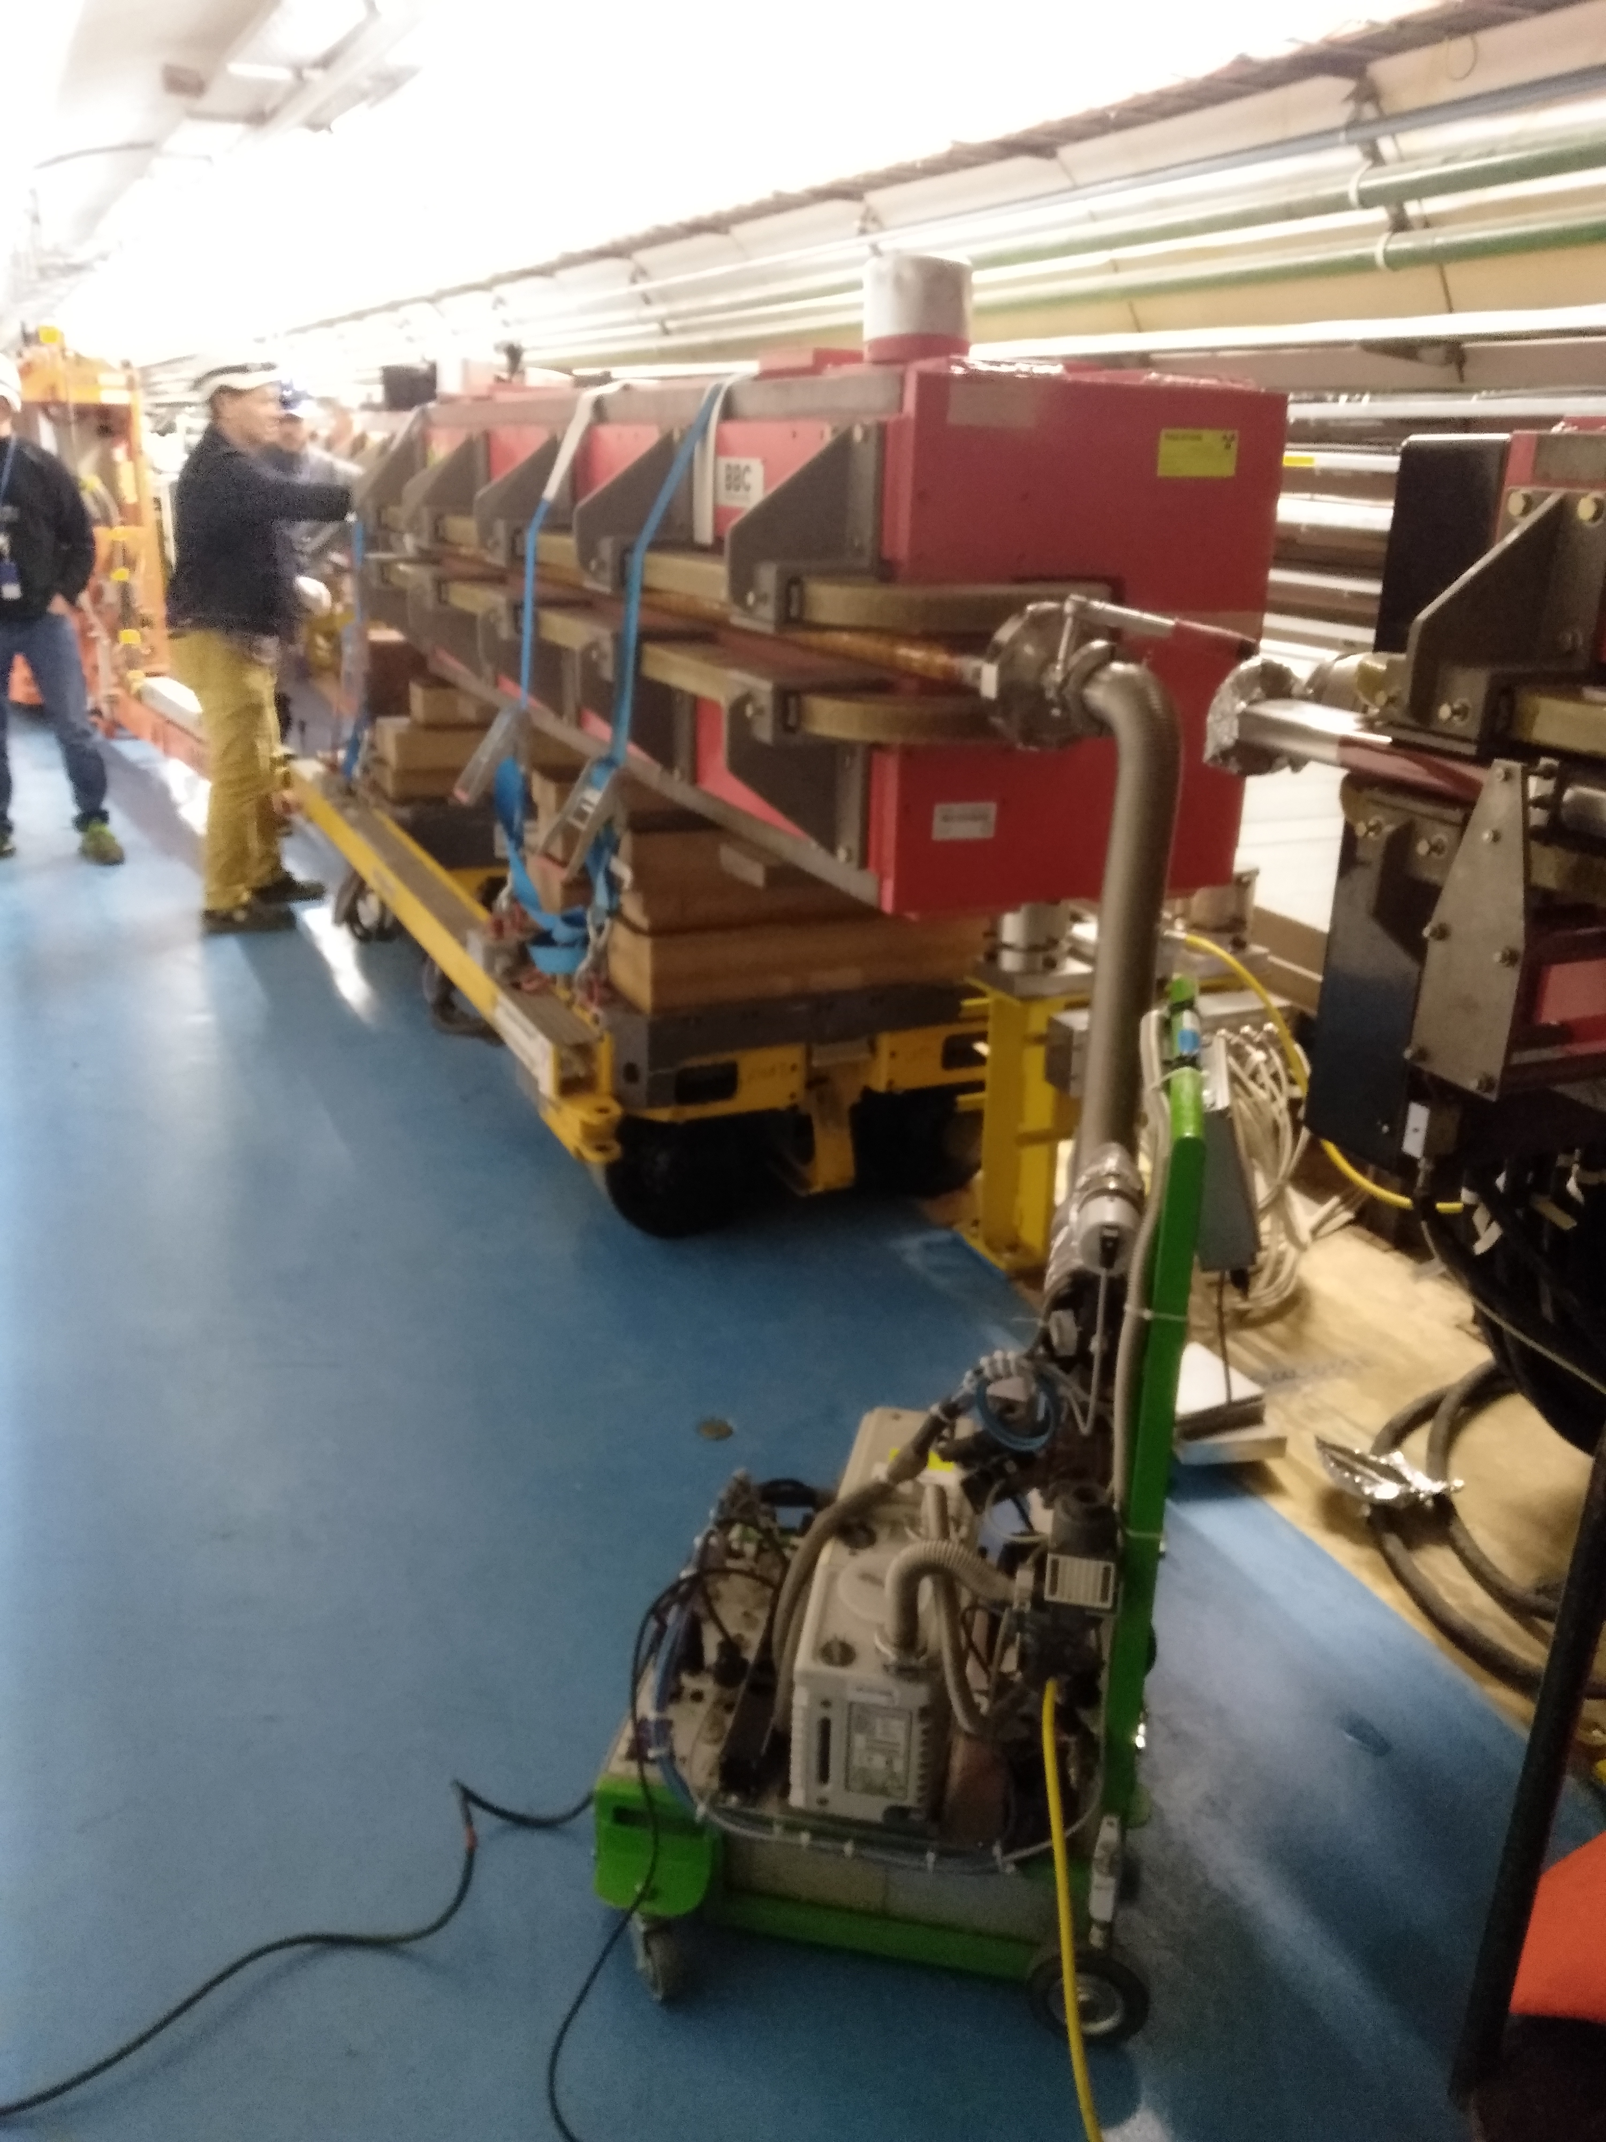
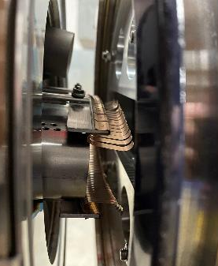
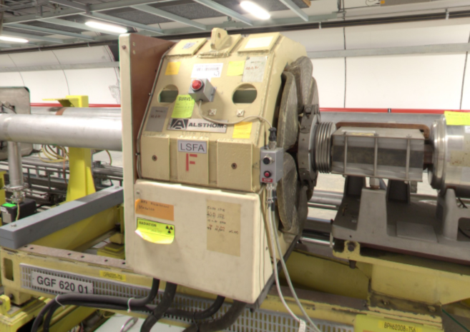
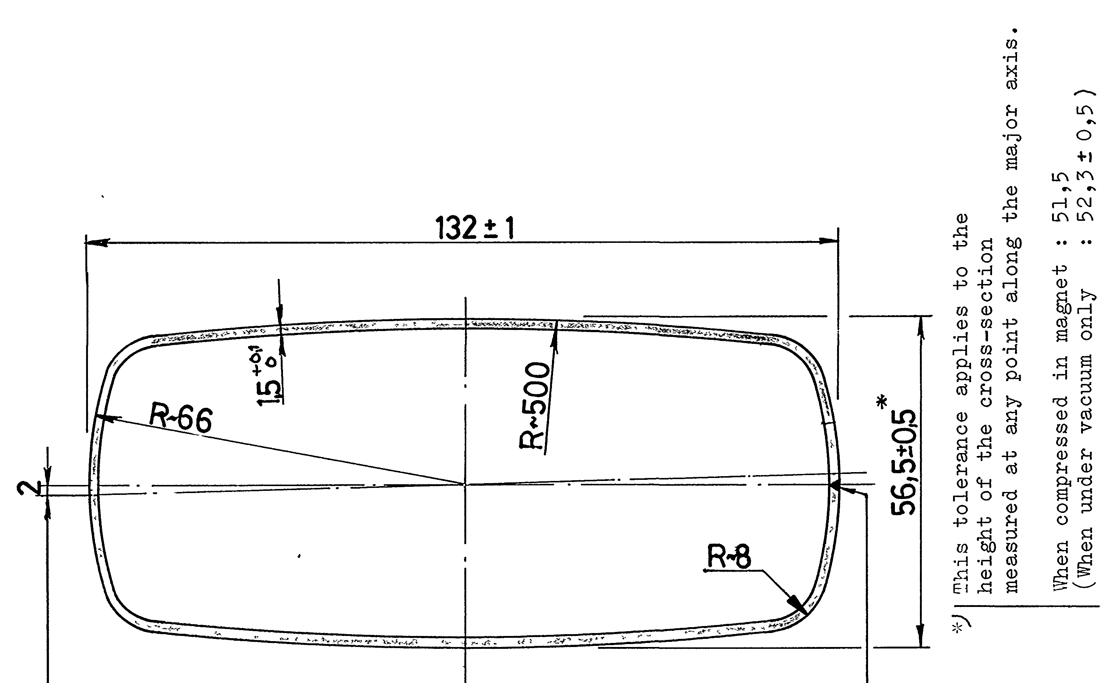
Magnet exchanges
13 magnets – all refurbished and tested at surface.
QF.61610 Pumping Port Shielding and RF fingers
MBS.660031
Chamber compressed within C-shaped magnet yolk.
Lab testing showed Δ compression 3.2mm.
LSFA.62005
Notes:
Chamber compressed within C-shaped yoke – resting space of 56(+/-0.02)mm, passage of 54(+/-0.02)mm
Chamber electrically isolated with Vetronite sheets
Lab testing measured chamber compression of 3.2mm

Slide 10
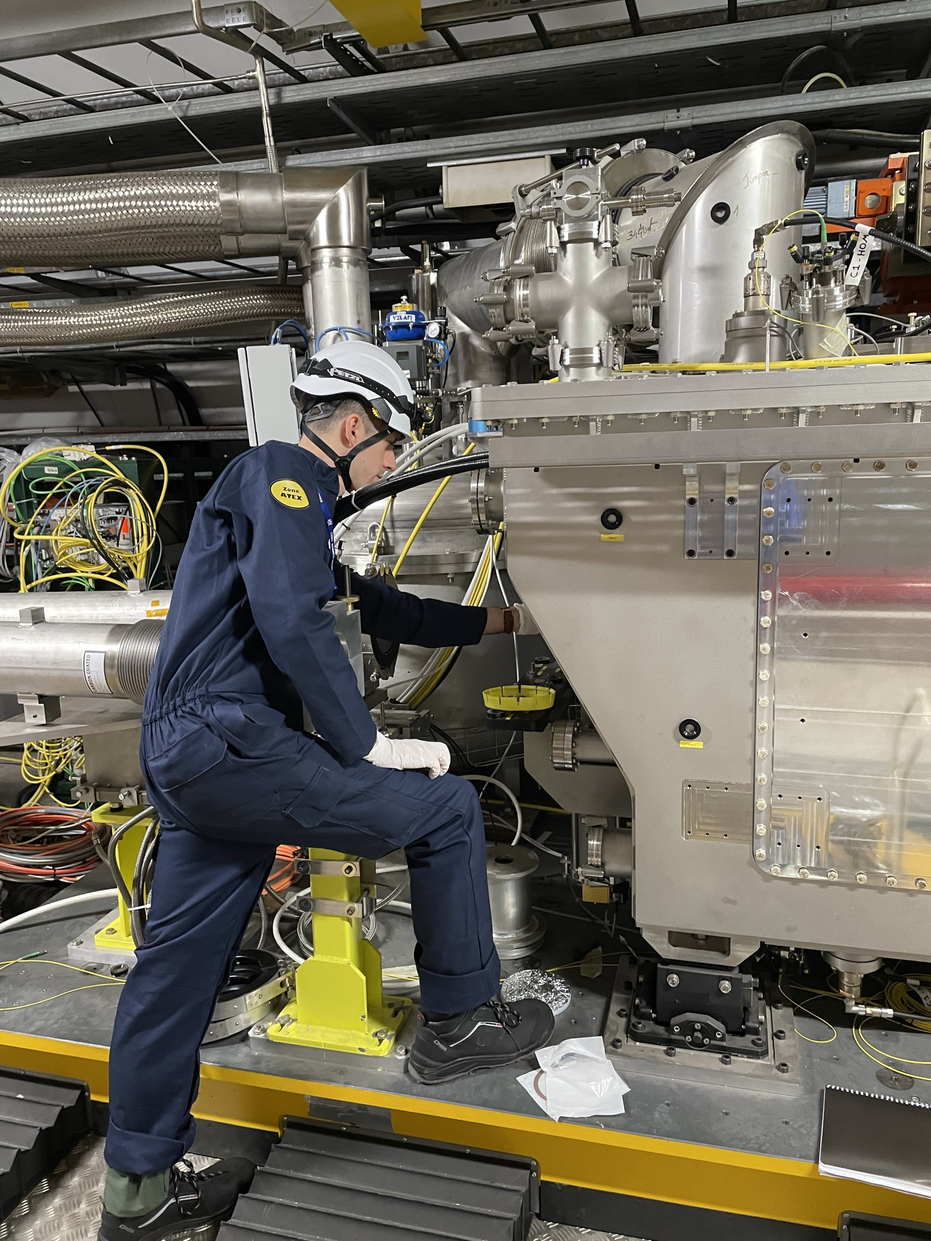
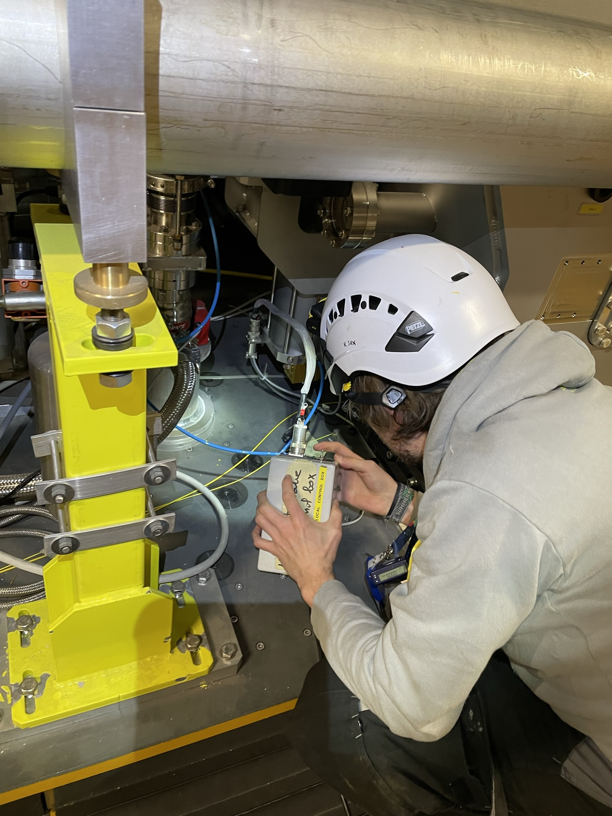
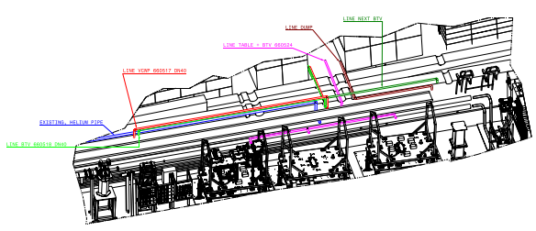
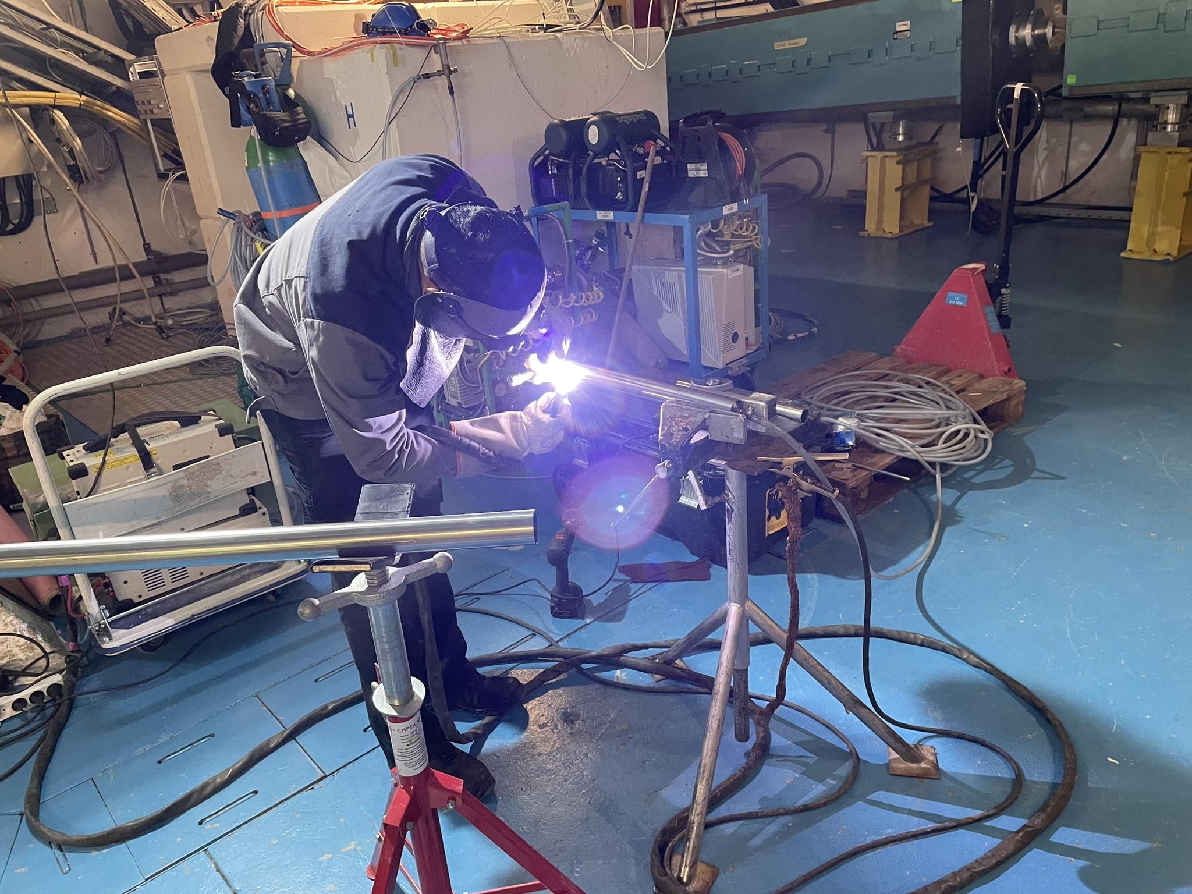
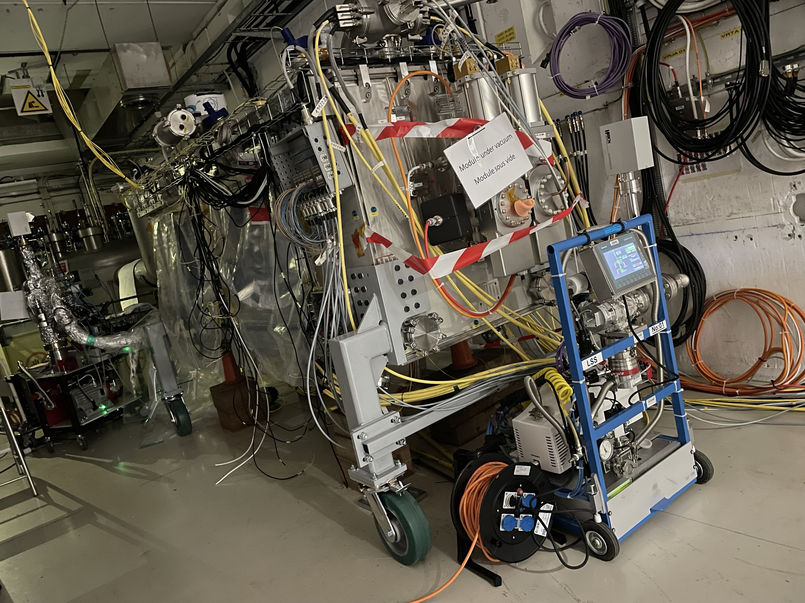
General activities
Removal of Crab Cavities DQW module from BA6
Primary vacuum line manifolds and extension of compressed air line
Collaboration between TE-VSC, SY-STI, SY-BI & BE-EA
Validation testing of Crab Cavities RFD module in SM18
ECR: HRM-V-EC-0003

Slide 11
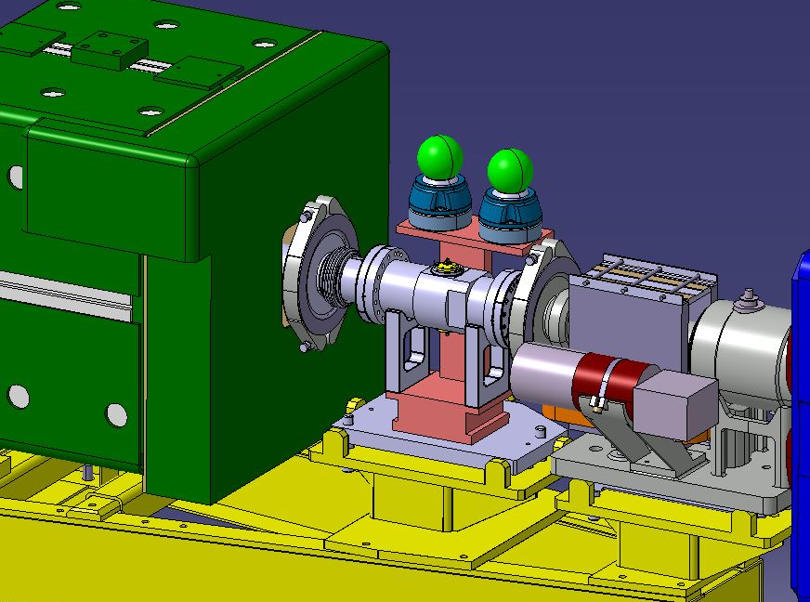
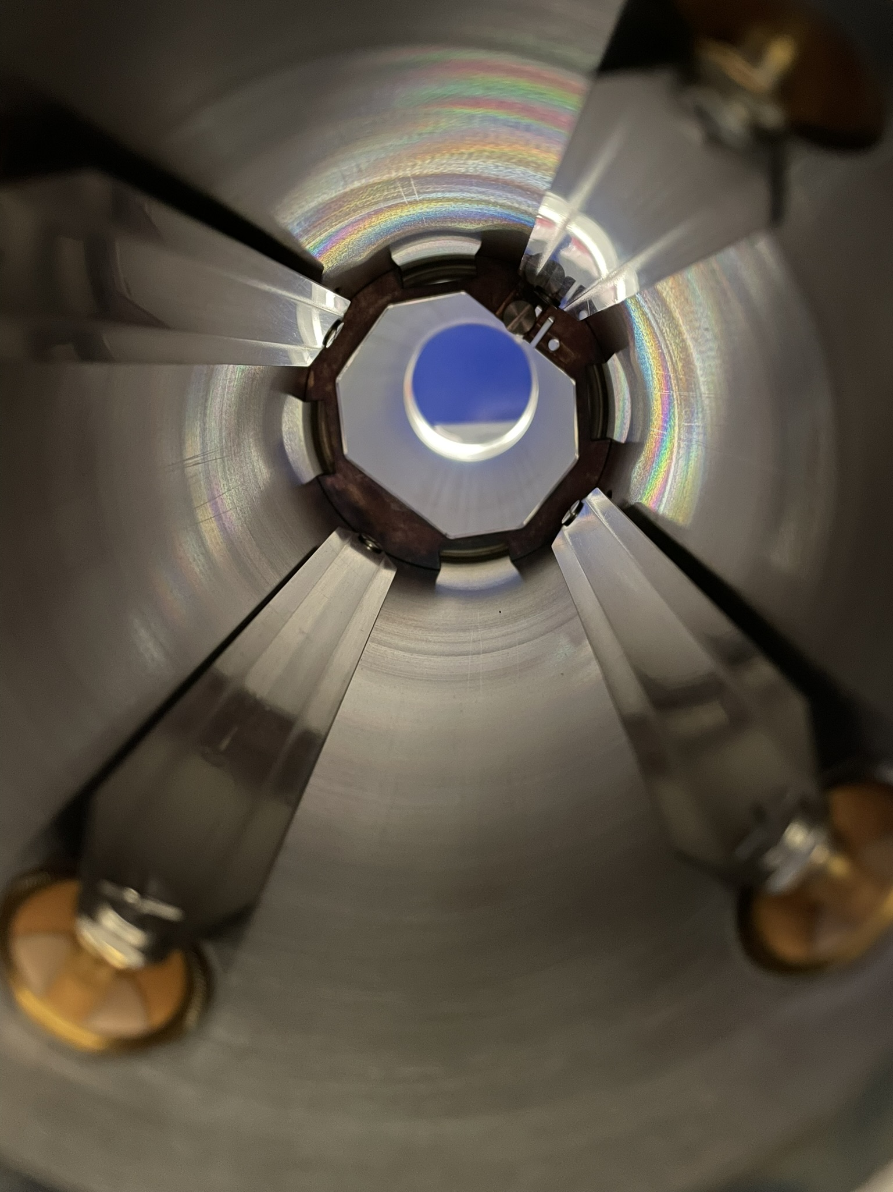
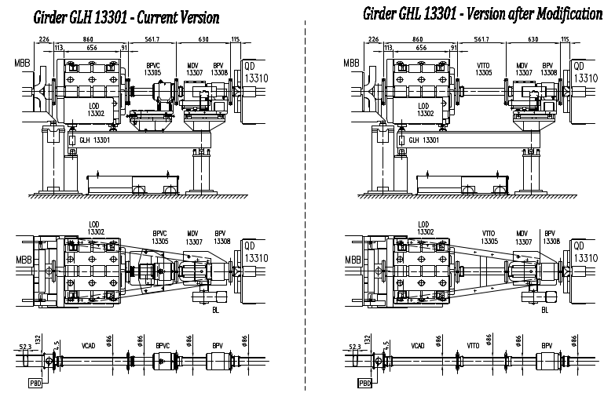
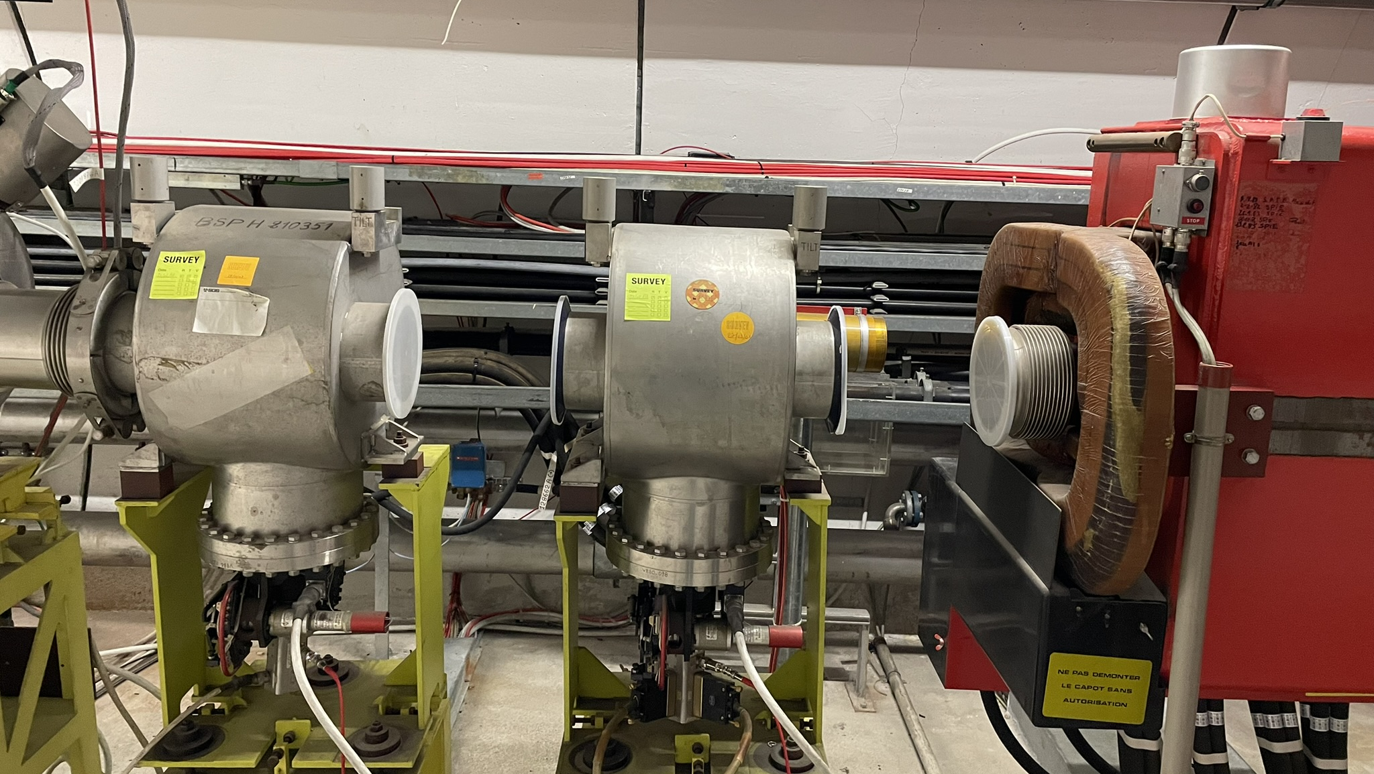
General activities
E-O Pick up
Aperture restrictions & Obsolete BPM’s
Spill Monitor (TT20)
ECR: SPS-BPM-EC-0002

Slide 12
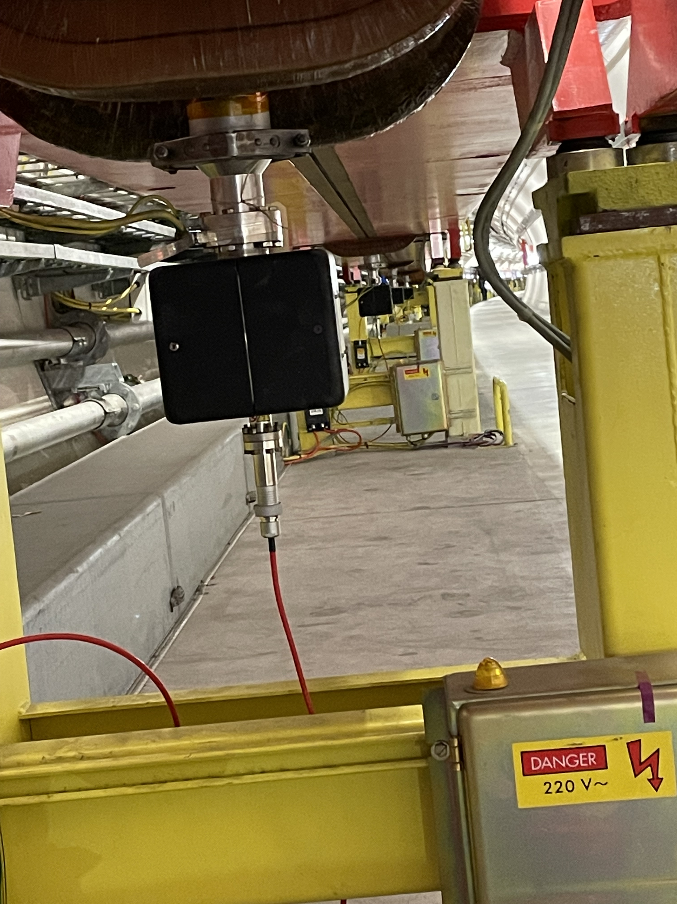
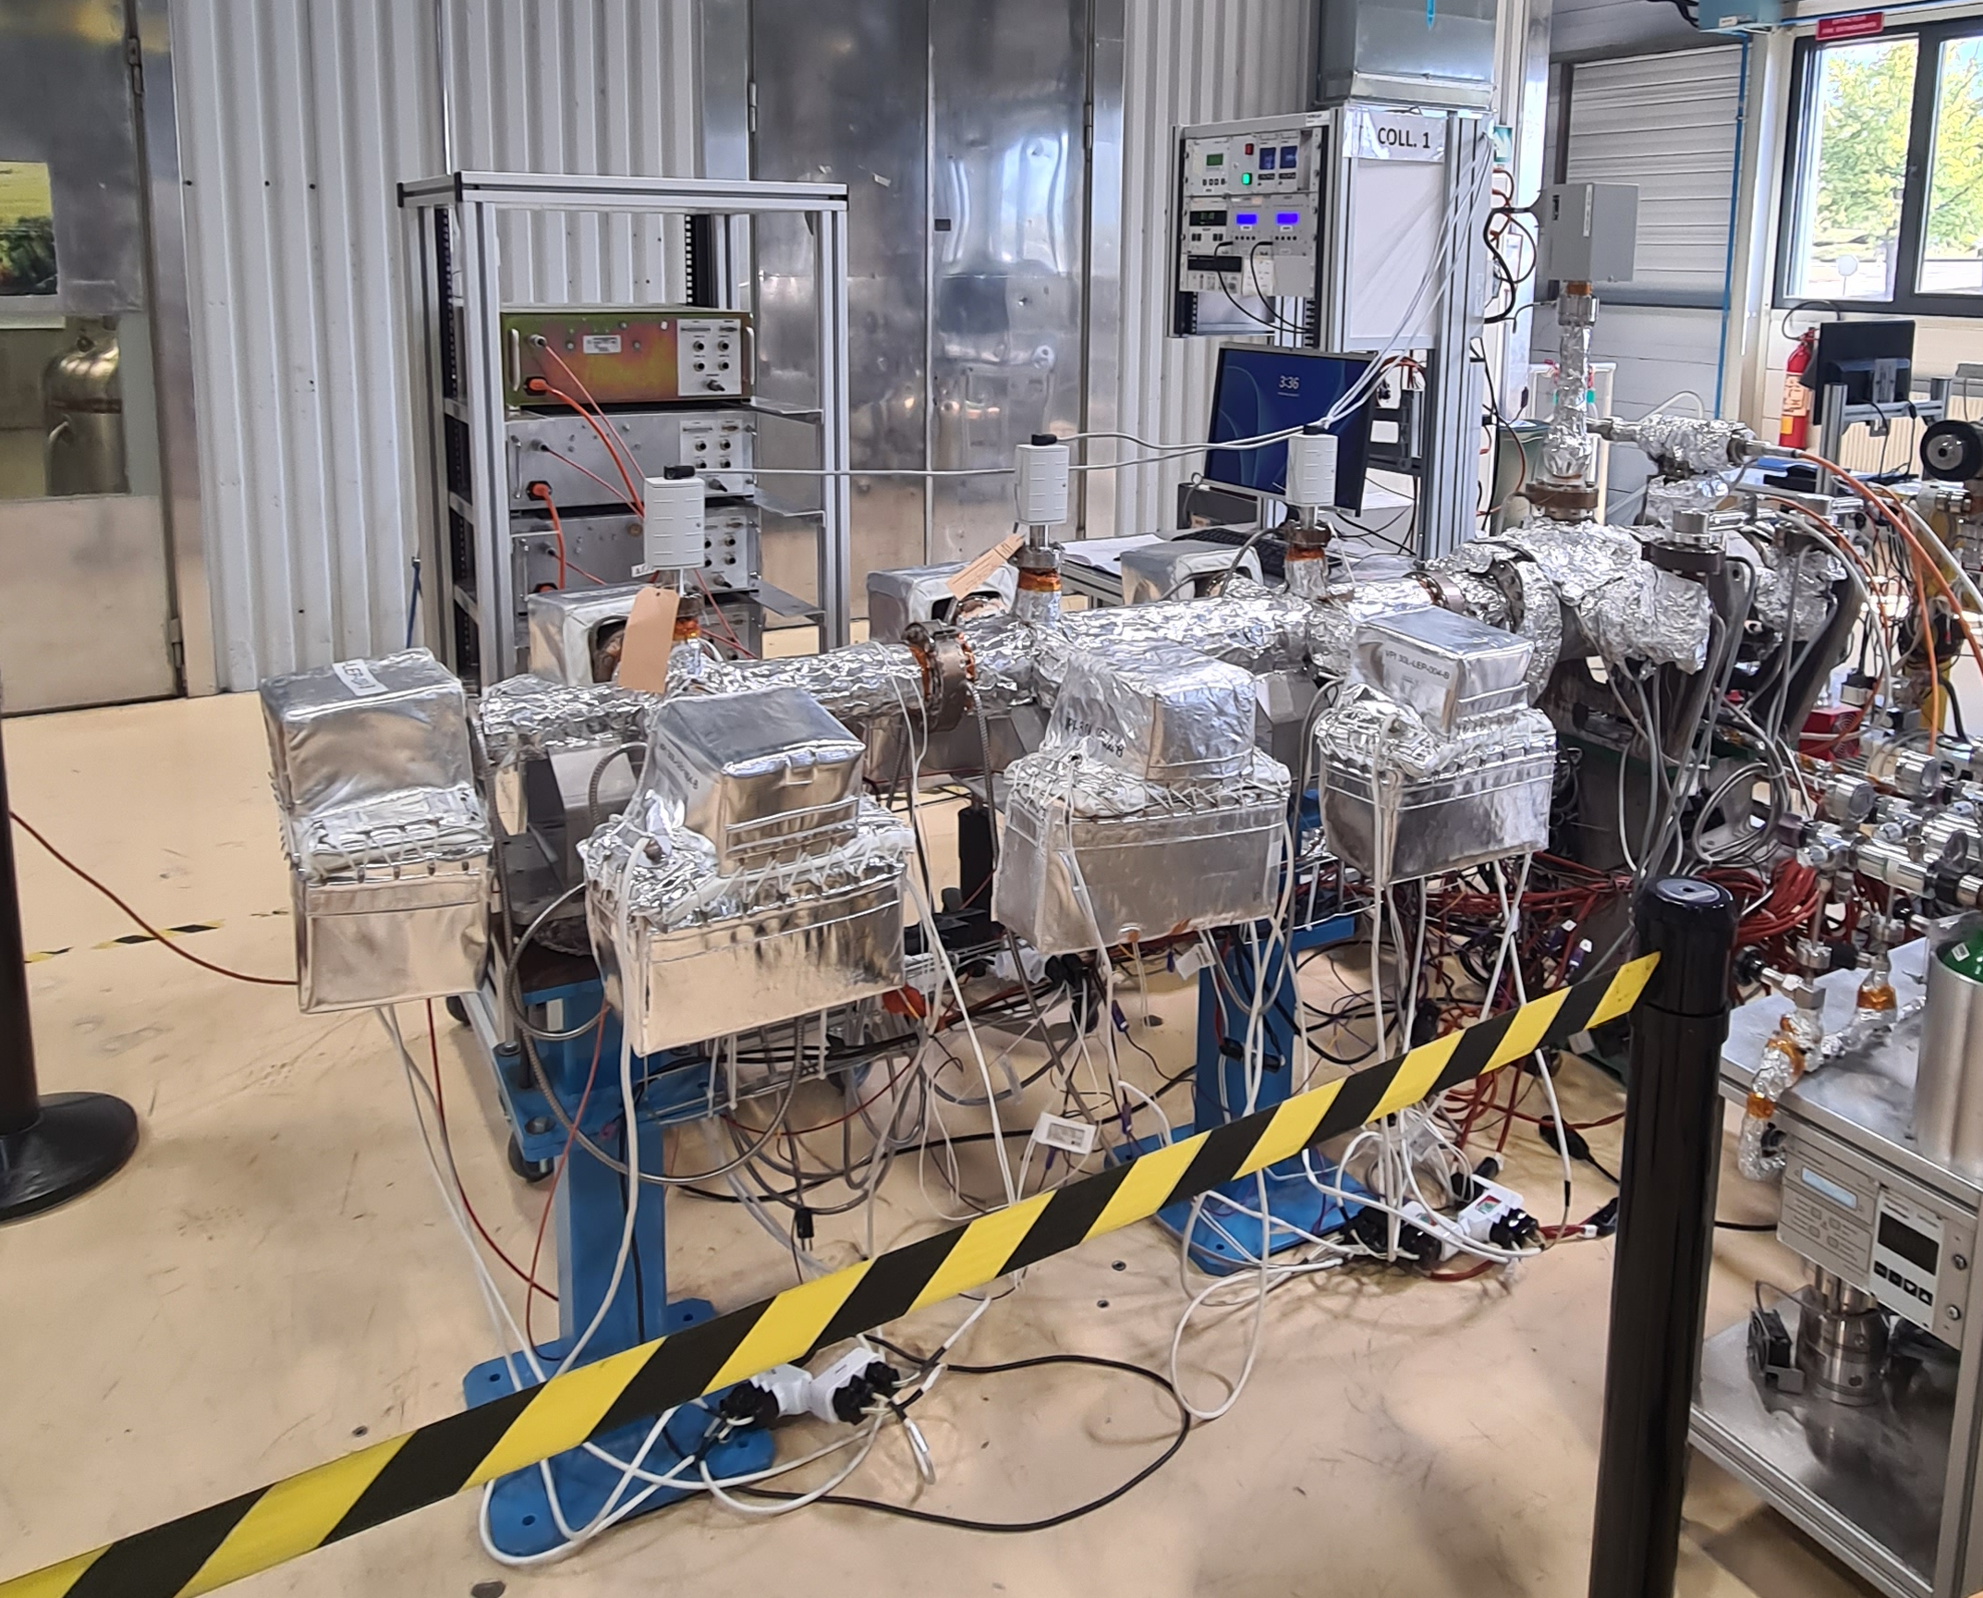
Consolidation
Three Consolidation programs ongoing:
Ion pump Consolidation – SPS ring
Transfer Lines Consolidation
North Area Consolidation – no VSC activities 2023/4
Ti2 ion pump consolidation (6x), exchange of feed-through and lab testing
Repair of known leaks
72x ion pumps exchanged in synergy with PSU & local boxes

Slide 13
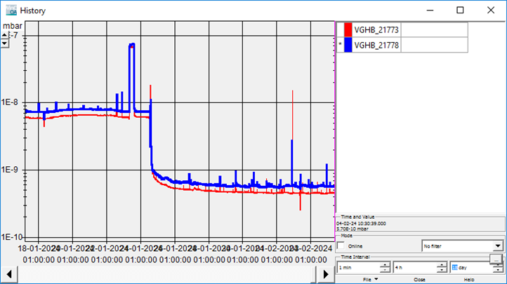
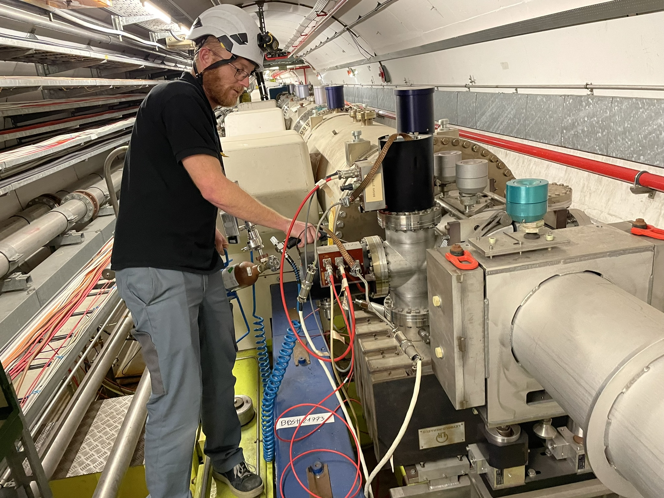
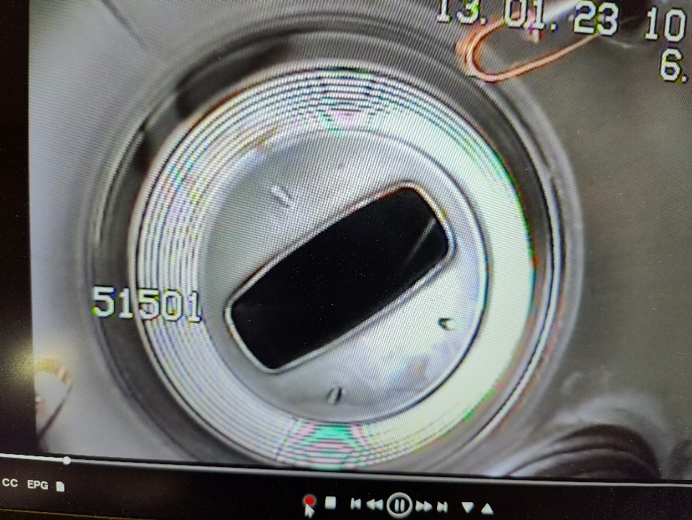
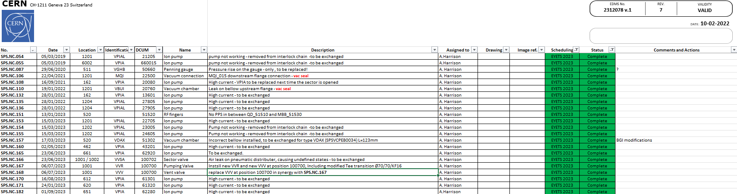
Non-conformities
22x non-conformities resolved, ion pumps, penning gauges and incorrect or damaged vacuum chambers
6x new non-conformities identified
MST leak/repair
Survey and endoscopy (2022), revealed missing PPS and obsolete pick-ups

Slide 14
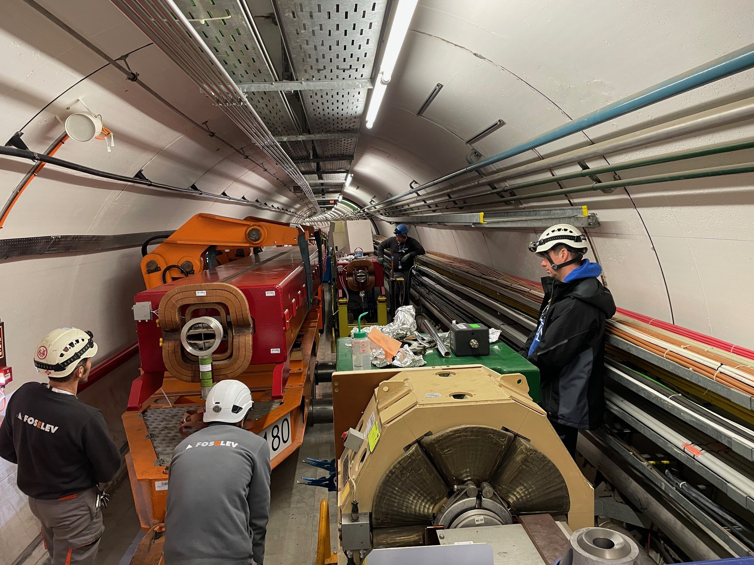
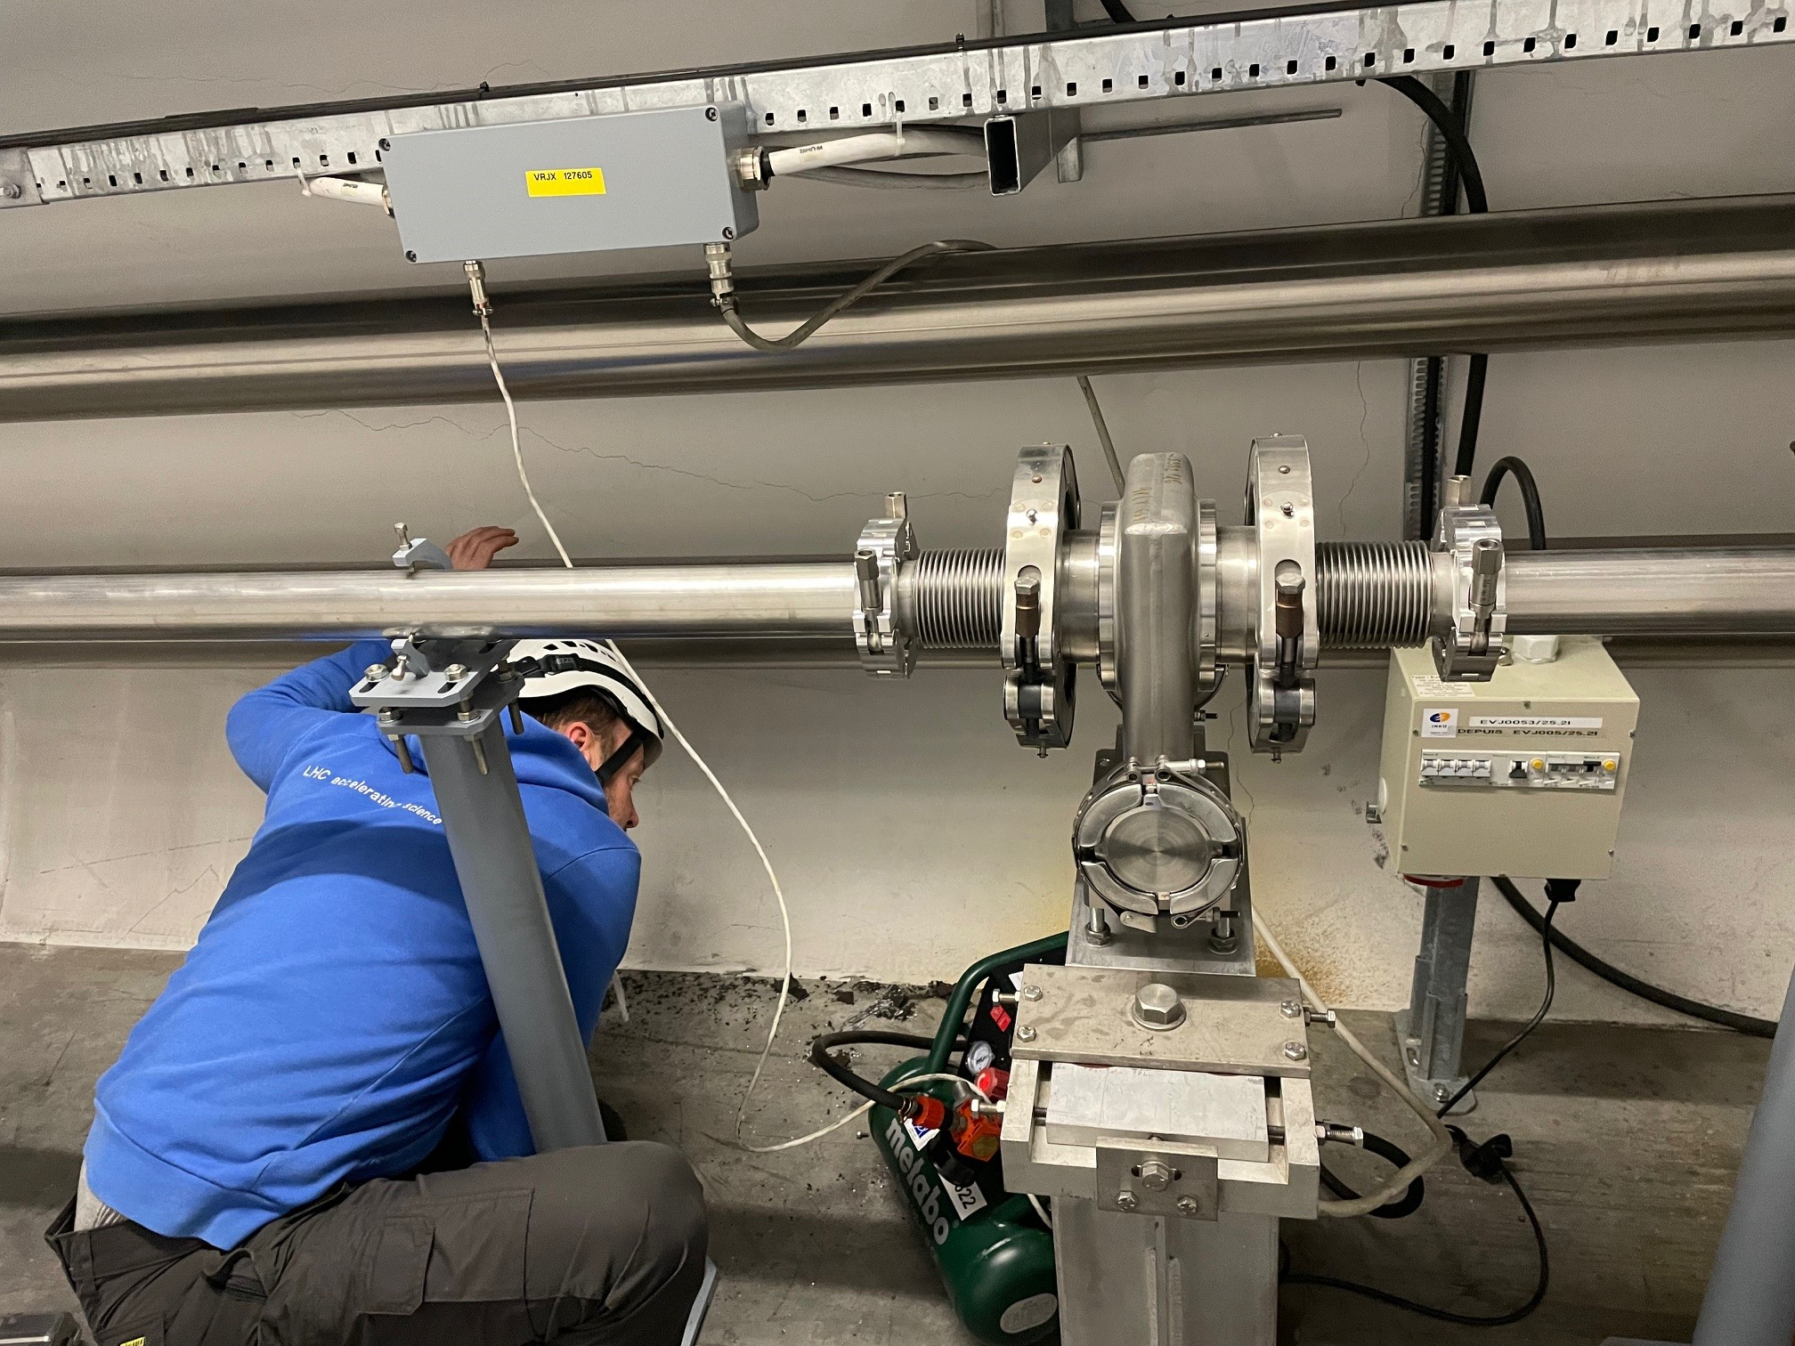
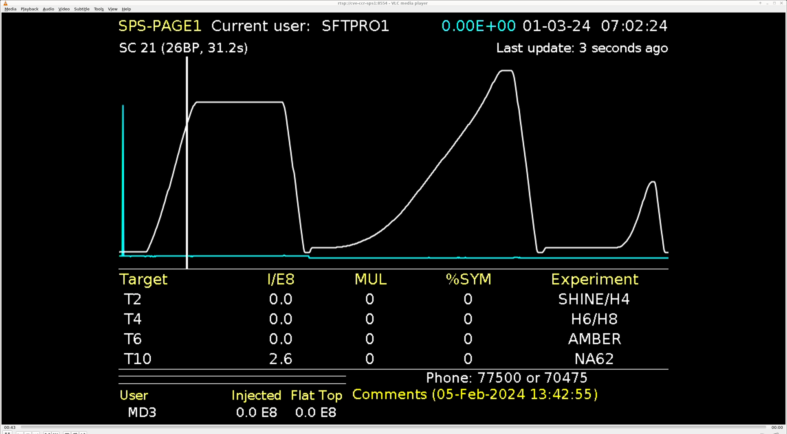
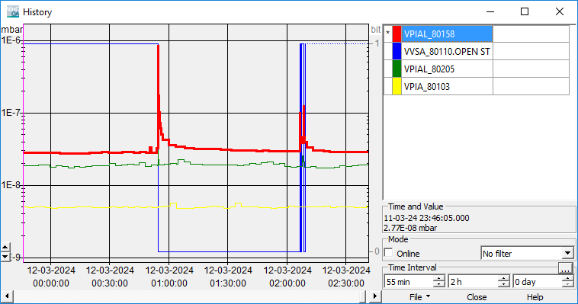
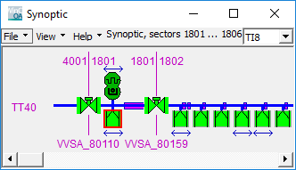
Start-up
MBA.61490 coil short circuit
VVSA.27605 compressor
1st Beam
Thanks to Piquet for their help!
VVSA.80110 pressure spike

Slide 15
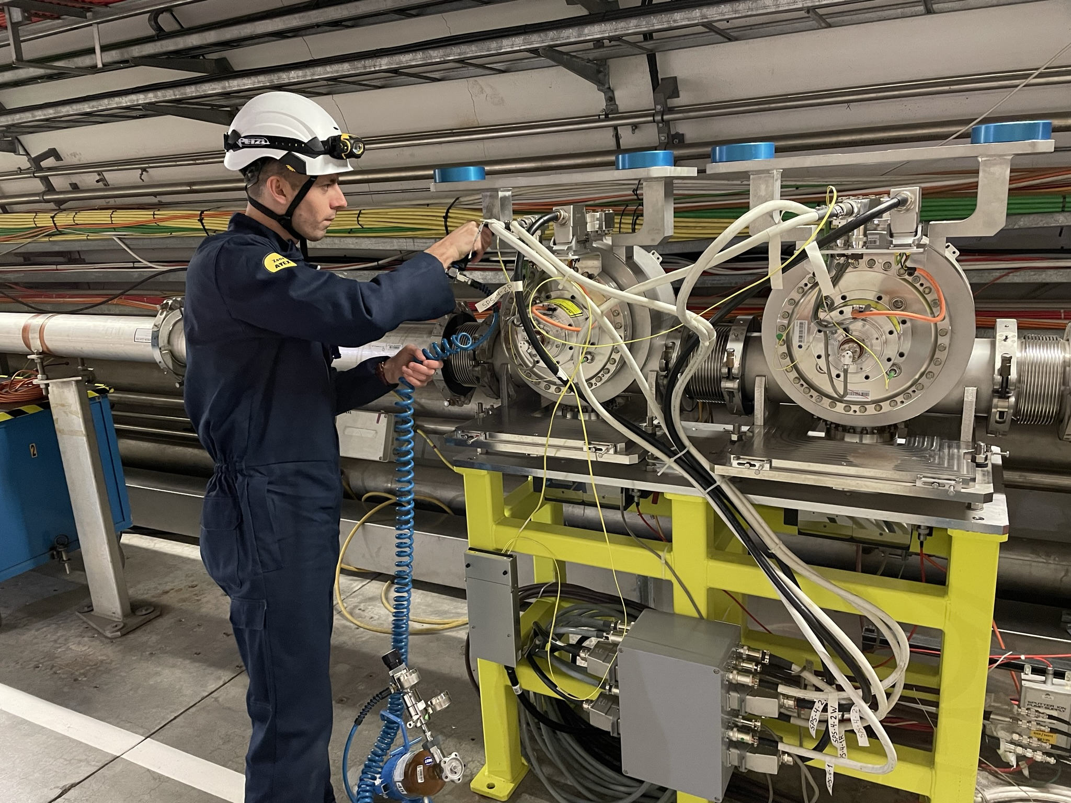
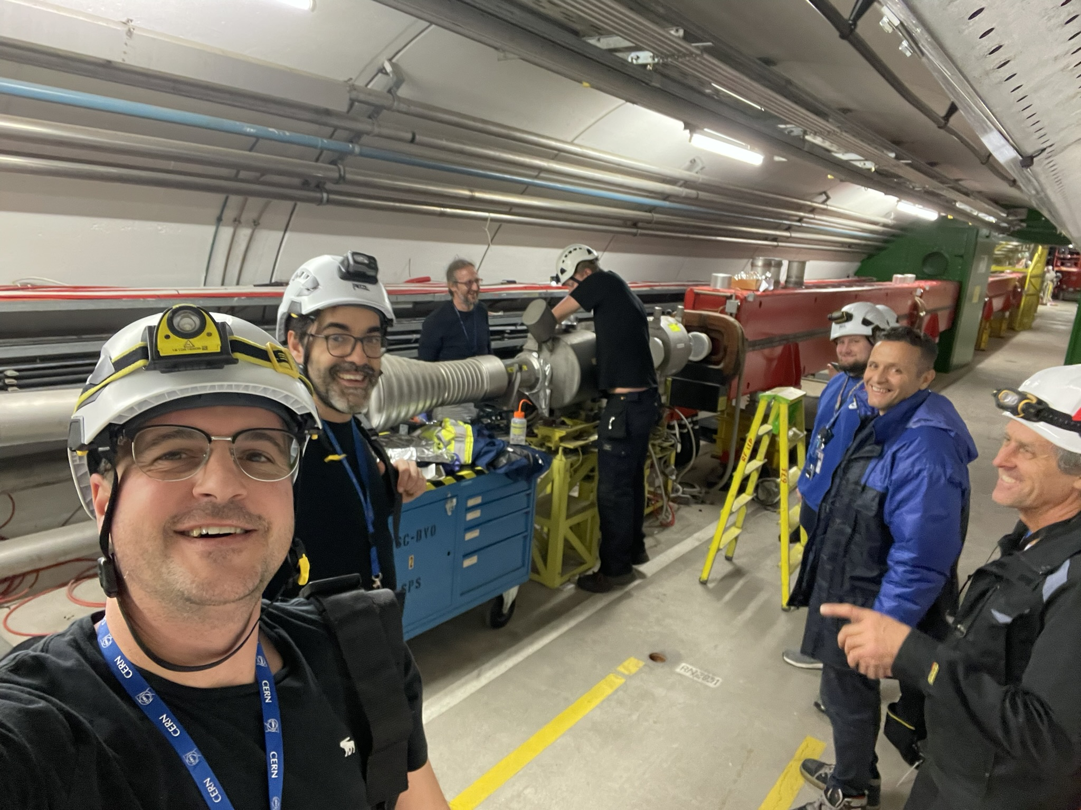
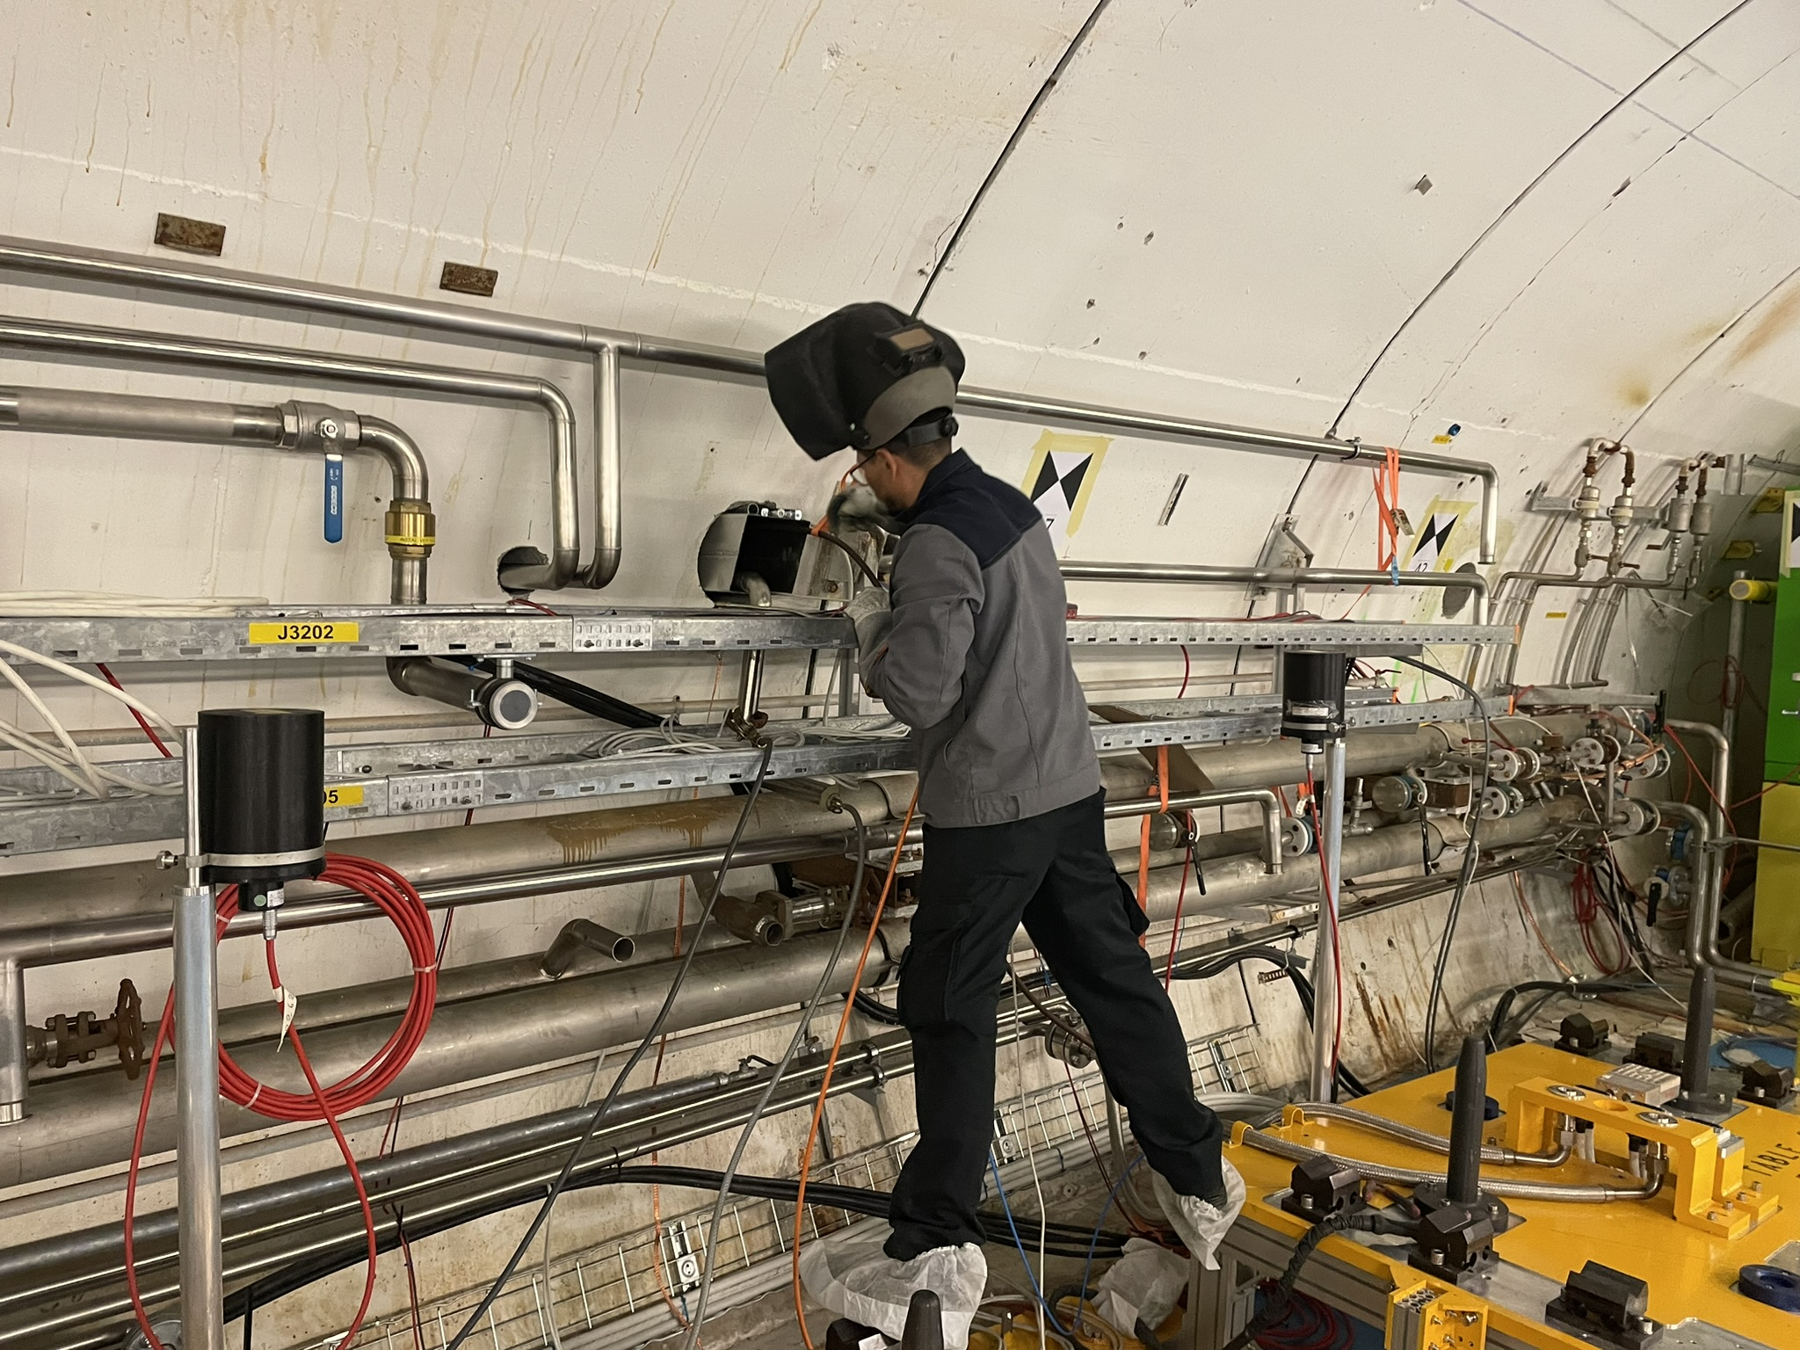
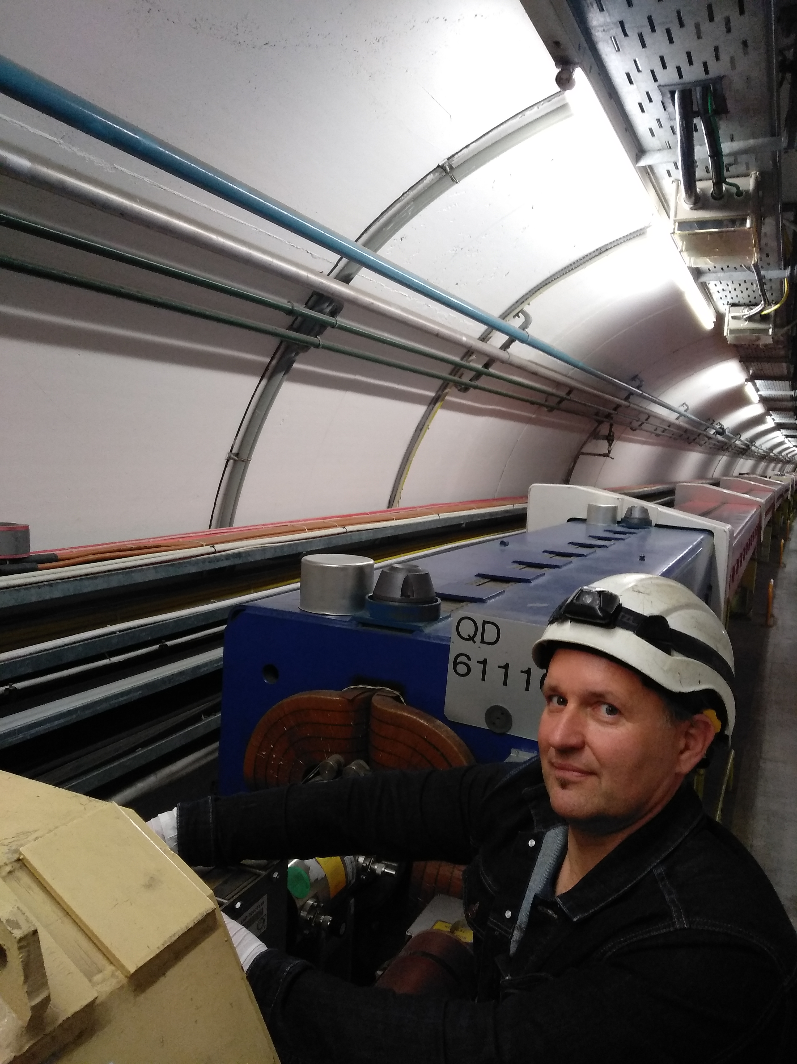
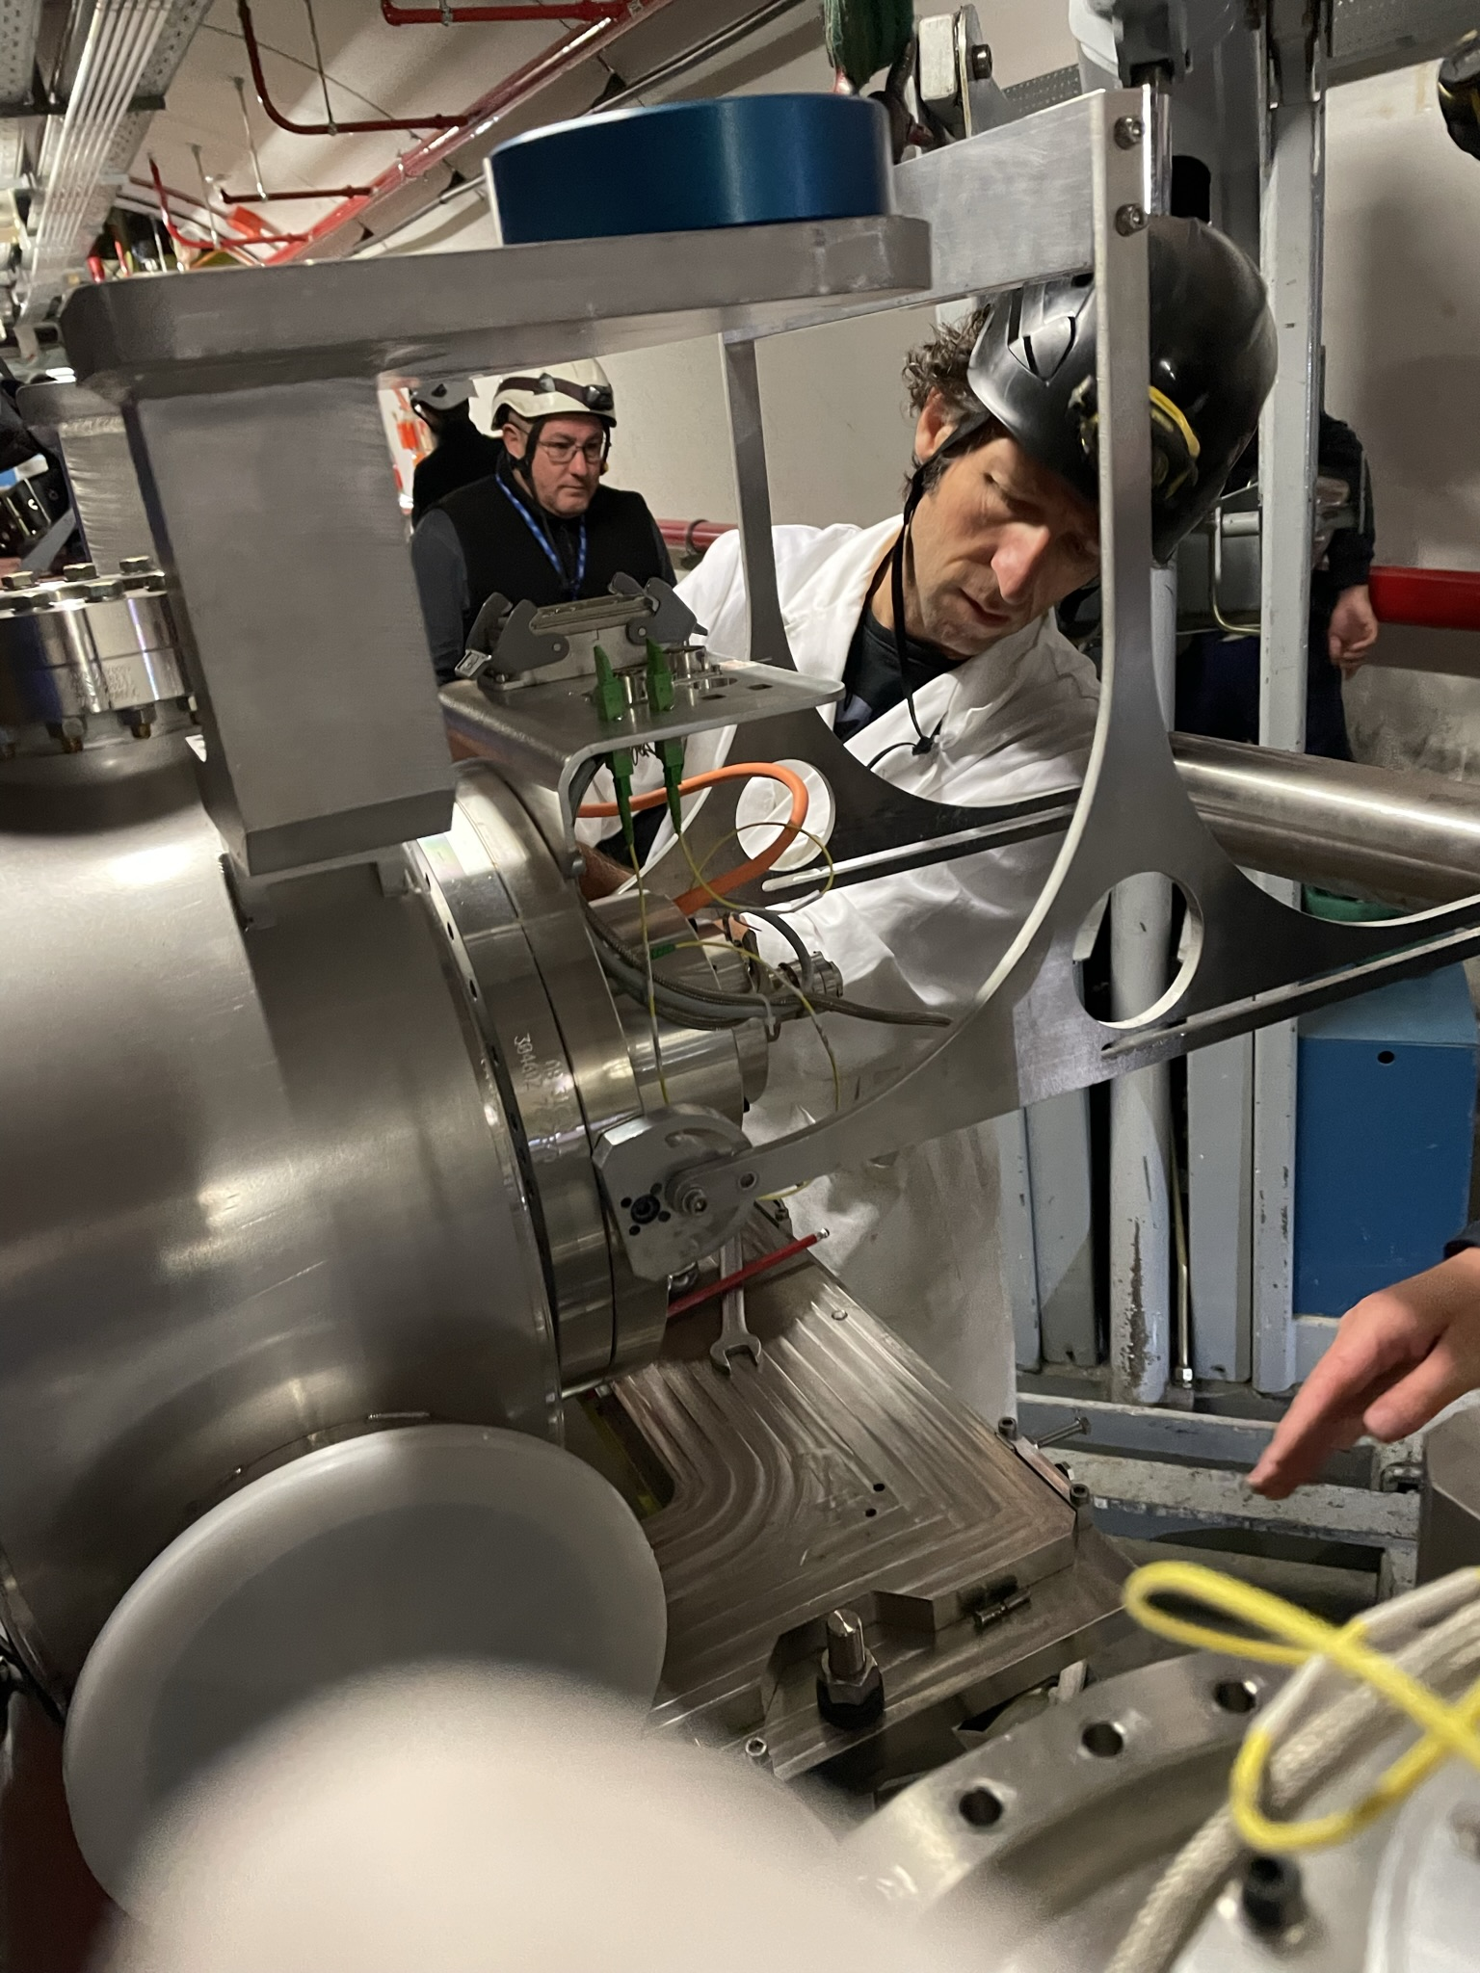



Thanks

