Slide 1


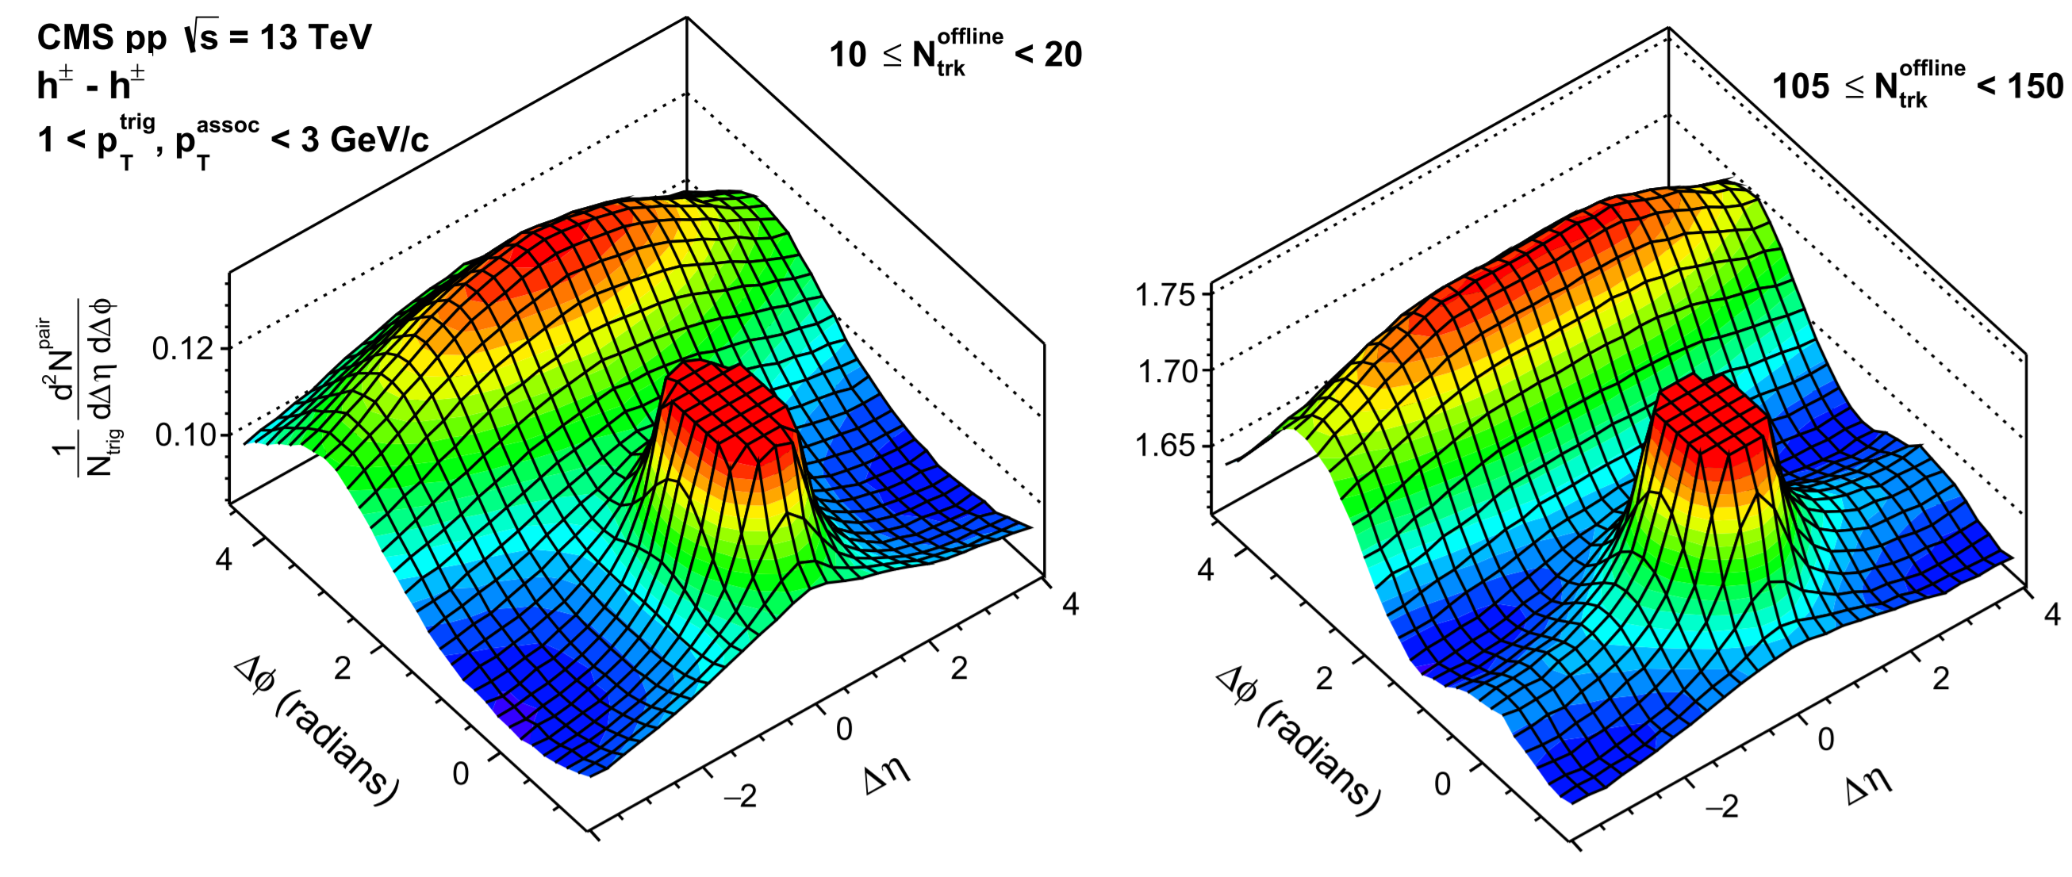
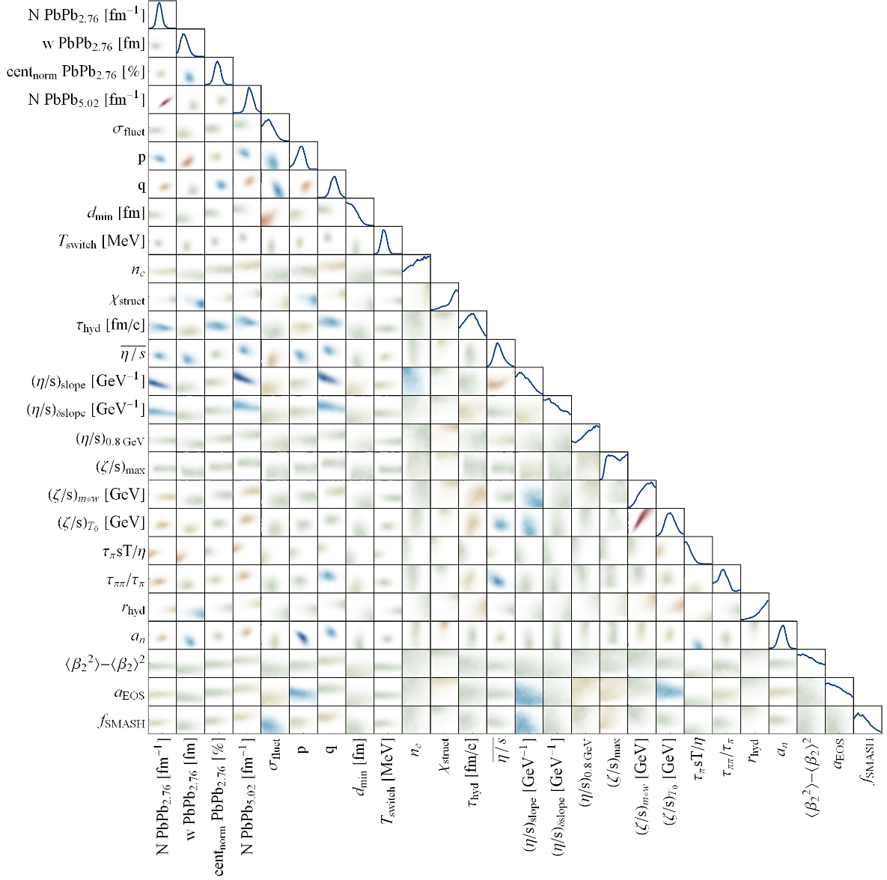
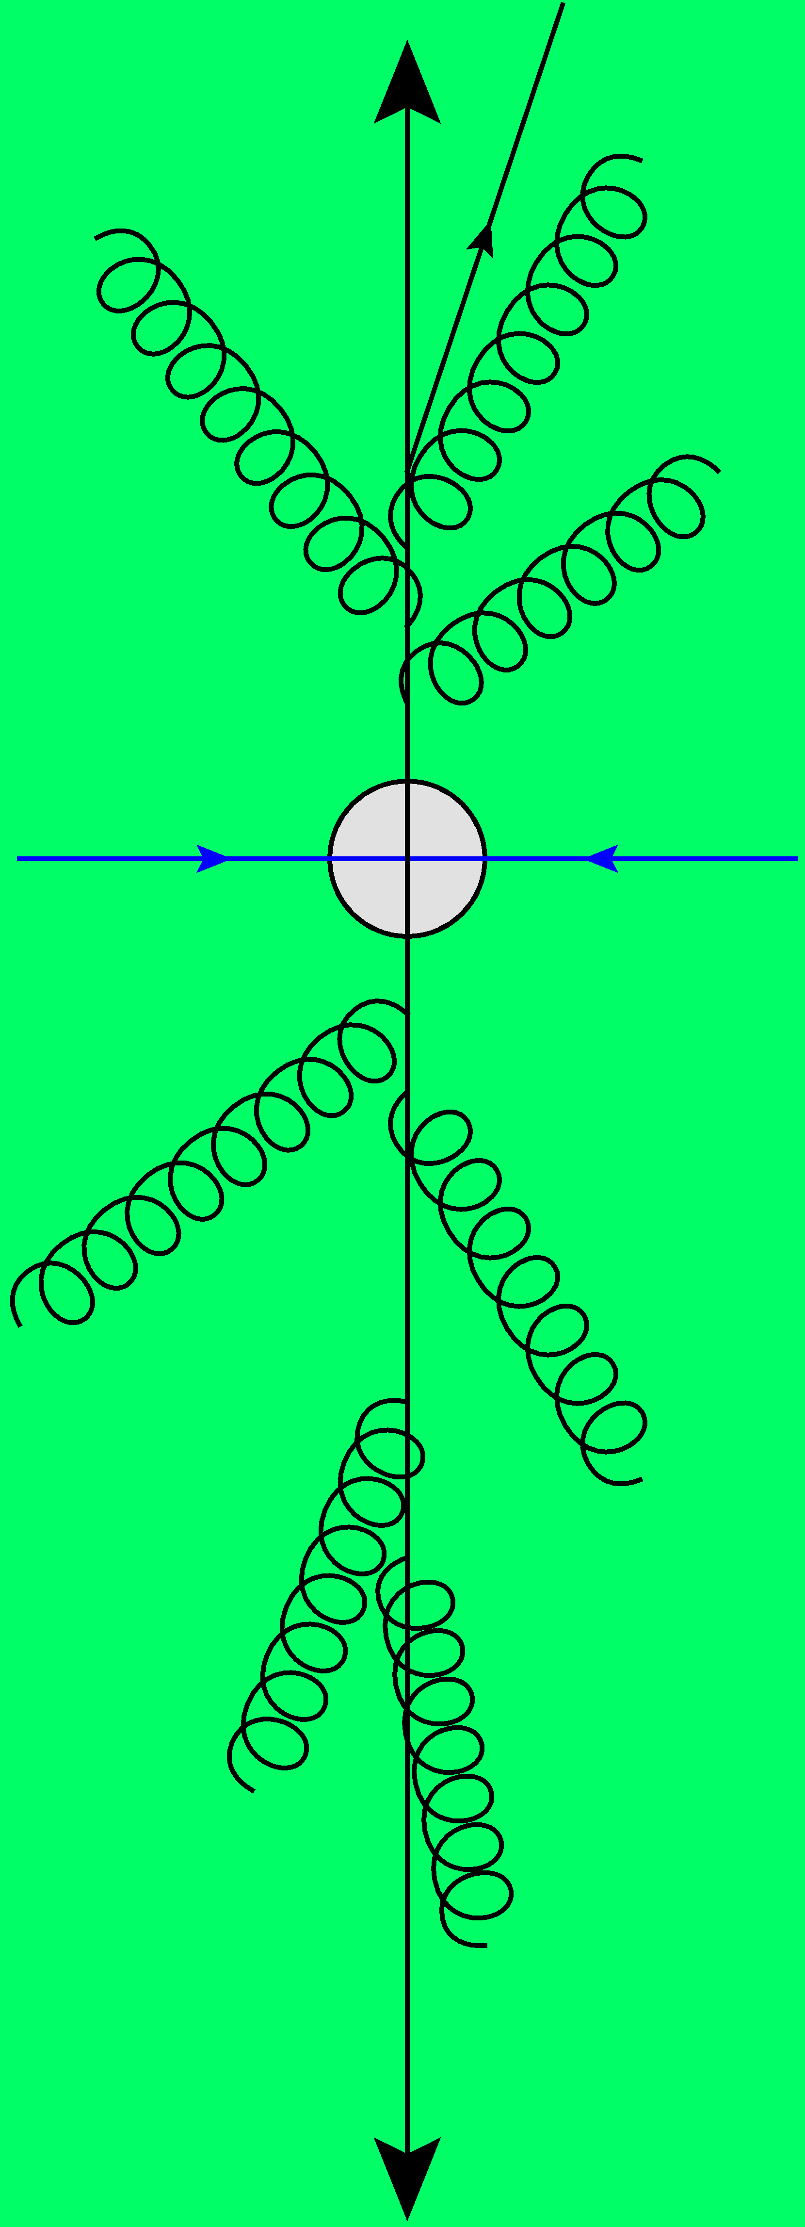
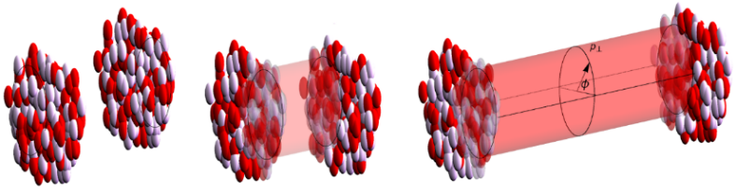
Anisotropic flow in small systems
Hydrodynamics at its limits
Together with Govert Nijs
Wilke van der Schee
Mini-event, CERN
11 March 2024

Slide 2
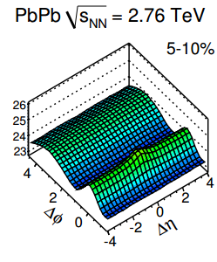

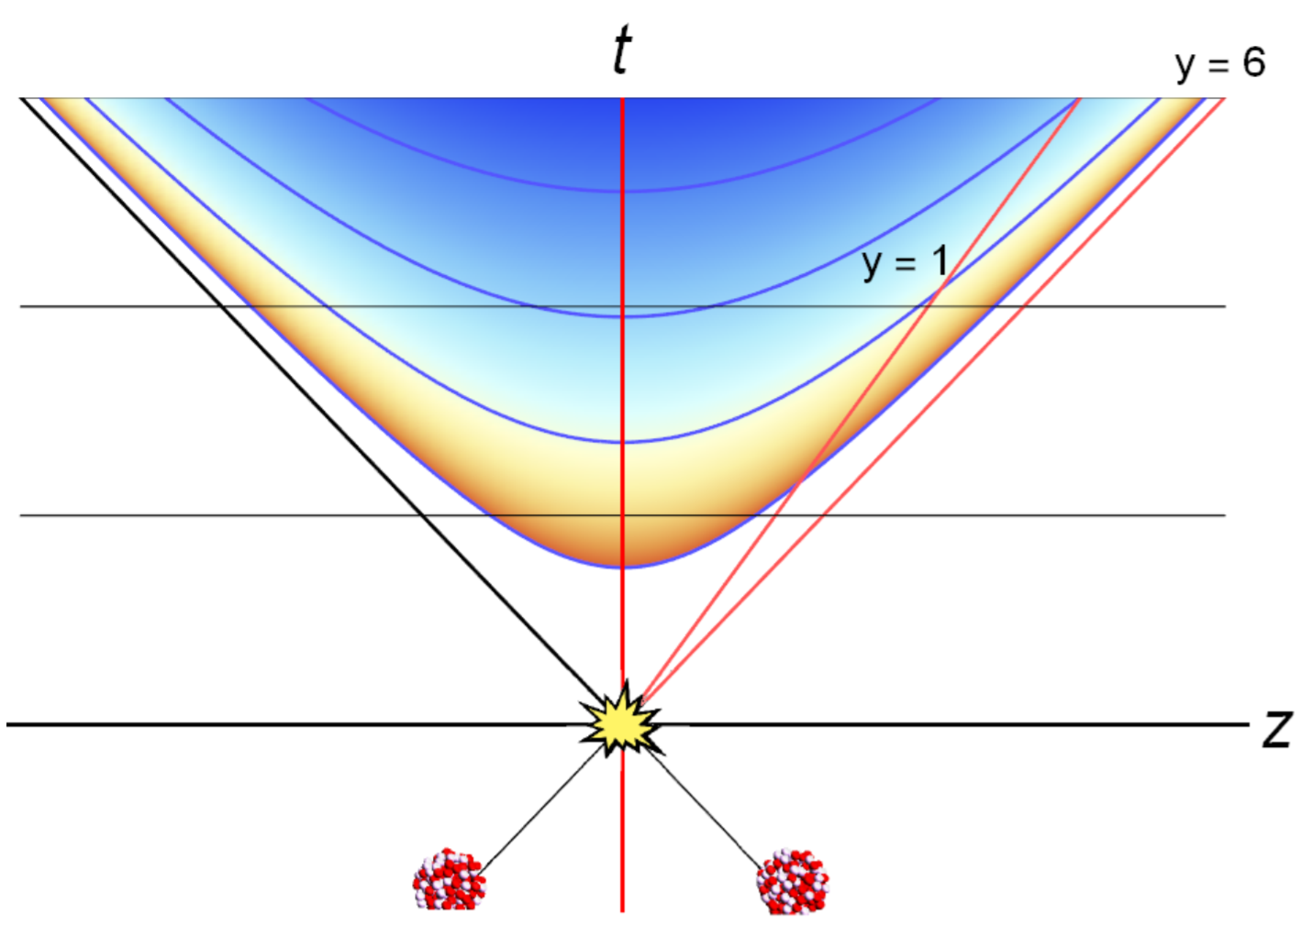
The ridge: from independent scattering to geometry
Ridge at Δφ=0 and large Δη
Back-to-back jet
Low multiplicity
High multiplicity
Jet fragmentation
(nearside)Ridge
CMS, Evidence for collectivity in pp collisions at the LHC (2016)
Notes:
From pp as we thought they are to as they are
Increases with multiplicity: cannot think

Slide 3
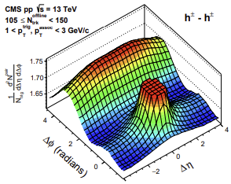
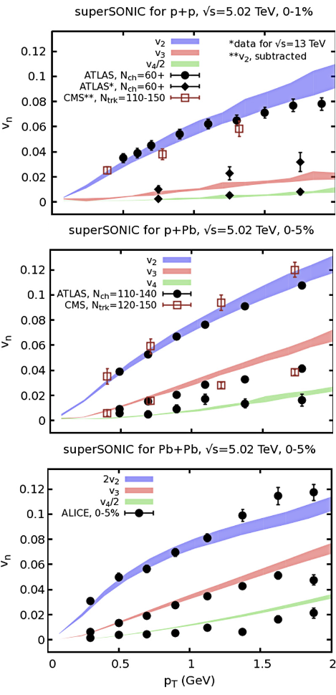
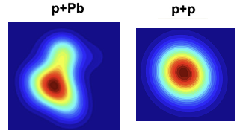
One fluid to rule them all --- Panta Rei
Wilke van der Schee, CERN/Utrecht
Long range rapidity correlations seen in near-side ridge
  Most natural explanation in terms of a geometric effect --- hydro?
  Low multiplicity: correlations dominated by `non-flow’ effects:
    Momentum conservation (away side ridge)
    Fragmentation (also: resonance decays)
Hydrodynamic models describe the data well (?)
  In the case of superSONIC a relatively simple initial Glauber model (3 constituents)
CMS, Evidence for collectivity in pp collisions at the LHC (2016)
Ryan Weller and Paul Romatschke, One fluid to rule them all: viscous hydrodynamic description of event-by-event central p+p, p+Pb and Pb+Pb collisions at s√=5.02 TeV (2017)

Slide 4
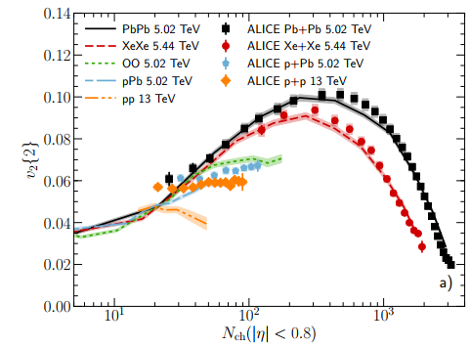
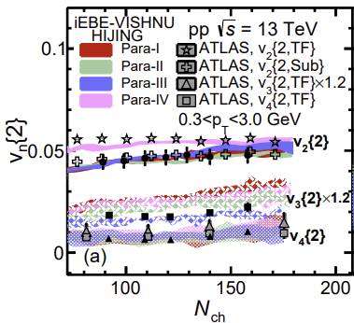
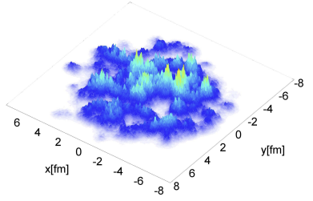
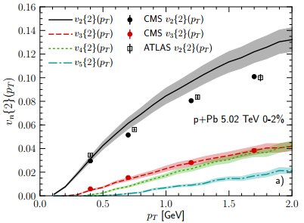
One fluid to rule them all --- Panta Rei
Wilke van der Schee, CERN/Utrecht
Similar results from IP-Glasma + MUSIC + UrQMD
  Initial state in this case very `bumpy’
Similar results from HIJING/Trento + iEBE-VISHNU for pp collisions
  Initial state is varied from HIJING to Trento
  Describes data well
Wenbin Zhao, You Zhou, Koichi Murase and Huichao Song, Searching for small droplets of hydrodynamic fluid in proton–proton collisions at the LHC (2020)
Bjoern Schenke, Chun Shen and Prithwish Tribedy, Running the gamut of high energy nuclear collisions (2020)

Slide 5
Anisotropic flow in small systems
Wilke van der Schee, CERN/Utrecht
The success of hydro or anything goes?
  Requires a systematic study: vary parameters consistent with PbPb data
    Including changes in initial state and changes in viscosities
  Do we do an apples-to-apples comparison?
    Small multiplicity: need to understand `non-flow subtraction’
    Resonance decays lead to non-trivial correlations
This talk: use Trajectum to study this in detail
Future aim: what are the limits of hydro?
The limits of hydrodynamics is a great motivation in theory and experiment:
upcoming OO and pO runs in 2025 ☺. Possibility of Neon run?

Slide 6
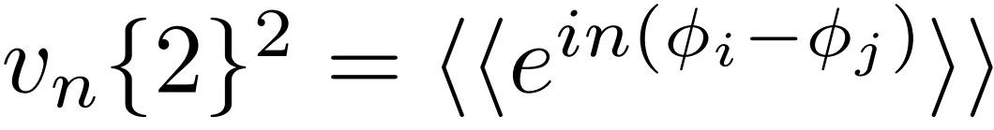
The elephant in the room: `non-flow’ subtraction
Wilke van der Schee, CERN/Utrecht
Theory: usually ignored in hydro (hydro does not have `non-flow’?)
  Exceptions: Zhao, Ko, Liu, Qin and Song (pp, 2001.06742) and Zhao, Ryu, Shen and Schenke (dAu, γ-Pb 2211.16376, 2203.06094)
Experiment: almost always subtracted as much as possible (?) by imposing largest Δη gap
  Δη gap depends on experiment and is rarely varied
Method 1: cumulants
First average: within acceptance all particle pairs i, j in a single event
Second average*: average over ensemble of events
Method 2: subevents
First average: within acceptance all particle pairs
i (with η < γ/2) and j (with η > γ/2)
Second average*: average over ensemble of events
Note: not equivalent even for γ = 0 (!)
* In practice one first averages over small centrality classes and then averages over those results to obtain a larger bin. For some observables this is extremely important (SC, ρ(v₂{2}, p_{T})), but for v_{n}{2} it makes only a small difference. Often it is not explicitly mentioned how the third averaging is done.

Slide 7
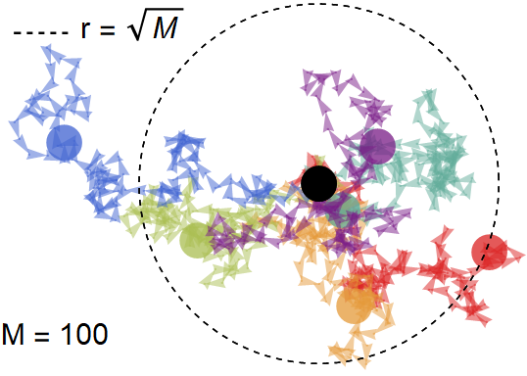
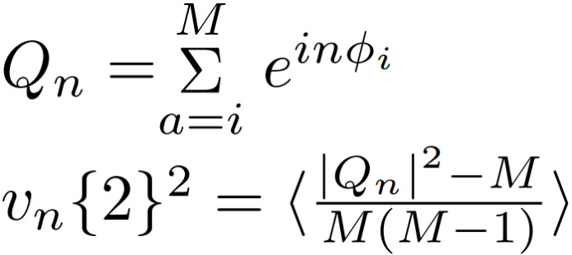
Cumulants
Wilke van der Schee, CERN/Utrecht
Method 1: cumulants
Efficient computation:
Requires M computations instead of M².
The – M subtracts i = j in double sum
Important theorem:
If φ_{i} are randomly drawn from f(φ) then v_{n}{2} will converge
to the true Fourier coefficients of f(φ)
Easy to understand for f(φ) = constant:
Q_{n} is a random walk, so for many events:
Important caveat:
φ_{i} are not drawn randomly
In this talk we focus on correlations
due to resonance decays

Slide 8
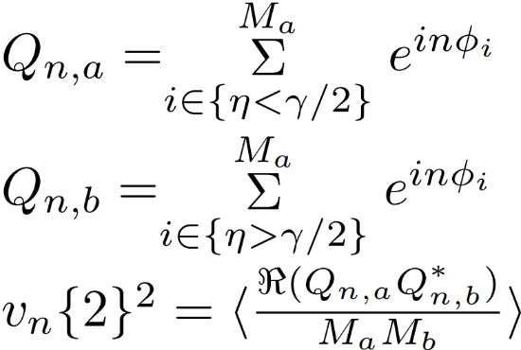
Subevent
Wilke van der Schee, CERN/Utrecht
Method 2: subevents
Efficient computation:
(for infinite # events the imaginary
part vanishes anyway)
Three comments
  Particles from different regions: less effect from resonances
  Smaller phase space: fewer particles, harder statistically
  For large γ event-plane decorrelation is important

Slide 9
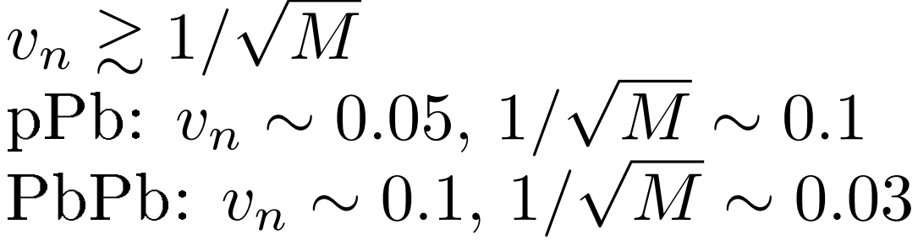
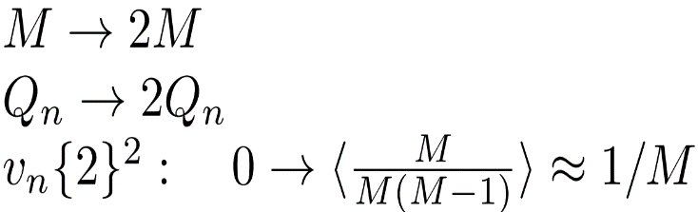
Intuition: random walk with resonances
Wilke van der Schee, CERN/Utrecht
Method 1: cumulants
Efficient computation:
Requires M computations instead of M².
The – M subtracts i = j in double sum
Oversimplified ansatz:
Zero intrinsic flow and every particle decays into two particles with the same transverse direction.
New `flow’ due to resonances:
When is can this be ignored?
For pPb and cumulants this can be the dominant effect
Also present in all hydro codes that include resonance decays (!)

Slide 10
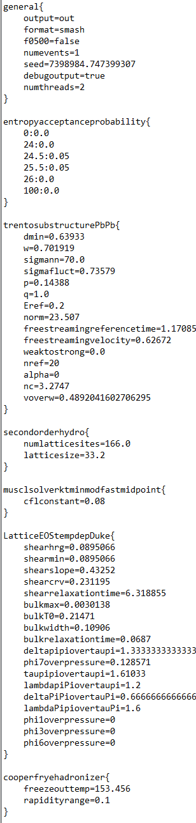
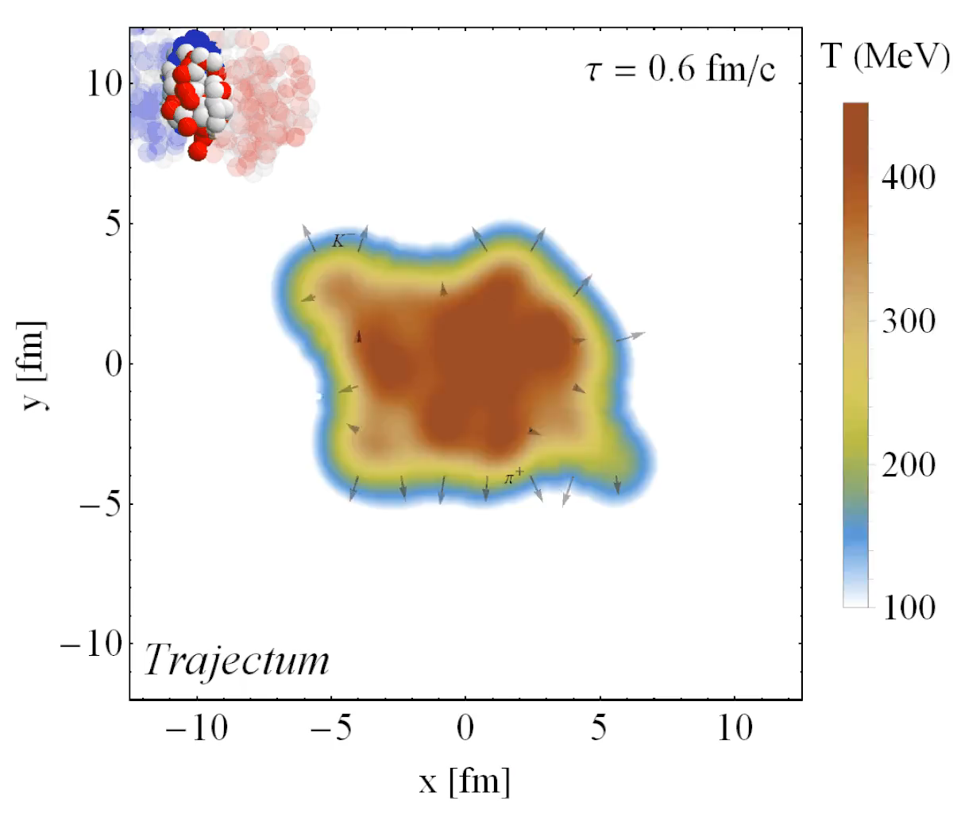
Trajectum + SMASH
Fully parallelized
  Can run unlimited number of events
Resonance decays/interactions handled by SMASH
http://sites.google.com/view/govertnijs/trajectum
http://wilkevanderschee.nl/trajectum

Slide 11
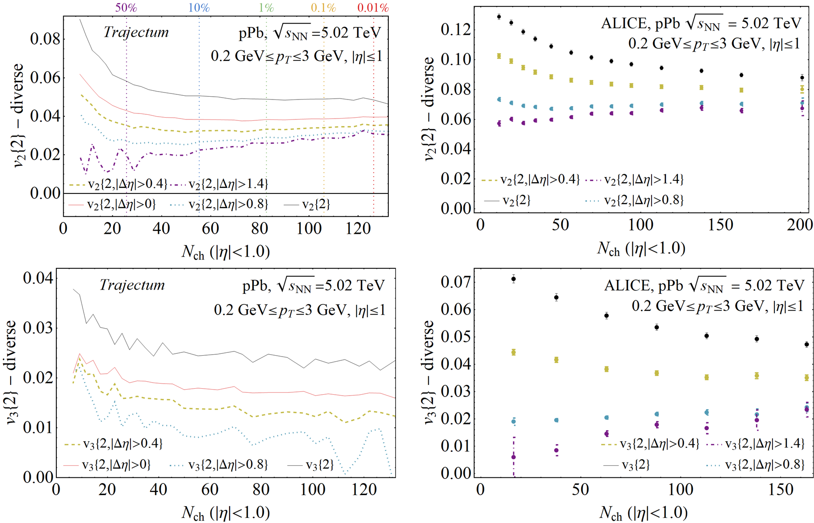
Δη in pPb collisions – MAP setting with varying cuts
Wilke van der Schee, CERN/Utrecht
Large and significant effects
  Even Δη=0 decreases flow by ~20%
  For low multiplicity Δη is dominant effect
    Even in ‘hydro’
  Relatively unique measurement from ALICE
  Qualitative agreement
  Does not agree quantitatively
    Not fitted in Bayesian analysis
ALICE, Multiparticle azimuthal correlations in p-Pb and Pb-Pb collisions at the CERN Large Hadron Collider (2014)

Slide 12
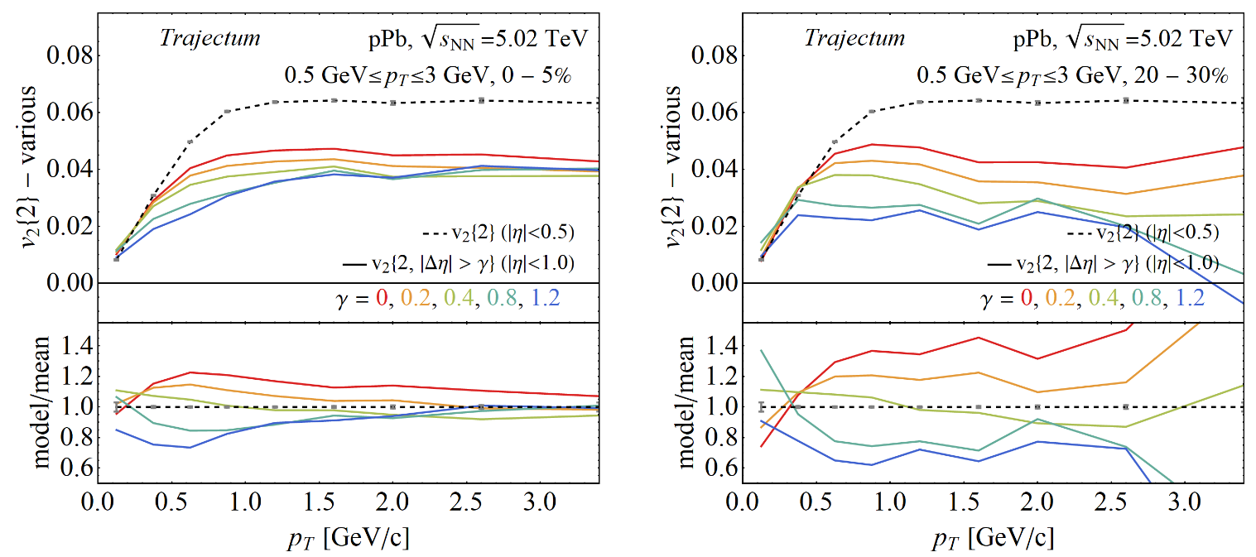
Δη in pPb collisions – p_{T} - differential
Wilke van der Schee, CERN/Utrecht
Similar effect when looking at p_{T} differential flow
  Stronger effect at lower multiplicity
  Converges at low p_{T} (attractor ;))

Slide 13
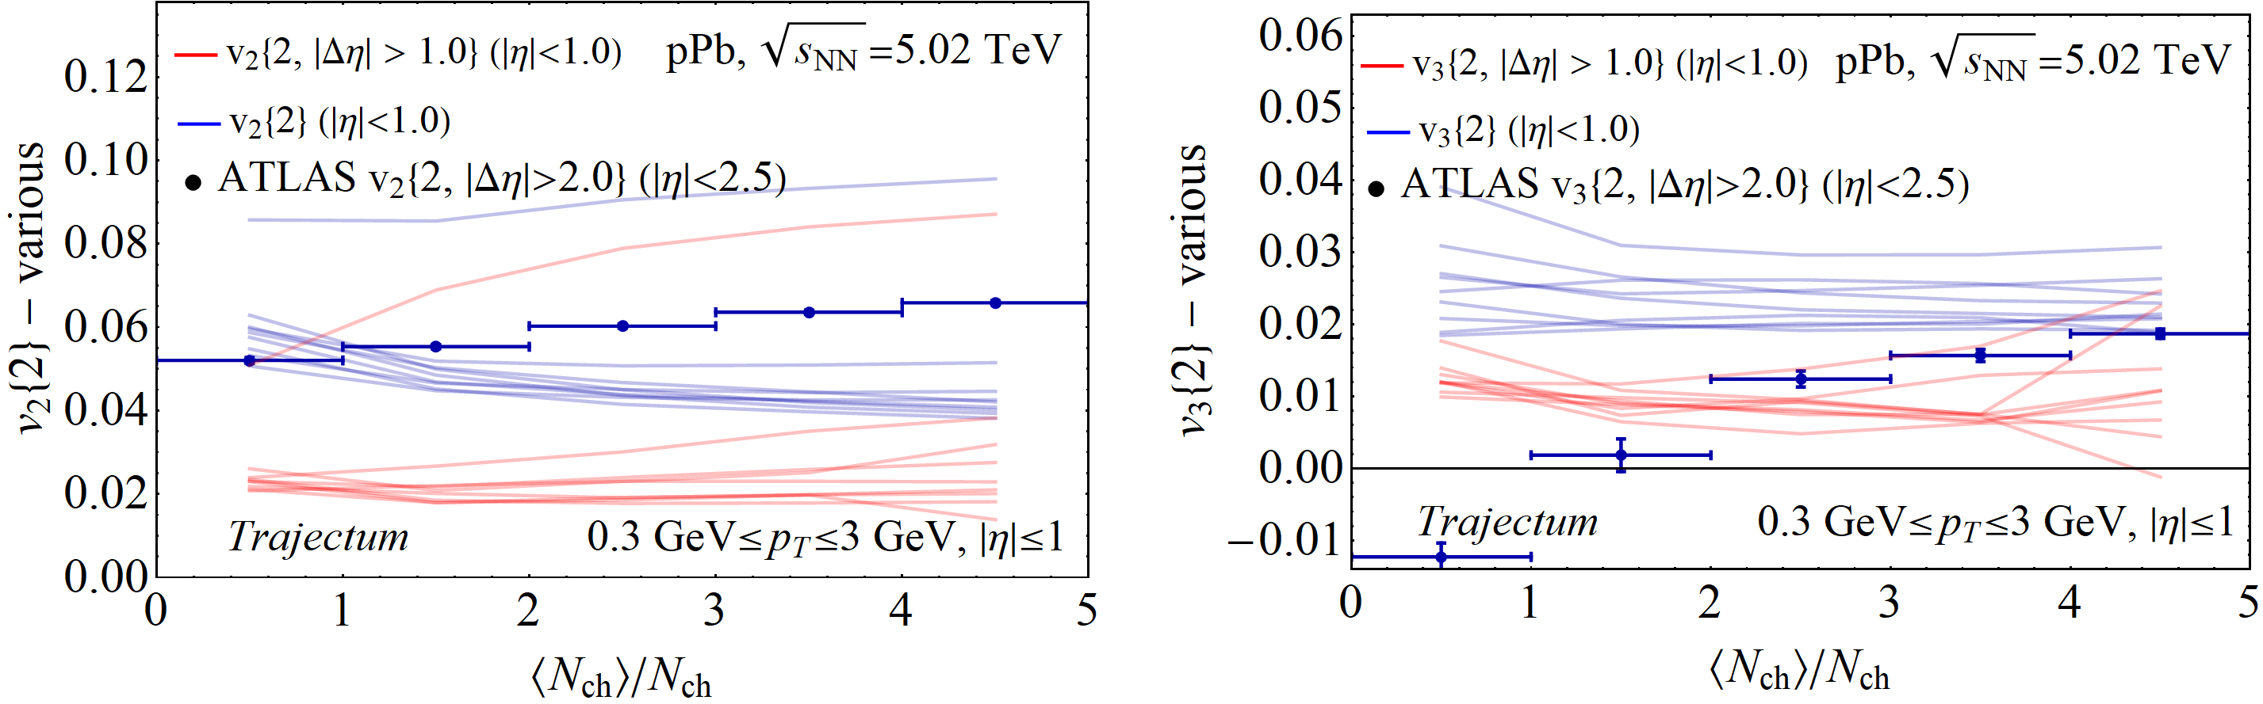
Elliptic flow in pPb collisions – a systematic analysis
Wilke van der Schee, CERN/Utrecht
Ten likely settings from posterior distribution
  Subevent method much smaller flow than cumulant method
  Realistically typically a factor two too low
    Points to caveat to all previous pPb flow studies that include an afterburner/resonances
  One exception (next slide)

Slide 14
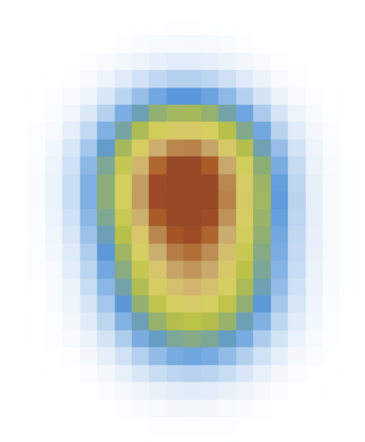

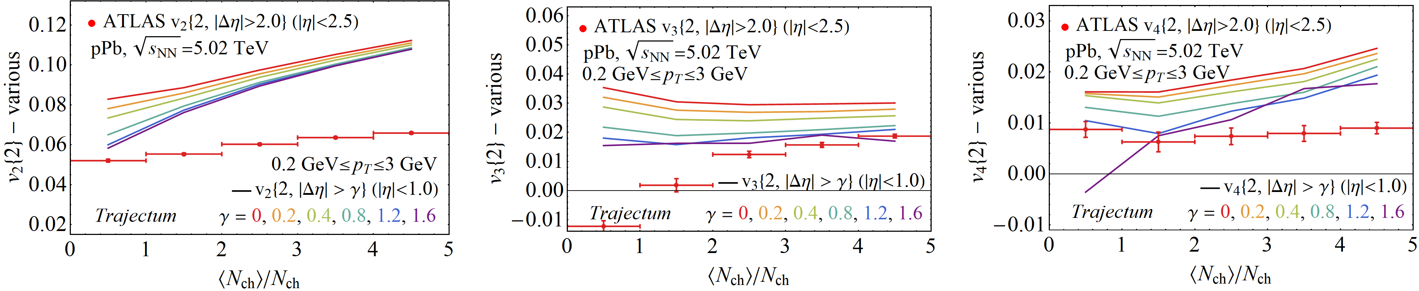
Elliptic flow in pPb collisions – two constituent model (?)
Wilke van der Schee, CERN/Utrecht
Guess based on previous parameters: two constituents with subwidth 0.3 fm (rest is MAP)
  Clearly much more elliptic flow (even too much)
  Effects from Δη gap smaller at large multiplicity (also because of higher flow: )

Slide 15

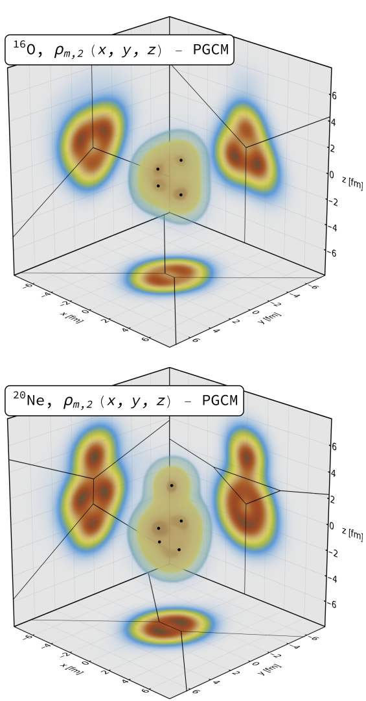
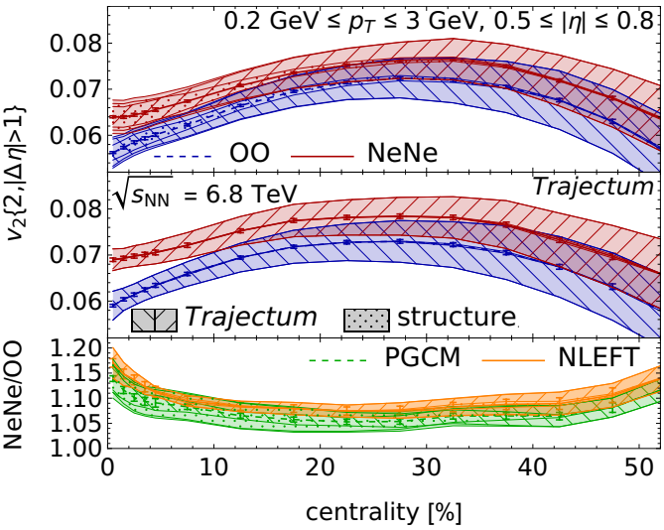
Exciting: upcoming Oxygen (and Ne?) run
Wilke van der Schee, CERN/Utrecht
Perfect system at moderate multiplicity: hydro at its limits
  Characteristic shape with four (¹⁶O) or five (²⁰Ne) alpha clusters
  Relatively precise hydrodynamic predictions (~10% systematic uncertainty)
  Much more accurate prediction for ratio Ne/O (~1% systematic uncertainty)
The ultimate test for the hydrodynamic paradigm?
Giuliano Giacalone, Benjamin Bally, Govert Nijs, Shihang Shen and et al, The unexpected uses of a bowling pin: exploiting ²⁰Ne isotopes for precision characterizations of collectivity in small systems (2024)
Jasmine Brewer, Aleksas Mazeliauskas and WS: http://cern.ch/ooatlhc or https://arxiv.org/abs/2103.01939

Slide 16


Important questions for small systems
Hydrodynamic signature is anisotropic flow
  Flow is small, signal and hence need to be careful
  Important: no discussion of `real non-flow’, e.g. jets and hard QCD
Collectivity is a broader concept than hydrodynamics
  pPb results depend sensitively on model parameters
    Hard to conclude that `panta rei’; systematics is important
  At the moment unclear if any parameters fit consistently (also spectra?)
Useful to have a tool like Trajectum
  Fast: each curve for pPb takes only about 5k CPU hours,
  Runs ~400M Trento IC, ~1M hydro runs and ~30M SMASH runs
  Message both to theory + experiment: details and specifically cuts matter
Exciting time ahead with Oxygen and other small systems (Ne?);

Slide 17
BACK-UP

Slide 18
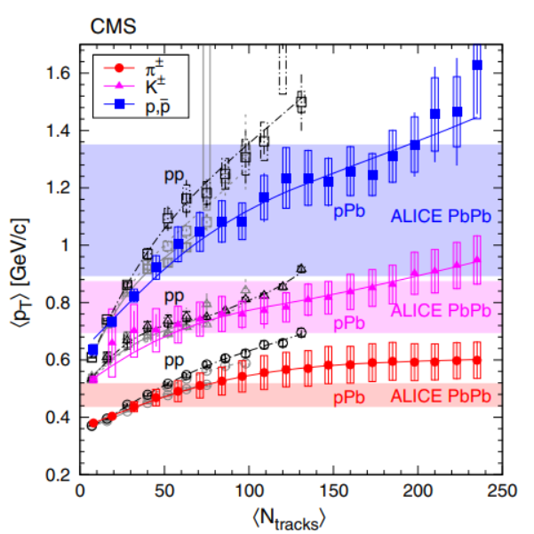
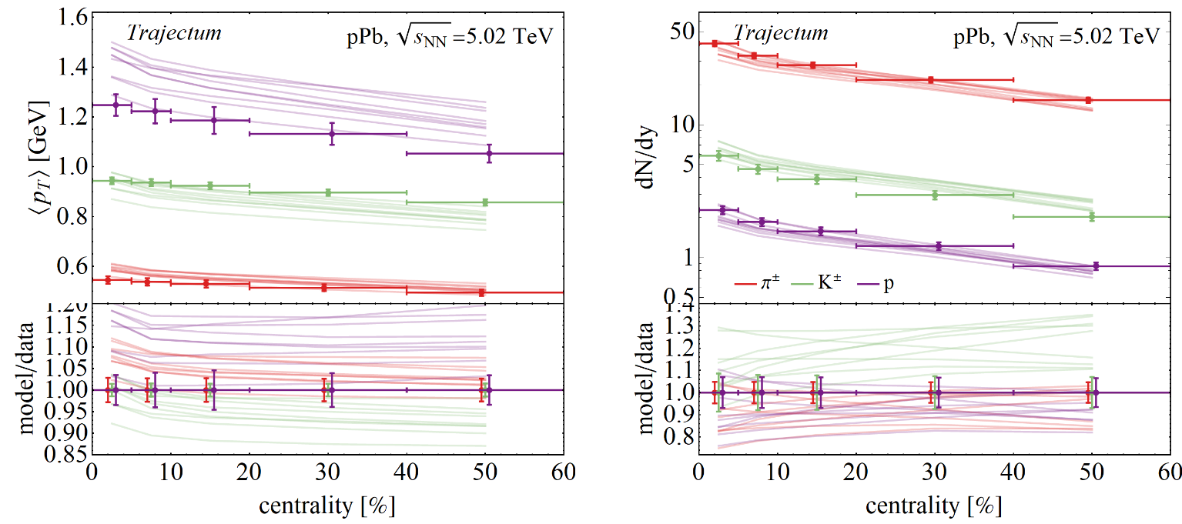
Yields and mean transverse momentum pPb
Wilke van der Schee, CERN/Utrecht
Same 10 likely settings that compare well with pPb
  No new fitting parameters (uses norm of PbPb)
  Proton mean p_{T} overestimated compared to ALICE (see however CMS)
  Significant systematic uncertainty: constrain by Bayesian global analysis?
CMS, Study of the production of charged pions, kaons, and protons in pPb collisions at √s_{NN} = 5.02 TeV (2014)

Slide 19
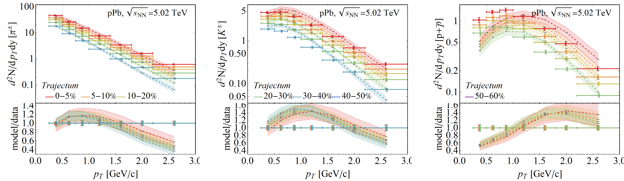
Spectra
Wilke van der Schee, CERN/Utrecht
More differential: identified spectra
  Significant distortions in shape
  Hadronisation is difficult, also uncertainty due to afterburner
ALICE, Multiplicity dependence of charged pion, kaon, and (anti)proton production at large transverse momentum in p-Pb collisionsat √s_{NN} = 5.02 TeV (2016)

Slide 20
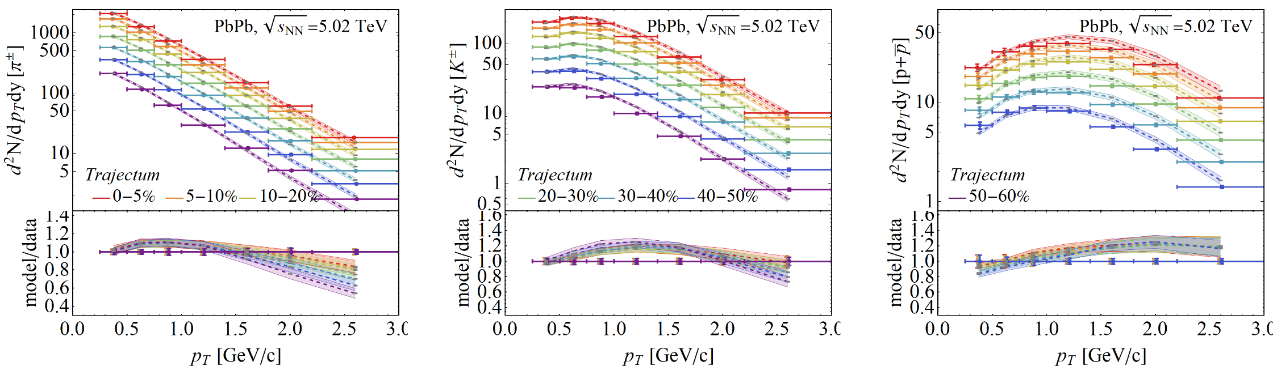
Spectra
Wilke van der Schee, CERN/Utrecht
More differential: identified spectra
  Significant distortions in shape
  Hadronisation is difficult, also uncertainty due to afterburner
  Smaller but similar tensions with data for PbPb

Slide 21
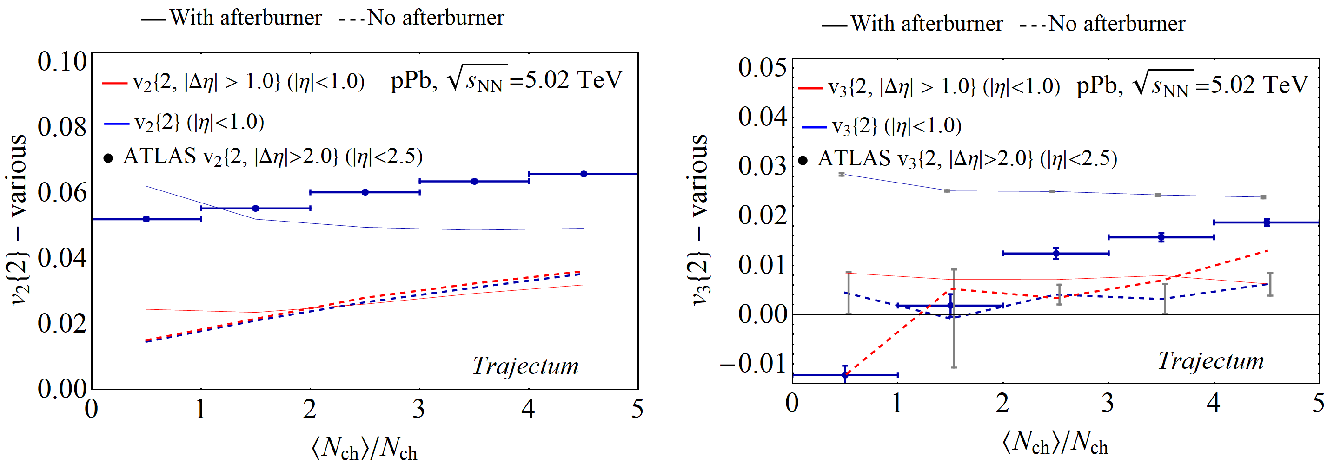
Δη in pPb collisions – Resonances and afterburner (SMASH)
Wilke van der Schee, CERN/Utrecht
Verification that effects are due to hadronic phase
  Cumulants (blue) and Subevent (red)
  Without afterburner the two methods agree (dashed)

Slide 22
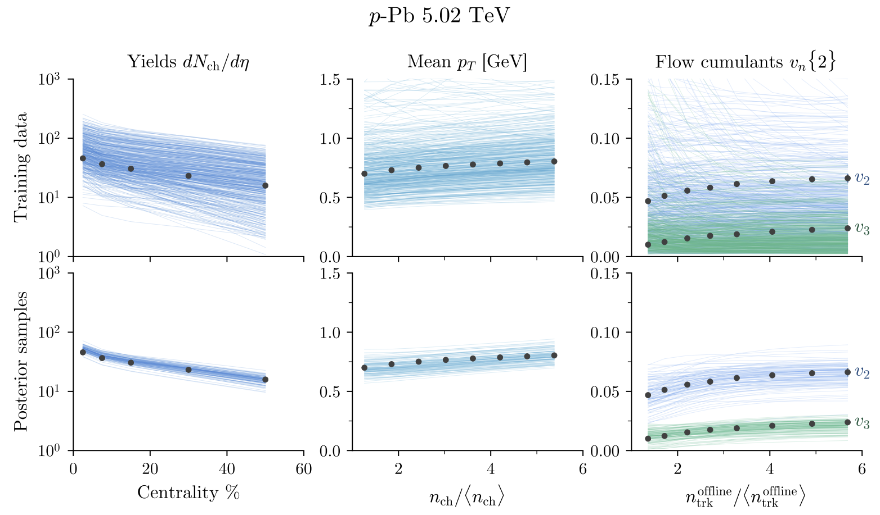
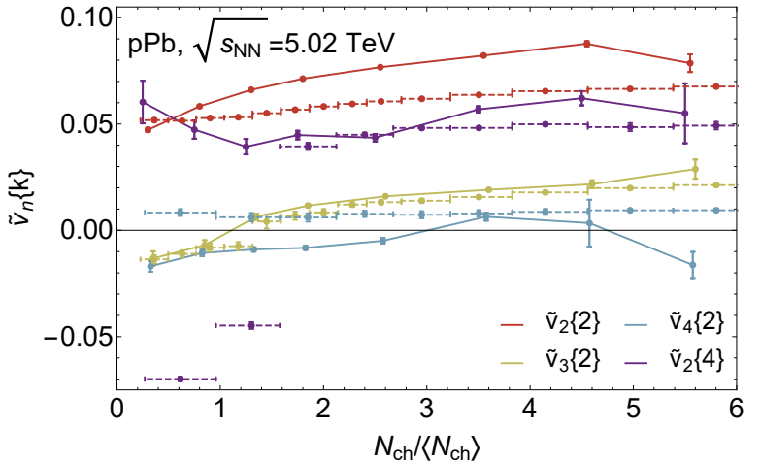
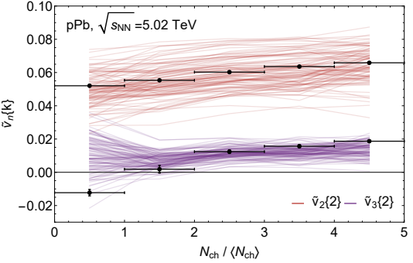
Bayesian analysis of p-Pb
Wilke van der Schee, CERN/Utrecht
Bayesian analysis including p-Pb collisions
  Requires nucleon `substructure’: n constituents of width v
  More challenging to emulate/compute than PbPb
MAP comparison of Trajectum in 2020
  Reasonable agreement
    Curious imaginary values both in theory and data of v₃{2}
Scott Moreland, Jonah Bernhard and Steffen Bass, Estimating initial state and quark-gluon plasma medium properties using a hybrid model with nucleon substructure calibrated to p-Pb and Pb-Pb collisions (2018)
Govert Nijs, WS, Umut Gürsoy and Raimond Snellings, Bayesian analysis of heavy ion collisions with the heavy ion computational framework Trajectum (2020)

Slide 23
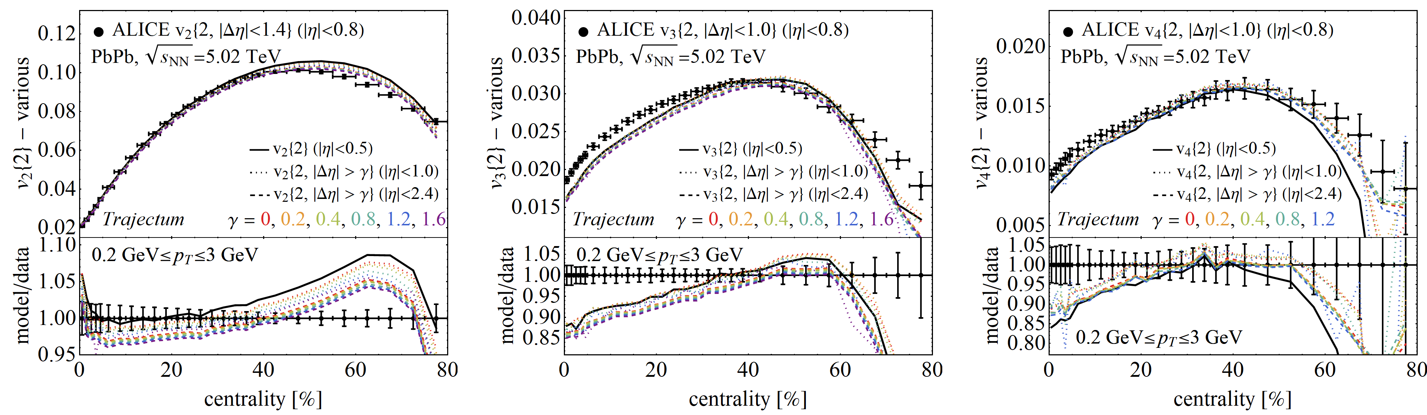
Δη in PbPb collisions – MAP setting with varying cuts
Wilke van der Schee, CERN/Utrecht
Small but significant effects
  Etagap always reduces v2, always increases v4 (even for Δη = 0)
  Settings fit to method 1 (black), but etacut potentially improves agreement (important within ALICE uncertainties)
  Larger effect for smaller detector acceptance (e.g. more important for ALICE than for ATLAS)
  In ratio with data effects are constant versus centrality (however small absolute effect: percent level * percent level)

Slide 24
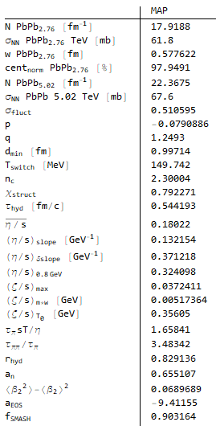
MAP settings
Wilke van der Schee, CERN/Utrecht
For reference the settings used for most runs
  Except 10 settings drawn from posterior

Slide 25
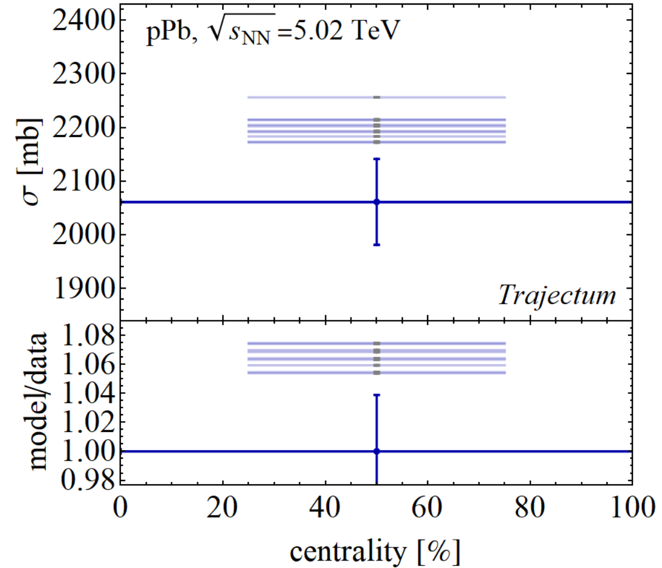
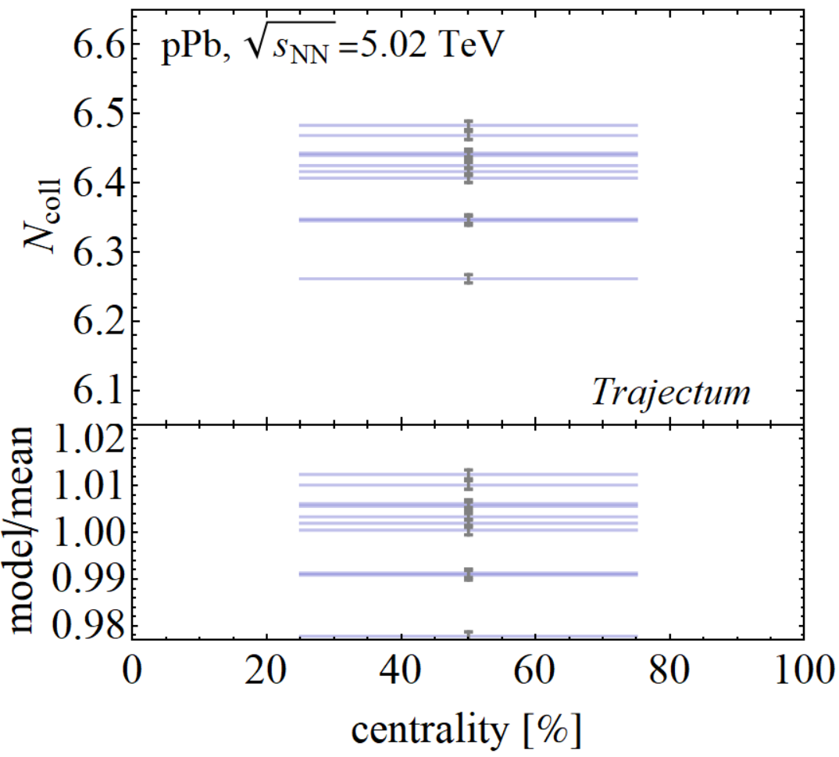
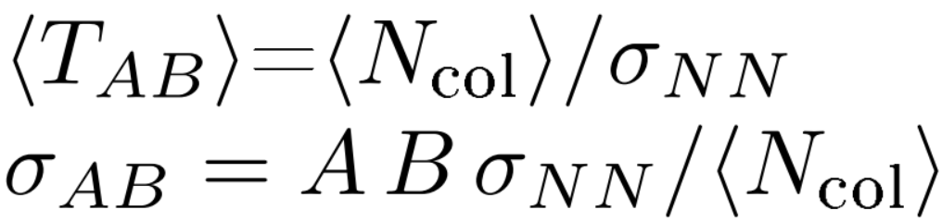
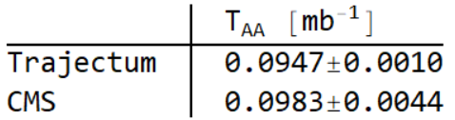
Back to basics: the total hadronic cross section
Wilke van der Schee, CERN/Utrecht
Total cross section on the high side
  Based on 10 `likely’ parameter settings
  Even with a nucleon width of ~0.6 fm
  Average N_{coll} hence a bit low
Implies reduce nuclear thickness of about 7% higher than CMS value
  Could have serious implications for pPb R_{AA}
CMS, Nuclear effects on the transverse momentum spectra of charged particles in pPb collisions at √ s_{NN}=5.02 TeV (2015)

Slide 26
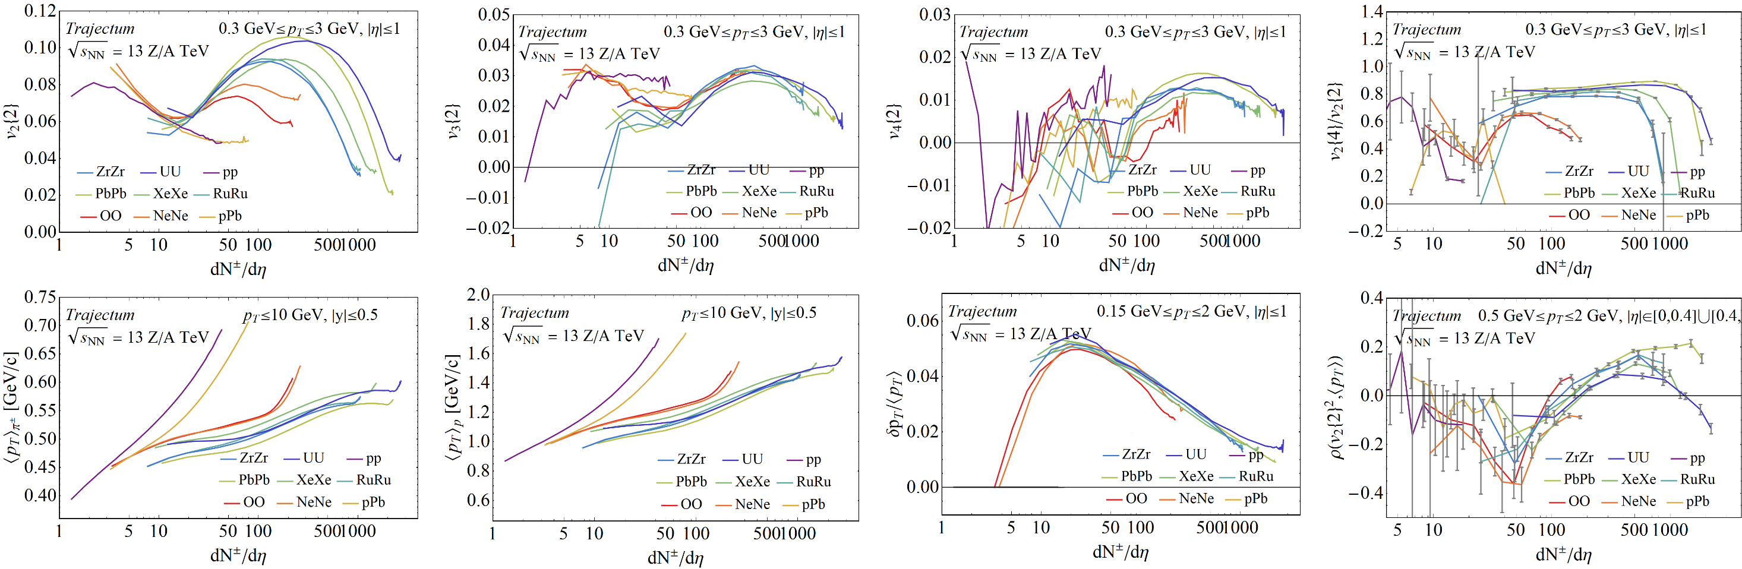
Bonus slide
Wilke van der Schee, CERN/Utrecht
Several systems with MAP settings (systematic analysis with ratios for some to appear)

