Slide 1
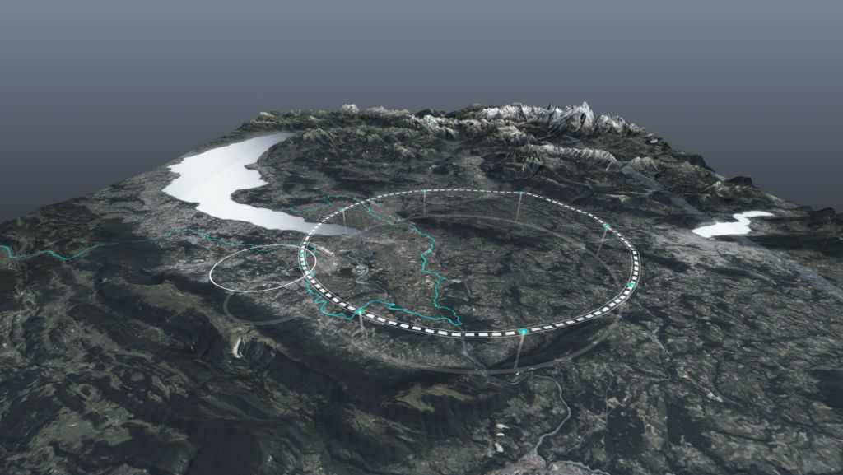


FCC – towards more luminosity
179th FCC-ee optics meeting & 50th FCCIS WP2.2 meeting, 23 February 2024
Frank Zimmermann, CERN
many thanks to Patrick Janot and Christophe Grojean for inviting this presentation
at the 7th FCC Physics Workshop in Annecy
Alert: this talk was not endorsed by FCC or CERN management !
Work supported by the European Commission under the HORIZON 2020 project, FCCIS, grant agreement 951754
photo: J. Wenninger

Slide 2

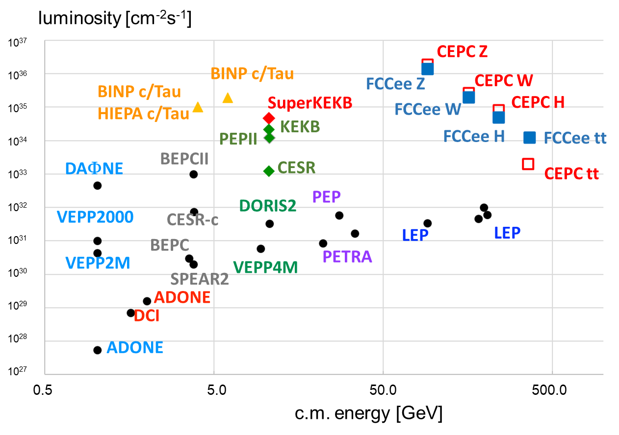
FCC-ee – 2nd highest luminosity collider
/ IP
~ same accelerator design
as twin machine CEPC
a few differences
 | FCC-ee | CEPC
#IPs | 4 or 2 | 2
collider SRF up to ZH | 400 MHz, 1- & 2-cell, Nb/Cu, 4.5 K | 650 MHz, 2-cell, Nb, 2 K
collider SRF ttbar | 800 MHz 5-cell, Nb, 2 K | 650 MHz, 5-cell, Nb, 2 K
booster SRF | 800 MHz 5-cell, Nb, 2 K | 1.3 GHz, 9-cell, Nb, 2 K
top-up | in collider | in booster
CEPC for 100 MW SR power & 2 IPs
FCC-ee with 4 IPs
Marica Biagini

Slide 3

risks of lower luminosity
trends from mid-term review
reduce linac rep rate from 400 to 200 Hz
stainless steel chamber for booster
replace 1-cell Z cavities by 2-cell cavities (the same cavities as for W and ZH)
..
all this is bad news for luminosity …

Slide 4


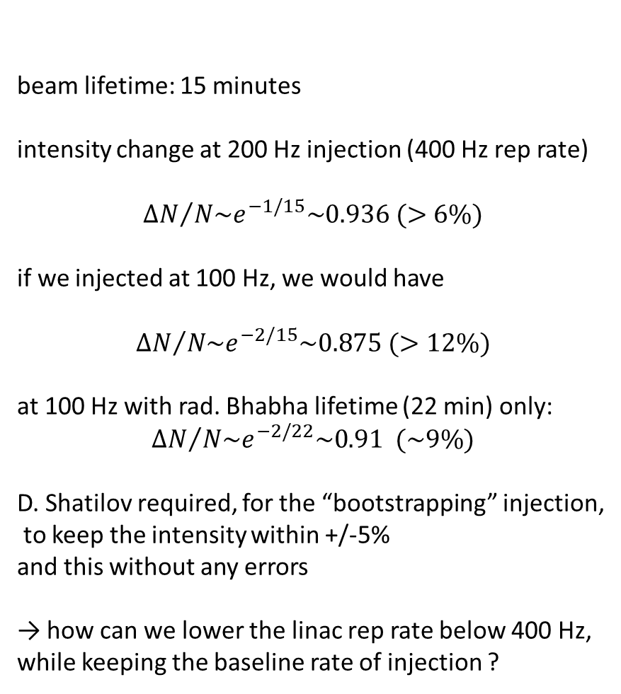
most demanding : operation at the Z
beam lifetime: 15 minutes
intensity change at 200 Hz injection (400 Hz rep rate)
$${ΔN}/{N\sim e^{−1/15}\sim 0.936 (>6\%)}$$
if we injected at 100 Hz, we would have
$${ΔN}/{N\sim e^{−2/15}\sim 0.875 (>12\%)}$$
at 100 Hz with rad. Bhabha lifetime (22 min) only:
$${ΔN}/{N\sim e^{−2/22}\sim 0.91 (\sim 9\%)}$$
D. Shatilov required, for the “bootstrapping” injection,
to keep the intensity within +/-5%
and this without any errors
→ how can we lower the linac rep rate below 400 Hz,
while keeping the baseline rate of injection ?
Mid-term parameters
11200 bunches / beam
injection at 2x200 Hz = 400 Hz
time to fill the booster = 11200/400 s = 28 s
up + top + down ramp ~ 1s
total cycle time 30 s
we can inject the same beam every 60 s or 1 minute
K. Oide
A. Vanel

Slide 5
risk mitigations to be studied
reduce linac rep rate from 400 to 200 Hz
new layout without common linac
operation with 4 bunches / pulse
stainless steel chamber for booster
larger aperture
Cu lamination
more cycles with fewer bunches / cycle
replace 1-cell Z cavities by 2-cell cavities (the same cavities as for W and ZH)
efficient HOM damping for 2-cell cavities
one fundamental power coupler per cell ?
new optics (Raimondi) with larger momentum acceptance?

Slide 6
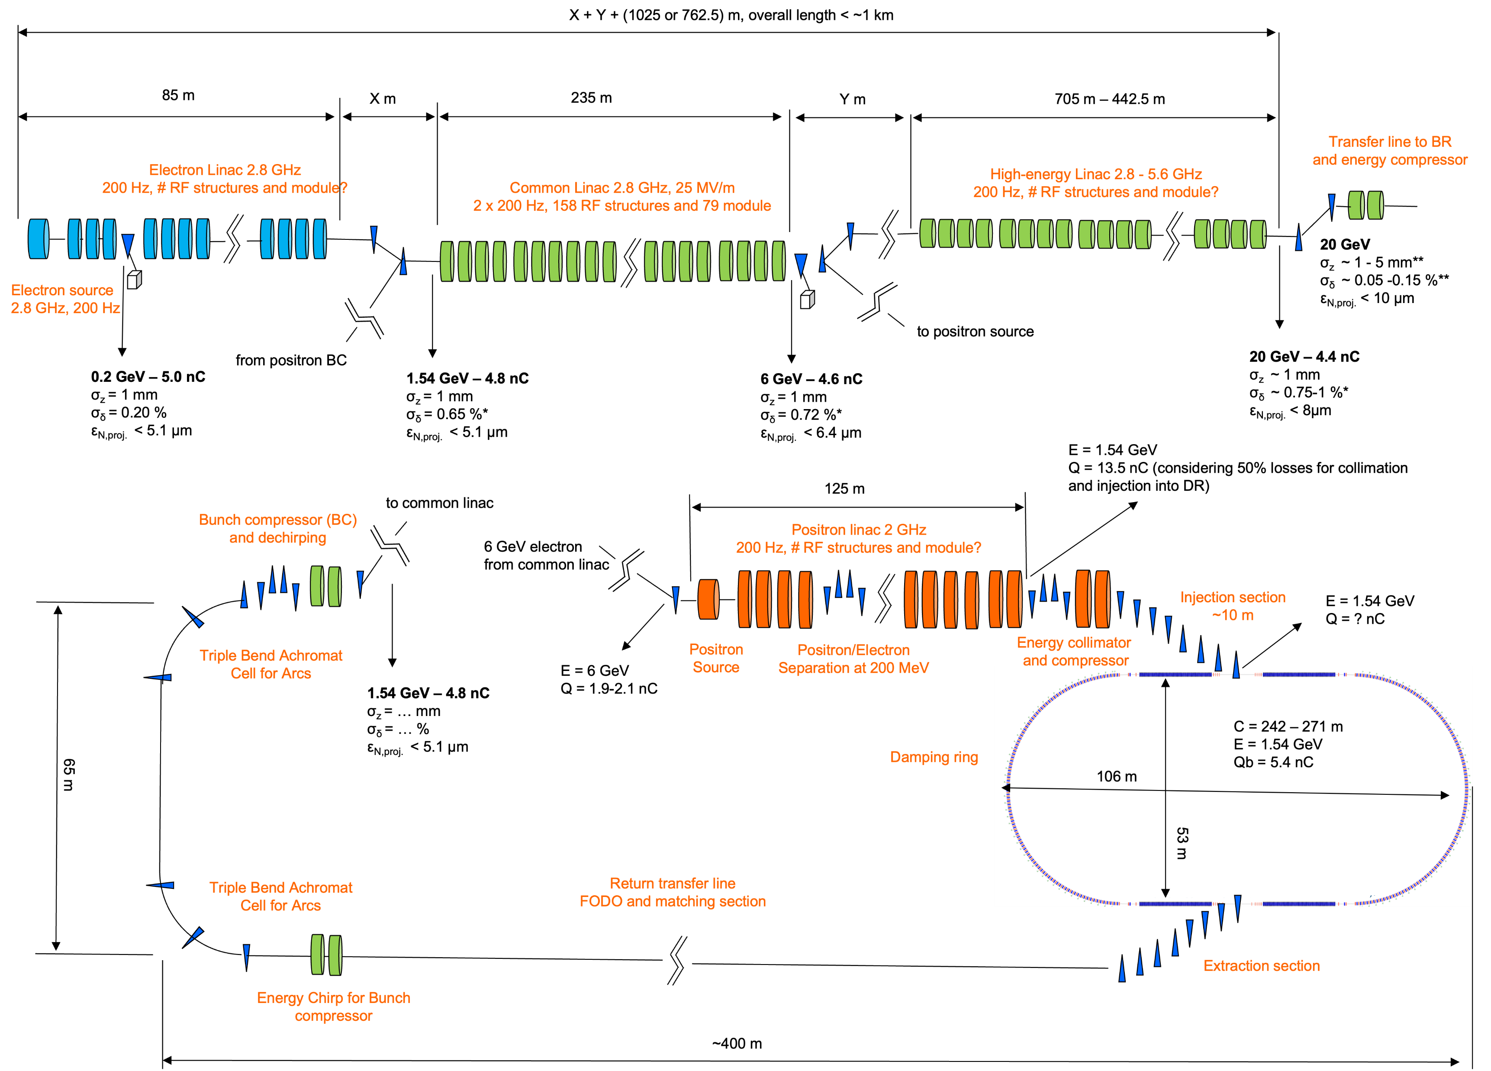
injector layout baseline
common linac
1.54 GeV → 6 GeV;
400 Hz rep rate,
total S-band linac length 1150 m
DR energy 1.54 GeV
e⁺ production at 6 GeV
P. Craievich et al.

Slide 7
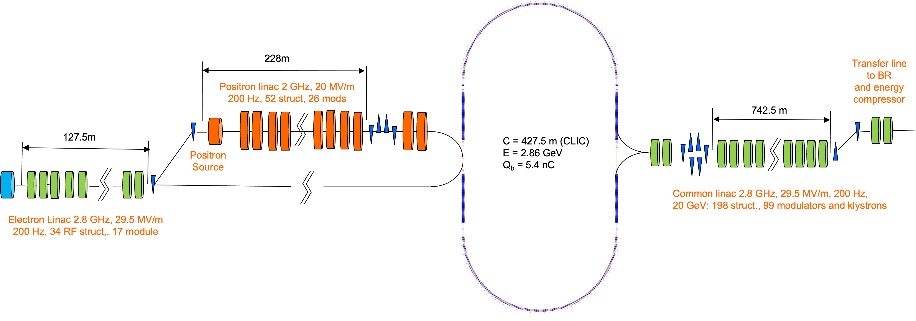
alternative injector layout
P. Craievich et al.
no common linac for e+ production,
200 Hz linac rep rates,
total S-band linac length 1095 m,
DR energy 2.86 GeV,
e⁺ production at 2.86 GeV

Slide 8

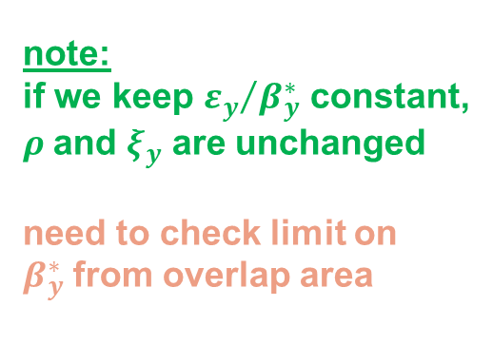

luminosity constraints
injector rate limitation for Z running – factor <2 margin
SR power limit – luminosity could be increased in proportion to SR power
---
beamstrahlung limit
beam-beam tune shift limit
constraint from coherent beam-beam instability
change emittances?
reduce beta *?
$$\frac{1}{ρ}∝\frac{ξ_{y}}{L_{i}}\sqrt{\frac{ε_{y}}{β_{y}^{∗}}}$$
note:
if we keep ${ε_{y}}/{β_{y}^{∗}}$ constant,
$ρ$and $ξ_{y}$ are unchanged
need to check limit on
$β_{y}^{∗}$ from overlap area
$$ξ_{y}=\frac{N_{b}r_{e}}{2πγ}\frac{β_{y}^{∗}}{σ_{x}σ_{y}\sqrt{1+Φ^{2}}}$$
$$ξ_{x}<Q_{s}$$
K. Oide

Slide 9
Mid-term Review Parameters | Z | WW | H (ZH) | ttbar
beam energy [GeV] | 45.6 | 80 | 120 | 182.5
beam current [mA] | 1270 | 137 | 26.7 | 4.9
number bunches/beam | 11200 | 1780 | 440 | 60
bunch spacing [ns] | 25
bunch intensity [10¹¹] | 2.14 | 1.45 | 1.15 | 1.55
SR energy loss / turn [GeV] | 0.0394 | 0.374 | 1.89 | 10.4
SR power [MW] | 100 | 100 | 100 | 100
total RF voltage 400/800 MHz [GV] | 0.080/0 | 1.0/0 | 2.1/0 | 2.1/9.4
long. damping time [turns] | 1158 | 215 | 64 | 18
horizontal beta* [m] | 0.11 | 0.2 | 0.24 | 1.0
vertical beta* [mm] | 0.7 | 1.0 | 1.0 | 1.6
horizontal geometric emittance [nm] | 0.71 | 2.17 | 0.71 | 1.59
vertical geom. emittance [pm] | 1.9 | 2.2 | 1.4 | 1.6
horizontal rms IP spot size [μm] | 9 | 21 | 13 | 40
vertical rms IP spot size [nm] | 36 | 47 | 40 | 51
beam-beam parameter ξ_{x} / ξ_{y} | 0.002/0.0973 | 0.013/0.128 | 0.010/0.088 | 0.073/0.134
rms bunch length with SR / BS [mm] | 5.6 / 15.5 | 3.5 / 5.4 | 3.4 / 4.7 | 1.8 / 2.2
luminosity per IP [10³⁴ cm⁻²s⁻¹] | 141 | 20 | 5.0 | 1.25
total integrated luminosity / IP / year [ab⁻¹/yr] | 17 | 2.4 | 0.6 | 0.15
beam lifetime rad Bhabha [min] | 22 | 16 | 14 | 12
beam lifetime (q+BS+lattice) [min] | 50 | 42 | 100 | 100

Slide 10
Parameters for 150 MW SR power | Z | WW | H (ZH) | ttbar
beam energy [GeV] | 45.6 | 80 | 120 | 182.5
beam current [mA] | 1905 | 206 | 40 | 7.4
number bunches/beam | 16800 | 2670 | 660 | 90
bunch spacing [ns] | <18
bunch intensity [10¹¹] | 2.14 | 1.45 | 1.15 | 1.55
SR energy loss / turn [GeV] | 0.0394 | 0.374 | 1.89 | 10.4
SR power [MW] | 150 | 150 | 150 | 150
total RF voltage 400/800 MHz [GV] | 0.080/0 | 1.0/0 | 2.1/0 | 2.1/9.4
long. damping time [turns] | 1158 | 215 | 64 | 18
horizontal beta* [m] | 0.11 | 0.2 | 0.24 | 1.0
vertical beta* [mm] | 0.7 | 1.0 | 1.0 | 1.6
horizontal geometric emittance [nm] | 0.71 | 2.17 | 0.71 | 1.59
vertical geom. emittance [pm] | 1.9 | 2.2 | 1.4 | 1.6
horizontal rms IP spot size [μm] | 9 | 21 | 13 | 40
vertical rms IP spot size [nm] | 36 | 47 | 40 | 51
beam-beam parameter ξ_{x} / ξ_{y} | 0.002/0.0973 | 0.013/0.128 | 0.010/0.088 | 0.073/0.134
rms bunch length with SR / BS [mm] | 5.6 / 15.5 | 3.5 / 5.4 | 3.4 / 4.7 | 1.8 / 2.2
luminosity per IP [10³⁴ cm⁻²s⁻¹] | 212 | 30 | 7.5 | 1.88
total integrated luminosity / IP / year [ab⁻¹/yr] | 25 | 3.6 | 0.9 | 0.23
beam lifetime rad Bhabha [min] | 22 | 16 | 14 | 12
beam lifetime (q+BS+lattice) [min] | 50 | 42 | 100 | 100

Slide 11
Parameters for smaller β_{y}* & ε_{y} | Z | WW | H (ZH) | ttbar
beam energy [GeV] | 45.6 | 80 | 120 | 182.5
beam current [mA] | 1270 | 137 | 26.7 | 4.9
number bunches/beam | 11200 | 1780 | 440 | 60
bunch spacing [ns] | 25
bunch intensity [10¹¹] | 2.14 | 1.45 | 1.15 | 1.55
SR energy loss / turn [GeV] | 0.0394 | 0.374 | 1.89 | 10.4
SR power [MW] | 100 | 100 | 100 | 100
total RF voltage 400/800 MHz [GV] | 0.080/0 | 1.0/0 | 2.1/0 | 2.1/9.4
long. damping time [turns] | 1158 | 215 | 64 | 18
horizontal beta* [m] | 0.11 | 0.2 | 0.24 | 1.0
vertical beta* [mm] | 0.35 | 0.5 | 0.5 | 0.8
horizontal geometric emittance [nm] | 0.71 | 2.17 | 0.71 | 1.59
vertical geom. emittance [pm] | 1.0 | 1.1 | 0.7 | 0.8
horizontal rms IP spot size [μm] | 9 | 21 | 13 | 40
vertical rms IP spot size [nm] | 18 | 24 | 20 | 26
beam-beam parameter ξ_{x} / ξ_{y} | 0.002/0.0973 | 0.013/0.128 | 0.010/0.088 | 0.073/0.134
rms bunch length with SR / BS [mm] | 5.6 / 15.5 | 3.5 / 5.4 | 3.4 / 4.7 | 1.8 / 2.2
luminosity per IP [10³⁴ cm⁻²s⁻¹] | 282 | 40 | 10.0 | 2.5
total integrated luminosity / IP / year [ab⁻¹/yr] | 34 | 4.8 | 1.2 | 0.3
beam lifetime rad Bhabha [min] | 11 | 8 | 7 | 6
beam lifetime (q+BS+lattice) [min] | 50 | 42 | 100 | 100

Slide 12
Parameters for 150 MW SRP and smaller β_{y}* & ε_{y} | Z | WW | H (ZH) | ttbar
beam energy [GeV] | 45.6 | 80 | 120 | 182.5
beam current [mA] | 1905 | 206 | 40 | 7.4
number bunches/beam | 16800 | 2670 | 660 | 90
bunch spacing [ns] | <18
bunch intensity [10¹¹] | 2.14 | 1.45 | 1.15 | 1.55
SR energy loss / turn [GeV] | 0.0394 | 0.374 | 1.89 | 10.4
SR power [MW] | 150 | 150 | 150 | 150
total RF voltage 400/800 MHz [GV] | 0.080/0 | 1.0/0 | 2.1/0 | 2.1/9.4
long. damping time [turns] | 1158 | 215 | 64 | 18
horizontal beta* [m] | 0.11 | 0.2 | 0.24 | 1.0
vertical beta* [mm] | 0.35 | 0.5 | 0.5 | 0.8
horizontal geometric emittance [nm] | 0.71 | 2.17 | 0.71 | 1.59
vertical geom. emittance [pm] | 1.0 | 1.1 | 0.7 | 0.8
horizontal rms IP spot size [μm] | 9 | 21 | 13 | 40
vertical rms IP spot size [nm] | 18 | 24 | 20 | 26
beam-beam parameter ξ_{x} / ξ_{y} | 0.002/0.0973 | 0.013/0.128 | 0.010/0.088 | 0.073/0.134
rms bunch length with SR / BS [mm] | 5.6 / 15.5 | 3.5 / 5.4 | 3.4 / 4.7 | 1.8 / 2.2
luminosity per IP [10³⁴ cm⁻²s⁻¹] | 423 | 60 | 15.0 | 3.8
total integrated luminosity / IP / year [ab⁻¹/yr] | 51 | 7.2 | 1.8 | 0.45
beam lifetime rad Bhabha [min] | 11 | 8 | 7 | 6
beam lifetime (q+BS+lattice) [min] | 50 | 42 | 100 | 100

Slide 13
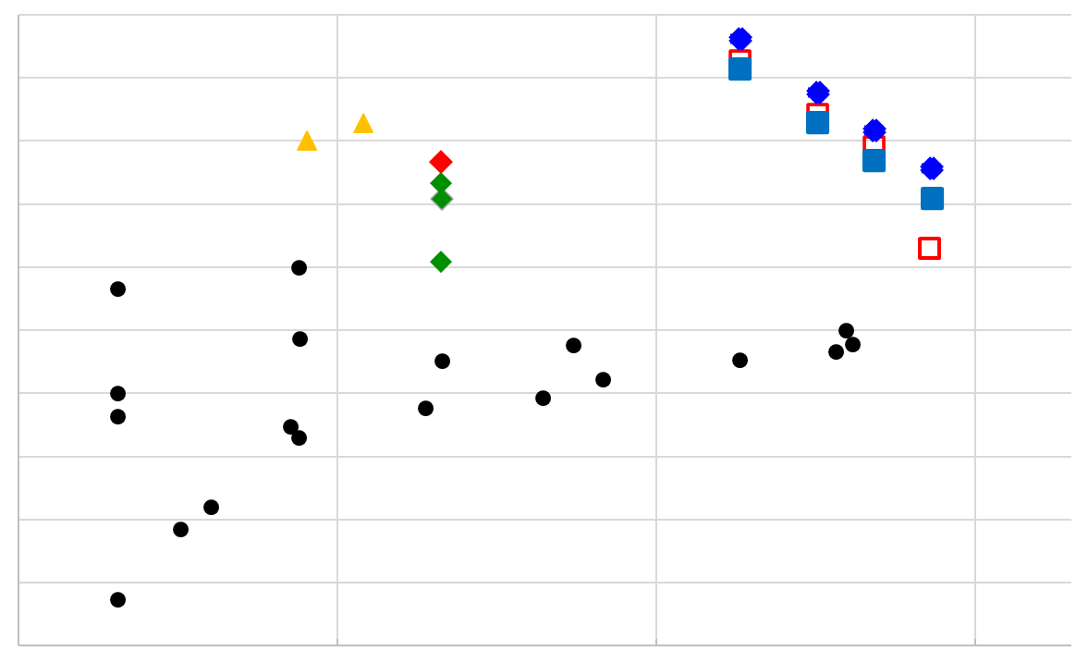
“HL-FCC-ee” – highest luminosity collider !
luminosity [cm⁻²s⁻¹]
/ IP
10³⁷
10³⁶
10³⁵
10³⁴
10³³
10³²
10³¹
10³⁰
10²⁹
10²⁸
10²⁷
CEPC Z
HL-FCC-ee Z
BINP c/Tau
FCC-ee Z
HL-FCC-ee W
BINP c/Tau
HIEPA c/Tau
CEPC W
HL-FCC-ee H
SuperKEKB
FCC-ee W
HL-FCC-ee tt
KEKB
CEPC H
PEPII
FCC-ee H
BEPCII
FCC-ee tt
DAΦNE
CESR
CEPC tt
DORIS2
PEP
VEPP2000
CESR-c
LEP
LEP
BEPC
VEPP2M
VEPP4M
PETRA
SPEAR2
ADONE
DCI
CEPC for 100 MW SR power & 2 IPs
FCC-ee with 4 IPs
ADONE
0.5 5.0 50.0 500.0
Marica Biagini
c.m. energy [GeV]

Slide 14
Conclusions
the alternative injector layout looks attractive and could support higher luminosity at reduced linac repetition rate
possible path to increasing the FCC-ee luminosity by a factor 2-3 at all energies, by decreasing β_{y}* along with ε_{y}, and/or by raising SR power, respecting all other relevant constraints
a good optics and excellent optics control will be essential
increasing luminosity at Z is most challenging; vertical design emittance from IR solenoids should be minimised (presently ~0.5 pm for 4 IPs at Z, Mike Koratzinos, arXiv 2101.05704); at Z also e-cloud could limit #bunches
there might be other ways to boost the FCC-ee luminosity (hor. emittance, crossing angle, hor. beta*, bunch length, bunch charge etc.)

