Slide 1
Introduction to
Beam Instrumentation and Diagnostics
Lecture II
Michal Krupa
(based on previous lectures by Rhodri Jones)

Slide 2
Outline
Lecture I - yesterday
  Introduction
  Beam position monitoring
  Beam intensity monitoring
  Beam loss monitoring
Lecture II - today
  Transverse beam profile monitoring
  Tune measurements
  Coupling measurements
  Chromaticity measurements
  Diagnosing accelerator issues

Slide 3
Transverse beam profile monitoring

Slide 4
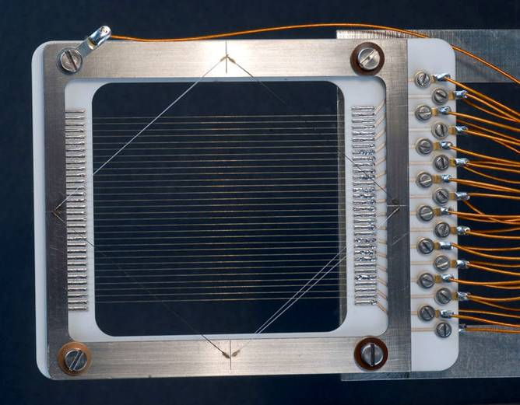
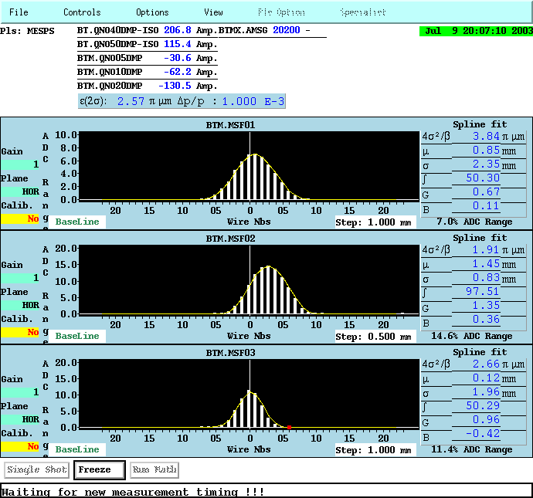
Beam profile monitoring using wires
Secondary Emission Monitors (SEM, HARP)
Secondary electrons emitted from beam-wire interaction – electric current in the wire
Current in each wire read-out independently – beam profile reconstruction
Wires can overheat – not ideal for circular machines

Slide 5
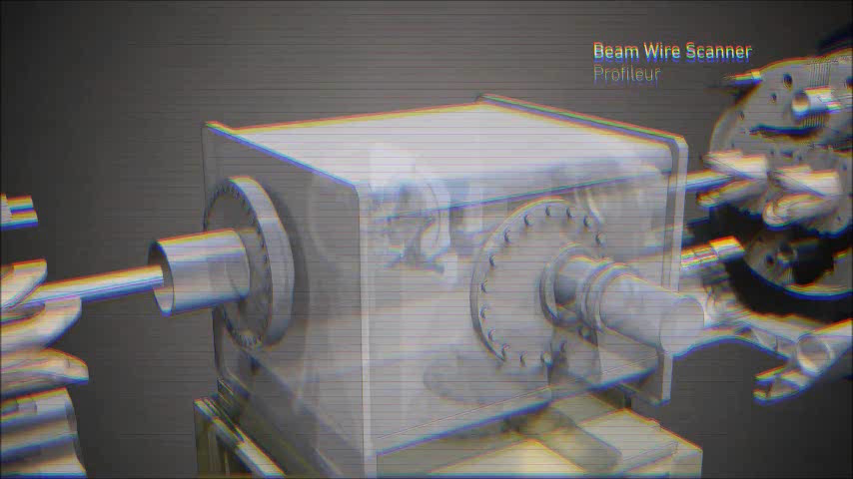
Beam profile monitoring using wires
Wire scanners
Single thin wire swept across the beam – corelate beam-wire interactions with the wire position
Low-energy beams: current in the wire due to secondary emission
High-energy beams: secondary shower measured outside of the vacuum (e.g. with scintillator)
Absolute measurements – can be used for cross-calibration of other instruments

Slide 6
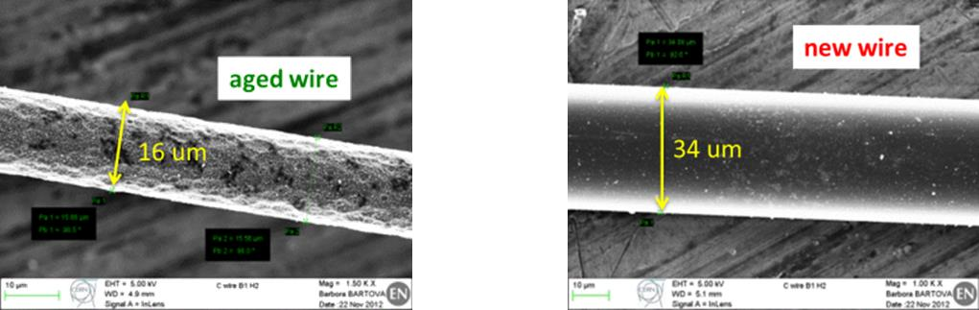
Wire scanner limitations
Wires can (and do!) get damaged
  Mechanical failures – due to errors in motor controls
  Melting / sublimation – energy deposition in the wire, large energy density for small beams
Thermal behaviour of the wire depends on the heat capacity (increases with temperature!) and cooling (negligible during a ~ 1 ms scan time)
Wire material: good mechanical properties, high heat capacity, high melting / sublimation point (e.g. 3915 K for carbon)

Slide 7
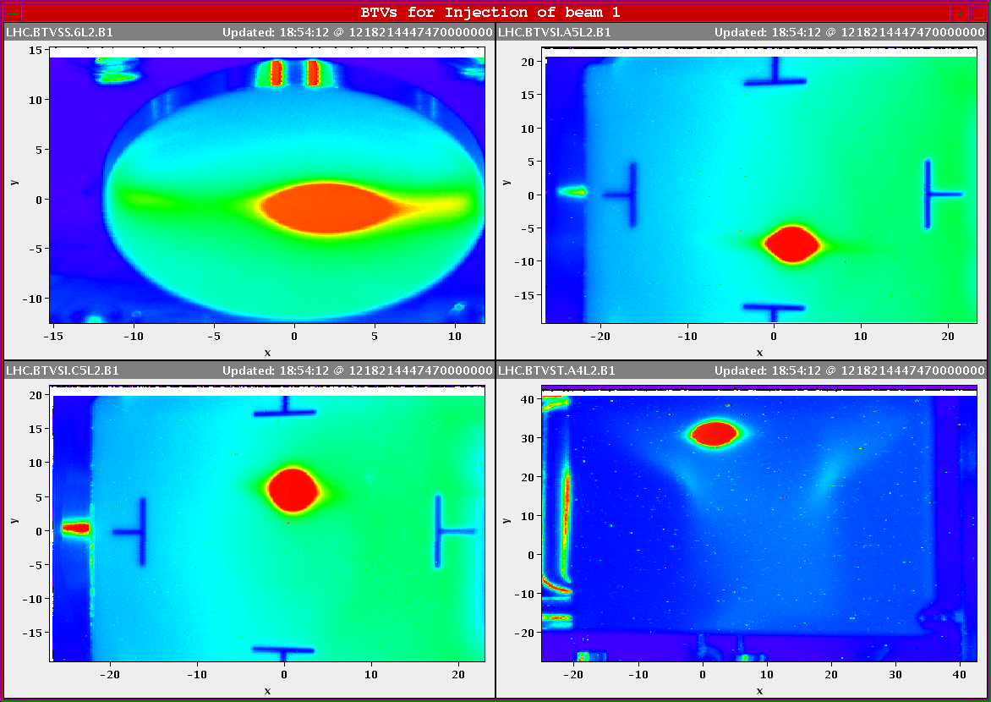
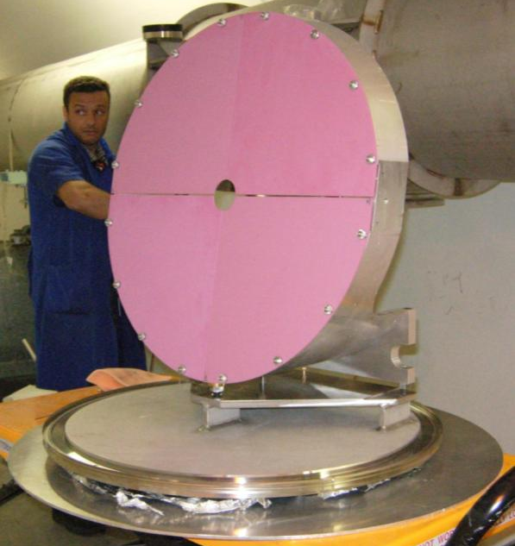
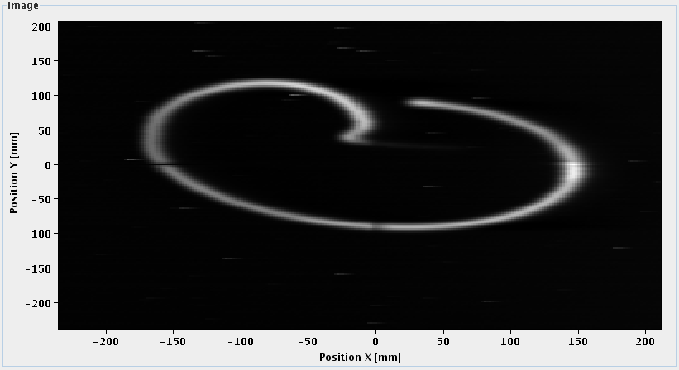
Beam profile monitoring using screens
Luminescence / scintillating screens
Light emission upon beam-screen interaction
Straight-forward instrument for beam size and position monitoring
  2D information with CCD cameras
Thick screens are destructive to the beam but work with low intensities

Slide 8
Beam profile monitoring using screens
Optical Transition Radiation (OTR) screens
Radiation emitted when a charged particle goes through an interface with different dielectric constants
Surface phenomenon – very thin (10 um) screens possible
  Multiple screen in single-pass lines
  Measurement over hundreds of turns in rings
Less destructive than scintillation but requires higher energy / intensity beams
Extremely high resolution possible
Beam
OTR Screen
Exit window
Intensifier -
CCD
Mirror
Lens

Slide 9
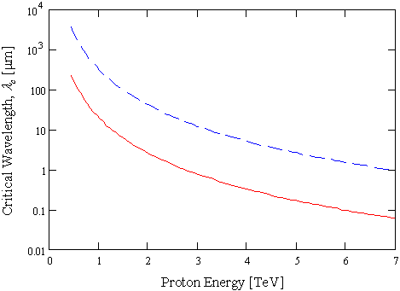
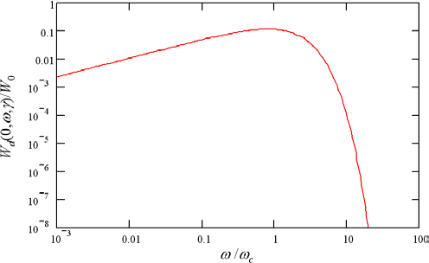
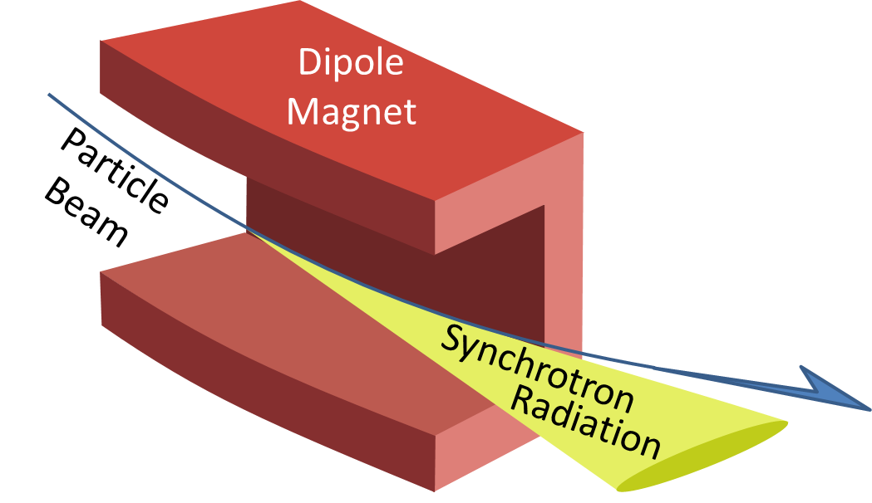
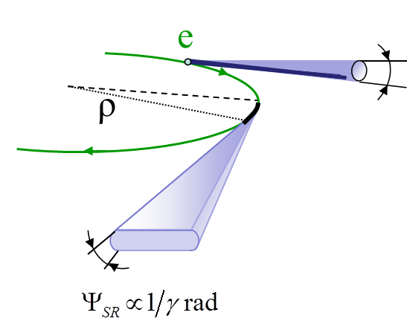
Beam profile monitoring using synchrotron light
Synchrotron light monitors
Light emission when the trajectory of a charged beam is bent (e.g. by a dipole, undulator, wiggler)
Scientifically exploited in light sources
Powerful diagnostic tool – non-invasive measurements
Measurements in the visible range possible in some conditions
critical wavelength
Protons
Lead ions
Intensity drops off sharply after critical wavelength
Visible light
Little visible light at injection energy
lower frequency higher wavelength
higher frequency lower wavelength

Slide 10
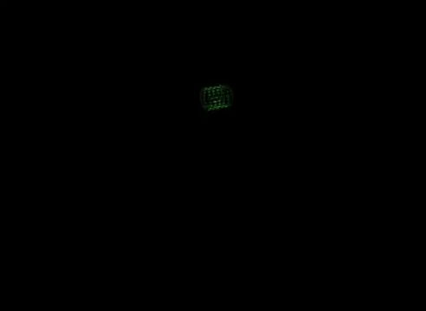
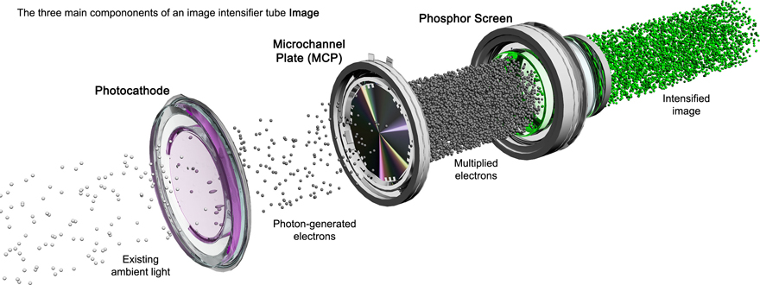

Beam profile monitoring using synchrotron light
Imaging possible with different camera types
  Standard CCD cameras – average beam size measurements
  Gated intensified cameras – bunch-by-bunch measurements
  X-ray pin hole cameras – for small, high-energy electron beams
  Streak cameras – for short bunch diagnostics

Slide 11
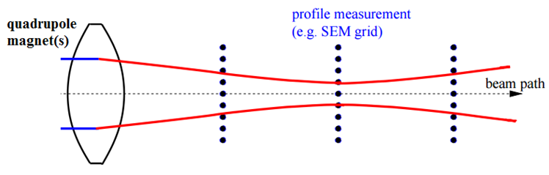
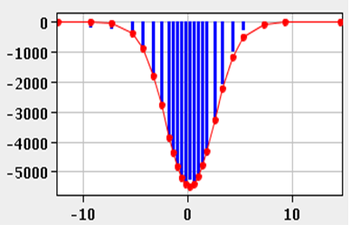
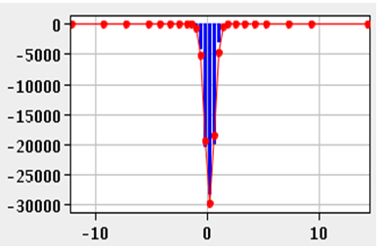
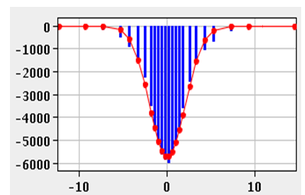






Optics measurements - 3 monitor method
Reconstruction of optics functions and initial emittance using transport matrix
Measured beam profiles
$$x′$$
$$x′$$
$$x′$$
RMS phase-space ellipses
$$x$$
$$x$$
$$x$$

Slide 12
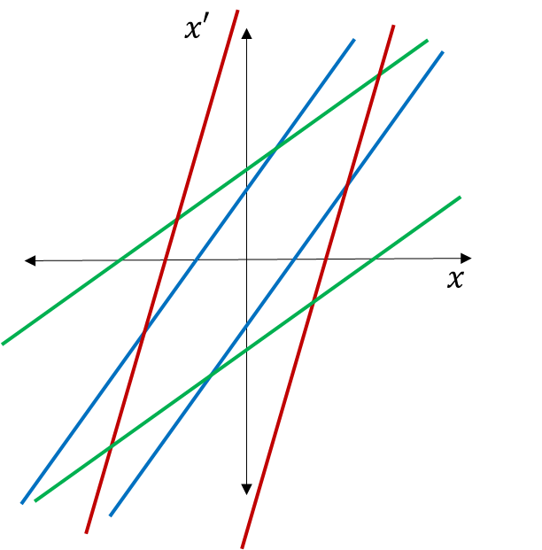
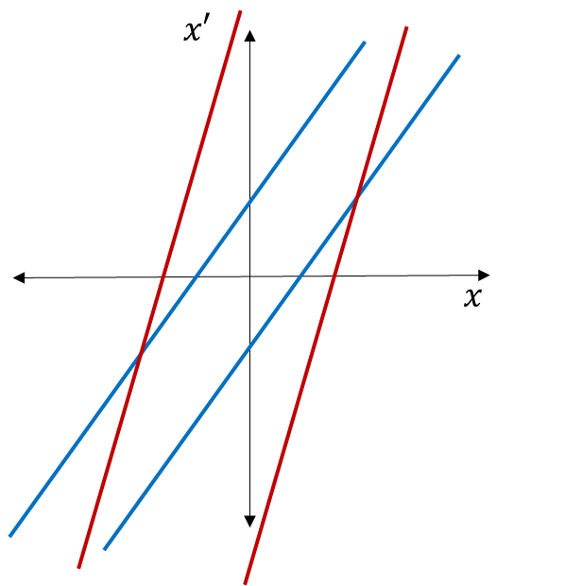
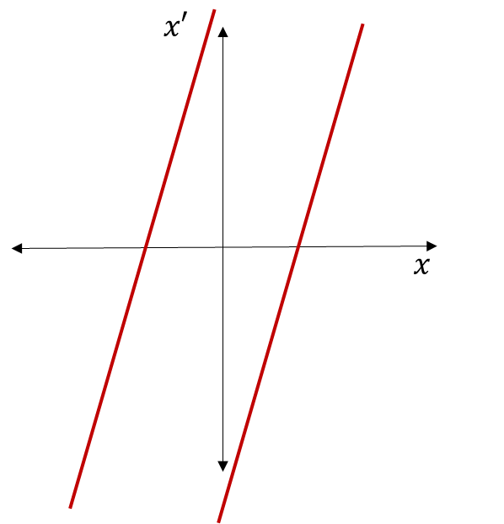






Optics measurements - 3 monitor method
Linear mapping of measured beam size onto initial phase space
Measured
beam profiles
$$x′$$
$$x′$$
$$x′$$
RMS ellipses
$$x$$
$$x$$
$$x$$

Slide 13
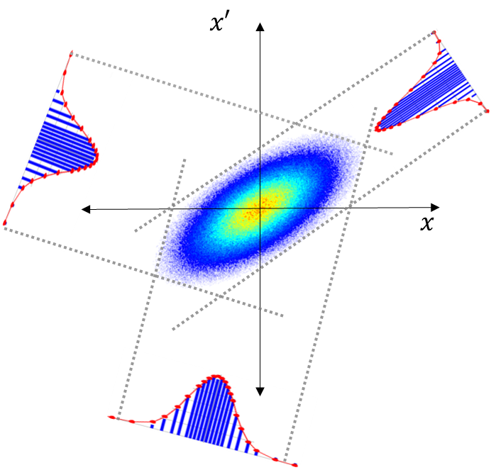
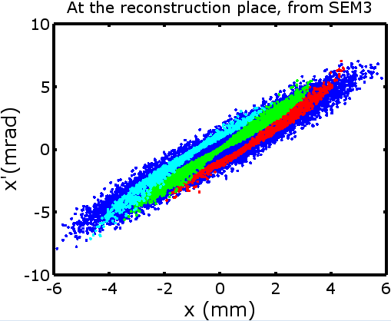
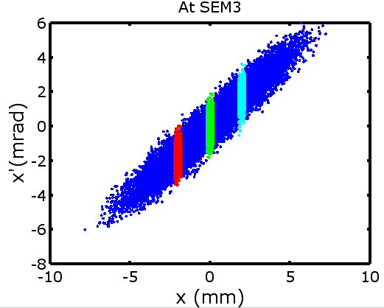
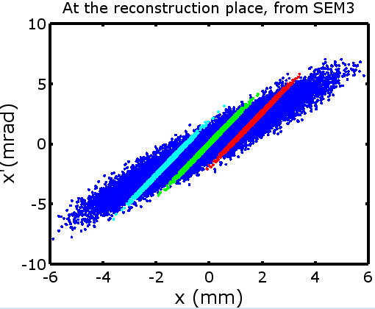
Optics measurements - 3 monitor method
Tomography – deriving the distribution of particle density in 2D from 1D beam profile measurements
Best results for low-current and/or high-energy beams – no non-linear effects (e.g. space charge)

Slide 14
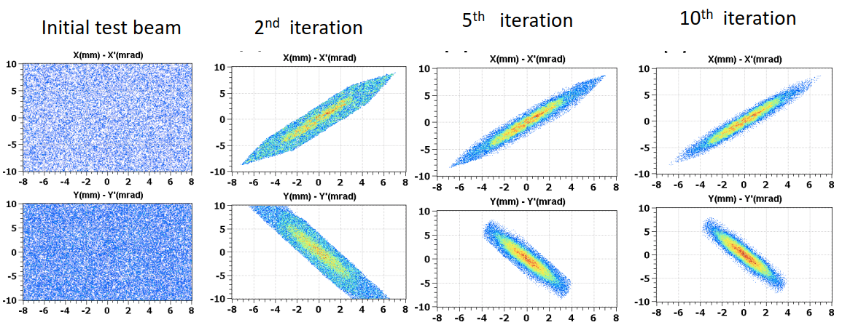
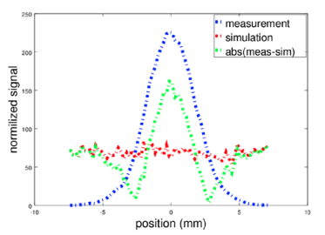
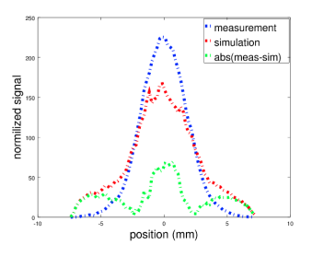
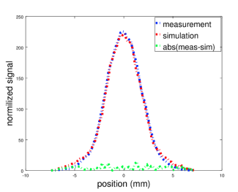
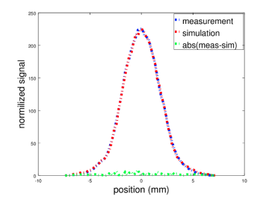
Hybrid phase space tomography – CERN Linac4
Random phase space at the reconstruction position
Transport it to the measurement position (track particles)
Compare the simulation output to the measurement
Deduce a better distribution at the reconstruction position
Repeat iteratively

Slide 15
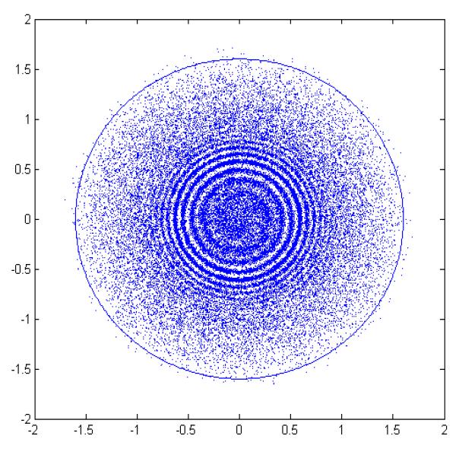
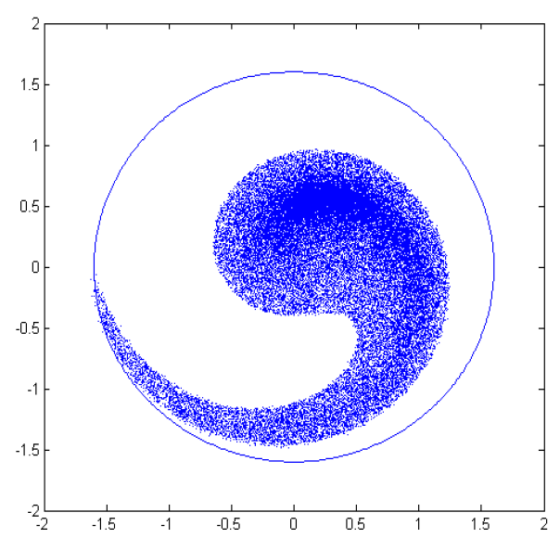
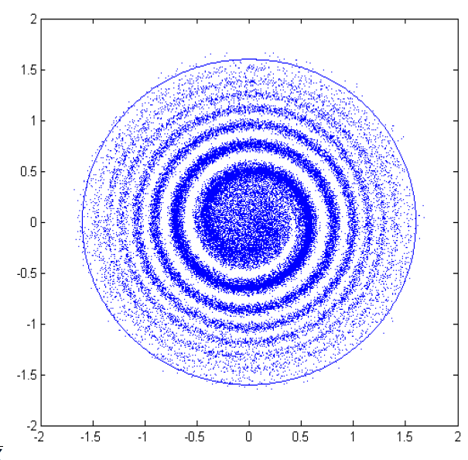

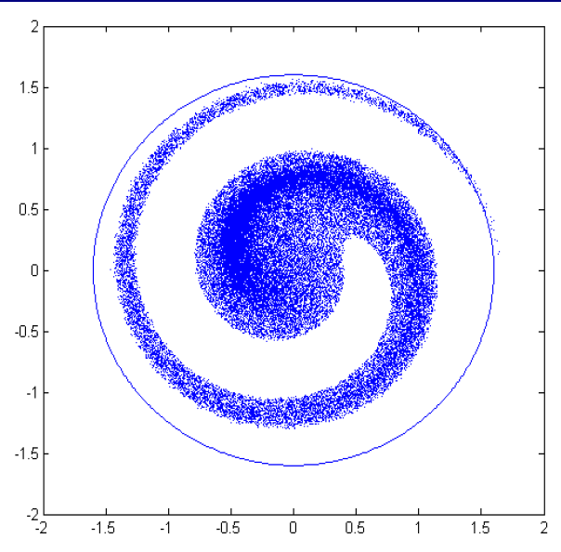
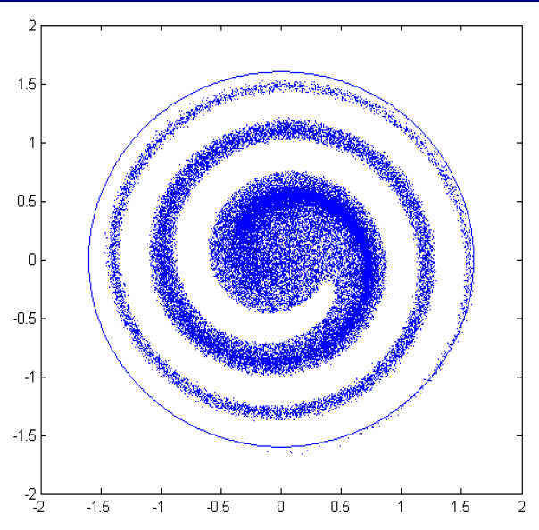
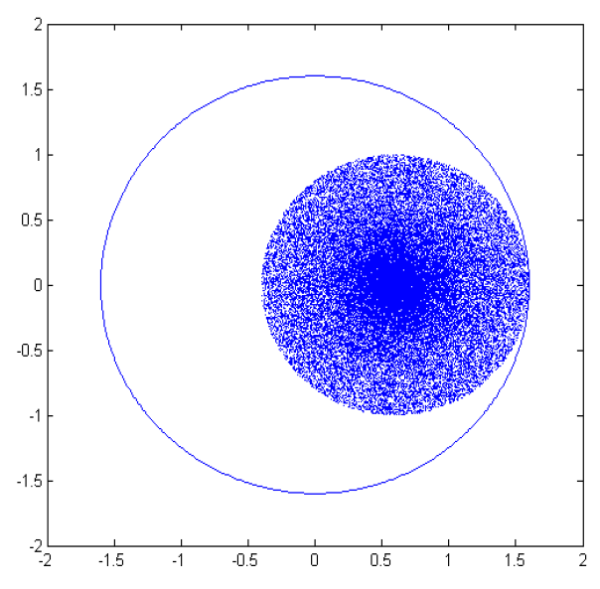
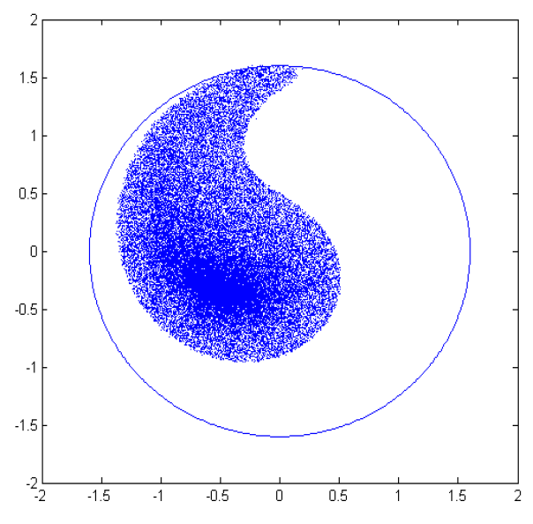
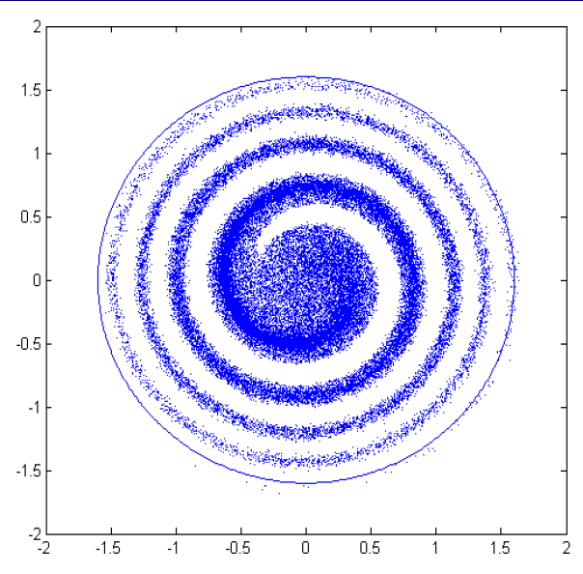
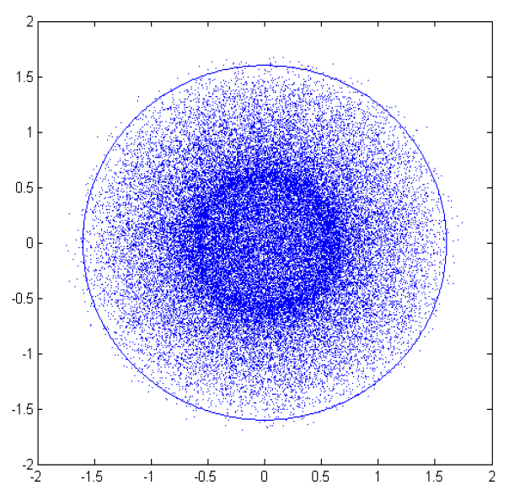
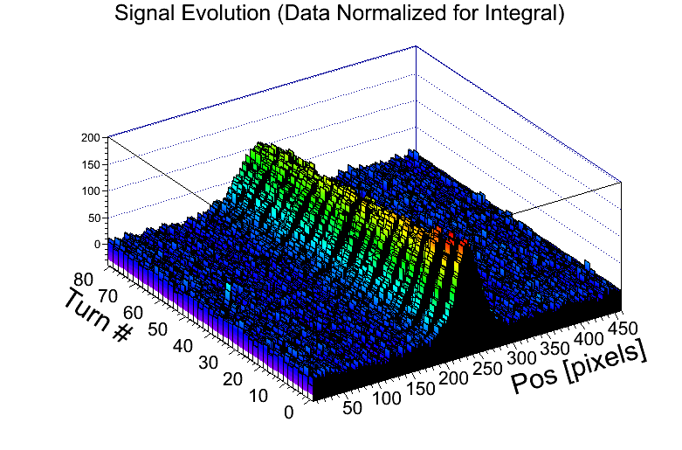
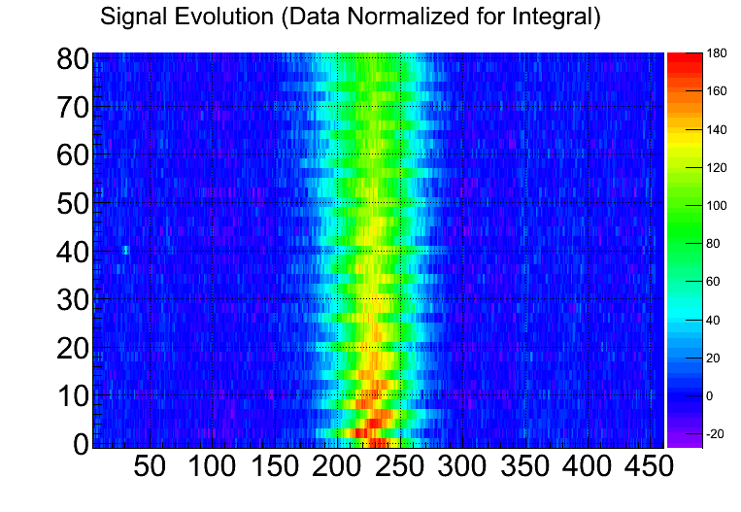
Injection matching with OTR screens
Injection off-axis due to machine-machine mismatch
Filamentation – beam moves around the phase space (oscillation) and fills the entire phase space ellipse
Emittance growth – beam quality degradation
simulations
Acceptance of the magnetic system
measurements
measurements
Phase
Turn #
Position [pixels]
Position

Slide 16
Tune measurements

Slide 17
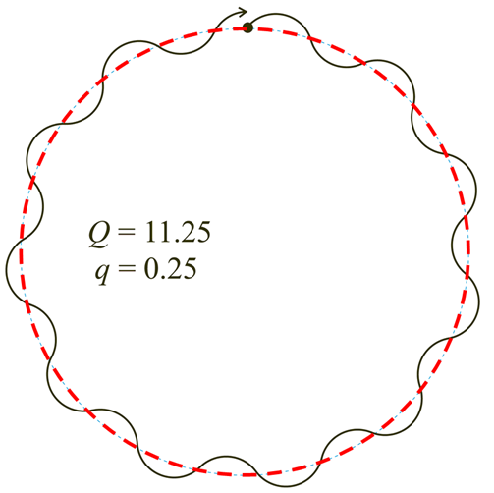
Accelerator tune
QD
QF
QD
QF
QF
Characteristic frequency of the magnetic lattice – betatron oscillation of off-axis beam particles
  Set by the strength of quadrupoles
For each transverse plane (H and V):
  Q – full betatron tune
  q – fractional tune (operating point)
Real life is more complex
  Oscillations in both planes are coupled
  Betatron oscillations are non-linear at large amplitudes
SD
SF
SD
SF
SF

Slide 18
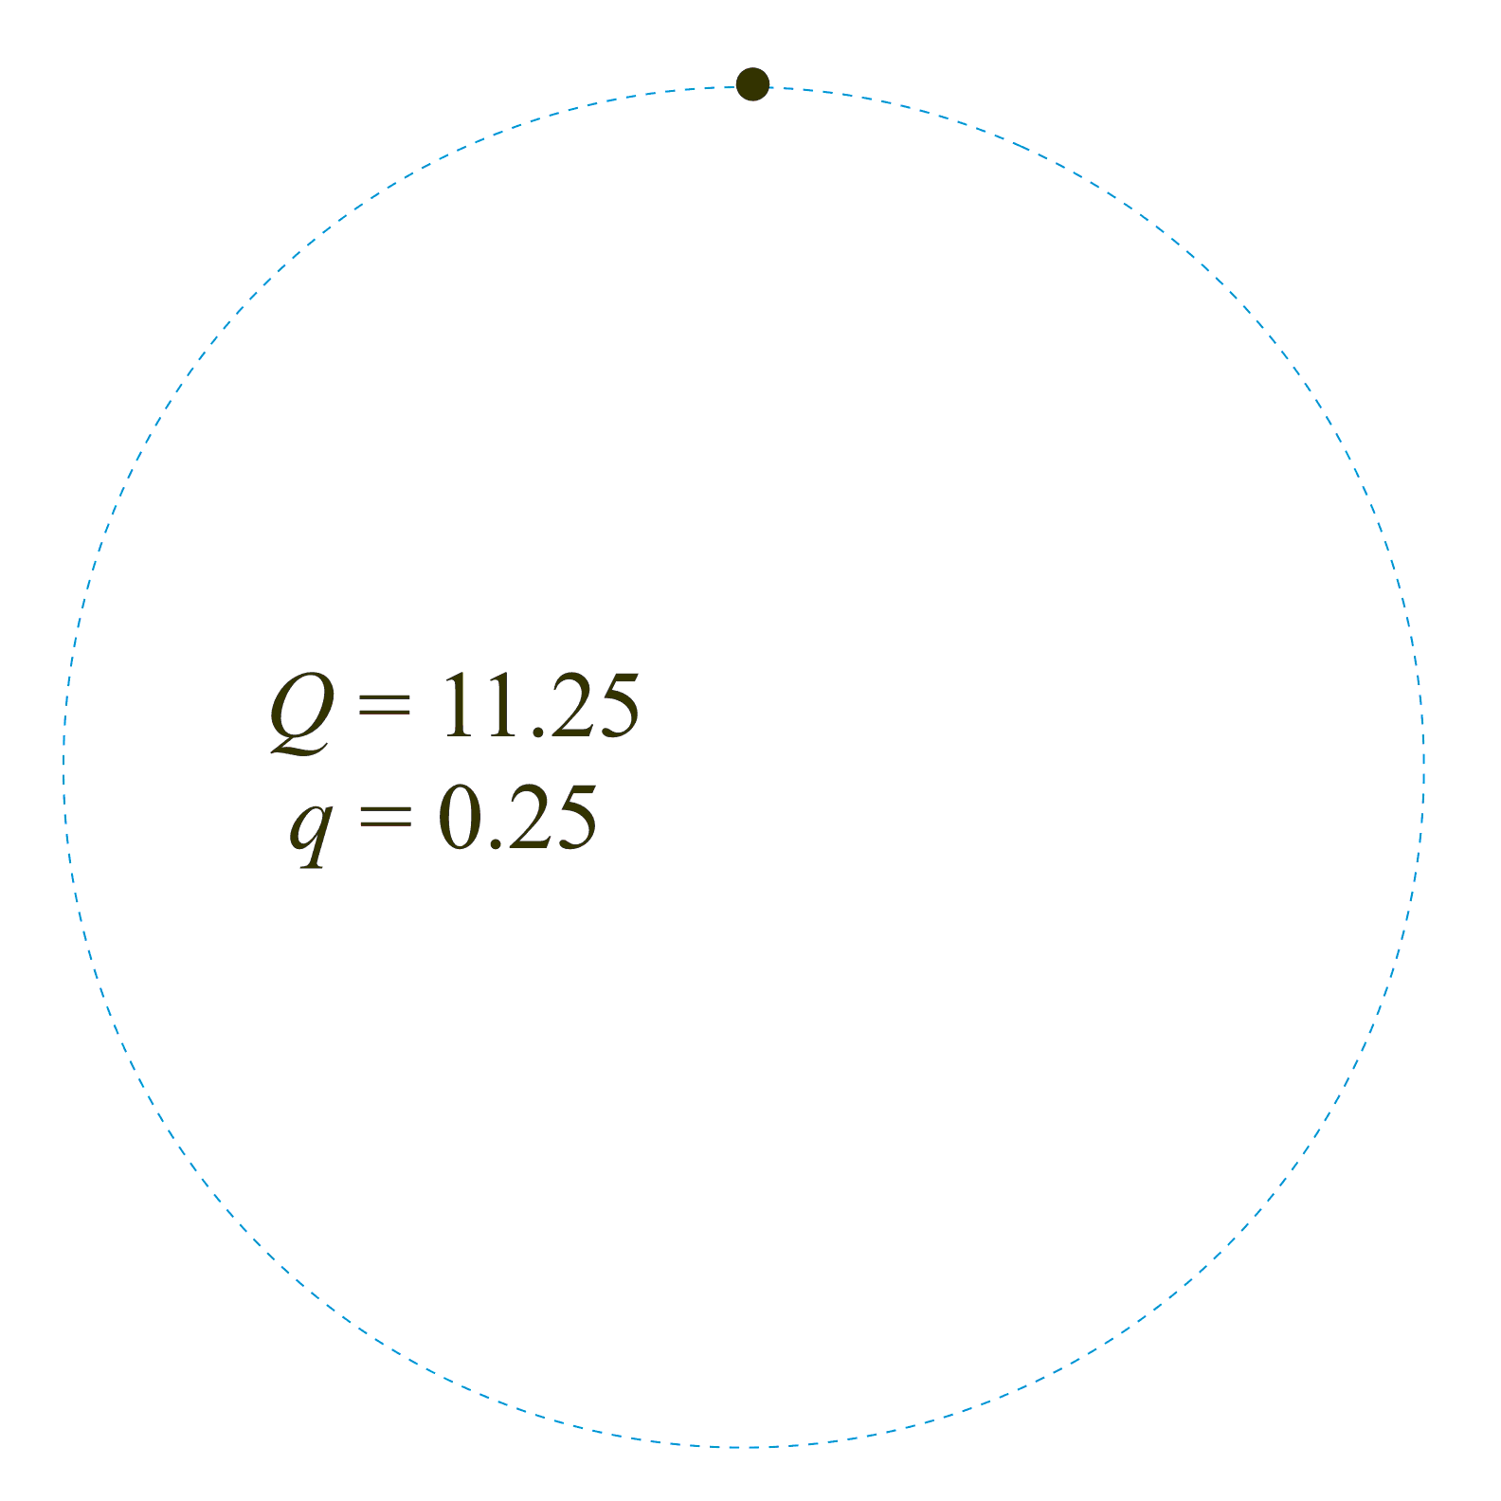
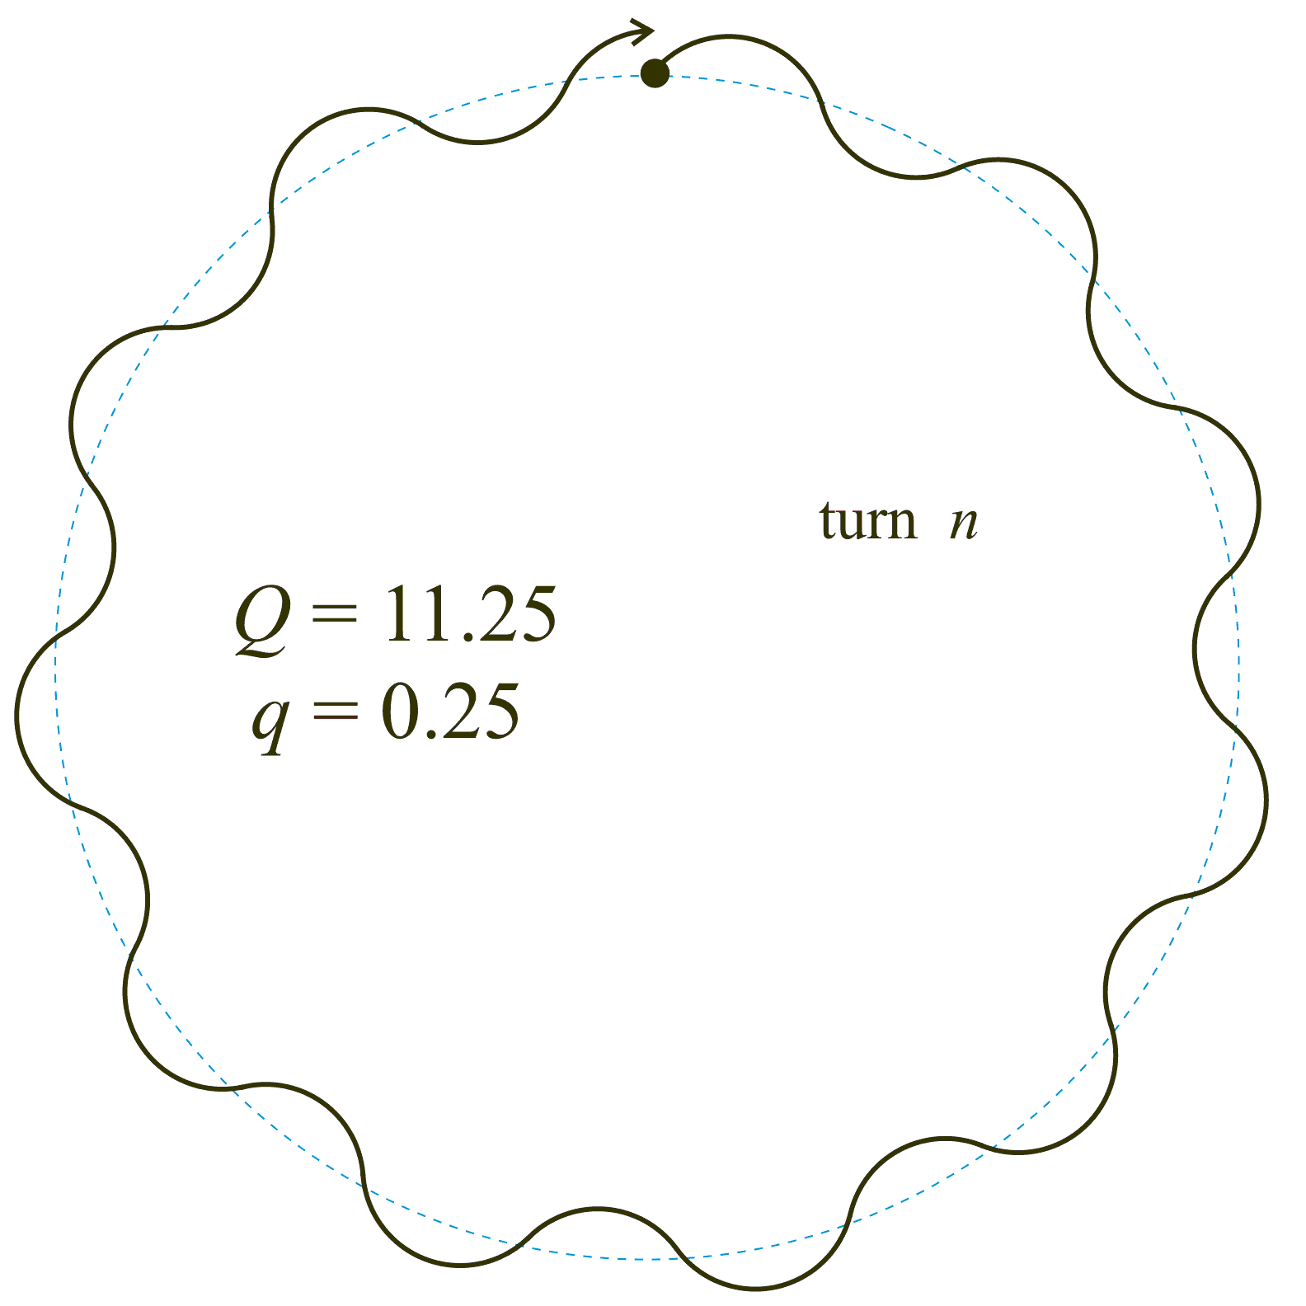
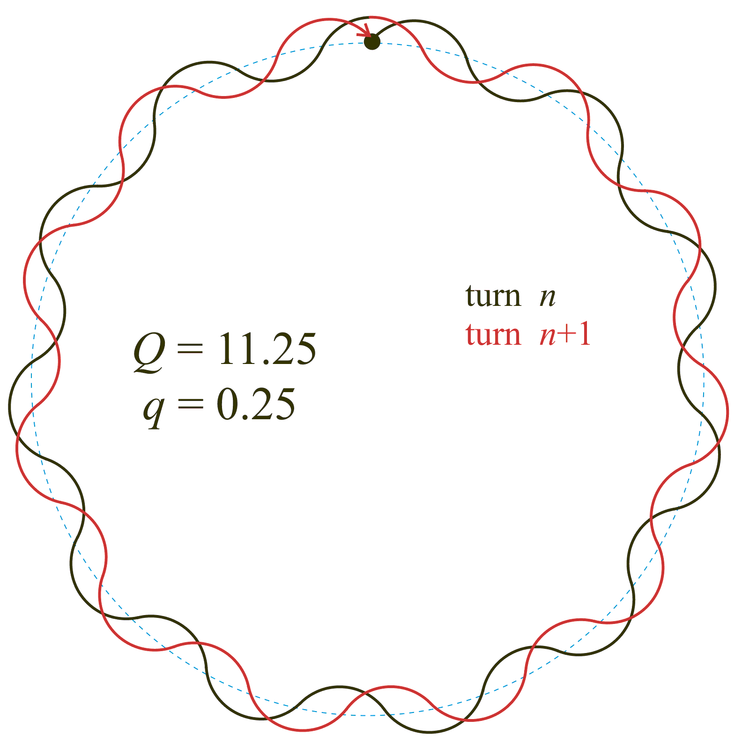
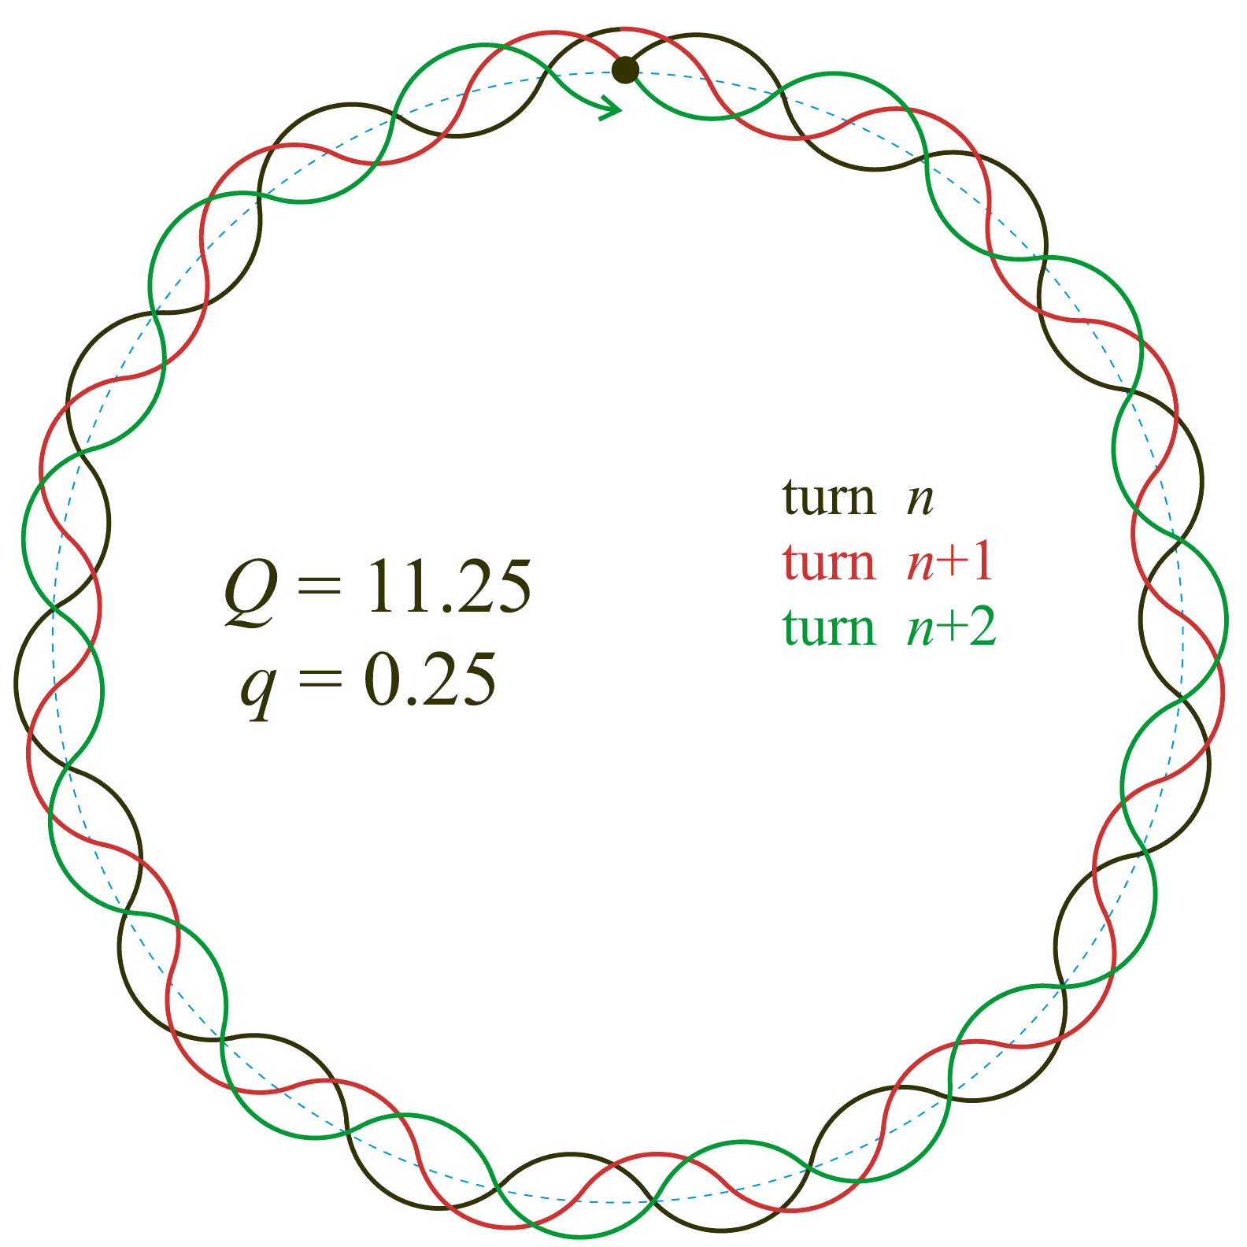
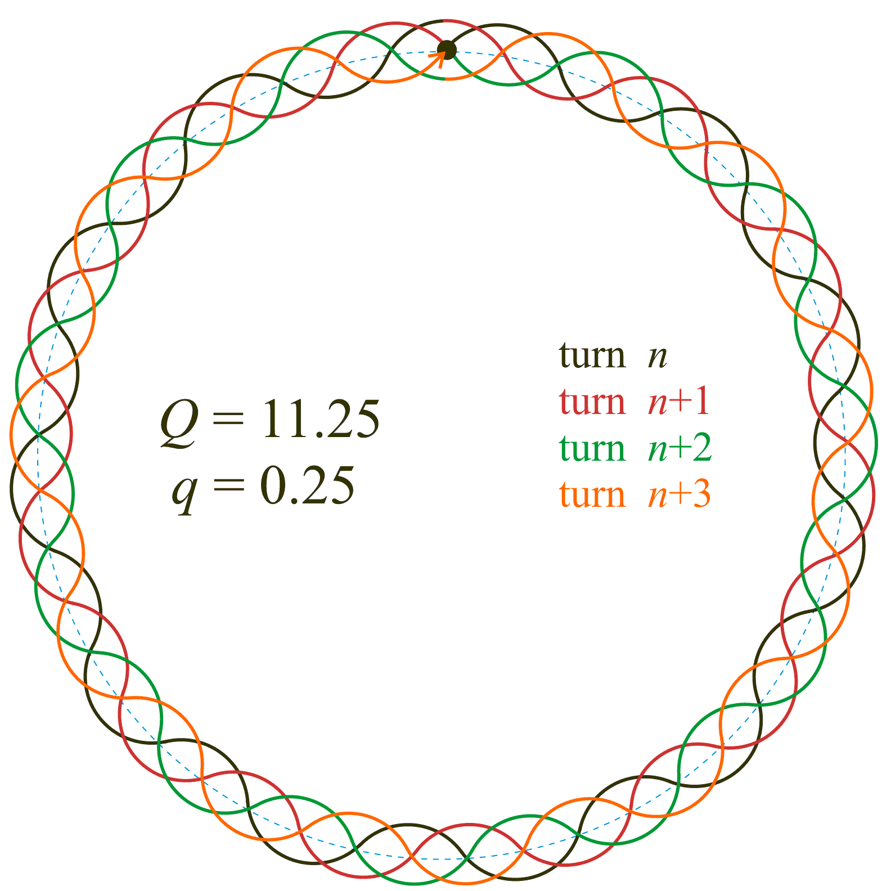
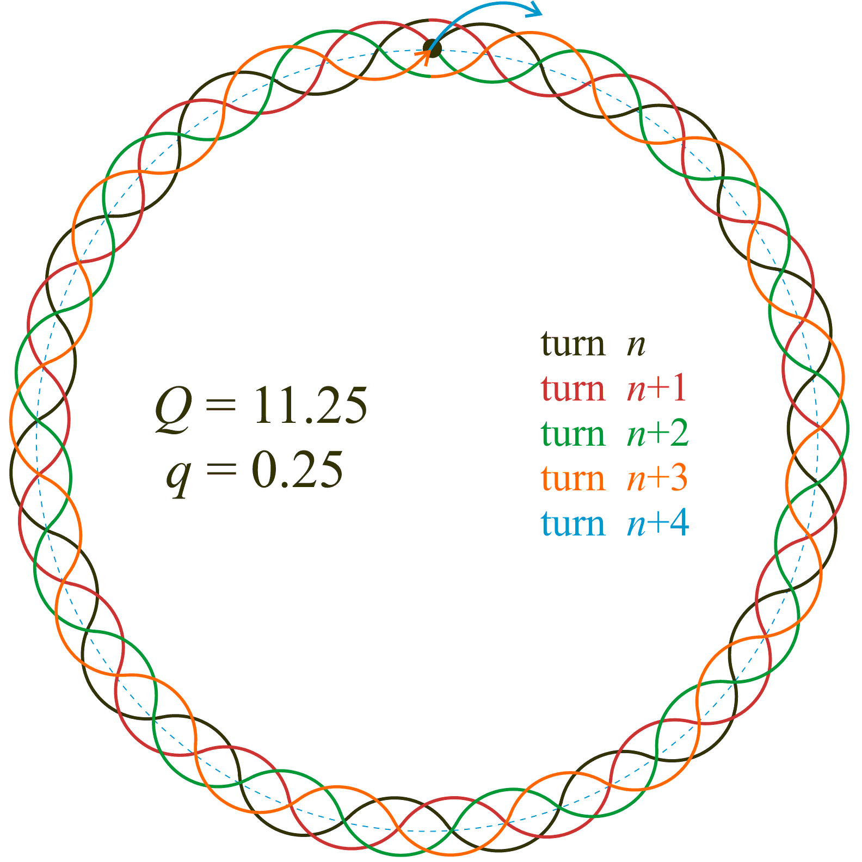
Betatron motion and accelerator tune
11
0.25
1
10
2
9
3
8
4
7
6
5
M. Gasior (CERN)

Slide 19
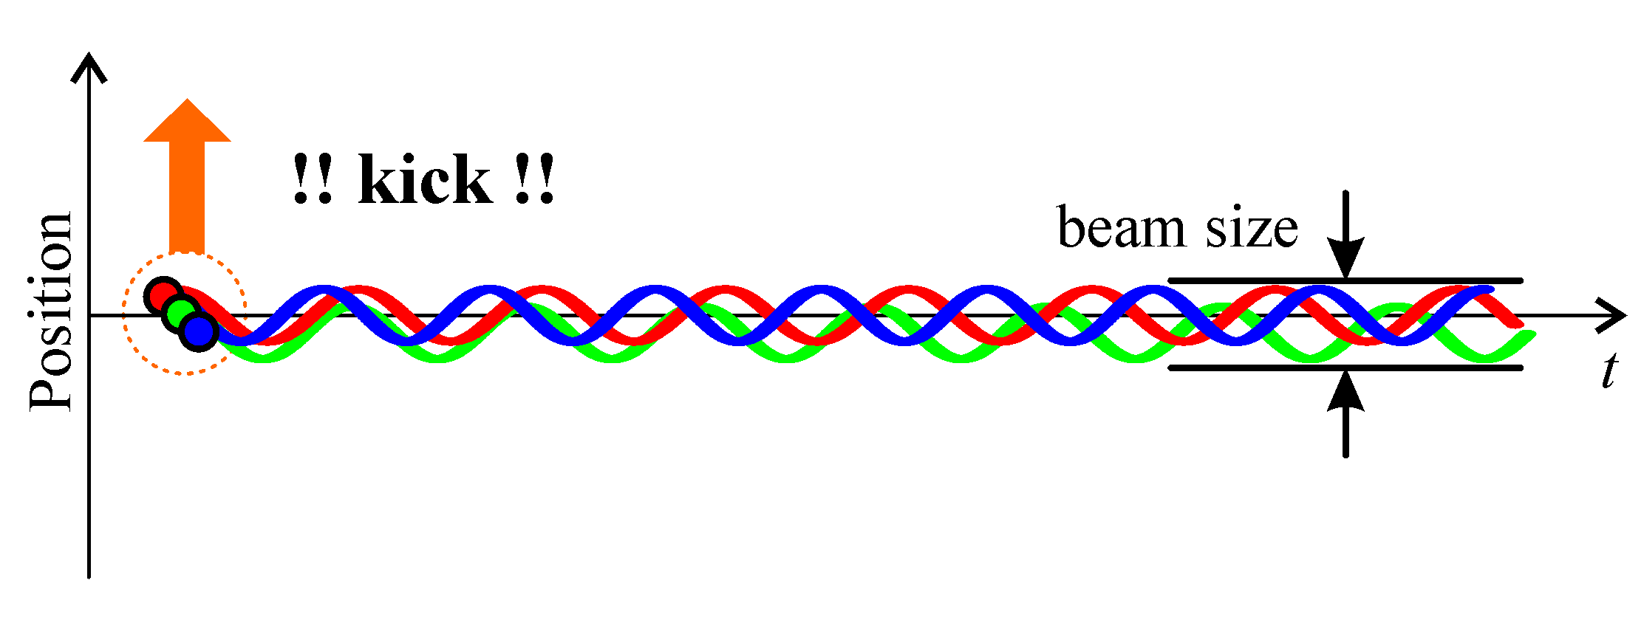
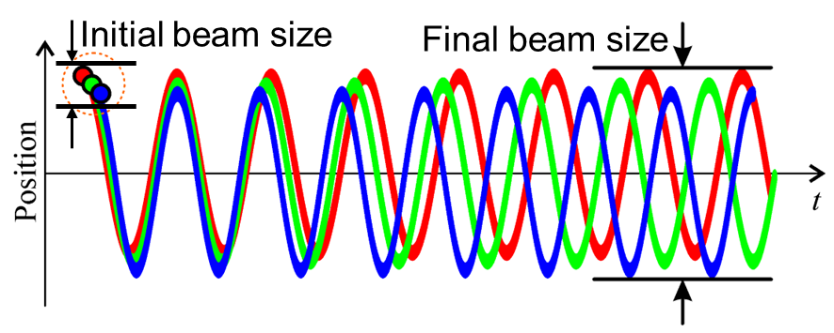
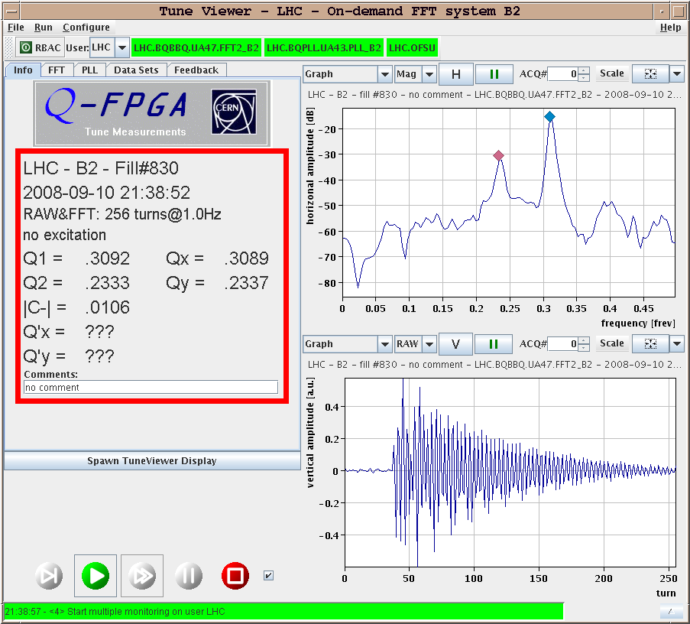
Betatron motion and accelerator tune
Beam size is defined by the incoherent betatron motion of all particles
Momentum spread of beam particles leads to a spread of focusing strenght by the quadrupoles and to a spread in the frequency of the betatron oscillations (chromaticity)
Coherent oscillations eventually de-cohere
  Hadrons do not forget and once hit they keep oscillating – there is no damping mechanism
  Any excitation must be kept as low as possible

Slide 20


Tune measurements
LHC: ~ 550 BPMs per beam; Integer tunes: H: 59, V: 64
Integer tune
  Seen in beam orbit measurements of all BPMs
Fractional tune (q)
  Seen in turn-by-turn measurements of a single BPM if a beam is kicked
  Resonant frequency (q) identification in the frequency domain through Fast Fourier Transform (FFT)

Slide 21

Tune measurements
M. Gasior (CERN)
Global beam excitation
Betatron oscillation measurement on a single BPM
Oscillation frequency

Slide 22

Tune measurements
Pre-requisite: turn-by-turn position measurements from a BPM
BPM electrode signal is proportional to the beam/bunch intensity and weakly modulated by the beam position (1-10% per mm of beam displacement)
  Such signals are difficult to simulate in laboratory environment
M. Gasior (CERN)

Slide 23



Tune measurements
Theory
Precision issues
Dynamic range issues
Practice
leakage
noise

Slide 24

BaseBand Tune (BBQ) system based on Direct Diode Detection
Single RF Schottky diode – peak voltage handling up to 50 V
  Several diodes in series possible (e.g. 6 for the LHC)
Downmixing of the betatron modulation to below the revolution frequency
  Signal processing with relatively inexpensive high-performance audio ADCs
Similar to an AM radio receiver but with extremely low noise, very slow discharge, and with brutal filtering of the carrier (revolution) frequency and the out-of-band signals

Slide 25

LHC BBQ performance
Intentional beam excitations
Residual beam oscillation with no added excitation
~ 10 nm noise floor

Slide 26

Real-time tune measurements
CERN SPS example:
Tune clearly visible from residual oscillations without additional excitation

Slide 27

LHC tune measurements during the energy ramp
Early LHC - what happens without good tune control

Slide 28


LHC tune feedback
FFT peak fit with 0.1-0.3 Hz bandwidth
Feedback correction with trim quadrupoles
Tune
Feedback
OFF
Tune
Feedback
ON

Slide 29
Coupling measurements

Slide 30

Coupling
Measured Tunes
Set Tunes
$$Q_{I, II}=\frac{1}{2}\left(Q_{x}+Q_{y}±\sqrt{{\left(Q_{x}−Q_{y}\right)}^{2}+{|C^{−}|}^{2}}\right)$$
Measured tunes - the physical observables seen in FFT
  Often called the ‘normal modes’ or ‘eigenvalues’
Set tunes - what the tunes would be in absence of coupling
  Tune split Δ = ( Q_{x} - Q_{y} ) – difference between the set X and Y tunes
Magnitude of the coupling coefficient |C⁻|
  The closest Q_{I} & Q_{II} can approach each other - ‘closest tune approach’
  Any closer is a ‘forbidden zone’ in a system of coupled oscillators

Slide 31
Coupling measurements
FFT of Horizontal Acquisition Plane
Decoupled machine – only horizontal tune in horizontal FFT
Gradually increase coupling – vertical mode shows up and frequencies shift
V
Set Tunes
V
H
Horizontal Acquisition Plane FFT
Magnitude
H
Frequency

Slide 32
Coupling measurements
Orbit changes
  Change orbit in one plane by exciting steering correctors or by changing injection conditions and measure effect in other plane
  Large coupling sources identiﬁed as locations where horizontal orbit change generates a vertical kick and vice versa
  Acquire large numbers of orbits for excitation of different correctors to determine skew quadrupole component of each magnet
Closest tune approach
  Approach horizontal and vertical tunes until they cross
  Coupling derived from how close tunes can approach
Kick response
  Kick the beam in one plane & measure in other using Tune FFT or pairs of BPMs to derive Resonance Driving Term

Slide 33



Closest tune approach
Measure tunes while changing the quadrupole strength
LHC (BBQ)
Q_{I (H)}
LEP (PLL)
|C⁻|
Q_{II (V)}

Slide 34



Kick response
Kick the beam in one plane and measure the tune in the other
  Magnitude of local coupling can be derived from amplitude ratios of tune peaks
$$|C^{−}| ∝\frac{\sqrt{r_{1}r_{2}}}{1+ r_{1}r_{2}}$$
$$r_{1}=\frac{A_{1,y}}{A_{1,x}}$$
$$r_{2}=\frac{A_{2,x}}{A_{2,y}}$$
x tune measured by y pick-up
y tune measured by y pick-up

Slide 35

Coupling and tune feedback at RHIC (BNL)
Measurement during the acceleration cycle using 4 PLLs:
Q_{H} (excite in H, measure in H), Q_{H,V} (excite in H, measure in V),
Q_{V} (excite in V, measure in V),
Q_{V,H} (excite in V, measure in H)

Slide 36
Coupling and tune feedback at RHIC (BNL)
At several points the measured tune is defined by coupling – tune feedback breaks at these points
Coupling must be corrected first

Slide 37


Coupling and tune feedback at RHIC (BNL)
Measure coupling and correct with skew quadrupoles to maintain a decoupled machine
Coupling and tune feedback tracks and corrects tune through the acceleration cycle

Slide 38
Chromaticity measurements

Slide 39
Chromaticity
Spread in the machine tune due to particle energy spread
  Controlled by sextupole magnets
Optics Analogy:
Lens
[Quadrupole]
First Order
Focal length is
energy dependent
Achromatic incident light
[Spread in particle energy]

Slide 40
Chromaticity measurement methods
Tune change for different beam momenta
  Standard method used on all machines
  Can be combined with PLL tune tracking to give on-line measurement
Width of tune peak or damping time
  Model dependent, non-linear effects, not compatible with active transverse damping
Amplitude ratio of synchrotron sidebands
  Difficult in hadron machines (low synchrotron tune); influence of collective effects
Width ratio of Schottky sidebands
  Used often and ideally suited to unbunched or ion beams; very slow
Bunch spectrum variations during betatron oscillations
  Difficult to disentangle all other sources – e.g. bunch filling patterns, pick-up response
Head-tail phase advance (same as above, but in time domain)
  Good results but requires kick stimulus (emittance growth!)

Slide 41

Tune change for different beam momenta
Slow RF modulation with continuous tune measurement
  Amplitude of the tune modulation is proportional to chromaticity
Example from the LHC
Sinusoidal RF modulation at 0.05 Hz
Tune continuously tracked in both planes of both beam
Chromaticity calculated once acquisition complete

Slide 42


Tune change for different beam momenta
Slow RF modulation with continuous tune measurement
  Amplitude of the tune modulation is proportional to chromaticity
Example from LEP (CERN)
  Triangular RF modulation
  Allows sign of chromaticity to be easily determined
Applied Frequency Shift
Q_{h} & Q_{v} Variation

Slide 43

Tune change for different beam momenta
q_{h}
Example from LEP (CERN)
  Tune measurement during beta-squeeze
q_{v}

Slide 44


Tune change for different beam momenta
Example from LHC
  Tune measurement during energy ramp
  RF continuously modulated
  Tune measured continuously
  Chromaticity calculated from tune modulation amplitude
RF frequency
Vertical tunes
Horizontal tunes

Slide 45

Amplitude ratio of synchrotron sidebands
Particle energy modulated by synchrotron motion – tune changes modulated at the synchrotron frequency due to chromaticity
Successfully demonstrated at Diamond (UK)
Beam Transfer Function (BTF) measurements on a single bunch using the transverse bunch-by-bunch feedback system
  Emittance blow-up of the single affected bunch irrelevant
Synchrotron sideband
BTF – frequency sweep across tune

Slide 46

Amplitude ratio of synchrotron sidebands
Must be careful with high-intensity effects!
Modification of tune spectra by space charge and impedance observed by GSI
Relative heights and mode structure given by chromaticity – can be calculated with simplified analytical models
Peaks move!
simulation
synchrotron sideband location
Increasing
beam intensity
Higher beam intensity
Stronger space charge

Slide 47
Diagnosing accelerator issues

Slide 48
LEP (CERN) – no circulating beam
Phase advance from BPMs show that optics is not longer correct after a specific quadrupole
Positrons
QL10.L1

Slide 49

LEP (CERN) – no circulating beam
After long investigation – open the vacuum chamber of QL10.L1
And 10 m downstream!
QL10.L1
Double sabotage – both bottles were empty!

Slide 50
Summary
We covered the most common BI systems and their diagnostics usage
  Two more lectures on longitudinal diagnostics by L. Bobb next week
  Much More at BI CAS in 2025!
Take home message: BI systems can give you a good insight into the beam and its behaviour
  Go and talk to your BI colleagues to see what is possible

