Slide 1

2024 CAS course on “RF for Accelerators”
RF Measurements
– Computer Lab Intro –
Manfred Wendt – CERN

Slide 2
Design Workflow
Limited, simple geometries for analytical solution
for electromagnetic field problems
Benchmark numerical EM codes to known analytical solutions for a similar, simple geometry
  here: perfect cylinder as resonant cavity with ideal materials
    Perfect electric conductor (PEC)
Benchmark the final, optimized geometry with different numerical codes (if possible)
Manufacturing a prototype and compare RF measurement with numerical results
analytical
analysis
numerical
analysis
measurement
verification

Slide 3
Software, Numerical Codes for RF Engineering
Electromagnetic field problems
  Dassault CST Studio Suite – commercial
  Ansys HFSS – commercial
  GdfidL (“Gitter drüber, fertig ist die Laube”) – commercial
  ACE3P – SLAC development
  Open source, e.g., Meep, grpMax, openEMS, FEniCS, Elmer FEM, FreeFEM, Bempp,…
  (still too many hurdles for practical use)
Circuit level simulations
  Keysight Pathwave ADS (Advance Design System) – commercial
  AWR Microwave Office – commercial
  Ansoft Designer – commercial
  Various commercial SPICE versions, e.g., Pspice, HSPICE, PrimeSim SPICE,…
  Open source / freeware: Qucs, Qucs-S, QucsStudio,
  various free SPICE versions, e.g., Berkeley SPICE, Ltspice Ngspice
Other RF software
  Too many to list. Here we will use:
  Dellsperger Smith, a software to introduce the Smith chart

Slide 4
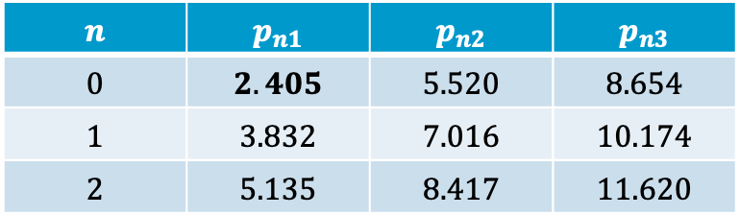

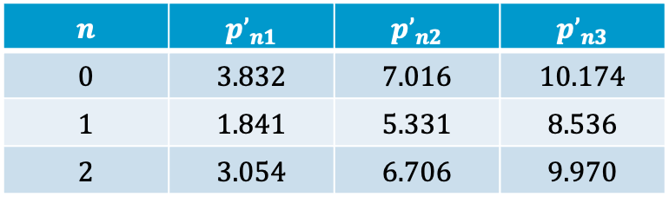
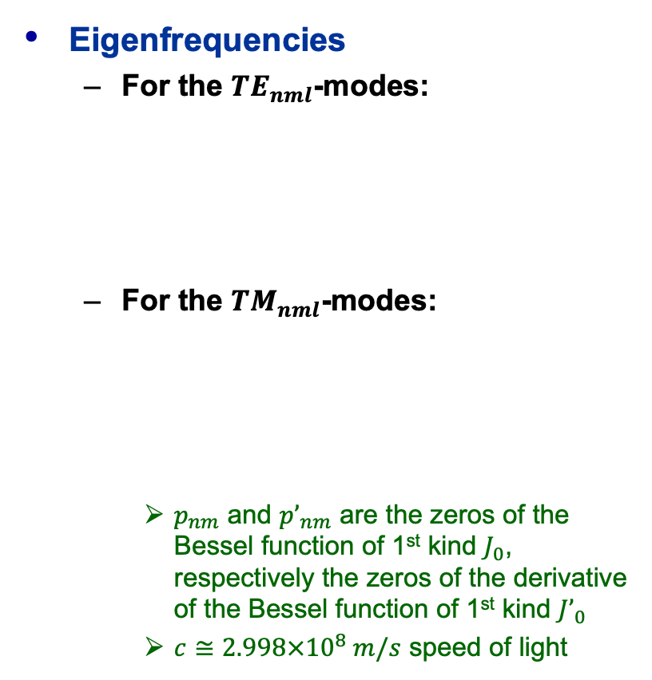
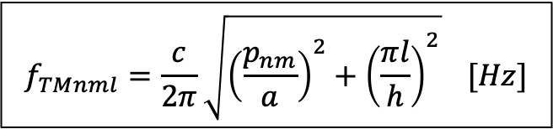
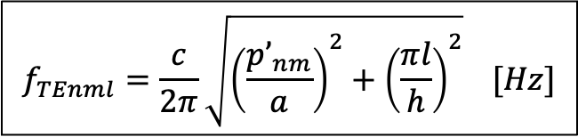

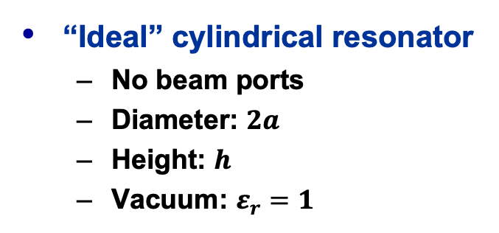
Cylindrical Resonator Equations (1)
Eigenfrequencies
  For the ${TE}_{nml}$-modes:
  For the ${TM}_{nml}$-modes:
    $p_{nm}$ and ${p’}_{nm}$ are the zeros of the Bessel function of 1st kind $J_{0}$, respectively the zeros of the derivative of the Bessel function of 1st kind ${J’}_{0}$
    $c≅2.998×{10}^{8} m/s$ speed of light
“Ideal” cylindrical resonator
  No beam ports
  Diameter: $2a$
  Height: $h$
  Vacuum: $ε_{r}=1$
beam axis
$$f_{TEnml}=\frac{c}{2π}\sqrt{{\left(\frac{{p’}_{nm}}{a}\right)}^{2}+{\left(\frac{πl}{h}\right)}^{2}} [Hz]$$
$$a$$
$$h$$
$$n$$ | $${p’}_{n1}$$ | $${p’}_{n2}$$ | $${p’}_{n3}$$
$$0$$ | $$3.832$$ | $$7.016$$ | $$10.174$$
$$1$$ | $$1.841$$ | $$5.331$$ | $$8.536$$
$$2$$ | $$3.054$$ | $$6.706$$ | $$9.970$$
$$f_{TMnml}=\frac{c}{2π}\sqrt{{\left(\frac{p_{nm}}{a}\right)}^{2}+{\left(\frac{πl}{h}\right)}^{2}} [Hz]$$
$$n$$ | $$p_{n1}$$ | $$p_{n2}$$ | $$p_{n3}$$
$$0$$ | $$2.405$$ | $$5.520$$ | $$8.654$$
$$1$$ | $$3.832$$ | $$7.016$$ | $$10.174$$
$$2$$ | $$5.135$$ | $$8.417$$ | $$11.620$$

Slide 5
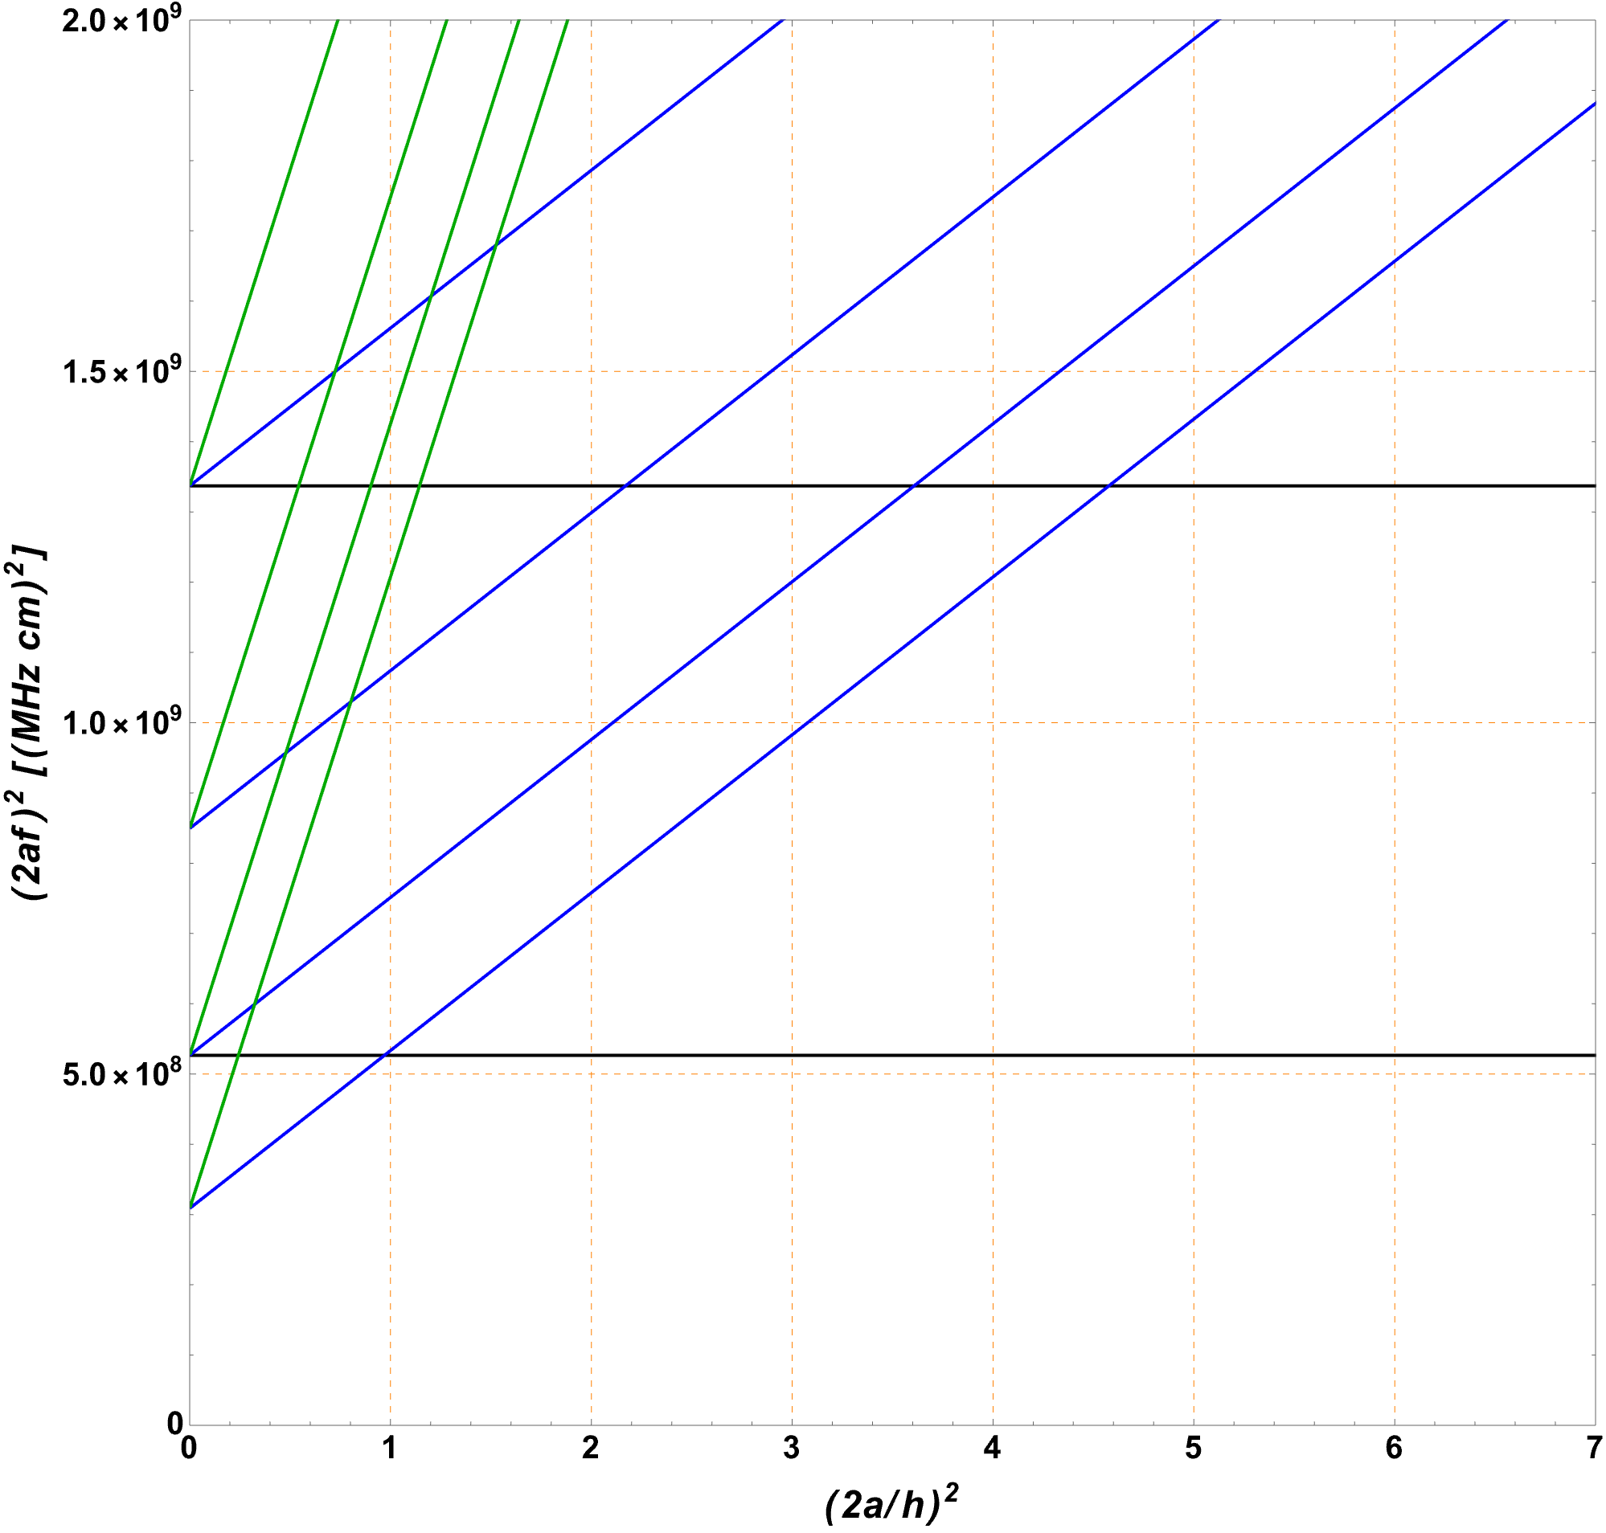


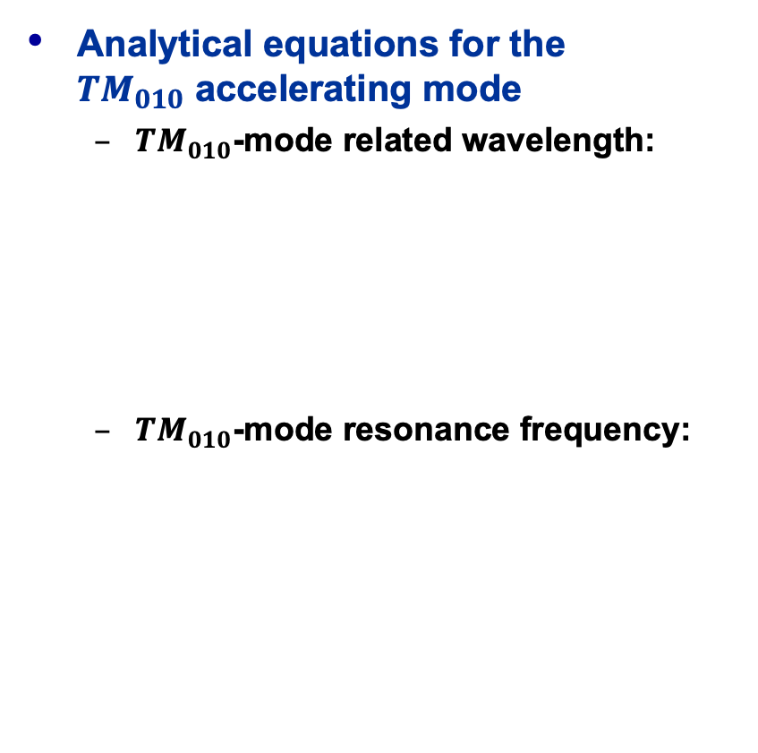


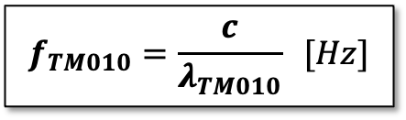



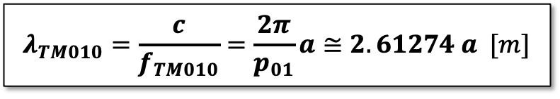


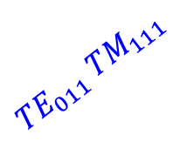
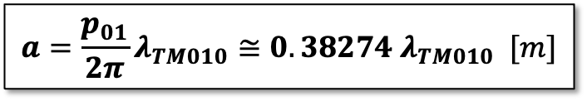
Cylindrical Resonator Equations (2)
Analytical equations for the
${TM}_{010}$ accelerating mode
  ${TM}_{010}$-mode related wavelength:
  ${TM}_{010}$-mode resonance frequency:
$${TM}_{112}$$
$${TE}_{112}$$
$${TE}_{212}$$
$${TM}_{012}$$
$${TE}_{011} {TM}_{111}$$
$${TE}_{211}$$
$${TM}_{011}$$
$${TE}_{111}$$
$$λ_{TM010}=\frac{c}{f_{TM010}}=\frac{2π}{p_{01}}a≅2.61274 a [m]$$
$${TM}_{110}$$
$$a=\frac{p_{01}}{2π}λ_{TM010}≅0.38274 λ_{TM010} [m]$$
$$f_{TM010}=\frac{c}{λ_{TM010}} [Hz]$$
$${TM}_{010}$$
Mode chart for cylindrical resonators

Slide 6


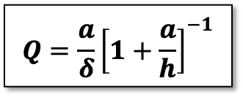


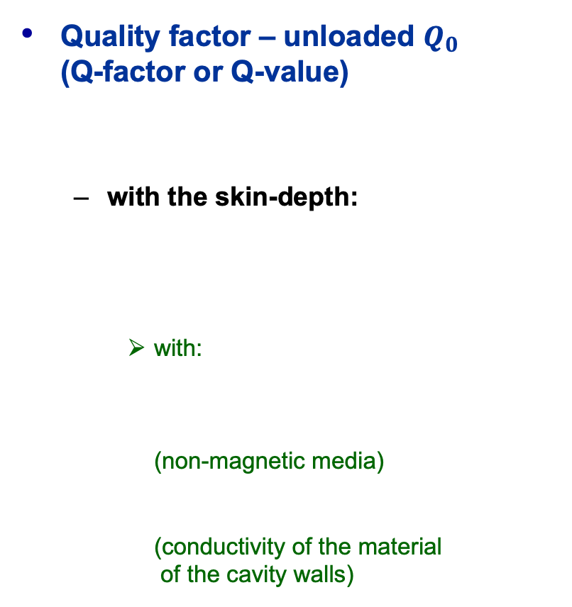

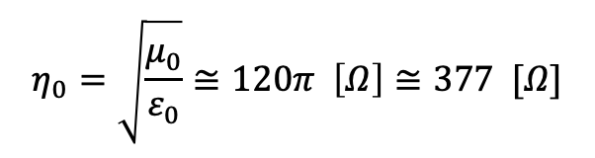



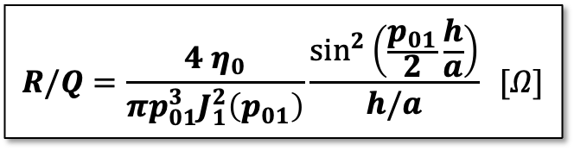
Cylindrical Resonator Equations (3)
Quality factor – unloaded $Q_{0}$
(Q-factor or Q-value)
  with the skin-depth:
    with:
    (non-magnetic media)
    (conductivity of the material
    of the cavity walls)
“Geometry factor” $R/Q$ (R-over-Q)
  With:
$$Q=\frac{a}{δ}{\left[1+\frac{a}{h}\right]}^{−1}$$
$$R/Q=\frac{4 η_{0}}{πp_{01}^{3}J_{1}^{2}\left(p_{01}\right)}\frac{\sin^{2}\left(\frac{p_{01}}{2}\frac{h}{a}\right)}{h/a} [Ω]$$
$$δ=\sqrt{\frac{2}{ω_{TM010}σμ}} [m]$$
$$R/Q≅128 Ω\frac{\sin^{2}\left(\frac{p_{01}}{2}\frac{h}{a}\right)}{h/a}[Ω] \\ ≈185 Ω h/a \left[Ω\right] for: \frac{p_{01}}{2}\frac{h}{a}≪1$$
$$ω_{TM010}=2πf_{TM010}$$
$$μ=μ_{r}μ_{0}≅1×4π∙{10}^{−7} H/m$$
$$η_{0}=\sqrt{\frac{μ_{0}}{ε_{0}}}≅120π \left[Ω\right]≅377 [Ω]$$
$$σ [S/m]$$
$$p_{01}=2.40483$$
$${J_{1}(p}_{01})=0.519147$$

Slide 7
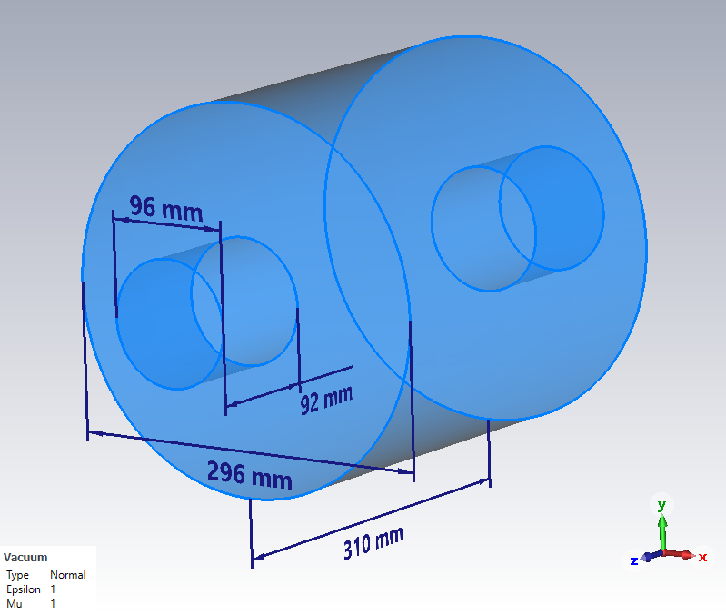
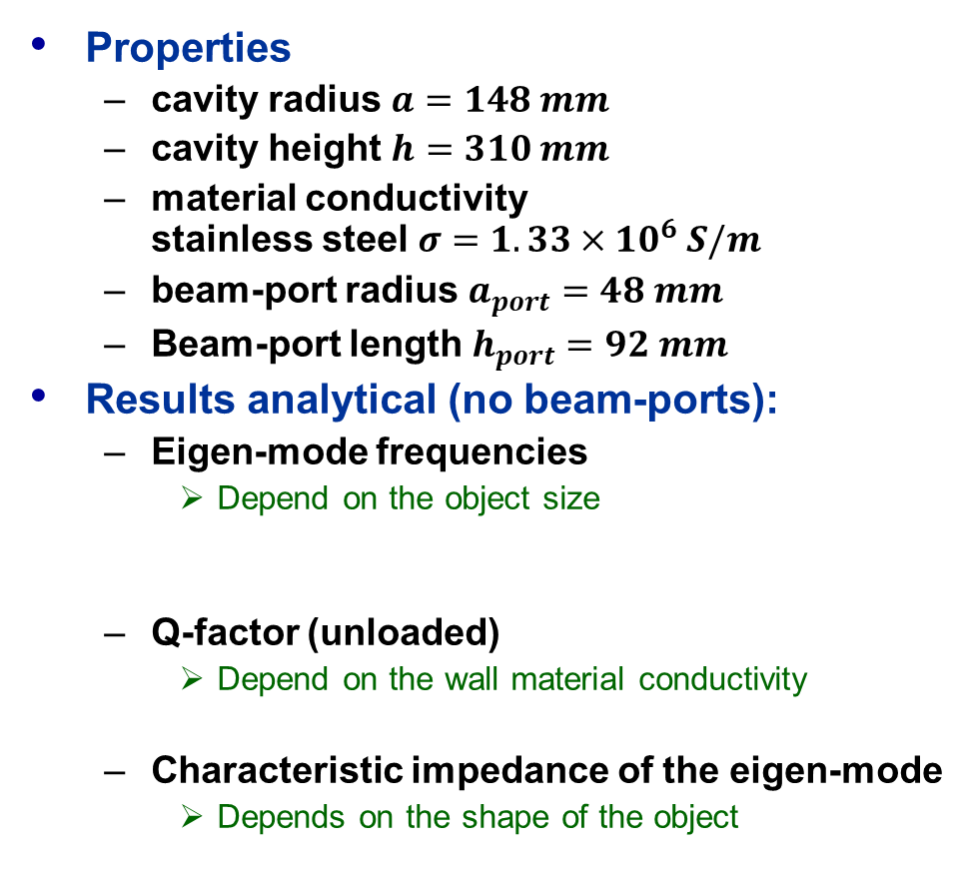
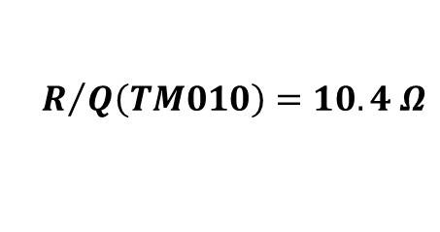



Cylindrical “Pill-box” Cavity
Properties
  cavity radius $a=148 mm$
  cavity height $h=310 mm$
  material conductivity
  stainless steel $σ=1.33×{10}^{6} S/m$
  beam-port radius $a_{port}=48 mm$
  Beam-port length $h_{port}=92 mm$
Results analytical (no beam-ports):
  Eigen-mode frequencies
    Depend on the object size
  Q-factor (unloaded)
    Depend on the wall material conductivity
  Characteristic impedance of the eigen-mode
    Depends on the shape of the object
$$f_{TE111}=766 MHz$$
$$f_{TM010}=776 MHz$$
$$Q_{0}(TM010)=6322$$
$$R/{Q\left(TM010\right)}=10.4 Ω$$

