Slide 1

Team track-ing
Lattice and tracking exploration varying tune, chromaticity… and much more
Sasha Horney, Victoria Isensee, Szymon Łopaciuk, Anna Radoslavova, André Donadon Servelle

Slide 2
outline
1) Introduction – lattice
2) Tracking and phase space
3) FMA, DA and intensity evolution for different octupolar and sextupolar strengths
4) RF insertion
5) 6D tracking and emittance computation

Slide 3
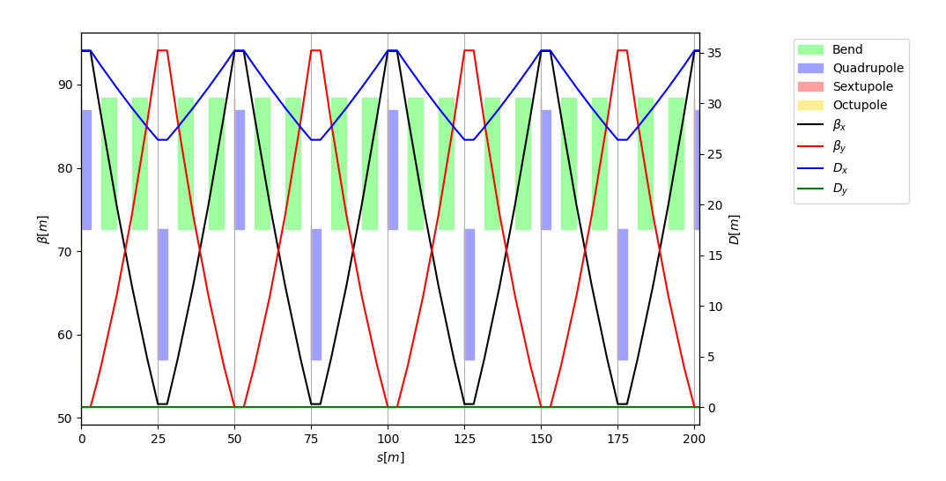
Lattice layout
4/20 cells

Slide 4
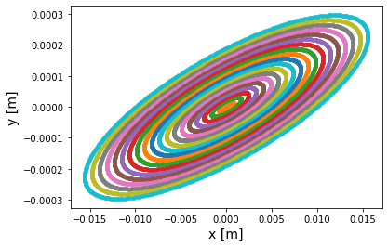
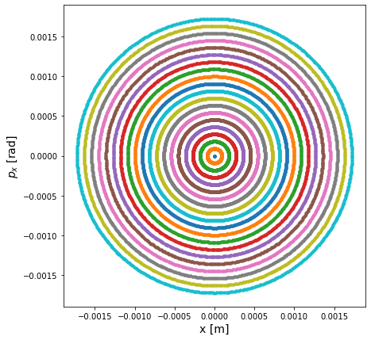
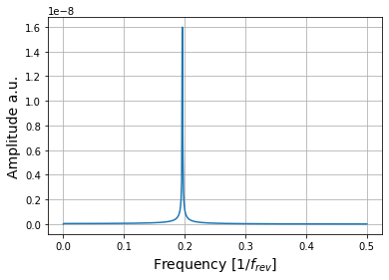
Phase space
Qx

Slide 5
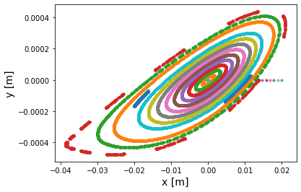
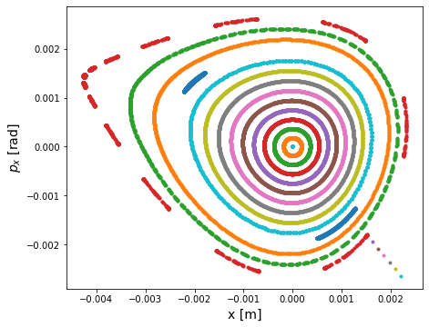
Particle with sextupolar perturbation

Slide 6
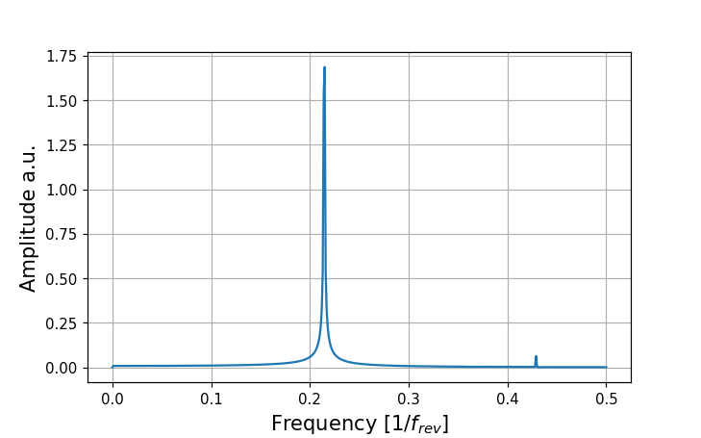
Frequency analysis

Slide 7
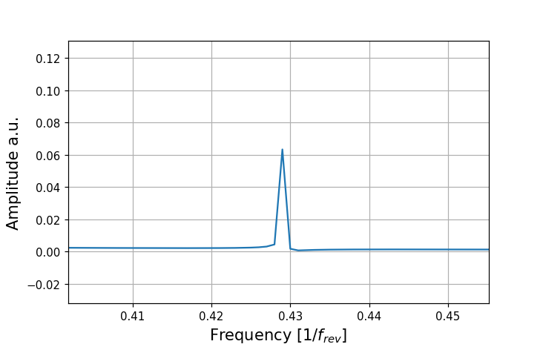
Frequency analysis
2Qy + Qx resonance

Slide 8
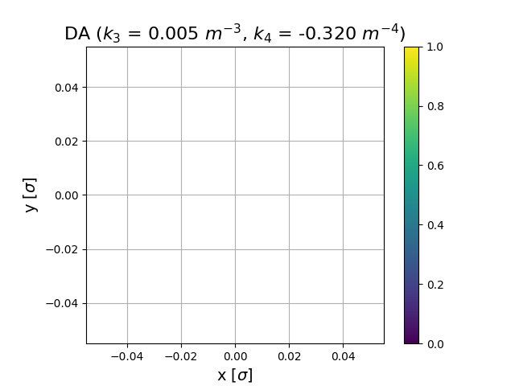
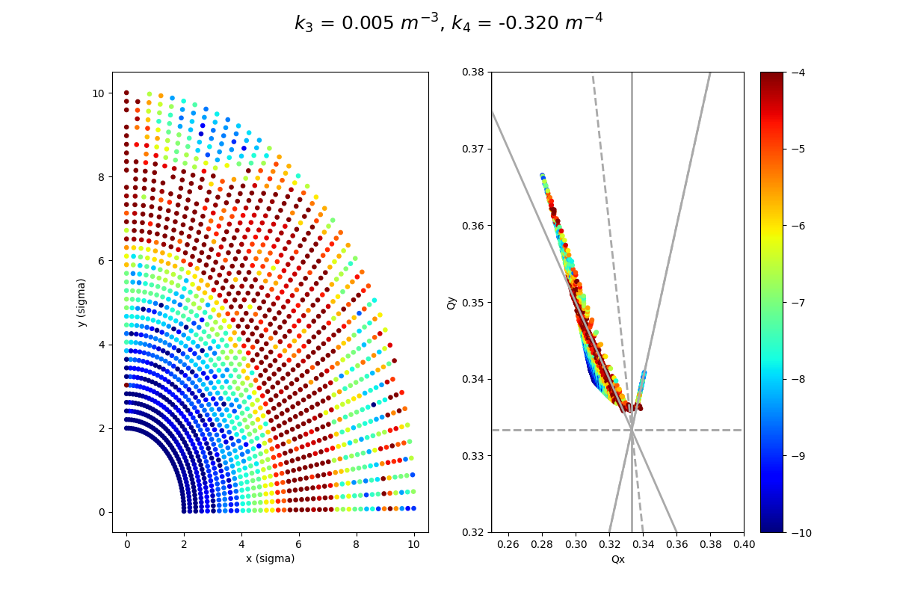
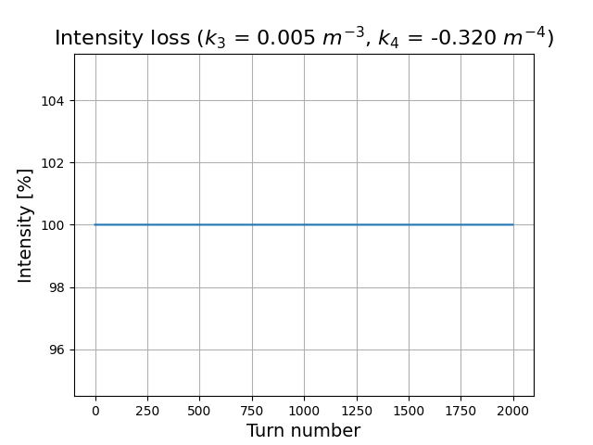
Case one, octupole change (Qx = 0.31, Qy = 0.34)
2Qy + Qx resonance

Slide 9
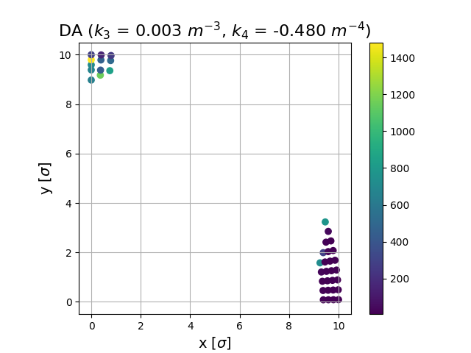
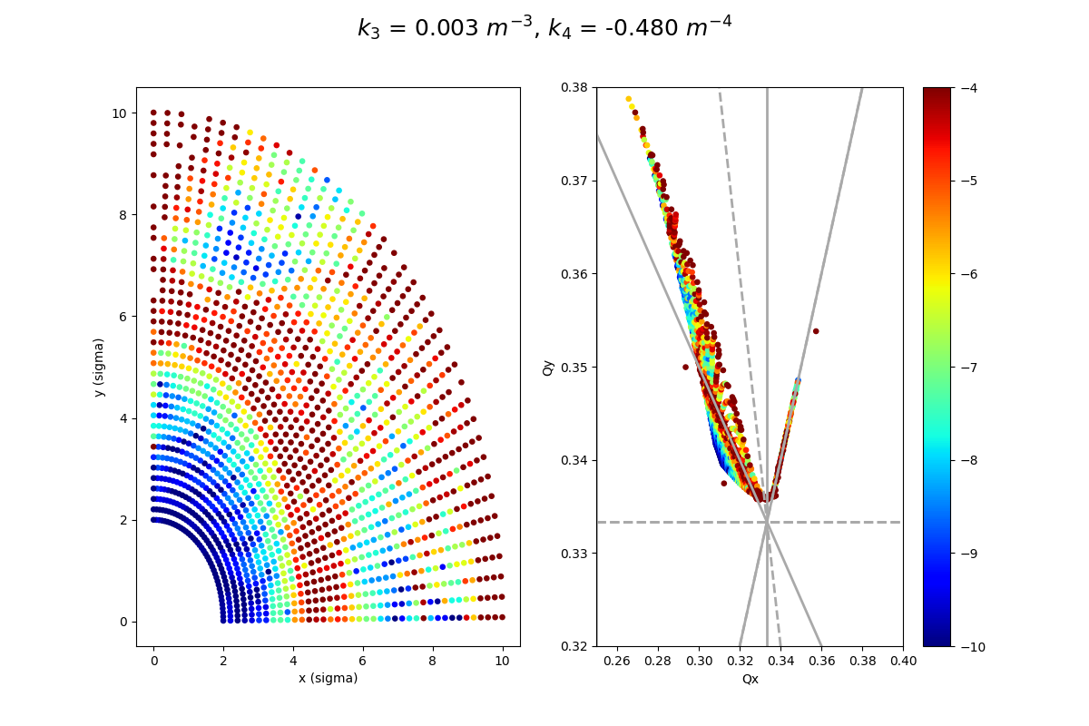
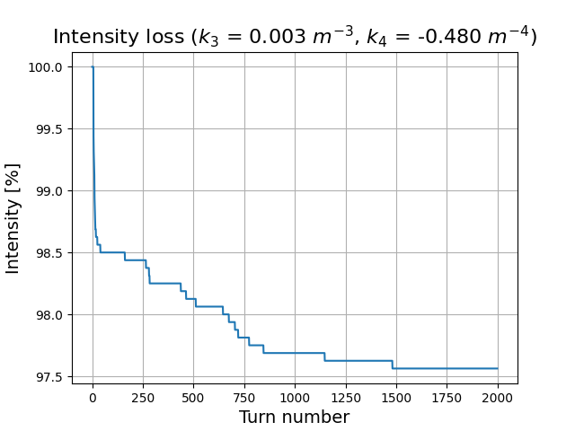
Case two, octupole change (Qx = 0.31, Qy = 0.34)

Slide 10
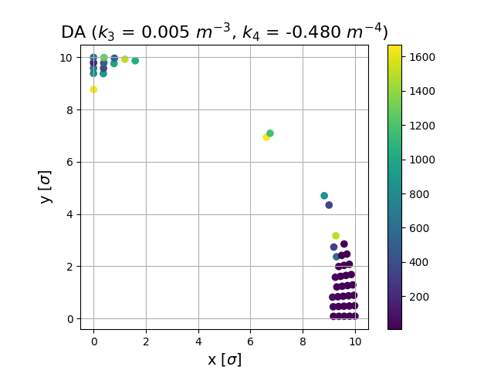
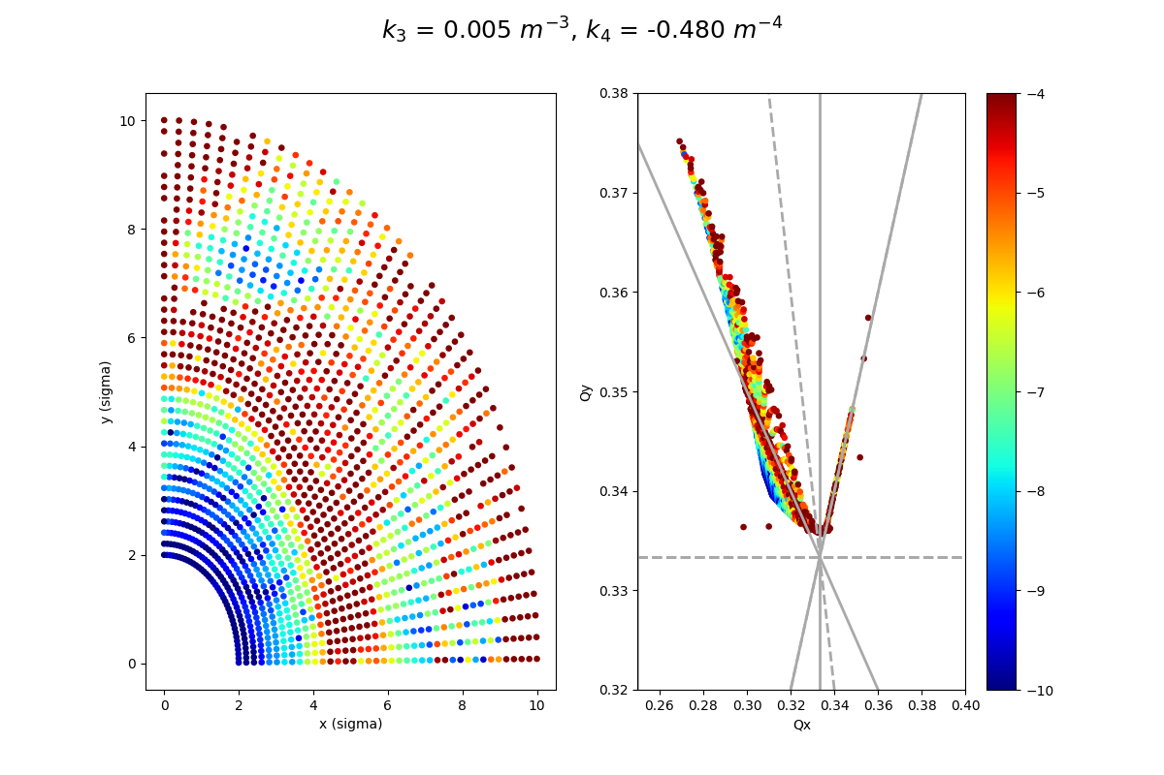
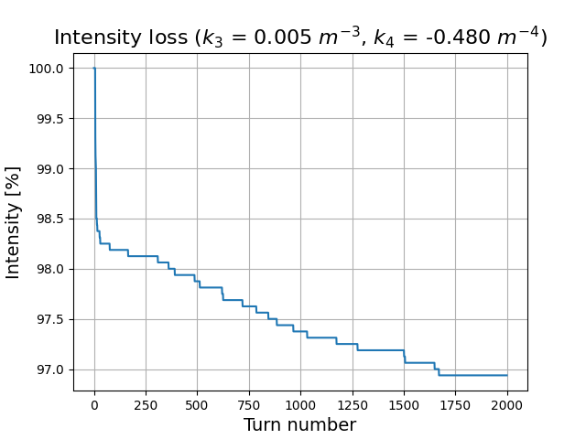
Case three, octupole change (Qx = 0.31, Qy = 0.34)

Slide 11
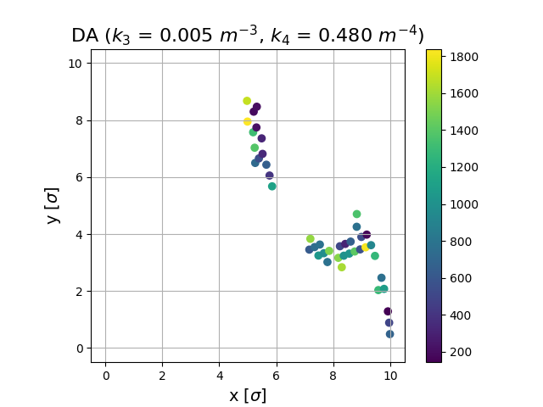
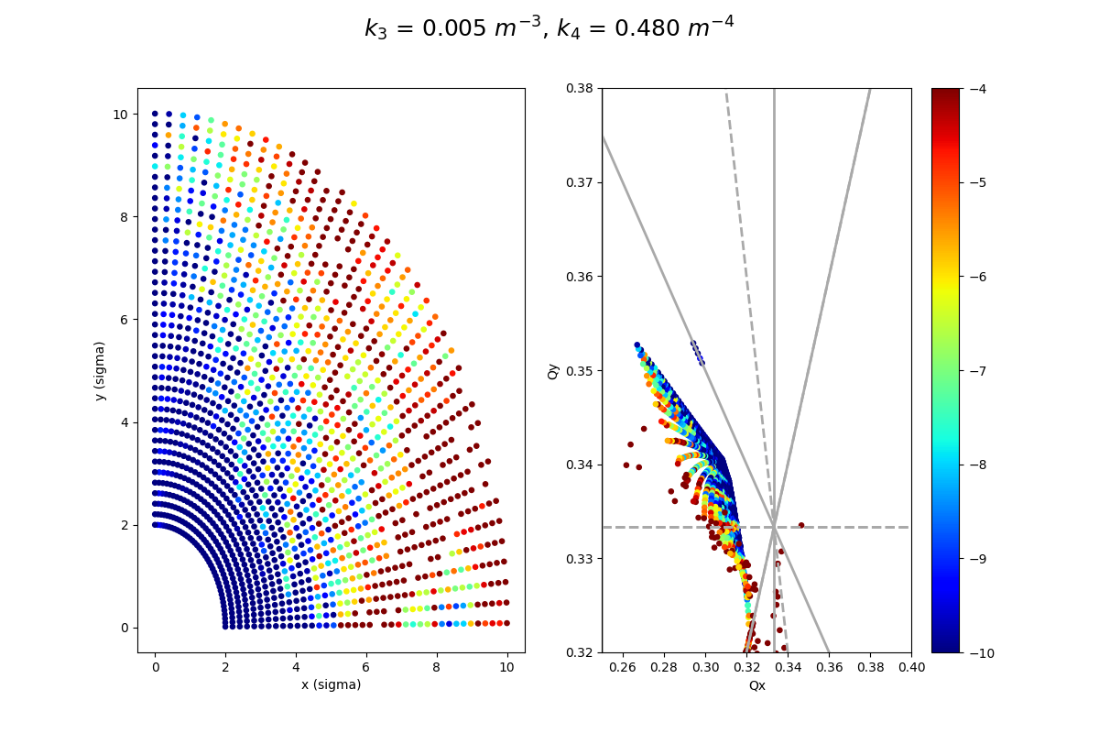
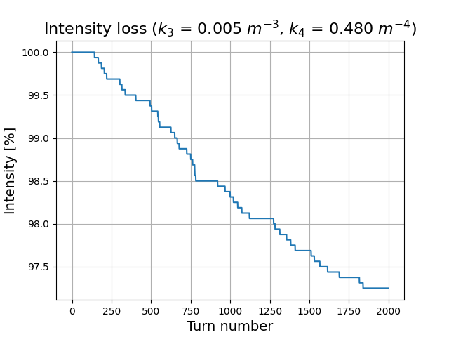
Case four, octupole change (Qx = 0.31, Qy = 0.34)

Slide 12
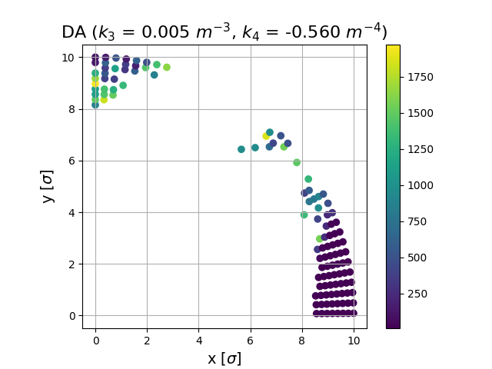
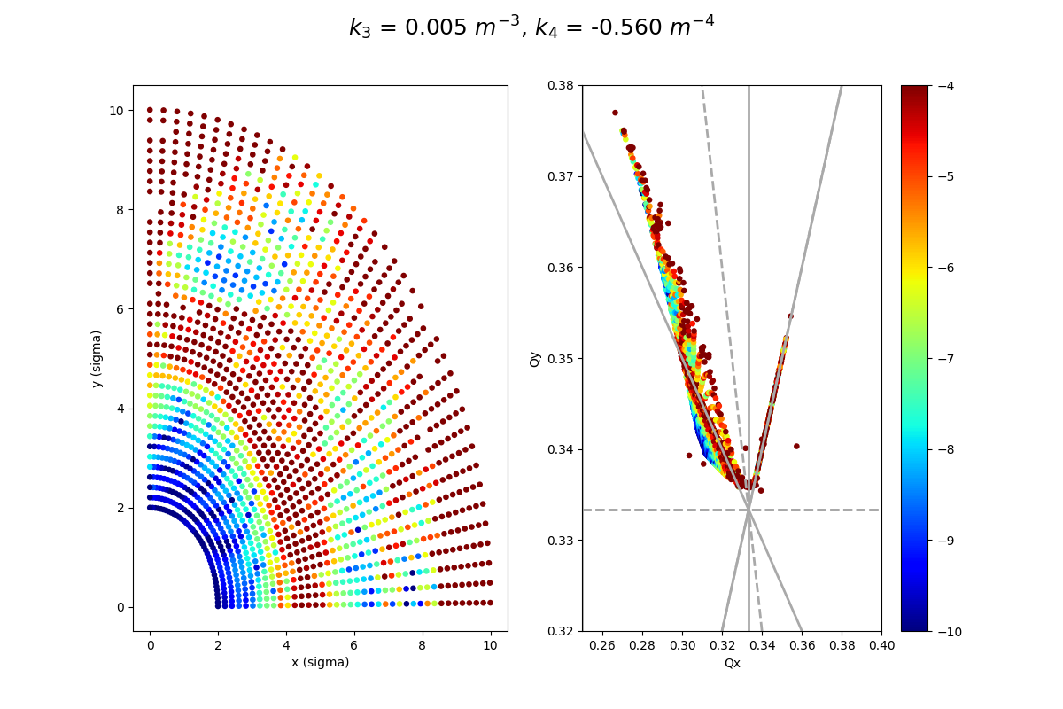
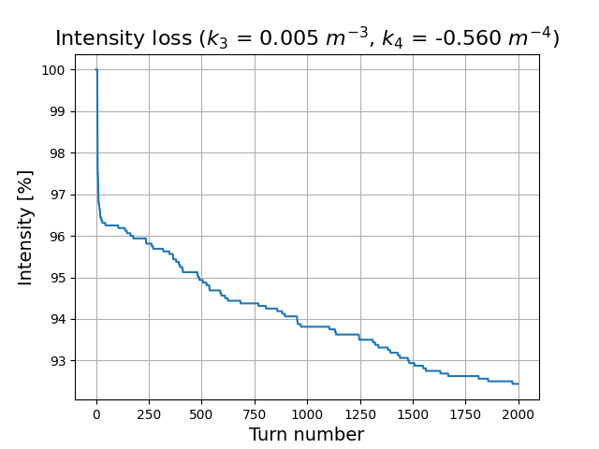
Case five, octupole change (Qx = 0.31, Qy = 0.34)

Slide 13
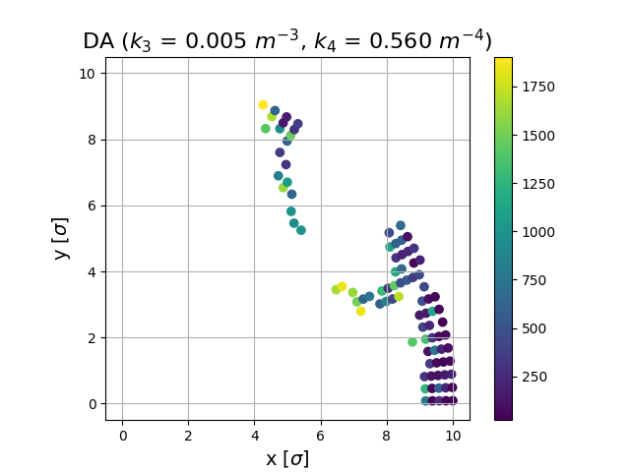
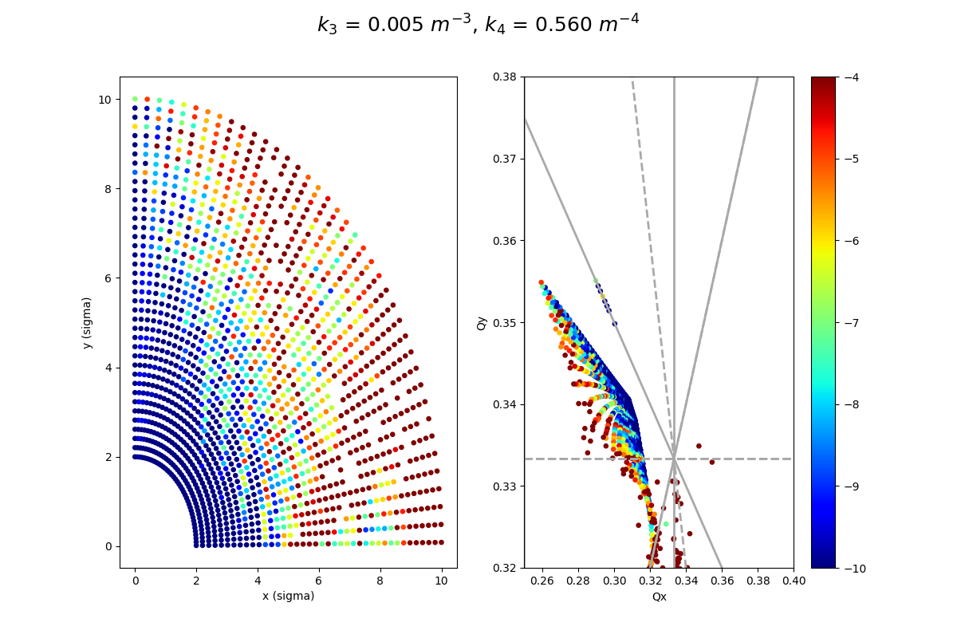
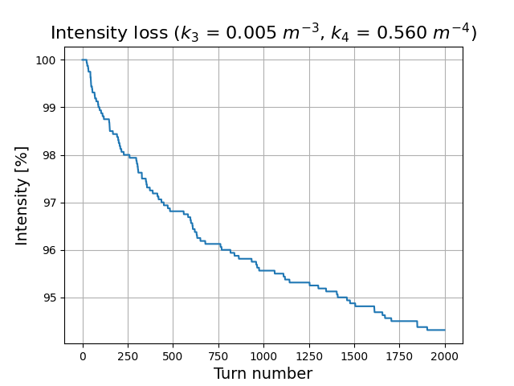
Case six, octupole change (Qx = 0.31, Qy = 0.34)

Slide 14
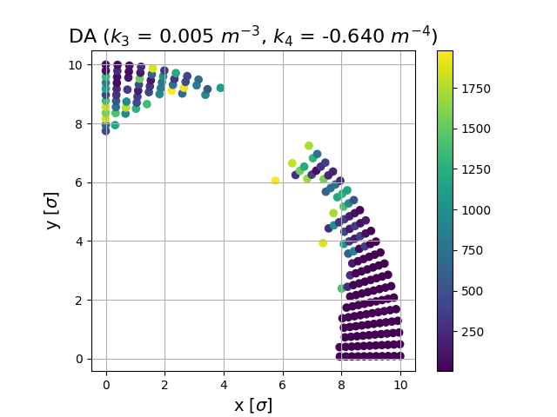
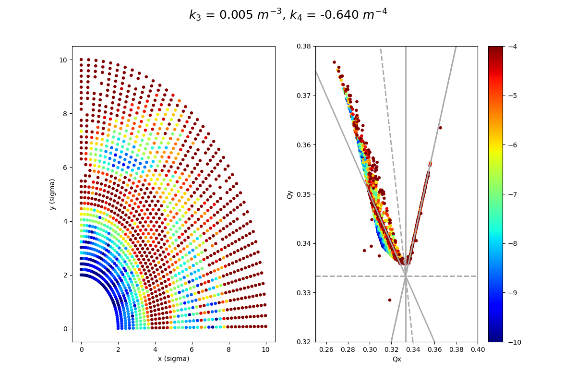
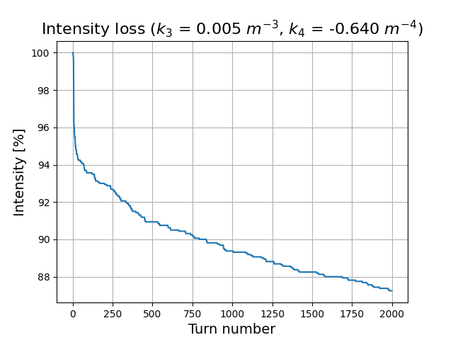
Case seven, octupole change (Qx = 0.31, Qy = 0.34)

Slide 15
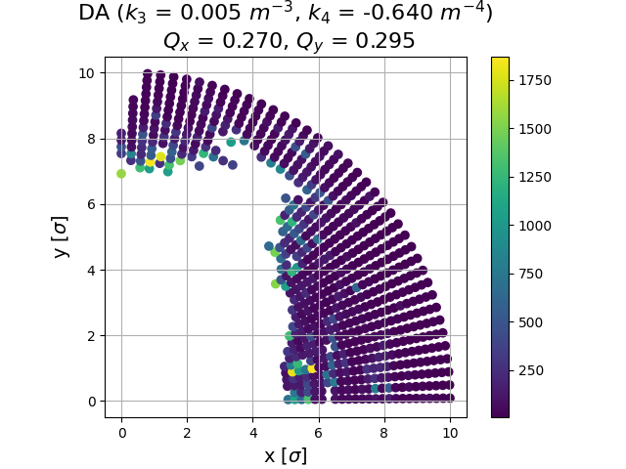
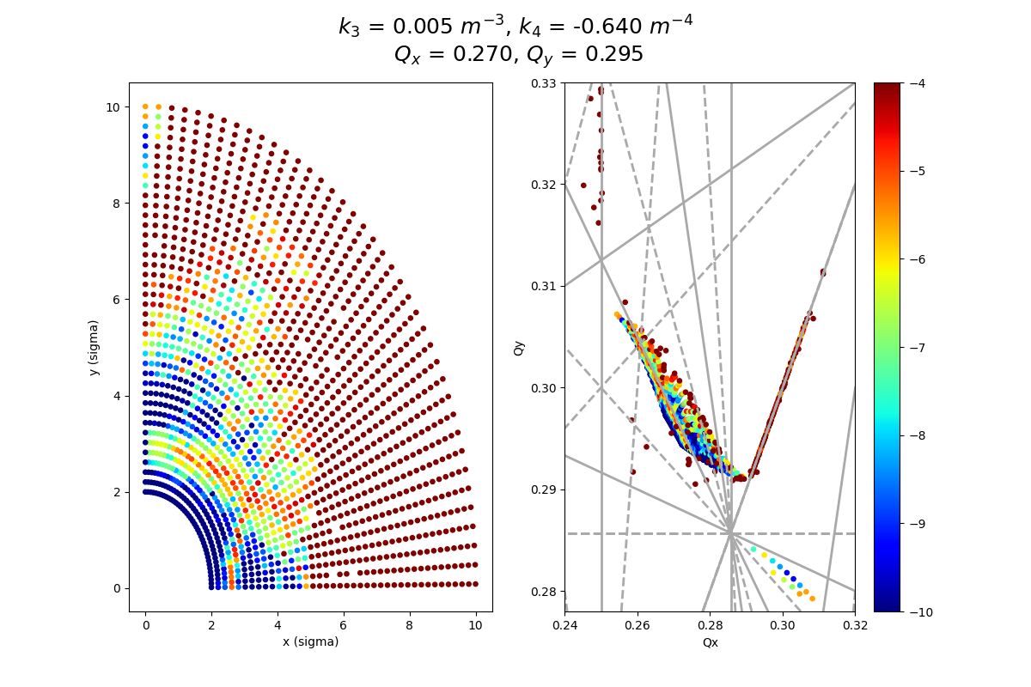
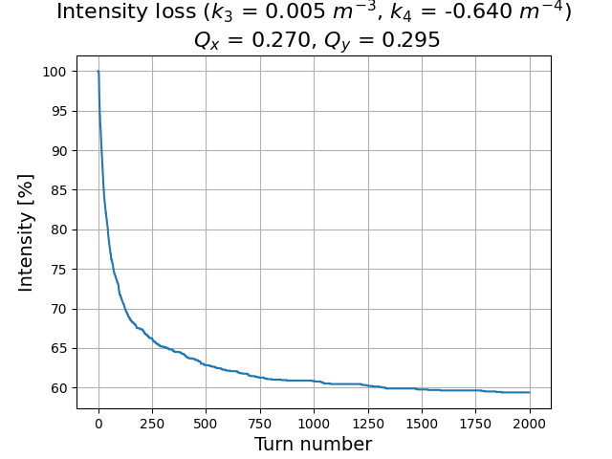
Case eight, octupole change (Qx = 0.270, Qy = 0.295)
3Qx + 4Qy

Slide 16
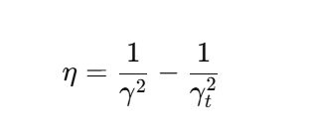
RF-cavity insertion
Gamma transition 2.68GeV
The sign of eta determines the relationship between the energy deviation of a particle (ΔE) and its arrival time deviation (Δt) relative to the synchronous particle.
Slip factor:
Beam energy 20 GeV RF voltage 1MV

Slide 17
RF-cavity insertion
The sign of eta determines the relationship between the energy deviation of a particle (ΔE) and its arrival time deviation (Δt) relative to the synchronous particle.
Slip factor:
Our particles are above transition energy.

Slide 18
RF-cavity insertion
The sign of eta determines the relationship between the energy deviation of a particle (ΔE) and its arrival time deviation (Δt) relative to the synchronous particle.
Slip factor:
Our particles are above transition energy.
We add a phase shift of 180 degrees to the synchronous phase.

Slide 19
RF-cavity insertion
The sign of eta determines the relationship between the energy deviation of a particle (ΔE) and its arrival time deviation (Δt) relative to the synchronous particle.
Slip factor:
Our particles are above transition energy.
We add a phase shift of 180 degrees to the synchronous phase.
Negative slope of the RF, thus higher-energy particles arrive earlier, and the RF system restores stability by accelerating them back to equilibrium.

Slide 20
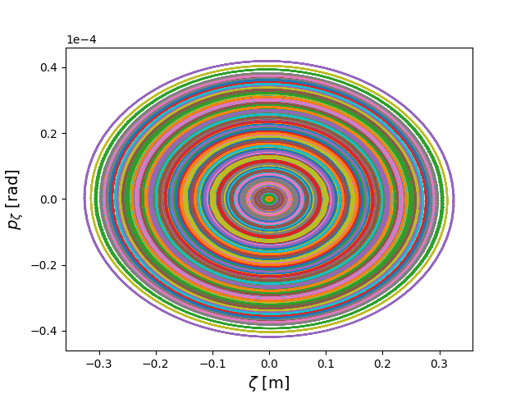
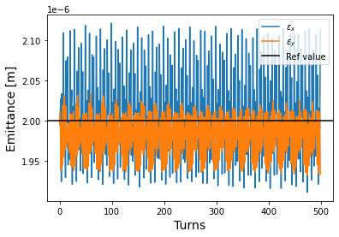
Emittance evolution and RF bucket

Slide 21
Thank you for your attention!!

Slide 22
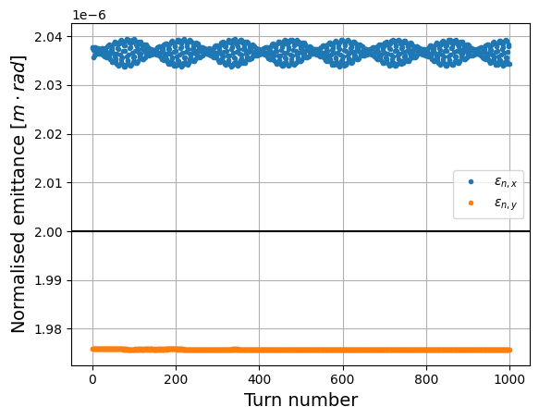
RF cavity on – 6d
Emittance computation
Why do we see this behavior?
- Liouville theorem is valid.
- rms-emittance

