Slide 1

BLM IC Drawings, Procedures, 20 Units for 2024 and Procurement
Gerhard Schneide
BLM Meeting 12.02.2024

Slide 2
Contents
Drawing Status
Order of 20 BLM parts for assembly in 2024
Procedure for Ceramics
Documentation Status

Slide 3
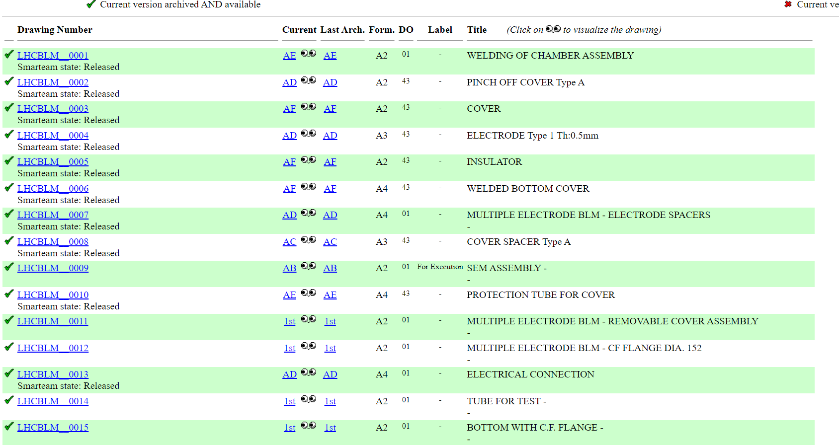
Drawing Status
All drawings for BLM IC signed - Good

Slide 4
Drawing Status
A mix of old and new BLM drawings on drawing code LHCBLM__%, total 281drawings, while BLM IC drawings are only 23.
  Declare others obsolete?
Any further input why not to do so?

Slide 5
Order of 20 BLM parts for assembly in 2024
Idea: Assure all drawings are o.k. and make all parts
→ Possible exceptions: Ceramics, Electrodes, screws…
Meeting today in the afternoon with J-M. Malzacker to launch production
Budget codes SPS cons 64756 and HL_LHC WU 192424 each 50%/50%

Slide 6
Procedure for Ceramic
Engineering specification for the Ceramic EDMS 2938685 written and distributed for comments to Christos, William and Dion
→ Distribution list?
→ What is missing to release the specification?
Sub-Procedure EDMS 2939948 - BLM IC-Electrical test procedure; D. Tzamarias and al
→ What is missing to release the procedure?

Slide 7
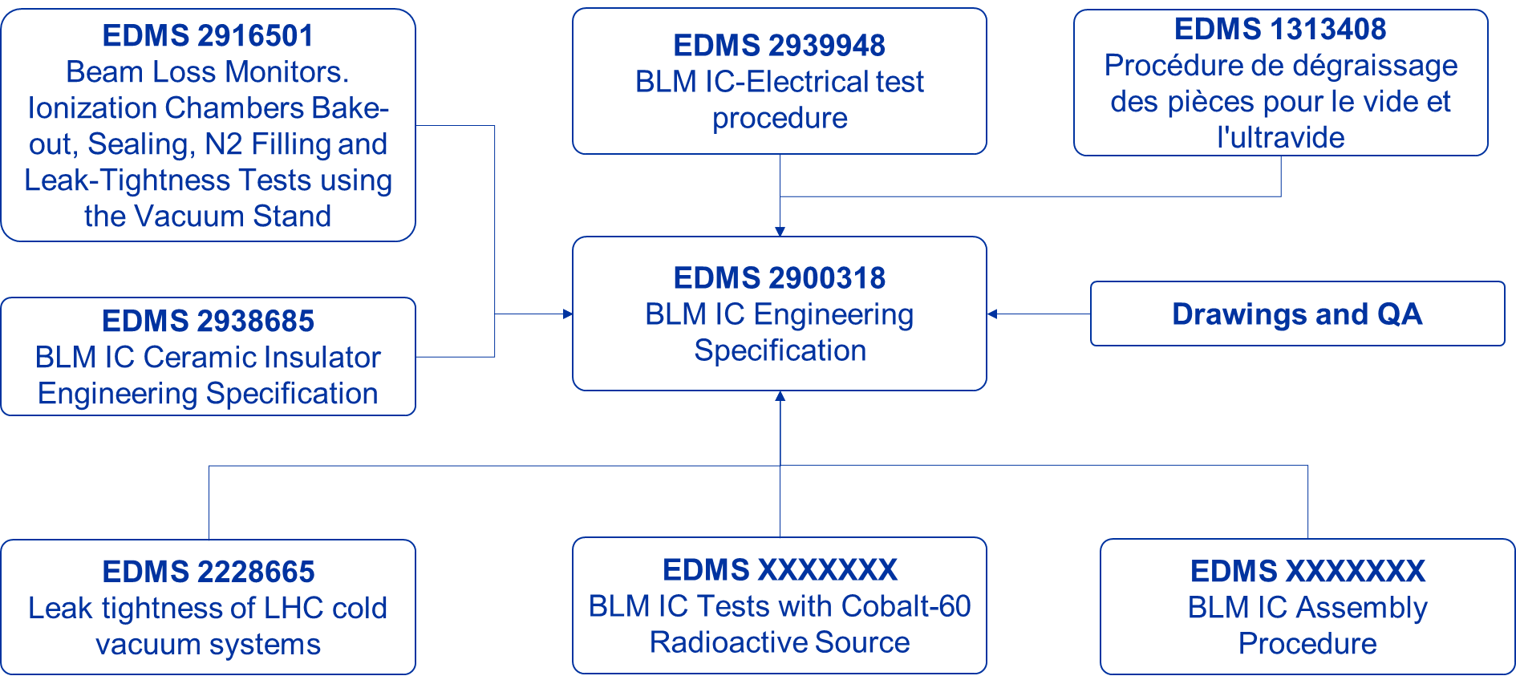
Present Situation –
Engineering Specifications

Slide 8
Open Issues:
Can we use the feedthroughs “found” in the stores? Any tests needed to assure functionality? Previous tests made?
Open design job for MME for shorter BLMs? Or functional physics considerations first?

Slide 9
Arrival of new technican:
Familiarise with BLMs and test stand
  Procedures
  RGA
  Re-assure functionality of the test stand
Build 10 BLMs once the parts are available

Slide 10
Procurement
Involve MME subcontracting service (JM Malzacker) already involved in last orders since 2014 or even before.
Prepare of the bigger orders now
  We need 1000 BLM IC. How many reserves do we order?
  What do we do with our stock?
Still open question where to assemble and leak test the series: Industry or collaboration.

Slide 11
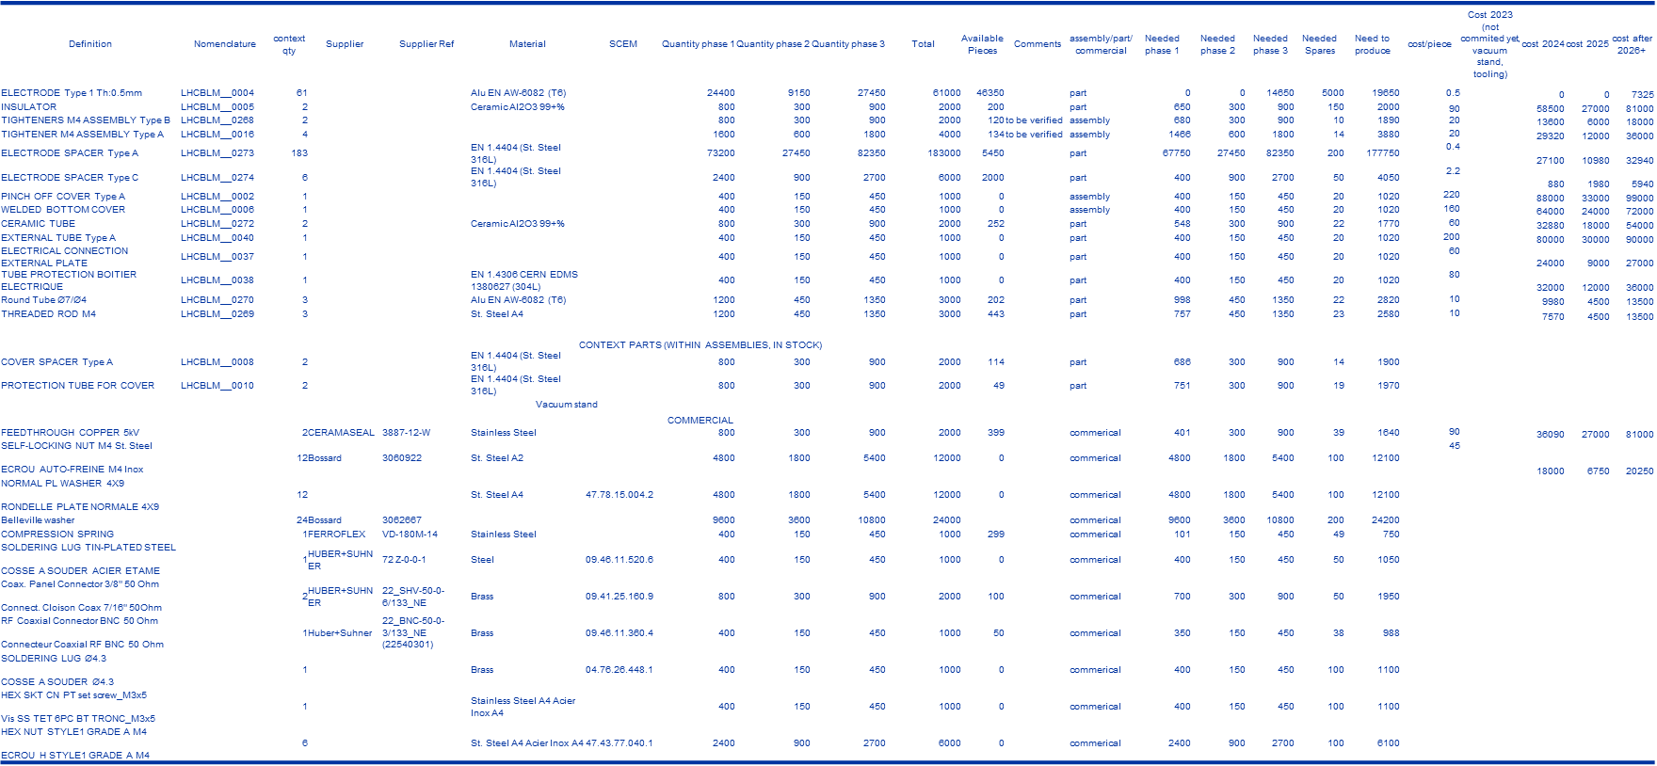
Stores situation

Slide 12
Summary
Drawing folder complete and signed
Technical specifications are advancing, still not all released
Preparation for start of new technician start on 01.03 almost done
Order for 20 BLM parts will be made today
Prepare now for big procurements of parts, MME involvement foreseen
Ceramics in stores electrically qualified.
Start design of shorter BLMs?
Still open question where to assemble and leak test the series: Industry or collaboration.

