Slide 1
State of Study
Annotations following meeting

Slide 2
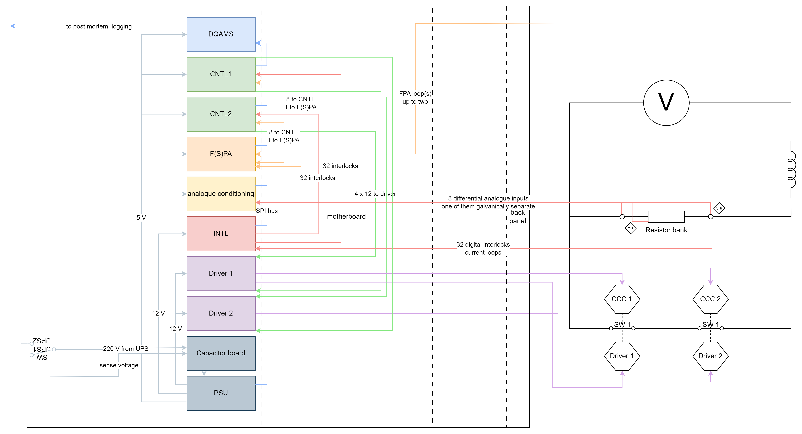
System Functional Diagram

Slide 3
Top-Level FMECA
situation | function | failure mode | effect (worst case) | criticality/downtime | reliability target | comment
quench or powering failure | detect FPA loop open | fail to detect FPA loop open (on time) | magnet damage | months | 1/100y
 | drive switch opening | fail to drive switch opening (on time) | magnet damage | months | 1/100y
 | drive switch opening | successful opening but internal problem preventing operation | cannot restart machine until problem solved | hours | 1/y
 | collect data and transmit | fail to collect data and transmit (on time) | cannot restart machine until problem diagnosed | hours | 1/y
normal operation | detect FPA loop closed | fail to detect FPA loop closed | spurious dump or delay of fill | hours | 1/y
 | continuously drive closed switch | spuriously open switch (with opening FPA loop) | spurious dump | hours | 1/y
 |  | spuriously open switch (without opening FPA loop) | PC will trip and send FPA
 | collect data and transmit | fail to collect data and transmit (on time) | cannot restart machine until problem diagnosed | hours | 1/y
spurious opening of EE switches | detect switches opening | fail to detect switches opening (on time) | PC will trip and send FPA | hours | 1/y | there is no active protection of the switches by the EE controls in case of spurious opening, except vacuum switches
 | open FPA loop | fail to open FPA loop (on time) | PC will trip and send FPA | hours | 1/y
 | open all other switches | (see above)
 | collect data and transmit | fail to collect data and transmit (on time) | cannot restart machine until problem diagnosed | hours | 1/y
interlock indicating unsafe operation | detect unsafe operation | fail to detect unsafe operation (on time) | EE damage, possibly magnet damage |  | 1/10y | better discuss on case by case
 | open switches | fail to open switches (on time) | EE damage, possibly magnet damage |  | 1/10y | better discuss on case by case
 | open FPA loop | fail to open FPA loop (on time) | PC will trip and send FPA
 | collect data and transmit | fail to collect data and transmit (on time) | cannot restart machine until problem diagnosed | hours | 1/y
loss of mains power (opens switches) | open FPA loop | fail to open FPA loop (on time) | PC will trip and send FPA
 | open switches | fail to open switches (on time) | they open anyways? |  |  | there is no active protection of the switches by the EE controls in case of spurious opening, except vacuum switches
 | collect data and transmit | fail to collect data and transmit (on time) | cannot restart machine until problem diagnosed | hours | 1/y
1: open switch upon FPA loop opening
2: prevent operation if interlock detected
3: behaviour of new vacuum switches under loss of power

Slide 4
1: Simulation of switch opening request
Single optocoupler with double read-out
F(S)PA (1)
CNTL 1
Driver 1
SW 1
Crossing here too
Crossing here too
F(S)PA (2)
CNTL 2
Driver 2
SW 2
Simulation model of most critical function generated following last meeting
  Failure if no path functional and demand (FPA open)
  Considers that upon each demand, blind failures are discovered and fixed (e.g. if CNTL stopped triggering Driver 1)
Used to estimate failure rate requirement for the “”boxes”
  Demand interval varied between 13 and 750 days
  Based on initial Top-level requirement, failure rate per box ~few hundred FITS (1E6 – 1E7 hours MTTF)
    FITS: failures in 10^9 hours, example: single discrete components have <10 FITS

Slide 5
1: Simulation of switch opening request
Next steps
Finalize top-level requirements
Based on requirements, estimate whether boards fulfill them based on component prediction
  To so so, would need design files (processed by design office) – so far: G:\Departments\TE\Projects\EnergyExtraction\UniversalElectronics\GLAB
  Possibly: FMECA for selected boards to get components on critical path

Slide 6
2: Critical interlocks?
Document and clarify
  Discussed e.g. interlock based on dump resistor temperature

Slide 7
3: Behavior of new vacuum switches under loss of power
Clarify and document
  New vacuum switches have to be latched not to re-close
  Clarify and check whether failure rate estimation also necessary

Slide 8
Notes (raw)
Bozhidar - state of EE
  chassis electronics able to serve all (beyond HL LHC)
    vacuum, IGBT, FRESCA, Prevessin test station
    programming of control cards different
    only connectors different (chassis backpanel)
    PSU & capacitor boards may still change
    universal motherboard
    backpanel connected to other side of motherboard; connectors adapted to system
current progress
  made prototype for vacuum switch (most urgent)
  launched pre series of ten systems for testing in poland and in charm
  series design -> little changes by end of sept
    have tester for PCBs
    boards are not testable yet
  launch production Jan/Feb next year
    go to design office with big order

Slide 9
Notes (raw)
our state of study
  slide 4: neach FPA channel is actually going to both
    depending on system different situation
      vacuum system
    focus on vacuum switches
      needs power upon loss
next steps
  link to GLAB
  vacuum switch critical path
    FPA
    critical interlock
    no electricity
  use a single optocoupler with two outputs
  driver card
    can be optocoupler (13KA) or relays (600A)
    vacuum sw
      three operations
        open switch
          pre charged capacitor
          done by two fibers
          same for sw2
        kill the arc
          pre charged capactiro
          after delay activated
          two fibers
            same for sw2
        trigger CC in opposite direction
          kill the arc in the other direction
          (mainly needed for D1 & D2)
        all done in microseconds
        keep non vacuum switches with relays in mind
    other switches
      always two relays in series
      EM switches
        cut current - switch opens (slow due to magnetization) - controlled by two relays
        transistor to push opening - faster than relay
        both fast enough (redundant)
    bozhidar prepares diagram for vacuum specifically
    meanwhile we get the full schematics
    electricity
      UPS 1&2
      distribution box
        regular circuit breakers
        emergency stop
      transfer switch
        single line goes to cluster of outlets
      monitor the output line + line to each vacuum drivers is monitored as well --> fiber to interlock board + 24V transformed -> two PSUs redundant - also monitored (four wires)

