Slide 1
Models for FPA/SPA and Interlocks
Energy Extraction Universal Controls #6

Slide 2
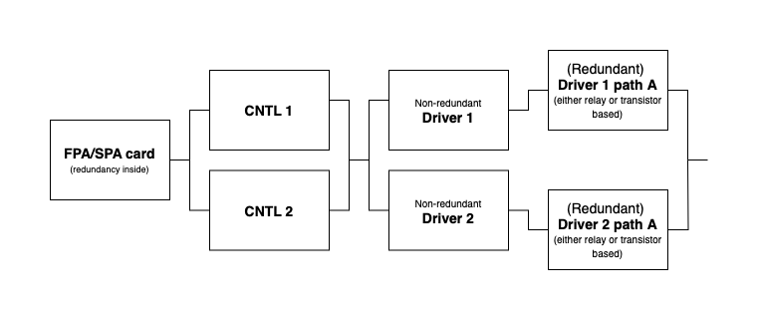
Model with the FSPA card
Description
FSPA card has internal redundancy leading to complete crossing of the output signals inside:
Signals ST LOOP A 1 and ST LOOP A 2 going to CNTL 1
Signals ST LOOP A 1R and ST LOOP A 2R going to CNTL 2
The driver cards have a redundant and non-reduntant paths.
Given the model, we pessimistically assume that there is just one path (i.e., as if the card was non-redundant).
Control boards inputs are coming from two redundant paths of the FSPA card; outputs are provided to two driver cards.

Slide 3
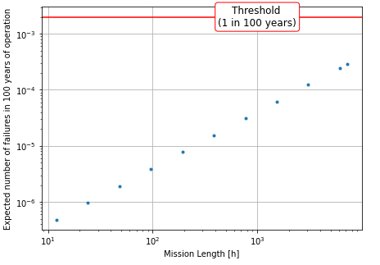
Model with the FSPA card
Results
Assumptions:
One FSPA card per system
Simplified models for calculations:
  driver model with just 1oo2 redundant path
  FSPA card without additional internal redundancies
→ with yearly testing & two fully redundant paths for switch opening, the reliability requirements are met

Slide 4
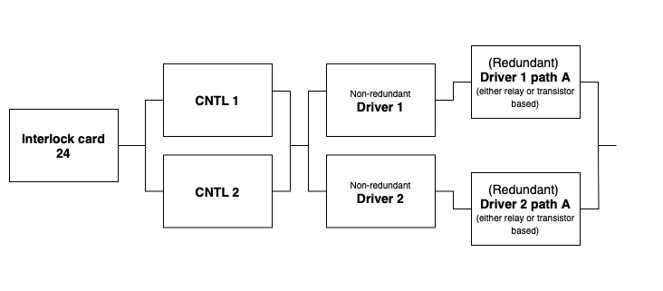
Model with interlocks
Description
X 24

Slide 5
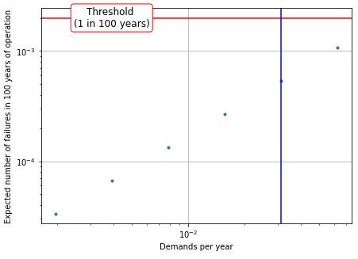
Model with interlocks
Results
Assumptions:
Between 600A and 13kA case, 13kA considered more critical
  Taken as baseline and results scaled to all EE systems
  Demand parameter scan (blue line is one demand per 32 systems per year)
  24 critical interlocks assumed
  Test every three years
→ with yearly tests, and critical interlock rates <= 1 per 32 EE systems, the reliability requirements are met
  Further gains possible if possible single points of failure in interlock card mitigated (last meeting)
  Yearly testing of interlocks

