Slide 1
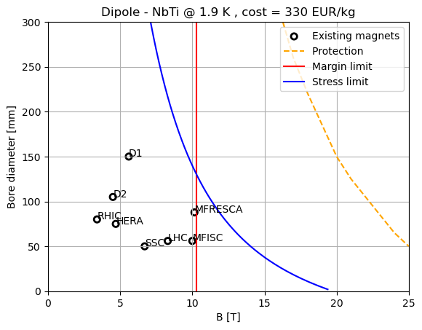
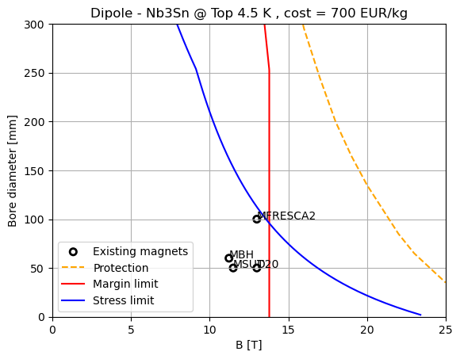
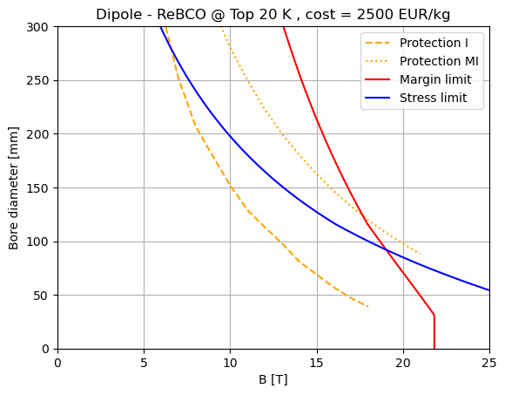
dipole – A-B plots

Slide 2
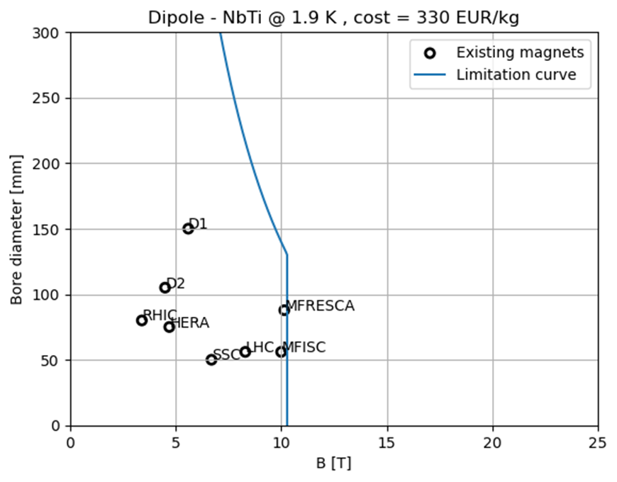
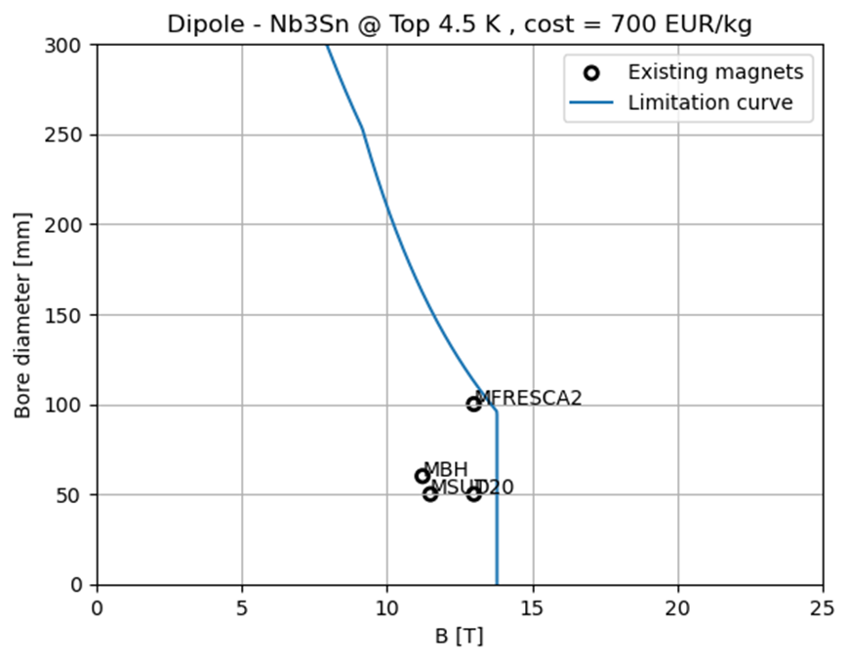
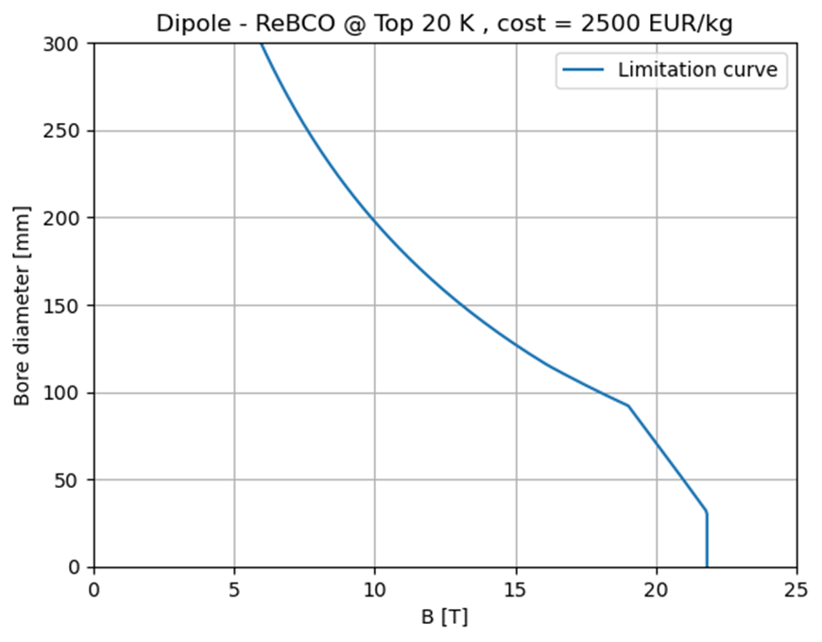
dipole – A-B plots

Slide 3
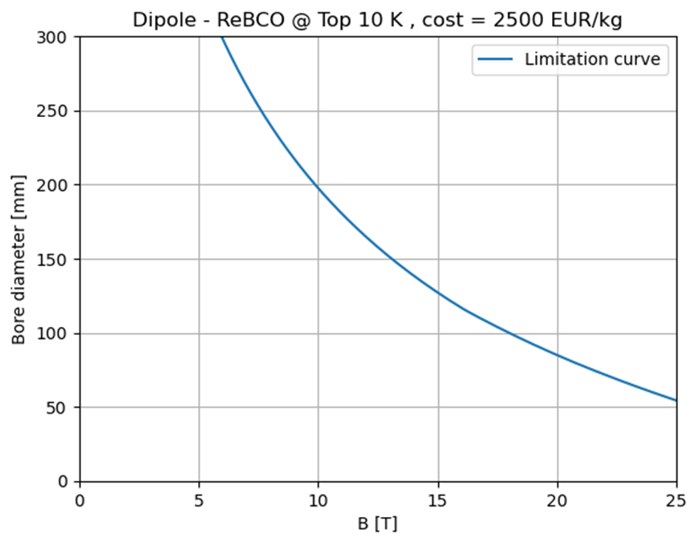
dipole – A-B plots

Slide 4
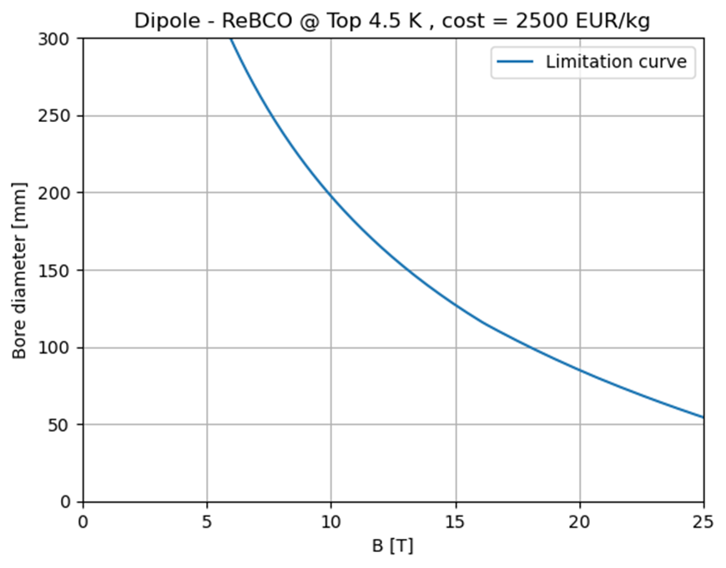
dipole – A-B plots

Slide 5
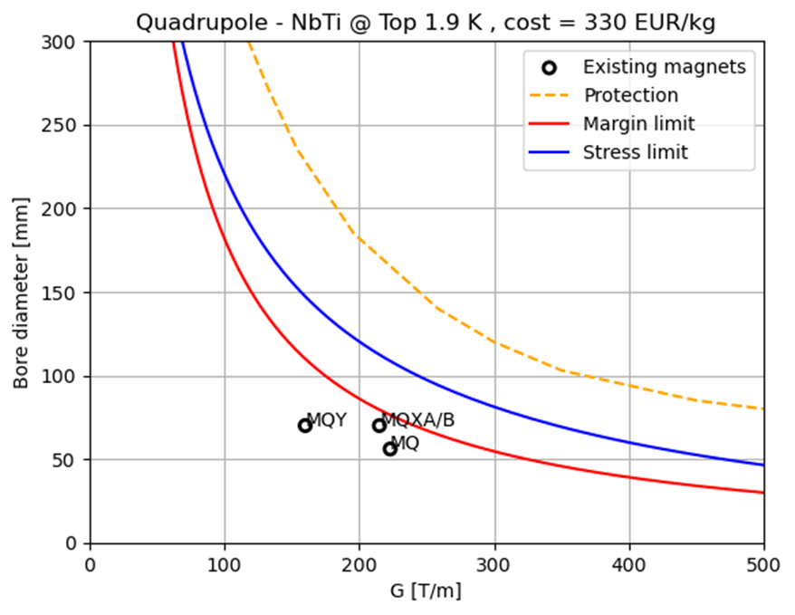
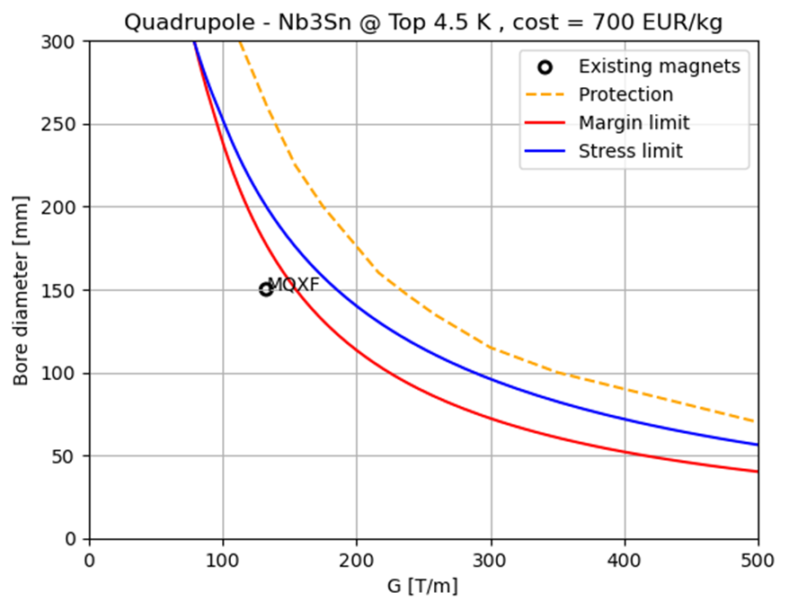
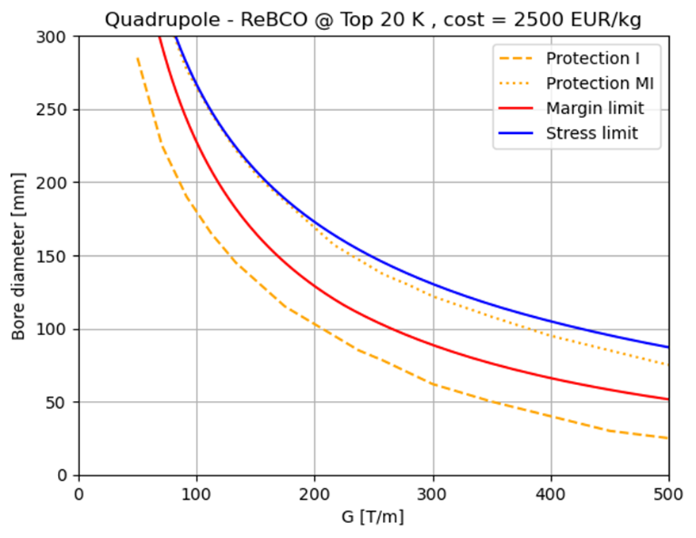
quadrupole – A-B plots

Slide 6
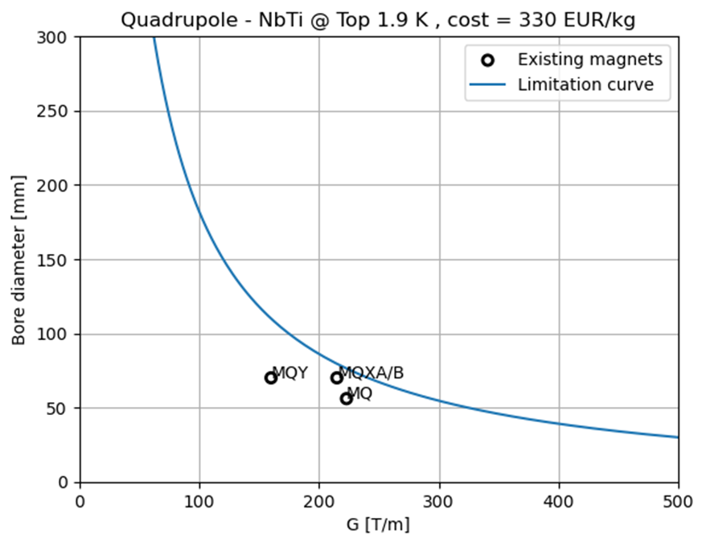
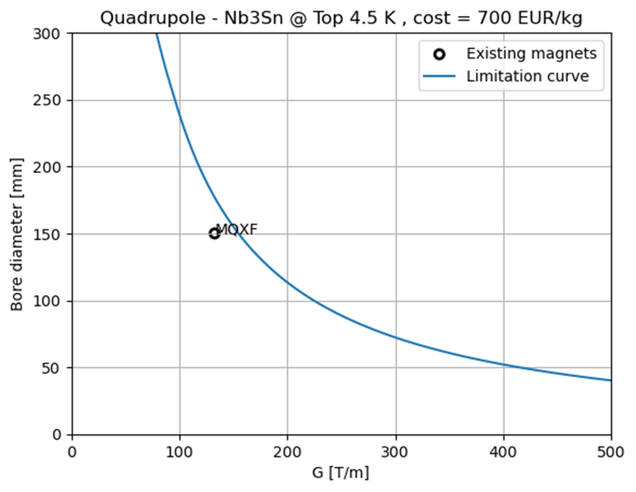
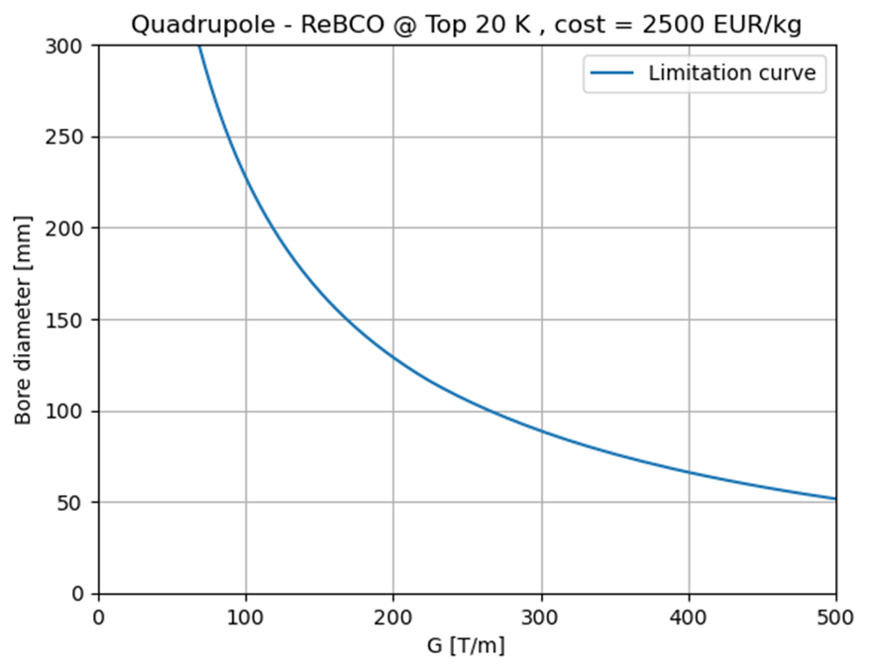
quadrupole – A-B plots

Slide 7
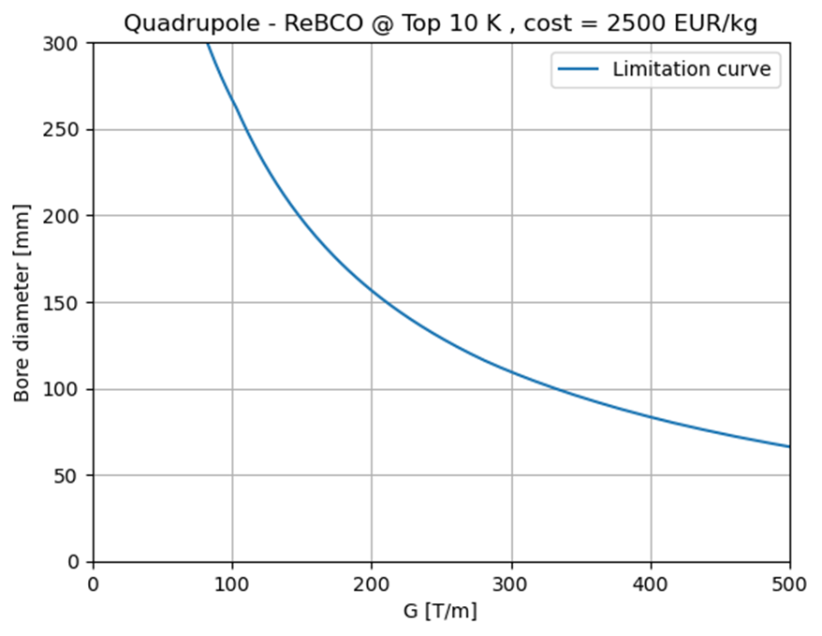
quadrupole – A-B plots

Slide 8
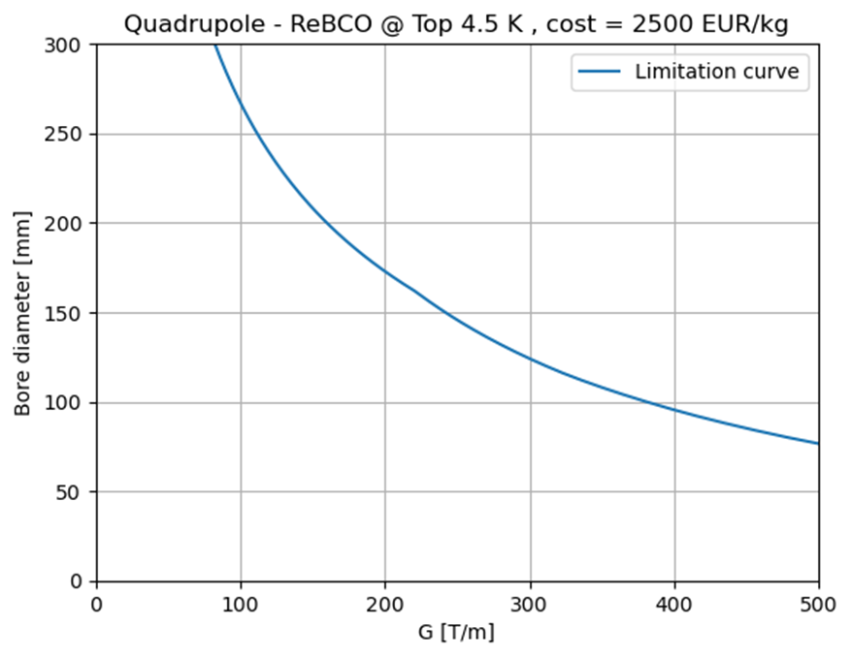
quadrupole – A-B plots

Slide 9





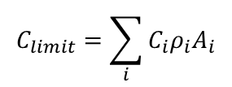





Neglecting f_{strand}
$$f_{strand}=\frac{non−insulated cable}{insulated cable}$$
$$C_{limit}=\sum_{i}{C_{i}ρ_{i}A_{i}}$$
$$C_{sc}ρ_{sc}A_{sc}$$
$$A_{sc}=\frac{2π}{3}\left(w^{2}−2a_{1}w\right)$$
$$k=\frac{supercond.}{strand}$$
$${w=w}_{sc}$$
$$Stress curve$$
$$Margin curve$$
$$J_{C, eng.}=J_{C}⋅k$$
$${w_{max}=80 mm}_{ }$$

Slide 10
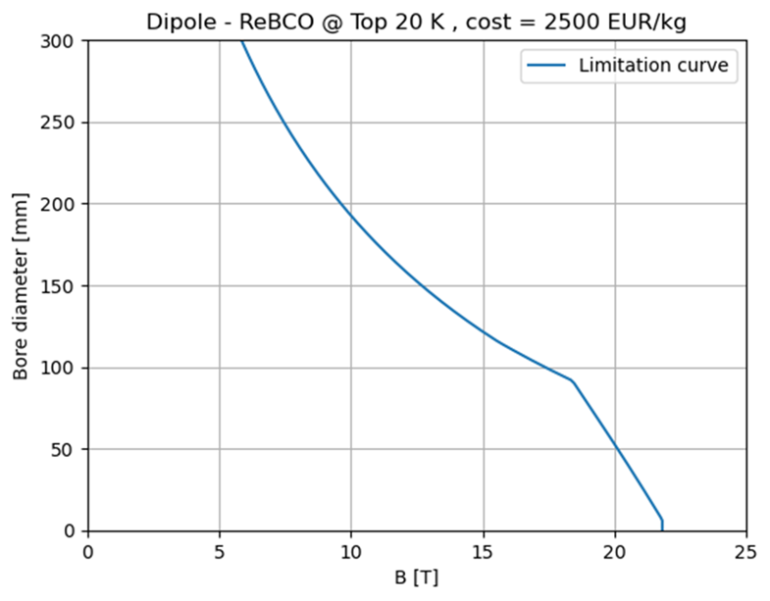
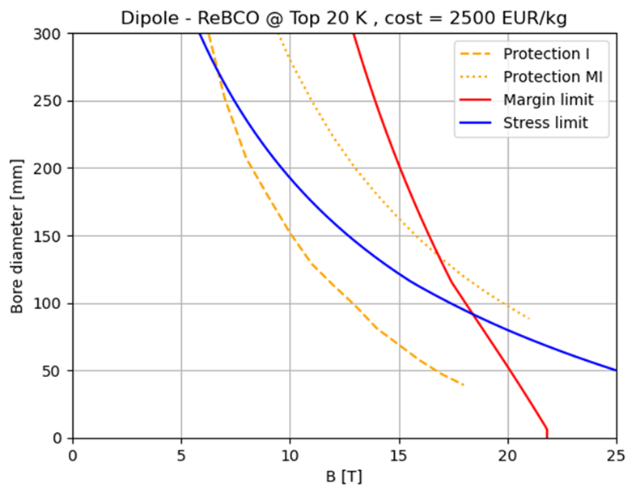






“Double” f_{strand}
$$f_{strand}=\frac{non−insulated cable}{insulated cable}$$
$$C_{limit}=\sum_{i}{C_{i}ρ_{i}A_{i}}$$
$$C_{sc}ρ_{sc}A_{sc}=C_{sc}ρ_{sc}{ A}_{ins.cable}{⋅f}_{strand}$$
$$A_{ins.cable}=\frac{2π}{3}\left(w^{2}−2a_{1}w\right)$$
$$k=\frac{supercond.}{strand}$$
$${w=w}_{ins.cable}$$
$$w_{sc}= w_{ins.cable}{⋅f}_{strand}$$
$$Stress curve$$
$${w_{max}=80 mm}_{ }$$
$$Margin curve$$
$$J_{C, eng.}=J_{C}⋅k$$

Slide 11
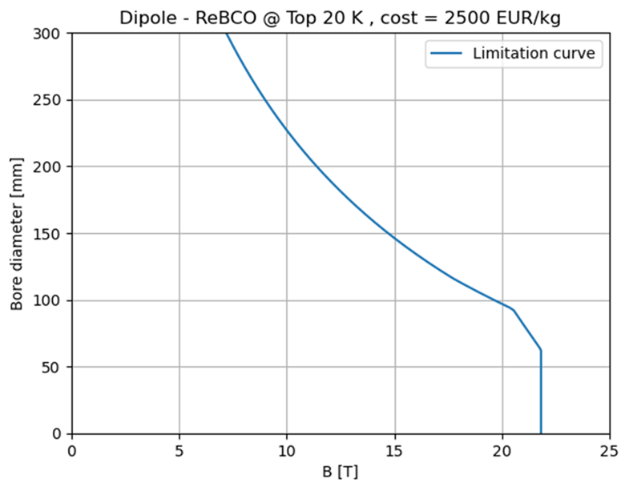
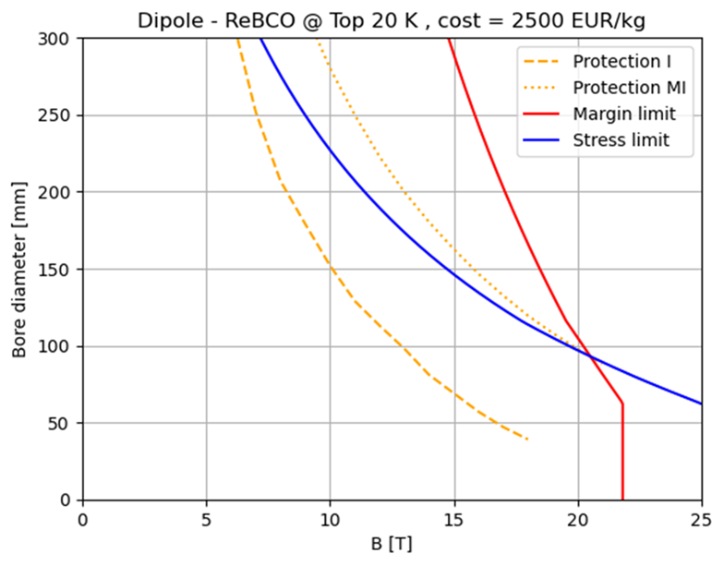




f_{strand} just in the Cost
$$f_{strand}=\frac{non−insulated cable}{insulated cable}$$
$$C_{limit}=\sum_{i}{C_{i}ρ_{i}A_{i}}$$
$$C_{sc}ρ_{sc}A_{sc}{⋅f}_{strand} =C_{sc}ρ_{sc}{ A}_{ins.cable}$$
$$A_{sc}=\frac{2π}{3}\left(w^{2}−2a_{1}w\right)$$
$$k=\frac{supercond.}{strand}$$
$${w=w}_{sc}$$
$$Stress curve$$
$$Margin curve$$
$$J_{C, eng.}=J_{C}⋅k$$
$${w_{max}=80 mm}_{ }$$

