Slide 1
Resource-Efficient Multi-Band Channelization
Timo Muscheid, Luis E. Ardila-Perez, Oliver Sander

Slide 2
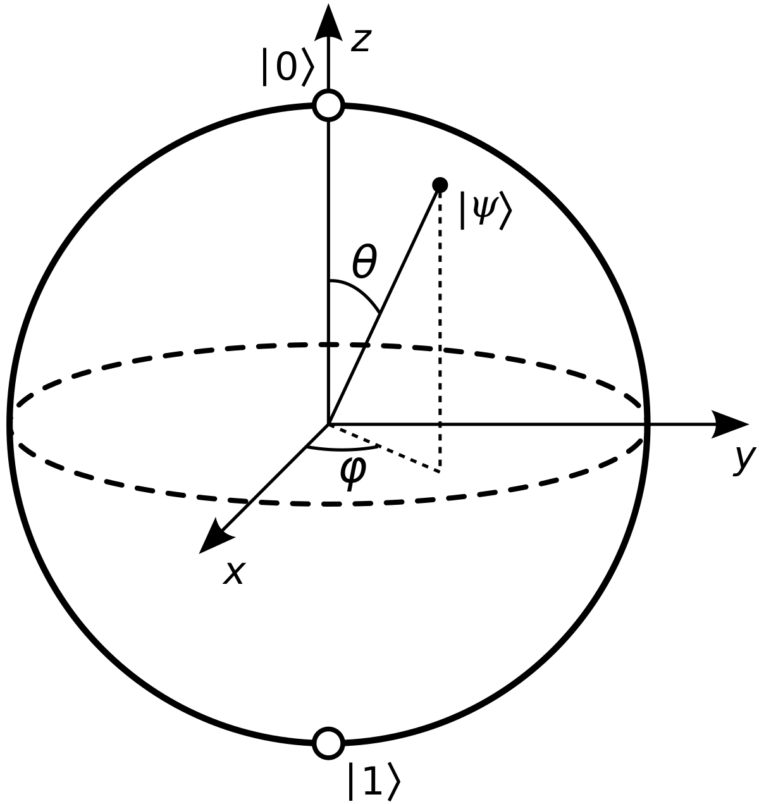
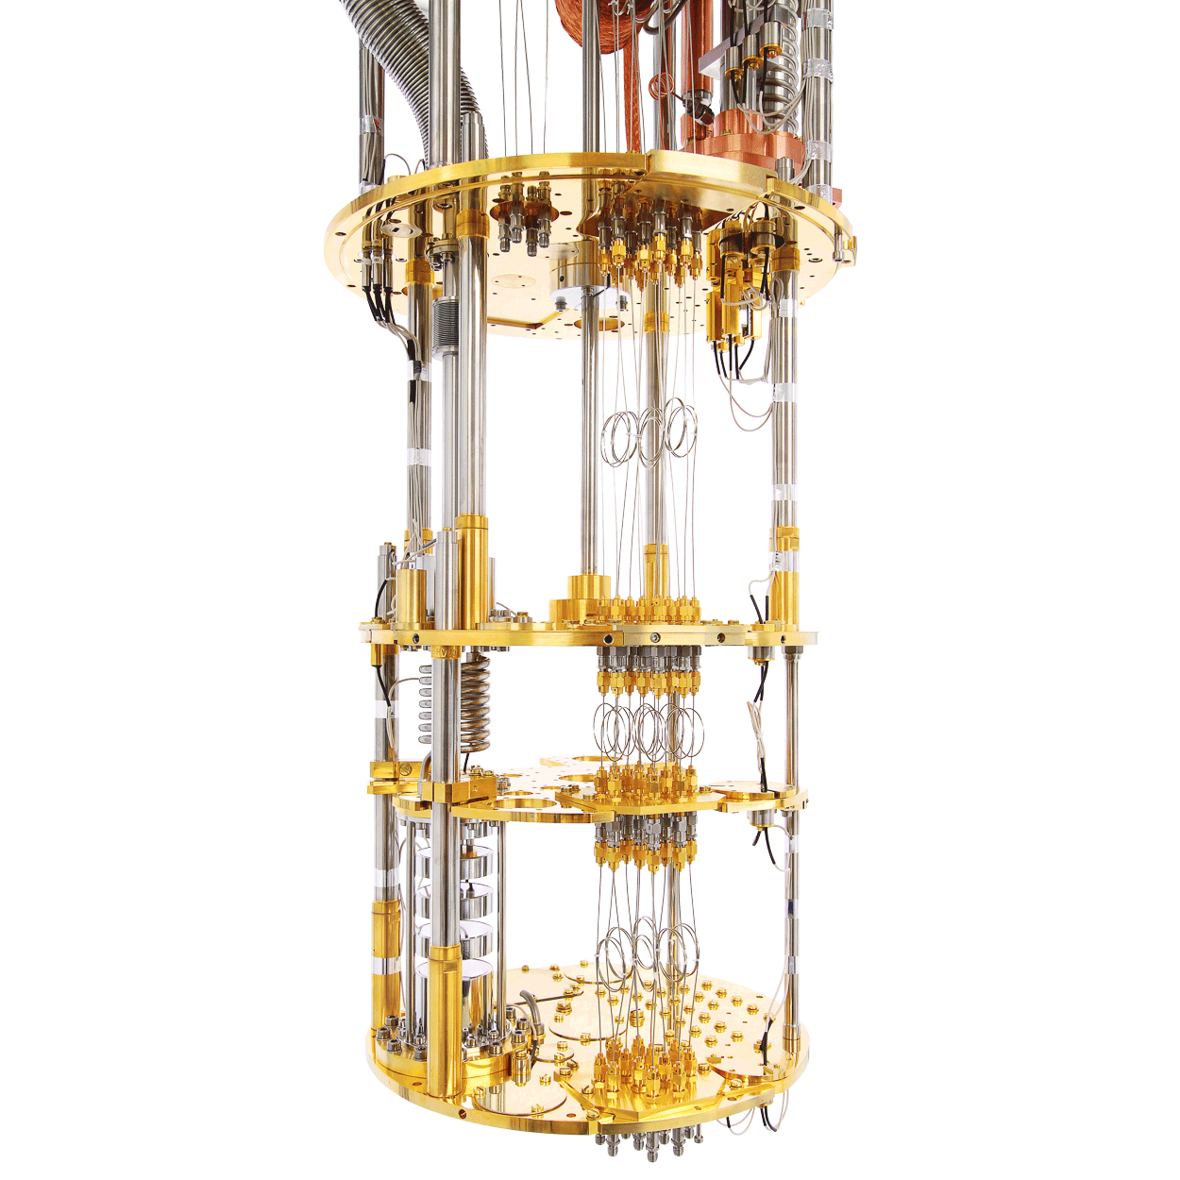
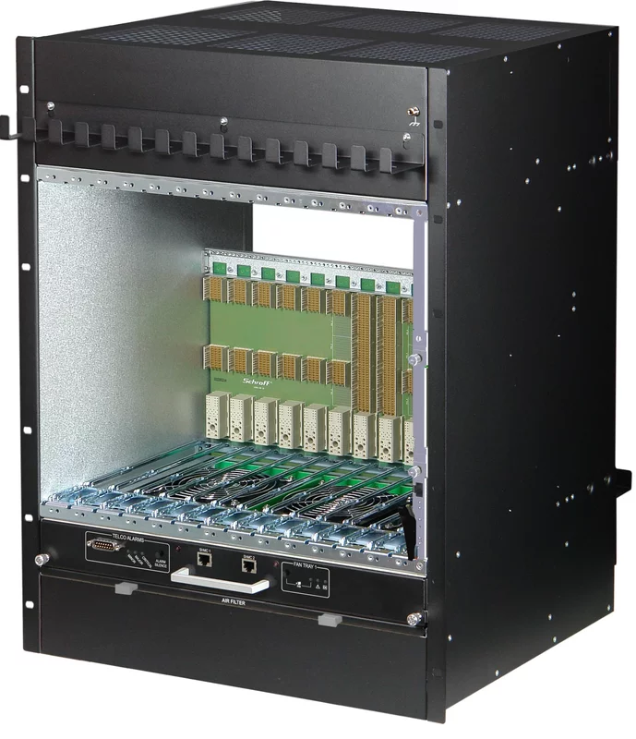
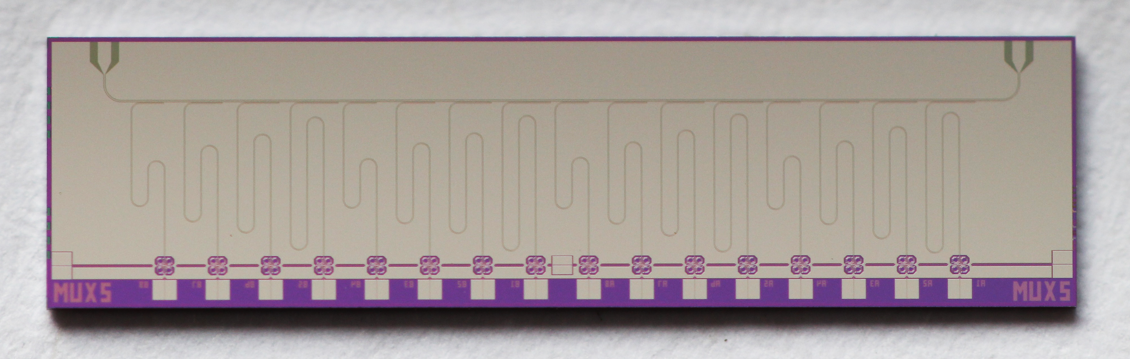
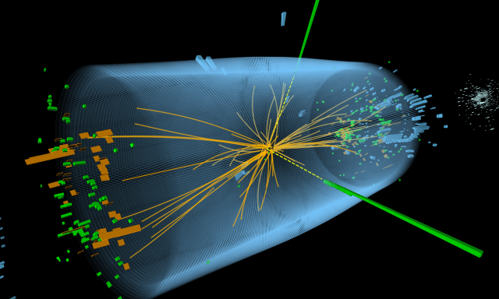
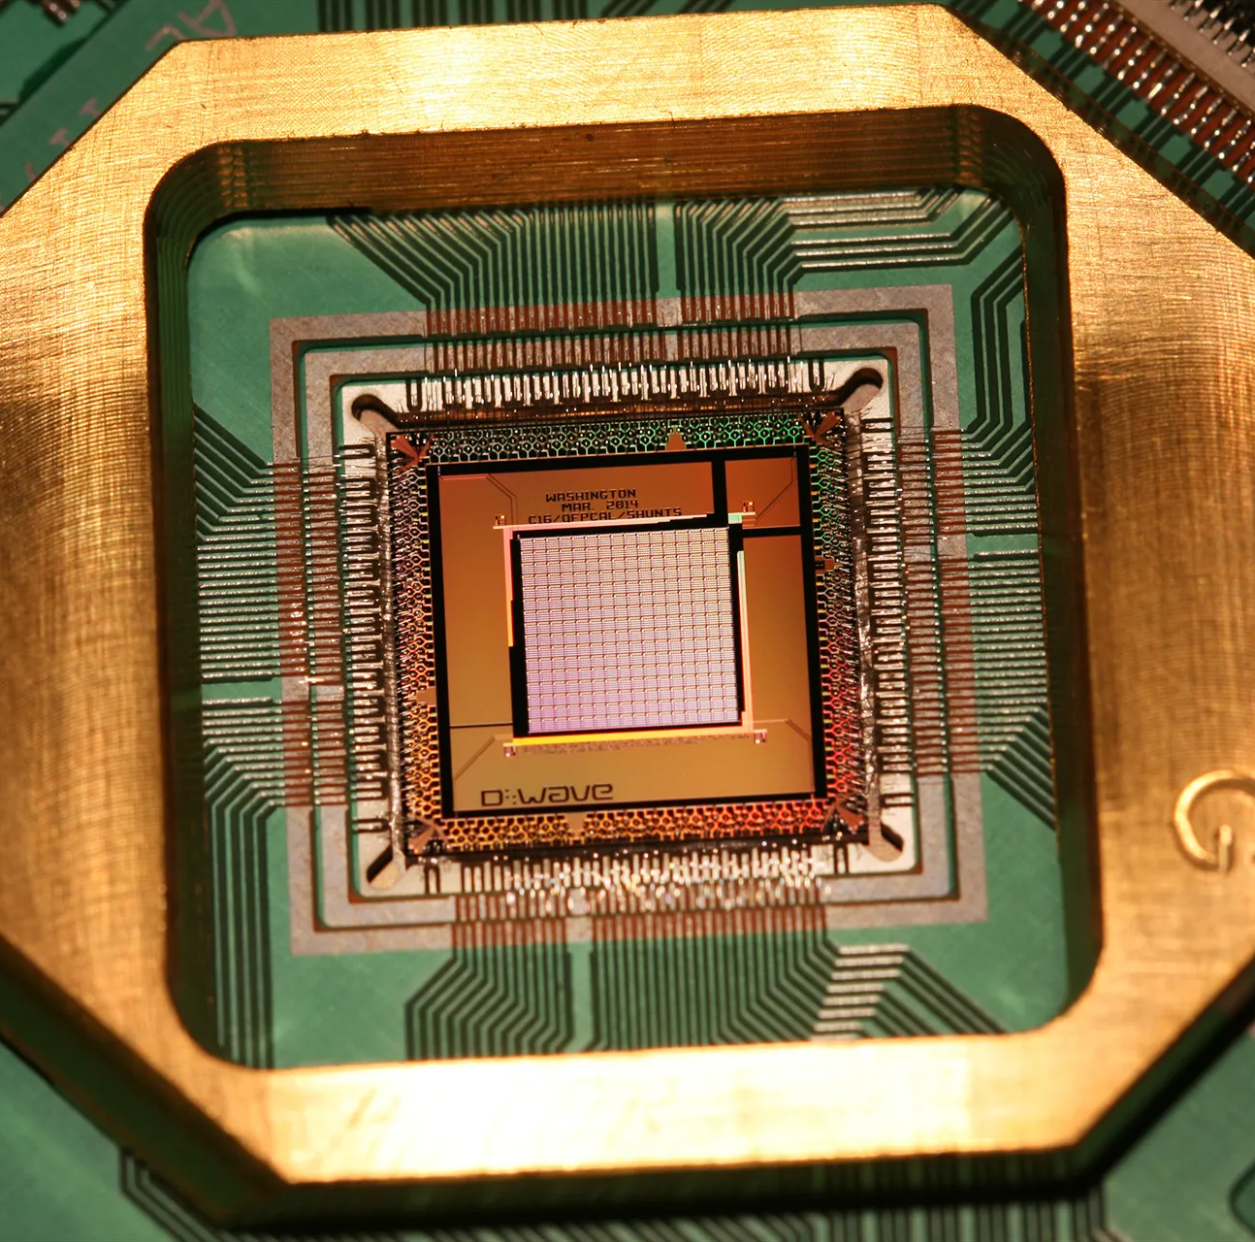
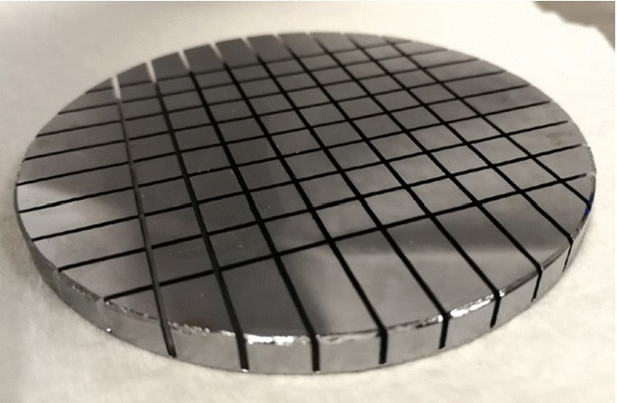
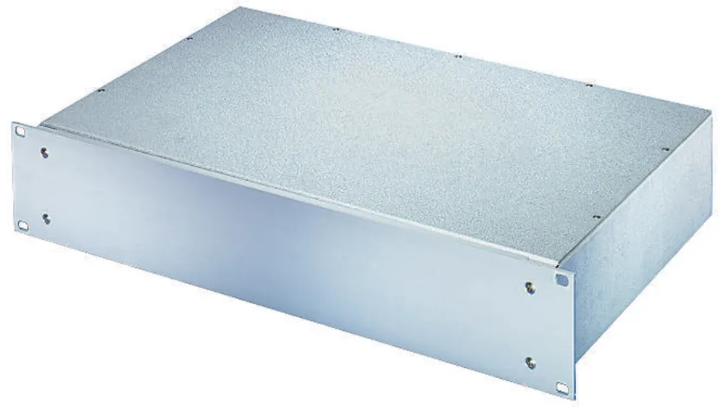
Research background of our working group
Low-latency readout and processing electronics for high-energy physics
Frequency multiplexed readout systems for quantum sensors
Quantum computing and qubit characterization platform
Tools and methods for modular and scalable next-gen DAQ systems

Slide 3
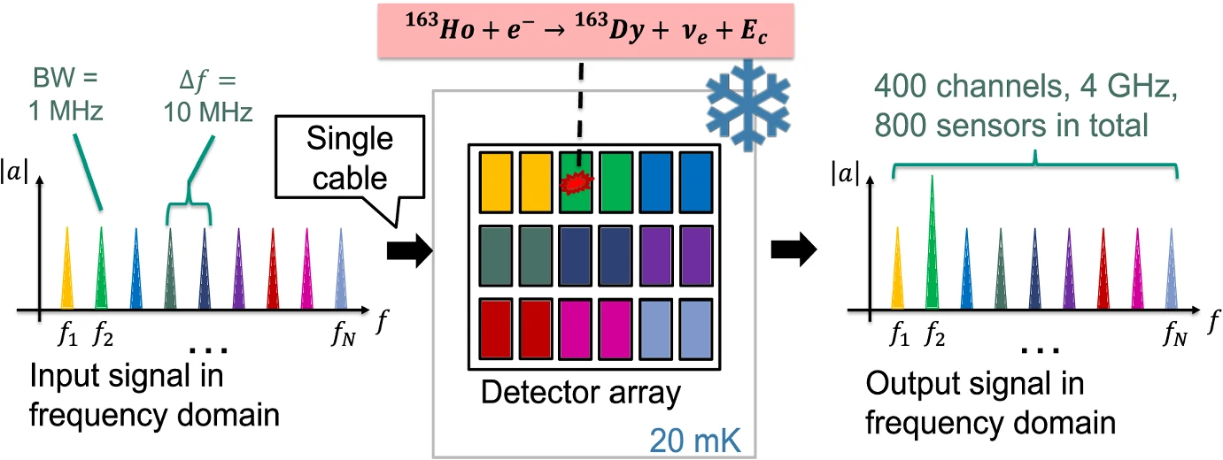
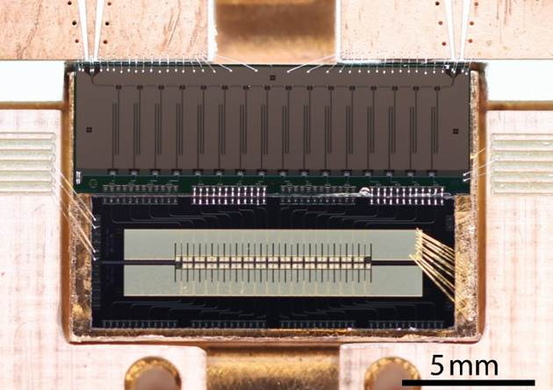
Experiment I : ECHo
Electron Capture of Holmium¹⁶³
Goal: Finding upper limit of electron neutrino mass
Frequency multiplexed magnetic microcalorimeters (MMC)
Detector bandwidth: 1 MHz
ECHo multiplexer
with 16 channels:

Slide 4
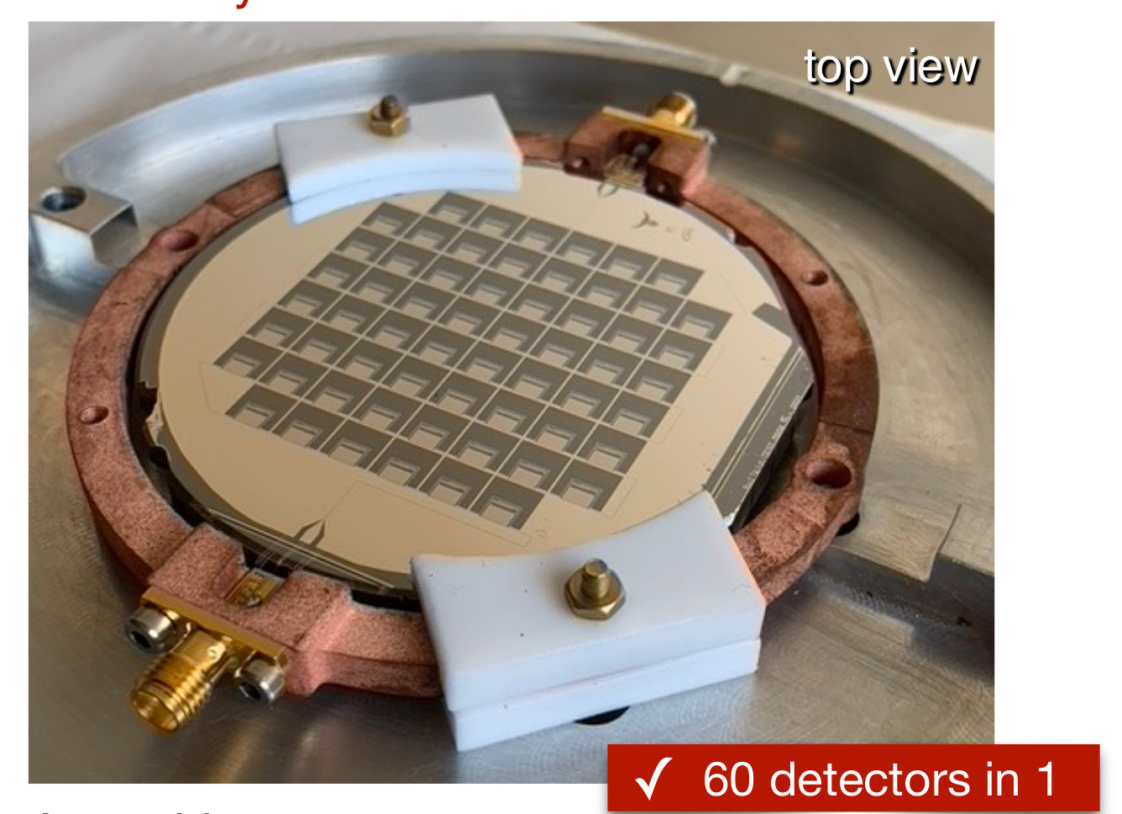
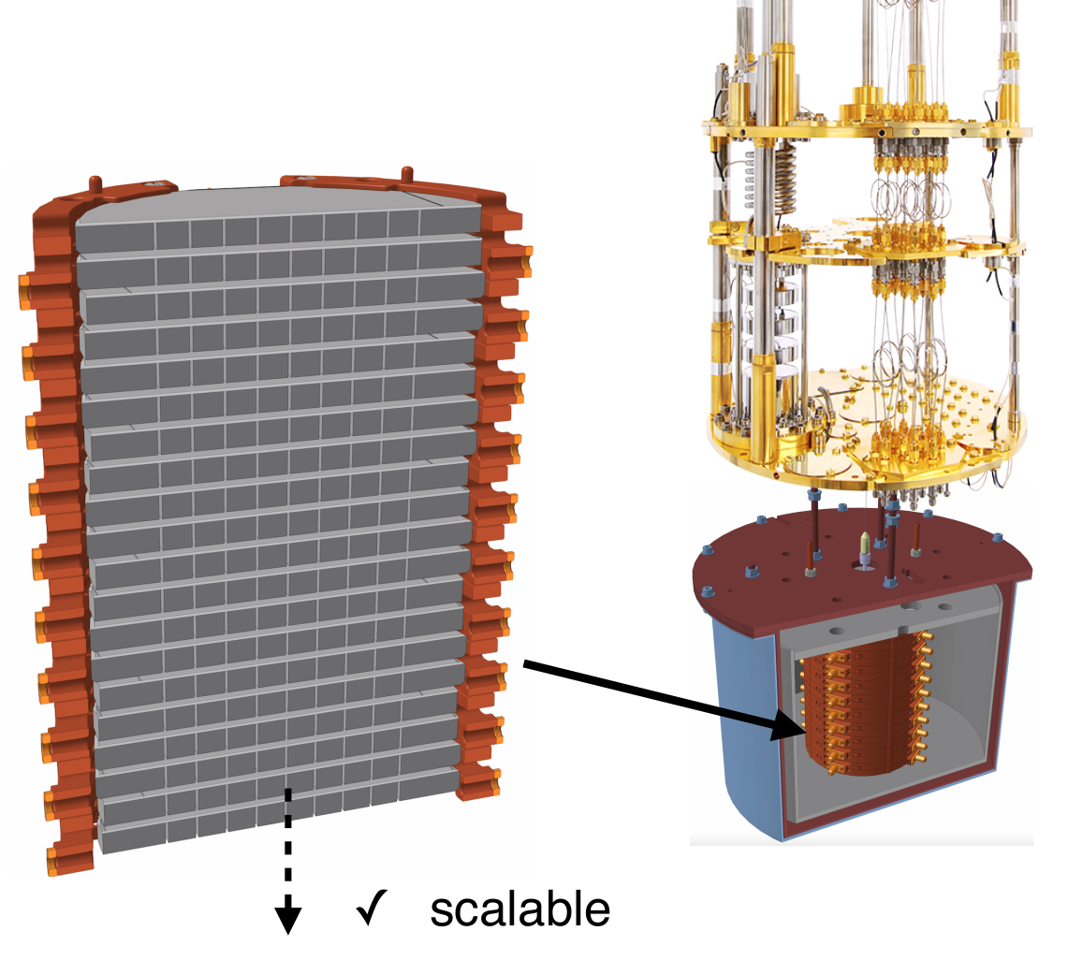
Experiment II : BULLKID
Goal: Direct dark matter search with kg-scale targets
Frequency multiplexed kinetic inductance detectors (KID)
Detector bandwidth: < 100kHz
  Slower signal rise time
  Resonatores can be placed more densely
BULLKID multiplexer with 60 channels

Slide 5
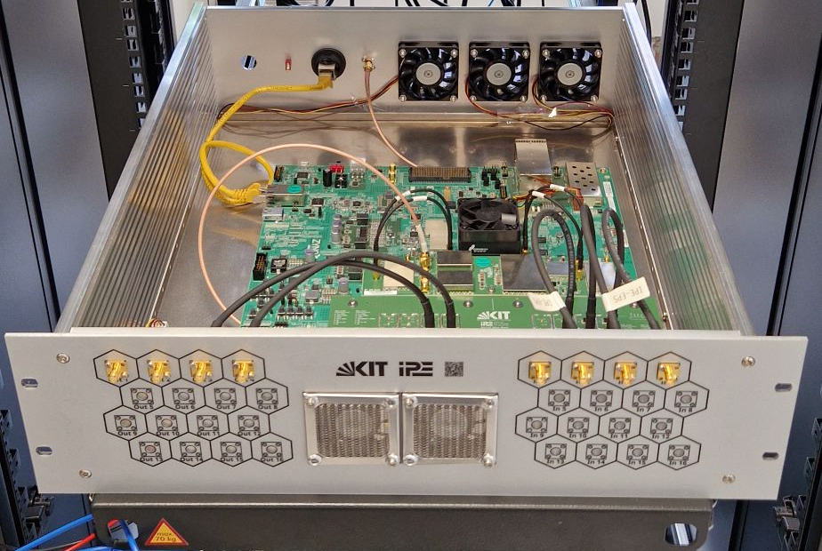
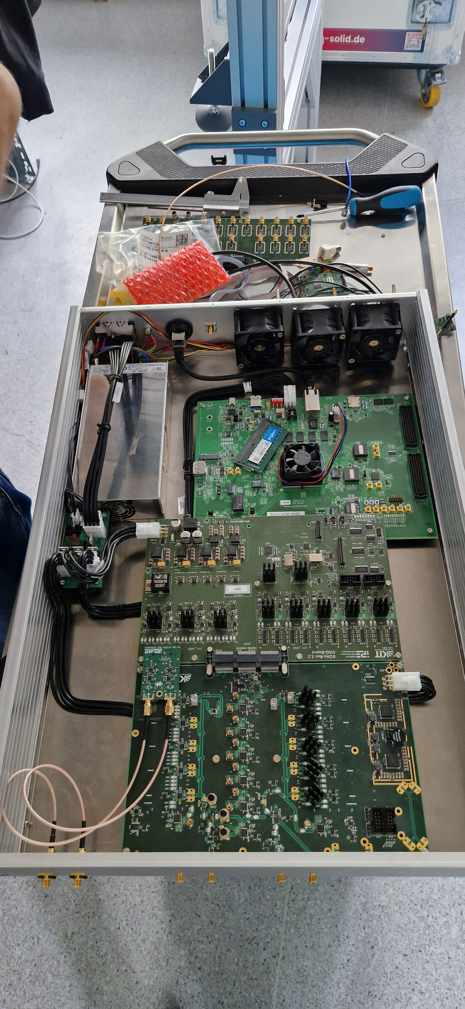

Hardware & build system
Supported device family: AMD Zynq UltraScale+
  MPSoC
  RFSoC
PL firmware in VHDL (Vivado 2020.2)
Device image creation with custom build system based on Yocto

Slide 6
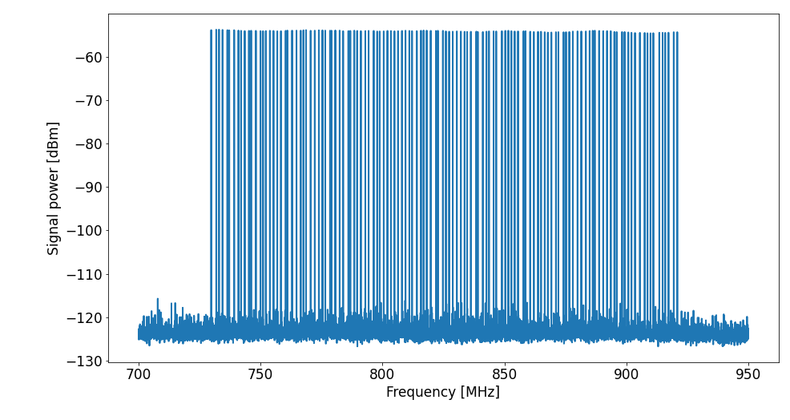
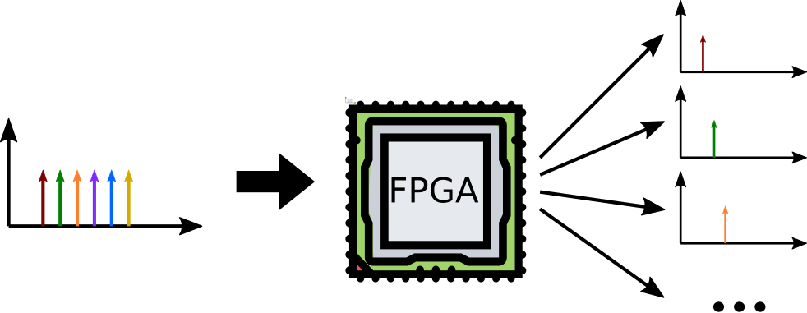
Problem statement
One tone per resonator
Realtime generation and analysis
Nonuniform spacing of tones
Independent processing

Slide 7
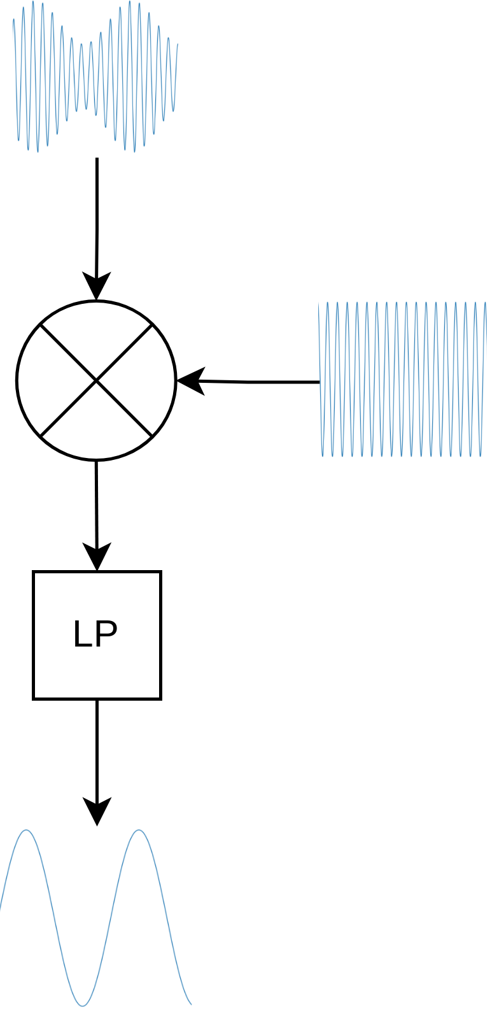
Intuitive solution
Direct downconversion by mixing readout tone to DC
Advantages:
  Full control of DDC frequency
  Optimal resolution in time
Disadvantages:
  One mixer and filter needed per resonator tone
  Full parallelisation of processing, no pipelining possible
  → Many PL resources required!

Slide 8
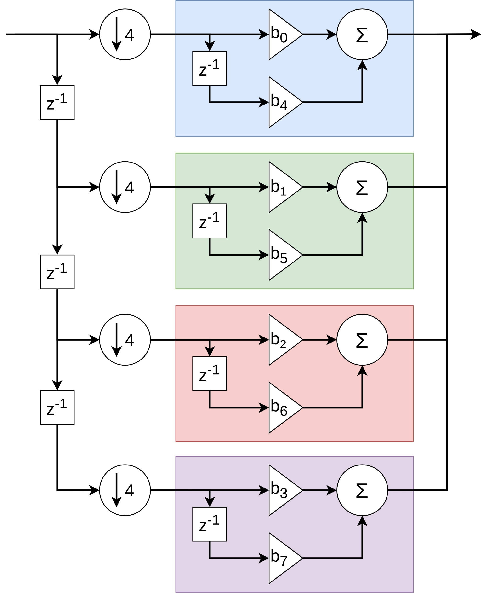
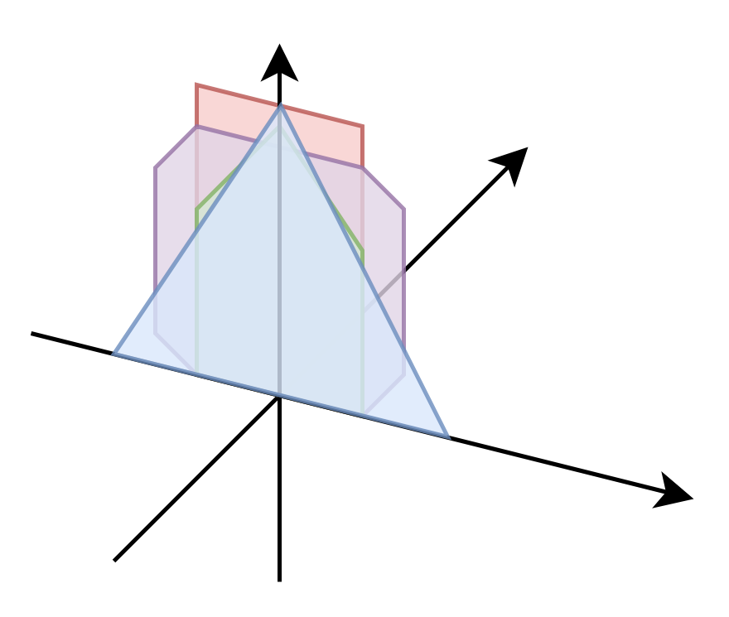
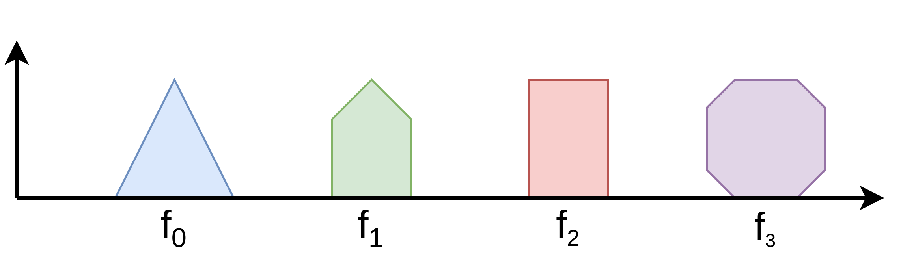
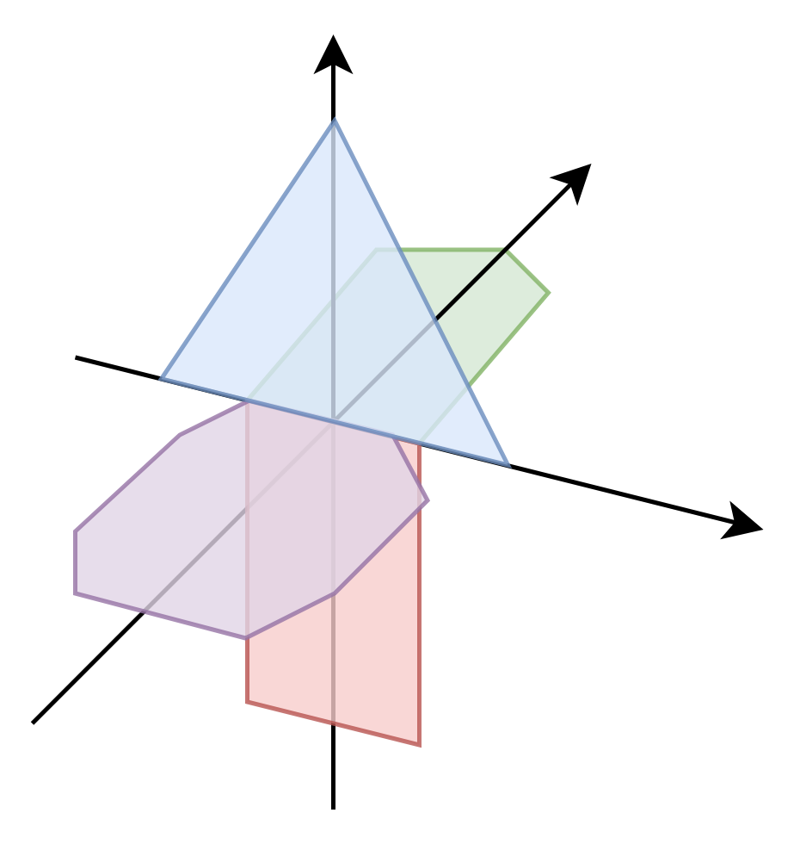
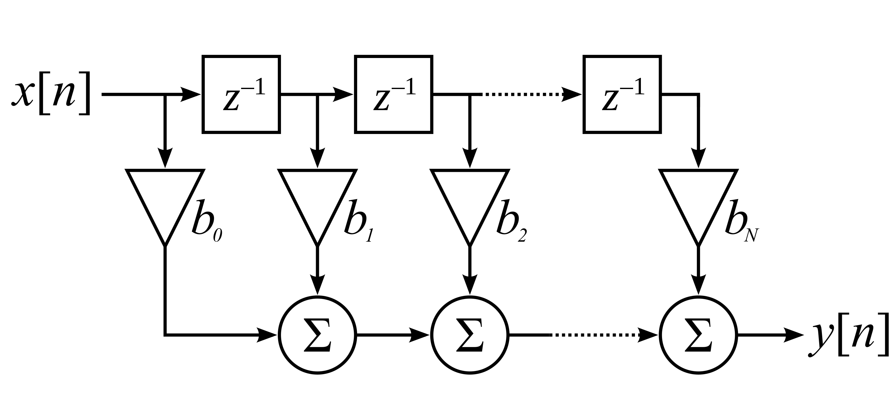
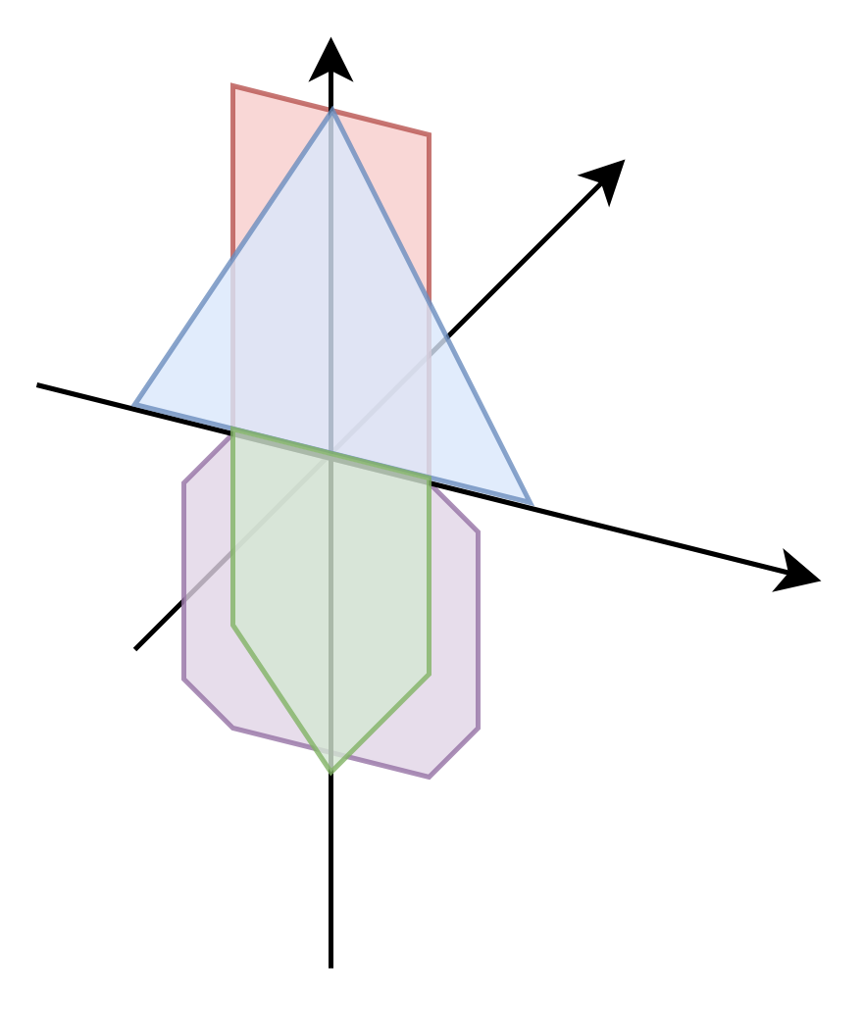
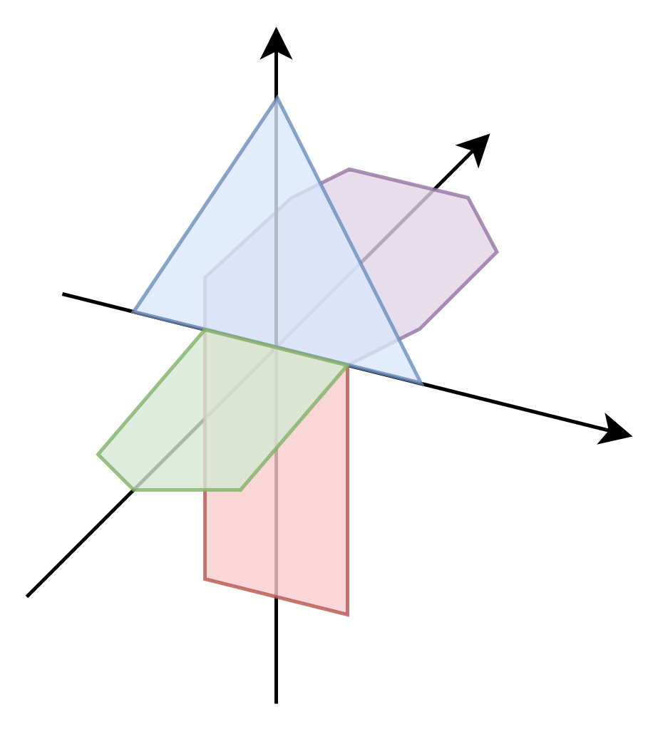
Polyphase channelizer algorithm I: FIR
Input spectrum:
Finite Impulse Response (FIR) Filter:
https://en.wikipedia.org/wiki/Finite_impulse_response
Diagrams based on:
Polyphase Channelizer Demystified [Lecture Notes]
(doi: 10.1109/MSP.2015.2477423)

Slide 9
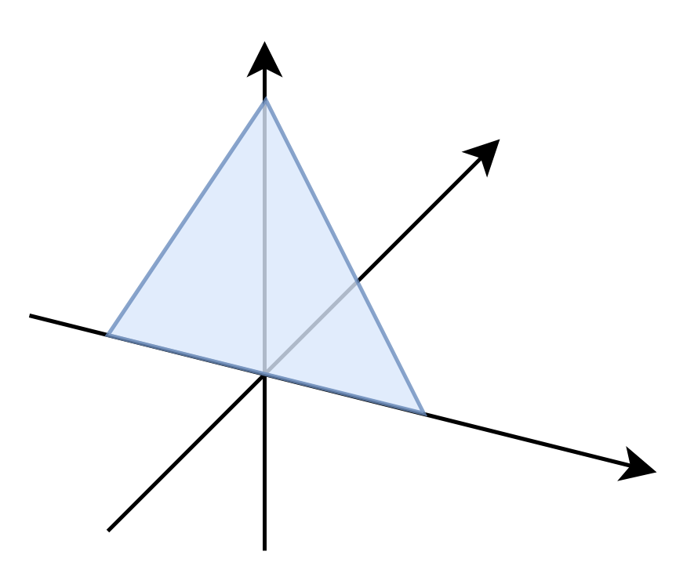
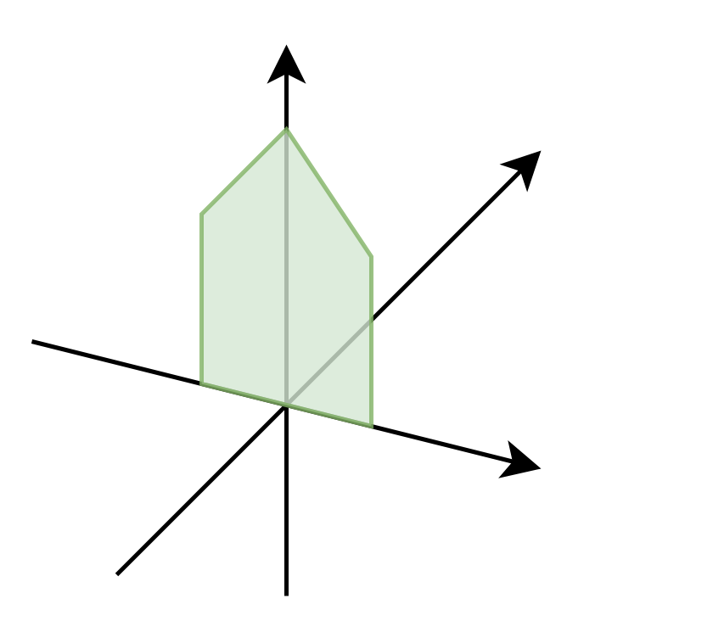
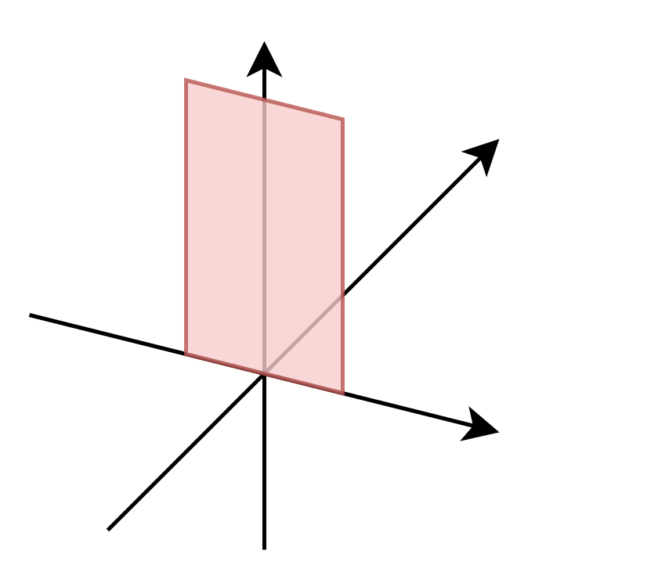
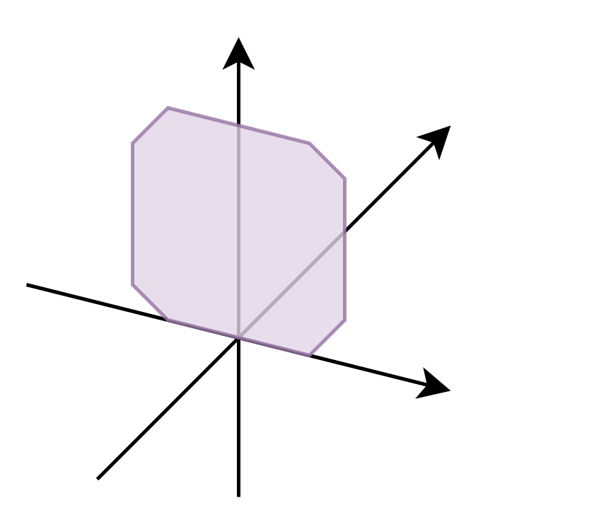
Polyphase channelizer algorithm II: DFT
1 1 1 1
1 -j -1 j
x
=
1 -1 1 -1
1 j -1 -j

Slide 10
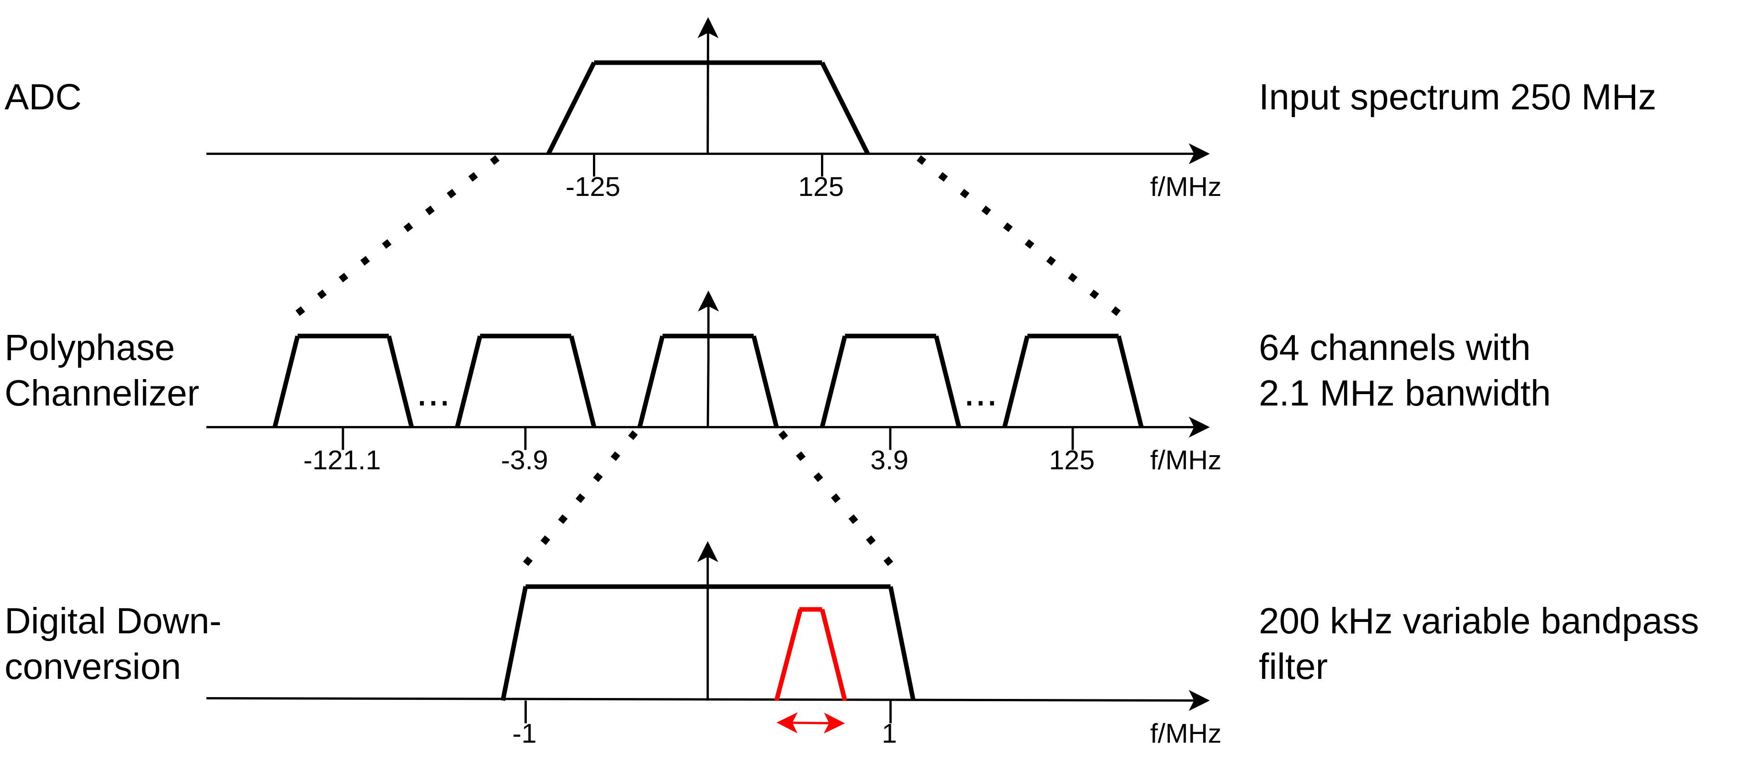
Channelization concept
Parameters for BULLKID:

Slide 11
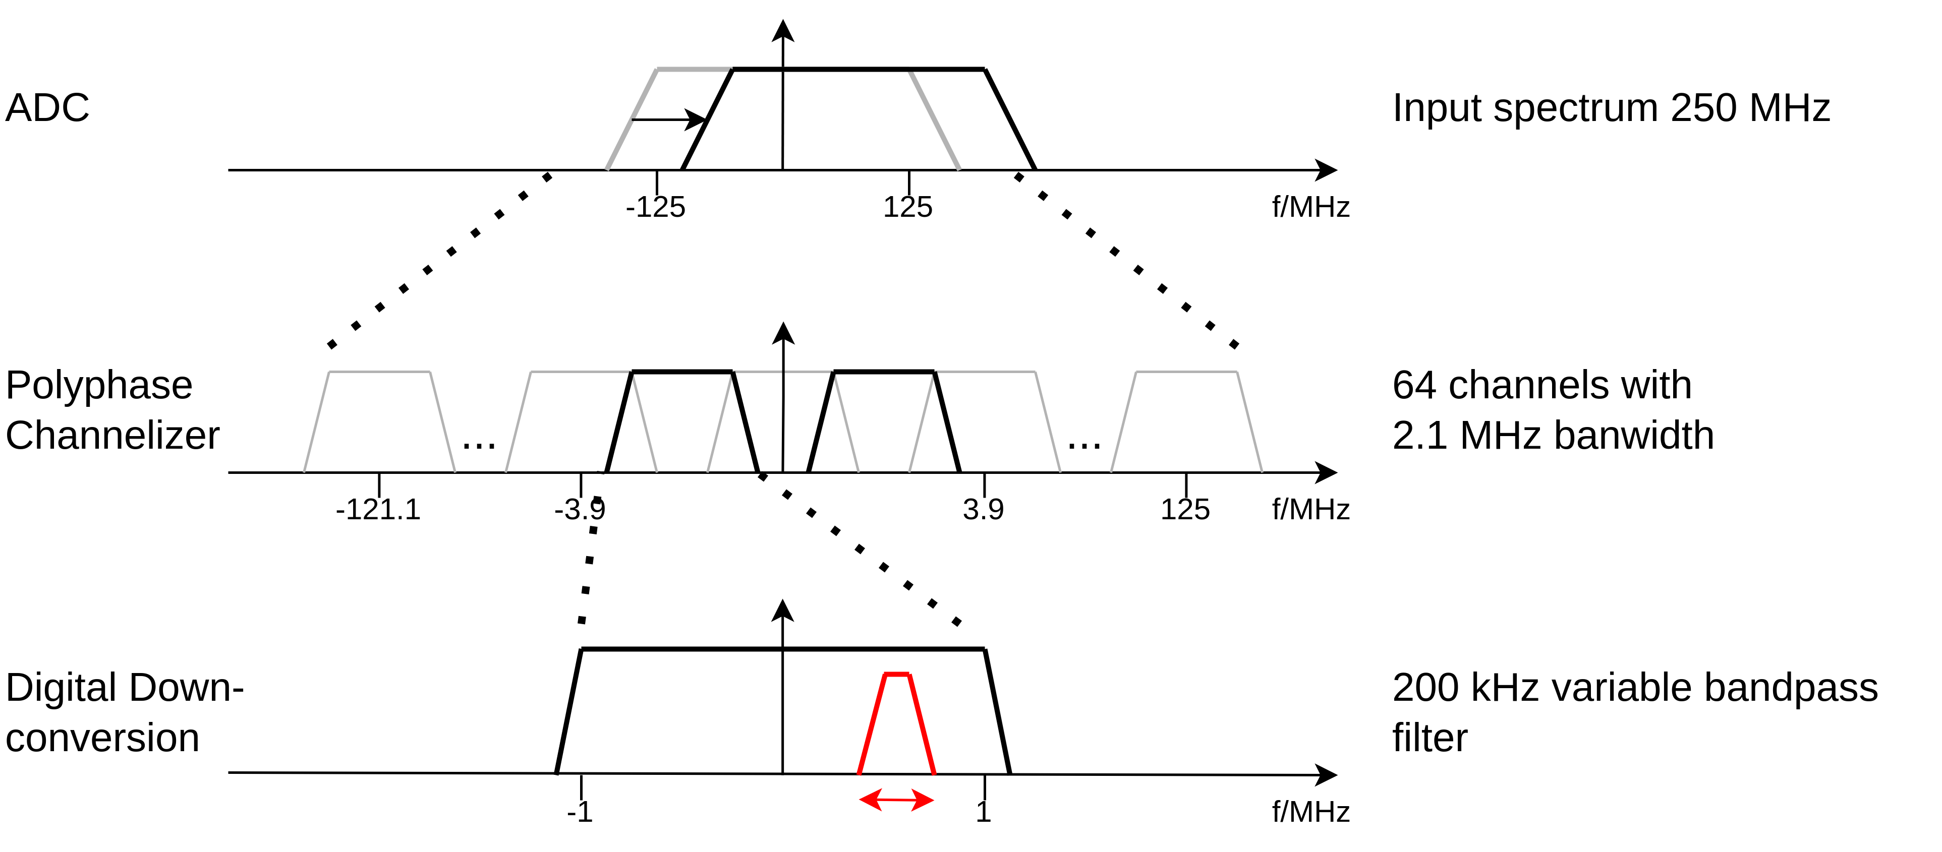
Channelization concept (2)
Parameters for BULLKID:

Slide 12
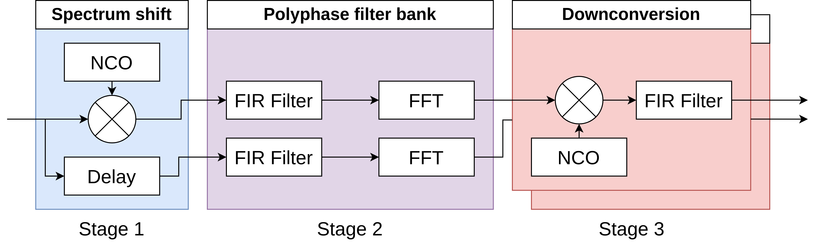
Block diagram of full channelization stage

Slide 13
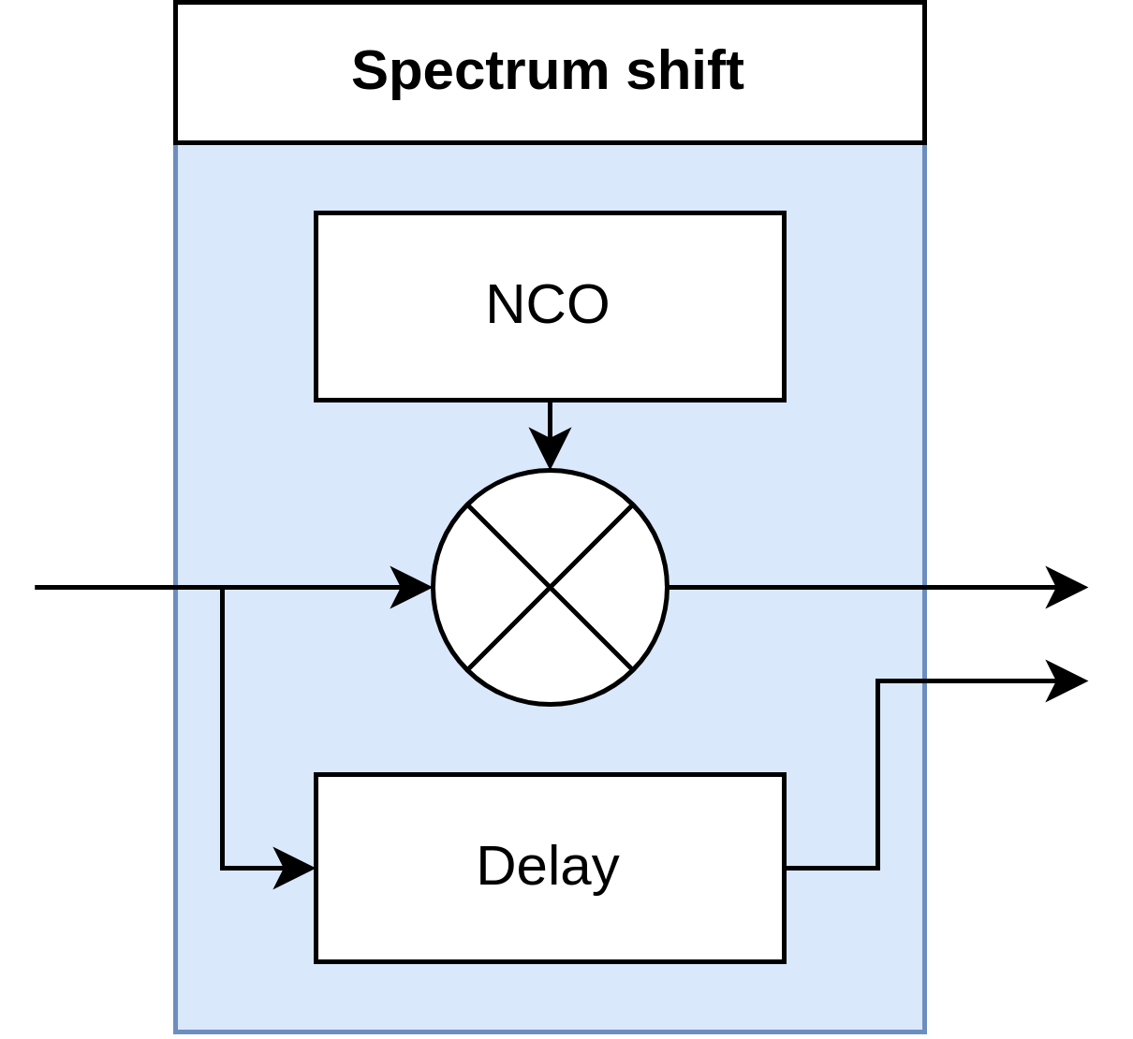
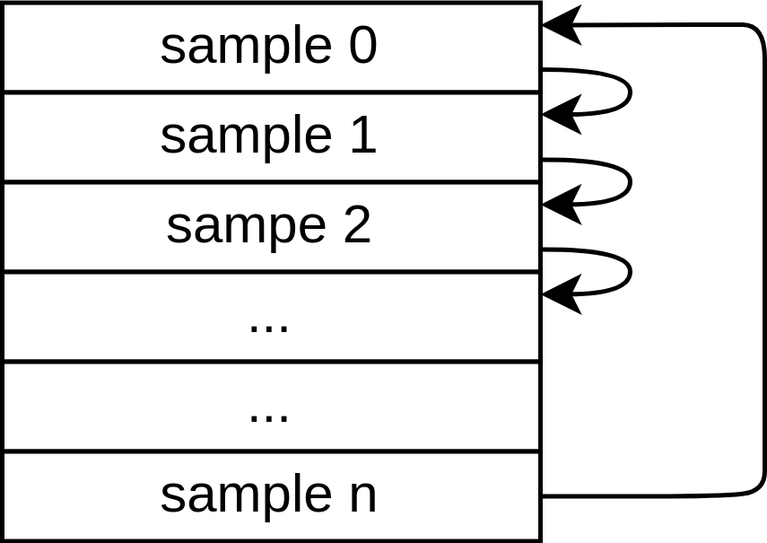
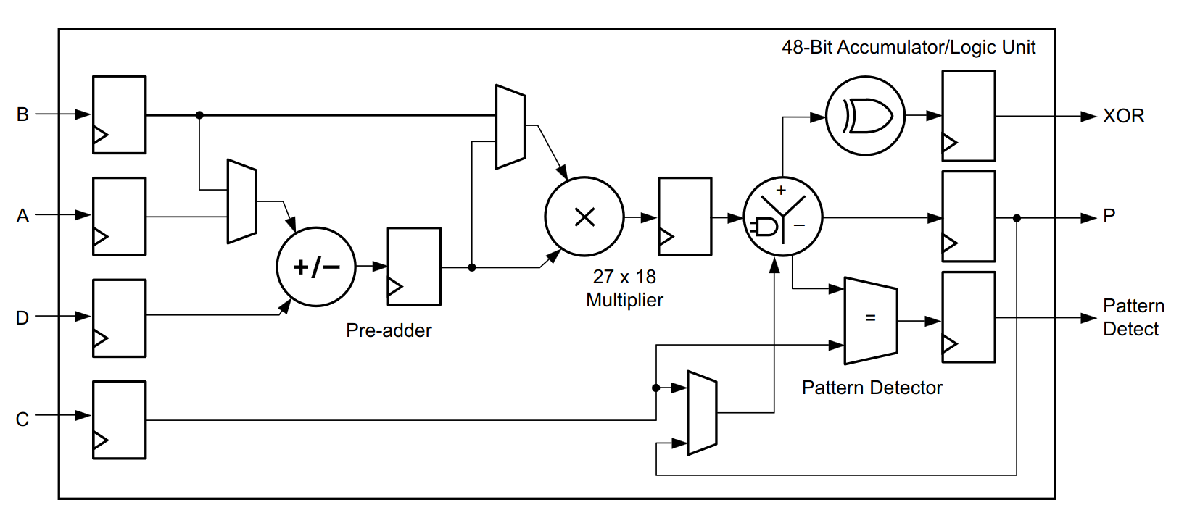
Stage 1: Spectrum shift
NCO:
Required NCO frequency: f_{spacing} / 2
NCO memory is automatically optimised for pointer increment of 1
Fixed configuration during runtime
  No extensive control logic required
  No user interface required
Delay original spectrum for synchronicity
Zynq US+ DSP-Slice for complex mixing:

Slide 14
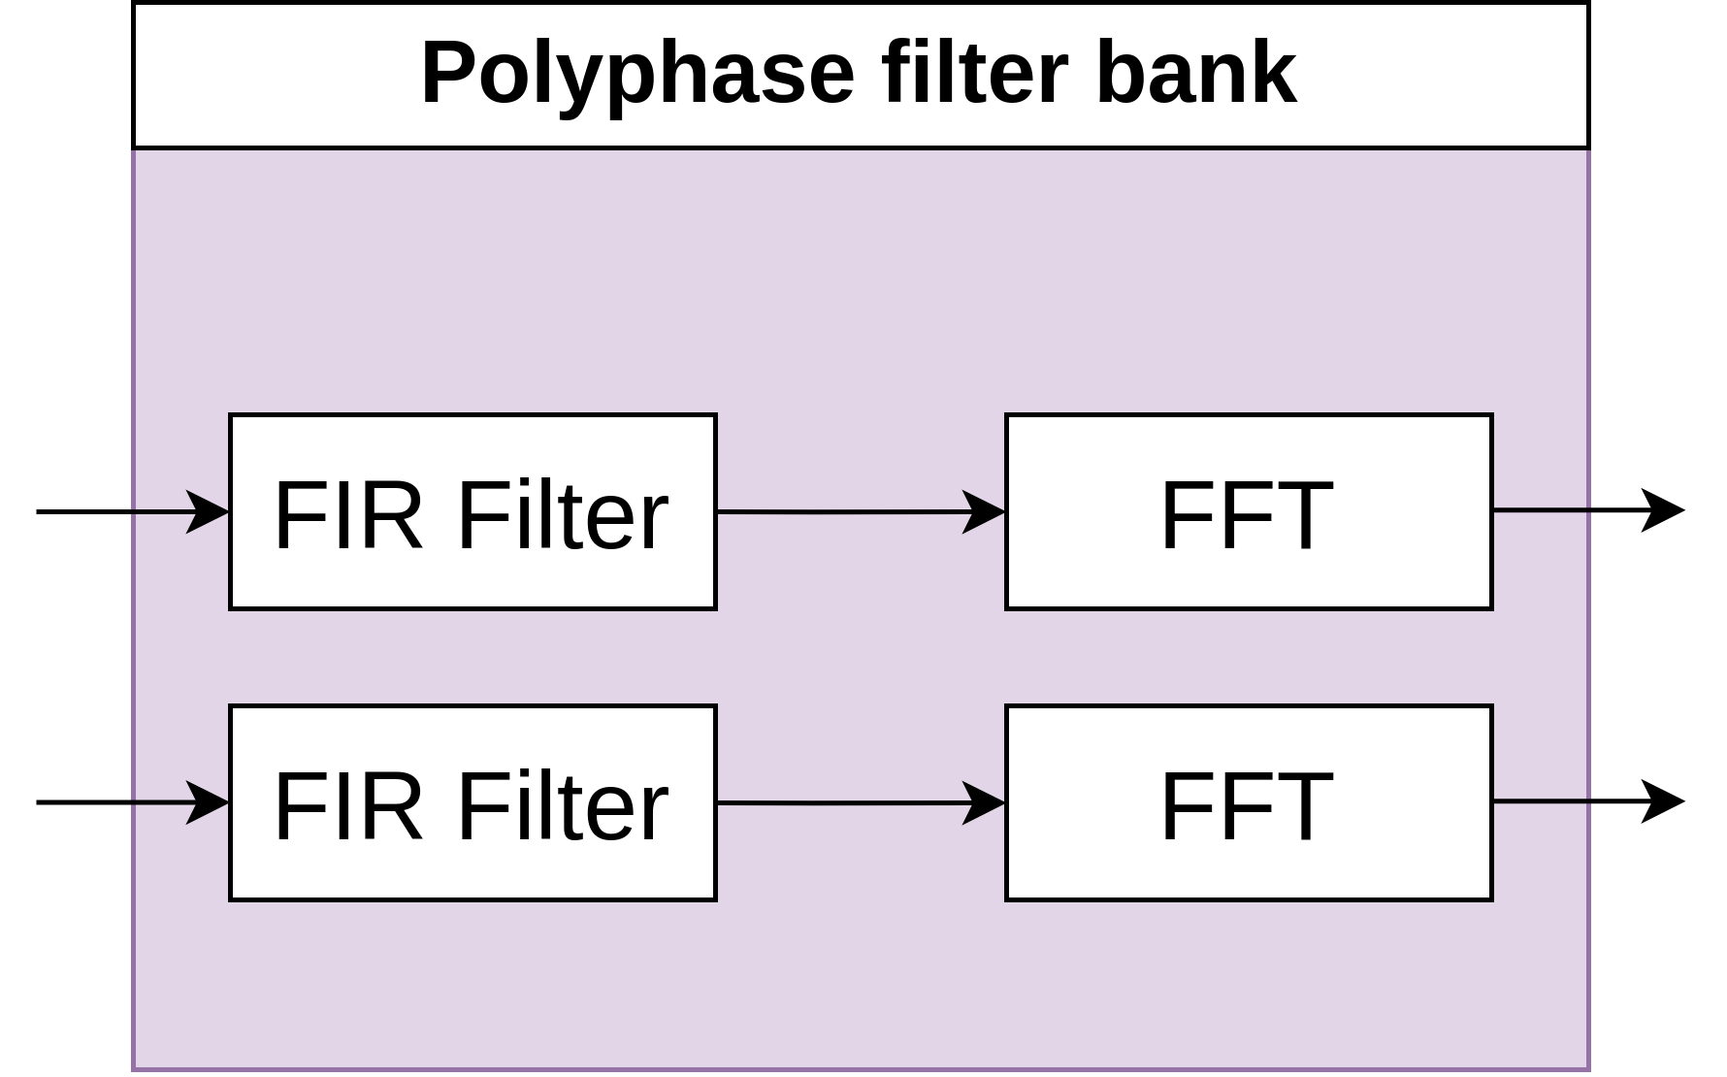
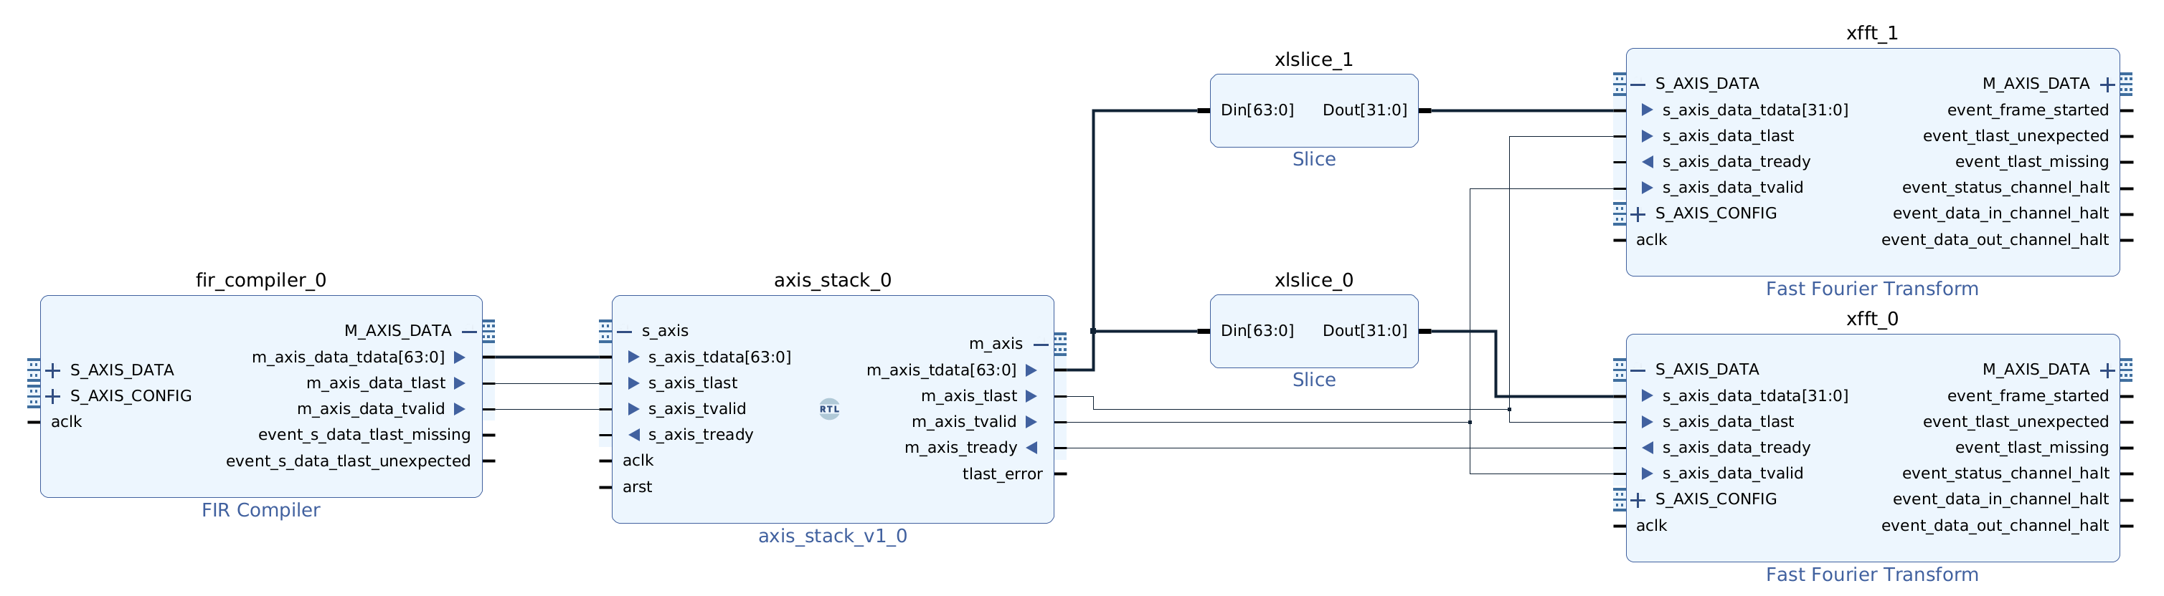
Stage 2: Polyphase filter bank
FIR-Compiler:
AMD IP-Core: fir_compiler (v7.2)
  Support for multiple channels
  User-defined filter taps (.coe-file) with MATLAB + python scripts
  Parallel paths -> One common filter for original and shifted spectrum
FFT:
AMD IP-Core: xfft (v9.1)
  Transform length =
  Number of subbands
Channel reorder required
(see Xilinx XAPP 1161)

Slide 15
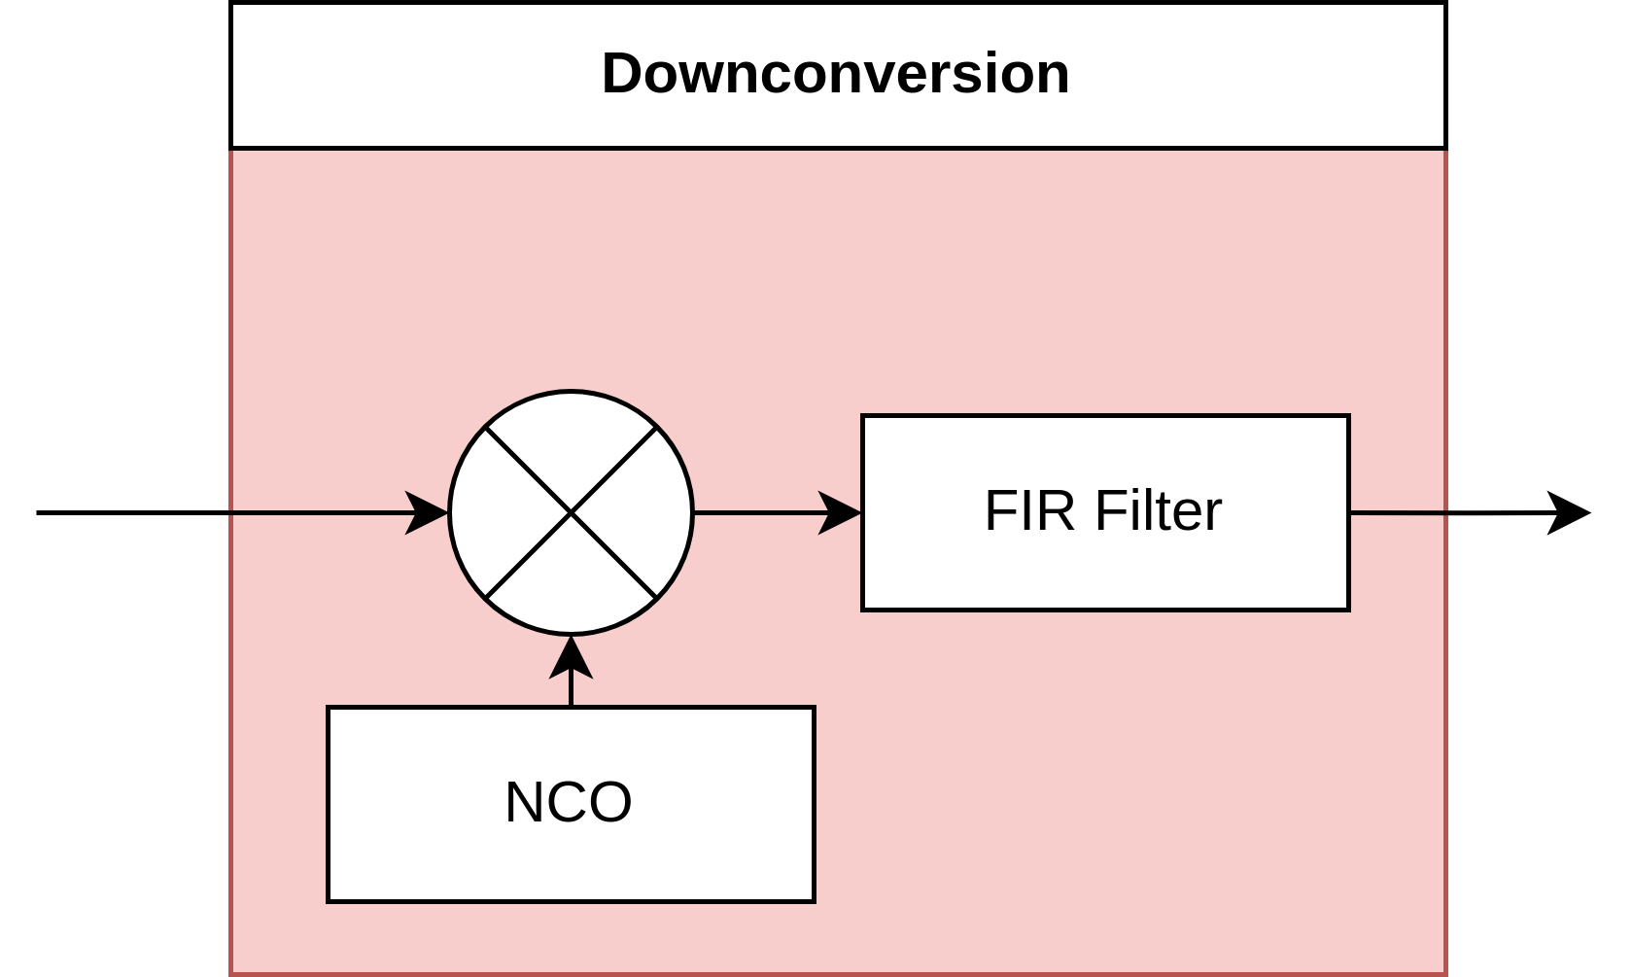
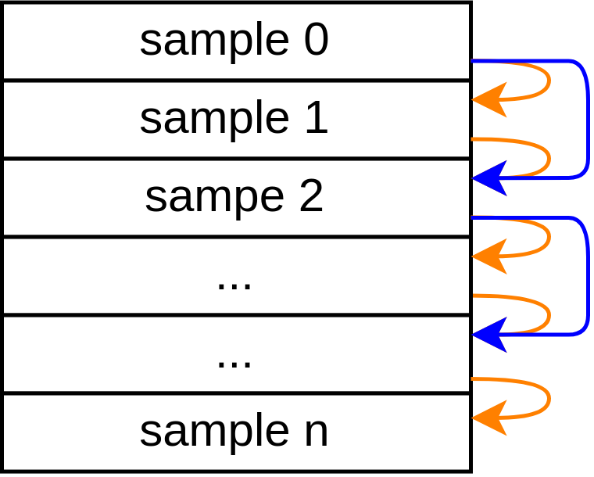
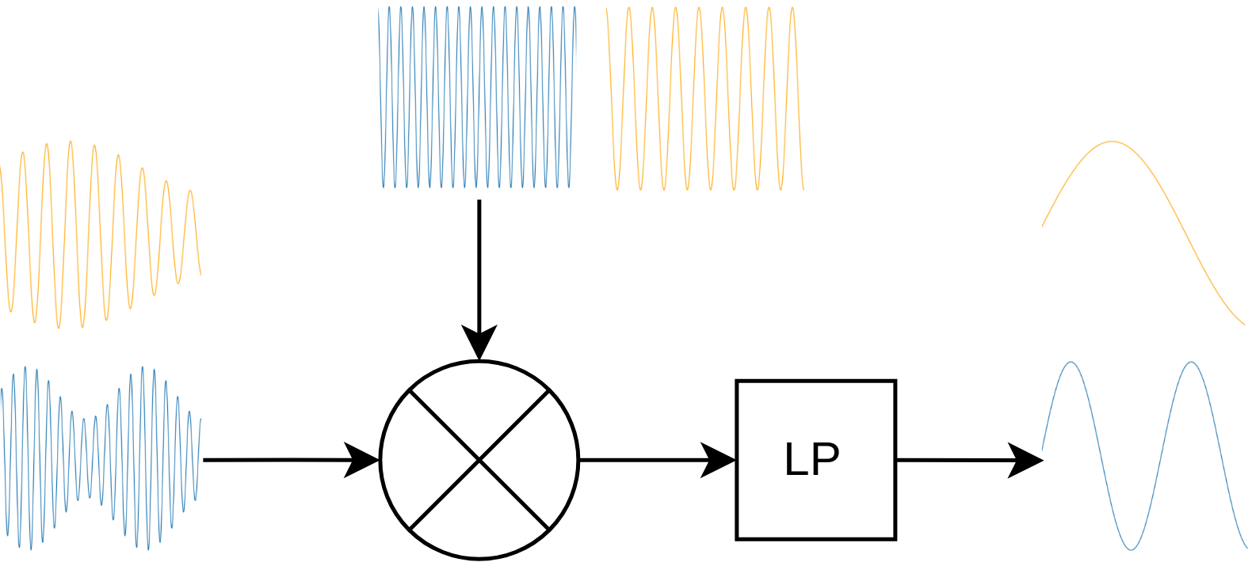
Stage 3: Fine downconversion
Multiple tones in TDM scheme
Single NCO + complex mixer in interleaved pipeline
Channel-specific NCO frequency adjustable via AXI-lite interface at runtime

Slide 16
Resource consumption
Parameters: 250 MHz input frequency, 64 subbands, 200 kHz channel bandwidth
Module | DSP | BRAM | LUT | CLB
Spectrum shift | 3 | 0.5 | 133 | 54
Polyphase filter bank | 64 | 0 | 4826 | 1053
- FIR filter | 52 | 0 | 2030 | 390
- FFT (x2) | 6 | 0 | 1341 | 377
Fine downconversion (x2) | 7 | 12 | 3960 | 1343
- NCO | 0 | 8 | 3399 | 834
- Complex mixer | 3 | 0 | 2 | 18
- FIR filter | 4 | 4 | 330 | 389
Resources for one channel in brute-force approach

Slide 17
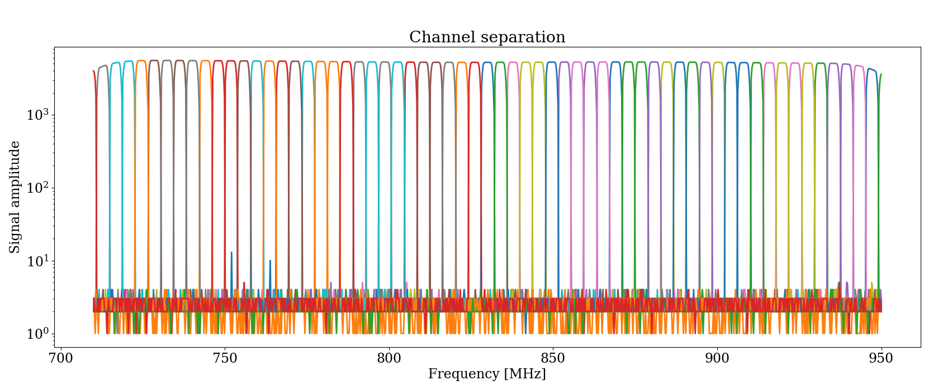
Output of channelization stage

Slide 18
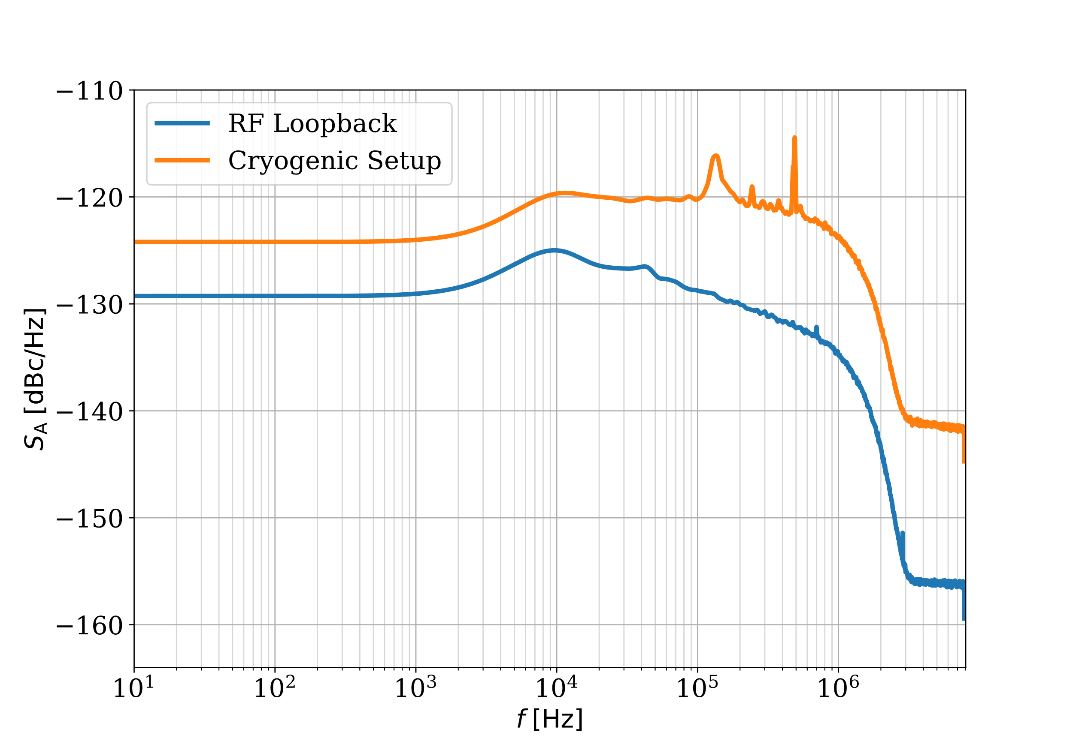
Amplitude noise measurement
Implementation for ECHo on MPSoC
Low-pass filter of downconversion stage reduces noise above 1 MHz
Channelizer is not the limiting factor for readout sensitivity

Slide 19
Conclusion
Full channelization stage for parallel tone processing successfully implemented
Capable of frequency division multiplexed quantum sensor readout
Modular system: input frequency, number of channels, bandwidth
→ Easy adaption to requirements of new experiments
Advantages:
+ Very efficient solution
+ Further processing in time
division multiplex possible
Disadvantages:
Limited tone separation capabilities
- only one tone per subband
- 2^{n} subbands

Slide 20
Backup

Slide 21
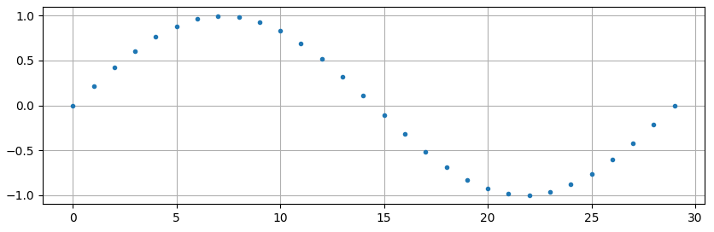
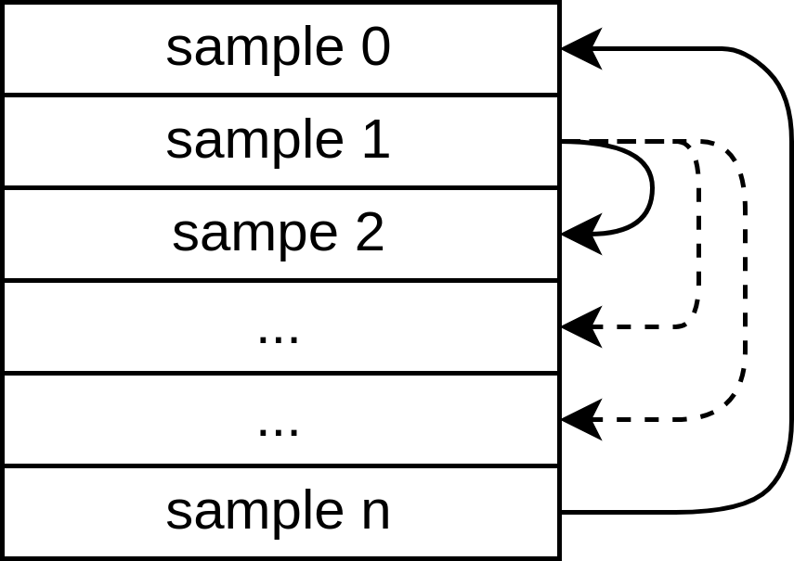
NCO (Numerically Controlled Oscillator)
Samples can be stored either in ROM or in LUT, depending on ressource availability
Frequency resolution depends on number of stored samples
Frequency and phase are adjustable at runtime by changing start point and increment of the read pointer

Slide 22
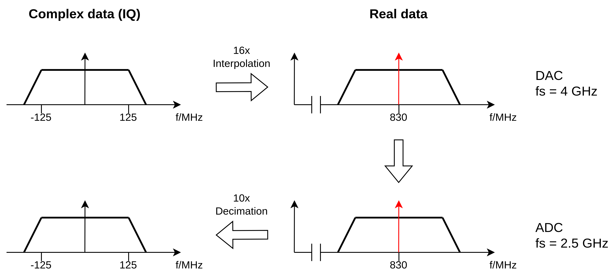
Analog downconversion

Slide 23
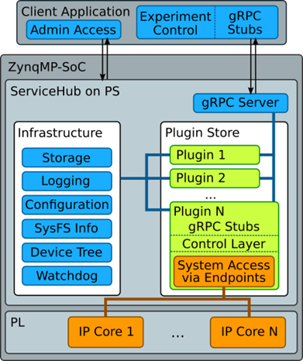
Software stack
Custom C++ server daemon for communication with the platform
Configuration and read-back of PL modules during runtime
Commands are sent via gRPC to the user

