Slide 1

Becoming vendor agnostic with the help of
model-based source code generation
Alexander Wirthmüller
aw@mpsitechnologies.com

Slide 2


Introduction
About me
Based in Munich
Diploma in Electrical Engineering
Founder and Director at MPSI Technologies
MPSI Technologies: make Embedded Software development more pleasant – by replacing repetitive tasks with
model-based source code generation
Senior Staff Engineer with Symeo / indie Semiconductor (industrial radar)

Slide 3
The Whiznium Universe & Developer Lifestyle
Concept | Key features | Workflow | Starter kit
WhizniumDBE (“Device Builder’s Edition”) is
NOT high-level synthesis (HLS), not a compiler
NOT your typical generator framework
NOT a visual design tool
WhizniumDBE is
a user-extensible framework written in C++, that for a given RTL design
interprets its structure and features, specified in text-based model files
composes and maintains a fine-grained RTL model *) in a SQL database
then is able to write VHDL and C++ code based on it
taking into account manual code contributions of previous design versions
*) from hierarchical structure down to FSM’s incl. state transitions, CDC fabric, generics/ports/signals/variables
Notes:
HLS: C-to-VHDL by vendors (“accelerators”)
Generator frameworks: MathWorks HDL Coder (Simulink), Spinal HDL (Scala)

Slide 4
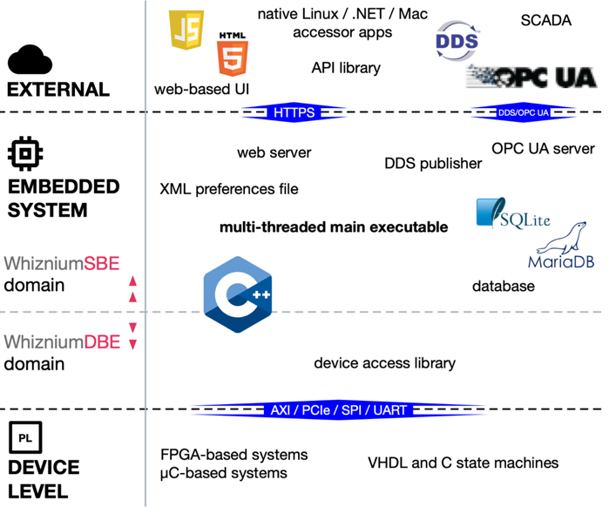
The Whiznium Universe & Developer Lifestyle
Concept | Key features | Workflow | Starter kit
Clean, ergonomic, source code structure
(“tasteful naming conventions”, etc.)
Parametrized templates for standard components (e.g. SPI, GPIO, CRC, Git-Ident; 35 and counting)
Custom templates can interact with the model / module surroundings while a design is composed (not just simple files with placeholders)
The applicable vendor(‘s primitives) can be an auto-derived template parameter
Scope extends beyond the FPGA world with WhizniumSBE (Service Builder’s Edition)

Slide 5
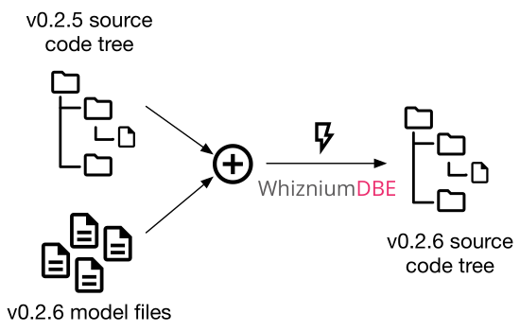
The Whiznium Universe & Developer Lifestyle
Concept | Key features | Workflow | Starter kit
Regular RTL workflow (including use of vendor IDE’s) augmented by “source code tree iteration”

Slide 6
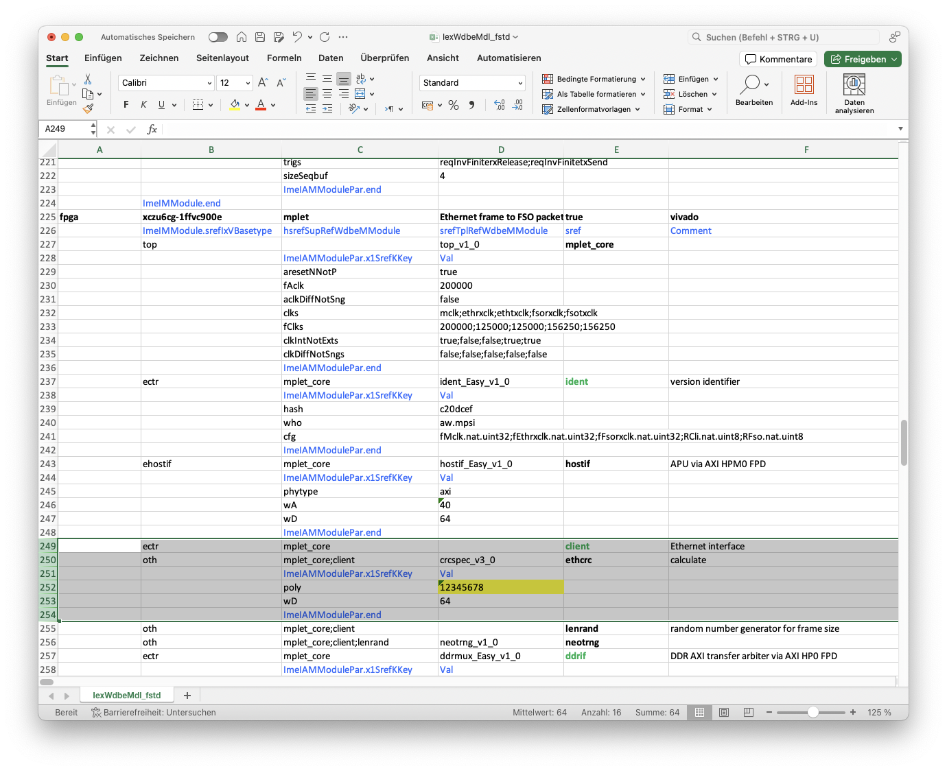
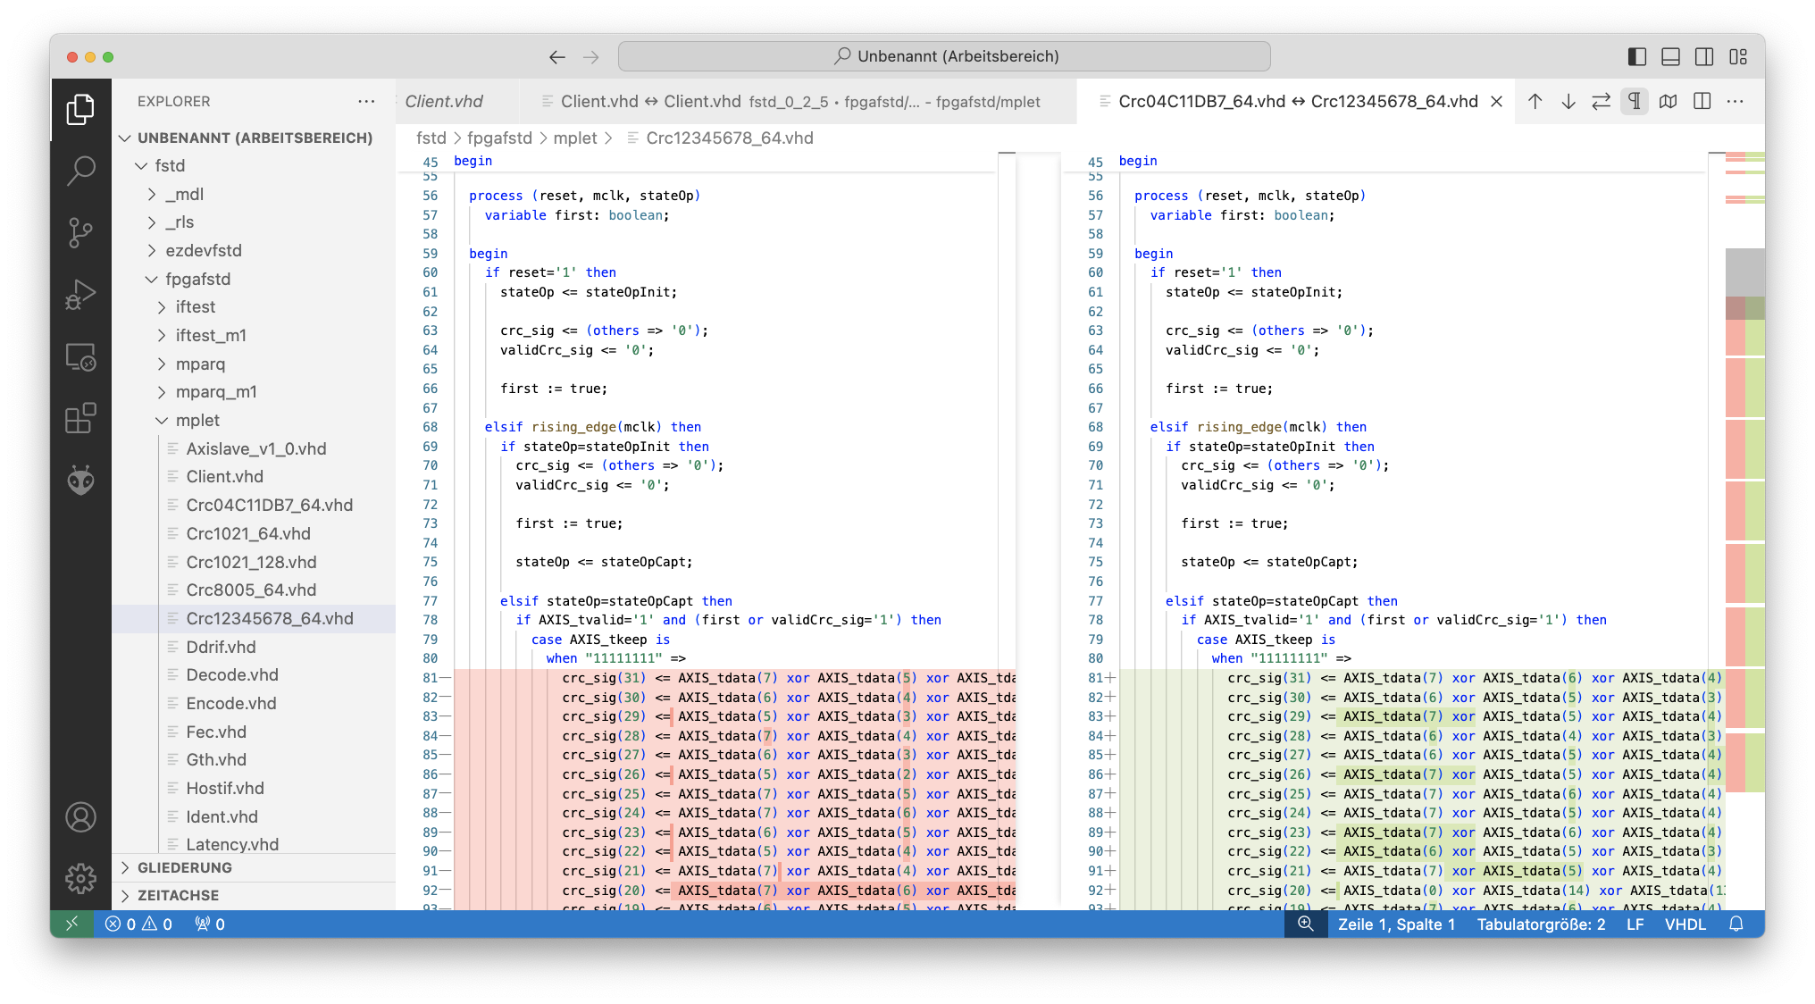
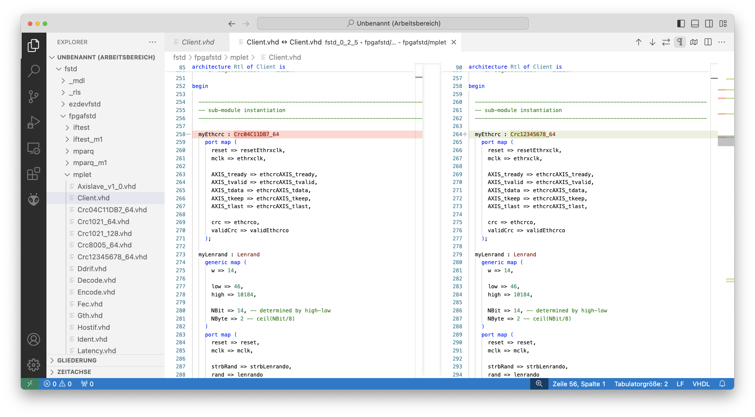
The Whiznium Universe & Developer Lifestyle
Concept | Key features | Workflow | Starter kit
Modular description (IexWdbeMdl.txt), CRC template, polynomial changed

Slide 7
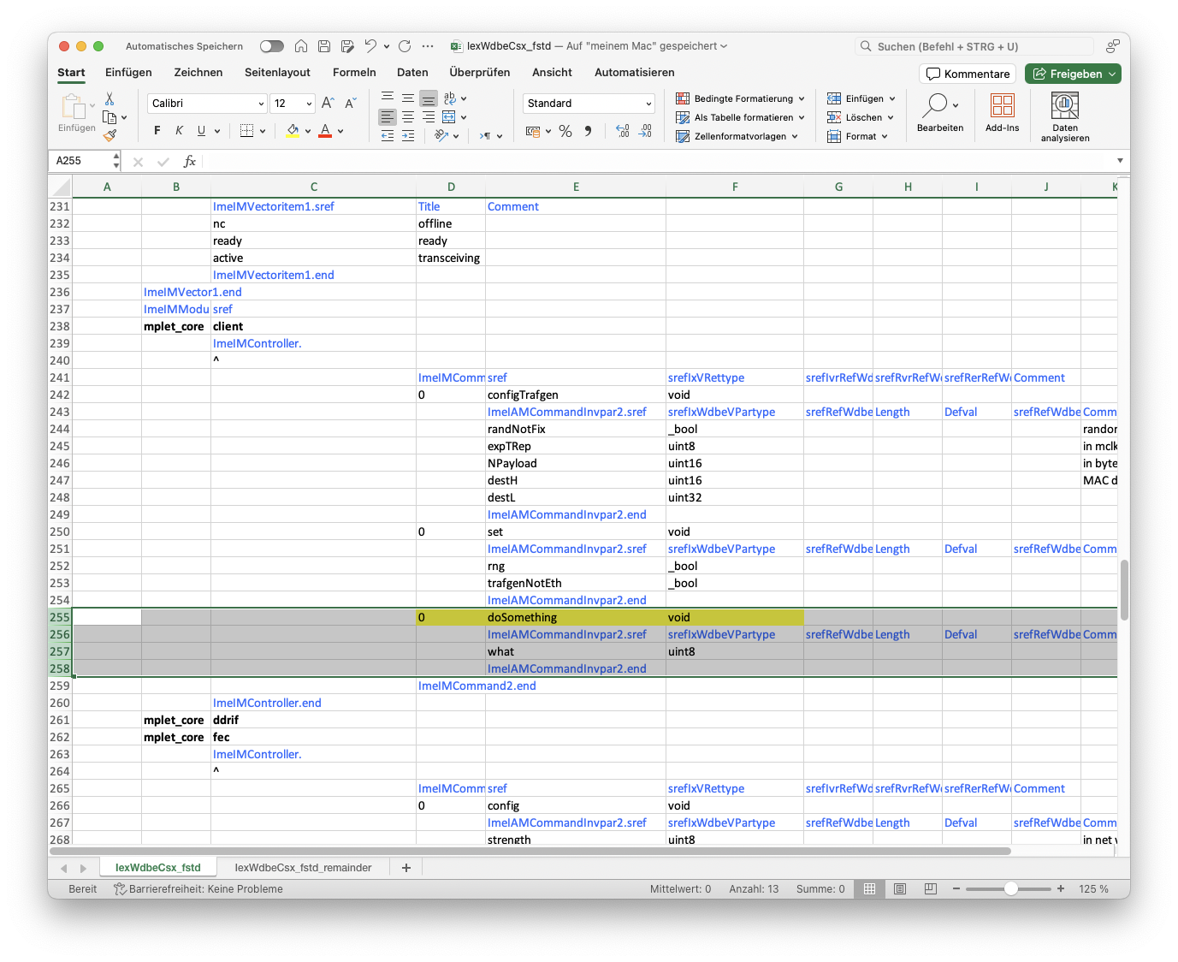
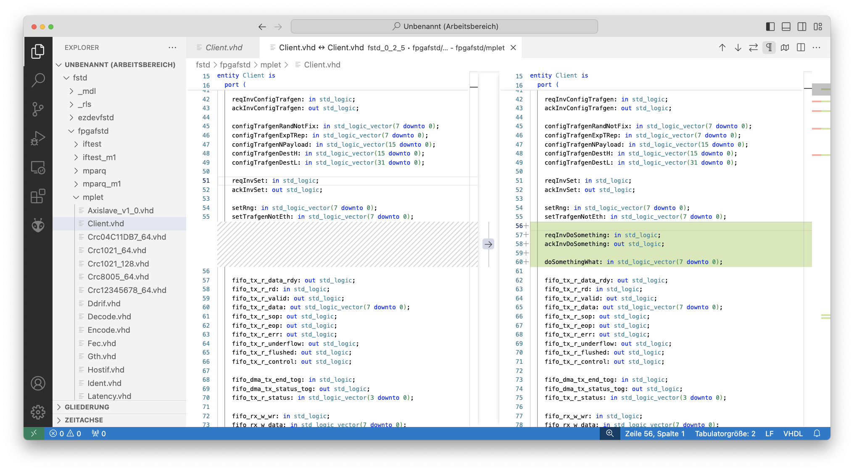
The Whiznium Universe & Developer Lifestyle
Concept | Key features | Workflow | Starter kit
Command set and buffer transfers (IexWdbeCsx.txt), command added to module “Client”

Slide 8
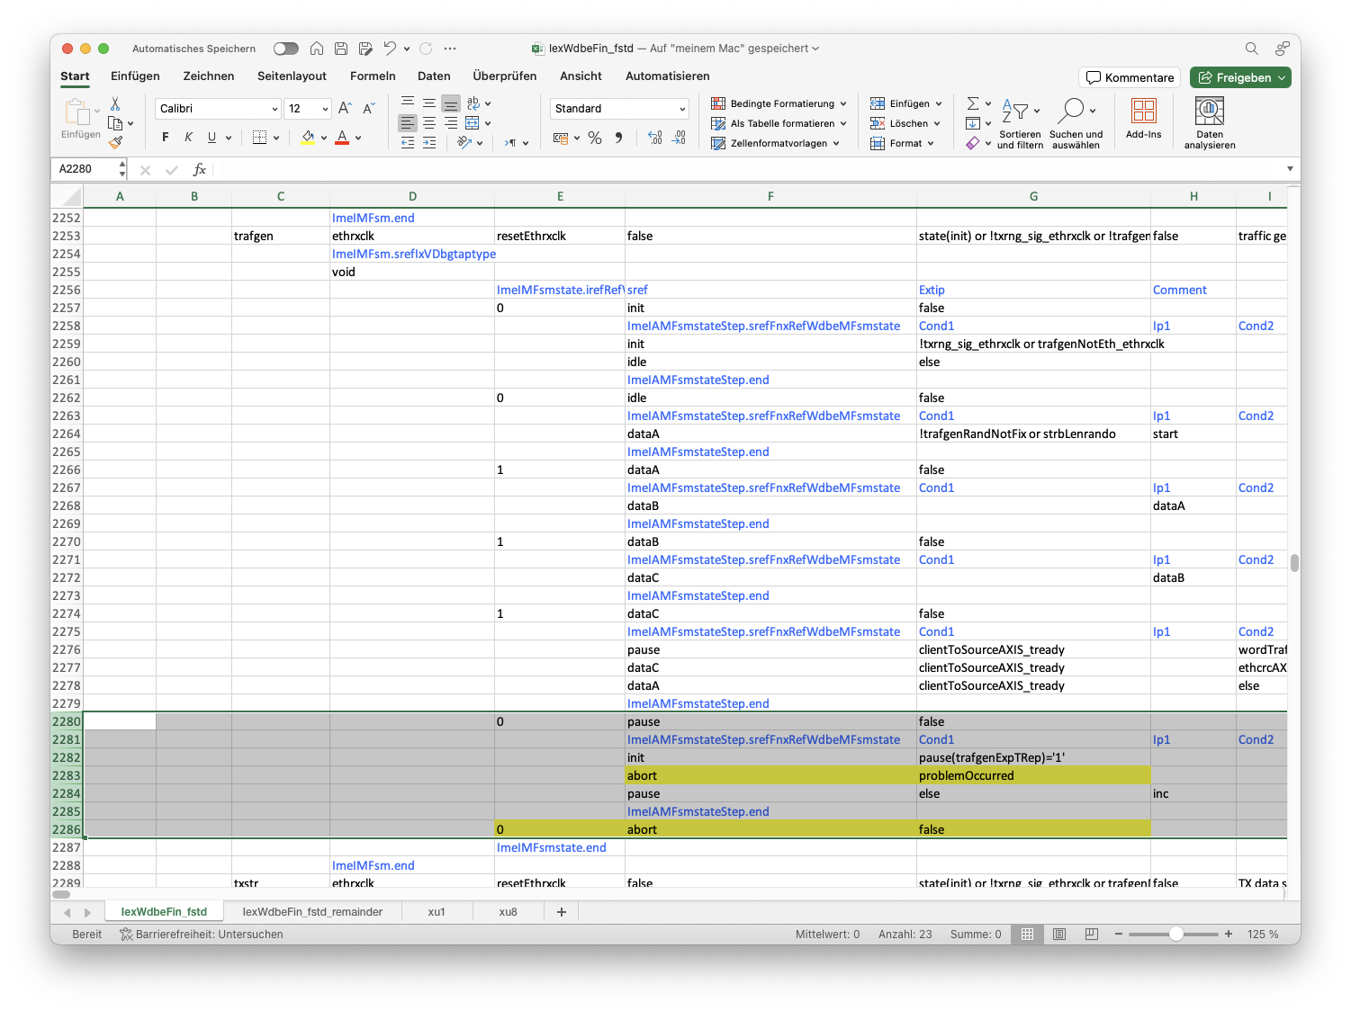
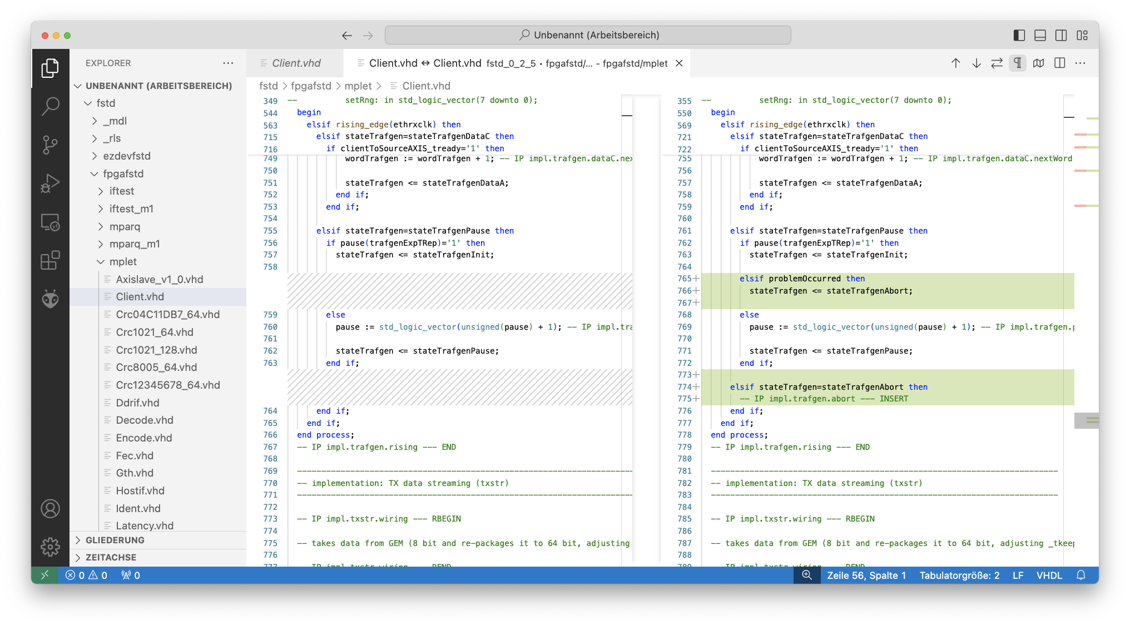
The Whiznium Universe & Developer Lifestyle
Concept | Key features | Workflow | Starter kit
Custom fine structure (IexWdbeFin.txt), FSM state added

Slide 9
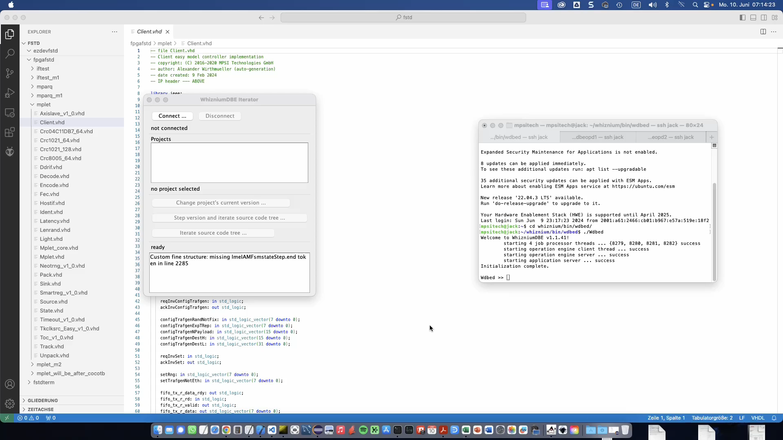
The Whiznium Universe & Developer Lifestyle
Concept | Key features | Workflow | Starter kit
WhizniumDBE Iterator (cross-platform Java tool accessing the WhizniumDBE daemon via it JSON API)

Slide 10
The Whiznium Universe & Developer Lifestyle
Concept | Key features | Workflow | Starter kit
Tabletop 3D laser scanner, implemented on mid-range devices from all major vendors
AMD Zynq, ZynqMP; Efinix Titanium; Lattice CrossLinkNX; Microchip PolarFire SoC
Work in progress: Altera CycloneV, Agilex E; Lattice Avant

Slide 11
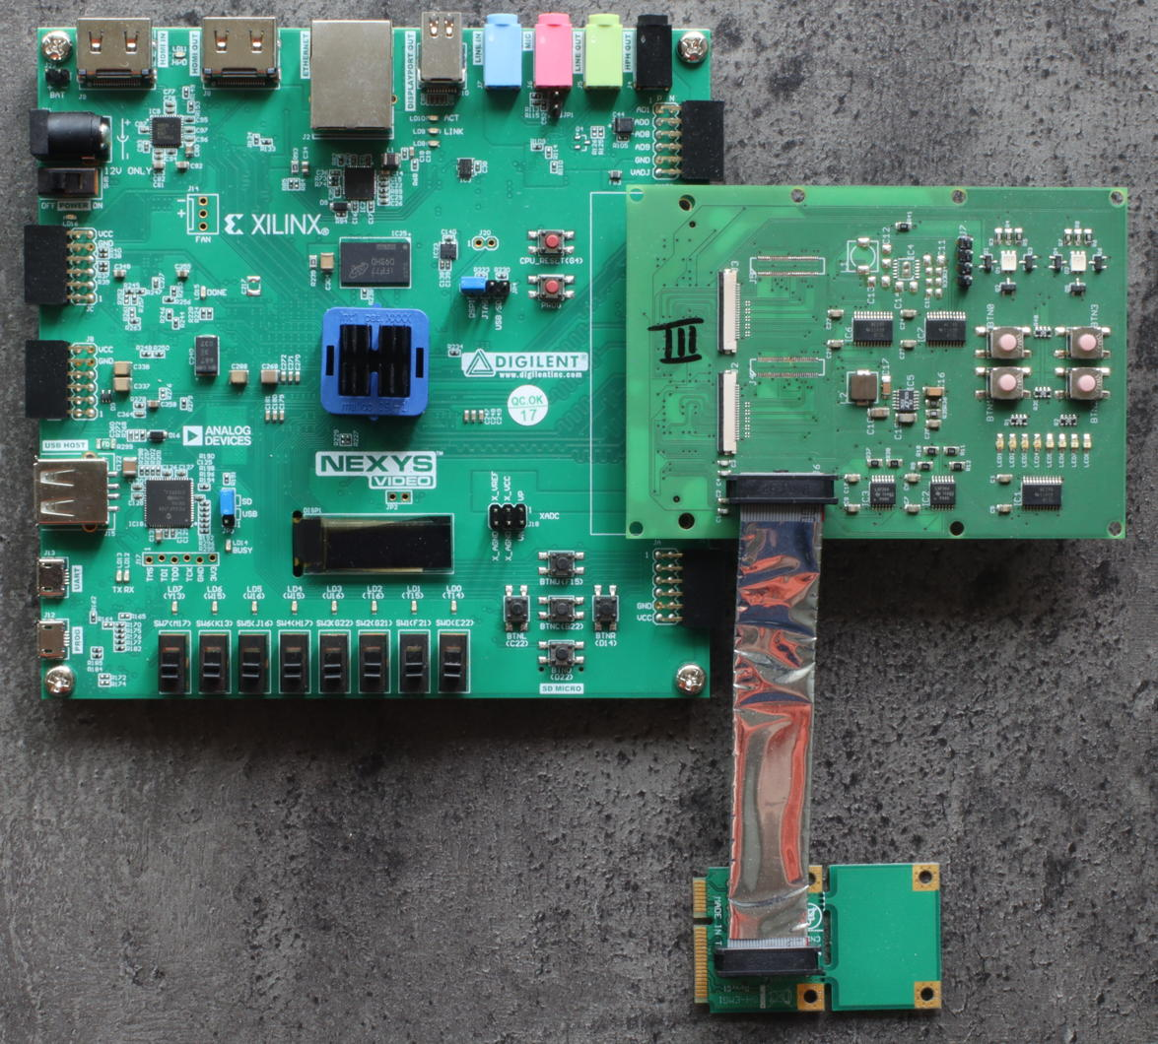
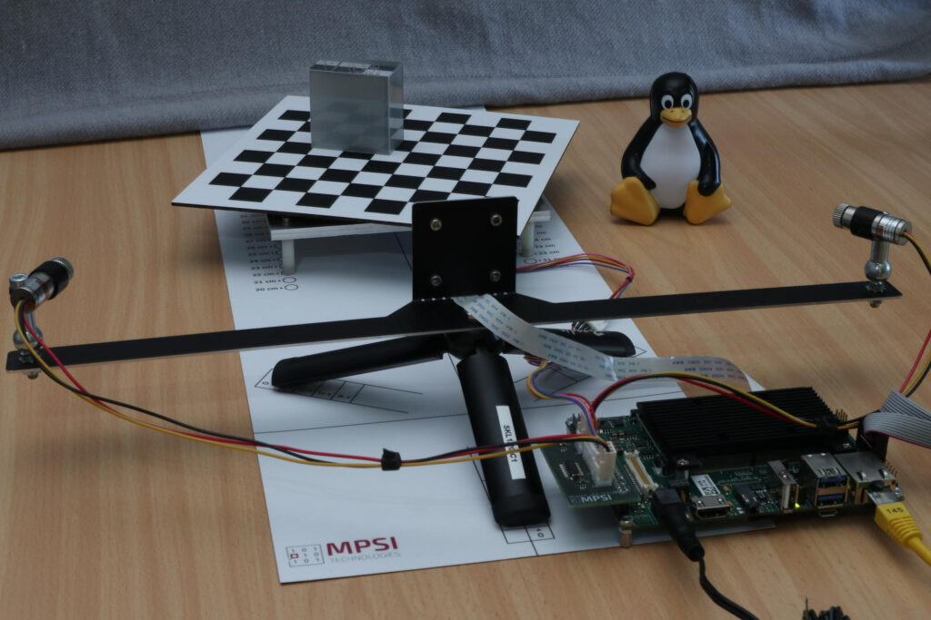
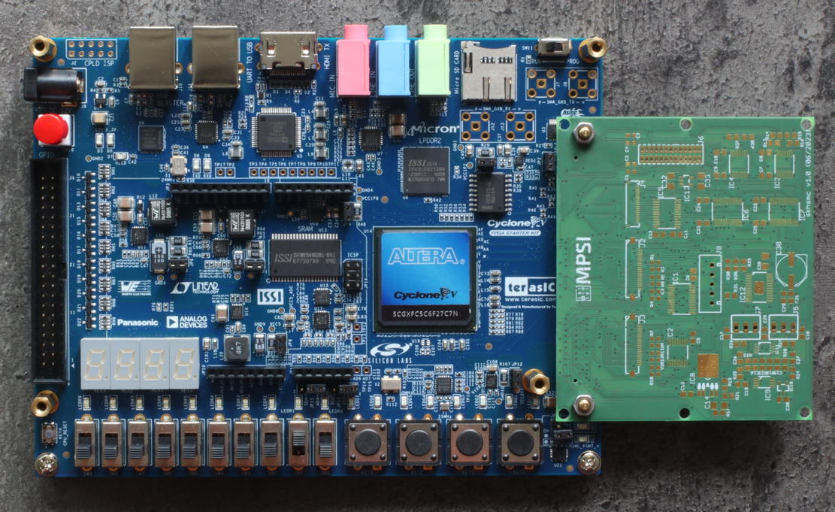
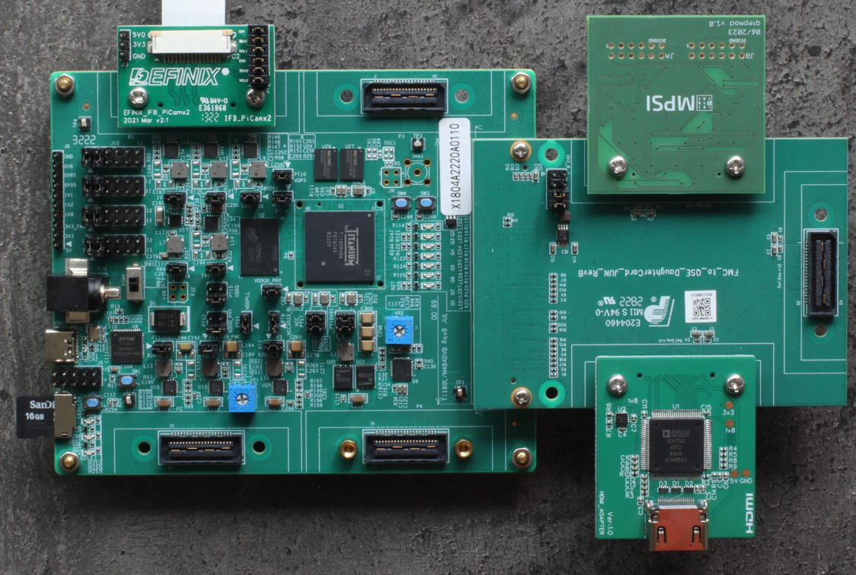
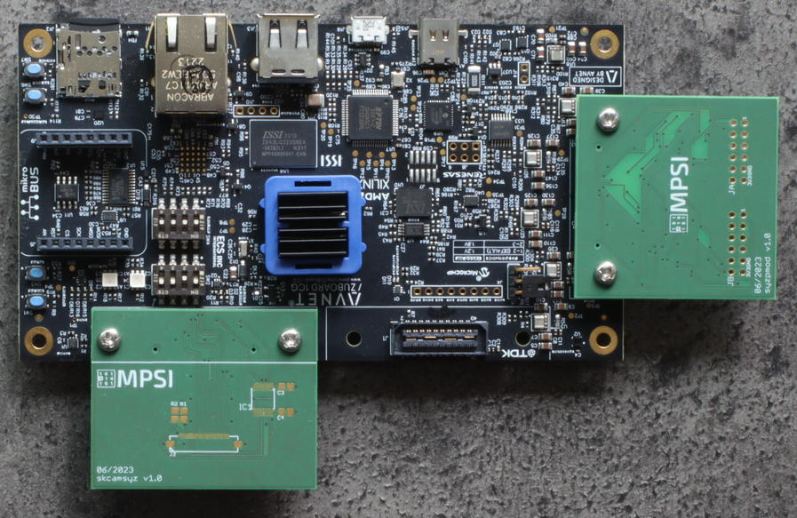
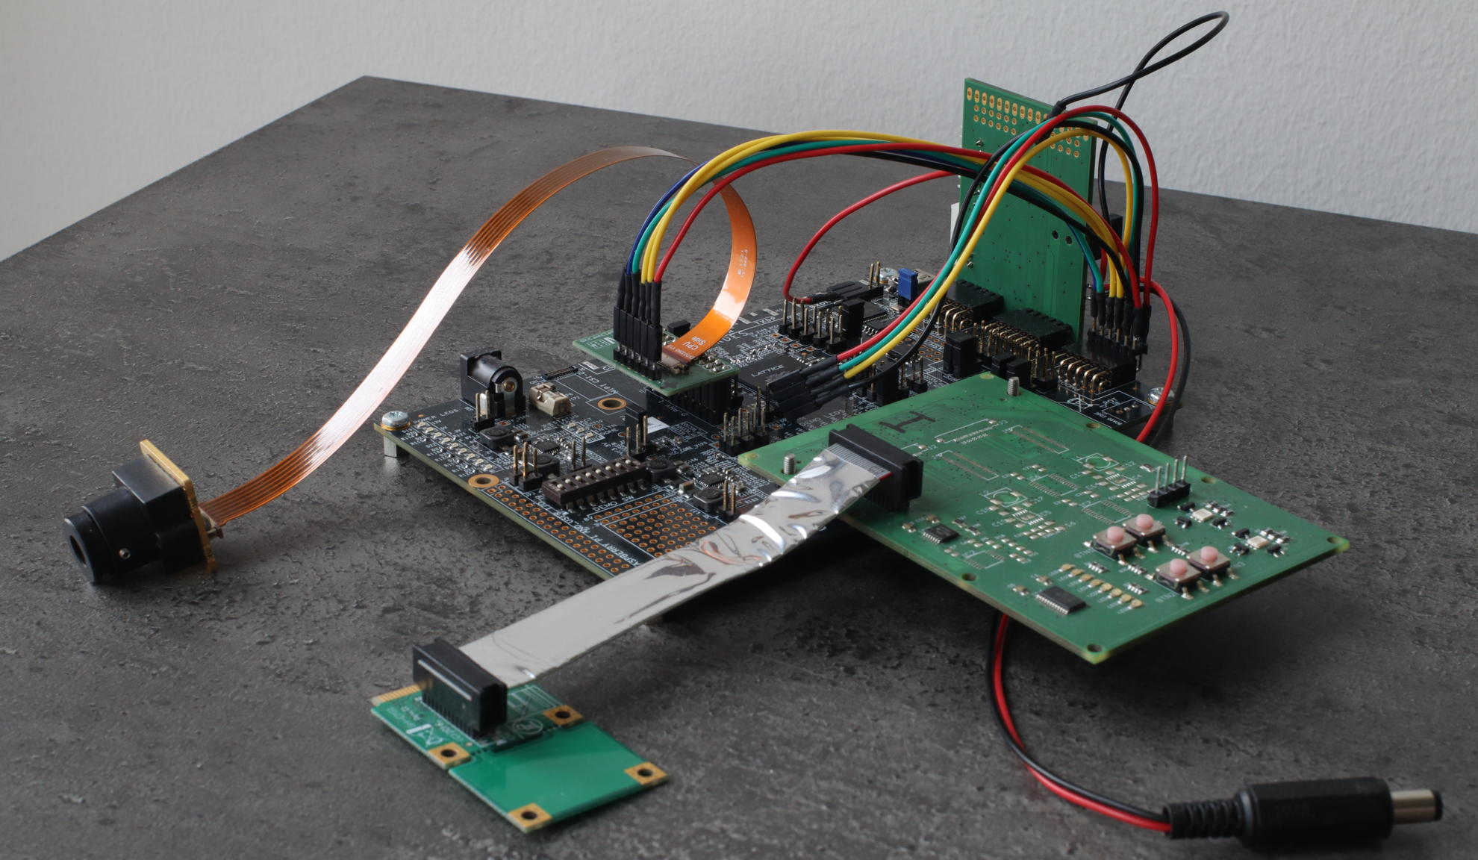
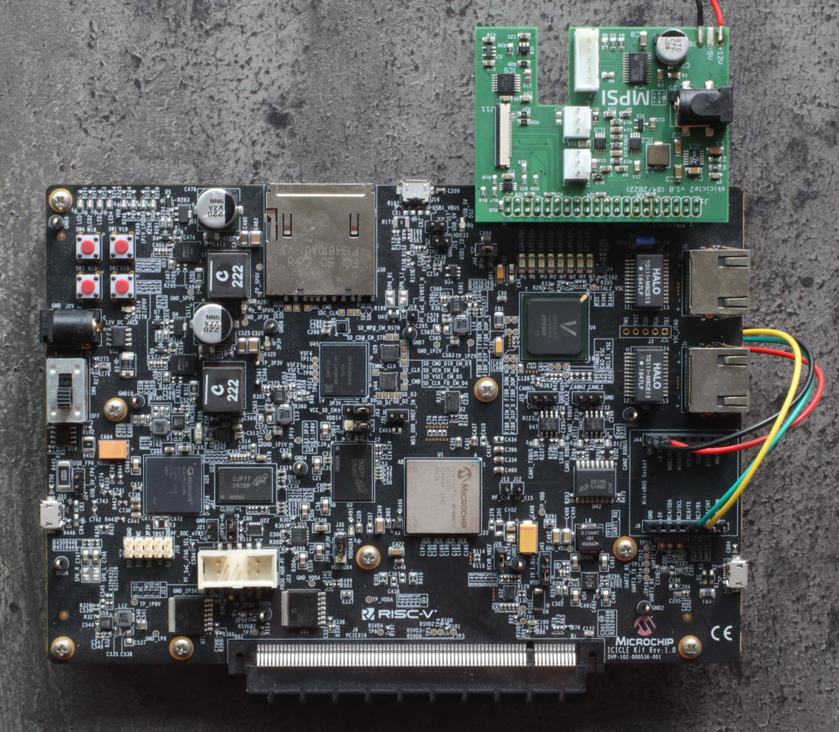
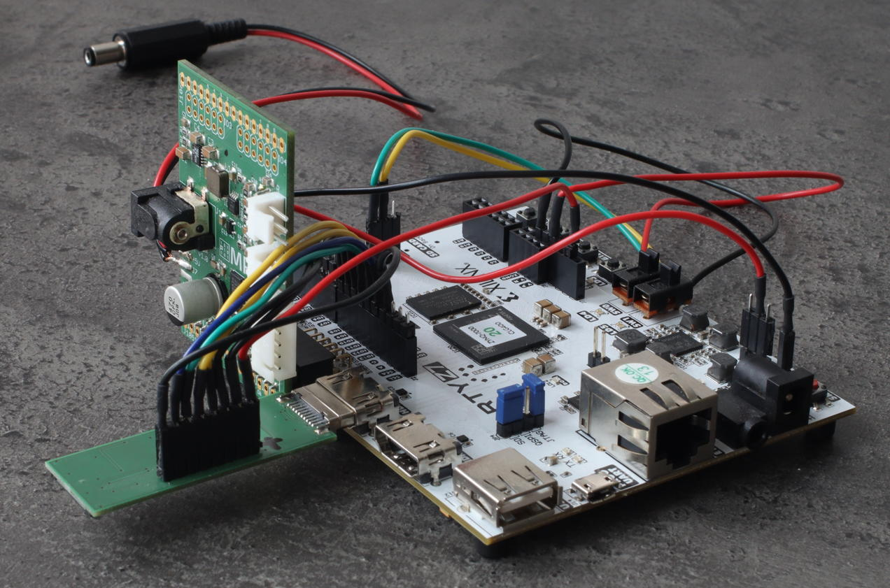
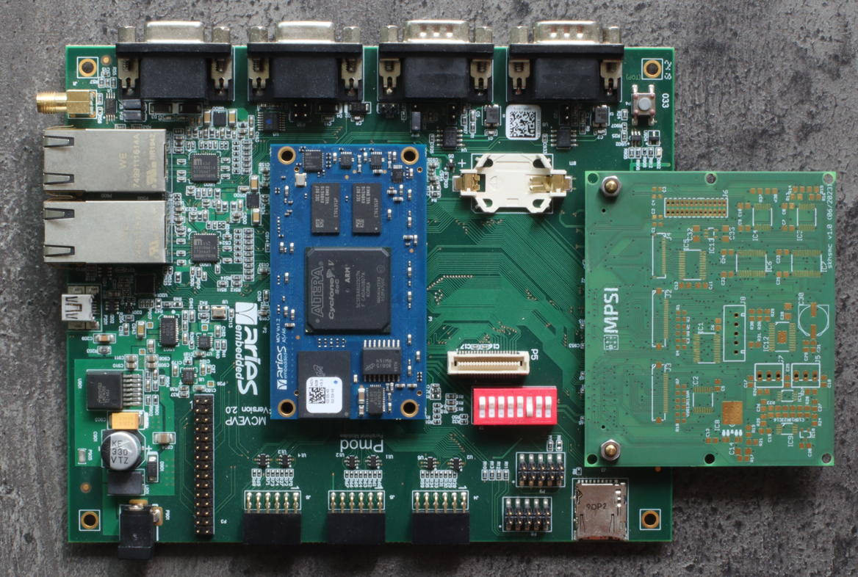
The Whiznium Universe & Developer Lifestyle
Concept | Key features | Workflow | Starter kit
Tabletop 3D laser scanner, implemented on mid-range devices from all major vendors
AMD Zynq, ZynqMP; Efinix Titanium; Lattice CrossLinkNX; Microchip PolarFire SoC
Work in progress: Altera CycloneV, Agilex E; Lattice Avant

Slide 12
The Whiznium Universe & Developer Lifestyle
Concept | Key features | Workflow | Starter kit
RTL design (Artix-7 with PCI Express)

Slide 13
Perk #1: Host – FPGA communication
C++/VHDL co-generation | Protocol | Terminals
Vendor agnostic and interface agnostic specification
Attribute commands with invocation and return parameters to RTL modules
Single source of truth code-generation for C++ host library and VHDL decoder
Also available: bulk buffer transfers (for sub-MB non-DMA scenarios)
Provocative thought: is “write some value to some memory mapped address” really the best we can do?
^^ leaving the decision of when to apply e.g. config parameters to an FPGA-based FSM may be much safer than trusting the CPU host with this task

Slide 14
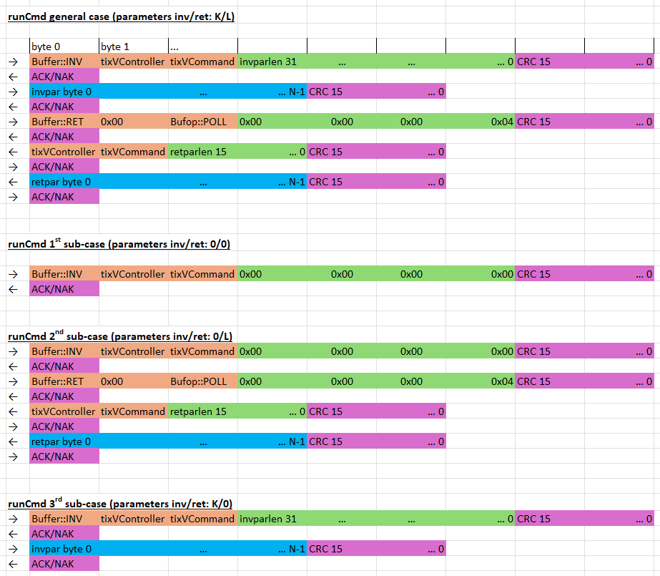
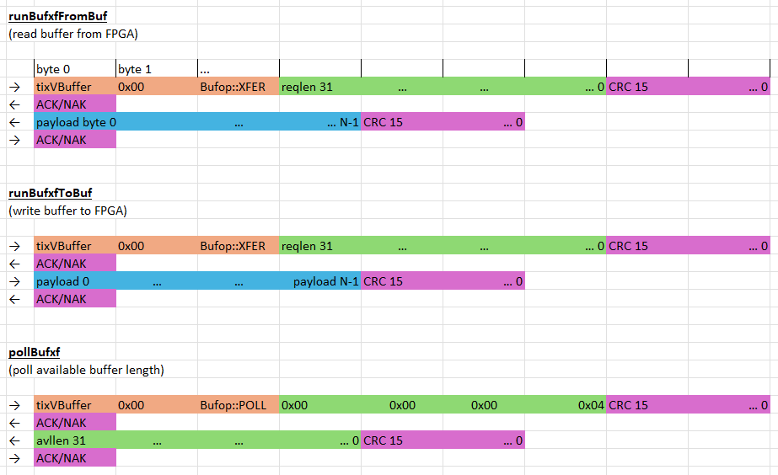
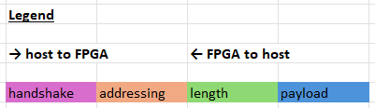
Perk #1: Host – FPGA communication
C++/VHDL co-generation | Protocol | Terminals
CRC-guarded handshake protocol
Notes:
EXCEL: protocol

Slide 15
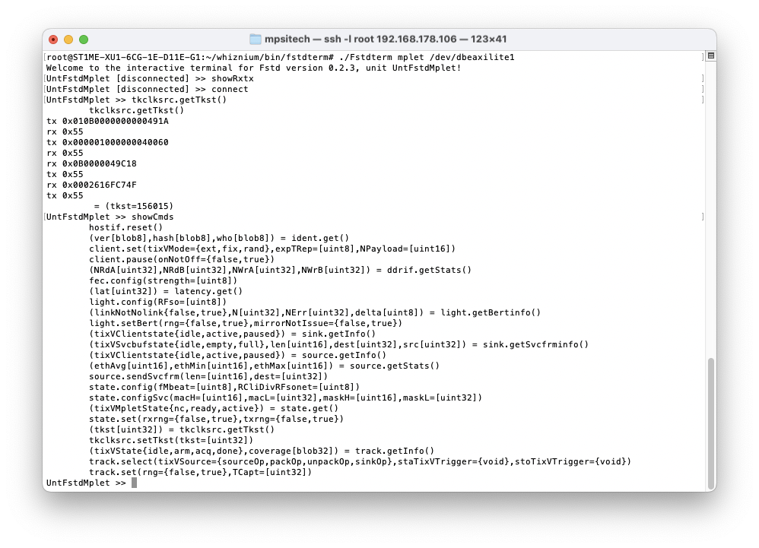
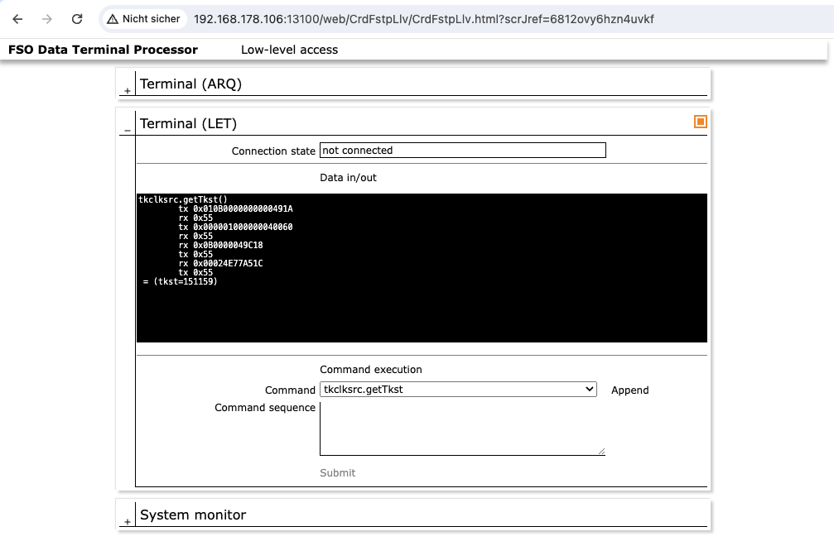
Perk #1: Host – FPGA communication
C++/VHDL co-generation | Protocol | Terminals
Command-line terminal based on C++ host library
Web-based interactive terminal in combination with WhizniumSBE (source code generator for Linux daemons)
Notes:
IMAGE: PnlFstpLlvMpletTerm

Slide 16
Perk #2: Access to high-speed interfaces
PCI Express | MIPI CSI-2 | HDMI (out) | DDR memory
PCI Express Gen1 (introduced 2003 as replacement for parallel PCI) offers 2.5 Gbps per lane
Focus on x1, i.e. single data lane, net data rate of 250MB/s
Physical layer:
Point-to-point communication (here: host-to-FPGA), FPGA is endpoint
NRZ line code: clock (1.25GHz, 0.4ns eye) is recovered from signal
Reference clock (100MHz) signal only present during system start-up
Among those presented here, the most demanding interface, impossible without dedicated silicon
I²C interface not relevant for FPGA implementation
Configuration / transaction layer:
Configuration (”capabilities”) read by host from FPGA during system start-up
Focus on “Memory Write” / ”Memory Read” only with 1k payload size per transaction

Slide 17
Perk #2: Access to high-speed interfaces
PCI Express | MIPI CSI-2 | HDMI (out) | DDR memory
MIPI CSI-2 is the (only remaining?) standard for megapixel camera sensors
Market dominance of SONY IMX range, from ArduCam’s to internal iPhone cameras
Physical layer:
Up to four lanes together with one clock lane, matching via FPGA-internal delay line
Time-division between ”low-power” (LP) 1.2V CMOS and “high-speed” (HS) LVDS modes
DDR protocol with e.g. 1600 Mbps per lane @800 MHz
Protocol:
“LP announces what comes in next HS chunk”, bit packing and distribution across lanes (RAW/YUV/…) specified by supplier
Configuration:
I²C interface configures everything: number of lanes, resolution, image format, frame rate, exposure time, …
without access to datasheet mostly stuck with default (workarounds: Linux kernel sources, contact SONY / FRAMOS)

Slide 18
Perk #2: Access to high-speed interfaces
PCI Express | MIPI CSI-2 | HDMI (out) | DDR memory
HDMI is one of the major standards to transmit image data to screens / projectors
Physical layer:
Three data lanes (typ. red/green/blue) together with one clock lane running at a 10th of the data speed
Clock range 25 MHz to 165 MHz (full-HD @ 60Hz)
TMDS packs 8 bits into 10 bits, i.e. @ 165 MHz, each lane carries 1.65 * 8/10 Gbps = 1.32 Gbps
Protocol:
vsync and hsync are embedded into the “blue” TMDS lane

Slide 19
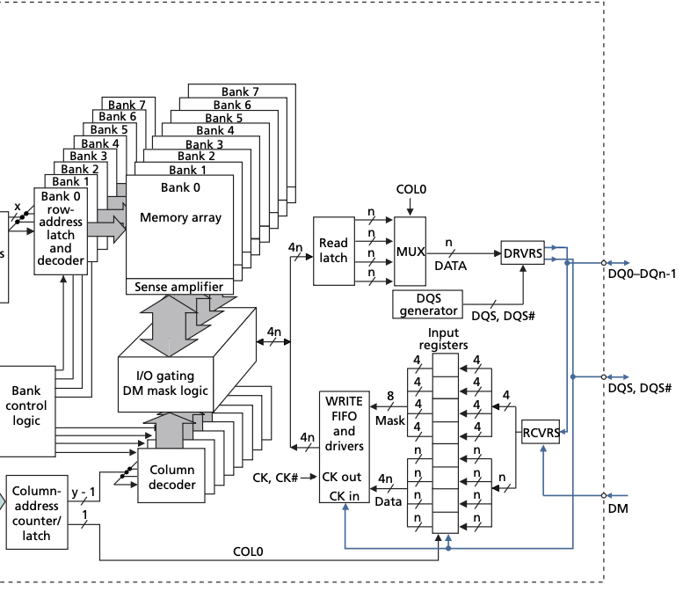
Perk #2: Access to high-speed interfaces
PCI Express | MIPI CSI-2 | HDMI (out) | DDR memory
(LP)DDR{2-6} is the interfacing standard for large dynamic RAM IC’s
Physical layer:
Column / row address inputs (start address)
Single-ended bidirectional data lanes (typ. 8/16/32 bits) with DDR sampling
One differential pair of synchronization signals per byte
DDR protocol e.g. DDR3-800 @400MHz
Protocol:
Sophisticated ”training” procedure in PHY to equalize wire lengths
Then burst transfer with IC-specific delay from column / row address input to data

Slide 20
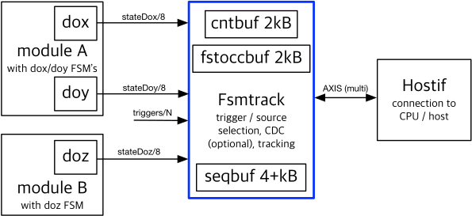
Perk #3: Live design probing
Design hook | Read-out
Targeted at FSM state monitoring
Arbitrary standard logic triggers, including design reset
Sequence buffer (with compression), First occurrence buffer, Count buffer
Work in progress: generalized standard logic (vector) observation
Notes:
DIAGRAM: fsmtrack

Slide 21
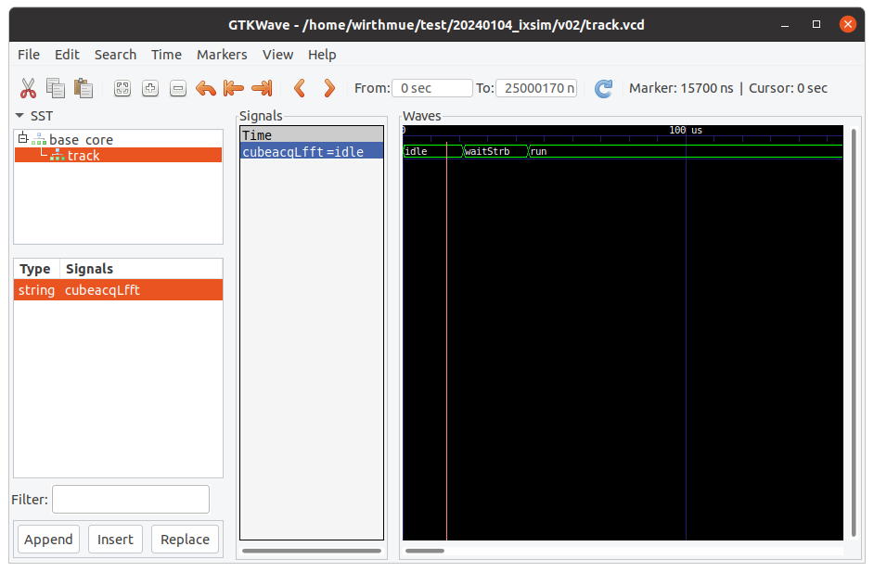
Perk #3: Live design probing
Design hook | Read-out
Textual output, information on FSM state coverage
Visualization in GtkWave
Work in progress: Linux daemon capability in analogy to interactive terminal
states covered: 0x00 (init), 0x01 (idle), 0x10 (runA), 0x11 (runB), 0x20 (done)
states missed:0x12 (runC), 0x30 (reset)
first state occurrence in ms:
[0.000000] 0x00 (init)
[0.000010] 0x01 (idle)
[0.003320] 0x10 (runA)
[0.003348] 0x11 (runB)
[0.019200] 0x20 (done)
state occurrence and share:
0x00 (init): 88.0% (1760/2000)
0x01 (idle): 0.1% (2/2000)
0x10 (runA): 3.3% (66/2000)
0x11 (runB): 6.6% (132/2000)
0x20 (done): 2% (40/2000)
Notes:
IMAGE: state share and first occurrence

Slide 22
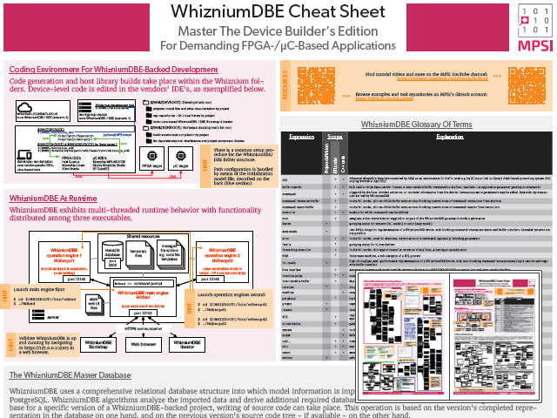
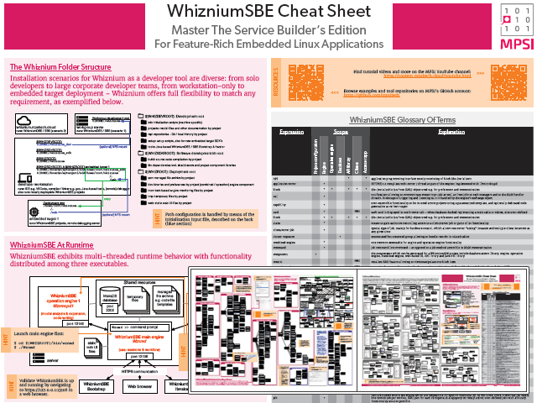
Resources
Both Whiznium tools are available free of charge on GitHub, including installation instructions
https://github.com/mpsitech/The-Whiznium-Documentation
The Open Source StarterKit ist available for various hardware platforms, with vendor-specific instructions also available on GitHub
“The Whiznium Developer Experience” webinar series on Whiznium is on YouTube (google it)
For advanced users WhizniumSBE/DBE cheat sheets are available which serve as reference for writing model files
(New) home for cross-vendor cores
https://mpsitech.github.io/Laser-Scanner-By-Platform
Some more presentations on the topic
https://www.mpsitech.com/documentation/presentations

Slide 23
Thank You!
Questions?
Also, feel free to connect.
https://www.linkedin.com/in/wirthmua
https://github.com/mpsitech

