Slide 1

Automatic code generation for managing the firmware and software for configuration/status registers and memories in the ATLAS Level-1 Central Trigger
Anna Kulińska
on behalf of the ATLAS Level-1 Central Trigger (L1CT) Group

Slide 2
Overview:
HardwareCompiler
Firmware & software development flow
XML register map
Firmware development
  VHDL package
  Register translator
Software development
  C++ code
  Python hardware test scripts
Summary
2

Slide 3
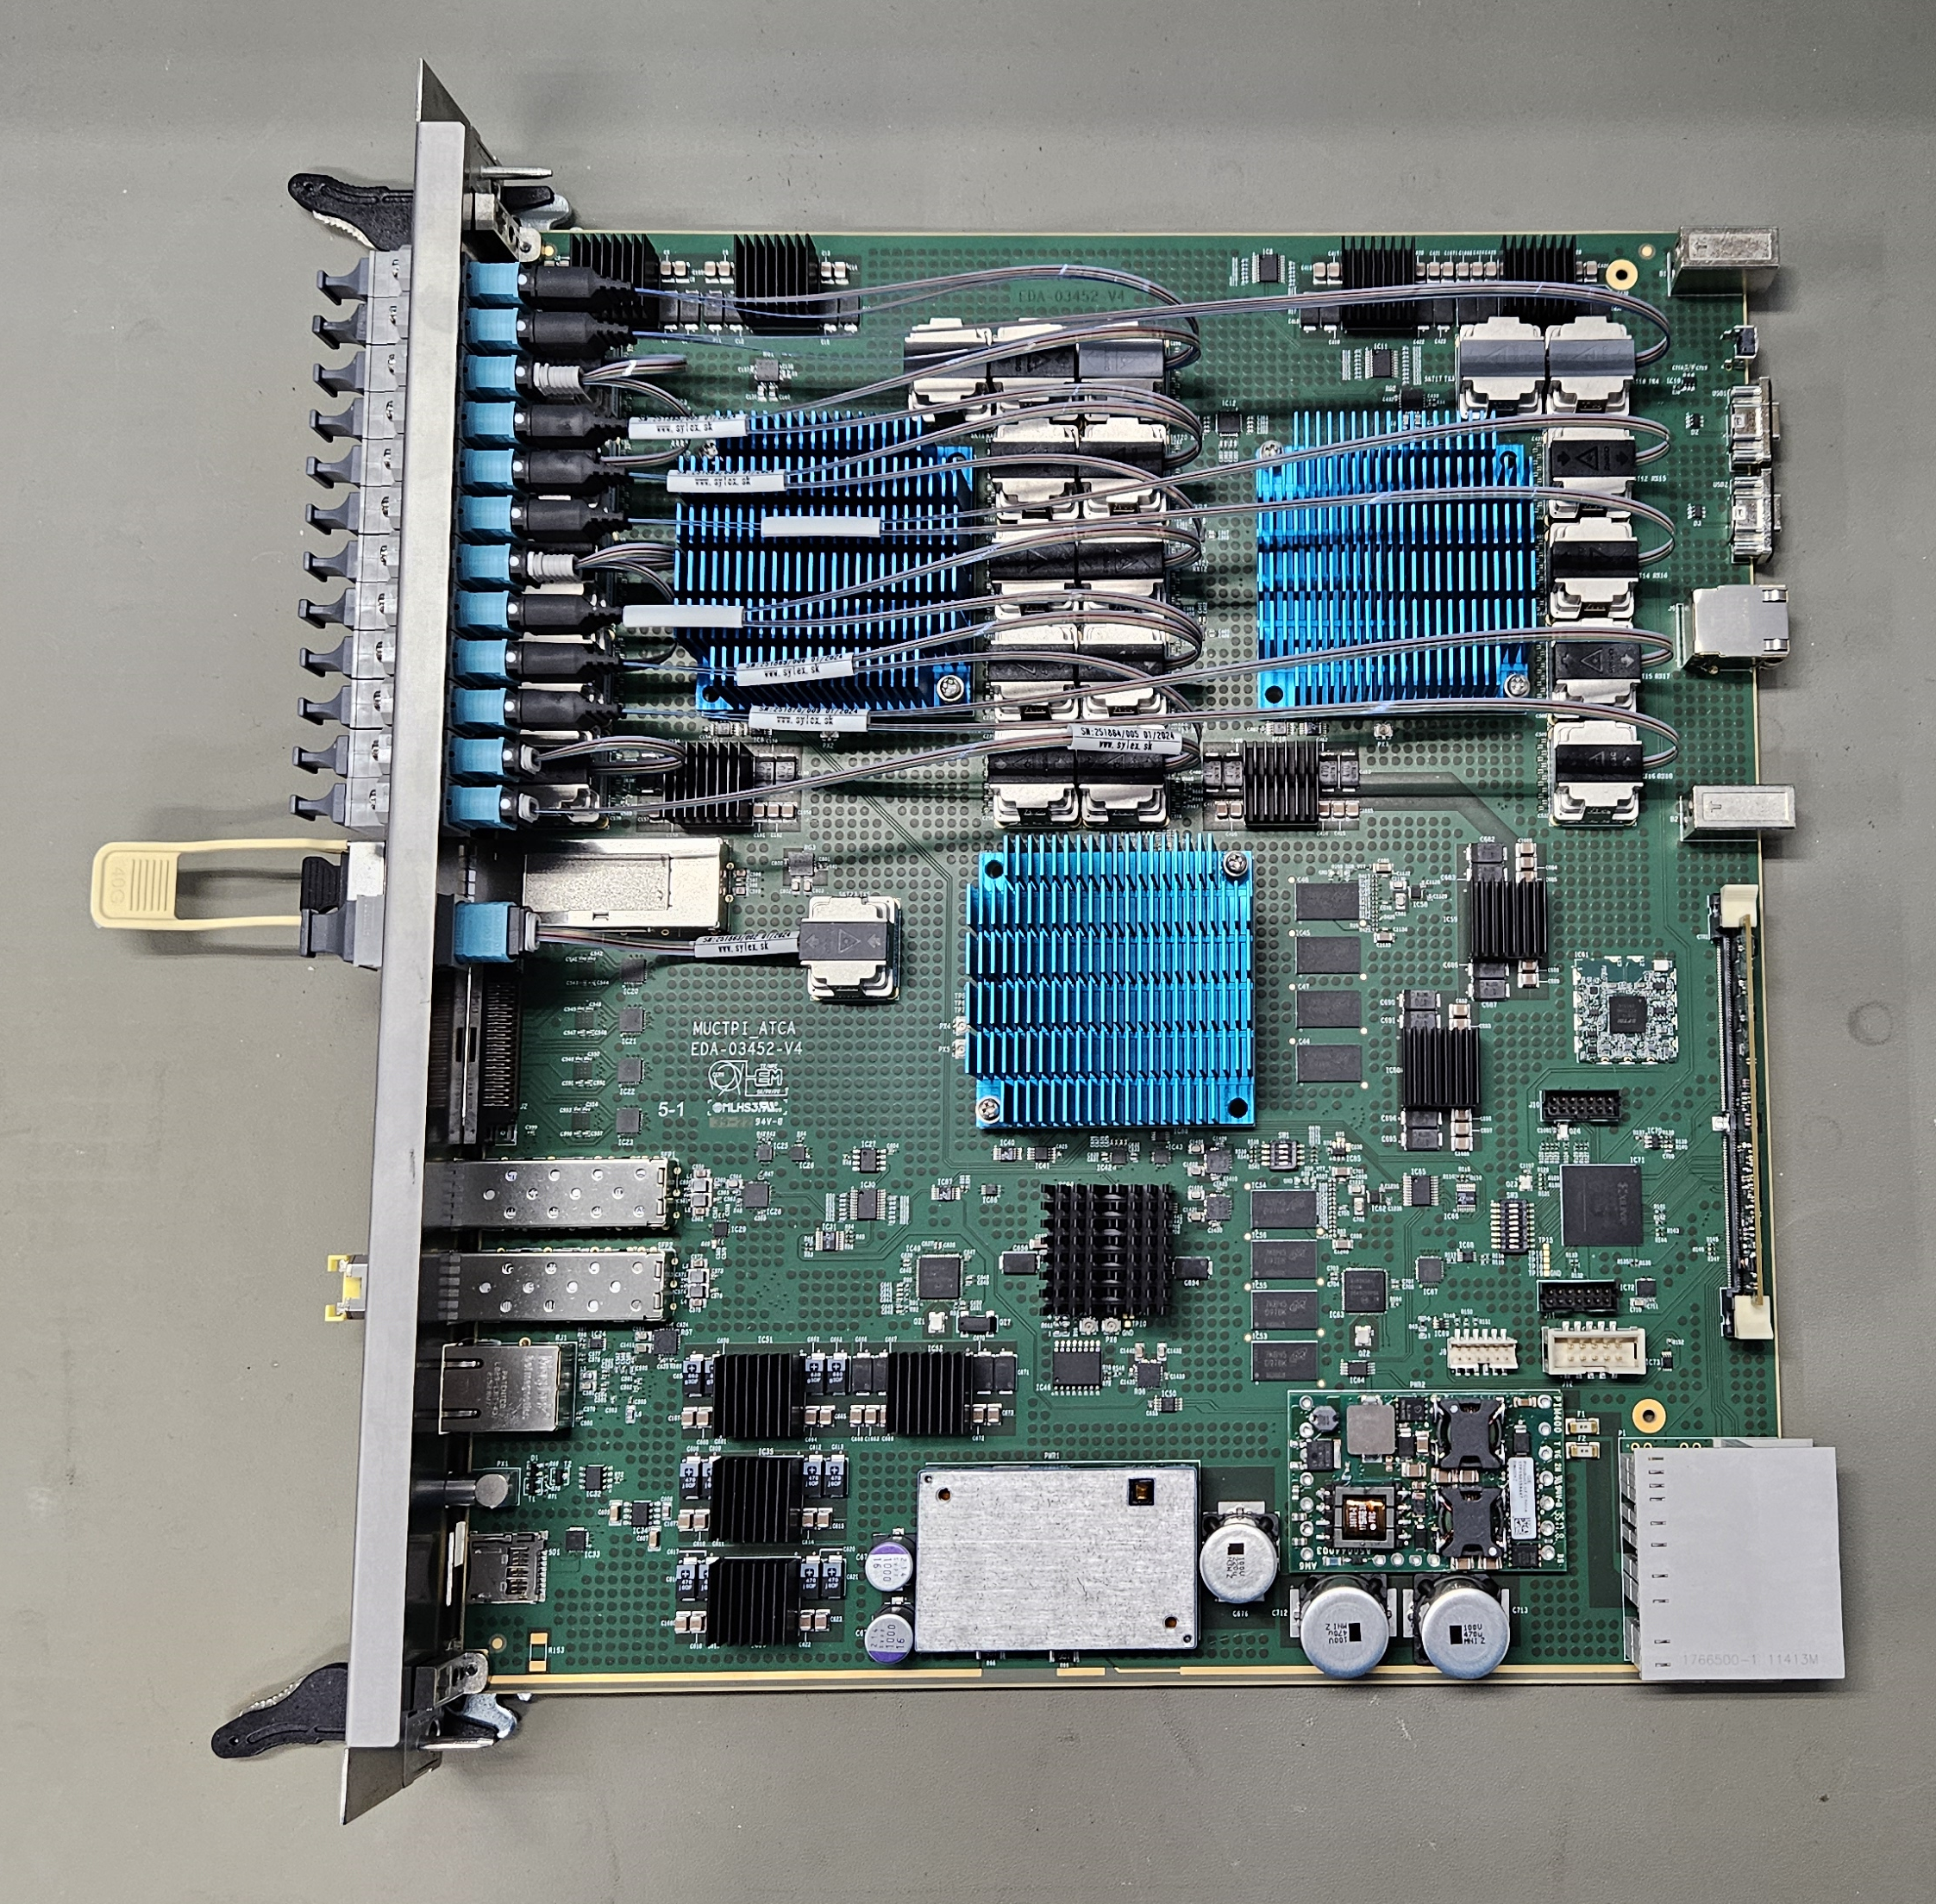
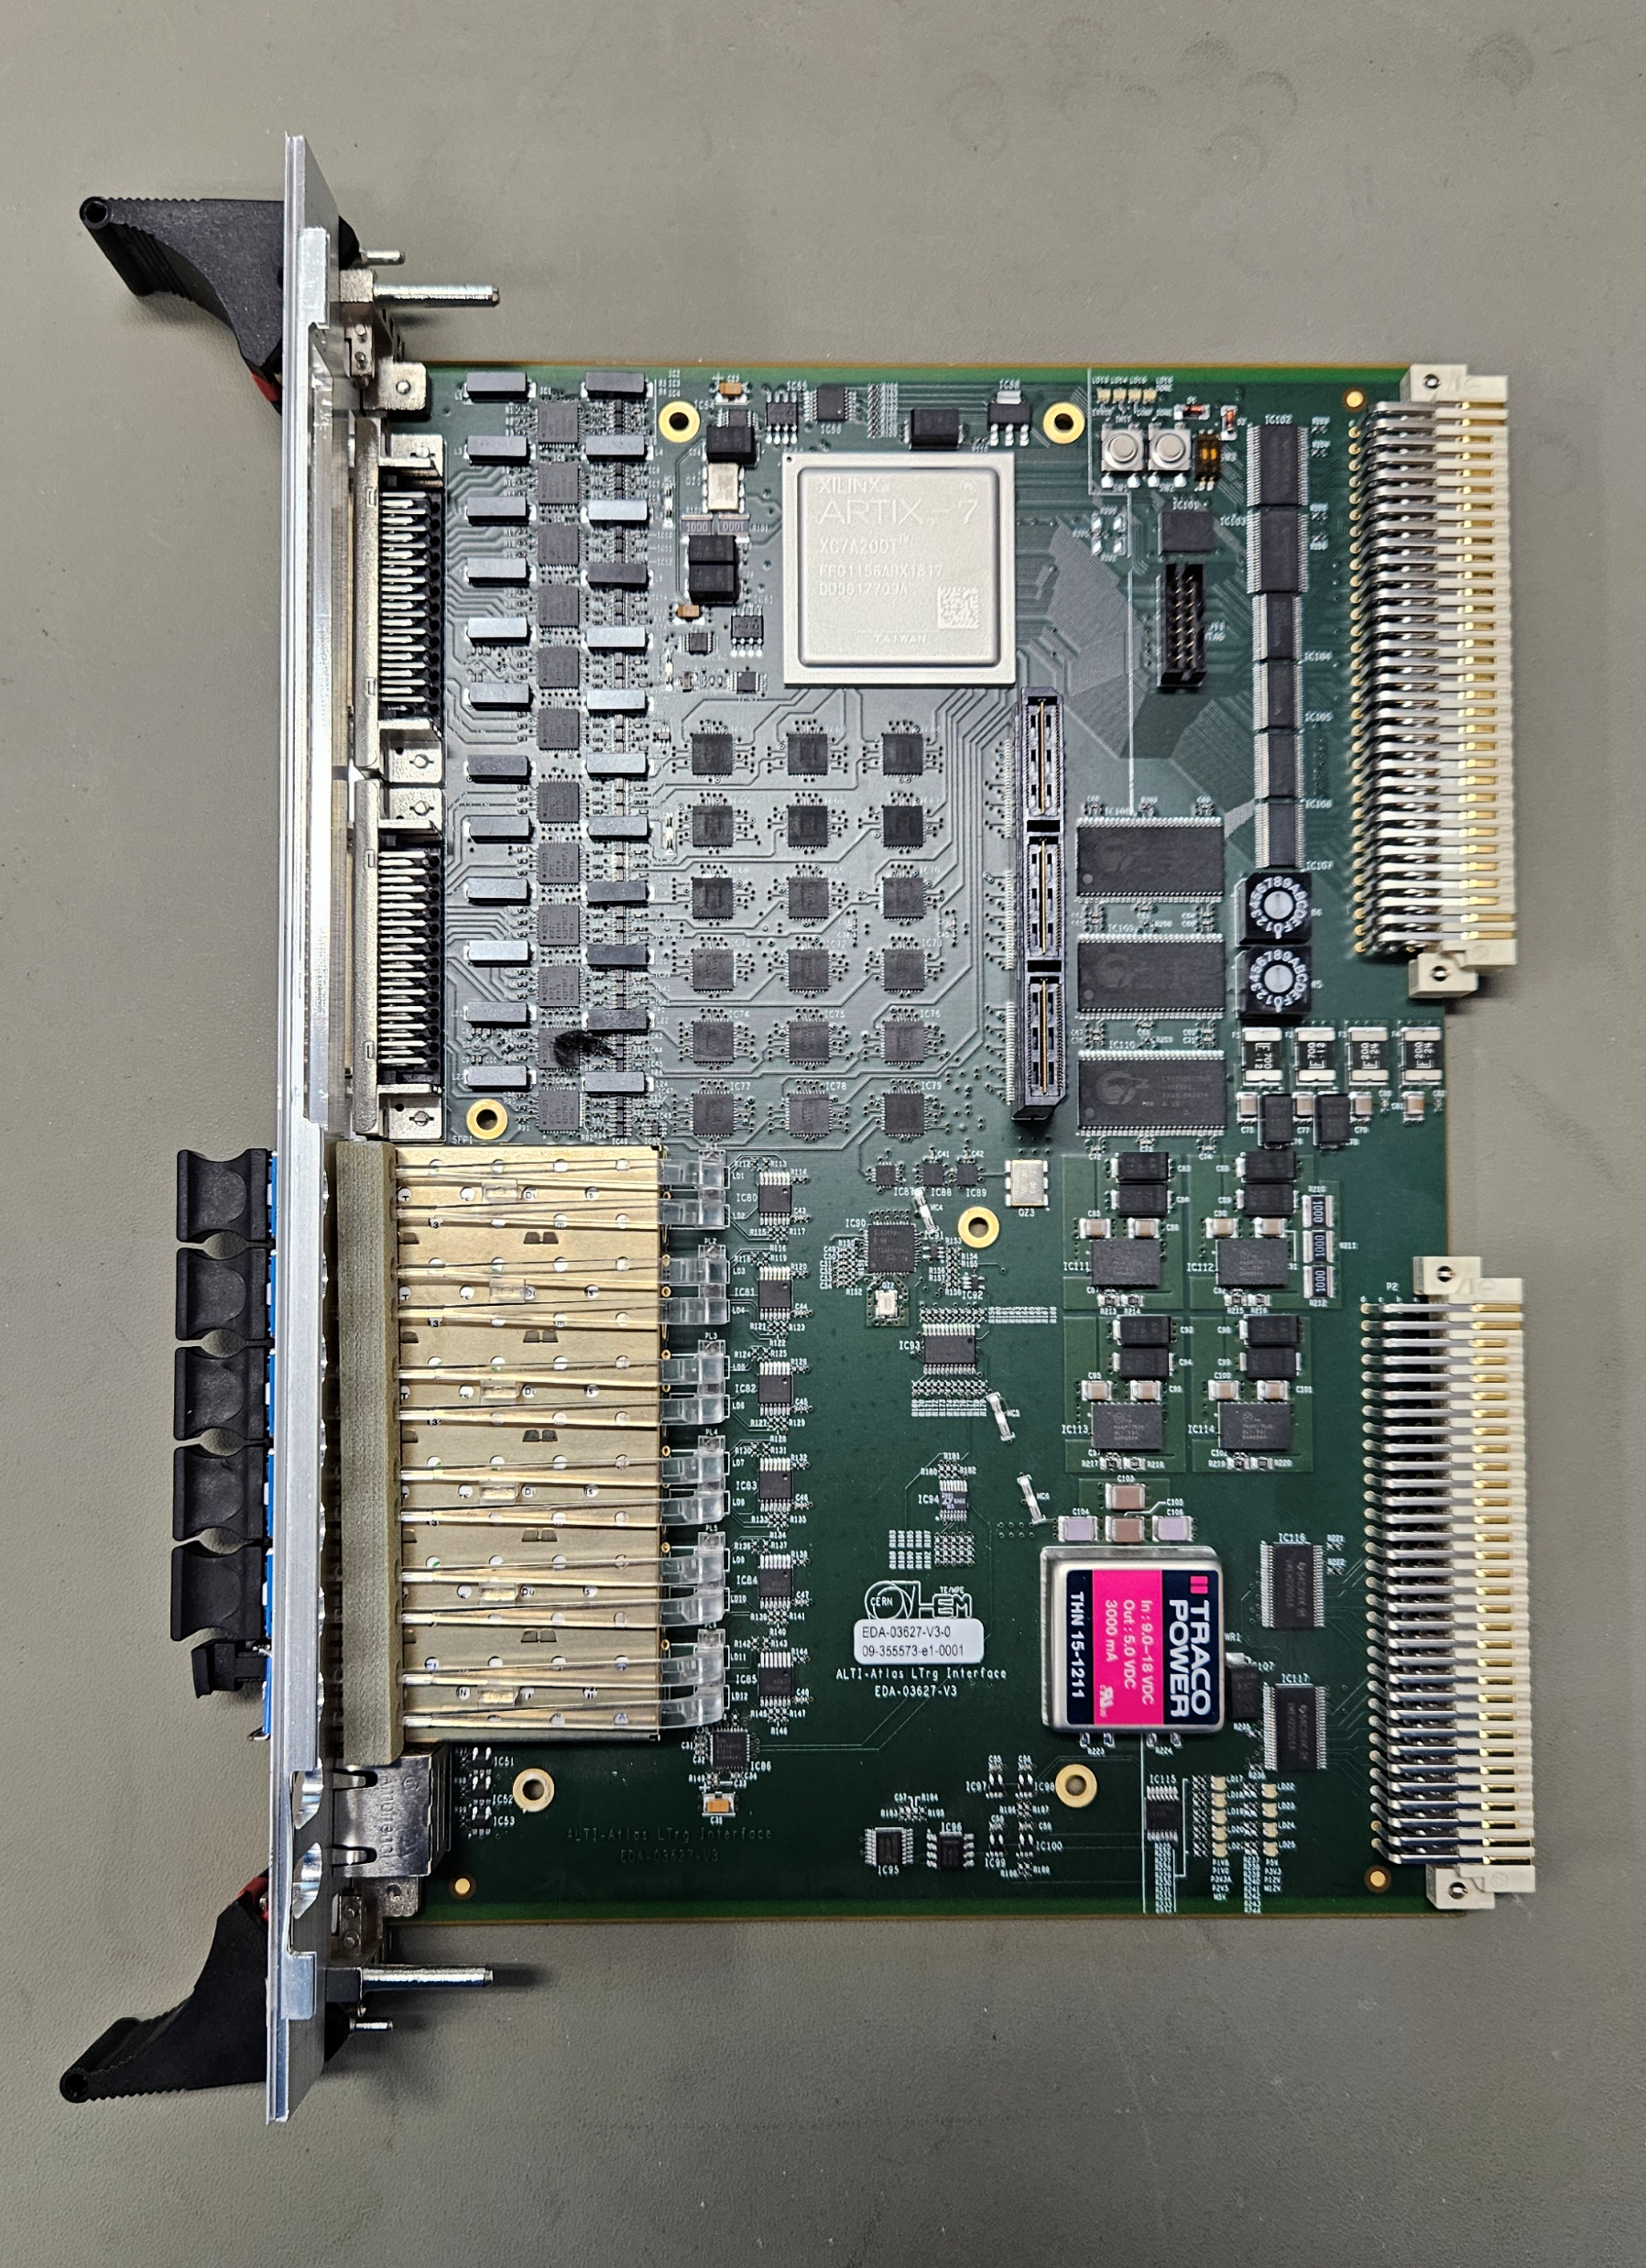
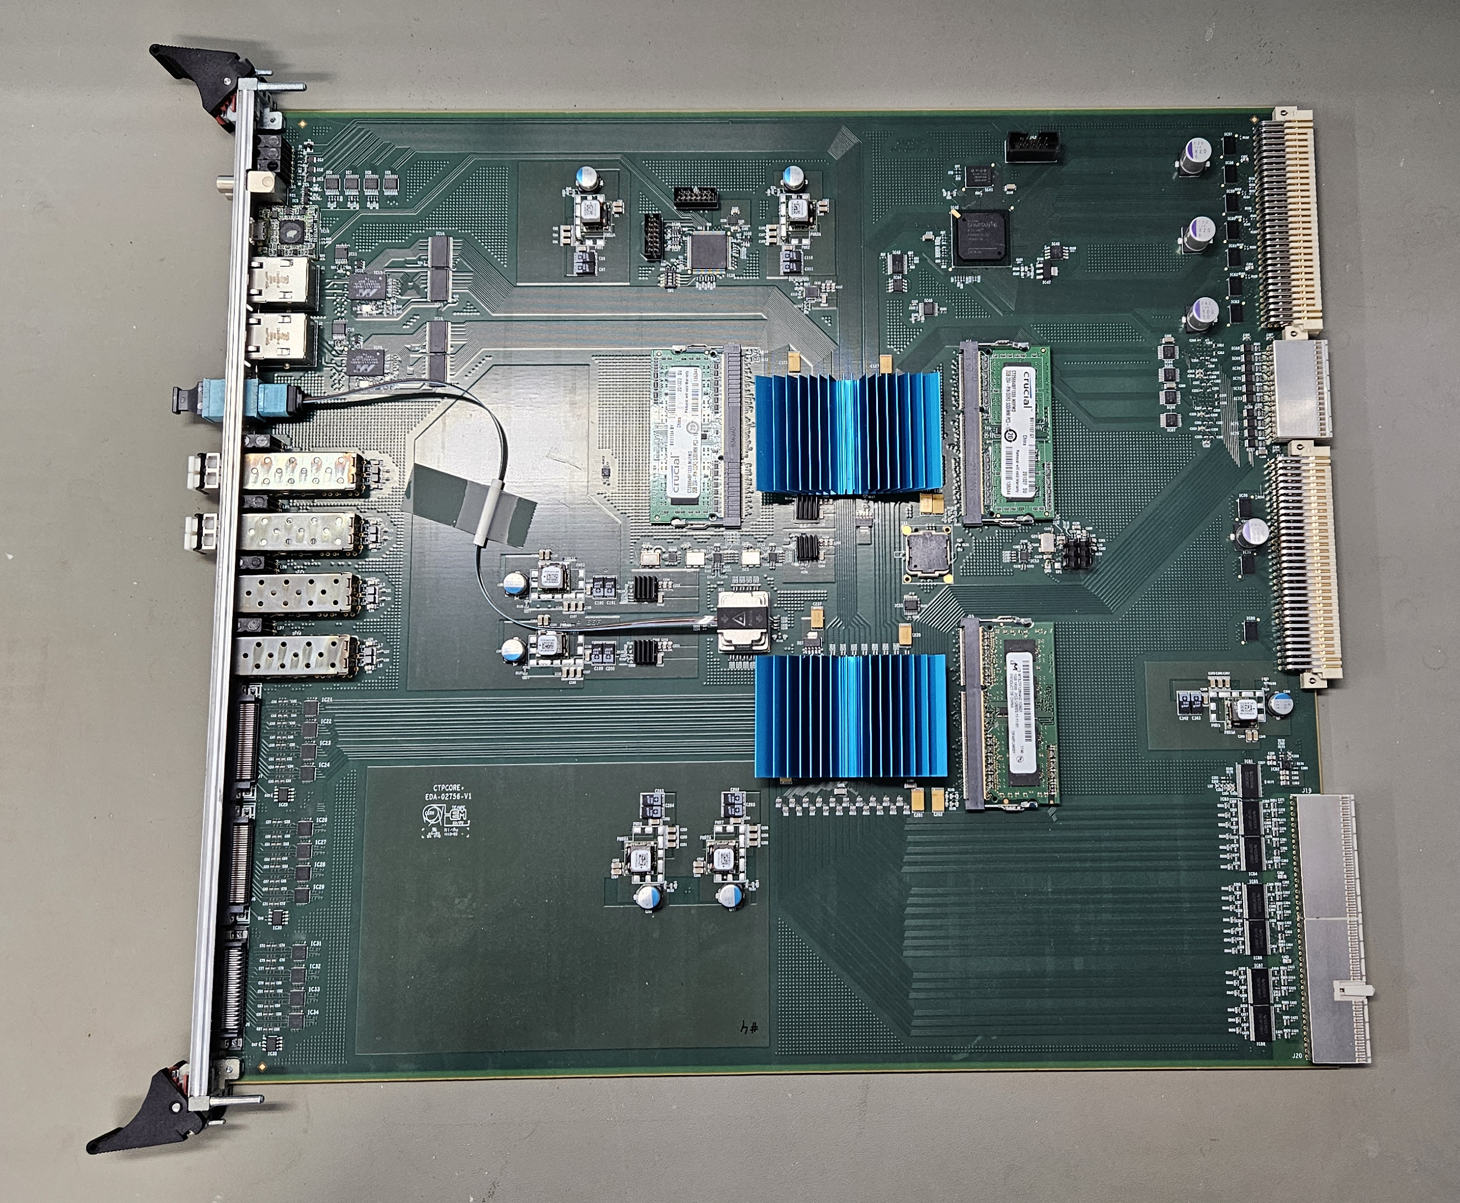
HardwareCompiler
Tool developed by the ATLAS Level-1 Central Trigger (L1CT) group
VHDL and C++ source code generator
Code generation is based on a XML register map containing definitions of registers & memories
Greatly simplifies firmware and software development and hardware tests for board with complex FPGA designs
The hardware compiler was developed in 2013 for generating C++ software. Since then, it was constantly improved, notably with writing VHDL code for firmware registers, and recently with writing VHDL address decoders.
It is currently being used for the development of all L1CT modules for the Run-4 TDAQ Upgrade, which are based on AMD Xilinx FPGAs and SoCs
MUCTPI board with two Virtex UltraScale+ XCVU9P FPGAs and one Kintex UltraScale XCKU095 FPGA
ALTI board with one Artix 7-Series XC7A200T FPGA
CTPCORE+ board with two Virtex 7-Series XC7VX485T FPGAs
3

Slide 4
Firmware & software development flow
1. Hardware compiler generates VHDL code for running in FPGAs, and software for running on the Xilinx MPSoC System-on-Chip
2. C++ software is wrapped in Python for simpler interactive testing and development of complex test sequences
Calling the HardwareCompiler & Python Wrapper is fully integrated into the software Continuous Integration framework
This scheme allows the software and firmware to be kept consistent
VHDL code:
VHDL package &
Registers/memories translators
include
Firmware (VHDL)
generate
Python module
import
Test scripts
(Python)
Register Map (XML)
IN SYNC
wrap: Python
High-level test programs (C++)
generate
C++ code:
API & text-based user interface
include
include
ATLAS TDAQ
Run Control (C++)
4

Slide 5
XML register map
REGISTERS ATTRIBUTES:
address
access type (read-only, read&write…)
data mask
Register data can also be described using a bit string:
bit fields with mask
symbolic names (human readable)
<module name="MuonSectorProcessor" size="0x10000000" type="D32" addr="0x00000000">
...
<block name="TTC" addr="0x00100000" decoder="SYS">
<register name="CounterL1a" addr="0x00000000" modf="R"/>
<register name="CounterSync" addr="0x00000004" mask="0xFFF" modf="R"/>
<register name="Control" addr="0x00000008" modf="RW">
<field name="ResetCounter" mask="0x00000001" multiple="2" offset="4"/>
</register>
...
</block> <!-- TTC -->
<block name="SLI" addr="0x00000000" decoder="SLR1">
<register name="SpyPlayControl" addr="0x00000008" modf="RW">
<field name="SpyEnable" mask="0x00000004" form="BOOLEAN"/>
<field name="PlaybackEnable" mask="0x00000008" form="BOOLEAN"/>
<field name="PlaybackLastAddress" mask="0x0000FFF0" form="NUMBER"/>
<field name="Mode" mask="0x00000003">
<value name="OFF" data="0x00000000"/>
<value name="SL" data="0x00000001"/>
<value name="PG" data="0x00000002"/>
<value name="SPY" data="0x00000003"/>
</field>
</register>
...
<memory name="SectorMemory" addr="0x00010000" size="0x10000"/>
</block> <!-- SLI -->
...
</module>
MEMORIES ATTRIBUTES:
Defined in the same way as registers
Additional size attribute
HIERARCHY:
Registers and memories can be arranged in blocks
Blocks can contain other blocks
Registers, memories, fields and blocks can have a “multiple“ attribute to generate arrays of elements
Blocks can have a “decoder” attribute to generate register translator for registers and memories
5

Slide 6
Firmware development
6

Slide 7
VHDL code
use work.MuonSectorProcessor_pkg.all;
snaplay_i : entity work.sl_snaplay
generic map(
Mode => SLI_SpyPlayControl_Mode_PG,
ADDR_WIDTH => SLI_SECTORMEMORY_ADDR_WIDTH,
)
port map(
rstn_i => not (rst_i),
clk_i => clk40_i,
mode_i => ctrl_i.SpyPlayControl.Mode,
--
pg_enable_i => ctrl_i.SpyPlayControl.PlaybackEnable,
pg_last_addr_i => ctrl_i.SpyPlayControl.PlaybackLastAddress,
spy_enable_i => ctrl_i.SpyPlayControl.SpyEnable,
--
sli_mem_mosi_i => sli_mem_mosi_i.SectorMemory,
sli_mem_miso_o => sli_mem_miso_o.SectorMemory,
pg_data_o => sl_pg_data,
sl_i => sl_data,
);
CONTROL REGISTER FIELD’S VALUE
MEMORY ADDRESS WIDTH CONSTANT
Automatically generated by HardwareCompiler
Contains declarations for registers and memories described in XML register map
  address, width, size constants
  data type declarations
  register field records
  conversion functions
Ensures consistency between XML register map and firmware implementation
Follows XML register map block structure
CONTROL REGISTER RECORD’S FIELDS
MEMORY INTERFACE
<block name="SLI" addr="0x00000000" decoder="SLR1">
<register name="SpyPlayControl" addr="0x00000008" modf="RW">
<field name="SpyEnable" mask="0x00000004" form="BOOLEAN"/>
<field name="PlaybackEnable" mask="0x00000008" form="BOOLEAN"/>
<field name="PlaybackLastAddress" mask="0x0000FFF0" form="NUMBER"/>
<field name="Mode" mask="0x00000003">
<value name="OFF" data="0x00000000"/>
<value name="SL" data="0x00000001"/>
<value name="PG" data="0x00000002"/>
<value name="SPY" data="0x00000003"/>
</field>
</register>
<memory name="SectorMemory" addr="0x00010000" size="0x10000"/>
</block> <!-- SLI -->
7

Slide 8
Register/Memory Translator
Translator implements control/status registers and read/write access to external memories with an AXI4 full bus interface
Registers and memories are grouped into translator’s blocks (based on the “decoder” block attribute):
Registers are instantiated inside the translator
Multiple decoder definitions can be used in a single XML register map
“decoder” attribute can be specified at any level of the block hierarchy
Control Registers
User logic
AXI4 FULL
Status Registers
Translator
Memory
Memory
BRAM
AXI
Master
AXI BUS
AXI Interconnect
…
Control Registers
User logic
Multiple translators may be needed in a design:
Split across different clock domains or different SLRs
Overcome address range limitation (1 Mbyte per translator)
AXI4 FULL
Status Registers
Translator
Memory
Memory
BRAM
Translator uses Xilinx AXI BRAM Controller IP core:
Translates between AXI4 full bus and BRAM access signals (address, read enable, write enable, read data, write data)
20 bits of address width limitation
Read Enable
Status Registers
Read Data
Memories
AXI4 Full MOSI
rdData
AXI BRAM Controller
IP
Address
ADDRESS
DECODER
AXI4 Full MISO
Write Data
Control Registers
Recent L1CT boards use Xilinx MPSoCs to control the hardware
=> AXI is the natural choice for SoC FPGAs and processing FPGAs (without SoC)
CONTROL
REGISTERS
Memories
Write Enable
wrData
wrEnable
Address
8

Slide 9
Translator instance example
slr1_i : entity work.SLR1_reg_translator
generic map(
ADDR_BITS => SLR1_ADDR_BITS
)
port map(
rst_i => rst_i,
clk_i => clk_i,
axi_full_mosi_i => axi_full_mosi_i(0),
axi_full_miso_o => axi_full_miso_o(0),
reg_mosi_o => slr1_reg_mosi,
reg_miso_i => slr1_reg_miso
mem_mosi_o => slr1_mem_mosi,
mem_miso_i => slr1_mem_miso
);
<block name="SLI" addr="0x00000000“ decoder="SLR1">
<register name="SpyPlayControl" addr="0x00000008" modf="RW">
<field name="SpyEnable" mask="0x00000004" form="BOOLEAN"/>
<field name="PlaybackEnable" mask="0x00000008" form="BOOLEAN"/>
<field name="PlaybackLastAddress" mask="0x0000FFF0" form="NUMBER"/>
<field name="Mode" mask="0x00000003">
<value name="OFF" data="0x00000000"/>
<value name="SL" data="0x00000001"/>
<value name="PG" data="0x00000002"/>
<value name="SPY" data="0x00000003"/>
</field>
</register>
<register name="BcidOffset" addr="0x0000000C" modf="RW"/>
<register name="SpyPlayStatus" addr="0x00000000" modf="R">
<field name="PlaybackBusy" mask="0x00000008" form="BOOLEAN"/>
<field name="SpyBusy" mask="0x00000004" form="BOOLEAN"/>
<field name="SpyAddress" mask="0x0000FFF0" form="NUMBER"/>
</register>
<register name="BcidMonitor" addr="0x00000004" modf="R"/>
<memory name="SectorMemory" addr="0x00010000" size="0x10000"/>
</block> <!-- SLI -->
SLR1 DECODER
AXI4 FULL BUS INTERFACE CONNECTIONS
CONTROL REGISTERS OUTPUT RECORD
STATUS REGISTERS INPUT RECORD
MEMORY INTERFACE IN/OUT
9

Slide 10
Software development &
Hardware testing
10

Slide 11
C++ methods
HardwareCompiler generates C++ class based on XML register map
Generates API methods to perform read and write operations on registers and memories
Generates a text-based user interface for interactive use:
  Exposes read and write operations for registers and memories
  Menu entry for each method defined in the class
  Adheres to XML register map hierarchy
  Very effective for basic firmware checks
Low-level software functions are used in higher-level user written C++ code (e.g. module configuration, control and monitoring, interface to control room framework)
“SLI"/“SLI_SpyPlayStatus" bit string = "MSP_SLI_SPYPLAYSTATUS_BITSTRING": 0x00000000
"PlaybackBusy" : "false"
"SpyBusy" : “true"
"SpyLastAddress" : 136
"read "SLI_SpyPlayStatus" [bit string]" returns 0
>>> MuonSectorProcessor main menu/SLI menu <<<
0 quit
1 read "SLI_SpyPlayStatus" [bit string]
2 read "SLI_SpyPlayStatus" [number]
…
8 read "SLI_SectorMemory" [number]
9 write "SLI_SectorMemory" [number]
10 read "SLI_SectorMemory" [vector]
11 write "SLI_SectorMemory" [vector]
12 read "SLI_SectorMemory" [block]
13 write "SLI_SectorMemory" [block]
14 read "SLI_SectorMemory" [file]
15 write "SLI_SectorMemory" [file]
Enter number [0..15]:
int MuctpiModule::SLISpyEnable() {
MUONSECTORPROCESSOR_SLI_SPYPLAYCONTROL_BITSTRING bs;
if((m_status = m_msp->SLI_SpyPlayControl_Read(bs)) != SUCCESS) {
return(m_status);
}
bs.SpyEnable(true);
bs.Mode("SPY");
if((m_status = m_msp->SLI_SpyPlayControl_Write(bs)) != SUCCESS) {
return(m_status);
}
return(m_status);
}
>>> MuonSectorProcessor main menu <<<
0 quit
1 CFG menu
2 SYS menu
3 GT menu
4 SLI menu
5 SLM menu
6 TTC menu
Enter number [0..6]:
11

Slide 12
Python hardware test scripts
Python is used for testing by firmware designers:
  simpler interactive testing of new firmware versions
  development of complex test sequences
  iterative development process
C++ software can be called from Python using SWIG (Simplified Wrapper and Interface Generator) tool
SWIG automatically generates python wrappers from the C++ header files and a simple interface file created by the user:
  Automatically generated C++ classes with registers/memories read/write methods, register bit strings
  User written C++ code
# import swig wrapper module
import MuctpiModule
# create Muctpi object
m = MuctpiModule.MuctpiModule(0)
# low-level functions from XML
# read a register from multiple block as an integer
stat, data = m.msp[0].SLI_BcidMonitor_Read()
# create a bitstring object
bs = MuctpiModule.SLI_SPYPLAYCONTROL_BITSTRING()
# read a register as a bitstring
m.SLI_SpyPlayControl_Read(bs)
# set bit fields
bs.PlaybackEnable(True)
bs.PlaybackLastAddress(22)
bs.Mode(“PG”)
# write a register as a bitstring
m.SLI_SpyPlayControl_Write(bs)
# C++ function in user written code
# reset the board
m.MuctpiModuleReset()
<block name="SLI" addr="0x00000000“ decoder="SLR1">
<register name="SpyPlayControl" addr="0x00000008" modf="RW">
<field name="SpyEnable" mask="0x00000004" form="BOOLEAN"/>
<field name="PlaybackEnable" mask="0x00000008" form="BOOLEAN"/>
<field name="PlaybackLastAddress" mask="0x0000FFF0" form="NUMBER"/>
<field name="Mode" mask="0x00000003">
<value name="OFF" data="0x00000000"/>
<value name="SL" data="0x00000001"/>
<value name="PG" data="0x00000002"/>
<value name="SPY" data="0x00000003"/>
</field>
</register>
<register name="BcidMonitor" addr="0x00000004" modf="R"/>
12

Slide 13
Summary
HardwareCompiler generates VHDL code and low-level C++ hardware access functions from a common XML description
Maintains consistency between firmware and software development
Speeds up development and testing, low-level software is automatically adjusted to changes in the firmware
Generated C++ code used in higher-level software to interface with the ATLAS TDAQ run control system
HardwareCompiler used for all ATLAS L1CT modules running in the experiment and currently being developed
Interested in further information on the L1CT HardwareCompiler? Don’t hesitate to reach out to us!
email: anna.kulinska@cern.ch, ralf.spiwoks@cern.ch
Call for discussion!
Managing large number of registers and memories is a common challenge for complex FPGA designs. We would also like to hear others’ experiences in this field
13

Slide 14
Thank you for your attention!
Questions?
14

Slide 15
VHDL package for registers includes:
constant TTC_COUNTERSYNC_ADDR : addr_slv_t := 28x"00100008";
constant TTC_COUNTERSYNC_WIDTH : integer := 12;
subtype TTC_CounterSync_slv_t is std_logic_vector(TTC_COUNTERSYNC_WIDTH - 1 downto 0);
subtype TTC_CounterSync_reg_t is TTC_CounterSync_slv_t;
CONSTANTS
NAME | DATA TYPE
<REG_NAME>_ADDR | std_logic_vector for “multiple” its array
<REG_NAME>_WIDTH | integer
<REG_NAME>_<FIELD_NAME>_WIDTH | integer
<REG_NAME>_<FIELD_NAME>_SHIFT | integer
<Reg_Name>_<Field_Name>_<VALUE> | std_logic_vector
constant SLI_SPYPLAYCONTROL_ADDR : addr_slv_t := 28x"00000008";
constant SLI_SPYPLAYCONTROL_WIDTH : integer := 16;
-- Register "SpyPlayControl", bitfield "Mode"
constant SLI_SPYPLAYCONTROL_MODE_WIDTH : integer := 2;
constant SLI_SPYPLAYCONTROL_MODE_SHIFT : integer := 0;
-- Register "SpyPlayControl", bitfield "Mode", value constants
subtype SLI_SpyPlayControl_Mode_t is std_logic_vector(SLI_SPYPLAYCONTROL_MODE_WIDTH - 1 downto 0);
constant SLI_SpyPlayControl_Mode_OFF : SLI_SpyPlayControl_Mode_t := "00";
constant SLI_SpyPlayControl_Mode_SL : SLI_SpyPlayControl_Mode_t := "01";
constant SLI_SpyPlayControl_Mode_PG : SLI_SpyPlayControl_Mode_t := "10";
constant SLI_SpyPlayControl_Mode_SPY : SLI_SpyPlayControl_Mode_t := "11";
-- Register "SpyPlayControl", bitfield "SpyEnable"
constant SLI_SPYPLAYCONTROL_SPYENABLE_SHIFT : integer := 2;
-- Register "SpyPlayControl", bitfield "PlaybackLastAddress"
constant SLI_SPYPLAYCONTROL_PLAYBACKLASTADDRESS_WIDTH : integer := 12;
constant SLI_SPYPLAYCONTROL_PLAYBACKLASTADDRESS_SHIFT : integer := 4;
SUBTYPES AND TYPES
NAME | DATA TYPE
<Reg_Name>_slv_t | std_logic_vector(DATA_WIDTH - 1 downto 0)
<Reg_Name>_reg_t | record of bitfields
subtype SLI_SpyPlayControl_slv_t is std_logic_vector(SLI_SPYPLAYCONTROL_WIDTH - 1 downto 0);
type SLI_SpyPlayControl_reg_t is record
Mode : SLI_SpyPlayControl_Mode_t;
SpyEnable : std_logic;
PlaybackEnable : std_logic;
PlaybackLastAddress : std_logic_vector(SLI_SPYPLAYCONTROL_PLAYBACKLASTADDRESS_WIDTH - 1 downto 0);
end record SLI_SpyPlayControl_reg_t;
FUNCTIONS
NAME | DATA TYPE CONVERSION
reg2slv | from record of bitfields to std_logic_vector
slv2reg | from std_logic_vector to record of bitfields
function reg2slv (reg : SLI_SpyPlayControl_reg_t) return SLI_SpyPlayControl_slv_t;
function slv2reg (slv : SLI_SpyPlayControl_slv_t) return SLI_SpyPlayControl_reg_t;
15

Slide 16
VHDL package for memories includes:
CONSTANTS
NAME | DATA TYPE
<MEM_NAME>_SIZE | integer
<MEM_NAME>_ADDR | std_logic_vector for “multiple” its array
<MEM_NAME>_ADDR_MASK | std_logic_vector
<MEM_NAME>_ADDR_WIDTH | integer
<MEM_NAME>_DATA_WIDTH | integer
constant SLI_SECTORMEMORY_SIZE : addr_t := 16#00004000#;
constant SLI_SECTORMEMORY_ADDR : addr_slv_t := 28x"00010000";
constant SLI_SECTORMEMORY_ADDR_MASK : addr_slv_t := 28x"0fff0000";
constant SLI_SECTORMEMORY_ADDR_WIDTH : integer := 16;
constant SLI_SECTORMEMORY_DATA_WIDTH : integer := 32;
subtype SLI_SECTORMEMORY_addr_t is std_logic_vector(SLI_SECTORMEMORY_ADDR_WIDTH - 1 downto 2);
subtype SLI_SECTORMEMORY_data_t is std_logic_vector(SLI_SECTORMEMORY_DATA_WIDTH - 1 downto 0);
type SLI_SectorMemory_mem_t is array (0 to SLI_SECTORMEMORY_SIZE - 1) of SLI_SECTORMEMORY_data_t;
SUBTYPES AND TYPES
type SLI_SectorMemory_mosi_t is record
addr : SLI_SECTORMEMORY_addr_t;
wdata : SLI_SECTORMEMORY_data_t;
wren : std_logic;
end record;
type SLI_SectorMemory_miso_t is record
rdata : SLI_SECTORMEMORY_data_t;
end record;
NAME | DATA TYPE
<Mem_Name>_addr_t | std_logic_vector(ADDRESS_WIDTH - 1 downto 0)
<Mem_Name>_data_t | std_logic_vector(DATA_WIDTH - 1 downto 0)
<Mem_Name>_mem_array_t | array of data_t std_logic_vectors
<Mem_Name>_mosi_t | memory write record
<Mem_Name>_miso_t | memory read record
16

Slide 17
VHDL package for blocks and decoders:
--------------------------------------------
-- Block "TTC" type(s)
--------------------------------------------
type TTC_miso_blk_t is record
CounterL1a : TTC_CounterL1a_reg_t;
CounterSync : TTC_CounterSync_reg_t;
end record TTC_miso_blk_t;
type TTC_mosi_blk_t is record
Control : TTC_Control_reg_t;
end record TTC_mosi_blk_t;
---------------------------------- -- Decoder "SYS" type(s)
---------------------------------- type SYS_miso_blk_t is record
TTC : TTC_miso_blk_t;
end record SYS_miso_blk_t;
type SYS_mosi_blk_t is record
TTC : TTC_mosi_blk_t;
end record SYS_mosi_blk_t;
BLOCK’S TYPES
NAME | DATA TYPE
<BLOCK_NAME>_miso_blk_t | record with all block’s read-only registers
<BLOCK_NAME>_mosi_blk_t | record with all block’s writable registers
<BLOCK_NAME>_mem_miso_blk_t | record with all block’s memories read records
<BLOCK_NAME>_mem_mosi_blk_t | record with all block’s memories write records
-------------------------------------------- -- Block "SLI" type(s)
-------------------------------------------- type SLI_miso_blk_t is record
SpyPlayStatus : SLI_SpyPlayStatus_reg_t;
CdcStatus : SLI_CdcStatus_reg_t;
end record SLI_miso_blk_t;
type SLI_mosi_blk_t is record
SpyPlayControl : SLI_SpyPlayControl_reg_t;
CdcControl : SLI_CdcControl_reg_t;
end record SLI_mosi_blk_t;
type SLI_mem_miso_blk_t is record
SectorMemory : SLI_SectorMemory_miso_t;
end record SLI_mem_miso_blk_t;
type SLI_mem_mosi_blk_t is record
SectorMemory : SLI_SectorMemory_mosi_t;
end record SLI_mem_mosi_blk_t;
---------------------------------- -- Decoder "SLR1" type(s)
---------------------------------- type SLR1_miso_blk_t is record
SLI : SLI_miso_blk_t;
end record SLR1_miso_blk_t;
type SLR1_mosi_blk_t is record
SLI : SLI_mosi_blk_t;
end record SLR1_mosi_blk_t;
type SLR1_mem_miso_blk_t is record
SLI : SLI_mem_miso_blk_t;
end record SLR1_mem_miso_blk_t;
type SLR1_mem_mosi_blk_t is record
SLI : SLI_mem_mosi_blk_t;
end record SLR1_mem_mosi_blk_t;
DECODER’S TYPES
NAME | DATA TYPE
<DECODER_NAME>_miso_blk_t | record with all decoder’s blocks with read-only registers
<DECODER_NAME>_mosi_blk_t | record with all decoder’s blocks with writable registers
<DECODER_NAME>_mem_miso_blk_t | record with all decoder’s blocks with memories miso records
<DECODER_NAME>_mem_mosi_blk_t | record with all decoder’s blocks with memories mosi records
17

Slide 18
BLOCK 1
MISO & MOSI RECORD TYPES
FOR BLOCKS AND DECODERS
IN VHDL PACKAGE
XML REGISTER MAP:
MISO
Read-Only Register 1
MOSI
DECODER 1
Read-Write Register 1
DECODER 1
BLOCK 1
Read-Only Register 1
MEM MISO
MISO
Memory 1 MISO
BLOCK 1 MISO
Read-Write Register 1
MEM MOSI
BLOCK 2 MISO
Memory 1 MOSI
Memory 1
BLOCK 2
MOSI
BLOCK 1 MOSI
MISO
Read-Only Register 2
DECODER 1
BLOCK 2 MOSI
BLOCK 2
MOSI
Read-Only Register 2
Read-Write Register 2
Read-Write Register 3
MEM MISO
Read-Write Register 2
BLOCK 1 MEM MISO
MEM MISO
Memory 2 MISO
BLOCK 2 MEM MISO
Read-Write Register 3
Memory 3 MISO
Memory 2
MEM MOSI
MEM MOSI
BLOCK 1 MEM MOSI
Memory 2 MOSI
Memory 3
BLOCK 2 MEM MOSI
Memory 3 MOSI
18

Slide 19
Translator example
read_p : process(clk_i) is
variable v_rd_data : std_logic_vector(31 downto 0);
variable v_mem_miso_rdata : SLR1_mem_miso_blk_t;
begin
if rising_edge(clk_i) then
-- default read data assignment
v_rd_data := (others => '0');
-- address pipelined to synchronise registers and memory reads
addr_reg <= m_addr(addr_reg'range);
-- SLI_SpyPlayStatus
SLI_SpyPlayStatus_rd_sel <= addr_reg ?= SLI_SPYPLAYSTATUS_ADDR(addr_reg'range);
reg_miso_rdata.SLI.SpyPlayStatus <= slv2reg(reg2slv(reg_miso_i.SLI.SpyPlayStatus) and SLI_SpyPlayStatus_rd_sel);
v_rd_data(SLI_SpyPlayStatus_slv_t'range) := v_rd_data(SLI_SpyPlayStatus_slv_t'range) or reg2slv(reg_miso_rdata.SLI.SpyPlayStatus);
-- SLI_SpyPlayControl
SLI_SpyPlayControl_rd_sel <= addr_reg ?= SLI_SPYPLAYCONTROL_ADDR(addr_reg'range);
reg_mosi_rdata.SLI.SpyPlayControl <= slv2reg(reg2slv(reg_mosi.SLI.SpyPlayControl) and SLI_SpyPlayControl_rd_sel);
v_rd_data(SLI_SpyPlayControl_slv_t'range) := v_rd_data(SLI_SpyPlayControl_slv_t'range) or reg2slv(reg_mosi_rdata.SLI.SpyPlayControl);
-- SLI_SectorMemory
SLI_SectorMemory_rd_sel <= m_addr(ADDR_BITS - 1 downto SLI_SECTORMEMORY_ADDR_WIDTH) ?= SLI_SECTORMEMORY_ADDR(ADDR_BITS - 1 downto SLI_SECTORMEMORY_ADDR_WIDTH);
v_mem_miso_rdata.SLI.SectorMemory.rdata := mem_miso_i.SLI.SectorMemory.rdata and SLI_SectorMemory_rd_sel;
v_rd_data(SLI_SECTORMEMORY_data_t'range) := v_rd_data(SLI_SECTORMEMORY_data_t'range) or v_mem_miso_rdata.SLI.SectorMemory.rdata;
-- rd_data assignment
m_rddata <= v_rd_data;
end if;
end process read_p;
SINGLE
READ-ONLY REGISTER
WITHOUT FIELDS
SINGLE
READ&WRITE REGISTER
WITHOUT FIELDS
SINGLE MEMORY
19

