Slide 1

Gantry Beam Optics
M. D’ Addazio, E. Felcini, G. Frisella, A. Mereghetti, M.G. Pullia, S. Savazzi, G. Tosetti

Slide 2
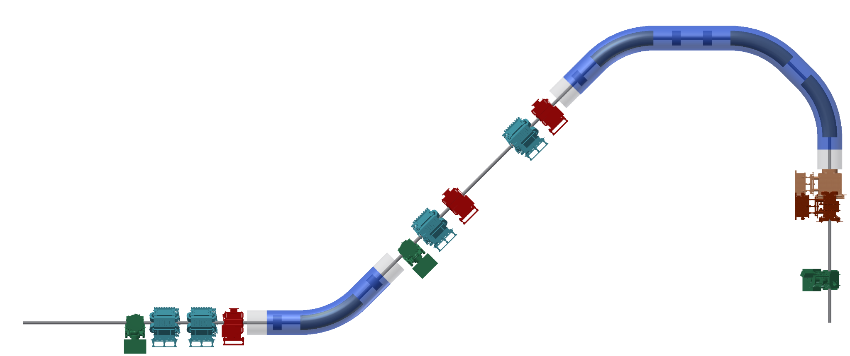
Gantry Key Features
Particles up to a rigidity of 6.6 Tm (430 MeV/u carbon ions)
14 m long, 5.75 high (beam line)
4T curved superconducting dipoles
Superconducting spool piece quadrupoles
Downstream scanning magnets
5.75m
3.09m
16.05m
14.05m

Slide 3

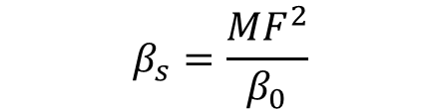
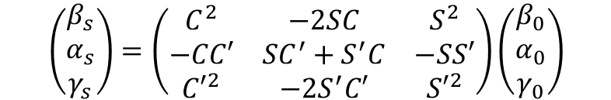


Optics details
Beam sizes
Parallel to point matching
Particles with the same initial divergence (x’, y’) end up in the same position independently of the initial position (x, y).
12mm spot (FWHM)
8mm spot (FWHM)
R11=R33=0; R12 and R34 for beam size control (MF*)
$$\left(\begin{matrix}β_{s} \\ α_{s} \\ γ_{s}\end{matrix}\right)=\left(\begin{matrix}C^{2} & −2SC & S^{2} \\ −CC′ & SC^{′}+S^{′}C & −SS′ \\ {C′}^{2} & −2S^{′}C′ & {S′}^{2}\end{matrix}\right)\left(\begin{matrix}β_{0} \\ α_{0} \\ γ_{0}\end{matrix}\right)$$
$$β_{s}=C^{2}β_{0}−2SCα_{0}+S^{2}γ_{0}$$
$$FWHM=2\sqrt{2ln⁡(2)}σ=2\sqrt{2ln(2)}\sqrt{βε_{RMS}}$$
With $ε_{RMS}$ const. = 1.4π (7π=5$ε_{RMS}$)
$$\left(C=0 and S=R_{12}=MF\right)$$
$$β_{s}=\frac{{MF}^{2}}{β_{0}}$$

Slide 4
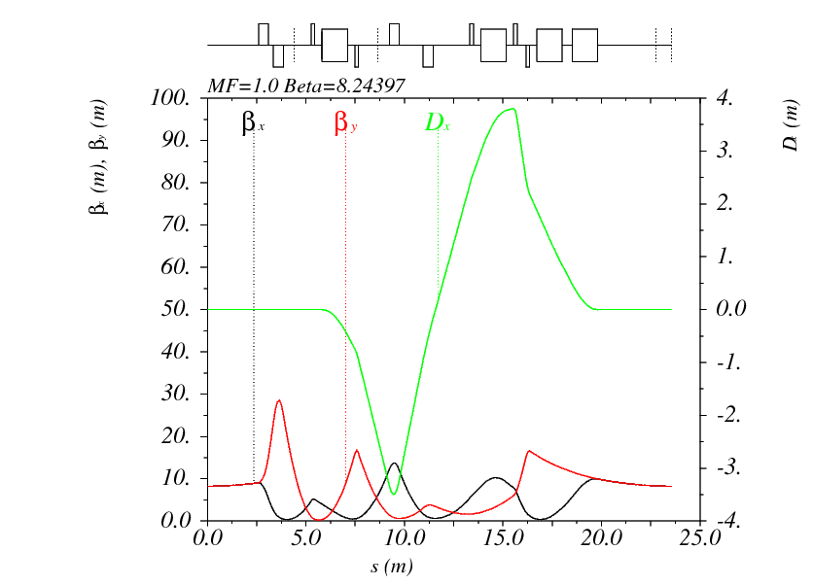
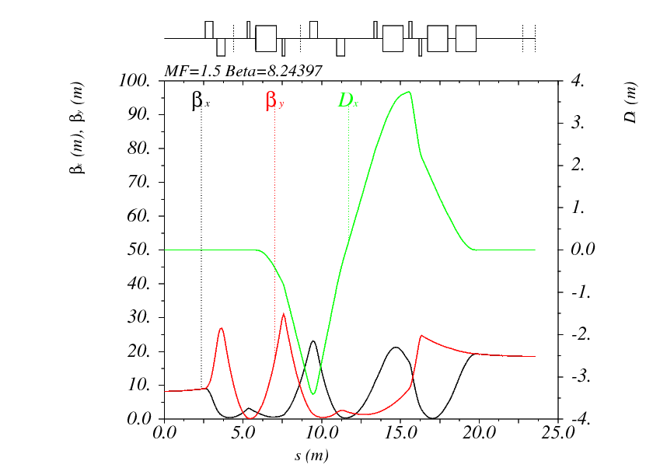
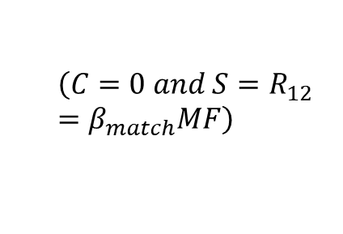
Optics details
MF 1
MF 1.5
$$\left(C=0 and S=R_{12}=β_{match}MF\right)$$

Slide 5
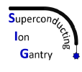
4 T SC dipole Features
SIG WP2 scope
Design, construction and test of a curved SC demonstrator magnet for ion gantries
Main demonstrator magnet parameters:
Cos-θ coils
Pure dipolar field: 4 T
Bore diameter: 80 mm
Small curvature radius: 1.65 m
Angular sector: 30° (demo) – 45° (prototype)
High field ramp-rate: 0.15 T/s (demo) – 0.4 T/s (prototype)
Fixed quadrupole gradient

Slide 6
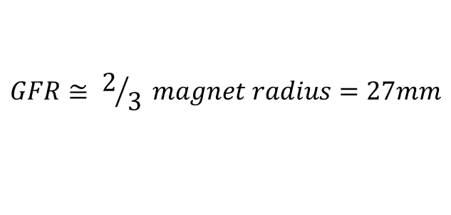
Constraint on the space required by the beam
Every alignment and magnetic error produces a deviation of the beam orbit from the nominal one.
Using monitors and correctors, one can correct the orbit deviation at the isocenter, but a residual orbit deviation
(𝑅𝑐𝑜𝑟𝑟 ) is till present along the line
The space occupied by the beam (𝑅tot) defines the required Good Field Region (GFR) for the magnets.
As commonly done in designing accelerator magnets we consider that the GFR is 2/3 of the magnet aperture.
Bore Ø: 80 mm
$$GFR≅ 2/3 magnet radius=27mm$$
The total (radial) space occupied by the beam (𝑅𝑡𝑜𝑡 ) is given by:
$$R_{tot}= R_{envelope}+R_{corrections}$$

Slide 7
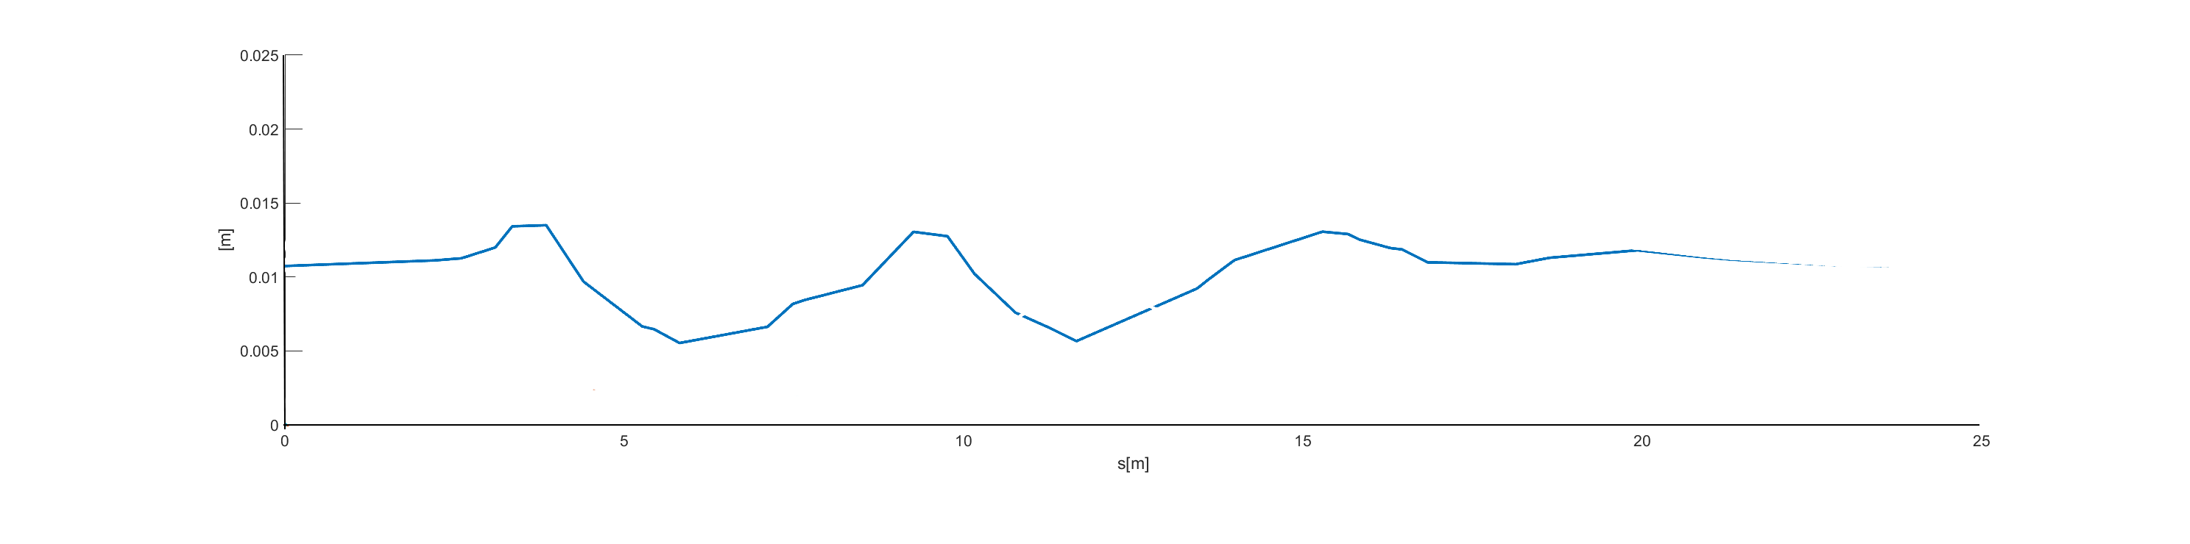
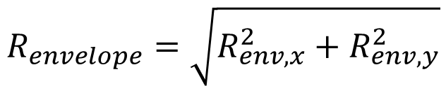

Beam envelope
$$R_{envelope}=\sqrt{R_{env,x}^{2}+R_{env,y}^{2}}$$
$$R_{env,x}=\sqrt{β_{x}ε_{x}}+D_{x}\frac{∆p}{p}$$

Slide 8
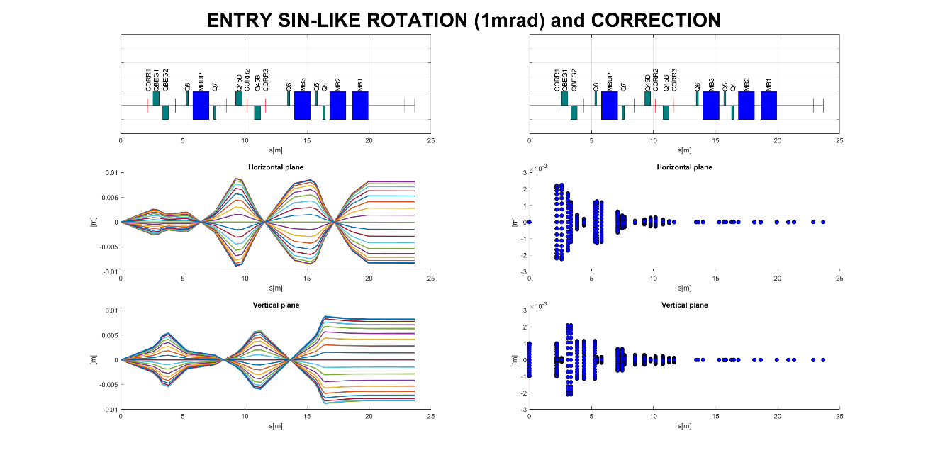
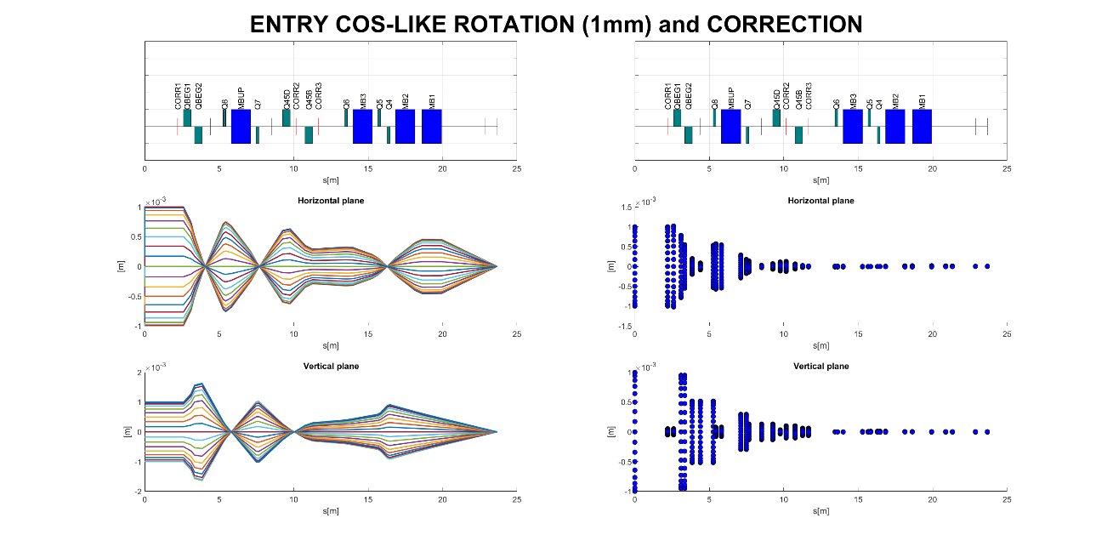
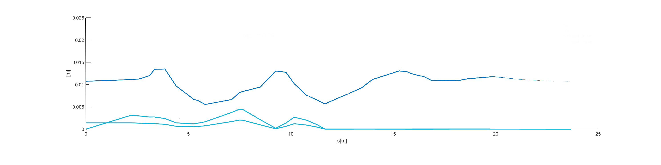
Entry Sin-like and Cos-like

Slide 9
Field errors
Absolute error (construction errors, i.e. a displacement in the length of the filament, and thus an error in the magnetic length)
  dk = 3・10⁻⁴ 1/m² for warm quadrupoles
  dk = 2.5・10⁻⁴ (1/m , 1/m²) for SC dipoles and quadrupoles
Relative error (describing errors coming from power supply)
  dkr = 3 ・10⁻⁴ 1/m² for warm quadrupole
  dkr = 5 ・10⁻⁴ (1/m , 1/m²) for SC dipoles and quadrupole

Slide 10
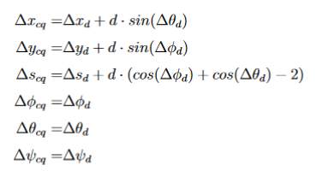
Misalignment errors
Misalignment error in MAD-x are defined at the entrance of the element.
Besides the deformation of the structure (WIP), that is part of separated studies, random alignment errors have been considered to take into account realistic alignment.
A conservative assumption has been made assuming Gaussian distributions truncated at 3𝜎 with 0.3mm (0.3 mrad) < 𝜎 < 0.6mm (0.6mrad) for the position (angle) error.
In case the SC quadrupoles are attached to the dipole, the error is not anymore independent: the error is generated in SC dipole and propagated to the quadrupoles
SC quadrupoles
SC 4T dipole
L_{es}
L_{cq}
L_{cd}

Slide 11
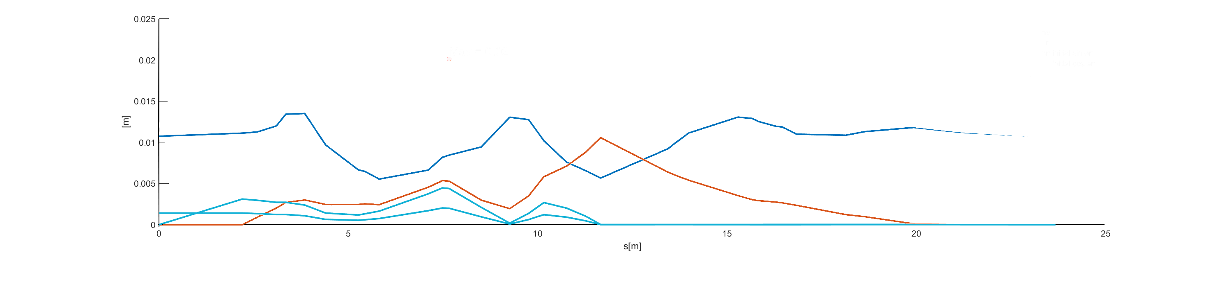
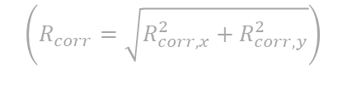
Misalignment plus Field errors
$$R_{corrections}= R_{sin−like}+R_{cos−like}+R_{misalignments,field}$$
$$\left(R_{corr}=\sqrt{R_{corr,x}^{2}+R_{corr,y}^{2}}\right)$$
1000 random misalignments (minor differences with 2000 cases)
95th percentile

Slide 12
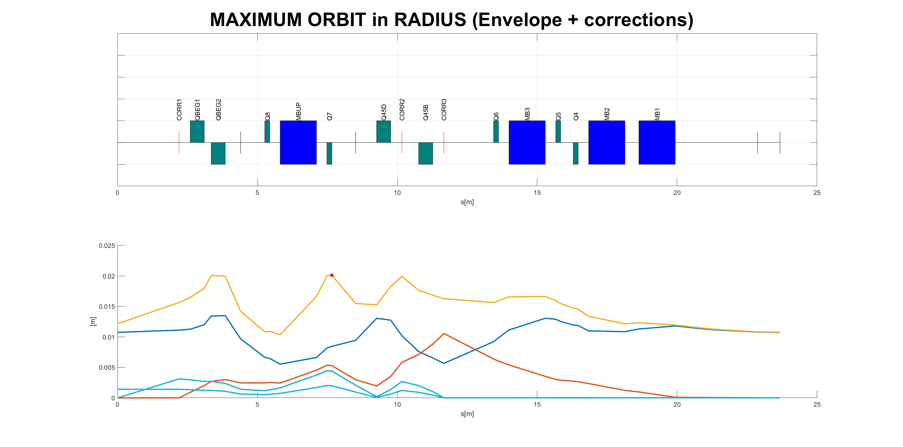
Space required by the beam

Slide 13
Problems
Optics-based optimization doesn’t mean minimum space occupied
Non-realistic SC dipole representation
Human bias can reduce space of solutions
Steerers strength can not be infinite

Slide 14

Solution

Slide 15

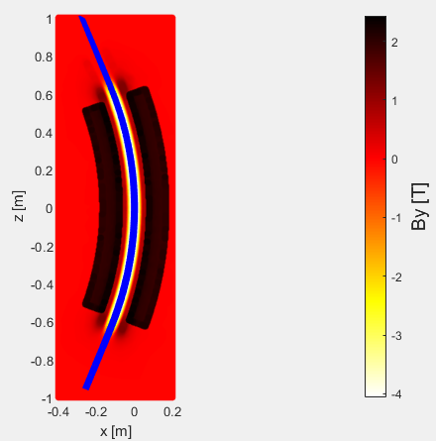



Multipoles representation
Field Map Representation
Real Representation
SC Magnet
Entrance
Exit
Entrance
Optic Representation
Exit
Multipolar Lens
CF $(k_{0}^{d},k_{1}^{d},k_{2}^{d})$
CF Dipole
ML1 $(k_{1}^{′},k_{2}^{′},k_{3}^{′})$
ML2 $(k_{1}^{′′},k_{2}^{′′},k_{3}^{′′})$
Optic axis

Slide 16


Total Envelope optimization
STEP 3
Reiteration: Position of active elements are varied until the matching value is under
STEP 1
Active elements are matched using parallel to point matching method
Optimization Function
Storing Data
Once the beam envelope is minimized the data are stored in a matlab table
STEP 2
If the matching value is under , the monitor and kicker positions are varied to minimize the beam envelope
STEP 2bis
Misalignment and Field gaussian errors are defined for all the elements and correct by kickers.
Opt. Function

Slide 17
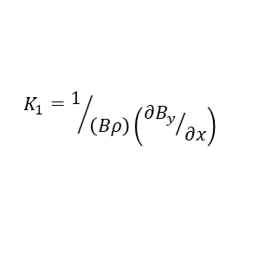

Different quadrupole gradients optimization
gradient [T/m] |  | K1 [m-2]
0.1 |  | 0.015107
0.092674667 |  | 0.014
0.08 |  | 0.012085
0.05 |  | 0.007553
0 |  | 0
$\text{Brho}\text{ 6.619619 ( }\text{C}\text{ 430}\text{MeV}\text{/}\text{u}$ )
$$K_{1}=1/{\left(Bρ\right)\left({∂B_{y}}/{∂x}\right)}$$
5 good solutions
K1 [m-2] | 0.014
 |  |  |  |  |  |  |  |  | 100th perc |  | 95th perc
case nr | val1_5 | val1 | l0 | l1 | l2 | l_mon2 | l_corr2 | l_corr3 | r_max_1_5 | r_max_1 | r_max_1_5 | r_max_1 | PercKick_x_MF1_5 | PercKick_y_MF1_5 | PercKick_x_MF1 | PercKick_y_MF1
1 | 1.56E-15 | 6.52E-14 | 0.985893453 | 1.310892133 | 2.433214414 | 0.353185305 | 0.811469266 | 1.319900282 | 0.027395321 | 0.028791809 | 0.023753941 | 0.024251372 | 3.7 | 23.3 | 3.066666667 | 23.83333333
2 | 1.16E-11 | 5.03E-13 | 0.995893453 | 1.310892133 | 2.423214414 | 0.354205945 | 0.812261895 | 1.315558725 | 0.026867793 | 0.028283885 | 0.023290335 | 0.023773574 | 3.733333333 | 23.56666667 | 3 | 23.86666667
3 | 1.35E-12 | 2.62E-13 | 0.985893453 | 1.320892133 | 2.423214414 | 0.355526083 | 0.818081121 | 1.316909179 | 0.02928376 | 0.030574292 | 0.025543659 | 0.02599667 | 3.8 | 22.63333333 | 3 | 23.43333333
4 | 1.24E-12 | 6.22E-15 | 0.995893493 | 1.310892068 | 2.423214438 | 0.35553301 | 0.813116669 | 1.316606913 | 0.029243777 | 0.030540408 | 0.025513499 | 0.025970254 | 3.766666667 | 23 | 2.966666667 | 23.8
5 | 4.57E-12 | 5.71E-15 | 1.2971709 | 1.459722912 | 1.973106188 | 0.358059601 | 0.884171343 | 1.115239679 | 0.025084223 | 0.025385609 | 0.020977018 | 0.021488575 | 1.9 | 19.73333333 | 1.333333333 | 20.46666667
6 | 2.76E-13 | 2.15E-11 | 1.326238785 | 1.500642804 | 1.90311841 | 0.455838127 | 0.850605834 | 1.042112235 | 0.026820347 | 0.026041353 | 0.019977887 | 0.020428963 | 1.733333333 | 19.86666667 | 1.366666667 | 20.46666667
7 | 7.19E-14 | 3.23E-14 | 1.130802393 | 1.448387928 | 2.150809679 | 0.398496051 | 0.875446871 | 1.191234339 | 0.026113262 | 0.026657179 | 0.021809925 | 0.022408743 | 2.5 | 20.06666667 | 1.733333333 | 20.33333333
8 | 1.24E-12 | 6.22E-15 | 0.995893493 | 1.310892068 | 2.423214438 | 0.35553301 | 0.813116669 | 1.316606913 | 0.029243777 | 0.030540408 | 0.025513499 | 0.025970254 | 3.766666667 | 23 | 2.966666667 | 23.8
9 | 2.71E-15 | 2.28E-14 | 1.143227037 | 1.634953015 | 1.951819948 | 0.361252515 | 0.966892228 | 1.109120922 | 0.028661673 | 0.029440686 | 0.025287859 | 0.025544178 | 1.9 | 15.73333333 | 1.266666667 | 16.33333333
10 | 4.22E-15 | 2.13E-15 | 1.341457406 | 1.636490983 | 1.752051611 | 0.360561041 | 0.966571589 | 1.018604769 | 0.027348521 | 0.02855659 | 0.024306131 | 0.02473294 | 1.5 | 15.73333333 | 0.9 | 16.3
K1 [m-2] | 0
 |  |  |  |  |  |  |  |  | 100th perc |  | 95th perc
case nr | val1_5 | val1 | l0 | l1 | l2 | l_mon2 | l_corr2 | l_corr3 | r_max_1_5 | r_max_1 | r_max_1_5 | r_max_1 | PercKick_x_MF1_5 | PercKick_y_MF1_5 | PercKick_x_MF1 | PercKick_y_MF1
1 | 3.74E-12 | 1.70E-10 | 0.986 | 1.301 | 2.443 | 0.388405815 | 0.807236299 | 1.322454972 | 0.029076527 | 0.030038861 | 0.024888834 | 0.025349283 | 1.8 | 26 | 1.4 | 26.43333333
2 | 1.46E-12 | 1.49E-10 | 1.244236195 | 1.470545018 | 2.015218787 | 0.357118897 | 0.890327759 | 1.135580066 | 0.027154574 | 0.027347109 | 0.022906567 | 0.023345713 | 0.866666667 | 20.8 | 0.533333333 | 21.46666667
3 | 5.07E-15 | 1.63E-10 | 1.706579825 | 1.98376723 | 1.039652945 | 0.51587944 | 1.11659297 | 0.68285577 | 0.02530555 | 0.024958366 | 0.020371337 | 0.020648411 | 0 | 11.5 | 0 | 11.93333333
4 | 4.85E-12 | 1.63E-10 | 1.723999487 | 2.140280892 | 0.977 | 1.218283031 | 0.701733488 | 0.65099999 | 0.039702985 | 0.038250269 | 0.033087129 | 0.032276453 | 0 | 18.53333333 | 0.033333333 | 16.13333333
5 | 6.81E-11 | 1.54E-13 | 1.83379856 | 2.140722688 | 0.977 | 0.450191456 | 1.19277069 | 0.651 | 0.025422002 | 0.025303711 | 0.021959564 | 0.022279032 | 0 | 9.633333333 | 0 | 9.233333333

Slide 18
95th perc optimization

Slide 19
Kick strenght analisys

Slide 21
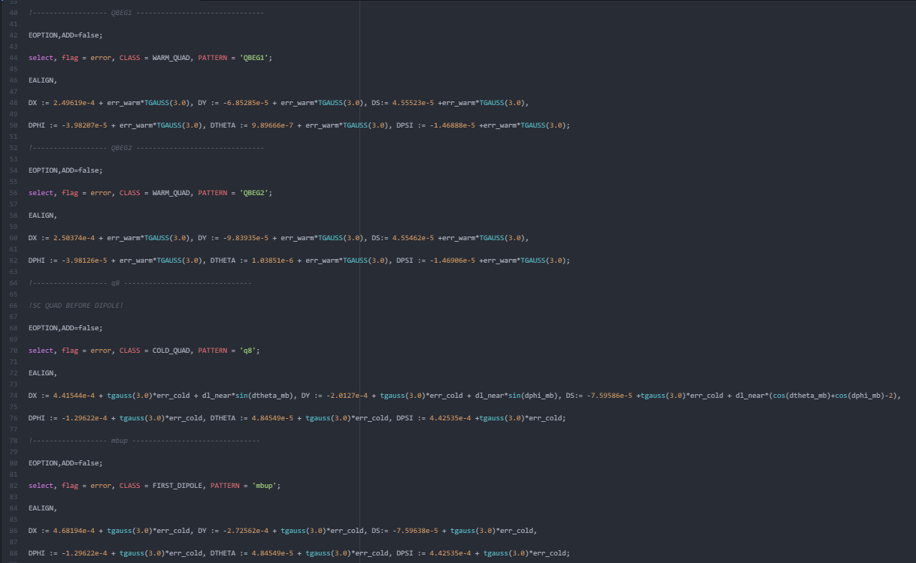
WORK in PROGRESS
Combining errors coming from structure deformations (thanks to Luca P. and Luca D.) (systematic) and the random contributes
0.1 T/m
0 T/m
Without multipoles
With multipoles
Without multipoles
With multipoles
MF 1
MF 1.5
MF 1
MF 1.5
MF 1
MF 1.5
MF 1
MF 1.5

Slide 22
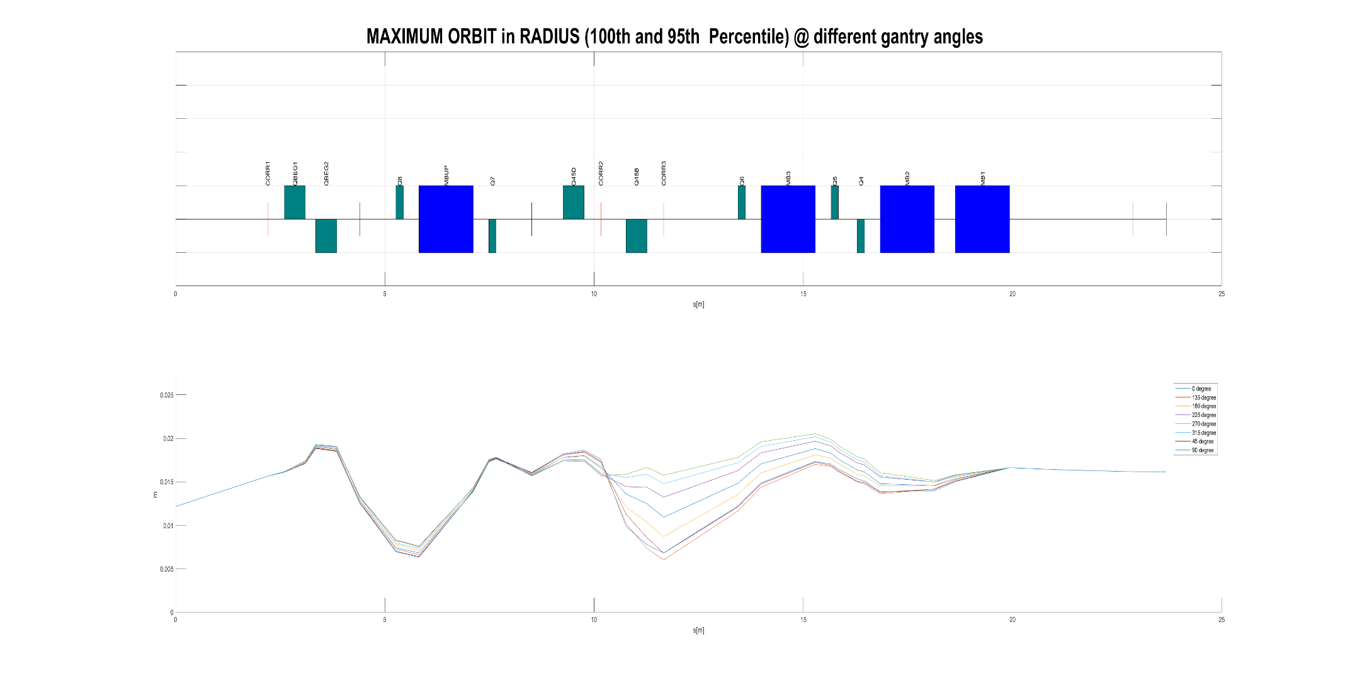
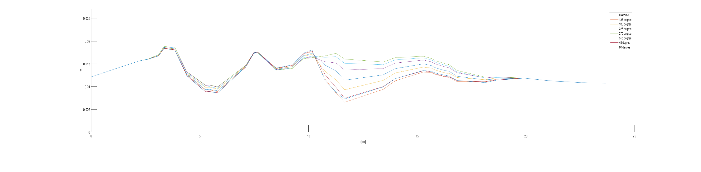
First results
0.1 T/m without multipoles representation
MF 1.5
MAX space occupied by the beam < 21mm
MF 1

Slide 23
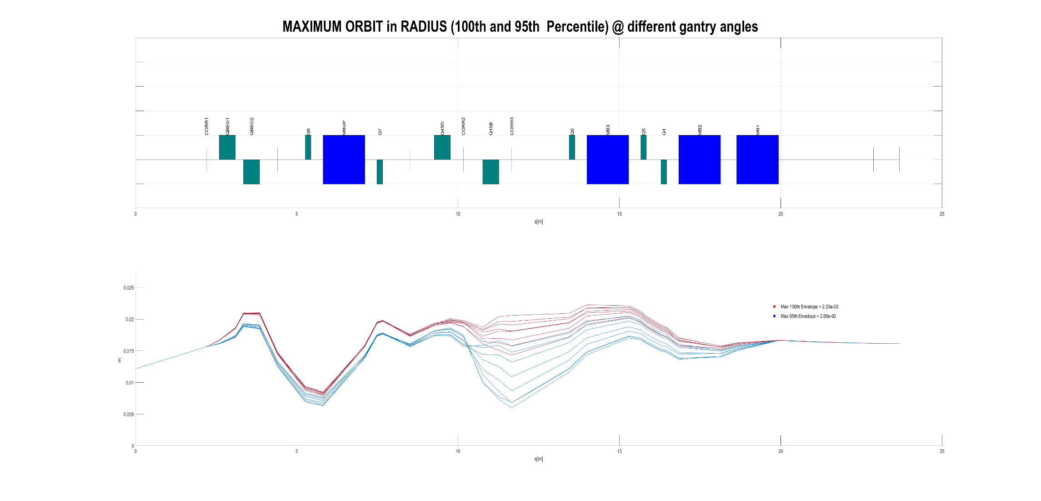
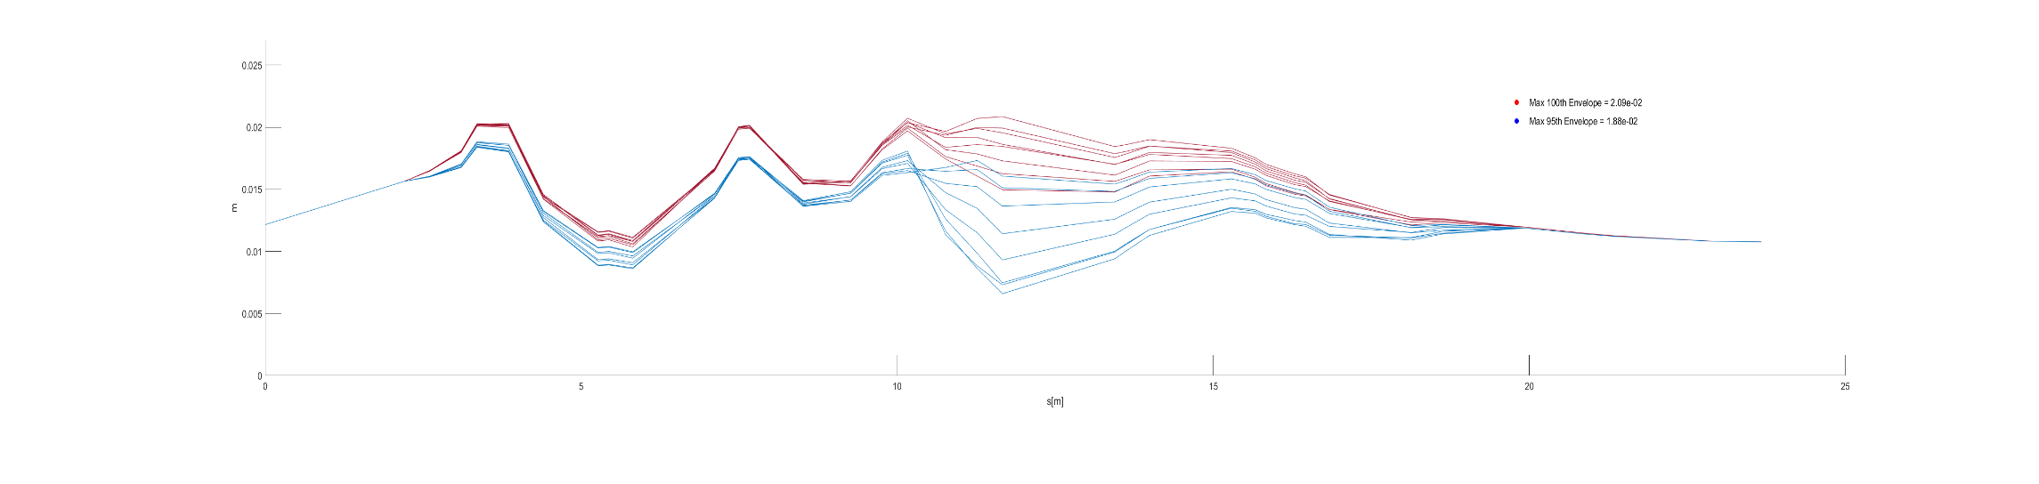
First results
0.1 T/m without multipoles representation
MF 1.5
MF 1

Slide 24
WORK in PROGRESS
Simulation of all the configurations to see if there is some incongruence
Effect of losing the beam on the coils in SC dipoles

Slide 25
Energy deposition studies on a SC magnet
Particle beam
Carbon ions:
- 400 MeV
- 115 MeV
Proton:
- 230 MeV
- 62 MeV
Material:
-Aluminum (Al)
-Insulated cable
-Niobium-Titanium (Nb-Ti)
-Strand
-Copper (Cu)

Slide 26
Quencing 10 mWatt/cm³
Particles/s
 | C 400 | C 115 | p 230 | p 62 | MeV/u
Al | 2,46E+07 | 3,70E+06 | 3,13E+09 | 1,45E+08 | [Particles/s]
 | 2,46E+07 | 3,70E+06 | 3,13E+09 | 1,45E+08 | [Particles]
Cable | 1,18E+07 | 2,26E+06 | 1,10E+09 | 8,45E+07 | [Particles/s]
 | 1,18E+07 | 2,26E+06 | 1,10E+09 | 8,45E+07 | [Particles]
NbTi | 8,33E+06 | 2,02E+06 | 9,62E+08 | 7,44E+07 | [Particles/s]
 | 8,33E+06 | 2,02E+06 | 9,62E+08 | 7,44E+07 | [Particles]
Strand | 6,65E+06 | 1,69E+06 | 6,01E+08 | 6,13E+07 | [Particles/s]
 | 6,65E+06 | 1,69E+06 | 6,01E+08 | 6,13E+07 | [Particles]
Cu | 5,84E+06 | 1,56E+06 | 4,46E+08 | 5,12E+07 | [Particles/s]
 | 5,84E+06 | 1,56E+06 | 4,46E+08 | 5,12E+07 | [Particles]

Slide 27
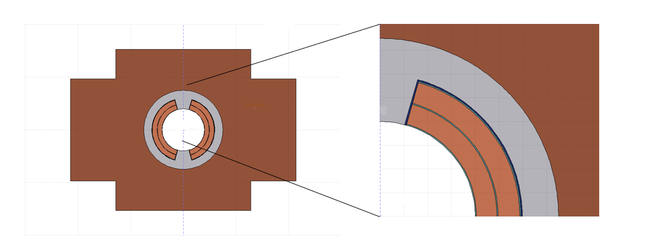
Overlook
Taking a conservative approach, the material selected for the coil composition consists of a strand comprising 36% Nb-Ti and 64% Cu.
The energy deposition study shows that the most dangerous particles are those with minimal energy. Pay attention: particles with maximum energy levels are also unsafe.
Energy deposition studies for the straight magnet geometry consider all the above discussed factors. Currently, simulations not only include front-face impacts but also various scenarios involving rotating beams

Slide 28
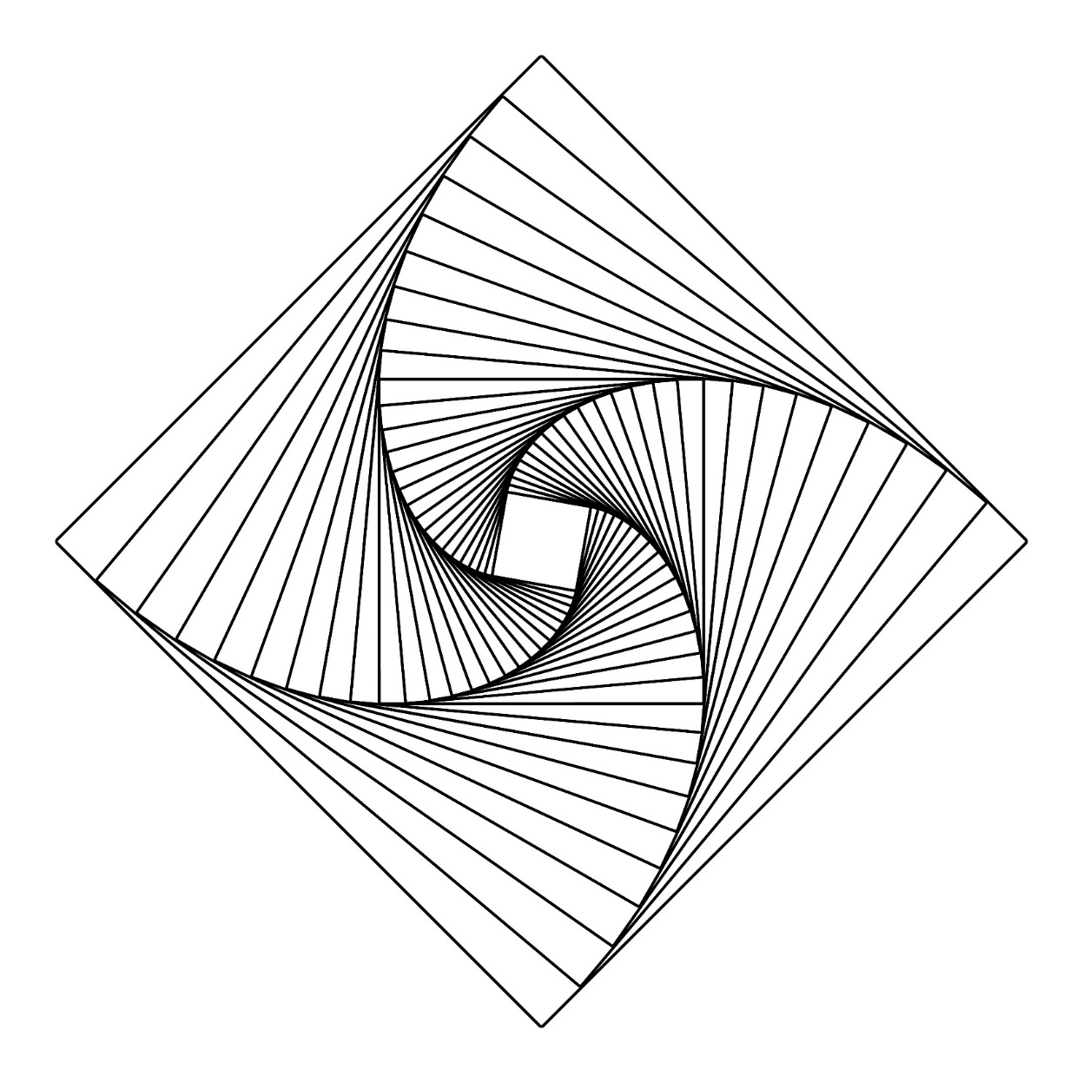
THANK YOU

