Slide 1
Gravitational Wave Probe of Massive Gauge Bosons at the Cosmological collider
Xuce Niu
3/20/2023
Based on JCAP02(2023)013 & arXiv 2211.14324

Slide 2
Outline
Introduction to inflation
My research motivation
Recent progress
Oscillation in three-point correlation function
P-violation in four-point correlation function
Gravitational wave
Conclusion and outlook

Slide 3
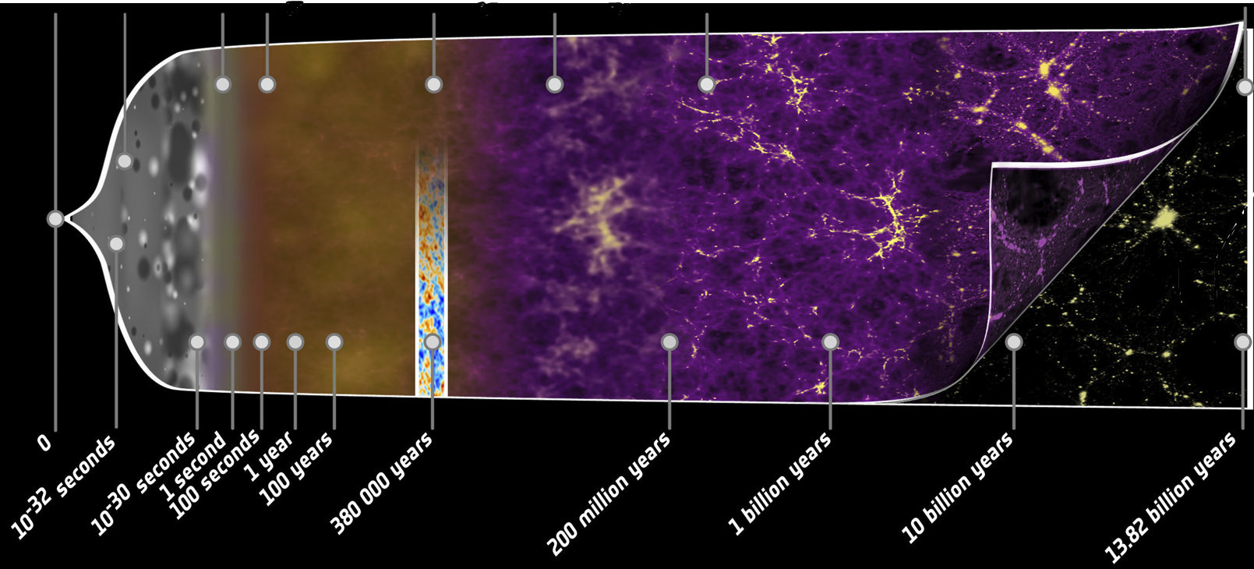
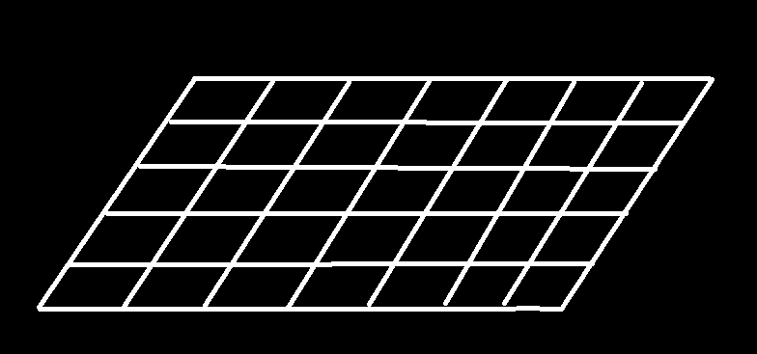
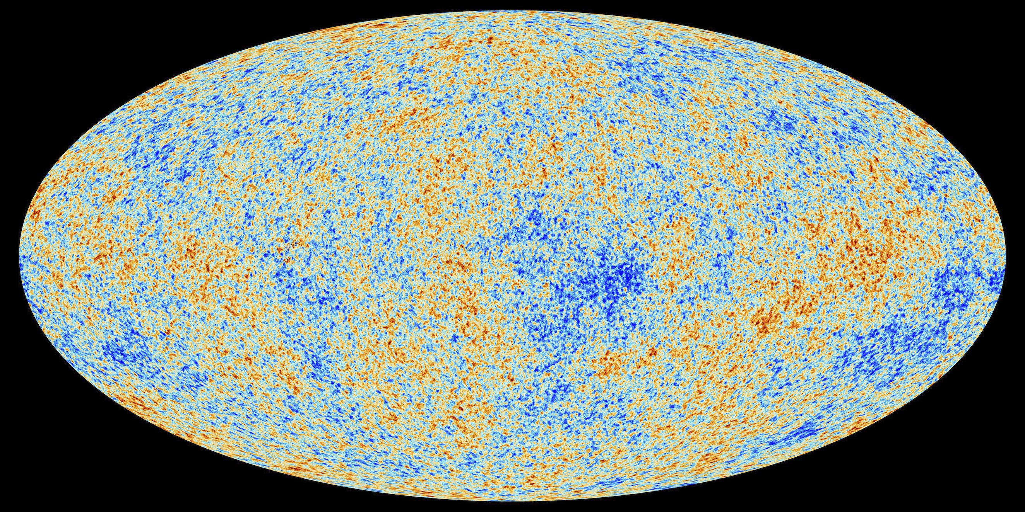


Inflation
Big Bang
Photon Coupled
SM Particle
Recombination
Dark Ages
Galaxy Formation
Today
93 Billion ly
$$\left|Ω−1\right|<{10}^{−56}$$
Flatness problem
Universe expands!
But why it is flat and homogeneous?
$$\frac{ΔT}{T}\sim {10}^{−5}$$
Horizon problem
1

Slide 4
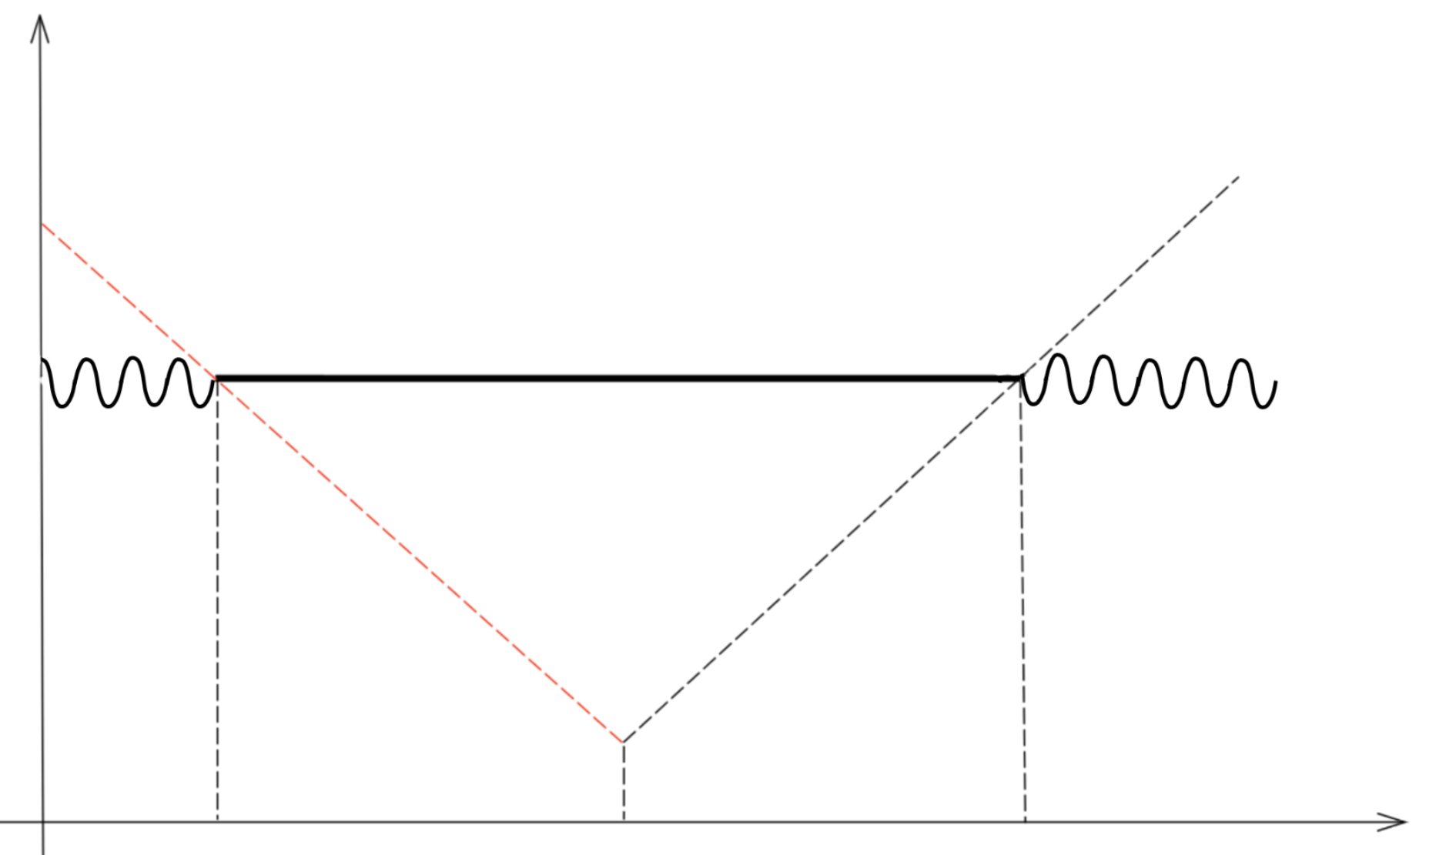
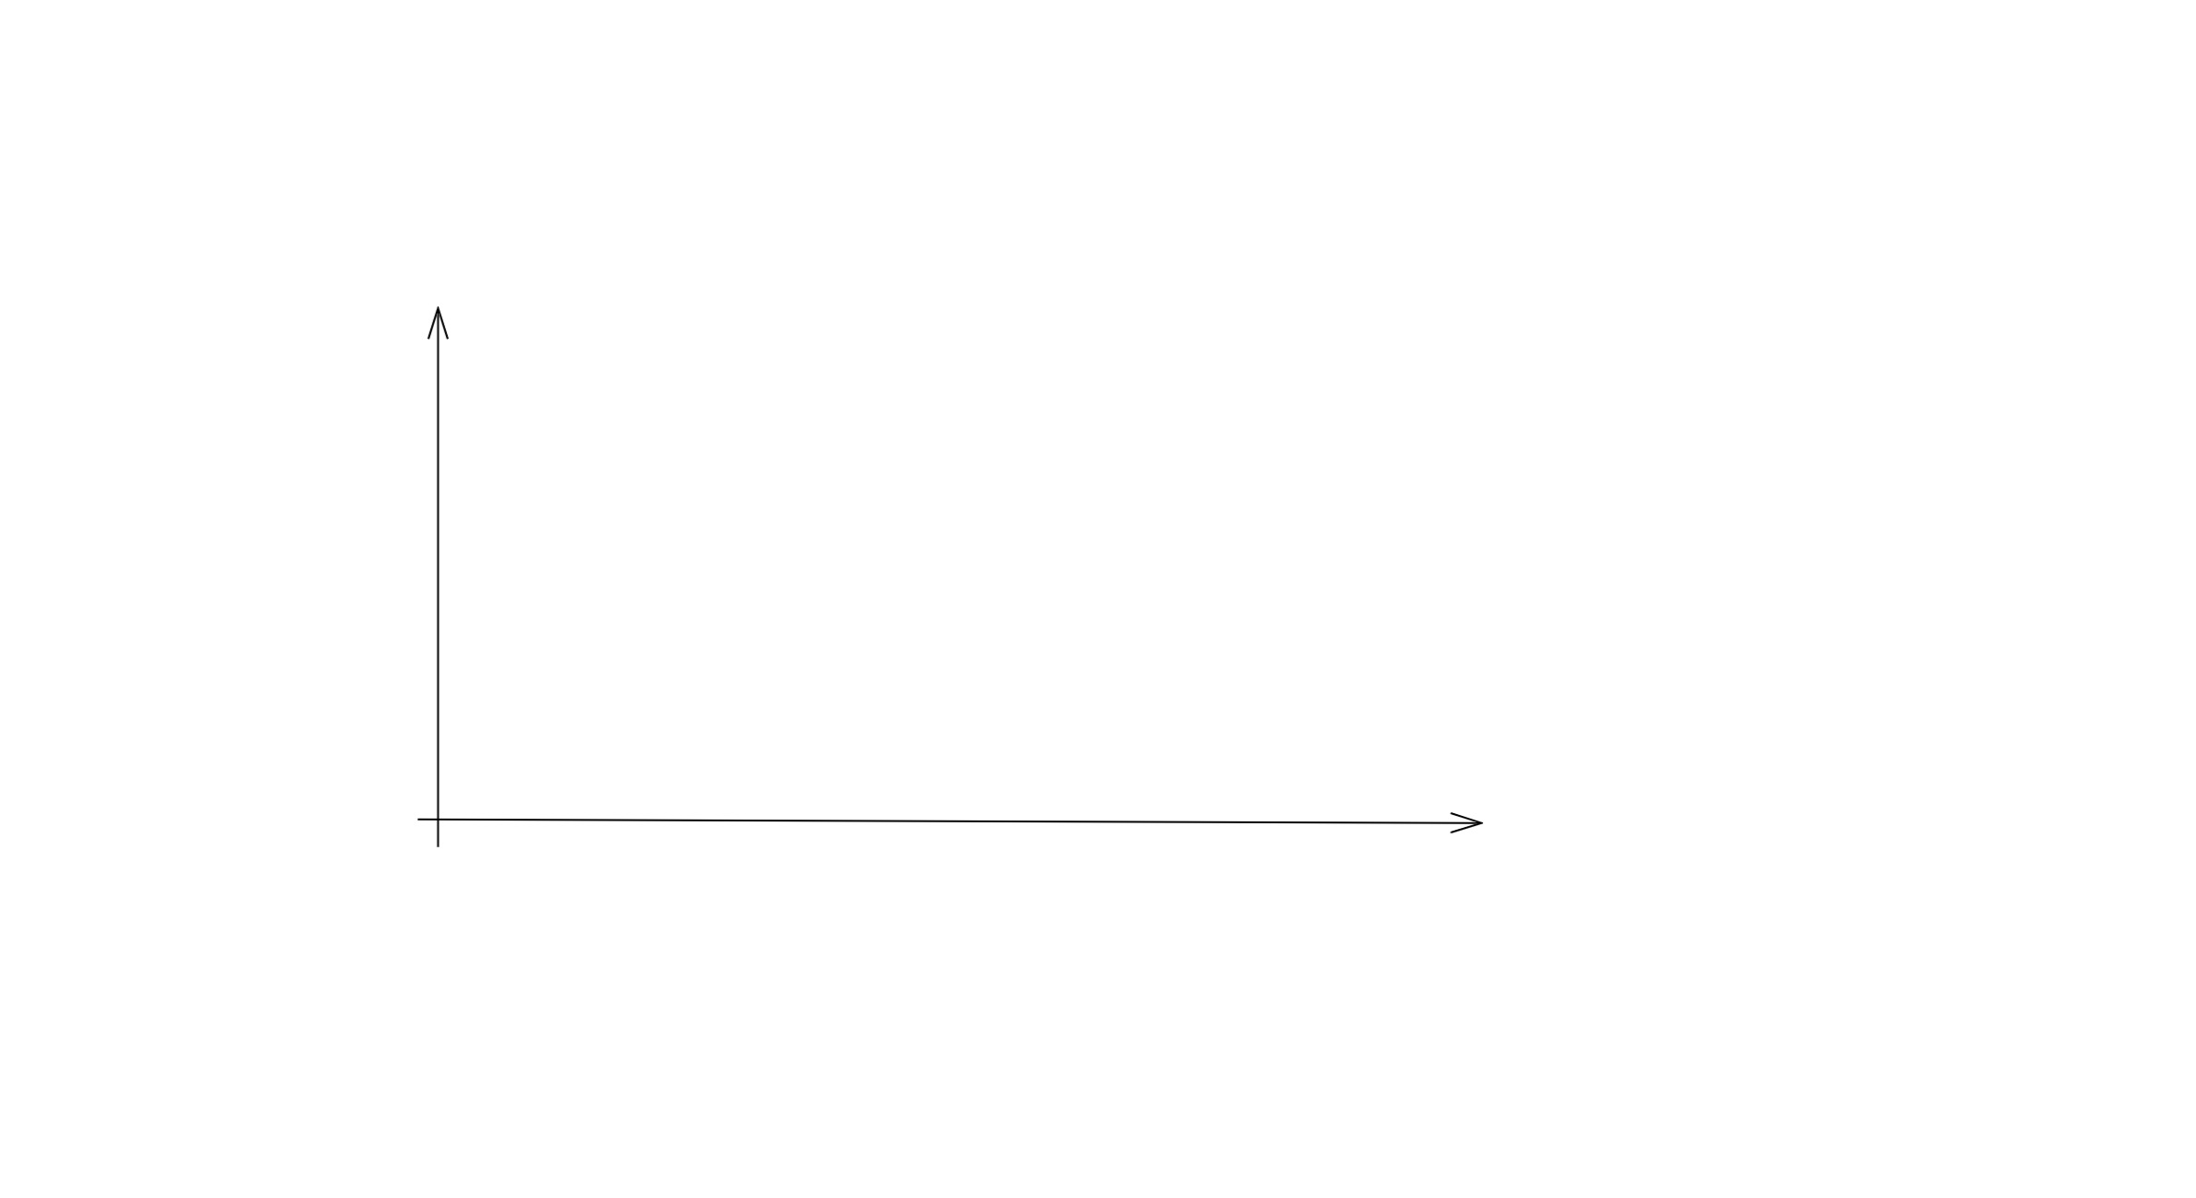
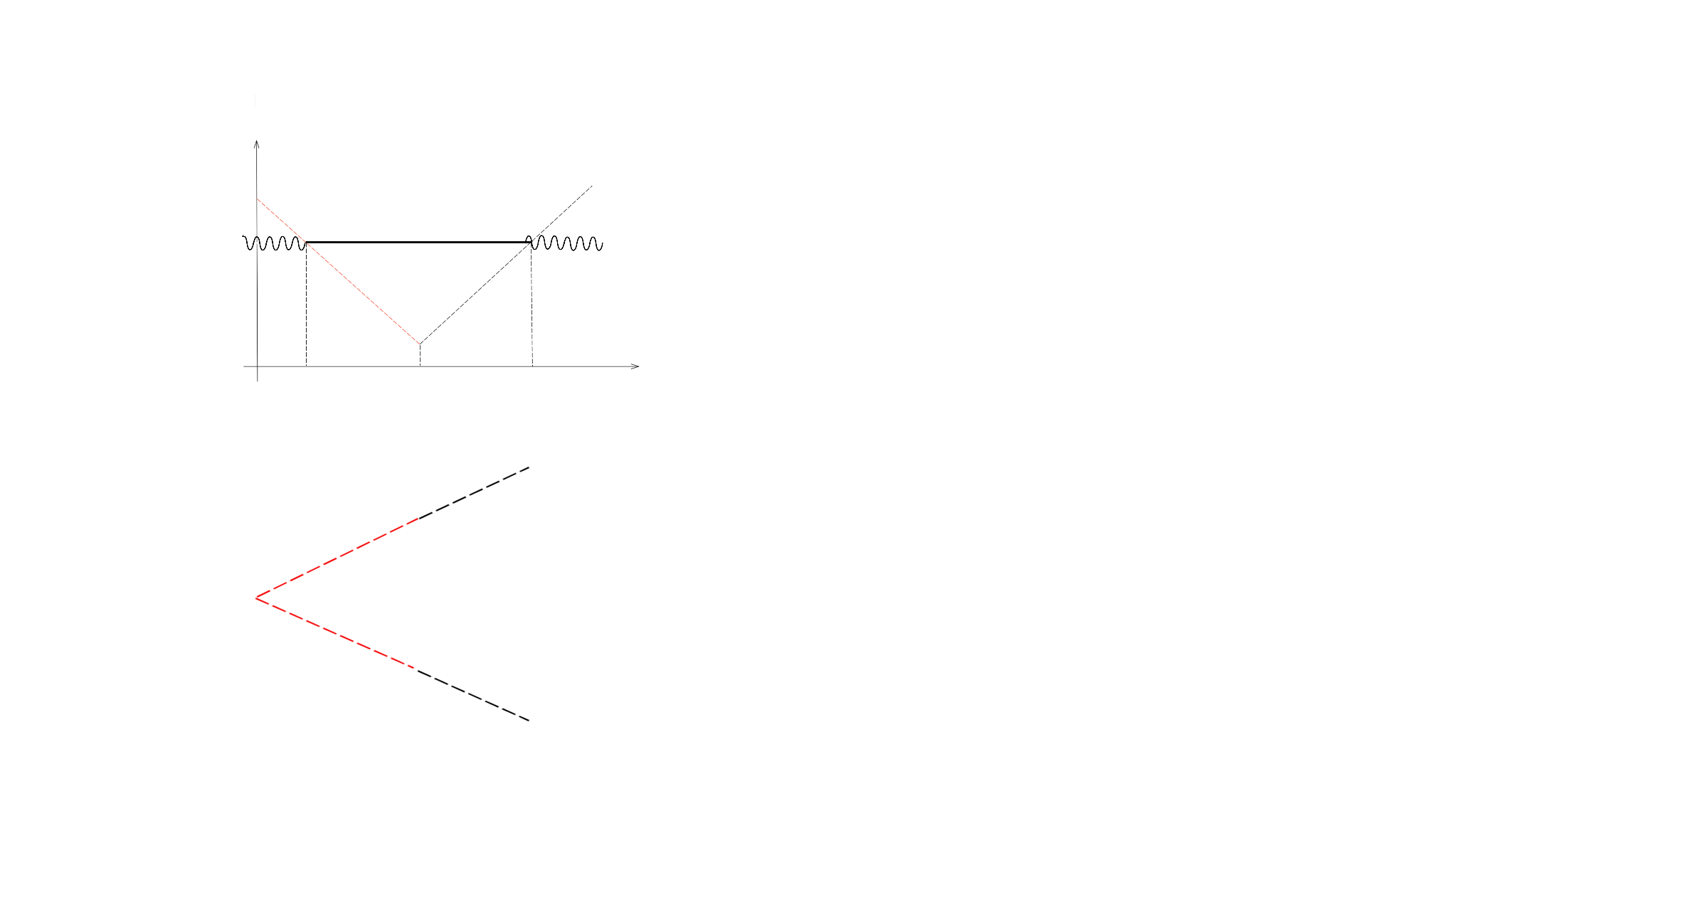
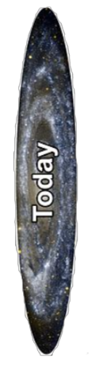

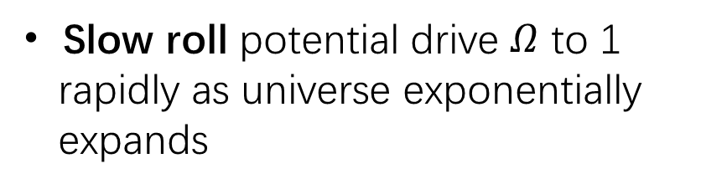
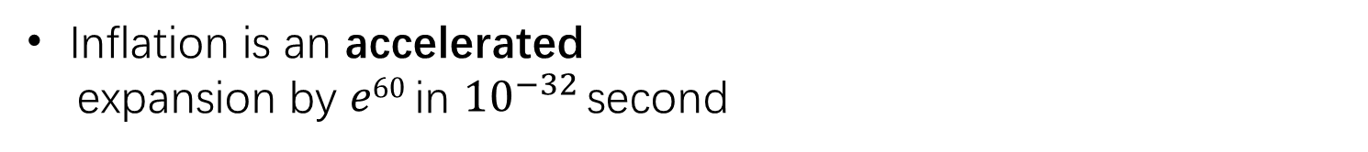



Inflation---Solution to Flatness and Horizon Problem
Inflation is an accelerated
expansion by $e60$ in ${10}^{−32}$ second
$Comoving$scale
$$\frac{1}{a H}$$
A homogeneous and causally
connected patch expands to
the observable universe
Super-horizon
$$λ$$
Inflation
(accelerated)
Decelerated
expansion
Slow roll potential drive $Ω$ to 1
rapidly as universe exponentially
expands
Horizon exit
Inflation end
Horizon re-enter
$$t$$
Physical scale
Inflation also explains the origin of
large scale structure and monopole
problem
Super-horizon
homogeneous
patch
2
$$t$$

Slide 5
Motivation: Inflation + SM = BSM？
Expansion and cooling make inflaton decay into SM particles.
SM is a successful theory, but we should go beyond...
dark matter/dark energy/neutrino mass/matter-antimatter asymmetry
Baryogenesis: ${10}^{9}+1$ baryon annihilate with ${10}^{9}$ anti-baryon.
Expansion breaks T, so C or CP may be violated during inflation.
3

Slide 6
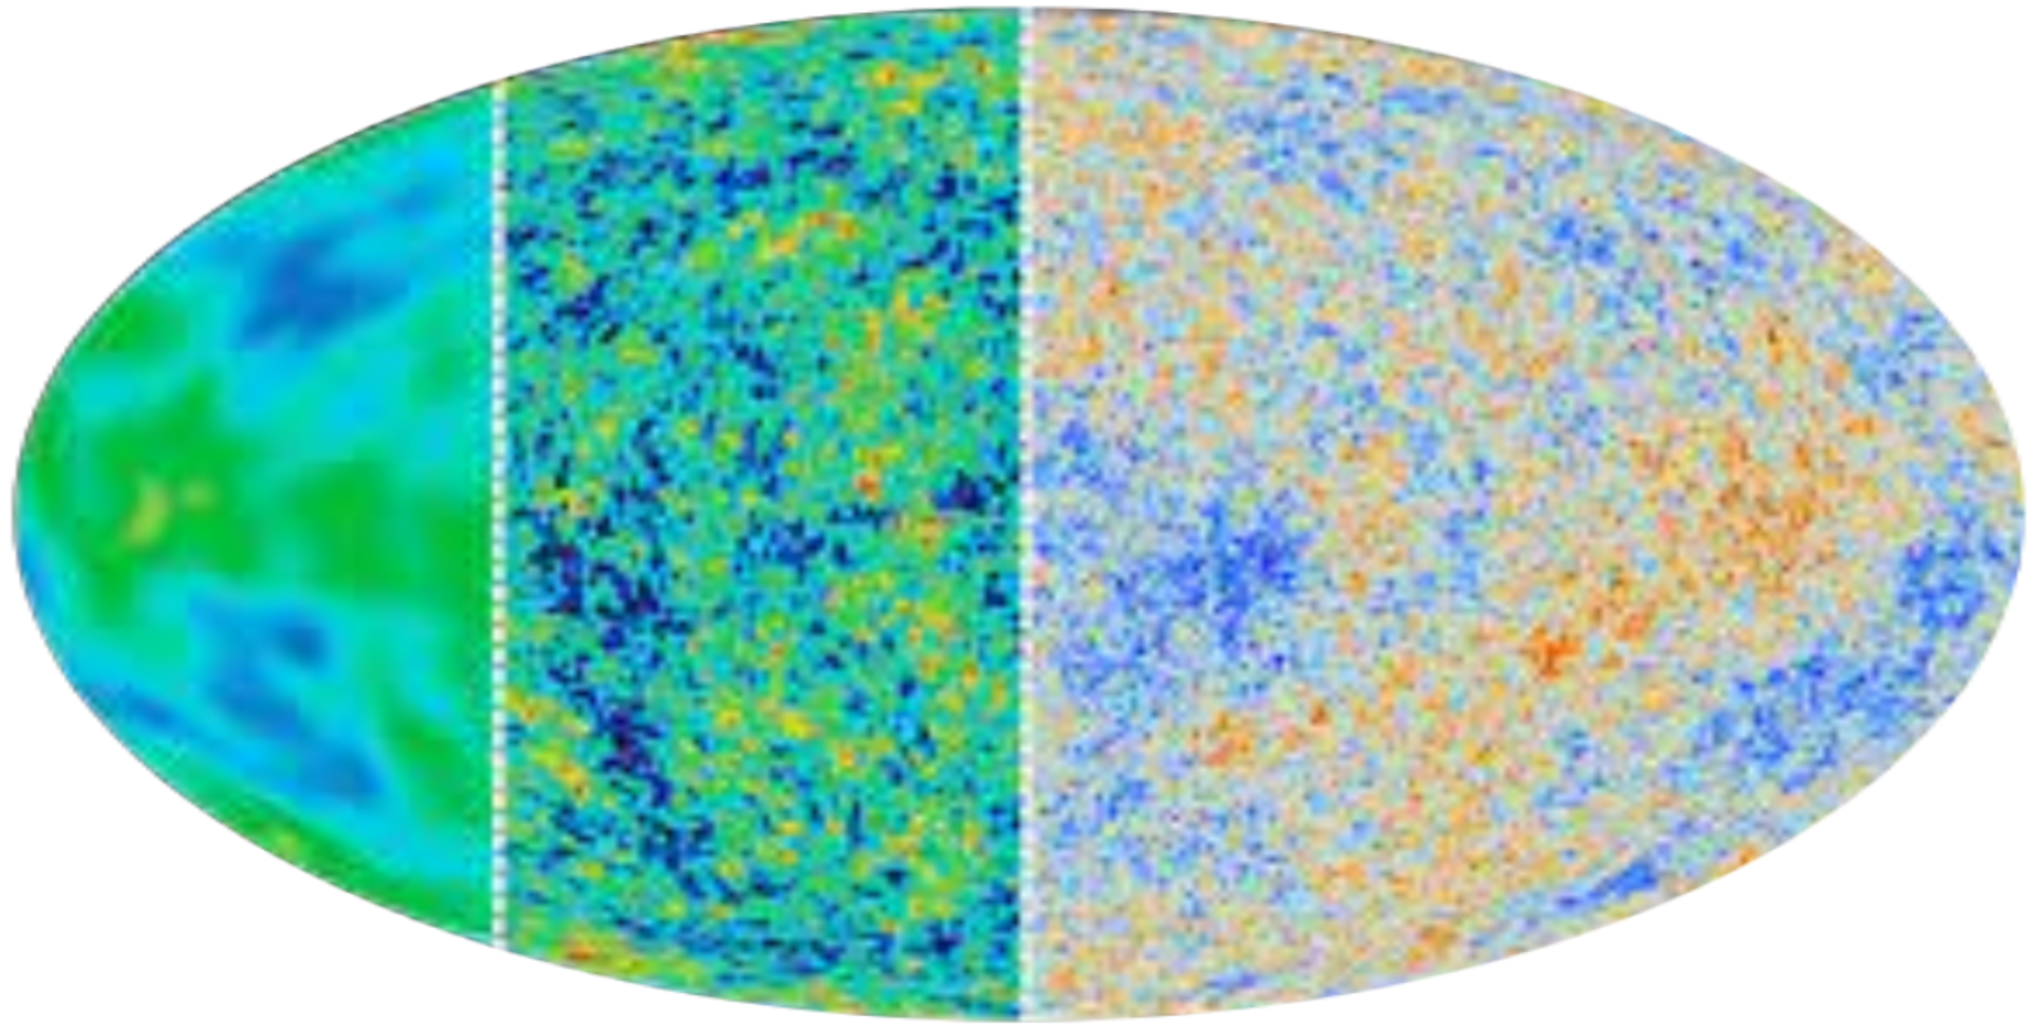







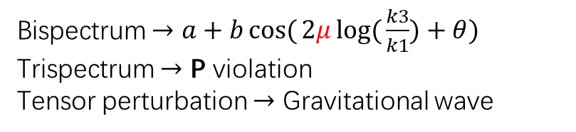



Motivation: Inflation as cosmological collider
Energy scale at inflation is ${10}^{14}$GeV (much larger than LHC).
$$Cosmological$$
$$Collider$$
$$M_{pl}$$
$$e$$
$$p$$
$$h$$
$$LHC$$
$$GUT$$
GeV
$${ 10}^{−3}{ 10}^{0}{ 10}^{3}{ 10}^{6}{ 10}^{9}{ 10}^{12}{ 10}^{15}{ 10}^{18}$$
CMB is well measured and we are going forward.
WMAP 2003
SPHEREX(June 2024)
COBE 1992
Planck 2018
$$f_{NL}\sim O(10)$$
$$f_{NL}\sim O(1)$$
Signals:
Bispectrum $→a+b\cos{(}2μ\log{(}\frac{k3}{k1})+θ)$
Trispectrum $→$ P violation
Tensor perturbation $→$ Gravitational wave
4

Slide 7
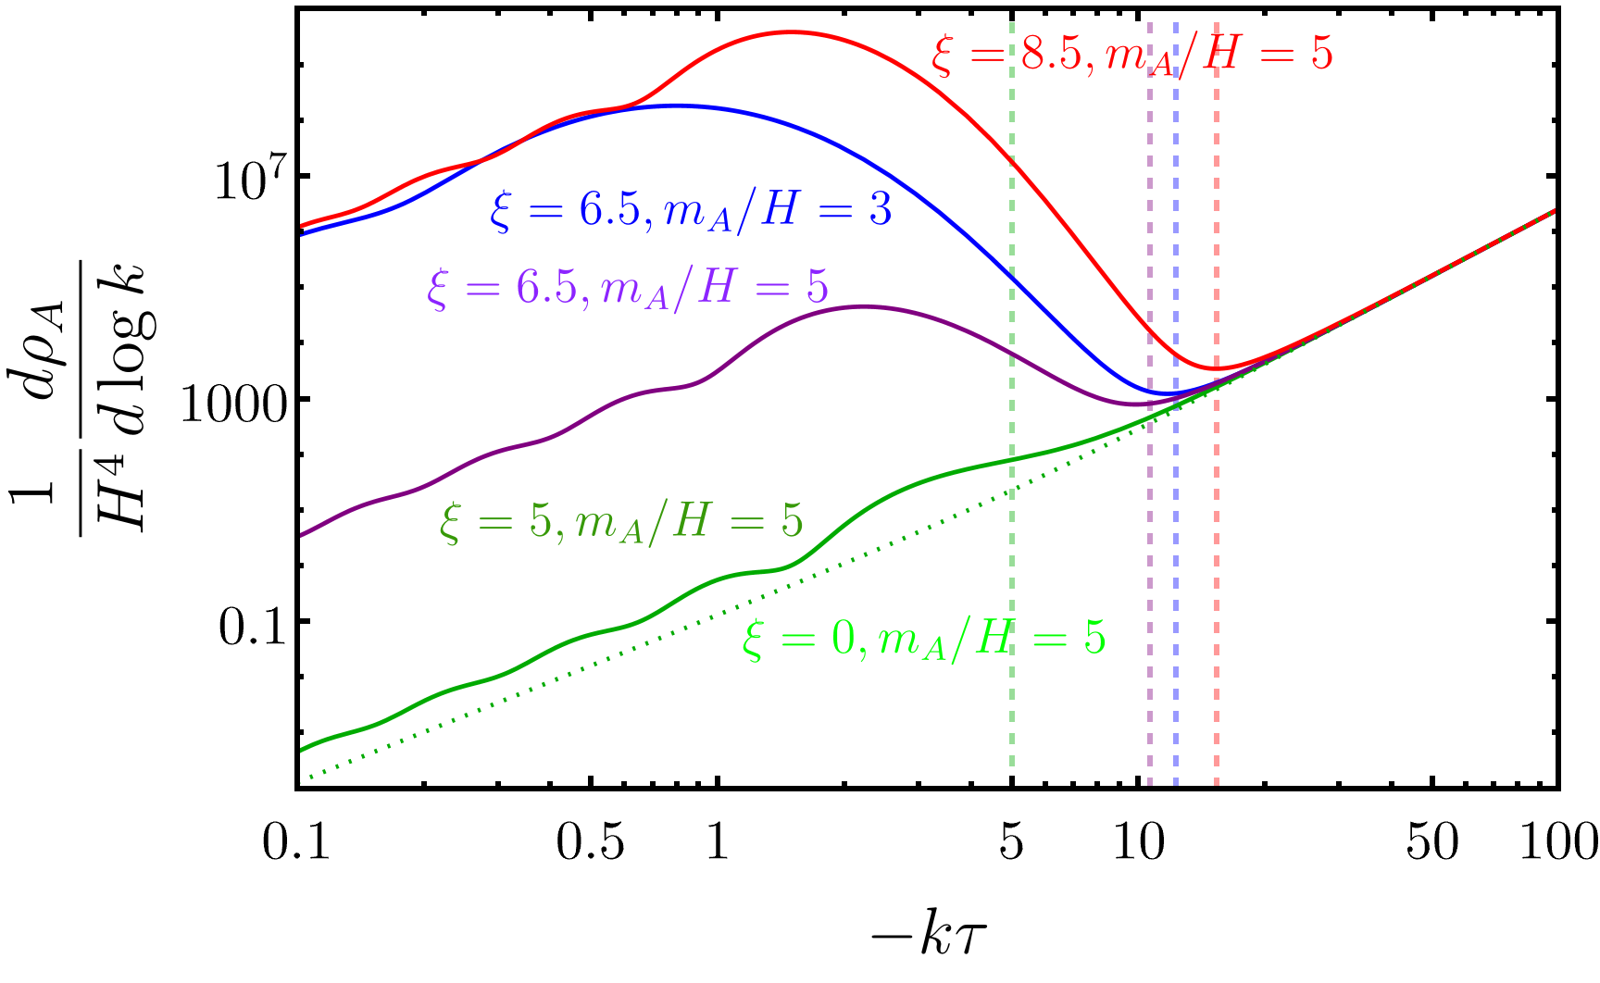
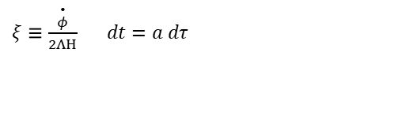
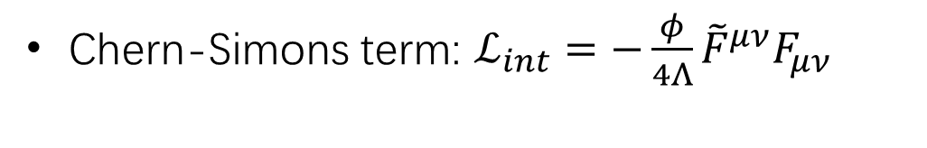
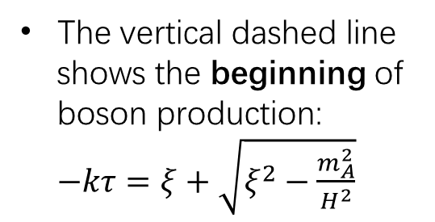
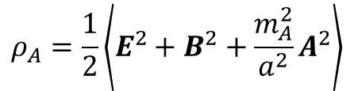
Massive gauge boson production
Chern-Simons term: $ℒ_{int}=−\frac{φ}{4Λ}{\tilde{F}}^{μν}F_{μν}$
Chemical potential$ξ$ overcome the Boltzmann suppression: $e^{−π\frac{m}{H}}→e^{π(ξ−\frac{m}{H})}$
$$ρ_{A}=\frac{1}{2}\left\langle E^{2}+B^{2}+\frac{m_{A}^{2}}{a^{2}}A^{2}\right\rangle$$
Evolution of energy density for a given mode
The vertical dashed line
shows the beginning of
boson production:
$−kτ=ξ+\sqrt{ξ^{2}−\frac{m_{A}^{2}}{H^{2}}}$
$ξ≡\frac{\overset{•}{φ}}{2ΛΗ}$ $dt=a dτ$
5

Slide 8
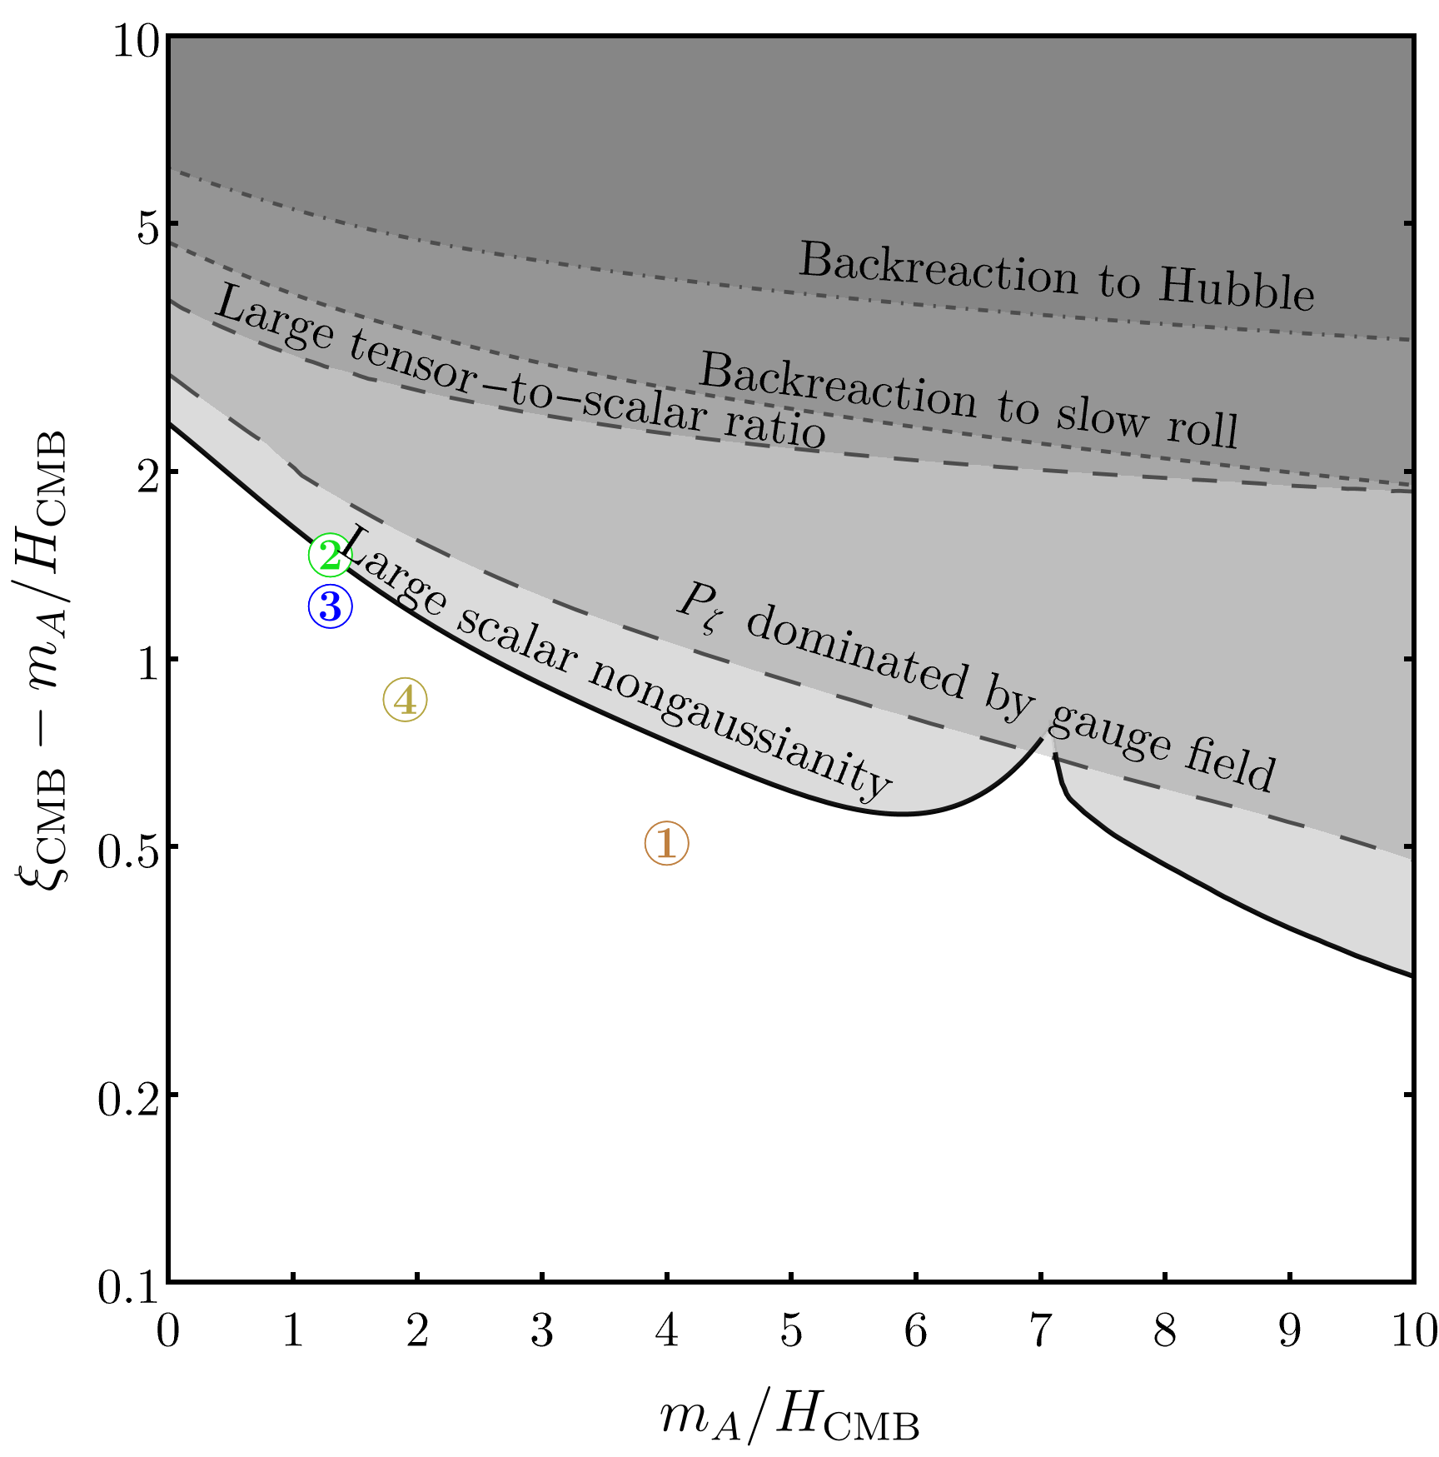

















Phenomenological Constrains at CMB
All constrains at CMB scale
Backreaction shouldn’t affect standard inflation
Tensor-to-scalar ratio $r<{0.056}^{[1]}$
Power spectrum domain at Tree level $P_{ζ}^{φ}>P_{ζ}^{A}$
$$A$$
$$φ$$
$$φ$$
$$φ$$
$$φ$$
$$>$$
$$A$$
Non-Gaussianity$f_{NL}^{equil}<{−27±47}^{[1]}$
$$φ_{\overset{→}{k_{1}}}$$
$$φ_{\overset{→}{k_{2}}}$$
$$A$$
$$\overset{→}{k_{1}}$$
$$\overset{→}{k_{2}}$$
$$A$$
$$A$$
$$\overset{→}{k_{3}}$$
$$φ_{\overset{→}{k_{3}}}$$
[1] Planck 2018 arXiv 1905.05697 and 1807.06211

Slide 9
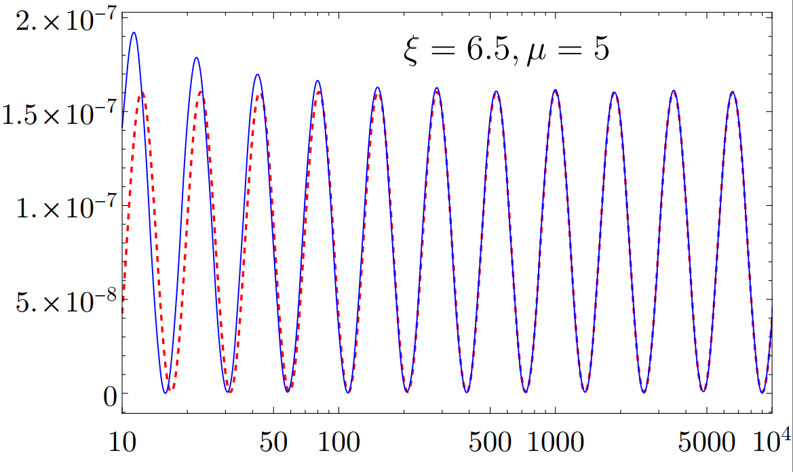
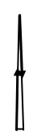

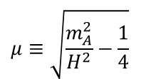


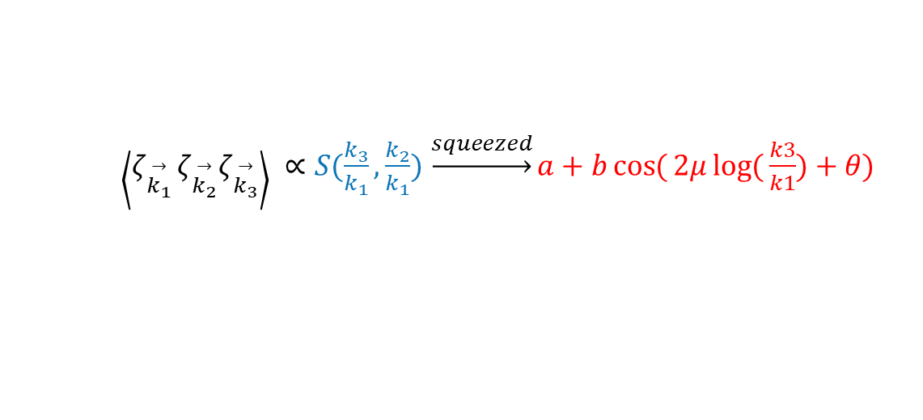




Signals from three-point correlation functions
Oscillation patten in squeezed three-point
$\left.\left\langle ζ_{\overset{→}{k_{1}}}\right.ζ_{\overset{→}{k_{2}}}ζ_{\overset{→}{k_{3}}}\right\rangle ∝S(\frac{k_{3}}{k_{1}},\frac{k_{2}}{k_{1}})$ $\underset{→}{squeezed}a+b\cos{(}2μ\log{(}\frac{k3}{k1})+θ)$
$$μ≡\sqrt{\frac{m_{A}^{2}}{H^{2}}−\frac{1}{4}}$$
Squeezed shape function(blue) and fitting curve (red)
$$\overset{→}{k_{3}}$$
$$\overset{→}{k_{2}}$$
$$\overset{→}{k_{3}}$$
$$\overset{→}{k_{2}}$$
$$\overset{→}{k_{1}}$$
$$\overset{→}{k_{1}}$$
$$\frac{k_{3}}{k_{1}}$$
7

Slide 10
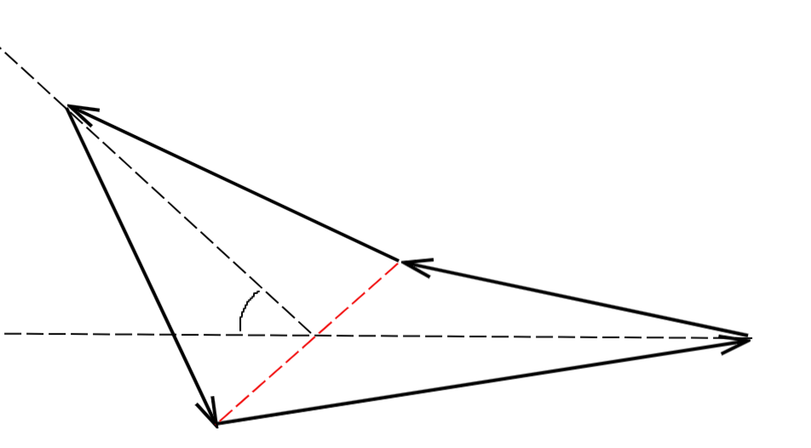
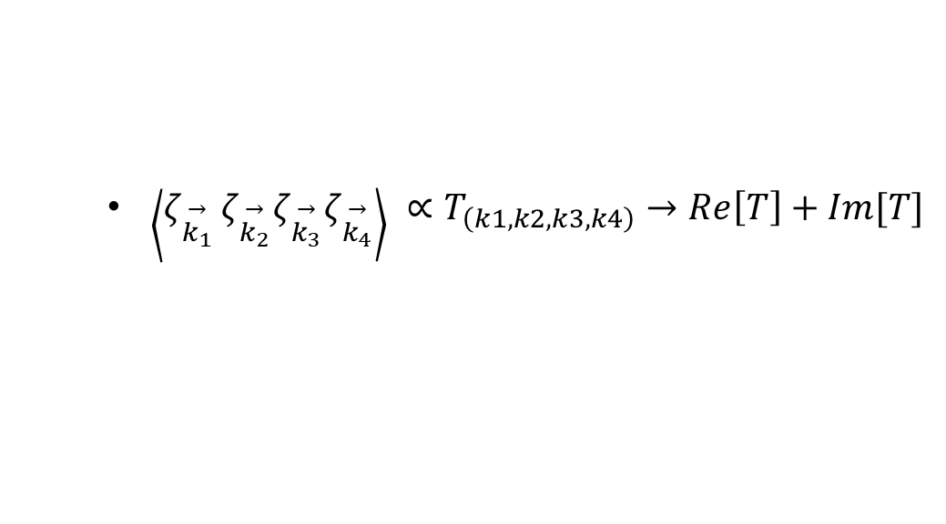



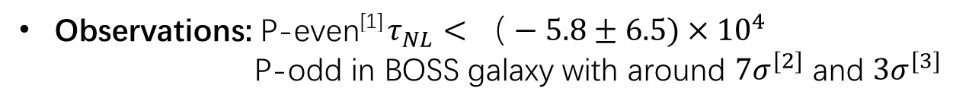




Signals from four-point correlation functions
Parity-violation happens when P-transformation can’t be achieved by rotation.
(typically four external momenta are NOT in a plane)
$$\overset{→}{k_{3}}$$
Two-point and three-point are P-even.
Four-point is the simplest configuration for P-odd
$$\overset{→}{k_{4}}$$
$$\overset{→}{k_{2}}$$
$$φ_{r}$$
$$\overset{→}{k_{1}}$$
$$P−even$$
$$P−odd$$
$\left.\left\langle ζ_{\overset{→}{k_{1}}}\right.ζ_{\overset{→}{k_{2}}}ζ_{\overset{→}{k_{3}}}ζ_{\overset{→}{k_{4}}}\right\rangle ∝T_{\left(k1,k2,k3,k4\right)}→Re\left[T\right]+Im[T]$
Observations: P-even^{[1]} $τ_{NL}<（−5.8±6.5)×{10}^{4}$
P-odd in BOSS galaxy with around ${7σ}^{[2]}$ and ${3σ}^{[3]}$
[1] Planck 2018 arXiv 1905.05697
[2] arXiv 2206.03625
[3] arXiv 2206.04227
8

Slide 11
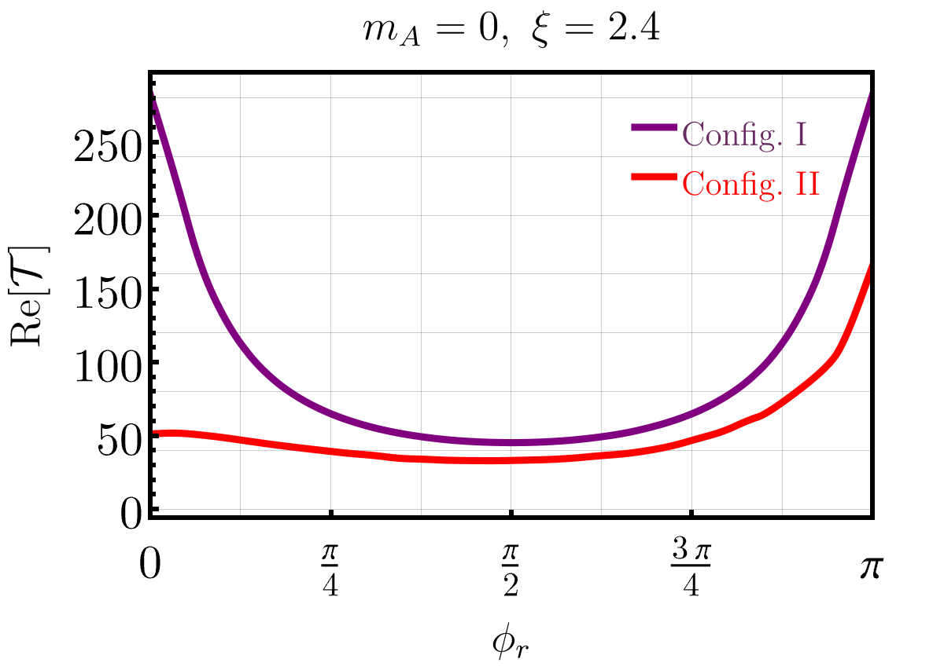
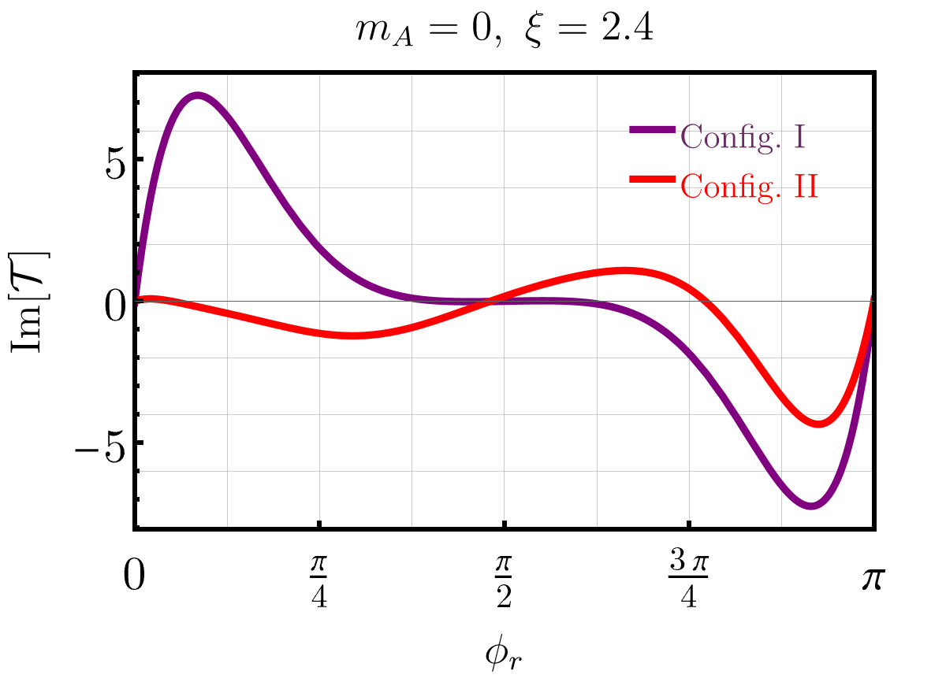
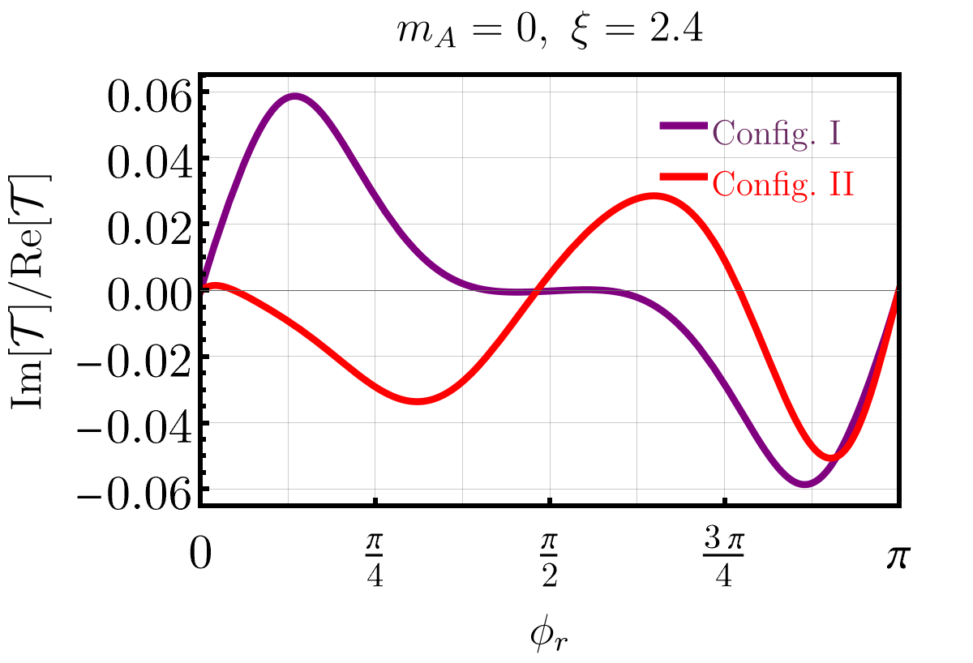
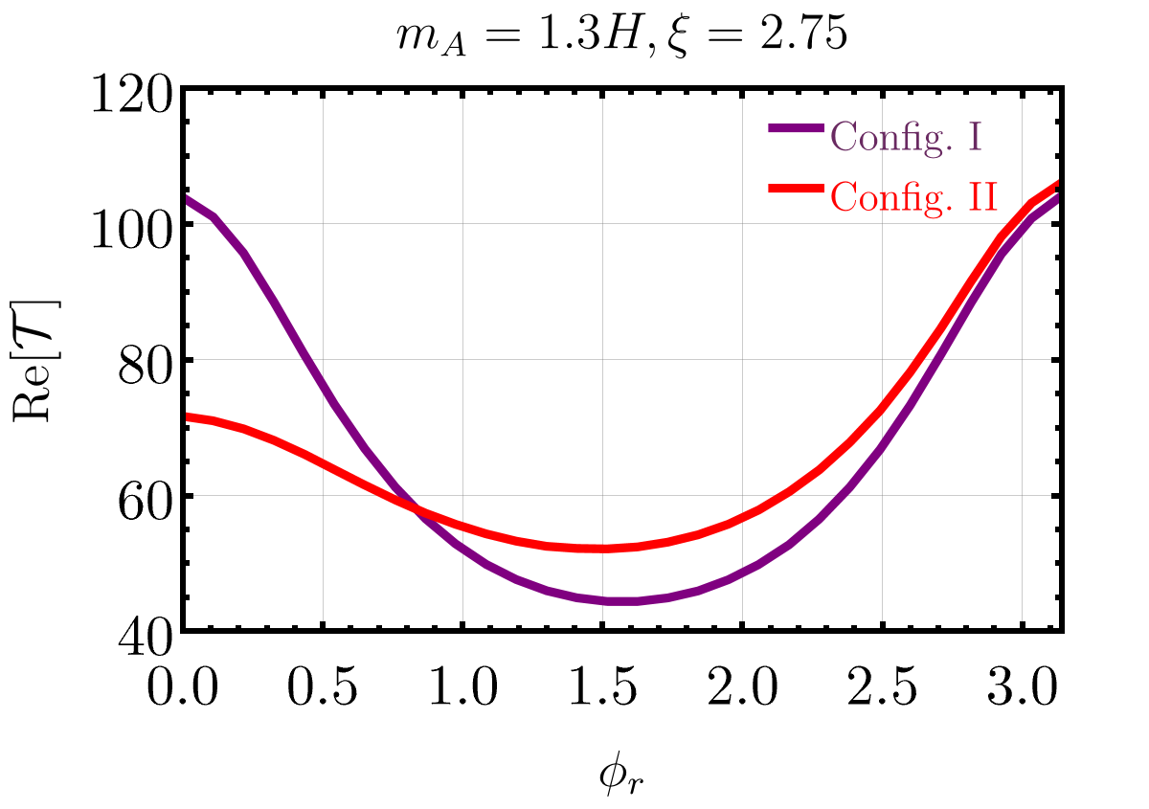
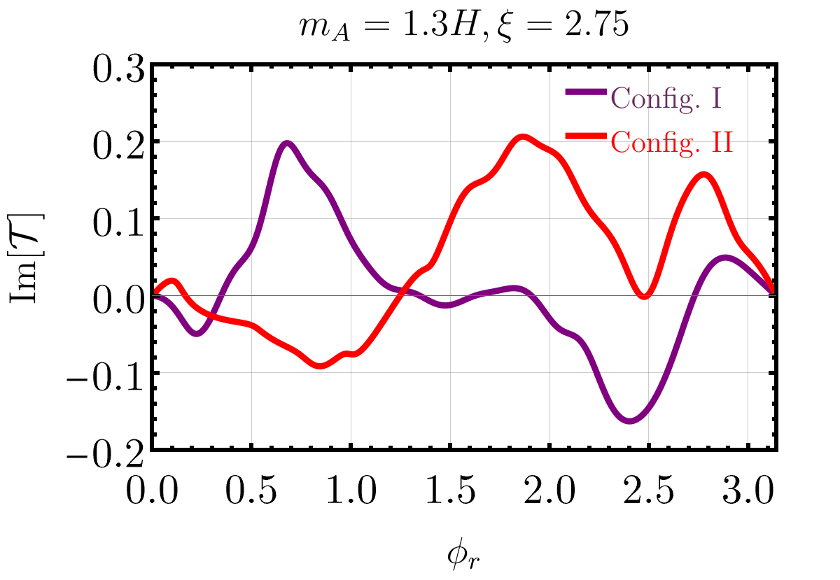
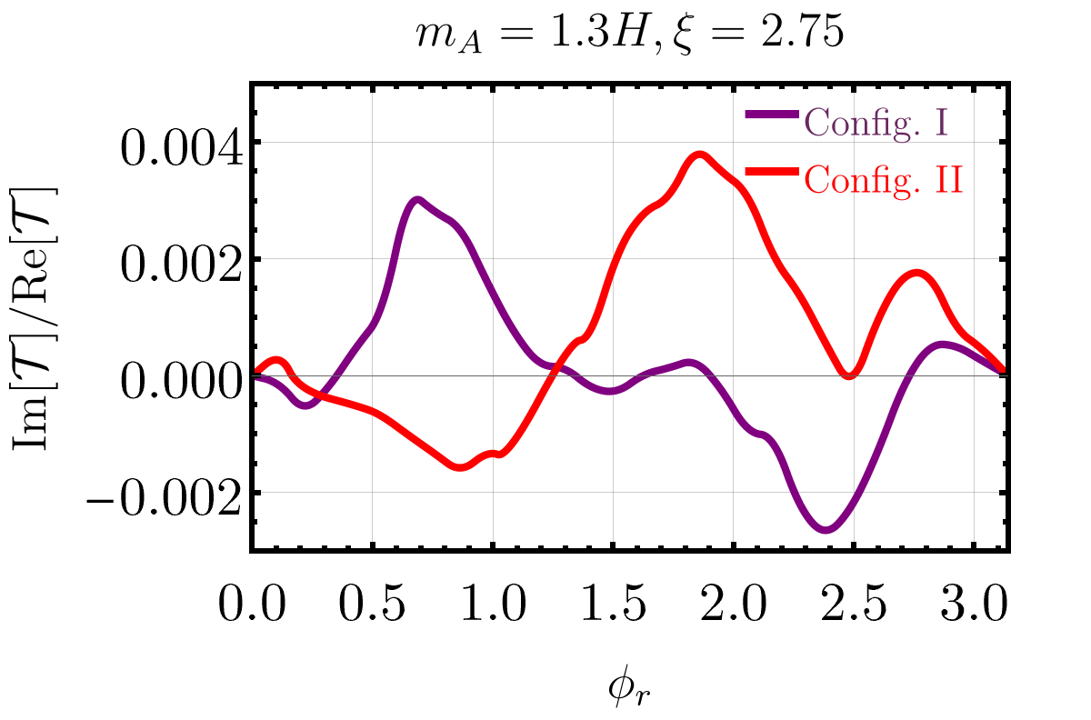

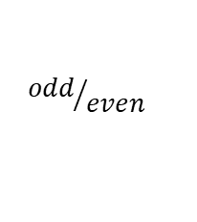

Signals from four-point correlation functions
$$P−even$$
$$P−odd$$
$${odd}/{even}$$
O(1%)~O(10%)
O(0.1%)~O(1%)
9

Slide 12
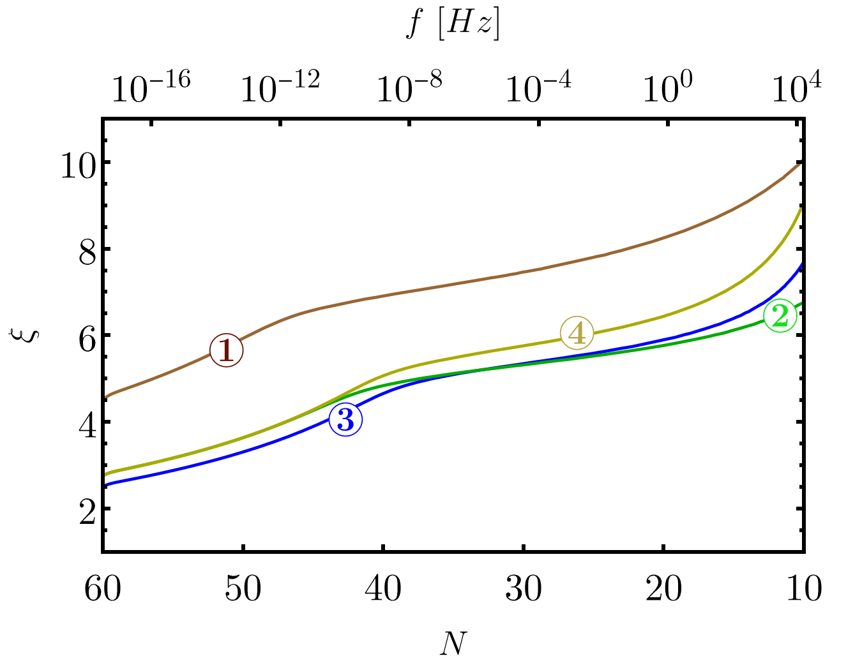
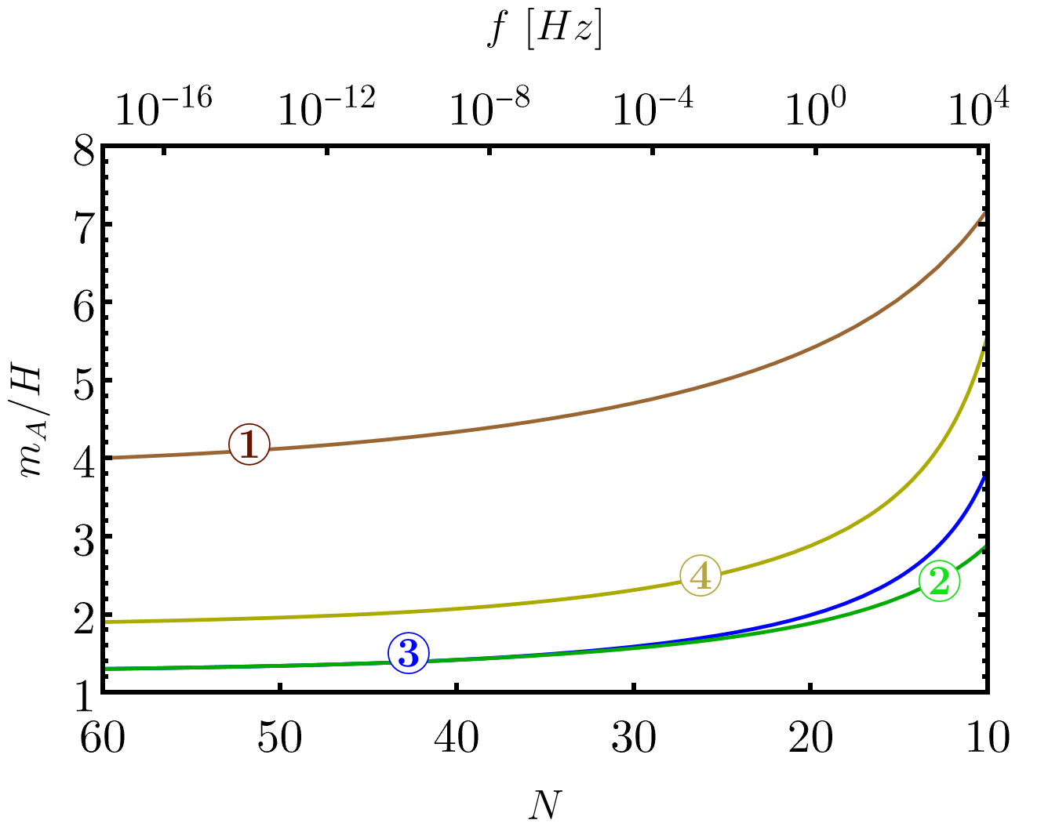
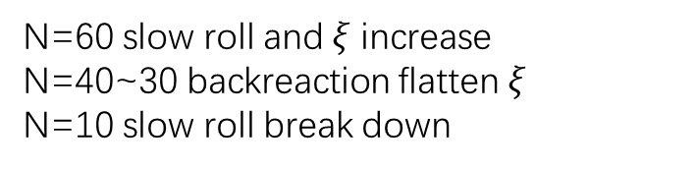

Signals from gravitational waves
Chemical potential $ξ$ and mass $\frac{m_{A}}{H}$ evolve due to slow roll and backreaction.
Four benchmark points at $N=$ 60
N=60 slow roll and$ξ$ increase
N=40~30 backreaction flatten$ξ$
N=10 slow roll break down
*Starobinsky potential is chosen.
10

Slide 13
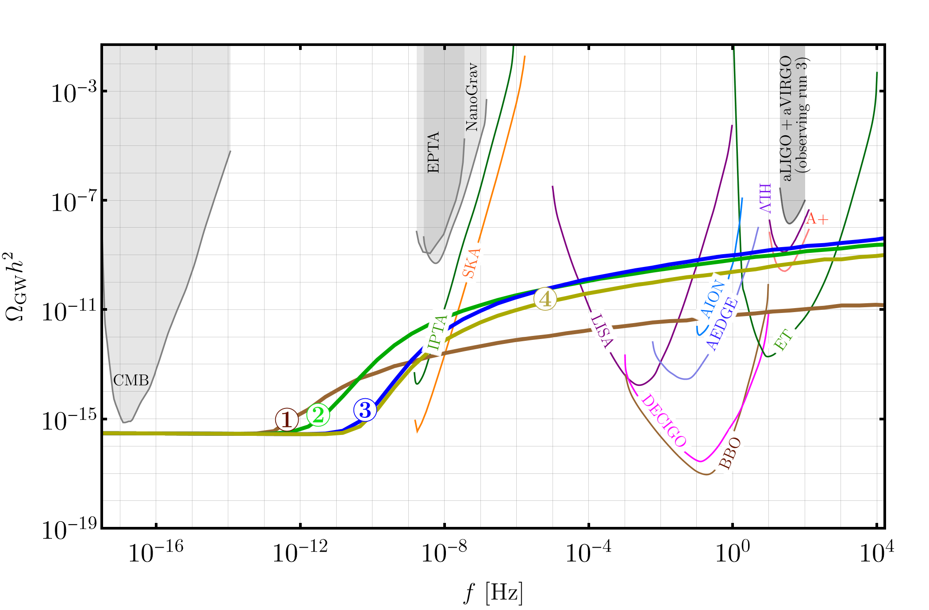


Signals from gravitational waves
Large chemical potential $ξ$ dramatically enhances the GW.
GW elude CMB scale, but can be detected at (future) interferometer scale.
① | 4.7 | 4
② | 2.75 | 1.3
③ | 2.4 | 1.3
④ | 2.75 | 2.1
$$ξ_{CMB}$$
$$\frac{m_{A}}{H_{CMB}}$$
11

Slide 14
Conclusions
Massive gauge boson can be sufficiently produced by Chern-Simons $φ{\tilde{F}}^{μν}F_{μν}$
We constrain Chemical potential and mass from CMB measured by Planck 2018
We show oscillation pattern in Bispectrum and P-violation in Trispectrum
We study the backreaction and evolution of chemical potential and mass. We show the gravitational wave(smaller than CMB scale) can be detected by the whole range of interferometers.
12

Slide 15


Outlooks
Schwinger effect:
1) $L_{int}=\overline{ψ}(iγ^{μ}D_{μ}−ma)ψ$. Fermion loops give gauge boson effective mass
$$A$$
$$ψ$$
2) Baryon asymmetry?
Cosmic string:
1) Topological defect created by phase transition
2) Large scale structure and dark matter
13

Slide 16
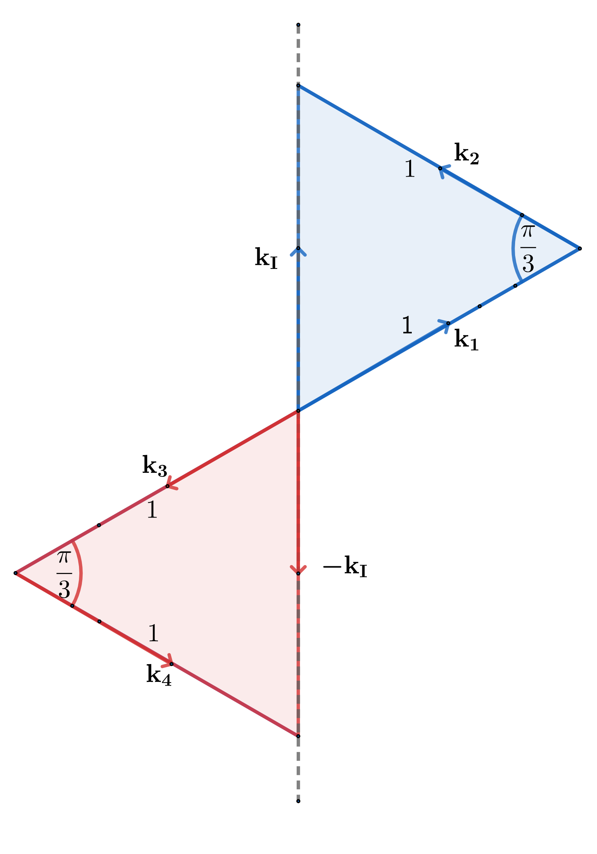
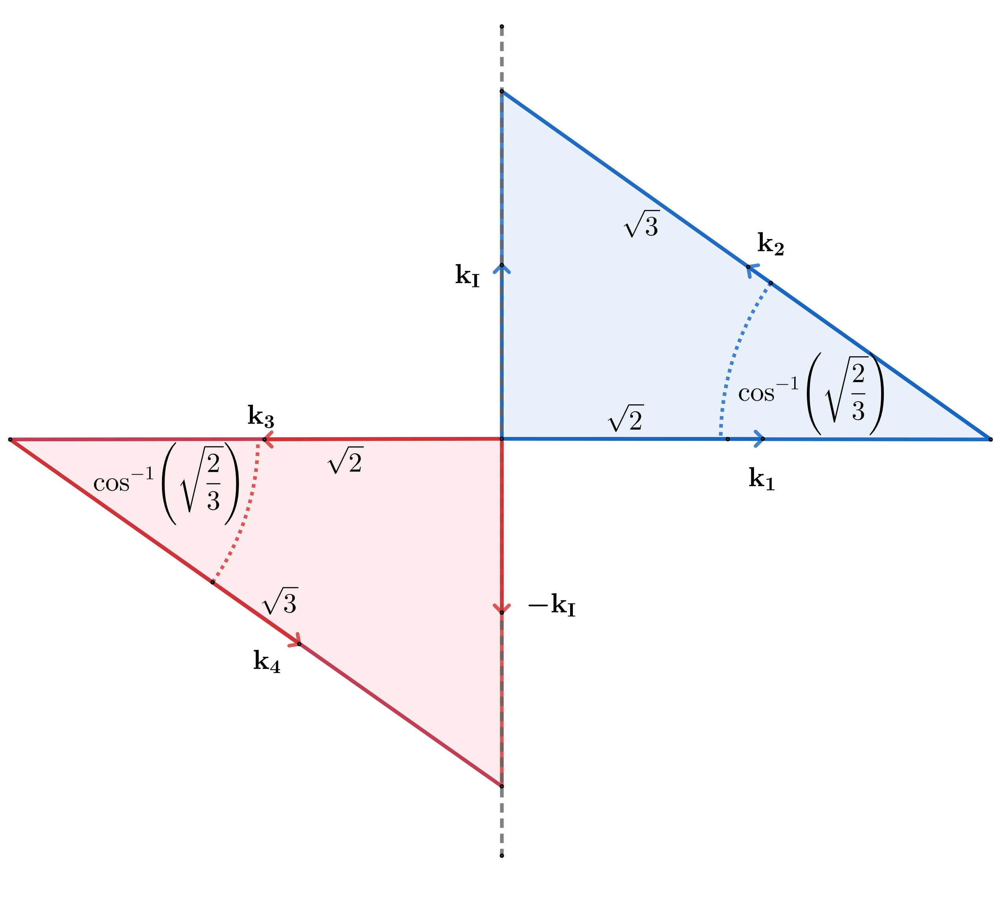
Signals from four-point correlation functions(Back-up)
Config. I
Config. II
Blue and red triangles rotate about the dashed line.
14

Slide 17

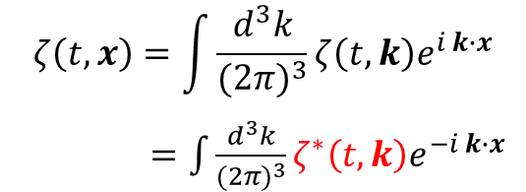
Why P-odd is Im[T](Back-up)
$$ζ\left(t,x\right)=\int{\frac{d^{3}k}{{(2π)}^{3}}}ζ\left(t,k\right)e^{i k∙x}$$
$=\int{\frac{d^{3}k}{{(2π)}^{3}}}ζ^{∗}\left(t,k\right)e^{−i k∙x}$
$$ζ\left(t,−x\right)=\int{\frac{d^{3}k}{{(2π)}^{3}}}ζ\left(t,k\right)e^{−i k∙x}$$
$ζ^{∗}\left(t,k\right)$ and $ζ\left(t,k\right)$ share the same real part, but different Imaginary part.
15

Slide 18
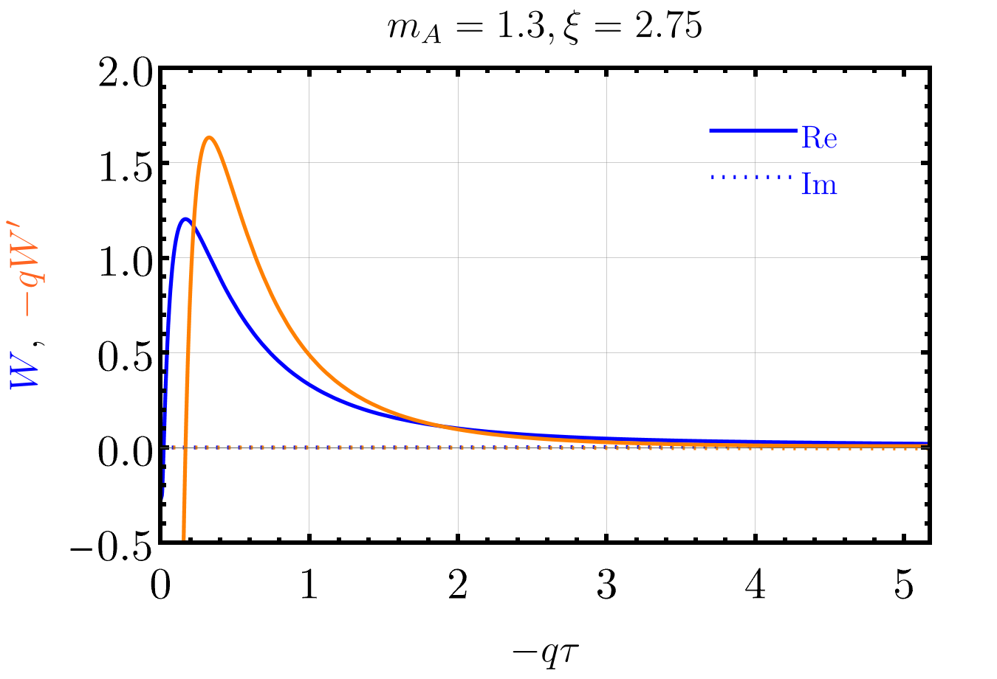
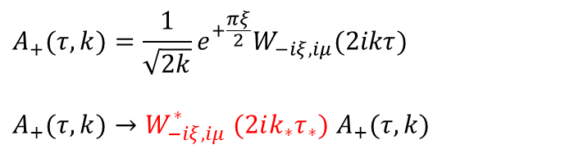
Zigzag in massive P-odd(Back-up)
Add a global phase to make mode function to be mostly real
$$A_{+}(τ,k)=\frac{1}{\sqrt{2k}}e^{+\frac{πξ}{2}}W_{−iξ,iμ}(2ikτ)$$
$A_{+}(τ,k)→W_{−iξ,iμ}^{∗} (2ik_{∗}τ_{∗})$ $A_{+}(τ,k)$
Thus we simplify in-in formalism to
fasten numerical calculation
16

