Slide 1
Target polarimetry for LHCspin
Breit Rabi polarimeter and Taget gas analyser
To-do list
2024-02-15 LHCspin Meeting
Achievements:
From the Pasquale email on 7 february 2024
Develop a concept of BRP compatible with the IR4 tunnel dimensions
Vacuum chamber discussion with the ABS BRP
LHC vacuum separation valve

Slide 2
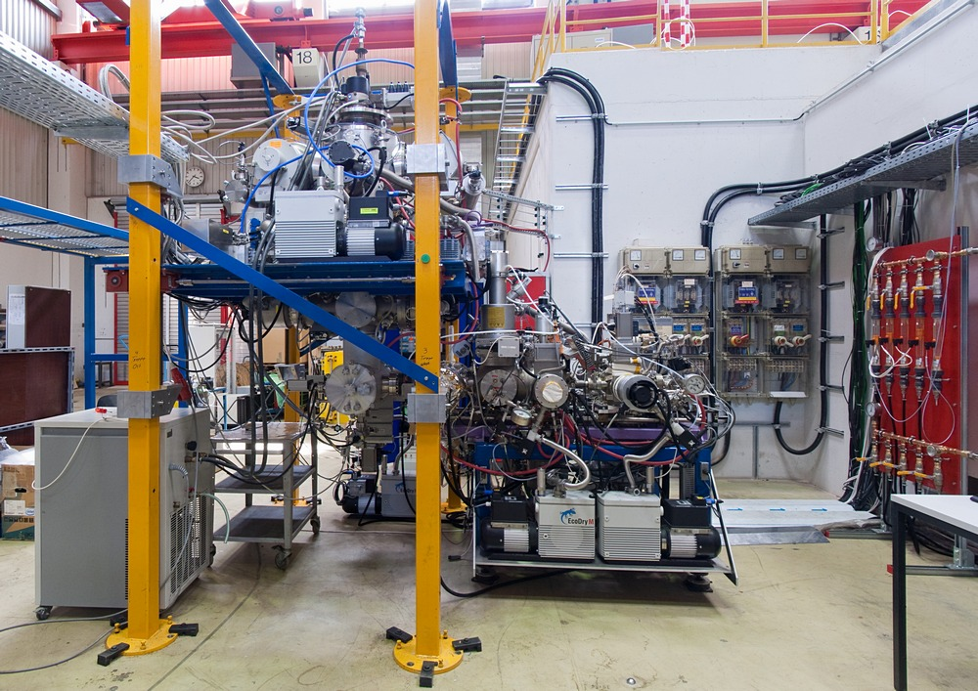
Target : ABS, openable cell e BRP working for test and calibration
Atomic beam Source
Power supply
Cooling Water
Target Vacuum Chamber
COSY/AD beam axis
Breit-Rabi
Polarimeter
Taget Gas analyser

Slide 3
Breit-Rabi Polarimeter Working Group (BRP-WG):
First and Last Names | Affiliation | e-mail
Davide Reggiani | PSI | davide.reggiani@psi.ch
Erhard Steffens | FAU Erlangen-Nürnber | Erhard.Steffens@fau.de
Giuseppe Ciullo | University and INFN Ferrara | ciullo@fe.infn.it
Giuseppe Tagliente | INFN Bari | Giuseppe.Tagliente@ba.infn.it
Paolo Lenisa | University and INFN Ferrara | lenisa@fe.infn.it
Pasquale di Nezza | LNF –INFN- Frascati | Pasquale.DiNezza@lnf.infn.it
Ralf Engels | FZJ - Jülich | r.w.engels@fz-juelich.de
Tarek El Kordy | FZJ - Jülich | …….
The BRP WG group is strongly connected to the pABS working group, cross information to be distributed.
Polarized Atomic Beam Source Working Group:
IN BRP | First and Last name | Affiliation | e-mail
NO | Alexander Nass | FZJ – Jülich | a.nass@fz-juelich.de
V | Davide Reggiani | PSI | davide.reggiani@psi.ch
V | Erhard Steffens | FAU Erlangen-Nürnber | Erhard.Steffens@fau.de
V | Giuseppe Ciullo | University and INFN Ferrara | ciullo@fe.infn.it
V | Giuseppe Tagliente | INFN Bari | Giuseppe.Tagliente@ba.infn.it
NO | Massi Ferro Luzzi | CERN | massimiliano.ferro-luzzi@cern.ch
V | Paolo Lenisa | University and INFN Ferrara | lenisa@fe.infn.it
V | Pasquale Di Nezza | LNF – INFN – Frascati | Pasquale.DiNezza@lnf.infn.it
NO | Norbert Koch | FZJ - Jülich | ………..
V | Ralf Engels | FZJ - Jülich | r.w.engels@fz-juelich.de
V | Tarek El Kordy | FZJ - Jülich | ………..

Slide 4
WG organization
Data Storage for the Working group:
Organize a Drive where to share documentation and works in progress.
Operational Documentation as starting points:
Logbook of HERMES Breit-Rabi at DESY and PAX-Breit-Rabi Modified at COSY
Baumgarten PhD and Diploma Thesis (HERMES operation)
Davide Reggiani PhD Thesis (HERMES operation)
Colin Barschel PhD Thesis (PAX operation)
Publications
C. Baumgarten et al. An atomic beam polarimeter to measure the nuclear polarization in the HERMES gaseous polarized hydrogen and deuterium target NIMA 482 (2002) 606-618.
C. Baumgarten et al. A gas analyzer for the internal polarized target of the HERMES experiment NIMA 508 (2003) 268-275.
A. Arapetian et al The HERMES polarized hydrogen and deuterium gas target in the HERA electron storage ring NIM 540 (2005) 68-101.
A. Nass et al. The HERMES polarized atomic beam source NIMA 505 (2003) 633-644.
Barschel C. et al Target Section for spin filtering studies at COSY and CERN/AD in the 13th International Workshop on Polarized Sources and Targets and Polarimetry – 7-11 September 2009 Ferrara.

Slide 5
Brainstorming
Brainstorming for Breit-Rabi at LHC-spin
Free Beam or accumulation in a Cell
The working group should work on both possibilities?
…
Geometry and available space
The working group should work on both possibilities?
…
Simulation of beam tracking (tracing):
Who can take in hands?
Michelle Stancari simulated the new optics for the Breit-Rabi at COSY, software in our hands, but to be brought in operation.
Tom Wise
Alexander Nass
Frank Rathman
J.L. Martinez-Marin, B. Mustapha, W. Armstrong, Argonne National Laboratory, Lemont, IL, USA Pytomic: A Python Tool for Polarized Atomic Beam Tracking
Poster presented at IPAC 21 –
Sextupole Magnets
…
…

Slide 6
Dual Cavity for operation with H and D:
A prototype of dual cavity is already in use in the Breit-Rabi.
The Homogeneous magnetic field coils are in air, the gradient field coils in vacuum.
No cooling pipe in vacuum, the support of the homogeneous field is cooled by water in air: more space required.
…
Starting from the present Breit-Rabi Polarimeter at COSY.
…
…
Slow Control
In hand the slow control already in use at COSY
…
Calibration and measuring software
In hand The calibration and measuring software strictly connected to the injection state of the ABS.
…
…
Integration in the CERN software.
…
…

